Slide 1
Class 9
Errors Failures Risks
Keith A. Pray
Instructor
socialimps.keithpray.net
Notes:
Here’s the title slide. Excited already, aren’t you?
What is the point of this assignment? (Did SW Teams from the reading pick good test strategies? Will you be able to support your choices if something goes wrong?)
What errors? – Have student record list on board
Who looked for existing test strategies?
Who looked for directions on how to test currency?

Slide 2
Survey Results (1/6 Participation) Too Low for Stats
Weekly Time Guideline – Now on Syllabus
  4 hours class time
  4 hours reading (2 chapters ~90 pages @ 2 minutes per page)
  8 hours practicing mastery of material
    papers, group project, class activity preparation
  ----
  16 hours / week
  If you are spending much more than this let me know
As promised assignments have a high degree of flexibility so you may explore subject matter that interests you. If you are unsure of what to do let me know.
Class discussions are going well but could be better if you participate too
Notes:
Instead of looking at results statistics (only 5 people took survey) I will try to address some of the comments.

Slide 3
Grades
To Date
34 Max Possible

Slide 4
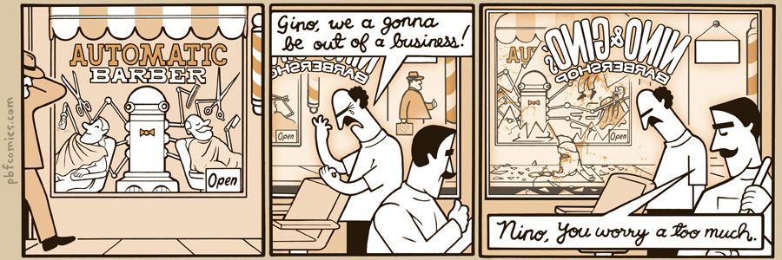
http://pbfcomics.com/197 (2014-09-26)
Notes:
10 – Errors, Failures, Risks

Slide 5
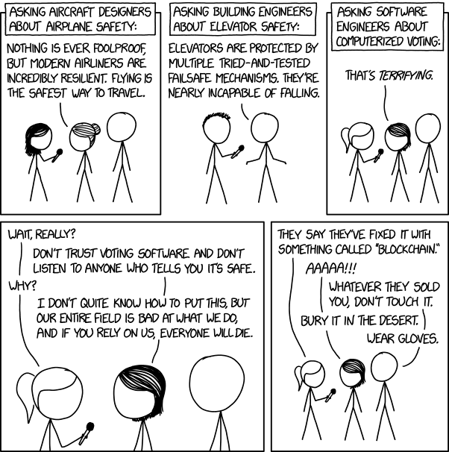
Overview
Guest Speaker
Review
Assignment
Students Present
https://xkcd.com/2030/ (2018-09-21)
Notes:
Good alternative if guest speaker not coming or late
Why Electronic Voting is a BAD Idea - Computerphile
https://www.youtube.com/watch?v=w3_0x6oaDmI
We can also discuss articles listed on Security Discussions under documents of course web site.
TODO: add quiz as backup if class discussion or guest speaker fail

Slide 6
My Reading Notes
pp. 366 Any false arrests since 1989?
pp. 368 Argument assumes DB cannot exist without existing inaccuracies.
pp. 373 This is not to keep the PATRIOT system from responding to false alarms.
pp. 375 Always encapsulate units! Not clear if SW involved.
pp. 376 Any SW diffs between Mars Missions?
pp. 378 Why did the Tokyo Stock Exchange refuse?
pp. 380 Republicans and Florida?
pp. 381. Do the second thoughts on DRE machines make the interview at end Chapter’s end less relevant?
pp. 389 No simulation examples since 2002?
pp. 390 Did The Limits to Growth predictions motivate people to change?
pp. 392 What happened to Verification?
pp. 394 “satisfies the specification” = verification. “needs of the user” = validation.
pp. 395 SW quality since 2009?
pp. 396 Gender bias nice addition!
pp. 406 21, source from 2004, is it implemented yet? 23 like game release question in next chapter.
Questions I liked: 10, 12, 16, 17, 18, 20, 21
Notes:
MSNBC on Denver's Automated Baggage System 2010-08-23 (2:27)
https://www.youtube.com/watch?v=xx8f4x6C_KY
Accessed 2019-04-09

Slide 7
Overview
Guest Speaker
Review
Assignment
Students Present
Notes:
We can also discuss articles listed on Security Discussions under documents of course web site.
ADD QUIZ AS BACKUP IF CLASS DISCUSSION OR GUEST SPEAKER FAIL

Slide 8
Assignment
Prepare for Debate
  From Chapter 9 In-class Exercises # 24.
  Should the company produce the game?
  Use the SWE Code Of Ethics as the basis for your argument.
  Use other sources for supporting data
Optional 1 paper on topic, lowest paper grade will be dropped

Slide 9
The Importance of Mission Critical Systems:
The recent incidents with the 737 MAX
David Vollum

Slide 10
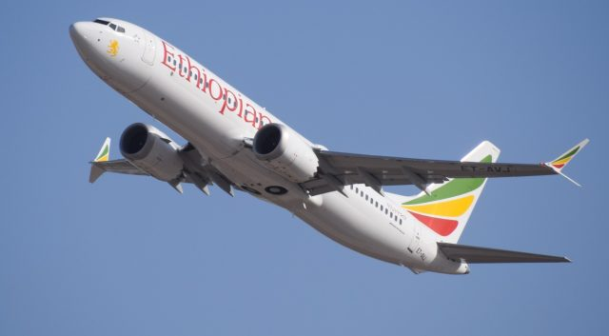
Overview of the Accidents
David Vollum
2 accidents
  Lion Air Flight 610
    189 Fatalities
  Ethiopian Airlines Flight 30
    157 Fatalities
  376 planes grounded indefinitely
  Thousands of flights canceled
  Caused by the Maneuvering Characteristics Augmentation System (MCAS) malfunctioning
[1][5]
Notes:
One was in 2018 and one was last month
Hopefully boeing will have it fixed by next month but who knows

Slide 11
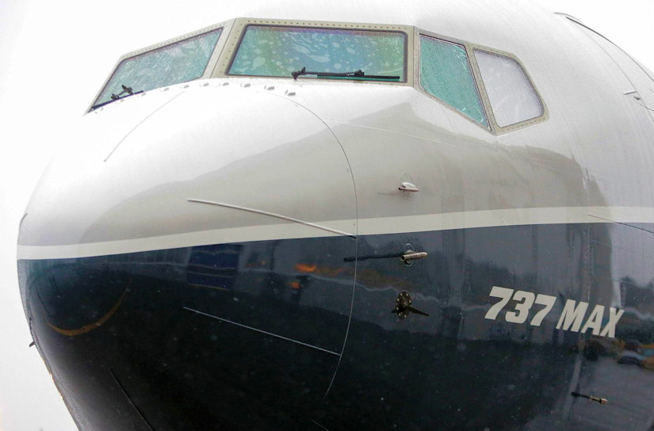
What is the MCas System
David Vollum
New on the 737 MAX
Takes in data from the angle of attack sensor
Adjusts the elevator trim automatically, to keep the downward pressure
  FAA requires a certain pressure to be pushing the nose down
Only in effect in high angles of attack with high airspeed
  Autopilot must be disabled
[2]
Notes:
Quick overview of what angle of attack and trim actually are
Use the the hand out of a car window as an example
737 did not meet those requirements
Issues came about because the system was getting faulty info from the AoA sensor
The flight computer thought the aircraft was angling up when in fact it was in level flight
A last resort way to get the certification
MCAS switches which sensor is uses each time it lands. No really sure why it does this, but probably related to the logic of choosing live as causing to many problems

Slide 12
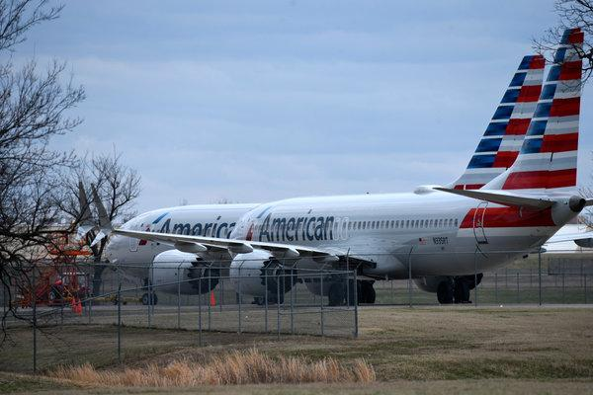
What Failed in this case?
David Vollum
The angle of attack sensor was broken that was feeding data to the MCAS
MCAS thought the aircraft was heading nose up at a high airspeeds
  so it trimmed the nose down
[2], [5]
Notes:
System received readings indicating that the nose pointed up at a high angle, when in fact it was decending.

Slide 13
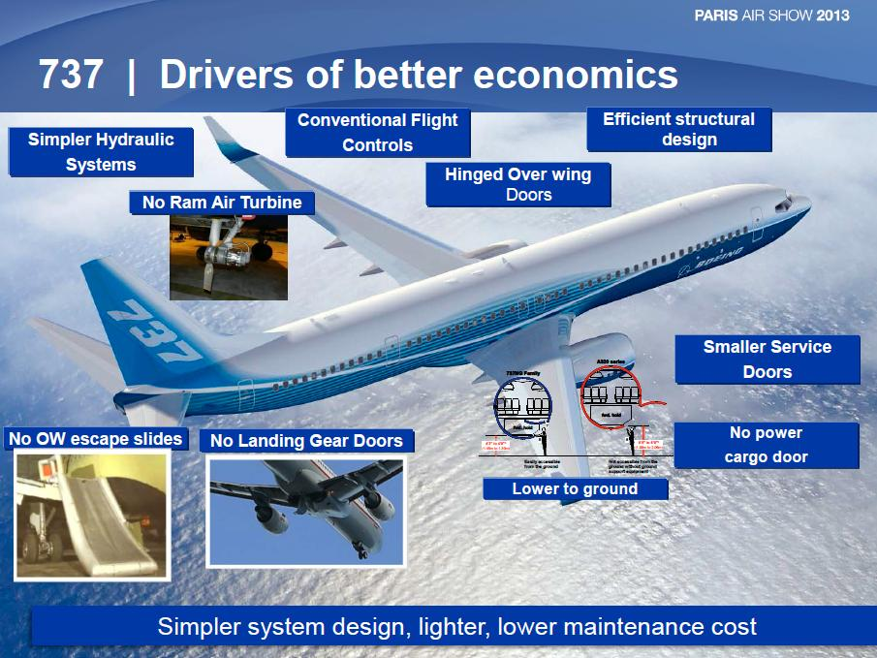
FAA and Boeing Response
David Vollum
Initially, Boeing would not admit there was an issue
Following the second crash, all of the aircraft were grounded
2 primary things that Boeing will do to fix this system
  Add angle of attack error warnings
  Publish in the operating handbook the correct response
[3], [5]
Notes:
Boeing states that they began working on a fix after the first incident
Boeing was charging extra for the system that would compare the AoA readings and warn if they were different
Boeing changed the max that the mcas could adjust the trim.

Slide 14
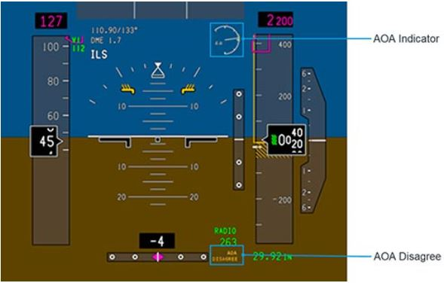
What can be learned from these incidents
David Vollum
Considering possible input failure in logic for any system
In “mission critical” systems, redundancy is very important
  Single point of failure has brought down multiple other aircraft
  United 232 lost all flight controls do to a single point of failure
The importance of strong documentation about failure scenarios
AoA Sensor
[4]
Notes:
If there had been a written procedure for what to do these lives could have been saved
Redundancy

Slide 15
References
David Vollum
[1] http://active.boeing.com/commercial/orders/displaystandardreport.cfm?cboCurrentModel=737&optReportType=AllModels&cboAllModel=737&ViewReportF=View+Report (Accessed 4/7/19)
[2] http://www.b737.org.uk/mcas.htm (Accessed 4/7/19)
[3] https://www.boeing.com/commercial/737max/737-max-update.page (Accessed 4/7/19)
[4] https://www.nytimes.com/2019/03/14/business/boeing-737-software-update.html (Accessed 4/7/19)
[5] https://theaircurrent.com/aviation-safety/vestigal-design-issue-clouds-737-max-crash-investigations/ (Accessed 4/7/19)

Slide 16
Self Driving Vehicles and Safety
Matthew Gulbin
Notes:
Introduction
Briefly talk about how this ties into computer reliability: self driving cars must be reliable

Slide 17
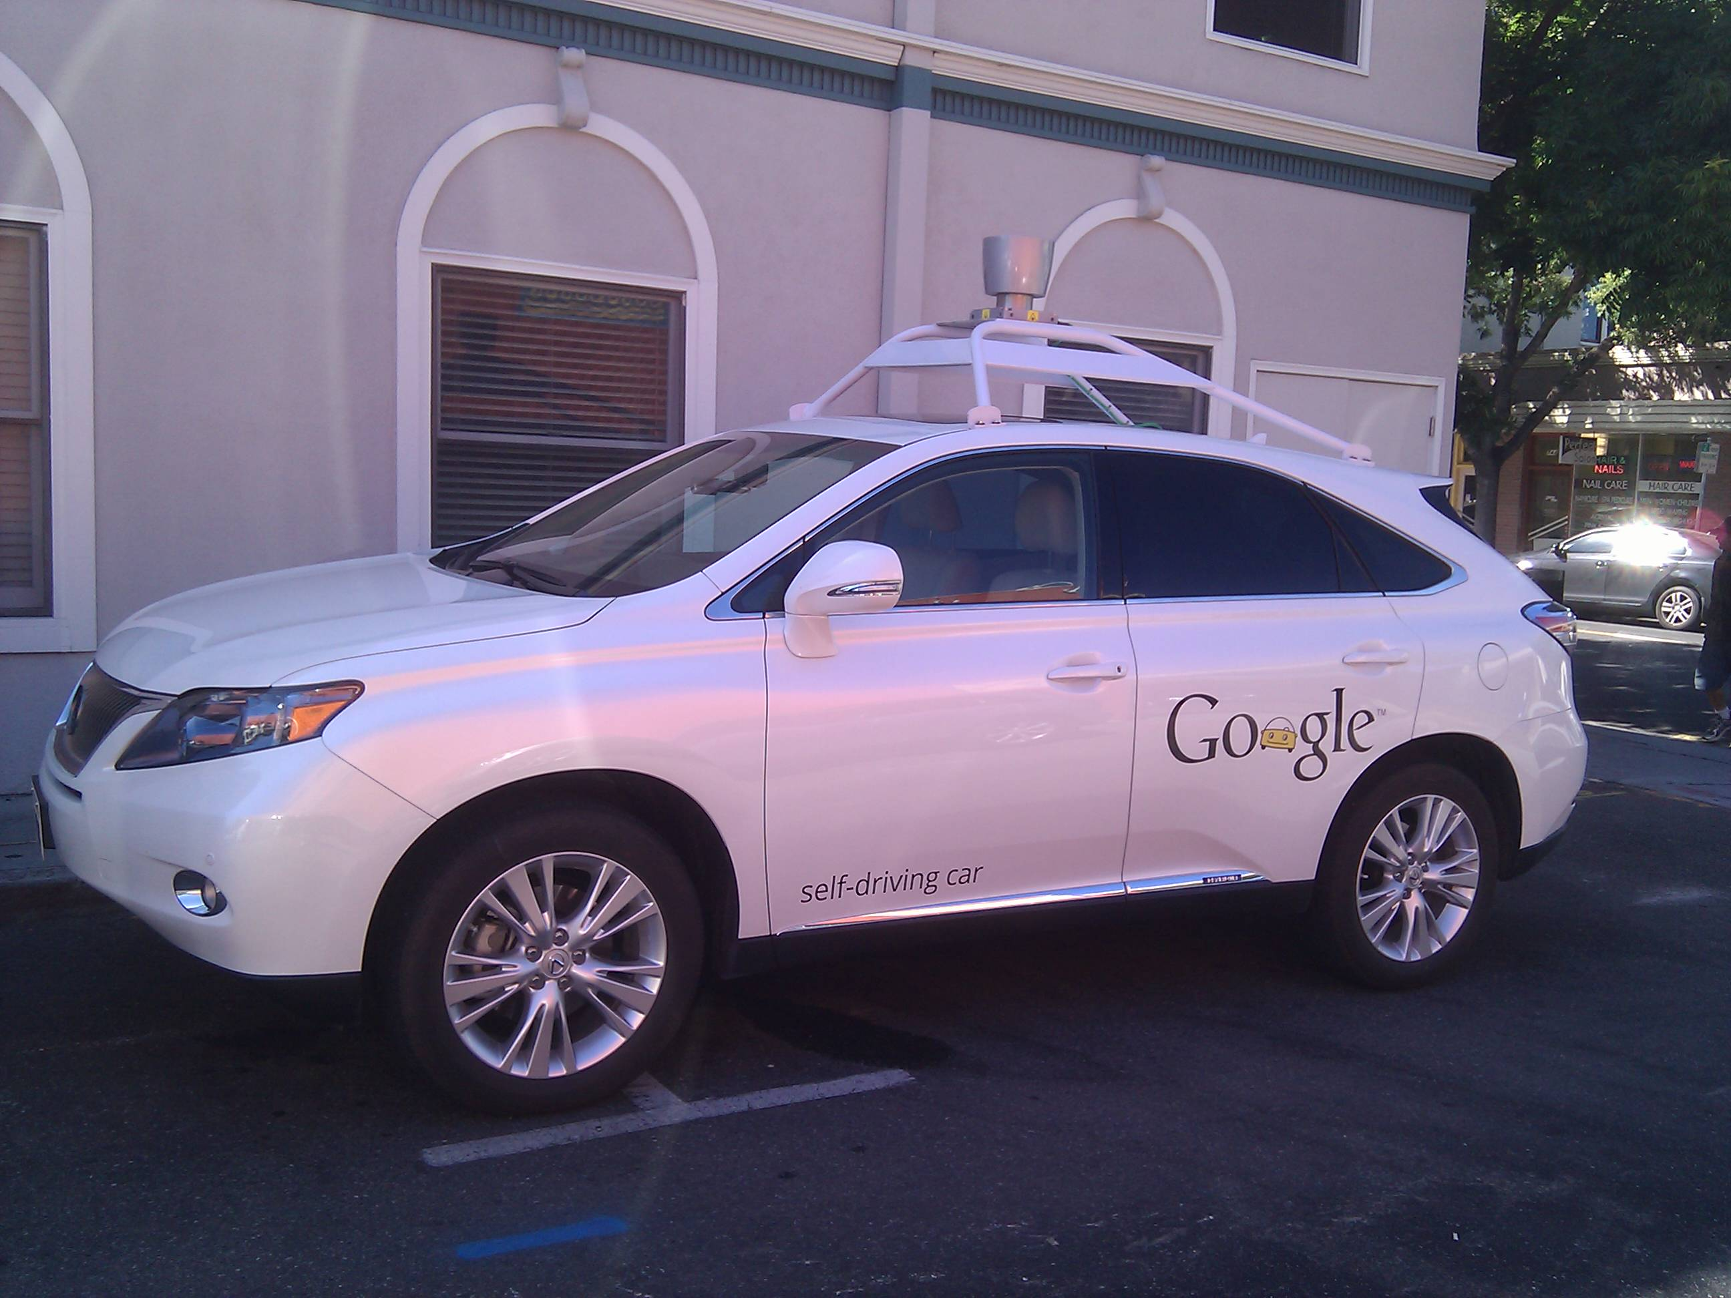
Introduction
Matthew Gulbin
Self driving vehicles is a newly developing technology.
However, I believe that limits should be put on their implementation.
[6]
Notes:
This is my conclusion: Self driving cars are a step in the right direction, but more testing and laws are necessary before they should be made readily available to the public.

Slide 18
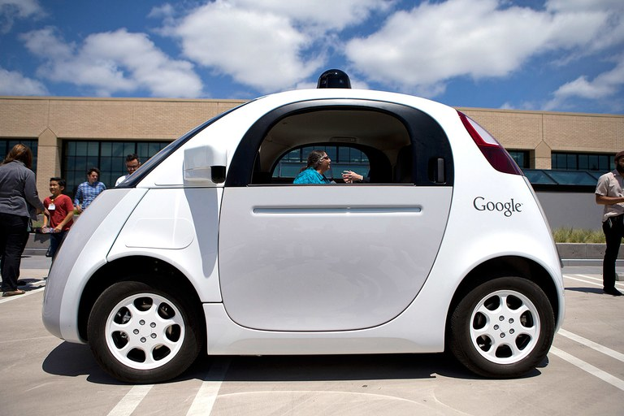
History of the Technology
Matthew Gulbin
Experiments with remotely controlled cars began in the 1920s.
In 1989, Carnegie Mellon used neural networks to control driverless cars.
Since 2010, Google have been working on their own driverless car system.
[2],[7]
Notes:
The history of self driving cars is closely tied to the history of remote controlled cars, since they are nearly identical.
The first experimentation with a remote controlled car came in the 1920s with the “Iinrrican Wonder,” a radio controlled “driverless” car which was controlled by a person in a car right behind it.
There were no real significant developments in this field until the 1980s, when Mercedes tested a vision guided van and the ALV (Autonomous Land Vehicle) Project developed a car with autonomous robotic controls.
The biggest development arose in 1989, when Carnegie Mellon University showcased the usage of neural networks to steer and control autonomous vehicles, which has influenced several projects today.
In the modern era, several companies have continued development on driverless cars, such as Ford in 2009 and Google in 2010
The first commercially available self driving car was the Tesla Model S, which released in 2015.

Slide 19

Case Study: Uber
Matthew Gulbin
In 2015, Uber began work in Pittsburgh with the Carnegie Mellon Robotics Institute
Uber deployed self driving cars in San Francisco in 2016, and in Tempe, Arizona in 2017.
[4],[5]
Notes:
One high profile company that has been very interested in self-driving technology is Uber.
In 2015, Uber began working on driverless technology in Pittsburgh, PA with the Robotics Institute at Carnegie Mellon University.
In December of 2016, driverless Ubers were deployed in San Francisco, CA, which quickly created issues, such as an Uber running a red light, causing the state DMV to order the company to stop the self driving service.
However, Uber kept progressing and released a fleet of unmanned vehicles in Tempe, AZ the following year.

Slide 20
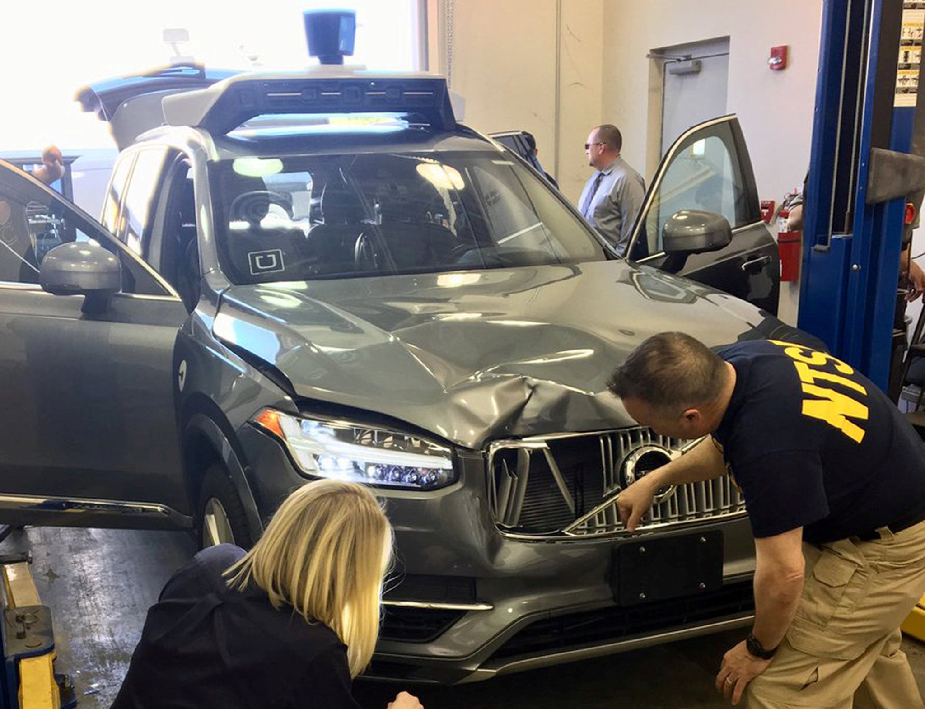
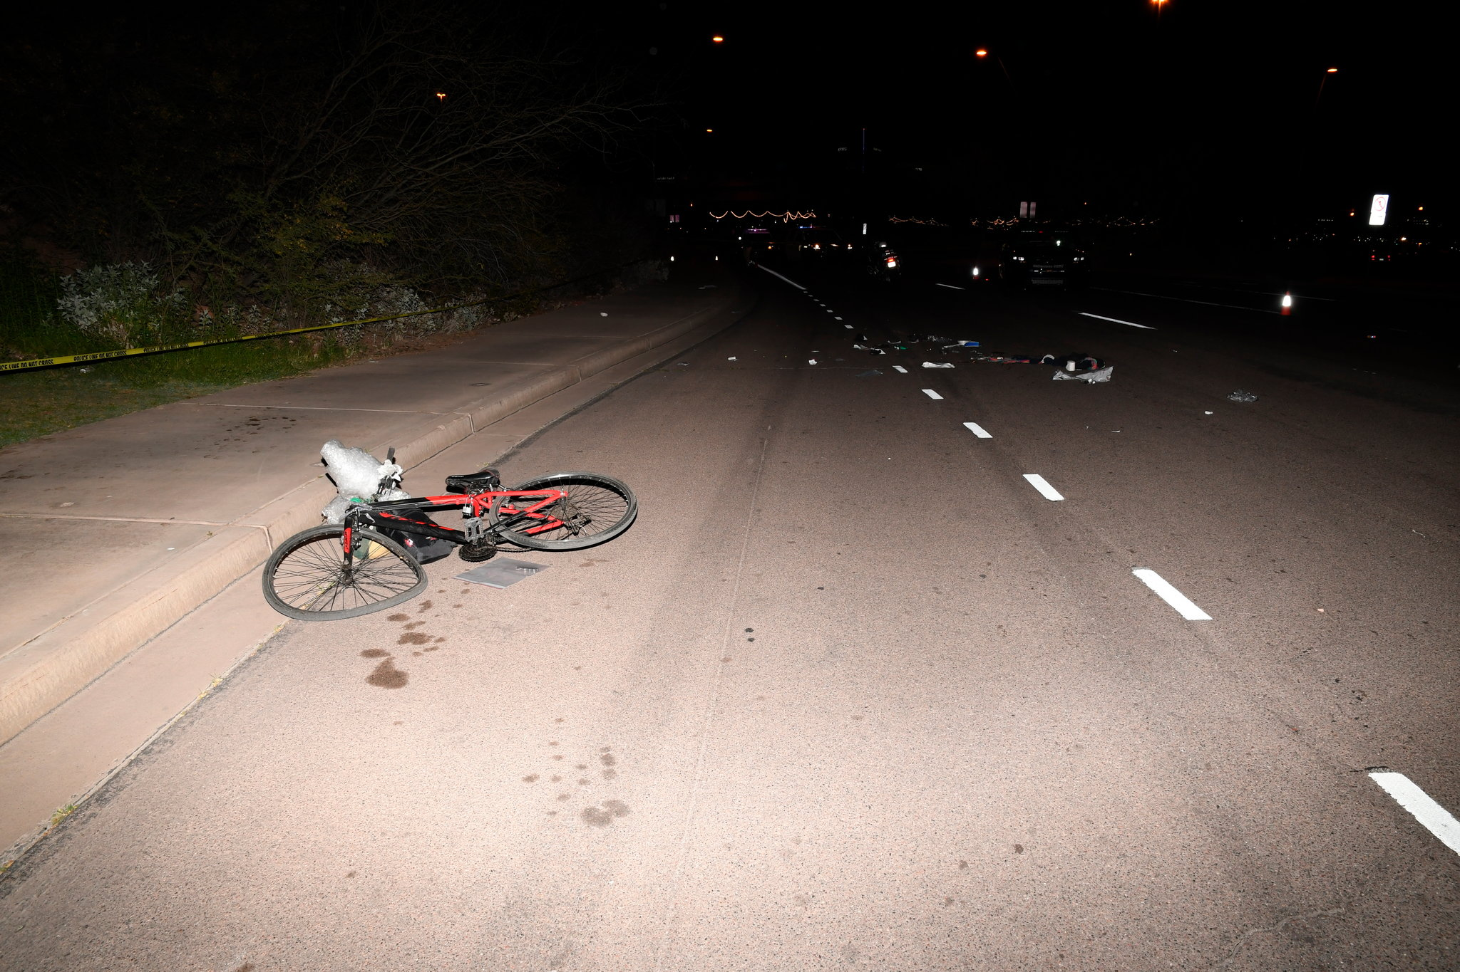
Case Study: Uber (cont.)
Matthew Gulbin
On March 18th, 2018, 49 year old Elaine Herzberg was struck and killed by a self driving Uber in Tempe.
Uber discontinued their self-driving program soon after.
However, Uber recently announced that they were restarting the self driving program.
[3],[9]
Notes:
However, tragedy struck on March 18th, 2018, when 49 year old Elaine Herzberg was struck and killed by a self driving Uber while crossing the street with her bike at night in Tempe, Arizona.
Prosecutors in Arizona decided not to hold charges against the Uber corporation.
However, Uber decided to immediately cease the use of all its self driving vehicles until they were tested more for safety
In December of 2018, Uber announced that it would be bringing its driverless cars back to Pennsylvania.

Slide 21
Conclusion
Matthew Gulbin
Before the development of this technology continues, I believe that more limitations should be imposed.
This is to prevent accidents from occurring like the one in Arizona
Even though there have only been 4 fatal self-driving car accidents in the world up to this point, if even more self driving car manufacturers arise, the number of accidents will go up if nothing is done.
[10]
Notes:
So, what’s the takeaway?
I believe that before these cars are made more commercially available, they should be well tested for safety, so that accidents do not occur.
Even though there have been only 4 fatal self driving car accidents, 3 of which occurred with the commercially available Tesla models, if the number of commercial self driving cars goes up, the number of accidents will rise as well unless they are tested very carefully.

Slide 22
References
Matthew Gulbin
[1] Sivak, Michael, and Brandon Schoettle. “ROAD SAFETY WITH SELF-DRIVING VEHICLES: GENERAL LIMITATIONS AND ROAD SHARING WITH CONVENTIONAL VEHICLES.” deepblue.lib.umich.edu/bitstream/handle/2027.42/111735/103187.pdf?sequence=1&isAllowed=y.
[2] “The History of Driverless Cars.” The Fact Site, 24 Mar. 2019, www.thefactsite.com/driverless-cars-history/.
[3] Zaveri, Mihir. “Prosecutors Don't Plan to Charge Uber in Self-Driving Car's Fatal Accident.” The New York Times, The New York Times, 6 Mar. 2019, www.nytimes.com/2019/03/05/technology/uber-self-driving-car-arizona.html.
[4] Biggs, John. “Uber Opening Robotics Research Facility In Pittsburgh To Build Self-Driving Cars.” TechCrunch, TechCrunch, 2 Feb. 2015, techcrunch.com/2015/02/02/uber-opening-robotics-research-facility-in-pittsburgh-to-build-self-driving-cars/.
[5] Hawkins, Andrew J. “You Can Hail a Self-Driving Uber in San Francisco Starting Today.” The Verge, The Verge, 14 Dec. 2016, www.theverge.com/2016/12/14/13921514/uber-self-driving-car-san-francisco-launch-volvo-xc90.

Slide 23
References (cont.)
Matthew Gulbin
[6] https://upload.wikimedia.org/wikipedia/commons/9/97/Google_self-driving_car_in_Mountain_View.jpg
[7] Kosoff, Maya. “Google's Big Bet: Old People Will Love Self-Driving Cars.” The Hive, Vanity Fair, 2 Mar. 2016, www.vanityfair.com/news/2016/03/self-driving-cars-seniors-old-people.
[8] https://en.wikipedia.org/wiki/Uber#/media/File:Uber_logo_2018.svg
[9] Edelstein, Stephen. “Uber Gets Permission to Restart Self-Driving Car Tests Months After Fatal Crash.” The Drive, 19 Dec. 2018, www.thedrive.com/news/25578/uber-gets-permission-to-restart-self-driving-car-tests-months-after-fatal-crash.
[10] “List of Self-Driving Car Fatalities.” Wikipedia, Wikimedia Foundation, 18 Mar. 2019, en.wikipedia.org/wiki/List_of_self-driving_car_fatalities.

Slide 24
Autonomous weapons systems
Oliver Sanderson

Slide 25
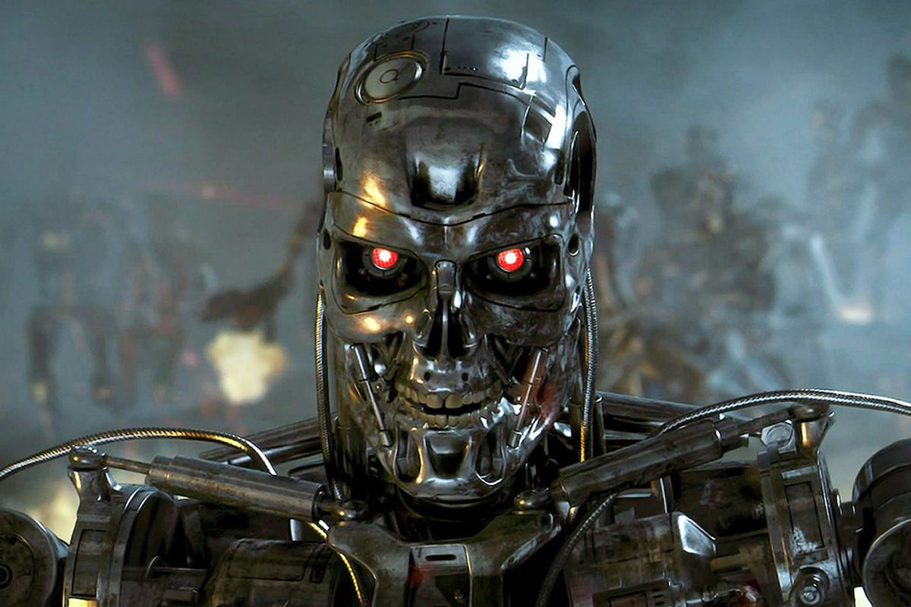
What are autonomous weapons systems?
Oliver Sanderson
Autonomous:
“A weapon system that, once activated, can select and engage targets without further intervention by a human operator.”
Semi-Autonomous:
“a weapon system that, once activated, is intended to only engage individual targets or specific target groups that have been selected by a human operator.”
Tiers of Semi-autonomy:
Munitions
Platform
Planning
[1][2]
Notes:
Highlight the differences between the two types
A: no further human intervention
SA: Specific target group selected by humans
Third group: human-supervised autonomous systems
Munitions:
Fire and forget weapons (AMRAAM)
Platform:
If Predator Drone wasn’t remotely controlled by a human
Planning:
Replacing military officers, making large strategic decisions (Skynet)

Slide 26
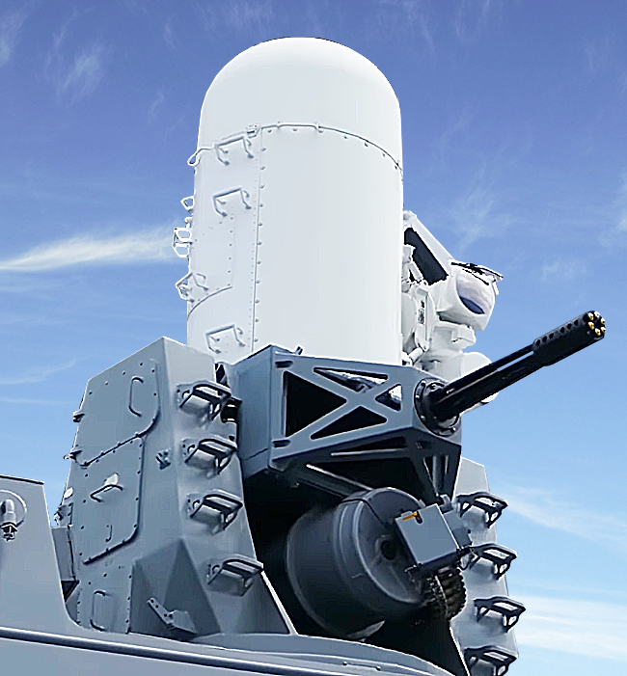
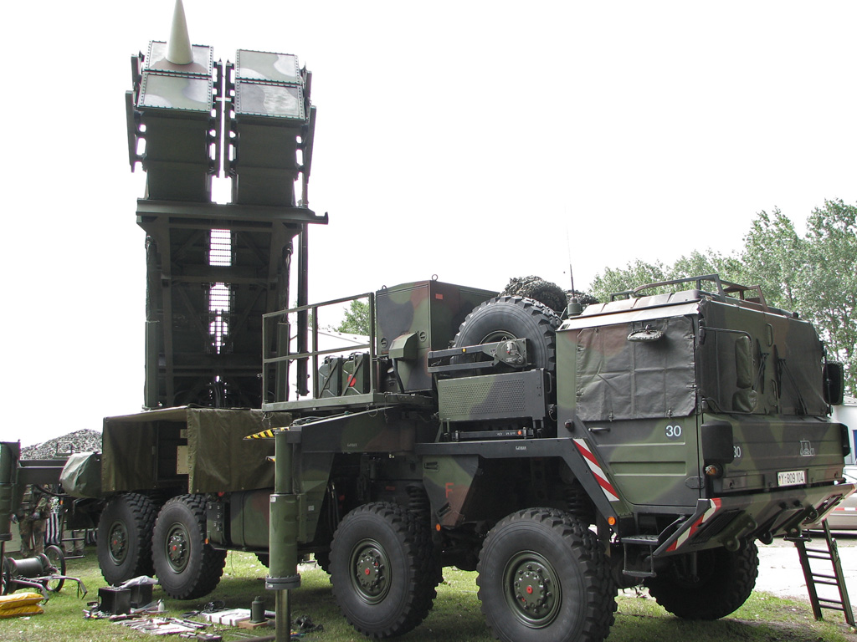
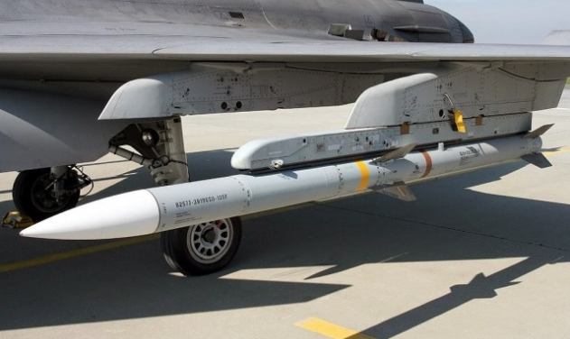
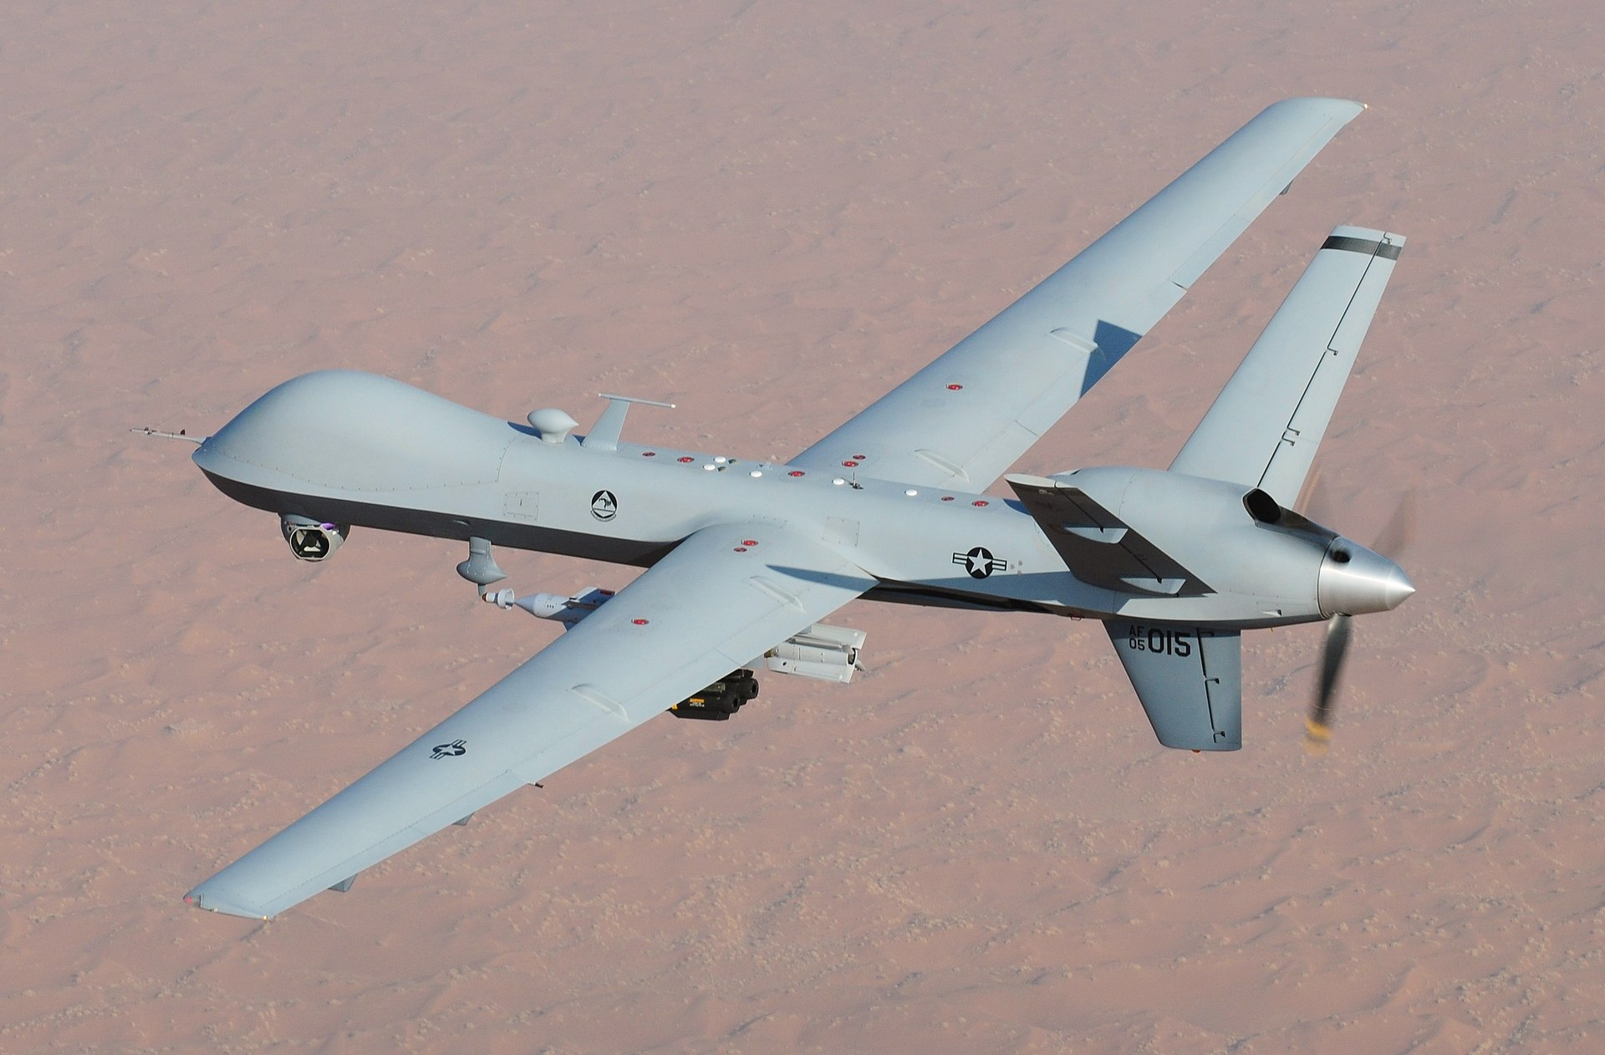
Current examples
Oliver
Sanderson
MIM-104 Patriot, Phalanx CIWS
  Specific target groups
AIM-120 AMRAAM
  Supervised by local human
MQ-1C Predator/MQ-9 Reaper
  Controlled by remote human
[4][5][6][7]
Notes:
No fully autonomous system is being widely used today (that I could find), these are all semi autonomous
First 2 examples:
Semi-autonomous because they target preprogrammed groups (incoming missiles)
Patriot missile: Surface to Air missile system designed for anti-ballistic missile
Has been used to shoot down UAVs and one manned aircraft in Israel, but this isn’t the main use
Phalanx: Automated Gatling-style rotary cannon, used for shooting down incoming anti-ship missiles
Installed on every US navy surface combat ship besides San Antonio class
AMRAAM
Advanced Medium-Range Air to Air Missile
Fire and forget style
Shoots down other aircraft
Autonomous targeting, but launched by a human in the aircraft
Predator/Reaper
Remotely piloted by human
No lethal force decisions made autonomously

Slide 27
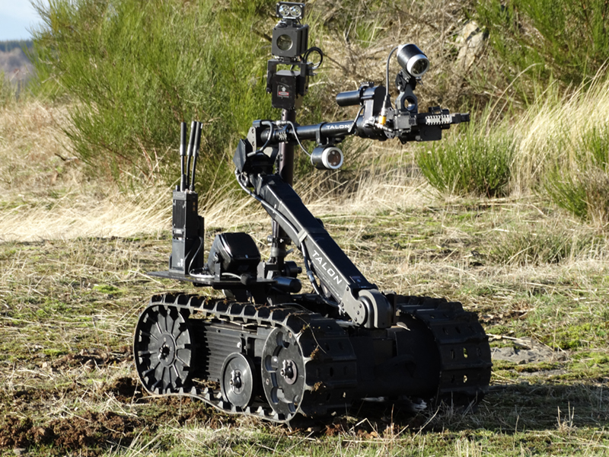
Arguments
Oliver Sanderson
For
Reduced collateral damage
Saves lives
Military superiority
Against
Technological limitations
Moral
Accountability
Trivializes war
[3][8]
Notes:
For:
Autonomous weapons are more precise, leading to less collateral damage
Humans soldiers are not putting their lives on the line
People don’t wasn’t to list it as an argument for, but the main driving force behind their development is military superiority
Autonomous systems act as a force multiplier
Average soldier in Afghanistan costs $850,000/year, while Talon robot system costs on $230,000 [8]
Against:
Programming will never be good enough to make decisions that satisfy legal and ethical principles
Maybe, maybe not. We shouldn’t rule out the possibility because the pace of technology always surprises us
It is simply wrong to take the human out of the firing loop
This is hard to address, because you either accept it or you don’t
We are turning over more and more life and death decisions to machines, e.g. self driving cars and robotic surgery
Reject this principle and replace it with whether the decision is at least as good as the one a human would make
There’s no one to hold accountable if a robot commits a war crime
You can hold the entire side accountable in totality
Focus on the overall good created instead of individual instances
SA systems lower the barrier to entry, making it easier to go to war
This argument has been made about UAVs and about high altitude bombing before that
Is this really a valid reason to use technologies that kill more people?

Slide 28
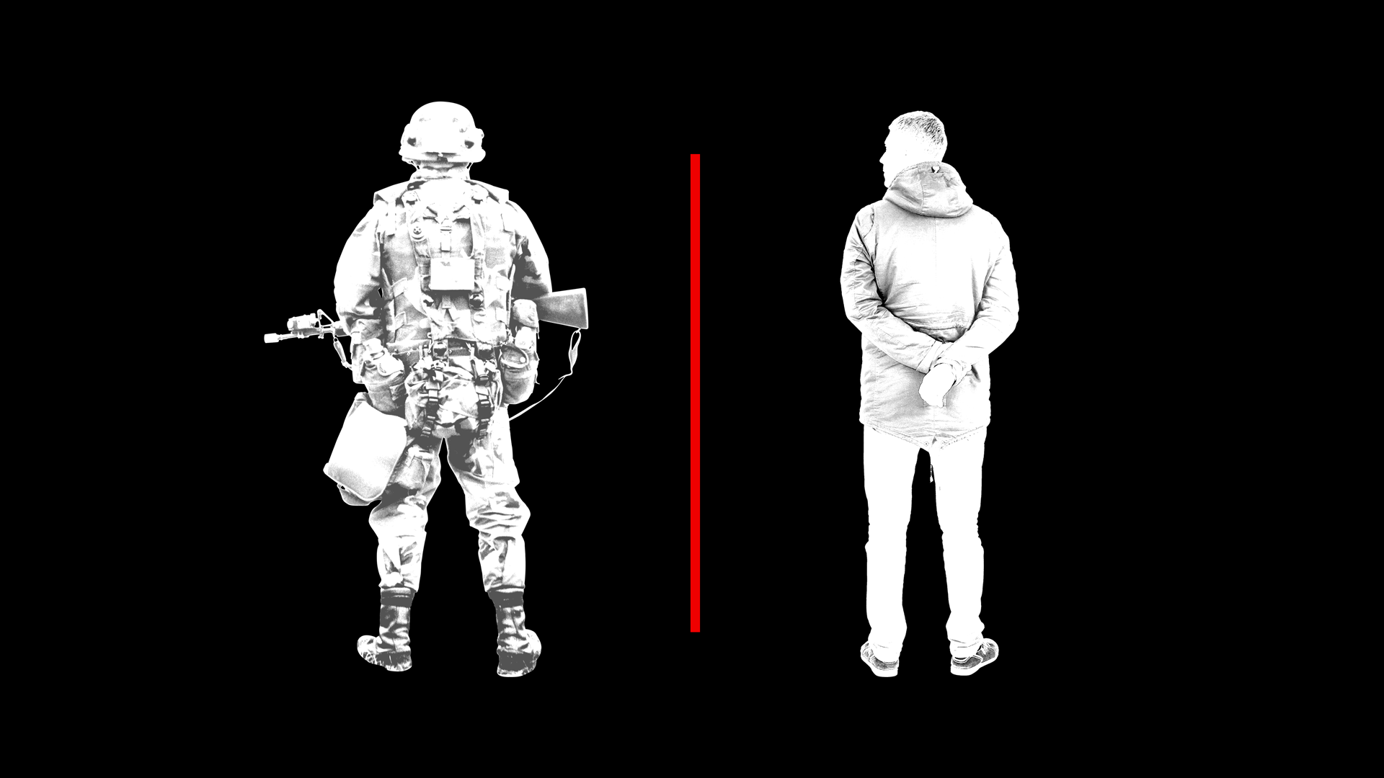
Distinction and proportionality
Oliver Sanderson
Distinction: Ability to recognize whether a potential target is a civilian or combatant
Proportionality: Civilian harm cannot be excessive when compared to anticipated military advantage
Image: Jim Cooke (GMG)
[3]
Notes:
These are the two most important principles that an AWS would have to satisfy
These ideas exist in current law
Provide enough of a basis for determining legality of AWS
Both follow from Walzer’s Just War Theory

Slide 29

Conclusion
Oliver Sanderson
Autonomous weapons are inevitable, and we should address them before it’s too late
  https://b-i.forbesimg.com/groupthink/files/2014/01/Auto.jpg
A set of norms should be developed through international and national discourse
  Scoping a treaty is difficult
  Quickly outdated
  Laser weapons
[3]
Notes:
There is a clear trend towards autonomy that can be seen across all industries, including the military
Show and explain graphic of automation over time
Other countries may be much more willing that we are to develop easy-to-build, unlawful AWS
Want to develop shared norms, not a binding treaty
Would be very difficult to create a treaty that is correctly scoped
Would most likely be outdated very quickly
Nations that want them the most would just ignore the treaty
Example: Laser weapons
Not banned outright, used in systems like the Boeing YAL-1 for missile defense
However, lasers that blind soldiers were resisted by US military officers and a treaty was later ratified (2009) to ban their use
If we can get to the point where expectations on AWS ethicality are widely accepted, we will have succeeded to the best of our ability

Slide 30
References
Oliver Sanderson
[1] Department of Defense Directive 3000.09, Autonomy in Weapon Systems 13 (November 21, 2012)
[2] “The Ethics & Morality of Robotic Warfare: Assessing the Debate over Autonomous Weapons.” Daedalus 145.4 (2016): 25–36. Web.
[3] Anderson, Kenneth and Waxman, Matthew C., Law and Ethics for Autonomous Weapon Systems: Why a Ban Won't Work and How the Laws of War Can (April 10, 2013).
[4] "MQ–1 Predator / MQ–9 Reaper". Aeroweb. Retrieved 7 April 2019.
[5] “AIM-120 Advanced Medium Range Air-to-Air Missile”. Military.com. Web. Retrieved 7 April 2019.
[6] “Phalanx Close-In Weapon System”. Raytheon.com. Web. Retrieved 6 April 2019.
[7] “Predator B RPA”. Ga-asi.com/predator-b. Web. Retrieved 7 April 2019.
[8] “Pros and Cons of Autonomous Weapons Systems”. Army University Press. May 2017.

Slide 31
Class 9
The End
Keith A. Pray
Instructor
socialimps.keithpray.net
Notes:
This is the end. Any slides beyond this point are for answering questions that may arise but not needed in the main talk. Some slides may also be unfinished and are not needed but kept just in case.

Slide 32
Reliability Of Statistics
Are other factors controlled?
Is enough time covered?
Is all data reported?
Use Intuition
  Are results reasonable?
Notes:
Power line dangers. Electromagnetic fields? PCBs in transformers?

Slide 33
Cost-Benefit Analysis
How much does it cost?
What do I get for this cost?
Notes:
Like a social contract.

Slide 34
Risk-Benefit Analysis
What could go wrong?
How likely is it?
How costly are the consequences?

Slide 35
Limitations to
Risk-Benefit Analysis
Hard to quantify probabilities
Hard to quantify costs
Who bears the costs?
Are the potential benefits worth it?
Notes:
What is the value of a human life?
What is the value of a species?
E.g. future generations, poor people.
Omelas

Slide 36
Some Measures
Mean Time To Failure (MTTF)
Mean Time Between Failures (MTBF)
Mean Time To Repair (MTTR)
Notes:
Is it repairable?
What does it mean to repair? Running again? Data fixed? Caught up?
Restoring the GBC Web site.

Slide 37
Relying Too Much
Limits of modeling reality
Limits of precision
Limits of algorithms
Limits of interpretation
Notes:
Battle of the X-Planes
Trusting the statistics. Are differences significant?
Colin Chapman’s Lotus 7 chassis.

Slide 38
Producing Good Software
Good specifications
Good usability
Good design
Robustness
Good implementation
Testing
Notes:
Specs: Know what you are going to do. Often difficult. What does the customer want? What does the customer need?
Usability: Logical and intuitive, Consistent, Helpful, Complete, Accessible, Disability. Complete—not have to write things down.
Design: Logical, Modular, Consistent, Well-specified, Flexible, Extensible, Adaptable, New features, new platforms.
Robustness: Tolerant of data errors, Tolerant of human errors, Tolerant of network errors, Enough detail / not too much. Stack trace vs. “?” “A script error has occurred. Do you want to debug?”
Implementation: Adequate hardware (E.g. memory, storage, speed), Adequate software (Languages, OS, libraries), Internal and external documentation
Testing: Should be at all phases of the development cycle. Plan ahead for it. Consistent, repeatable, documented. Regression testing.

Slide 39
Plan For The Long Term
Version control
Future development
New platforms
Patches
Security
Training
Customer support

Slide 40
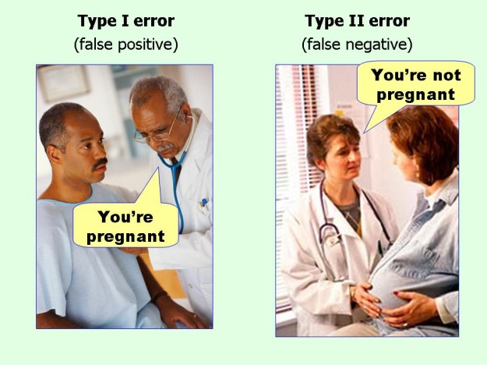
marginalrevolution.com/marginalrevolution/2014/05/type-i-and-type-ii-errors-simplified.html (2016-04-11)

