Slide 1
Class 8
Crime
Keith A. Pray
Instructor
socialimps.keithpray.net
Notes:
Here’s the title slide. Is anyone not excited?

Slide 2
Papers
Make decisive conclusions
  may, could, etc. = trivial
Quantify
  Do not use terms like: less, more, a lot, huge, great, big, tiny, growing, etc.
Absolute statements are difficult to prove
  Avoid: all, always, any, every, everyone, never, none… unless you can show it
Read paper aloud to proof
http://socialimps.keithpray.net/assignments/paper-guidelines/
Notes:
0s not included.
Save for next time:
Absolute statements are difficult to prove
Avoid: all, always, any, every, everyone, never, none… unless you can show it
Be sure to put quotes around entire quote
Hyperbole is the best thing ever!
but not in these papers
Print 2 sided and save a tree
Use template, saves time (and -1 point)

Slide 3
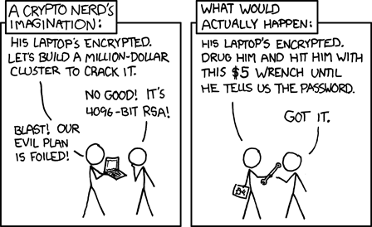
Overview
Review
Assignment
Students Present
http://xkcd.com/538/ (2010-11-14)
Notes:
Are there any questions on the assigned reading?
Use the slides ahead to explain any of the attack methods from the text.
If there are no questions you can skip those slides.

Slide 4
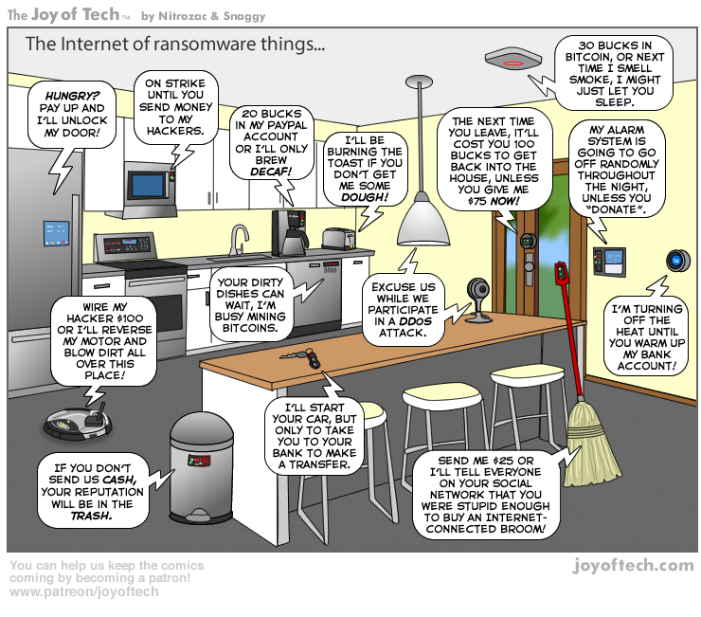
https://cointelegraph.com/storage/uploads/view/5e8f6e0d3a029807dfe181dc3d160cf0.png
Notes:
Find publish date
Note which really exist
Extra credit

Slide 5
My Reading Notes
pp. 323 Might be interesting to compare password guidance over the years.
pp. 325 plenty not sent with HTTP
pp. 328 Getting on TV much more difficult than releasing software
pp. 330 Virus could be new
pp. 332 Goals include infect 3 machine per LAN and as many computers as possible? Never make last minute changes before release. Were they related to the defects?
pp. 333 Testing w/out DEBUG often neglected
pp. 335 Do people use the Internet as an experimental laboratory these days? Shutdown right after booting, “benign” doesn’t seem like the right word.
pp. 337 “send reports back to a host computer”?
pp. 338 Firewalls often not running on same machine as malware, routers?
pp. 339 Have 2003 fears of cyber terrorist attacks been realized?
pp. 347 How is online voting a moral issue?
End of Chapter questions: 14. 25. 29.

Slide 6
Group Quiz
A denial of service attack shuts down a bunch of retailer, stock brokerage, large corporate entertainment and information web sites. Possible guilty parties:
  Terrorist who aimed to cause billions of damage to U.S. economy.
  Protest organization opposing commercialization of the web and corporate manipulation of consumers.
  Script kiddie (a minor) just having fun with tools he found on the web.
  Show off hacker in search of bragging rights.
State what penalties are appropriate for each.
Explain your answer to 1. using a single Ethical Theory for all.
Name the laws/acts under which these parties could be prosecuted.
Notes:
Works well as small group exercise.
Note: short answer format expected.
Note: 2. only one argument needed, should include logic for all parties
Note: 3. same law(s) should be applicable to all parties

Slide 7
Assignment
Code Testing 1 Page Paper 1/2
Given code you did not write yourself, you need to test and potentially break it
Find as many bugs possible
There are major and minor bugs to find
Once testing is done write paper arguing your testing was adequate
Things that might be useful in your argument:
  Explanations of defects
  How to fix them
  Consequences of leaving defects in production code
Use weaknesses (or strengths) in your testing methods as a counter argument
Working example: http://socialimps.keithpray.net/assignments/Test_Sales_Fun
Notes:
If guest presenter coming next class remind students to prepare questions for him.
Remember to work on groups projects.
Each group should have material on their sites for the topics we’ve covered so far.
OLD Prompt:
Design tests for the code on the following slide.
Contains at least one major defect and several minor ones.
Write a paper (1 page not counting any source code) including :
Did you choose a good test strategy? (This is your conclusion.)
The inputs and expected outputs
What defects you found
How you would fix the defects (you may include fixed source)
Why would that fix the problems?
What could happen if the defects are not found before the code is put into production?

Slide 8
Assignment
Code Testing 2/2
import java.text.NumberFormat;
public class SalesFun {
public static double calculateSalesTotal ( double amount, double discountRate, double taxRate ) {
double discount = amount * discountRate;
double total = amount - discount;
double tax = total * taxRate;
double taxedTotal = tax + total;
NumberFormat numberFormat = NumberFormat.getCurrencyInstance();
System.out.println ( "Subtotal : " + numberFormat.format ( amount ) );
System.out.println ( "Discount : " + numberFormat.format ( discount ) );
System.out.println ( "Total : " + numberFormat.format ( total ) );
System.out.println ( "Tax : " + numberFormat.format ( tax ) );
System.out.println ( "Tax+Total: " + numberFormat.format ( taxedTotal ) );
return taxedTotal;
}
}
} Lines of interest
Notes:
Bold lines are real focus.
Example input:
amount = 100.05;
discountRate = 0.10;
taxRate = 0.05;
OR
0.70, 0.0, 0.05
95.67, 0.20, 0.7

Slide 9
Overview
Survey
Review
Assignment
Students Present

Slide 10
The Next generation anti-Malware: Using AI to anticipate attacks
By: Matthew Aguiar

Slide 11
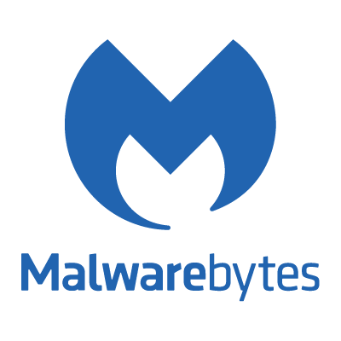
How does anti-malware currently work?
Matthew Aguiar
Definitions
  Compares against existing malware.
  Will flag as malware if match occurs.
Heuristics
  Code Analysis
  Does the code do bad things?
Sandboxing
  Creates a protected environment to test a program’s behavior.
  Simulates a scenario where malware has full control.
[1]
Notes:
Definitions
Antimalware will compare a possibly malicious program with a database of know malware definitions.
These definitions contain data about what the program does and how to recognize it.
DOWNSIDE: This requires the database to be regularly updated.
Heuristics:
Allows anti-malware to discover malware that was not previously discovered and put into a database.
Does this by analyzing behaviors.
Often checks to see if the program wants to remove important system files.
DOWNSIDE: Could actually flag non-malware as malware.
Sandboxing:
The coolest one of them all!
Finds malware by running it in a protected space in the computers memory.
The potential malware believes it is running with full access to the computer.
If the program is well behaved, it will be released from the sandbox to the computer.
DOWNSIDE: Some malware may be better programmed than others to know they are in a sandbox environment.

Slide 12

Questions to consider about AI?
Matthew Aguiar
Lack of sufficient real world data.
  No one has concrete training data.
How will AI classify programs?
Scalability?
How will AI Anti-Malware protect against AI powered malware?
[2]
Notes:
No one has concrete training data that represents right from wrong when it comes to how programs behave.
What will the AI do to decided whether a program is malicious or is behaving legitimately?

Slide 13
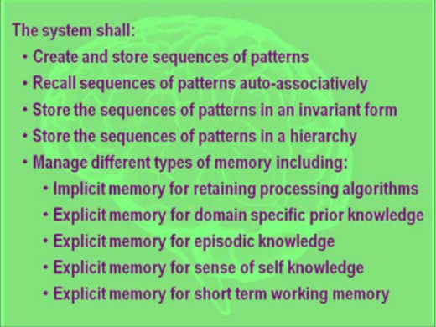
Constructing the ai
Matthew Aguiar
Graphic to the right shows CHAMPION, [4].
  Columnar Hierarchical Auto-associative Memory Processing In Ontological Networks
Mimics functionality of Cortical Column, [4].
  Cortical Column is a unit of the Cerebral Cortex.
  Capable of memorizing complex relations.
  Neurons in this part of the brain are analogous to logic gates.
Notes:
Explain CHAMPION quickly.
Talk about the Cortical Column and how this part of the brain is especially good for mimicking with computers due to analogous nature.

Slide 14
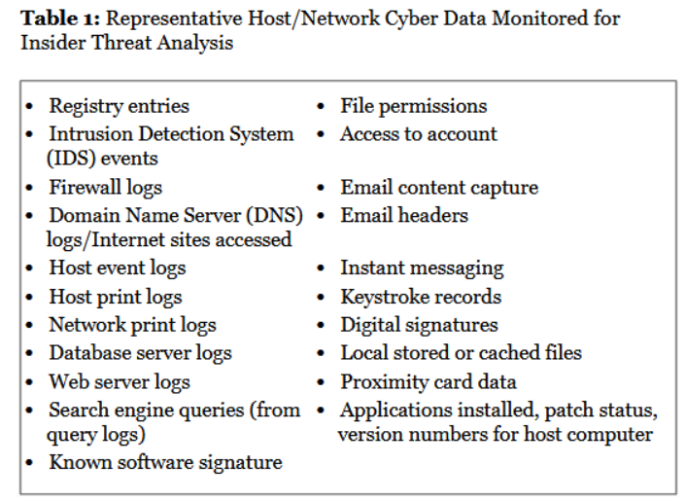
Representing AI at a Machine level
Matthew Aguiar
[4]
Notes:
This all of the data that will be harvested in order to perform the proper malware detection.

Slide 15
Conclusion
Matthew Aguiar
AI is the future of Anti-Malware.
Far more sophisticated.
  Replicates brain functionality!
Gathers information 21 ways.
  See previous slide.
Needs to be scalable.
Notes:
Far more sophisticated than the already advanced Anti-Malwares.

Slide 16
References
Matthew Aguiar
[1] Wendy Zamora, How does Anti-Malware Work? https://blog.malwarebytes.com/101/2015/12/how-does-anti-malware-work/, (April 4, 2019)
[2]https://upload.wikimedia.org/wikipedia/commons/thumb/4/48/Emblem-question.svg/1024px-Emblem-question.svg.png
[3] Frank L. Greitzer, Modeling Human Behavior to Anticipate Insider Attacks, (Journal of Strategic Security, 2011), pp. 25 - 31
[4] Yves Burnod, An Adaptive Neural Network: The Cerebral Cortex, https://www.ruf.rice.edu/~lngbrain/Farh/col.html, (April 4, 2019)
…

Slide 17
Quadcopter Security
Ryan Beaver
Notes:
-Hello, my name is Ryan Beaver. The subject of my presentation today is Security in relation to small commercial drones.

Slide 18
Drones: Pros and Cons
Ryan Beaver
Pros:
  Great educational tool
  Inexpensive and easy to use
  Great for photography and video
  Versatile: can be used in a variety of ways by:
    Hobbyists
    Businesses
    Emergency and Rescue teams
    The Military
Cons:
  Very under regulated on a recreational level
  Threat to airspace
  Potential interference
  Invasion of privacy
  Most commercial models can be very easily hacked.
<Citation>
Notes:
-So, Quad-Copters, also known as drones (or more specifically, Multi-rotor UAV’s) are a steadily growing industry in this decade, becoming one of the most popular hobbies in the US. They have become popular only due to the fact they are relatively inexpensive (depending on the model of course), but also their versatility. They are used by educators, hobbyists, businesses, sporting events, emergency and rescue teams, and even the US Military.
-Now like all emerging technologies from the past few decades, they have been subject to controversy. While they have very strict regulations when used for a commercial or Professional use, they are VERY under regulated on a recreational level. This has led to concerns about airspace invasion, potential interference of emergency situations, and Invasion of privacy.
-However the topic we will be focusing on is probably one of the scariest to think about. While drones can be a scary thought to some, an even more terrifying thought is what happens if someone hacks INTO a drone, and seizes control. Sadly, this is the case with most commercial drones.

Slide 19
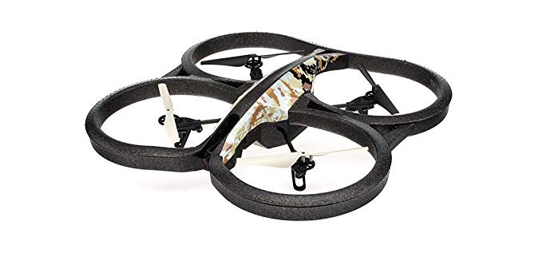
Hacking Drones
Ryan Beaver
Many commercial drones use Apps to access Cameras or control the drone
Drones using unencrypted Wi-Fi are the most vulnerable
Hackers can access cameras and take control of the drone from the pilot
An example of a Parrot-AR-Drone-2-0-Elite-Quadcopter. Photo by Amazon.com
Notes:
Most commercial models can be very easily hacked.
Drones using unencrypted Wi-Fi are the most vulnerable
Hackers can access cameras and take control of the drone from the pilot

Slide 20
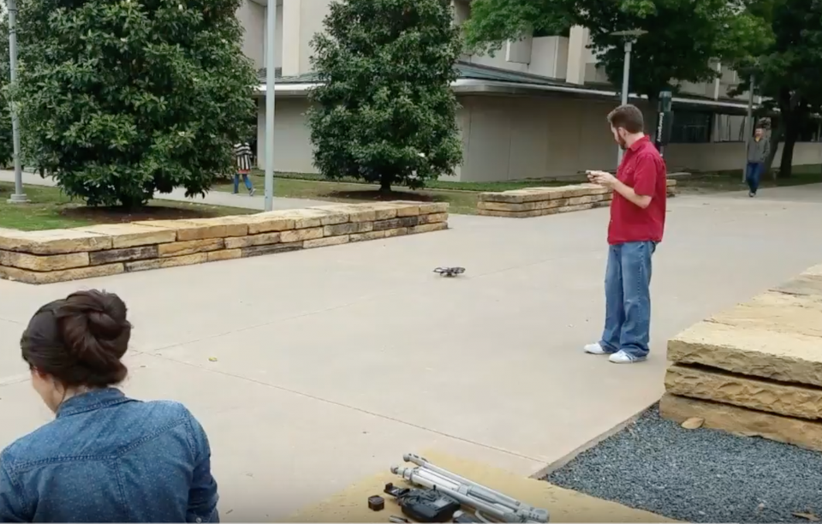
How easy are they to hack?
Ryan Beaver
Since the data streamed is unencrypted, camera feeds can easily be accessed.
By accessing a FTP [file transfer protocol] servers, hackers can overwrite a system file to remove the password for the root user.
Filesystem backdoors give hackers even more advantages.
https://www.youtube.com/watch?v=bAxPBNDeCmM
Photo by: DALLAS CYBER-PHYSICAL SYSTEMS SECURITY LAB'S YOUTUBE
Notes:
Several organizations have shown how easy it is to hack into a drone and take it over.
At a day-long workshop on drones and privacy in October of 2016, researchers from the Federal Trade Commission showed they were able to hack into three different off-the-shelf drones, all costing less than $200. The three drones tested were the AR Drone Elite Quadcopter from Parrot, the Hawkeye II 2nd FPV Motion Sensing Quadcopter from DBPower and the oneCase CX-10w made by Cheerson. While they didn’t reveal which hacks that they used to take over the drones (for obvious reasons), they did reveal what they were able to accomplish. Researchers were able to take over the video feed on all three of the drones, since the data was sent unencrypted. With two of the drones, they were able to take control of the flight path, as well as turn off the aircraft, causing both to fall from the sky. All of the smartphone apps made for the devices gave no indication or inconsistent notifications when a third party was connecting to the drone, so the operator wouldn’t know if someone was watching the video feed. Each of the drones acted as a Wi-Fi access point, allowing devices to connect to the drone like a home router, but, according to the FTC, they required no password to actually connect. Researchers from the FTC then demonstrated how they were able to connect to one of the drone’s camera feeds from any computer, since the drone’s Wi-Fi access point wasn’t password protected.
Another test was run in April of 2017 by the Carnegie Mellon Computer Emergency Response Team on the DBPOWER Quadcopter. It was shown that the drone was vulnerable to a rudimentary attack that allowed anyone within range of the drone's Wi-Fi connection to take it out of the sky. The researchers who uncovered the bug, from the Cyber-Physical Systems Security Lab at University of Texas at Dallas, put together a video for Forbes showing how they quickly obtained root access to the quadcopter and cut its power. The Chinese-made drone is currently listed as a best seller at $140 on Amazon (though it's been reduced to $80). It contained a number of worrying vulnerabilities, according to UT Dallas researcher Junia Valente. "The device contains an open access point not protected by any password and a misconfigured FTP [file transfer protocol] server that allows unauthorized users to read and write to the drone filesystem," Valente said. "One of the attacks we did was precisely to overwrite sensitive system files to gain full root access. "She explained that the misconfigured FTP access allowed the researchers to overwrite a system file to remove the password for the root user. That gave them complete control of the drone and shut the power off, preventing the drone owner from controlling their flying machine with the system's proprietary smartphone app.
https://www.youtube.com/watch?v=bAxPBNDeCmM

Slide 21
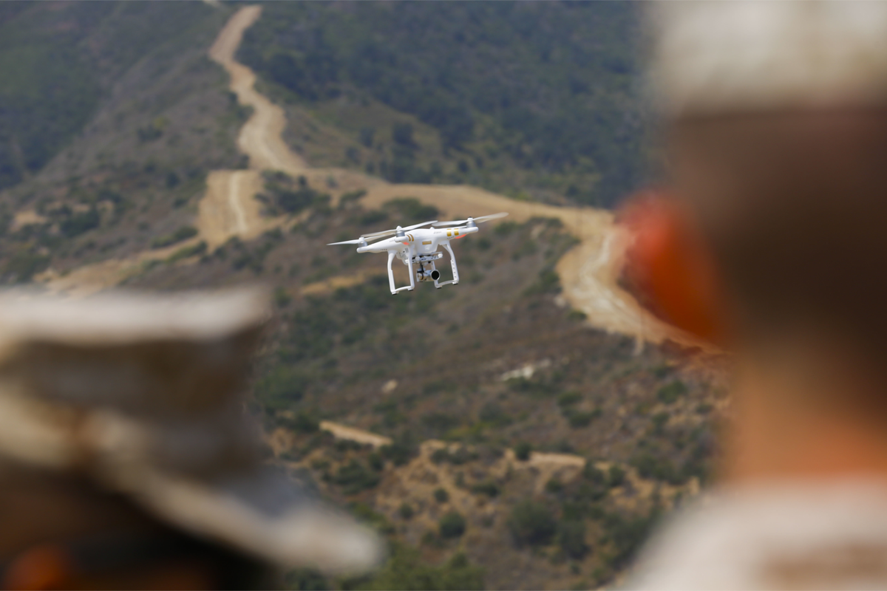
Potential Consequences of drone hacking
Ryan Beaver
Drone theft
Crashing the Drone
Invasion of privacy
Espionage
Interception of deliveries
Compromise a military operation
U.S. Marine Corps photo by Lance Cpl. Frank Cordoba/Released
Notes:
Should an attacker successfully take over a drone, there could be severe consequences:
- Theft: if a drone is taken over mid-flight, the attacker could fly the drone to an alternate location, similar to how a thief could steal a car, and either use it, take it apart, or sell it.
- Damage: The Hacker could also destroy the drone by crashing it into the ground. This could not only damage the drone, but other objects, buildings, and even people depending on where and how badly the attacker crashes the drone
- For Drones with Cameras, the attacker could use the camera to invade privacy. They could take pictures or spy on people without the pilots knowledge or consent
- If a drone used by a business, they could intercept deliveries
- Drones are also currently being used in
- Quad-copters are being actively used by the military and marines now for Reconnaissance and Mapping. If a drone used by the Military (not predator drones, still quadcopters) is hacked, they could potentially risk jeopardizing an operation by counter spying or using the information received by the drone to perform a counter-strike. In fact, this very issue is why over 2000 drones meant to be issued to the marines were refused deployment since the Defense Department Inspector General reported that the Pentagon did not have adequate procedures to assess cybersecurity risks associated with using commercial drone systems.

Slide 22
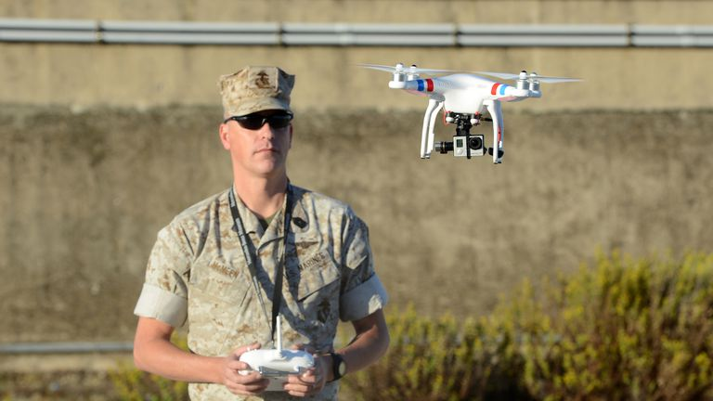
What should be done?
Ryan Beaver
Conclusion:
Quadcopter/Drone manufactures need to start looking into ways to prevent their products from being hacked
  Better encryption
  Stronger password protection
Operators should make sure their communication lines are secure before operating a drone
U.S. ARMY PHOTO BY VISUAL INFORMATION SPECIALIST JASON JOHNSTON
Notes:
Slide 6:
Conclusion: Drone manufactures need to start looking into ways to prevent their products from being hacked
This can be achieved by better encrypting the networks that people use to fly the drones, using
Stronger password protection
Operators should make sure their communication lines are secure before operating a drone

Slide 23
References
Ryan Beaver
[1] Thomas Brewster, Watch A Very Vulnerable $140 Quadcopter Drone Get Hacked Out Of The Sky, https://www.forbes.com/sites/thomasbrewster/2017/04/25/vulnerable-quadcopter-drone-hacked-by-ut-dallas-cyber-researchers/#1a2374681037 (Accessed 4/3/2019)
[2] Sander Walters How Can Drones Be Hacked? The updated list of vulnerable drones & attack tools, https://medium.com/@swalters/how-can-drones-be-hacked-the-updated-list-of-vulnerable-drones-attack-tools-dd2e006d6809 (Accessed 4/3/2019)
[3] Pike, George H, The Internet of Drones, https://search.proquest.com/docview/1761258746?rfr_id=info%3Axri%2Fsid%3Aprimo (Accessed 4/3/2019)
[4] Johann-Sebastian Pleban, Ricardo Band, Reiner Creutzburg, Hacking and securing the AR.Drone 2.0 quadcopter: investigations for improving the security of a toy, https://www.spiedigitallibrary.org/conference-proceedings-of-spie/9030/1/Hacking-and-securing-the-ARDrone-20-quadcopter--investigations-for/10.1117/12.2044868.full?SSO=1 (Accessed 4/3/2019)
[5] Hope Hodge Seck, Pentagon Policy Bars Marines from Using New Infantry Quadcopters, https://www.military.com/dodbuzz/2018/06/15/pentagon-policy-bars-marines-using-new-infantry-quadcopters.html (Accessed 4/3/2019)
[6] Kyle Mizokami, The Marine Corps' Latest Weapon Is a Quadcopter, https://www.popularmechanics.com/military/a16762519/the-marine-corps-latest-weapon-is-a-quadcopter/ (Accessed 4/3/2019)
[7] Kelsey D. Atherton, Pentagon suspends commercial drone purchases and use https://www.c4isrnet.com/unmanned/2018/06/12/pentagon-suspends-commercial-drone-purchases-and-use/ (Accessed 4/3/2019)
[8] April Glaser, The U.S. government showed just how easy it is to hack drones made by Parrot, DBPower and Cheerson https://www.recode.net/2017/1/4/14062654/drones-hacking-security-ftc-parrot-dbpower-cheerson (Accessed 4/3/2019)
[9] https://www.amazon.com/Parrot-AR-Drone-2-0-Elite-Quadcopter/dp/B00FS7SSD6 (Accessed 4/4/2019)
Notes:
-Thank you, do you have any questions?

Slide 24
The Lenovo SuperFish Incident
Peter Jankowski
Notes:
Hello everyone, I’m going to be talking about the time when Lenovo preinstalled adware from the company Superfish on all of their PCs. What I’d like to do is teach everyone what happened, and what should be done to prevent something like it from happening again.

Slide 25
What I Concluded/What I’m Trying to say:
Peter Jankowski
Strictly enforced security inspections on preinstalled software should be a requirement, not a punishment.
The problem Superfish caused, (and similar security flaws), would have been easily prevented with proper security checks.
Notes:
I’ll start by laying out what I’m trying to conclude from this presentation:
Frist, stricter security inspections on preinstalled software should be a required than what we have now. Waiting until after security holes are found to enforce airtight security checks means that really bad things will happen.
Second, the security flaw from Superfish’s software would easily have been stopped if this was implemented.

Slide 26

Quick Background:
Peter Jankowski
Superfish founded in 2006, as a startup developing visual search software.
By 2014 was ranked 4th fastest growing private company in US, 80 million users, $38 million in revenue.
[5] [6] [11]
Notes:
A bit of background that you all should know:
Superfish was a tech startup founded in Israel in 2006, and soon moved to Palo Alto, California. They primarily developed visual search software, (as you can see by the logo, Search Visually), which as it sounds, allows for web searches from images. By 2014, Superfish was the 4th fastest growing company in the US according to Inc. Magazine, with over 80 million users of their software worldwide, and $38 million in annual revenue as of early 2015.
It sounds like a startup’s dream success story, doesn’t it? Well, there’s a catch.

Slide 27
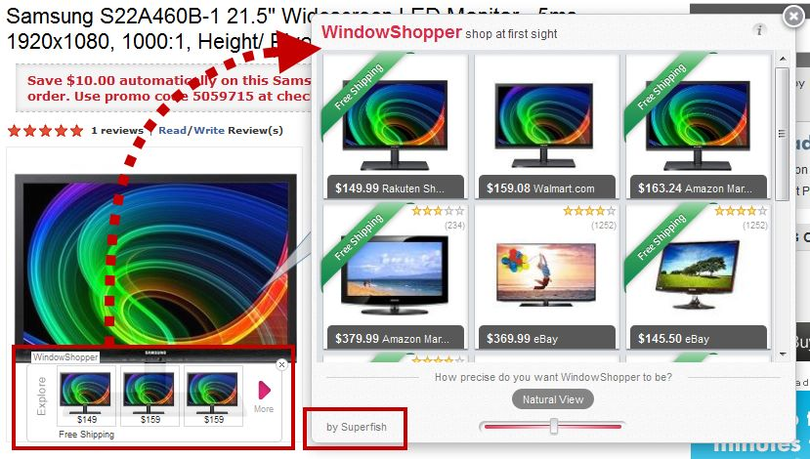
Not all is well (Visual Search = Popup Ads):
Peter Jankowski
Problems started with WindowShopper, 2011.
Customers called Superfish products adware.
Often hidden in software bundles.
VisualDiscovery preinstalled on all of Lenovo computers by December 2014.
[3] [6] [13]
Notes:
When Superfish’s first product was released in 2011, there were immediate complaints. Called WindowShopper, it took visual search software that Superfish developed and used it to spam your browser with popup ads whenever you viewed an image. As you can see in the image, its pretty disruptive. Even more worrying was the fact that WindowShopper was usually bundled with other preinstalled software to hide it from unsuspecting users, which as the reading mentioned, is common for adware since nobody would choose to download it.
The controverst did not seem to slow Superfish down, though. They managed to strike a deal with Lenovo to have their VisualDiscovery software on all Lenovo computers by December 2014.

Slide 28
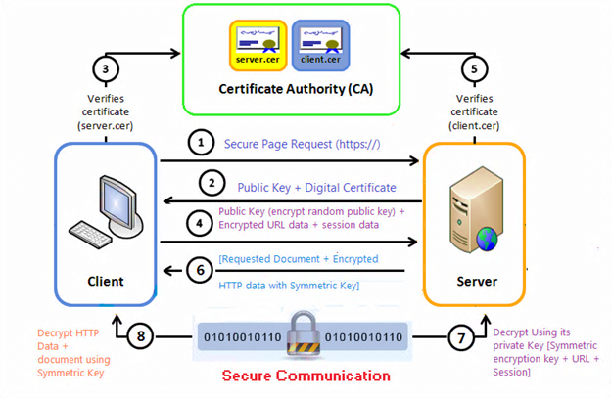
Certificates and Man in the middle attacks:
Peter Jankowski
VisualDiscovery installed a presigned security certificate from Komodia.
Performed man-in-the-middle attacks to insert ads.
Anyone on your Wi-Fi network could attack you, the certificate’s private signing key was always the same and available.
[4] [8] [9]
Notes:
There was a major flaw in Superfish’s VisualDiscovery software besides the fact that nobody likes popup advertising. The VisualDiscovery software used a third party self signed certificate, by Komodia Inc., in order to insert ads even over secure connections.
I’ll take a moment here to describe how certificate authorities work. Essentially, public keys encrypt information sent over a network, and can be widely shared. Private keys decrypt the information, and have to be kept private. Normally, they work in a pair to allow for encrypted connections. Man in the middle attacks occur when an attacker swaps out your public key for theirs, so that they can intercept your encrypted information, read it, encrypt with your public key, and then pass it along to its intended sdestination with nobody knowing any better. Certificate authorities stop this by taking a pair of public and private keys, and signing them with their own private key to tie them to the company’s secure certificate. Each key pair can’t be swapped out by an attacker, since they don’t have the company’s signature. As you can see in the image, this allows for clients to set up an encrypted connection with servers, exchanging public keys, which each can verify to be legitimate from the certificate.
Normally, security certificates have to be verified from a certificate authority, but since Superfish inserted and verified its own certificate, everything using that certificate was trusted, so Superfish could insert ads over even secure connections.
There’s a major security flaw in what Superfish did. VisualDiscovery trusts anything encrypted and signed with the Superfish certificate’s private key, but since that key was installed on all Lenovo devices, attackers could get it, and use it to sign their own keys and attack any Lenovo device they wanted. Any encrypted searches by Lenovo users could be intercepted by an attacker, and man in the middle attacked using Superfish’s own installed private key.
I’ve included a link to a video that goes in depth on man in the middle attacks and Superfish, but it’s a bit long for this presentation.

Slide 29
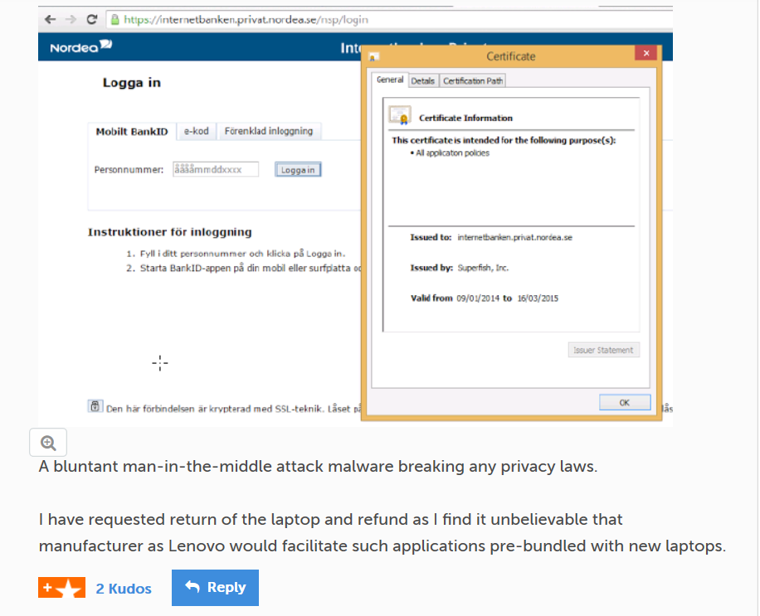
The outcome for Superfish:
Peter Jankowski
Approx. 750,000 Lenovo users had their browsers hijacked.
Security hole had been complained about less than a month after full launch.
The Department of Homeland Security gave instructions to uninstall VisualDiscovery.
By May 2015, Superfish renamed to JustVisual. Defunct by 2016. Komodia is still in business.
[1] [3] [4] [12]
Notes:
An estimated 750,000 Lenovo users had their browsers hijacked, in the roughly 2-3 month period while Lenovo scrambled to fix the issue.
The flaw in Komodia’s certificate scheme was so obvious that security experts were astounded that such a thing could have been allowed to happen unnoticed. Complaints about VisualDiscovery on the first Lenovo computers were raised in November, even before Lenovo had finished adding it to all of their products. The first complaint outlining the full scale of the certificate issue was on Lenovo’s support forums on January 21, 2015, less than a month after Superfish’s certificate from Komodia had been preinstalled on all Lenovo computers, which is shown here.
The situation was so bad that the Department of Homeland Security issued an urgent warning with instructions on how to install the certificate in February, (recall that VisualDiscovery was launched on Lenovo computers in December).
As a result of all this, Superfish went bankrupt by May, relaunched as JustVisual.com, and went bankrupt again the next year. Komodia, the company that provided the certificate Superfish used, is still in business. As for how things went for Lenovo in the long term…

Slide 30
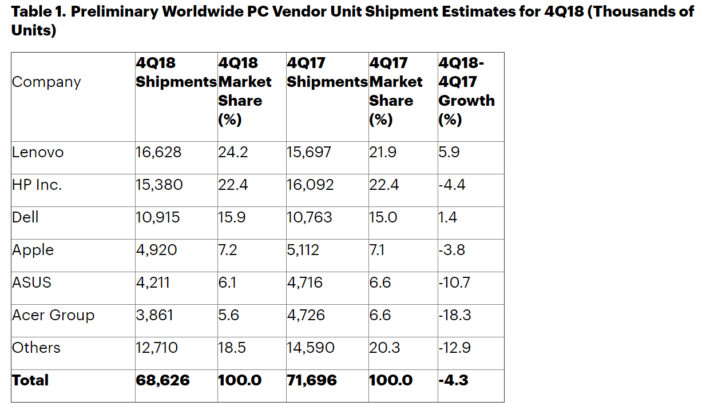
How Lenovo is doing:
Peter Jankowski
Lenovo settled with FTC in 2017 for $3.5 million, along with other concessions. ($4.67 per victim).
Lenovo is now biggest PC seller on the market.
This punishment would be good enough if it’s a sufficient deterrent, which it’s not.
<Graphic as big as will fit>
[2] [10]
Notes:
Remember that Lenovo agreed to preinstall Superfish’s adware on their products. In response to the injunction raised against them, Lenovo eventually settled with the FTC for $3.5 million, along with requiring that they cannot misinform consumers about any preinstalled software with advertising or that transmits information to third parties, and that they maintain a software security program subject to outside audits for the next 20 years.
That sounds not too bad of a punishment, but remember that $3.5 million / 750,000 users hacked = $4.67 per customer hacked. That’s not much, and Lenovo’s business has improved since the incident instead of continuing to decline.
In 2014 Lenovo controlled 19.8% of the worldwide market in PCs, and in 2018 they had a 24.2% market share, putting them on top above HP, as you can see here.
But surely we’ve learned our lesson about certificates, so even if Lenovo got off easy, we know it’ll never happen again, right?

Slide 31
The Problem Continues:
Peter Jankowski
There was eDellRoot only months later, with their own security certificate with the same flaw.
Preinstalled, insecure software like Superfish still exists since:
1 – PC Companies can get away with it, with minimal consequences.
2 – As Superfish showed, there’s a lot of money if companies don’t care.
[7]
Notes:
Anyone who guessed it would take less than a year for someone else to repeat Superfish’s screwup, you’re correct. eDellRoot was a security certificate installed on Dell laptops, and found by users in November 2015. It had the same problem as VisualDiscovery, in that the software was installed with its own private key and certificate, so anyone could take the key and sign their own certificates with it, pretending to be from Dell. Naturally, eDellRoot was given the nickname, “Superfish 2.0”, and again there was angry backlash against Dell for allowing this to happen. But like Lenovo, Dell is doing just fine now, (last slide actually shows them at 3rd market share for PCs, and like Lenovo, still growing).
So I’ve hopefully demonstrated by now two things. First, PC companies like Lenovo can get away with putting insecure software on their computers. Second, as long as there’s money to be made, or at least not enough incentive to ensure software is secure, massive security flaws from preinstalled software will continue to happen. As a reminder, Superfish had access to $38 million in revenue in 2014, so they easily had enough to pay Lenovo to convince them to install their adware, and potentially enough to not look too closely at it.

Slide 32
What Should be done:
Peter Jankowski
PC vendors need to be held more accountable for the software they sell preinstalled on their computers.
There has to be stricter monitoring in the first place, not after the problem occurs.
If Superfish inspected the Komodia certificates, or Lenovo inspected VisualDiscovery, this could have easily been prevented.
Notes:
Back to what I said at the beginning.
To prevent another Superfish from happening, stricter security monitoring must be enforced to stop software with such a gaping security hole from being put onto devices in the first place, rather than waiting until they cause a problem.
The type of security hole VisualDiscovery had was, as I’ve shown, easily preventable with more careful monitoring. If Superfish had just inspected the way that Komodia handled certificates, or if Lenovo inspected VisualDiscovery for security flaws, this whole mess could have easily been prevented.
Any questions?

Slide 33
References
"Superfish; Superfish Ranked #4 on Inc. 500 List of America's Fastest Growing Private Companies." Journal of Engineering, Sep 03 2014, p. 427. ProQuest. Web. 3 Apr. 2019 .
Peter Jankowski
[1] “Alert (TA15-051A) Lenovo Superfish Adware Vulnerable to HTTPS Spoofing,” https://www.us-cert.gov/ncas/alerts/TA15-051A. Accessed April 3rd, 2019.
[2] Claburn, Thomas. “Remember When Lenovo Sold PCs with Superfish Adware? It Just Got a Mild Scolding from FTC.” The Register, 5 Sept. 2017, www.theregister.co.uk/2017/09/05/lenovo_gets_wristslap_from_ftc_for_superfish_adware_debacle/. Accessed April 1st, 2019.
[3] Brandon Bailey. “After Security Scandal, a Tech Firm Says It's Changing Focus.” ABC News, (Yahoo!-ABC News Network, 28 May 2015), at web.archive.org/web/20150529003146/http:/abcnews.go.com/Technology/wireStory/security-scandal-tech-firm-changing-focus-31373750. Accessed April 2nd, 2019.
[4] Auerbach, David. “Lenovo's Superfish Scandal Is One of the Worst Consumer Computing Screw-Ups Ever.” Slate, Slate Magazine, 20 Feb. 2015, https://slate.com/technology/2015/02/lenovo-superfish-scandal-why-its-one-of-the-worst-consumer-computing-screw-ups-ever.html Accessed April 1st, 2019.
[5] "Superfish; Superfish Ranked #4 on Inc. 500 List of America's Fastest Growing Private Companies." (Journal of Engineering, Sep 03 2014). Page 427.
[6] Perlroth, Nicole. "How Superfish's Security-Compromising Adware Came to Inhabit Lenovo's PCs." (New York Times, Mar 02 2015). Page 1.
[7] Joel Hruska. “Dell apologizes for Superfish-like scandal, offers eDellRoot removal instructions.” by EXTREMETECH.com. https://advance.lexis.com/api/permalink/722f686f-f428-4457-a973-6a2623b7d2d9/?context=1516831 Retrieved from Nexis Uni, Accessed April 3rd, 2019.
[8] Tom Scott,. “Man in the Middle Attacks & Superfish – Computerphile.” www.youtube.com/watch?v=-enHfpHMBo4. Accessed April 2nd, 2019.

Slide 34
References, Continued
"Superfish; Superfish Ranked #4 on Inc. 500 List of America's Fastest Growing Private Companies." Journal of Engineering, Sep 03 2014, p. 427. ProQuest. Web. 3 Apr. 2019 .
Peter Jankowski
[9] Perry, Scott S. “Protect Yourself Against Fraudulent SSL Certificates.” (DigiCert, 2015), www.digicert.com/protecting-against-fraudulent-certificates.htm. Accessed April 4th, 2019.
[10] Costello, Katie. “Gartner Says Worldwide PC Shipments Declined 4.3 Percent in 4Q18 and 1.3 Percent for the Year.” (Gartner, 10 Jan. 2019), www.gartner.com/en/newsroom/press-releases/2019-01-10-gartner-says-worldwide-pc-shipments-declined-4-3-perc. Accessed April 2nd, 2019.
[11] “Superfish on the Forbes America's Most Promising Companies List.” Forbes, Forbes Magazine, 21 Jan. 2015, www.forbes.com/companies/superfish/#18eed7284c2b. Accessed April 2nd, 2019.
[12] Lenovo forum user zibarstk. “Re: Potentially Unwanted Program.” (Lenovo, 21 Jan. 2015), https://forums.lenovo.com/t5/Security-Malware/Potentially-Unwanted-Program-Superfish-VisualDiscovery/m-p/1860408/highlight/true#M1697. Accessed April 4th, 2019.
[13] Hruska, Joel. “Lenovo Officially Responds to Superfish, Releases List of Affected Systems.” ExtremeTech, (Ziff Davis LLC, 20 Feb. 2015), www.extremetech.com/computing/199628-lenovo-officially-responds-to-superfish-releases-list-of-affected-systems. Accessed April 2nd, 2019.

Slide 35
Class 8
The End
Keith A. Pray
Instructor
socialimps.keithpray.net
Notes:
This is the end. Any slides beyond this point are for answering questions that may arise but not needed in the main talk. Some slides may also be unfinished and are not needed but kept just in case.

Slide 36
Buffer Overrun
Run time stack
Local Variables
Return Address
Parameters
Variable Attack
buffer
Target Variable
Stack Attack
buffer
Return Address
code
Return Address
Notes:
Retire slide. Most students have this in depth from new class now.
When a function call is made, local variables, return address, parameters stored on run time stack. Local variables occupy lower memory addresses.
Variable attack – change variable value. Program expects user to input character and allocates a buffer for them. Attacker supplies too many characters and ends up over writing a variable.
Stack Attack – goal is to change value of return address so execution control goes to code which the attacker has provided in the input buffer.
Prevention – add checks against array bounds being exceeded, or modify operating system to not execute instructions stored on run time stack.

Slide 37
Run Example Code
Notes:
Retire demonstration. Most students have this in depth from new class now.
> imps
> assembly
> 123456789qwerty1

Slide 38
Buffer Overrun Code
#include <stdio.h>
#include <string.h>
int main ( void ) {
char buff [ 15 ]; int ace = 0;
printf ( "\n Enter best class ever : \n" );
gets ( buff );
if ( strcmp ( buff, "imps" ) ) {
printf ( "\n %s is wrong! You should FAIL! \n ace=%i\n", buff, ace ); }
else { printf ( "Correct! \n") ; ace = 1; }
if ( ace ) { printf ( "You get an A! \n" ); }
return 0; }
} The Naughty Line
Notes:
Retire slide. Most students have this in depth from new class now.

Slide 39
TCP Three-way Handshake
SYN
SYN-ACK
ACK
Notes:
Retire slide. Most students have this in depth from new class now.
SYNchronize
SYNchronize ACKnowledgement (socket reserved awaiting ACK)
ACKnowledgement
TCP socket connection established

Slide 40
SYN Flood Attack
SYN
SYN-ACK
Notes:
Retire slide. Most students have this in depth from new class now.
Attacker spoofs the IP address so the SYN-ACK is sent to a different machine that cannot respond to the SYN-ACK.
This leaves the connection half open on the server machine decreasing the resources (sockets, memory, threads/processes) available to respond to legitimate clients.
The attacker send many such spoofed SYN messages.

Slide 41
Ping Attack
Target
Attacker
ping
ping
Notes:
Retire slide. Most students have this in depth from new class now.
Attacker finds routers that support broadcasting messages to all computers on their local area networks.
The attacker sends a spoofed ping message, which the routers echo to the spoofed address.

Slide 42
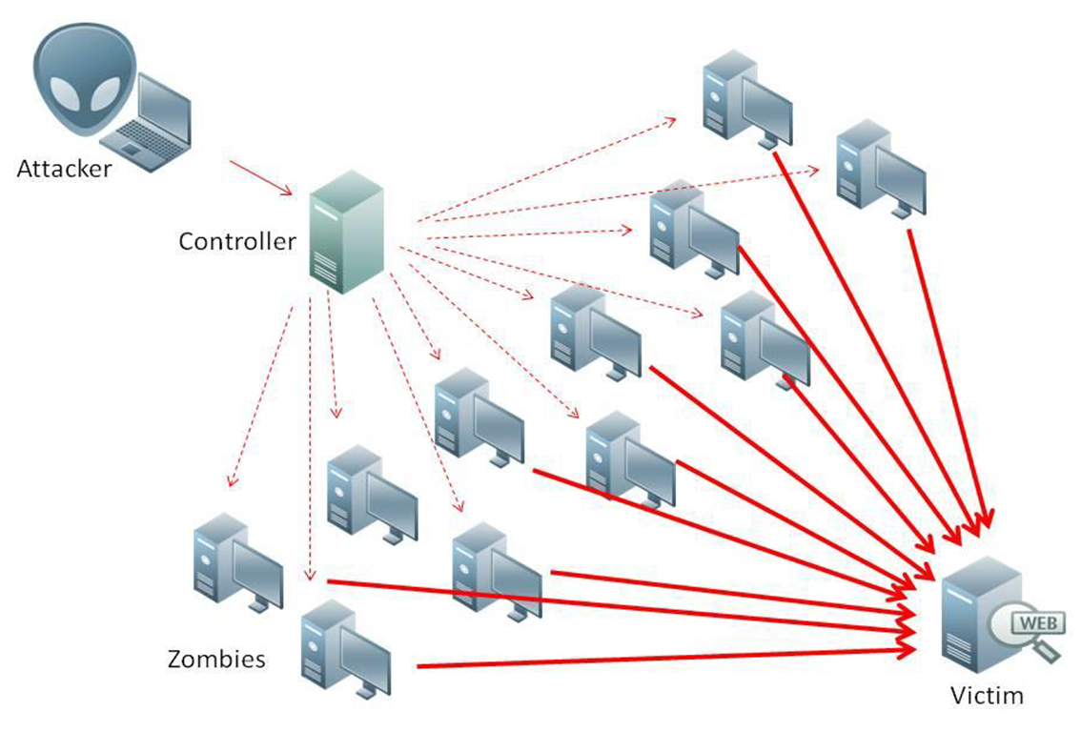
What is Denial of Service (DoS)
Attempts to make target unavailable by flooding with traffic
If victim has to filter attack, it’s too late
Internet Providers have no incentive to help
  Businesses get affected, but would not pay provider enough to make worthwhile
  This is why Cloudflare, e.g., exists
Many ways to perform this attack
Notes:
Contributed by Brett Ammeson.
https://www.cloudflare.com/ddos/reflection-attack-1.png
https://i.imgur.com/lxYv8cF.png

Slide 43
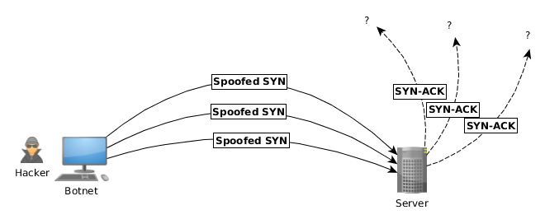
Distributed DoS Vectors
TCP SYN attack
  SYN packets are small, low difficulty for attacker
  Leaves half-open connections on server
  SYN cookies mitigate this
DNS amplification attack
  DNS requests are small
  Can request all records on server
  Crippled by proper configuration
Ingress/egress filtering will reduce effect
Notes:
Contributed by Brett Ammeson.
TCP SYN: https://www.cert.org/historical/advisories/CA-1996-21.cfm
DNS amplification: https://www.cert.org/historical/incident_notes/IN-2000-04.cfm
Ingress/egress: www.giac.org/paper/gsec/705/egress-filtering-keeping-internet-safe-systems/101588

Slide 44
Crime How
Technical and Non-Technical
  Break into computer.
  Prevent access to computer.
What things make computer related crime easy?
Notes:
Exploit security holes, Break encryption, Spoofing
Social Engineering: Guess passwords, Find out passwords and procedures
Poor passwords, Insecure protocols, Program limitations (buffer overruns), Eavesdropping (Email, Interactive), Insecure files

Slide 45
Crime Bane
Trojan Horse
Virus
Worm
Bot Network
Buffer Overrun
(Distributed) Denial Of Service Attack
How do they work?
How harmful are they?

Slide 46
Crime Why
Why?
Notes:
Money: stolen credit cards, change records, stolen property.
Political, military, economic.
Challenge, Revenge, Mean
Why do at all? Have motivation, think about it, think it will help, think it’s acceptable.
Feel forced. Don’t agree. Don’t care.

Slide 47
Crime Time
What is different now compared to:
  10 years ago?
  20 years ago?
  30 years ago?
  40 years ago?
Notes:
More computers. Unsophisticated owners. More complex software. Greater connectivity. Easy access to cracking tools. Incentives. File-sharing
In ’60s and ’70s, access was mostly localized.
Modems. Wardialing.
Some Arpanet and Usenet.

Slide 48
Crime Doers
Hacker or Cracker
  Pre-1980 - Golden Age ☺ ?
  Eighties
  Nineties
  Naughts
Criminal Hacking == Cracking?
Notes:
Script kiddies
Phreakers
Security analysts
Packet monkey

Slide 49
Crime Gain
Justifications for Computing Crimes?
What can be done after access is gained?
  What resources are available?
  How valuable are they?
Notes:
Machines are unused. No harm done. Education. Exposes security holes. Exposes abuses.
Use computer and/or resources. Take data. Destroy data. Alter data. Lock out others. Attack other computers.
Equipment, Processor Time, Disk space, Printer time / paper, Bandwidth

Slide 50
Crime Pay
Computer Fraud and Abuse Act (1986)
  Bans :
    unauthorized access or use of computers, copying, modifying, or destroying data, disclosing of passwords.
    disrupting government and utilities.
  Covers government, financial, medical, and interstate systems.
USA Patriot Act (2001)
  Raised penalties.
  Permits freer surveillance and monitoring to detect illegal activity.
Electronic Communications Privacy Act
  Illegal to intercept telephone, email, other data transmissions, access stored email messages without authorization
Assign Cybercrime Treaty (2006), Wire Fraud Act, National Stolen Property Act, Identity Theft and Assumption Deterrence Act
Notes:
Are either of these laws still in effect? Have they been changed?
For additional legislation ask for presenting volunteers to brief recent incidents/cases.
Also ask for volunteers to find out laws from their home country/state.

Slide 51
Crime Stop
Technical
  Protect Data
  Protect Machine
  Protect Access
Non-technical?
  Social?
  Legal?
Notes:
Encryption, Authentication, Biometrics, Anti-virus, File integrity checking (E.g. Tripwire), Virtual private networks, Point-to-point networking (Twisted-pair Ethernet vs. Coax vs. wireless)
Security through obscurity, physical access required, not on network, behind locked doors.
Remove desire, remove incentives
Legalize, increase penalties, increase chance of getting caught.

