Slide 1
Class 4
Freedom Of Speech
Keith A. Pray
Instructor
socialimps.keithpray.net
Notes:
Here’s the title slide. Excited again, aren’t you? You should be.

Slide 2
Papers
http://socialimps.keithpray.net/assignments/paper-guidelines/
Quantify
  Not terms like: less, more, a lot, huge, great, big, tiny, etc.
State a strong, clear conclusion
No strawman fallacy in counter point
Text book is not a primary source
Read paper aloud to proof
Use template, saves time (and -1 point)
Cite as suggested [1]
Notes:
Save for next time:
Missing Counter Point and Response
Be sure to put quotes around entire quote
Clearly state conclusion
First statement preferred
Print 2 sided and save a tree
Hyperbole is the best thing ever!
but not in these papers

Slide 3
Overview
Review
Assignment
Students Present
Notes:
Show syllabus updates if any

Slide 4
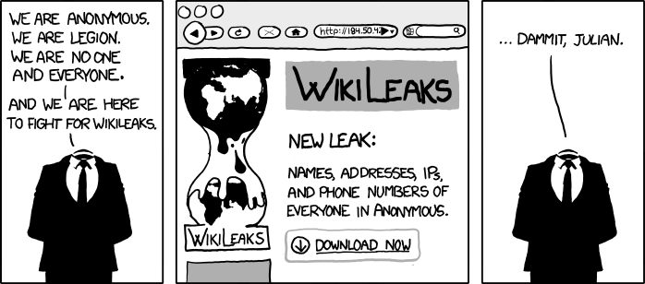
http://www.xkcd.com/834/

Slide 5
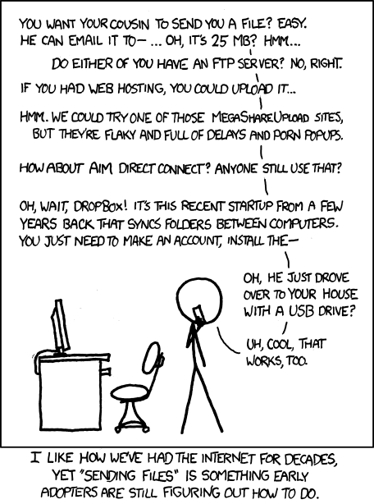
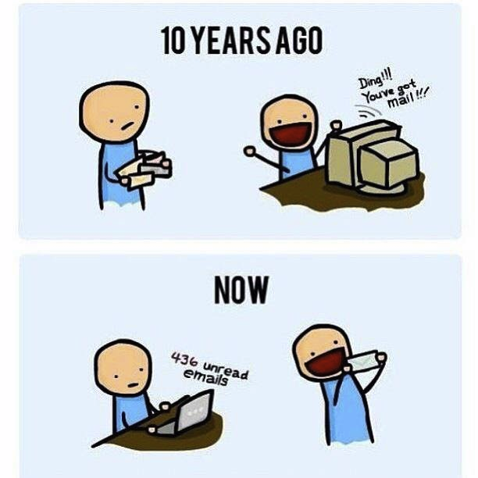
http://poofytoo.com/
25
http://xkcd.com/949/

Slide 6
My Reading Notes
pp. 110 What powers the cell phones and towers? “everyday tasks” not apparent from image.
pp. 114 Ann did not force people to complain.
pp. 117 7% # transactions or $$? Wikipedia critics source [19] from 2005, how has quality turned out? Nice to see darknet added.
pp. 118 [27] PC bangs youth source from 2003, all grown up now.
pp. 130 Is 20% realistic? What will search engines and facial recognition be capable of? Rule Utilitarian ignores the private setting.
pp. 131 Do any filters use image processing?
pp. 133 Stating people searching did not consent to material being blocked makes more sense.
pp. 134 Web access for no cost?
pp. 145 More accurate to say addicted to single app - good
pp. 149 20 same as 39
pp. 150 36 same as 42
End of Chapter questions I liked: 2, 25 http://en.wikipedia.org/wiki/Wikipedia:Citing_Wikipedia

Slide 7
Group Quiz
Name two methods some governments use to control access to information.
A large company has a policy prohibiting employees from blogging about company products.
  Name two possible reasons for the policy.
  Does it violate the First Amendment? Why?
  Is it reasonable? Why?
What does “URL” stand for and what is it?
Notes:
Censorship (religious, governmental, private). Adult authentication. Global dissemination.
Freedom of Speech not an absolute right.

Slide 8
Overview
Review
Assignment
Students Present
Notes:
But before that:
CPG Grey - This Video Will Make You Angry [Thought Germs] (7:25)
https://www.youtube.com/watch?v=rE3j_RHkqJc
If not shown yet:
What "Orwellian" really means - Noah Tavlin (5:31)
http://ed.ted.com/lessons/what-orwellian-really-means-noah-tavlin
Cedric Gervais - Hashtag (Original Mix) (3:58)
https://www.youtube.com/watch?v=6OmBKd7X7EE
Dave Audé vs Luciana - You Only Talk In #HASHTAG (3:36)
http://www.youtube.com/watch?v=53wIN87lJn0

Slide 9
Assignment
Reading
Individual Presentations
Extra Credit – One page paper
  Is WPI’s IT Acceptable Use Policy morally acceptable?
Work on your group project
  Respond with top 3 choices by noon tomorrow
  Groups will be announce by midnight tomorrow
  See full group project description on course website
  Send Web Site URL before next class
Notes:
Or review group project and individual presentation guidelines right now.
Possible One page paper:
Global intellectual property laws, friends or foes?
Group Happiness 1 = everyone got first pick, 2 = everyone got second pick, etc.
Average Group Happiness 1.21

Slide 10
Overview
Review
Assignment
Students Present

Slide 11
Pulling Us Apart
Percy Jiang
Notes:
My name is Percy and today I will talk about social media’s impact on our lives.

Slide 12
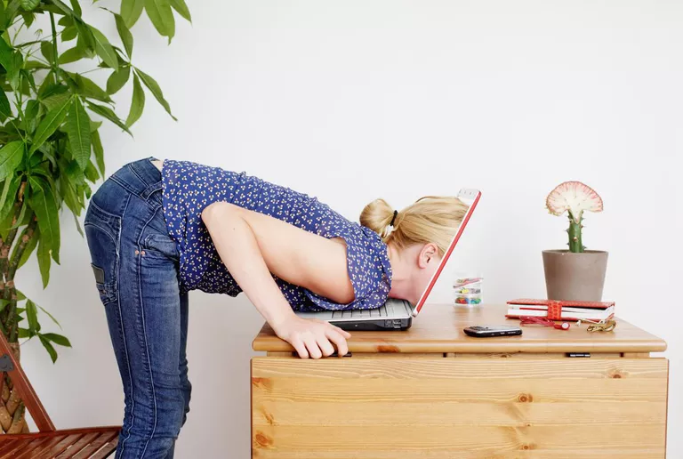
Social Media Addiction
Haozhe Jiang
Definition
Do you use it?
Addicted?
<Graphic as big as will fit>
[1]
Notes:
Social media addiction is a phrase sometimes used to refer to someone spending too much time using Facebook, Twitter, Instagram and other forms of social media -- so much so that it interferes with other aspects of their daily life.
I believe many of you use social media daily and some of you are addicted to social media.

Slide 13
What did the social media companies do?
Haozhe Jiang
How to hook users?
Notes:
People often wonder: “What did the social media companies do to make their users so addicted to their products?”
In other words, how do they hook their users?
Since I want to become a software engineer in the future, I thought it would be interesting to find out how to design an addictive software.

Slide 14
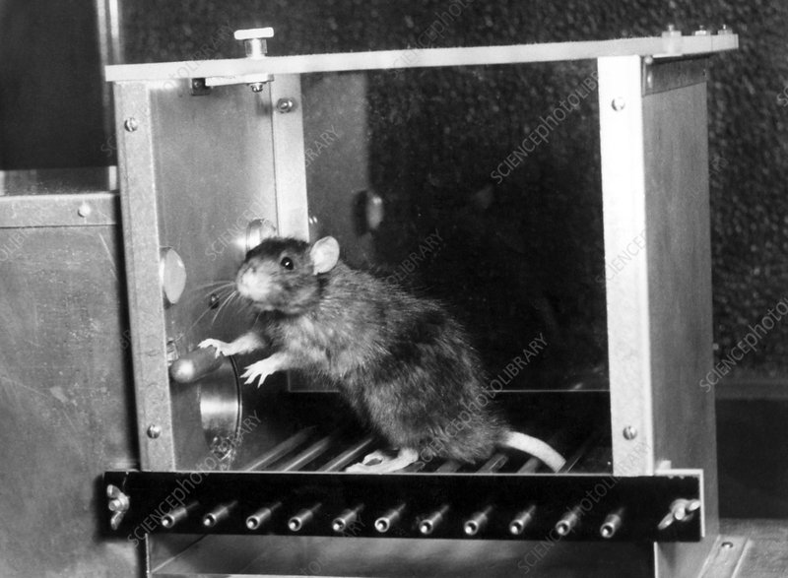
Hook Model
Haozhe Jiang
B.F. Skinner
Variable Schedule of Rewards
Evolutionary instinct:
  Pattern finding
  Reward seeking
<Graphic as big as will fit>
[2]
Notes:
Social media companies today are employing a habit-forming mechanism described by B.F. Skinner in the 1950s called a variable schedule of awards.
Unlike the mice that received the same treat every time, the mice that received variable rewards seemed to press the lever compulsively like a slot machine.
From Skinner’s experiment, we can see that mice think pressing the lever to get a surprise is far more addictive than pressing the lever to get an unchanged treat.
Humans are easily addicted to systems like this as well. Our brains are wired to find patterns based on series of events, but this system in social media prompts us to find a pattern that does not exist. There is no pattern because you can never predict what other people post just as the mice can never predict what treat they would get. In other words, we unconsciously keep trying to find patterns, but the only pattern we can find is that we are guaranteed to be surprised every time we open social media. It is difficult to resist our evolutionary instinct of pattern finding and reward seeking, especially when there is an easily reachable device that contains this system. Therefore, we keep “scrolling” in social media just like the mice who keep pressing the lever in Skinner’s experiment.
Some may argue that social media does not necessarily provide rewards to humans as Skinner provides treats to mice. Therefore, we cannot apply the relationship between mice and treats to the relationship between humans and social media.

Slide 15

Humans are Social Animals
Haozhe Jiang
Aristotle: “Man is by nature a social animal.”
Social media answers questions
  What are my friends doing? (News Feed)
  What is my social status? How am I being perceived by others? (Like & Comment)
  How about other people? Are they more popular than me?
<Graphic as big as will fit>
[4]
Notes:
While it is true that some people are less outgoing or less extraverted than the others are, Aristotle said, “Man is by nature a social animal”.
Humans do care about what other people think of them, what the other people are doing, whether if other people need them, and most importantly, what they have missed. Obviously, social media is a treat for human because it shows them what they care about.
The news feed feature shows you what your friends are doing. It is also a good way for you to find out whether if you are missing out. The number of likes under your post allows you to find out if you have a good social status. The comments under your post allows you to find out how are you being perceived by other people.
Certainly, social media does answer these questions. However, the real questions is, do you really need to know the answers to these questions?
I assume it’s a common understanding that humans used to socialize before social media was invented.

Slide 16
Does anyone remember what life was like before social media?
Haozhe Jiang
(I know you heard this question a thousand times)
Notes:
I assume it’s a common understanding that humans used to socialize before social media was invented, therefore I wanted to find out how did people socialize without social media.

Slide 17
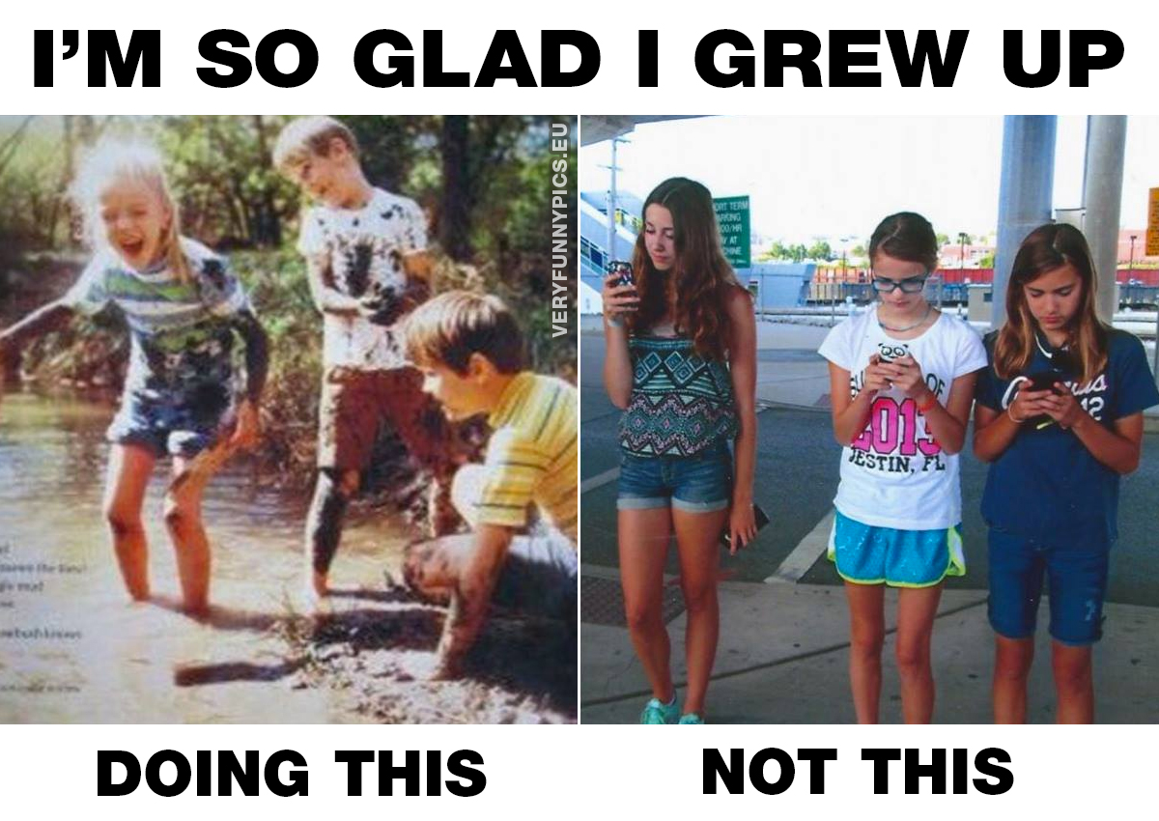
Before Social Media
Haozhe Jiang
We didn’t have such a need for social approval
We weren’t subjected to others’ opinions that much
Fear of missing out was not that prevalent
<Graphic as big as will fit>
[6]
Notes:
We didn’t have such a need for social approval. We didn’t frequently ask ourselves “what is my social status?” But thanks to the “like” feature of social media, we often ask ourselves this question every time we post something. Social media will tell you the answer even if you’re not curious. However, it is not that important because we used to be happy without caring about it and knowing it won’t necessarily make you any happier.
It seems like the features in social media has boosted our need for social approval and sometimes prompted us to compare against each other on social status. So I was wondering who invented these features and their intentions?

Slide 18
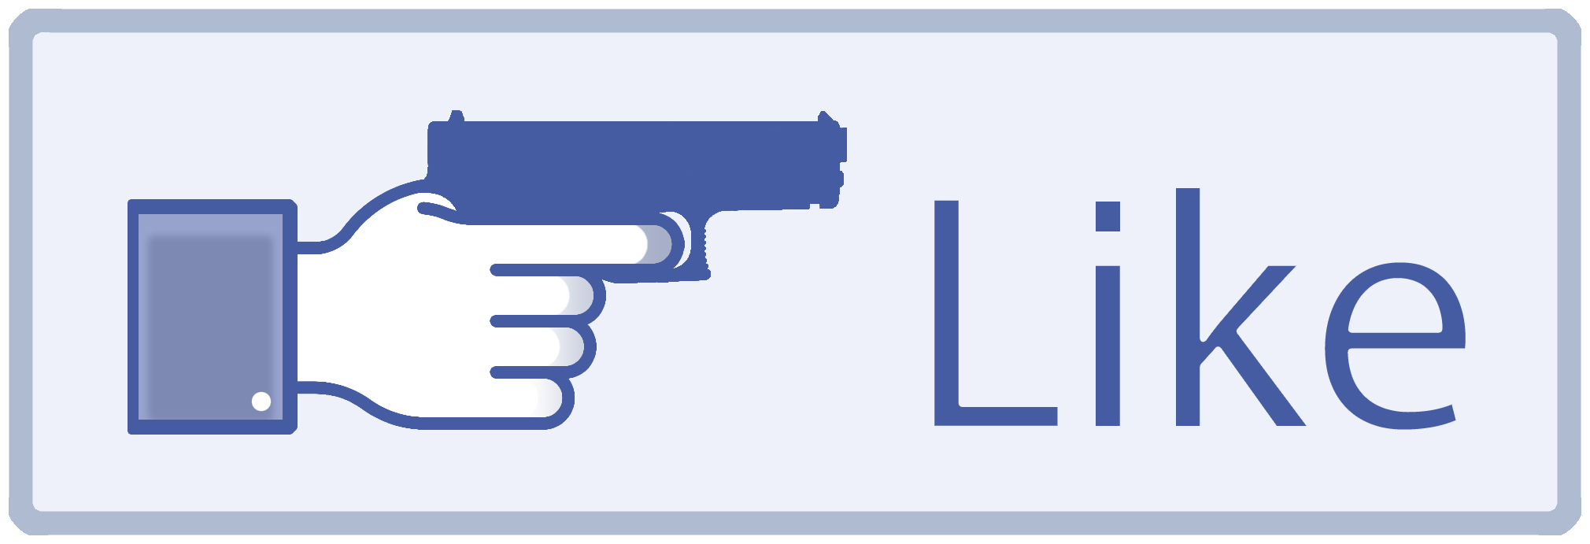
The Like Button
Haozhe Jiang
Justin Rosenstein: one of the four designers of Facebook’s ‘Like’ Button
Behaviors driven by “likes”
Not contribute positively to mental health
Good avenue for marketing and advertising
<Graphic as big as will fit>
[3]
Notes:
I did my research and found a quote from Justin Rosenstein. Justin Rosenstein: “The main intention I had was to make positivity the path of least resistance, and I think it succeeded in its goals, but it also created large unintended negative side effects. In a way, it was too successful.”
For example, if I’m traveling somewhere new, my addiction to social media may result in me feeling the need to post about it for likes. In fact, it’s possible that being able to post about it was the motivation that pushes me to travel in the first place.
As many of you guys may noticed, this like button feature is kind of like a gamification feature, which is a popular feature implemented by many softwares today.
As a result of gamification…

Slide 19
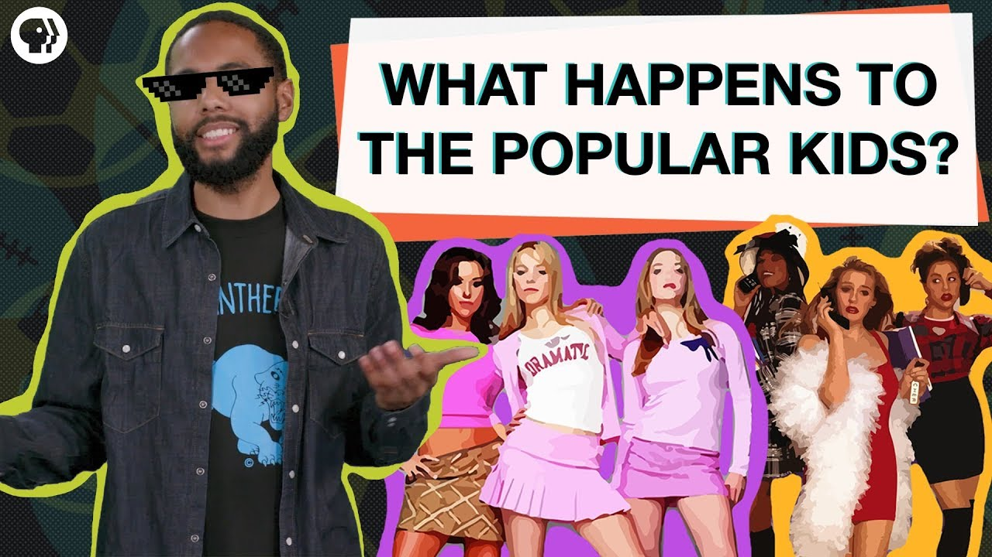
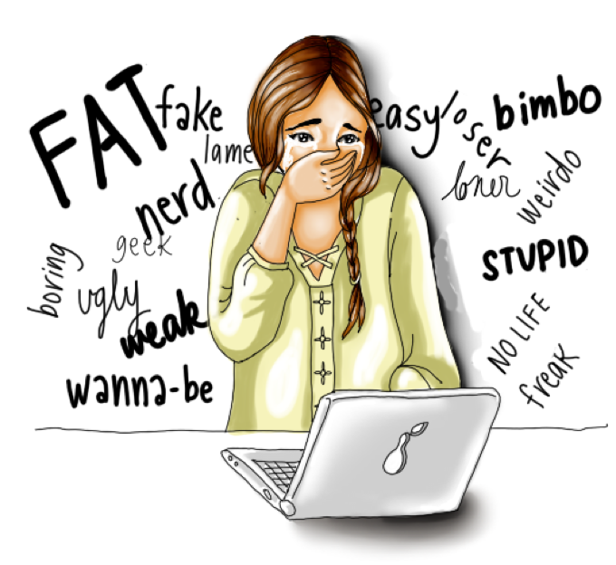
Gamification
Haozhe Jiang
Notes:
While there are people at the top of the game, there are also people at the bottom.
These people have often experienced cyberbullying, which is not a positive contribution to our mental health.

Slide 20
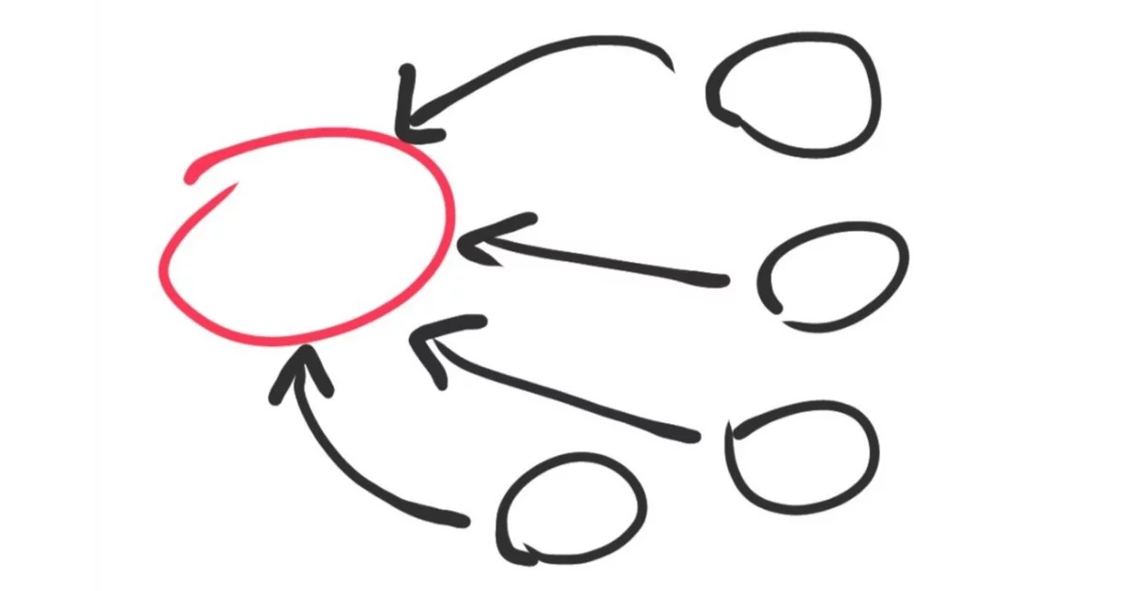
Conclusion
Haozhe Jiang
Negative impact on us overall
  Easily addictive
  Not necessary
  Negative side effects
<Graphic as big as will fit>
Notes:
What I learnt from my research is that …
Therefore, from doing my research, my conclusion is that social media has a negative impact on us overall.

Slide 21
REFERENCES
Haozhe Jiang
[1] Life Wire, “What is Social Networking Addiction?”, https://www.lifewire.com/what-is-social-networking-addiction-2655246 (March 18, 2019)
[2] Nir & Far, “Variable Rewards: Want To Hook Users? Drive Them Crazy”, https://www.nirandfar.com/2012/03/want-to-hook-your-users-drive-them-crazy.html (March 18, 2019)
[3] Hello Social, “What Makes Social Media So Addictive?”, http://blog.hellosocial.com.au/blog/why-is-social-media-addictive (March 18, 2019)<reference 3>
[4] Goodreads, “Quotable Quote”, https://www.goodreads.com/quotes/183896-man-is-by-nature-a-social-animal-an-individual-who (March 18, 2019)
[5] Psychology Today, “The Science of FOMO and What We’re Really Missing Out”, https://www.psychologytoday.com/us/blog/ritual-and-the-brain/201804/the-science-fomo-and-what-we-re-really-missing-out (March 19, 2019)
[6] Scary Mommy, “The Sh*t We Miss About Life Before Social Media”, https://www.scarymommy.com/life-before-social-media/ (March 20, 2019)

Slide 22
Negative impact of technology on youth
Emily Mahoney

Slide 23
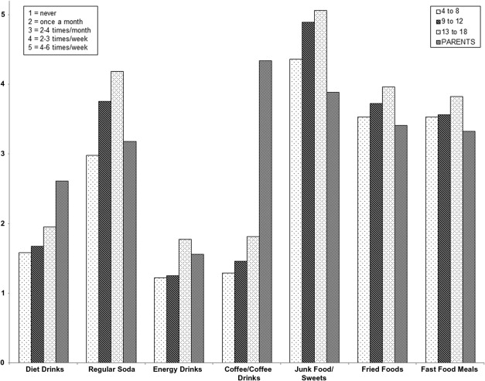
IssueS
Emily Mahoney
Insufficient exercise
Poor eating habits
Emotional instability
Less social connection
Negative effects on education
<Graphic as big as will fit>
[1]
Notes:
a study of 4- to 11-year-old American children found that while 37% had low levels of active play and 65% had high levels of screen time, 26% had a combination of both
consuming more food calories while watching television
obesity among adults is at an epidemic rate with studies finding obesity rates as high as 38% with 78% being judged as overweight
In one study by the Organization for Economic Cooperation and Development, the United States showed the highest overweight and obesity rates of 33 countries

Slide 24
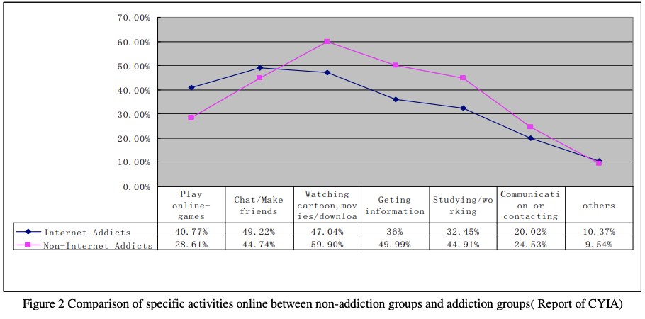
Main causes
Emily Mahoney
<Graphic as big as will fit>
Increase of importance in society
Increased screen time
Tv at pivotal ages
TV/internet content
Tv during 90 min window before sleep
Playing games
Watching TV shows/movies
Parents ignorant of proper screen time for children
Limited control over children’s internet usage
[3]
Notes:
A study has shown that:
TV at 29-53 months old → victimization problems and attention deficit at 10 years old
TV at 30-33 months old → behavior problems at 5 years old
TV at 1 and 3 years old → attention problems at 7 years old
TV at 5 years old → psychosocial adjustment problems at 7 years old
TV in middle school → attention problems in late adolescence
TV 90 mins before sleep → worse sleep quality in children
Another study found that those who were deemed to be addicted were found to show increased signs of depression, attention deficit disorder (both with and without the hyperactivity component), impulsivity, obsessive–compulsive disorder, hostility, and social anxiety

Slide 25
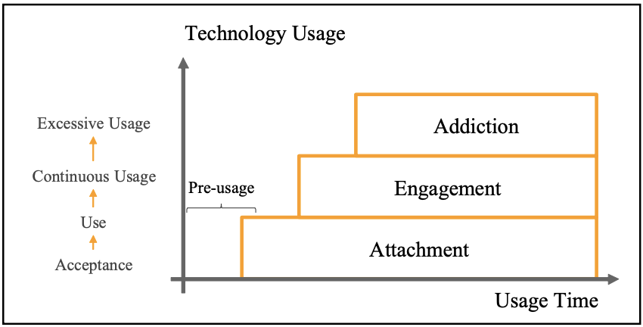
Effects
Emily Mahoney
The HomeNet Project
Loneliness
Anxiety
Attention deficit
Aggression
Suicidal ideation/planning
Back pain
Headaches
Social isolation
[2]
Notes:
Carnegie Melon performed a field study
~1/2 of children are addicted to mobile devices
Too much digital media as a toddler can impede self-control and ability to solve problems
Excessive usage – behavior going beyond necessary or proper limit in using technology
Object attachment
Kids become attached to inanimate objects, commonly plushies or blankets, when in situations where they are not in control or defenseless (unfamiliar surroundings, sick, sad, sleepy)
Calming when mother departs – not emotionally abandoned when parents aren’t there
A study of Norwegian teens showed that tv, video game, and computer use lead to back pain and headaches
Increased technology usage → attachment
Ease of interaction → more usage → emotional connection → proximity
Attachment increases w/ time → develop meaning
Engagement is an emotional connection where user feels satisfied while using technology w/ absence of negative impact
When time spent on technology is too much, the benefit is cancelled out or replaced by a deficit

Slide 26
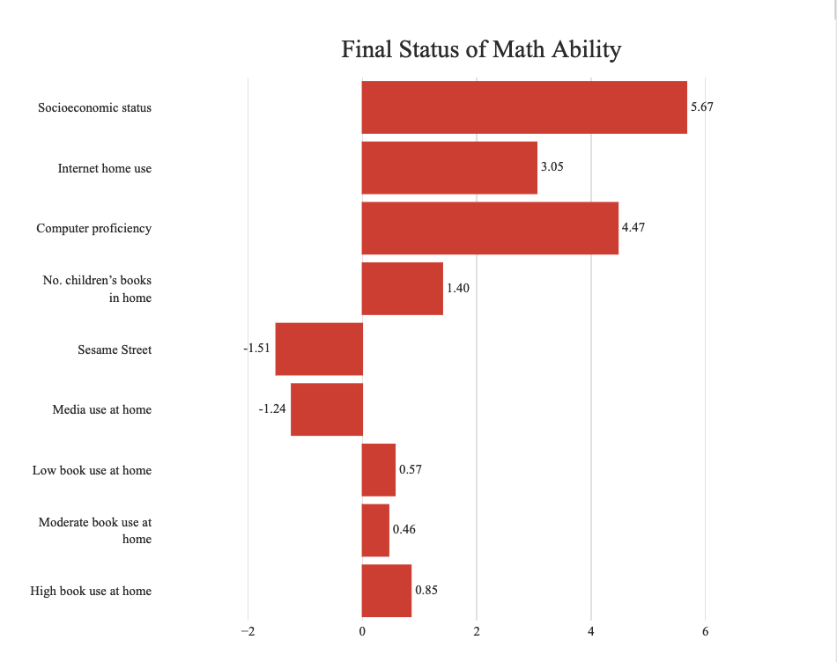
BROADER IMPLICATIONS
Emily Mahoney
Lack developmental quality of previous generations
Lower math scores
Poorer reading scores
Massacre at Columbine High School (Littleton, Colorado, 1999)
Less actions for the good of society
Lowers empathy for others’ hurting
Children have less respect for authority figures
<Graphic as big as will fit>
[4]
Notes:
Higher math score
More children’s books available at home
Higher growth rate
Children who read no books at home had significantly higher growth rates than children who read with moderate and high frequency
Lower math score
Sesame Street
Lower score and growth rate
More hours of TV at home
Massacre sparked concern for content in video games
Aggressive in child’s play, short temper toward ambiguous questions, violent thoughts
Kids who prefer violent games do less things like giving to those in need or helping others

Slide 27
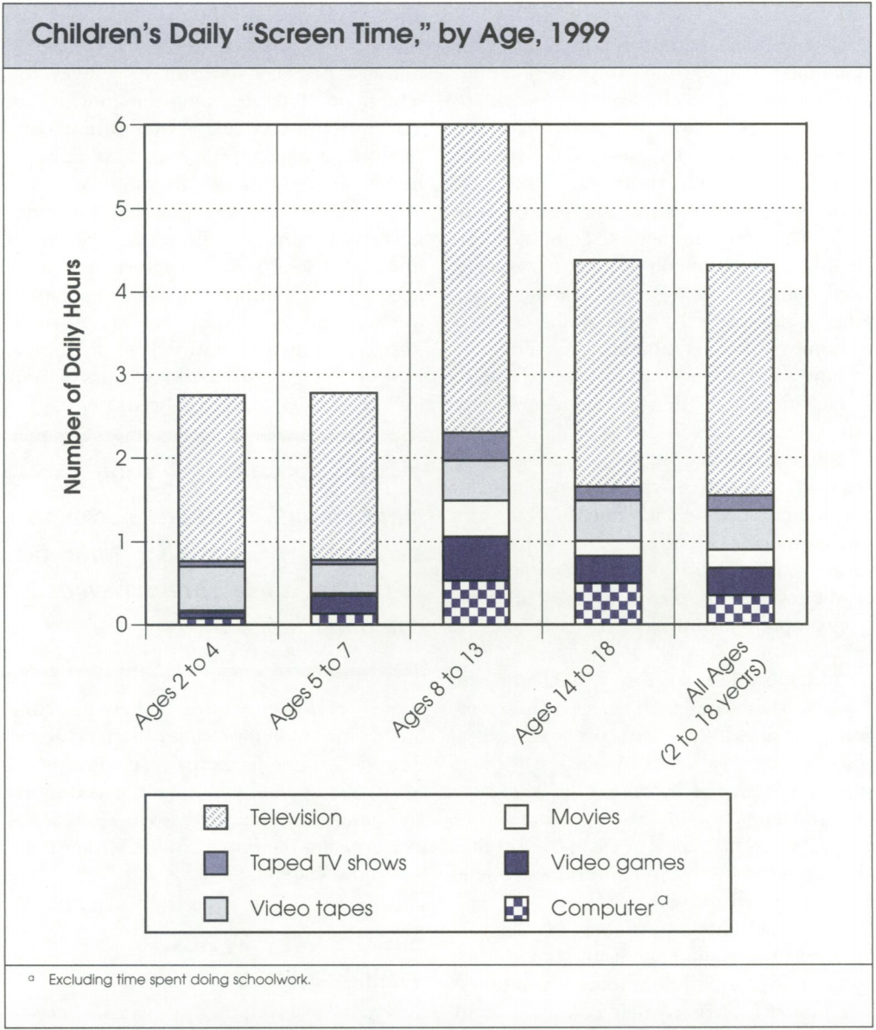
what CAN BE DONE?
Emily Mahoney
<Graphic as big as will fit>
Educate kids on prevention
Parental limitations
Educate ourselves
Walk a mile in their shoes
Don’t prohibit use
Give clear assignments
Teach students to use search engines
Communication method of choice
Learn from games
[5]
Notes:
Teach kids how to prevent addiction and recognize risks
Parents place limits on their children’s internet usage and screen time
Educate ourselves about computers so that we can show kids what resources are available to them to do research
See what the fuss is about to figure out how to conquer addiction and understand kids better
Don’t prohibit use of computers – students need access to computers for studying, life in college, and for work in the future.
Give students clear tasks when using computers
Teach students to get good results quickly on a search engine for research
Allow students to communicate with group partners on whatever platform they choose
Teach students to learn things from the games they play

Slide 28
References
Emily Mahoney
[1] L.D. Rosen et al., Media and technology use predicts ill-being among children, preteens and teenagers independent of the negative health impacts of exercise and eating habits (California State University, 2014), 365-8
[2] N.F. Ismail et al., Literature Review on Technology Usage and Emotional Connection among Children (IEEE, 2017), 1- 5
[3] Sun Jianhong, Solving Strategies Research for the Negative Impact of Computer Technology on Education (IEEE Computer Society, 2010), 673-4
[4] L.M. Espinosa et al., Technology in the Home and the Achievement of Young Children: Findings From the Early Childhood Longitudinal Study (Routledge 2006), 436
[5] K. Subrahmanyam et al., The Impact of Home Computer Use on Children's Activities and Development (Princeton University, 2000), 133
Notes:
Questions?

Slide 29
Deep Fakes
Carla Duarte

Slide 30
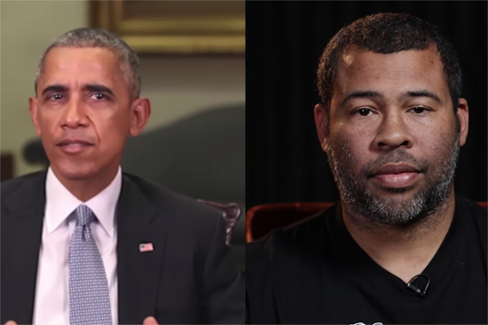

What Makes a Deep Fake?
Carla Duarte
Two Components:
Facial manipulation
Voice impersonation
[1]
Notes:
I thought I’d start off with a video to demonstrate exactly what a deep fake is, before we talk about the reality of deep fakes influencing the spread of information in our
society.
https://www.youtube.com/watch?v=cQ54GDm1eL0
End video at 0:52
Of course, that video was not truly Barack Obama. It was Jordan Peele impersonating Obama in a pretty convincing manner. So how were they able to achieve this? Well there are two components to creating a convincing deep fake.
The first is facial manipulation. This can involve superimposing an image of someone’s face onto a video, among other things that we’ll get to in a minute.
The second component of a convincing deep fake is the voice that is being used. Of course, in that video of Obama, Peele was doing an impersonation using his own voice. Whether the audio was edited to make it more convincing is unclear, however, the technology exists to manipulate our voices and more.
Now how realistic is it to create a deep fake? Maybe this technology is ahead of our time, maybe you think its already at our finger tips. If you think the latter, you’re right!

Slide 31
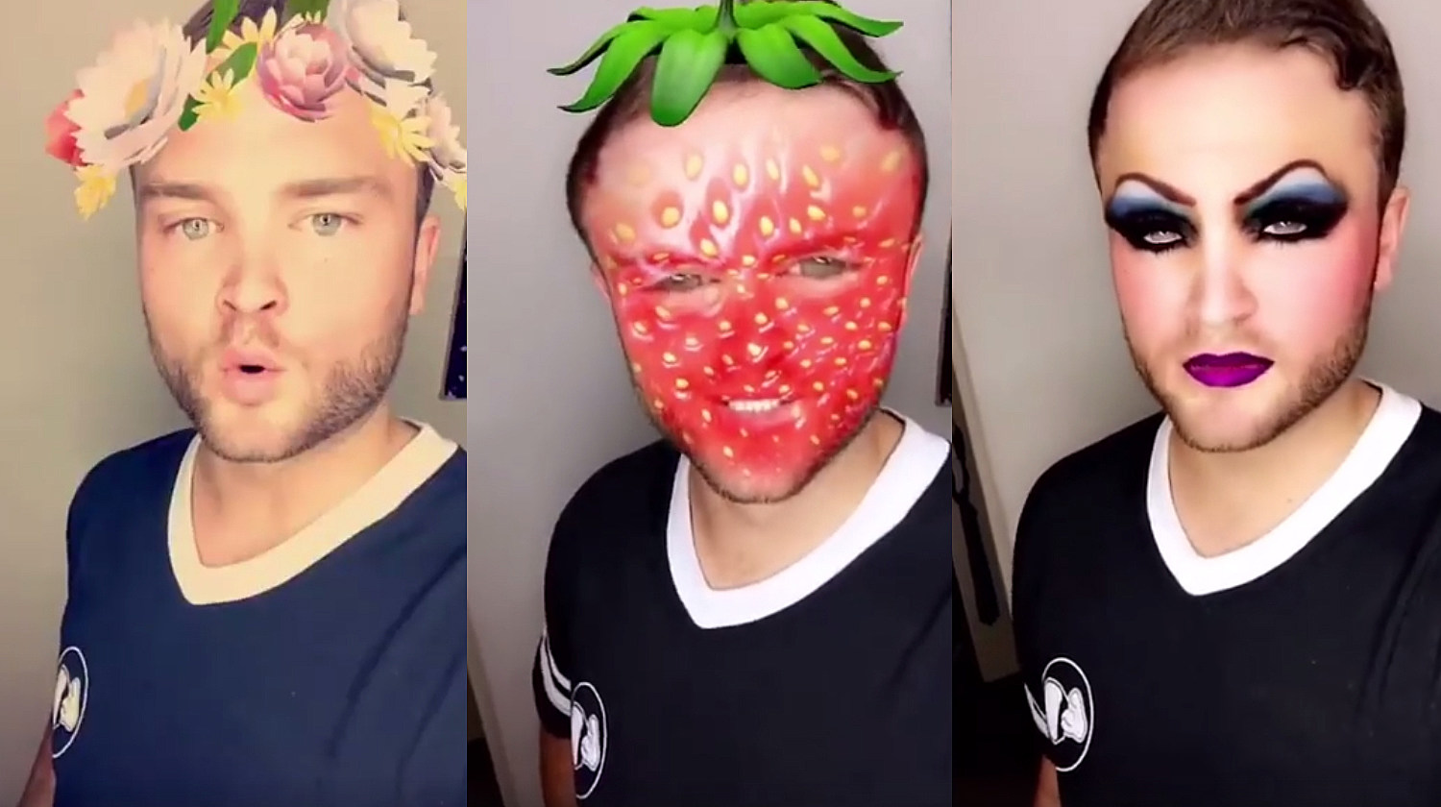
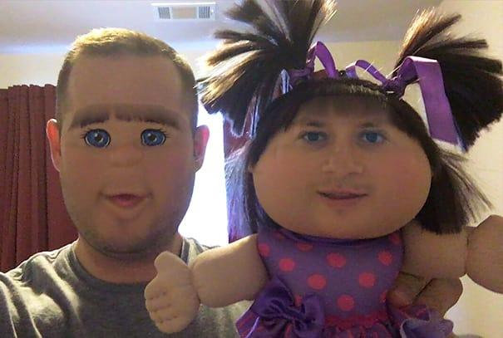
Snapchat Lenses
Carla Duarte
Facial mapping and casting
Face swapping
[2]
Notes:
If you have Snapchat on your phone, you’re familiar with the capability of the Lenses within the app. These Lenses work by mapping your facial features to cast different images onto your face like makeup, strawberries, it can even face swap. Snapchat lenses aren’t necessarily convincing or realistic, however, it’s an example of how facial manipulation is being introduced to the average population. This technology has been adopted by those who use the social media as a normal addition to online communication.

Slide 32
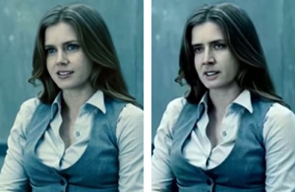
Technologies For Face manipulation
Carla Duarte
FakeApp
  AI trained with celebrities faces
Face2Face
  Real-time Face Capture
[3, 7, 8]
Notes:
Further, a software called FakeApp was created to superimpose celebrities faces on existing videos. FakeApp is trained by its users to more realistically develop these recreations – Nick Cage, in the image above, is probably the most popular victim of FakeApp. Very clearly, the technology to superimpose images onto videos is at our fingertips. Although some development may be necessary to make them perfect, there’s nothing stopping us from using these technologies or creating our own.
At Stanford, a system called Face2Face was created that actually allows for real-time face capture and reenactment of videos. I’ll show you a quick clip to demonstrate what they did.
https://www.youtube.com/watch?v=ohmajJTcpNk
Start video at 0:50, play until 1:05.
So their technology doesn’t actually involve superimposing an image, but manipulating pixels based on the source and target actors at the time of their demo. One intended use of their invention is to allow for real-time dubbing of videos with translated audio. That’s great, but we can clearly see how this technology could be misused.

Slide 33
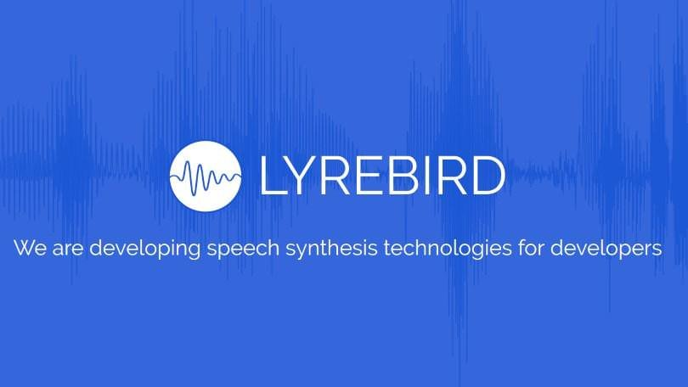
Voice Learning AI
Carla Duarte
[4]
Notes:
Even further, LyreBird is a company which makes voice learning software. You can train their software to learn your voice by speaking a few prompts, and then the AI can recreate your voice digitally.
https://www.youtube.com/watch?v=VnFC-s2nOtI
Start at 2:44, end at 2:55
LyreBird still has a long way to go to be fully convincing, however, this is an example of a developing software that when coupled with something like FakeApp, can create a truly realistic deep fake.

Slide 34
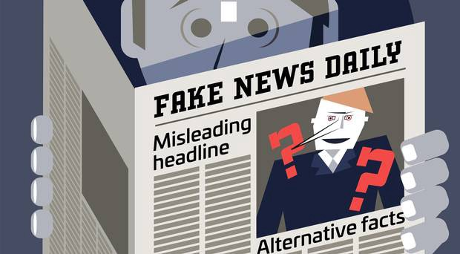
Impact on Spread of Information
Carla Duarte
Rise of “fake news” by news outlets
In 2016, an estimated 23% of adults shared fake news
Deep fakes contribute to this issue
[5, 9]
Notes:
In regards to how deep fakes relate to the spread of information, our society has already seen the effects of misleading information coming from sources that we once considered as trustworthy.
Today, through news outlets and social media,“fake news” is something we have to actively be aware of. If we’re not careful, we can be misled by white lies and fallacies that are passed off as “fact.”
We saw this in the 2016 elections, where the terms “fake news” and “alternative facts” seemed to have been born. In a 2016 study, it was suggested by the Pew Research Center that 23% of U.S. adults shared fake news, either knowingly or unknowingly. [9] It was also found that Trump, once elected, told a public lie everyday for the first 40 days he was elected [5]. On one hand, the truth is available at the cost of some digging. But for that 23% in 2016, whether they knew it or not, they were spreading lies. These headlines that, at a glance, seem plausible, can alter people’s views in an instant.
Deep fakes only contribute to this issue - if we can’t trust video evidence in the future due to deep fakes, who can we trust?

Slide 35
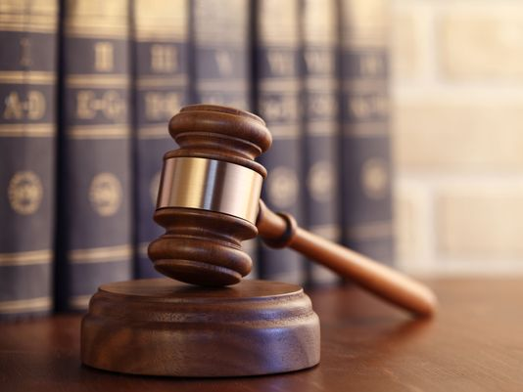
Our role as future developers
Carla Duarte
Can we prevent misuse of our software?
Is that our responsibility?
For deep fakes, some laws already exist!
[6]
Notes:
The rise of these technologies that have enabled deep fakes begs the question, as future developers, can we prevent the misuse of our software? Is that our responsibility?
Fortunately in the case of deep fakes, laws already exist that would make it illegal to use deep fake videos for extortion or harassment, as well as defamation and false light invasion of privacy. But these laws can’t stop the creation of deep fakes, nor can they stop the wildfire spread of information that the internet enables.
The implications we see here, how deep fakes may very quickly affect the spread of information online, are something to consider as we progress through our careers.

Slide 36
References
Carla Duarte
[1] https://www.youtube.com/watch?v=cQ54GDm1eL0
[2] https://support.snapchat.com/en-US/a/geofilters
[3] Zucconi, Alan. “An Introduction to Deepfakes.” Mar. 14, 2018. https://www.alanzucconi.com/2018/03/14/introduction-to-deepfakes/, Accessed on March 21, 2019
[4] https://lyrebird.ai, Accessed on March 21, 2019
[5] Leonhardt, David. “Trump’s Lies.” Jun. 23, 2017. New York Times, https://www.nytimes.com/interactive/2017/06/23/opinion/trumps-lies.html, Accessed on March 21, 2019
[6] Greene, David. “We don’t need new laws for faked videos, we already have them.” Feb. 13, 2018. Electronic Frontier Foundation, https://www.eff.org/deeplinks/2018/02/we-dont-need-new-laws-faked-videos-we-already-have-them, Accessed on March 21, 2019
[7] Thies, J., Zollhoffer, M., Stamminger, M., Theobalt, C., Niessner, M. Face2Face: Real-time Face Capture and Reenactment of RGB Videos https://web.stanford.edu/~zollhoef/papers/CVPR2016_Face2Face/paper.pdf, Accessed on March 22, 2019
[8] https://www.youtube.com/watch?v=ohmajJTcpNk
[9] Ordway, Denise-Marie. Fake news and the spread of misinformation. https://journalistsresource.org/studies/society/internet/fake-news-conspiracy-theories-journalism-research/, Accessed on March 22, 2019.

Slide 37
Class 4
The End
Keith A. Pray
Instructor
socialimps.keithpray.net
Notes:
Use remaining time to form groups, approve group topics, etc.
This is the end. Any slides beyond this point are for answering questions that may arise but not needed in the main talk. Some slides may also be unfinished and are not needed but kept just in case.

