Slide 1
Class 11
Work
Keith A. Pray
Instructor
socialimps.keithpray.net
Notes:
Here’s the title slide. Excited already, aren’t you?

Slide 2
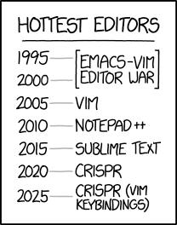
Overview
Review
Assignment
Students Present
https://www.xkcd.com/1823/
Notes:
Full circle.
CRISPR: Clustered Regularly Interspaced Short Palindromic Repeats
Allows permanent modification of genes within organisms.
Kickstarter Charter
https://www.kickstarter.com/charter?ref=about_subnav

Slide 3
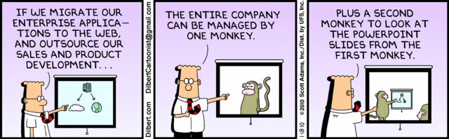
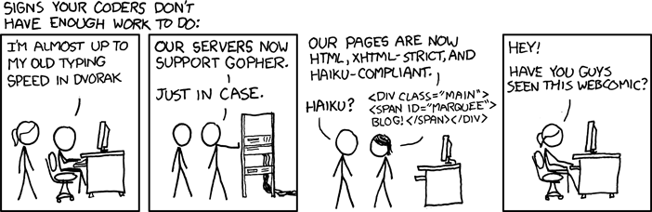
http://xkcd.com/554/
Notes:
Poll class:
Expected salary range upon graduation? Min, Max? Put on board.
Assume 40 hour work week.
How many people would work:
32 hours for 0.8 * Max? Put on board.
24 hours for 0.6 * Max? Put on board.
…continue until Min is reached.

Slide 4
Group Quiz
List 2 ways IT can lead to organizational change.
List 4 ways a Video Game Producer may protect its IP and what specific IP each protects.
List a computing technology that can be used to protect an individual’s privacy.
List a computing technology that can be used to intrude upon an individual’s privacy.
Notes:
Could split into groups of 4-5 for this.
Fill time with Work Discussion on Course Web Site

Slide 5
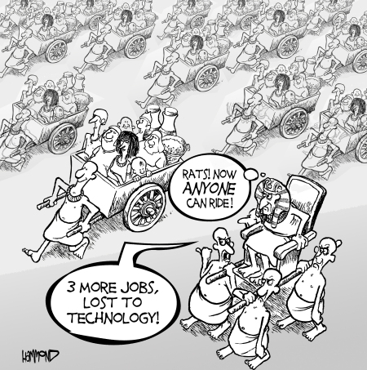
Overview
Review
Assignment
Students Present
©2009, MobileRobots Inc.
Notes:
Review Group Assignment Details.
Or first watch video: depends on student presentations, no thunder stealing.
CGP Grey
Humans Need Not Apply (15:00) – 2014-08-13
http://www.youtube.com/watch?v=7Pq-S557XQU
Last access 2016-04-22
These 3D printed homes can be constructed for $4,000 (3:00 – 2018-04-02)
http://www.businessinsider.com/3d-printed-homes-constructed-icon-new-story-tech-charity-4000-dollars-2018-3
https://www.youtube.com/watch?v=SvM7jFZGAec (1:28)
Last access 2018-04-22
Look at:
BBC Intelligent Machines
http://www.bbc.com/news/technology-33978561
BBC Likelihood of robot taking your job
http://www.bbc.com/news/technology-34066941

Slide 6
Overview
Review
Assignment
Students Present

Slide 7
I'm Gonna School Ya
The Impact of Technology on Education
John Dyer
Notes:
My presentation is on how technology is impacting education

Slide 8
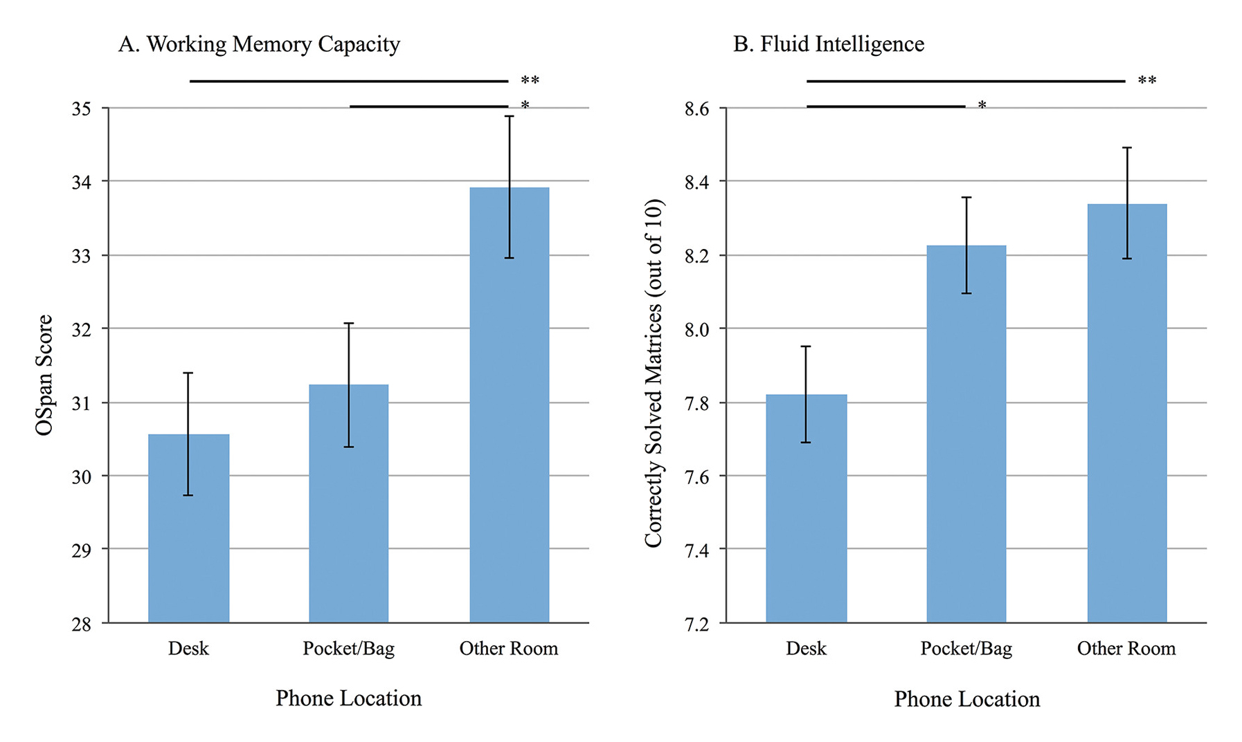
Cell phones increase distraction
John Dyer
Cell phone notifications “disrupt performance” on tasks [1]
Disruptive even when silenced [2]
Several similar studies [3] [4]
Notes:
First, technology has had some negative effects on education. There have been multiple studies done that indicate that smartphones increase distraction and can lead to worse performance on certain tasks. One study found that people who received notifications while performing a task, even if they didn’t interact with them, performed similarly to people who were allowed to actively use their phones while performing the same task. Another study found that even when phones are silenced, people who had their phones in sight on the desk while performing tasks, did worse than those who placed them in their bags, or left them in another room.

Slide 9
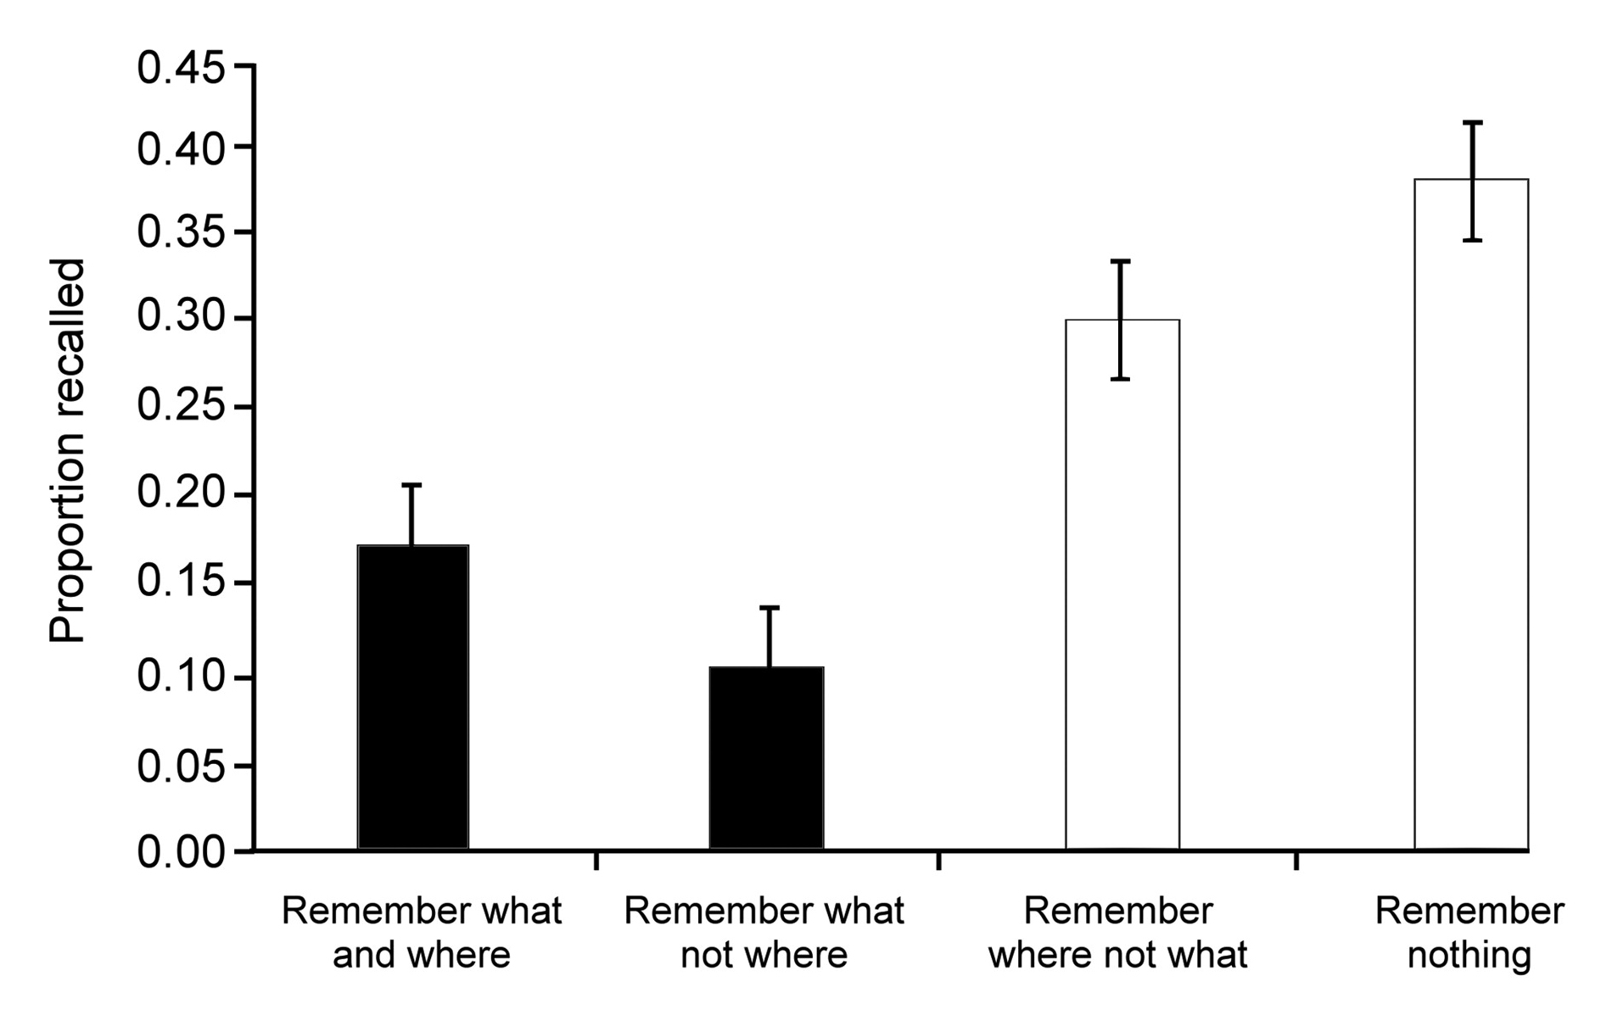
Wealth of Info Online Creates Problems
John Dyer
Less likely to remember a fact we expect to be saved [5] [6]
More likely to remember where the fact is saved than the fact itself [5]
“Being able to read (or view) anything quickly on a topic can provide one with information, but actually having a knowledge of or understanding about the topic will always require critical study. The Internet will never change that” - Larry Sanger [7]
Notes:
The amount of information that’s freely available online also causes issues for learning. One study found that participants were less likely to remember a fact they expected to be saved. They were given a bunch of trivia facts, and instructed to type them into a computer. Half were told that the computer would save the information, and half were told it would be erased. They were then quizzed on those facts and found that those who thought the computer would save them remembered less. In a variation of that experiment, when participants typed a fact, the computer program would inform them it was saved to a certain location. When they were quizzed on the facts, more people remembered the location the fact was saved to than the actual fact itself. The quote there is by Larry Sanger, one of the founders of Wikipedia. He says, [quote]. He wrote that in an article arguing that the process of understanding something complex begins by committing the basic facts of it to memory.

Slide 10
Technology can be an asset for learning
John Dyer
Purposeful use of tech in the classroom has benefits [8]
  In-class polling system
  Online discussion board
Student perspective of this tech
  Allowed for active participation: 63%
  Encouraged engagement: 56%
  Helped develop critical thinking: 65%
“It made class less boring and I was more alert”
“I was forced to engage in the content more actively”
Notes:
While those are some of the negative effects of technology on education, it can also be used as an asset. One study examined an undergraduate nursing class that used a polling system that allowed students to answer questions in class, and an online discussion board outside of class. Students were surveyed at the end of the class, and the majority had a favorable opinion on the use of technology. 63% believed those systems allowed for active participation, 56% believed they encouraged engagement, and 65% believed they helped develop critical thinking skills. The two quotes there are from students, and indicate that the technology helped them focus more in class, and take a more active role in their own learning.

Slide 11
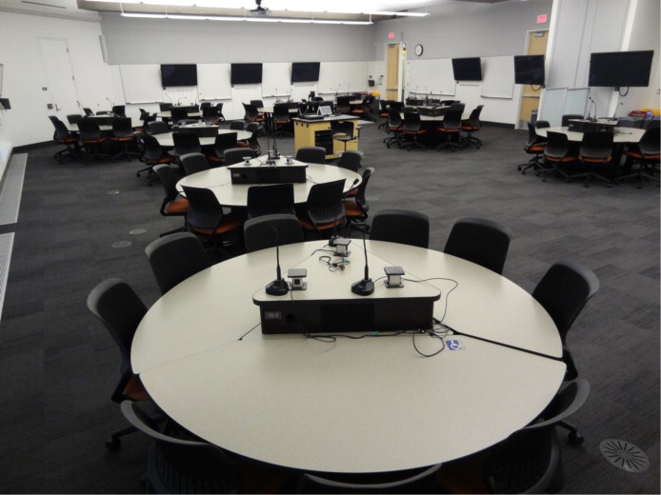
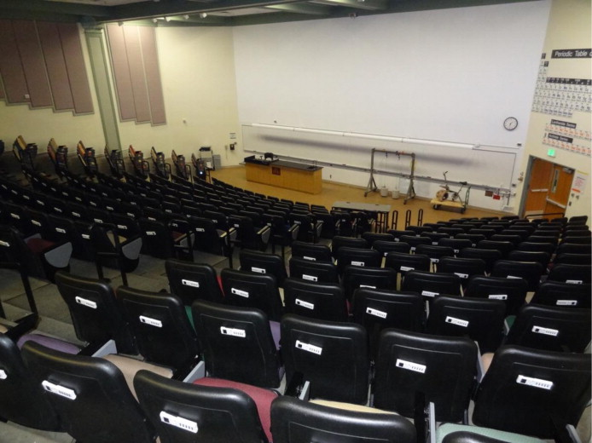
Benefits of a blended classroom
John Dyer
Blended classroom [9]
  Instructional material available online
  Students learn on their own time
  In class activities focus on problem solving, collaboration, communication, and critical thinking
At least as good exam scores [10]
Higher engagement, learning, and confidence [10]
Increased participation: 88% vs 76% [11]
Notes:
There is also the concept of a blended classroom, where some amount of the instructional material is available online, and it is up to the students to learn it on their own time. Then in class, students can focus more on problem solving activities that require them to apply the material, and promote important skills such as collaboration, communication, and critical thinking. One study looked at students taking a general chemistry college class, where some sections were taught using a blended classroom model, and some were taught using more traditional lectures. It was found that students in the blended classroom scored just as well, if not slightly better on a standard exam at the end of the term. The students were also surveyed about their thoughts on the course and it was found that students in the blended classroom reported higher levels of engagement, learning and confidence. Another study looked at high school algebra courses, and found that students in a blended classroom participated more often, and found it easier to focus and be engaged throughout the class.

Slide 12
Tech should be encouraged in Education
John Dyer
Restricting it is impractical [2]
Digital literacy is important for jobs [12]
Tech can increase engagement and promote 21st century skills [13]
  Critical thinking
  Communication
  Collaboration
  Creativity
Notes:
While there are positives and negatives to technology in education, I believe its use should be encouraged. First of all, restricting it is impractical. Going back to cell phone distraction, you can’t really tell students not to bring cell phones into the classroom, and even if they’re not supposed to use them, just having them on them can lead to distractions. Second, technology and digital literacy is important to a lot of modern jobs, and this should be reflected in education, so students feel confident using technology. Third, a lot of jobs are looking for interdisciplinary skills including critical thinking, communication, collaboration, and creativity, which can be difficult to teach. As explained previously, when used purposefully, technology can help students develop those skills.

Slide 13
Conclusion
John Dyer
Negative impacts of technology
  Increases distraction
  Lower performance on tasks
  Less likely to remember facts
Positive impacts of technology
  Increases engagement
  Helps develop important skills
Tech should be encouraged
  Increasingly important for jobs
Notes:
In conclusion, negative effects of technology in education include increased distraction, worse performance on certain tasks, and the fact that we’re less likely to remember things that we can look up online. Positive effects include increased student engagement, ability to focus, and participation in class, and technology also enables students to develop important skills like critical thinking. Overall, because of the realities and expectations of the modern workforce, the positives outweigh the negatives, and technology should be encouraged in education to adequately prepare students for their careers.

Slide 14
References
John Dyer
[1] Stothart, C., Mitchum, A., & Yehnert, C. (2015). The attentional cost of receiving a cell phone notification. Journal of Experimental Psychology: Human Perception and Performance, 41(4), 893-897
[2] Ward, A. F., Duke, K., Gneezy, A., & Bos, M. W. (2017). Brain Drain: The Mere Presence of One’s Own Smartphone Reduces Available Cognitive Capacity. Journal of the Association for Consumer Research,2(2), 140-154. doi:10.1086/691462
[3] Thornton, B., Faires, A., Robbins, M., & Rollins, E. (2014). The Mere Presence of a Cell Phone May be Distracting. Social Psychology,45(6), 479-488. doi:10.1027/1864-9335/a000216
[4] Lee, S., Kim, M. W., Mcdonough, I. M., Mendoza, J. S., & Kim, M. S. (2017). The Effects of Cell Phone Use and Emotion-regulation Style on College Students Learning. Applied Cognitive Psychology,31(3), 360-366. doi:10.1002/acp.3323
[5] Sparrow, B., Liu, J., & Wegner, D. M. (2011). Google Effects on Memory: Cognitive Consequences of Having Information at Our Fingertips. Science,333(6043), 776-778. doi:10.1126/science.1207745
[6] Wegner, D. M. (2013, December 01). The Internet Has Become the External Hard Drive for Our Memories. Retrieved September 26, 2018, from https://www.scientificamerican.com/article/the-internet-has-become-the-external-hard-drive-for-our-memories/?mod=article_inline
[7] Sanger, L. (2010). Individual Knowledge in the Internet Age. Educause Review,45(2), 14-24. Retrieved September 26, 2018, from https://er.educause.edu/articles/2010/4/individual-knowledge-in-the-internet-age.

Slide 15
References
John Dyer
[8] Swart, R. (2017). Purposeful Use of Technology to Support Critical Thinking. JOJ Nursing & Health Care,4(1). doi:10.19080/jojnhc.2017.04.555626
[9] Garrison, D., & Kanuka, H. (2004). Blended learning: Uncovering its transformative potential in higher education. The Internet and Higher Education,7(2), 95-105. doi:10.1016/j.iheduc.2004.02.001
[10] Baepler, P., Walker, J., & Driessen, M. (2014). Its not about seat time: Blending, flipping, and efficiency in active learning classrooms. Computers & Education,78, 227-236. doi:10.1016/j.compedu.2014.06.006
[11] Clark, K. (2015). The Effects of the Flipped Model of Instruction on Student Engagement and Performance in the Secondary Mathematics Classroom. The Journal of Educators Online,12(1). doi:10.9743/jeo.2015.1.5
[12] Kivunja, C. (2014). Do You Want Your Students to Be Job-Ready with 21st Century Skills? Change Pedagogies: A Pedagogical Paradigm Shift from Vygotskyian Social Constructivism to Critical Thinking, Problem Solving and Siemens’ Digital Connectivism. International Journal of Higher Education,3(3). doi:10.5430/ijhe.v3n3p81
[13] Soulé, H., & Warrick, T. (2015). Defining 21st century readiness for all students: What we know and how to get there. Psychology of Aesthetics, Creativity, and the Arts,9(2), 178-186. doi:10.1037/aca0000017

Slide 16
It’s Alive! Or is it?
Sean Tidd

Slide 17
Alife being Considered alive
Sean Tidd
Life definition
  Sum of organic phenomenon
  Tenacity in the face of opposition
Alife
  Study of biology through the attempt to create it
  Alife is to biology as AI is to psychology
  Allows better understanding of biological phenomenon
[6],[1]
Notes:
Life is defined as the sum of organic phenomenon. This includes reproduction, growth, and adaptability to name a few. The main defining feature of life is its tenacity in the face of opposition which we know as evolution. There are many forms of study for life and one unique approach is through artificial life. Alife is the study of biology through the attempt to create it. This can be through robots, AI, virtual experiments and the such. I use ALife and Artificial Intelligence interchangeably in this presentation for how they relate to each other. Alife is to biology as AI is to psychology. The goal of AI is to replicate the human mind or consciousness, while the goal of Alife is to extend the number of entities which can be considered alive. Through the examples of Alife we can get a better understanding of those phenomenon that are considered natural regardless if the means are like those found in our biosphere

Slide 18
Defending Artificial life
Sean Tidd
Misconceptions about non-self aware Alife
  Representational requirements of a cockroach vs human
  Hypocrisy of non-self aware organic life
ALife is not organic and therefore can not evolve
  Adaptability in ALife copied from nature
  Artificial Structural Self-Organization
[1],[3]
Notes:
There are a few oppositions that people have towards ALife. One is the misconception about non-self aware synthetics. These are synthetic creatures that do not show an advanced intelligence such as our own. However that does not give reason for their insignificance. For instance the representational requirements of a cockroach may not relate anything to the representational requirements of a human, but that does not make synthetic cockroaches any less influential in the grand study of the phenomenon on life. The hypocrisy here is that something such as an ant, which has no indication of emotion or self awareness to our own, is still valued as something alive because it has other characteristics that define it. With this same mindset and given the characteristics, this Alife could also be considered alive.
Another opposition is the belief that to evolve, as mentioned an important characteristic in life, one must be organic. This is not entirely true, as Alife has the ability to adapt and change its behavior or function. There are two forms of artificial adaptation: controlled based and AI based. As shown in the picture both show use of controls engineering: an attempt to keep the output of a device consistent. On the left there is the added parameters that allow the control function to adapt to changes in its environment by changing values slightly. There is a limit here to what the control function can handle. On the right is a control function with AI adaptability. This is more similar to evolution as information is gathered and then is cross referenced against things it already knows. The resulting action could be anything it deems as appropriate. For example swarm robots that have artificial structural self-organization are able to combine and take in an environments information. From this they can change form and behavior until they figure out the best course of action. When the robots separates, this new code is given to all the mini bots. In this way the robot has reproduced and sent its information to others. Similar to how our genes are distributed during birth.

Slide 19
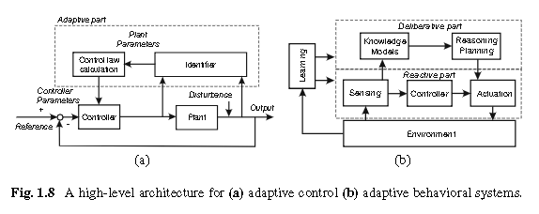
Sean Tidd
[3]

Slide 20
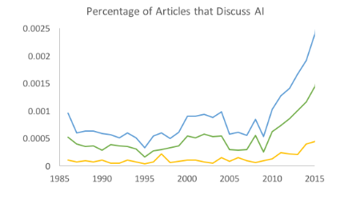
Public perception
Sean Tidd
Interest towards AI
  Increase from 1985 to 2015
  Generally more positive views than pessimistic
Associated key words about AI evolving through time
  Strong correlation of words associated with robotic like capabilities nearing 2010 to 2015
[4]
Notes:
Even if some of the public may not be interested in Alife replicating simple creatures, a large desire to know more about what AI can deliver when incorporated in machines has increased. This graph shows the trends of general articles about AI (blue) and from that positive AI articles(green), and pessimistic articles(orange) from 1985 to 2015. The interest of AI began to decline until 1995 and then began to recover until growing rapidly in 2010. The view of AI has been greatly positive in recent years. There are a few pessimistic views that have increased such as the fear of losing control and the fear of losing jobs, however there is also an increase in the desire to see AI improve healthcare and for AI to progress more. On the bottom are a few common words found in the AI articles. Prior to 1995, AI was associated with many science fiction based concepts. It took the Deep Blue chess playing AI to beat champion Kasparov to put AI back on the map.

Slide 21
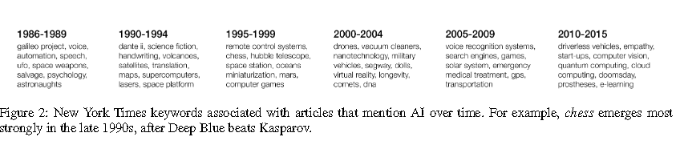
Sean Tidd
[4]

Slide 22
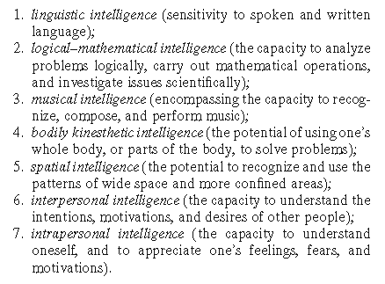
Standard of intelligence
Sean Tidd
Gardner’s Intelligence List
Howard Gardner
  Describes how intelligence is a spectrum
Children’s Judgement
  Experiment where different artifacts were shown to kids
  Determine if alive or not given a specific quality with the artifact
  Robots had the most variation
[2],[7]
Notes:
Although there is an increase desire to see artificial intelligence progress, no one knows what actually qualifies as intelligence. Without a standard there are many variations of requirements however, Howard Gardner does an excellent job at listing subgroups of intelligence. If an entity has a few of these sub intelligences then it can be considered intelligent. In terms of abilities there is reading and writing, mathematics, musical ability, spatial awareness, mastery over body, and understand the desires or emotions of oneself or others. This is very informative and allows for different Alife to be considered intelligent, but lets take a second opinion, however this time from children. An experiment with kindergarteners to fourth graders were shown pictures of objects of three categories: animals, computational artifacts ,things such as rocks or a pencil. They were then asked if this object was considered alive. Of the artifacts shown the largest variation was found for robot. They were then asked if the robot had a certain attribute did it make it more alive? Of the categories that included emotion or cognitive abilities, the children believed that having volition or the ability to set your own goals and achieve them set it apart from others.

Slide 23
Deserving of rights?
Sean Tidd
Can Artificial life qualify for moral consideration?
  Non self aware animals (pigs and goats)
  Opposite spectrum with Artificial Life
How would Alife qualify for moral consideration?
  Property account
  Relational account
[8],[5]
Notes:
With Alife having the capacity to expand the definition of life and the trend of AI becoming popular , is it possible for synthetic life to qualify for moral consideration? Well first we already have rights for entities that do not have self-awareness such as pigs or goats. The reason that we give these creatures rights is because although they don’t have our intellectual capabilities, they experience pain, reciprocate emotion, and benefit us through companionship and produce. Well a robotic dog could achieve all this although it doesn’t feel pain or think like a human. But on the other spectrum a humanoid robot may not feel or get sick, but it is of intelligence on par with our own and benefits us with not only companionship but a blending of minds and ideas between us and themselves.
There are two well known discussions on how this would be done. The first one is property account which states that an Alife would be morally considered if it can prove that it possesses intelligence, emotions, sentience, and the such. Relational account on the other hand deals with how someone views the Alife and whether their relationship is sound enough to warrant giving it rights.

Slide 24
Conclusion
Sean Tidd
Artificial Life has the capability to be considered alive
These lives require their own sets of rights.
Notes:
Artificial Life is an ambitious attempt to create new life. Only after expanding your views on what life can be can you fully understand that these machines have the ability to be considered in biology. With their artificial intelligence and benefit to humanities collective information, these lives require their own sets of rights.

Slide 25
References
Sean Tidd
[1] Keeley, Brianl. “Artificial Life for Philosophers.” Philosophical Psychology 11.2 251–260. Web. 9/8/2018. https://www-tandfonline-com.ezproxy.wpi.edu/doi/abs/10.1080/09515089808573260
[2] Pagliarini, L. “Artif Life Robotics” (2008) 12: 24. Web. 9/8/2018. https://doi-org.ezproxy.wpi.edu/10.1007/s10015-007-0498-9
[3] Levi, Paul., and Kernbach, Serge. Symbiotic Multi-Robot Organisms Reliability, Adaptability, Evolution . Berlin, Heidelberg: Springer Berlin Heidelberg, 2010. Web. 9/8/2018. https://link.springer.com/book/10.1007%2F978-3-642-11692-6
[4] Fast, Ethan, and Horvitz, Eric. “Long-Term Trends in the Public Perception of Artificial Intelligence.” n. pag. Print. 9/11/2018. https://arxiv.org/abs/1609.04904
[5] Tavani, Herman T. “Can Social Robots Qualify for Moral Consideration?Reframing the Question about Robot Rights.” Rivier University, 29 Mar. 2018. Web. 9/9/2018. http://www.mdpi.com/2078-2489/9/4/73/htm …
[6] “Life.” Dictionary.com, Dictionary.com. Web. 9/8/2018. www.dictionary.com/browse/life?s=t.
[7] K., Milena, et al. “If Robots Make Choices, Are They Alive?: Children's Judgments of the Animacy of Intelligent Artifacts.” EScholarship, University of California, 14 Sept. 2016. Web. 9/9/2018. https://escholarship.org/uc/item/6bw2h51d
[8] “List of Animals That Have Passed the Mirror Test.” Animal Cognition, Animal Cognition, 29 Oct. 2016, Web. 9/26/2018. www.animalcognition.org/2015/04/15/list-of-animals-that-have-passed-the-mirror-test/.

Slide 26
How should we govern ai?
Joseph Caltabiano

Slide 27
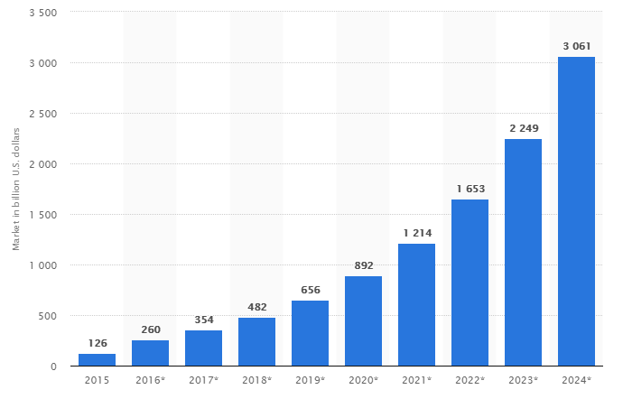
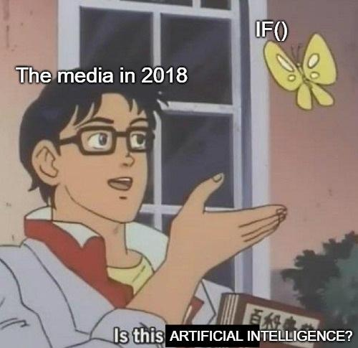
What is ai & should we govern it?
Joseph Caltabiano
A machine attempting to simulate intelligent behavior
Extreme recent market growth
Serious yet unpredictable implications
Projected Revenue of Global AI Market
[3]
Notes:
Define AI – Not just machine learning but something that simulates intelligence, even if intelligent behavior for a very specific task like predicting illness, search and find etc.
Almost 4x growth in the past 3 years, more to come
QUESTION - Should we regulate AI now and slow its progress and maybe cede to other nations or regulate later and deal with the consequences?

Slide 28
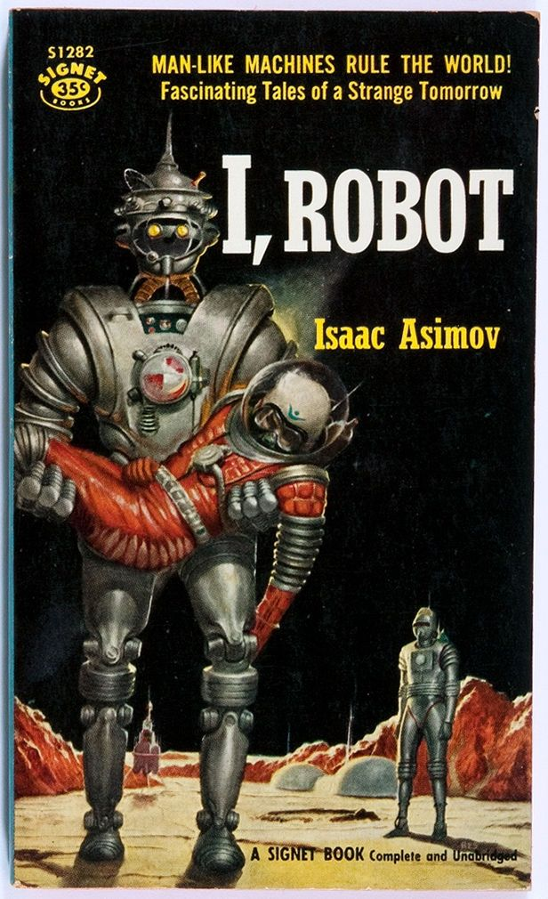
What we’ve already done
Joseph Caltabiano
Self Drive Act (H.R.3388)
AV Start Act (S.1885)
Future of AI Act (H.R.4625)
National Security Commission AI Act (H.R.5356)
→ So what do we need to be doing?
[1][2]
Notes:
Current focus on regulating problems as they arise instead
- House passed BILL Self Drive Act – safety of autonomous vehicles
- One part requires manufacturers to have privacy and cybersec plans before selling car
- AV – “encourage gradual introduction of highly autonomous vehicle tech” in a way that
1) Promotes public safety
2) “Avoids unreasonable restrictions on the introduction of the technology…”
- bipartisan Senate BILL Future of AI – to establish advisory committee to study and advise on AI issues
- BILL National Sec – to establish a commissions to review advances in AI with focus on national security
Typically think of Asimov’s three laws, but are not real world and probably will never be done

Slide 29
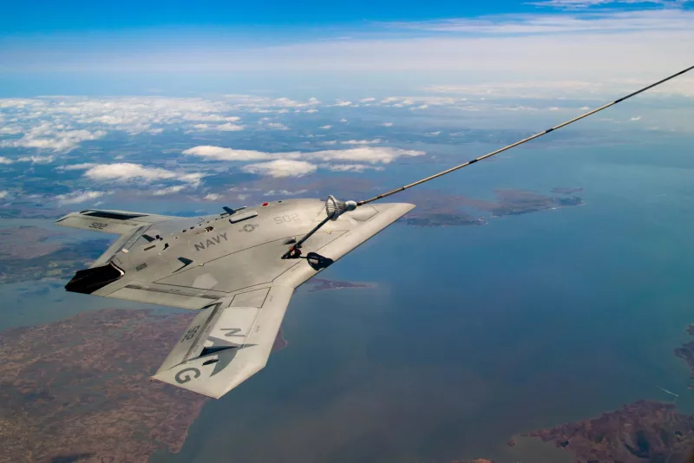
Issues with making laws
Joseph Caltabiano
Who is held responsible?
  Swiss bot’s illegal purchases
  Autonomous car crimes
  Erroneous military drone
Mens Rea
  Legal concept of intent
Semi-autonomous X-47B
[4][5][6][7][8][9][10]
Notes:
Who should be held responsible if AI breaks the law?
Traditionally operator only liable if there was negligence, 2007 NY case, defendant not liable for worker injury caused by robotic gantry loading arm, manufacturer complied with regulations
- Swiss artists create bot that randomly makes dark net purchases with BTC, buys ecstasy and fake passport
- Seized by police and later returned because effective art, sparked debate
- Car realizes everyone is going 65 on a 55 and goes 65 to be safe but it is illegal
Auto car with backup driver behind wheel kills pedestrian, no charges pressed
- Who should be help responsible if error in military drone causes it to kill civvies
- Smarter the machine, less solid ties of responsibility back to human creators
If human creators cannot be held responsible the smarter machines get, should the AI be responsible?
- Machines do not have intent so would not have malice in committing crime
- Cannot be punished
We have laws applying to creation of AI but should AI themselves be subject to laws? How can this be enforced and how would they be punished?
- Machines, if they ever have free will, will not care about following laws or dealing with social retaliations for unacceptable behavior like a human would
- Should a robot be punished or rehabilitated? Is either possible?

Slide 30
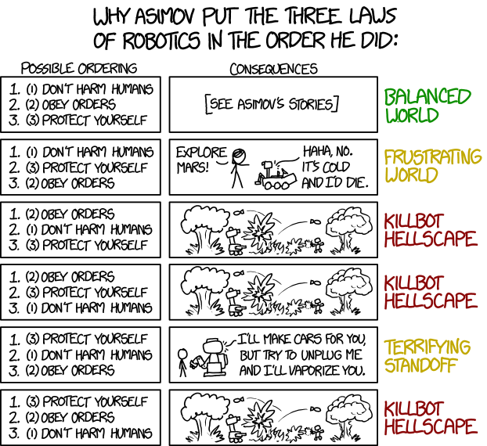
What needs to be done
Joseph Caltabiano
Regulate industries, not AI
Shared lexicon for tech, industry, and legislators
Shared ethical code
  Limit some decisions
Transparency
  Google Duplex
<Citation>
Notes:
Need to have a shared vocabulary of terms so everyone understand what is being talked about, and so that two separate vocabs evolve that could have words meaning very different things
Prohibit decisions – do not allow it to make decisions about life or death of any human
Transparency
- Cannot store or disclose classified info without direct confirmation
Announce it is not human – Google Duplex has unnerving similarity to human caller and can make phone calls autonomously - https://www.youtube.com/watch?v=D5VN56jQMWM
Beyond this, each individual AI industry should be regulated independently. AI is much too vast and vague to try to govern all types of AI under one umbrella

Slide 31
References
[1] Fonzone, Christopher, and Kate Heinzelman. “Should the Government Regulate Artificial Intelligence? It Already Is.” TheHill, The Hill, 26 Feb. 2018, thehill.com/opinion/technology/375606-should-the-government-regulate-artificial-intelligence-it-already-is.
[2] Fonzone, Christopher, and Kate Heinzelman. “What Congress's First Steps Into AI Legislation Portend.” Big Law Business, 15 May 2018, biglawbusiness.com/what-congresss-first-steps-into-ai-legislation-portend/.
[3] Transparency Market Research. "Revenues from The Artificial Intelligence (Ai) Market Worldwide from 2015 to 2024 (in Billion U.S. Dollars)." Statista - The Statistics Portal, Statista, www.statista.com/statistics/621035/worldwide-artificial-intelligence-market-revenue/, Accessed 28 Sep 2018
[4] Schneier, Bruce. “When Thinking Machines Break the Law.” What to Think About Machines That Think, edited by John Brockman, HarperCollins, 2015, pp. 311–313.
[5] Farivar, Cyrus. “Dark Web Drug-Buying Bot Returned to Swiss Artists after Police Seizure.” Ars Technica, Ars Technica, 15 Apr. 2015, arstechnica.com/tech-policy/2015/04/dark-web-drug-buying-bot-returned-to-swiss-artists-after-police-seizure/.
[6] Etzioni, Amitai and Etzioni, Oren, Keeping AI Legal (February 2, 2016). Vanderbilt Journal of Entertainment & Technology Law Vol. XIX: 1. . Available at SSRN: https://ssrn.com/abstract=2726612 or http://dx.doi.org/10.2139/ssrn.2726612
[7] Wakabayashi, Daisuke. “Self-Driving Uber Car Kills Pedestrian in Arizona, Where Robots Roam.” The New York Times, The New York Times, 19 Mar. 2018, www.nytimes.com/2018/03/19/technology/uber-driverless-fatality.html.
[8] IMG URL: https://foxtrotalpha.jalopnik.com/bask-in-the-awesome-of-the-bat-winged-x-47b-sipping-gas-1699562585
[9] Elman, Jeremy, and Abel Castilla. “Artificial Intelligence and the Law.” TechCrunch, TechCrunch, 2016, techcrunch.com/2017/01/28/artificial-intelligence-and-the-law/.
[10] Gibbs, Samuel. “Google's Self-Driving Car Gets Pulled over for Driving Too Slowly.” The Guardian, Guardian News and Media, 13 Nov. 2015, www.theguardian.com/technology/2015/nov/13/google-self-driving-car-pulled-over-driving-too-slowly.

Slide 32
Class 11
The End
Keith A. Pray
Instructor
socialimps.keithpray.net
Notes:
If there’s time and we didn’t get to it:
Kickstarter Charter
https://www.kickstarter.com/charter?ref=about_subnav
CGP Grey
Humans Need Not Apply (15:00) – 2014-08-13
http://www.youtube.com/watch?v=7Pq-S557XQU
Last access 2016-04-22
These 3D printed homes can be constructed for $4,000 (3:00 – 2018-04-02)
http://www.businessinsider.com/3d-printed-homes-constructed-icon-new-story-tech-charity-4000-dollars-2018-3
https://www.youtube.com/watch?v=SvM7jFZGAec (1:28)
Last access 2018-04-22
Look at:
BBC Intelligent Machines
http://www.bbc.com/news/technology-33978561
BBC Likelihood of robot taking your job
http://www.bbc.com/news/technology-34066941
This is the end. Any slides beyond this point are for answering questions that may arise but not needed in the main talk. Some slides may also be unfinished and are not needed but kept just in case.

