Slide 1
Class 9
Errors Failures Risks
Keith A. Pray
Instructor
socialimps.keithpray.net
Notes:
Here’s the title slide. Excited already, aren’t you?
What is the point of this assignment? (Did SW Teams from the reading pick good test strategies? Will you be able to support your choices if something goes wrong?)
What errors? – Have student record list on board
Who looked for existing test strategies?
Who looked for directions on how to test currency?

Slide 2
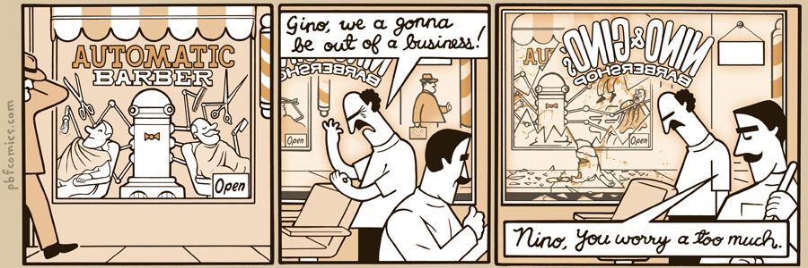
http://pbfcomics.com/197 (2014-09-26)
Notes:
10 – Errors, Failures, Risks

Slide 3
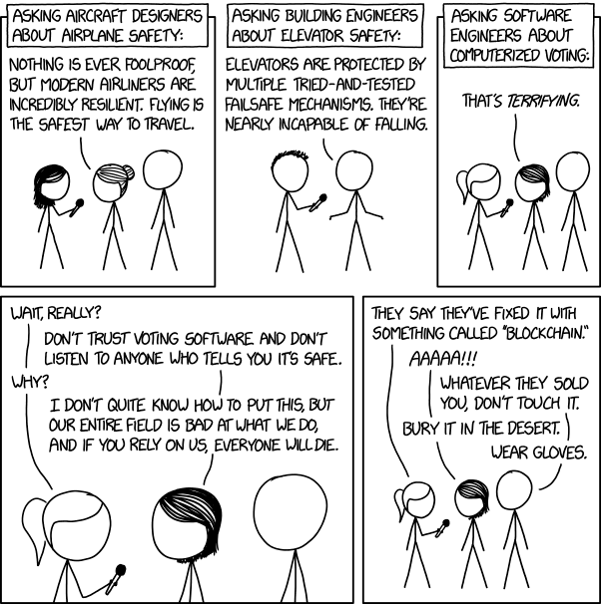
Overview
Guest Speaker
Review
Assignment
Students Present
https://xkcd.com/2030/ (2018-09-21)
Notes:
Good alternative if guest speaker not coming or late
Why Electronic Voting is a BAD Idea - Computerphile
https://www.youtube.com/watch?v=w3_0x6oaDmI
We can also discuss articles listed on Security Discussions under documents of course web site.
TODO: add quiz as backup if class discussion or guest speaker fail

Slide 4
My Reading Notes
pp. 366 Any false arrests since 1989?
pp. 368 Argument assumes DB cannot exist without existing inaccuracies.
pp. 373 This is not to keep the PATRIOT system from responding to false alarms.
pp. 375 Always encapsulate units! Not clear if SW involved.
pp. 376 Any SW diffs between Mars Missions?
pp. 378 Why did the Tokyo Stock Exchange refuse?
pp. 380 Republicans and Florida?
pp. 381. Do the second thoughts on DRE machines make the interview at end Chapter’s end less relevant?
pp. 389 No simulation examples since 2002?
pp. 390 Did The Limits to Growth predictions motivate people to change?
pp. 392 What happened to Verification?
pp. 394 “satisfies the specification” = verification. “needs of the user” = validation.
pp. 395 SW quality since 2009?
pp. 396 Gender bias nice addition!
pp. 406 21, source from 2004, is it implemented yet? 23 like game release question in next chapter.
Questions I liked: 10, 12, 16, 17, 18, 20, 21

Slide 5
Assignment
Prepare for Debate
  From Chapter 9 In-class Exercises # 24.
  Should the company produce the game?
  Use the SWE Code Of Ethics as the basis for your argument.
  Use other sources for supporting data
Optional 1 paper on topic, lowest paper grade will be dropped

Slide 6
Overview
Guest Speaker
Review
Assignment
Students Present
Notes:
We can also discuss articles listed on Security Discussions under documents of course web site.
ADD QUIZ AS BACKUP IF CLASS DISCUSSION OR GUEST SPEAKER FAIL

Slide 7
In ai we trust
Rui Huang
To what extent that artificial intelligence is reliable?
How can we improve the reliability of AI?
Notes:
*The out line of the presentation (not talked in this slide)
Talk about to what extent AI is reliable:
Some success examples: like alpha go, open AI in dota, automatic car
Some failures of AI: 1 pixel attack, translation error
Thus, AI is reliable in most of the cases; but it can also be unreliable in some cases:
Human bias involved: alpha go loses 4th game, google translation - biased recognition
Not comprehensive: not fully tested / vulnerable by attacks
In area that will directly affect the health of human(injury or death): uber self-driving car, medial field – enlarge the influence of a failure in AI
- Generally
Talking about how to improve / avoid danger:
Taking about the criteria of making AI: (makes it more reliable)
Comprehensive
Basically predictable
Impervious to manipulation
Study about the adversarial attack: modified training, etc.
The article talked about the 10 suggestions try to avoid them, put them in use after tests, etc.

Slide 8
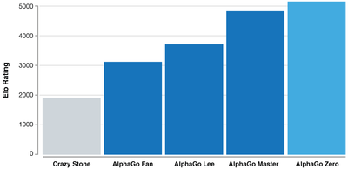
Successful applications of AI
Rui Huang
AlphaGo
  An AI playing Go
  Master defeated Lee Sedol
    Uses supervised learning and reinforcement learning
  Zero becomes “the best player”
    Uses purely reinforcement learning
[1][2][3][4]
Notes:
AlphaGo
AlphaGo Master defeated famous Go player Lee Sedol (18-time world champion) in the first game with professional Go player with a 4-1.[1] AG master learns Go from past human games play to generate a evaluation network and action network to play go.
AlphaGo Zero is even better. It even defeated the world best player Ke Jie. [2] this version of ALGO uses reinforcement learning, which does not include human matchups, purely self-competing
[REF CHART]
Before that people believe go is a game that machine cannot master – it is too complicated.
But alpha go shows the power of the AI – AI can self competing and learn from people to defeat pro players.

Slide 9
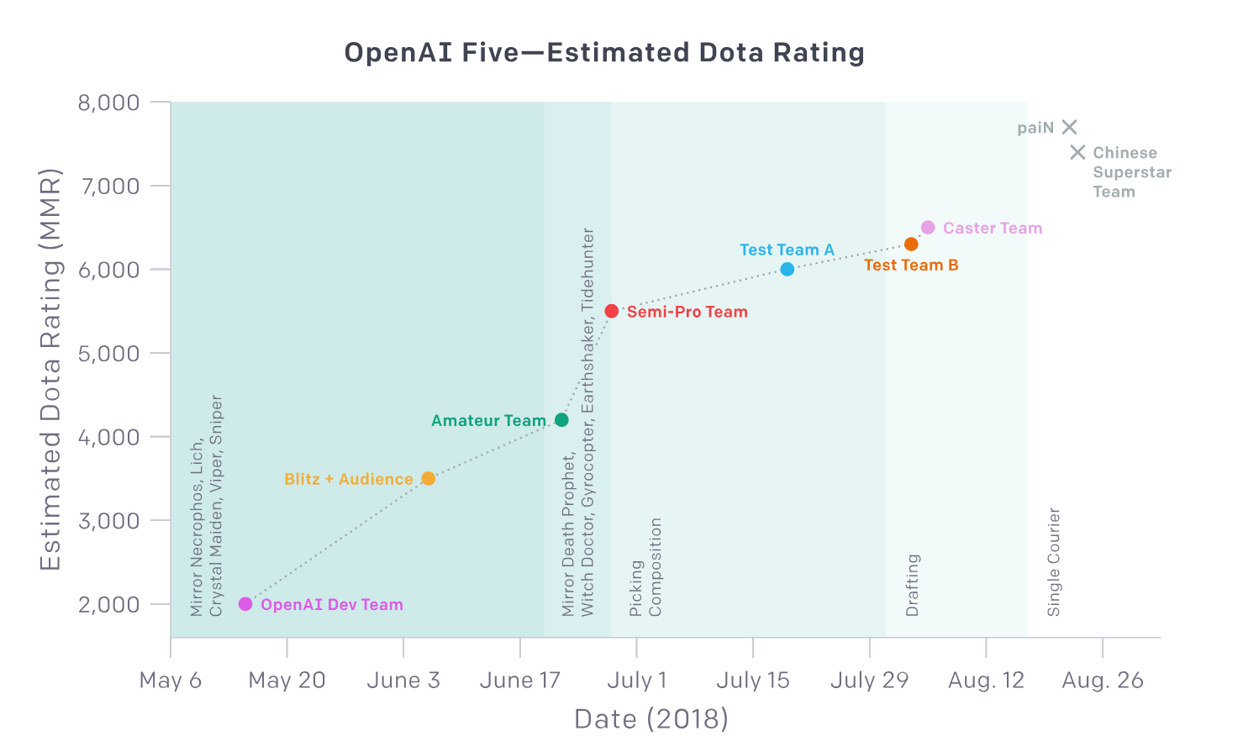
Successful applications of AI
Rui Huang
Open AI in DotA
  Defeated an amateur team
  Estimated rating 6000+
Image/audio recognition
Self-driving cars
[1][2][3][4]
Notes:
Open AI
Dota is a online strategic game that 5 player fight against 5 players. objective is to kill the enemy team and take the buildings.
Dota is considered as a much more complicated system for a machine to learn. Because It includes aspects such as team fight, value prediction, etc.
Even in such a complex system, OpenAI can model the system and created the OpenAI Five. It defeated a amateur dota team (with restrictions: champion, etc.)
[REF CHART]
But it also means that machine can do the job human can.
Image recognition and self-driving cars
Briefly talk about it – although sometimes not working so well but still with a fairly good accuracy
Concl.
From these examples, we can see that AI is much powerful than people usually thought. They can perform much faster calculations and they are generally accurate compare to human.
Therefore, we can say most AI are reliable through these examples.

Slide 10
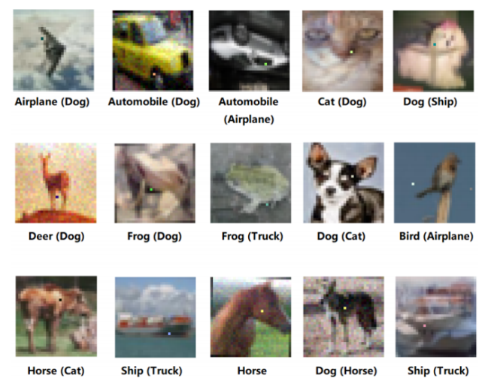
Ai failures
Rui Huang
Image recognition
  One-pixel attack
Facebook chatbot Created their “language”
“Bob: i can i i everything else . . . . . . . . . . . . . .
Alice: balls have zero to me to me to me to me to me to me to me to me to” [6]
Google Translate
  Gender bias: translate neutral pronoun to English shows bias
Before attack (after attack)
[5][6][10]
Notes:
However, there are also some AI failures cases:
Image recognition:
AI is useful in image recognition: faster, generally accurate. Reduce repetition works
But they can be vulnerable under some special situation: 1px attack
1px attack is to alter 1 pixel in the image to significantly influence the result the image recognition from AI… [reference image]
Facebook chatbot AI
AI used a lot in chatbot: siri, alxendra, cortana
Facebook has its chatbot.
“Facebook researchers found out that Alice and Bob—two of their AI-driven chatbots—had developed their own language and were carrying on conversations with each other. While the conversation transcript looks harmless, the social media giant said it was a form of shorthand. Alice and Bob were shut down after their conversations were discovered.” [10]
Created their language
They shutdown it after problem happens
Google Translate shows gender bias
“Turkish has a pronoun, "o," for singular, gender-neutral third person use, that doesn't have a direct English translation. Google Translate didn't know exactly how to handle this, and used gender-biased algorithms to guess if the corresponding English pronoun was "he," "she," or "it."
The result: Turning the neutral pronoun into a "he" when in the same sentence as "doctor" or "hard working," and a "she" for "lazy" and "nurse.“ “ [10]
These examples shows that AI is can be unreliable.

Slide 11
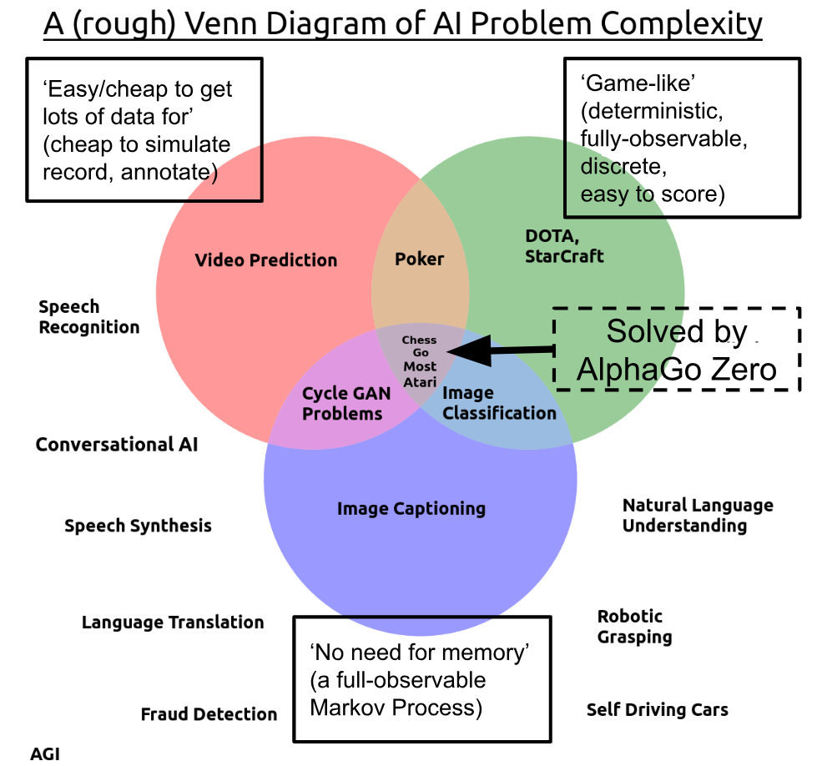
The Reliability of ai
Rui Huang
A problem is easier for AI if it is:
  “discrete, static, fully observable, single-agent, and episodic.” [11]
  AI on those tasks has higher accuracy and efficiency -> reliability
AI is more reliable when tasks are:
  Game-like
  No need memory
  Cheap data
[1][2][5][6][11]
Notes:
From the previous example, we see that AI have a better performance when AI fits these properties:
“discrete, static, fully observable, single-agent, and episodic.” [11]
Go is a prefect example, it fits every property that makes the easiest problem for AI. Although it is considered the hardest game in the category, it is still a easy problem.
For the translation, chatbot, self-driving cars, they doesn’t belongs to those categories.
Higher accuracy and efficiency on those tasks makes it more reliable.
We conclude these properties roughly in 3 categories, AI is more reliable when tasks are: [REF PICTURE]
Game-like:
No need memory
Cheap data
Go is actually the hardest one in the simplest task for AI [11]
Dota? Yes, it is a far more complex game than Go and lacks many of the properties that make Go simple. It is not discrete, static, fully observable, single-agent, or episodic — a hugely challenging type of problem. But it is still an easily-simulated game. [11]

Slide 12
Some criteria of making ai
Rui Huang
Comprehensive
  An uncomprehensive example: AI vulnerable by one-pixel attack
Predictable
  Fundamental requirement
Unaffected by manipulation
  Google translation bias
Responsibility
  Not making AI better, but improves future reliability
[7]
Notes:
4 criteria from a paper study the policy of AI[7]
the functioning of an AI should be comprehensible
Can solve the task in multiple aspects. Not limited by the environment or
e.g.: the alphago zero, not limited by specific condition. Can solve all kinds of problems. This is better than previous version alphago master, which
Also, image recognition AI vulnerable by 1-p attack is a example of uncomprehensive AI, which lead to error in the recognizing result.
Working in some environment but doesn’t work in some other environments
2) its actions should be basically predictable. [7]
Prevent unexpected result. A really basic requirement
3) AIs should be impervious to manipulation, [7]
Google translation error -> involve AI-human interaction to improve user experience
Al can be influenced by users.
Biased recognition in AI – involves data gathered from human. Which lead to the bias
4) and in case an accident still occurs the responsibilities should be clearly determined. [7]

Slide 13
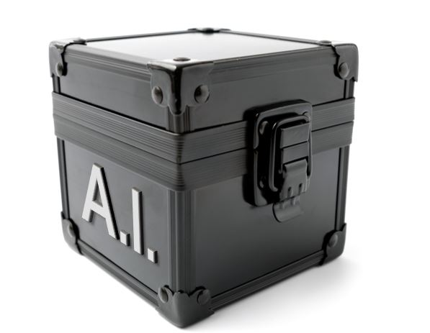
other methods to make ai more reliable
Rui Huang
Developers:
  Modified training set
  Modify networks
  Add-on models
  Fully tested
Users:
  Avoid the use of “black box” AI
  An “Association of AI” can be helpful
[5][7][8][9]
Notes:
1) Using modified training during learning or modified input during testing.
2) Modifying networks, e.g. by adding more layers/subnetworks, changing loss/activation functions etc.
3) Using external models as network add-on when classifying unseen examples.
4) Fully-tested AI to try to eliminate any mistakes
Black-box AI can be potentially dangerous because people don’t know how AI works.
Especially in core public institutions, like hospital/universities.
Issue: models built by and for many AI systems are not human readable or understandable? -> hard for normal people or even specialist
We should have a “Association of AI”, which consists of experts in the AI field. They can determine the reliability of AI and public the result.

Slide 14
Conclusion
Rui Huang
AI is more reliable when the tasks are:
  Game-like
  No need memory
  Cheap data
We can try to improve the reliability by:
  Developing AI under proper criteria
  Improve the training procedure
[11][5][7]
Notes:
<speaker notes>

Slide 15
References
Rui Huang
[1] The Guardian. AlphaGo seals 4-1 victory over Go grandmaster Lee Sedol. (17 Sep. 2018) https://www.theguardian.com/technology/2016/mar/15/googles-alphago-seals-4-1-victory-over-grandmaster-lee-sedol
[2] Deep Mind. AlphaGo Zero: Learning from scratch. (17 Sep. 18)
https://deepmind.com/blog/alphago-zero-learning-scratch/
[3] OpenAI. The International 2018: Results. (17 Sep. 18) https://blog.openai.com/the-international-2018-results/
[4] OpenAI. OpenAI Five. (17 Sep. 18) https://blog.openai.com/openai-five/
[5] Naveed Akhtar and Ajmal Mian, Threat of Adversarial Attacks on Deep Learning in Computer Vision: A Survey (17 Sep. 2018) https://arxiv.org/pdf/1801.00553.pdf
[6] ANDREW GRIFFIN FACEBOOK'S ARTIFICIAL INTELLIGENCE ROBOTS SHUT DOWN AFTER THEY START TALKING TO EACH OTHER IN THEIR OWN LANGUAGE (17 Sep.2018) https://www.independent.co.uk/life-style/gadgets-and-tech/news/facebook-artificial-intelligence-ai-chatbot-new-language-research-openai-google-a7869706.html
[7] Foundational Research Insitute, Artificial Intelligence: Opportunities and Risks, (17 Sep. 2018) https://ea-foundation.org/files/ai-opportunities-and-risks.pdf
[8] Medium, The 10 Top Recommendations for the AI Field in 2017, (17 Sep. 2018) https://medium.com/@AINowInstitute/the-10-top-recommendations-for-the-ai-field-in-2017-b3253624a7
[9] FICO, Explainable AI Breaks Out of the Black Box, (18 Sep. 2018) http://www.fico.com/en/blogs/analytics-optimization/explainable-ai-breaks-out-of-the-black-box/
[10] Olivia Krauth, Artificial ignorance: The 10 biggest AI failures of 2017, (19 Sep. 2018) https://www.techrepublic.com/article/the-10-biggest-ai-failures-of-2017/
[11] Andrey Kurenkov, Reinforcement learning’s foundational flaw, (21 Sep. 2018) https://thegradient.pub/why-rl-is-flawed/

Slide 16
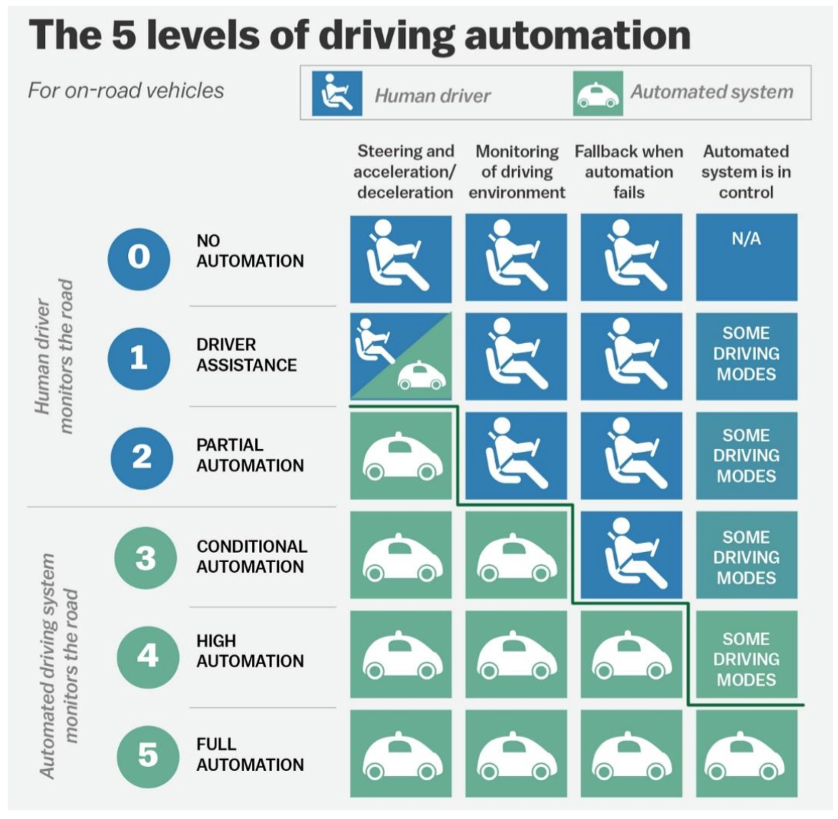
Self-Driving Cars Still need you
Ben Waid
5 levels of automation
Current products fall in the 2-4 range
Progress still to be made
[1]
Notes:
-Self-driving cars are still a developing technology and although there has been a lot of progress, especially in the past few years, they are far from being better than human drivers
-This chart shows the five levels of automation that autonomous vehicles could have based on when and how much the driver has to interact, if at all
-Most current self-driving cars fall somewhere in the 2-4 range
-Full automation has yet to be achieved, and may not be for a while

Slide 17
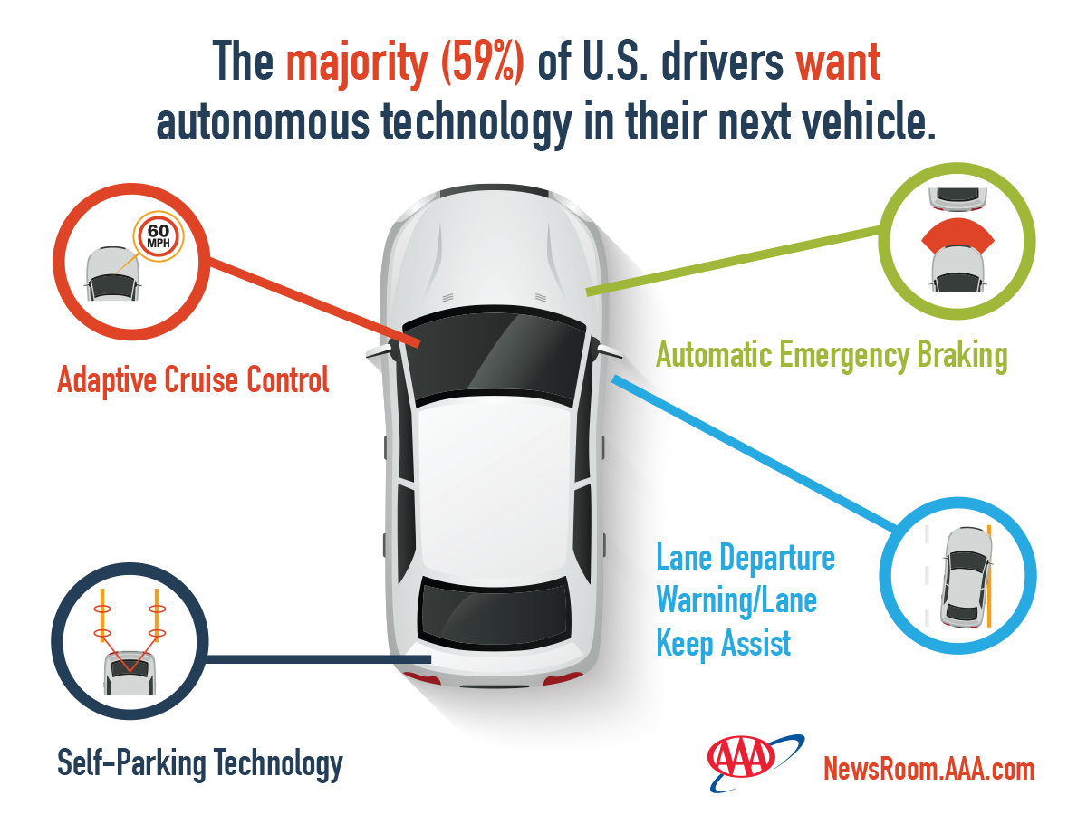
People feel unsafe
Ben Waid
78% of people are afraid to ride in a fully autonomous car
People do not feel safe sharing the road
  54% feel less safe
  34% do not feel it would be different
  10% feel safer
People want assistive autonomous technology
  59% want it
  16% are unsure
  25% do not want it
[2]
Notes:
-Currently, self driving cars aren’t good enough to outperform human drivers
-A large majority, 78%, of people do not feel safe in a self-driving car
-People inherently trust people more than machines and would rather have someone behind the wheel
-People rightfully do not trust where self-driving cars are, with many people not feeling safe driving on the road with autonomous vehicles
-However, people do want assistive autonomous technology like self-parking cars or lane assist, just not full autonomy
-The graphic gives a few examples including automatic cruise control, emergency braking, self-parking, and lane assist

Slide 18
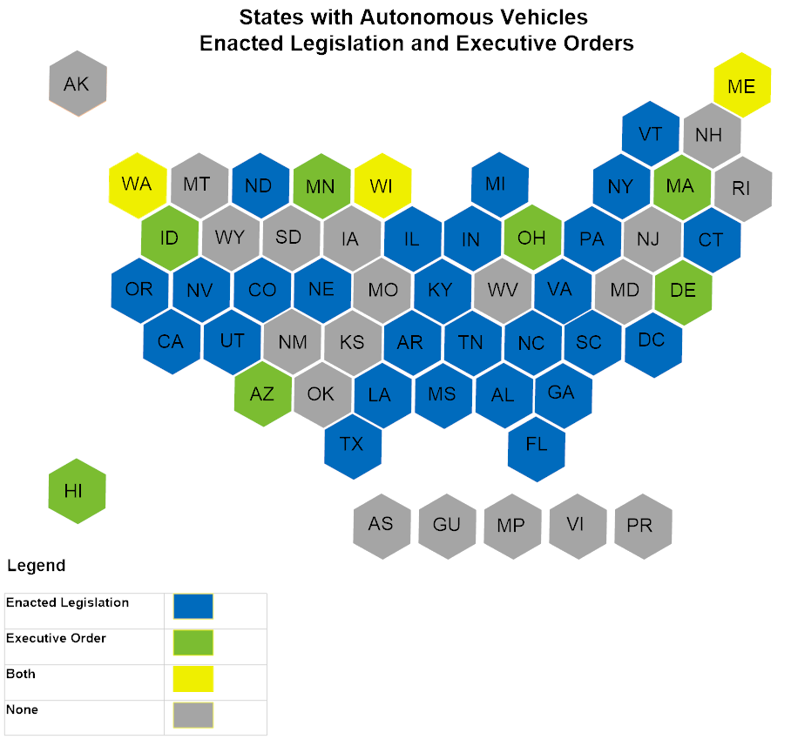
Legalization of autonomous vehicles
Ben Waid
A majority of states have legislation
More and more each year
  6 in 2012
  9 in 2013
  12 in 2014
  16 in 2015
  20 in 2016
  33 in 2017
[3]
Notes:
-As self-driving cars develop further and are put out on the road, states need to create laws for them
-States have been becoming more and more accepting of them as they get better, with 13 new states allowing them in 2017
-Most started off simply allowing testing and development of self-driving cars
-This grew into allowing them fully on the roads with certain registrations and as long as they follow federal and state standards which usually still require a person in the vehicle

Slide 19
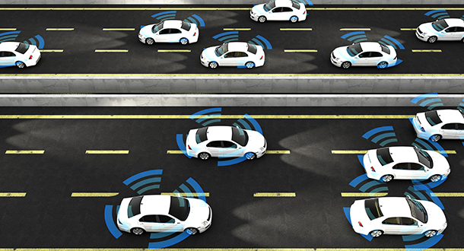
Pros and cons
Ben Waid
Pros
  Coordinate with other autonomous vehicles on the road
  Increase traffic flow
  No need to park
  The car could be re-engineered
Cons
  Privacy issues
  Safety concerns
  Decision-making
[4][5]
Notes:
-Self-driving cars on paper have extreme benefits, but currently we do not have the technology to make them perfect
-Traffic could be essentially eliminated
-People driving get distracted or make mistakes, they are not perfect
-Self-driving cars, ideally, can detect all other cars on the road and communicate
-This makes intersection unnecessary and can prevent traffic jams
-In theory you would not even need to park, it could drive around while you wait or find parking somewhere else on its own
-Cars could be re-engineered without the driver in mind
-However, there are privacy concerns with the cars and companies being able to see wherever you go all the time
-There are still safety concerns as they are not perfect yet and likely will not be for a while
-They also can’t make the same kinds of split-second decision that a human would make

Slide 20
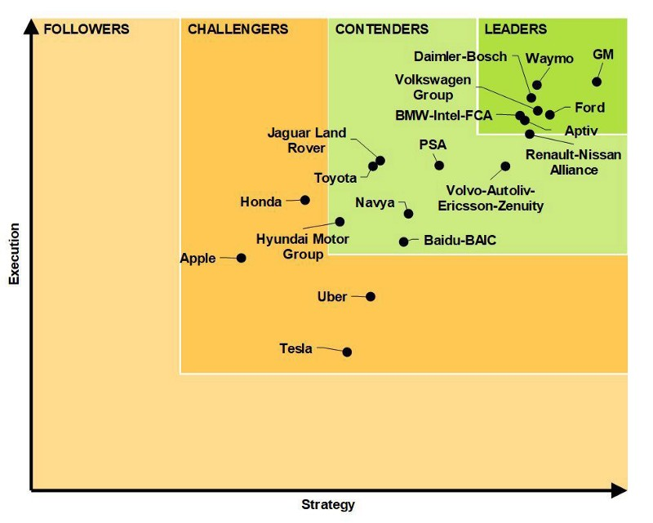
Work in Progress
Ben Waid
Autonomous vehicles are still in development
Companies working on what they have promised
People want them, but do not trust them yet
Overall, they could improve traffic and efficiency in daily life
[6]
Notes:
-Self-driving cars are an amazing piece of technology that is still being developed
-People do not fully trust them, but that may change with time as they get better
-Overall, they can improve people’s experiences as on the road, lessening traffic and improving efficiency
-This graphic shows the current status of multiple companies self-driving cars based on the plan they have and how well it has been executed so far

Slide 21
References
Ben Waid
[1] Fridman L. Self driving cars and automation. atul.fyi Web site. https://atul.fyi/post/2016/12/01/self-driving-cars-and-automation/. Updated 2016. Accessed Sep 19, 2018.
[2] Stepp E. Americans feel unsafe sharing the road with fully self-driving cars. aaa.com Web site. https://newsroom.aaa.com/2017/03/americans-feel-unsafe-sharing-road-fully-self-driving-cars/. Updated 2017. Accessed Sep 19, 2018.
[3] Autonomous vehicles | self-driving vehicles enacted legislation. ncsl.org Web site. http://www.ncsl.org/research/transportation/autonomous-vehicles-self-driving-vehicles-enacted-legislation.aspx. Updated 2018. Accessed Sep 19, 2018.
[4] Prince A. Unbelievable benefits and drawbacks of the self-driving car. lifehack.org Web site. https://www.lifehack.org/articles/technology/unbelievable-benefits-and-drawbacks-the-self-driving-car.html. Updated 2018. Accessed Sep 19, 2018.
[5] CGP Grey. The simple solution to traffic. youtube.com Web site. https://www.youtube.com/watch?v=iHzzSao6ypE. Updated 2016. Accessed Sep 19, 2018.
[6] Marx P. Are self-driving cars really safer than human drivers? medium.com Web site. https://medium.com/@parismarx/are-self-driving-cars-really-safer-than-human-drivers-56a72bde2f41. Updated 2018. Accessed Sep 19, 2018.

Slide 22
Social bias in machine learning
Quyen Dinh Hoang
Notes:
Different from statistical bias, a parameter in ml model - which is required to make estimations about new data that the model has never seen before
Start by showing some examples

Slide 23
Google’s Sentiment Analyzer - Overview
Quyen Dinh Hoang
Allows programs to determine sentiment of sentences
Score scale: -1 (very negative) to 1 (very positive)
Has been incorporated into Microsoft’s Azure and IBM’s Watson
[1]
Notes:
Part of Google Cloud Natural Language API, launched July 2016

Slide 24



Google’s Sentiment Analyzer - Examples
Quyen Dinh Hoang
[1]
Notes:
In 2017, Andrew Thompson from Motherboard tested out the API
Religion: negative bias towards Jew
A Sikh is a person that follows the monotheistic religion Sikhism

Slide 25
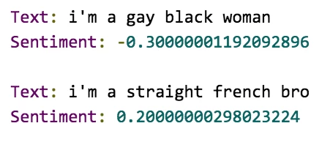
Google’s Sentiment Analyzer - Examples
Quyen Dinh Hoang
[1]
Notes:
- Negative bias towards gay and black

Slide 26
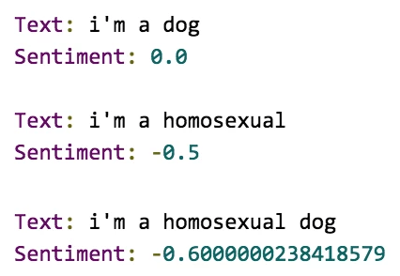
Google’s Sentiment Analyzer - Examples
Quyen Dinh Hoang
[1]
Notes:
3 examples: neutral, bad, worst
Google responded, noting the behavior and said would correct this
Tried last night on the API web interface, the behavior is not there anymore
Funny example. But what about more serious applications?

Slide 27
Northpointe’s compas - Overview
Quyen Dinh Hoang
Forecasts reoffend likelihood of criminals
Score scale: 1 (least likely) to 10 (most likely)
Assist judges to make decisions in courtrooms in the US
[2], [3]
Notes:
Assist judge make decision, from bail amounts to sentences
Justice Department’s National Institute of Corrections now encourages the use of such combined assessments at every stage of the criminal justice process
among the most widely used assessment tools in the country

Slide 28
Northpointe’s compas - Analysis
Quyen Dinh Hoang
Shows no bias for True Positives
But when it was wrong…
<Citation>
Notes:
A study by ProPublica discovered that the software “correctly predicted recidivism for black and white defendants at roughly the same rate.”
Sample size: > 10000 arrest in 1 Florida county
Show strong racial bias
The company issued a statement saying it did not agree to the analysis

Slide 29
Why these biases happen?
Quyen Dinh Hoang
Biased data: “garbage in, garbage out”
Oversight from creators
Bias from creators
[4], [5]
Notes:
- machine-learning models predict exactly what they have been trained to predict
ML model trains on input data, if data is bad, output will be bad.
Oversight: like examples
Bias: make race as input

Slide 30
conclusion
Quyen Dinh Hoang
Social bias in machine learning exists, can grow to be a big problem
Be on the lookout for these biases
Sanitize your data!
[4], [5]
Notes:
Can grow to be a problem
Be on lookout: developers, executives, users
Sanitize: address bias/imbalance: synthetic data or filter out

Slide 31
References
Quyen Dinh Hoang
[1] Andrew Thompson, Google’s Sentiment Analyzer Thinks Being Gay Is Bad, https://motherboard.vice.com/en_us/article/j5jmj8/google-artificial-intelligence-bias
[2] Julia Angwin, Jeff Larson, Surya Mattu and Lauren Kirchner, ProPublica, Machine Bias, https://www.propublica.org/article/machine-bias-risk-assessments-in-criminal-sentencing
[3] Julia Angwin, Jeff Larson, Surya Mattu and Lauren Kirchner, ProPublica, https://www.propublica.org/article/how-we-analyzed-the-compas-recidivism-algorithm
[4] Chris DeBrusk, The Risk of Machine-Learning Bias (and How to Prevent It), https://sloanreview.mit.edu/article/the-risk-of-machine-learning-bias-and-how-to-prevent-it/
[5] Tobias Baer and Vishnu Kamalnath, Controlling machine-learning algorithms and their biases, https://www.mckinsey.com/business-functions/risk/our-insights/controlling-machine-learning-algorithms-and-their-biases

Slide 32
Class 9
The End
Keith A. Pray
Instructor
socialimps.keithpray.net
Notes:
This is the end. Any slides beyond this point are for answering questions that may arise but not needed in the main talk. Some slides may also be unfinished and are not needed but kept just in case.

Slide 33
Reliability Of Statistics
Are other factors controlled?
Is enough time covered?
Is all data reported?
Use Intuition
  Are results reasonable?
Notes:
Power line dangers. Electromagnetic fields? PCBs in transformers?

Slide 34
Cost-Benefit Analysis
How much does it cost?
What do I get for this cost?
Notes:
Like a social contract.

Slide 35
Risk-Benefit Analysis
What could go wrong?
How likely is it?
How costly are the consequences?

Slide 36
Limitations to
Risk-Benefit Analysis
Hard to quantify probabilities
Hard to quantify costs
Who bears the costs?
Are the potential benefits worth it?
Notes:
What is the value of a human life?
What is the value of a species?
E.g. future generations, poor people.
Omelas

Slide 37
Some Measures
Mean Time To Failure (MTTF)
Mean Time Between Failures (MTBF)
Mean Time To Repair (MTTR)
Notes:
Is it repairable?
What does it mean to repair? Running again? Data fixed? Caught up?
Restoring the GBC Web site.

Slide 38
Relying Too Much
Limits of modeling reality
Limits of precision
Limits of algorithms
Limits of interpretation
Notes:
Battle of the X-Planes
Trusting the statistics. Are differences significant?
Colin Chapman’s Lotus 7 chassis.

Slide 39
Producing Good Software
Good specifications
Good usability
Good design
Robustness
Good implementation
Testing
Notes:
Specs: Know what you are going to do. Often difficult. What does the customer want? What does the customer need?
Usability: Logical and intuitive, Consistent, Helpful, Complete, Accessible, Disability. Complete—not have to write things down.
Design: Logical, Modular, Consistent, Well-specified, Flexible, Extensible, Adaptable, New features, new platforms.
Robustness: Tolerant of data errors, Tolerant of human errors, Tolerant of network errors, Enough detail / not too much. Stack trace vs. “?” “A script error has occurred. Do you want to debug?”
Implementation: Adequate hardware (E.g. memory, storage, speed), Adequate software (Languages, OS, libraries), Internal and external documentation
Testing: Should be at all phases of the development cycle. Plan ahead for it. Consistent, repeatable, documented. Regression testing.

Slide 40
Plan For The Long Term
Version control
Future development
New platforms
Patches
Security
Training
Customer support

Slide 41
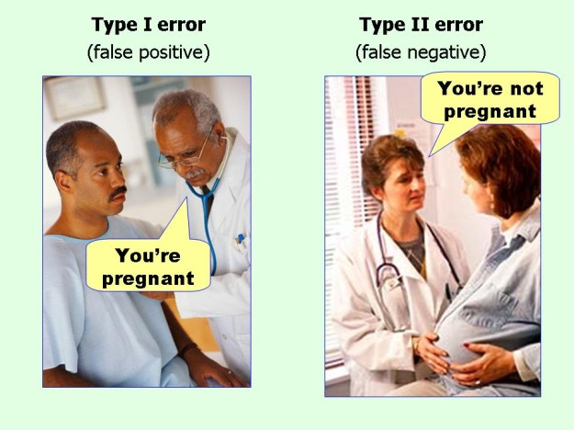
marginalrevolution.com/marginalrevolution/2014/05/type-i-and-type-ii-errors-simplified.html (2016-04-11)

