Slide 1
Class 7
Privacy and Government
Keith A. Pray
Instructor
socialimps.keithpray.net
Notes:
After this class we will be half done with the course… very sad I know.
Play Somebody’s Watching Me (1984) – Rockwell (3:36)
https://www.youtube.com/watch?v=7YvAYIJSSZY
Be the envy of all your classmates if you know the band and/or year:
Rockwell (1984) Michael Jackson sings chorus and Jermaine Jackson on backing vocals.

Slide 2
Overview
Review
Assignment
Students Present
Notes:
Review before debate in case anyone unsure of something in reading

Slide 3
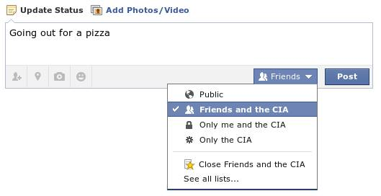
Notes:
Source?
Let’s see who said National ID yes and no. Let’s debate!

Slide 4
My Reading Notes
pp. 274 Arrests, altering and deleting records are violations of privacy?
pp. 275 Why not try to verify and correct records?
pp. 276 Figure does not show # cameras increasing.
pp. 277 300 times = frames, locations, …?
pp. 289 “…don’t want anyone to know…” like seeking medical advice, etc.?
UPDATE
pp. 291 Just because it’s been happening for years doesn’t make it right.
pp. 297 Wouldn’t it be easy to make and show a fake SSN card?
pp. 298 Confusing false positive and negative explanations.
End of Chapter questions: 1, 31, 51

Slide 5
Debate Ground Rules
Before Debate
  15 minutes to converse with your team
  Share argument points, counter points, and responses so everyone can represent
  Decide who will respond to what points from the opposing side
During Debate
  Stand up when speaking
  1 turn per person until everyone on your team has spoken
  30 second limit (elect a timekeeper)
  Switch sides at any time if you change your mind
Notes:
National ID or Not Debate

Slide 6
Group Quiz
List two problems with using biometrics for identification.
List two advantages of using biometrics for identification.
Describe two tools people can use to protect their privacy on the Web.
For each of the 4 categories of Daniel Solove’s privacy taxonomy give an example not listed in the book.
Notes:
Only if need to fill time, Orwellian video better use of time if we’ve not seen it yet.

Slide 7
Overview
Review
Assignment
Students Present

Slide 8
Assignment – Group Project
Catch up on reading
List of computing technologies portrayed in movie
Categorize computing technologies as existing, future, emerging, impossible, plausible with rationale
Analyze movie for all topics covered to date
See group project slide deck for more
Notes:
Movie group project:
Technology group project:
Add list of movies portraying your computing technology
State if the computing technologies was existing, future, or emerging

Slide 9
Overview
Review
Assignment
Students Present
Notes:
What "Orwellian" really means - Noah Tavlin (5:31)
http://ed.ted.com/lessons/what-orwellian-really-means-noah-tavlin

Slide 10
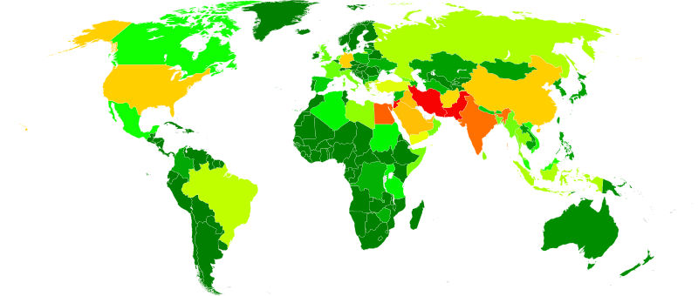
Buying Privacy
John Bieber
Technology is limiting consumer privacy in the United States
Executive order 12333 [3]
  Allows data that is moved outside of the US to be stored in a govt. controlled database
Modern technology trades privacy for cost and convenience
  Decrease in monetary cost may mean an increase in other costs
2007 Global surveillance by NSA [2]
(least=green, most=red)
[2][3]
Notes:
- Hello, my name is John Bieber. The title of my presentation is “Buying Privacy”. The conclusion that I reached is that advancing technology is limiting consumer privacy in the United States.
One motivation for these limitations is in the textbook: the rise of terrorism fears in the US after 9/11. You can see in this heatmap of NSA surveillance throughout the world that the US is one of the more-surveilled countries. One specific item that the book did not mention is executive order 12333, enacted by President Reagan in 1981. This order is credited with allowing the collection of information that is sent outside the US, such as in the case of Google or Yahoo! moving data between data centers that are not located in the US. Even if the data is an email from a person in the US to another person in the US, if the data is sent outside of the US then this order allows it to be collected in a government database.
Another motivation for the limitations is simple market forces. Consumers tend to choose the less monetarily costly service, regardless of what information is being collected. Consumers provide a lot of data to online services, and depending on how these services are controlling the data, it could be subject to executive order 12333, allowing all of that information to be collected by the US government. By providing data to companies, it may very well be the same as providing it to the government.

Slide 11
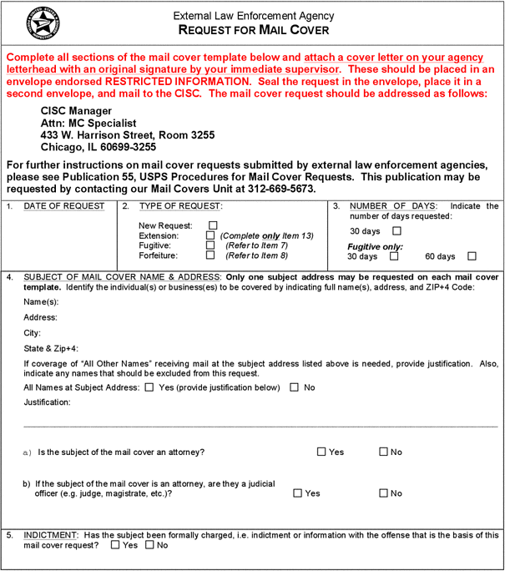
Decreasing privacy from the government
John Bieber
Mail covers pre-2001: [4]
  Images taken of covers of mail for particular recipient
  Instituted as part of law-enforcement investigations upon request
Mail covers post-2001: [5]
  USPS has effectively been conducting mail covers on all US mail as part of the Mail Isolation and Tracking program
  Takes an image of every piece of mail and stores it in a database
[4][5][6]
Notes:
One specific instance of policy-related privacy reduction has to do with mail covers. Mail covers are a tool that law enforcement can use to monitor a suspect’s communications through the USPS. Law enforcement can submit a request, shown on the right, to a post office, which will then photograph the covers of any mail that a suspect receives.
After 2001, prompted by Anthrax attacks that killed several people, the USPS instituted the Mail Isolation and Tracking program, which effectively conducts mail covers on all mail sent through the USPS. The system automatically takes an image of every piece of mail sent and stores it in a database.
This system was actually used to track down a woman who sent Ricin to President Obama in 2013. The letter did not have a return address, but by examining about 60 letters that were sent before and after the malicious package, the FBI was able to extrapolate who the letter was sent from.
This is just one example of advancing technology restricting the privacy of US citizens.

Slide 12
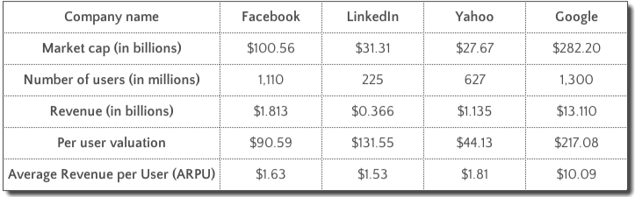
Cost Versus privacy
John Bieber
Monetarily free services are clearly more popular
  These companies earn revenue through advertising and user data
App.net, a service that did not advertise or sell user data:
  July 13, 2012 announced to be an ad-free social media platform
  Crowdfunding raised $750,000 by August 13, 2012
  Platform became freemium on Feb 25, 2013
  App.net shut down March 17, 2017 due to lack of subscription renewals
[12][13]
Notes:
Another example of privacy limitation, this time due to consumers themselves, is the choice between a cheap or free service versus a paid service.
Some of the most well-known free services are Facebook, LinkedIn, Yahoo, and Google. These companies are also well-known for selling their consumers’ information.
An author for Forbes did a basic analysis of how much revenue each user provides to these services, the results are shown on the left.
One service that attempted to appeal to users who did not want to be advertised to or have their data sold was App.net. On July 13th of 2012, they announced their creation of this ad-free social media platform.
By August 13th of 2012, they crowd-funded about $750,000. On Feb 25th 2013, they announced their transition to being a freemium service.
On March 17 of 2017, they finally shut down due to lack of subscription renewals.
This demonstrates just one case of consumers picking the cheapest option, despite the non-monetary costs.

Slide 13
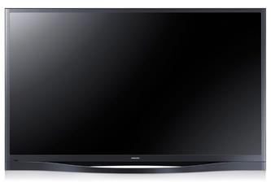
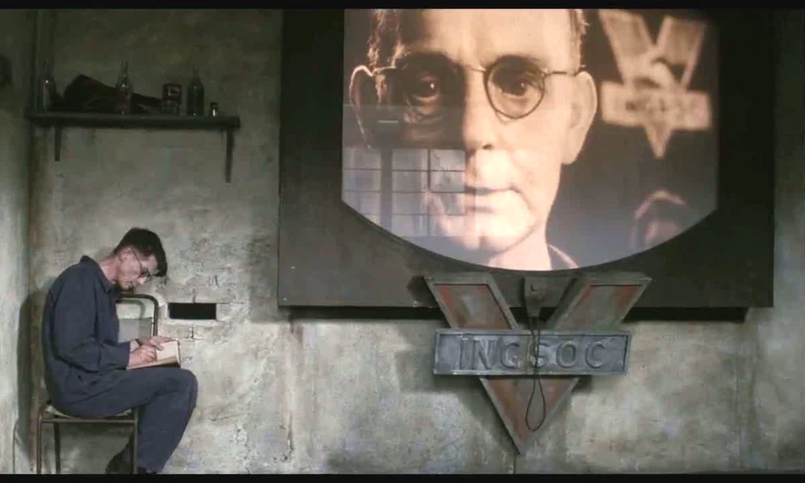
Technology Decreasing Consumer privacy
John Bieber
Samsung Smart TV warns users not to talk about personal information
Literally parallels the devices in 1984:
  “The television received and transmitted simultaneously. Any sound that Winston made, above the level of a very low whisper, would be picked up by it…”[8]
“Please be aware that if your spoken words include personal or other sensitive information, that information will be among the data captured and transmitted to a third party through your use of Voice Recognition.” [7]
[7][8][11]
Notes:
An example of a physical manifestation of technology decreasing consumer privacy came in 2015 with Samsung’s line of Smart TVs.
The smart TV terms read: “Please be aware that if your spoken words include personal or other sensitive information, that information will be among the data captures and transmitted to a third party through your use of Voice Recognition.”
This sounds a lot like the description of the televisions in George Orwell’s 1984: “The television received and transmitted simultaneously. Any sound that Winston made, above the level of a very low whisper, would be picked up by it…”
In 1984, Oceania’s authoritarian government was able to use this technology to very overtly watch over its citizens, ensuring that they did not express any ideas that were contrary to the government’s.
Because of executive order 12333, whether the government receives the data that is sent to a “third party” depends on where it is stored. If the government receives the transcripts of people’s conversations in their living rooms, the only difference between 1984 and reality is how that information ends up being used.

Slide 14
References
John Bieber
[1] James Bamford, “The Agency That Could Be Big Brother”, https://www.nytimes.com/2005/12/25/weekinreview/the-agency-that-could-be-big-brother.html, 9/13/2018
[2] By Rezonansowy [CC0], from Wikimedia Commons, https://commons.wikimedia.org/wiki/File:Boundless_Informant_data_collection.svg, 9/13/2018
[3] U.S. Government, “Executive Order 12333—United States intelligence activities”, https://www.archives.gov/federal-register/codification/executive-order/12333.html, 9/12/2018
[4] U.S. Government, “39 CFR 233.3 – Mail covers.”, https://www.law.cornell.edu/cfr/text/39/233.3, 9/12/2018
[5] Ron Nixon, “U.S. Postal Service Logging All Mail for Law Enforcement”, https://www.nytimes.com/2013/07/04/us/monitoring-of-snail-mail.html, 9/10/2018
[6] By US Postal Services [Public domain], via Wikimedia Commons, https://commons.wikimedia.org/wiki/File:Mail-cover-documents-p19-normal.gif, 9/13/2018
[7] Parker Higgins (@xor), “Left: Samsung SmartTV privacy policy, warning users not to discuss personal info in front of their TV Right: 1984”, 1:35 AM 2/8/2015, Tweet, 9/13/2018
[8] George Orwell, 1984 (Secker and Warburg, 1949), page 1
[9] Matt Sledge, “Alex Kozinski, Federal Judge, Would Pay $2,400 A Year, Max, For Privacy”, https://www.huffingtonpost.com/2013/03/04/alex-kozinski-privacy_n_2807608.html, 9/13/2018
[10] Joe Mullin, “How much do Google and Facebook profit from your data?”, https://arstechnica.com/tech-policy/2012/10/how-much-do-google-and-facebook-profit-from-your-data/, 9/13/2018
[11] Nineteen Eighty-Four, Dir. Michael Radford, 20th Century Fox, 1984, Film
[12] Tristan Lous, “How Much Is A User Worth?”, https://www.forbes.com/sites/tristanlouis/2013/08/31/how-much-is-a-user-worth/#8a8fd81c514e, 9/14/2018
[13] Dalton Caldwell, “App.net is Shutting Down”, https://web.archive.org/web/20170304171621/http://blog.app.net/2017/01/12/app-net-is-shutting-down/, 9/14/2018

Slide 15
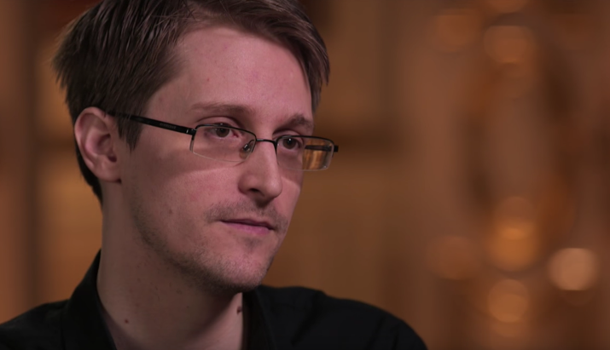
Trust Us, Really
Oliver Jay
“The NSA is saying… 'well I have a gun pointed at your head. I'm not going to pull the trigger. Trust me.’”
-Edward Snowden
[1]
Notes:
Hello, my name is Oliver
In a famous interview with John Oliver, Edward Snowden described the NSA’s defense for spying on US citizens as holding a gun to our heads and asking us to trust them.
I like this quote because I feel it is a good introduction to several questions I want to raise today.
What does Snowden mean by this? Do people do trust the NSA to use the tools they have fairly? and should people trust them?

Slide 16

NSA’s Defense of their surveillance
Oliver Jay
Necessary to defend against terrorism
Not to be used against US Citizens without extreme necessity
The question remains, can we trust them
[2][3]
Notes:
Snowden is referring to the NSA’s defense of their program that need the ability for mass data collection to counter terrorism, but they would never use it against US citizens

Slide 17
What do people think THE NSA IS doing?
Oliver Jay
70% of adults believe surveillance data is used beyond anti-terror
49% are not confident in the US to protect their data
34% of people with knowledge of surveillance took steps to hide their data (Pew research center)
[4]
Notes:
70% of American’s are skeptical of this defense. Additionally many are skeptical their data is securely held by the government. Many people have even responded by being more cautious online.

Slide 18
Is this acceptable?
Oliver Jay
Gmail
82% feel monitoring suspected terrorists is acceptable
57% say monitoring US citizens is unacceptable
  PRISM allows access to any data that leaves or enters the US
Toronto
Boston
SF
Sender
Recipient
[4]
Notes:
While most people agree monitoring terrorists is worthwhile, Americans are divided on whether it is acceptable to monitor US citizens. As the law is phrased, they are not supposed to target citizens, but can collect any data that moves outside of the US. This includes any content on the cloud that is stored in overseas servers.

Slide 19
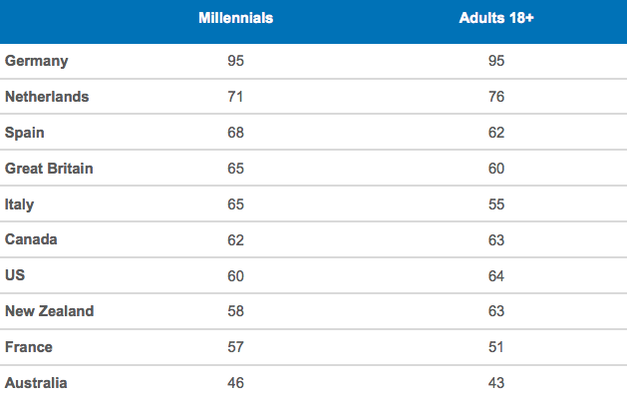
International knowledge of Snowden
Oliver Jay
[5][7]
Percent of people aware of Snowden (March 2015)
Notes:
You all did the reading and should know about Snowden, but many people in the US don’t. As you can see, many European countries are more aware of what our government is doing than we are. Snowden’s leaks were especially meaningful to Germans because the NSA targeted Angela Merkel, and Germans have stronger historical concerns about dictatorships

Slide 20

Is Mass surveillance necessary?
Oliver Jay
Technology has brought criminals new ways to hide, and government needs to respond
NSA Claims Surveillance prevented “50 terrorist events”
NSA won’t provide data to properly evaluate usefulness
[2][8]
Notes:
The digital age has made it far easier for criminals to hide, so it makes sense that we need to protect them. NSA claims 50 prevented terror plots, but won’t give any specifics of the scale of use of PRISM. ACLU has challenged the NSA claiming that it should be using traditional warrants to fight terrorism

Slide 21
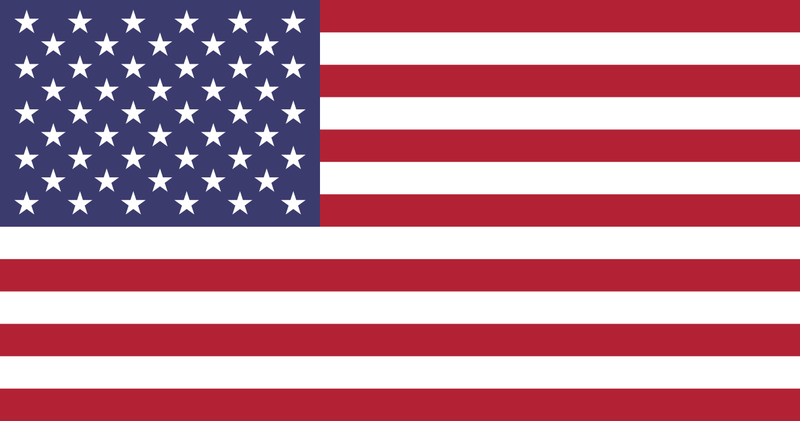
Has the government earned our trust?
Oliver Jay
Government hid and denied the program until Snowden leaked proof
NSA will not provide courts with necessary documents demonstrating why secrecy is necessary
The US government has not earned our trust, and very few Americans are aware of the dangers
[2][6]
Notes:
As mentioned in our textbook, previous surveillance programs have been used to implement problematic programs such as Japanese Internment. Additionally, it is difficult to trust the NSA about what they are doing after they denied it for so long.

Slide 22
References
Oliver Jay
[1] Last Week Tonight with John Oliver (4/4/15 Episode) https://www.youtube.com/watch?v=XEVlyP4_11M
[2] New York Times (accessed 9/12/18) https://www.nytimes.com/2013/10/13/us/nsa-director-gives-firm-and-broad-defense-of-surveillance-efforts.html
[3] NSA (accessed 9/13/18) https://www.nsa.gov/
[4] Pew Research (accessed 9/12/18) http://www.pewresearch.org/fact-tank/2018/06/04/how-americans-have-viewed-government-surveillance-and-privacy-since-snowden-leaks/
[5] ACLU (accessed 9/13/18) https://www.aclu.org/sites/default/files/field_document/snowden_poll_results.pdf
[6] NY Daily News (accessed 9/13/18) http://www.nydailynews.com/news/national/cops-nation-abuse-confidential-databases-snoop-article-1.2809777
[7] BBC (accessed 9/13/18) https://www.bbc.com/news/world-europe-33106044
[8] Politico (accessed 9/13/18) https://www.politico.com/story/2013/06/nsa-leak-keith-alexander-092971

Slide 23
ENCRYPTION AND YOU
Chris Myers
Why you should encrypt your cell phone, and the police shouldn’t stop you
© 2018 Keith A. Pray
23
Notes:
23

Slide 24
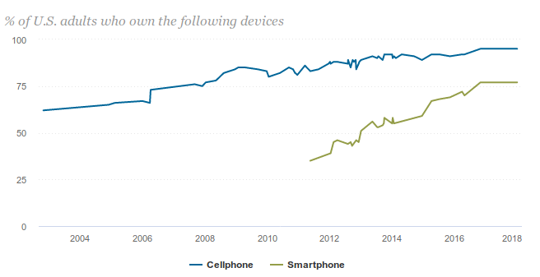
YOUR PHONE MATTERS
Chris Myers
77% smartphone ownership
Devastating consequences if lost or stolen
<Graphic>
[1], [2]
© 2018 Keith A. Pray
24
Notes:
* 77% of US adults have a smartphone
* Phones carry texts, pictures, videos, calls, contacts, financial stuff, etc.
* Starting storage size for an iPhone 8 is 64 GB – that’s a lot of data
* Stealing or losing a phone is easy – they can be pickpocketed, left behind in a store, dropped out a pocket, etc.
* [Maybe pre-arrange with someone to casually pick their phone up off their desk as an example? Might be effective!]
* Example: Woman had identity stolen after hackers leveraged a “stolen” phone number to break through every two-factor authentication block
24

Slide 25
YOUR PHONE IS YOUR SAFE
Chris Myers
“The right of the people to be secure in their persons, houses, papers, and effects, against unreasonable searches and seizures, shall not be violated, and no Warrants shall issue, but upon probable cause, supported by Oath or affirmation, and particularly describing the place to be searched, and the persons or things to be seized.”
...nor shall be compelled in any criminal case to be a witness against themselves...
Modern smartphones can be encrypted
Can the police ask for access?
[3], [4]. [5]
© 2018 Keith A. Pray
25
Notes:
* Practically all modern smartphones can be encrypted, requiring not only a passcode or fingerprint to unlock once started, but a password to unlock the storage before the OS will even boot
* [Quick ~10 second demo of my phone, locked]
* Police want to be able to access your phone, but they can’t if it’s encrypted. If they want access, they need your passcode.
* 4th amendment protects you against unreasonable search and seizure – requires warrant
* Carpenter example – police needed warrant to access phone location data
* 5th amendment protects against incriminating yourself – password could be construed as incriminating info, since encrypted data makes no sense without it
25

Slide 26
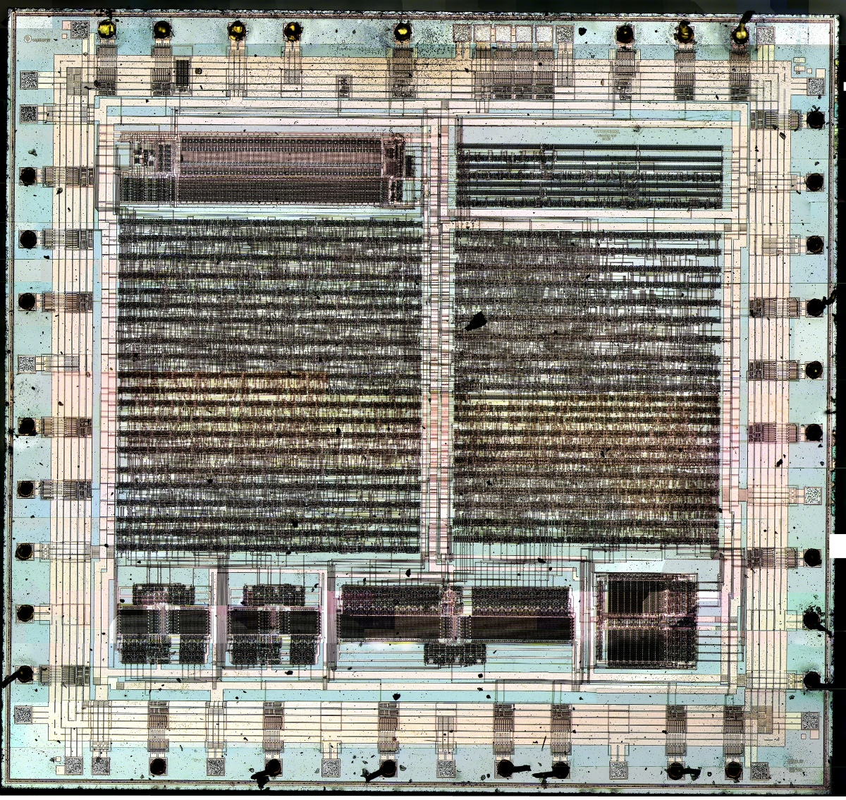
COMPROMISING ON SECURITY
Chris Myers
Authorities have good reasons to ask for access
Encryption that criminals can’t break is encryption police can’t break either
Key escrow is a miserable failure
Disassembly of a Clipper Chip [10]
[6], [7], [8], [9]
© 2018 Keith A. Pray
26
Notes:
Point/counterpoint -- there are pros and cons to all approaches, but citizen safety is more important than police access
* Police have a legitimate case to ask for access – criminals frequently use privacy measures such as encryption to cover themselves
* A man was held in contempt of court for not giving passwords to decrypt drives that were thought to have child pornography – authorities called it a “forgone conclusion” that the material was there (but then why did they need it in the first place?)
* Police can’t force you to answer “Where are the bodies buried?”, so they shouldn’t be able to force password disclosure (reference 8)
* Encryption that criminals can’t break can’t be broken by police either – society has good cause to let police in
* Key escrow is a miserable failure – authorities could hold a second key to unlock your data/phone that they alone have access to, but the moment that key gets stolen or reverse-engineered, everyone’s data is completely vulnerable.
* TSA approved baggage locks were broken in this way
* Clipper chip -- device designed and promoted by the NSA in the 1990’s, allowed law enforcement officials access to encrypted communications. Contained a secret key that differed from chip to chip. Serious vulnerability discovered that enabled the escrow part (what authorities wanted) to be trivially disabled -- the chip itself was also easy to reverse engineer, shown in the picture.
26

Slide 27
CONCLUSION
Chris Myers
Go encrypt your phone!
5th amendment still in the air
© 2018 Keith A. Pray
27
Notes:
* Everyone should encrypt their phones! Do it! Right now!
* Issue of whether police can force password disclosure has not been decided by the Supreme Court yet
* There’s good reason to allow police access, but electronic devices should not be treated any different than a particularly well-hidden secret staircase to your basement – you shouldn’t have to aid the police in their search.
27

Slide 28
REFERENCES
Chris Myers
[1] Mobile Fact Sheet. (2018, February 05). Retrieved September 12, 2018, from http://www.pewinternet.org/fact-sheet/mobile/
[2] Langone, A. (2018, June 08). My Cell Phone Number was Stolen. It Nearly Ruined My Life| Time. Retrieved September 13, 2018, from http://time.com/money/5245878/cell-phone-porting-scam-t-mobile/
[3] Carpenter v. United States (June 22, 2018).
[4] U.S. Const. amend. IV
[5] U.S. Const. amend. V
[6] Kravets, D. (2017, August 29). Man in jail 2 years for refusing to decrypt drives. Will he ever get out? Retrieved September 13, 2018, from https://arstechnica.com/tech-policy/2017/08/man-in-jail-2-years-for-refusing-to-decrypt-drives-will-he-ever-get-out/
[7] A Tale of Three Backdoors. (2015, August 28). Retrieved September 13, 2018, from https://www.lawfareblog.com/tale-three-backdoors
[8] Myers, E. M. (2018, September 12). [Online interview].
[9] Blaze, M. (1994, August 20). Protocol Failure in the Escrowed Encryption Standard. Retrieved from http://mattblaze.org/papers/eesproto.pdf
[10] Goodspeed, T. (2009, April 24). Picture of a Clipper Chip. Retrieved from Wikimedia Commons.
© 2018 Keith A. Pray
28

Slide 29
Class 7
The End
Keith A. Pray
Instructor
socialimps.keithpray.net
Notes:
This is the end. Any slides beyond this point are for answering questions that may arise but not needed in the main talk. Some slides may also be unfinished and are not needed but kept just in case.

