Slide 1
Class 6
Information Privacy
Keith A. Pray
Instructor
socialimps.keithpray.net
Notes:
Here’s the title slide. Excited already, aren’t you?
How did the self search paper go?
Who: found a lot, very little, surprised, not surprised, creepy, share conclusions

Slide 2
Logistics
Groups presentation volunteers for first day via email
Notes:
Not needed this time:
Address email to entire course staff for quickest response time
Send presentations via email as attachment.
Do not change the format, footers, etc. in the template slides.
Paper writing process: Sources → Notes → Conclusion → Argument → Counter Point → Response
Turn extra credit paper in on myWPI/Canvas and hard copy in class like regular papers
Presentations are due 24 hours before class
Use Presentation Guidelines on course web site

Slide 3
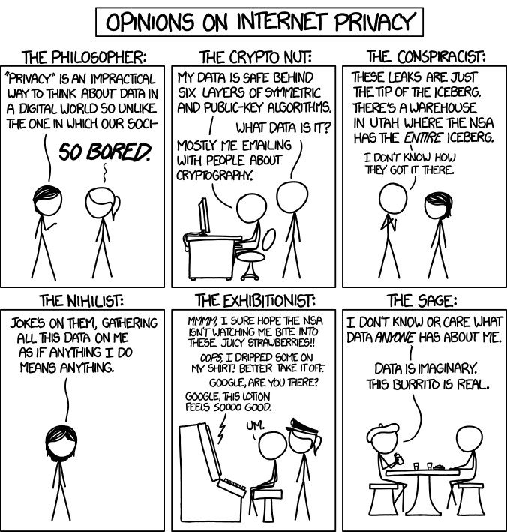
Overview
Review
Assignment
Students Present
http://xkcd.com/1269/
Notes:
1 – Accessed 2014-04-14
Personal Information Privacy

Slide 4
My Reading Notes
pp. 229 means to end?
pp. 230 who videotapes anymore?
pp. 231 “businesswoman” nice change. Moral capitol – source published in 1984, “taking away” “1984”
pp. 234 Hilton consent to pic being in book?
pp. 237 Most daycares monitor, any studies yet?
pp. 238 “…privacy…in their own homes…” != nanny to expect privacy “…when… insides Sullivans’ home.
pp. 244 Human chip implant sources getting old, 2002, 2004, 2007, 2010
pp. 250 2012 source same year Target outed pregnant teen to parents
pp. 255 Why did Apple not enforce policy of asking permission in the API?
pp. 245 “…by 2015” did it happen?
pp. 246 Web Browsers put cookies on on your hard drive, not Web Servers.
pp. 250 why is bills – responsibility assumption flawed?
pp. 268 Why WPI not in list?
Notes:
Find out what your DNA says about you and your family.
https://www.23andme.com/
https://motherboard.vice.com/en_us/article/xwkaz3/23andme-sold-access-to-your-dna-library-to-big-pharma-but-you-can-opt-out?utm_source=vicefbus
Jimmy Kimmel Live – What is your password? (2:49)
https://www.youtube.com/watch?v=opRMrEfAIiI
Notes updated: 2018-04-03

Slide 5
Assignment
Prepare for class debate: Is a National ID System a good thing?
  Come prepared with notes, facts, dates, high quality sources
  You can build upon your self search work
  Optional One Page Paper on the topic, lowest paper grade will be dropped
Mid Term Survey on Canvas

Slide 6
Overview
Review
Assignment
Students Present

Slide 7
Consumer backlash
Noah Van Stralen
When do consumers think data mining has gone too far?
Notes:
Hello
We all know that may sites track our data, but at some point people decide that it has gone too far.
It honestly surprised me how few examples I could find of backlash recently with all of the tracking that is done.

Slide 8
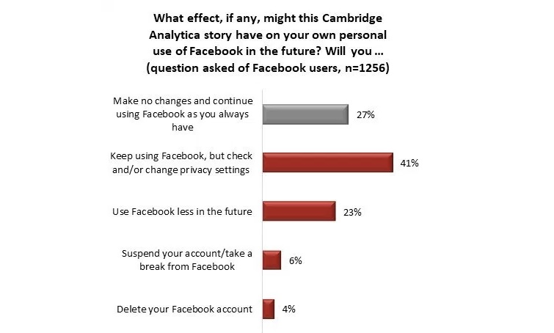
3rd party data use
Noah Van Stralen
Facebook
  Cambridge Analytica
Online advertisement
  24% decrease in ad click through
After data is used in ways consumers don’t like many will take steps to prevent it
[1][5]
Notes:
When data from one site or company gets used by a different one people may react
-Facebook currently facing #deletefacebook because Cambridge Analytica used data gathered from Facebook to try and sway the US election in 2016(did not look in to how that happened)
-one Harvard study showed that when people know data is taken from other sites interest in targeted adds drops
- This graph shows the response of Facebook users after the Cambridge analytical incident. 33% said they would take actions that would directly impact Facebook revenue

Slide 9
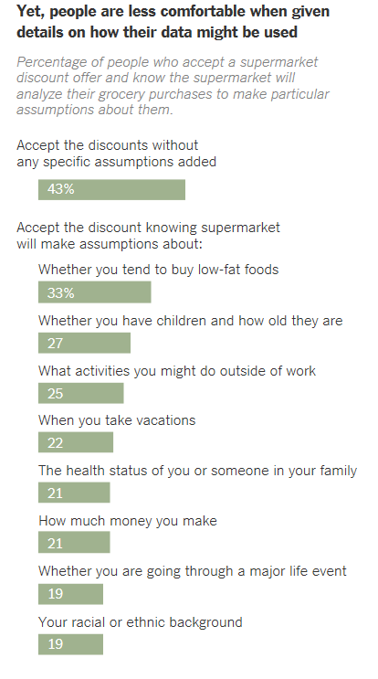
Making assumptions
Noah Van Stralen
The more sensitive the data you try to predict the less people will accept it
Online adds
  17% interest drop
Shopping data
Facebook
  Targeting adds at those feeling down
[2][5][6]
Notes:
Using the data to infer information about the person is also frowned upon
-the same Harvard study showed inferring information about a person also can drop interest
-a different survey found that the more specific you get with the information you are trying to infer the less people are willing to give the data
-Facebook(again) was called out by the media in 2017 for targeting adds at those who are emotionally vulnerable
-unfortunately these uses while people don’t like them are not very visible

Slide 10
Location tracking
Noah Van Stralen
Uber
  Track up to 5 min after ride
  Complaint was filed with FTC
Movie Pass
  Made joking statement how much their data can show
  Also looking for other ways to gather data
[3][4]
Notes:
More recently it seems to be location tracking, that is getting backlash
-about a year ago Uber had their app set up to track you even if it was only running in the background it has since changed but they would track people up to 5 minutes after a ride had ended
-forced to change their privacy policy and have a 3rd party audit every 2 years for the next 20.
-Movie pass was also tracking users movements before and after people went to the theaters. “we know all about you

Slide 11
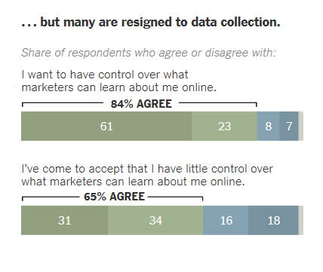
conclusion
Noah Van Stralen
Data collection that gets negative reactions generally mirrors physical actions that would get negative reactions
Despite everything many people seem to feel there is not much they can do
[6]
Notes:
Ultimately from the data I found, and those mentioned in the textbooks, it ultimately comes down to if you wouldn’t send someone to do it in person, you will probably get a negative response if you are tracking that data.
This is at least if the tracking is noticed

Slide 12
References
Noah Van Stralen
[1] Facebook backlash continues, http://www.rcinet.ca/en/2018/03/26/facebook-backlash-continues/, 9/7/18
[2] Get Ready for the Next Big Privacy Backlash Against Facebook, https://www.wired.com/2017/05/welcome-next-phase-facebook-backlash/, 9/8/18
[3] Uber Ends Its Controversial Post-Ride Tracking Of Users' Location, https://www.npr.org/sections/thetwo-way/2017/08/29/547113818/uber-ends-its-controversial-post-ride-tracking-of-users-location, 9/8/18
[4] "We know all about you": MoviePass faces backlash over data collection, https://www.cbsnews.com/news/moviepass-admits-to-gathering-data-on-users/, 9/8/18
[5] Ads That Don’t Overstep, https://hbr.org/2018/01/ads-that-dont-overstep, 9/8/18
[6]Sharing Data, but Not Happily, https://www.nytimes.com/2015/06/05/technology/consumers-conflicted-over-data-mining-policies-report-finds.html, 9/8/18

Slide 13
OPTINg in
Michael Collins
How framing choices differently affect business
Notes:
Debate between opt in and opt out has been going for long time
Often argued that opt-in hurts business, making data access harder
Look at information for both moral and economic standpoint.

Slide 14
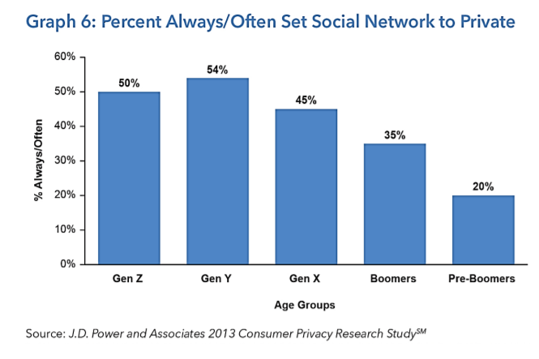
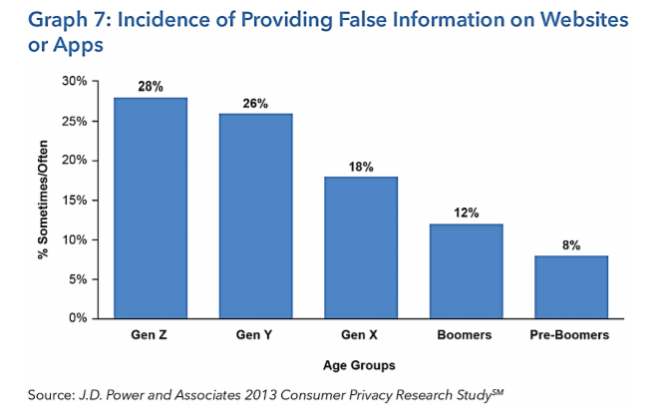
Increasing Privacy Concerns
Michael Collins
Young people are taking more measures to ensure their privacy
The younger someone is, the more likely they will find ways to circumvent a lack of privacy measures
[1]
Notes:
Graphs show that more recent generations (gen z is us at 50%), are more likely to set social network to private (avoiding sharing information, guaranteeing privacy)
Over a quarter of people in our generation provide false information in order to increase privacy

Slide 15

Privacy Backlash
Michael Collins
When consumers feel that their privacy is violated, the backlash can be devastating
After the Cambridge Analytica scandal, several companies ceased working with Facebook
Facebook ended implementing the EU’s GDPR, which forces companies to use opt-in policies
[3],[5]
Notes:
Scandal: Facebook was giving personally identifying info to CA, which sold to politicians and others without subject’s knowledge
Italian banking company stopped using Facebook for advertising
GDPR requires subjects be informed of data use and asked for permission in clear and concise language
Also gives subjects right access, rectify, and be forgotten

Slide 16
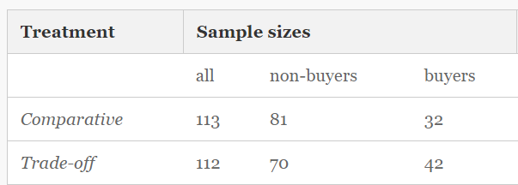
Opt-in does not hurt business
Michael Collins
Studies have shown that offering even a small benefit in exchange for opting in to giving private information results in more people choosing that option
A positive frame (“Will you participate”), leads to more participation than a negative frame
[2],[4]
Notes:
Study is done with buying products online with an invasive survey at the end. Comparative is simply with the survey. Trade-off is where users are offered a discount of 1 euro off their product in exchange for the survey. Participation increases from 28% to 38%.
Graph for second point on next slide (conducted asking if subjects will participate in invasive health questionnaire) positive frame gives ~10% more participation

Slide 17
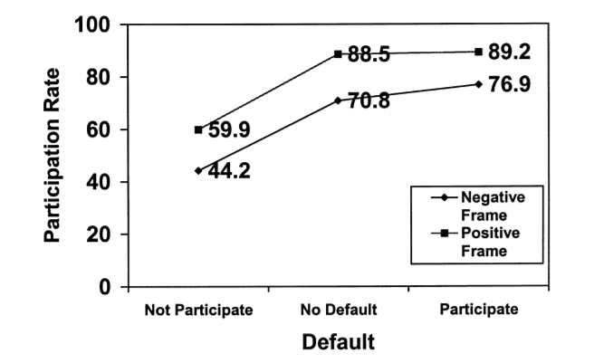
The moral argument
Michael Collins
Kantian, and Social Contract theory agree that Opt-In is morally better
Utilitarian:
  Opt-out gives companies easier access to data, allowing for business with other companies (+10) and improved customer experience (+10)
  However, it is potentially misleading, and when customers find out, they become upset (-5). Companies have to change their policy, removing the benefits (-20), and often lose business (-10)
  This is overall negative, so opt-out is wrong according to utilitarian theory
[3],[4]
Notes:
Opt-out leads to consumer not knowing about data usage. This is using the data subject as a means to an end, so it goes against categorical imperative.
According to social contract theory, ethics is a fair agreement between people. Using information about a person violates the contract.

Slide 18

Conclusions
Michael Collins
From an ethical standpoint, opt-in is a better choice than opt-out
Opt-out policies that do not fully inform consumers can cause backlash with damaging results
Opt-in policies do not damage a company’s ability to use information
Therefore, opt-in is superior

Slide 19
References
Michael Collins
[1] Gina Pingitore, Jay Meyers, Molly Clancy, Kristin Cavallaro, Consumer Concerns About Data Privacy Rising, https://www.jdpower.com/sites/default/files/Consumer_Concerns_Data_Privacy.pdf (9/9/18)
[2] Soren Preibusch, Dorothea Kubler, Alastair Beresford, Price versus privacy: an experiment into the competitive advantage of collecting less personal information, https://link.springer.com/article/10.1007/s10660-013-9130-3 (9/10/18)
[3 ] Stephen Jewkes, UniCredit has stopped using Facebook for advertising: CEO, https://www.reuters.com/article/us-facebook-unicredit/unicredit-has-stopped-using-facebook-for-advertising-ceo-idUSKBN1KS1N5 (9/10/18)
[4] Eric Johnson, Stephen Bellman, Gerald Lohse, Defaults, Framing and Privacy: Why Opting In-Opting Out, https://www0.gsb.columbia.edu/mygsb/faculty/research/pubfiles/1173/defaults_framing_and_privacy.pdf (9/9/18)
[5] Intersoft Consulting, EU General Data Protection Regulation Article 12, https://gdpr-info.eu/art-12-gdpr/ (9/10/18)

Slide 20
The Dark web still lit
Malika Nurbekova
What ethical issues do the existing methods of criminal activity enforcement on the Dark Web possess?
Notes:
Table of content:
Content on the Dark Web
Existing methods of law enforcement on Dark Web
The Playpen operation that is an example of such methods
Ethical issues with Playpen operation
Conclusion

Slide 21
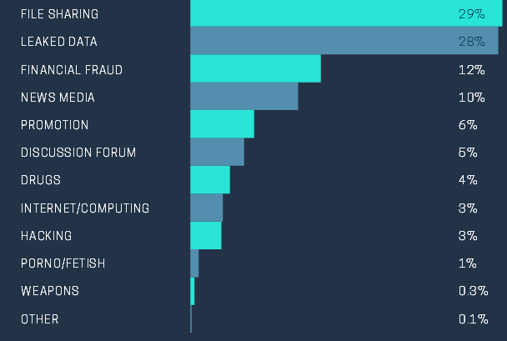
Content on the Dark web
Malika Nurbekova
Dark Web is “a series of encrypted networks that serve to anonymize the people” [1]
  ~30,000 websites
Legal use
  Journalist and whistleblowers
68% illegal content
  i.e. confidential files sharing, drugs, pornography, violence etc.
[1], [2], [3]
Notes:
First of all I would like to introduce what the dark web is. Dark web is a part of a deep web that provides secrecy and anonymity to its users[2]. It hides them from the internet service providers by means of peer-to-peer encryption and authentication. To put it short, it is “a series of encrypted networks that serve to anonymize the people” [1]. One of the study I was looking at concluded that there are in total 30,000 of those anonymous websites. The graph represents the kind of content found on dark web. As you can see from the graph, some of the content is legal, such as discussion forums and file sharing, and can be used by people who need to protect their identity and communications from private surveillance. An example can be journalists and whistleblowers.
However, 68% of those websites found, contain illegal or illicit content such as leaked data, financial fraud, drug or weapons markets, hacking, pornography etc [3].

Slide 22
Existing methods of enforcement on Dark web
Malika Nurbekova
Undercover investigation
  Arrested Ross Ulbricht, the creator of “Silk Road”
Honeypot traps
  Websites that have an illicit content but set up by police
  E.g. Playpen operation
Hacking
  Police uploads the malware files on offenders’ computers
[4], [5]
Notes:
Now that we know that 68% of the websites on the dark web contain illegal content, there should be ways the government and police use to catch and legally enforce the criminals who operate in that content.
The existing methods so far include undercover investigation, honeypot traps and hacking.
In undercover investigation method, the officers pretend to be offenders and go on illegal forums to win the trust of actual offenders and reveal criminals’ identity. One successful example of such method was the FBI operation in 2015, when using this tactic they found out the gmail address of Ross Ulbricht, the creator of “Silk Road” (the biggest criminal marketplace), and performed his arrest as a consequence.
In honeypot traps method, the police sets up illegal websites as a honeypot trap and once the criminal visits the website, it drops a malware on visitors computers (which is considered hacking) to further identify their location and identity. The FBI argues that honeypot traps should deter criminals from acting on the web.
Hacking methods include the police uploading their software on criminal’s device and gaining an access and control over it

Slide 23
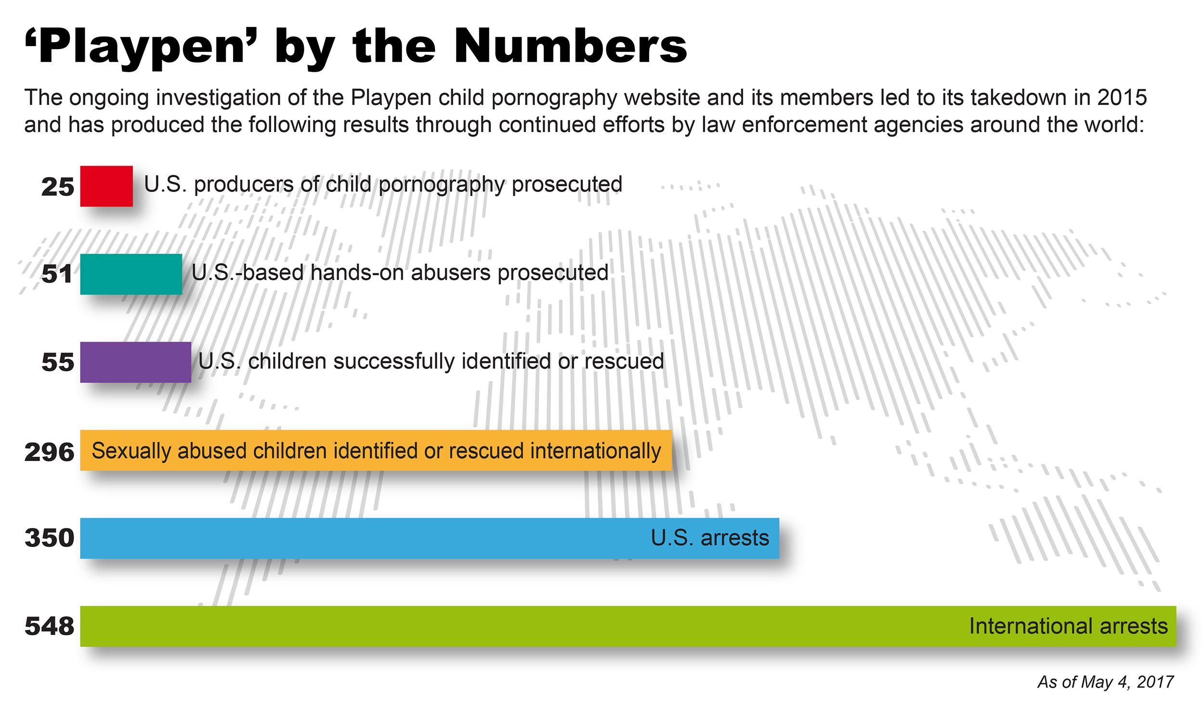
The “Playpen” operation
Malika Nurbekova
The owner of the website arrested
FBI made Playpen continue operating online
Honeypot trap was successful and caught many offenders
[4], [5], [7], [8]
Notes:
The Playpen Operation is one example that combines two out of three law enforcement methods that we discussed.
So where is the name of the operation coming from? Playpen is a website on the dark web that contains child pornography videos and images, aka child exploitation material.
The FBI was not able to make a substantial progress in gaining control over Playpen for a long time until 2014 when the suspected owner of the website, Steven Chase, accidentally revealed the IP address of the site. From that point on, the police seized the website and obtained a warrant to email accounts followed the money. The traces led them back to Chase. The police then arrested Chase and other administrators of Playpen.
One would assume that FBI would instantly shut down the abusive website once they gained the control over it, but instead of that they obtained a warrant to continue Playpen’s operation to catch more pedophiles, i.e. set up a honeypot trap. However, by doing that they left 23,000 active links and 9,000 downloadable files of sexually explicit images and videos of children out there on the web, allowing more people to make copies and consequently distribute those copies even after police would have shut down the website. With each copy and link opened by the offenders, the malware got uploaded to the their device, giving the FBI a full access and control over visitor’s computer and consequently revealing their IP address. As a result, FBI was able to arrest and prosecute many sexual offenders, as shown on the graph.

Slide 24
Ethical Issues with Playpen Operation
Malika Nurbekova
Re-victimizing vulnerable people
Use of victims as a way to pursuit criminal justice
Does the malware threaten constitutional privacy protections in PC
[4],[6],[7],[9]
Notes:
Even though FBI was able to arrest and prosecute more people as a result of setting up a honeypot and extending the operation of the website, they caused the re-victimizing of children involved in this material and their families again and again [9][4] with each new offender downloading or accessing the material on Playpen. By extending the hosting of Playpen in an attempt to catch more criminals, they used the victims (children depicted on those websites) as a way to pursuit criminal justice.
Additionally, according to ethics in law enforcement [4][6], officers can use tricks of deception on criminals to solve the crimes, however they are not allowed to perform illegal criminal activities such as sexual abuse and violence. But in a way, by keeping Playpen online, FBI assisted the distribution of the abusive material performing the abuse that way.
Lastly, by uploading the malware on visitors computers, FBI threatened constitutional privacy protections in personal computers of those who visited the website [7].

Slide 25
Conclusion
Malika Nurbekova
The improvement of the existing methods is required to account for ethical issues
Call for action:
  Develop a framework for policing operations in Dark web
  Compensate and mitigate re-victimization
Ideas for framework:
  Do not allow for honeypots that use an abusive material
  Establish the limitations for the malware used in “hacking” operations
[9], [4]
Notes:
The conclusion is that the improvements of the existing investigation and enforcement methods should be made to account for most common ethical issues associated with the given method. The call for action at this point would be to compensate and mitigate the use of victims as a way to pursuit criminal justice, and develop a framework for policing operations on Dark Web.
Some ideas for the framework would be:
To not use actual abusive websites as honeypots, but create dummy websites for that to eliminate re-victimization
Establish a set of rules and limitations that one can use to develop a software that does not violate constitutional privacy as a way to access criminal’s IP address

Slide 26
References
Malika Nurbekova
[1] M. Sigaloz, The Dark Web and How to Access It, https://www.cnbc.com/2018/04/13/the-dark-web-and-how-to-access-it.html (08/10/2018)
[2] K. Finklea (2017), Dark Web, Retrieved from Congressional Research Service Report https://fas.org/sgp/crs/misc/R44101.pdf (08/10/2018)
[3] Intelliagg (2016), Shining a light on the dark web on the Dark Web, Retrieved from https://news.softpedia.com/news/there-are-only-30-000-websites-on-the-dark-web-502725.shtml (08/10/2018)
[4] D. Clayton, Addressing the Challenges of Enforing the Law on the Dark Web, https://www.law.utah.edu/addressing-the-challenges-of-enforcing-the-law-on-the-dark-web/#_ftn8 (08/10/2018)
[5] I. Warren, A. Molnar, M. Mann, Poisoned water holes: the legal dangers of dark web policing, https://theconversation.com/poisoned-water-holes-the-legal-dangers-of-dark-web-policing-82833 (08/10/2018)
[6] S. McCartney, R. Parent, Ethics in Law Enforcement, (Bccampus), ch4.3. Retrieved from https://opentextbc.ca/ethicsinlawenforcement/ (08/10/2018)
[7] M. Rumold, Playpen: The Story of the FBI’s Unprecedented and Illegal Hacking Operation, https://www.eff.org/deeplinks/2016/09/playpen-story-fbis-unprecedented-and-illegal-hacking-operation (08/10/2018)
[8] FBI News, Playpen Creator Sentenced to 30 Years, https://www.fbi.gov/news/stories/playpen-creator-sentenced-to-30-years (08/10/2018)
[9] University of Warwick and TNO, Policing the Dark Web: Ethical and Legal Issues, (p10-12) , Retrieved from http://media4sec.eu/downloads/d4-3.pdf (08/10/2018)

Slide 27
Class 6
The End
Keith A. Pray
Instructor
socialimps.keithpray.net
Notes:
This is the end. Any slides beyond this point are for answering questions that may arise but not needed in the main talk. Some slides may also be unfinished and are not needed but kept just in case.
If there’s time and we didn’t already look at:
Find out what your DNA says about you and your family.
https://www.23andme.com/
Jimmy Kimmel Live – What is your password? (2:49)
https://www.youtube.com/watch?v=opRMrEfAIiI

