Slide 1
Class 11
Work
Keith A. Pray
Instructor
socialimps.keithpray.net
Notes:
Here’s the title slide. Excited already, aren’t you?

Slide 2
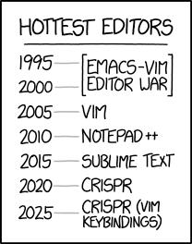
Overview
Review
Assignment
Students Present
https://www.xkcd.com/1823/
Notes:
Full circle.
CRISPR: Clustered Regularly Interspaced Short Palindromic Repeats
Allows permanent modification of genes within organisms.
Kickstarter Charter
https://www.kickstarter.com/charter?ref=about_subnav

Slide 3
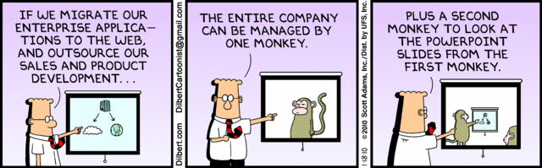
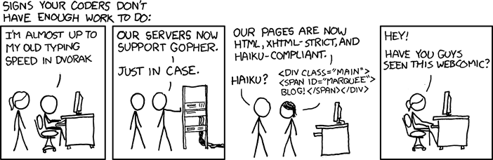
http://xkcd.com/554/
Notes:
Poll class:
Expected salary range upon graduation? Min, Max? Put on board.
Assume 40 hour work week.
How many people would work:
32 hours for 0.8 * Max? Put on board.
24 hours for 0.6 * Max? Put on board.
…continue until Min is reached.

Slide 4
Group Quiz
List 2 ways IT can lead to organizational change.
List 4 ways a Video Game Producer may protect its IP and what specific IP each protects.
List a computing technology that can be used to protect an individual’s privacy.
List a computing technology that can be used to intrude upon an individual’s privacy.
Notes:
Could split into groups of 4-5 for this.
Fill time with Work Discussion on Course Web Site

Slide 5
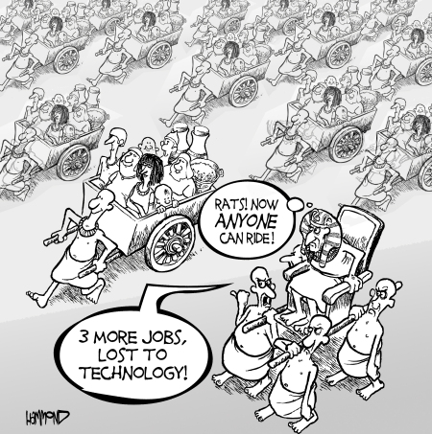
Overview
Review
Assignment
Students Present
©2009, MobileRobots Inc.
Notes:
Review Group Assignment Details.
Or first watch video: depends on student presentations, no thunder stealing.
CGP Grey
Humans Need Not Apply (15:00) – 2014-08-13
http://www.youtube.com/watch?v=7Pq-S557XQU
Last access 2016-04-22
These 3D printed homes can be constructed for $4,000 (3:00 – 2018-04-02)
http://www.businessinsider.com/3d-printed-homes-constructed-icon-new-story-tech-charity-4000-dollars-2018-3
https://www.youtube.com/watch?v=SvM7jFZGAec (1:28)
Last access 2018-04-22
Look at:
BBC Intelligent Machines
http://www.bbc.com/news/technology-33978561
BBC Likelihood of robot taking your job
http://www.bbc.com/news/technology-34066941

Slide 6
Overview
Review
Assignment
Students Present

Slide 7
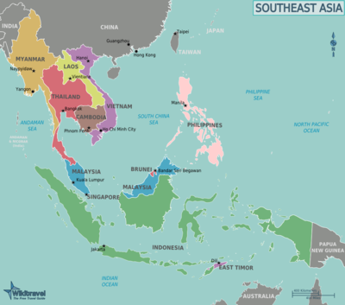
SouthEast Asia and the digital divide
Jake Scheide
3% of the world’s total land area
8.5% of the world’s population
Amalgamation of extremely rich (Brunei, Singapore) and extremely poor (Cambodia, Myanmar) territories
Projected to be the 5th largest economy by 2020
[1]
Notes:
Southeast Asia is one of the most densely populated regions in the world.
No country in the region is recognized as a world superpower, and the highly developed countries are relatively small compared to the less developed ones.
The telecommunications infrastructure in the region is rudimentary at best, and the technology market is largely untapped.
The argument presented in our book is that less developed regions such as Southeast Asia are being placed further behind in their development due to a lack of access to modern technology. I’ll explain why that isn’t true, and hasn’t been since the early 2010s, starting with the Blackberry.

Slide 8
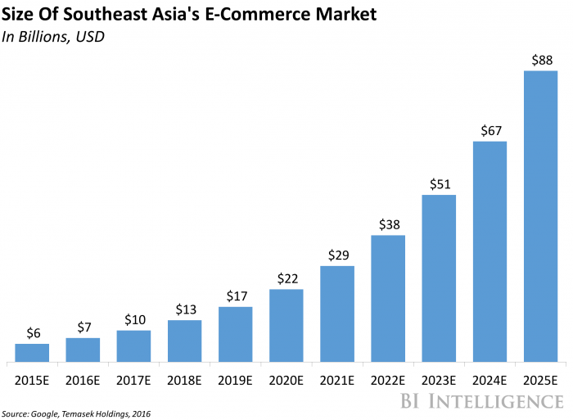

Demographics and development
Jake Scheide
Far less developed retail industry
Leads to growth in e-commerce
Profitable to focus development on one cash crop
Country has far more efficient processes in that sector
[2,3]
Notes:
US has 3.7m^2 of retail space per capita, compared to China’s 0.38, and SEA’s 0.08m^2. This stark difference has caused immense growth in the e-commerce sector. While the US is projected to experience a 23% increase in its e-commerce industry before 2021, SEA is expected to see a growth of 261%.
We can draw similarities between e-commerce growth in SEA and “Banana Republic” economies such as Honduras and Guatemala. The distribution of an economy shifts depending on geographical need, and this goes beyond growing food. A densely populated region such as SEA continues to see its technology sectors increase at a much faster rate than countries with sparse geography, such as Australia.

Slide 9
Southeast asia is interconnected
Jake Scheide
4
Notes:
Taiwan 70.4% (5th) ----30th
Malaysia 64.1% (20th) ---- 70th
Thailand 40.5% (31st) ---- 97th
Vietnam 26.4% (42nd) ---- 158th
Philippines 23.3% (44th) ---- 152nd
Indonesia 20.7% (46th) ---- 124th
The point: despite these countries having relatively lower wealth, the priority on owning a smartphone is extremely high.

Slide 10
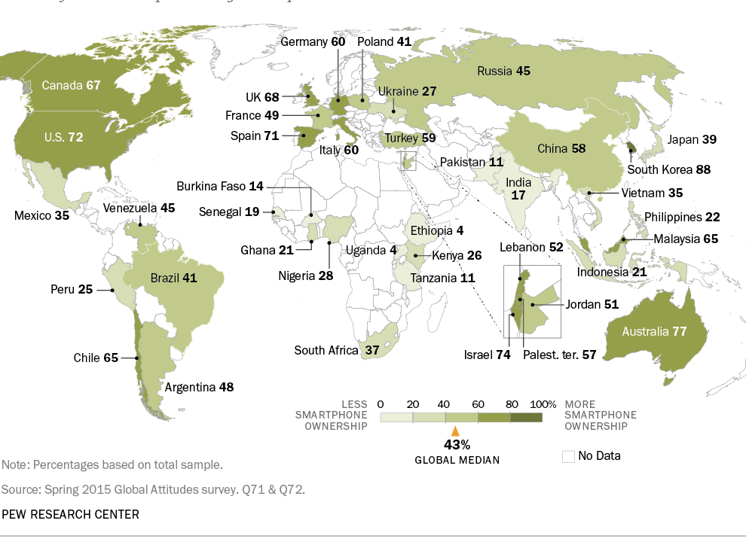
Other regions
Jake Scheide
[5]
Notes:
Uganda, Ethiopia have 4% smartphone ownership
Geographic clusters have relatively similar rates

Slide 11
Concluding thoughts
Jake Scheide
The digital divide is extremely overstated, and culture is the more important informant of technological adoption than economic development.
[2,3]
Notes:
We can see that Southeast Asia as a region is relatively less developed compared to the US
Despite this, the region is experiencing immense growth in the technology sector, even moreso than its economic growth

Slide 12
References
Jake Scheide
[1] "Southeast Asia." Wikipedia. April 23, 2018. Accessed April 24, 2018. https://en.wikipedia.org/wiki/Southeast_Asia.
[2] Camhi, Jonathan. "Southeast Asia's Set for Explosive E-commerce Growth." Business Insider. May 16, 2017. Accessed April 24, 2018. http://www.businessinsider.com/southeast-asias-set-for-explosive-e-commerce-growth-2017-5.
[3] W, T. "Where Did Banana Republics Get Their Name?" The Economist. November 21, 2013. Accessed April 24, 2018. https://www.economist.com/blogs/economist-explains/2013/11/economist-explains-16.
[4] "Top Countries by Smartphone Penetration & Users." Newzoo. Accessed April 24, 2018. https://newzoo.com/insights/rankings/top-50-countries-by-smartphone-penetration-and-users/.
[5] Poushter, Jacob. "Smartphone Ownership and Internet Usage Continues to Climb in Emerging Economies." Pew Research Center's Global Attitudes Project. February 22, 2016. Accessed April 24, 2018. http://www.pewglobal.org/2016/02/22/smartphone-ownership-and-internet-usage-continues-to-climb-in-emerging-economies/.

Slide 13

Assembly line COMPUTER AUTOMATION benefits
Amanda Pennie
Increases productivity
Reduces cost of labor
Improves working conditions
Allows for better competition
[1][2]
Notes:
Automation:
Increases productivity, as seen in graphic later in presentation, there is greater output per hour of labor input
Customers are getting their orders faster
Reduces cost as companies aren’t paying as many employees anymore since they are being replaced by automation
makes work safer for employees because they are supervising instead of participating
according to bureau of labor statistics, injuries in the workplace reduced 44% from 1994 to 2008 [5]
reduces repetitive work for employees which causes fatigue
Companies that don’t have automation find themselves at a disadvantage because of the better productivity rate that comes with automation

Slide 14
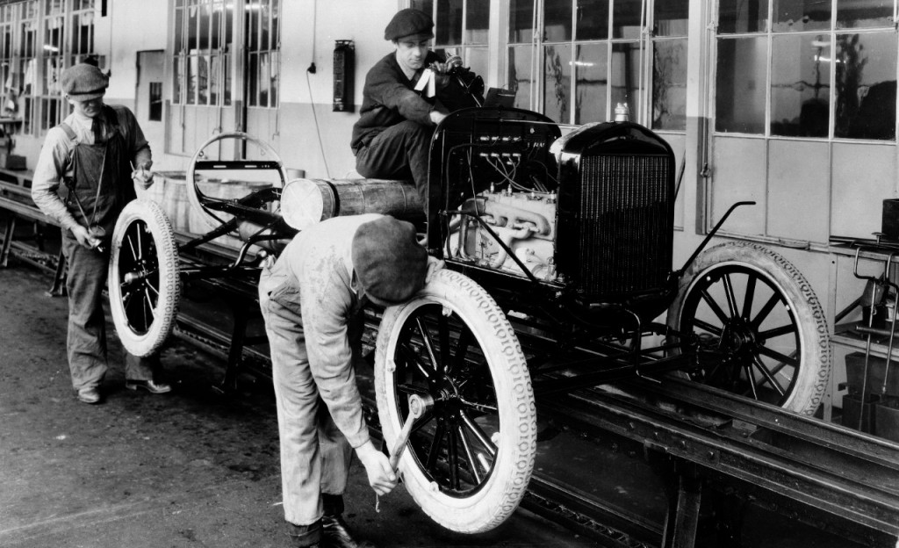
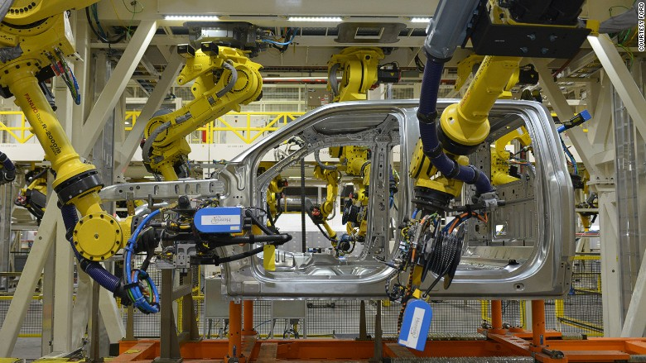
EVOLUTION OF ASSEMBLY LINE
Amanda Pennie
12th Century: workers take expertise in one portion of product
1901: Ransom Olds patented the assembly line
1913: Henry Ford launched moving assembly line
1969: Victor Scheinman created 6-axis robot arm for repeated patterns
[3][4][11]
Notes:
Just to give you an idea of how the assembly line has developed over time, I wanted to go over the evolution of the assembly line.
In the 12th century, employees had expertise in one part of a product, as you can see in the top picture, one is working on the wheel while another works on the engine and so on
8 centuries later and the stationary assembly line was finally patented by Ransom Olds – after this it took 12 hours to buy a car
12 years later and Henry Ford made this a moving assembly line, increasing efficiency and increasing output by 500% in one year – reducing time it takes to build a car from 12 to 2.5 hours
Finally, the robot arm was created and has been improved over the years as automation grows 16 FORDS BUILT EVERY MINUTE
112 years after Ford first invented the assembly line, this is what it looks like today *point at bottom picture*, there are 16 fords built every minute. The assembly line has obviously developed over time but it is still developing and has expanded to more industries than just automotives.

Slide 15
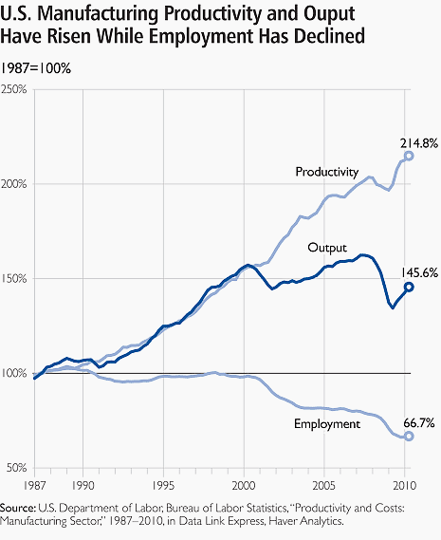
Productivity vs. employment
RATE
Amanda Pennie
Production rate in manufacturing is still increasing even though employment rate in manufacturing is decreasing
[2]
Notes:
As seen in this graph, productivity and output are increasing even though the percent of people employed within manufacturing is has decreased from 18 million to 12 million people over the years. This is due to the automation producing more rapidly while having higher output per hour over the years. This is specifically in the manufacturing industry and just goes to show how automation has completely changed this industry.

Slide 16
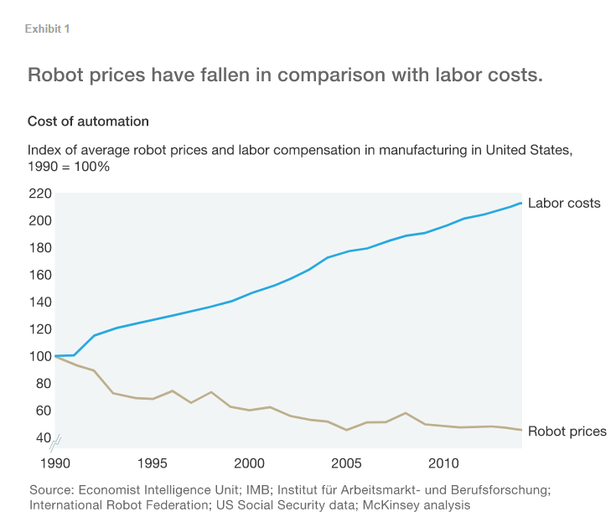
Companies using robots instead of people
Amanda Pennie
Fanuc plant: robots produce robots with 4 supervisors per shift
Phillips plant: robots to production workers is 14 to 1
Tesla: fully automated factory
[7][8][12]
Notes:
These three companies are examples of where robots are overpowering companies, reducing employees jobs. There are other companies where robots are being used less and less (such as Toyota).
Fanuc in Japan is a robot production plant and they only have 4 supervisors for the robots per shift
At the Phillips plant (electric razor company) in Netherlands, there are 126 robots and 9 production workers
Tesla is trying to create a fully automated factory to produce 1 million copies of the Model Y in one year
This graph shows itself that employees are far more expensive than robots, which is one reason why many companies are making the switch. Some companies are taking this too far and not thinking about the market such as Tesla when Electric Vehicles aren’t tha† in demand [12]

Slide 17
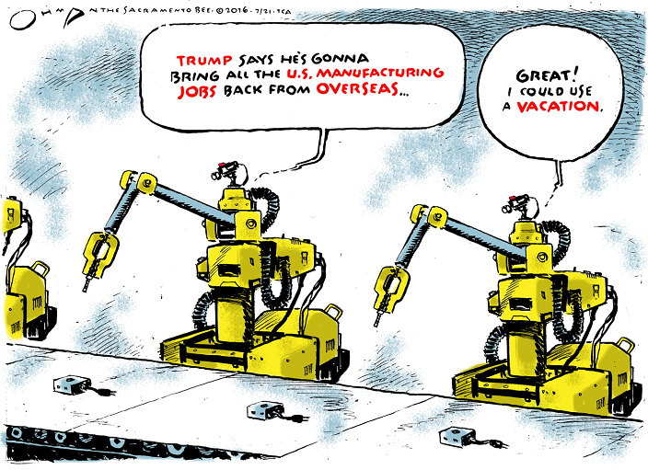
CONCLUSION
Amanda Pennie
Some factories will be 100% automated
It all depends on the company and the industry
AI will soon change manufacturing
[6][9][10]
Notes:
Many factories are going to become 100% automated, this doesn’t mean I think everyone’s roles in the manufacturing industry will be replaced just hopefully they will be moved to new roles.
At the end of the day, it is up to the company whether or not they want their production to be automated
We need to consider what values automation can bring to manufacturing
Automation varies from industry, many are more easily to automate than others, such as food services
Feasibility needs to be considered – what is feasible to automate and what isn’t
On a side note: AI is going to make automation popular and reliable by applying more intelligence to the robots that are running production in factories. Automation has already changed manufacturing but artificial intelligence will change it again. Automation needs more advanced AI to perform diverse sets of tasks in order to completely eliminate workers

Slide 18
References
Amanda Pennie
[1] Automation Cartoons, David Visnich, https://www.automation.com/library/comics/automation-cartoons-april-6-2011-cartoon-caption-contest (April 18, 2018)
[2] Edvard, 9 Reasons for Automation of Manufacturing Process http://electrical-engineering-portal.com/9-reasons-for-automation-of-manufacturing-processes (April 20, 2018)
[3] The evolution of assembly lines: A brief history, Robert Corday, http://robohub.org/the-evolution-of-assembly-lines-a-brief-history/ (April 18, 2018)
[4] Rise of the robots: The evolution of Ford's assembly line, Sheena McKenzie, http://money.cnn.com/gallery/technology/2015/04/29/ford-factory-assembly-line-robots/12.html (April 18, 2018)
[5] U.S. Department of Labor, Bureau of Labor Statistics, “Workplace Injuries and Illnesses” 1994-2008 https://www.bls.gov/iif/oshsum.htm (April 23, 2018)
[6] Arnie Gordon, What the Future of Manufacturing Could Look Like, https://www.forbes.com/sites/forbestechcouncil/2018/02/01/what-the-future-of-manufacturing-automation-could-look-like/#5f6c70b26c9c (April 23, 2018)
[7] Jonathan Tilley, Automation, robots, and the factory of the future, https://www.mckinsey.com/business-functions/operations/our-insights/automation-robotics-and-the-factory-of-the-future (April 23, 2018)
[8] Joann Muller, Musk Thinks Tesla Will School Toyota On Lean Manufacturing, https://www.forbes.com/sites/joannmuller/2018/02/16/tesla-thinks-it-will-school-toyota-on-lean-manufacturing-fixing-model-3-launch-would-be-a-start/#eec29794c74d (April 23, 2018)
[9] Michael Chui, Human + machine: A new era of automation in manufacturing, https://www.mckinsey.com/business-functions/operations/our-insights/human-plus-machine-a-new-era-of-automation-in-manufacturing (April 23, 2018)
[10] Cartoon of the Day, Occasional Links and Commentary https://anticap.wordpress.com/2016/07/28/cartoon-of-the-day-1968/ (April 23, 2018)
[11] History Channel, Ford’s assembly line starts rolling https://www.history.com/this-day-in-history/fords-assembly-line-starts-rolling (April 24, 2018)
[12] Patti Domm, Electric vehicles: The little industry that could take a bite out of oil demand, https://www.cnbc.com/2018/02/28/soon-electric-vehicles-could-cause-an-oil-crisis-.html (April 24, 2018)

Slide 19
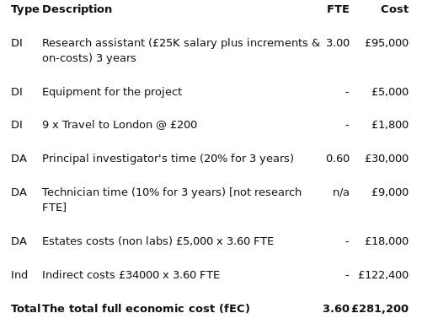
Innovation is expensive and funded more by companies
Juan Luis Herrero Estrada
2015 budget for research was 135.110 billion USD [8]
⅔ of money invested in research was provided by the private sector [10]
Between 2010 and 2013 federal funds for research have been reduced across the board [11]
Researchers are looking at private donors [11]
<Graphic>
Average cost of research in the UK [2]
Notes:
Research is a very expensive process with unforeseen expenses and costs vary from field to field.
However, there are certain expectations of costs between labor hours and equipment.
The amount of money allocated towards research has been reduced year after year by the federal government.
Currently it is less than 3% of the total GDP and more of the money placed is from private companies.
As we all know these companies are helping research and innovation as a means to make profit in the future.
This means to reduce costs of production, making superior products (higher quality) or making brand new solutions.
The areas of computer science of robotics have been receiving the most funding in views of reducing production costs.
Yes, I’m talking about automation. Thus if researchers are financed by a sector that desires to cut human labor then
It is incentivized to produce new solutions to those needs.
These means that the entities already with high acquisitive power can develop new ways to make even more money.
The rich get richer by RORC (return on research capital) measure the extra money made.
It is calculated as the total profit over gross profit per trimester
Apple RORC in 2009 was around 11$ dollars for every dollar spent on research
IBM has been spending more and more on R&D even though its revenue has been shrinking.

Slide 20
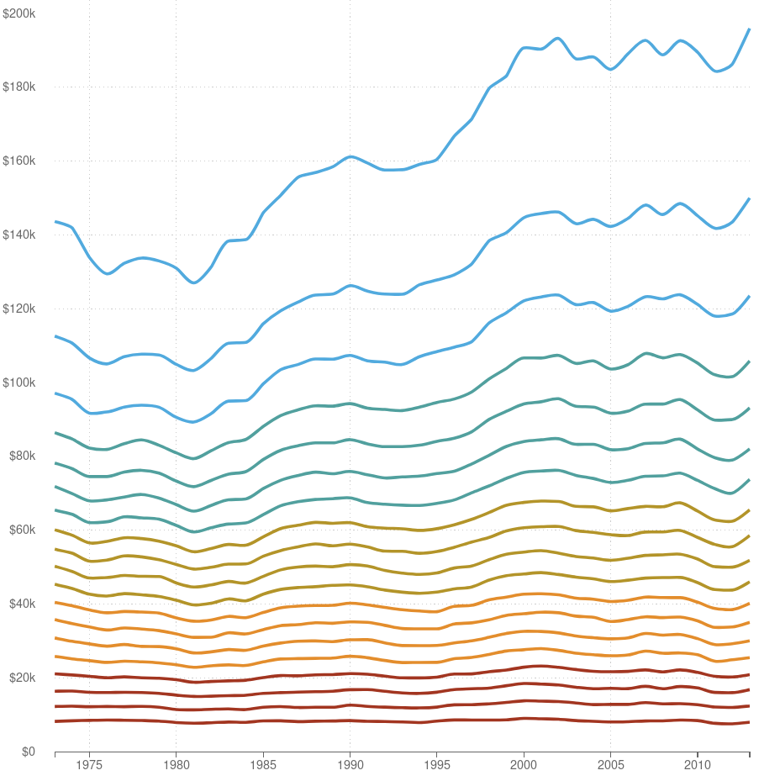
Income inequality is growing
Juan Luis Herrero Estrada
Median income in Silicon Valley (very innovative area) was 94,000$ in 2013 [1]
National median income was 53,000$ in 2013 [1]
31% of jobs pay 16$/hr in Silicon Valley [1]
Automation is holding down wages but profits are going up [14]
<Graphic>
Adjusted income of percentile groups in the US over 40 years [4]
Notes:
In the last 40 years, the wages of the lower echelons of the socioeconomic pyramid have maintained or slightly reduced.
Meanwhile the top 5% or 10% have had an overall growth in their wages.
Education correlates positively with the level of income.
This might indicate that there’s a higher demand for skilled labor in engineering, medicine, etc.
A demand for individuals to produce innovative solutions to increase efficiency and costs
An example of this is the bay area and silicon valley
The median income in Silicon Valley was 94k in 2013 (its probably higher by now) which is much higher than the national income.
However there is a stark contrast with individuals between wage tiers
White-collar jobs have maintained stable as mentioned before. For instance 31% of jobs in Silicon Valley pay 16$/hr
Which is not enough given prices in the area rise at a faster rate
Who is to blame?
The culprit seems to be automation.
Companies have no incentive to raise wages but rather finance R&D department for making new solutions

Slide 21
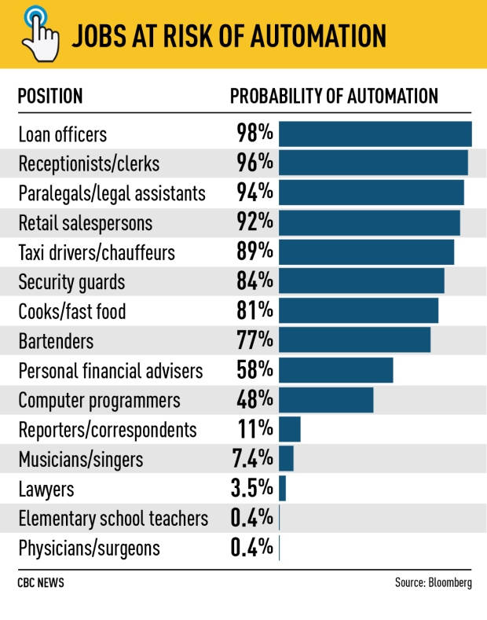
Innovation will cause more inequality
Juan Luis Herrero Estrada
Research is the motor of innovation and the key to automation
Research is mostly funded for and by private corporations
47% of jobs in the US are in high risk of becoming automated [13]
~75% of jobs in the developing world are in high risk of becoming automated [13]
[12]
Notes:
The trend indicates that the market will allocate more resources to R&D for company needs
Now, who is more at risk?
Loan officers, receptionists, sales people, cashiers, and even computer programmers (many times the creators of these systems) are at risk of losing their positions.
47% of jobs in the US are at high risk and the number varies from developed country to developed country.
However in the developing world around ~75% of jobs are at risk of being automated.
This could actually mean the end of outsourcing labor to cheaper countries
Industries would be brought home however non of the original workers would get his/her job back

Slide 22
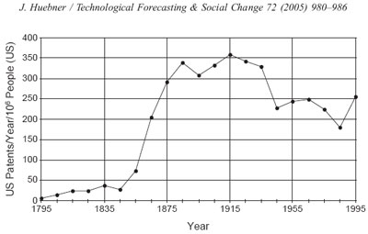
Innovation is driven by industry and it won’t stop
Juan Luis Herrero Estrada
Can be measured by the number of patents granted [5]
Historic high: 400 patents per 1000 residents [5]
In 1999, ⅘ of all patents were awarded to private companies [7]
Moore’s Law: processing power will double every two years [6]
[7]
Notes:
One way to measure how quickly innovation is moving is by the number of patents.
The total number of patents were in a decline between 1914 and 1990 however from 1990 until today it has been on a steep rise reaching a historic high.
What is agreed upon is that the majority of patents are granted to companies rather than individuals like it used to be at the beginning of the 20th century.
Akin to patents filed, Moore’s law indicates the speed of processors will double every two years.
Even though this was true during the 90s and the early 2000s, now processing power is plateauing and increase is long and difficult.
Barriers of this kind combined with the ever increasing demand of machines to perform more complex operations will force companies to double down
On R&D to build newer solutions
patents being awarded to corporations instead of
individuals that less of the population is involved in filing patents
based in part on the per unit rate but also due only those employed at
those companies are doing this work. These people do seem to be less at
risk of losing their job to automation

Slide 23
REFERENCES
Juan Luis Herrero Estrada
[1] Technology and Inequality, October 21, 2014, Retrieved From https://www.technologyreview.com/s/531726/technology-and-inequality/
[2] Costing and pricing a research proposal, (n.d), Retrieved From https://www.vitae.ac.uk/doing-research/leadership-development-for-principal-investigators-pis/leading-a-research-project/applying-for-research-funding/costing-and-pricing-a-research-proposal
[3] Automated Inequality, October 2, 2016, Retrieved From https://harvardpolitics.com/world/automation/
[4] 40 Years of Income Inequality in America, In Graphs, October 4, 2014, Retrieved From https://www.npr.org/sections/money/2014/10/02/349863761/40-years-of-income-inequality-in-america-in-graphs
[5] Rate of Innovation, July 18, 2013, Retrieved From https://atintellectualproperty.com/rate-of-innovation/
[6] Moore’s Law, (n.d), Retrieved From http://www.mooreslaw.org/
[7] Measuring Innovation in an Accelerating World: Review of a “Possible Declining Trend for Worldwide Innovation”, (n.d), Retrieved From http://accelerating.org/articles/huebnerinnovation.html
[8] R&D in the 2015 Budget, May 2014, Retrieved From https://www.whitehouse.gov/sites/default/files/microsites/ostp/fy2015rdtables.pdf
[9] Policy Budget Authority and Outlay by Function, Category and Program, (n.d), Retrieved From https://www.whitehouse.gov/sites/default/files/omb/budget/fy2015/assets/28_1.pdf
[10] Stewart, Shannon; Springs, Stacy (2015). United States of America. In: UNESCO Science Report: towards 2030. Paris: UNESCO
All References accessed on April 22, 2018

Slide 24
REFERENCES
Juan Luis Herrero Estrada
[11] Who picks up the tab for science?, (n.d), Retrieved From https://www.bu.edu/research/articles/funding-for-scientific-research/
[12] As well or better than humans: Automation set for big promotions in white-collar job market, Feb 28, 2017, Retrieved From http://www.cbc.ca/news/business/automation-jobs-canada-computers-white-collar-1.3982466
[13] The future of Employment: How Susceptible are Jobs to Computerisation?, September 17, 2013, Retrieved From https://www.oxfordmartin.ox.ac.uk/downloads/academic/The_Future_of_Employment.pdf
[14] Is Automation labor-displacing? Productivity growth, employment, and the labor share, March 8, 2018, Retrieved From https://www.brookings.edu/bpea-articles/is-automation-labor-displacing-productivity-growth-employment-and-the-labor-share/
[15] Does Income Redistribution Affect Economic Growth?, April 4th, 2014, https://www.gailfosler.com/income-redistribution-affect-economic-growth
All References accessed on April 22, 2018

Slide 25

Will AI and Automation Strip Us of our humanity?
Dimitri Berardi
  Artificial Intelligence: imitate intelligent human behavior [1]
  Automation: perform tasks that were previously performed by humans [2]
  Domotics: enables automating tasks within a home [3]
[8]
Notes:
-Introduction: State Name and Topic
-First we must define these topics as to avoid confusion
-AI: machine that thinks like a human
-Automation: does tasks like a human
-Domotics: Formal name for Home Automation
-To better understand, JARVIS from Iron Man is the perfect example of all three put into one
-While this topic can be researched and studied, it is also a question of personal responsibility.
-Ultimately if we continue to go down the road of replacing everything we
do, whether we enjoy it or not, with a machine we will find ourselves in a
world where the things that make us human no longer exist

Slide 26
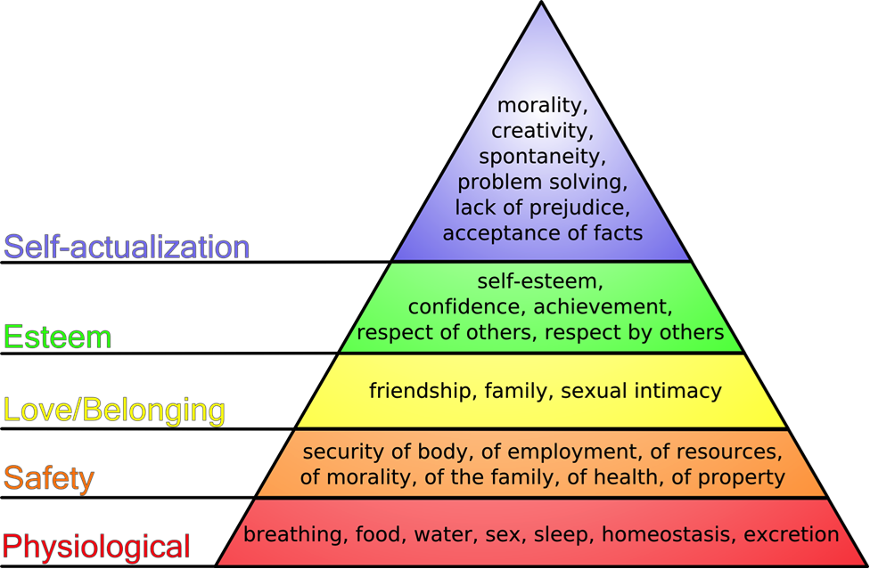
The 5 tiers of Humanity
Dimitri Berardi
[4]
Notes:
-So what does it mean to be human?
-While your core values may differ, the majority falls under this general theory
-in 1943, American psychologist Abraham Maslow wrote the paper 'A Theory of Human Motivation,' which outlined a hierarchal structure for what motivates human behavior
-5 tiers include:
-Physiology (bodily needs)
-Safety (security)
-Love/Belonging (social needs)
-Esteem (mental needs)
-Self-Actualization (personal needs)
-So, what is AI and Automations role in all of this

Slide 27
Affect On Humanity: Regulate & Record
Dimitri Berardi
Positive | Negative
Regulate & Treat Bodily State | Record Bodily State -> Create Physiological Profile
Produce Resources Quicker
Deliver Resources More Effectively | What Constitutes Effectively
Notes:
Regulate & Treat Bodily State
-Hospital Machines
-Fitbits
-Imagine a world where your temperature is regulated and your house heat is adjusted accordingly or your sleep patterns cause changes to the nuance of your bedroom
-These devices will ultimately create a profile on you, is this okay?
Resources
-Resources such as food and water are already being processed through highly automated factories
-Machines are faster than humans, allowing those who need food to get it quicker
Delivery
-Determine who needs food the most and supply it there (but what is the determining factor?)

Slide 28
Affect On Humanity: False sense of security
Dimitri Berardi
Positive | Negative
Monitor Home | Record Home
Protect Humans | Physical Harm to Humans
 | Reduce Employment & Income[5]
 | False Sense of Safety
Notes:
-With every system there is always a good side and a bad side, good vs evil
-Your job is to weigh the cost with the benefit
-AI and Home Automation can Monitor Your Home thus providing security
-Your home, which functions as the only private space in the world to each of us, is no longer private
-Are you willing to give up privacy for security
-AI can determine potential danger and even act to prevent it, however it also has the potential to use the same mechanisms of defense against us
-Automation is slowly killing jobs, and therefore income for millions of people. These are two major pieces of being human, employment and the ultimate resource: money
-As we put our faith in AI and home automation systems, we will cease to question it. We will live in a false sense of safety, simply believing that it is helping us

Slide 29
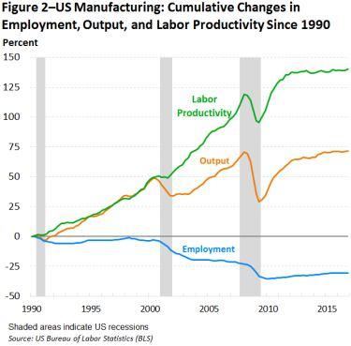
Dimitri Berardi
  Since 1990, computing, sensing and data capabilities have significant improvements [12]
  Result: Automation increase replacing need for human workers. Does job better than humans
  Machine needs average 1 person to run. Job machine is replacing needs much more
[6]
Notes:
-We can see here the good side and bad side as technology and automation in manufacturing got better over the years
-While we have seen much greater productivity which boosts our security of resources, we also see loss of jobs thus threatening our security of employement

Slide 30
Affect On Humanity: Replace human connection
Dimitri Berardi
Positive | Negative
Easier Contact | Non-Human Relations
In a sample of 263 heterosexual men, just over 40 per cent “could imagine buying a sex robot over the next five years” [7]
“The ‘sex tech’ market is worth an estimated $30.6bn” [13]
Notes:
-With the development of AI and home automation, we can now call and video chat loved ones with little to no effort
-As simple as telling your AI to make a call, schedule a call, or make a plan
-The future may even coordinate your calendar to enable us to keep in touch and make plans with those who we care about
-With the creation of intelligent AI companions and Sex Droids, we will begin to develop and depend on non-human relations

Slide 31

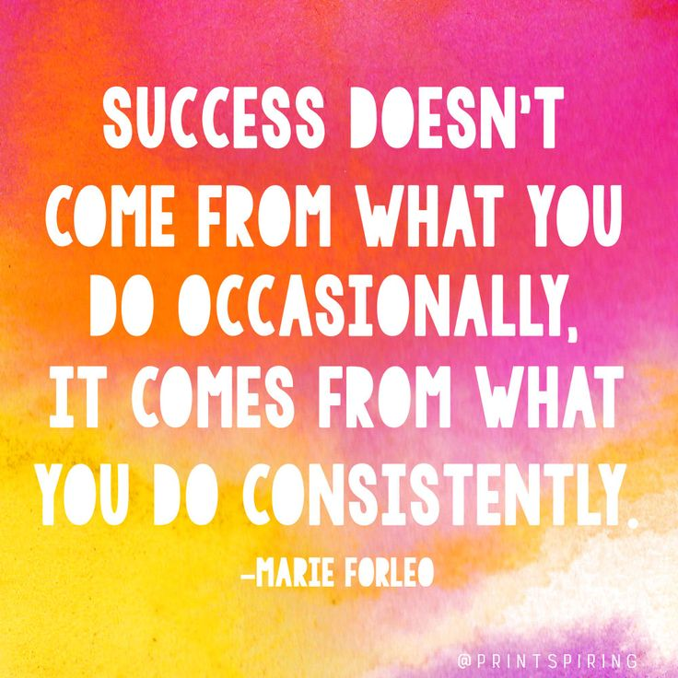
Affect On Humanity: replace not improve
Dimitri Berardi
[9]
[14]
Notes:
-These quotes embody everything that is most wrong with AI and automation
-Instead of doing for ourselves, AI and Automation is only getting started in doing it themselves
-Let’s quickly take a look at the definitions from the beginning of the presentation, to illustrate my point
-No positives

Slide 32
Automation Replacing Responsibility
Dimitri Berardi
  Artificial Intelligence: imitate intelligent human behavior [1]
  Automation: perform tasks that were previously performed by humans [2]
  Domotics: enables automating tasks within a home [3]
[8]
Notes:
-”Imitate intelligent human behavior”
-”Perform tasks that were previously performed by humans”
-”Automating tasks within a home”
-All denote that the aim is to replace human capabilities and responsibilities

Slide 33
Affect On Humanity: replace not improve
Dimitri Berardi
[9]
[14]
Notes:
-While many might say this allows us to focus on more important tasks ,
I would say that the smaller tasks are what give us the confidence of achievement
which drives us to pursue and ultimately conquer the bigger, tougher tasks
-Confidence is built on self esteem which is built from achievement,
and respect is derived from that which others
see you achieve
-If we began to live in a world where we no longer needed to achieve tasks
because technology could do it for us, we will one day find ourselves in
a world lacking any sense of purpose or self

Slide 34
Affect On Humanity: Stunt Creativity
Dimitri Berardi
Positive | Negative
Create new ideas to be explored | Do all the work for us
Notes:
-AI has/is acquiring the ability to think like we do. Thus it may one day be able to exhibit similar qualities as these
-In turn, these new ideas will be new building blocks for us to play with and expand ourselves
-However, AI may get so smart as to cripple us beneath it and stifle out ourselves. If the day comes when
We are second to AI, our whole definition of self will change. We will no longer need these skills, because AI
Can do it better and quicker than we can. Then what? Who are we? What do we do?

Slide 35
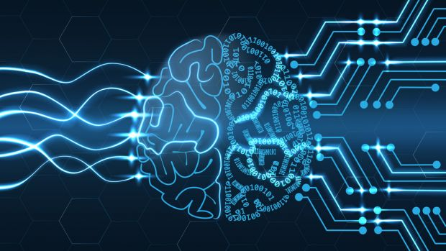
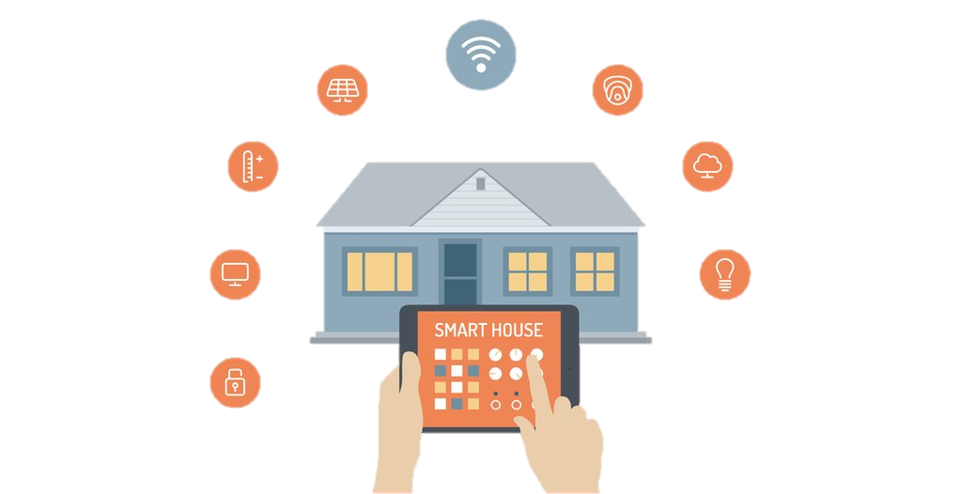
Final thoughts
Dimitri Berardi
  AI gives a false sense of security
  Automation will replace us, not improve us
  We need little tasks to validate our abilities as humans
[10]
  Limit Data Gathering
  Set Boundaries For The Future
  Improve, Not Replace
  Strive For More, Not Less
[11]
Notes:
-AI and Automation makes us feel
-invisible in a world that is only getting increasingly dangerous
-Inferior, as we no longer must strive to become better at tasks,
instead we strive to make machines that do them better
-Little tasks are what make life enjoyable, and fulfill our sense of
accomplishment and ability. Replacing these is dangerous to our
future selves
-the costs far out-way the utility
-How do we prevent this?
-Make laws to limit the data gathered BEFORE the technology exists
-Set limits for how far we are willing to bring this technology
-Make goals to improve the quality of human life, not replace the things that make us human
-Set a desire of using the technology to further us as a society, not diminish our roles and tasks
-Thoughts?

Slide 36
References
Dimitri Berardi
[1] https://www.merriam-webster.com/dictionary/artificial%20intelligence, (4/9/2018)
[2] https://www.techopedia.com/definition/32099/automation, (4/9/2018)
[3] https://www.techopedia.com/definition/29999/home-automation-system, (4/9/2018)
[4] http://lifestyle-leadership.com/finding-your-tribe/,
(4/15/2018)
[5]https://www.forbes.com/sites/forbestechcouncil/2016/05/27/eleven-ways-automation-will-change-our-lives/#3450e35d2436, (4/15/2018)
[6]https://www.ncci.com/Articles/Pages/II_Insights_QEB_Impact-Automation-Employment-Q2-2017-Part1.aspx, (4/15/2018)
[7] https://www.timeshighereducation.com/news/sexbots-are-coming#survey-answer, (4/16/2018)
[8] http://marvel-movies.wikia.com/wiki/J.A.R.V.I.S., (4/16/2018)
[9]https://twitter.com/diegodalcero/status/830956899717804033, (4/16/2018)
[10] http://www.itpro.co.uk/strategy/28181/what-is-ai, (4/9/2018)
[11] https://gettecla.com/blogs/news/the-best-smart-home-automation-devices-for-tecla-e-users, (4/9/2018)
[12]https://www.britannica.com/technology/automation/Modern-developments, (4/22/2018)
[13] http://www.dailymail.co.uk/sciencetech/article-4453628/30-BILLION-race-create-AI-sex-doll.html, (4/22/2018)
[14] http://thedailyquotes.com/what-you-do-consistently/, (4/22/2018)

Slide 37
Class 11
The End
Keith A. Pray
Instructor
socialimps.keithpray.net
Notes:
If there’s time and we didn’t get to it:
Kickstarter Charter
https://www.kickstarter.com/charter?ref=about_subnav
CGP Grey
Humans Need Not Apply (15:00) – 2014-08-13
http://www.youtube.com/watch?v=7Pq-S557XQU
Last access 2016-04-22
These 3D printed homes can be constructed for $4,000 (3:00 – 2018-04-02)
http://www.businessinsider.com/3d-printed-homes-constructed-icon-new-story-tech-charity-4000-dollars-2018-3
https://www.youtube.com/watch?v=SvM7jFZGAec (1:28)
Last access 2018-04-22
Look at:
BBC Intelligent Machines
http://www.bbc.com/news/technology-33978561
BBC Likelihood of robot taking your job
http://www.bbc.com/news/technology-34066941
This is the end. Any slides beyond this point are for answering questions that may arise but not needed in the main talk. Some slides may also be unfinished and are not needed but kept just in case.

