Slide 1
Class 10
Professional Ethics
Keith A. Pray
Instructor
socialimps.keithpray.net
Notes:
Here’s the title slide. Excited already, aren’t you? You may not be depending on how you enjoyed the last class.

Slide 2
Papers
Clearly state conclusion
  First statement preferred
Quantify
  Do not use terms like: less, more, a lot, huge, great, big, tiny, etc.
Read paper aloud to proof
http://socialimps.keithpray.net/assignments/paper-guidelines/
Notes:
Save for next time:
Absolute statements are difficult to prove
Avoid: all, always, any, every, everyone, never, none… unless you can show it
Be sure to put quotes around entire quote
Hyperbole is the best thing ever!
but not in these papers
Print 2 sided and save a tree
Use template, saves time (and -1 point)
Include Counter Point and Response

Slide 3
Overview
Review
Debate
Assignment
Students Present
Notes:
We can also discuss articles listed on Security Discussions under documents of course web site.
ADD QUIZ AS BACKUP IF CLASS DISCUSSION NOT LONG ENOUGH

Slide 4
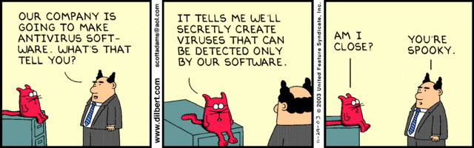
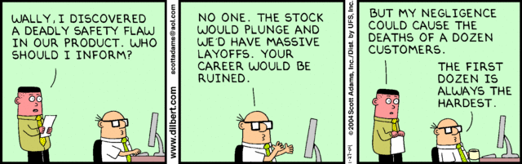
Notes:
Ask how many people in ACM or IEEE

Slide 5
Debate Ground Rules
Before Debate
  15 minutes to converse with your team
  Share argument points, counter points, and responses so everyone can represent
  Decide who will respond to what points from the opposing side
During Debate
  Stand up when speaking
  1 turn per person until everyone on your team has spoken
  30 second limit
  Switch sides at any time if you change your mind
Notes:
Release Game or Not Debate
Chapter 9 In-class Exercises # 24.
Should the company produce the game?
Use the SWE Code Of Ethics as the basis for your argument.

Slide 6
My Reading Notes
pp. 409 Can one perform services for one’s self?
pp. 412 1993-1999 Does this seem like a long time?
pp. 413 “errors of omission or commission”?
UPDATE
pp. 422 3. Would people agree – social contract?
pp. 438 So the baby can be left outside and no one is responsible?
Notes:
An error of commission is one where the person responds where they should not. This is compared to an error of omission, where the person fails to respond when they should.

Slide 7
Assignment
1 Page Paper
  What should computerized automated be applied to next?
Finish all reading
Group Project
  Add analysis to website addressing all topics covered to date
  Group Presentation Draft
    Email presentation as attachment to course staff
    Post on group website
Notes:
1 Page Paper Ideas:
For Good - How will you use your computing related education to do good in the world?
Dark Net - Is the Dark Net good or bad?
Does computerized automation help the economy or society?
What should computerized automated be applied to next?
If productivity has increased so much, why are we working so hard? Should we?
What job skills will survive computerized automation?

Slide 8
Overview
Review
Debate
Assignment
Students Present
Notes:
Show WPI and/or corporate code of ethics.

Slide 9
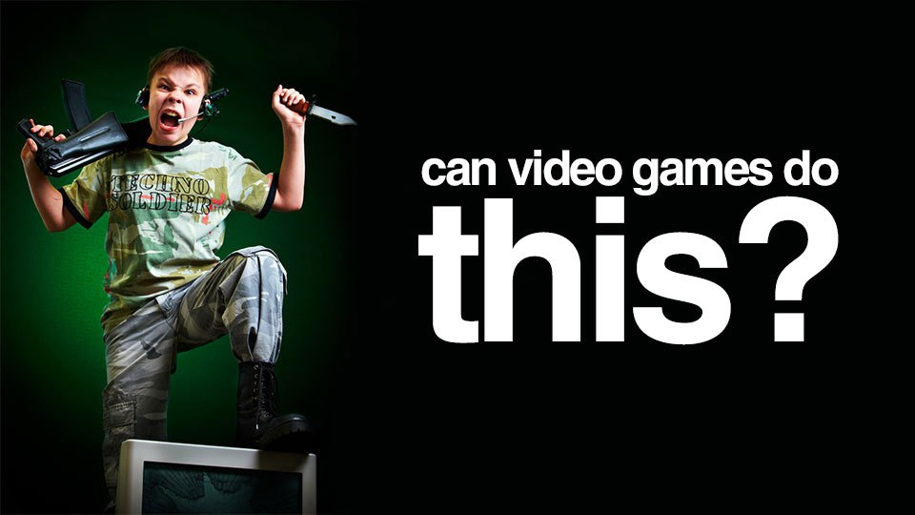
Video Games Made Me Do It
Leo Grande
Physical violence to others
Controversy surrounding violent video games
This issue always becomes a topic when a tragic event committed by a teenager occurs [11]
[6]
Notes:
Overview of the presentation - Video Games Made me do it
Focusing on physical violence to others - Not focusing on overall aggression such as giving someone a cold shoulder
There is a lot of controversy surrounding violent video games, especially when a tragic event is committed by a teenager (columbine, sandy hook)

Slide 10
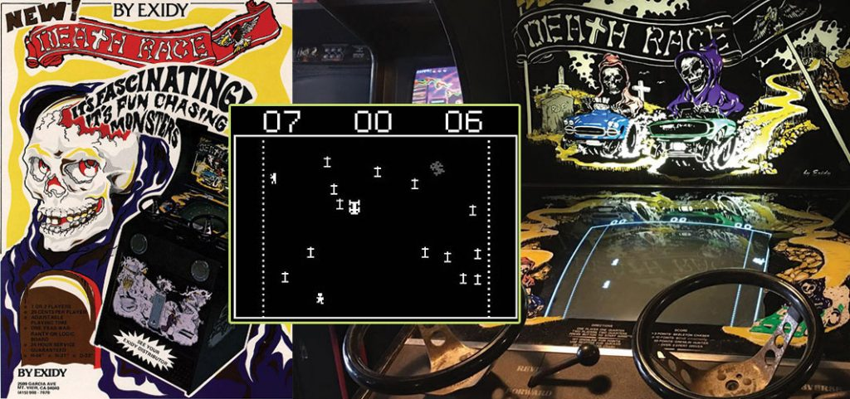

Violent Video Game Evolution
Leo Grande
Violent video game controversy started in 1976 with Death Race [2]
Mortal Kombat was the first video game with realistic violence
Today there is a lot of violence, such as Fortnite and Call of Duty
In 2016, more than half of the top 50 selling games were violent[11]
[7],[8]
Notes:
Video game violence has been around since 1976 through death race
Death race was the first murder simulator
More games started popping up with violence, and the first realistic violence came about through Mortal Kombat in 1992
For those that do not know, mortal kombat has two humans fight each other side by side until knockout/death
Since then, there are numerous amounts of violent video games that are realistic and unrealistic, such as call of duty, fortnite
I can probably name a lot more violent compared to non violent video games
2016, more than half of top 50 are violent

Slide 11

Studies On Violent Video Games
Leo Grande
APA started studies in the early 2000s [4]
2011 Supreme Court case to restrict these games to minors in California [5]
President Trump recently discussed this topic at the White House [1]
[9]
Notes:
There have been numerous discussion points and studies around violent video games and their correlation with violent
APA (American Psychological Association) has studied this since the early 2000s, and in 2017 crafted a statement telling the media to stop correlating these two topics because there is no concrete evidence
In 2011, there was a supreme court casing trying to restrict violent video games to minors based off of the premise that violent games cause violent behavior, however, it was denied because there is no concrete evidence of this and a violation of the first amendment
Trump recently discussed with his panel whether or not these video games are leading to tragic events such as school shootings, yet again there was no evidence presented at this meeting that clearly condemns violent games to be the root cause
Could not find a reasonable number on how many studies have been done

Slide 12
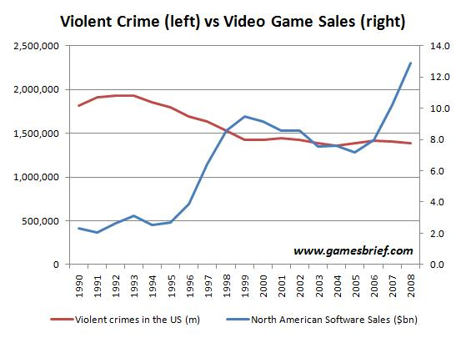
Video Game Sales vs. Violent Crimes (2008)
Leo Grande
[12]
Notes:
Clearly, the amount of video game sales does not increase the amount of violent crimes (until 2008, cannot find later dates)

Slide 13

No Concrete Evidence
Leo Grande
No evidence proving video games cause violent behavior
Some evidence states aggression, outside of physical violence [1]
Studies show all media should be grouped together [1]
I do not think video games cause violent behavior and that people are wasting their time on this
Change my mind?
[10]
Notes:
In conclusion, there has not been any complete evidence that proves violent video games cause violent behavior
Some evidence states that violent video games cause aggression, yet this entails verbal and mental, not just physical
Giving someone the cold shoulder is seen as aggression, and no violent act has been directly tied to these games
Furthermore, video games should not be their own category. Instead violent media as a whole should be grouped together
It can be argued video games are different because the individual playing is taking control of the situation, but studies say otherwise [1] (will be talked about through the point of violent media being grouped together as a whole)

Slide 14
REFERENCES
Leo Grande
[1] What Research Says About Video Games, https://www.npr.org/2018/03/08/592046294/what-research-says-about-video-games-and-violence-in-children, Author: NPR, Created: March 8, 2018, Accessed: April 14, 2018
[2] Timeline of Video Game Controversies, http://ncac.org/resource/a-timeline-of-video-game-controversies, Author: NCAC, Last Updated: 2018, Accessed: April 14, 2018
[3] It’s Time to Debate, http://theconversation.com/its-time-to-end-the-debate-about-video-games-and-violence-91607, Author: Christopher J. Ferguson, Created: February 16, 2018, Accessed: April 15, 2018
[4] American Psychological Association, https://www.apa.org/, Last Updated: 2018, Accessed: April 15, 2018
[5] Brown v. Entertainment Merchants Assn., https://www.law.cornell.edu/supct/html/08-1448.ZS.html, Argued: November 2, 20101, Decided: June 27, 2011, Accessed: April 15, 2018

Slide 15
REFERENCES (2)
Leo Grande
[6] Slide 1, Picture 1, https://www.gamerpros.co/violent-video-games-may-taxed-new-legislation
[7] Slide 2, Picture 1, https://www.epicgames.com/fortnite/en-US/buy-now/battle-royale
[8] Slide 2, Picture 2, http://www.horror.land/the-evolution-of-horror-videos-games-1972-1982
[9] Slide 3, Picture 1, http://flashgamegate.com/violent-video-games-have-an-impact-on-behavior/
[10] Slide 4, Picture 1, http://drewmckissick.com/three-types-of-media/
[11] Violent VIdeo Games, https://videogames.procon.org/view.resource.php?resourceID=006520, Author: ProCon, Created: June 3, 3016, Accessed: April 16, 2018
[12] If Video Games Caused Violence, http://www.gamesbrief.com/2010/08/if-video-games-cause-violence-there-should-be-a-correlation-between-game-sales-and-violent-crime-right/, Author: Nicholas Lovell, Created: 2010, Accessed: April 16, 2018

Slide 16
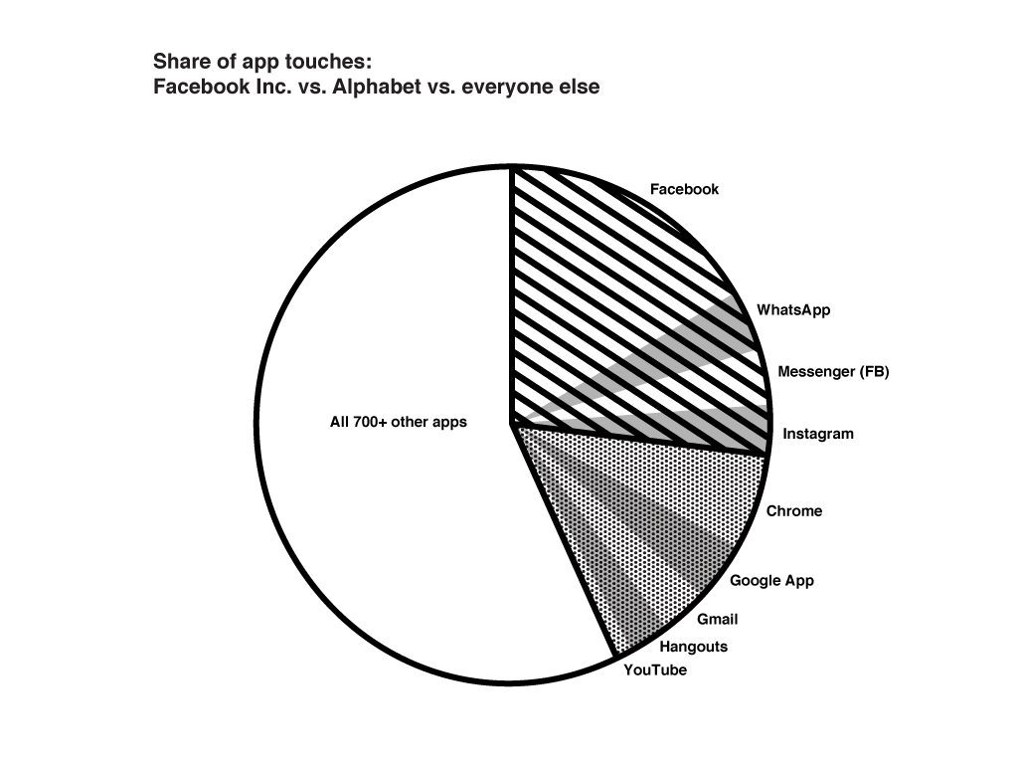
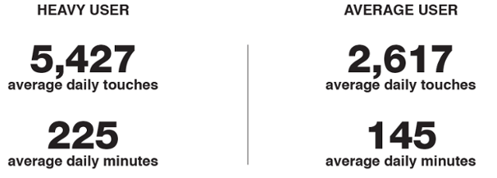
Apps that Steal Your Attention
Kartik Thooppal Vasu
Designers have an incentive to keep your attention
They must use “increasingly persuasive techniques to keep us glued” [1].
Directed efforts towards steering user’s thoughts.
Ideally, business models must align with the best interests of the user
[5]
Notes:
Today I want to talk to you about how app design can be improved to benefit the user. From a professional ethics point of view, I am going to argue that it is important as designers of applications and anything with an interface to keep the interests of the user in mind. We all have heard at different points in time about different types of technology being bad for us. For example, the TV. In this presentation I am going to argue that applications are different. “This time it’s different”. Smartphones have become pervasive- <explain the graphic on the right>. The study included 94 Android phone users and tracked them over 5 days (24hrs a day). For starters- it is clear that app designers have an incentive to capture and keep your attention, especially when there are so many other apps competing to do the same as you can see in the graph. This means that they have to spend more directed efforts towards persuasive techniques and having control over steering a user’s thoughts.
Facebook made $40bn in total revenue in 2017 bulk of which is $39bn came from digital advertisements. [11]

Slide 17
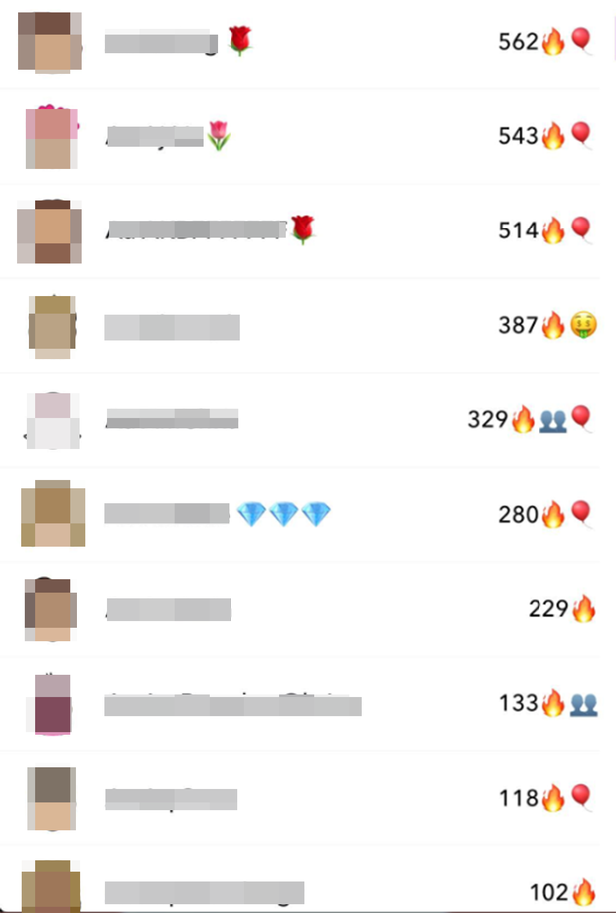
Techniques
Kartik Thooppal Vasu
Human psychology can be manipulated to capture attention
  “If it can’t be used for evil, it’s not a superpower,” author of Hooked: How to Build Habit Forming Products [7]
Customer-profiling
  Facebook showed advertisers that it can determine feelings and emotions
  “Insecure”, “worthless”, “need a confidence boost”. [9]
Other examples:
  Facebook auto plays videos as you scroll through by default.
  Snapchat turns conversations into streaks.
Snapchat
[6]
Notes:
So what are some techniques that app designers currently use? Most techniques work around the idea of manipulating human psychology to capture users’ attention. For example, psychological studies about red being a more stimulating color, might dictate it to be used for a notification. One of the authors of a book that outlines psychological principles and design steps to make your app habitual to a user, also says about clever app design, that if it can’t be used for evil, then it’s not a superpower. And this is in reference to clever app design.
Another technique that is often used is customer profiling that will allow companies to serve directed information/advertisements/news feed to keep them on the page/app. For example, Facebook showed their advertisers that they could determine when a teen was feeling insecure, worthless, require a confidence boost, etc. Other examples of manipulative deisng include Facebook’s autoplaying of videos as you scroll through the news feed. And Snapchat gamifying conversations by having streaks.
Most of these psychological techniques are based on cognitive psychology. That is, an understanding of how the human brain tends to work. As opposed to con-men, who use techniques that charm their victims.

Slide 18
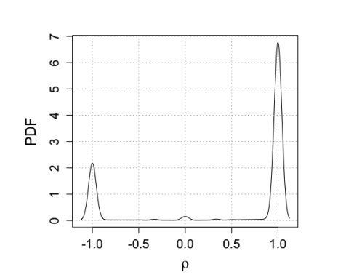
Effects of Incentivizing Attention
Kartik Thooppal Vasu
Mental health [12]
  Harder to disconnect, increases anxiety, affects sleep
Children [12]
  Susceptible to doing things that bring in most likes
Social Relationships
  Direct rewards in the virtual world (likes, shares, etc.) make it more pleasurable
Democracy
  Creates echo chambers [13], encourages the sensational and outrageous.
Density of users’ concentrating their activity (>95% likes) on -1 (science-related pages) and +1 (conspiracy-related pages) [13]
Notes:
So what are the effects of incentivizing users’ attention and keeping them glued to their screens? For one, it affects mental health. It makes it harder for people to disconnect which could lead to a lack of sleep and increased social anxiety when it comes to fearing missing out. Younger children that begin to use smartphones are going to be susceptible to doing things that bring in the most likes, etc. Social relationships take a backseat when there are easier social rewards in the virtual world in the form of likes and shares and so on. Finally, as we have seen in recent news, it affects democracy-- by creating echo chambers, and encouraging sensational news.

Slide 19
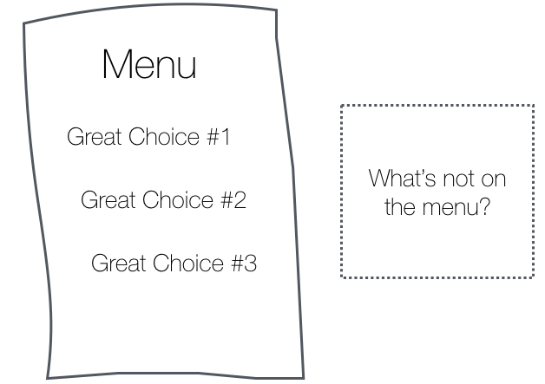
It’s Different This Time
Kartik Thooppal Vasu
“I have the choice to open a video/notification/scroll”
  Persuasive techniques often hijack unconscious psychological systems [10]
24/7 [5]
  No other form of media stays with you at all times during the day.
Personalization [14]
  TV/Newspapers/Books are not personalized to your preferences, behavior
[10]
Notes:
I want to talk about why it’s different specifically this time as compared to older technological advancements. You may think that you have the choice or that it’s up to you to watch a video/disable your settings/etc. but the truth is that persuasive techniques hijack your psychological systems that are typically unconscious and not controllable with volition. When everyone around you is using Messenger to talk to each other, you cannot be social without being on Messenger yourself. Some applications require you to link your accounts to others so you have to spend time on the others as well. This is not easily avoidable. Next, we are with our phones 24/7 and they are always on. It is good that anyone can reach us when in trouble or urgent, but when this mode of communication is intercepted by useless applications that can send you notifications in the middle of the day, it becomes hard to disconnect. Finally, personalization (to a user-level) of content delivery has never existed before.

Slide 20
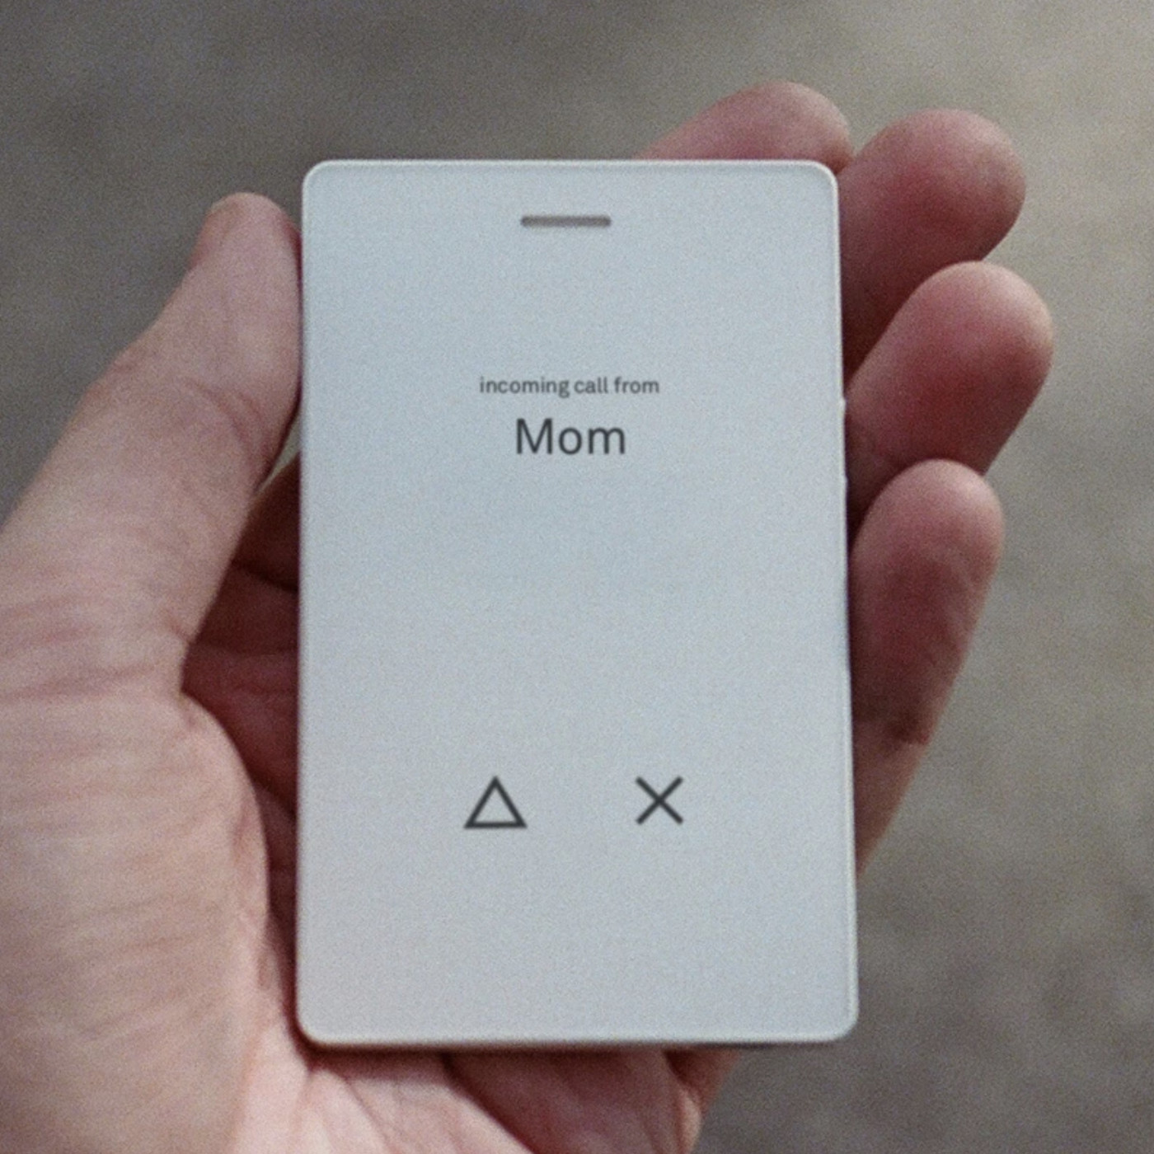
Conclusion
Kartik Thooppal Vasu
As UI designers we must follow ethical design principles that allow users to disconnect and minimize distractions.
Many platforms lose money if the problem is solved.
Must acknowledge that we are susceptible
Align business model with the best interests of the user.
  Easier for some companies: those that make the hardware.
[15]
Notes:
The problem we face, however, is that many platforms lose money if the problem is solved. Their business models require that they have their users’ attention for the longest time and longer than others that are in competition with them. We must also acknowledge that we are susceptible to these methods of manipulation. When we do so, companies will be forced to serve their users’ best interests and align their business models with the user. We must follow ethical design principles as designers of these applications. For example, instead of designing with the idea that users are free to choose what they think, it is more realistic to design with the knowledge that you are directly influencing the user’s thoughts (and choosing default settings that help them regardless of whether it helps you as a designer or not). Following these ethical design principles and helping users disconnect is typically easier for hardware companies because they are not dependent on your attention as much as social media applications.

Slide 21
REFERENCES
Kartik Thooppal Vasu
[1] “Our Society is Being HIjacked By Technology” Retrieved from http://humanetech.com/problem (April 15, 2018)
[2] Newton, Casey. (Jan 7, 2018). ‘Time well spent’ is shaping up to be tech’s next big debate.
https://www.theverge.com/2018/1/17/16903844/time-well-spent-facebook-tristan-harris-mark-zuckerberg (April 14, 2018)
[3] Harris, Tristan. The Manipulative Tricks Companies Use to Capture Your Attention. https://www.ted.com/talks/tristan_harris_the_manipulative_tricks_tech_companies_use_to_capture_your_attention#t-440715 (April 16, 2018).
[4] Lewis, Paul. (Oct 6, 2017) 'Our minds can be hijacked': the tech insiders who fear a smartphone dystopia
https://www.theguardian.com/technology/2017/oct/05/smartphone-addiction-silicon-valley-dystopia (April 16, 2018)
[5] Winnick, Michael. (June 16, 2016). Putting a Finger on Our Phone Obsession. https://blog.dscout.com/mobile-touches (April 16, 2018)
[6] Moloney, Aisling. (8 Sep, 2017). What is a Snapchat Streak. http://metro.co.uk/2017/09/08/what-is-a-snapchat-streak-6910821/ (April 16, 2018)

Slide 22
REFERENCES
Kartik Thooppal Vasu
[7] Hooked: How to Build Habit Forming Products http://www.hookmodel.com/ (April 15, 2018)
[8] https://www.theodysseyonline.com/children-excessive-amount-technology (Image)
[9] Levin, Sam. (May 1, 2017) Facebook told advertisers it can identify teens feeling ‘insecure’ and ‘worthless’. https://www.theguardian.com/technology/2017/may/01/facebook-advertising-data-insecure-teens (April 14, 2018)
[10] Harris, Tristan. (May 18, 2016) How Technology is Hijacking Your Mind — from a Magician and Google Design Ethicist https://medium.com/thrive-global/how-technology-hijacks-peoples-minds-from-a-magician-and-google-s-design-ethicist-56d62ef5edf3 (April 17, 2018)
[11] https://www.investopedia.com/ask/answers/120114/how-does-facebook-fb-make-money.asp (April 17, 2018)
[12] Twenge, Jean M., Joiner, Thomas E. Rogers, Megan L., Martin, Gabrielle N. Increases in Depressive Symptoms, Suicide-Related Outcomes, and Suicide Rates Among U.S. Adolescents After 2010 and Links to Increased New Media Screen Time (Vol 6, Issue 1, 2018) pp. 3 - 17
[13] Quattrociocchi, Walter and Scala, Antonio and Sunstein, Cass R., Echo Chambers on Facebook (June 13, 2016). Available at SSRN: https://ssrn.com/abstract=2795110 or http://dx.doi.org/10.2139/ssrn.2795110
[14] Personalized Marketing https://en.wikipedia.org/wiki/Personalized_marketing

Slide 23
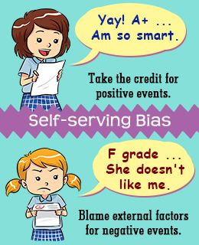
Blame the user, not the phone
Adam Bettigole
Self-serving bias – taking credit for good things that happen to you, but blaming misfortunes on others [1]
  Degree of bias can vary by demographic according to study[12]
No one is forcing you to overuse your smartphone
[2]
Notes:
Hi, my name is Adam and I’m going to be talking about how addicted people have gotten to their smartphones. A lot of people blame the technology, and the developers for making inherently addicting devices, but I believe that it’s really the users who are to blame for their addiction. People have a tendency to take credit for good things that happen to them, but not to take responsibility for their shortcomings, and immediately resort to blaming others. This is called self-serving bias. This graphic explains the premise of self-serving bias, as we can see the girl on the top takes credit for doing well on the test, but the one on the bottom just assumes she didn’t do well because the teacher doesn’t like her. One study compiled data from over 260 prior studies and calculated a “d” value for different demographics, which represented the extent of their self-serving biases. The average was 0.96, which is relatively large. Americans had a d value of 1.05, with children and older adults generally having the largest biases. It also showed that people with depression and anxiety had significantly lower biases, with d values of .21 and .46 respectively. People need to start taking responsibility for their smartphone addictions, because no one is forcing you to use their devices as much as you do. Before I go on, I’d also just like to say that I’m not excluding myself from this. I’ll admit that I use my phone a lot, and probably waste more time scrolling through social media on it than I should. But I don’t blame my iPhone for distracting me because I’m the one who chooses to do that scrolling. I’m just saying that smartphone users are responsible for a certain level of self-control when it comes to using their devices, and if they can’t maintain that, then they shouldn’t be blaming technology for the fact that they can’t go 2 minutes without checking their phone.

Slide 24
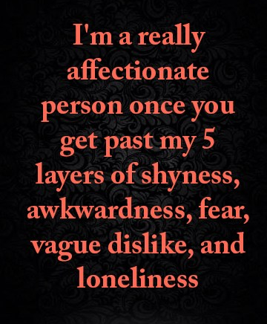
factors causing increased risk of addiction
Adam Bettigole
Loneliness and shyness [3]
  Those unsatisfied with relationships often turn to the internet
Shyness [3]
  Smartphones allow for more comfortable social environment
Parenting style [4]
[9]
Notes:
There have been studies done on conditions and personality traits that might put someone more at risk of becoming addicted to smartphone use. Loneliness and shyness are two of them. Lonely people might become unsatisfied with the number or quality of their personal relationships, so that might turn them toward increased internet use. For those who are shy, smartphones can provide a more comfortable environment for them, where they could either not interact with others, or communicate with them without being in the same room. Parenting styles can also come into play when talking about smartphone addictions because teens can get dependent on their devices if their parents don’t encourage them to communicate in different ways or do other things. One argument against smartphones is that they are decreasing the amount of face-to-face interaction between people, and maybe the poor quality of some personal relationships is a result of smartphone overuse, rather than a cause. But again, I’d like to emphasize that in these cases, it’s the people who are choosing not to interact face-to-face, and if it weren’t through a smartphone, it could just as easily be on their laptop or landline phone.

Slide 25
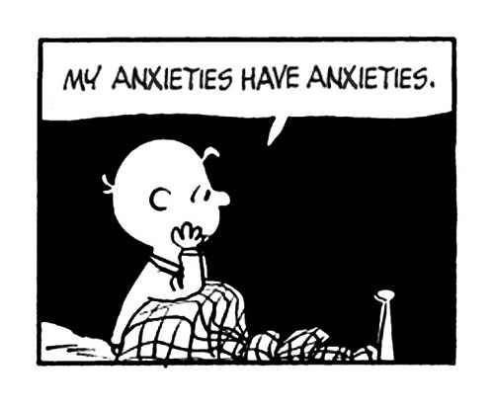
Mental health conditions
Adam Bettigole
Depression
Anxiety
Rumination – focusing only on upsetting aspects of situations [6]
  Can link depression and anxiety to problematic smartphone use [5]
[10]
Notes:
Depression and anxiety can also lead to increased use of smartphones. People often use their smartphones to relieve stress or depression, which can become unhealthy if done too often. It can lead to becoming absorbed into the virtual world, and ignoring real-life problems. Rumination is a psychological term for focusing primarily on the bad or upsetting aspects of a situation. Some research indicates that depression and anxiety alone may not lead to increased risk of smartphone addiction, but rumination can act as a mechanism for linking these mental health conditions to problematic smartphone use. Rumination can cause excessive reassurance-seeking behavior, which might lead someone to constantly check their phone for new notifications.

Slide 26
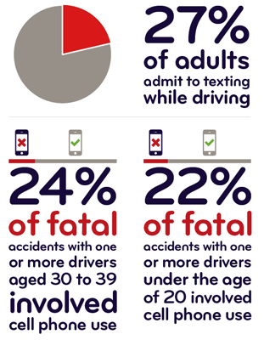
Case study
Adam Bettigole
Automaticity – response with limited awareness of one’s behavior
925 college students and adults asked about their actions involving habit automaticity
Regression results
  Automaticity: (β = .14, p < .001)
  Awareness: (β = -.24, p < .001)
[7][8]
Notes:
There was a study done in 2015 to learn more about people’s automatic behaviors and habits. Automaticity refers to doing something with limited awareness or intentions to do so – it is a result of extreme addiction. 925 people, including adults and college students, were surveyed about the extent to which they perform actions without thinking or intending to do them, such as texting. The researchers used linear regression to see if automatic habits could predict how often someone might text and drive. They did the same for the opposite of automaticity, which is acting with awareness. They found that people who have automatic habits are more likely to text and drive. These results show that an increase in one unit of automaticity will result in a .14 unit increase in texting while driving, and a 1 unit increase in awareness results in a .24 unit decrease in texting while driving. As people get more and more attached to their smartphones, we can only expect automaticity, and therefore, frequency of texting while driving to increase. So basically, if you are aware of your texting habits, you could be less prone to texting and driving. Automaticity doesn’t remove the responsibility from the driver though. Their excessive smartphone use got them to the point where they text without intending to, and they must be held responsible for the consequences. If someone sues you because you hit them while you were texting, I don’t think the “I didn’t know I was texting” argument would get you too far. You can’t blame the technology because all the phone did was buzz.

Slide 27
Summary
Adam Bettigole
Users should take responsibility for their own use
Take measures to reduce smartphone usage
  Silent your phone during mealtimes, when you’re with your family, etc.
  Reconfigure notification settings
  Try an addiction-breaking app
Notes:
My main point is that users need to take responsibility for their smartphone addictions, rather than blaming the technology. A few measures you could take to reduce the amount of time you spend on your phone are listed up here. You could silent your phone at different times throughout the day, such as when you’re eating or with your family. You could also change your notification settings so your phone isn’t constantly buzzing and asking for your attention. There are also apps out there that aim to get you to use your phone less. Some show you how many times you unlock your phone everyday, give you a breakdown of how long you’re spending in each of your apps, or set time limits for specific apps [11]. Even if you don’t take any of these suggestions, you might just want to be mindful of how much you use your phone so it doesn’t take over your life. Any questions?

Slide 28
References
Adam Bettigole
[1] Harley Therapy, Why We Put the Blame On Others – and the Real Cost We Pay, https://www.harleytherapy.co.uk/counselling/why-we-put-the-blame-on-others.htm, (4/14/18)
[2] Understanding Self-serving Bias With Practical Examples, https://psychologenie.com/understanding-self-serving-bias-with-examples, (4/14/18)
[3] Mengwei Bian, Louis Leung, Linking Loneliness, Shyness, Smartphone Addiction Symptoms, and Patters of Smartphone Use to Social Capital, http://journals.sagepub.com/doi/full/10.1177/0894439314528779, (4/14/18)
[4] Hafidha Sulaiman et al., Smartphone Addiction Reasons and Solutions from the Perspective of Sultan Qaboos University Undergraduates: A Qualitative Study, https://www.graphyonline.com/archives/IJPBA/2016/IJPBA-113/, (4/14/18)
[5] Jon D. Elhai, et al. Depression and social anxiety in relation to problematic smartphone use: The prominent role of rumination, https://www.emeraldinsight.com/doi/full/10.1108/IntR-01-2017-0019#_i20, (4/14/18)
[6] Edward A. Shelby, Rumination: Problem Solving Gone Wrong, https://www.psychologytoday.com/us/blog/overcoming-self-sabotage/201002/rumination-problem-solving-gone-wrong, (4/14/18)
[7] Jared Wadley, Lack of attention, self-control predict dangerous texting behaviors, http://www.ns.umich.edu/new/releases/22828-lack-of-attention-self-control-predict-dangerous-texting-behaviors, (4/14/18)
[8] Texting and driving, https://www.esurance.com/info/car/texting-and-driving, (4/15/18)
[9] Galaxy Vibes, Im a really affectionate person once you get past my 5 layers of shyness, awkwardness, fear, vague dislike, and loneliness, http://www.bestlovequoteslove.com/im-a-really-affectionate-person-once-you-get-past-my-5-layers-of-shyness-awkwardness-fear-vague-dislike-and-loneliness/, (4/14/18)
[10] Katherine Tennett, 5 Ways to Deal with Anxiety in Your Daily Life, https://www.theodysseyonline.com/5-ways-deal-with-anxiety-your-daily-life, (4/16/18)
[11] David Nield, Everything you need to cure your smartphone addiction, https://www.popsci.com/cure-smartphone-addiction, (4/16/18)
[12] Amy H. Mezulis, et al., Is There a Universal Positivity Bias in Attributions? A Meta-Analytic review of Individual, Developmental, and Cultural Differences in the Self-Serving Attributional Bias, http://www.sakkyndig.com/psykologi/artikler/positivbias.pdf, (4/17/18)

Slide 29
Class 10
The End
Keith A. Pray
Instructor
socialimps.keithpray.net
Notes:
This is the end. Any slides beyond this point are for answering questions that may arise but not needed in the main talk. Some slides may also be unfinished and are not needed but kept just in case.

