Slide 1
Class 7
Privacy and Government
Keith A. Pray
Instructor
socialimps.keithpray.net
Notes:
After this class we will be half done with the course… very sad I know.
Play Somebody’s Watching Me (1984) – Rockwell
Be the envy of all your classmates if you know the band and/or year:
Rockwell (1984) Michael Jackson sings chorus and Jermaine Jackson on backing vocals.
Self Search paper – 6.0
Paper averages to date:

Slide 2
Overview
Review
Assignment
Students Present
Notes:
Review before debate in case anyone unsure of something in reading

Slide 3
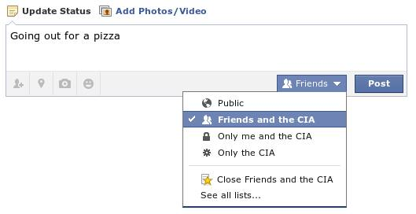
Notes:
Source?

Slide 4

Notes:
Source?
Let’s see who said National ID yes and no. Let’s debate!

Slide 5
My Reading Notes
pp. 274 Arrests, altering and deleting records are violations of privacy?
pp. 275 Why not try to verify and correct records?
pp. 276 Figure does not show # cameras increasing.
pp. 277 300 times = frames, locations, …?
pp. 289 “…don’t want anyone to know…” like seeking medical advice, etc.?
UPDATE
pp. 291 Just because it’s been happening for years doesn’t make it right.
pp. 297 Wouldn’t it be easy to make and show a fake SSN card?
pp. 298 Confusing false positive and negative explanations.
End of Chapter questions: 1, 31, 51

Slide 6
Debate Ground Rules
Before Debate
  15 minutes to converse with your team
  Share argument points, counter points, and responses so everyone can represent
  Decide who will respond to what points from the opposing side
During Debate
  Stand up when speaking
  1 turn per person until everyone on your team has spoken
  30 second limit
  Switch sides at any time if you change your mind
Notes:
National ID or Not Debate

Slide 7
Group Quiz
List two problems with using biometrics for identification.
List two advantages of using biometrics for identification.
Describe two tools people can use to protect their privacy on the Web.
For each of the 4 categories of Daniel Solove’s privacy taxonomy give an example not listed in the book.

Slide 8
Overview
Review
Assignment
Students Present

Slide 9
Assignment – Group Project
Catch up on reading
List of computing technologies portrayed in movie
Categorize computing technologies as existing, future, emerging, impossible, plausible with rationale
Analyze movie for all topics covered to date
See group project slide deck for more
Notes:
Movie group project:
Technology group project:
Add list of movies portraying your computing technology
State if the computing technologies was existing, future, or emerging

Slide 10
Overview
Review
Assignment
Students Present

Slide 11
Social credit scores
Jerish Brown
A score that rates you as a citizen is being implemented in China
This score has real-world consequences that can affect you positively and negatively.
The score can be used to influence behavior of people en masse.
But first, a disclaimer:
  This presentation is about topics relevant to Chinese culture.
  I do not have first-hand experience with some of the topics discussed.
Notes:
Begin presentation with a quick mention of bias and perspective.
I’m an American, and I will be discussing a topic relevant to Chinese culture. Thus, this presentation will be based in some of my American ideals (such as freedom of speech, individual privacy, etc).
Offer anyone with corrections, or a different perspective (especially anyone from China) to comment at the end
Finally, I present my topic, social credit scores.

Slide 12
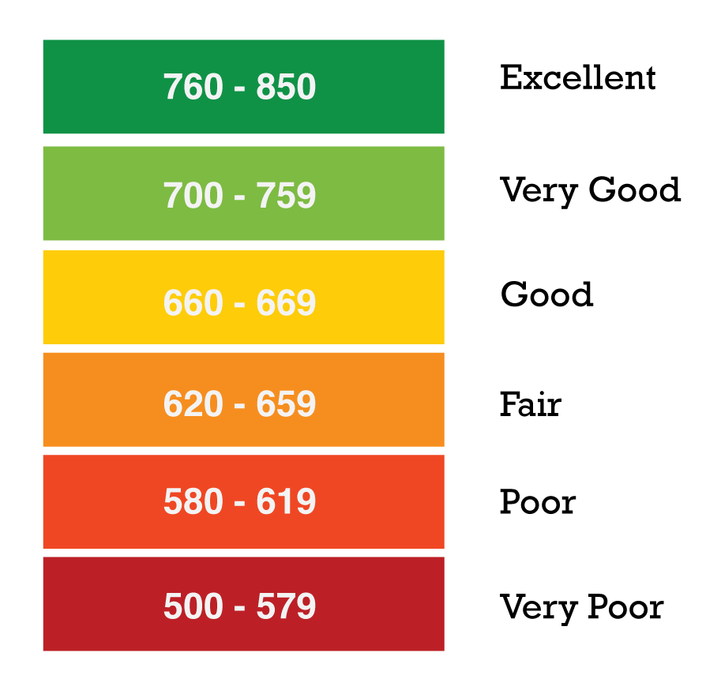
Credit scores
Jerish Brown
A numerical score that represents your credit risk
Used by banks and credit card companies to evaluate risk of lending money
Based off an individuals repayment of loans and debts
Primarily used in the US, but similar systems exist in Germany, the UK, South Africa, Hong Kong, Malaysia, and Singapore. [5]
https://www.besmartee.com/images/blog/FICO-score-chart.png
Notes:
To start, I give some background on credit scores.
Credit scores are a numerical representation of your ability to pay back debt.
Ran by banks, based off of your spending and loan repayments
Used to evaluate risk

Slide 13

Social credit scores
Jerish Brown
A score that rates how good a citizen you are.
China plans ratings will be mandatory by 2020 [1].
Multiple pilot systems currently running.
  Tencent, Alibaba, and more…
Determined using Big Data.
  Where does the data come from?
Notes:
Social credit scores
A score used to rate you as a citizen
Being implemented and used in China as we speak
Multiple “pilot” systems currently being run
Tencent, who own WeChat and many other internet companies.
Also own Riot Games, PUBG Mobile, Activision / Blizzard, etc…
Alibaba, largest online retailer in the world
The score is determined using data about you
Where is this data coming from?

Slide 14
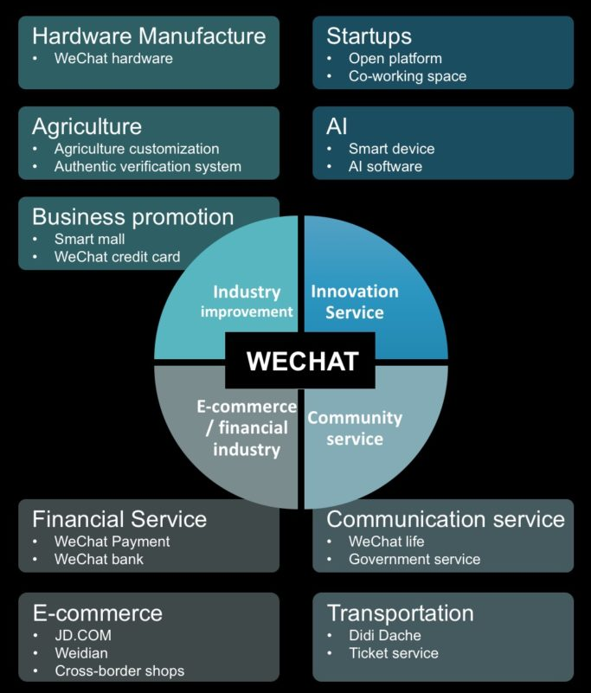
WeChat: the do-it-all super app
Jerish Brown
650 million users in 2015 [2]
  More than the population of the US
Main feature is messaging and microblogging
  Similar to Facebook, Twitter, or WhatsApp
Mobile payments are widespread and often used in China
Includes many other “micro apps”
Requires mobile phone number to sign up [2]
https://walkthechat.com/wechat-impact-report-2016/
Notes:
I want to give context of what WeChat is to those who don’t know
650 million users in 2015
Almost twice the population of the US
Mainly concerned with messaging and microblogging
Has expanded into forms of social media, payment, and app distribution
WeChat “micro apps” let WeChat facilitate different functionalities.
Accounts are linked to real people via a mobile phone number

Slide 15
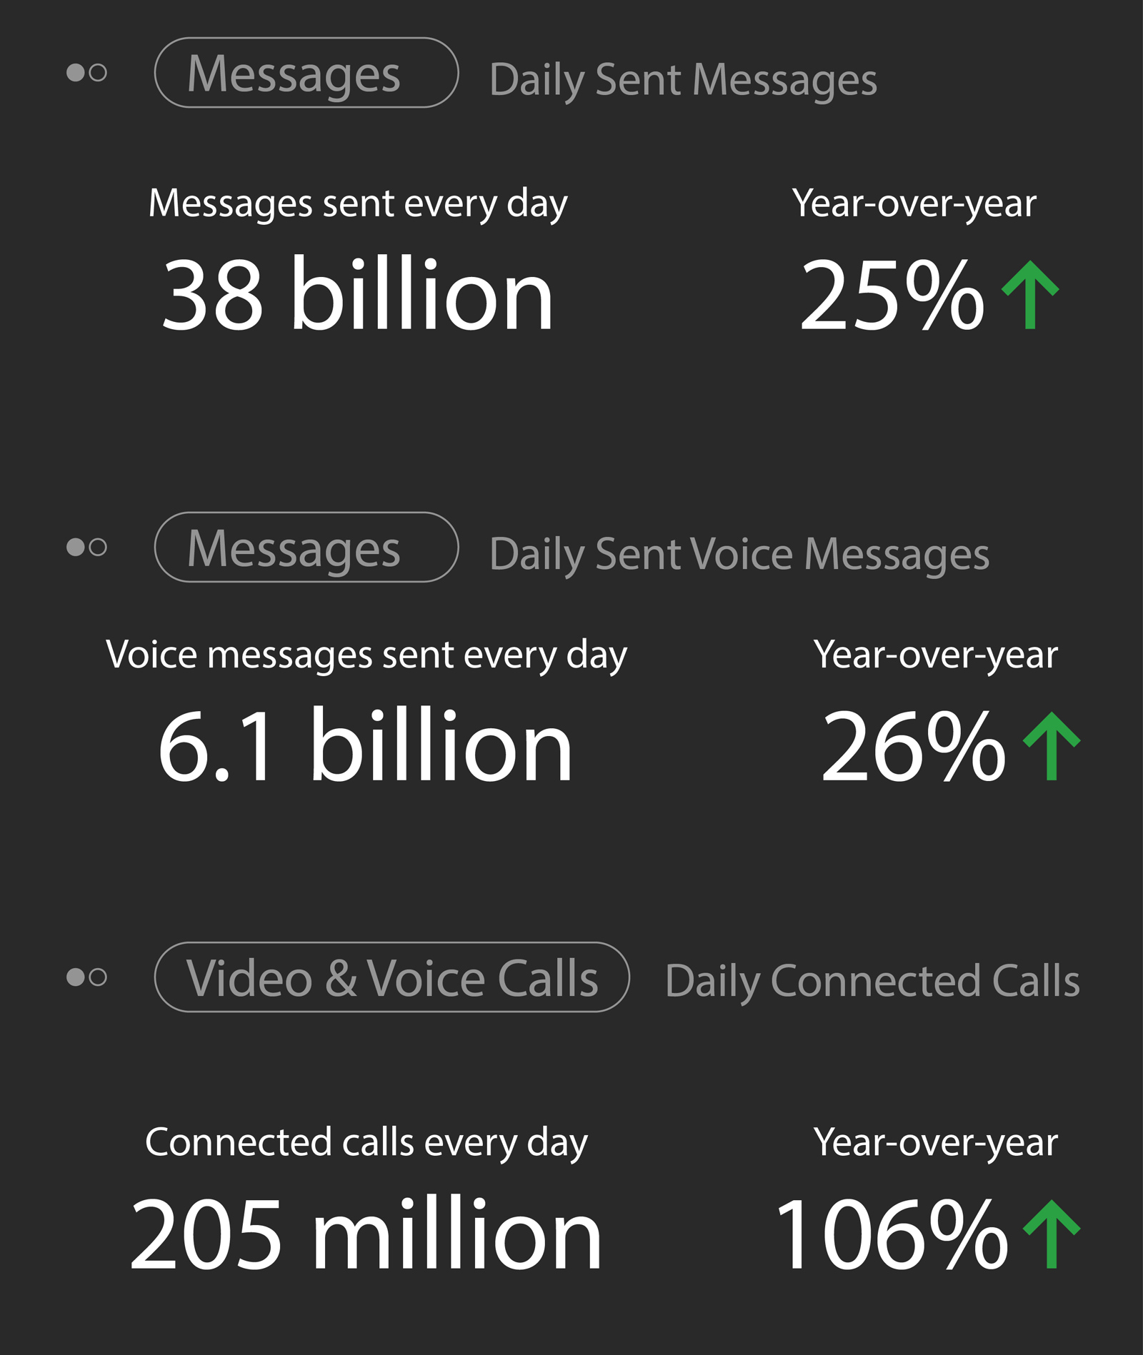
WeChat: data
Jerish Brown
We chat knows a lot about its users.
  Messaging habits
  Topics users are interested in
  What users do in the real world
  Where users travel
  Where users make payments
  Other apps users use
WeChat censors “objectionable” text and punishes repeat offenders. [2]
http://blog.wechat.com/2017/11/09/the-2017-wechat-data-report/
Notes:
Consider all the data that WeChat can collect about its users.
Chat logs
Things people talk about
Topics can be censored
Photos/videos watched and shared
Real world
Restaurant reservations
Movie tickets
Travel
Train/Plane tickets
Payments
Mobile payments through payment service

Slide 16
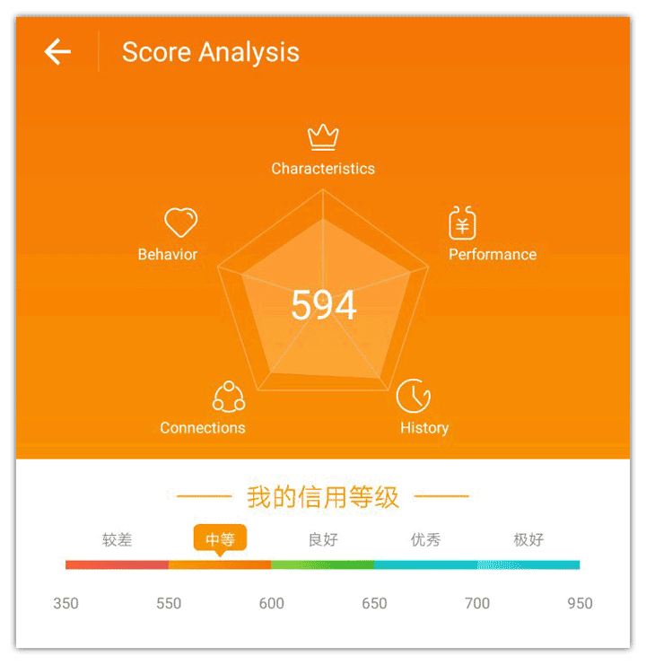
Sesame credit
Jerish Brown
Owned by Ant Financial
  Affiliated with Alibaba, the largest online retailer in the world.
Scores range from 950 to 350.
Your score is based on: [3]
  Social media presence.
  Your purchase history.
  Your friends.
Your score is public knowledge. [3]
https://chinachannel.co/tencent-credit-score-wechat/
Notes:
Sesame Credit is one of the trial systems currently in place in China.
Ran by Ant Financial.
Affiliated with Alibaba, the largest online retailer in the world.
Score range 950 to 350. Point out the scale on the bottom of the chart.
Also make note of the 5-point chart.
Social media presence
Sharing pro-government news: score goes up
Expressing dissent towards the government: score goes down
Purchase history
With data from the largest online retailer in the world, a very clear profile of you could be created
Purchasing local goods from china: score goes up
Purchasing items the system deems bad (video games, or import anime from japan are examples): score goes down
Friends
If you are affiliated with people with a high score, your score can increase.
Likewise, associating with low scoring people can bring your score down.
Finally: your score is public knowledge. Your friends can see it, and that can affect their behavior.

Slide 17
Reactions and benefits
Jerish Brown
People in China seem to enjoy the system.
Well-scoring users can reap benefits
  Easier to aquire visas to Singapore and Europe [4]
  Zero-down payment on hotel rooms or car rentals [3]
  Loans without collateral for online shopping [3]
Low-scoring users can punished
  As of May 1st 2018, restrictions are being placed for low-scoring users [6]
  Low scoring users can be barred from using planes and trains for up to one year [6]
Notes:
People in China seem to like this system, due to the benefits it provides. Chinese citizens are used to surveillance as well.

Slide 18
conclusion
Jerish Brown
Compare to current use of credit scores:
  A bad credit score is difficult to repair
    Negatively impacts your life if you need credit
  A good credit score makes certain tasks easier
    Getting a car, loans, etc
    You get rewards from maintaining good credit
The use of Big Data to create a rating of you as a citizen has scary consequences
  The government can influence your actions using the score
  People can become obsessed with ratings
Notes:
I think this system is dangerous. As an American who values privacy (to some extent) and freedom of speech, a system like this seems like a nightmare.
Consider if the government could punish you for having thoughts or ideas it disagrees with. This can lead to complete control of it’s populace, in the most extreme case. Hopefully we’ve all read 1984.
A bad score could make life hard. You may be limited to lesser jobs, not be able to get a car, or any other things. Punishing lower scored people and rewarding higher scored people could lead make it very hard to improve your score.

Slide 19
References
<Your Name>
[1] BBC (2015) China 'social credit': Beijing sets up huge system. Accessed April 2nd, 2018. http://www.bbc.com/news/world-asia-china-34592186
[2] Eric Harwit (2016) WeChat: social and political development of China’s dominant messaging app, Chinese Journal of Communication, 10:3, 312-327, DOI: 10.1080/17544750.2016.1213757
[3] Rick Falkvinge (2015) In China, Your Credit Score Is Now Affected By Your Political Opinions – And Your Friends’ Political Opinions. Privacy News Online. Accessed April 5th, 2018. https://www.privateinternetaccess.com/blog/2015/10/in-china-your-credit-score-is-now-affected-by-your-political-opinions-and-your-friends-political-opinions/
[4] Jay Stanley (2015) China’s Nightmarish Citizen Scores Are a Warning For Americans. ACLU. Accessed April 3rd, 2018. https://www.aclu.org/blog/privacy-technology/consumer-privacy/chinas-nightmarish-citizen-scores-are-warning-americans
[5] Credit.com (2012) How Do Credit Scores Work in Other Countries? Huffington Post. Accessed April 6th, 2018. https://www.huffingtonpost.com/creditcom/how-do-credit-scores-work_b_1723362.html
[6] Reuters (2018) China to bar people with bad 'social credit' from planes, trains. Accessed April 6th, 2018. https://www.reuters.com/article/us-china-credit/china-to-bar-people-with-bad-social-credit-from-planes-trains-idUSKCN1GS10S

Slide 20

drawbacks OF the GREAT FIREWALL IN CHINA
Ming Shen
Focusing on:
Negative impacts on innovation of China
Hurting business both in and outside China
What is it and what is the cost to build GFW ?
Regulate the Internet domestically
Financial resource: 770 million dollars to start up in 2003.
Human Resource: Government employ at least 50000 people to maintain
[1]
Notes:
The Great Firewall of China is technology action enforced by the People’s Republic of China to regulate the Internet domestically. Its role in the Internet censorship of China is to block access to selected foreign websites and mobile apps and to slow down cross-boarder Internet traffic. Selected foreign websites includes Google, YouTube, Facebook, Gmail and so on.
Since the Great Firewall is a complex system that monitors all level of information flows within the Mainland China and across China’s border, the Chinese government invested heavily to build this system. Although its cost remains a secret, but recorded by China Central Television (CCTV), at least 770 million dollars was spent at the start up point, which was 2003. Up to now, at least 50000 people was employed by the government to enforce the firewall. How much does it cost from 2003 to 2018? It is a secret, I wish I knew.
Not trying to convince everybody that Great Firewall of China is bad or horrible or should be eased immediately, but to talk about some actual drawbacks brought by it. At least what I can see.

Slide 21
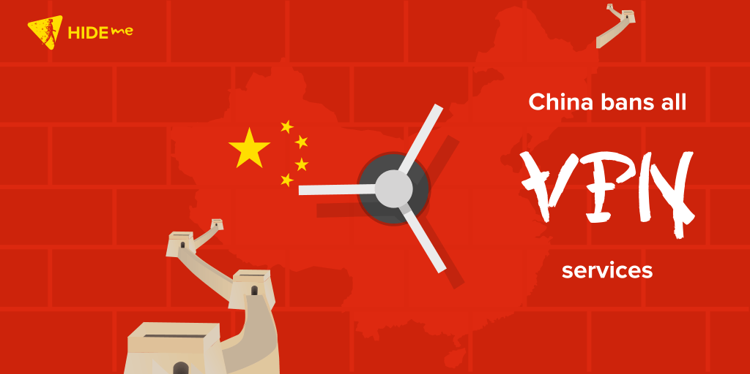
Barrier is even getting harder
Ming Shen
Stamping out VPN
Require all VPN providers be registered
Unregistered VPNs becomes illegal
Using unregistered VPN is actually a crime for business
Gray area for individual
[2]
Notes:
Now Beijing is preparing to create a much harder barrier by stamping out the virtual private network (VPN), that everyone use to access foreign information.
China government demand all the VPN providers be registered as a part of 14-month cleanup program, which started in 2017 and run until March 31, 2018. According to the notice released in Beijing, all VPN services require a prior approval from the government to operate in mainland China – a move making most of the VPNs illegal. The same rule applies to the Internet users – it is now officially a crime using a VPN without prior approval from the Chinese government.
HOW?
All the major State-owned Chinese telecom giants have already been told to make sure that their 1.3 billion subscribers can’t use VPN services to circumvent government censorship.
You may also recall that last year, Apple ejected a number of VPN apps from its App Store over in China at the behest of the government.
As an individual though, there’s a lot of gray area as to whether or not it’s legal to use a VPN. In places like Tibet and Xinjiang which are politically sensitive areas in China, there have been reports that locals have been put in prison for using a VPN. But in areas other than that, you won’t go to jail but you will have trouble.(Confiscate? Watch you to delete the VPN or so?)

Slide 22
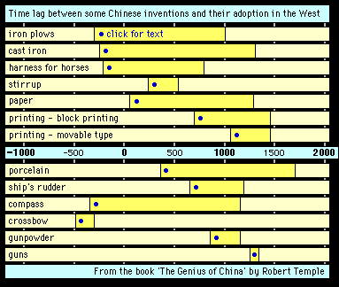
INNOVATION in ANCIENT CHINA, great! but........
Ming Shen
[3]
Notes:
What was it like in ancient China?

Slide 23
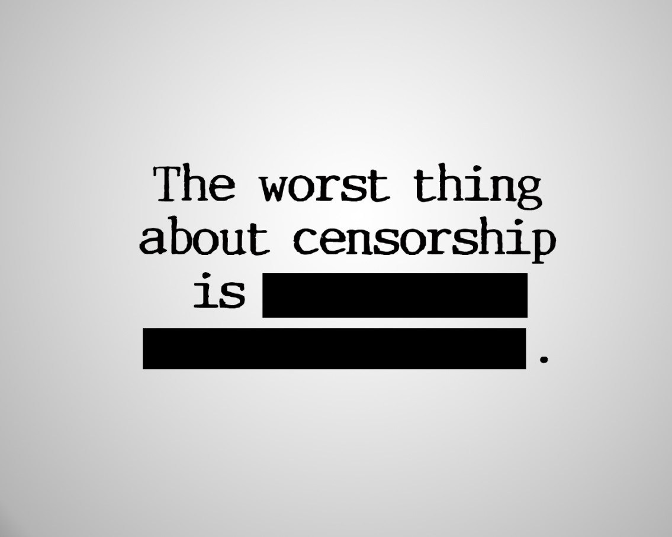
Negative impact on innovation in china
Ming Shen
Entrepreneurs
Not knowing latest trends since global Internet gathers information
Exchanging ideas domestically isn’t enough
Undermines entrepreneurs’ creativity as a result
[4]
Notes:
In some sense, indigenous innovation is dying because of the existence of firewall.
Entrepreneurs don’t know enough about the latest trends with the block of access to world wide Internet where large amount of information are gained.
Free exchange of ideas is an essential part of fostering creativity.
As a result, the concept of Chinese censorship undermines creativity in China.
Yu Dan, a best-selling Chinese author and media expert, says that the creative industries in China suffer from a lack of imagination when compared to the West and attributes it partly to China’s education system. Some of this can be explained by the country’s omnipresent censorship program. Having ‘alien’ philosophies banned or absent from general discourse no doubt feeds into a sense of ‘learned helplessness’ in Chinese culture, affecting Chinese creativity.

Slide 24




Negative impact on innovation in china
Ming Shen
Young Generation
Without direct acknowledge to word leading Internet Companies
Information received always censored
GitHub, Python was blocked for some time period
Online study courses website super slow, like Udacity and Coursera
[5]
Notes:
Generation of youth grown up without direct access to some of the leading international Internet companies and knowledge of how they work.
They hear about them from friends who have spent time aboard, but their access to the newest Internet technology is usually through the offer of Chinese domestic competitors, where information is not original in the first place. Transferred both in language and technologically.
Also, slow traffic is playing the trick inside of it. Imaging this, if you subscribe an online study channel on YouTube but only able to watch it with frequently buffering, you might just get frustrated in the process of seeking inspiration and just quit study from this channel.
For programmers around the world, Github is definitely the primary place to learn and keep track of the international trend. Censoring it will only result in programmers in China being left behind and loosing competitive, not to mention innovation.
Kaifu Lee, who developed world’s first speech recognition system. He posted on Weibo that government should not at least block Github. (Reposted nearly 100 thousands times and 20 thousands comments)
After this, Chinese government can’t take the public opinion and thus Github was unblocked in a few days.

Slide 25
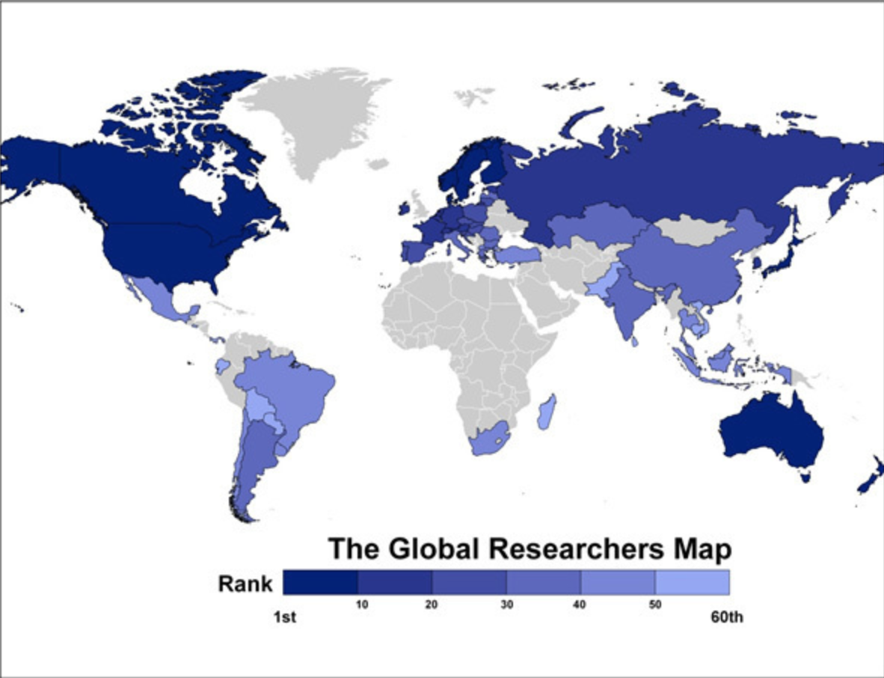
Negative impact on innovation in china
Ming Shen
Scientific Research and Domestic Scholars
Short of resources and lack of comparison
Vital research data and scientific research exist outside mainland China
China ranks only 39th
Maybe not the biggest factor, but important enough
[6]
Notes:
With firewall, the knowledge of other countries’ achievement and world leading technology research results would be limited, or hard to get.
And it is very difficult to achieve world-leading results or to be a frontrunner in global scientific research with those limited resources or even without those knowledge of other countries’ achievements and without comparison.
Vital scientific research exist outside China.
The map shows scientific and engineering researchers per capita. The United States ranks seventh. The top spot would be Finland, and followed by Sweden, Japan, Singapore, and Denmark. China ranks only 39th on the chart.
I am not saying that Internet Censorship is the only or the biggest cause of keeping scientific researches and researchers outside mainland China, what I mean is this censorship is at least playing a significant role of this. Maybe, top researchers may have the impression that China is just not the right place for them selves to do research because of censorship. And maybe slow collaboration with any foreigners keep this outside of China like how to communicate.
China’s president set ambitious targets for Chinese innovation. He urged the nation’s researchers to put China into the ranks of the World’s most innovation societies by 2020. By 2049, president expects China to transform into the world’s leading science and technology power.
How can Chinese researchers fulfill this given that the Firewall blocks everything from online tools like Google Scholar? If China can’t access Google or other resources on the Internet, it is impossible for Chinese scholars to have a good vision and open minds.

Slide 26

Hurting business both in and outside china
Ming Shen
Could Computing Industry
Impact on world-wide business
[7]
Notes:
Cloud Computing Business in China:
Cloud computing makes user signing up online and having access to computer service through out Internet without human intervention. Many international firms offers cloud computing services that can hold massive amount of customer data and run software around the world, but because of regulatory restriction in mainland China and also Great Firewall makes internet access to offshore sites slow and unreliable, they generally don’t set up servers in China. So, the impact brought by the Internet wall not only holds back Chinese international Internet access, but also hurt Chinese cloud computing industry.

Slide 27
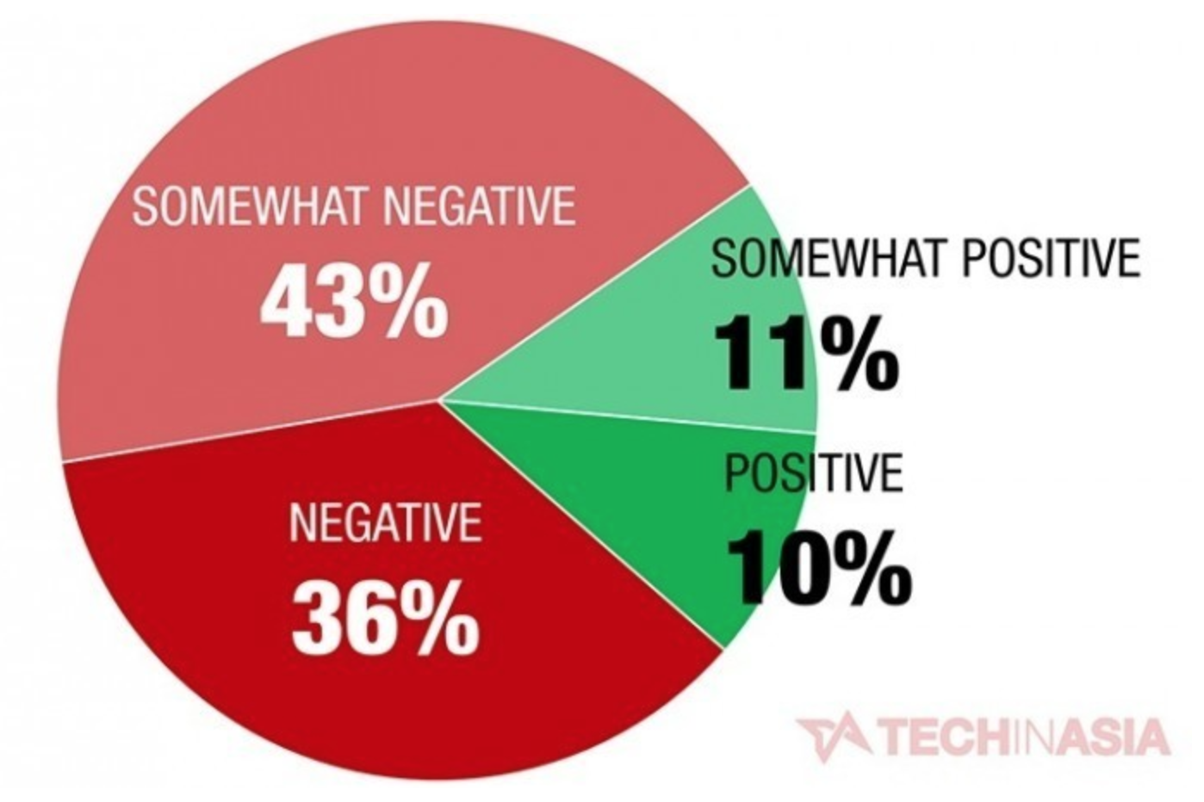
Hurting business both in and outside china
Ming Shen
Slow traffic
VPN bans
80 percent of American companies operate in China suffers from the Great Firewall
[8]
Notes:
For overseas companies, many of them set up their own corporate VPNs for Internet use or subscribe to a corporate VPN package for their China offices. Accessing foreign website inside China mainland is already slower than accessing Chinese domestic website, and using VPN to bypass the wall slows the speed even more. Sometimes VPN services or individual connections can stop functioning properly for hours or even days. These all leads to unexpected drop in productivity.
According to a report put out by American Chamber of Commerce in China, four in five American companies operates in China say that the country’s heavy internet censorship has negatively impacted their business. Only 5 percent say they have “no complaints” about the country’s Internet controls. The report focuses on American companies, but its trends should hold true for most foreign companies operating in China.

Slide 28
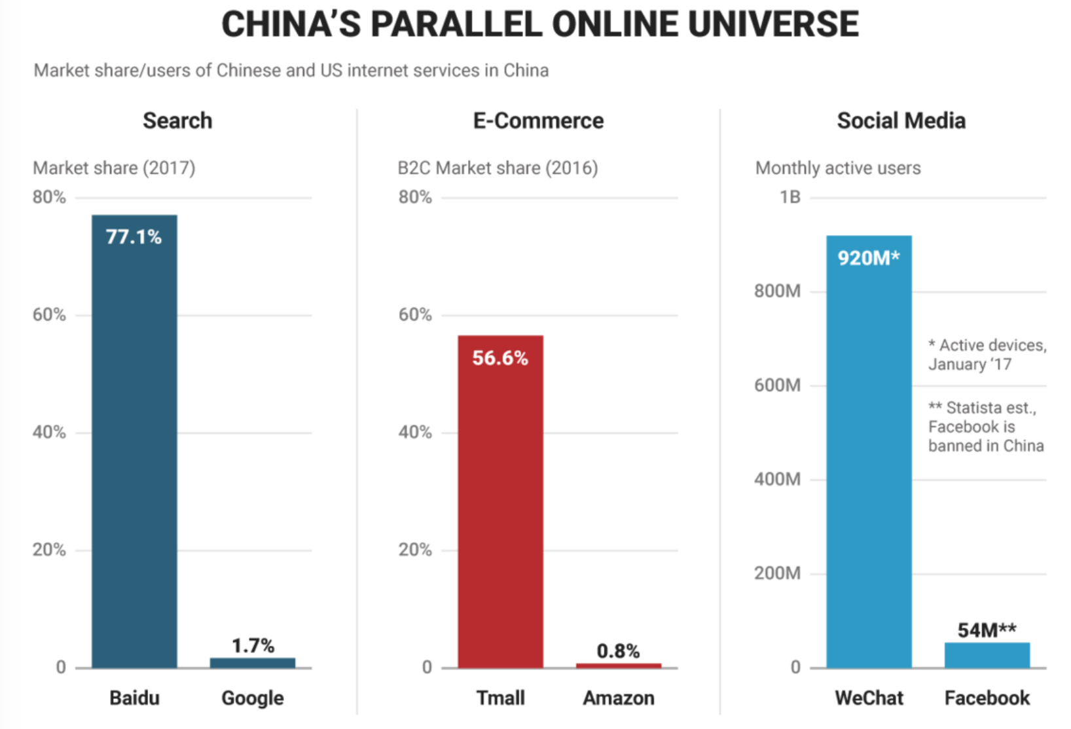

Counter point does exist
Ming Shen
Domestic competitors have a lot more breathing room
Example: RenRen
[9]
Notes:
Counter point also exist that China’s investment in web censorship isn’t such a bad thing because such censorship can provide a mechanism for protecting local technology firms by fending off competition from some powerful international players. Thus local firms have a lot more breathing room here.
As we can see in the chart, the vast majority of people in China flock to domestic sites and services with the existence of the Great Firewall.
Example: RenRen
After Facebook and Twitter banned in 2009 in China, a domestic Facebook competitor quickly sweeping in to claim the market. Actually Renren is one of the most direct comparable to Facebook, also founded by colledge students at Tsinghua University in Beijing. Also like Facebook, it was initially open only to college students, before expanding to open itself to the broader population.

Slide 29
References
Ming Shen
[1] Briefing, China. "China’s Great Firewall: Business Implications." China Briefing News., last modified -06-01T16:49:03+08:00, accessed Apr 3, 2018, http://www.china-briefing.com/news/2017/06/01/chinas-great-firewall-implications-businesses.html.
[2] "China Bans the use of Unauthorized VPN Services to Bypass Great Firewall." hide.me., last modified -01-24T16:12:03+00:00, accessed Apr 3, 2018, https://hide.me/en/blog/2017/01/china-bans-vpn-use/.
[3] "China Document Based Questions." Smore., last modified -04-19T14:25:01, accessed Apr 4, 2018, https://www.smore.com/5eauw-china-document-based-questions.
[4] Blogger, Guest. 2015. Why Internet Censorship is Bad for Everyone | Techish. Techish Kenya. https://tech-ish.com/2015/09/10/why-internet-censorship-is-bad-for-everyone/.
[5] Kumar, Mohit. "Indian Government Blocks 32 Sites, Including GitHub, Pastebin, Imgur and Vimeo." The Hacker News., accessed Apr 4, 2018, https://thehackernews.com/2015/01/indian-government-blocks-32-sites.html.
[6] Florida, Richard. "The World’s Leading Nations for Innovation and Technology." CityLab., accessed Apr 4, 2018, http://www.theatlanticcities.com/technology/2011/10/worlds-leading-nations-innovation-and-technology/224/.
[7] "What is Cloud Computing?" | Vizteams., last modified -04-12T13:36:28+00:00, accessed Apr 4, 2018, http://www.vizteams.com/blog/what-is-cloud-computing/.
[8] "79% of American Companies Say China’s Internet Restrictions are Hurting Them." Tech in Asia., last modified -01-20T09:47:48, accessed Apr 4, 2018, https://www.techinasia.com/china-amcham-restrictions-internet-survey.
[9] Cakebread, Caroline. "One Chart shows how Different the Internet Landscape Looks in China." Business Insider., accessed Apr 4, 2018, http://www.businessinsider.com/one-chart-shows-the-companies-dominating-the-chinese-internet-2017-8.

Slide 30
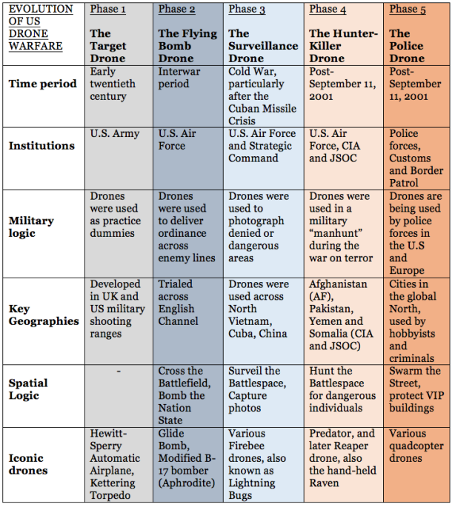
Evolution of Drones
Henry Dunphy
https://understandingempire.wordpress.com/2-0-a-brief-history-of-u-s-drones/
Notes:
First drones were remote controlled vehicles used for target practice. Flying bomb drone are missiles like V1 and V2. Surveillance drone predecessor of Predator. Hunter Killer drone Predator/Reaper. Smaller easier to control drones that can provide surveillance for anyone including police.

Slide 31
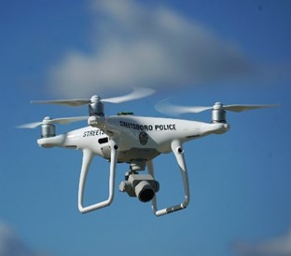
Drones in Law enforcement
Henry Dunphy
Makes work simpler and safer
Able to locate targets and civilians
Records the events
1st Arrest in 2011
https://www.policeone.com/police-products/Police-Drones/
Notes:
Drones make police work simpler and safer. Can send drone in first to gain intelligence without the risk of human lives. Reduces surprises where cops accidentally kill innocent people. Not just used for criminals, but also very useful in disaster relief efforts. Able to spot people in need and cut down on searching time. Can save video which can be used for evidence or to confirm targets. [1] Rodney Brossart, a North Dakotan cattle rancher was first American arrested with assistance from a drone, for terrorizing police officers who were trying to arrest him at his property in 2011. Used drone to locate him since it was a big property and he had a high powered rifle [2].

Slide 32
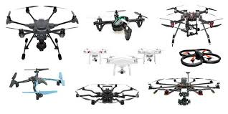
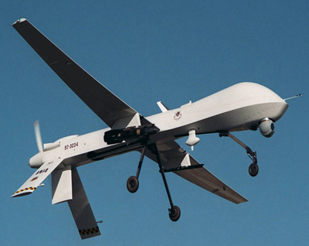
Examples of use
Henry Dunphy
1st Arrest in 2011
Arlington, Texas Police Department
LA Police Department
Little Rock Police Department
http://3dinsider.com/hexacopters-quadcopters-octocopters/
https://science.howstuffworks.com/predator.htm
Notes:
Rodney Brossart, a North Dakotan cattle rancher was first American arrested with assistance from a drone, for terrorizing police officers who were trying to arrest him at his property in 2011. Used drone to locate him since it was a big property and he had a high powered rifle [2].
Arlington police first used it for an aerial view of crash scene. Second time was there was an active shooter hiding in his apartment. Used drone to get an idea of where he was so they could know where to put their officers [3].
LAPD stopped using drones do to public opinion, people felt as if their every move was being watched [3].
Little Rock already has a lot of public surveillance, but they were too unreliable with a few crashes decided to abandon the UAVs [3].

Slide 33
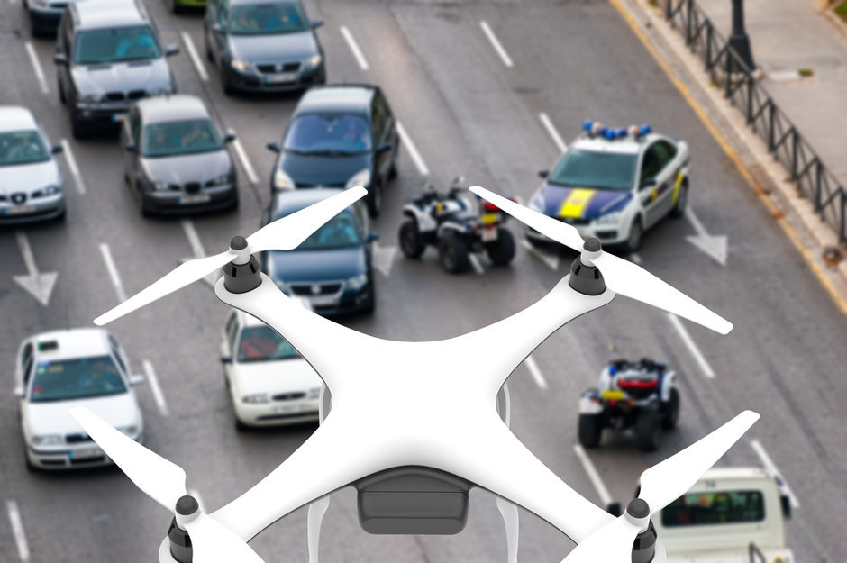
Ethical Considerations
Henry Dunphy
4th Amendment
FAA – Federal Aviation Administration
Orwellian society
Update privacy laws
http://www.govtech.com/public-safety/Drones-Offer-New-Advantages-for-Police.html
Notes:
The Fourth Amendment protects against arbitrary arrests, and is why police need search warrants, wiretaps, and other forms of surveillance [4]. Police need a warrant in order to use drone. Is there a difference between a drone on patrol and a cop car, most people would say yes, but right now (at least federally) cops can send drones on patrol [1].
FAA has some laws in place about where you can fly. Within line of sight, not near other aircraft or over people, away from airports, and only during the day below 400 feet [5].
No laws specifically about privacy, Airspace around private property is considered public airspace and officers could use drones to observe suspects from “public airspace” similarly to Florida v. Riley supreme court case [6]. Where police officer flew about a house to look for marijuana.
Orwellian society used small flying robots to spy on people and make sure they didn’t do anything wrong [7].
Stanford lawyer argues drones will force us to update privacy laws which have lagged behind other technological development such as the internet, GPS, biometrics, or facial recognition [7]

Slide 34
References
Henry Dunphy
[1] Cedar Attanasio, “Drones Offer New Advantages for Police”. Justice and Public Safety. http://www.govtech.com/public-safety/Drones-Offer-New-Advantages-for-Police.html (4/4/18)
[2] Jason Koebler. "North Dakota Man Sentenced to Jail In Controversial Drone-Arrest Case". US News. (4/5/18)
[3] Anthea Mitchell, “Should America be Worried about Police Drones?”. The CheatSheet. https://www.cheatsheet.com/politics/are-police-drones-a-privacy-nightmare-or-a-safety-advantage.html/?a=viewall (4/5/18)
[4] U.S. Const. amend. IV. Retrieved from https://www.law.cornell.edu/constitution/fourth_amendment (4/5/18)
[5] https://www.faa.gov/uas/getting_started/ (4/5/18)
[6] Florida v. Riley, 488 U.S. 445 (1989) (4/5/18)
[7] Ryan Calo. “The Drone as Privacy Catalyst”. Stanford Law Review. https://www.stanfordlawreview.org/online/the-drone-as-privacy-catalyst/ (4/5/18)

Slide 35
Class 7
The End
Keith A. Pray
Instructor
socialimps.keithpray.net
Notes:
This is the end. Any slides beyond this point are for answering questions that may arise but not needed in the main talk. Some slides may also be unfinished and are not needed but kept just in case.

