Slide 1
Class 5
Intellectual Property
Keith A. Pray
Instructor
socialimps.keithpray.net
Notes:
Here’s the title slide. Excited already, aren’t you?
Weird Al Yankovic “Don’t Download This Song” (3:53)
https://www.youtube.com/watch?v=zGM8PT1eAvY

Slide 2
Logistics Reminder
Do not change the format, footers, etc. in the template slides
Put your name on each slide in the location indicated
Send email, especially presentation drafts, to both evan@wpi.edu and kap@wpi.edu
Notes:
If needed:
Paper writing process: Sources → Notes → Conclusion → Argument → Counter Point → Response

Slide 3
Overview
Review
Assignment
Students Present
Guest Speaker –

Slide 4
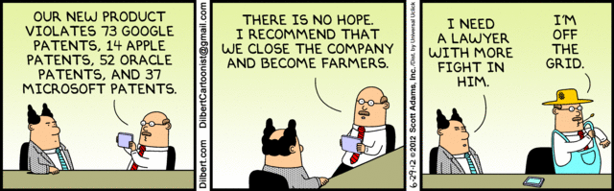
Notes:
Comments, observations, questions on IP Chapter?

Slide 5
My Reading Notes
pp. 165 “...ownership of ideas...” not quite right
pp. 168 public domain year 1997/1999 from source published in 1996?
pp. 170 SaaS, Google Search example? “…before he gave them the plot.”? “…cannot erase the memories...” Paycheck (2003)
pp. 180 4.4 #2 preferred?
pp. 186/196 revenue != profit
pp. 190 blocking 100% seems impossible
pp. 194 Any legitimate BitTorrent use examples since 2005?
pp. 197 “licensing agreement … hardware”?
pp. 198 4.7.3 references?
pp. 205 Perhaps friends should not ask you to break the law?
Any successful industries operate as a support service?
pp. 207 Is Perl still most popular? Quality study from 2003, change?
pp. 209 who uses tape?
pp. 210 “human-readable, lawyer-readable…”
pp. 223 Interview has nothing to do with computing

Slide 6
Group Quiz
For each On the left answer a–d on Right
Trademark
Copyright
Patent
Trade Secret
What kind of IP does it protect?
What qualifications does the IP have to meet to be protected?
How long does the protection last?
Give a specific example of IP currently protected?
Notes:
Trademark
Used to denote a product or service.
Apply in specific areas of commerce. Only applies in specified area of business
Indefinite term as long as in use and protected against becoming a common noun or verb.
You do not have to register a trademark unless you want to bring litigation before a federal court (there are other benefits too, but what are they?)
Copyright
Expression, not ideas: Fuzzy. E.g. derivative works, characters, merchandising, plots.
Mickey Mouse, Tarzan.
US Default : Original Author, Exception: work for hire, Transferred: yes
Rights: Publication, Performance / exhibition, Adaptation to other media, Excerpting, Attribution, Derivative works
US Term: Lifetime of author plus 70 years., 95 years for companies.
Governed by US law and international treaties (e.g. WIPO).
Fair Use: News reporting, reviews, etc., Scholarly / educational use, Private, non-commercial use, Lending libraries and archives
Fair Use restrictions: Admission charge, Re-transmission
In general, you can: Read, view, play, etc., Copy for personal use., Time-shift, Space-shift
In general, you cannot: Copy for others., Transfer to someone else but keep a copy., Show / perform it publicly.
What about video rentals?
Rationale: Encourage creativity. Encourage dissemination. Balance between private and public good. It’s a social contract.
Patent
A mechanism, process, or composition of matter.
Must be: Novel. Useful. Non-obvious. Described clearly. Must do what it says.
Usual term 20 years.
Utility and plant patents: 20 years.
Design patents last 14 years. (ornamental design of functional item)
Provisional patent gives 1 year, before full patent
Trade Secret
You must take steps.
Enforceable by: Contracts, Laws against industrial espionage.

Slide 7
Overview
Review
Assignment
Students Present
Guest Speaker
Notes:
But first take a look at:
CGP Grey
Copyright: Forever Less One Day (6:27)
https://www.youtube.com/watch?v=tk862BbjWx4
Tom Scott
http://tomscott.com
Welcome To Life (2:44)
https://www.youtube.com/watch?v=IFe9wiDfb0E&feature=youtu.be

Slide 8
Assignment - Self Search 1/3
Profile 2
Is You
1 Page
Paper
Filter
Inspiration
Search Methods
…
…
…
…
Filter
Profile 1
Could Be You

Slide 9
Assignment - Self Search 2/3
Discussion Board
Post ways one can search for information about a person. Do not repeat entries.
Use each search method listed to produce 2 profiles as an appendix of your paper. Provide a brief description if you’d rather not list the details.
  Profile 1: all information someone might think is you
  Profile 2: all information you know is you.
  You are not responsible for methods posted less than 24 hours before class.
For each search method result consider:
  Exactly how did the data get there?
  How can this data be used?
  Is this a secondary use?
  Did you authorized use of the data? If not and you want to, request its use be discontinued and post the correspondence.
Dig deeper than a basic search engine’s (Google, etc.) results.
Do not pay for search services

Slide 10
Assignment - Self Search 3/3
1 Page Paper
Use your search results to help support your conclusion.
This assignment requires you revisit the Discussion Board frequently as new search methods are posted, subscribe to it.
Conclusion idea examples (not comprehensive):
  What impression would a potential employer have of you given these results, assuming they also had a resume and possibly a cover letter from you?
  What would your elder family members (or equivalent) think?
  Are you comfortable with what you found or did not find?
  Do you believe protecting your privacy is important or needed?
5 High quality sources still required

Slide 11
Overview
Review
Assignment
Students Present
Guest Speaker

Slide 12


Facebook’s Relicense to MIT From BSD+Patents was worse
Dylan Fontana
June 2017
  Apache blacklists Facebook License
June-Sept 2017
  Community discussion on Licensing
  Centered on ReactJS
Sept 2017
  Automattic (Wordpress) plans to change from ReactJS
  Facebook relicenses to MIT
Notes:
Today I want to talk about Facebook’s relicensing of their popular ReactJS library from their in-house BSD+Patents license to MIT, and how removing the patent protection puts mot people in a worse position. The chain of events leading to this started this past June when the Apache Software Foundation blacklisted Facebook’s BSD+Patents license due to incompatibilities with their own. This sparked a community wide debate centered around ReactJS in the subsequent months, finally coming to a peak in September when Wordpress released a statement that finally swayed Facebook to change.
Images:
Apache: https://www.apache.org/foundation/press/kit/
Facebook: https://en.facebookbrand.com/assets/f-logo

Slide 13


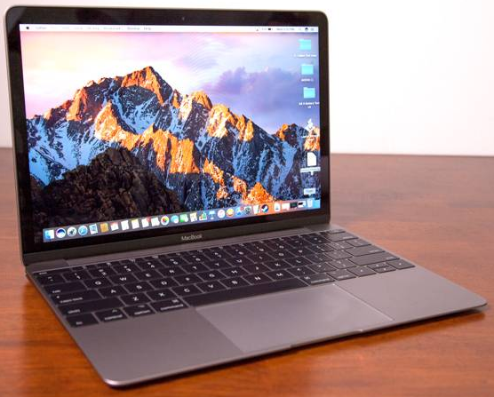
Patent Retaliation Clauses
Dylan Fontana
Weak
Example: Slide to Unlock [4]
  Apple Licenses to Venmo
  Venmo patents “Slide to Pay”
  Apple blocked from using in Apple Pay
Patent Retaliation Clauses [3]
  Weak revokes license if suit on related software (Apache) [5]
  Strong revokes license if suit on any patent held (Facebook) [2]
License
Infringement
Strong
License
Infringement
Notes:
To clarify, the issue with Facebook’s licensing wasn’t with the Copyright portion of it – it was strictly with how the patent license was phrased. Their patent licensed gave explicit permission for the user to utilize Facebook’s ReactJS with the patents inside it.
But an issue arises with patented code, however, that can be demonstrated as such. Apple holds the patent “Slide to Unlock”, and licenses to Venmo to secure their payment app. Venmo realizes they can apply this and make “Slide to Pay,” an improvement that they patent. Now Apple is blocked from using “Slide to Unlock” in Apple Pay without a license from Venmo [4].
To solve the problem of Patent blocking, a ”Patent Retaliation Clause” is included to prevent Venmo from suing Apple for patent infringement in this realm, by revoking the underlying license that allowed Venmo to utilize Apple’s technology to build their improvement [3]. A Weak clause is one that will revoke the license if the infringement case is related to the specifically licensed software (Apache License). A Strong clause will revoke the license if the infringement case is for any product made by the licensing company, no matter the relation (Facebook BSD+Patents). In the illustration, this would be akin to if Venmo had a patented laptop that Apple copied in their new Macbook, and in defending their patent, Apple revokes their license to use “Slide to Unlock.”
Images:
Macbook: https://www.laptopmag.com/reviews/laptops/macbook
Apple: https://logos-download.com/18516-apple-logo-download.html
Venmo: https://bucknellian.net/73035/satire/senior-student-stays-saturday-night-refreshes-venmo-feed-feel-included/

Slide 14
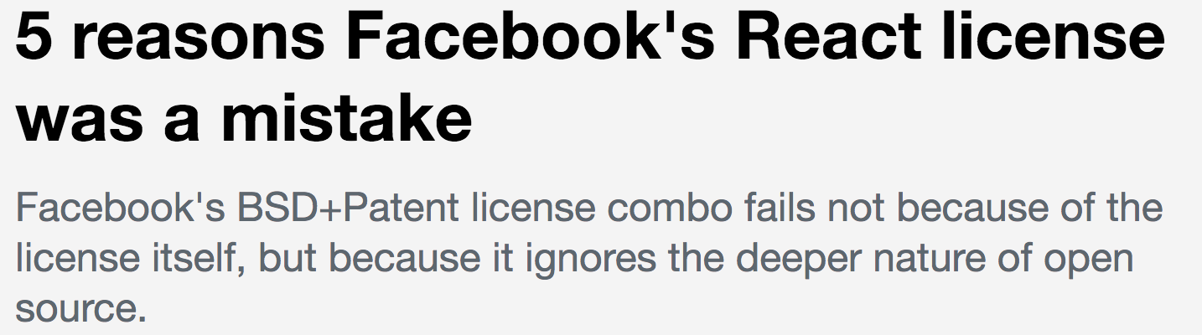

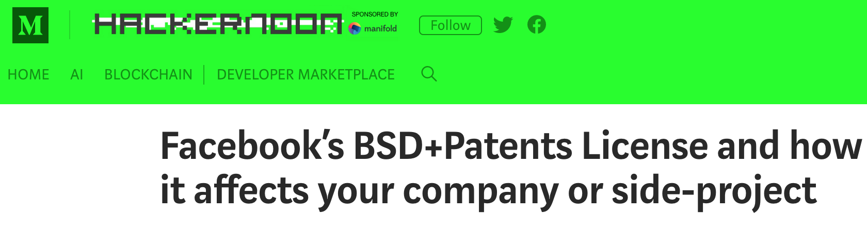

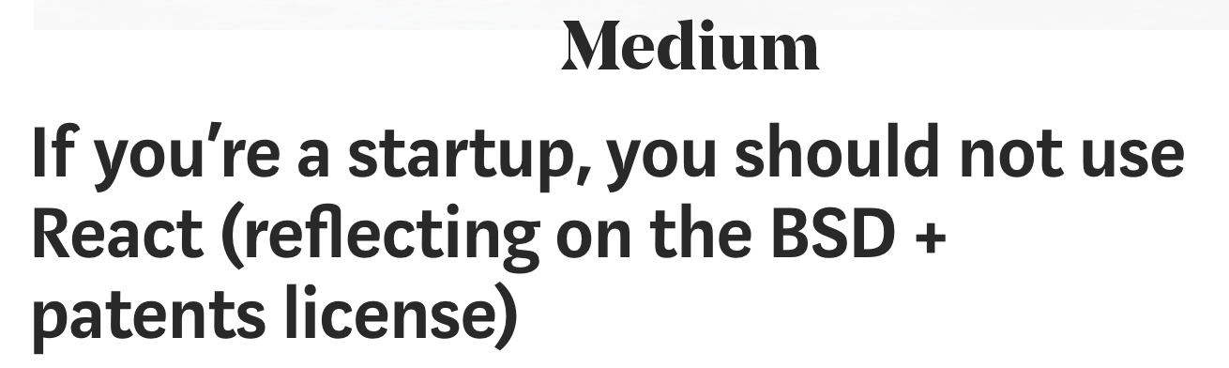
Strong is too Strong
Dylan Fontana
Grants Legal Immunity
  Protect without punishment?
  Can’t be acquired by Giants
Require swapping frameworks
  Customers must too
WordPress plans removal
  30% of Web, $1.16B [13, 14]
  Shouldn’t have to explain ‘BSD + Patent’ is okay [8]
Notes:
As a result of the strong policy, the community feared this would inhibit protecting your patented idea if Facebook decided to enter your arena. If you tried to sue Facebook, any products you made with React (or other Facebook libraries) would be compromised [7]. Articles surrounding the license were published, GitHub issues opened, and a lot of people were generally concerned about the implications [pictured]. If they couldn’t protect their ideas, what were they to do?
Additionally, some recognized that if their startup wanted to sell to a large corporation such as Google, their usage of Facebook’s product now prevents Google from protecting itself from patent infringement against Facebook. If Google (or any company) wanted to sue Facebook, they would need to swap their products from using Facebook’s first, as well as ensure none of their customers are using an outdated version still using Facebook’s product. This is both prohibitively expensive and time consuming, making it near impossible to fight back.
In wake of the backlash, WordPress felt the need to drop React. Being a representative of 30% of Websites and worth $1.16B, their usage of ReactJS would be a significant boost to the libraries already popular uptake. Wordpress, in fact, didn’t see anything wrong with the license itself. Their issue was with dealing with the community, and as they put it, they “… have a lot of problems to tackle, and convincing the world that Facebook’s patent clause is fine isn’t ours to take on. It’s their fight” [8]. At this point, the argument had moved past just the licensing and was now about handling the widespread concerns with licensing.
Images:
5 Reasons: https://opensource.com/article/17/9/5-reasons-facebooks-react-license-was-mistake
Replace with mithril: https://github.com/Automattic/wp-calypso/issues/650
Hackernoon: https://hackernoon.com/facebooks-bsd-patents-license-and-how-it-affects-you-66088e052845
Medium: https://medium.com/@raulk/if-youre-a-startup-you-should-not-use-react-reflecting-on-the-bsd-patents-license-b049d4a67dd2
On react: https://ma.tt/2017/09/on-react-and-wordpress/

Slide 15
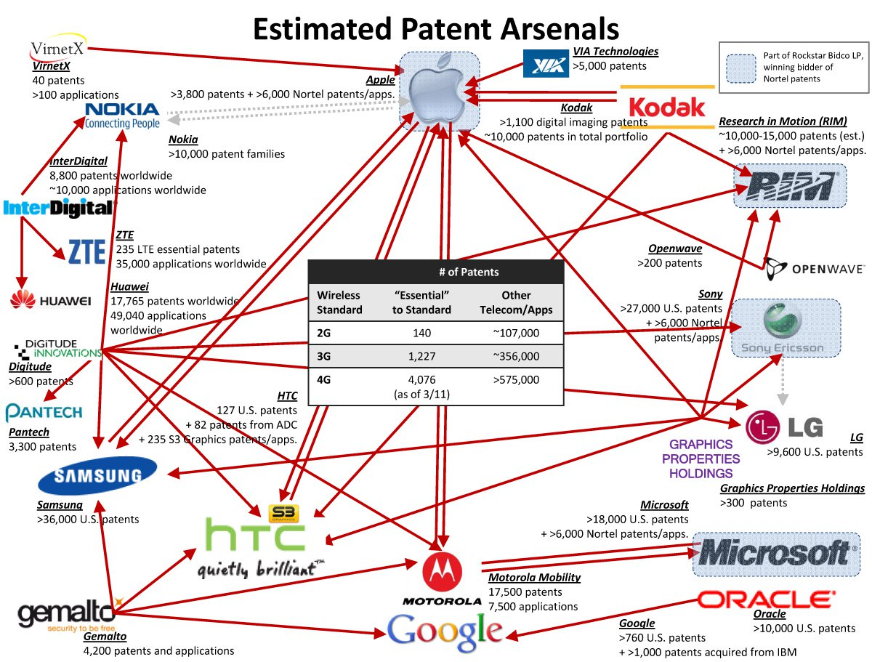
IS facebook in the right?
Dylan Fontana
Fight meritless litigation [9]
  AIPLA Litigation cost $4.4M
  60% from NPEs (Meritless) [15]
Adoption of license is good [9]
  Trolls lose a part of their case
  Companies save time and money
  Customers get explicit license
Inhibits valid patent defenses
  Most won’t conflict/desire to sue
  NPEs & Tech Giants worse off [11]
Notes:
Was Facebook Wrong? Their intent was to protect from patent litigation due to high cost and meritless basis. According to the American IP Law Association Economic Survey of 2013, the average cost of a litigation suit was $4.4 Million (discovery+deposition). Additionally, 60% of all litigation suits originate from NPEs (Non-practicing entities). As such, Facebook’s actions are true, given that litigation is extremely costly and mostly meritless.
If we consider all affected by this policy – the trolls, the companies, and the customers – then we can see these actions further justified. By adding a clause such as this, meritless lawsuits lose a credible court case given their patents are now based on unlicensed technology. The companies save both time in court and the costs of defending themselves. Customers get the explicit license they need to safely work.
If this was a weak clause, we’d stop there. In the strong case, however, some argue that innocent cases (“merit-ful”) of patent litigation would be unable to properly protect their patent. If Facebook were to intrude upon a patent of theirs, to defend their patent this company would lose all licensing they have for their other products using Facebook products – and as such they would be forced to rewrite their codebase, costing them additional time and money they may not have. The counter point to this, and the reasoning why WordPress was okay with the license, is that only NPEs with large patent portfolios and Tech Giants would be worse off, as they are the ones who would most likely have conflicting patents with an interest to litigate [11]. The majority of others, in their legal councils eyes, wouldn’t have a patent that conflicts or an interest in offensive litigation to begin with.
Image: http://c4sif.org/2012/04/web-of-tech-patent-lawsuits-infographic/ (As reported in PCMag: https://www.pcmag.com/article2/0,2817,2399098,00.asp)

Slide 16
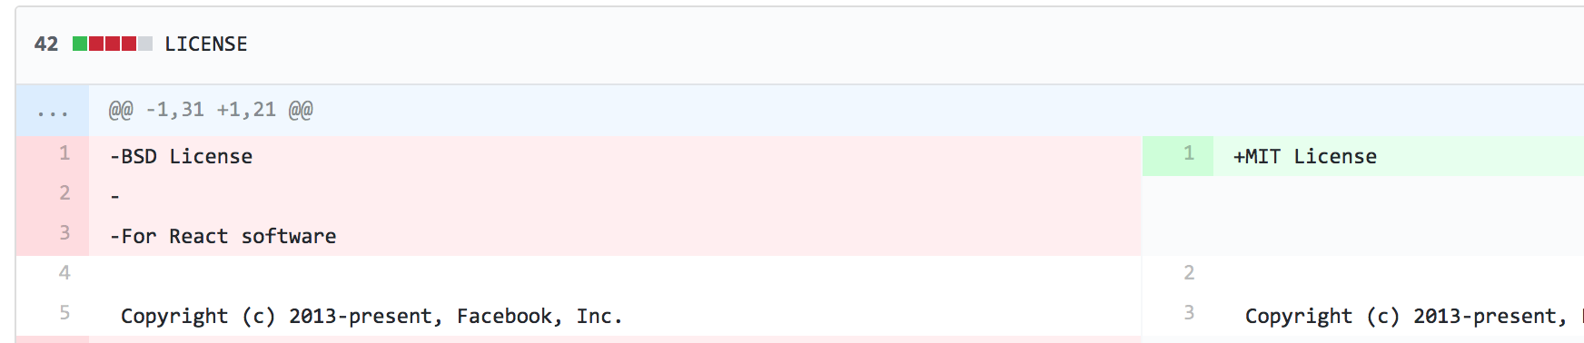
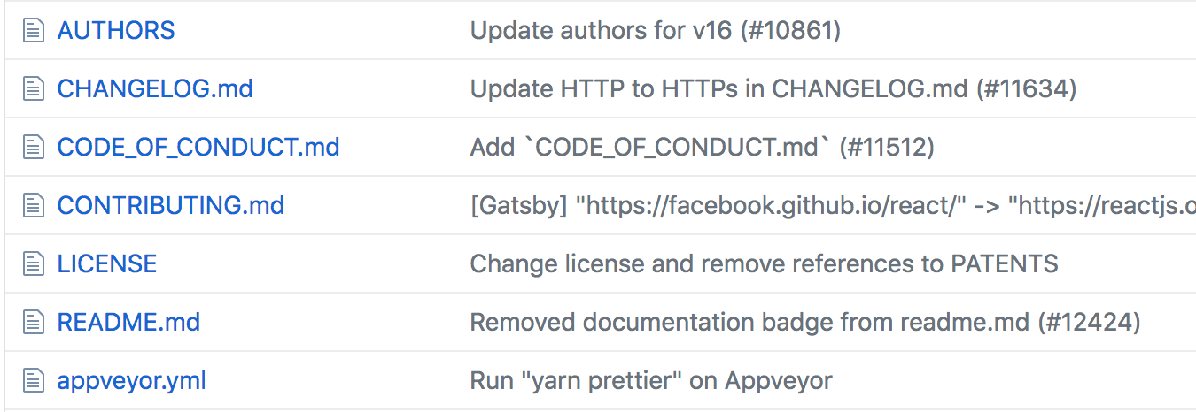
  Most in a worse position than with BSD+Patents
Dylan Fontana
Facebook moved to MIT
  Daniel Nazer - “You’ve gone from having an express license to an open question” [10]
Problem went on for years
  Noticed after PATENTS read
  Misinterpretation and panic lead to sweeping actions
Remember your role
Notes:
In the end, Facebook relicensed to MIT to resolve the community unrest and WordPress concerns – removing both BSD and Patent clauses. Unfortunately in doing so, this removes the explicit permission to utilize Facebook’s patents leaving a large legal gray area. As the Electronic Frontier Foundation’s patent attorney Daniel Nazer puts it, “You’ve gone from having an express license to an open question. …Only if you were planning to sue Facebook for patent infringement, or thought that was reasonably likely in your future, are you better off now.” [10]
The larger lesson learned from this entire matter, perhaps, is that open source doesn’t mean free to use. This license went used for years as the library grew in popularity, but only until someone looked more closely at the Patents clause did they realize what they signed up for. The widespread misinterpretation of this license then lead to sweeping actions as the community attempted damage control. And as a final result, the legal protections Facebook sought to give their users are now a gray, murky swamp of unknowns.
As developers in the business world, its important to remember your role when bringing in new libraries and licensing your own. Being wary of more than just copyright is one of your responsibilities.
Images: https://github.com/facebook/react/blob/d63249d03488fec1ea92a81ba29f0e87a82feeae/PATENTS

Slide 17
References (1/2)
Dylan Fontana
[1] Open Source Initiative (n.d.) Retrieved from https://opensource.org/licenses/BSD-3-Clause
[2] Facebook. (2017). GitHub. Retrieved from https://github.com/facebook/react/blob/d63249d03488fec1ea92a81ba29f0e87a82feeae/PATENTS
[3] Rosen, Lawrence & Einschlag, Michael. (2004). Rosenlaw & Einschlag. Retrieved from https://www.rosenlaw.com/lj9.htm
[4] Walsh, Dennis. (2017). Medium. Retrieved from https://medium.com/@dwalsh.sdlr/react-facebook-and-the-revokable-patent-license-why-its-a-paper-25c40c50b562
[5] Apache Software Foundation. (2017). Apache Software Foundation. Retrieved from http://www.apache.org/licenses/LICENSE-2.0.html#patent
[6] Mattmann, Chris. (2017). Apache Software Foundation. Retrieved from https://issues.apache.org/jira/browse/LEGAL-303?focusedCommentId=16052957&page=com.atlassian.jira.plugin.system.issuetabpanels%3Acomment-tabpanel#comment-16052957
[7] Kripalani, Raul. (2017). Medium. Retrieved from https://medium.com/@raulk/if-youre-a-startup-you-should-not-use-react-reflecting-on-the-bsd-patents-license-b049d4a67dd2
[8] Mullenweg, Matt. (2017). WordPress. Retrieved from https://ma.tt/2017/09/on-react-and-wordpress/
All webpages displayed were accessible on March 28th, 2018.

Slide 18
References (2/2)
Dylan Fontana
[9] Wolff, Adam. (2017). Facebook. Retrieved from https://code.facebook.com/posts/112130496157735/explaining-react-s-license/
[10] Collins, Keith. (2017). Quartz. Retrieved from https://qz.com/1087865/outraged-programmers-stood-up-to-facebook-fb-over-open-source-licensing-and-won-sort-of/
[11] Sieminski, Paul. (2017). Github. Retrieved from https://github.com/Automattic/wp-calypso/issues/650#issuecomment-235086367
[12] Wolff, Adam. (2017). Facebook. Retrieved from https://code.facebook.com/posts/300798627056246/relicensing-react-jest-flow-and-immutable-js/
[13] Gannes, Liz. (2014). Recode. Retrieved from https://www.recode.net/2014/5/5/11626458/wordpress-parent-automattic-has-raised-160-million-now-valued-at-1-16
[14] W3Techs. (2018). W3Techs. Retrieved from https://w3techs.com/technologies/details/cm-wordpress/all/all
[15] Neumeyer, Chris. (2013). Ipwatchdog. Retrieved from http://www.ipwatchdog.com/2013/02/05/managing-costs-of-patent-litigation/id=34808/ as cited in AIPLA Economic Report, American Intellecutal Property Law Association, at http://www.aipla.org/learningcenter/library/books/econsurvey/Pages/default.aspx
All webpages displayed were accessible on March 28th, 2018.

Slide 19
Video Game piracy: Good for Sales
Alexandra Wheeler
*According to 2011 Results
Notes:
<speaker notes>
How prevalent is video game piracy? What are the rates of piracy for top video games? According to this chart there are large numbers of piracy. You have some games that the number of downloads is about 25% of the games sales,. There are also games where the number of illegal downloads is equivalent to the number of legal purchases. While only Battlefield was relased in 2011, other games were introduced from 2007-2010. Despite these numbers, I can tell you that the number of illegal downloads are actually beneficial for the gaming industry.

Slide 20
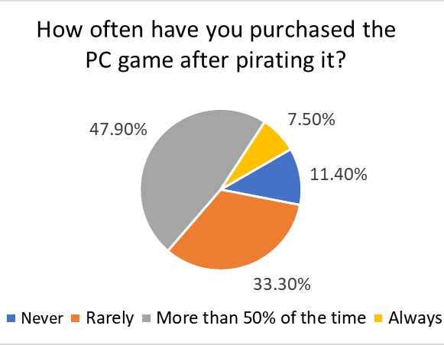
How is it Good
Alexandra Wheeler
Illegal consumption leads to increased legal consumption [6]
Boosts popularity [5]
67% of file sharers are buyers [5, 6]
Infographic: [3]
Notes:
<speaker notes>
So there are a few reasons why it’s good, but the main conclusion is that the illegal consumption of video games leads to increased legal consumption. The first reason is that this piracy boosts the popularity of a game, a lot of games that are being pirated aren’t the new ones, there the ones that have been popular. So if people have heard of the game, they will pirate it, then tell everyone else leading to people will noticing the product and see the value of it.[5] Around 67% of the people that pirate the game also end up buying it [5,6]. So of the people that illegally downloaded the game, 2/3 of them downloaded it and played it for a while and then bought it. Along with this every 100 illegal downloads induces 24 extra legal transactions [6].

Slide 21
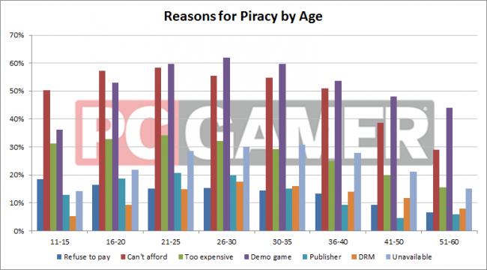
Alexandra Wheeler
[3]
Notes:
<speaker notes>
Indeed, extra transactions. If you look at this chart, most people pirated the game because they couldn’t afford it or wanted to demo it. Even if you look at the other percentages, very few of them would have bought the game in the first place. The top reasons here do not change by age, however the youngest from 11-25 and 51+ are most likely to pirate a video game [6].

Slide 22
How does this happen?
Alexandra Wheeler
People Pirates a Game
They Play it
People Like the Game
People Buy it for Appreciation
Sampling effect [5]
Successful in converting illegal users to paying users. [5, 6]
  Ex: Offering gameplay with extra bonuses or extra levels if consumers pay
People Buy it for Extra Content
[5]
Notes:
<speaker notes>
Demoing a video game creates the sampling effect, this introduces the video game to a person allowing them to test it before making the decision of buying it. Piracy also does well in converting illegal users to paying users. Most pirated versions won’t receive updates or expansions and if the game is that good, well people are going to buy the game. Some pirated games have fun secrets that make you stop the game halfway through such as Video Game Tycone, if a player likes the game thus far they will be more likely to buy it.

Slide 23
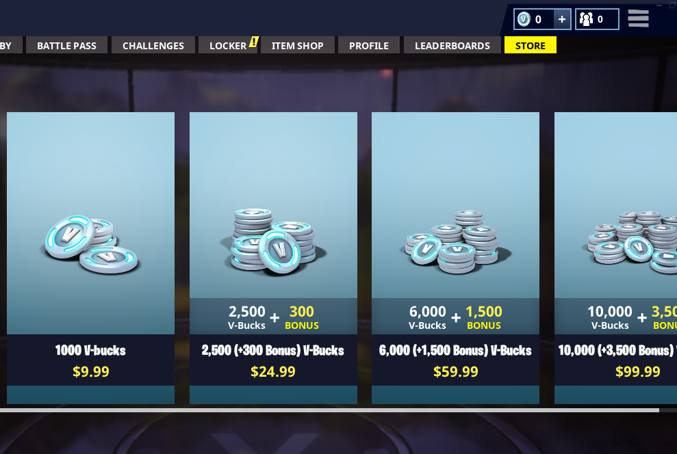
Effects of piracy
Alexandra Wheeler
Two Types of Companies [7]
  Ubisoft
  Valve
Switch to Microtransactions [1]
  FIFA $450 million vs $650 million
  Fortnite $126 million
Self
Notes:
<speaker notes>
This creates two types of companies, one were spend a lot of money on their DRMs and anti-cracking software. The other ignores piracy and instead put the money into creating a better game. Companies such as Ubisoft will create more intensive DRMs, and others like Valve don’t believe piracy is as much of an issue and instead puts that money towards the games themselves.
Piracy also lead to the development of microtransactions. While microtransactions have been around since the late 2000s, they have become more prevalent in pc games such as fortnite, team fortress 2, and star Wars Battlefront 2 just to name a few. Instead of worrying about pirates, the companies make the game cheaper or even free and then have add ons through microtransactions to make the games more appealing. A 2016 game Fifa earned about $450 million from game sales and $650 million from microtransactions. Other games like fortnite made $126 million last month mostly from microtransactions.
To conclude piracy was good for sales, it made people that wouldn’t have bought the game buy it and it led to microtransactions which makes more money for the industry.

Slide 24
References
Alexandra Wheeler
[1] Agarwal, P. (2017, December 20). The Economics of Microtransactions in Video Games. Retrieved March 29, 2018, from https://www.intelligenteconomist.com/economics-of-microtransactions/
[2] Call of Duty Total Franchise Revenue Units Sold. (2017, November 11). Retrieved March 29, 2018, from https://www.statisticbrain.com/call-of-duty-franchise-game-sales-statistics/
[3] Fenlon, W. (2016, August 26). PC piracy survey results: 35 percent of PC gamers pirate. Retrieved March 29, 2018, from https://www.pcgamer.com/pc-piracy-survey-results-35-percent-of-pc-gamers-pirate/
[4] Online Piracy in Numbers - Facts and Statistics [Infographic]. (2011, November 1). Retrieved March 29, 2018, from https://www.go-gulf.com/blog/online-piracy/
[5] Poort et al. (2013) Baywatch: two Approaches to Measure the Effects of Blocking Access to The Pirate Bay. University of Amsterdam - Institute for Information Law (IViR), the Netherlands
[6] Van der Ende, M., Poort, J., Haffner, R., De Bas, P., Yagafarova, A., Rohlfs, S., & Van Til, H. (2015, May). Estimating displacement rates of copyrighted content in the EU. Retrieved March 29, 2018, from https://www.bing.com/cr?IG=8C16AE5D66BC41DE9528BDD197E3D02A&CID=19C09497C4A0655F2C4C9F56C50F6435&rd=1&h=qdoWbED5LMQIVLqIR9PhtR7Q6F7q2Loix8C_PpeMu0A&v=1&r=https://cdn.netzpolitik.org/wp-upload/2017/09/displacement_study.pdf&p=DevEx,5064.1
[7] Van Eijden, E. (2011, June 26). PIRACY AND DRM IN PC VIDEO GAMES: STRIKING A BALANCE. Retrieved March 29, 2018, from https://hbo-kennisbank.nl/record/sharekit_hu/oai:surfsharekit.nl:1f57c626-3ecb-459c-a323-88e1307caf75

Slide 25
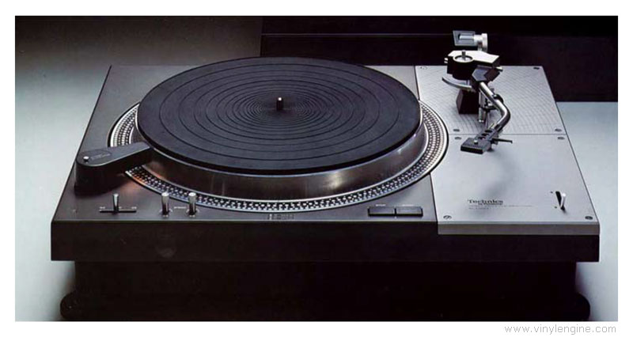
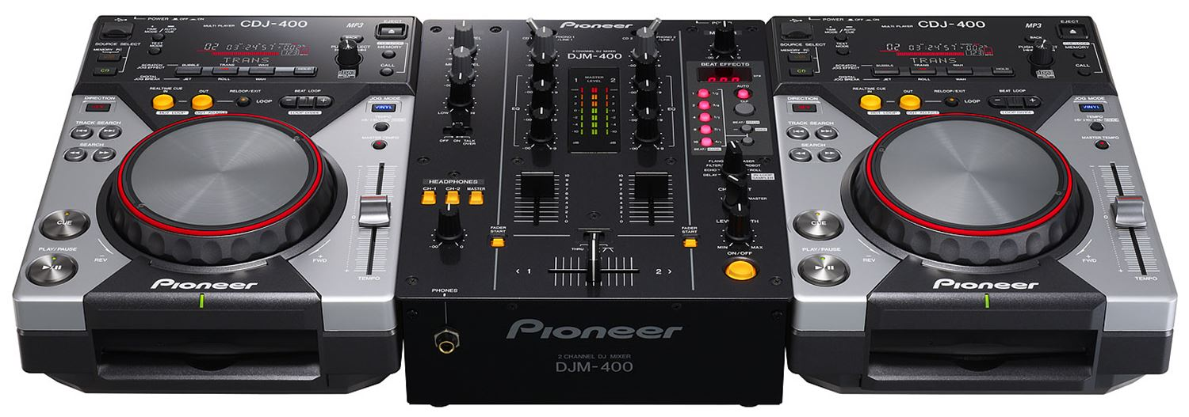
Digital Vinyl Systems: a brief History
Grant Zahorsky
Notable dates:
  1877 – phonograph
  1887 – gramophone
  1907 – 10” records
  1977 – Technics SL-1100 and SL-1200
  1979 – Technics 1200MK2
  2007 – CDJ-400
  2017 – Serato DJ
[8]
[7]
[6] [2]
Notes:
How many of you listen to electronic music or pop music?
Who here has been to a pop/electronic dance music (EDM) concert?
Who are some of your favorite artists?
Each of these artist and performances use turntables in one way or another almost all of the time. Pop music concerts will usually use a virtual DJ system while performing. Hip hop music will usually have an onstage DJ to provide instrumentals to songs. At EDM concerts, the DJ is the main act and headliner and typically uses Pioneer CDJ-2000NXS2’s.
Today
Turntables preceded by phonograph – invented by Thomas Edison in 1877
Gramophone, first turntable with speaker, invented in 1887 by Emile Berliner.
Global market for 10” 78bpm records in 1907
Technics SL-1100 and SL-1200 turntables began being used in the disco scene in 1977
1979 - Technics 1200MK2s arrived and was “tough enough to take the disco beat and accurate enough to keep it”
2007 – Pioneer released the CDJ-400. It had USB ports and CD trays on all models. Vinyl systems drastically died off
2017 – Serato DJ package released. This allowed for DJ’s to use laptops on stage and mix entirely from their computer without the use of a turntable. There are similar products, such as Traktor, that allow for virtual DJing. Now, there are even iPad and iPhone apps that allow someone to “DJ” on the go.

Slide 26
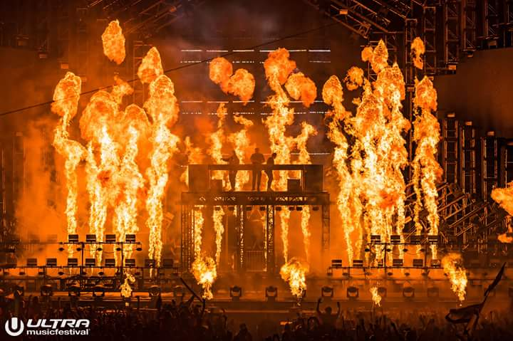
The modern DJ: a brief History
Grant Zahorsky
Notable dates:
  1900s – Stefan Wolpe
  1920s – László Moholy-Nagy
  1950s – Genre classification
  2000s – Mashups, DJing, and copyright
[10]
[4] [3]
Notes:
The term ”DJ” has evolved significantly.
1900s – those we now refer to as DJs focused primarily on radio broadcasting
German composer Stefan Wolpe performed one of the first concerts as a “modern DJ”. He used 8 gramophones simultaneously to perform and mix songs at various speeds.
Hungarian composer László Moholy-Nagy composed a song in which two gramophones could be used as instruments through scratching in 1922/23
Terms like “rock ‘n roll” and “rhythm ‘n blues” were popularized by DJs (on the radio) to help classify the music they were playing.
The modern DJ basically creates one large, 60 minute mashup for each show he plays. Usually, a DJ will not play all of his own music, and sometimes, only music that isn’t his. This creates an interesting copyright situation. He is playing other people’s music for sometimes thousands of people, and getting paid a significant amount of money for it. At the same time, the venue is also getting paid a significant amount of money for his performance.
So who pays?
Well, typically, the DJ will not pay any royalties for the music he is mixing. If he is playing at a concert venue, the venue will pay. If he is releasing an official mix with a label, the label will pay. This means that the DJ will not need an American Society of Composers, Authors and Publishers (ASCAP) or Broadcast Music, Inc. (BMI) license to perform.

Slide 27
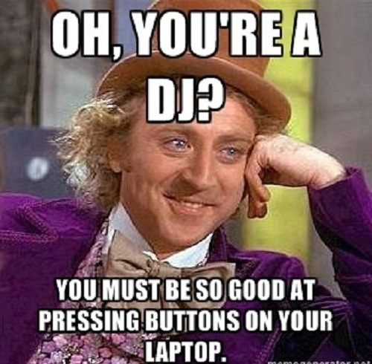
What’s the point?
Grant Zahorsky
Side A: Technological advancements have dumbed down the modern DJ
Side B: Technological advancements have provided more opportunities for improvisation
[12]
Notes:
Side A is that of scratch DJs and a lot of the mainstream, music-connoisseurs .
Side B is that of the modern DJ and those heavily involved in the electronic music industry.
Both sides have their cases, so, who’s right?

Slide 28
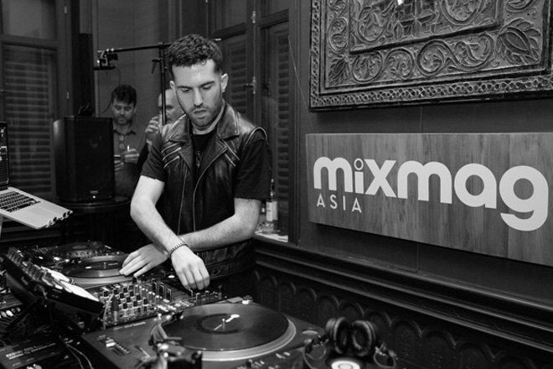
Who’s right...?
Grant Zahorsky
The evolution of turntables
Vinyl vs. digital vinyl systems
Scratch DJs vs. concert DJs
[9]
[4] [5]
Notes:
The advancements in technology have significantly changed the concept of the modern DJ.
Vinyl systems are close to outdated in popular culture except for scratch DJs.
Scratch DJs argue that the modern concert DJ is simply a superficial button-masher and being a modern concert DJ requires little to no skill. This argument stems from the fact that one can throw on the “sync” and ”quantize” buttons and not do anything while scratch DJs must constantly adjust bpm while also using the records as instruments with which to scratch.

Slide 29
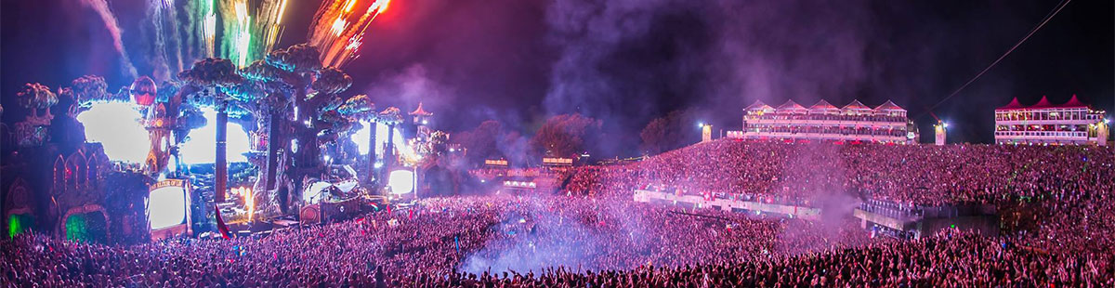
…It’s complicated.
Grant Zahorsky
“Sync” and “Quantize”
Music Production
Stage Production
[11]
[1]
Notes:
Technology has made DJing easier in SOME aspects.
With “sync” and “quantize” the modern DJ can beatmatch automatically and not have to worry about monitoring the tempo sliders through each and every song. Compared to what a scratch DJ does, this seems much simpler on the surface.
In reality, while these advancements have made DJing easier, it has also opened many more doorways for the DJ. For example, during a set, averaging and hour long, many DJs will play upwards of 50 songs. Beatmatching is partly to thank for this. Another large reason this is possible though is how the music is loaded onto the controllers (digital turntables). Before products like the CDJ-400 came about, DJs had to carry around physical vinyl records of every song that they were going to play. Today, artists simply carry around a USB drive.
Other new paths that were created with the new technology include the ability to add effects to songs as well as sample songs on the go. This allows the DJ to cut up the music on the spot, during a performance.
Many modern DJs today, also focus on the production of their own music. This allows the DJ to focus more on using their computer as an “instrument” rather than the physical turntable as one.
Stage production is also a major focus in these concerts. This means that the focus of the concert is less on an instrument, like when a band performs, and more on the experience, visuals, and the music.
Side B is right because of these statements.
After this, ask questions.

Slide 30
References
Grant Zahorsky
[1] Veen, Tobias C. Van, and Bernardo Alexander Attias. “Off the Record: Turntablism and Controllerism in the 21st Century (Part 2).” Dancecult, vol. 4, no. 1, 2012, doi:10.12801/1947-5403.2012.04.01.09.
[2] "Audio-Technica turntable system enables digital transfer of vinyl." Broadcast Engineering, 7 Mar. 2008. General OneFile, http://link.galegroup.com/apps/doc/A176250946/ITOF?u=mlin_c_worpoly&sid=ITOF&xid=db1cbb15. Accessed 29 Mar. 2018.
[3] Uwins, Michael (2015) Analogue Hearts, Digital Minds? An investigation into perceptions of the audio quality of vinyl. In: 138th Annual Audio Engineering Society AES Convention, 7th - 10th May 2015, Warsaw, Poland.
[4] Emsley, Jason. The Laptop DJ Handbook: Setups and Techniques of the Modern Performer. Course Technology, 2011.
[5] Crooks, Katrina. "From Vinyl to Digital-the Second Hand Digital Music Market and Implications for Copyright." The Licensing Journal Jun 2015: 1-7. ProQuest. Web. 29 Mar. 2018 .
[6] “The Evolution of the Turntable 1877 - 2017.” Mixmag, mixmag.net/feature/the-evolution-of-the-turntable. Accessed on March 27th, 2018.
[7] Playa, Da, and Jonas. “PIONEER CDJ-400 TABLETOP CD/MP3/USB PLAYER.” ProSound and Stage Lighting, 24 June 2008, www.pssl.com/PIONEER-CDJ-400-TABLETOP-CDMP3USB-PLAYER. Accessed on March 27th, 2018.
[8] “Technics SL-1100.” Latest News, www.vinylengine.com/library/technics/sl-1100.shtml. Accessed on March 27th, 2018.
[9] “Watch A-Trak Live from Bangkok.” Mixmag, mixmag.net/read/watch-a-trak-live-from-bankok-live-streams. Accessed on March 29th, 2018.
[10] Stevo. “Ultra 2018 Live Sets: Swedish House Mafia, The Chainsmokers, & More.” EDM Sauce, 26 Mar. 2018, www.edmsauce.com/2018/03/25/ultra-2018-live-sets/. Accessed on March 29th, 2018.
[11] “Tomorrowland 2017 Lineup: Stages, Themes and Artists Announced - Festicket Magazine.” Festicket, 10 May 2017, www.festicket.com/magazine/news/tomorrowland-2017-lineup-stages-themes-and-artists-announced/. Accessed on March 29th, 2018.
[12] You're A DJ - Funny Willy Wonka Meme, www.50-best.com/willy_wonka_memes/pics/youre_a_dj.htm. Accessed on March 30th, 2018.

Slide 31
Class 5
The End
Keith A. Pray
Instructor
socialimps.keithpray.net
Notes:
This is the end. Any slides beyond this point are for answering questions that may arise but not needed in the main talk. Some slides may also be unfinished and are not needed but kept just in case.

