Slide 1
Class 4 Freedom Of Speech
Keith A. Pray
Instructor
socialimps.keithpray.net
Notes:
Here’s the title slide. Excited again, aren’t you? You should be.
Paper Notes:
Average: LATE (usually 4)
Please use the template
Quantify
Missing Counter Point and Response
Be sure to put quotes around entire quote
Try reading paper aloud to proof
Save for next time:
State Conclusion clearly

Slide 2
Overview
Review
Assignment
Students Present
Notes:
Show syllabus updates

Slide 3
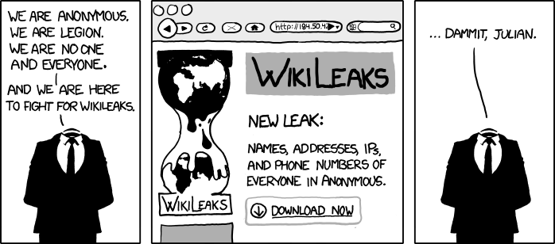
http://www.xkcd.com/834/

Slide 4
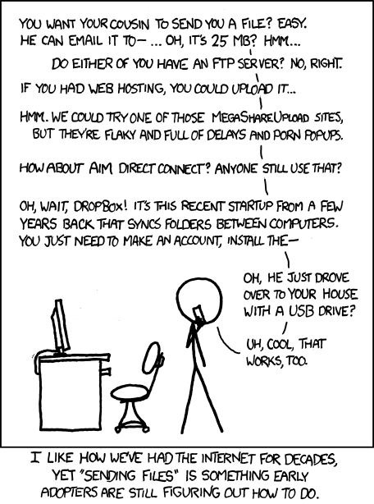
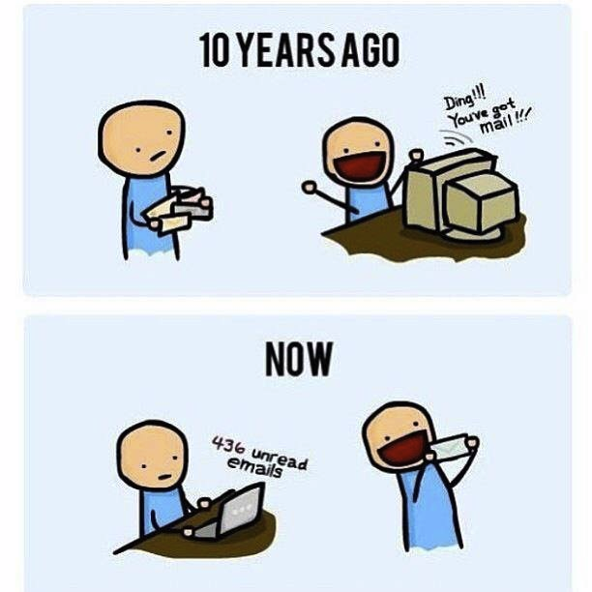
http://poofytoo.com/
20
http://xkcd.com/949/

Slide 5
My Reading Notes
pp. 110 What powers the cell phones and towers? “everyday tasks” not apparent from image.
pp. 114 Ann did not force people to complain.
pp. 117 7% # transactions or $$? Wikipedia critics source [19] from 2005, how has quality turned out? Nice to see darknet added.
pp. 118 [27] PC bangs youth source from 2003, all grown up now.
pp. 130 Is 20% realistic? What will search engines and facial recognition be capable of? Rule Utilitarian ignores the private setting.
pp. 131 Do any filters use image processing?
pp. 133 Stating people searching did not consent to material being blocked makes more sense.
pp. 134 Web access for no cost?
pp. 145 More accurate to say addicted to single app?
pp. 149 20 same as 39
pp. 150 36 same as 42
End of Chapter questions I liked: 2, 25 http://en.wikipedia.org/wiki/Wikipedia:Citing_Wikipedia

Slide 6
Group Quiz
Name two methods some governments use to control access to information.
A large company has a policy prohibiting employees from blogging about company products.
Name two possible reasons for the policy.
Does it violate the First Amendment? Why?
Is it reasonable? Why?
What does “URL” stand for and what is it?
Notes:
Censorship (religious, governmental, private). Adult authentication. Global dissemination. Freedom of Speech not an absolute right.

Slide 7
Overview
Review
Assignment
Students Present
Notes:
But before that:
CPG Grey - This Video Will Make You Angry [Thought Germs] (7:25)
https://www.youtube.com/watch?v=rE3j_RHkqJc
Cedric Gervais - Hashtag (Original Mix) (3:58)
https://www.youtube.com/watch?v=6OmBKd7X7EE
Dave Audé vs Luciana - You Only Talk In #HASHTAG (3:36)
http://www.youtube.com/watch?v=53wIN87lJn0

Slide 8
Assignment
Reading
Individual Presentations
Extra Credit – One page paper
Is WPI’s IT Acceptable Use Policy morally acceptable?
Work on your group project.
See full group project description on course website.
Notes:
Or review group project and individual presentation guidelines right now.
Possible One page paper:
Global intellectual property laws, friends or foes?

Slide 9
Overview
Review
Assignment
Students Present

Slide 10
Start From the book
Yihong Zhou
Negative impacts of computer beyond book material
Cyber-bully
Repeated escapism from real life
Distortion of love view
More
Focus on positive aspect of computer usage
Reference[2]
Notes:
???why I talk this topic
beyond the material mentioned in the book, there are other terrible issues happen in the real life. Such as…
Here I selected problems associated with deprecation of mental health and brain function.
All of these harmful impact are at least unsolvable problems right now and they are inducing some degrees of mental issue to the users.
I am going to focus more on positive side of computer technology on strengthening brain and help us improved the mental health

Slide 11
Target Computer User
Yihong Zhou
Middle-aged and older adults
Patients
Video game player
Programmer
Notes:
The target population category is going to be talked about
Majority of them not so familiar with computer usage
Athletic ability
Programmer => master skill of using computer compare with the rest of population

Slide 12
Middle-aged and older adults
Yihong Zhou
Study with 24 volunteers between age 55 and 76
Web searches and book-reading tasks under fMRI scans
Significant brain activity during the book-reading task
Twofold increase in brain activation with internet experience
Reference[3]
Notes:
For the study, the UCLA team worked with 24 neurologically normal research volunteers between the ages of 55 and 76. Half of the study participants had experience searching the Internet, while the other half had no experience.
All study participants showed significant brain activity during the book-reading task, demonstrating use of the regions controlling language, reading, memory and visual abilities
However, when doing the internet searches, researchers found that during Web searching, volunteers with previous internet experience registered a twofold increase in brain activation when compared with those with little Internet experience.
The study results are encouraging, that emerging computerized technologies may have physiological effects and potential benefits for middle-aged and older adults
Internet searching engages complicated brain activity, which may help exercise and improve brain function

Slide 13
patients
Yihong Zhou
Computer-based cognitive training for rehabilitation
Computer-based drill
Computer puzzle games
Computer-based Speed-of-processing task
Reduce the risk of Alzheimer
Mouse-use research
Shape basic sensorimotor behavior
Help with stroke patients to regain the control of their limps
Reference[4],[8]
Notes:
Cognitive gains are considered in the context of the interaction between the patient and the environment
There have been studies of computer-based cognitive training in AD using software packages that isolate and repeatedly train specific cognitive domains such as divided attention, spatial memory, or object discrimination.
computer-based drill practice cognitive training for sustained attention and visual motor processing speed
Prevent neurodegeneration
-----------
computer-use experience shaped our basic sensorimotor behaviors

Slide 14
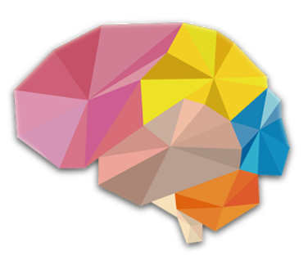
Video game player
Yihong Zhou
General game benefit
Cognitive improvements
Motivational improvements
Emotional improvements
Social improvements
Games target to enhance intelligence
Brainwars app
Reference[6]
Notes:
Attention
-- the shooter video game condition requires faster and more accurate attention allocation, higher spatial resolution in visual processing, and enhanced mental rotation abilities
Resilience in the face of failure
-- Notably, video games use failure as motivational tools and provide only intermittent chances for large-scale success.
gaming environments actually cultivate a persistent, optimistic motivational style
Mood management
- studies suggest that playing puzzle video games— games with minimal interfaces, short-term commitments, and a high degree of accessibility (e.g., Angry Birds) can improve players’ moods, promote relaxation, and ward off anxiety
Prosocial skill
Playing prosocial games led to causal, short-term effects on “helping” behaviors, and in the researches longitudinal effects were also found, in that children who played more prosocial games at the beginning of the school year were more likely to exhibit helpful behaviors later that year.

Slide 15
Programmer
Yihong Zhou
Some developers claim:
“Its more math and science than anything”
Some developers claim:
“Besides a mathematical inclination, an exceptionally good mastery of one’s native tongue is the most vital asset of a competent programmer.”
Reference[5]
Notes:
‘Dijkstra
Researches observed 17 participants inside an fMRI scanner while they were comprehending short source-code snippets, and trying to locating syntax errors.
The programmers in the study recruited parts of the brain typically associated with language processing and verbal oriented processing
the team found a clear, distinct activation pattern of five brain regions when programmers doing the test, which are related to language processing, working memory, and attention.
The brain part concerned with logic areas are activated sometimes, but more

Slide 16
Conclusion
General computer usage is good
Use computer if you don’t want to get Alzheimer
Play game is good primarily
Be a programmer is the best!

Slide 17
References
Yihong Zhou
[1] Whitlock, L. A., Mclaughlin, A. C., & Allaire, J. C. (2012). Individual differences in response to cognitive training: Using a multi-modal, attentionally demanding game-based intervention for older adults. Computers in Human Behavior, 28(4), 1091-1096. doi:10.1016/j.chb.2012.01.012
[2] Quinn, M. J. (2014). Ethics for the information age. Pearson.
[3] Small GW, e. (2017). Your brain on Google: patterns of cerebral activation during internet searching. - PubMed - NCBI . Ncbi.nlm.nih.gov. Retrieved 28 March 2017, from https://www.ncbi.nlm.nih.gov/pubmed/19155745
[4] Choi, J., & Twamley, E. (2013). Cognitive Rehabilitation Therapies for Alzheimer’s Disease: A Review of Methods to Improve Treatment Engagement and Self-Efficacy. Neuropsychology Review, 23(1), 48-62. doi:10.1007/s11065-013-9227-4
[5] Scientists Begin Looking at Programmers' Brains: The Neuroscience of Programming. (2014). The Huffington Post. Retrieved 27 March 2017, from http://www.huffingtonpost.com/chris-parnin/scientists-begin-looking-_b_4829981.html
[6] Granic, I., Lobel, A., & Engels, R. C. (2014). The benefits of playing video games. American Psychologist, 69(1), 66.
[7] (2017). Play.google.com. Retrieved 27 March 2017, from https://play.google.com/store/apps/details?id=jp.co.translimit.brainwars&hl=en
[8] Wei, K., Yan, X., Kong, G., Yin, C., Zhang, F., Wang, Q., & Kording, K. (2014). Computer Use Changes Generalization of Movement Learning. Current Biology, 24(1), 82-85. doi:10.1016/j.cub.2013.11.012

Slide 18
Class 4 The End
Keith A. Pray
Instructor
socialimps.keithpray.net
Notes:
Use remaining time to form groups, approve group topics, etc.
This is the end. Any slides beyond this point are for answering questions that may arise but not needed in the main talk. Some slides may also be unfinished and are not needed but kept just in case.

