Slide 1
Class 11
Work
Keith A. Pray
Instructor
socialimps.keithpray.net
Notes:
Here’s the title slide. Excited already, aren’t you?
Code Test paper average:
Game paper average:
Total points not counting extra credit so far:

Slide 2
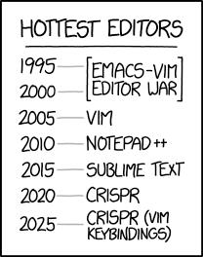
Overview
Review
Assignment
Students Present
https://www.xkcd.com/1823/
Notes:
Full circle.
CRISPR: Clustered Regularly Interspaced Short Palindromic Repeats
Allows permanent modification of genes within organisms.
Kickstarter Charter
https://www.kickstarter.com/charter?ref=about_subnav

Slide 3
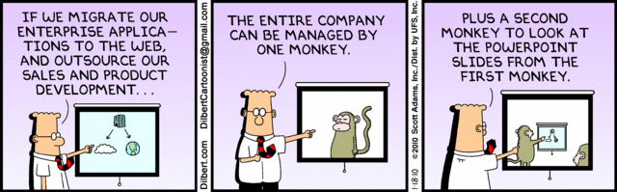
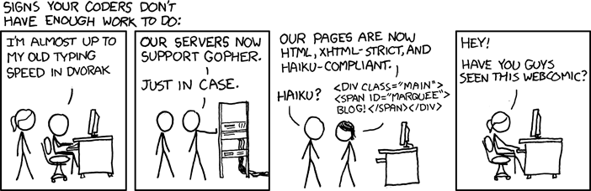
http://xkcd.com/554/
Notes:
Poll class:
Expected salary range upon graduation? Min, Max? Put on board.
Assume 40 hour work week.
How many people would work:
32 hours for 0.8 * Max? Put on board.
24 hours for 0.6 * Max? Put on board.
…continue until Min is reached.

Slide 4
Group Quiz
List 2 ways IT can lead to organizational change.
List 4 ways a Video Game Producer may protect its IP and what specific IP each protects.
List a computing technology that can be used to protect an individual’s privacy.
List a computing technology that can be used to intrude upon an individual’s privacy.
Notes:
Could split into groups of 4-5 for this.
Fill time with Work Discussion on Course Web Site

Slide 5
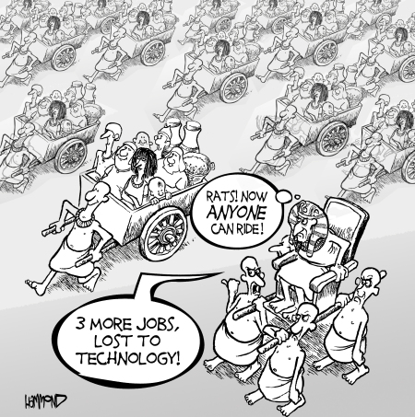
Overview
Review
Assignment
Students Present
©2009, MobileRobots Inc.
Notes:
Review Group Assignment Details.
Or first watch video: depends on student presentations, no thunder stealing. Wait until end this time.
CGP Grey
Humans Need Not Apply (15:00) – 2014-08-13
http://www.youtube.com/watch?v=7Pq-S557XQU
Last access 2016-04-22
Look at:
BBC Intelligent Machines
http://www.bbc.com/news/technology-33978561
BBC Likelihood of robot taking your job
http://www.bbc.com/news/technology-34066941

Slide 6
Overview
Review
Assignment
Students Present

Slide 7
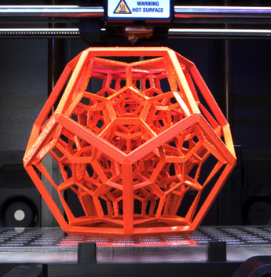
3D printing and new challenges
Vakhtang Margvelashvili
3D printing is new, exciting and really useful technology. But as all new technologies it introduces a lot of new challenges.
Overview
What is it?
Why use it?
Why not?
What are we doing to improve it?
<Graphic>
http://stylewhack.com/wp-content/uploads/2016/06/environment.jpg
Notes:
<speaker notes>

Slide 8
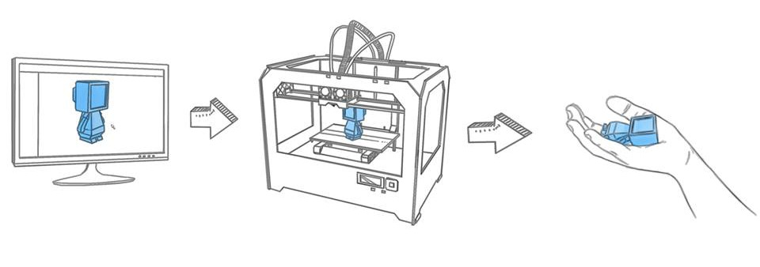
What is 3D printing
Vakhtang Margvelashvili
Additive Manufacturing -1980s
Process
  Modeling
  Printing
  Finishing
Types of 3D printing
  Selective Laser Sintering
  Stereolithography
  Fused Deposition Modeling
http://doodlesplash.co.uk/image/3D-printing/3d-process-2.jpg
Notes:
Computer Aided design, 3D scanning or taking photos.
Most of the 3d printers use the same process called additive manufacturing.
The first patent first additive manufacturing appeared 3D printing started in 1984 for stereolithography.
Additive manufacturing is a process of building 3d object by adding layer by layer on the object.
The process of 3d printing consist of 3 steps. 3d modelling in a software application.
Printing the object. Finishing the object means cleaning up the details. Sometimes people manufacture objects that are bigger than planned so that they can later pin down to details.
3 Types of 3D printing techniques

Slide 9
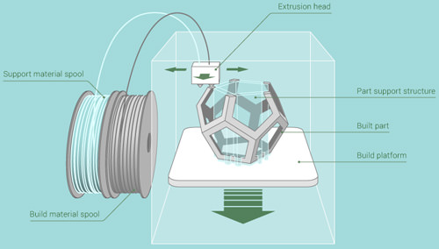
Fused Deposition Modeling
Vakhtang Margvelashvili
http://media02.hongkiat.com/things-know-buying-3d-printer/fused-deposition-modeling.jpg
Notes:
Fused Deposition Modeling is using additive process, by heating and extruding plastic the printer puts together the object layer by layer.

Slide 10
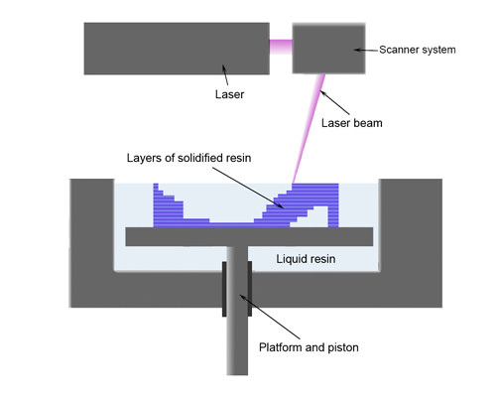
Stereolithography
Vakhtang Margvelashvili
http://media02.hongkiat.com/things-know-buying-3d-printer/stereolithography.jpg
Notes:
Stereolithography is using ultraviolet light beam to harden a model from a pool of photosensitive liquid.

Slide 11
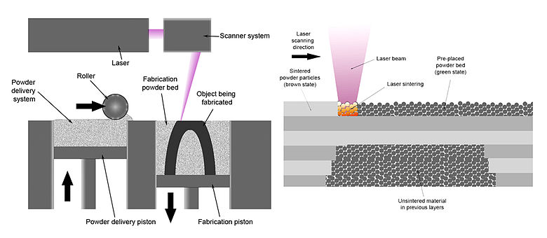
Selective Laser Sintering
Vakhtang Margvelashvili
https://upload.wikimedia.org/wikipedia/commons/thumb/3/33/Selective_laser_melting_system_schematic.jpg/780px-Selective_laser_melting_system_schematic.jpg
Notes:
Selective Laser Sintering is using a laser that melts the powder, creating a layer of the printed material. Selective Laser Sintering is also good because it can use metals.

Slide 12
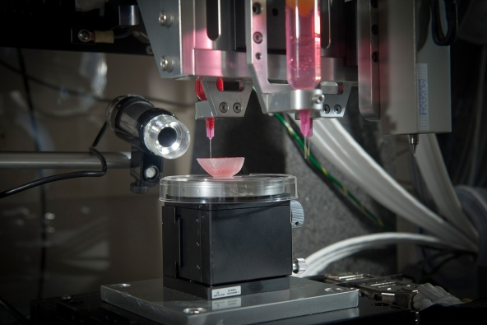
Why do we need 3d printing
Vakhtang Margvelashvili
Time
Cost
Creating complex structures
Biotechnology
Chemical Science
Bone Tissue engineering
Organs
Houses
http://www.nature.com/polopoly_fs/7.25376.1429101801!/slideshowimage/6kidney%20prototype.jpg_gen/derivatives/landscape_592/6-kidney%20prototype.jpg
Notes:
3 main reasons for 3D printing are Time. Cost and Complexity of manufacturing.
3D printing introduces ability to create objects with great complexity. With the variety of materials used, 3d printers can create soluble support materials that are used only for manufacturing and are gone in final product.
With 3D printing one can design and create an object on a same day. You don’t need to create whole new hardware for each object you design.
This also cuts down the cost and time of manufacturing for small amounts of products.
These abilities of 3D printing introduce great inventions, such as creating organs from stem cells, or 3d printing houses. Chemical Science and Biotechnology drug delivery systems.

Slide 13


New problems
Vakhtang Margvelashvili
First 3D printed Gun – 2013
Environment
  Air emission
  Plastic
Toxic plastic
Copyright, patenting and licensing
http://stylewhack.com/wp-content/uploads/2016/06/environment.jpg
https://3dprint.com/wp-content/uploads/2015/01/3D-printed-gun-Liberator-006.jpg
Notes:
University student in Texas Cody Wilson – 2013 may 5
2013 they raided a gang in Manchester 3d printed gun parts.
2014 Japan arrest of Yoshitomo Imura.
In at least one instance, a loaded 3D printed firearm was found during a police raid on a meth lab.
2013 may 9 US bans the company Defense Distributed that provided blueprints for weapons but it is reported that blueprints have been downloaded more than 100.000 times.
plastic gun could be threat to airport scanners
It will be much harder to track copyright and patenting, since one can print anything on a 3d printer.
ABS plastic, it is not BPA-free. Can’t make kitchenware.
ABS filament is still the most commonly used type of plastic and its not biodegradable.
3D printers shown to emit potentially harmful nanosized particles.

Slide 14

3d printing and laws
Vakhtang Margvelashvili
Intellectual Property
20 years - Patents for functional features.
Lifetime + 70 – Copyright for nonfunctional.
3D scanners change copyright rules.
Gun legislation and administration
  2013 - US renews Undetectable Firearms Act.
  1968 – UK manufacturing ban.
  1996 – Australia digital plan criminalization.
http://landwehrlawmn.com/wp-content/uploads/2015/03/law-wallpapers-hd-1080p-1920x1080-desktop-02.jpg
Notes:
Patents can only be made on technical and functional features. The patent lasts 20 years so printing, using, selling of a patented is not allowed.
One can patent Processes, Machines, Manufactures, and Compositions of matter. If there is a special type of wheel that is patented one can’t print that.
Copyright. It can be if it is nonfunctional. The feature design can be copyrighted during the lifetime of the author + 70 years.
Both – It can’t be copyrightable if it can’t be separated from the functional aspect of the item.
US-the Undetectable Firearms Act any firearm that cannot be detected by a metal detector is illegal to manufacture.
US proposed legislation to ban 3D printing of weapons, but a lot of individuals fear that it might not work, since they will need to track what files people send each other so they don’t send the gun blueprints.
2015 Defence Distributed and Second Amendment Foundation filed a lawsuit against the state department for violation of the first amendment.
UK declared that printing a gun would violate their gun-control law.
Defense Distributed spread the blueprint downloads to UK, Germany, Spain, and Brazil.
1968 Firearms act UK bans manufacturing any gun parts without government approval.
They still updated Firearms licensing law to specifically mention 3d printed guns.
Australia criminalized possession of digital plans of weapons Firearms act 1996.

Slide 15
Summary
Vakhtang Margvelashvili
3D printing is very useful but also dangerous.
There are no solid plans or actions how to stop weapon 3d printing.
There needs to be more regulations on 3d printing safety and its effects on environment.

Slide 16
References
Vakhtang Margvelashvili
[1] Brent Stephens, P. A. (2013). 3D printers shown to emit potentially harmful nanosized particles. Atmospheric Environment.
[2] Jin-Feng Xing, M.-L. Z.-M. (2015). Two-photon polymerization microfabrication of hydrogels: an advanced 3D printing technology for tissue engineering and drug delivery. Royal Society of Chemistry.
[3] Rial, N. (2013). Files have been downloaded 100,000 times in two days. New Europe.
[4] Susmita Bose, ,. S. (2013). Bone tissue engineering using 3D printing. Materials Today.
[5] The Law and 3D Printing, 31 J. Marshall J. Info. Tech. & Privacy L. 505. …

Slide 17
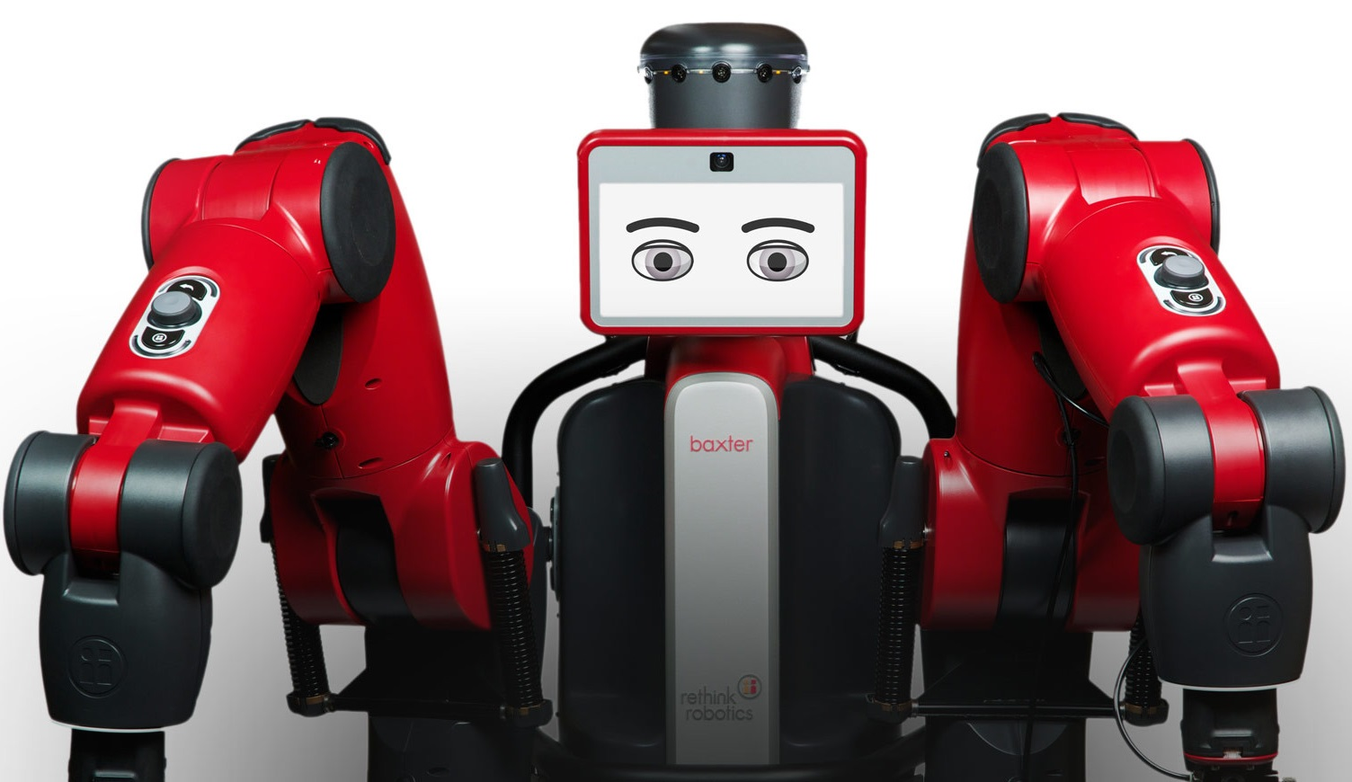
Humans Irrelevant with the advent of AI
Arthur Dooner
You’re probably wondering:
  “Is he seriously going to say people will not matter? Surely he has an uplifting message beyond that!”
It is really difficult to argue with and really hard to see the direction.
  AI in Popular Culture
  Perceptions of AI
  What AI and automation actually entail
  The Singularity
Baxter, a general purpose Robot [1]
[1]
Notes:
Right after Lauren’s presentation would be excellent, since we’re basically a continuation of topics
“I do, and don’t call me Shirley”
AI is difficult to discuss because people think that they’re personally important. They assign a level of uniqueness to the human experience and convince themselves that no one could recreate or simulate the experiences they have in a moment. As technology moves closer to taking our ‘unique’ abilities, people are more and more challenged by artificial intelligence.
To understand why AI is going to make us irrelevant to progress, we must first understand how AI is conveyed, what people view AI to be, and what it actually means. From there, we can disucss what’s coming.
Perceptions of AI in popular culture, examples of what people perceive AI to be
Engage the class to ask (if mood is sensed as normal enough) to ask what they think of with AI

Slide 18
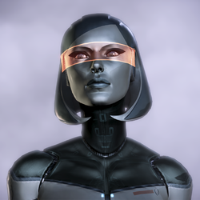

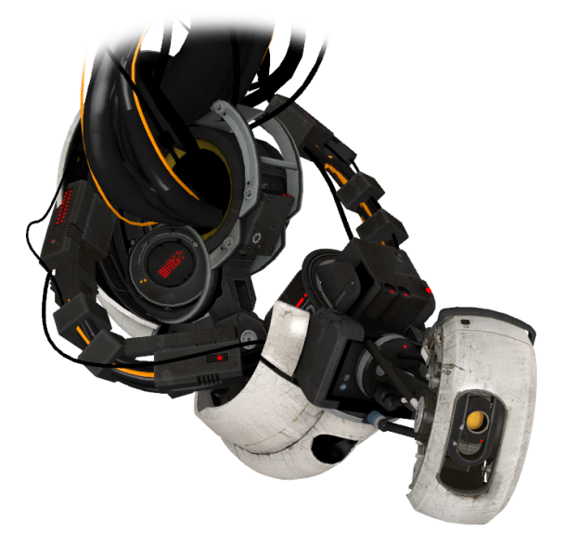
AI In Popular Culture
Arthur Dooner
Conversational
Usually Corporeal
  Often with a humanoid body or other physical form
Already beyond what humans can hope to achieve (like EDI, Data, SAM, GLaDOS, KITT, etc)…
  Or idiotic (C-3PO)
  Or both (The Geth, Joshua, V’Ger, Rosie the Maid)
A lot of evil AI presented
Larger point: AI is not what people make it out to be (at first)
[2], [3], [4]
Notes:
Explain what these AI do (if they need it):
Can do general purpose tasks to the fidelity of a human
Learn in the way humans can (most, like EDI, Data, and GLaDOS)
Can do millions of computations of bulk data processing and exact calculations
Learn how to express emotions and further their own quests from human insight
Always looking for more understanding
First image is EDI’s physical form (somewhat tethered to larger ship, the SSV Normandy, separate and with a communications interface in between)
Second image is Data, from Star Trek, a sentient android who seeks to be more human, understood, and help his friends
Third image is GLaDOS, an AI ambivalent to humans (starts out hating them and grows to collaborate and appreciate them in some ways)
Often the AI we see as idiotic are the one that don’t ask or ask simplistic questions
Others are not as general purpose, and not quite understood in ways we’re okay with
Some are evil, and just as many misunderstood
This type of AI is exciting and sells movies and tv shows and games
AI really shouldn’t be visualized as that
AI is a lot more abstract than what is conveyed by popular culture

Slide 19
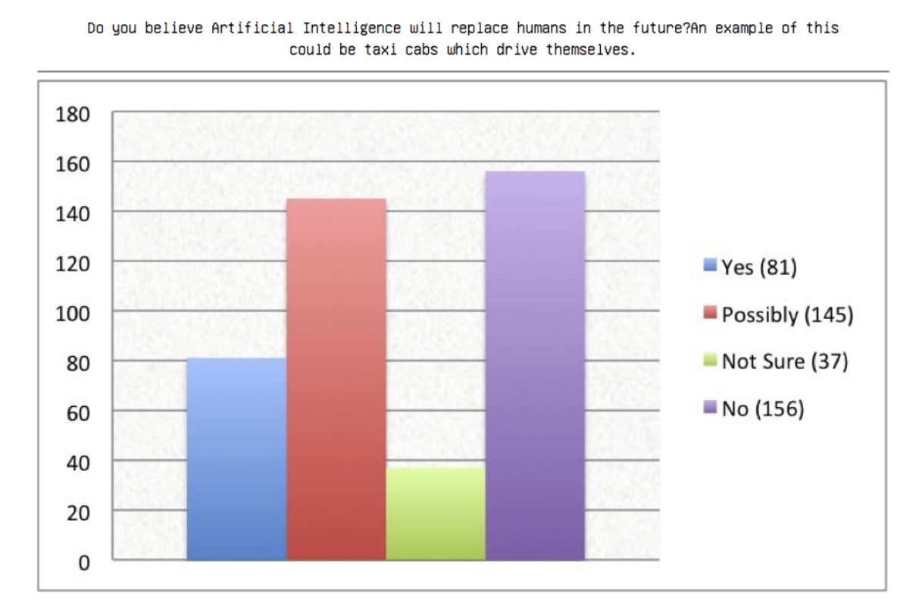
The Modern Day Perceptions of AI
Arthur Dooner
Understanding of what AI entails is more comprehensive than we would otherwise feel, although starts with ‘robots’ [5]
Seen as unifying data and helping humans process it
The potential for more is observed
People trust AI a lot , 50% trust for elder care for example, 40% to cook, clean, manage many aspects of their lives [5]
Terrified by job loss [5] [6]
WPI IQP “Artificial Intelligence Through the Eyes of the Public” asking “Do you believe AI will replace humans in the future”? [6]
[5], [6]
Notes:
Talk about this source some https://hbr.org/2016/10/what-do-people-not-techies-not-companies-think-about-artificial-intelligence
Very interesting discussion of what people think of AI , 2100 people in 5 global markets [5]
45% compared to 5% positive to negative view AI, the rest aren’t sure
18% know a lot about AI, 33% knew nothing, 22% robots
92% expect AI eventually
Specialization and knowledge of the platform/experiencing it builds trust
80% interact with a form of AI regularly
Don’t see AI as improving social equality, only 26% do
Talk about Artificial Intelligence Through the Eyes of the Public, https://web.wpi.edu/Pubs/E-project/Available/E-project-030411-114414/unrestricted/Artificial-Intelligence_Through_the_Eyes_of_the_Public.pdf [6]
Study of 419 people, 14 to 69 average 24, 80% college students
63% interact with AI regularly
Nearly 70% believe that there is a chance that human thought could be replicated with AI
(Image), More than 53% find it to at least be possible that AI will replace their jobs
72% of respondents aren’t scared by what AI could entail
Discuss how people will take understanding of AI and view from pop culture to apply to their real world beliefs
The trend is people are aware of these AI technologies in their lives but don’t associate them with the concept of AI

Slide 20
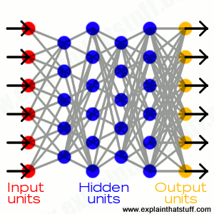
The GENERAL PURPOSE AI
Arthur Dooner
Baxter, from the first slide, for simple, physical tasks, especially repetitive ones that humans do, replacing blue collar jobs [1]
Automation is powerful with these simple tasks [7]
Many jobs are replaced yearly with automation [7]
And only get smarter with Neural Networks [7] [8]
AI can be non-corporeal, replacing white collar jobs along the path
[1], [7], [8]
Notes:
Baxter discussion, he’s general purpose and generally can do things all day long despite costing ~$40000 upfront he pays for himself in a year or two if he could be replace a minimum wage job
Baxter is reprogrammable to several tasks, making him more general purpose than most
Baxter fills a difficult use case for general purpose, but making more specific AI is typically easier than general purpose
Automation in simple tasks simplifies and unifies processes
Specific purpose is already better than people
More convenient, and the benefits end up adding up for the developer with less and less need for human intervention. Businesses can stay open longer, save money by making an initial investment on robotics, saving millions for corporations
Physical structures that exist today won’t need to in 10, 20, etc years
Wall Street and others are really, really fake and don’t actually need people there on the whole
AI manage it, since specific purposes are really easy for AI
How do we train all that?
What NNs imply
Neural Networks learn by weighting paths through a network and assigning weights to different inputs
The hidden layers allow combined weighting of certain things (associate dependency)
Outputs are the final result
All you need are to show the input, specify parameters of how many layers and nodes, then how many outputs, and show expected outputs and it can weight itself
We could never train a person to say, design a garbage collector for Java specifically, but it becomes almost algorithmic here
Non-corporeal AI already make our lives so much easier, but already AI are working on code for problem statements: AI writing code already (George Heineman)

Slide 21
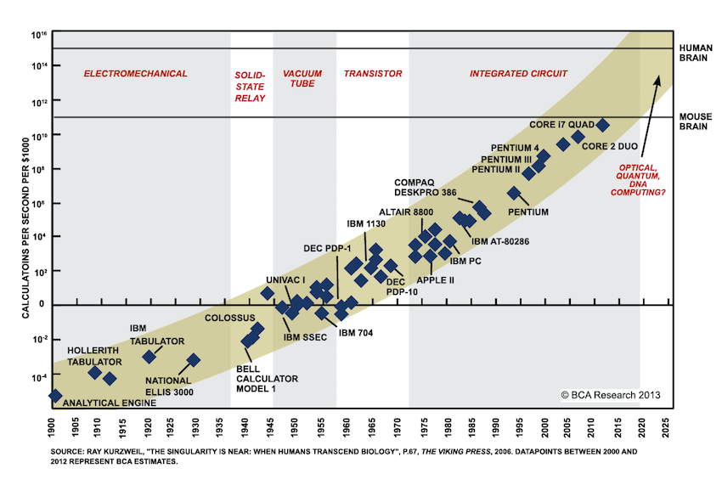
The Singularity
Arthur Dooner
Computational power equivalent of the human mind for the price of a laptop (~$1000) expected around 2025 [9]
Likely that computer intelligence will interface with biological intelligence, eventually merging [10]
If there is a computer that can do everything every person can do, what’s the point to us trying after that point?
We’re already working on it [11]
[1], [8], [9], [10], [11]
Notes:
If people are already being replaced with simplistic devices and singular purpose devices, how can we expect them to retain their jobs when AI is as smart as us?
Or specifically better than us in so much already, how much longer until their general purpose is better than ours?
Unions/organizations always lose in the face of new technologies. Small subsets survive, but in token and eventually fading subsets- it becomes something cultural rather than economic
Pretty self explanatory. Make sure people understand the singularity: the point where human computational power is equated by the computer
All human intelligence discussion around 2045; an AI could express all of our intelligence in one instantiation of itself
In that case, to not become irrelevant and just doing AI’s tasks that it has not yet designed a robot for, we basically have to merge with technology to stay relevant
Algorithms will still need work, and it’s not an impending problem for us yet, but the second a computer is powerful enough, it gets a lot more real and a lot more reasonable to implement those simulations
For the final bulletin point, we can already simulate human brain activity, albeit slowly [11]

Slide 22
The Conclusion
Arthur Dooner
Training us for a world of automation helps us right in this moment
Will not protect future generations, and AI will make our behaviors change
After a point however, humans will not be a significant factor in the workforce
How will we be relevant, especially if AI can be creative too? [7] [11]
  Merging with machines
  People will be shifting to a life of abundance and really searching for meaning their own ways since any jobs we provide will be artificial
Notes:
As Lauren discussed, being ready for AI will help us work and work efficiently in the moreso automated world of the near future
It’s not going to last forever. As I’ve discussed, the general purpose AI and general purpose robot will be coming. We can model the human mind alone if we can’t get anything else, we just need to wait for computers to be powerful enough to do so
Algorithms designed along the way will make this more efficient.
If AI can do everything better, and has no limit to life, why should we have to work?
If a computer can do it, people may want to, but it won’t actually matter.
Merging with machines will allow us to keep up, as long as the interface is smart enough
Otherwise, any meaning we assign is artificial

Slide 23
References
Arthur Dooner
[1] “With Our Smart, Collaborative Pioneer, Imagine What’s Possible”, http://www.rethinkrobotics.com/baxter/ (Accessed April 23, 2017)
[2] “EDI”, http://masseffect.wikia.com/wiki/EDI (Accessed April 23, 2017)
[3] “Data, 2379” http://memory-alpha.wikia.com/wiki/File:Data,_2379.jpg (Accessed April 23, 2017)
[4] “GLaDOS P2” https://theportalwiki.com/wiki/File:GLaDOS_P2.png (Accessed April 23, 2017)
[5] Leslie Gaines-Ross, “What do People – Not Techies, Not Companies – Think About Artificial Intelligence?”, https://hbr.org/2016/10/what-do-people-not-techies-not-companies-think-about-artificial-intelligence (Accessed April 23, 2017)
[6] Matthew Dodd, Alexander Grant, Latiff Seruwagi, “Artificial Intelligence Through the Eyes of the Public”, https://web.wpi.edu/Pubs/E-project/Available/E-project-030411-114414/unrestricted/Artificial-Intelligence_Through_the_Eyes_of_the_Public.pdf (Accessed April 23, 2017)
[7] CGP Grey, “Humans Need Not Apply”, https://www.youtube.com/watch?v=7Pq-S557XQU (Accessed April 23, 2017)
[8] Chris Woodford, “Neural Networks”, http://www.explainthatstuff.com/introduction-to-neural-networks.html (Accessed April 23, 2017)
[9] Max Plenke, “Scientists Think They Know the Exact Year Computers Will Render the Human Brain Obsolete”, https://mic.com/articles/123027/moores-law-explained-computers-more-powerful-than-human-brains#.0JWdarPUB, (Accessed April 24, 2017)
[10] Michio Kaku, “The Technological Singularity and Merging with Machines”, http://bigthink.com/dr-kakus-universe/the-technological-singularity-and-merging-with-machines (Accessed April 24, 2017)
[11] Matthew Sparkes, “Supercomputer Models One Second of Human Brain Activity”, http://www.telegraph.co.uk/technology/10567942/Supercomputer-models-one-second-of-human-brain-activity.html (Accessed April 25, 2017)

Slide 24
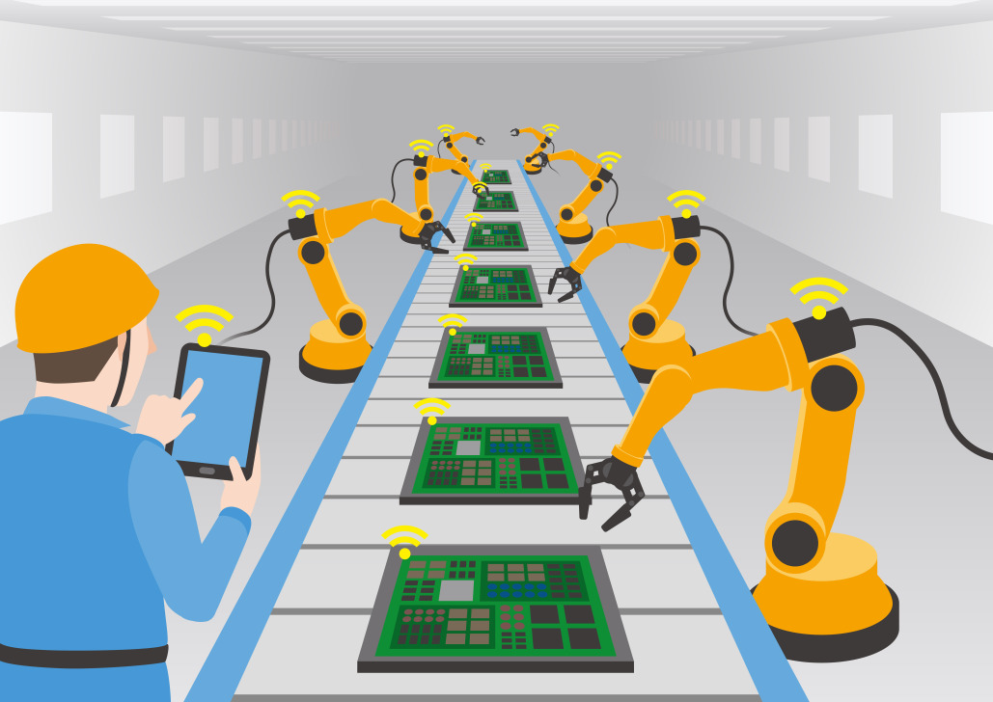
Temporarily Halting AI Development is Necessary
Lauren Pontbriant
Important Topics:
American education system
Skills required in an evolving workplace
Looking to a future with a heavily automated workplace
Notes:
Today I am going to talk about how the American education system prepares students for the workforce. Then, using that, I am going to attempt to convince you that we should hold off on developing AI and automation until we have a society that can support it. Sounds like a big jump? Let me try anyway!

Slide 25
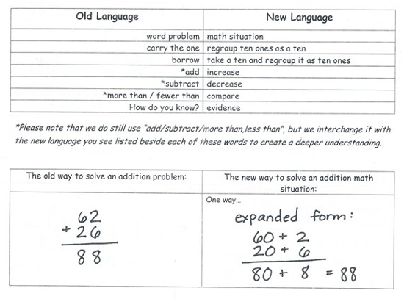
The American Education System
Lauren Pontbriant
Currently, we use Common Core.
Developed to give all students an equal education.
Attempts to develop collaborative skills in students
A Hay Group survey found that 80% of employers have difficulty finding graduates with soft skills
Results in vocabulary divide
[3][6][7]
Notes:
Common core has good intentions, but the implementation is bonkers. Parents and teachers alike spend inordinate amounts of time staring at problems trying to figure out what they mean so they can teach kids. It also results in younger generations having completely different vocabularies for concepts like basic math. Ex “Number sentences” rather than “equations”. It encourages students to discuss problems together, with the intent of making them better at communication than current graduates, but it is unclear yet if this approach will be successful when these students reach the workforce.

Slide 26
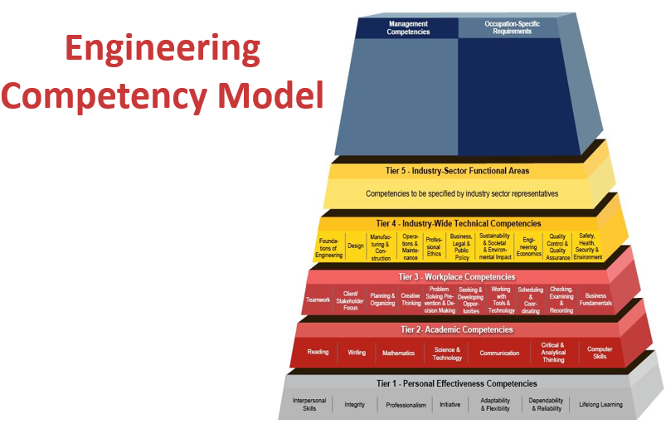
Most Desired Worker Skills
Lauren Pontbriant
The skills in highest demand for young workers according to experienced members of the workforce are:
Accountability
Communication
Responsibility
American Association of Engineering Studies
[1][2][4]
Notes:
You can see that many people agree on what are important skills for young engineers to have. There is a gap between the skills that my generation has and the ones that come after us. We have strong technical skills and weak soft skills, while the generation behind us has been tipped the other way, with stronger soft skills and weaker technical skills. The blue squares are for skills that older millennials are strong in, while the orange are ones that we are weak in. It is important to note that approximately half of these skills are not possessed by either group.

Slide 27

Why are these skills lacking?
Lauren Pontbriant
Standardized testing combined with Common Core encourages “teaching to the test”
Strict schedule combined with standardized testing does not allow for teachers to expand the curriculum
Results in students not having a common base
69% of graduates surveyed believe soft skills are unnecessary
[1][3][6][7]
Notes:
I surveyed teachers that I know for this slide because I had difficulty finding academic sources. My mother, who has been teaching for over 30 years, said that common core specifies skills that must be learned, but gives no guidance as to how to teach those skills. Then standardized testing forces teachers to push through material and some kids end up with a shaky foundation. This combination results in kids all having different ways of solving problems that don’t always result in the same answer. As an example, I got into an argument with a freshman this year about how to long divide.

Slide 28

Skills Required For careers alongside Automation
Lauren Pontbriant
Creativity
Empathy
Sociability
Communication
Entrepreneurship
Machine training
[5]
Notes:
Humans will still be needed that can work alongside the robots and provide qualities that robots cannot mimic. The image on this slide is Mettaton from the video game Undertale, who is notorious as a terrible robotic entertainer. AI is not yet capable of creativity or innovation and these will become the primary domain of human workers. Society will also need “overseers and maintainers” for all of the automated systems.

Slide 29
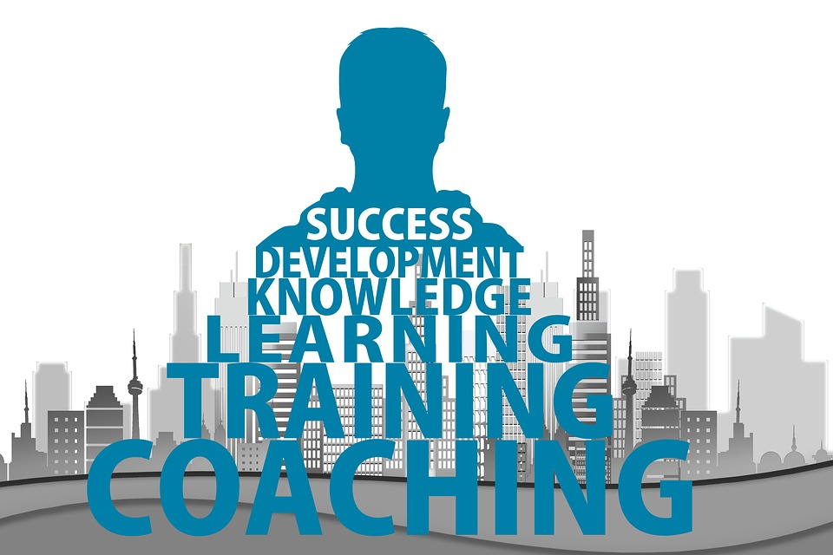
How does education need to change?
Lauren Pontbriant
Students need education that focuses equally on soft skills, basic skills and technical proficiency
We must move away from focusing on the many tasks that will be completed by automation in the near future.
Education must continue into adulthood with training courses, standards, technical presentations and events.
[1][2]
Notes:
The thinking that there is a static pool of knowledge engineers must go to college to obtain needs to change. A society that relies on this much technology will require a wide breadth of skills that are constantly changing and content will need to be continually developed to teach new information and skills to engineers. I anticipate a society where people with technical aptitude become innovators or managers, while others become part of other sectors like healthcare, education, and entertainment.

Slide 30
Conclusion
<Your Name>
We need another push in education to better prepare students for the workforce
It took 5 years to fully implement Common Core
We should allow for a 5 year wait before continuing to automate the workforce
Notes:
The shortest time taken for any organized educational reform is the 5 years taken to implement Common Core. Therefore, I am going to use that time as a minimum, even though the changes would be vastly different. The time it takes to change the education curriculum from its current state to a more beneficial one is the reason I believe we should delay implementing automation until we have a society that better supports the effects that automation would have.

Slide 31
References
<Your Name>
[1] Tulgan, Bruce. ”Bridging the soft skills gap : how to teach the missing basics to today's young talent” Jossey-Bass, 2015. Accessed on April 21, 2017.
[2] Cosman, Eric C. “Automation workforce development: Additional skills required” International Society of Automation. Accessed at https://www.isa.org/intech/201608work/: Accessed on: April 23, 2017
[3]craxycrawfishinpolitics. “Crawfish are Real and So is the Problem with Common Core” Published: April 22, 2015. Accessed on: April 23, 2017. Accessed at: https://crazycrawfish.wordpress.com/2015/04/22/crawfisharereal/
[4] American Association of Engineering Societies. “Engineering Competency Model”. Accessed at: http://www.aaes.org/model Accessed on: April 23, 2017
[5] Cunniffe, Aidan “The automation revolution and the rise of the creative economy”. Crunch Network. Published: April 21, 2016. Accessed on: April 21, 2017. Accessed at: https://techcrunch.com/2016/04/21/the-automation-revolution-and-the-rise-of-the-creative-economy/
[6] Torres, Alec. “10 Dumbest Common Core Problems” Published: March 20, 2014. Accessed on: April 24, 2017. Accessed at: http://www.nationalreview.com/article/373840/ten-dumbest-common-core-problems-alec-torres
[7] Satter, Marlene Y. “Poor Communication Skills Hinder Millennials in Workplace” Benefits Pro. Published: April 13, 2016. Accessed on April 25, 2017. Accessed at: http://www.benefitspro.com/2016/04/13/poor-communication-skills-hinder-millennials-in-wo

Slide 32
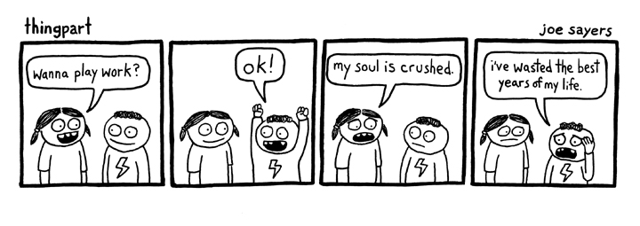
Effects of automation
Michael Giancola
Work
  “The performance of some act or skill … in return for economic reward, or in the ultimate hope of receiving some such reward.”
    Dr. John Danaher [1]
Technological Unemployment
  “the replacement of human workers, engaging in work … by technological alternatives”
    Dr. John Danaher [1]
  Long term
[1]
http://management.curiouscatblog.net/images/playwork.jpg
Notes:
Hi everyone, I’m Mike, and I’m going to be talking about the effects of technological automation. Before I get to my conclusion, I’ll need to start with a brief background. First, some terms: It’s important to define work in a way that makes it clear exactly what is work and what is not.
I will use Dr. John Danaher’s definition of work; that is, “the performance of some act or skill in return for economic reward, or in the ultimate hope of receiving some reward.” I like this definition because it is careful to include activities such as unpaid internships as work, without classifying everything we do as work.
Next, Danaher defines technological unemployment as “the replacement of human workers engaging in work by technological alternatives”. Broadly, technological unemployment refers to any job which is made obsolete by a new technology. However, for the rest of this presentation, when I refer to technological unemployment, I will be referring specifically to long-term technological unemployment. This is the idea that eventually, there will be no work left for humans, as machines will do it all.

Slide 33
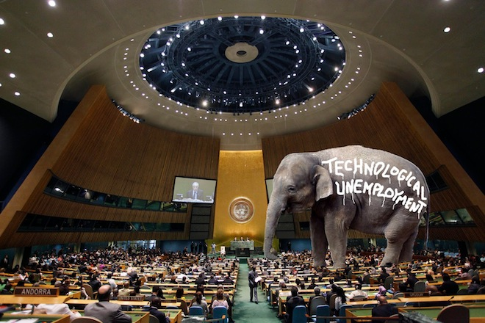
Assumptions
Michael Giancola
Lots of debate over likelihood of technological unemployment
  Many experts believe it’s likely
  [1][2][3]
Not the topic of my presentation
I will assume technological unemployment is inevitable
http://robotswillstealyourjob.com/read/part1
[1][2][3]
Notes:
There’s lots of debate over the likelihood of long-term technological unemployment. However, many experts, such as the ones I’ve cited here, believe it’s likely or inevitable. Regardless, the likelihood of technological unemployment is not the topic of this presentation. For the purposes of this talk, I will assume, like the authors above, that technological unemployment is inevitable.

Slide 34
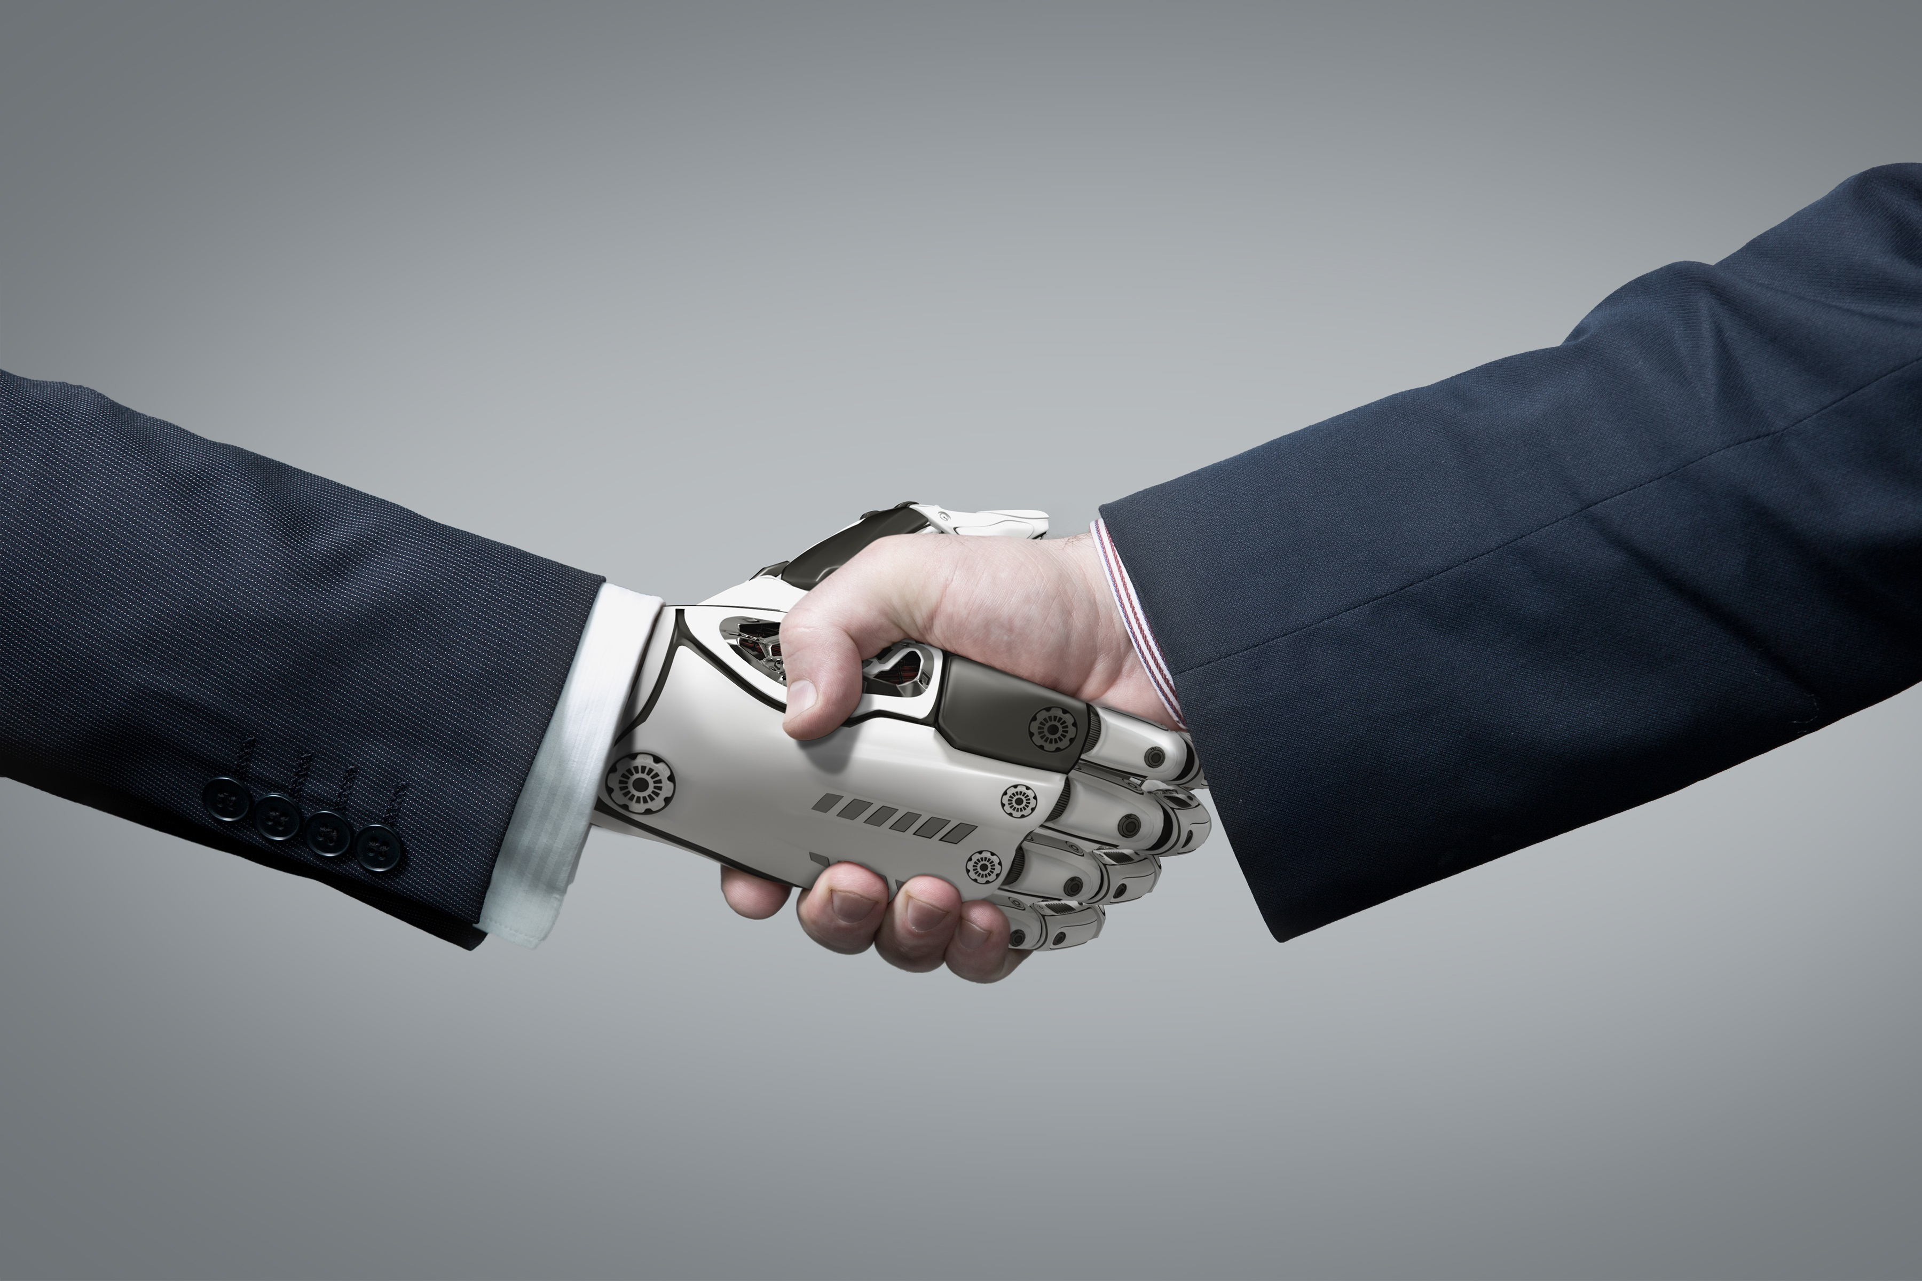
Conclusion
Michael Giancola
Technological unemployment will improve our lives
Emerging technology will enable us to enjoy our lives in a post-work world
https://www.achieveit.com/wp-content/
uploads/2016/05/robot-shaking-hands.jpg
Notes:
With that said, I seeked to understand what would happen next. What will we do with our lives without work? I will argue that technological unemployment will improve our lives, and that computing technology will enable us to continue to enjoy our lives.

Slide 35
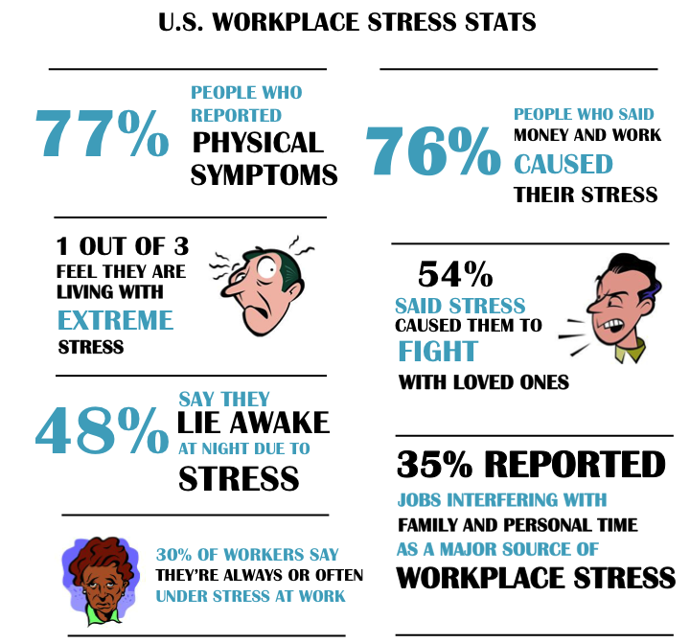
Antiwork critique
Michael Giancola
A life without work is objectively better [1]
A lot of work is bad
Even if you enjoy your job, you would likely be less stressed and happier overall without it
https://s-media-cache-ak0.pinimg.com/originals/e4/
69/75/e46975c5b2ee787a48de6f97807f06de.jpg
[1]
Notes:
A well-known argument for positive outcomes of technological unemployment is called the antiwork critique. There are a couple forms of the antiwork critique, but the form I use argues that technological unemployment is good because a life without work is always strictly better than one with work.
There are many supporting arguments for this. First, many forms of work are objectively bad. They may be degrading, dangerous, or exhausting. Not having to do such a job would clearly be preferred.
Work is also a major cause of stress. One statistic I would like to call your attention is the one in the top right: 76% of people surveyed said money and work caused their stress. Even if these people enjoy their jobs, certainly they would be better off without the stress of having to work, free to pursue whatever they wish, unencumbered by the economic requirement to work.

Slide 36
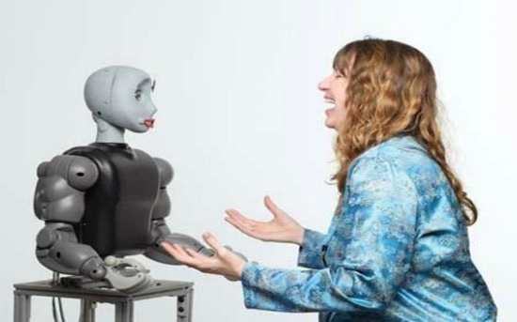
Social robots
Michael Giancola
Definition
  “autonomous robots that interact and communicate with humans”
    Melanie Swan [4]
May improve our well being
  Robotic therapists [5]
USC Study
  Small group of autistic children interacted with a social robot [6]
  50% had a positive interaction
http://www.paperdroids.com/wp-content/uploads/2013/02/autism-robot.jpg
[4][5][6]
Notes:
As much as technology will play a role in replacing us as workers, in many ways technology will also improve our lives in the age of technological unemployment. One such technology is social robotics. In a report on the topic, Melanie Swan defines social robots as autonomous robots that interact and communicate with humans. Several studies have found that they can improve our well being. Some studies have considered the effects of social robots as therapists. They’re able to improve quality of life for many groups of people, such as the elderly. These robots can work 24 hours a day, and don’t need to be individually trained the way human therapists are.
A USC study found that a social robot was able to improve the mood of half of the children with various autism spectrum disorders. The study found that the predictability of robots comforts many people with autism, as the unpredictability of human-to-human interactions is commonly cited as uncomforting to people with autism.

Slide 37
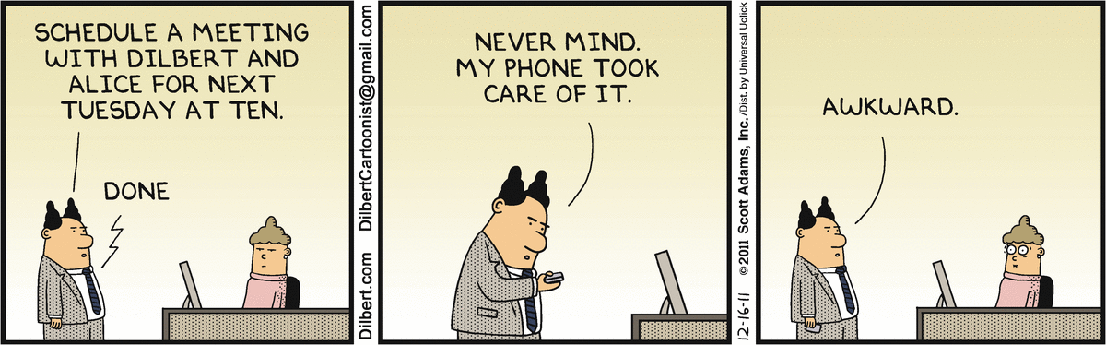
Work gives us Incentives & purpose
Michael Giancola
Work incentivizes us
  A world without work may make us lazy and bored [7]
Would you work if you didn’t have to?
People identify with their work
http://dilbert.com/strip/2011-12-16
[7]
Notes:
Nicholas Carr gives a counter argument to my conclusion. He argues that work provides us with incentives to be productive and accomplish things, which will lead to happiness. Without work, we may not be motivated to do anything, and may find ourselves bored and without purpose.
I think it’s fair to say that most of us are here studying because we are interested in our studies. We all plan to pursue careers which interest and engage us. However, we all also expect to be paid for our work and know that we need to work to survive. Would all of you be motivated to work if you didn’t have to? If you could have a high quality of life without working for your living? It’s hard to say for sure without truly having the option.
However, it’s a valid point that many people will likely miss work. People identify with their jobs. Think about when you meet someone and introduce yourself. I bet the first thing you tell them is your name, followed by “what you do”. So for me, I generally introduce myself as, “I’m Mike Giancola, I’m a Computer Science student at WPI.”

Slide 38

Work isn’t our only source of incentive [1]
Michael Giancola
Other motivators
  Sporting contests
  Raising children
Modern technology can help to motivate us
  Activity/fitness tracker
  Apps that help you stay on a diet
  Apps that help you avoid distractions
https://www.imore.com/sites/imore.com/files/styles/larger/public/field/image/2016/02/Fitbit-Hero-Surge-Run-Press-Web.jpg?itok=LVnTrVRv
[1]
Notes:
However, even today, work is not our only incentive to achieve things. Based on the definition of work I presented at the beginning of this talk, many personal accomplishments which we “work” towards are not, by definition, work. For example, training for and running a marathon is not work, assuming you aren’t running solely for the prize money. Similarly, parents can be motivated to raise their children well. People are able to motivate themselves to do a wide range of things without financial incentives.
Also, we are developing technology to help us stay motivated and achieve our goals. A few well-known examples are fitness tracking wristbands and apps which can help you monitor your physical activity and stay on track with your diet. Also, there are apps to help keep you focused and away from distracting websites or apps, such as Cold Turkey for Windows, and Self-Control for Mac.

Slide 39
Conclusion
Michael Giancola
Technological unemployment will improve our lives
Emerging technology will enable us to enjoy our lives in a post-work world
https://www.achieveit.com/wp-content/
uploads/2016/05/robot-shaking-hands.jpg
Notes:
To sum up, I argued using an antiwork critique that technological unemployment will improve our lives, and that emerging technology such as social robots and incentivizing apps will enable us to enjoy our lives more in a post-work world.

Slide 40
References
Michael Giancola
[1] John Danaher, “Will Life Be Worth Living in a World Without Work? Technological Unemployment and the Meaning of Life” (Springer, 2016) https://link.springer.com/article/10.1007%2Fs11948-016-9770-5 (Accessed 3/30/2017)
[2] Martin Ford, “The lights in the tunnel: Automation, accelerating technology and the economy of the future” (CreateSpace Independent Publishing, 2009)
[3] Federico Pistono, “Robots Will Steal Your Job, But That’s OK: How to Survive the Economic Collapse and Be Happy” (CreateSpace Publishing, 2014)
[4] Melanie Swan, “Philosophy of Social Robotics: Abundance Economics” (Springer, 2016) https://link.springer.com/chapter/10.1007%2F978-3-319-47437-3_88 (Accessed 3/30/2017)
[5] Romeo Viteli, Ph.D., “The Rise of the Robot Therapist” (Psychology Today, 2014) https://www.psychologytoday.com/blog/media-spotlight/201411/the-rise-the-robot-therapist (Accessed 04/19/2017)
[6] David Feil-Seifer et. al., “Development of Socially Assisitive Robots for Children with Autism Spectrum Disorders” (USC Viterbi School of Engineering, 2009) http://robotics.usc.edu/publications/media/uploads/pubs/648.pdf (Accessed 04/19/2017)
[7] Nicholas Carr, “The glass cage: Where automation is taking us” (The Bodley Head, 2015)
Notes:
This concludes my presentation. Are there any questions?

Slide 41
Class 11
The End
Keith A. Pray
Instructor
socialimps.keithpray.net
Notes:
This is the end. Any slides beyond this point are for answering questions that may arise but not needed in the main talk. Some slides may also be unfinished and are not needed but kept just in case.

