Slide 1
Class 8
Crime
Keith A. Pray
Instructor
socialimps.keithpray.net
Notes:
Here’s the title slide. Is anyone not excited?
Paper Reminders:
Self Search Paper average 6.0
5 High quality, primary sources, text book and encyclopedias do not count
Use template
Conclusion, Argument, Counter Point, Response
Try reading paper aloud

Slide 2
Survey Results
Notes:
I sincerely apologize to anyone who has felt like I’ve talked down to them, made fun of opinions, or have shown negative favoritism. This was not intended. Please speak up if you believe this is happening so I may correct it promptly.
Please bring current events into the class discussion.
Everyone will have the same opportunities to speak. I’m happy to discuss topics further during office hours.
Review 5 sources rationale at: http://socialimps.keithpray.net/assignments/paper-guidelines/
Back to back papers: I’d love suggestions on interesting papers I can assign every other class. There’s even a discussion board open for paper ideas.

Slide 3
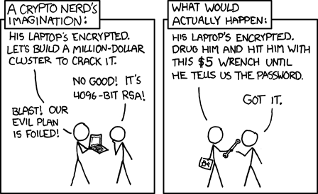
Overview
Review
Assignment
Students Present
http://xkcd.com/538/ (2010-11-14)
Notes:
Are there any questions on the assigned reading?
Use the slides ahead to explain any of the attack methods from the text.
If there are no questions you can skip those slides.

Slide 4
My Reading Notes
pp. 321 Might be interesting to compare password guidance over the years.
pp. 323 How does Firesheep always get a user photo?
pp. 328 Not current or virus unknown…
pp. 330 Goals include infect 3 machine per LAN and as many computers as possible? Never make last minute changes before release. Were they related to the defects?
pp. 332 Do people use the Internet as an experimental laboratory these days? Shutdown right after booting, “benign” doesn’t seem like the right word.
UPDATE
pp. 334 “send reports back to a host computer”?
pp. 335 Firewalls often not running on same machine as malware, routers?
pp. 337 Have 2003 fears of cyber terrorist attacks been realized?
pp. 345 How is online voting a moral issue?
pp. 346 Is Internet access due to financial restrictions still relevant? Could issue specific, unrelated code for each vote.
End of Chapter questions:

Slide 5
Group Quiz
A denial of service attack shuts down a bunch of retailer, stock brokerage, large corporate entertainment and information web sites. Possible guilty parties:
  Terrorist who aimed to cause billions of damage to U.S. economy.
  Protest organization opposing commercialization of the web and corporate manipulation of consumers.
  Script kiddie just having fun with tools he found on the web.
  Show off hacker in search of bragging rights.
State what penalties are appropriate for each.
Explain your answer to 1. using a single Ethical Theory for all.
Name the laws/acts under which these parties could be prosecuted.
Notes:
Works well as small group exercise.
Note: short answer format expected.
Note: 2. only one argument needed, should include logic for all parties
Note: 3. same law(s) should be applicable to all parties

Slide 6
Assignment
Code Testing 1 Page Paper 1/2
Given code you did not write yourself, you all should (hopefully) feel the need to test and potentially break said code.
For this assignment, you will be given the following snippet and asked to unearth as many bugs possible.
There will be major and minor bugs worth noting. Once you have unearthed as many bugs as you can find, decide if your ways of testing were adequate and explain why.
Please include explanations of bugs, how you would fix them, and explain why leaving these errors in the code could be problematic if put into production.
Consider the weaknesses in your testing methods as a counter argument and address how you could have done things differently as well.
Working example: http://socialimps.keithpray.net/assignments/index.jsp?content=Code_Test.jsp
Notes:
The online working example source code is best not viewed with IE though looking at the source for the page will reveal the implementation.
If guest presenter coming next class remind students to prepare questions for him.
Remember to work on groups projects.
Each group should have material on their sites for the topics we’ve covered so far.
OLD Prompt:
Design tests for the code on the following slide.
Contains at least one major defect and several minor ones.
Write a paper (1 page not counting any source code) including :
Did you choose a good test strategy? (This is your conclusion.)
The inputs and expected outputs
What defects you found
How you would fix the defects (you may include fixed source)
Why would that fix the problems?
What could happen if the defects are not found before the code is put into production?

Slide 7
Assignment
Code Testing 2/2
import java.text.NumberFormat;
public class SalesFun {
public static double calculateSalesTotal ( double amount, double discountRate, double taxRate ) {
double discount = amount * discountRate;
double total = amount - discount;
double tax = total * taxRate;
double taxedTotal = tax + total;
NumberFormat numberFormat = NumberFormat.getCurrencyInstance();
System.out.println ( "Subtotal : " + numberFormat.format ( amount ) );
System.out.println ( "Discount : " + numberFormat.format ( discount ) );
System.out.println ( "Total : " + numberFormat.format ( total ) );
System.out.println ( "Tax : " + numberFormat.format ( tax ) );
System.out.println ( "Tax+Total: " + numberFormat.format ( taxedTotal ) );
return taxedTotal;
}
}
} Lines of interest
Notes:
Bold lines are real focus.
Example input:
amount = 100.05;
discountRate = 0.10;
taxRate = 0.05;
OR
0.70, 0.0, 0.05
95.67, 0.20, 0.7

Slide 8
Overview
Survey
Review
Assignment
Students Present

Slide 9
Cyber Vigilantism
Andrew Rottier
Snowden VS NSA
Vulnerability disclosure cases
Is it okay for vigilant cyber criminals to hack or break the law if it’s with good intent?
[10] Laws that censor information that could protect people
Notes:
Here is a brief overview of my presentation.
I will touch upon laws and ethics pertaining to cybercrime in regards to Edward Snowden and the NSA leaks and then about some cases of vulnerability disclosures.
We have a lot of grey areas around what is ethical and what is legal with these things.
---------------Saving this content here incase I need to talk about later---------------
Check out Computer Fraud and Abuse Act
Crime to access computers connected to the internet without authorization.
Transmitting government classified information
Trafficking computer passwords.
General, computer fraud (phishing), computer extortion.
Electronic Communications Privacy Act
illegal to intercept telephone conversations, email, or any data transmission that isn't yours.
Illegal to access stored email messages without authorization.
Wire Fraud Act
Deals with falsifying banking transactions.
National Stolen Property Act
Can deal with stealing property related/linked to online accounts.
Patriot Act
Created after 9/11 which gives broad powers to prevent against threats to the united states.

Slide 10
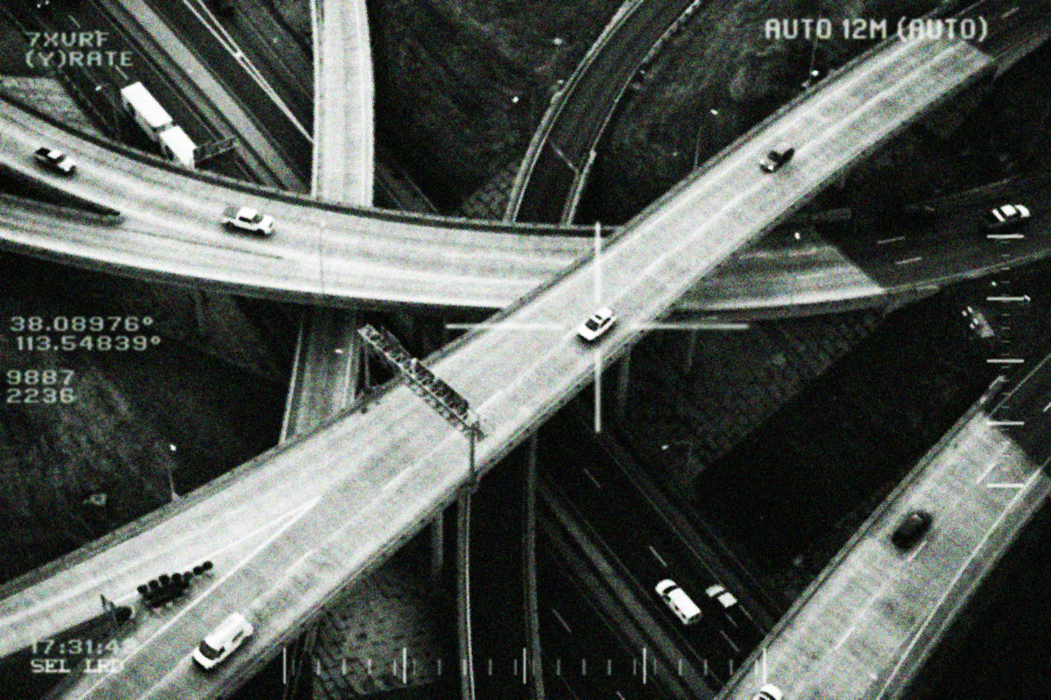
Edward Snowden and NSA Leaks [2]
Andrew Rottier
Leaked information about government programs used to surveillance the population.
XKeyscore
TEMPORA
Drone Surveillance
Results:
Skepticism of government
Companies increasing their security [11]
[7] Drone surveillance camera, allows complete roving surveillance of someone.
Notes:
XKeyscore - person querying software. This program allows the NSA to query across billions of collected records ranging from VoIP data, account credentials, personal information, web searches, and private communications.
Data collected was an aggregate of government abused exploits, data collected through government mandated backdoors in internet and telephone service providers and large computer companies like Facebook, Google, Apple, etc [2][9].
Data is linked once accounts are connected. Credit card to phone, credit card to metro card. Concept - ‘Linkability’ described by Jacob Appelbaum
All they need is a person’s email, username, some bit of info that uniquely identifies you and they can start to connect the dots.
Violates Computer Fraud and Abuse Act (Trafficking computer passwords, computer extortion)
Electronic Communications Privacy Act (illegal to intercept telephone conversations, email, or any data transmission that isn't yours, Illegal to access stored email messages without authorization.)
TEMPORA - Britain’s Government Communication Headquarters (GCHQ), devised a system that extracted internet communications through secret fiber-optic interception points. The data is stored so that it can later be searched
Violates same things as above
Drone Surveillance - government still has the ability to monitor ‘anyone they deem a threat’ to national security.
Anyone can get on these government watch lists and are very difficult to get off of.
So all of these programs obscurify existing laws - like the Patriot Act which gives broad provisions over surveillance of the population (roving wiretapping - completely destroy the concept of privacy). When the government defines it’s power broadly, it has the ability to stretch the rules in their favor - very evident after Snowden released information on the programs just described. These programs violate the Electronic Communications Privacy Act and the Computer Fraud and Abuse Act.
Snowden broke the law by releasing government classified documents. But who is the government really protecting? The government sets the laws, and then is breaking them. Who is to police the government? Why should government get to act in the dark? We fund them..
<option 1 – results of Snowden> This release of information has negatively affected the view upon our governing bodies. Although users might be upset about this, they are still dependent on these applications for work and communicating. Fortunately, some companies have stepped up their security by encrypting their data [10]
-<option 2 - maybe say, maybe not – depends on time> An obscure analogy to this is the 2nd Amendment, right to bare arms. It was created with the intent to allow organization of citizens to bare arms to takedown corrupt governments. This means it was created with the intent to allow the people to have power to bring down corrupt government. Why shouldn’t this concept apply for things that happen online?

Slide 11
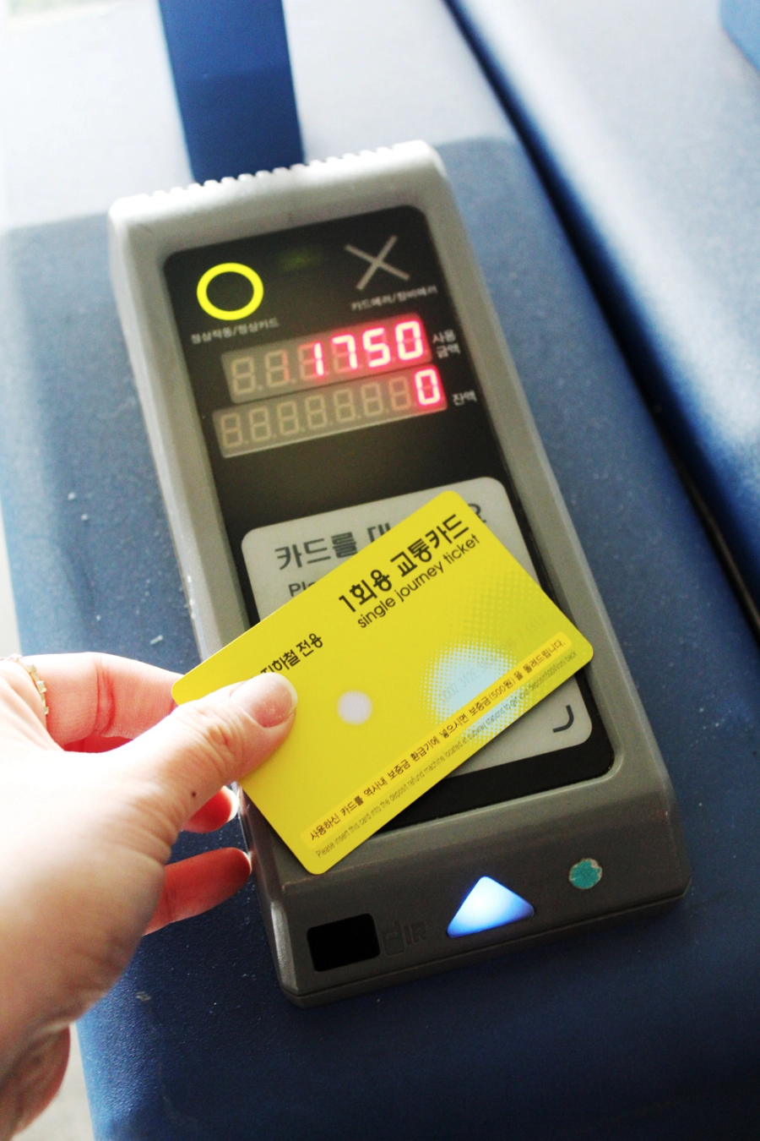
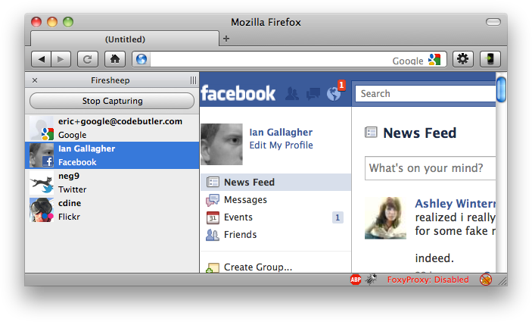
Vulnerability Disclosure [1]
Andrew Rottier
FireSheep – Side-jacking [9] -from book
FireEye vs ERNW [4]
Boston Subway Officials vs MIT students [6]
[6] MiFare Card Exploit – MIT students create open source tools for users to exploit MBTA payment system.
[5] FireSheep Side-jacking add-on
Notes:
FireSheep – side-jacking - from the textbook
Eric Butler wanted to raise awareness of unencrypted http connections from public wifis. Users could easily steal other people’s sessions. Butler made a tool that made this very easy.
Claimed to be done with the intent to get companies to fix this issue.
<Optional>Deals with Computer Fraud and Abuse Act (Crime to access computers connected to the internet without authorization),
Electronic Communications Privacy Act (Illegal to access stored email messages without authorization),
National Stolen Property Act (Can deal with stealing property related/linked to online accounts)
FireEye vs ERNW - two security firms
FireEye hired ERNW to do security consulting on their own security product.
FireEye got a court order to prevent researchers from publicly disclosing information about discovered vulnerabilities with their product.
Researchers had found 3 vulnerabilities
Although they was initially an agreement between the two organizations. FireEye later backed out by taking legal action.
A researcher from ERNW argued that bringing upon legal action discourages the research community - negatively affects those who are trying to help.
MIT VS BOSTON - MiFare Classic Card system
3 undergrad students from MIT were going to present vulnerabilities they discovered at DefCon (a major hacking conference in Las Vegas) with the Massachusetts Mass Transit System payment system.
They reverse engineered RFID tags from a magnetic strip on paper CharlieCard tickets.
The MBTA claimed this exploit cause damages that could not be specified by them.
They’re suing the students and the university for violating Computer Fraud and Abuse Act.
Huge legal dispute over whether or not the students should still hold their talk.
Unfortunately, the presentation slides were already distributed to DefCon attendees before MBTA filed lawsuit.
Benefits,
forces product owners to update with patches sooner - more people benefit from a secure product.
Prevents someone with malicious intent from discovering/exploiting it first.
Drawbacks
Some of FireEye’s source code would have to be released
Hurts their company branding - showing that there are security flaws.
Malicious hacker could come along and exploit the vulnerabilities before it’s patched.
A legal gray area for those seeking vulnerabilities.

Slide 12
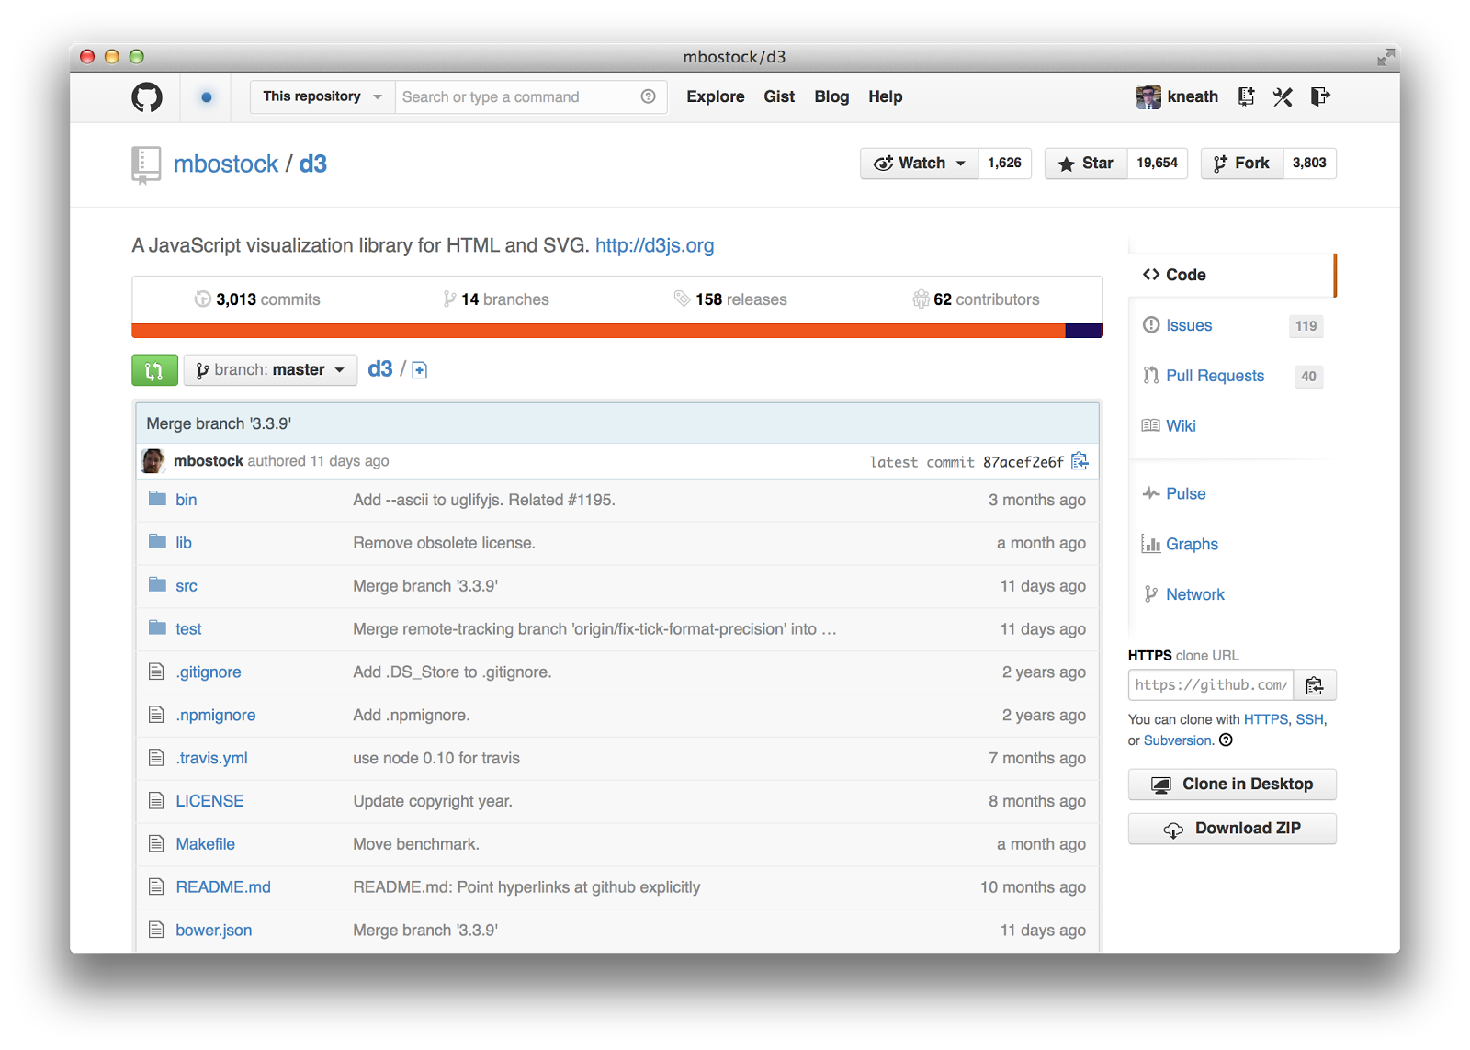
Are these actions okay?
Andrew Rottier
Yes.
Anything to be done to protect the good of the people should be done.
[8] Open source tools should be used to create more secure products
Notes:
Software is created and released with the intent on helping people. If there is a vulnerability with that product, it has the potential to harm those users. Patching a vulnerability can save millions of users from a malicious attack. If a company claims to have secure services or allows you to privately communicate, then they should be liable for vulnerabilities in their product.
Example: If a food product has E. coli in it, the companies don’t hush those who discovered it. They callback the product and immediately fix the problem. Why should this be any different with your personal data, bank account information or medical records?
In the case of Edward Snowden. There should be clarity in the government’s capabilities. Laws should not broadly be defined so that they can be exploited without the citizens knowing.
They don’t spy on everyone that buys a gun, so why are they targeting some threats, but not others?
Solutions: Open source projects. People want software that works and is secure.
There are only so many smart people out there, by making software proprietary, it is limiting the the number of brains/developers that could be contributing to it. Get different viewpoints on how to solve problems. This allows researchers and computer scientist from all over the world, a chance to create the best/most safe product.
Could even argue it saves companies money
If code is proprietary,
open source parts of the code that need protecting
Or abstract the context of the code
The government and companies should be about protecting the people, not themselves. Regardless of what they deem ‘legal’ because sometimes the law can hurt people too.

Slide 13
References
Andrew Rottier
[1] https://www.wired.com/2008/08/injunction-requ/ (Accessed, April 9, 2017)
[2] Poitras, L. (Director), & Bonnefoy, M. (Producer). (2014). Citizenfour [Video file]. United States: Radius-TWC. Retrieved April 1, 2017.
[3] http://www.thetruthaboutguns.com/2014/09/daniel-zimmerman/second-amendment-founders/ (Accessed, April 8, 2017)
[4] https://www.wired.com/2015/09/fireeye-enrw-injunction-bizarre-twist-in-the-debate-over-vulnerability-disclosures/ (Accessed, April 9, 2017)
[5] http://codebutler.com/firesheep (Accessed, April 9, 2017)
[6] https://2minds1sky.wordpress.com/2016/04/11/subway-ticketing/ (Accessed, April 9, 2017)
[7] http://dronecenter.bard.edu/weekly-roundup-210/ (Accessed, April 9, 2017)
[8] https://guides.github.com/introduction/getting-your-project-on-github/ (Accessed, April 9, 2017)
[9] Quinn, M. J. (2005). Ethics for the information age. Boston: Pearson/Addison-Wesley.
[10] https://www.illustrationsource.com/stock/image/126479/man-covering-his-mouth-with-an-american-flag/?&results_per_page=1&detail=TRUE&page=8 (Accessed, April10, 2017)
[11] http://www.nydailynews.com/news/world/5-ways-edward-snowden-impacted-world-nsa-leaks-article-1.2381980 (Accessed, April 10, 2017)

Slide 14
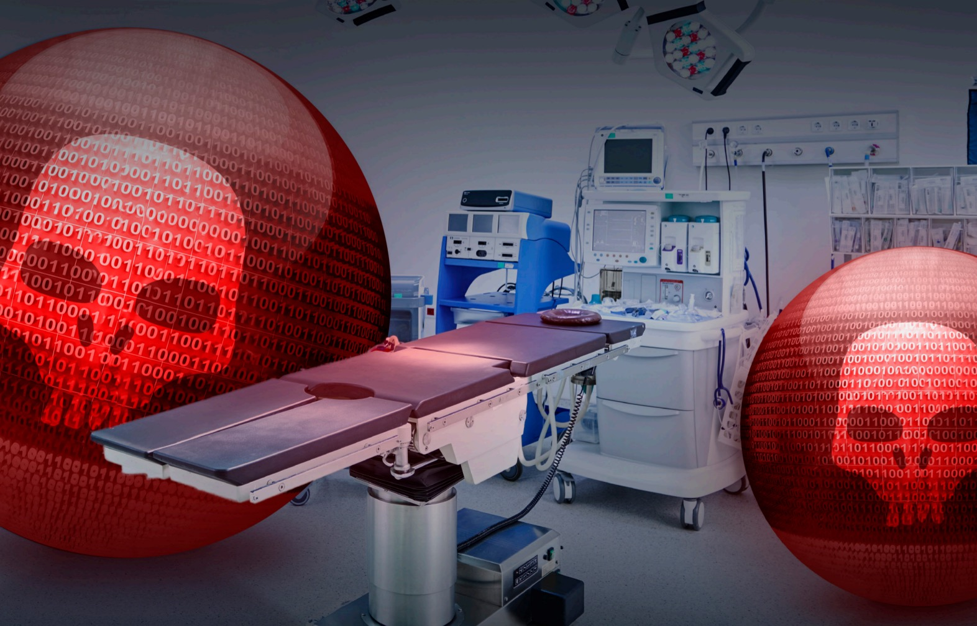
Medical Devices
James Chow
Conclusion: The factors that open the world of Medical Devices to vulnerabilities make defense a more challenging endeavor than with other IoT devices.
Source: http://www.zdnet.com/article/new-exploit-targets-hospital-devices-places-patients-at-risk/
Notes:
My conclusion after doing research was that factors that open the world of Medical Devices to vulnerabilities make defense a more challenging endeavor than other IoT devices. The image here illustrates how even machines used during surgeries may be infected with malware.

Slide 15
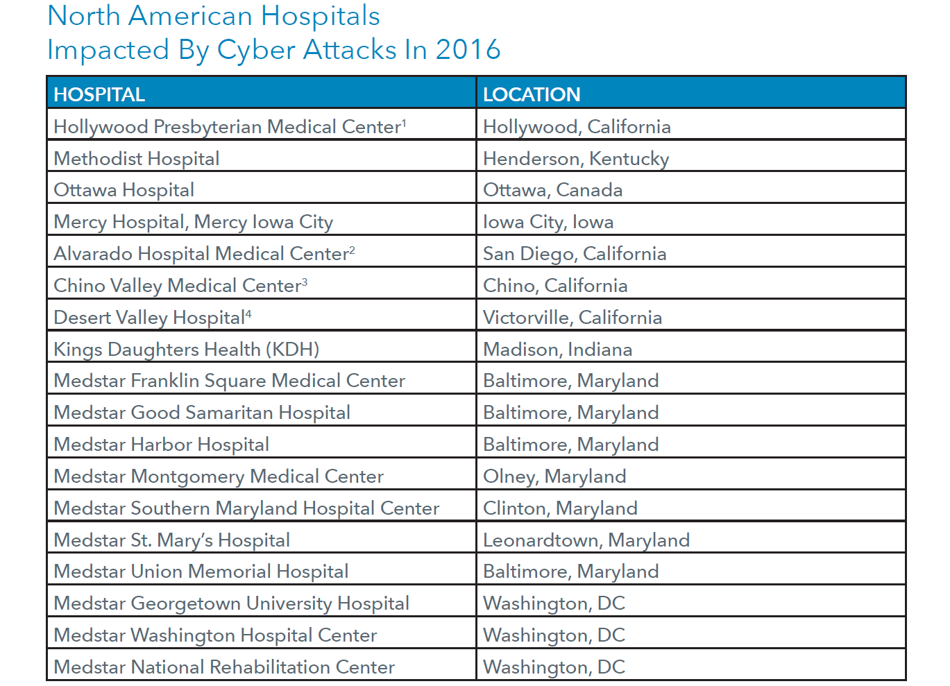
The Problem
James Chow
Much Usage [6]
Wi-Fi and Bluetooth
Security not inherent in design [6]
    Result: Stolen Records[7]
    Result: Injury or Death [8]
Top: https://trtpost-wpengine.netdna-ssl.com/files/2016/07/TrapX_Graphic_Impacted-By-Cyber-Attacks-In-2016_MedJack.png
Notes:
-Many people use medical devices.
-In 2015, 2.5 million people relied on medical devices ranging from MRI machines to pacemakers.
-To facilitate efficient use of medical devices, various devices support everything from Wi-Fi to Bluetooth. For example, one device that I will talk about communicates with an implanted pacemaker to read the patient’s data.
-However, these devices are subject to unauthorized access from cyber adversaries. 655,000 healthcare records stolen in June 2016.
-Between 2006 and 2011, 5,294 recalls and approximately 1.2 million adverse events of medical devices were reported to the FDA’s Manufacturer and User Facility Device Experience (MAUDE) database.
-The image on the right lists some hospitals that had data breaches because the hacker was able to either steal information or encrypt the information to ransom.

Slide 16
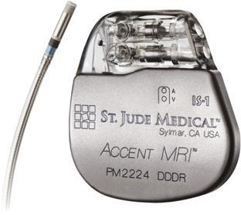
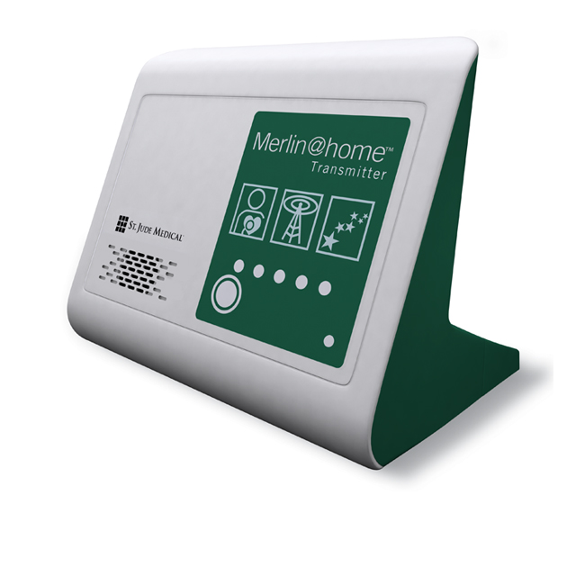
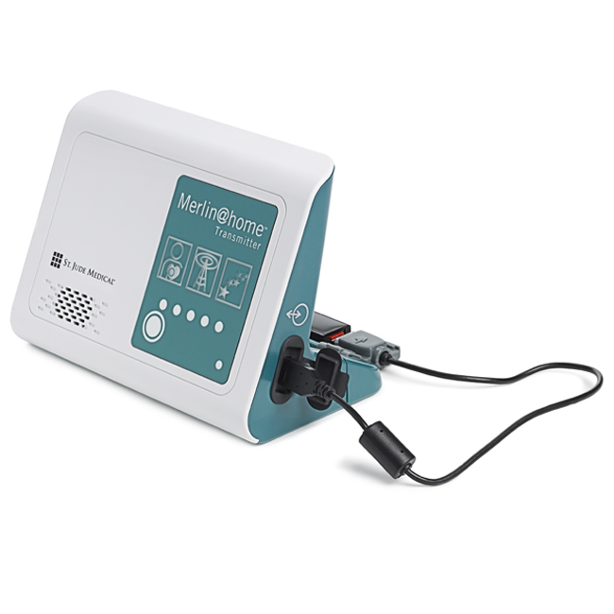
St. Jude’s Cardiac Devices
James Chow
Devices include pacemakers, defibrillators
Merlin@home allows wireless communication
Attack
  Connect laptop to Merlin@Home via USB or Ethernet
  Send Remote Commands
Source: https://www.sjm.com/en/professionals/featured-products/cardiac-rhythm-management/remote-care/remote-care/merlin-home-transmitter?clset=af584191-45c9-4201-8740-5409f4cf8bdd%3ab20716c1-c2a6-4e4c-844b-d0dd6899eb3a
Notes:
Merlin@Home allows for operations like
vibrating Pacemaker
shocking patients
drain battery
Make the pacemaker enable or disable therapies (i.e., shock at will)
This attack is possible because there is no authentication between Merlin@Home and cardiac device and reverse engineering code is easy.
The top image is the implantable pacemaker and the two bottom images are the transmitters. One can be connected via USB.

Slide 17
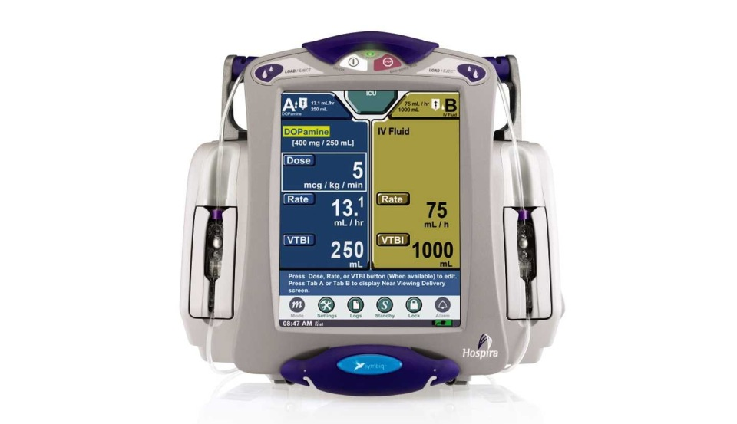
Symbiq Infusion System
James Chow
Computerized pump
Problem – Remote access of System
  Control dosage of pump delivery
Transition to other infusion systems
Source: https://s.aolcdn.com/hss/storage/midas/239e8f0528391a77703cf4b1daf62ac/202405502/symbiq-infusion-pump.jpg
Notes:
This infusion system, shown in the image on the right, was a computerized pump design for the continuous delivery of general infusion therapy.
It was confirmed that the system could be remotely accessed through the hospital’s network.
Due to recent cyber security concerns, the FDA strongly encourages health care facilities to begin transitioning to alternative infusion systems as soon as possible

Slide 18
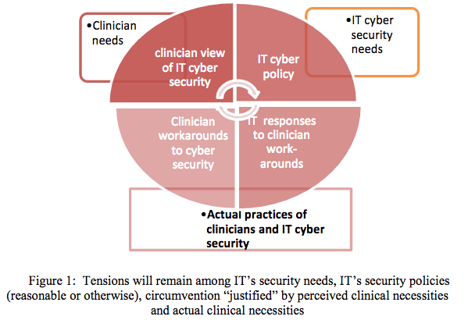
Hospital Security Practices
James Chow
Healthcare workers observe security as annoyance
Security workarounds normal
  Persistent Sessions
  Written Passwords
  Permission Management
[3]
Notes:
In order to defense and cyber security to work, there must be focus on the policy side in order to employees to help prevent cyber attacks. In healthcare, we see a contrast between efficiency and security. Nurses or doctors do not log out of their accounts when finished (led to prescription delivery to wrong patient), writing passwords down and leaving them on the screen, and one person have authorization under multiple departments according to 2015 study.
This allows for attacks and insider threats to easily take over a system.
The image here represents how healthcare professionals needs come into contrast security needs.

Slide 19
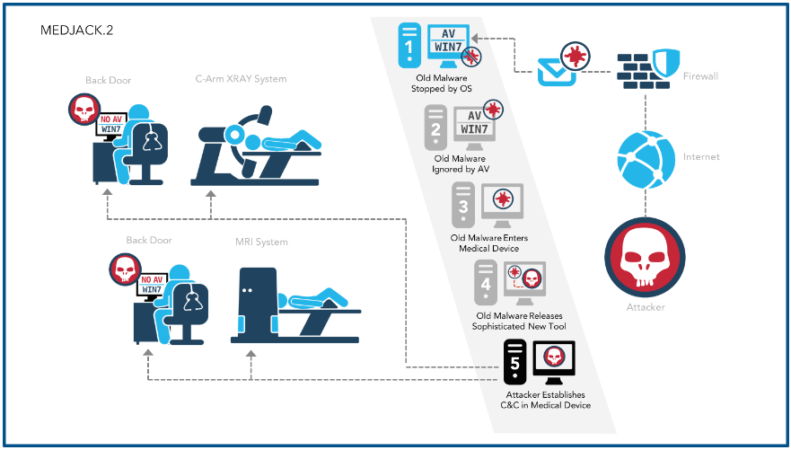
Legacy Systems
James Chow
Medical Devices with outdated software
  Still operational
  Expensive to Upgrade
Leads to Vulnerabilities
  Security Backdoors
  Misconfigurations
  Unauthorized access
Source: http://deceive.trapx.com/rs/929-JEW-675/images/AOA_Report_TrapX_MEDJACK.2.pdf
Notes:
Researchers from TrapX Labs discovered attackers targeting unpatched medical equipment running Windows XP and Windows 7 with variations of attacks such as the Conficker worm, long thought obsolete [7].
The image here outlines how malicious software can bypass medical devices supporting older operating systems and laterally moving in the network to its target.

Slide 20
Summary
James Chow
Medical Devices lack security features
Lack of software updates and patches
Lack of security awareness and enforcement
Legacy System and Software
[4]
Notes:
All of these factors contribute to the current situation of medical devices and the security flaws associated with them.

Slide 21
References
James Chow
[1] United States Food and Drug Adminstration. (2017). Cybersecurity Vulnerabilities Identified in St. Jude Medical's Implantable Cardiac Devices and Merlin@home Transmitter: FDA Safety Communication. Retrieved from https://www.fda.gov/MedicalDevices/Safety/AlertsandNotices/ucm535843.htm. Date Accessed: April 8, 2017.
[2] United States Food and Drug Adminstration. (2015). Cybersecurity Vulnerabilities of Hospira Symbiq Infusion System: FDA Safety Communication. Retrieved from https://www.fda.gov/MedicalDevices/Safety/AlertsandNotices/ucm456815.htm. Date Accessed: April 8, 2017.
[3] Koppel, R., Smith, S. W., Blythe, J., & Kothari, V. (2015). Workarounds to computer access in healthcare organizations: you want my password or a dead patient?. In ITCH (pp. 215-220).
[4] Williams, P. A., & Woodward, A. J. (2015). Cybersecurity vulnerabilities in medical devices: a complex environment and multifaceted problem. Medical Devices (Auckland, N.Z.), 8, 305–316. http://doi.org/10.2147/MDER.S50048. Date Accessed: April 9, 2017.
[5] Ayala, L. (2016). Cybersecurity for Hospitals and Healthcare Facilities.
[6] Middaugh, D. J. (2016). Do security flaws put your patients' health at risk?. MedSurg Nursing, 25(2), 131-133.
[7] Spring, Tom (11 July 2016). IoT Medical Devices: A Prescription for Disaster. ThreatPost. Retrieved from https://threatpost.com/iot-medical-devices-a-prescription-for-disaster/119155/. Date Accessed: April 8, 2017
[8] Fu, K., & Blum, J. (2013). Controlling for cybersecurity risks of medical device software. Communications of the ACM, 56(10), 35-37.

Slide 22
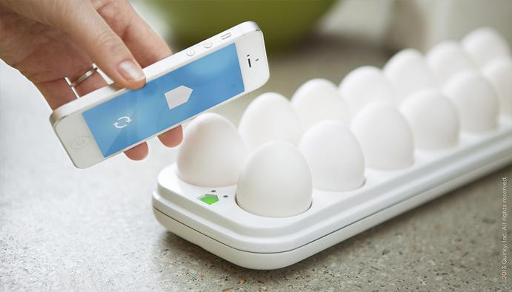
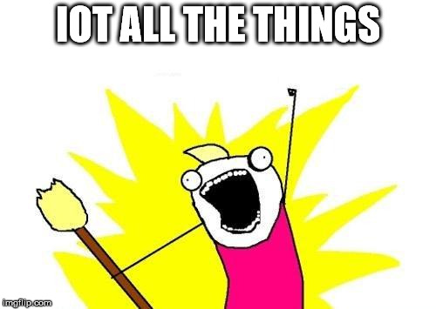
IOT Security
Seth Norton
Security camera
Lights
Thermostat
Alexa/Google home
Outlets
Fridge
Door locks
Egg carton
Sensibility
icdn6.digitaltrends.com/image/quirky-egg-minder-phone-691x395.jpg & imgflip.com/i/1n05hs
Notes:
Standard Greeting
We will be discussing…
As a quick definition, an IoT device is…
You can buy an IoT device for just about anything these days.
Some make more sense than others as to why you would connect them to the internet but we’re really here to talk about…

Slide 23

Takeaway 1
Seth Norton
$$security=\frac{1}{convenience}$$
Notes:
…security.
If something is convenient to you, question what security you could be giving up.
Consumer and developer.
App to turn off your lights from work because you forgot to this morning.
Increased convenience = increased attack surfaces = reduced security
Flick your lights on and off and blast Katy Perry, why?…

Slide 24
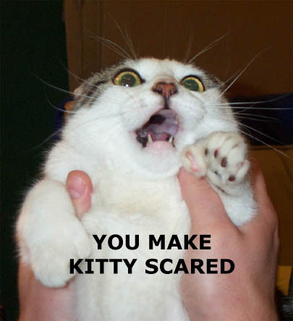
Takeaway 2
Seth Norton
c1.staticflickr.com/1/137/407007831_a550c6319c.jpg
Notes:
…because you like scaring your cat.
Keeping it light,
if you can, someone else can scare you.
So remember, DON’T SCARE THE KITTY!

Slide 25
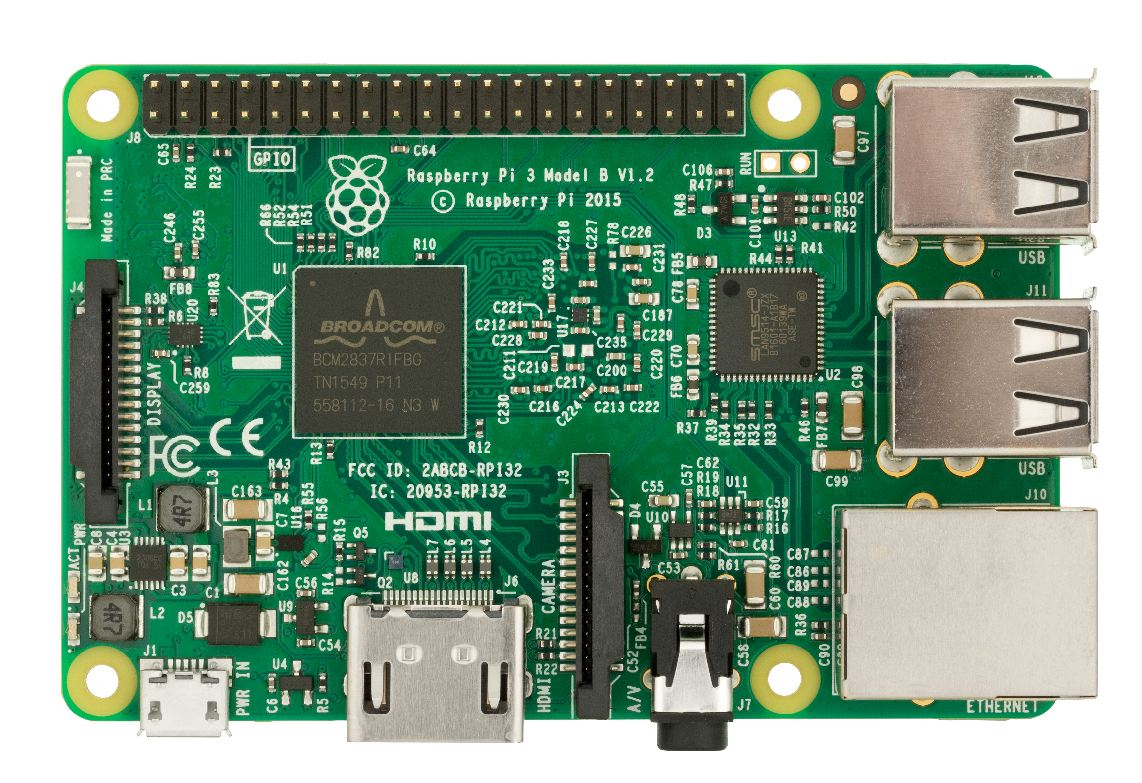
Device layer
Seth Norton
Universal Asynchronous Receiver/Transmitter (UART) [3]
Same System-on-a-Chip (SoC) [1]
IOT Network Structure
upload.wikimedia.org/wikipedia/commons/e/e6/Raspberry-Pi-3-Flat-Top.jpg
Notes:
Many moving parts, but always a device.
Most use System-on-a-Chips or prototyping boards.
UART pins allow full control of the board, often with a root shell.
Guess what aren’t removed? (Not many exceptions) [1]
Using the same SoC is a convenience.
But one vulnerability = entire product line now botnet [1].
Bed and breakfast, one guest knows a thing or two about embedded devices.
Suddenly you can’t turn down the thermostat or your door locks are permanently shut and…

Slide 26
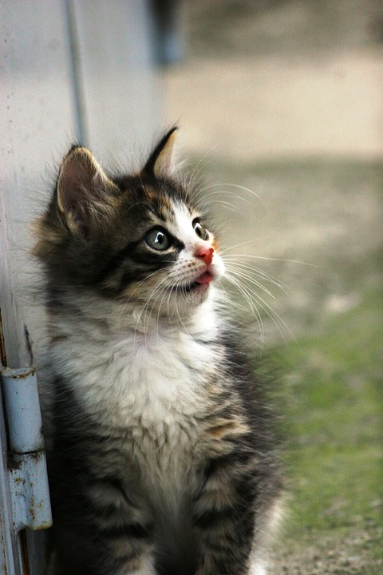
Seth Norton
pixabay.com/p-455529/
Notes:
…your cat is locked outside and scared! DON’T SCARE THE KITTY!

Slide 27
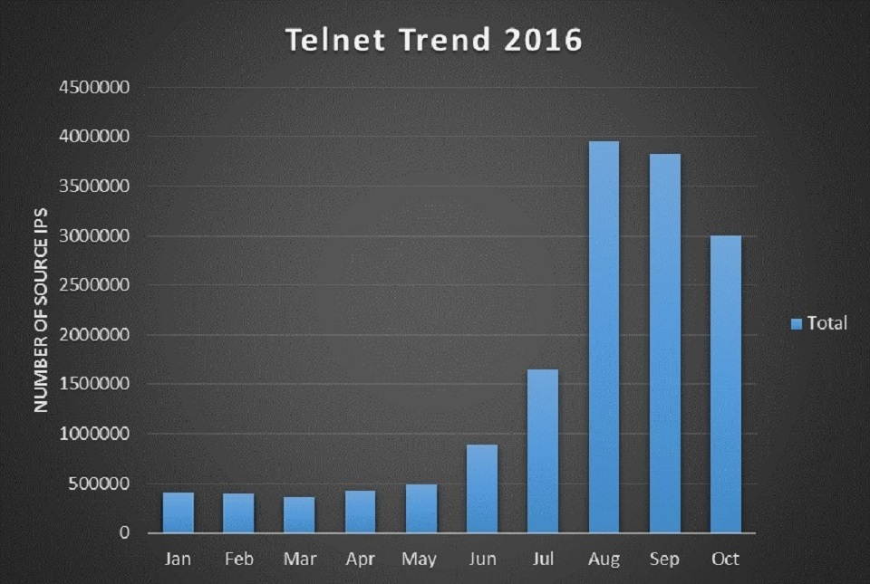
Local-network layer
Seth Norton
Local access point [1]
Software updates [1,9]
Telnet [3,10]
Web interface [9]
IOT Network Structure
static.securityintelligence.com/uploads/2016/11/telnet-ipsources.jpg
Notes:
Making your life easier at the networking level includes…
Telnet open can make it easy to remotely support the devices, but notoriously hard to secure.
Convenient web interface sometimes use default/support accounts
or are vulnerable to any number of other web attacks.
A lot of problems such as software updates and web interfaces are due to “Me write C good someday”
Your network doesn’t stop at your walls.
Your neighbor, mad that your cat has been sitting on THEIR fence,
watches through your webcam until your cat is next to the fridge and suddenly the fridge is dispensing ice cubes and….

Slide 28
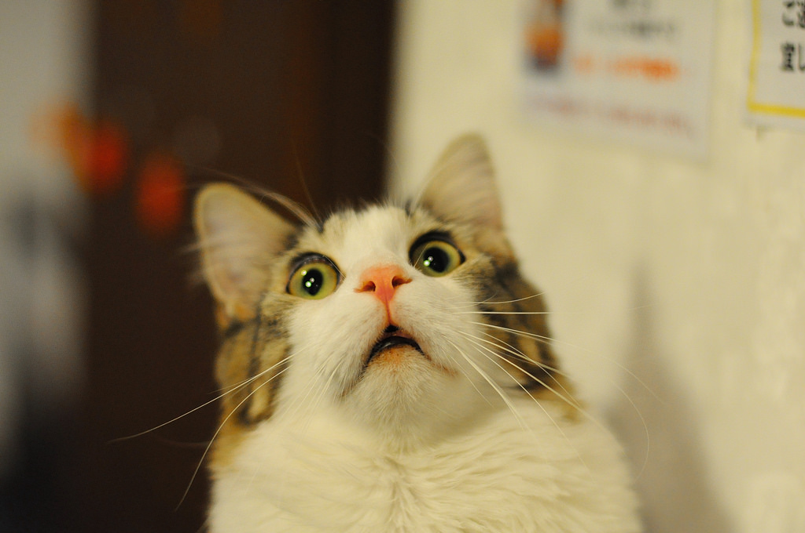
Seth Norton
c1.staticflickr.com/5/4058/4553277701_32fefab169_b.jpg
Notes:
Just…. don’t scare the kitty.

Slide 29
remote layer
Seth Norton
Hard coded/default credentials [1]
Insecure network traffic [5,9]
Cloud system [1,9]
  Authentication
  Encryption
  Data storage
Certificate check/pinning [2]
IOT Network Structure
Notes:
Finally, one of the big draws of IoT is availability from any distance away.
If you can touch them over the internet, so can others.
Cloud service “APIs” may be HTTP requests with no authentication or default credentials [1].
Convenient to develop for and can be accessed anywhere, but it’s a security nightmare.
Why not SSL? Why not encrypted data storage?
Amazon storage example.
Using secure libraries include their own baggage, such as OpenSSL heartbleed
TRENDnet sold cameras in 2013 that let allowed live feeds via a IP+URL (Shodan/Google) [1].
Why? Bug but allowing you to see a feed remotely is the convenience to you as the consumer.
Your house is part botnet attacking government websites or DNS like October of last year [4],
FBI agents show up asking you to take your home off the internet…
-If asked about it-
<Example of cloud system data storage: There was a camera that sent the video clips to Amazon S3, all stored in one bucket, and only protected by being able to guess the filename. Also, no SSL so anyone in the same coffee shop could watch the same home feed you were [1]>

Slide 30
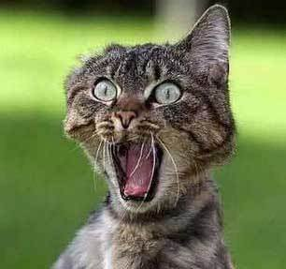
Seth Norton
funnydayz.com/wp-content/blogs.dir/6/files/2012/09/Scared-Animal-08.jpg
Notes:
…your kitty gets scared. Oh and the agents saw how good the leftovers in your fridge look and they’ll be taking those as evidence.

Slide 31

Conclusion
Seth Norton
Correct:
Spend money
Take time for best practices
Minimal design
Less correct:
Get hit by BrickerBot [6]
goto Correct;
$$security=\frac{1}{convenience}$$
Notes:
Why aren’t companies using good security practices?
It’s easier not to.
It’s more convenient to not use encryption, hardcode credentials, and to leave the UART headers on the board.
Examples of good design:
Ikea IoT lighting solution = minimal design and functionality = relative security [7].
Very little economic incentive for security.
It costs money and yet cheaper devices often sell well.
Would you pick the $50 Phillups bulb that is probably secure or $15 off-brand?
Not to say there’s no incentive,
FTC came down on TRENDnet for leaving vulnerabilities open on webcam [8].
Very recently, a botnet called BrickerBot has been attempting to “brick” or destroy insecure IoT devices.
It may be unfair to the consumer, inefficient, and not the best way of solving security, but it provides a serious incentive for manufactures to improve [6].
Almost similar to Firesheep in reading but more destructive.

Slide 32
References
Seth Norton
[1] Lanier, Z., Stanislav, M. (2014). The Internet of Fails: Where IoT Has Gone Wrong and How We’re Making It Right. DEF CON 22. Retrieved from: slideshare.net/markstanislav/the-internet-of-fails-where-iot-has-gone-wrong-and-how-were-making-it-right. 04/10/2017
[2] Farooq, M. U., Waseem, M., Khairi, A., & Mazhar, S. (2015). A critical analysis on the security concerns of internet of things (IoT). International Journal of Computer Applications, 111(7).
[3] Wurm, J., Hoang, K., Arias, O., Sadeghi, A. R., & Jin, Y. (2016, January). Security analysis on consumer and industrial iot devices. In Design Automation Conference (ASP-DAC), 2016 21st Asia and South Pacific (pp. 519-524). IEEE.
[4] Cobb, Stephen (2016). 10 things to know about the October 21 IoT DDoS attacks. We Live Security. Retrieved from: welivesecurity.com/2016/10/24/10-things-know-october-21-iot-ddos-attacks/. 04/10/2017
[5] Heer, T., Garcia-Morchon, O., Hummen, R., Keoh, S. L., Kumar, S. S., & Wehrle, K. (2011). Security Challenges in the IP-based Internet of Things. Wireless Personal Communications, 61(3), 527-542.
[6] Leigh. Bricking IoT devices gives incentives for better security. SecurityBytes (2017). Retrieved from: securitybytes.io/how-to-force-manufacturers-to-take-iot-security-seriously-33a3e9b5ba55. 04/10/2017
[7] Garrett, Matthew (2017). A Quick Look at the Ikea Tradfri Lighting Platform. Personal Blog. Retrieved from: mjg59.dreamwidth.org/47803.html. 04/10/2017
[8] Marketer of Internet-Connected Home Security Video Cameras Settles FTC Charges It Failed to Protect Consumers’ Privacy. Federal Trade Commission (2013). Retrieved from: ftc.gov/news-events/press-releases/2013/09/marketer-internet-connected-home-security-video-cameras-settles. 04/10/2017
[9] Wineberg, W. (2015). Cameras Thermostats and Home Automation Controllers. DEF CON 23. Retrieved from: youtube.com/watch?v=majPZcqlVjI&index=7&list=WL. 04/10/2017
[10] Alvarez, M. (2016). Consequences of IoT and Telnet: Foresight Is Better Than Hindsight. Security Intelligence. Retrieved from: securityintelligence.com/consequences-of-iot-and-telnet-foresight-is-better-than-hindsight/ 04/11/2017

Slide 33
Class 8
The End
Keith A. Pray
Instructor
socialimps.keithpray.net
Notes:
This is the end. Any slides beyond this point are for answering questions that may arise but not needed in the main talk. Some slides may also be unfinished and are not needed but kept just in case.

Slide 34
Buffer Overrun
Run time stack
Local Variables
Return Address
Parameters
Variable Attack
buffer
Target Variable
Stack Attack
buffer
Return Address
code
Return Address
Notes:
Retire slide. Most students have this in depth from new class now.
When a function call is made, local variables, return address, parameters stored on run time stack. Local variables occupy lower memory addresses.
Variable attack – change variable value. Program expects user to input character and allocates a buffer for them. Attacker supplies too many characters and ends up over writing a variable.
Stack Attack – goal is to change value of return address so execution control goes to code which the attacker has provided in the input buffer.
Prevention – add checks against array bounds being exceeded, or modify operating system to not execute instructions stored on run time stack.

Slide 35
Run Example Code
Notes:
Retire demonstration. Most students have this in depth from new class now.
> imps
> assembly
> 123456789qwerty1

Slide 36
Buffer Overrun Code
#include <stdio.h>
#include <string.h>
int main ( void ) {
char buff [ 15 ]; int ace = 0;
printf ( "\n Enter best class ever : \n" );
gets ( buff );
if ( strcmp ( buff, "imps" ) ) {
printf ( "\n %s is wrong! You should FAIL! \n ace=%i\n", buff, ace ); }
else { printf ( "Correct! \n") ; ace = 1; }
if ( ace ) { printf ( "You get an A! \n" ); }
return 0; }
} The Naughty Line
Notes:
Retire slide. Most students have this in depth from new class now.

Slide 37
TCP Three-way Handshake
SYN
SYN-ACK
ACK
Notes:
Retire slide. Most students have this in depth from new class now.
SYNchronize
SYNchronize ACKnowledgement (socket reserved awaiting ACK)
ACKnowledgement
TCP socket connection established

Slide 38
SYN Flood Attack
SYN
SYN-ACK
Notes:
Retire slide. Most students have this in depth from new class now.
Attacker spoofs the IP address so the SYN-ACK is sent to a different machine that cannot respond to the SYN-ACK.
This leaves the connection half open on the server machine decreasing the resources (sockets, memory, threads/processes) available to respond to legitimate clients.
The attacker send many such spoofed SYN messages.

Slide 39
Ping Attack
Target
Attacker
ping
ping
Notes:
Retire slide. Most students have this in depth from new class now.
Attacker finds routers that support broadcasting messages to all computers on their local area networks.
The attacker sends a spoofed ping message, which the routers echo to the spoofed address.

Slide 40
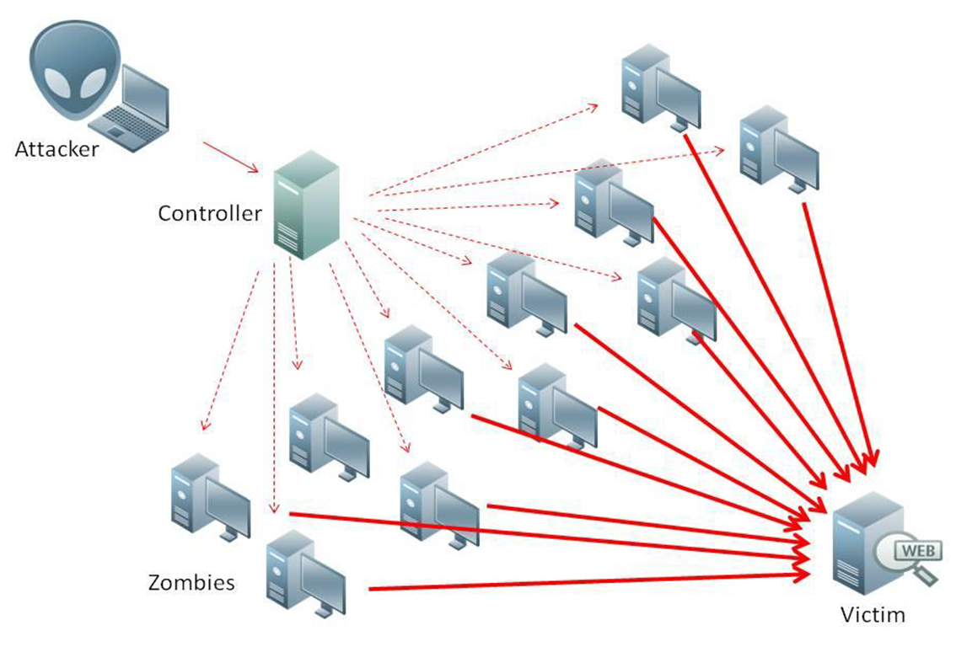
What is Denial of Service (DoS)
Attempts to make target unavailable by flooding with traffic
If victim has to filter attack, it’s too late
Internet Providers have no incentive to help
  Businesses get affected, but would not pay provider enough to make worthwhile
  This is why Cloudflare, e.g., exists
Many ways to perform this attack
Notes:
Contributed by Brett Ammeson.
https://www.cloudflare.com/ddos/reflection-attack-1.png
https://i.imgur.com/lxYv8cF.png

Slide 41
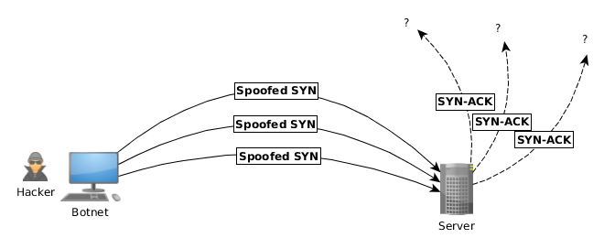
Distributed DoS Vectors
TCP SYN attack
  SYN packets are small, low difficulty for attacker
  Leaves half-open connections on server
  SYN cookies mitigate this
DNS amplification attack
  DNS requests are small
  Can request all records on server
  Crippled by proper configuration
Ingress/egress filtering will reduce effect
Notes:
Contributed by Brett Ammeson.
TCP SYN: https://www.cert.org/historical/advisories/CA-1996-21.cfm
DNS amplification: https://www.cert.org/historical/incident_notes/IN-2000-04.cfm
Ingress/egress: www.giac.org/paper/gsec/705/egress-filtering-keeping-internet-safe-systems/101588

Slide 42
Crime How
Technical and Non-Technical
  Break into computer.
  Prevent access to computer.
What things make computer related crime easy?
Notes:
Exploit security holes, Break encryption, Spoofing
Social Engineering: Guess passwords, Find out passwords and procedures
Poor passwords, Insecure protocols, Program limitations (buffer overruns), Eavesdropping (Email, Interactive), Insecure files

Slide 43
Crime Bane
Trojan Horse
Virus
Worm
Bot Network
Buffer Overrun
(Distributed) Denial Of Service Attack
How do they work?
How harmful are they?

Slide 44
Crime Why
Why?
Notes:
Money: stolen credit cards, change records, stolen property.
Political, military, economic.
Challenge, Revenge, Mean
Why do at all? Have motivation, think about it, think it will help, think it’s acceptable.
Feel forced. Don’t agree. Don’t care.

Slide 45
Crime Time
What is different now compared to:
  10 years ago?
  20 years ago?
  30 years ago?
  40 years ago?
Notes:
More computers. Unsophisticated owners. More complex software. Greater connectivity. Easy access to cracking tools. Incentives. File-sharing
In ’60s and ’70s, access was mostly localized.
Modems. Wardialing.
Some Arpanet and Usenet.

Slide 46
Crime Doers
Hacker or Cracker
  Pre-1980 - Golden Age ☺ ?
  Eighties
  Nineties
  Naughts
Criminal Hacking == Cracking?
Notes:
Script kiddies
Phreakers
Security analysts
Packet monkey

Slide 47
Crime Gain
Justifications for Computing Crimes?
What can be done after access is gained?
  What resources are available?
  How valuable are they?
Notes:
Machines are unused. No harm done. Education. Exposes security holes. Exposes abuses.
Use computer and/or resources. Take data. Destroy data. Alter data. Lock out others. Attack other computers.
Equipment, Processor Time, Disk space, Printer time / paper, Bandwidth

Slide 48
Crime Pay
Computer Fraud and Abuse Act (1986)
  Bans :
    unauthorized access or use of computers, copying, modifying, or destroying data, disclosing of passwords.
    disrupting government and utilities.
  Covers government, financial, medical, and interstate systems.
USA Patriot Act (2001)
  Raised penalties.
  Permits freer surveillance and monitoring to detect illegal activity.
Electronic Communications Privacy Act
  Illegal to intercept telephone, email, other data transmissions, access stored email messages without authorization
Assign Cybercrime Treaty (2006), Wire Fraud Act, National Stolen Property Act, Identity Theft and Assumption Deterrence Act
Notes:
Are either of these laws still in effect? Have they been changed?
For additional legislation ask for presenting volunteers to brief recent incidents/cases.
Also ask for volunteers to find out laws from their home country/state.

Slide 49
Crime Stop
Technical
  Protect Data
  Protect Machine
  Protect Access
Non-technical?
  Social?
  Legal?
Notes:
Encryption, Authentication, Biometrics, Anti-virus, File integrity checking (E.g. Tripwire), Virtual private networks, Point-to-point networking (Twisted-pair Ethernet vs. Coax vs. wireless)
Security through obscurity, physical access required, not on network, behind locked doors.
Remove desire, remove incentives
Legalize, increase penalties, increase chance of getting caught.

