Slide 1
Class 6
Information Privacy
Keith A. Pray
Instructor
socialimps.keithpray.net
Notes:
Here’s the title slide. Excited already, aren’t you?
How did the self search paper go?
Who: found a lot, very little, surprised, not surprised, creepy, share conclusions

Slide 2
Logistics
Send group web site URL and volunteer for first day via email.
Address email to entire course staff for quickest response time
Turn extra credit paper in on myWPI/Canvas and hard copy in class like regular papers
Presentations are due 24 hours before class
Use Presentation Guidelines on course web site
Notes:
Not needed this time:
Send presentations via email as attachment.
Do not change the format, footers, etc. in the template slides.
Paper writing process: Sources → Notes → Conclusion → Argument → Counter Point → Response

Slide 3
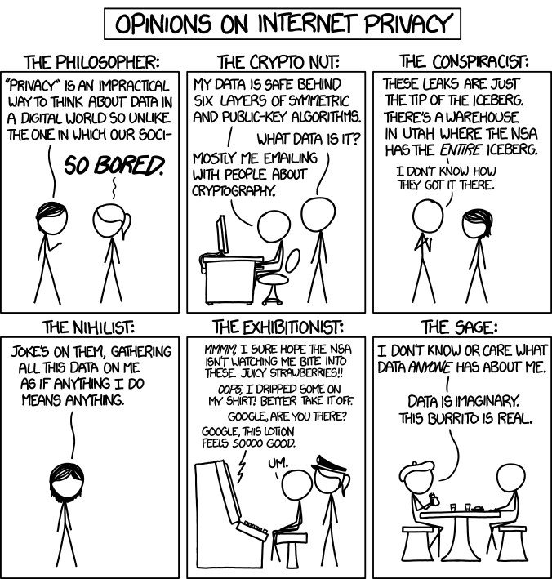
Overview
Review
Assignment
Students Present
http://xkcd.com/1269/
Notes:
1 – Accessed 2014-04-14
Personal Information Privacy

Slide 4
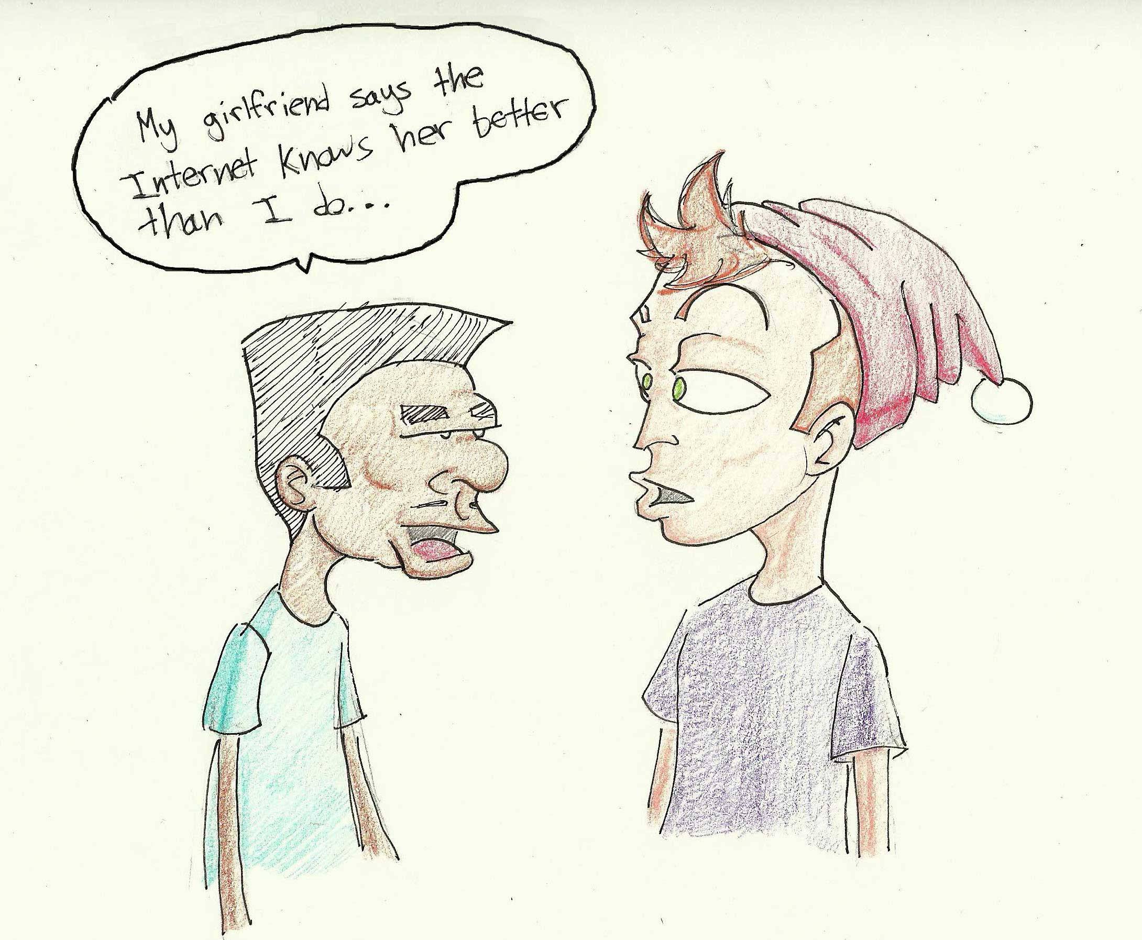
http://dailytrojan.com/2010/04/25/online-information-sharin>
ts-benefits

Slide 5
My Reading Notes
pp. 230 who videotapes anymore?
pp. 231 “businesswoman” nice change. Moral capitol – source published in 1984, “taking away” “1984”
pp. 238 “…privacy…in their own homes…” != nanny to expect privacy “…when… insides Sullivans’ home.
pp. 244 Human chip implant sources getting old, 2002, 2004, 2007, 2010
pp. 255 Why did Apple not enforce policy of asking permission in the API?
pp. 245 “…by 2015” did it happen?
pp. 246 Web Browsers put cookies on on your hard drive, not Web Servers.
pp. 250 why is bills – responsibility assumption flawed?
Notes:
Find out what your DNA says about you and your family.
https://www.23andme.com/
Jimmy Kimmel Live – What is your password? (2:49)
https://www.youtube.com/watch?v=opRMrEfAIiI

Slide 6
Assignment
One Page Paper
Would a National ID System be a good thing?
  Feel free to reference or build upon your self search work if it helps your argument.

Slide 7
Overview
Review
Assignment
Students Present

Slide 8
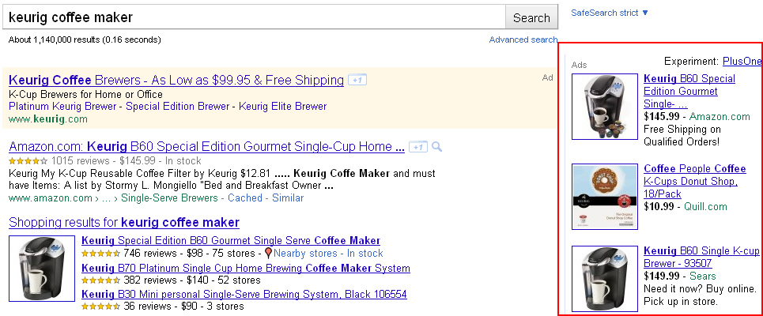
Targeted ads
Ziyan Ding
http://www.gsqi.com/imd/?p=880
Notes:
Self introduction
Noticed it is prevalent recent years
Today is going to discuss how website tracks users activities and what’s public reaction

Slide 9


Utilized users information
Ziyan Ding
Ads use the context of a page
  Search term, domain
  Keyword analysis, word frequency, font size, and the overall link structure of web[1]
Ads use the information of user
  Basic information
  Cookies and IP address
  Conversion tracking that records online activities
https://www.google.com/url?sa=i&rct=j&q=&esrc=s&source=images&cd=&cad=rja&uact=8&ved=0ahUKEwin8aWxl4vTAhVK74MKHZ-yCF0QjRwIBw&url=https%3A%2F%2Fwww.youtube.com%2Fwatch%3Fv%3DAv-sx5BIfLA&psig=AFQjCNFSExpqCEUrypTpGczQxJSc5KXWiQ&ust=1491408385344411
https://www.accelerateinsightsmarketing.com/social-media-advertising/
Notes:
There are several ways to target audience
Google's system analyzes the content of each webpage using factors like keyword analysis, word frequency, font size, and the overall link structure of web to determine its central theme, which is then matched to your ad using your keywords and topic selections, your language and location targeting, a visitor's recent browsing history, and other factors.
Advertisers add a conversion tracking tag, or code snippet, to their website or mobile app code. When a customer clicks on the ad from Google Search or selected Google Display Network sites, a temporary cookie is placed on their computer or mobile device. When customers complete the action advertiser defined like whether they purchased a product, signed up for users newsletter or confirming the purchase across devices, system recognizes the cookie (through the code snippet user added), and it record a conversion.
Purpose: retargeting purchaser who don’t finish purchase like putting thing in cart but not pay
targeting lookalike customer (page fan who like advertisers page, visited specificwebsite)

Slide 10
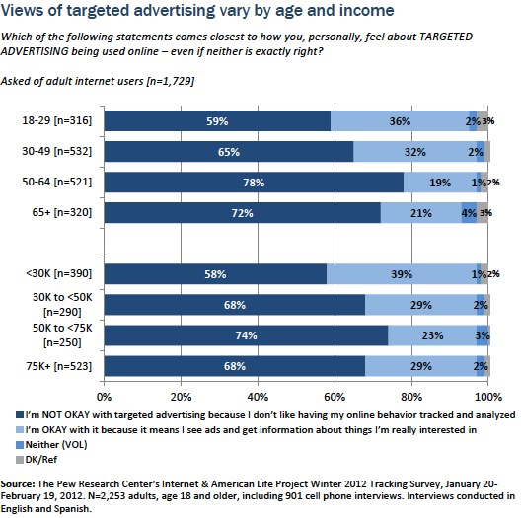
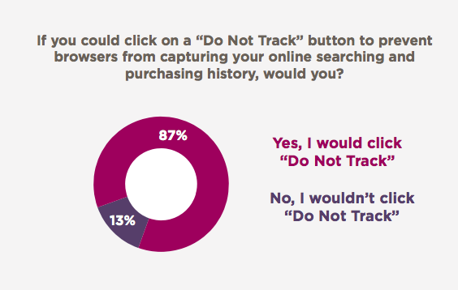
Public disapprove of tracking data
Ziyan Ding
[3] survey
[2]Search Engine Use Over Time
Notes:
Left picture suggests that 68% disapproved of target advertisement (2253 people) 2012 Winter
Right is online consumer survey(8000) from multiple countries where 87% were from America in 2013
All two pictures suggest that apparent hostility to data-mining and targeting
Younger people are more willing to share their information

Slide 11
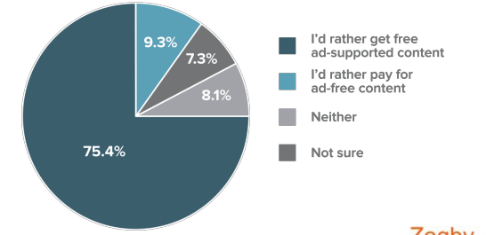
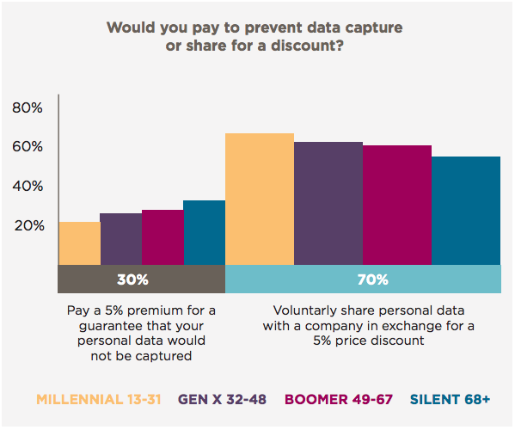
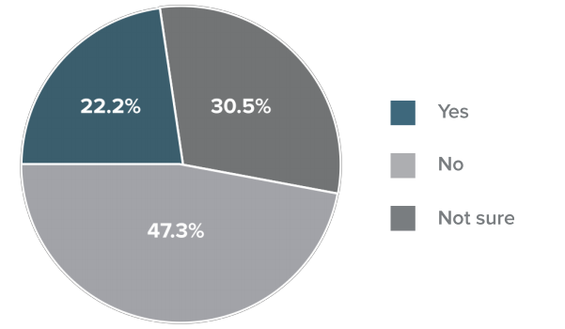
Privacy could be comprised
Ziyan Ding
[4]
[3]
[4]
Notes:
1000 people 2013 Spring
It is interesting that although people dislike the system tracking their system, they are likely to compromise when it comes to paid survey.
Left conner picture:
Would you support a law that restricted how data is used for Internet advertising, but also potentially reduced the availability of free content like blogs and video sites online?
Right picture shows another question in the same survey as the right picture in the previous slide.
Given the apparent hostility to data-mining and targeting in the survey, the price of consumer data sharing was relatively cheap. Communispace found that 70 percent would share their data for only a 5 percent discount. And apparantly, younger people tends to share their information

Slide 12

Privacy could be comprised
Ziyan Ding
380 New Yorkers gave up sensitive information for a cookie [5]
Notes:
From fingerprints to partial ssn
1/3 gave finger prints (117)
162 gave photos

Slide 13
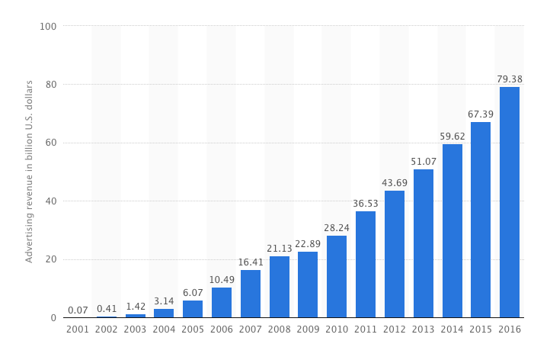
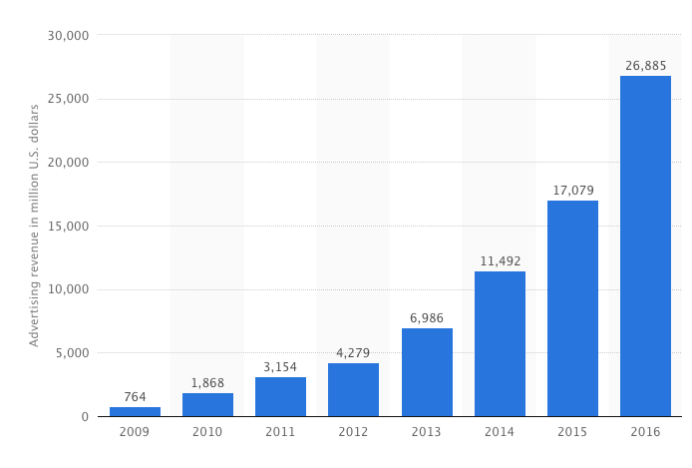
Large revenue
Ziyan Ding
[7]Facebook Advertising Revenue
[6]Google Advertising Revenue
Notes:
2015 Google 90% comes from advertising revenue
2015 Facebook 95% comes from advertising revenue
Both keep increasing dramatically -> people may not that angry about it although most of people think it violates their privacy

Slide 14
summary
Ziyan Ding
Advertising networks collect data when user visited a website and use the data for further recommendation
It is effective and cheaper that yields large profits for advertisers but hurt customers privacy
People dislike websites tracking their data but compromise to free serveries
Younger people have a favorable view of target ads
Notes:
Although people complained much about the privacy, they may not actually care about it.
Or maybe they get used to it or start to modify privacy setting to protect theirselves

Slide 15
References
Ziyan Ding
[1] Information Resources Management Association ,E-Marketing: Concepts, Methodologies, Tools, and Applications. (2017).
[2] KRISTEN PURCELL, JOANNA BRENNER AND LEE RAINIE, Search Engine Use 2012(2012), Pew Research Center
[3]Greg Sterling, Survey: 87 Percent Want “Do Not Track” To Elude Marketers, retrieved from http://marketingland.com/survey-87-percent-use-track-elude-marketers-76097 on April 4th, 2017
[4] Zogby Analytics, Interactive Survey of US Adults (April 2013), The Digital Advertising Alliance, retrieved from http://www.aboutads.info/resource/image/Poll/Zogby_DAA_Poll.pdf
[5] Lois Beckett, How Much of Your Data Would You Trade for a Free Cookie?, retrieved from https://www.propublica.org/article/how-much-of-your-data-would-you-trade-for-a-free-cookie
[6]n.d, Google's ad revenue from 2001 to 2016 (in billion U.S. dollars), https://www.statista.com/statistics/266249/advertising-revenue-of-google/ on April 4th, 2017
[7]n.d., Facebook's advertising revenue worldwide from 2009 to 2016 (in million U.S. dollars),retrieved from https://www.statista.com/statistics/271258/facebooks-advertising-revenue-worldwide/ on April 4th, 2017

Slide 16
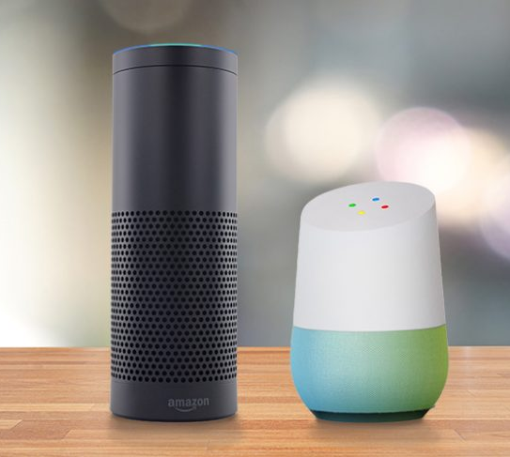
Is your privacy safe with amazon echo & google home?
Jordan Feeley
Amazon Echo starts recording with trigger words: “Amazon”, “Alexa”, “Echo”
Google trigger words: “Hey Google”, “Okay Google”
With listening technology in many homes these days, could our privacy be exploited?
[1]
Notes:
Hi my name is Jordan and today I’m going to talk about how new listening devices such as Amazon Echo, and Google Home impact your privacy.
For those of you who are not familiar with these devices Echo and Google home are devices in the home with voice technology that assists users with queries and tasks. These devices can be triggered by certain words like okay Google for Google home and Alexa for Amazon then answer questions or do a task like making a alarm or calendar event. These devices can also be connected to other IoT devices like a Roomba or light switch so we can we can verbally start the device.

Slide 17
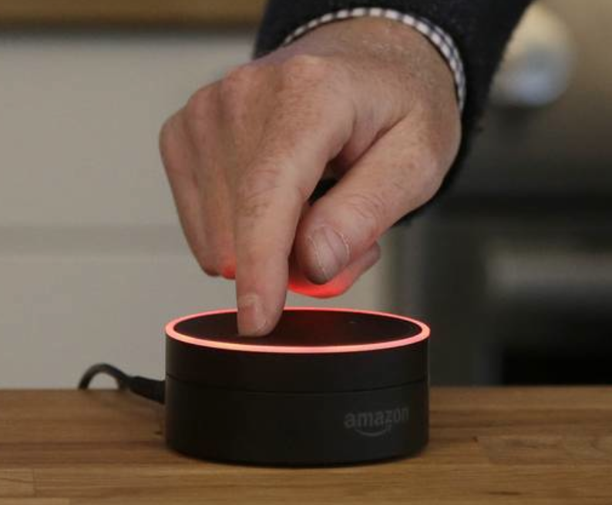
Listening & Recording Devices
Audio clips of what is said after the wake word sent to a server
"All voice queries are encrypted as they are transmitted to the servers, hopefully making them hackproof,”[2]
Under the Fourth Amendment, if you have installed a device that's listening and is transmitting to a third party, then you've waived your privacy rights under the Electronic Communications Privacy Act.”
Option to mute mic
Data/Recordings can be deleted
Notes:
So these devices are technically sometime referred to as always listening or always on because to hear for that trigger word. Once the device does hear the word it will send whatever is said after is encrypted then sent to the server and processed for a response. Now having a device that is always listening in your home might seem weird but many users claim its very helpful and technically since we are installing this in our own homes that is waiving our privacy rights. Now if you don’t want it always listening they do allow options like you can physically mute the device, and the data/or recordings can be deleted online.
Amazon Echo keeps past recordings to improve the accuracy of future queries.

Slide 18
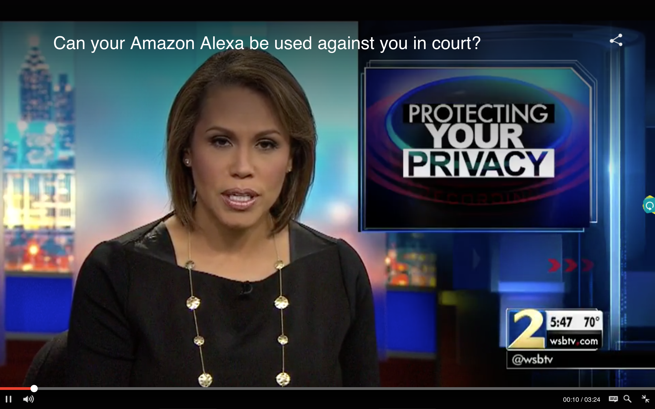
Should Amazon Give Up Voice Recordings To Help Solve A Possible Murder?
November 2015 former Georgia police officer Victor Collins found floating in friend’s hot tub after a party
Amazon Echo present at the party may contain recordings
Originally Amazon refuses to release customer information
  March 6, 2017 Amazon released the recordings after defendants permission [9]
Can your Alexa be used against you in court? [7]
Notes:
So one way this has gotten into the news is back in November 2015 there was a murder case where Echo might have information useful to the police. The case was a former police office was found dead in a hot tub after a friends party but the police suspected foul play. One of the witnesses claimed Amazon Echo was playing music at the party so
They wanted to see if there was any recordings from that night. Sometimes its triggered by chatter or TV. Although police served Amazon with a warrant Amazon refuses to release customer information without binding legal demand. Not sure why a warrant wasn’t enough legal demand but in the end Amazon did not release that information but instead did release the subscriber info.
The Amazon Echo entered the November 2015 murder case because someone present on the night of Collins' death allegedly recalled hearing music streaming through the device that evening.
"Amazon will not release customer information without a valid and binding legal demand properly served on us," it said in a statement. "Amazon objects to overbroad or otherwise inappropriate demands as a matter of course."

Slide 19
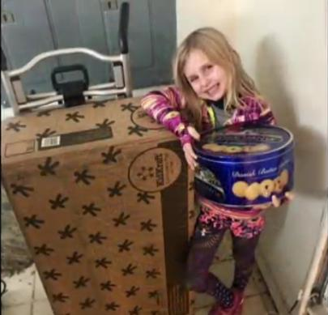
Potential Vulnerabilities
Device will start recording if it even thinks its hears the wake word
  Television & Radio
  Non-key words
At risk if devices are on unsecure Wi-Fi networks [4]
An answering machine could trigger the device [5]
  Neighbor could order things off Amazon
Children ordering items off Amazon
Kid orders doll house, cookies using Alexa [ 6]
Notes:
Some potential vulnerabilities are the device will start recording even if it thinks it hears the wake word. Like I said it can be triggered by chatter, or radio or tv commercial.
It also can be connected to sensitive accounts so it is a identity thief's dream to hack in and get connected to those devices if its unsecure,
In one case they tested it that the device can be triggered by a answering machine so your neighbor could potentially hack alexa by calling and seeing if your home and just ordering something off alexa. There has been multiple reports of children using Alexa to order things like this adorable 6 yr old girl who ended up ordering a doll house and 4 pounds of cookies

Slide 20
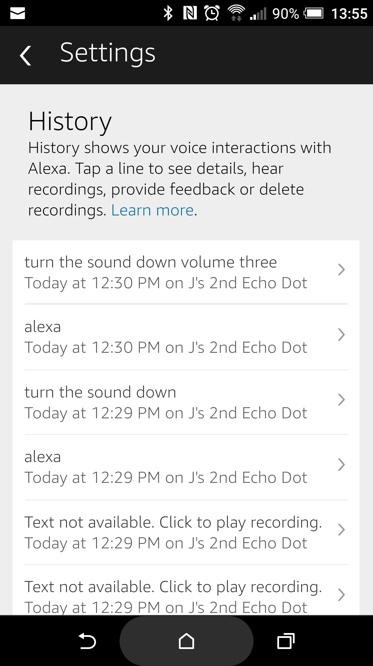
Ways To Protect Your Privacy
Amazon Echo & Google Home allow users to delete past recordings
  Mute button
Don’t connect sensitive accounts to these devices
  Change name of the device
  Connect to secure guest network [5]
Tighten settings
  Put a code on requests to buy
  Change wake word on Amazon Echo
User’s past recordings under History [8]
Notes:
Some ways to protect your privacy is that the companies do allow you to delete past recordings by logging in and listening to your self and deleting one by one.
You can physically mute the device
Good tips are don’t connect sensitive accts to the device, change the name to the device on the wifi and if possible connect it to a secure guest network
Options to tighten security like putting a 4 digit code on purchase orders so your sneaky neighbor or 5yr old kid cant order 10 boxes of cookies

Slide 21
Conclusion
Is your privacy safe with these “always on” listening devices
If you take precautions, yes
  Treat it like your computer or phone
Trust companies
  Are deleted audio clips really gone?
  Devices aren’t listening or storing data before the trigger word
Notes:
To end I'm going to bring up the question again is your privacy safe with these devices
Technically yes but be smart about it, treat it like your phone or computer. Keep it secure, take precautions
But this is just if we believe the companies, be the devil on the shoulder. Right now companies say they only record after the trigger word and don’t use the recordings anywhere. A scary thought that they could be lying and in the future change this policy or someone could hack into Amazons server and decrypt all these audio files. Be safe

Slide 22
References
<Your Name>
[1] http://www.roboticstrends.com/search/results/search&keywords=Amazon+Echo/ (April 2017)
[2] https://mic.com/articles/162865/amazon-echo-privacy-is-alexa-listening-to-everything-you-say#.238FhwT5v
(April 2017)
[3] http://ktla.com/2016/12/28/data-on-amazon-echo-sought-by-prosecutor-in-arkansas-murder-trial/ (April 2017)
[4] http://abc7chicago.com/technology/who-is-listening-smart-hub-devices-spark-privacy-concerns/1753155/ (April 2017)
[5] http://www.sandiegouniontribune.com/news/science/sd-me-echo-home-20170105-story.html (April 2017)
[6] http://www.wrdw.com/content/news/WATCH-Kid-orders-doll-house-cookies-using-Alexa-409748785.html (April 2017)
[7] http://www.wsbtv.com/news/2-investigates/can-your-amazon-alexa-be-used-against-you-in-court/490740878 (April 2017)
[8] https://www.comparitech.com/blog/vpn-privacy/amazon-echo-and-google-home-more-privacy-settings/ (April 2017)
[9] http://bigstory.ap.org/article/1110e4449c3f4191909e4010da935056/amazon-shares-data-arkansas-prosecutor-murder-case (April 2017)

Slide 23
Class 6
The End
Keith A. Pray
Instructor
socialimps.keithpray.net
Notes:
This is the end. Any slides beyond this point are for answering questions that may arise but not needed in the main talk. Some slides may also be unfinished and are not needed but kept just in case.
If there’s time and we didn’t already look at:
Find out what your DNA says about you and your family.
https://www.23andme.com/
Jimmy Kimmel Live – What is your password? (2:49)
https://www.youtube.com/watch?v=opRMrEfAIiI

