Slide 1
Class 14
Last Day
Keith A. Pray
Instructor
socialimps.keithpray.net
Notes:
This is the loneliest title slide you’ll ever see…

Slide 2
Overview
Course Evaluations
Students Present
Guest Speaker
Students’ Choice

Slide 3
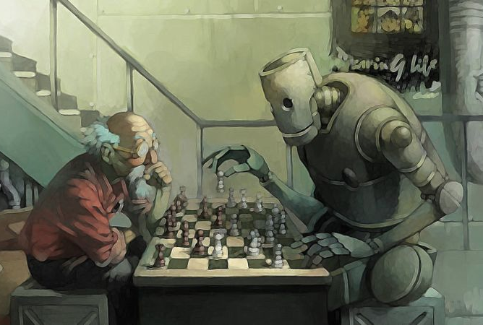
Artificial Intelligence vs humanity
Rene Jacques
Will AI destroy humanity?
Notes:
Short Answer: Not Necessarily

Slide 4
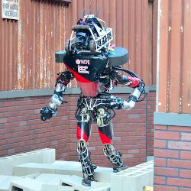
AI Applications
Rene Jacques
Disaster Relief
  ATLAS
Prosthetics
  Össur’s Smart Knee
Medical Care
  Clinical Decision Making
Data Analysis
  Big Data
Notes:
ATLAS
Project in response to Fukishima Plant disaster
Smart Knee
Prosthetic knee that learns how you walk
Clinical Decision Making
Smart diagnosis
Automated reasoning
Big Data
Finding patterns in massive data sets

Slide 5
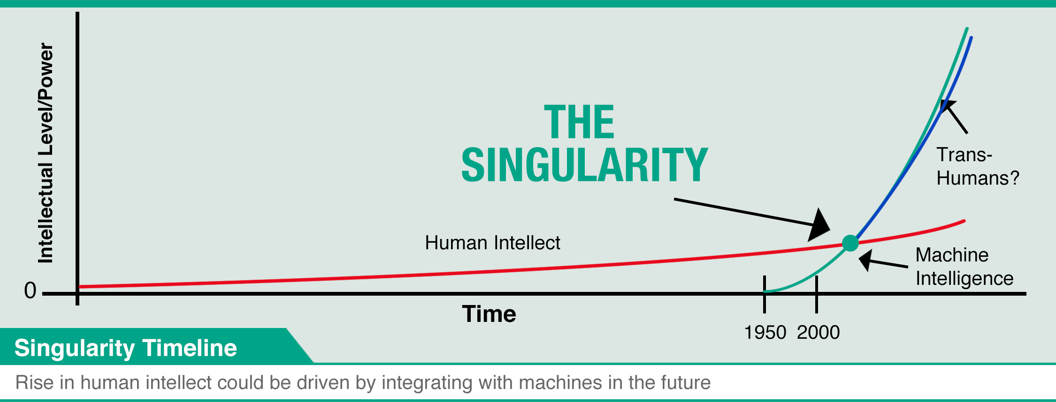
The singularity
Rene Jacques
Human Intellect
Machine Intelligence
Trans-Humans
Notes:
The point at which we create a super intelligent AI
No longer needs humans to function
Can potentially create more of itself
Currently AI is a tool for humans
We are moving towards becoming tools for AI
Lots of money being spent moving towards singularity
Global robotics market expected to reach $152.7 billion by 2020
Until recently not a lot of effort put into public understanding of AI
Partnership on Artificial Intelligence to Benefit People and Society
Google, Facebook, Amazon, IBM, Microsoft
Seeks to:
Conduct research
Recommend best practices
Publish research
Ethics
Fairness
Inclusivity
Transparency
Privacy
Interoperability
Promote
Collaboration between people and AI
“trustworthiness, reliability, and robustness of the technology”
Step in the right direction

Slide 6
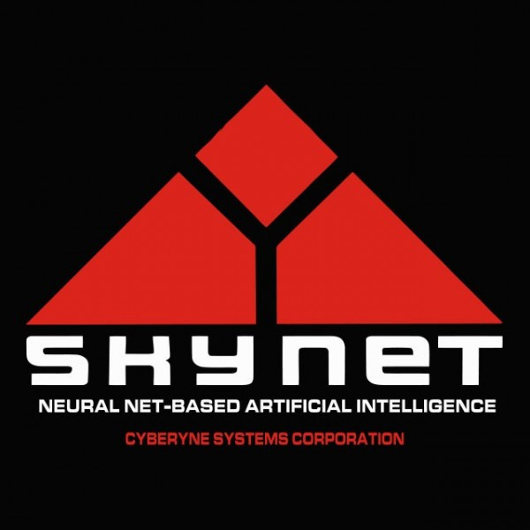
Possible scenarios
Rene Jacques
Skynet
  AI destroys humanity
Ultron
  AI solution to problem hurts humanity
Human Misuse/ Misunderstanding
  Glitches
  Intentional misuse
Notes:
Skynet
AI decides that it doesn’t need humanity anymore so it actively seeks to destroy them.
This is also the scenario where a super intelligent machine has the capability to make more intelligent machines, or anything, meaning that it does not need humans at all.
AI given control of weapons
Even without darker intent, can have trouble identifying valid threats and targets
Ultron /Eagle Eye/War Games
AI seeks to fulfill the task set to it by its creators
The solution the AI comes up with is harmful to humanity while technically being a possible solution, just not a human solution
Human Misuse/ Misunderstanding
AI fulfills its purpose as intended
However, it can be misused in different ways
It can be hacked and made to do something harmful
Perhaps its original use is harmful, and therefore it performs as intended
It might have a glitch that causes harm
Misunderstood
Humans, through lack of understanding fear and mistrust AI
This could result in potential harm to society
Rifts between supporters and rejecters
Most likely not a big issue

Slide 7
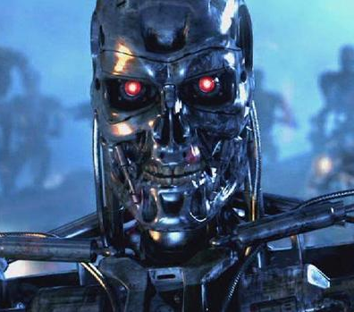
Fear of AI
Rene Jacques
Sci-fi movies and books have spread the fear of killer AI
  Terminator Series
  Eagle Eye
  I, Robot
  Wargames
  Matrix Series
  A Space Odyssey
Notes:
Fear Media
Terminator Series
Eagle Eye
I, Robot
Wargames
Matrix Series
A Space Odyssey
28.9% robots replacing workforce
25.8% trusting AI to do work
22.2% AI
27.9% fear AI (WPI IQP report)

Slide 8
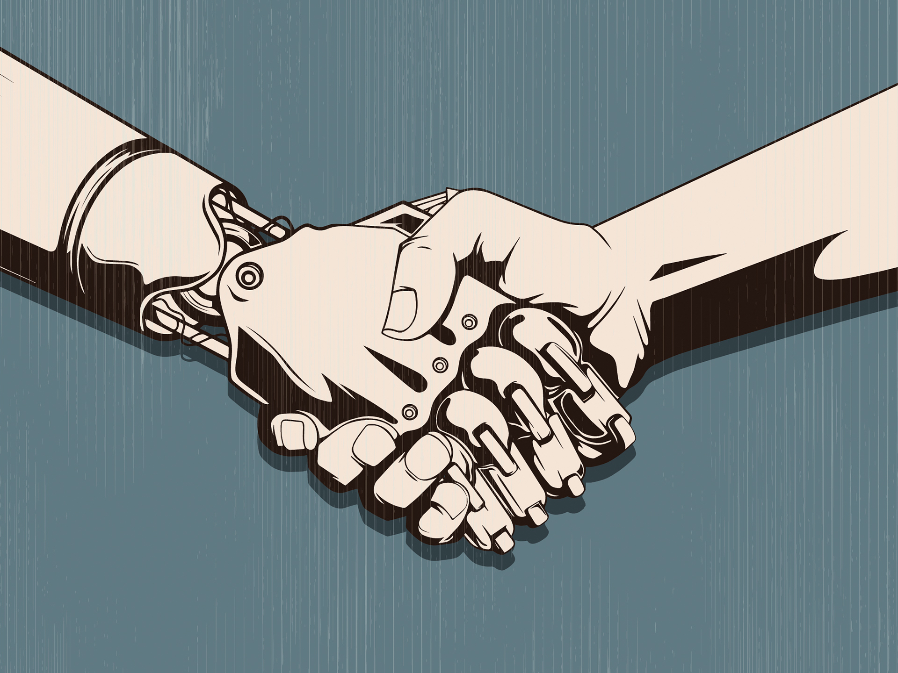
Conclusion
Rene Jacques
AI will not end humanity
Risks can be mitigated
Ban AI controlled weapons
Notes:
<speaker notes>

Slide 9
References
<Your Name>
18 artificial intelligence researchers reveal the profound changes coming to our lives. (2016). Business Insider. Retrieved 9 October 2016, from http://www.businessinsider.com/researchers-predictions-future-artificial-intelligence-2015-10/#because-of-that-michael-littman-says-we-will-have-to-rethink-how-we-value-people-18
AI vs. Human Intelligence: Why Computers Will Never Create Disruptive Innovations. (2015). The Huffington Post. Retrieved 10 October 2016, from http://www.huffingtonpost.com/nick-seneca-jankel/ai-vs-human-intelligence-_b_6741814.html
America's Top Fears 2015. (2015). Wilkinson College of Arts, Humanities, and Social Sciences. Retrieved 9 October 2016, from https://blogs.chapman.edu/wilkinson/2015/10/13/americas-top-fears-2015/
Artificial Intelligence VS. Humanity: Is Future AI A Friend Or A Foe?. (2016). Parent Herald. Retrieved 10 October 2016, from http://www.parentherald.com/articles/40542/20160502/artificial-intelligence-vs-humanity-future-ai-friend-foe.htm
Armstrong, P. (2016). Forbes.com. Retrieved 10 October 2016, from http://www.forbes.com/sites/paularmstrongtech/2016/08/17/technology-vs-human-who-is-going-to-win-an-interview-with-gerd-leonhard/#6f7572b15915
Satell, G. (2016). Forbes.com. Retrieved 10 October 2016, from http://www.forbes.com/sites/gregsatell/2016/06/03/3-reasons-to-believe-the-singularity-is-near/#7b01ffd71cbe
Global Catastrophic Risks. (2016). Global Priorities Project. Retrieved 9 October 2016, from http://globalprioritiesproject.org/wp-content/uploads/2016/04/Report-2016-Executive-Summary-FINAL.pdf
Is Artificial Intelligence Really A Threat To Humanity?. (2015). Tech Times. Retrieved 9 October 2016, from http://www.techtimes.com/articles/80029/20150828/artificial-intelligence-really-threat-humanity.htm
Koch, C. (2015). When Computers Surpass Us. Scientific American Mind, 26(5), 26-29. http://dx.doi.org/10.1038/scientificamericanmind0915-26

Slide 10
References
<Your Name>
Technological Singularity. (2016). Pinterest. Retrieved 9 October 2016, from https://www.pinterest.com/nahumespinosa/technological-singularity/
Bring the Robot Uprising to Your Desktop With These Amazing Wallpapers. (2016). Io9.gizmodo.com. Retrieved 9 October 2016, from http://io9.gizmodo.com/bring-the-robot-uprising-to-your-desktop-with-these-wal-1451993999
sinister.ly. (2016). Google.com. Retrieved 9 October 2016, from https://www.google.com/url?sa=i&rct=j&q=&esrc=s&source=images&cd=&cad=rja&uact=8&ved=0ahUKEwjG7Iyko9LPAhVKziYKHSuYBwIQjRwIBw&url=https%3A%2F%2Fsinister.ly%2FUser-Skynet&psig=AFQjCNEHJ-wjMDVMg_3AMO1nlaSEqZnaiw&ust=1476258949191114
Terminator 6 is still active, says Arnold Schwarzenegger. (2016). Den of Geek. Retrieved 9 October 2016, from http://www.denofgeek.com/movies/terminator/39381/terminator-6-is-still-active-says-arnold-schwarzenegger
DARPA Challenge Greatly Propelled Humanoid Robotics. (2016). Cacm.acm.org. Retrieved 10 October 2016, from http://cacm.acm.org/news/189153-darpa-challenge-greatly-propelled-humanoid-robotics/fulltext
Metz, C. (2016). AI Helps Humans Best When Humans Help the AI. WIRED. Retrieved 10 October 2016, from https://www.wired.com/2015/09/ai-helps-humans-best-humans-help-ai/
Demand for robots, artificial intelligence rising. (2016). Cbsnews.com. Retrieved 9 October 2016, from http://www.cbsnews.com/news/demand-for-robots-artificial-intelligence-rising/
Dodd, M., Grant, A., & Seruwagi, L. (2016). Artificial Intelligence Through the Eyes of the Public. WPI.edu. Retrieved 10 October 2016, from https://web.wpi.edu/Pubs/E-project/Available/E-project-030411-114414/unrestricted/Artificial-Intelligence_Through_the_Eyes_of_the_Public.pdf
Office, L. (2016). Automating big-data analysis. MIT News. Retrieved 11 October 2016, from http://news.mit.edu/2015/automating-big-data-analysis-1016
Medicine, A. & Medicine, A. (2016). Artificial Intelligence in Medicine - Journal - Elsevier. Journals.elsevier.com. Retrieved 11 October 2016, from http://www.journals.elsevier.com/artificial-intelligence-in-medicine/
VIDEO: This Icelandic Company Creates AI-Powered Prosthetic Limbs. (2016). HPE Matter. Retrieved 11 October 2016, from https://www.hpematter.com/issue-no-3-winter-2015/video-bionic-prosthetic-knee-powered-artificial-intelligence

Slide 11
Overview
Course Evaluations
Students Present
Guest Speaker
Students’ Choice

Slide 12
Students’ Choice
CGP Grey - Humans Need Not Apply (15:00)
Last Week tonight with John Oliver – Patriot Act, Edward Snowden (33:14)
Weird Al – It’s All About The Pentiums (3:34)
Epic Rap Battles of History: Steve Jobs vs. Bill Gates (If ok with lyrics) (2:47)
Which topic did we cover do you think will be most relevant in the coming years?
Emacs – psychoanalyze-pinhead
  doctor (implementation of ELIZA)
  yow (quotes from Zippy the Pinhead zippythepinhead.com)
Notes:
CGP Grey
Humans Need Not Apply (15:00) – 2014-08-13
http://www.youtube.com/watch?v=7Pq-S557XQU
Last access 2016-04-22
Last Week tonight with John Oliver – Patriot Act, Edward Snowden (33:14)
http://www.upworthy.com/john-oliver-flew-10-hours-to-russia-to-interview-edward-snowden-and-get-him-on-record?c=ufb1
Weird Al – It’s All About The Pentiums (3:34) and look at lyrics
https://www.youtube.com/watch?v=qpMvS1Q1sos
Tie into Ray Kurzweil Singularity
Epic Rap Battles of History: Steve Jobs vs. Bill Gates (If class ok with obscene lyrics) (2:47)
https://www.youtube.com/watch?v=njos57IJf-0
Also Work links on web site http://socialimps.keithpray.net/documents/
-----
Tom Scott
http://tomscott.com
Welcome To Life (2:44)
https://www.youtube.com/watch?v=IFe9wiDfb0E&feature=youtu.be
Passphrases (2:08 need to give context for video)
https://firstlook.org/theintercept/2015/03/26/passphrases-can-memorize-attackers-cant-guess/
If not shown during first class
What "Orwellian" really means - Noah Tavlin (5:31)
http://ed.ted.com/lessons/what-orwellian-really-means-noah-tavlin
Weird Al – White and Nerdy (2:50) and look at lyrics
https://www.youtube.com/watch?v=N9qYF9DZPdw

Slide 13
Class 14
The End
Keith A. Pray
Instructor
socialimps.keithpray.net
Notes:
This is the end. Any slides beyond this point are for answering questions that may arise but not needed in the main talk. Some slides may also be unfinished and are not needed but kept just in case.

Slide 14
Evaluations
Use only BLUE or BLACK ballpoint pen
Use an X to mark (Do NOT fill in box)
Course Evaluation
  Write MY NAME and COURSE TITLE in box at top of form
  Keith A. Pray
  CS 3043 Social Implications Of Information Processing
  Return to Academic Advising Office in Daniels Hall
  Include “Evaluation Sheet” cover letter
TA/SA Evaluation
  Name: Fiona Heaney
  Return to CS Department: Fuller 233

