Slide 1
Class 7
Privacy and Government
Keith A. Pray
Instructor
socialimps.keithpray.net
Notes:
After this class we will be half done with the course… very sad I know.
Play Somebody’s Watching Me (1984) – Rockwell
Be the envy of all your classmates if you know the band and/or year:
Rockwell (1984) Michael Jackson sings chorus and Jermaine Jackson on backing vocals.
Self Search paper – 6.0
Paper averages to date:

Slide 2
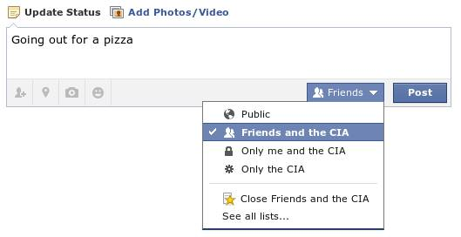
Notes:
Source?

Slide 3
Overview
Survey
Review
Assignment
Students Present

Slide 4

Notes:
Source?
Let’s see who said National ID yes and no. Let’s debate!

Slide 5
Debate Ground Rules
Before Debate
  15 minutes to converse with your team
  Share argument points, counter points, and responses so everyone can represent
  Decide who will respond to what points from the opposing side
During Debate
  Stand up when speaking
  Only those who have not spoken may respond until everyone has had a turn
  Switch sides at any time when you change your mind
Notes:
National ID or Not Debate
----- Meeting Notes (2016-04-05 16:54) -----
add 30 second limit per person

Slide 6
My Reading Notes
pp. 274 Arrests, altering and deleting records are violations of privacy?
pp. 275 Why not try to verify and correct records?
pp. 276 Figure does not show # cameras increasing.
pp. 277 300 times = frames, locations, …?
pp. 289 “…don’t want anyone to know…” like seeking medical advice, etc.?
pp. 291 Just because it’s been happening for years doesn’t make it right.
pp. 297 Wouldn’t it be easy to make and show a fake SSN card?
pp. 298 Confusing false positive and negative explanations.
End of Chapter questions: 1, 31, 51

Slide 7
Group Quiz
List two problems with using biometrics for identification.
List two advantages of using biometrics for identification.
Describe two tools people can use to protect their privacy on the Web.
For each of the 4 categories of Daniel Solove’s privacy taxonomy give an example not listed in the book.

Slide 8
Overview
Survey
Review
Assignment
Students Present

Slide 9
Assignment – Group Project
Suggestions:
Catch up on reading
Add list of movies portraying your computing technology
State if the computing technologies was existing, future, or emerging
Add analysis to group project website addressing all topics covered to date
See group project slide deck for more
Notes:
For other group project:
Categorize computing technologies as existing, future, emerging, impossible, plausible with rationale
Add list of computing technologies portrayed in movie

Slide 10
Overview
Survey
Review
Assignment
Students Present

Slide 11
Government Backdoors And Privacy
Hugh Whelan
Government backdoors compromise privacy.
  “Excessive surveillance and unjustified secrecy can threaten civil liberties, public trust, and the core processes of democratic self-government.”
Do they compromise security?
Notes:
QUOTE: [1]
This Quote a finding from a presidential task force set up by Obama, tasked with examining the NSA
Today focusing on excessive surveillance involving backdoors, and civil liberties
Civil Liberties: Personal Privacy [2]
Argued that in order to Protect our security, the government is undermining our privacy
This loss of privacy Undermines our public trust in communication
gives the public less incentive to use these technologies [4]
Compromise security
Encryption has historically been very important for military
Over 40 million cyberattacks between 2014 and 2015 [10]
Lack of privacy can lead to lack of security

Slide 12
What are backdoors?
Hugh Whelan
Intentional workarounds in security
  Hardware and firmware
    Hard drive
  Software
    Encryption
Notes:
Backdoors in technology refer to workarounds implemented in security that allow a party to bypass it
Hardware and firmware [3]
By embedding backdoors such as rootkits in hard drives’ firmware
Imagine Western digital has a backdoor in all hard drives shipped
Connections can be established between the hard drive and a server, which allows the server to directly access data stored on the disk intercept commands
Can have very small performance affects (1% performance overhead)
Software [4]
Most common is encryption backdoor
NSA allegedly working to weaken cryptographic standards
Forcing companies to provide a method of bypassing encryption

Slide 13
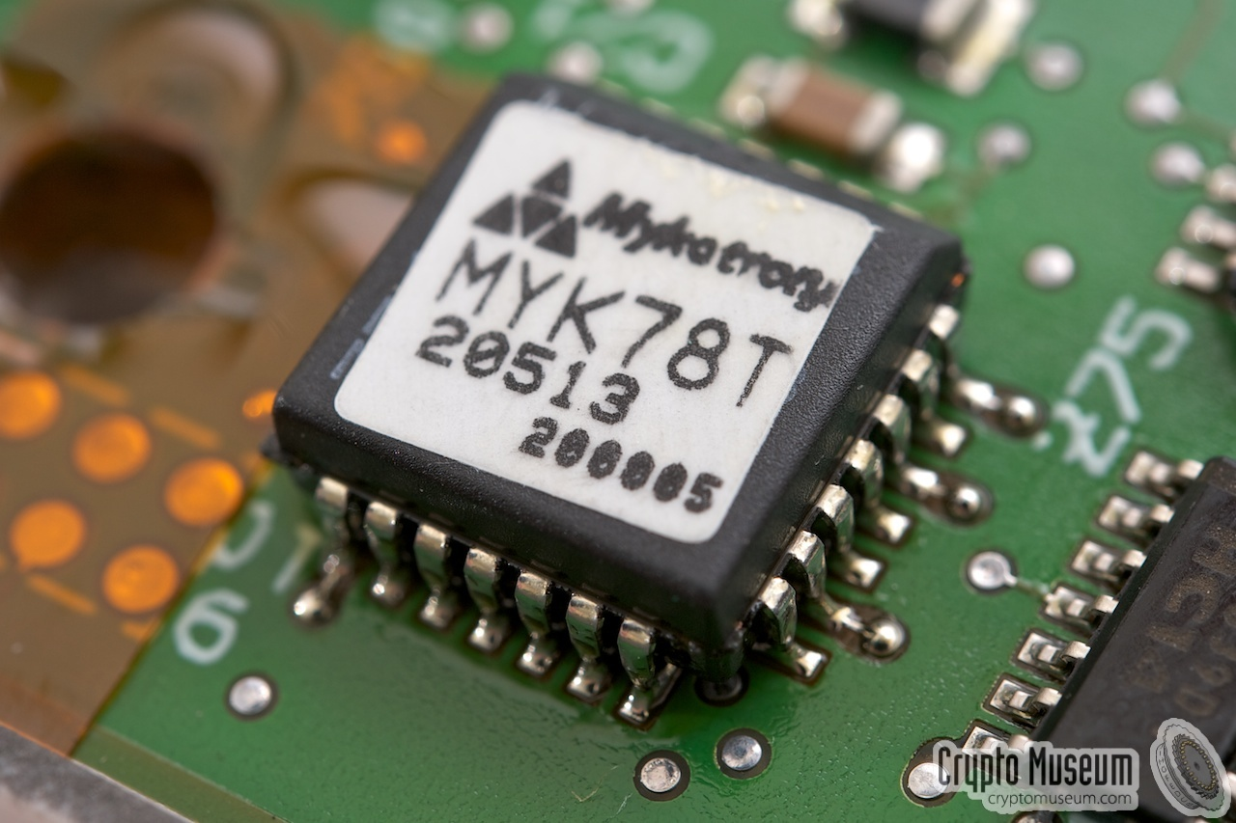
The Clipper chip
Hugh Whelan
In the 1990’s, encryption was heavily regulated.
The Clipper Chip provided a way to use strong encryption for communication legally.
  Key escrow
Privacy concerns raised:
  Not competitive in foreign markets
Notes:
Image: http://www.cryptomuseum.com/crypto/usa/clipper.htm
Heavily regulated encryption[5]
Domestically, encryption was not as heavily regulated
However, encryption was strongly regulated
Meaning that shipping hardware or software with encryption globally was technically covered by the same regulations that controlled trafficking guns and nuclear weapons
1993 - government introduced the Clipper Chip
Used a cipher algorithm developed by the NSA
Before Clipper chips communicated, they communicated a session key
A session key that itself could be decrypted by the government
“Key escrow”
However, there was backlash concerning privacy[6]
Foreign markets would not want their faxes and phone calls to be able to be decrypted by US govt
1994 – researcher found way to generate apparently valid session keys that allowed the devices to communicate
Fall of the clipper chip

Slide 14
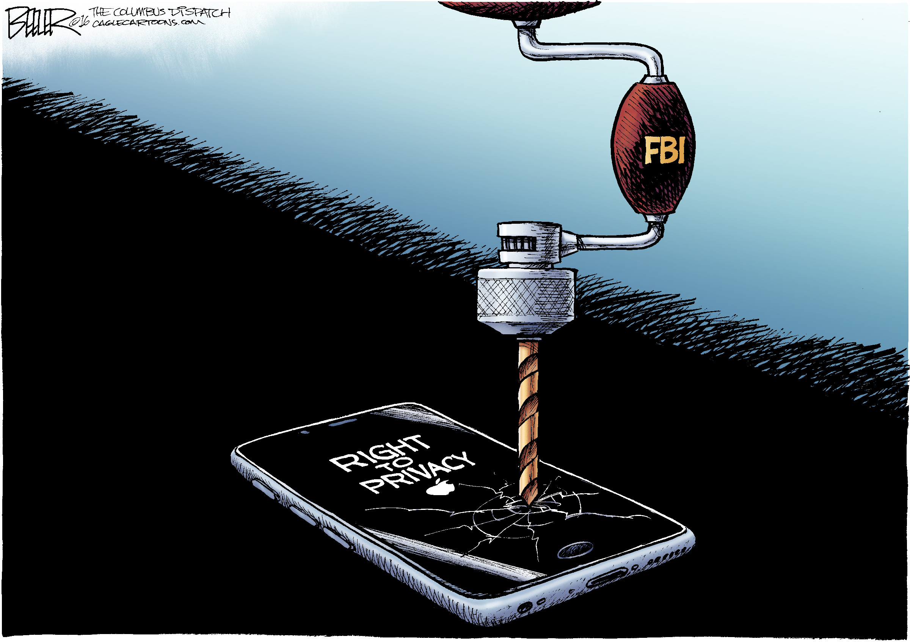
Recent incidents
Hugh Whelan
Apple ordered to help FBI unlock iPhone.
Talks of banning WhatsApp and other encrypted mobile technologies in UK.
Notes:
Image: http://nerdsmagazine.com/apple-vs-fbi-here-is-why-we-need-to-support-tim-cooks-stance/
Apple was ordered to help FBI unlock a iPhone
Investigation of San Bernardino shooting
Apple refused [7]
Stated concerns that it could be used to unlock any iPhone
Weakens security
Sets Dangerous Precedent
Government’s fight against encryption [8]
Strong encryption means no way for the government to listen to communications
Talks in UK of banning app WhatsApp due to strong encryption
PM David Cameron proposed complete ban on strong encryption
Wants to ensure that in extreme cases, govt can access communications
Skype, imessage as well
Corporate and public backlash
Emphasizing importance of encryption for security and privacy

Slide 15

Exploitation of backdoors
Hugh Whelan
Many are afraid that backdoors will be hacked.
  Exposes personal and private information.
Government abuse.
Notes:
Image:http://www.debbieschlussel.com/3321/interesting-your-encryption-password-now-a-fifth-amendment-right/
Fear that criminals could use backdoors to access people’s private information [9]
For example the iPhone’s vulnerability could be used by people who steal iPhones
Also foreign governments
Government could abuse the ability to access encrypted data
More and more companies could be forced to provide backdoors in all products, creating more vulnerabilities
Introducing more and more vulnerabilities

Slide 16
Conclusion
Hugh Whelan
Backdoors put privacy at risk.
Benefits do not outweigh the costs.
  People do not have a say in government actions.
Notes:
Backdoors do put privacy at risk
New Vulnerabilities
To protect security, risk privacy
Benefits don’t outweigh costs
Backdoors are secret, unknown to public
Meaning that people cannot have say in governments actions

Slide 17
References
Hugh Whelan
[1] "More NSA Revelations: Backdoors, Snooping Tools and Worldwide Reactions." Network Security 2014.1 (2014): 1-20. Web. 12 Sept. 2016.
[2] Smith, Josh. "Amid Chinese Telecom Probe, FBI Calls for Surveillance 'Backdoors'." Nationaljournal.com 19 Sept. 2012. General OneFile. Web. 12 Sept. 2016.
[3] Zaddach, Jonas, Anil Kurmus, Davide Balzarotti, Erik-Oliver Blass, Aurélien Francillon, Travis Goodspeed, Moitrayee Gupta, and Ioannis Koltsidas. "Implementation and Implications of a Stealth Hard-drive Backdoor." Proceedings of the 29th Annual Computer Security Applications Conference on - ACSAC '13 (2013): 279-88. Web. 14 Sept. 2016.
[4] Curran, John. "NSA 'backdoor' surveillance weakens security, panelists say." Cybersecurity Policy Report 14 July 2014. General OneFile. Web. 13 Sept. 2016.
[5] Blaze, Matt. "Key Escrow from a Safe Distance." Proceedings of the 27th Annual Computer Security Applications Conference on - ACSAC '11 (2011): 317-21. Web. 13 Sept. 2016.
[6] Carrera, Nora. "Clipper Chip calls up privacy, trade questions." Denver Business Journal 4 Nov. 1994: 28A+. General OneFile. Web. 14 Sept. 2016.

Slide 18
References
Hugh Whelan
[7] "Customer Letter - FAQ - Apple." Apple. N.p., n.d. Web. 13 Sept. 2016.
[8] "WhatsApp, Snapchat and iMessage could be banned in the UK." Flare 31 Aug. 2015. General OneFile. Web. 15 Sept. 2016.
[9] Werner, Gregory R. "Cell Phones, Passwords, and Search Warrants." Computer and Internet Lawyer 33.5 (2016): 1-33. Print.
[10] Castillo, Andrea. "Giving Government 'Backdoor' Access to Encrypted Data Threatens Personal Privacy and National Security." Reason.com. N.p., 16 June 2015. Web. 16 Sept. 2016.

Slide 19
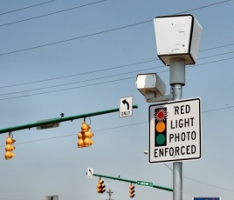
Automated Enforcement Systems
Logan Tutt
Types:
  Red Light Cameras
  Automated Speed Enforcement (Speed Cameras)
Goals:
  Enforce traffic laws
  Lower accident rates
[1]
Notes:
Explain types of systems:
Red light:
Cameras watch for cars running lights at traffic intersection
Record license plates and mail tickets
Goal of lowering accidents at intersections
Speed Cameras
Radar used to measure speed
Gives ticket/warning if speed is over a designated speed
Goals of systems:
Aim to enforce traffic laws more efficiently, requires less officers
Lowers accident rates by deterring violating traffic laws

Slide 20
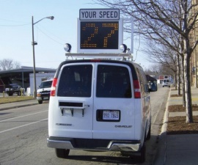
Efficacy of Automated Systems
Logan Tutt
Red Light Cameras:
  Reduce right-angle collisions by 10-25%
  Increase in rear-end collisions by 15-40%
  Decrease fatal collisions by 10-20%
Speed Cameras
  Reduces speeding by up to 24-71%
  40% reduction in fatal accidents
[1],[2],[3]
Notes:
Red light camera effectiveness is a very debated topic
All statistics vary wildly between studies
Based on some meta studies analyzing many different studies overall trends appear
Reduce right angle collisions (ones caused by red light running)
Increase rear ending (likely due to people breaking hard to not run lights)
Overall appear to decrease fatalities
Speed Cameras also are very debated
Appear to reduce speeding significantly
Likely partially due to people breaking for speed radars
Can cause increase in accidents
Causes reduction in major accidents, especially ones that are related to speed, ie reckless driving
Can cause increases in minor accidents, again likely due to breaking

Slide 21
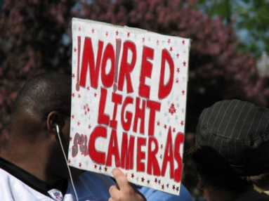
Arguments against Enforcement Systems
Logan Tutt
Lack of accuser
Cannot easily identify driver
Most violations are unintentional
Notification can be delayed
Some areas use these systems for monetary reasons and not for public good
No police Discretion
[4],[5],[6],[7]
Notes:
Many people are opposed to these systems:
Lack of accuser. This conflicts with the constitutional right to face ones accuser
Most systems only identify the vehicle, so if another person is driving, the owner may be fined
Some argue most traffic violations are unintentional, thus red lights would not stop these. Proponents argue that the cameras will increase road awareness, reducing accidents
Notifications are sent through mail, so if lost in transit the recipient can be fined or arrested for failing to pay a ticket they never actually received
Some departments use cameras to gain additional funds from tickets.
cost around 70-80,000 per intersection
Houston had a $10million dollar shortfall when 70 red light cameras were removed.
That’s around a 2:1 return on investment in one year
Other cities have been found to lower yellow light lengths below minimums to increase violations
Police can use their discretion when giving traffic tickets, but red light cameras can not. No room for extenuating circumstances except in courtroom

Slide 22
Conclusions
Logan Tutt
Automated Enforcement Systems save lives
Technical limitations still need to be addressed
When Implemented with oversight they offer a significant public benefit
[1]
Notes:
Overall, the traffic data seems to show that these systems save lives
They do still have technical limitations, like accuracy and driver identification, but these can likely be solved or improved in time
Proper oversight and regulation can address many of the other issues with the systems
With this oversight ,they can offer a great public good.

Slide 23
References
Logan Tutt
[1] Poole, B. (2012, December). An Overview of Automated Enforcement Systems and Their Potential for Improving Pedestrian and Bicyclist Safety.
[2] Erke, A. (2009). Red light for red-light cameras? A meta-analysis of the effects of red-light cameras on crashes. Accident; Analysis and Prevention, 41(5), 897-905. doi:10.1016/j.aap.2008.08.011
[3] Willis, David K. (2006) Speed Cameras: An Effectiveness and a Policy Review. TTI-2006-4
[4] 10 Reasons To Oppose Red-Light Cameras - National Motorists Association. (2007, November 15). Retrieved September 15, 2016, from https://www.motorists.org/blog/10-reasons-to-oppose-red-light-cameras/

Slide 24
References
Logan Tutt
[5] The Arguments Against Red Light Cameras - St Petersburg, FL Red Light Cameras. (n.d.). Retrieved September 15, 2016, from http://www.stpetecameras.org/home/for-and-against-rlcs/the-arguments-against-red-light-cameras
[6] Petrocelli, J. (n.d.). Picture This...No Police Discretion | Officer.com. Retrieved September 16, 2016, from http://www.officer.com/article/10249949/picture-thisno-police-discretion
[7] Implementation costs for automated red light camera systems range from $67,000 to $80,000 per intersection. Retrieved September 16, 2016, from http://www.itscosts.its.dot.gov/ITS/benecost.nsf/ID/2B209AD2C5AD2AB985256DB10045892B?OpenDocument&Query=CApp

Slide 25

The Right to be forgotten
Charles Sinkler
Should the United States adopt a similar policy?
What exactly is the “Right to be Forgotten”?
Is it that simple?
<http://www.sigmalive.com/en/uploads/images/news/044_046_data+protection_right+to+be+forgotton.jpg>
Notes:
Hi, I will cover the EU Right to be Forgotten laws. The question I was aiming to answer is “Should the United States Adopt a Similar Policy?”, but first must understand the Right to be Forgotten. People already might be thinking that it is simple censorship and can not be instituted in the United States. But it just isn’t as simple as “Erase Past.”

Slide 26
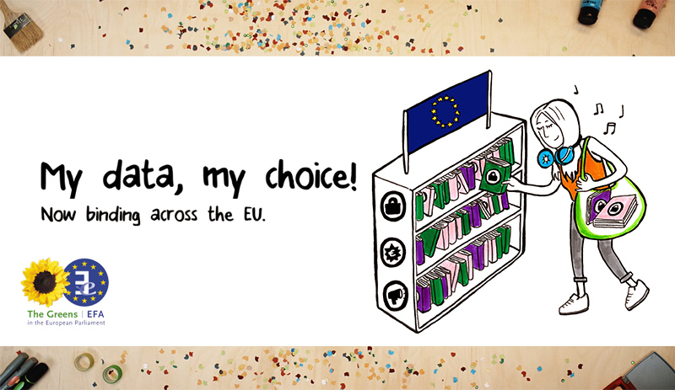
The Right To Be Forgotten
Charles Sinkler
In 1995, EU Passed the Data Protection Directive [2]
  Data kept must be “adequate, relevant, and not excessive” [2]
  Will be superseded by the General Data Protection Regulation in May 2018
<http://www.greens-efa.eu/fileadmin/dam/Images/GDPR-share-final-EN.jpg>
Notes:
The law in EU is the 1995 Data Protection Directive
Applies to all people doing data processing
Data kept must be adequate, relevant, and not excessive
This law will be superseded by the General Data Protection Regulation in May 2018, which will increase protections for private citizens

Slide 27
The right to be forgotten
Charles Sinkler
2010, Spanish citizen complained, claiming online records were no longer relevant [1].
  Won the case, set precedent.
  Google removed URL from search results
Notes:
In 2010, a Spanish citizen complained to an EU court, claiming that the online records of his repossessed home from over 10 years ago were no longer relevant. He argued that this continued to damage his reputation, yet were not indicative of his current life, and thus should be removed. According to the EU 1995 Data Protection Directive, any data processed by any third party must be adequate, relevant, and not excessive. The important thing to note is that Google itself is a data processing company. This means that search engines are not exempt from the rules of the Data Protection Directive. The case fell in the citizen’s favor, leaving the EU with precedent for deleting no longer relevant web search results.

Slide 28
Google’s role in the right to be forgotten
Charles Sinkler
Since 2014, Google has evaluated over 1M URLs, and removed 41% of those processed [3]. - Is this censorship OK?
While much of this is automated, the final takedown decision is made by a human [3].
No matter where a server is located, if they operate within EU borders, they are subject to the RTBF laws [5].
Yahoo and Bing, and all others that sell advertising space are also required to remove URLs [1]
Notes:
Since 2014, Google has been requested to remove over 1M URLs, and has removed 41% of those requested. Large scale removal of content in search results. Important – How people access the web.
Project oblivion automates much of the process, final takedown decision by human.
Because Google sells advertising space in EU member countries, it is subject to these laws.
Google, as the most prevalent search engine, plays an important role in the right to be forgotten. Since 2014, they have been requested over 500,000 times, for the removal of over 1M URLs, and removed 41% of those requested. This requires huge amounts of manpower, because it is done on a case-by-case basis, with a human making the final decision to remove or leave a URL. Even though Google’s servers operate in the United States, because they sell advertising space in EU countries, they are bound by the right to be forgotten laws in the EU.

Slide 29
Current American rtbf
Charles Sinkler
California has underage “Eraser Button” laws, Illinois and New Jersey bills in state congress [4].
Do Not Track Kids Act introduced as amendment to COPPA, but is stuck in committee[6].
<Image taken from https://www.congress.gov/bill/114th-congress/house-bill/2734>
Notes:
California passed their underage Eraser Button law in May 2015. Enforces websites to have delete buttons on any posts made by users if there are any users under the age of 18.
The DNTKA was introduced as an amendment to COPPA on June 11, 2015, and was put in committee June 12, 2015. Would make the same law a federal law, but is stuck in committee and is unlikely to go anywhere.
Currently, there is actually some semblance of the Right to be Forgotten in the United States. A few states have underage eraser button laws, where if a site has users under the age of 18 that are posting things, they must be able to remove anything that they have posted. The DNTKA was introduced as an amendment to COPPA (Children’s online privacy protection act) to make this a federal law, but has not gone anywhere in congress.

Slide 30
Is it right for America?
Charles Sinkler
Clearly there are concerns with censorship and the First Amendment.
Is this really censorship? Or does it fall under the right to privacy? How long ago is something no longer relevant?
Makes sense for kids. It probably isn’t right to remove records on adults.
Similar to getting a newspaper to destroy all copies of a story if the information is no longer relevant.
Notes:
Is it right for America? There are a few questions that should be answered first. At what point does removal of online information become malicious censorship, and at what point does it violate the first amendment? Unfortunately, it seems that the first amendment is at direct odds with the RTBF. Is this protection of privacy? How does one determine “no longer relevant”? The ability to remove things you post as a child makes a lot of sense – I am sure people have previously posted things that they would be embarrassed to today. The thing is, for a lot of the historical record online, it would be like walking into a library and asking them to destroy a book because it contains information about you that is no longer relevant, and them being obligated to do so.

Slide 31
References
Charles Sinkler
[1] European Commission. Factsheet on the Right to be Forgotten Ruling. http://ec.europa.eu/justice/data-protection/files/factsheets/factsheet_data_protection_en.pdf (9/13/16)
[2] European Parliament, Directive 95/46/EC. http://eur-lex.europa.eu/LexUriServ/LexUriServ.do?uri=CELEX:31995L0046:en:HTML (9/13/16)
[3] Woollaston, Victoria. Could the Right to be Forgotten Become Automated? http://www.dailymail.co.uk/sciencetech/article-3140534/Could-right-forgotten-automated-Oblivion-software-help-Google-remove-hundreds-people-web-seconds.html (9/13/16)
[4] Dewey, Caitlin. How the Right to be Forgotten could take over American internet, too. https://www.washingtonpost.com/news/the-intersect/wp/2015/08/04/how-the-right-to-be-forgotten-could-take-over-the-american-internet-too/ (9/14/16)
[5] Lee, Dave. What is the ‘right to be forgotten’ http://www.bbc.com/news/technology-27394751 (9/14/16)
[6] US Congress. H.R.2734. https://www.congress.gov/bill/114th-congress/house-bill/2734 (9/14/16)

Slide 32
Class 7
The End
Keith A. Pray
Instructor
socialimps.keithpray.net
Notes:
This is the end. Any slides beyond this point are for answering questions that may arise but not needed in the main talk. Some slides may also be unfinished and are not needed but kept just in case.

