Slide 1
Class 1
Introduction
Keith A. Pray
Instructor
socialimps.keithpray.net
Notes:
Here’s the title slide to the first class. Excited already, aren’t you?
Who knows what Emacs or vi is?

Slide 2
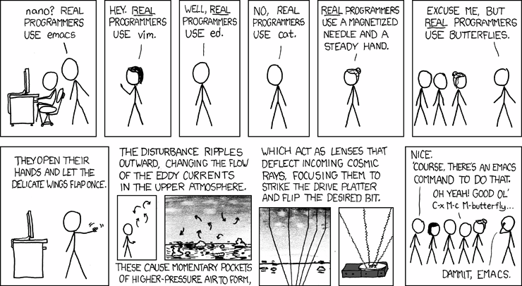
http://xkcd.com/378/
Notes:
How many people in the world get this joke?
According to wolframalpha.com (2012-08-23):
2.34% (of 6.79 billion people) attend secondary school
50 million secondary school grads in United States (of 309 million people) 16.18%
3.3 million computer specialists in United States (of 309 million people) 1.06% (or 6.6% of college grads)

Slide 3
/(BB|[^B]{2})/
Notes:
/
bb # two b's
| # or
[^ # not
b]{2} # two b's
/
How many people in the world get this joke?
According to wolframalpha.com (2012-08-23):
2.34% (of 6.79 billion people) attend secondary school
50 million secondary school grads in United States (of 309 million people) 16.18%
3.3 million computer specialists in United States (of 309 million people) 1.06% (or 6.6% of college grads)

Slide 4
Overview
Introduction
  Course Staff
  Logistics
  Outcomes
Assignment

Slide 5
Course Staff
Instructor
Assistants
Keith A. Pray
kap@wpi.edu
FL 140
SA
  Fiona Heaney
  fhheaney@wpi.edu
Office Hours
  By Appointment
Notes:
Here’s our contact info.
Introduce yourself.
Get to know class:
Youngest? Oldest? Country of origin?
Majors? Years?
Reasons for taking class

Slide 6
Outcomes – You will:
Demonstrate understanding of links between computing technology, society, and computer professional responsibilities.
Discover and use primary sources relevant to course topics in support of arguments.
Present personal verbal and written opinions based on well reasoned arguments.
Be familiar with social, moral, and ethical issues faced by computer professionals.
Be able to recognize ethical issues.
Understand professional codes and ideals and apply them in decision making.
Analyze popular portrayal of computing and its effects on society.
Practice critical thinking, written, and oral presentations skills.
Notes:
Paraphrased from Outcomes on web site.
Stress students are responsible for their own learning
Stress dealing with ambiguity as useful skill

Slide 7
Logistics
Course Web Site
myWPI
http://socialimps.keithpray.net
Syllabus
Grading Policy
Due Dates
Etc.
Interactive assignments
Notes:
Let’s go to the course website for this stuff.
Always check course web site for grading.
Individual presentations are due 24 hours before class so that they can be incorporated into those class slides.
Since most things due class to class are small in the number of points we will not be giving credit late work. You can still turn it in and we’ll tell you how well you would have done.

Slide 8
Group Quiz!
What is computing?
What is the oldest computing device you can think of?
What computing technology do you wish society had not adopted?
What good will you do with your degree?
Notes:
The counters in an abacus is where the term “counter” meaning place in a shop where transactions take place.
What is computing?
What is the oldest computing device you can think of?
manual calculating aids – clay or wax tablet (5500 BC or older), slate tablet (1300s BC), paper tablet, abacus (2700 BC), mathematical tables (190 BC) (logarithms is an important one 1500s) Antikythera Mechanism analog computer (0 BC)
What computing technology do you wish society had not adopted?
What good will you do with your degree?
What is the biggest impact computing has had on your life?
What is the difference between liberties (negative rights) and claim rights (positive rights)?

Slide 9
What is Technology?
Merriam-Webster: The use of science in industry, engineering, etc., to invent useful things or to solve problems [1]
Alan Kay: Technology is anything invented after you were born
Hillis Danny: Technology is anything that doesn't work yet
Notes:
[1] http://www.merriam-webster.com/dictionary/technology (Accessed 2016-08-26)
Allan Kay: Pionner in object oriented programming
Hilli Danny: Of Thinking Machines Corporation

Slide 10
Manufacturer | Compaq Computer Corporation, United States
Type | Portable computer
Release date | January 1983
Introductory price | US $3,590
Operating system | MS-DOS
Storage capacity | Two 5.25" floppy drives or, 1 floppy drive + 10 MB HD
Memory | 128 kilobytes (expandable to 640)
Display | Built-in 9" green screen monitor + CGA-compatible video card
Weight | 28 lbs (12.5 kg)
Processor | Intel 8088
Speed | 4.77 MHz
Notes:
Show old portable computer.
Info in slide from http://en.wikipedia.org/wiki/Compaq_portable
Links on web site.
http://socialimps.keithpray.net/documents/index.jsp?content=Show_and_Tell.html

Slide 11
Utopias and Dystopias
Types:
  Economic
  Political
  Technological
What makes it a utopia or dystopia?
Why do we create them?
Examples, real or fictional?
Notes:
What "Orwellian" really means - Noah Tavlin (5:31)
http://ed.ted.com/lessons/what-orwellian-really-means-noah-tavlin

Slide 12
Overview
Introduction
  Course Staff
  Logistics
  Outcomes
Assignment

Slide 13
Assignment 1/2
Movie Discussion Board on myWPI
  List 2 movies you believe relevant to computing AND society
  State why in a paragraph, citing the text book and/or other sources
  I suggest reading the chapter summaries in the beginning of the text in addition to the first chapter
  Please create a new thread for each movie
  Do not repeat any existing entries, they will not be counted
  Comment on a minimum of 2 movies you did not add
    No “me too” comments
  Cite reference materials

Slide 14
Assignment 2/2
Sign up for individual presentation
Current schedule at:
  http://socialimps.keithpray.net
Slots start disappearing the third day of class.
Send course staff email
Specify your topic
  By that I mean be specific
  It may take time to refine your topic
  I’ll be happy to discuss your ideas

Slide 15
Class 1
The End
Keith A. Pray
Instructor
socialimps.keithpray.net
Notes:
This is the end. Any slides beyond this point are for answering questions that may arise but not needed in the main talk. Some slides may also be unfinished and are not needed but kept just in case.

