Slide 1
Class 14
Last Day
Keith A. Pray
Instructor
socialimps.keithpray.net
Notes:
This is the loneliest title slide you’ll ever see… (Three Dog Night fans?)

Slide 2
Overview
Course Evaluations
Students Present
Guest Speaker
Students’ Choice
Notes:
Fill time with Work Discussion on Course Web Site

Slide 3
Evaluations
Use only BLUE or BLACK ballpoint pen
Use an X to mark (Do NOT fill in box)
Course Evaluation
  Write MY NAME and COURSE TITLE in box at top of form
  Keith A. Pray
  CS 3043 Social Implications Of Information Processing
  Return to Academic Advising Office in Daniels Hall
  Include “Evaluation Sheet” cover letter
TA/SA Evaluation
  Name: Fiona Heaney
  Return to CS Department: Fuller 233

Slide 4
Overview
Course Evaluations
Students Present
Guest Speaker
Students’ Choice
Notes:
Fill time with Work Discussion on Course Web Site

Slide 5
Trusted certificate signed malware
Himanshu Sahay
Trusted certificates are a popular way of guaranteeing trust in software and on the internet.
What happens where there are fundamental attacks on the trust structure?
Notes:
The way trusted certificate signed malware works is that the attacker steals legitimate digital certificates from an organization, then signs malware with these certificates and releases the malware where the digital certificate is accepted, thereby guaranteeing that the malware will inherently be trusted

Slide 6
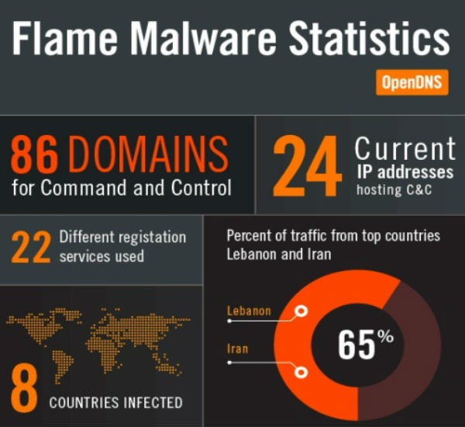
FLAME malware
Himanshu Sahay
Discovered as “Flame” in 2012
Used for targeted cyber espionage in the Middle East – mainly Iran
Used stolen Microsoft digital certificate
According to the Washington Post, jointly developed by US & Israel
<Graphic>
1, 2, 7
Notes:
Flame had been around for many years prior
Kaspersky discovered in first “by accident” in 2010, but properly in 2012
US NSA, CIA and Israeli military jointly developed Flame by at least 2007
Overview
Example of how easily trusted certificates can be stolen (maybe Bit9 or some other)
Give an example of trusted certificate signed malware (maybe Flume)
Then delve into technical details for a slide
Larger implications on trust
Conclusion – trust with a grain of salt, be wary, secure your certificates, software is written by people just like all of us in this room
Overarching implications – meaning of trust will change in the digital world (with privacy and security concerns as we have seen)

Slide 7
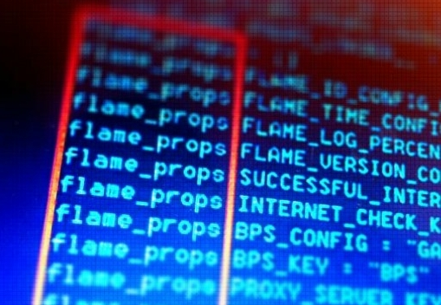
Flame DETAILS
Himanshu Sahay
Remote Desktop Services or Terminal Services
Certificates to be used locally repurposed to show Microsoft verification on the Internet
Trojan and worm
Makes it possible to steal different types of information
3, 4
Notes:
How Microsoft certs were stolen
Microsoft servers have a feature called Remote Desktop Services or Terminal Services, which allow "dumb" workstation computers to run their applications on a centralized server instead of locally.
Microsoft issues each server a license certificate, which tells workstations that the server is indeed running genuine Microsoft server software and is safe to connect to.
"What we found is that certificates issued by our Terminal Services licensing certification authority, which are intended to only be used for license server verification, could also be used to sign code as Microsoft," wrote Ness.
In other words, digital certificates that were only meant to be used locally, within organizations, could be repurposed to show Microsoft verification across the entire Internet.
Flame details
Big file – 20 MB, usually malware is 10-15 kb. Initially infected about 1000 machines
Worm and trojan – so it can propagate on its own and it doesn’t show itself to the computer as a potential threat
Most documents under scrutiny were AutoCAD files, PDF files and text files, seemingly on building plans and nuclear plans
Can spread via local networks and USB sticks
It can record audio, screenshots, keyboard activity, network traffic, and even files.
gathering technical diagrams for intelligence purposes

Slide 8

Bit9
Himanshu Sahay
Only security firm to stop Flame before it was found by anti-virus companies
Digitally signed certificates stolen in Feb 2013
Impact – if a target is using Bit9, gaining Bit9’s trust is a golden ticket to the target
Potential for a supply-chain attack
5, 8
Notes:
BUT WHAT HAPPENS WHEN THE COMPANY PROTECTING YOU FACES THE SAME FATE
Ironic logo at the time (the leader in *trust* based security)
several US government organization and over 30 of the Fortune 100 companies use Bit9
Potential for a supply-chain attack at the organizations protected by Bit9
If the malware is trusted by Bit9, it will inherently bypass the security of the system being attacked since Bit9 is protecting that system

Slide 9
Implications of such attacks
Himanshu Sahay
Make malware virtually indistinguishable from trusted software
Call for alternatives to current certificate authority infrastructure
  Perspectives Project - public notary servers used to validate SSL certificates
  Convergence - notary system that uses network probing from various locations to determine the validity of websites
There needs to be an understanding of what trust means, in the digital world.
6
Notes:
We are used to ignore certificate warnings, expired certificates, mismatches. This makes it way easier for discrepancies in certificates to pass through
A new understanding of trust in the digital world is needed. What could this be? Still an open ended question. Involves safeguarding privacy, providing robust security, and managing authentication, authorization. Trust may be “owned” by certain companies that create products to protect us. How do we trust these companies?
CAs are thought to be trustworthy, but they have been compromised, as we have seen

Slide 10
References
Himanshu Sahay
[1] https://www.washingtonpost.com/world/national-security/us-israel-developed-computer-virus-to-slow-iranian-nuclear-efforts-officials-say/2012/06/19/gJQA6xBPoV_story.html Accessed April 7, 2016
[2] https://www.rt.com/news/flame-virus-cyber-war-536/ Accessed April 8, 2016
[3] http://www.nbcnews.com/id/47675971/ns/technology_and_science-security/t/flame-malware-uses-stolen-microsoft-digital-signature/#.VwabOqQrLIU Accessed April 7, 2016
[4] http://www.thewire.com/technology/2012/05/complete-guide-flame-malicious-computer-virus-ravaging-iran/52949/ Accessed April 8, 2016
[5] http://krebsonsecurity.com/2013/02/security-firm-bit9-hacked-used-to-spread-malware/ Accessed April 7, 2016
[6] http://searchsecurity.techtarget.com/magazineContent/Breaches-prompt-call-for-certificate-authority-architecture-alternatives Accessed April 8, 2016
[7] http://rack.3.mshcdn.com/media/ZgkyMDEyLzA2LzA0LzEzXzM4XzA1XzIzMF9maWxlCnAJdGh1bWIJMTIwMHg5NjAwPg/a02ae042 Accessed April 7, 2016
[8] http://krebsonsecurity.com/wp-content/uploads/2013/02/bit9.png Accessed April 7, 2016

Slide 11
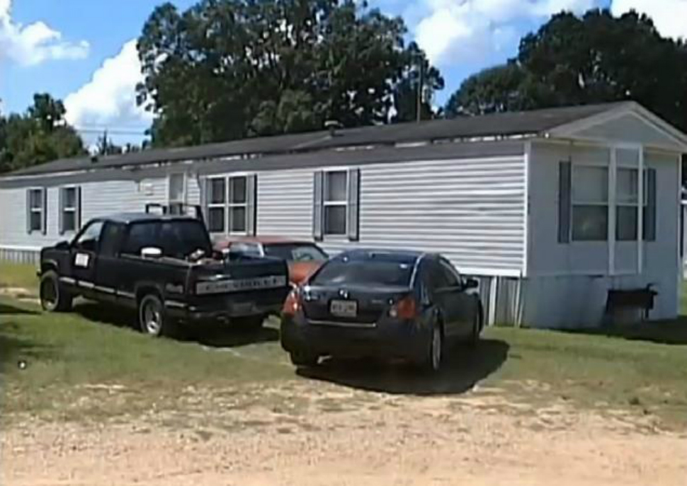
Case Study: Copycat crime of gta
Qiaoyu Liao
In August 2013, a 8-year-old boy killed his grandmother
Police believes that it is influenced by GTA4(Grand Auto Theft)
  They shared a “normal, loving relationship”
  He was playing the game minutes before the shooting
[5]
Notes:
Shooting a gun
In a trailer-the picture at the right

Slide 12

Case Study: Copycat crime of gta
What is this game?
  is an open world action-adventure video game series
Why?
  mostly violent and sexual scenes
  Encourage violence
  Wrongful depiction of women
  Already has numbers of teenager copycat crimes
[6,8]
Notes:
GTA: it includes large amount of violent and sexual scenes
Series more than 235 million units worldwide, 2.5 billion revenue only in GTA5
Even in the promotional poster
Player can fire gun freely and massacre civilians. It also hinted the player to kill police officer to advance in the game
It also allows player to use torture equipment to torture characters.
4:1 ratio of male to female player
Female character are mostly prostitutes and player can trade woman in the game.
I’ve spot at least 15 copycat crimes
On June 7, 2003, eighteen year old Devin Moore killed police officers Arnold Strickland and James Crump, and dispatcher Leslie Mealer when brought to police station. It is similar to what can happen in the GTA game. Also the case of William and Josh Buckner, Cody Posey, New York and Thailand Teenager Groups and Eldon G. Samuel III.

Slide 13
Case Study: Copycat crime of gta
Qiaoyu Liao
“There is nothing in the game you would not see in a TV show, or a movie a hundred times over, so I don’t understand what the conversation is about.”
    Dan Houser, Rockstar head writer and VP for creative[1]
“The video game manufacturer did not make these parents buy a gun and leave it in the presence of a small child. That is [the parents’] fault and it is a crime.”
    Shannon Watts, founder of Moms Demand Action for Gun Sense in America[2]
[5,7]
Notes:
Both proves that they believe violence video game is not the main reason
“We set out to make games that felt like they could culturally exist alongside the movies we were watching and the books we were reading, and hopefully we’re getting close to those goals.”

Slide 14
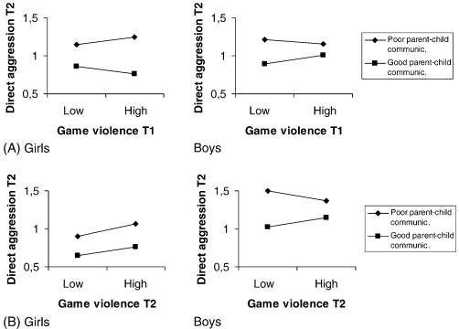
One side opinion
Qiaoyu Liao
Small number incidents
Youth criminal arrests has dropped
Controller Study proved that exposed to video game was not related to negative outcomes
<Graphic>
[1, 2]
Notes:
15 vs 25million
All the cases compared to how many copies the game have sold are trivial.
40-year lows measured by victimology data (Childstats.gov, 2011)
via youth arrests data, In the past year, violent crimes have dropped a further 12%
despite continued high video games sales
serious errors in much of the past research.
Picture at the right, low and high expose to violence
When properly controlled, the effects of violent content appear to vanish.
imprecise simulations
In essence, the forecast wave of “harm” to minors has simply not materialized. This has led some scholars to conclude that claims of harm to youth were greatly exaggerated

Slide 15
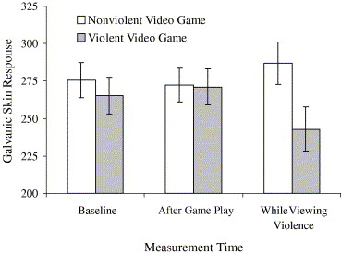
Another side opinion
Qiaoyu Liao
Youth exposed to violent media tend to become more aggressive
Study shows the effect on mental and psychology health
<Graphic>
[3]
Notes:
Youth exposed to violent media tend to become more aggressive immediately after exposure,
and become more aggressive adults
exposure at an early age (between 6 and 11 years old) larger than the effects of low IQ, abusive parents, exposure to antisocial peers, and being from a broken home
on later violent behavior
Also increase physiological arousal, decreases in prosocial behavior and cause desensitization
At the right measure of heart rate and Galvanic skin response can prove the conclusion. That in the picture, the response of violent video game is exactly the opposite from playing normal video game.

Slide 16
Problem of the current studies
Qiaoyu Liao
Lack of clinical validity
Failure to control for third variables
Selective interpretation
Outcomes besides violence: mental health, and academics
[4]
Notes:
It has been well-understood for some time that many of the aggression measures used in this research,
even ignoring the standardization issue, are not easily generalized to real-life aggression, let alone to violent crime
Controlling for gender as well as other theoretically critical factors—such as trait aggression, family violence, peer delinquency, and mental health—is essential.
By now it is clear that effect sizes are substantially reduced when control variables including gender, trait aggression, and family environment are included in analyses.
How about other critical factors?
With prior hypothesis, study will achieve null result or inconsistent.
including aggression, prosocial behavior, depression, and attention-deficit/hyperactivity disorder
mental health, prosocial behavior, and academics

Slide 17
Conclusion
Qiaoyu Liao
Video game violence is still going to be controversial
Video game violence has a casual effect on violent behavior, especially for children
Hope that current and future analysis may provide guidance
[4]
Notes:
It will still be controversial until someone find a casual link between the violence in video game and person’s violent behavior in long run.
But for now, because either to prove the casual link or to prove there’s no link is really difficult, it is still unclear what is the relation between game violence and criminal activities.
Hope that further study can provide guidance to the future social study in
psychology and clinically study
Mental health and academics

Slide 18
References
Qiaoyu Liao
[1] Ferguson, C. J., San Miguel, C., Garza, A., & Jerabeck, J. M. (2012). A longitudinal test of video game violence influences on dating and aggression: A 3-year longitudinal study of adolescents. Journal of Psychiatric Research, 46(2), 141-146.
[2] Wallenius, M., & Punamäki, R. (2008). Digital game violence and direct aggression in adolescence: A longitudinal study of the roles of sex, age, and parent–child communication. Journal of Applied Developmental Psychology, 29(4), 286-294.
[3] Carnagey, N. L., Anderson, C. A., & Bushman, B. J. (2007). The effect of video game violence on physiological desensitization to real-life violence. Journal of Experimental Social Psychology, 43(3), 489-496.
[4] Ferguson, C. (2015). Do angry birds make for angry children? A meta-analysis of video game influences on children's and adolescents' aggression, mental health, prosocial behavior, and academic performance. Perspectives on Psychological Science, 10(5), 646-666.
[5] Russell, Lauren. "Police: 8-year-old Shoots, Kills Elderly Caregiver after Playing Video Game." CNN. Cable News Network. Web. 25 Mar 2016.
[6] "Controversies Surrounding Grand Theft Auto V." Wikipedia. Wikimedia Foundation. Web. 25 Mar. 2016.
[7] "Rockstar Games' Dan Houser on Grand Theft Auto IV and Digitally Degentrifying New York." Vulture. 2008. Web. 25 Mar. 2016
[8] “Suit: Video Game Sparked Police Shootings” ABC News. Web. 25 Mar. 2016.

Slide 19
Overview
Course Evaluations
Students Present
Guest Speaker
Students’ Choice
Notes:
Fill time with Work Discussion on Course Web Site

Slide 20
Students’ Choice
Discuss which section of the book/class topic we think will be most relevant in the coming years.
Notes:
Could watch:
Last Week tonight with John Oliver – Patriot Act, Edward Snowden (33:14)
http://www.upworthy.com/john-oliver-flew-10-hours-to-russia-to-interview-edward-snowden-and-get-him-on-record?c=ufb1
Passphrases (2:08 need to give context for video)
https://firstlook.org/theintercept/2015/03/26/passphrases-can-memorize-attackers-cant-guess/
If not shown during first class
What "Orwellian" really means - Noah Tavlin (5:31)
http://ed.ted.com/lessons/what-orwellian-really-means-noah-tavlin
Weird Al – It’s All About The Pentiums (3:34) and look at lyrics
https://www.youtube.com/watch?v=qpMvS1Q1sos
Weird Al – White and Nerdy (2:50) and look at lyrics
https://www.youtube.com/watch?v=N9qYF9DZPdw

Slide 21
Class 14
The End
Keith A. Pray
Instructor
socialimps.keithpray.net
Notes:
This is the end. Any slides beyond this point are for answering questions that may arise but not needed in the main talk. Some slides may also be unfinished and are not needed but kept just in case.

