Slide 1
Class 11
Work
Keith A. Pray
Instructor
socialimps.keithpray.net
Notes:
Here’s the title slide. Excited already, aren’t you?
Last paper average: 4.5 - 5.5 - 5 - 6 – 6 – 6.5
Total points not counting extra credit so far: 28 – 50 – 64.5

Slide 2
Overview
Review
Assignment
Students Present

Slide 3
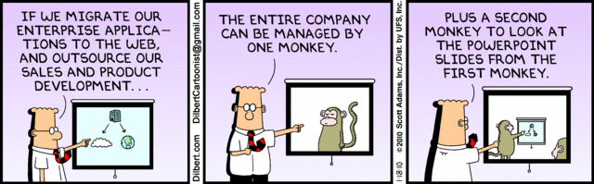
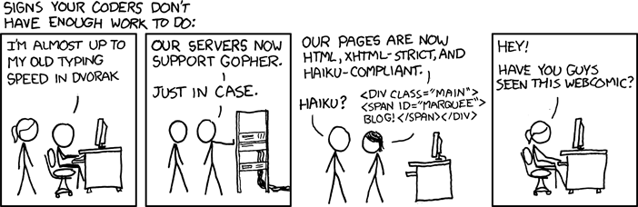
http://xkcd.com/554/

Slide 4
Group Quiz
List 2 ways IT can lead to organizational change.
List 4 ways a Video Game Producer may protect its IP and what specific IP each protects.
List a computing technology that can be used to protect an individual’s privacy.
List a computing technology that can be used to intrude upon an individual’s privacy.
Notes:
Could split into groups of 4-5 for this.
Fill time with Work Discussion on Course Web Site
Maybe watch video:
CGP Grey
Humans Need Not Apply (15:00) – 2014-08-13
http://www.youtube.com/watch?v=7Pq-S557XQU
Last access 2016-04-22
Look at:
BBC Intelligent Machines
http://www.bbc.com/news/technology-33978561
BBC Likelihood of robot taking your job
http://www.bbc.com/news/technology-34066941
Find out what your DNA says about you and your family.
https://www.23andme.com/
Maybe move to personal info day

Slide 5
Overview
Review
Assignment
Students Present
Notes:
Review Group Assignment Details.

Slide 6
Overview
Review
Assignment
Students Present

Slide 7
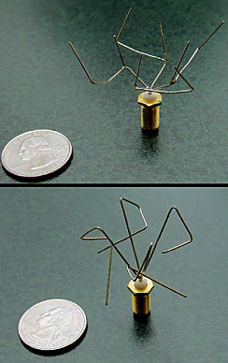
Existing creative artificial intelligence
Alec Thompson
Genetic algorithms
  FPGA programmed to distinguish between two frequencies [1]
  Designing antennas for spacecraft [1]
AARON
  Produced works that are now in galleries [2]
  Relatively limited, only exhibits experimentation with color [2]
Google DeepDream
  Pattern and matching recognition vital part of creativity [3]
  Enhances features in images [4]
http://cdn.damninteresting.com/wp-content/uploads/2007/06/nasa_antennae.jpg
Notes:
Existing creative AIs fall into a few categories – those that exhibit creative behavior without true creativity, and those that utilize some of the same underlying processes as humans do to think creatively.
Genetic algorithms are an example of the former. The algorithms are an AI technique where a large population of random items are generated, and then each generation, the top performing percentage acts as parents for the next generation. This can generate optimized solutions for problems relatively easily. However, they aren’t creative, in the same way that the process of evolution isn’t creative. There’s no guiding creativity or plan or final vision, as the process just relies on probability, and ‘environmental pressure’ in the form of evaluating the performance of each member of the population.
For example, genetic algorithms were used to program a 100-gate Field-Programmable Gate Array (FPGA) to distinguish between a 1kHz and 10kHz tone. After 4000 generations, the circuit could respond properly, and further training for only a few hundred more generations allowed it to react to vocal ‘stop’ and ‘go’ commands as well. The chip also only used 37 of its 100 logic gates, compared to the thousands that would be in a specialized audio chip. In fact, 5 of those gates were in a separate, self-contained loop, and the algorithm’s solution took advantage of interference created by small defects in the FPGA.
NASA has also used genetic algorithms to design antenna for a spacecraft, that exhibited better performance than any design a human would arrive at. The two best antenna designs are pictured on the right.
Creative AI also has applications in the arts. AARON was an AI created by Harold Cohen, a painter and computer scientist. The intelligence was created to act as a partner in coloring the works he drew. Some of its works are now in galleries. However, it is relatively limited in its painting style based on the heuristic it was designed with, and only really experiments with the colors it uses.
Google’s DeepDream is a little different. It doesn’t act particularly creatively. But what it does do is perform pattern recognition and matching extremely we, and use that to enhance particular features it recognizes in an image. These are both important parts of how we think creatively, and this is an important step in creating creative AIs.

Slide 8
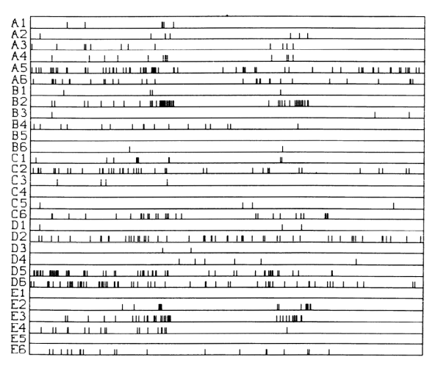
Future AI Technologies
Alec Thompson
Genetic Algorithms
  Not true creativity
  Can perform optimization impossible by humans [2]
  Quantum computing is applicable [5]
Neural networks
  Spiking neural networks [6]
  Larger and deeper networks, with hundreds to thousands of layers [7]
  Quantum Neural Networks are being developed [8]
The timing of neural spikes in a monkey’s visual cortex encodes information being processed
J. Vreeken, “Spiking neural networks, an introduction,”
Notes:
A lot of the technologies that will have a big impact in creating creative AIs, or at least AIs that can accomplish creative tasks, are still being developed.
Genetic algorithms, though not creative, can perform creative optimizations not possible by a human, and could absolutely replace humans in the phases of the engineering design process, both for software and hardware. However, one of the current limitations is the time and processing power required to run the algorithm. Research into genetic algorithm implementations that take advantage of the unique properties of quantum computing to speed up the process.
Neural networks, due to their similarity to the brain, are another area being looked toward for more advanced AI. One particularly interesting technology here is spiking neural networks, which more accurately replicate neurons by operating the network continuously, and the neurons in the network, when triggered, spike and reset over a period of time in the same way biological neurons do. This primary benefit of this is that information can be encoded and learned via the timing of the spikes, instead of only the values of the impulses, allowing networks to learn the features with less nodes. An example of this can be seen in the graphic on the right, which is a four second recording of the neural spikes in 30 neurons from a monkey’s visual cortex. The timing of the spikes is what is used to encode information, not the absolute electric potential of each neuron at each point in time, and is what spiking neural networks try to replicate.
Additionally, networks are growing larger. Microsoft and Google are using networks with anywhere from hundreds to thousands of layers, with varying performance results. Microsoft recently took the crown of best image classification network from Google using a network with 150 layers.
And, like with genetic algorithms, methods for creating and training neural networks using quantum computing are being developed, which may lead to much faster and larger networks than conventional computing would allow.

Slide 9
Impacts of creative ai
Alec Thompson
Automation of workforce
  Manufacturing has been automated through robotics, not using AI yet
  Doesn’t necessarily create a net loss of jobs [9]
  Fields requiring problem solving to address unpredictable problems should be safe [10]
Replacement of creative jobs
  No job is safe from a truly creative AI [10]
  ‘Subjective’ professions (humanities and arts) are less at risk [10]
  Could lead to a situation where AIs are programming each new generation of AIs
Notes:
The impacts of creative AI is difficult to quantify, simply because it’s a new frontier. Some elements we can base predictions off of past automation efforts – such as the automation of manufacturing processes with robots. This didn’t result in a net loss of jobs – it merely shifted them from manufacturing to design and maintenance of the automation. It’s likely that task-specific AI methods such as genetic algorithms, and even AIs similar to Google’s AlphaGo or IBM’s Watson targeted at commercializable problems, would lead to similar results. They’re very task specific, and therefore wouldn’t be able to be used for different problems encountered without modifications. They’d still require upkeep and design like manufacturing automation.
However, a truly creative AI poses a lot of dangers. By virtue of it’s creativity, it would have the flexibility to address the unpredictable problems an engineer, or a scientist may face. I hesitate to use the term conscious AIs to describe them, because it’s beyond the scope of this presentation, but a conscious AI would fall into the category of ‘truly creative’.
Whatever form truly creative AIs would take, the only professions that would not be at risk of being replaced by artificial intelligence would be subjective professions such as art and music, where the products can only be evaluated subjectively, and thus AIs would have little advantage except for the speed at which they could create works.

Slide 10
Conclusions
Alec Thompson
Using AI techniques for optimization of existing work is likely to be beneficial
  Will allow better designs than a human could create
  Created designs still need human supervision for testing
  These AIs would be task-specific, and require manpower to design and maintain
Truly creative AI is dangerous
  Could lead to the elimination of entire fields of employment via AI replacement
  Need careful planning to prevent mass unemployment
Notes:
AI is absolutely a very useful and potentially beneficial technology, but is a double-edged sword due to the risks presented by not carefully planning the implementation of the AI.
If implemented safely, using task-specific AIs that use techniques that provide creative results without being truly creative, they’re harmless, and can create things far better than a human could, just as a self-driving cars can reach a point where they are far better drivers than a human could. These AIs would still require professionals to create and fine-tune them, and could easily produce the same beneficial effects brought about by factory automation.
But the path toward creating truly creative AIs needs to be tread carefully. Those AIs are what would cause social upheaval by replacing human workers in every field, and are very dangerous if society is not prepared.

Slide 11
References
<Your Name>
[1] A. Bellows, “On the Origin of Circuits,” Damn Interesting, 10-Dec-2013. [Online]. Available at: http://www.damninteresting.com/on-the-origin-of-circuits/. [Accessed: 19-Apr-2016].
[2] J. Wakefield, “Intelligent Machines: AI art is taking on the experts,” BBC News, 18-Sep-2015. [Online]. Available at: http://www.bbc.com/news/technology-33677271. [Accessed: 19-Apr-2016].
[3] F. T. Hong, “The role of pattern recognition in creative problem solving: A case study in search of new mathematics for biology,” Progress in Biophysics and Molecular Biology, vol. 113, no. 1, pp. 181–215, Apr. 2013.
[4] A. Mordvintsev, C. Olah, and M. Tyka, “Inceptionism: Going Deeper into Neural Networks,” Research Blog, 17-Jun-2015. [Online]. Available at: http://googleresearch.blogspot.com/2015/06/inceptionism-going-deeper-into-neural.html. [Accessed: 19-Apr-2016].
[5] H. Wang, J. Liu, J. Zhi, and C. Fu, “The Improvement of Quantum Genetic Algorithm and Its Application on Function Optimization,” Mathematical Problems in Engineering, vol. 2013, pp. 1–10, 2013.
[6] J. Vreeken, “Spiking neural networks, an introduction,” Exploratory Data Analysis, 2002. [Online]. Available at: http://eda.mmci.uni-saarland.de/pubs/2002/spiking_neural_networks_an_introduction-vreeken.pdf. [Accessed: 19-Apr-2016].
[7] A. Linn, “Microsoft researchers win ImageNet computer vision challenge - Next at Microsoft,” Next at Microsoft, 10-Dec-2015. [Online]. Available at: http://blogs.microsoft.com/next/2015/12/10/microsoft-researchers-win-imagenet-computer-vision-challenge/. [Accessed: 19-Apr-2016].
[8] B. Ricks and D. Ventura, “Training a Quantum Neural Network,” NIPS Proceedings. [Online]. Available at: http://papers.nips.cc/paper/2363-training-a-quantum-neural-network.pdf. [Accessed: 20-Apr-2016].
[9] W. Leontief and F. Duchin, “The Impacts of Automation on Employment, 1963-2000. Final Report.,” rep.
[10] E. Brynjolfsson and A. McAfee, “Brynjolfsson and McAfee: The jobs that AI can't replace,” BBC News, 13-Sep-2015. [Online]. Available at: http://www.bbc.com/news/technology-34175290. [Accessed: 20-Apr-2016].

Slide 12
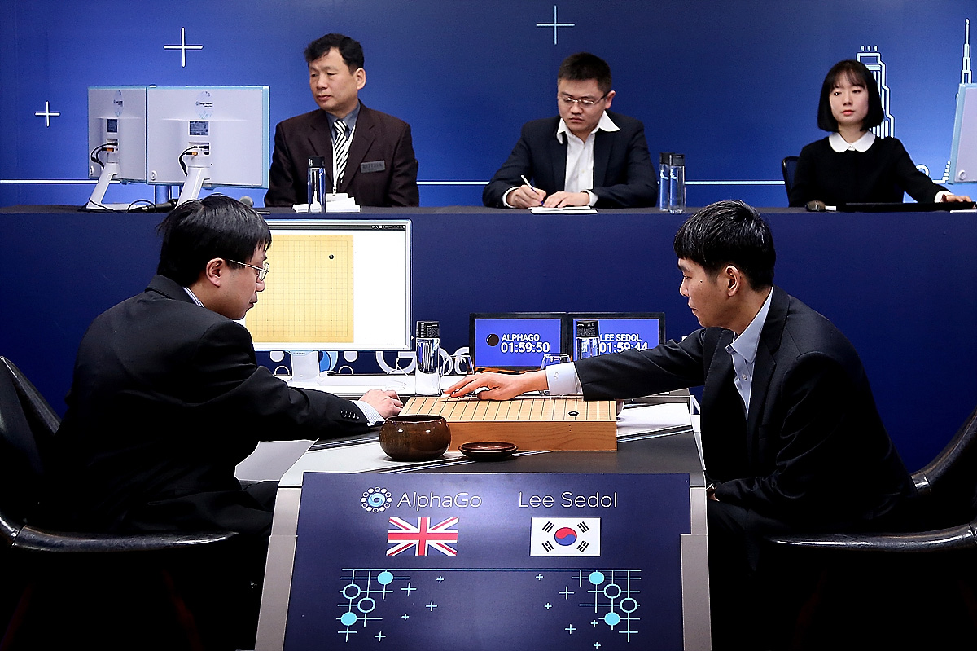
AlphaGO
Zachary Robbins
Artificial General Intelligence
Precursor to AlphaGo
The Challenge of Go
AlphaGo
Limitations & Concerns
Conclusions
[9]
Notes:
Summary, make this slide quick

Slide 13
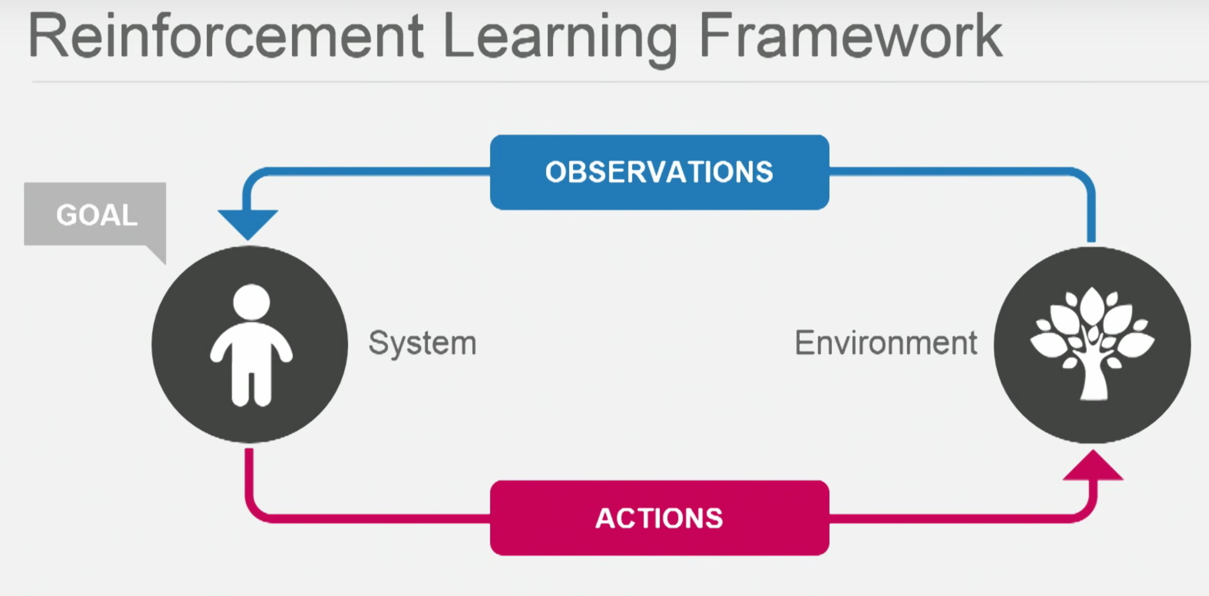
Artificial general intelligence
Zachary Robbins
AGI vs Narrow AI
  IBM DeepBlue, Watson
AGI = General Purpose Learning Machines
Reinforcement learning
  Human dopamine system
  The key to intelligence
Google DeepMind
  Mission: Create AGI
[1]
Notes:
Artificial General Intelligence is AI that can perform any intellectual task a human can, usually by learning to by itself through
General purpose learning algorithms
Narrow AI is AI that has been specifically built to solve one problem, even if it learns to solve that problem better and better over time
IBM Deep Blue beating Karry Kasparov in Chess
IBM Watson beating Jeopardy players
Reinforcement learning:
System has a view of the environment, and makes observations based on the environment it is given to analyze
Makes action that it think will best achieve its goal
Environment changes, and new observations are made
This is the same as the human dopamine system, and is the key to intelligence

Slide 14
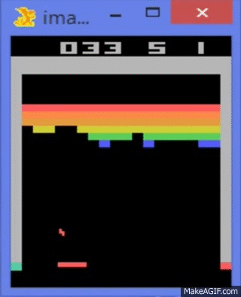
Precursor to Alphago
Zachary Robbins
Created by Google DeepMind
DQN = Deep Q-Network
  Reinforcement learning
  Deep neural network
Received only pixels and score as inputs
Same algorithm, 49 Atari games
  Training w/ hundreds of iterations
  Reached professional level
[1], [3], [5]
Notes:
DQN: A combination of reinforcement learning and a deep neural network
Neural networks are a huge number of simple, yet highly interconnected, processing nodes
Modeled loosely after human neural structure
Each node takes a number of weighted inputs, and gives an output
When we take a plethora of these and connect them in layers, we get a neural network
The neural network changes weights between nodes as it learns and finds the ideal path to a successful approach
The same algorithm was used for all 49 Atari games.
Played hundreds of games, started off bad, ended up very skilled like in picture.
Achieved more than 75% of professional human player in 29 of the games

Slide 15
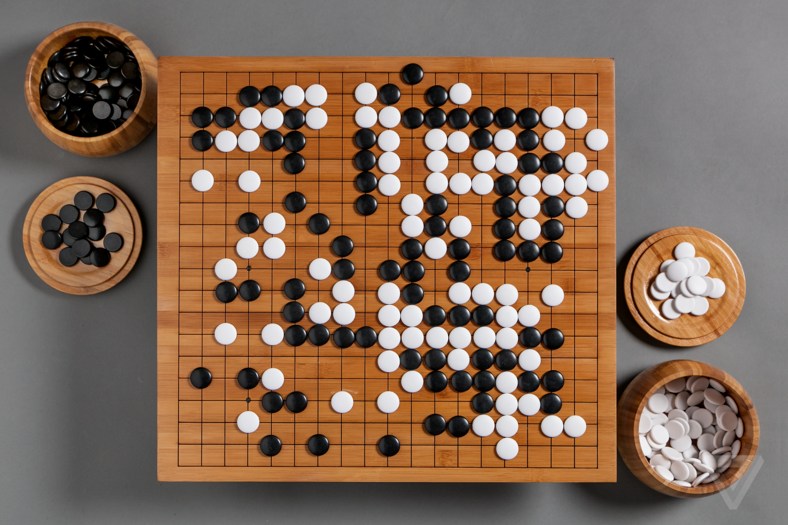
The Challenge of GO
Zachary Robbins
Complexity of Go
  Number of positions ≈ 250¹⁵⁰
  A game of intuition
Considered one of the grand challenges of reaching AGI
Wasn’t expected to reach competition level for 10 years
[2], [4], [7], [8]
Notes:
Complexity of Go
250 legal moves per position, 150 moves to a game
More move positions than atoms in the universe
A googol more complex than chess
Professional players often describe their reasoning behind a good move is intuition (gut feel); that the pieces had a “good shape”
Standard tree search of all possible moves is computationally impossible
Researchers believed AI that could compete with Go professionals was at least another decade away

Slide 16
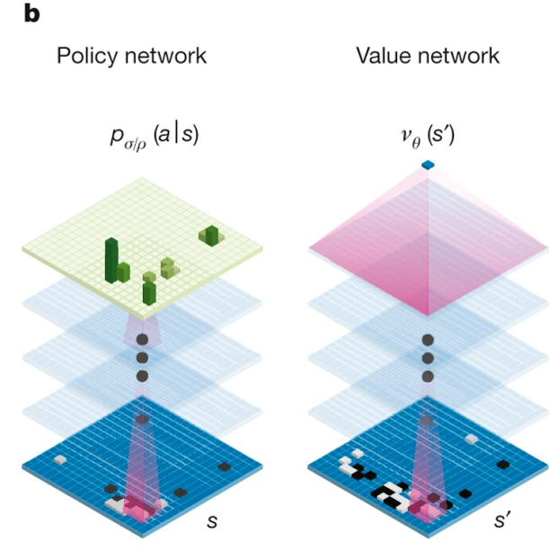
Alphago
Zachary Robbins
Implementation
  Monte-Carlo Tree Search using Deep Neural Networks
    Policy Network
    Value Network
Results
  Won 494 of 495 CPU games
  European Champion Fan Hui
  World Champion Lee Sedol
[2], [4], [6], [7]
Notes:
Implementation
Monte Carlo: A tree search with heuristics (deep neural networks)
When win, Monte Carlo updates stats to remember winning path
Combined with DNNs:
Policy network predicts set of most likely next moves (limits breadth)
Value network limits search depth, guesses what will lead to best outcome
Uses reinforcement learning to get better (played against itself)
Generated thousands of less moves per turn than DeepBlue! More efficient

Slide 17
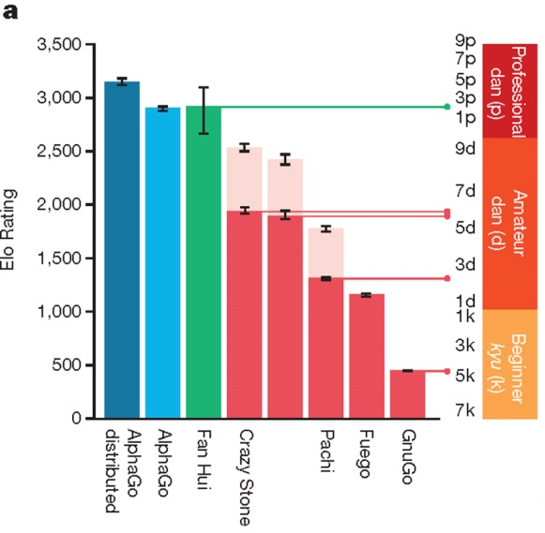
Limitations & concerns
Zachary Robbins
Limitations of AlphaGo
  Huge data set needed to train
  Time + computing power
  Tailored for Go, not truly general purpose
Ethical concerns
Fear of AI hampers development
  Elon Musk, Stephen Hawking, Bill Gates
[2], [4], [7], [10]
Notes:
Talk about graphic
“Solve Intelligence. Use it to solve everything else.”
This raises concerns, do we want something of human level intelligence in machines?
Ethical concerns:
If we create a computer that can make decisions of free will, then is it ethical to control it and prevent it from making decisions out of free will?
How can we assure a general learning machine is benevolent?
If AGI surpasses humans in all capabilities, where does that leave us? Obsolete?
Fear of AI hampers AI development - Microsoft director of Research Chris Bishop
Both Stephen Hawking, Elon Musk, Bill Gates have publicly announced the risk they think the development of AGI poses

Slide 18
conclusions
Zachary Robbins
Correlation between computing power and learning capabilities
We are still a long way away from AGI
AGI has potential for solving problems through use of big data
However, we should be cautious
  Abide by a standards of ethics for A.I. Development
Notes:
As computing power increase, general purpose learning machines can learn more faster
AlphaGo was only possible because of the use of Google’s extensive cloud resources for intensive training
Go was considered the Holy Grail of A.I. due to its complexity, it has been conquered
Still a decade away from AGI
There is a lot of data in the world, and AGI can utilize this data to learn and develop patterns to solve problems
E.g. Analyzing genomes to discover and combat genetic diseases
We should be cautious, as our computing power increases exponentially each year, so does the power of artificial intelligence

Slide 19
References
Zachary Robbins
[1] The Theory of Everything, https://www.youtube.com/watch?v=rbsqaJwpu6A (Accessed 4/21/16)
[2] https://googleblog.blogspot.nl/2016/01/alphago-machine-learning-game-go.html (Accessed 4/21/16)
[3] http://www.nature.com/nature/journal/v518/n7540/full/nature14236.html (Accessed 4/21/16)
[4] http://www.nature.com/nature/journal/v529/n7587/full/nature16961.html (Accessed 4/21/16)
[5] http://www.kdnuggets.com/2015/01/deep-learning-explanation-what-how-why.html (Accessed 4/21/16)
[6] https://jeffbradberry.com/posts/2015/09/intro-to-monte-carlo-tree-search/ (Accessed 4/21/16)
[7] http://googleresearch.blogspot.com/2016/01/alphago-mastering-ancient-game-of-go.html (Accessed 4/21/16)
[8] https://cdn1.vox-cdn.com/thumbor/cxHFEPUtYJkaAz2Uf0dV5qLtc90=/cdn0.vox-cdn.com/uploads/chorus_asset/file/6160055/akrales_160307_0970_a_0127.0.png (Accessed 4/21/16)
[9] http://s1.ibtimes.com/sites/www.ibtimes.com/files/2016/03/12/alphago.jpg (Accessed 4/21/16)
[10] http://www.iflscience.com/technology/fear-artificial-intelligence-hampering-its-development (Accessed 4/21/16)

Slide 20
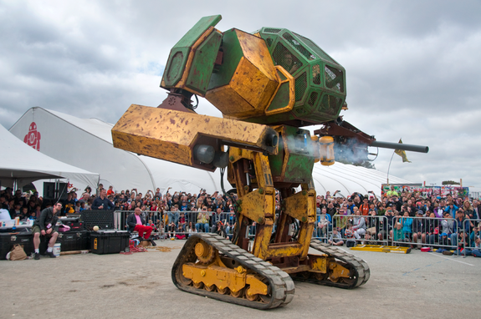
Society Guiding Robotic Development
Greg Port
Overview
  Autonomous vehicles
  Humanoid robots
  Focus on DARPA
  Human perceptions of robots and how they influence robotic development
MegaBot Mk. II [10]
[10]
Notes:
To give a brief overview of this presentation, first I will be going over autonomous vehicles and an event that caused a large spike in the development of autonomous vehicles. Next, I will go over humanoid robots and the goals that are being targeted presently. With both of these fields, I will be focusing on DARPA’s involvement and challenges. Lastly, I will be analyzing humans’ perceptions of robots and how that has influenced how robots have developed.

Slide 21
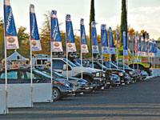
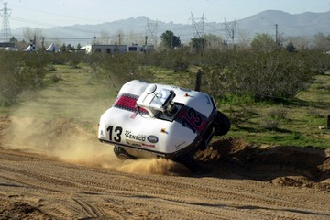
Autonomous Vehicles – Influence and Modern Example
Greg Port
Google self-driving car
  Began in 2009
  Meant to reduce accidents
  Inspired by DARPA Grand Challenges
DARPA Grand Challenge/Urban Challenge
  Autonomous vehicle race
  Event has ranged from race across tough terrain to city driving
DARPA Urban Challenge [3]
DARPA Grand Challenge [2]
[1], [2], [3], [4]
Notes:
Beginning in 2009, Google’s self-driving cars have driven over 1.5 million miles through city streets [1]
Google has stated that the overall goal of this project is to reduce accidents and increase safety on the roads
Google’s website has directly stated that some inspiration lies in DARPA’s Grand Challenges in the mid 2000s
DARPA’s Grand Challenge was the originator of the “self-driving car revolution” [2] in 2004
DARPA stands for the “Defense Advanced Research Projects Agency”
Partnered with the Department of Defense
Mission: “to make pivotal investments in breakthrough technologies for national security” [4]
Original event involved 15 self-driving cars going through 142 mile course between California and Nevada
Teams competed to complete the course in less than 10 hours for a $1 million prize
Meant to help technology for autonomous vehicles that could be used to help transport cargo and supplies in military zones

Slide 22
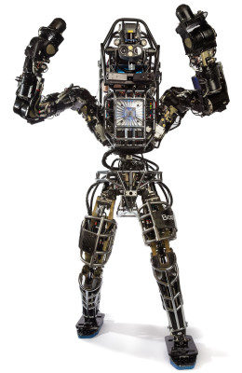
Humanoid Robotics – Where they came from; Where they Are going
Greg Port
DARPA Robotics Challenge
  Several events meant to test these robots
  Challenge designed to foster innovations for disaster aid
Atlas
  Used by several teams
  Humanoid robot capable of bipedal walking
  28 hydraulically-actuated degrees of freedom, two hands, arms, legs, feet and a torso
Boston Dynamics’ Atlas Robot [6]
[5], [6]
Notes:
Challenge events include: driving, egress, opening and going through a door, turning a valve, drilling through a wall to remove a prescribed shape, traversing rubble, going up stairs, and a “surprise” event [5]
Overall, these events are meant to mimic human capabilities in some form or another
Ultimately, according the DARPA Robotics Challenge website, this challenge is meant to “generate groundbreaking research and development in hardware and software that will enable future robots, in tandem with human counterparts, to perform the most hazardous activities in disaster zones, thus reducing casualties and saving lives” [5].
Atlas is an anthropomorphic robot designed by Boston Dynamics
“Articulated, sensate hands will enable Atlas to use tools designed for human use. Atlas includes 28 hydraulically-actuated degrees of freedom, two hands, arms, legs, feet and a torso” [6].
“Atlas can walk bipedally leaving the upper limbs free to lift, carry, and manipulate the environment. In extremely challenging terrain, Atlas is strong and coordinated enough to climb using hands and feet, to pick its way through congested spaces” [6].

Slide 23
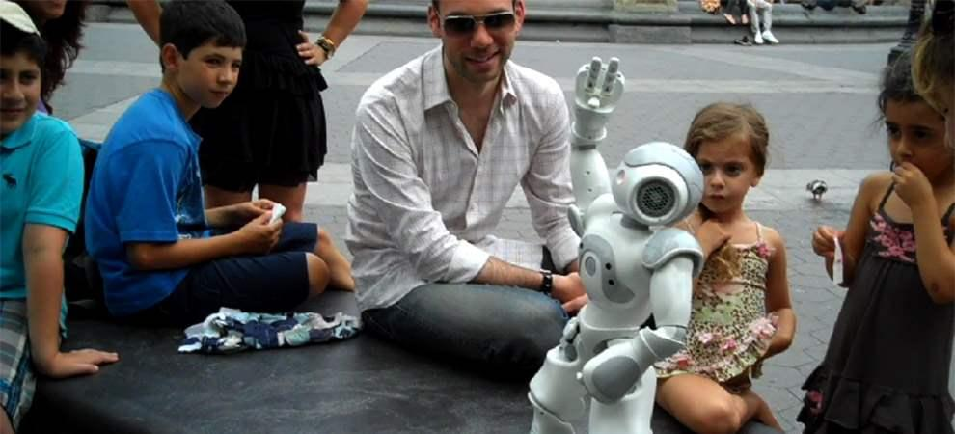
Human Perception of Robots - General
Greg Port
Humans have a desire to better understand and emulate human intelligence.
  AI
  Robot motion
Humans also have tendency to anthropomorphize objects
  Leads to human traits in robots
  Also leads to human-like robots
Robots as partners
  Aid humans in tasks
  Autonomous vehicles
  Elderly assistance
[7], [8]
Notes:
“Humans seem to have a particular curiosity about understanding and simulating nature in general, and, specifically, human beings” [7].
“Since its origin, which can be dated back to 1956, AI research has been strongly inspired and motivated by human intelligence; human thinking and problem-solving dominated until the late 1980s, whereby chess-playing, theorem-proving, planning and similar ‘cognitive’ skills were considered to exemplify human intelligence and were proposed as benchmarks for designing systems that should either simulate human intelligence (weak AI) or become intelligent (strong AI)” [7].
“More recently, sensorimotor skills emphasizing the embodied nature of human intelligence (including locomotion, object manipulation, etc.) are considered to be the more fundamental but certainly more biologically and developmentally plausible milestones that researchers are aiming at, highlighting the close relationships between mind, body and environment” [7].
“In fact, as social creatures, it is often our default behavior to anthropomorphize moving robots” [8].
Furthermore, robots have developed into a partnership role with humans.
More and more, they are meant for aiding humans with tasks to either improve life or reduce risk.
This was a large reason for the DARPA Grand Challenge – keep soldiers safe when transporting goods in dangerous areas.
Furthermore, more and more robots are emerging to aid in various tasks, such as telepresence (often with humanoid robots), helping the elderly, aiding in social tasks humans have (resulting in the term “social robot” [8]), or being used for entertainment in some form or another.
To summarize, robots are being viewed more and more as partners, largely due to their anthropromorphic traits.

Slide 24
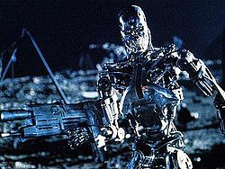
Human Perception of Robots - Media
Greg Port
Movies
  Terminator
  I, Robot
  Movies like these establish fear of robots being able to do too much
News
  Drones
  Fear of government using technology for own agenda or invading privacy
800 Series Terminator [14]
[11], [12], [13], [14]
Notes:
Movies such as these depict robots surpassing and either surprising or killing humanity.
This results in a fear of giving robots too many capabilities or too much control
Furthermore, with the drone controversy, namely over privacy, concerns are raised over the government or another entity using this technology for undesirable purposes.
As an example, spying on citizens.
Ultimately, these factors of fear keep some robotic technologies at bay.

Slide 25

Conclusions
Greg Port
Organizations and government play large role in robotic development
  Technology trickles from government sponsored programs to society
  Large technological strides made this way
  So far proven to be generally good
Society’s perception of robots has impact
  Human desire to replicate human attributes
  Human fear of too powerful of AI
  Keeps robotic technology in check
Ultimately, government should have influence, but needs society to keep it in check
  Government provides funding and stimulates innovation
  Society prevents undesirable results
DARPA’s Logo [9]
Notes:
To summarize, there are numerous organizations, governmental or not, influencing modern robotics.
DARPA is one example that is helping to lead robotics to keeping humans safe and reducing the risks they encounter.
Their Grand and Urban challenges aimed to aid soldiers on the battlefield.
The Robotics Challenge sought to create robots for disaster relief.
In turn, they have also created a “revolution” in autonomous vehicles and humanoid robots.
This also results in other companies adding this technology to their products.
As an example, many cars now have some sort of automated braking, lane departure correction, etc.
This can be further sourced to how humans perceive robots.
They are often given anthropomorphic traits out of humanity’s simple desire to better understand and emulate humans.
As such, they are more and more becoming partners to humans.
However, the media presence keeps some technologies in check
Fear of robots not performing in desirable ways results in these robots being designed in such a way to prevent undesirable results, as defined by society.
Ultimately, a combination of government and societal influence is desirable.
The past has shown that government influence has resulted in numerous technological innovations, even further than what has been discussed in this presentation.
This technology also moves into commercial businesses, which is then further refined for public use and benefit.
However, society control, through both media and personal beliefs, is also needed to ensure this type of technology is not abused and is properly constructed.

Slide 26
References
Greg Port
[1] "Google Self-Driving Car Project." Google Self-Driving Car Project. Google, n.d. Web. 21 Apr. 2016. <https://www.google.com/selfdrivingcar/>.
[2] Chow, By Denise. "DARPA and Drone Cars: How the US Military Spawned Self-Driving Car Revolution." LiveScience. TechMedia Network, 21 Mar. 2014.
Web. 21 Apr. 2016. <http://www.livescience.com/44272-darpa-self-driving-car-revolution.html>.
[3] "Urban Challenge." DARPA. DARPA, n.d. Web. 21 Apr. 2016. <http://archive.darpa.mil/grandchallenge/>.
[4] "About DARPA." DARPA. DARPA, n.d. Web. 21 Apr. 2016. <http://www.darpa.mil/about-us/about-darpa>.
[5] "What Is the DARPA Robotics Challenge (DRC)?" DARPA Robotics Challenge. DARPA, n.d. Web. 21 Apr. 2016.
<http://www.theroboticschallenge.org/overview>.
[6] "Atlas - The Agile Anthropomorphic Robot." Boston Dynamics: Dedicated to the Science and Art of How Things Move. Boston Dynamics, n.d. Web. 21
Apr. 2016. <http://www.bostondynamics.com/robot_Atlas.html>.
[7] Dautenhahn, Kerstin. "Socially Intelligent Robots: Dimensions of Human–robot Interaction." Philosophical Transactions of the Royal Society B:
Biological Sciences. The Royal Society, 13 Feb. 2007. Web. 21 Apr. 2016. <http://www.ncbi.nlm.nih.gov/pmc/articles/PMC2346526/>.
[8] Knight, Heather. "How Humans Respond to Robots: Building Public Policy through Good Design." Brookings. The Brookings Institution, n.d. Web. 21
Apr. 2016. <http://www.brookings.edu/research/reports2/2014/07/how-humans- respond-to-robots>.
[9] DARPA Logo image: "DARPA." Wikipedia. Wikimedia Foundation, n.d. Web. 21 Apr. 2016. <https://en.wikipedia.org/wiki/DARPA>.
[10] MegaBot Mk. II Image: Staff, By Live Science. "Photos: Massive 'Battle Bot' Gears Up for Robot Duel." LiveScience. TechMedia Network, 19 Aug. 2015.
Web. 21 Apr. 2016. <http://www.livescience.com/51909-megabots-battle-robot-photos.html>.
[11] "The Terminator (1984)." IMDb. IMDb.com, n.d. Web. 22 Apr. 2016. <http://www.imdb.com/title/tt0088247/>.
[12] "I, Robot (2004)." IMDb. IMDb.com, n.d. Web. 22 Apr. 2016. <http://www.imdb.com/title/tt0343818/>.
[13] K, K. "A Looming Threat." The Economist. The Economist Newspaper, 19 Mar. 2015. Web. 22 Apr. 2016.
<http://www.economist.com/blogs/democracyinamerica/2015/03/drones-and-privacy>.
[14] Terminator image:"Terminator (character Concept)." Wikipedia. Wikimedia Foundation, n.d. Web. 22 Apr. 2016.
<https://en.wikipedia.org/wiki/Terminator_(character_concept)>.

Slide 27
Unions in the Software Industry
Rick Wight
Very few tech workers are union members
  3.9% membership rate for “computer and mathematical occupations” [5]
  16.8% for all “professional and related occupations” [5]
Unionized tech workers make less money
  $46 per week less on average [6]
[5, 6]
Notes:
Statistics from National Bureau of Labor Statistics
3.9 percent is lower than any other grouping except sales (3.3%) and farming/fishing/forestry (1.9%)
$46 is higher than any other grouping
Of 21 groupings, only three others were negative (architecture/engineering, business/financial, and sales)
Unweighted average is $141 in favor of union members

Slide 28

Traditional benefits of unions
Rick Wight
Give workers collective bargaining power
Various discounts
  Legal help
  Scholarships
  Financial services
[7, 11]
Notes:
Individual workers are easily replaceable and have no real leverage, but as a group they can make demands.

Slide 29

Why is software different?
Rick Wight
Software engineers are in demand
  High salaries
  Individuals have leverage
Big gap between good and bad employees
[17]

Slide 30

Traditional downsides of unions
Rick Wight
Can restrict personal flexibility
Heavy emphasis on seniority
Members must pay dues
[12]
Notes:
Restrictions on flexibility:
Salaries often decided by formula of education and experience, not value added
Restrictions on who can do “union jobs” and how fast
Bureaucracy makes things slow
Dues:
- IWW ranges from $11 to $33 per month, depending on income

Slide 31

Is that enough?
Rick Wight
Software engineers are arguably underpaid relative to their contributions
Companies can take advantage of employees
  2014 collusion case
What will the future bring?
[8, 10, 16]
Notes:
Rework this slide title
Find reference for underpaid statement

Slide 32

Alternatives to unions
Rick Wight
Licensed Professionals
  Covered in book
Guilds
  British Computing Society
[9, 13]
Notes:
Guilds are very similar to licensed professional organizations, but with less legal restrictions. They offer educational opportunities, certifications, access to legal help and professional Identity Insurance

Slide 33

How to make unions better
Rick Wight
“Workplace democracy”
Decentralized model
  Companies don’t need to be officially unionized
Emphasis on improving workplaces and working conditions
[2, 14]
Notes:
“Industrial Workers of the World”
Some focus on the usual “I want to get paid more” aspect, but less
Try to solve problems on an individual level where possible
Workers managing themselves

Slide 34
Conclusion
Rick Wight
Little urgency for Software Engineers to unionize
“Right choice” probably depends on individual situation
If job markets shift, unionization becomes more beneficial
[15]
Notes:
Broad strokes overview: unions offer some benefits, but not enough to make them clearly worthwhile. Organizations like ACM, IEEE, and the BCB offer many of the “softer” benefits with less restrictions.
However, if or when software engineers become more common and demand falls off, unionization could become much more attractive.

Slide 35
References
Rick Wight
[1] "Communications, Computer, and Software Workers Industrial Union 560." Industrial Workers of the World. N.p., n.d. Web. 21 Apr. 2016. http://www.iww.org/unions/dept500/iu560.
[2] Finley, Klint. "Want To Unionize Developers? Focus On Workplace Democracy." TechCrunch. N.p., 01 Nov. 2012. Web. 21 Apr. 2016. http://techcrunch.com/2012/11/01/want-to-unionize-developers-focus-on-workplace-democracy/.
[3] "Graphical, Paper, Media & Information Technology." Graphical, Paper, Media & Information Technology. N.p., n.d. Web. 21 Apr. 2016. http://www.unitetheunion.org/how-we-help/list-of-sectors/graphical-paper-media--information-technology/.
[4] "Union Members Summary." U.S. Bureau of Labor Statistics. U.S. Bureau of Labor Statistics, 28 Jan. 2016. Web. 21 Apr. 2016. http://www.bls.gov/news.release/union2.nr0.htm.
[5] "Table 3. Union Affiliation of Employed Wage and Salary Workers by Occupation and Industry." U.S. Bureau of Labor Statistics. U.S. Bureau of Labor Statistics, 28 Jan. 2016. Web. 21 Apr. 2016. http://www.bls.gov/news.release/union2.t03.htm.
[6] "Table 4. Median Weekly Earnings of Full-time Wage and Salary Workers by Union Affiliation, Occupation, and Industry." U.S. Bureau of Labor Statistics. U.S. Bureau of Labor Statistics, 28 Jan. 2016. Web. 21 Apr. 2016. http://www.bls.gov/news.release/union2.t04.htm.
[7] "Union Plus." Benefits of Union Membership. N.p., n.d. Web. 21 Apr. 2016. https://www.unionplus.org/about/labor-unions/benefits-union-membership.
[8] "Silicon Valley Software Engineers Accuse Google, Apple, Intel, Adobe of Collusion." CBSNews. CBS Interactive, 22 Apr. 2014. Web. 21 Apr. 2016. http://www.cbsnews.com/news/silicon-valley-software-engineers-accuse-google-apple-intel-adobe-of-collusion/.

Slide 36
References
Rick Wight
[9] Guild Logo 1. Digital image. N.p., n.d. Web. 22 Apr. 2016. https://pollardtrumpets.wordpress.com/2011/05/16/peter-pollard-welcome-to-the-guild-of-master-craftsmen/.
[10] D-man-standing-top-business-graph. Digital image. Dreamstime. N.p., n.d. Web. 22 Apr. 2016. http://www.dreamstime.com/royalty-free-stock-images-d-man-standing-top-growth-business-graph-looking-red-bar-chart-over-white-background-reflection-image30896559.
[11] Union Yes Sign. Digital image. Akron Building Trades. N.p., n.d. Web. 22 Apr. 2016. http://akronbuildingtrades.org/work-union/.
[12] Union No. Digital image. Newsbusters. N.p., n.d. Web. 22 Apr. 2016. http://www.newsbusters.org/blogs/noel-sheppard/2012/08/04/far-left-propaganda-machine-moveonorg-casts-public-service-ad-non-uni.
[13] "BCS - The Chartered Institute for IT." BCS - The Chartered Institute for IT. N.p., n.d. Web. 22 Apr. 2016. http://www.bcs.org/.
[14] Improvement Icon. Digital image. Pd4 Pictures. N.p., n.d. Web. 22 Apr. 2016. http://pd4pictures.com/pages/i/improve-icon/.
[15] Balancing Scale. Digital image. Clipart Best. N.p., n.d. Web. 22 Apr. 2016. http://www.clipartbest.com/balancing-scale-clipart.
[16] Manjoo, Farhad. "Are Silicon Valley's Engineers Underpaid?" Fast Company. N.p., Mar. 2011. Web. 22 Apr. 2016. http://www.fastcompany.com/1722687/are-silicon-valleys-engineers-underpaid.
[17] Businessman with a Pile of Money. Digital image. Dreamstime. N.p., n.d. Web. 22 Apr. 2016. http://www.dreamstime.com/stock-photo-business-man-pile-money-vector-illustration-cartoon-image35110170.

Slide 37
Class 11
The End
Keith A. Pray
Instructor
socialimps.keithpray.net
Notes:
This is the end. Any slides beyond this point are for answering questions that may arise but not needed in the main talk. Some slides may also be unfinished and are not needed but kept just in case.

