Slide 1
Class 9
Errors Failures Risks
Keith A. Pray
Instructor
socialimps.keithpray.net
Notes:
Here’s the title slide. Excited already, aren’t you?
What is the point of this assignment? (Did SW Teams from the reading pick good test strategies? Will you be able to support your choices if something goes wrong?)
What errors? – Have student record list on board
Who looked for existing test strategies?
Who looked for directions on how to test currency?
Paper Reminders:
Use #’s and facts instead of “great, a lot, numerous, many, most, much…”
Avoid absolutes unless quoting facts “always, never, must, will…”
Make organization clear, avoid CP R, CP R through out whole paper.

Slide 2

http://pbfcomics.com/197 (2014-09-26)
Notes:
10 – Errors, Failures, Risks
Why Electronic Voting is a BAD Idea - Computerphile
https://www.youtube.com/watch?v=w3_0x6oaDmI

Slide 3
Overview
Review
Assignment
Students Present
Guest Speaker
Notes:
We can also discuss articles listed on Security Discussions under documents of course web site.
ADD QUIZ AS BACKUP IF CLASS DISCUSSION OR GUEST SPEAKER FAIL

Slide 4
My Reading Notes
pp. 362 Any false arrests since 1989?
pp. 368 This is not to keep the system from responding to false alarms.
pp. 371 Always encapsulate units!
pp. 373 Why did they refuse?
pp. 376 Republicans and Florida.
pp. 385 Did the predictions motivate people to change?
pp. 388 What happened to Verification?
pp. 389 “satisfies the specification” = verification. “needs of the user” = validation.
pp. 405 How are votes counted for non-DRE voting proposed?

Slide 5
Assignment – 1 Page Paper
From Chapter 9 In-class Exercises # 24.
Should the company produce the game?
Use the SWE Code Of Ethics as the basis for your argument.
The SWE Code of Ethics should not be the sole source for your premises.

Slide 6
Overview
Review
Assignment
Students Present
Guest Speaker
Notes:
We can also discuss articles listed on Security Discussions under documents of course web site.
ADD QUIZ AS BACKUP IF CLASS DISCUSSION OR GUEST SPEAKER FAIL

Slide 7
Robot Assisted Surgery
Daniel Benson
First introduced in 1980’s
  FDA Approved in 2000
Two main types of robotic surgery
  Telemanipulation
  Autonomous smart instruments
Many different medical fields use robot assisted surgery
[1],
Notes:
I would like to start with a brief history and introduction of robot assisted surgery. The idea was first introduced in the early 1980’s. The first use ever was in a neurosurgical biopsy, using the PUMA 560 robotic armwith the first minimally invasive surgery with robot assistance taking place in 1987. The procedure was a laparoscopic cholecystectomy, the removal of the galbladder. The FDA approved the first robotic surgery device in 2000, the da Vinci. This machine has gone through multiple iterations and improvements and is used widely today.
The two types of robotic surgery are telemanipulation in which the surgeon sits a terminal like the one in the picture and uses the controls to manipulate the multiple arms of the robot. The second type is the autonomous smart instruments which use sensors and feed back to react in real time. These are used in tasks such as rib spreading. This is a task which is done much easier and more steadily by a robot than a human.
There are many different fields in the medical community which currently use or are considering the use of robot assisted surgery. A few examples are cardiovascular surgery, colon and rectal surgery, gynecology, orthopedics, transplants, urology, vascular surgery and many more.

Slide 8
Benefits of robot assisted surgery
Daniel Benson
Multiple universities and hospitals report many positive health effects:
  Smaller incisions
  Less infection
  Less Scaring
  Quicker healing
Telesurgery could mean a doctor could help a patient nearly anywhere in the world
[2], [3], [8]
Notes:
There are many benefits to robot assisted surgery. The main benefit is regarding the health of the patient the surgery is being performed upon. Multiple different universities and hospitals report that patients of robot assisted procedures will experience less pain and discomfort after their procedure. This is due to the robot needing smaller incisions than a normal surgeon, this causes less scaring, less chance of infection, quicker healing times, and less chance of blood loss or the requirement of a blood. In the picture shown, a prostatectomy can be done on a patient with prostate cancer, using 5 pencil diameter sized holes rather than a large incision. The return time of the patient to normal activities is 2-3 weeks versus 6-8 for the normal procudure.
While this is not as popular or well developed yet, there is an increasing ability for a doctor to perform surgery remotely. This could be helpful for patients who are unable to travel. This was first done in 2001 between New York City and Lindebergh, France. It is still not currently completely feasible due to the high cost and hospitals lacking the bandwidth and technology. Most experts expect this to change in the future

Slide 9
Drawbacks
Daniel Benson
Cost and maintenance
  Over $2 million to install
  $100,000-$200,000 in annual licensing and maintenance fees
No study on long term health effects
Size
  Overcrowding operating room
Surgeons today become more dependent on the tech and less comfortable with conventional open surgery.
[4], [5], [6]
Notes:
The main drawback of the system is the high cost to the hospital and to the patient. Costs of a procedure done using robotic assistance costs about $3500 more than ones without on average. They cost over $2 million to install and 100,000-200,000 in costs yearly. hysterectomies: $49,526 for a robotic procedure. The nice thing for the patient is that most insurances will cover robot assisted surgery as normal minimally surgery, but it obviously depends on the persons health insurance. The high cost of the procedure is due to the hospital needing to recoup some of the cost of the installation of the machines and the training of doctors to use them
There are currently no long term studies that have been able to prove that robot assisted surgery provides long term health benefits
The size of the machines in the operating room can be very large causing some hospitals to have rebuilt operating rooms to incorporate the systems
Some doctors say that surgeons who are currently residents or learning in school will not be as adept at conventional open surgery which is still a crucial skill due to the reliance on the technology

Slide 10
Computer Reliability
Daniel Benson
Issues regarding the breaking or malfunctioning of the robots
367,000 procedures involving robots performed in 2012.
Only 70 deaths related to robot assisted surgery from 2009 to 2013
Low percentage of mortality <.001%
  Complications
  Operator error
[7]
Notes:
Some people are anxious about the reliability of the system. This is due to negative publicity related to malfunctions in the systems. But data that I have found shows that the number of deaths and injuries related to the breaking or malfunction of the robot systems is very small compared to the number of operations performed. These deaths or injuries can also be related to the operator error by the doctor or from unseen complications that could occur in surgery regardless of it being robot assisted or not.
Because there are so many different types of procedures I was not able to find concrete data on the comparisons between death rates for normal open surgery and robot assisted surgery.

Slide 11
Conclusions
Daniel Benson
Robot assisted surgery is the future of many medical fields
  Already used in 90% of Urology surgeries
As technology advances and becomes cheaper, its use will become more widespread
Telesurgery will allow experts to help patients around the world
Patients will benefit from better precision and the resulting health effects
  Less chance of infections and other complications
[5], [8]
Notes:
Robot surgery is the future for many different medical fields. It is already utilized in about 90% of urology surgeries. As the technology improves, most expect it to become much cheaper and the use will become more widespread. It will also allow for more accuracy using haptic technology decreasing the amount of injuries.

Slide 12
References
Daniel Benson
[1] Samadi, David, MD. "History of Robotic Surger." Robotic Oncology. N.p., n.d. Web. 10 Apr. 2016.
[2] "Benefits of Robot Surgery." Robot Surgery Program. UC Health, n.d. Web. 11 Apr. 2016.
[3] "Robotic-Assisted Prostatectomy." Department of Urology. UCDavis, n.d. Web. 10 Apr. 2016.
[4] Lanfranco, Anthony R., MD, Andres E. Castellanos, MD, and Jaydev P. Desai, MD. "Robotic Surgery: A Current Perspective." Medscape. WebMD, 2004. Web. 11 Apr. 2016.
[5] Pinkerton, Stewart. "The Pros and Cons of Robotic Surgery." Wall Street Journal. Wall Street Journal, 17 Nov. 2013. Web. 11 Apr. 2016.
[6] Scott, Cameron. "Is Da Vinci Robotic Surgery a Revolution or a Rip-off?"Healthline. Healthline Media, 12 Feb. 2015. Web. 11 Apr. 2016.
[7] Naish, John. "Would YOU Put Your Life in the Hands of a Robot Surgeon?” Daily Mail. Associated Newspapers, 21 Oct. 2013. Web. 11 Apr. 2016.
[8] Polland, Jennifer. "Watch: This Robot Is Poised To Change Surgery Forever."Business Insider. Business Insider, Inc, 01 Aug. 2012. Web. 11 Apr. 2016.

Slide 13
Scenario
Ray Wang
You are the human operator of a self-driving car. As the car approaches a stop sign, you notice that the car slows down but does not fully stop. A software glitch causes the car to ignore the stop sign, causing an accident. Who is at fault?
Notes:
Read the scenario to the accident
Possible discussion topics: Who’s at fault?
Company/Software engineer? (Bug in the Software, improper testing, release before ready, negligence)
The user? (did not take over when you did not notice the car stopping)

Slide 14
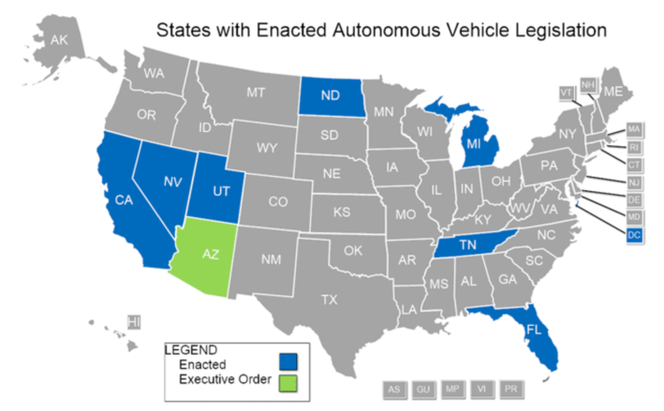
Introduction to autonomous vehicles
Ray Wang
“A motor vehicle that … safely operate[s] without the active control and continuous monitoring of a human operator” [1]
Legislation adopted by 6 states, introduced in 14 states [4]
RAND Corporation: 5 Levels of Autonomy [2][3]
[1] Joyce, Brian A. Bill S.1841, 2016; [2] RAND Corporation, Autonomous Vehicles: A Guide for Policymakers, 2015; [3] RAND History and Mission; [4] Image: National Conference of State Legislatures
Notes:
Self-Driving cars still a relatively new field. According to MA state legislature introduced in January 2015, “Autonomous vehicle” a motor vehicle that uses computers, sensors, and other technology and devices that enable the vehicle to safely operate without the active control and continuous monitoring of a human operator. A vehicle equipped with one or more crash avoidance systems, including, but not limited to, electronic blind spot assistance, automated emergency braking systems, park assist, adaptive cruise control, lane keep assist, lane departure warning, traffic jam and queing assist, or other similar systems that enhance safety or provide driver assistance, but are not capable, collectively or singularly, of driving the vehicle without the active control and continuous monitoring of a human operator, is not an autonomous vehicle.

Slide 15
5 levels of autonomy [2]
Ray Wang
0 – Human driver completes all functions
1 – One function is automated
2 – More than one function, but driver must be fully engaged
3 – Driver must be ready to take control “within a few seconds”
4 – Fully autonomous, does no require a human operator
[2] RAND Corporation, Autonomous Vehicles: A Guide for Policy Makers, 2015
Notes:
5 levels of autonomy:
0 – completely driver propelled and mechanically driven where the human driver complete all functions of the vehicle
1 – one function is automated, such as park assist, automated braking…
2 – more than 1 function, but driver must still be fully engaged
3 – Driver may not be fully attentive, but must be ready to take over “within a few seconds notice”
4 – Fully autonomous with any attention of a human operator

Slide 16
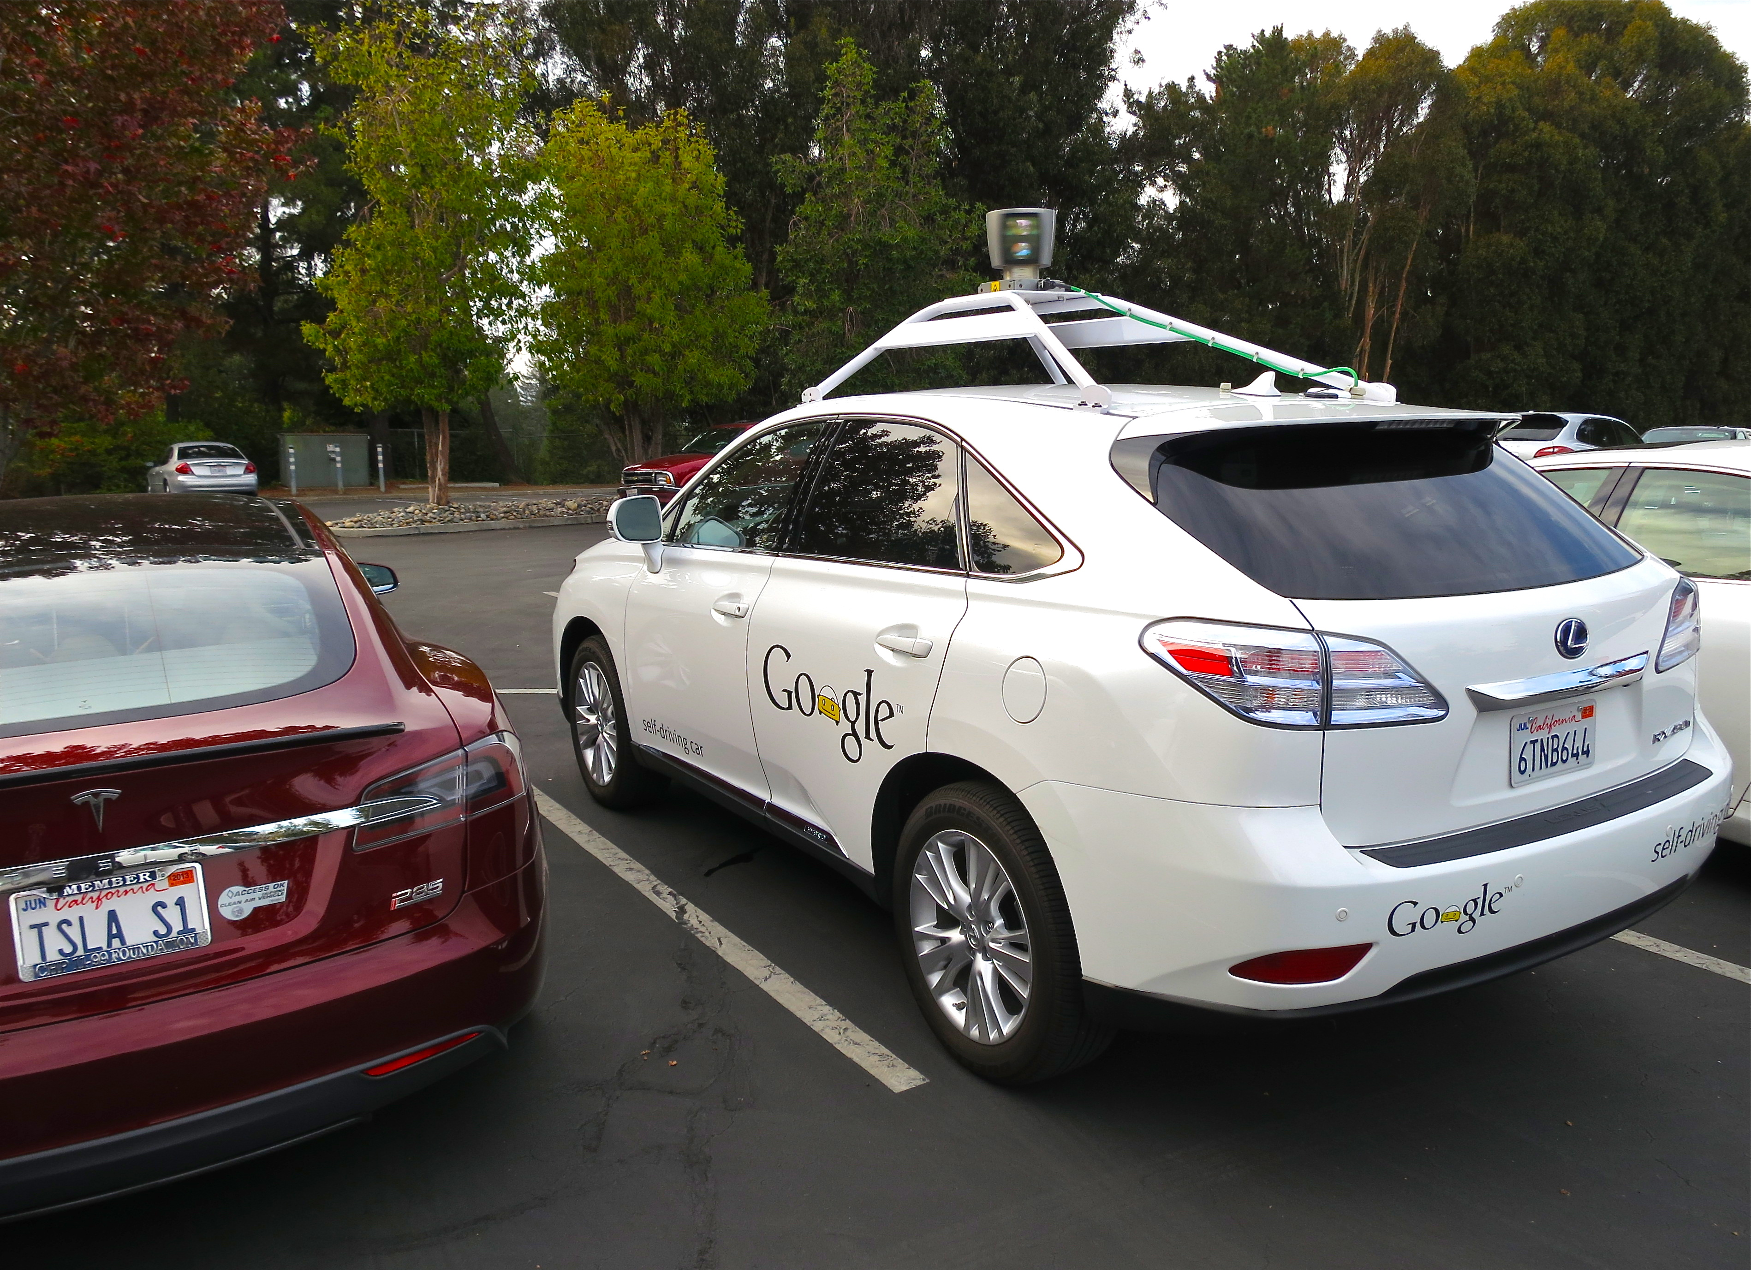
Google’s Autonomous Vehicle
Ray Wang
21 cars driven a combined total of 1.5 million miles [6]
19 total accidents, only 1 where Google is at fault [6][7]
Accidents like this happen in everyday human-human interactions [7]
[5] Image: Google Self-driving Car: Lexus RX450h; [6] Google Self-Driving Car Project: Monthly Reports; [7] The Verge: A Google self-driving car caused a crash for the first time
Notes:
Every month, Google releases a report, which describes improvements made to the project, caveats, faults, and accidents.
As of March 31, 21 Lexus RX450h SUVs, driven a combined 1.5 million miles on public streets there have been a total of 19 accidents, 18 of which were at the other person’s fault
Accident Report:
A Google Lexus-model autonomous vehicle ("Google AV") was traveling in autonomous mode eastbound on El Camino Real in Mountain View in the far right-hand lane approaching the Castro St. intersection. As the Google AV approached the intersection, it signaled its intent to make a right turn on red onto Castro St. The Google AV then moved to the right-hand side of the lane to pass traffic in the same lane that was stopped at the intersection and proceeding straight. However, the Google AV had to come to a stop and go around sandbags positioned around a storm drain that were blocking its path. When the light turned green, traffic in the lane continued past the Google AV. After a few cars had passed, the Google AV began to proceed back into the center of the lane to pass the sand bags. A public transit bus was approaching from behind. The Google AV test driver saw the bus approaching in the left side mirror but believed the bus would stop or slow to allow the Google AV to continue. Approximately three seconds later, as the Google AV was reentering the center of the lane it made contact with the side of the bus. The Google AV was operating in autonomous mode and traveling at less than 2 mph, and the bus was travelling at about 15 mph at the time of contact.
The Google AV sustained body damage to the left front fender, the left front wheel and one of its driver’s -side sensors. There were no injuries reported at the scene.

Slide 17
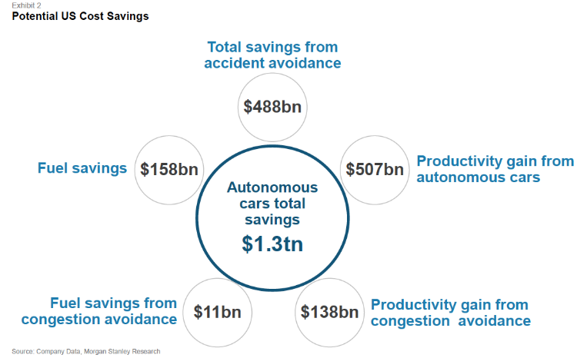
Conclusion
Ray Wang
Motivation for reliable autonomous vehicle technology [8]
Currently, humans are more to blame for vehicle accidents involving autonomous cars
No instance so far where the autonomous car and the driver belong to separate parties
Responsibility should be based on new legislature and licensing agreements
[8] Image: Company Data - Morgan Stanley Research
Notes:
The motivation for autonomous vehicles are staggering. A study conducted by Morgan Stanley Research estimated a total savings of 1.3 trillion dollars. This is just an estimate taking into consideration of productivity, fuel expenses. More so, Currently humans more to blame simply because there are much more human operated drivers than autonomous. In the case study of Google’s car, both the driver and the car belonged to Google as a company, therefore throwing all the blame on Google. In the future where we see a consumer buying and operating a self-driving car made by a manufacturer, I believe we will see more proposed legislature to where the responsibility shifts, as well as licensing agreements and warrantees for companies to protect themselves.

Slide 18
References
Ray Wang
[1] Joyce, Brian A. The Commonwealth of Massachusetts Bill S.1841: An act relative to autonomous vehicles. Filed on January 15, 2015, Updated January 2016. Retrieved on April 11, 2016.
https://malegislature.gov/Bills/189/Senate/S1841
[2] Anderson, James M and Authors. Autonomous Vehicle Technology: A Guide for Policymakers. 2016.
http://www.rand.org/content/dam/rand/pubs/research_reports/RR400/RR443-2/RAND_RR443-2.pdf
[3] RAND Corporation: History and Mission. Retrieved April 12, 2016
http://www.rand.org/about/history.html
[4] National Conference of State Legislatures: Autonomous|Self-Driving Vehicles Legislation. April 8, 2016. Retrieved April 12, 2016.
http://www.ncsl.org/research/transportation/autonomous-vehicles-legislation.aspx
[5] Google Self-Driving Car: Lexus RX450h https://upload.wikimedia.org/wikipedia/commons/9/94/Driving_Google_Self-Driving_Car.jpg
[6] Google Self-Driving Car Project: Monthly Reports. Retrieved April 11, 2016. https://www.google.com/selfdrivingcar/reports/
[7] Ziegler. Chris. The Verge: A Google self-driving car caused a crash for the first time. February 29, 2016. Retrieved April 11, 2016
http://www.theverge.com/2016/2/29/11134344/google-self-driving-car-crash-report
[8] Company Data - Morgan Stanley Research. Retrieved March 6, 2015, from https://media.licdn.com/mpr/mpr/shrinknp_750_750/p/6/005/096/073/02b4075.png

Slide 19
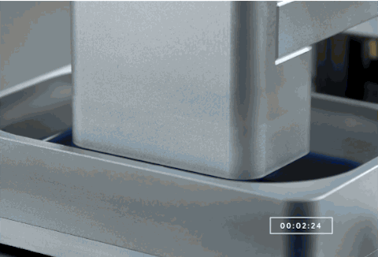
Safety of 3d Printing
Andrew Lewis
Goals
Inform on recent technology
Highlight societal concerns
Provide understanding of importance
Give a sense of feel
<Citation>
Notes:
Safety of 3D Printing
> Hello my name is Andrew Lewis, and my topic today will be the Safety of 3D Printing
> Hopefully, by the end of the presentation I will be able to
> Inform you guys on some recent advances with 3D printing
> Highlight some concerns about them and their importance
> … and lastly, really give you a sense of feel regarding the whole implication

Slide 20
What Exactly is 3D Printing?
Andrew Lewis
It is a rather old technology [13]
Also known as additive manufacturing [13]
Fabricates objects by layer [14]
Commercial type is called fused deposition modeling or FDM [14]
Pros
  Fast manufacturing speed [1]
  Lower cost and waste [1]
  Great for prototypes and customization [1]
  Reliably create complex constructs [14]
Cons
  Limited materials [2]
  Limited size
  Requires technical ability [2]
Notes:
What Exactly is 3D Printing
> Well, what exactly is 3D printing?
> A lot of you might have heard of 3D printing before, but I’m going to provide some background so you can really have an idea what’s going on
> Well… it may seem magical to some, but it’s actually a rather old technology (at least older than all of us students in the room) ☺
> The first patent application for additive techniques was by Dr Kodama in Japan, in May 1980, which used cross-sectional lasers to harden resin
> Really — in essence — 3D printing is just fabricating objects layer by layer
> The commercial version that you see nowadays is called fused deposition modeling or FDM,
> and — like its name — simply refers to the fusing of dispensed material to generate a volumetric shape
> *show GIF*
> read pros and cons

Slide 21
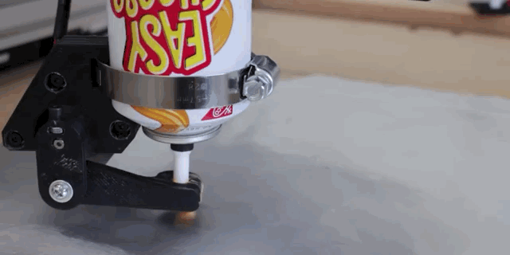
Andrew Lewis

Slide 22

So… What do we do with it?
Andrew Lewis
Create new objects
Create customized objects
Create improvements to objects
Create objects that are “socially” restrictive
Create objects that are legally restricted
Notes:
So… What do we do with it?
> Now, the next question is — What do we do with it?
> When I say “We” I’m talking about the individual consumer, because that’s where the social implications mainly lie
> — and basically I have broken it down into 5 categories
> new objects, customized objects, and improvements to objects (which are self explanatory)
> and then objects that are “socially” restrictive
> an example might be that you are a Satanist and would like to obtain an object of worship without the eye of public scrutiny
> but the most significant example of this might be a little obscure to those of us here that are more innocent
> for this I have a more visual representation *pulls up photo*
> Sexual metaphors aside, Regarding safety in 3D printing, we will focus on the 5th category, which is Objects that are legally restricted *zooms text*

Slide 23

The Real Issue: Weapons
Andrew Lewis
Currently, home-made guns are legal [15]
Currently, most states don’t require a license for purchasing ammo [16]
Controversy on 3D printing mainly centered around 3 instances of gun fabrication:
  3D Printed Lower Receivers [3]
  Solid Concepts 1911 DMLS [4]
  Liberator [5] [6]
Notes:
The Real Issue: Weapons
> So we arrive on our main social implication — production of weapons
> 2 Important concepts to understand beforehand is that
> Currently, home-made guns (without needing a license) are completely legal (as long as you don’t sell or distribute them)
> Secondly, most states don’t require a license for purchasing ammo, so you can assume that that essence is available
> In articles and other media outlets, you will basically see 3 different instances of gun fabrication commonly reported on
> — and these are 3D printed lower receivers, the Solid Concepts 1911 DMLS pistol, and the Liberator pistol

Slide 24
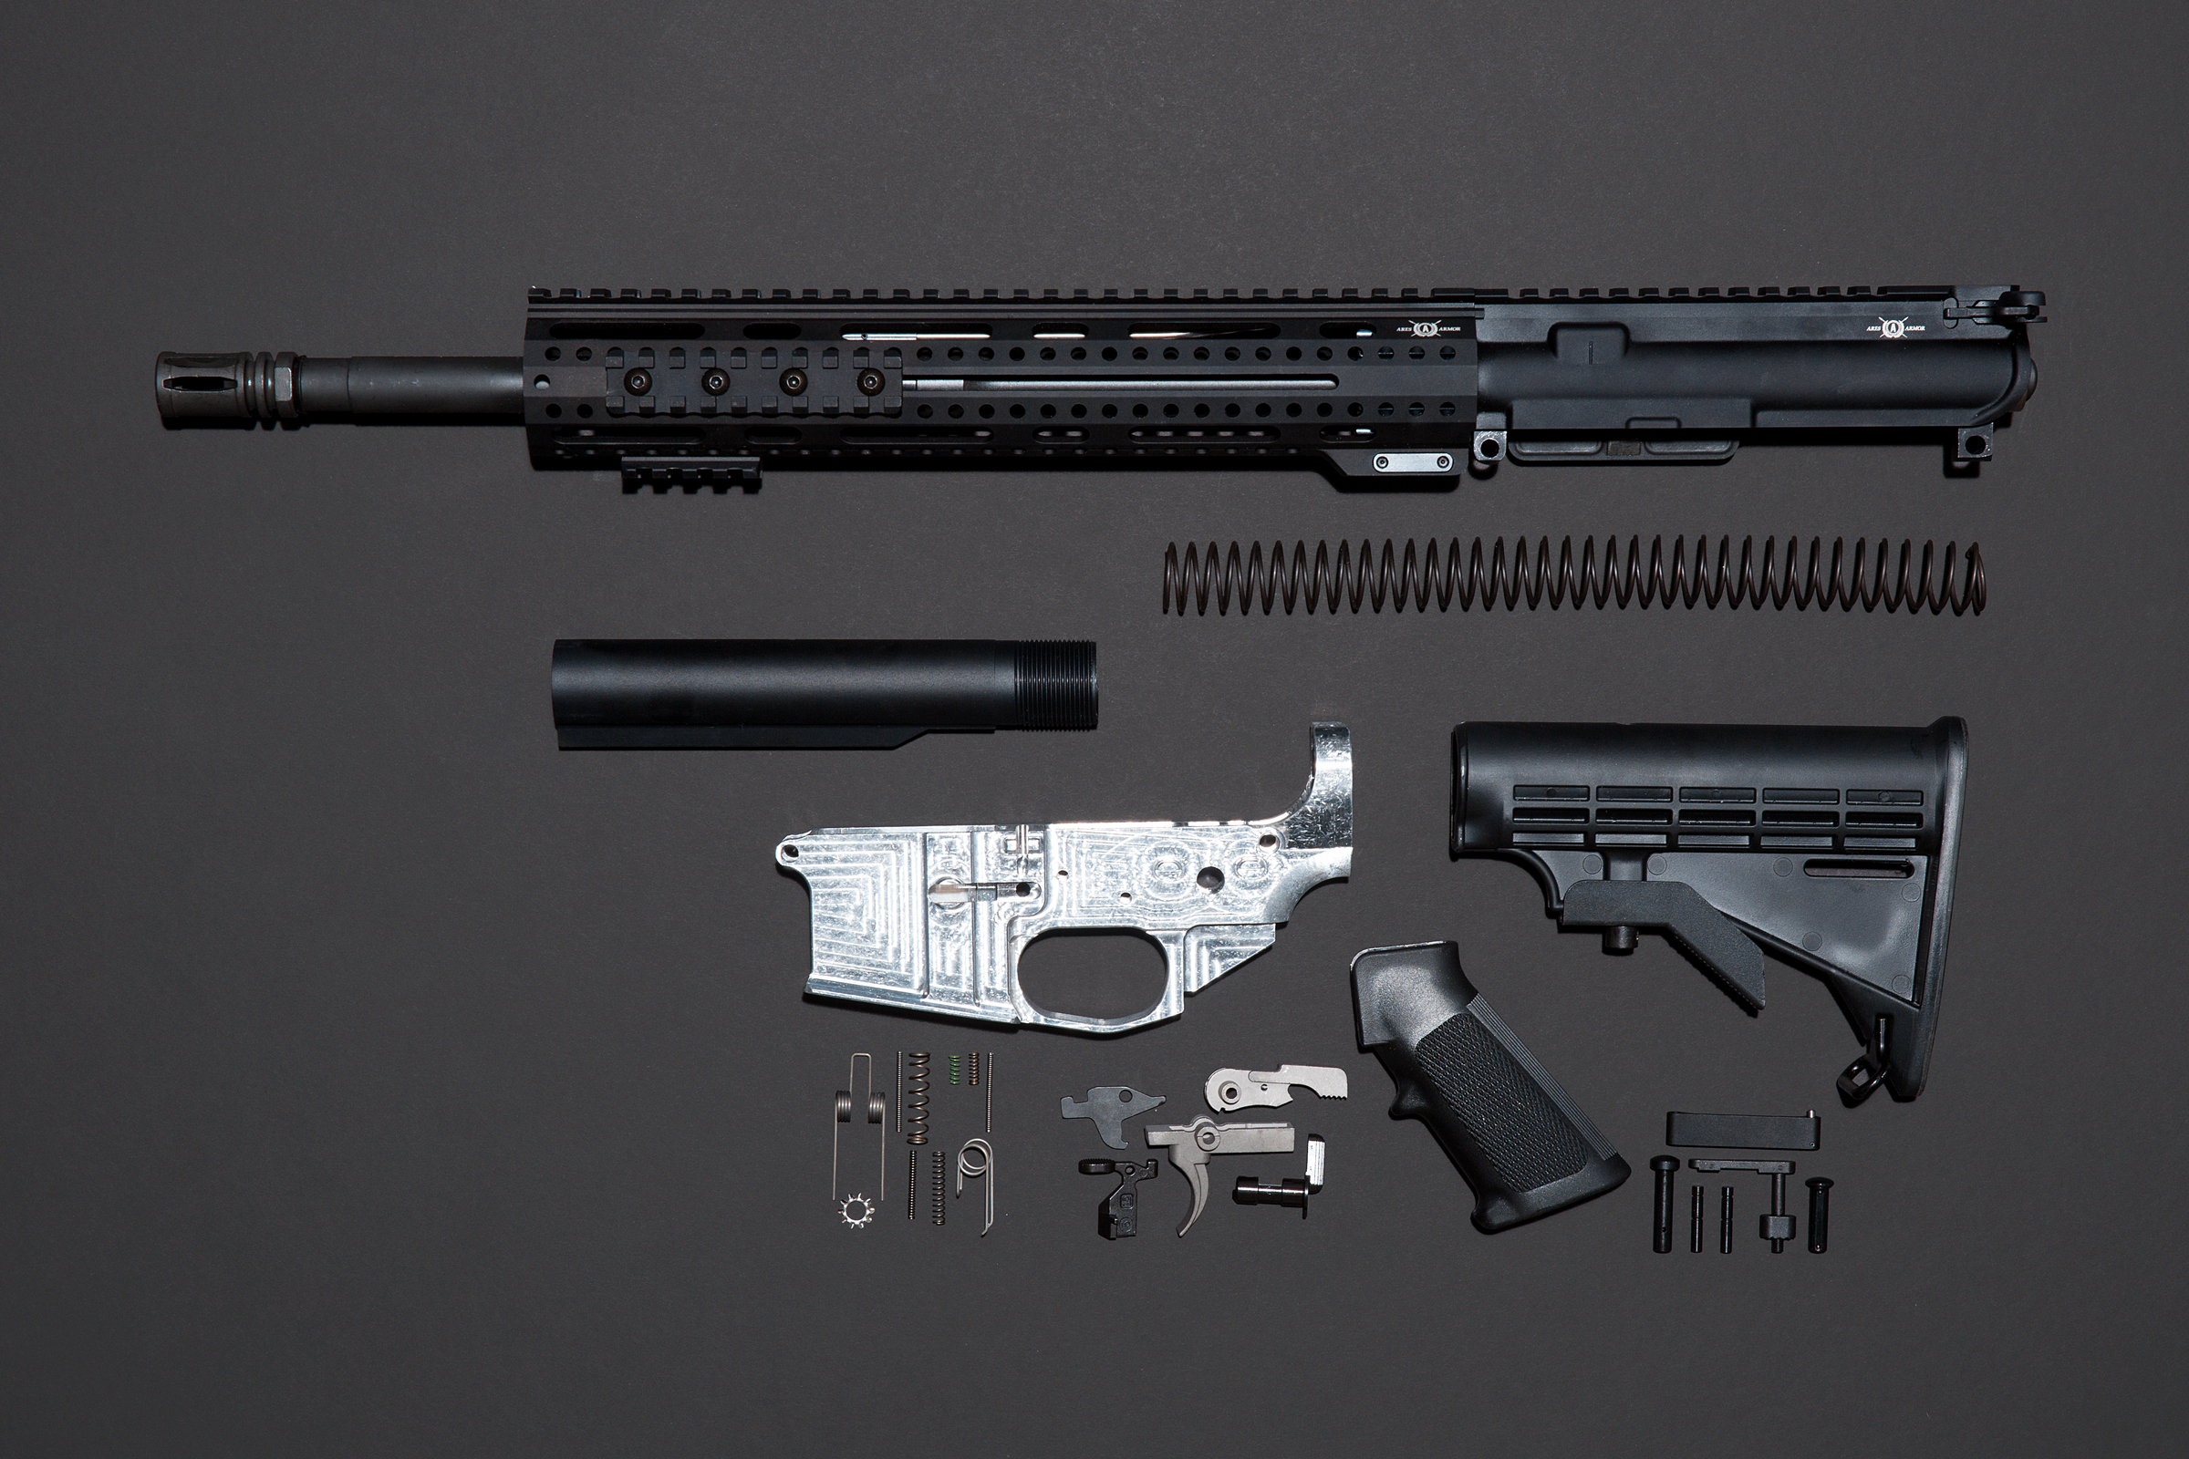
3D Printed Lower Receivers: AR-15 Ghost Guns
Andrew Lewis
What is a receiver?
  Motherboard of the gun [10]
  Contains the serial number [10]
How it was made previously
  CNC Mill, power tools [10]
Controversy
  Weapon itself is untraceable [10]
  Made with low technical expertise [10]
  Does not require license to build/own [16]
Weak Points
  Very expensive — (aside from tools and 3D printed part) requires approx. $704 for official gun components [10]
  Not customizable [10]
Notes:
3D Printed Lower Receivers: AR-15 Ghost Guns
> As mentioned, the first thing of interest are 3D printed lower receivers, which are commonly used with the AR-15 rifle to create “ghost guns”
> The receiver itself, is basically the motherboard of the gun
> It is the main gun component that the other parts are attached to, so like a bike frame, it is what remains when other parts are worn out and replaced
> It also contains the serial number and is the only regulated portion of a gun
> Before 3D printing, the idea of creating just the receiver already existed, and it was commonly made using CNC mills and power tools
> In terms of controversy, the fact that the weapon has no serial number means that it can’t be traced to a dealer or purchaser
> — with 3D printing, it requires very little expertise
> — and it legally doesn’t require a license to build or own
> All of this aside, the gun is still very much “gun” priced, since you have to buy actual gun components — the price being around $704 dollars
> Also, the gun is essentially a manufacture model, and is not customizable to the user (for better or for worse)

Slide 25
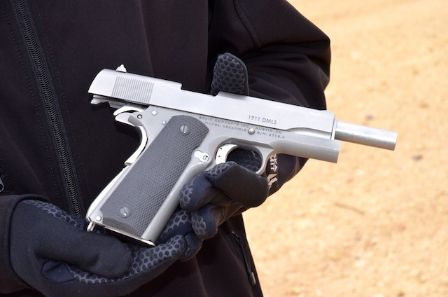
Solid Concepts 1911 DMLS
Andrew Lewis
Outrage because all-metal [4]
Made by Solid Concepts 3D printing company to showcase manufacturing capability [4]
Controversy
  Gun is metal [4]
Weak Points
Costs literally about a million dollars to make [4]
Notes:
Solid Concepts 1911 DMLS
> Next up is the Solid Concepts 1911 DMLS
> This one’s not a very strong argument regarding 3d printed gun controversy
> — but since it shows up too often online, I felt a need to talk about it
> Basically it caused outrage because it is 3D printed fully in metal
> However, it was made by Solid Concepts — an additive manufacturing company to showcase their capabilities
> It represents a new way for manufactures to make guns, not consumers
> and with $600 dollars for the printer and $400 dollars for the material, it costs over 1 million dollars to produce

Slide 26
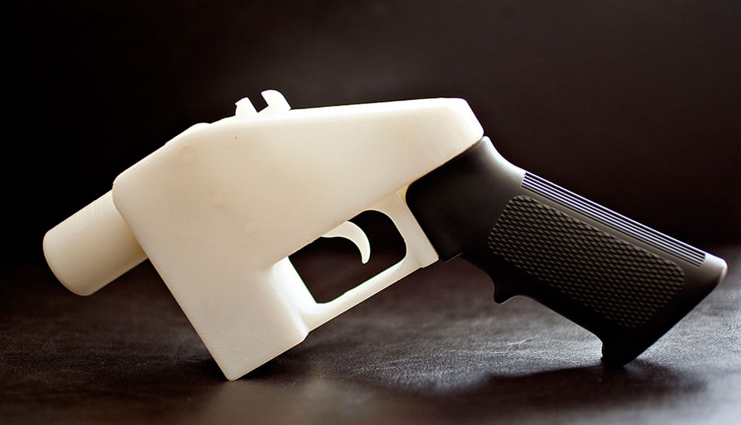
Liberator
Andrew Lewis
Made by Cody Wilson from Defense Distributed [6]
Aim is to provide guns to everyone without restriction [5]
Controversy
  Made entirely on commercially available 3D printer [5]
  Requires low technical expertise [5]
  Untraceable [5]
  Undetectable [5]
  Fully customizable [5]
  Extremely cheap [5]
  Open source [5]
Weak Points
  Not durable or fully reliable [5] [6]
Notes:
Liberator
> Next and most importantly is the Liberator
> This one is the scariest and most representative of the social implication
> *Read first 2 bullets*
> *Read controversy and explain briefly*
> There are many problems this could bring in the future, as even the durability and unreliability kinks can be ironed out from its status as “open source”

Slide 27

Regulations
Andrew Lewis
Recent change to regulations bans posting schematics for 3D printed gun parts online [11]
Printing undetectable guns is illegal [12]

Slide 28
MY Conclusions
Andrew Lewis
3D Printing guns is easy and will become increasingly reliable in the future
We need some serious laws: Attacking online file posting and sharing is virtually useless
My proposition:
  Regulate possession
  Regulate ammunition
  Make licenses easier to obtain, but more thorough

Slide 29

Questions?
Andrew Lewis
Anything I missed?
What do you think about 3D printed guns?
Does regulating 3D printing violate our rights?

Slide 30
References
Andrew Lewis
[1] http://cerasis.com/2014/07/25/3d-printing-manufacturing/
[2] http://www.finecut.co.uk/label-engraving-news/industry-features/the-pros-and-cons-of-3d-printing-and-the-future/801794205
[3] https://3dprint.com/62597/ca-deputies-raid-3d-print-gun/
[4] http://www.thetruthaboutguns.com/2013/12/robert-farago/gun-review-solid-concepts-1911-dmls-direct-metal-laser-sintering/
[5] https://3dprint.com/14636/3d-prnted-guns/
[6] http://www.wired.com/2014/05/3d-printed-guns/
[7] http://motherboard.vice.com/blog/3d-printing-is-getting-stoned
[8] http://criminal.findlaw.com/criminal-charges/drug-paraphernalia-charges.html

Slide 31
REFerences (cont.)
Andrew Lewis
[9] http://www.haddonfieldnj.org/borough_dept_police_victim.php
[10] http://www.wired.com/2015/06/i-made-an-untraceable-ar-15-ghost-gun/
[11] http://www.foxnews.com/tech/2015/07/01/proposed-regulation-could-keep-3d-printed-gun-blueprints-offline-for-good.html
[12] http://blogs.findlaw.com/law_and_life/2015/10/3-things-that-are-illegal-to-3d-print.html
[13] http://3dprintingindustry.com/3d-printing-basics-free-beginners-guide/history/
[14] http://3dprinting.com/what-is-3d-printing/
[15] http://www.criminaldefenselawyer.com/resources/homemade-guns-are-they-legal-must-they-be-registered.
[16] http://smartgunlaws.org/ammunition-regulation-policy-summary/
[17] http://www.ixdaily.com/the-buzz/mia-partysquad-double-bubble-trouble-video

Slide 32
Images
Andrew Lewis
[1]https://img0.etsystatic.com/116/0/12152774/il_fullxfull.902244510_dcxz.jpg
[2] http://www.gizmodo.com.au/2015/01/3d-printed-guns-are-only-getting-betterand-scarier/
[3] http://49.media.tumblr.com/f8d593e6425879880312db34c709494f/tumblr_nlbpliwTxD1rwn6y8o1_500.gif
[4] http://pop.h-cdn.co/assets/15/14/640x320/landscape-1427921928-chz-robot-3.gif
[5] http://www.wired.com/wp-content/uploads/2015/06/GhostGun-02.jpg
[6] http://www.thetruthaboutguns.com/wp-content/uploads/2013/12/Solid-Concepts-1911-DMLS-courtesy-The-Truth-About-Guns.jpg
[7] https://3dprint.com/wp-content/uploads/2014/09/a-lib.jpg
[8] http://www.3ders.org/images2015/legal-aspects-3d-printing-european-law-firm-weighs-in2.jpg

Slide 33
Class 9
The End
Keith A. Pray
Instructor
socialimps.keithpray.net
Notes:
This is the end. Any slides beyond this point are for answering questions that may arise but not needed in the main talk. Some slides may also be unfinished and are not needed but kept just in case.

Slide 34
Reliability Of Statistics
Are other factors controlled?
Is enough time covered?
Is all data reported?
Use Intuition
  Are results reasonable?
Notes:
Power line dangers. Electromagnetic fields? PCBs in transformers?

Slide 35
Cost-Benefit Analysis
How much does it cost?
What do I get for this cost?
Notes:
Like a social contract.

Slide 36
Risk-Benefit Analysis
What could go wrong?
How likely is it?
How costly are the consequences?

Slide 37
Limitations to
Risk-Benefit Analysis
Hard to quantify probabilities
Hard to quantify costs
Who bears the costs?
Are the potential benefits worth it?
Notes:
What is the value of a human life?
What is the value of a species?
E.g. future generations, poor people.
Omelas

Slide 38
Some Measures
Mean Time To Failure (MTTF)
Mean Time Between Failures (MTBF)
Mean Time To Repair (MTTR)
Notes:
Is it repairable?
What does it mean to repair? Running again? Data fixed? Caught up?
Restoring the GBC Web site.

Slide 39
Relying Too Much
Limits of modeling reality
Limits of precision
Limits of algorithms
Limits of interpretation
Notes:
Battle of the X-Planes
Trusting the statistics. Are differences significant?
Colin Chapman’s Lotus 7 chassis.

Slide 40
Producing Good Software
Good specifications
Good usability
Good design
Robustness
Good implementation
Testing
Notes:
Specs: Know what you are going to do. Often difficult. What does the customer want? What does the customer need?
Usability: Logical and intuitive, Consistent, Helpful, Complete, Accessible, Disability. Complete—not have to write things down.
Design: Logical, Modular, Consistent, Well-specified, Flexible, Extensible, Adaptable, New features, new platforms.
Robustness: Tolerant of data errors, Tolerant of human errors, Tolerant of network errors, Enough detail / not too much. Stack trace vs. “?” “A script error has occurred. Do you want to debug?”
Implementation: Adequate hardware (E.g. memory, storage, speed), Adequate software (Languages, OS, libraries), Internal and external documentation
Testing: Should be at all phases of the development cycle. Plan ahead for it. Consistent, repeatable, documented. Regression testing.

Slide 41
Plan For The Long Term
Version control
Future development
New platforms
Patches
Security
Training
Customer support

Slide 42
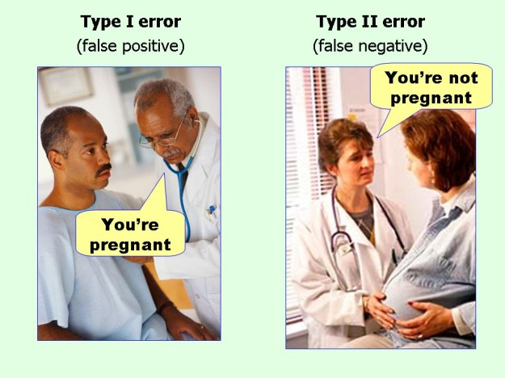
marginalrevolution.com/marginalrevolution/2014/05/type-i-and-type-ii-errors-simplified.html (2016-04-11)

