Slide 1
Class 7
Privacy and Government
Keith A. Pray
Instructor
socialimps.keithpray.net
Notes:
After this class we will be half done with the course… very sad I know.
Play Somebody’s Watching Me (1984) – Rockwell
Be the envy of all your classmates if you know the band and/or year:
Rockwell (1984) Michael Jackson sings chorus and Jermaine Jackson on backing vocals.
Self Search paper – Progressive.com search is for address, not name.
Paper averages to date: 4.5 - 5.5 – 5.0

Slide 2
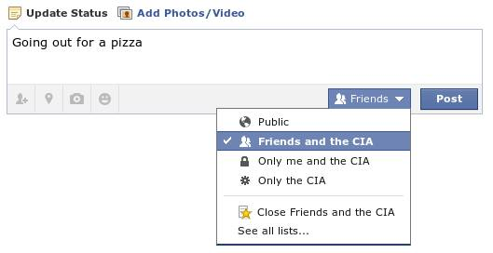
Notes:
Source?

Slide 3
Overview
Survey
Review
Assignment
Students Present

Slide 4
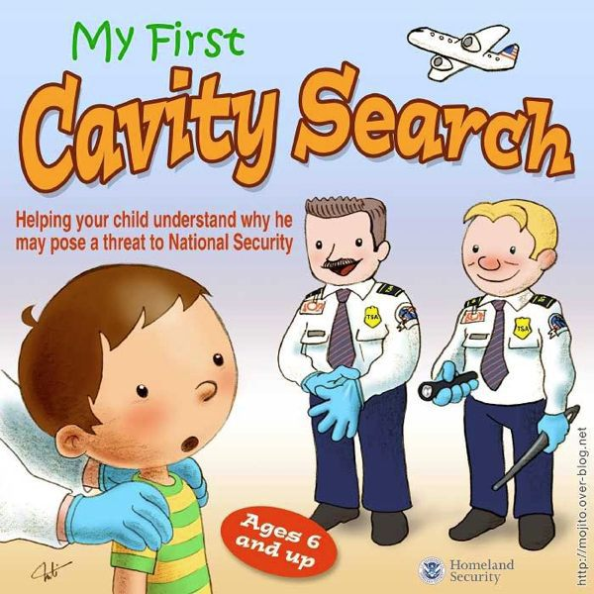
Notes:
Source?
Let’s see who said National ID yes and no. Let’s debate!

Slide 5
Debate Ground Rules
Before Debate
  15 minutes to converse with your team
  Share argument points, counter points, and responses so everyone can represent
  Decide who will respond to what points from the opposing side
During Debate
  Stand up when speaking
  Only those who have not spoken may respond until everyone has had a turn
  Switch sides at any time when you change your mind
Notes:
Release Game or Not Debate
----- Meeting Notes (2016-04-05 16:54) -----
add 30 second limit per person

Slide 6
My Reading Notes
pp. 274 Arrests, altering and deleting records are violations of privacy?
pp. 275 Why not try to verify and correct records?
pp. 276 Figure does not show # cameras increasing.
pp. 277 300 times = frames, locations, …?
pp. 289 “…don’t want anyone to know…” like seeking medical advice, etc.?
pp. 291 Just because it’s been happening for years doesn’t make it right.
pp. 297 Wouldn’t it be easy to make and show a fake SSN card?
pp. 298 Confusing false positive and negative explanations.
End of Chapter questions: 1, 31, 51

Slide 7
Group Quiz
List two problems with using biometrics for identification.
List two advantages of using biometrics for identification.
Describe two tools people can use to protect their privacy on the Web.
For each of the 4 categories of Daniel Solove’s privacy taxonomy give an example not listed in the book.

Slide 8
Overview
Survey
Review
Assignment
Students Present

Slide 9
Assignment – Group Project
Suggestions:
Catch up on reading
Add list of computing technologies portrayed in movie
Categorize computing technologies as existing, future, emerging, impossible, plausible with rationale
Add analysis to group project website addressing all topics covered to date
See group project slide deck for more

Slide 10
Overview
Survey
Review
Assignment
Students Present

Slide 11
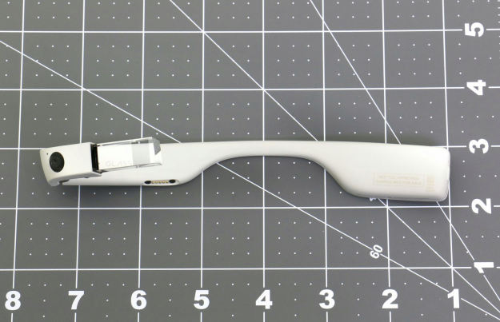
Google Glass and Wearable Computing
Dean Kiourtsis
Glass Explorer available starting May 2014. [3]
Quietly pulled from the market in January 2015. [1]
New version in development. [3]
Glass could change the government
[3], [1]
Notes:
Google Glass is a wearable computer with a heads up display developed by Google. Glass was able to take audio commands from the user, record camera footage, audio, and gps, and install applications for use by the consumer. Glass was originally released to the public mid 2014 through the Glass Explorers program, but it was quietly pulled from the shelves eight months later due to a number of concerns. Despite the issues in the original Google Glass, a filing with the Federal Communications Commission in 2015 shows that Google is developing a newer version focused for use in medical and business environments. I will be talking about the possible government applications of Glass, and how it could change the government.

Slide 12
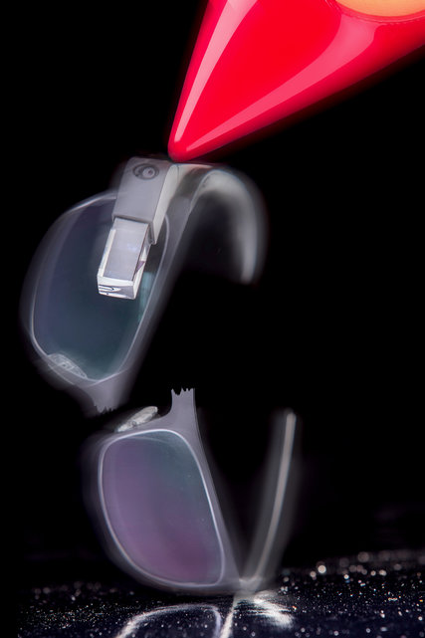
Why Google Stopped Marketing Glass
Dean Kiourtsis
Poor performance
  Poor battery life [1]
  Buggy software [1]
User concerns and issues
  Glass doesn’t have proper security measures [6]
  Other people using Glass could invade your privacy [1]
[1], [6]
Notes:
Before talking about the future of Google Glass, it is important to note the issues of the original release, as Google has been working to correct them for their new version. A majority of customers issues with the Glass was the abysmal battery life (three to five hours) and the buggy software due to Glass still being in development at the time. In addition, there was a lot of consumer complaints on how the Glass software does not use accounts or passwords, a blatant security flaw. Also, due to the device's ability to record audio and video, it was banned from a large number of public places, notably movie theaters. The combination of these issues resulted in Google terminating the Glass Explorers project, and Google hopes to fix these issues as they develop the new Glass.

Slide 13
Glass Can Change the Government
Dean Kiourtsis
Can help speed up crisis management efforts. [2]
Enhanced training of medical personnel for health care. [2]
Real time communication for inspectors. [7]
Information gathering and surveillance. [4]
Google Apps For Government (GAFG) [5]
[2], [7], [4], [5]
Notes:
Despite pulling the public version of Glass, Google continued working on the Glass for private organizations and businesses, with one of the possible customers being the government. There are a number of ways Glass can potentially be used in the government. For example, there are considerations of using Glass during crisis scenarios so that medical personnel have fast access to medical records of the injured. Also along this line, Glass is being looked at for possible use in government healthcare to expedite training of medical personnel. Governments also perform a large number of inspections, and Glass can help record and monitor issues they find, as well as communicating with personnel to expedite fixing the issues. On a different note, Glass's ability to record audio and video as well as being integrated with facial recognition technology and gathering “always on” information makes Glass a prime candidate, albeit controversial, for use in law enforcement and government surveillance. Google is currently developing applications for government solutions with GAFG, and had plans for government focused Glass applications.

Slide 14
Risks of Government use of Glass
Dean Kiourtsis
Google Glass still does not come with strong security measures built into it. [6]
The privacy policy allows the Glass to combine information from multiple apps. [5]
Google Glass can be easily hacked or infected when on Wi-Fi. [6]
Risks can be mitigated through smart use of the device. [6]
[5], [6]
Notes:
The possible use of Google Glass in a government environments brings up a slew of issues and concerns. The biggest concern is that like the Explorer edition, Glass does not have a authentication method, meaning that if someone got a hold of a government Google Glass, it could result in a leak of classified or personal information. This would be compounded by privacy risks if Glass is used for surveillance. It remains to be seen if Google will fix this in the newer version of Glass. Also of note is that Google Glass's privacy policy allows it to combine information gathered by it's applications. This brings up concerns for government applications using cloud databases, as it could result in private information leaking out. All of these risks are amplified by the fact that Google Glass was designed to be usable with Wi-Fi, which makes it an easy target for hackers when on public Wi-Fi. Nevertheless, all of these issues can be mitigated, if not removed, by smart use. If Google implements account security on Glass, and the users turn off the Wi-Fi capabilities, the Glass will be safe to use by the government.

Slide 15
Conclusion
Dean Kiourtsis
Google Glass is very much alive despite the Explorer program failing.
The new Google Glass should be used in government facilities.
Governments should not use Glass for security or surveillance.
Notes:
In conclusion, Google Glass is still very much alive just with a focus on larger businesses. The failure of the Explorer program will encourage Google to make a safer, more reliable product. With all of the possibilities the new Google Glass brings, government areas such as healthcare and building inspection should adopt it after Google finishes designing it. However, the government should avoid using glass for security or surveillance purposes, as it would result in a number of privacy issues, and likely result in legislation on the use of wearable computers.

Slide 16
References
Dean Kiourtsis
[1] Bilton, Nick. "Why Google Glass Broke." The New York Times. The New York Times, 04 Feb. 2015. Web. 03 Apr. 2016.
[2] David, Kathryn. "3 Ways Google Glass Will Transform Government." GovLoop. GovLoop, 29 Aug. 2013. Web. 3 Apr. 2016.
[3] Eadicicco, Lisa. "See the New Version of Google's Wildest Product." Time. Time, 29 Dec. 2015. Web. 03 Apr. 2016.
[4] "EPIC - Google Glass and Privacy." EPIC - Google Glass and Privacy. EPIC, n.d. Web. 03 Apr. 2016.
[5] Evans, Karen, and Jeff Gould. "Google's New Privacy Policy Is Unacceptable and Jeopardizes Government Information in the Cloud." SafeGov.org. SafeGov, 25 Jan. 2012. Web. 03 Apr. 2016.
[6] Irvine, Jerry. "Google Glass: Security Risk For Governments? - InformationWeek." InformationWeek. UBM, 21 Aug. 2013. Web. 03 Apr. 2016.
[7] Veen, Chad Vander. "Wearable Tech Is Set to Take Off." Government Technology. Government Technology, 4 Feb. 2014. Web. 04 Apr. 2016.

Slide 17
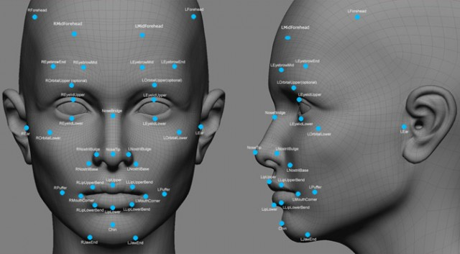
The Truth about face detection
Tyler Jaskoviak
What it is?
  The computer process of using picture data of a person to detect the individual in other pictures
Application
  Criminal tracking
  Identity Protection
  Better Photos
  Auto Tagging
[1][2][12]
Notes:
Hi everyone, so today I’m going to be talking about facial recognition software and how it’s used and is being used
First of all it is a program that uses different points of data to map an individuals face allowing it to compare the face with other pictures
Methods started with matching eye and mouth position of front facing pictures and have evolved to allow 10% of freedom for a frontal image and full 3D mapping that allows all angles that are in front of the face
This kind of technology can be used for tracking criminals (by comparing mug shots to newer images), protecting identities (by checking if the same people are accessing their accounts), and even for taking better photos, as some picture taking software detects if one of the subjects blinks and immediately takes another photo
The face that you can see right now shows many the points that are mapped in a more recent version of facial recognition that Facebook is working on. The program would try to match the points to your face and then measure all the distances for a unique profile

Slide 18
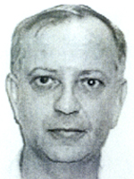

Positive Use: Catching Lynn Cozart
Tyler Jaskoviak
Lynn Cozart
  Criminal convicted of sexual assault
  Managed to hide for 19 years
  FBI found him after investing in a facial recognition program and matching images of him to his mugshots
[5][6][13]
Notes:
Now the first case I’m going to show is the potential benefits of the system
Lynn Cozart was a man who was arrested in 1996 for sexual assault but he skipped bail and went on the run for 19 years.
In 2015 the FBI was able to connect his mugshot to the picture of the driver’s license that he had managed to get under an assumed name.
This is one example of the benefits of having a system like this in place, you can track down criminals more easily and keep the streets safer

Slide 19


ShutterFly and Facebook
Tyler Jaskoviak
Collected and used biometric data to tag photos of the same people
Both claimed that the service was to make organizing you data easier
  Shutterfly for organizing different people in their photos
  Facebook for making it easier to spot your friends and tag in photos
Ruling that you cannot take biometric data without the user’s consent
[3][4][7][8]
Notes:
Now I’m going to go on to an entirely different case involving Shutterfly an image publishing site and the social network Facebook
It was discovered that both of these companies had been using facial recognition of people you had tagged in images to tag them in future images
If you put a picture of your friends on Facebook and it included suggested tags is a good example, you all read that so I’m going to focus on Shutterfly
Last year a man who had never used Shutterfly himself sued them for $5 Million because the company had made a facial profile of him without his permission using his friends pictures
The ruling was made in December that a company cannot use biometrics, like facial recognition, without the users permission
Compared to government mass surveillance it doesn’t use video footage from public spaces it uses the pictures that you and your friends put up even if they might have strong privacy

Slide 20
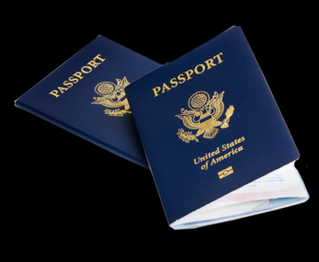
Government Use
Tyler Jaskoviak
The FBI has been consolidating both criminal and civilian fingerprints and pictures
  Background checks that require pictures and fingerprints are often put in the FBI database
No-smile policy
  Makes it easier for facial recognition to detect you
[9][10][11]
Notes:
In the government the FBI has been building up its NGI (Next Generation Identification) system. This is an archive of fingerprints of both criminals and civilians
Two years ago the NGI system was expanded to include facial profiles of individuals connected to their fingerprints. The FBI acquires criminal profiles from booking of a criminal
during which they take fingerprints and mugshots that can be added to the database
The FBI also gains access to civilian files that have been given a background check.
If an employer wants a background check on an employee the they might take fingerprints and a picture to check if they are associated to any crime.
The FBI can take all of this data and add it to their database since it is fairly easy and it prepares them if the individual decides to commit a crime. It’s a form of preparedness.
Facial recognition is also the backing for the no-smile policy. By not smiling it is easier for the facial recognition to compare you to other images

Slide 21
Drawing Conclusions
Tyler Jaskoviak
Facial recognition is a valuable technology and despite its flaws it could be very valuable given the right regulations
  Blind checks
  Knowledge if an action will record biometric data
Notes:
Facial recognition is useful under the right conditions. This includes double blind checking, meaning that the image being check and the biometric profile being check never know about each other. Also all users should be made aware if anything they do is going to be recorded and where the data might end up

Slide 22
References
Tyler Jaskoviak
[1] Smith, K; “Facial Recognition” Retrived 4/3/16 from biometrics.gov
[2] Federal Trade Commission Conference “Face Facts: A Forum on Racial Recognition Technology” Held Dec 8, 2011 in Washington DC.
[3] Adams-Heard, R; (2015) “Facebook’s Use of Facial-Recognition Tool Draws Privacy Ire”, Retrieved 4/3/16 from Bloomberg.com
[4] Roberts, J. J; (2016) “ Court Ruling on Shutterfly Face Scans Could Spell Trouble for Facebook”, Retrieved 4/3/16 from fortune.com
[5] Casey, M; (2015) “FBI using facial recognition despite privacy concerns” Retrieved 3/4/16 from cbsnews.com
[6] Images of Lynn Cozart: https://www2.fbi.gov/wanted/fugitives/cac/cozart_lo.htm
[7] Image of Facebook logo: Facebook.com
[8] Image of Shutterfly logo: Shutterfly.com
[9] Image of US Passport: https://travel.state.gov/content/passports/en/passports.html
[10] Lynch, J; (2014) “FBI Plans to have 52 Million Photos in its NGI Face Recognition Database by Next Year” Electronic Frontier Foundation, Retrieved 4/4/16
[11] Frank, T; (2009) “Four States adopt ‘no-smiles’ policy for driver’s licenses” retrieved 4/4/16 from usatoday.com
[12] Image of face at start: http://www.extremetech.com/extreme/178777-facebooks-facial-recognition-software-is-now-as-accurate-as-the-human-brain-but-what-now
Notes:
Any Questions

Slide 23
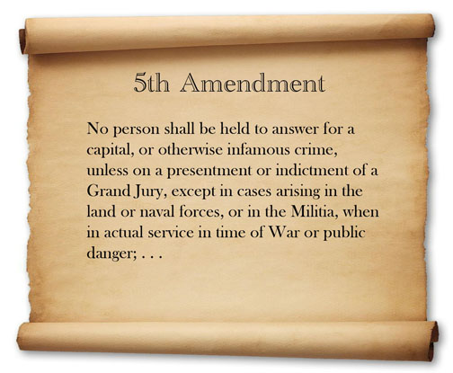
Encryption Under Oath is Protected
Brett Ammeson
Fifth amendment is key
Central point is evidence given
http://georgiainfo.galileo.usg.edu/gastudiesimages/5th%20Amendment%201.jpg
[1, 2]
Notes:
Opening – re FBI iPhone, start with background and historical cases
5th amendment is Miranda rights – you cannot be obligated to incriminate yourself
In court, passphrases to accounts can be circumvented or forced to be given, like a key to a safe or combination to a lock
Mainly depends on plausibility of evidence
Good encryption looks random, so decrypting is handing over incriminating evidence; four main court cases relevant

Slide 24
Prior Encryption Cases Are Complex
Brett Ammeson
Four main cases referenced
  2012 & 2013
Split verdicts
  Subjective and objective
[2]
Notes:
2012 U.S. vs. Doe, child pornography, no “reasonable particularity” for files in encrypted data
Commonwealth v. Gelfatt, fraud case, “Explain” information, coded papers have meaning
2013, On appeal, ruling stated key must be given as computers were admittedly used in fraud company
U.S. v Friscou, bank fraud, Recording of defendant
2013, child pornography, First, could not, reversed upon FBI’s successful partial decryption
So, judges have gone both ways
Determined by particularity of evidence, defendant’s prior statements, but generally case-by-case
Sufficient evidence determined by judge (subjective), but in general needs to have certainty of guilt and specific knowledge of data on drive (objective)

Slide 25
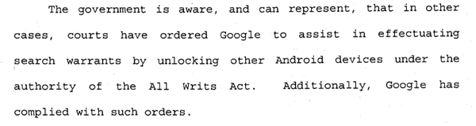
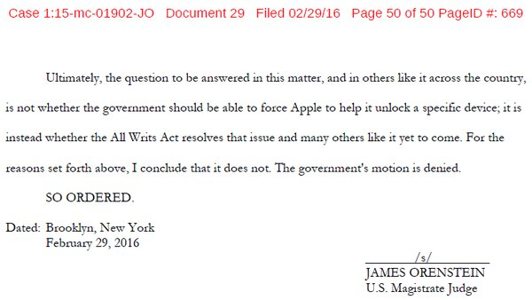
FBI’s Lawsuit Broader
Brett Ammeson
https://twitter.com/bskibinski
How is this different?
  Entire device
  Personal, not only data
Precedents
  All writs, Google and Apple
  None of this scale
cryptome.org
[3,4, 6, 7]
Notes:
Significantly different from previous cases
No “reasonable particularity”, want a backdoor into all iPhones
An entire device, personal, not just a drive containing data
Global decryption ability, not just one particular key/drive
Trying to use All Writs Act (1789) to expand authority, not law through Congress:
The Supreme Court and all courts established by Act of Congress may issue all writs necessary or appropriate in aid of their respective jurisdictions and agreeable to the usages and principles of law.
Previous `All Writs` use – CCTV/phone records, Google access to Android devices, not compromise security
Not really much else on this scale, previous crypto cases always one drive
Any encryption software could be forced to break itself using this case as precedent (Truecrypt from a few years back?)

Slide 26
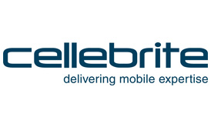
Is it resolved?
Brett Ammeson
Cellebrite exploit
  Commercial?
  Still unpatched?
Second DOJ case in Brooklyn, NY
No legal precedent set
http://www.cellebrite.com/
[5, 6, 8]
Notes:
Case got dropped, FBI got data, Apple may learn current security exploit, so everyone happy? Does this really feel resolved?
Israeli company Cellebrite has crack? May be forced to share in another FBI vs. Apple case (NY)?
Exploit commercial, for other investigations? (No response)
No, because court never found that use of a forced backdoor to be incorrect, so precedent is not set and this could come back to light again
Exploit may not be revealed, could remain for several generations of phones
Nature of exploit may be remotely usable, could compromise phones across cities, nations, worlds
But no legal precedent set, so legally encryption still safe from mandated backdoors/decryption

Slide 27
References
Brett Ammeson
[1] http://www.uclalawreview.org/the-fifth-amendment-encryption-and-the-forgotten-state-interest/
[2] https://www.policeone.com/legal/articles/7108215-4-court-cases-on-decryption-and-the-Fifth-Amendment/
[3] https://www.apple.com/customer-letter/
[4] http://www.popularmechanics.com/technology/a19483/what-is-the-all-writs-act-of-1789-the-225-year-old-law-the-fbi-is-using-on-apple/
[5] http://www.theverge.com/2016/3/23/11290374/apple-iphone-fbi-encryption-crack-cellebrite
[6] http://www.theguardian.com/technology/2016/feb/25/fbi-director-james-comey-apple-encryption-case-legal-precedent
[7] http://arstechnica.com/tech-policy/2016/03/feds-used-1789-law-to-force-apple-google-to-unlock-phones-63-times/
[8] http://www.reuters.com/article/us-apple-encryption-idUSKCN0WU1RF
Accessed 2016-04-04

Slide 28
BREAKING ENCRYPTION WITH QUANTUM COMPUTING
Dalton Tapply
If we don’t move towards quantum resistant encryption, within the next 10-30 years, our confidential data will no longer be protected against those that have great power
[9]
Notes:
<speaker notes>

Slide 29
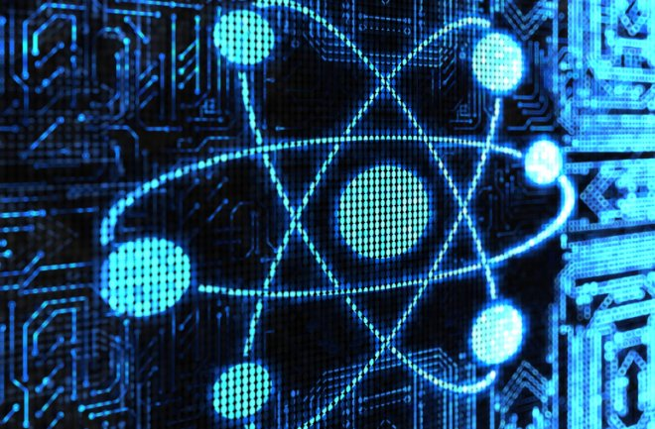
Quantum computing
Dalton Tapply
Quantum Mechanics
Quantum Bits
Quantum Algorithms
Need for High Performance
  Searching
  Machine Learning
  Cryptography
Stability
[1, 3, 5, 10]
Notes:
The good of quantum computing
Very fast data processing [3]
Government and large agencies are pushing funding for quantum computing [3]
Shor’s Algorithm applied with quantum computing can crack almost any key length [1]
Given integer N, find its prime factors
Improved performance by a factor of 3, compared to previous quantum algorithms [5]

Slide 30
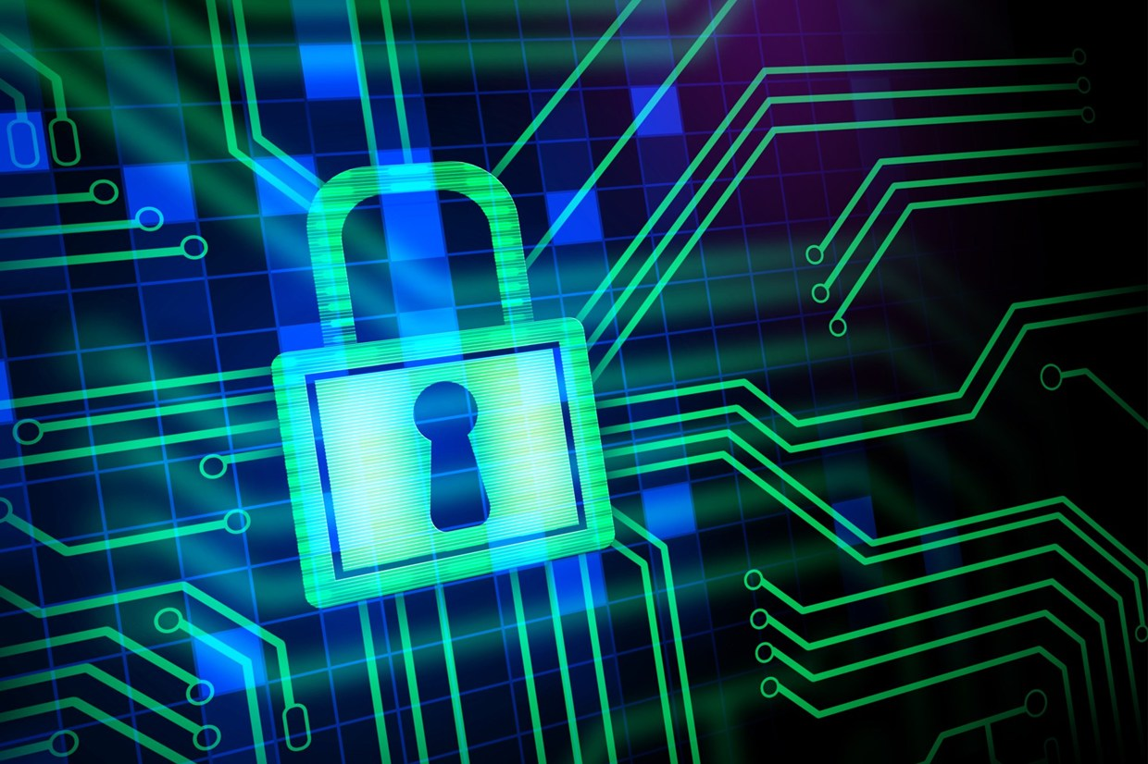
Encryption
Dalton Tapply
Securing Data
Public vs Symmetric Key Encryption
RSA
Elliptic Curve
Diffie-Hellman
AES 256
[1, 6]
Notes:
Encryption methods based on factoring primes or modular exponentials are broken [1]
RSA
Elliptic curve cryptography
Diffie-Hellman
RSA
Two large secret prime numbers for decrypting
One large public prime number for encrypting
Elliptic curve
Smaller keys, same security
256 bit ECC -> 3072 bit RSA token
Diffie-Hellman
Securely exchange cryptographic keys over public channel

Slide 31
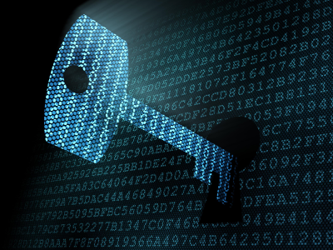
Privacy and security issues
Dalton Tapply
Shor’s Algorithm
Public key encryption obsolete
  HTTPS
  RSA
  Elliptic Curve
NSA is taking it seriously
Confidential Data
  Credit Cards
  State Secrets
  Etc.
[1, 3, 4, 7]
Notes:
Public key encryption out the door [1]
No more HTTPS, PGP [1]
RSA
credit cards, state secrets, and other confidential data [4]
Even NSA is taking quantum threat seriously
Swapped with elliptic curve crypto, realized later it’s going to be obsolete [1]
Already planning on moving to quantum resistant systems [3]

Slide 32
Possible Solutions
Dalton Tapply
Symmetric Keys
  AES 256
Error Code Correction
Lattice-Based
Multivariate Systems
Issues
  New quantum algorithms
  Performance Loss
Quantum-Breakable | Quantum-Secure
RSA | Lattice-Based
Diffie-Hellman | Code-based
Elliptic Curve | Multivariate
[1, 2]
Notes:
Symmetric Keys are harder to break (only makes it easier by factor of 2) [1]
AES 256 (since AES 128 is strong now, 256 factor of two, should be good then)
Alternatives
McEliece Cryptosystems came out with alternative to public key [1]
Error code correction system (create noise, correct with ECC)
Some ECC’s are hard to crack with quantum computing
Lattice-based [2]
Find nearest point in lattice with hundreds of dimensions
Multivariate [2]
Rely on hardness of solving multivariate systems of equations
Problems with Error Code Correction system [1]
Tough to implement
Not “uber optimized” so slower
Problems with Lattice-based [2]
Not completely proven quantum algorithms can’t be implemented to solve them

Slide 33
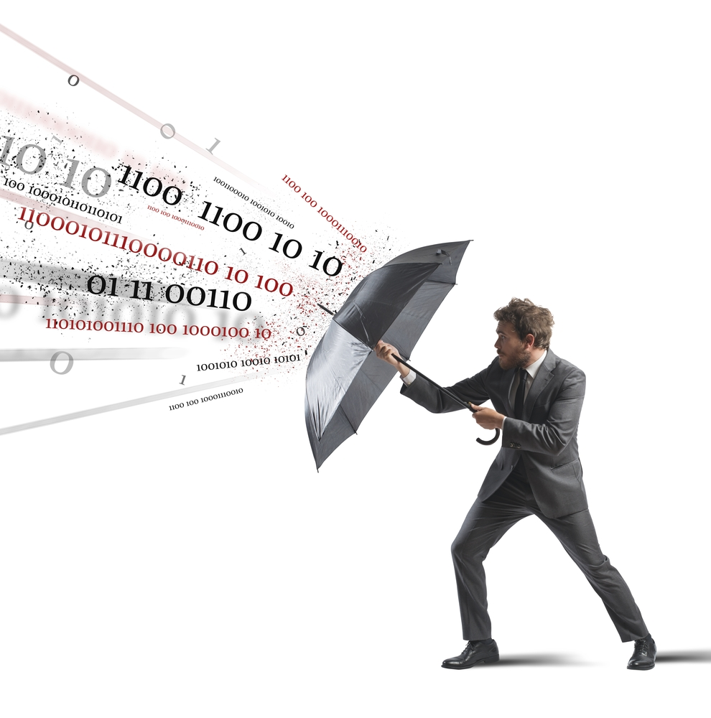
Conclusion
Dalton Tapply
Moving towards quantum resistance
Quantum computer timeframe
  Estimated 10-30 years
In the mean time – AES 256
NSA is here to protect your data?
[1, 2, 8]
Notes:
Conclusion: If we don’t move towards quantum resistant encryption, within the next 10-30 years, our confidential data will no longer be confidential to those that have great power. [1]

Slide 34
References
Dalton Tapply
[1] http://hackaday.com/2015/09/29/quantum-computing-kills-encryption/ (4/2/16)
[2] http://www.wired.com/2015/09/tricky-encryption-stump-quantum-computers/ (4/2/16)
[3] http://www.tripwire.com/state-of-security/featured/will-quantum-computers-threaten-modern-cryptography/ (4/3/16)
[4] http://www.infoworld.com/article/3040991/security/mits-new-5-atom-quantum-computer-could-make-todays-encryption-obsolete.html (4/3/16)
[5] http://science.sciencemag.org/content/351/6277/1068.full (4/4/16)
[6] http://www.wired.co.uk/news/archive/2014-11/18/free-tls-encryption-for-all-domains/viewgallery/330291 (4/4/16)
[7] http://www.ip-watch.org/weblog/wp-content/uploads/2015/06/encryption-image.png (4/4/16)
[8] http://www.gfi.com/blog/wp-content/uploads/2013/12/av-protection.jpg (4/4/16)
[9] http://www.learncomputer.com/secure-your-database/ (4/4/16)
[10] http://www.eetimes.com/document.asp?doc_id=1326468 (4/4/16)

Slide 35
Class 7
The End
Keith A. Pray
Instructor
socialimps.keithpray.net
Notes:
This is the end. Any slides beyond this point are for answering questions that may arise but not needed in the main talk. Some slides may also be unfinished and are not needed but kept just in case.

