Slide 1
Class 6
Information Privacy
Keith A. Pray
Instructor
socialimps.keithpray.net
Notes:
Here’s the title slide. Excited already, aren’t you?
Paper Ave ~5.5, full point higher!

Slide 2
Logistics
We need to schedule Groups present days.
Send your group web site URL and choice of day via email.
Address email to entire course staff for quickest response time
Presentations are due 24 hours before class
Notes:
Not needed this time:
Send presentations via email as attachment.
Do not change the format, footers, etc. in the template slides.
Paper writing process: Sources → Notes → Conclusion → Argument → Counter Point → Response
Use Presentation Guidelines on course web site

Slide 3
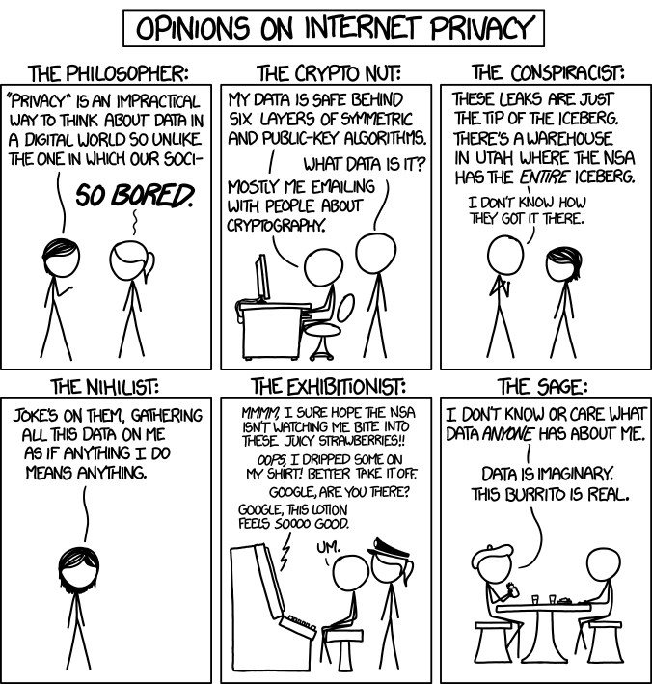
Overview
Review
Assignment
Students Present
http://xkcd.com/1269/
Notes:
1 – Accessed 2014-04-14
Personal Information Privacy

Slide 4
My Reading Notes
pp. 231 Moral capitol – 1984?
pp. 237 “…privacy…in their own homes…” != nanny to expect privacy “…when… insides Sullivans home.
pp. 245 Web Browsers put cookies on on your hard drive, not Web Servers.
pp. 249 why is assumption flawed?
pp. 251 Are call records really a “social network”?
pp. 255 Why does Apple not enforce policy of asking permission in the API?
pp. 256 5. 2003 is a while ago.
pp. 267 Does not answer first question.

Slide 5
Assignment
One Page Paper
Would a National ID System be a good thing?
  Feel free to reference or build upon your self search work if it helps your argument.

Slide 6
Overview
Review
Assignment
Students Present

Slide 7
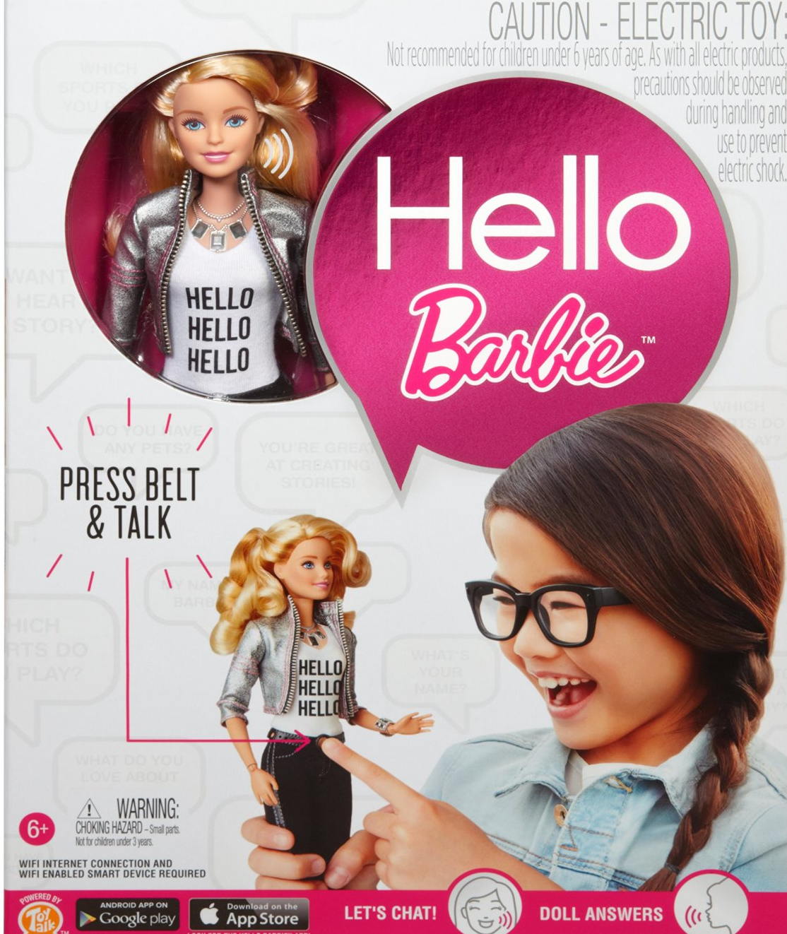
Hello BArbie^{Tm}
Amanda Adkins
Talking doll Made by Mattel® and ToyTalk [1]
Released in November, retail cost: $75 [3]
Records child’s speech when belt buckle pressed [1]
Audio files sent to and stored on ToyTalk servers via Wi-Fi [1]
Uses AI to choose from ~8,000 lines to say [2]
[4]
Notes:
Hello Barbie is a talking Barbie doll made by Mattel and ToyTalk, which is a company specializing in using artificial intelligence techniques to enable toys to have conversations. Hello Barbie can have conversations with kids by recording their speech when her belt buckle is pressed and then sending the audio to toy talk servers to be processed. Once the recording has been processed, the toy uses artificial intelligence to determine one of 8000 different pre-set lines to say.

Slide 8
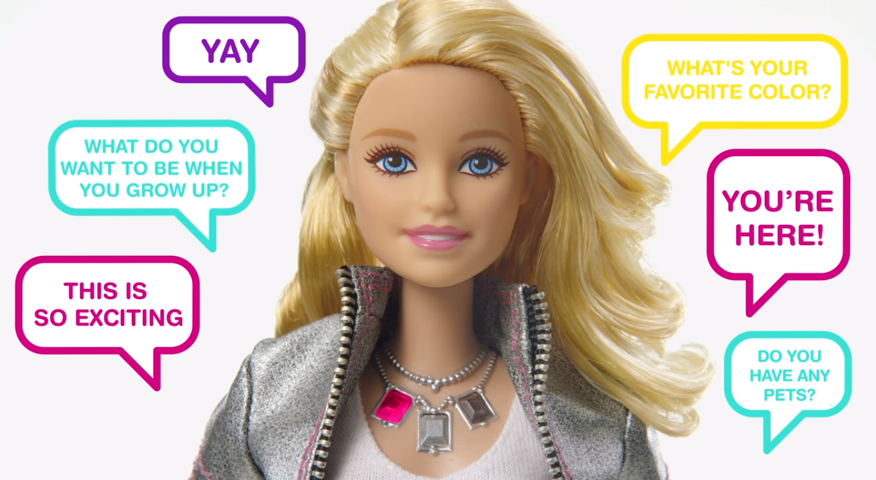
HELLO BARBIE HAS Potential benefits
Amanda Adkins
Could raise child’s self-esteem by encouraging talents and confidence [5]
Build conflict resolution, and problem-solving, and social skills [5]
Adaptive conversation ability extends current talking toys [5]
[6]
Notes:
At first glance, this looks like a pretty cool toy. Hello Barbie could help kids build self-esteem. For example, if a child asks if they’re pretty, Hello Barbie would reply with affirmatively, but also encourage the child to be proud of their talents and intellect. Another scenario has Barbie encourage kids that they can make new friends if they say that they are shy. She can also encourage development of different skills through conversations and games, such as problem-solving, conflict resolution, and social skills. She can also recommend that a child talk to a parent if they’re being bullied. Her adaptive conversation capabilities are also a great advance in talking toys.

Slide 9
Recording Technology Raises Privacy Concerns
Amanda Adkins
Company data collection
  Audio files stored on ToyTalk servers [7]
  Used for research and development by ToyTalk and partners [3]
Parent data collection
  Parents have access to all of child’s conversations with Barbie [8]
  Can post conversations to social media or send via email [2]
Notes:
However, if you look a little deeper, you’ll see that there are several issues raised by the technology that enables Barbie to have conversations.
The main issue is privacy. Though Hello Barbie only records speech when her belt buckle is pressed, all of the audio recorded is sent from Barbie to ToyTalk’s servers. This data is recorded there and can be used by ToyTalk and their partners, who have not been disclosed. ToyTalk and Mattel say that this information will never be used to improve marketing efforts for Barbie or advertise to children, and that audio data will only be used for research and development by those companies and their partners. Privacy experts and advocacy groups question what limitations this R&D restriction actually places on ToyTalk and Mattel and argue that it is unknown who and how many people could listen to a child’s conversations with Barbie. ToyTalk also says that they would report a conversation that endangers the safety of a child or others to law enforcement and would respond to subpoenas. Another safeguard is that parents must consent to recordings of their child and they also have the ability to delete certain recordings, but there is still the potential for a lot of recordings of a child using the toy to be stored on remote servers.
Parent data collection
In addition to the company being able to access the child’s conversations, parents can also access this data. They can also share parts of conversations on social media or through email. Though there isn’t much of an expectation of privacy between young children and their parents, children might tell things to their doll that they might not tell to their parents. One employee at ToyTalk who worked on writing many of Barbie’s potential responses acknowledged this and said “I have no doubt she will ask Barbie all manner of those intimate questions that she wouldn’t ask an adult”. Is this fair to the child? Should parents tell their kids that they can access these conversations?
These privacy issues are furthered by the fact that, unlike adults using speech recognition technology, children might not be fully aware of what is happening to their data or the ramifications of this

Slide 10
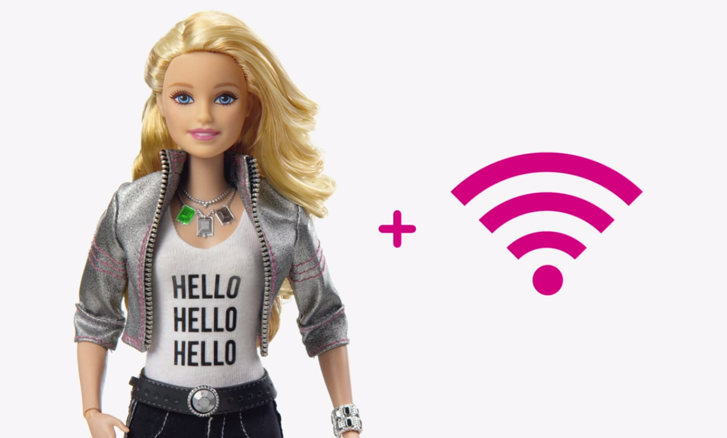
Wi-fi connectivity Brings Security Issues
Amanda Adkins
Protections
  HTTPS [3]
  Requires client side certificate [3]
  Only Wi-Fi connection information stored on doll and is encrypted [7]
[6]
Vulnerabilities
  POODLE attack [9]
  Connects to any unsecured network that has “Barbie” in name [10]
  Obtained Wi-Fi network names, MAC addresses, account IDs, and MP3 files [3]
Notes:
It’s possible that not only children’s parents, ToyTalk, and Mattel could have access to conversations between children and Hello Barbie. Network security issues introduce the possibility that hackers could access these recordings or other information collected by Hello Barbie and it’s accompanying app. ToyTalk and Mattel have acknowledged this and have put in some security measures, such as preventing eavesdropping by using HTTPS, requiring a certificate to communicate with Barbie, and only putting Wi-Fi connection information on the doll in a hardware encrypted section, so that minimal data is compromised if the doll is lost. There have also been no examples of recording activated remotely.
However, several vulnerabilities in the Hello Barbie system have already been exposed. Bluebox, a security firm, found that the cloud server architecture for ToyTalk was susceptible to the POODLE attack, which could potentially allow hackers to downgrade connection security and listen in on transmissions of audio files to the server. Bluebox also found that the app would connect to any unsecured network with Barbie in the name, opening up smartphones to malicious Wi-Fi networks spoofing the Hello Barbie system. In addition, security researcher Matt Jakubowski said that he could get several pieces of information, including Wi-Fi network names, user’s system information and Wi-Fi network names, which could be used to find a home address. ToyTalk has responded and said that they have fixed a number of these issues, including the Poodle vulnerability, but still acknowledged that the doll carries the possibility of being hacked, like other internet of things devices.

Slide 11
Hello Barbie raises Other Ethical Issues
Amanda Adkins
What if child tells Barbie about a crime or threat to commit a crime? [11]
  How seriously should threat be taken?
  Does company have obligation to report crimes or threats?
What if parent shares conversation that could be damaging to child’s reputation later in life? [11]
Notes:
Are Mattel and ToyTalk obligated to inform the appropriate government agency about the threat or crime? Does either company have the right or obligation to listen to recordings for implications of crimes committed against children? What if the parent is committing crime against child and can use the app to review and delete the recordings? Though no reports of these scenarios happening have occurred yet, they are certainly plausible situations.
Children might not always realize the potential ramifications of something they say and parents might not consider that something they perceived as cute at age 7 could end up damaging the child’s chance at a job when they are 27
Also a number of potential psychological effects that befriending a toy with advanced conversation abilities could have on a child.

Slide 12
Conclusions and discussion
Amanda Adkins
Hello Barbie is a pretty cool toy
  Impressive artificial intelligence
  Several security measures taken
It is still not worth the associated issues
  Security risks
  Privacy concerns
  Issues resulting from children as target market
Notes:
Overall, Barbie is a really cool example of artificial intelligence and speech recognition technology and ToyTalk and Mattel have made significant steps to secure transmissions and data. However, given the security breaches, already discovered and future, the privacy concerns involved in remotely storing audio of children’s conversations, and other ethical situations raised by the technology involved and potential uses, the benefits don’t outweigh the potential and actual risks of Hello Barbie.

Slide 13
References
Amanda Adkins
[1] Bisson, David. "Hello Barbie Brings Smiles to Kids, Nightmares to Privacy Advocates“, 2015, https://www.grahamcluley.com/2015/11/hello-barbie-brings-smiles-kids-nightmares-privacy-advocates/. Access Date: 25 Mar 2016
[2] Walker, Lauren. "Hello Barbie, Your Child's Chattiest and Riskiest Christmas Present”. 2015. http://www.newsweek.com/2015/12/25/hello-barbie-your-childs-chattiest-and-riskiest-christmas-present-404897.html. Access Date: 25 Mar 2016.
[3] Meers, Whitney. "Hello Barbie, Goodbye Privacy? Hacker Raises Security Concerns”. 2015. http://www.huffingtonpost.com/entry/hello-barbie-security-concerns_us_565c4921e4b072e9d1c24d22. Access Date: 25 Mar 2016
[4] Amazon.com. “Barbie - Hello Barbie Doll”. http://www.amazon.com/Barbie-DKF74-Hello-Doll/dp/B012BIBAA2/ref=sr_1_1?ie=UTF8&qid=1459491317&sr=8-1&keywords=Hello+barbie . Access Date: 1 Apr 2016
[5] Vlahos, James. “Barbie Wants to Get to Know Your Child”. 2015. http://www.nytimes.com/2015/09/20/magazine/barbie-wants-to-get-to-know-your-child.html?_r=0. Access Date: 25 Mar 2016
[6] ToyTalk. “Hello Barbie”. 2015. https://www.youtube.com/watch?v=QEDk2M2_tH4. Access Date: 30 Mar 2016.

Slide 14
References
Amanda Adkins
[7] Lever, Rob. “High-Tech Barbie Stokes Privacy Fears”. 2015. http://phys.org/news/2015-11-high-tech-barbie-stokes-privacy.html. Access Date: 25 Mar 2016
[8] Rattigan, Kathryn. ’Hell No Barbie’ Campaign Against the New Interactive Doll with Artificial Intelligence”. 2015. https://www.dataprivacyandsecurityinsider.com/2015/11/hell-no-barbie-campaign-against-the-new-interactive-doll-with-artificial-intelligence/?utm_source=feedburner&utm_medium=feed&utm_campaign=Feed%3A+DataPrivacyAndSecurityInsider+%28Data+Privacy+and+Security+Insider%29. Access Date: 25 Mar 2016.
[9] Hackett, Robert. “Hello Barbie Doll Vulnerable to Hackers”. 2015. http://fortune.com/2015/12/04/hello-barbie-hack/. Access Date: 30 Mar 2016.
[10] Business Insurance, “Hello Barbie Has It All – Including Security Risks”. 2015. http://www.businessinsurance.com/article/20151214/NEWS06/151219937/hello-barbie-has-it-all-including-cyber-risks?tags=%7C329%7C302%7C299. Access Date: 30 Mar 2016.
[11] Zink, Amanda. "Hello Barbie: Considering Potential Unforeseen Problems with AI Dolls and What Chidlren Tell Them“. 2015. http://www.bioethics.net/2015/09/hello-barbie-considering-potential-unforeseen-problems-with-a-i-dolls-and-what-children-tell-them/. Access Date: 25 Mar 2015.

Slide 15
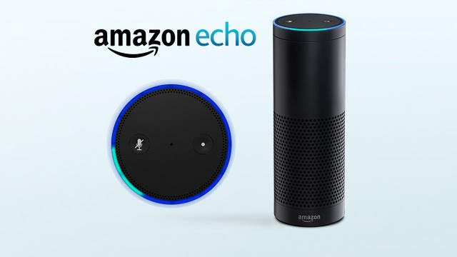
Amazon Alexa
Technology and Privacy
Xiaosong Wen
Architectural Overview
  Hardware and Interaction
  Backend Software (AVS)
Sufficient Protection
  Account is Privacy Protective
  Privacy Protection During Usage
[1]
Notes:
Amazon Alexa is the title given to Amazon’s cloud-based voice service system, capable of providing compatible hardware with a slew of voice-activated capacities

Slide 16
Hardware and Interaction
Xiaosong Wen
Primarily featured on the Amazon Echo
Constantly listening for the “wake-word” [1]
Records until interpreted end of user interaction
Sends a bit more than just the conversation to the cloud [2]
With the Echo, a separate remote/microphone is available
[2,3]
Notes:
2. like “ok google” on android or “siri” on iphone, user can also customize the “wake-word”
3.Will echo always listening? The answer is yes the Echo is always listening, but it is waiting to hear its “wake” word. Current policy is to record and send to Amazon what uses say after the wake work and three seconds prior.
Amazon says, “Echo only streams recordings from the home when the device hears the wake-up word.” Which means Amazon is only using and hearing the conversations you have with the Echo. The three seconds prior to the wake word is so Amazon can get a better context of why and how people are using the devise

Slide 17
Xiaosong Wen
Backend Software [4]
Interpretation software (Alexa Voice Services) is stored on Amazon Web Services servers
All data transferred to and from the servers is encrypted
Recorded user interactions are stored on the server
User interaction is parsed for relevant data
Response is then streamed to the device
[4]

Slide 18
Account is Privacy Protective
Xiaosong Wen
The Amazon.com Privacy Notice states [5]
  No activity is stored that identifies the user
  Developers have limited access to Alexa’s information
Uses Secure Sockets Layer (SSL) encryption
[5]
Notes:
The user’s identity is not correlated to their registered email address or phone number
Personally Identifiable Information is not shared

Slide 19
Xiaosong Wen
Privacy Protection During Usage [6]
The Echo lights up when awoken
Users can have Alexa play a sound at the beginning and end of the transmission
Users can delete the recording stored in the cloud
Users can disable voice activation/remote control
[6]
Notes:
If someone is worried enough, they should be able to stop the Echo from listening and recording; for example, “Alexa turn off for 10 minutes”. That way if someone feels they need to have a very private conversation they can have the device turned off.
Already has an on/off feature that can be controlled by a button

Slide 20
References
Xiaosong Wen
[1] https://www.youtube.com/watch?v=pIeIgwHMOUU
[2] "Amazon Echo: Always Ready, Connected, and Fast. Just Ask." Amazon.com: Online Shopping for Electronics, Apparel, Computers, Books, DVDs & More. N.p., n.d. Web. 31 Mar. 2016.
[3] "Amazon Echo: Always Ready, Connected, and Fast. Just Ask." Amazon.com: Online Shopping for Electronics, Apparel, Computers, Books, DVDs & More. N.p., n.d. Web. 31 Mar. 2016.
[4]. "Alexa Voice Service (AVS) - Amazon Apps & Games Developer Portal." Amazon Developer Services. amazon, n.d. Web. 31 Mar. 2016.
[5]. "Amazon.com Help: Amazon.com Privacy Notice." Amazon.com: Online Shopping for Electronics, Apparel, Computers, Books, DVDs & More. N.p., 3 Mar. 2014. Web. 1 Apr. 2016.
[6]. Curry, David. "How to Remove Your Voice Data from Amazon Echo .com." ITProPortal. N.p., 25 Jan. 2015. Web. 1 Apr. 2016.

Slide 21
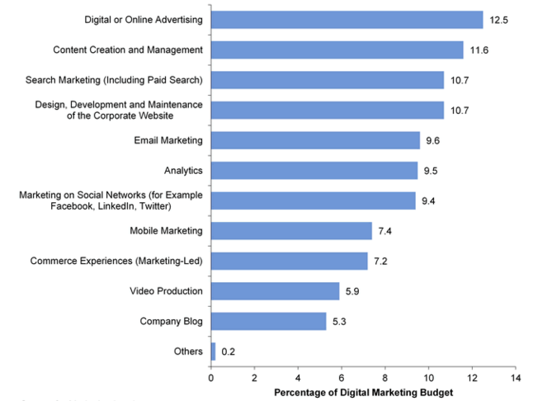
Why Websites Advertise
Ian Jacoway
In General:
  Websites can use advertising to make money
The owner of PodcastDirectory.com a website with nearly a million hits a month in 2007, made $30,000 to $40,000 a year solely from ads
96% of Google’s revenue is from advertising, 84% for Facebook
(Noguchi, 2007)(Donohue)(Gartner, 2013)
Notes:
Premise & Ex #1 12.5% of typically market budgets are spend on online ads. Likewise because companies budget so much for web advertising there is a demand for it.

Slide 22

Targeted Advertising
Ian Jacoway
Websites can collect data on user behavior to craft more specific ads
Spotify self advertises to those they already know use want their service
(Spotify, 2016)
Notes:
Example #2 Show image quickly

Slide 23
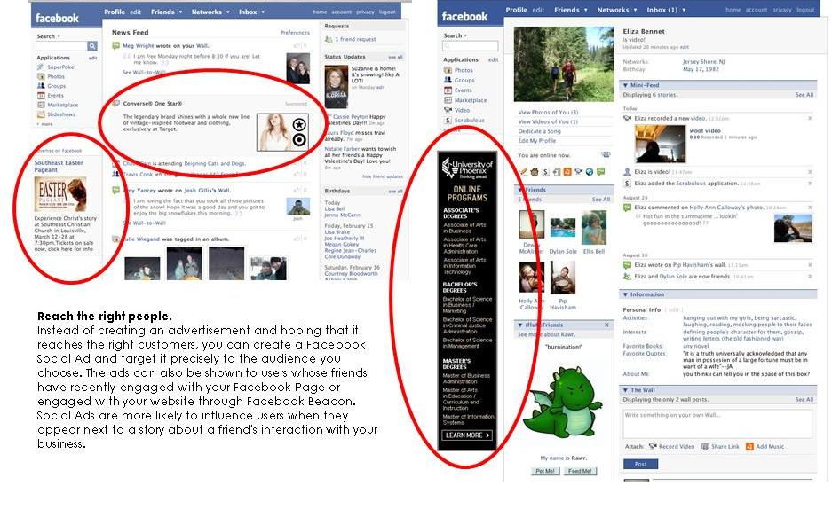
Targeted Advertising
Ian Jacoway
Google Analytics can be used to better shape targeted audience
Targeted Social Advertising through Facebook
  Characterization through user’s likes and dislikes
(Vecchiarelli, 2012)
Notes:
Example #3 Show image quickly

Slide 24
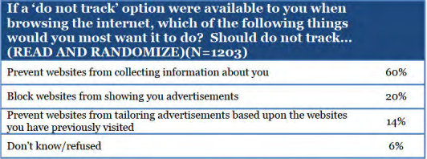
User Privacy
Ian Jacoway
The typical user finds the large amount of advertising aggravating and the data collection a breach of privacy.
(Hoofnagle, 2012)
Notes:
User thoughts on privacy

Slide 25
“Aggravated” User Response
Ian Jacoway
45% of users who respond do so by installing one or more of the following in an attempt to block all ads and tracking:
Adblock Plus:
  A popular ad blocking extension.
uMatrix:
  Extension to blacklist/whitelist website calls (blocks ads)
    However this extension breaks most sites and requires the user to understand what to unblock to retain functionality.
Milk:
  An extension that strives to maintain functional privacy, by storing cookies in separately and restricting which sites have access to those cookies. (combats cookie tracking)
duckduckgo.com:
  A search engine that promises not to track users
(Fair Page, 2014)(AdBlock Plus, 2012)(uMatrix, 2016)(Walls, 2012)(Duck Duck Go, 2016)
Notes:
Explain the differences between letting else block your ads, blocking ads yourself, making sure cookies data is only given to those required, explain “Do not track receipts”

Slide 26
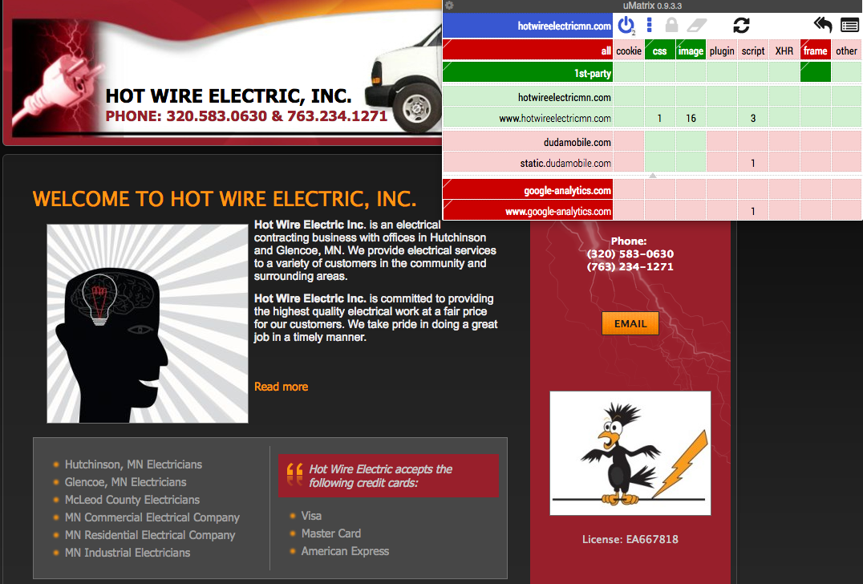
Ian Jacoway
(Hot Wire Electric, 2015)(uMatrix, 2016)
Notes:
Blacklisting all but 1st party calls on a website disables a small time company’s ability to collect stats to better advertise as well. Meaning its harder for them to expand and create a foundation.

Slide 27
“Concerned” User Response
Ian Jacoway
30% of adblocking users do so in order to remove a subset of specific advertising, one
Fair AdBlock:
  Allows users discriminate between ads that:
      Support the website the user is browsing
      Ads that support a STANDS cause (charitable ads)
      Unwanted ads, popups, tracking, and malware
(Fair Page, 2014)( STANDS, 2016)
Notes:
Replaces all ads and allows users to select the number of ads to allow as well as the amount raised by allowing those ads. Overall helping a cause and still allowing small sites to collect stats.

Slide 28
Conclusion
Ian Jacoway
The abuse of obnoxious online advertising has led 144 million users to browse using extensions to block Ads, a 123 million user increase since 2010
These ad blocking services can be categorized as follows:
  Replaces ads with fewer company whitelisted ads (doesn’t tell user)
  Replaces ads with fewer charitable ads (user is told of this action)
  Blacklists all calls to non 1st party websites (user can choose to whitelist others)
(Fair Page, 2014)
Notes:
Summary & Questions 4.9% of all internet users) a number which has increased 69% over the previous 12 months

Slide 29
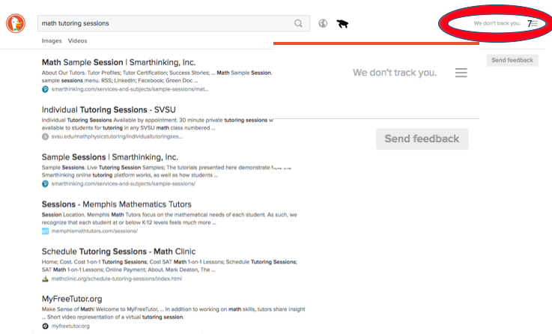
Ian Jacoway
(Duck Duck Go, 2016)
Notes:
Just a quick example

Slide 30
References
Ian Jacoway
  [1] Vecchiarelli, J. (2012). Facebook Ads: Thumbs Up or Down? Retrieved from http://featswithtweetsmarketing.com/2012/06/25/facebook-ads-thumbs-up-or-down/
  [2] STANDS. (2016). Homepage. Retrieved from https://www.standsapp.org/
  [3] Hot Wire Electric. (2015). Homepage. Retrieved from http://www.hotwireelectricmn.com/
  [4] Google. (2016). Math Tutoring Sessions. Retrieved from https://www.google.com/?gws_rd=ssl#q=free+math+tutoring+sessions
  [5] Spotify. (2016). Browse. Retrieved from https://play.spotify.com/collection/songs
  [6] Duck Duck Go. (2016). Math Tutoring Sessions. Retrieved from https://duckduckgo.com/?q=math+tutoring+sessions
  [7] Walls, Robert J. (2012). Retrieved from https://github.com/rjwalls/Milk
  [8] uMatrix. (2016). Retrieved from https://github.com/gorhill/uMatrix
  [9] Adblock Plus. (2016). Retrieved from https://adblockplus.org/

Slide 31
References
Ian Jacoway
  [10] Hoofnagle, Chris Jay and Urban, Jennifer M. and Li, Su, Privacy and Modern Advertising: Most US Internet Users Want 'Do Not Track' to Stop Collection of Data about their Online Activities (October 8, 2012). Amsterdam Privacy Conference, 2012. Available at SSRN: http://ssrn.com/abstract=2152135
  [11] Gartner. (2013). Key Findings From U.S. Digital Marketing Spending Survey, 2013. Retrieved from http://www.gartner.com/technology/research/digital-marketing/digital-marketing-spend-report.jsp
  [12] Fair Page. (2014). AdBlocking Goes Mainstream. Retrieved from http://downloads.pagefair.com/reports/adblocking_goes_mainstream_2014_report.pdf
  [13] Yuki Noguchi. (2007). Web ads add to profit. Retrieved from http://www.seattletimes.com/business/web-ads-add-to-profit/
  [14] Kellen Donohue. What are some examples of public internet companies that solely rely on advertising? Retrieved from https://www.quora.com/What-are-some-examples-of-public-internet-companies-that-solely-rely-on-advertising?share=1
  [*] URLs checked & working as of 04/01/16

Slide 32
Class 6
The End
Keith A. Pray
Instructor
socialimps.keithpray.net
Notes:
This is the end. Any slides beyond this point are for answering questions that may arise but not needed in the main talk. Some slides may also be unfinished and are not needed but kept just in case.

