Slide 1
Class 5
Intellectual Property
Keith A. Pray
Instructor
socialimps.keithpray.net
Notes:
Here’s the title slide. Excited already, aren’t you?
Reminders:
Do not change the format, footers, etc. in the template slides.
Paper writing process: Sources → Notes → Conclusion → Argument → Counter Point → Response

Slide 2
Overview
Review
Assignment
Students Present
Guest Speaker

Slide 3
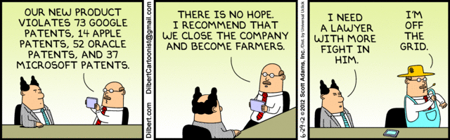
Notes:
Let’s see what everyone decided for the paper!

Slide 4
My Reading Notes
pp. 162 Illegal software stats changed since 2009?
pp. 169 SaaS, Google Search example? “…before he gave them the plot.”?
pp. 176 4.4 #2 preferred?
pp. 182 dial-up is not ordinary any more. revenue != profit
pp. 189 blocking 100% seems impossible
pp. 197 4.7.3 reference?
pp. 202 Perhaps friends should not ask you to break the law? Any successful industries operate as a support service?
pp. 203 Is Perl still most popular? Quality study from 2003, change?
pp. 205 GUI argument ignores Android.
pp. 208 who uses tape?
pp. 223 Any news?
End of Chapter questions I liked: 31

Slide 5
Group Quiz
For each On the left answer a–d on Right
Trademark
Copyright
Patent
Trade Secret
What kind of IP does it protect?
What qualifications does the IP have to meet to be protected?
How long does the protection last?
Give a specific example of IP currently protected?
Notes:
Trademark
Used to denote a product or service.
Apply in specific areas of commerce. Only applies in specified area of business
Indefinite term as long as in use and protected against becoming a common noun or verb.
You do not have to register a trademark unless you want to bring litigation before a federal court (there are other benefits too)
Copyright
Expression, not ideas: Fuzzy. E.g. derivative works, characters, merchandising, plots.
Mickey Mouse, Tarzan.
US Default : Original Author, Exception: work for hire, Transferred: yes
Rights: Publication, Performance / exhibition, Adaptation to other media, Excerpting, Attribution, Derivative works
US Term: Lifetime of author plus 70 years., 95 years for companies.
Governed by US law and international treaties (e.g. WIPO).
Fair Use: News reporting, reviews, etc., Scholarly / educational use, Private, non-commercial use, Lending libraries and archives
Fair Use restrictions: Admission charge, Re-transmission
In general, you can: Read, view, play, etc., Copy for personal use., Time-shift.
In general, you cannot: Copy for others., Transfer to someone else but keep a copy., Show / perform it publicly.
What about video rentals?
Rationale: Encourage creativity. Encourage dissemination. Balance between private and public good. It’s a social contract.
Patent
A mechanism, process, or composition of matter.
Something patentable must be: Novel. Useful. Non-obvious. Described clearly. Must do what it says.
Usual term 20 years.
Utility and plant patents: 20 years.
Design patents last 14 years. (ornamental design of functional item)
Provisional patent gives 1 year, before full patent
Trade Secret
You must take steps.
Enforceable by: Contracts, Laws against industrial espionage.

Slide 6
Overview
Review
Assignment
Students Present
Guest Speaker
Notes:
But first take a look at:
CGP Grey
Copyright: Forever Less One Day
https://www.youtube.com/watch?v=tk862BbjWx4
Tom Scott
http://tomscott.com
Welcome To Life
https://www.youtube.com/watch?v=IFe9wiDfb0E&feature=youtu.be

Slide 7
Assignment - Self Search 1/3
Discussion Board
Post ways one can search for information about a person. Do not repeat entries.
Use each search method listed to produce 2 profiles as an appendix of your paper. Provide a brief description if you’d rather not list the details.
  Profile 1: all information someone might think is you
  Profile 2: all information you know is you.
  You are not responsible for methods posted less than 24 hours before class.
For each search method result consider:
  Exactly how did the data get there?
  How can this data be used?
  Is this a secondary use?
  Did you authorized use of the data? If not and you want to, request its use be discontinued and post the correspondence.
Dig deeper than a basic search engine’s (Google, etc.) results.

Slide 8
Assignment - Self Search 2/3
1 Page Paper
Use your search results to help support your conclusion.
This assignment requires you revisit the Discussion Board frequently as new search methods are posted, subscribe to it.
Conclusion idea examples (not comprehensive):
  What impression would a potential employer have of you given these results, assuming they also had a resume and possibly a cover letter from you?
  What would your elder family members (or equivalent) think?
  Are you comfortable with what you found or did not find?
  Do you believe protecting your privacy is important or needed?

Slide 9
Assignment - Self Search 3/3
Profile 2
Is You
1 Page
Paper
Filter
Inspiration
Search Methods
…
…
…
…
Filter
Profile 1
Could Be You

Slide 10
Overview
Review
Assignment
Students Present
Guest Speaker

Slide 11
ALTERNATIVE ONLINE PUBLISHING
Will Frick
Ways of dealing with piracy
  The book covered many that can be summed up as “fighting back”
  Seems reasonable, but there are other ways
  What about embracing piracy, or even just undercutting it?
Notes:
Hi, my name is Will and my presentation is about alternative online publishing: particularly of music, but we’ll touch on some other media as well.
We all just completed a reading about copyright law, and you can’t talk about online copyright without talking about piracy and the fight against it. We read about all kinds of methods that have been used to counteract pirates: encryption, DRM, site shutdowns, and so on. It’s all very negative, and that makes sense! It’s natural to have the response of fighting back: “Bad guys are stealing from us! We have to stop them!” And while I don’t disagree that it’s sometimes the right choice, there have been some interesting alternatives that the book didn’t really cover. Believe it or not, some content creators have embraced the idea of piracy. Others have found that, since piracy can’t be fought directly, it’s more effective to undercut it with a new legal service. We’ll talk about those in a moment, but first let’s take a look at some data about piracy itself.

Slide 12
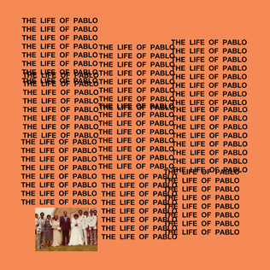
PIRACY
Will Frick
Kanye West’s The Life of Pablo was torrented an estimated 500,000 times in 2 days [1]
  RIAA filed almost 20 takedown requests, but admitted the attempts were “increasingly pointless” [1]
NY Post claims that, since the album cost $20, piracy cost West $10 million [2]
  But is every download a lost sale?
[3]
[1, 2, 3]
Notes:
Earlier this year, Kanye West released his new album, The Life of Pablo. Within just two days, there had been an estimated 500,000 illegal downloads of the album. Naturally, the RIAA tried to fight back with takedown notices, but clearly they weren’t effective. Even their chief executive admitted, in an earlier interview, that these techniques were becoming increasingly pointless, as pirates are able to post new copies faster than they can be taken down.
Shortly after the 500,000 downloads statistic went public, New York Post ran an article claiming that, since the album cost $20, that meant that West had lost $10 million to pirates. Sounds terrible, right? It’s no wonder that artists and record labels are so desperately fighting against pirates. But wait a second; is it really fair to say that Kanye lost $10 million? Would every single one of those 500,000 downloaders gone and purchased the album if they weren’t able to torrent it?

Slide 13
LOST SALES
Will Frick
The idea that each download is a “lost sale” is controversial [4]
Minecraft creator Markus “Notch” Persson rejected the idea completely [4]
  “If you steal a car, the original is lost. If you copy a game, there are simply more of them in the world” - Notch [4]
  “Give people a reason to buy” - Notch [4]
  Minecraft had a reported 70% piracy rate [4], yet is still a runaway success with over 20 million sales on PC alone [5]
[4,5]
Notes:
Well, that’s a controversial question. It’s difficult to quantify precisely - we can’t calculate people’s behavior in theory - but Notch, the creator of Minecraft, certainly doesn’t think so. He completely rejects the idea that software piracy is theft. If you steal a car from a dealership, he says, that’s theft because the original car is gone; the company can no longer sell it. But by pirating Minecraft, he argues, you have only made a new copy in the world. Anyone who was going to buy the game can still do so, so Notch insists it’s more important to give people a reason to buy the game than waste effort fighting pirates. And it seems to have paid off: even though Minecraft is widely pirated - one source reported 70% of copies of the game were illegal - it is nevertheless an extremely successful title, with tens of millions of sales on PC alone.

Slide 14

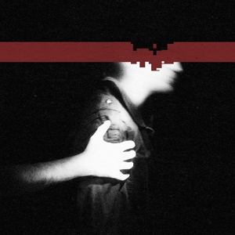
FREE DISTRIBUTION
Will Frick
What about offering the content for free in the first place?
Trent Reznor released two Nine Inch Nails albums for free download in 2008 to positive reception [6,7]
  “Will we ever pay for an album again?” [7]
Both albums were also released physically for sale, and sold well enough to chart [8,9]
  The Slip sold over 98,000 physical copies [18]
  Ghosts I-IV made $750k in three days [19]
[8]
[9]
[6,7,8,9,18,19]
Notes:
Some people have taken it even further. What about just giving stuff away? That’s what Trent Reznor did with a couple of Nine Inch Nails albums. In 2008, Reznor released Ghosts I-IV and The Slip completely for free on his website. Reception was positive; ABC News was even heralding it as the future of music, asking “Will we ever pay for an album again?” But while good press is nice, you might be wondering how this was supposed to make Reznor any money. The thing is, he released physical copies of the albums too. They weren’t free, obviously, yet they still sold well enough to chart on the Billboard Top 100. The physical bonus features of the albums, like the liner notes and cover art, were apparently enough to sway buyers, especially when they already knew they liked the music from having downloaded it. You can see some statistics on the screen about each release’s sales. This seems like a success story, but free releases have backfired as well. Who recognizes...

Slide 15
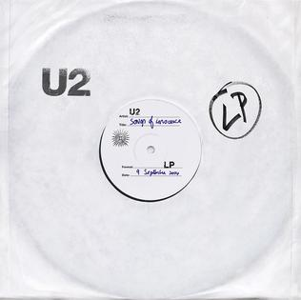
FREE DISTRIBUTION - BACKFIRING
Will Frick
U2’s Songs of Innocence was automatically added to Apple users’ accounts [10,11]
Heavily criticized as overly aggressive and intrusive [10]
  “Even worse than spam” - Wired [10]
Virtually no impact on sales of previous U2 albums [11]
  Only 60 CDs and 6,047 digital purchases the following week [11]
  “As damaging as piracy” - Entertainment Retailers Association [11]
[12]
[10,11,12]
Notes:
...this album? For those who aren’t aware, this is Songs of Innocence by U2, and in 2014 it was automatically added to the iTunes account of every Apple user in the world. Apparently this was too much, and U2 received a ton of bad press. Remember spam? Well, Wired Magazine said this was even worse. Supposedly, the hope was that, with everyone in the world listening to the album, a new generation of fans would discover U2 and start buying their back catalog. That flat out didn’t happen; sales were as low as ever in the following weeks; they literally sold sixty CDs the week after it came out, and digital sales were a paltry six thousand. In fact, the Entertainment Retailers Association went so far as to call the release “as damaging as piracy” to the value of music.

Slide 16
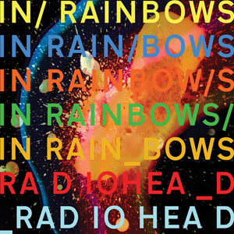
PAY-WHAT-YOU-WANT
Will Frick
Radiohead’s acclaimed In Rainbows was considered groundbreaking and sparked discussion of the PWYW model [13]
One study found that most buyers paid very little for PWYW goods, but directing some income to a charity greatly increased payment [14]
[15]
[13,14,15]
Notes:
There’s another model called pay-what-you-want, and it’s exactly what it sounds like. Some of you might have bought a Humble Bundle of games before, or an indie album on Bandcamp, and been asked to enter the amount you “thought it was worth.” Radiohead’s In Rainbows was the first high-profile music release with this model, and it attracted a lot of attention, which - unlike Songs of Innocence - was mostly positive. Interest in pay-what-you-want releases skyrocketed after the album, and a study was done to see how successful the model could be. They found that, predictably, average payment was usually very low, but receipts could be greatly improved by diverting some of the income to a charity.

Slide 17

STREAMING
Will Frick
A study found that Spotify had caused a significant drop in music piracy... [16]
...and a significant drop in music sales, too. [16]
Net benefit to the industry was estimated at zero. [16]
[17]
[16,17]
Notes:
And lastly, I would be remiss if I didn’t mention streaming. Services like Spotify have been heralded as the ultimate way to undercut piracy. And it’s true! After Spotify was introduced, there was a significant drop in illegal music downloads… and legal ones, too. Spotify didn’t really kill piracy, it just killed the idea of owning music, legally or not. It was estimated that there wasn’t really any net benefit or harm to the industry.

Slide 18
CONCLUSIONS AND DISCUSSION
Will Frick
Directly fighting online piracy is increasingly futile, but there other ways to deal with it
Offering content for free can be surprisingly effective
Some schemes are prone to backfiring
When successful, embracing or undercutting piracy can be far more successful than aggressive techniques
Notes:
So as we’ve seen, while directly fighting piracy is increasingly futile, there are a lot of interesting release models that can have greater effects. We saw that releasing content for free can actually be surprisingly effective, and although there is a risk of backfiring, the success stories have shown that embracing or undercutting piracy has the potential to be far more lucrative than fighting back.

Slide 19
REFERENCES, 1/2
Will Frick
[1] Kleinman, Zoe. Kanye West album ‘pirated 500,000 times’ already. http://www.bbc.com/news/technology-35587381 (Mar 26, 2016)
[2] Morgan, Richard. Kanye’s botched album release costs him $10M. http://nypost.com/2016/02/17/kanyes-lost-at-least-10m-thanks-to-illegal-downloads/ (Mar 26, 2016)
[3] West, Kanye. The Life of Pablo http://tidal.com/album/57273408 (Mar 26, 2016)
[4] Enigmax. Piracy is theft? Ridiculous. Lost sales? They don’t exist, says Minecraft creator. https://torrentfreak.com/piracy-is-theft-ridiculous-lost-sales-they-dont-exist-says-minecraft-creator-110303/ (Mar 27, 2016)
[5] Tyson, Mark. Minecraft sales reach 70 million, 20 million copies sold on PC. http://hexus.net/gaming/news/industry/84371-minecraft-sales-reach-70-million-20-million-copies-sold-pc/ (Mar 27, 2016)
[6] Lomax, Alyce. Music Industry Gets Nailed Again. http://www.fool.com/investing/general/2008/03/04/music-industry-gets-nailed-again.aspx (Mar 27, 2016)
[7] Malone, Michael S. Will We Ever Pay for an Album Again? http://abcnews.go.com/Business/story?id=4813233&page=1 (Mar 27, 2016)
[8] AllMusic. Ghosts I-IV Awards http://www.allmusic.com/album/ghosts-i-iv-mw0000783108/awards (Mar 27, 2016)
[9] AllMusic. The Slip Awards http://www.allmusic.com/album/the-slip-mw0000788369/awards (Mar 27, 2016)
[10] Assar, Vijith. Apple’s Devious U2 Album Giveaway is Even Worse Than Spam. http://www.wired.com/2014/09/apples-devious-u2-album-giveaway-even-worse-spam/ (Mar 27, 2016)

Slide 20
REFERENCES, 2/2
Will Frick
[11] NME News Desk. Entertainment Retailers Association calls U2’s album giveaway ‘as damaging as piracy’. http://www.nme.com/news/u2/79810 (Mar 27, 2016)
[12] U2. Songs of Innocence. http://www.u2.com/news/title/songs-of-innocence/ (Mar 27, 2016)
[13] Pareles, Jon. Pay What You Want For This Article. http://nyti.ms/1RsVYsf (Mar 27, 2016)
[14] Gneezy, Ayelet; Gneezy, Uri; Reiner, Gerhard; Nelson, Leif D. Pay-what-you-want, identity, and self-signaling in markets. http://www.pnas.org/content/109/19/7236.full (Mar 27, 2016)
[15] Donwood, Stanley. In Rainbows. http://www.allmusic.com/album/in-rainbows-mw0000496930 (Mar 27, 2016)
[16] Resnikoff, Paul. Spotify Kills Piracy AND Paid Downloads, European Study Finds. http://www.digitalmusicnews.com/2015/10/28/spotify-kills-piracy-and-paid-downloads-european-study-finds/ (Mar 27, 2016)
[17] Spotify. Spotify Logo. https://www.spotify.com (Mar 27, 2016)
[18] Muller, Andrew. How Trent Reznor’s “The Slip” Helped Pave The Way For New Music Distribution Models. http://www.therealmusician.com/trent-reznor-the-slip.html (Mar 29, 2016)
[19] Anderson, Nate. Reznor makes $750,000 even when the music is free. http://arstechnica.com/uncategorized/2008/03/reznor-makes-750000-even-when-the-music-is-free/ (Mar 29, 2016)

Slide 21
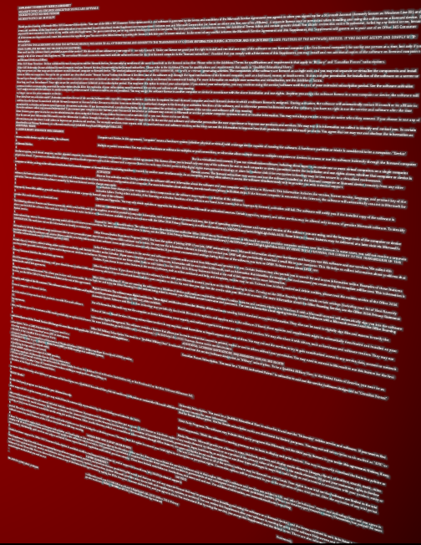
End user license agreements
…and why they could use standardization
Nick Diaz
What do they involve?
Numbers!
What do the courts think?
The Microsoft PowerPoint EULA, softly glowing blue in 2 pt. font
Notes:
Introduction – mainly saying hello, introducing topic, then moving to next slide. Agenda will not be reviewed in any sort of detail

Slide 22
WHAT ARE YOU AGREEING TO?
Nick Diaz
Varies
Can involve a product being “sold” vs. “licensed”
Liability [4]
Information on how your data is being collected
Restriction on product comparisons [4]
Prohibition on reverse-engineering [4]
Notes:
Discussing what a EULA is:
Generally speaking, it’s a legal agreement between the user and the manufacturer of a piece of software.
The exact terms can vary greatly between products, and there is no universal standard
Listing some common elements:
-------------------------------------------
THESE ELEMENTS TO BE COVERED VERY BRIEFLY
EULAs can specify how a product is being transmitted to you, whether you are being sold the software, or just licensing it [more on this later]
Liability concerns. These are discussed in the book, in chapter 8, but suffice to say companies will often have you agree that they are not liable for any damages the product may cause.
-----------------------------------------------------------------------
They also often allow for the collection of data from the software
In some cases, (Microsoft XML, VMware Desktop) there are clauses restricting unauthorized benchmarking
EULAs can also contain sections restricting the reverse engineering of software, such as attempts to disassemble code
Transition: But you guys probably already know all this, because you read these agreements all the time

Slide 23
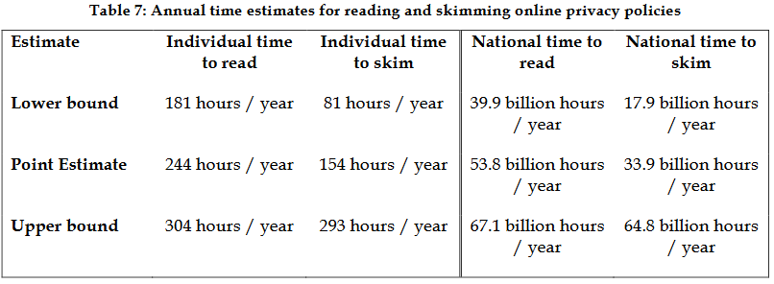
THE ELEPHANT IN THE ROOM – DOES ANYONE READ THESE AGREEMENTS?
Nick Diaz
Not many people read license agreements and privacy policies in full
From a study of 2500 people, about 8% bothered to read them (and that’s optimistic) [2]
70% of those people were finished reading within 12 seconds
We’re conditioned to accept them [1]
Reading all your privacy policies would take a VERY long time [3]
Notes:
Jokes aside, very few people read these agreements in full.
According to analysis of 2500 people installing software from a major provider, only 8% spent at least two minutes reading the agreement before accepting.
70% of these users were done within a mere 12 seconds.
Another study investigated our conditioning to accept these agreements without reading them, finding that when a relatively short passage was presented to users during an installation they were significantly more likely to agree to it when the button text was worded with traditional EULA terminology as opposed to conversational speech.
Finally, a study of privacy policies [very close cousins of the EULA] found that if you were to read every policy you came across in full you’d spend about 244 hours a year exclusively on that. For perspective…
If we went on a roadtrip to Mexico City and you sat in the back reading your agreements, you’d still have almost 50 hours of reading to go when we get back to Worcester

Slide 24
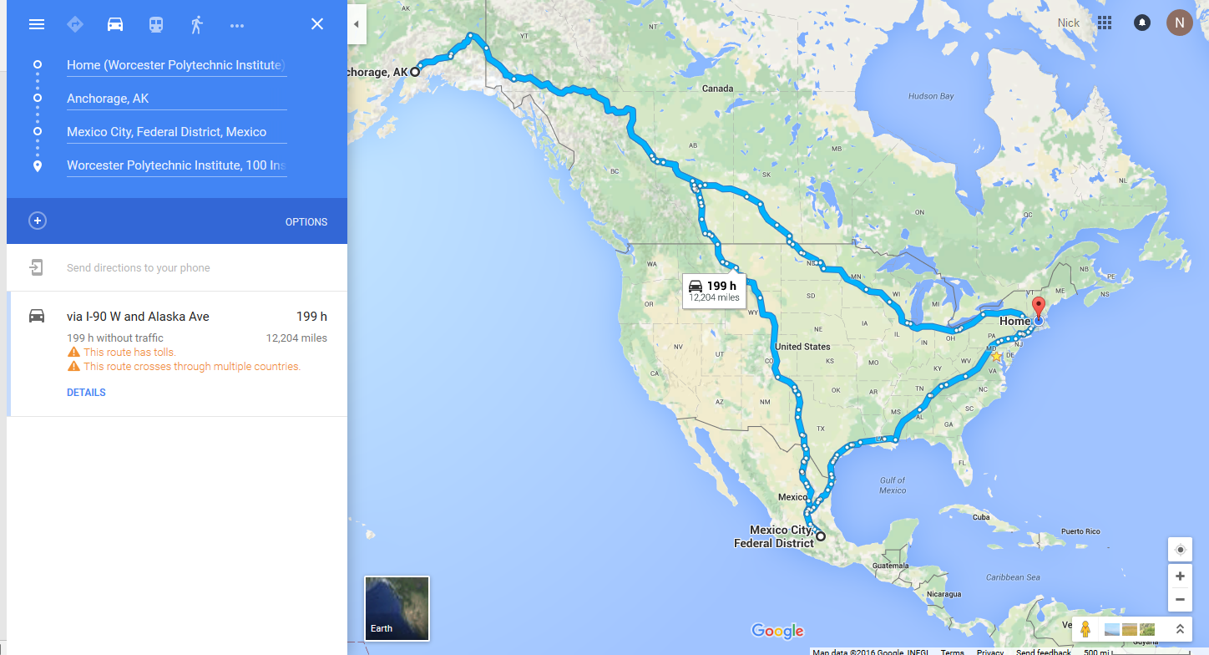
Estimate from Google Maps
Nick Diaz
Notes:
…and that’s a roadtrip to Mexico City by way of Anchorage Alaska. So companies are expecting us to do a lot of reading.
For another perspective, you can consider the dollar cost of all that lost productivity – $3,534 per year.

Slide 25
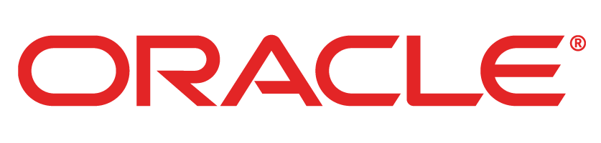

LEGAL CASES, FOR AND AGAINST THE EULA
Nick Diaz
Timothy S. Vernor v Autodesk Inc. [6] (2010)
  US Case on software resale, ruled in favor of the EULA
UsedSoft GmbH v Oracle International Corp [5] (2012)
  EU Case on software resale, ruled against the EULA
Notes:
So the question that may remain is: are these agreements valid if people don’t read them?
The answer to that is unfortunately the answer to most things: it depends. Some courts will rule that the agreement is valid, some will rule that the user is forced into it unreasonably. It also varies a lot depending on what the case relates to – for example, there are laws protecting reverse engineering specifically, so a EULA prohibiting that may be invalid in that instance.
I’ve chosen two cases to quickly review today, which show opposite sides of the spectrum for similar circumstances.
Autodesk case: This is a US case that was resolved in 2010, in which a man “Vernor” was reselling used Autodesk software on Ebay. According to the Autodesk license agreement, this is unacceptable, as their customers are stated to be licensing the product, not buying it, and therefore cannot resell and transfer their codes. Vernor argued that his reselling was protected under first sale doctrine, a law established in 1908 saying that after a product is sold once, protections on its resale are lifted (see used books). The court ultimately shot that down, and sided with the license agreement written by Autodesk, despite Vernor not even accepting the agreement for the software he was selling.
UsedSoft Case: This is a case from the EU, in which a similar dispute over software resale occurred. Here, Oracle was in court against UsedSoft, a German company that resells licenses for Oracle products. These licenses can then be used to download the product directly from the Oracle website, as if the customer of UsedSoft had bought the license from Oracle originally. The EU court determined that this was entirely legal, stating that once a rightholder sells a copy of software to a user for an unlimited period, the user is then entirely able to resell that software, despite any stipulations in the license agreement.
So as you can see, this is far from set in stone – granted we have courts on different continents in these examples, but it still shows that a clear answer to the legality of EULAs in various situations is debatable.

Slide 26
MY conclusion – STANDARDIZATION WOULD MAKE EVERYONE HAPPIER
Nick Diaz
EULAs would benefit greatly from standardization
  Users would know what to expect, requiring less exorbitant amounts of reading
  Companies could be better protected without as many concerns of misinterpretation or laws turning against them
Potential Downsides:
  It might be more difficult to specify certain needs for specialist software that might need unique considerations
  Standards require significant effort to create and maintain, and there isn’t much incentive for companies to pursue them when the current system is functioning
Check out tosdr.org [7]
Notes:
Discuss conclusion, highlighting the points mentioned on the slide.
As a final point, recommend anyone who is interested to look at tosdr.org, or “Terms of Service Didn’t Read” for a community sourced breakdown of the terms of service for many websites and applications.

Slide 27
References
Nick Diaz
[1] http://dl.acm.org/citation.cfm?doid=1753326.1753689
[2] http://www.measuringu.com/blog/eula.php
[3] http://lorrie.cranor.org/pubs/readingPolicyCost-authorDraft.pdf
[4] https://www.eff.org/wp/dangerous-terms-users-guide-eulas
[5] http://curia.europa.eu/jcms/upload/docs/application/pdf/2012-07/cp120094en.pdf
[6] http://cdn.ca9.uscourts.gov/datastore/opinions/2010/09/10/09-35969.pdf
[7] https://tosdr.org/
All sources retrieved on 3/27/16.

Slide 28
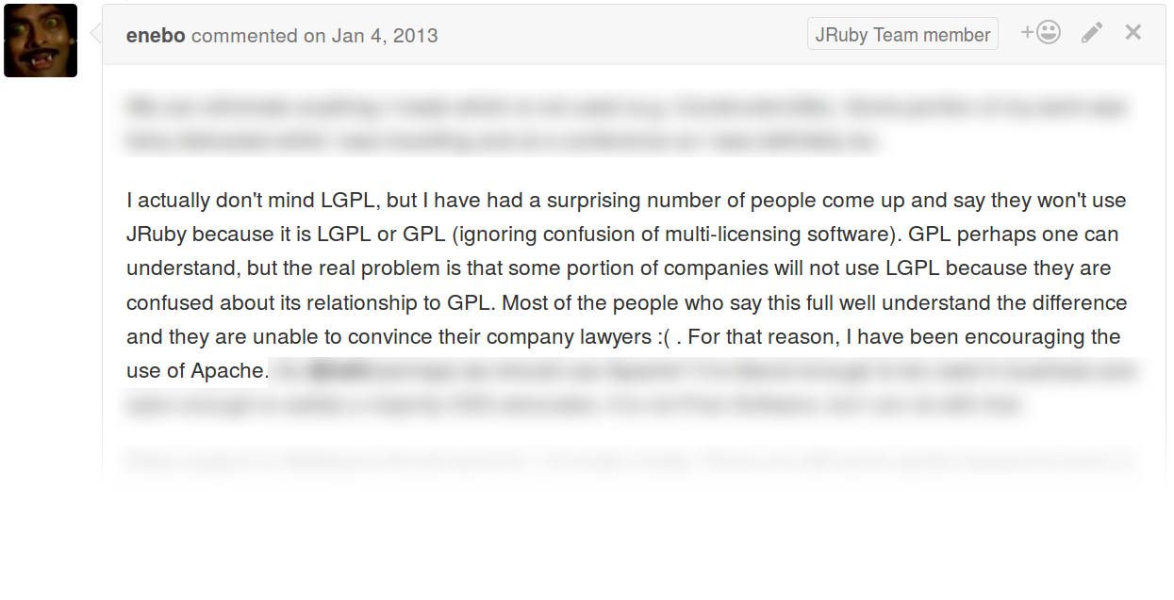
Deciding on licenses is fun
Patrick Plenefisch
<Supporting statements>
[1, 6, 7]
© 2016 Keith A. Pray & Patrick Plenefisch
28
Notes:
Licenses can make all the difference in software. Choosing the wrong one for your project means that the potential of your project is limited. Different licenses appeal to different developers and users in different ways, and I hope to touch on these effects in the next few minutes. On the screen here we see an interesting argument for what license to use. This is part of an actual conversation I had on an open source project, and essentially boils down to "I like GPL, you like GPL, dumb lawyers don't, so let's keep adoption up by not using the GPL". Research has shown that conscientious individuals choose popular licenses that they believe strike the right balance between user rights and corporate rights. So what do people choose?
28

Slide 29
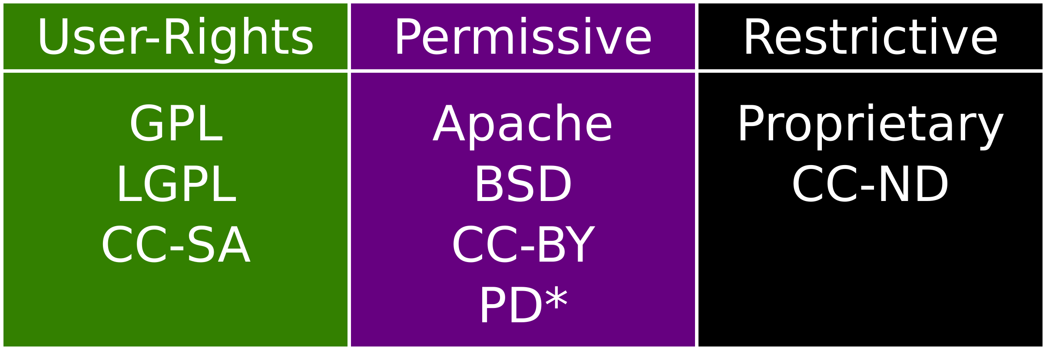
License categorization
Patrick Plenefisch
Groups I used
  User-Rights
  Permissive
  Restrictive
Include many works
  Software
  Music & Videos
  Pictures & Art
[2,3,4,6,7]
© 2016 Keith A. Pray & Patrick Plenefisch
29
Notes:
I started by classifying licenses into 3 licensing groups: user-rights, permissive, and restrictive. In the table of acronyms on the right, you can see where popular licenses fall. I also noted where the public domain is, but I excluded this from my search as it is vast. For comparison, I also looked at the Creative Commons licenses, even though they are not normally used for software but for music, videos, photographs, and artistic works. What I found was interesting, although limited in the restrictive category for software as I couldn't find any meaningful data for the mounds of proprietary software that exists. I thus limited the software to publicly available source as there have been several surveys of that. It is also important to note that while originally Open source software was entirely developed by individuals, these days about 2/3 of companies develop software based on open source efforts, and 3/4 use OSS in one way or another. Companies prefer the permissive licenses as they can then keep their modifications trade secrets if needed.
29

Slide 30
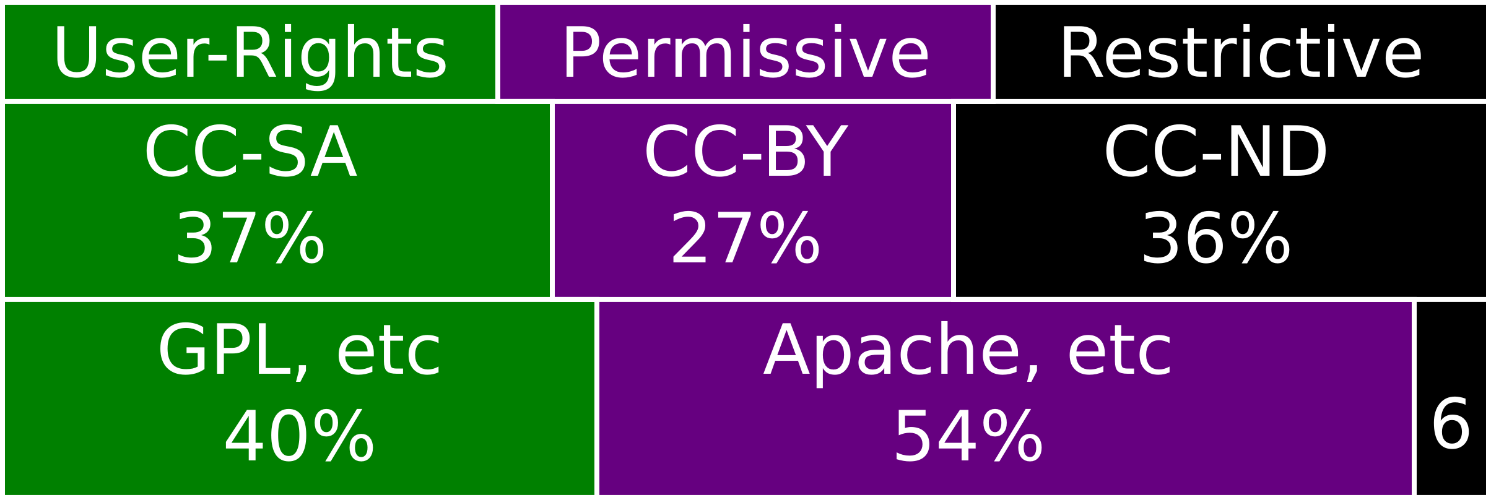
License Utilization
Patrick Plenefisch
Conflicting sources of estimates for software
Proprietary is hard to quantify
Permissive
driven by
adoption
User-Rights
driven by
competition
[2,3,5,6,7,8]
© 2016 Keith A. Pray & Patrick Plenefisch
30
Notes:
So we found that first of all: software estimates varied significantly based on the platform that the survey was done over. However, I did manage to find a reasonable survey over many of those platforms that should reflect a more diverse set of software. It was, however, only looking at publicly available sources, so proprietary sources were underrepresented as they are often not published. This makes it very hard to accurately quantify proprietary software. On this chart, we can see the Creative Commons breakdown as reported by Creative commons themselves, which again is biased in artistic endeavors and not software. On the bottom we see the software, and permissive takes up more than half of it. Looking at several papers, it was clear that permissive licenses are often chosen to gain marketshare rapidly for what people want as standards for interoperability, such as codecs and libraries. User-rights licenses are chosen more often when trying to compete with established, dominant proprietary software, like the GNU userland was. Restrictive software licenses were rarely chosen, but were biased to prevent commercialization most often. Additionally, one paper mentioned that new individuals are often biased to start contributing on user-rights projects vs permissive projects. This is interesting, and although they didn't explore it much further, it could be that individuals want to stand up for their rights after they are users. Questions?
30

Slide 31
References
Patrick Plenefisch
[1] https://github.com/jruby/jrubyfx/pull/6#issuecomment-11897867
[2] https://www.gnu.org/licenses/license-list.en.html
[3] https://stateof.creativecommons.org/2015/
[4] https://opensource.com/business/15/5/report-future-open-source-survey
[5] https://www.blackducksoftware.com/resources/data/top-20-open-source-licenses
[6] http://repository.cmu.edu/cgi/viewcontent.cgi?article=2479&context=tepper
[7] https://www.ime.usp.br/~kon/papers/TheAttractionofContributorsinFOSP.pdf
[8] http://www.infoworld.com/article/2615869/open-source-software/github-needs-to-take-open-source-seriously.html
© 2016 Keith A. Pray & Patrick Plenefisch
31

Slide 32
Class 5
The End
Keith A. Pray
Instructor
socialimps.keithpray.net
Notes:
This is the end. Any slides beyond this point are for answering questions that may arise but not needed in the main talk. Some slides may also be unfinished and are not needed but kept just in case.

