Slide 1
Unintended Consequences of a career in Engineering

Slide 2
How to end up a mass murderer
without even trying

Slide 3
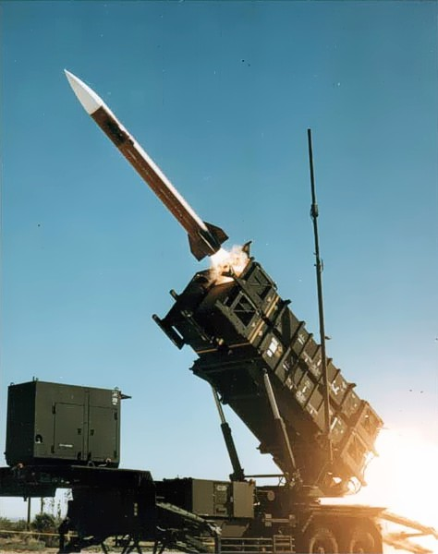
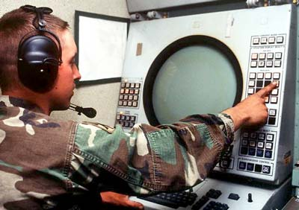
What am I here to talk about?
The PATRIOT System, and my part in it
  Anti-aircraft / ABM system
  PATRIOT stands for:
Phased
Array
Tracking
Radio
Intercept
Of
Target

Slide 4
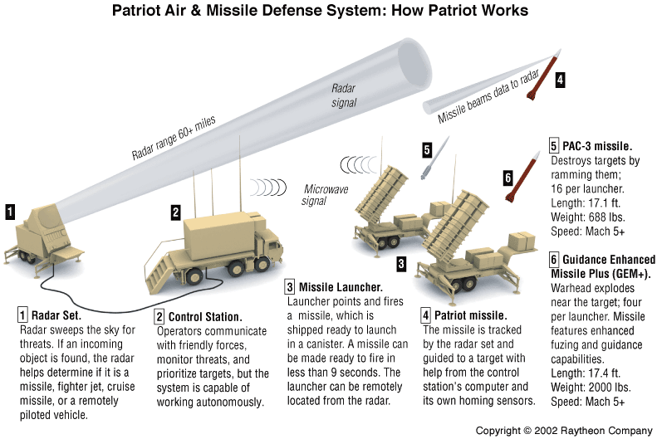
Here's what it looks like

Slide 5
PATRIOT TMU Program
Meant to upgrade the PATRIOT transmitter units with new control logic
  Simpler, fewer parts to replace
  Faster to repair
  More self-test information available (450 bits vs. 24)
  Better health monitoring
Replaced 63 circuit cards with 13 cards (including a microprocessor)
Program length was 5+ years from contract start to first units leaving factory
True Waterfall development effort
I worked this for 4 ½ years

Slide 6
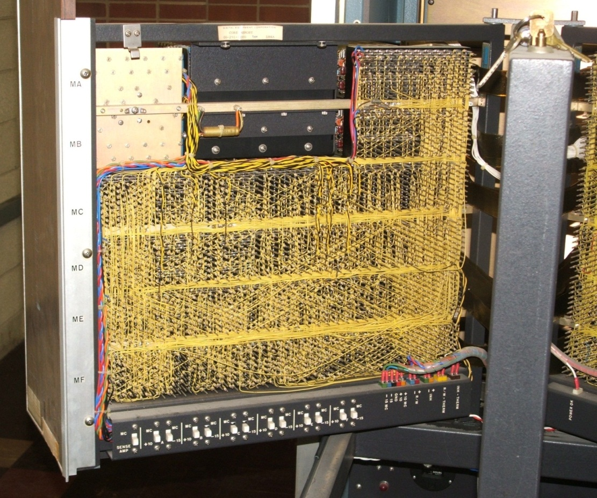
PATRIOT TMU Program
63 circuit cards
AND cards
OR cards
Inverter cards
Digital counter cards
All circuits wired on a backplane, using individual wires, like this:

Slide 7
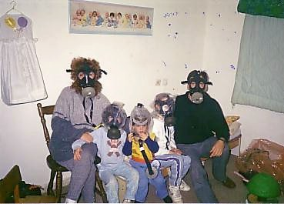
First Gulf War
Aug 2, 1990 – Feb 28, 1991 a.k.a. Desert Storm
In response to the constant air strikes, Iraq started launching Scud missiles first at Saudi Arabia, then Israel
PATRIOT batteries were permanently placed around sensitive areas, manned and running 24/7, in case of missile attack
Conventional high explosives
were carried by the Scuds,
but the fear was they would be
armed with chemical or biological weapons

Slide 8
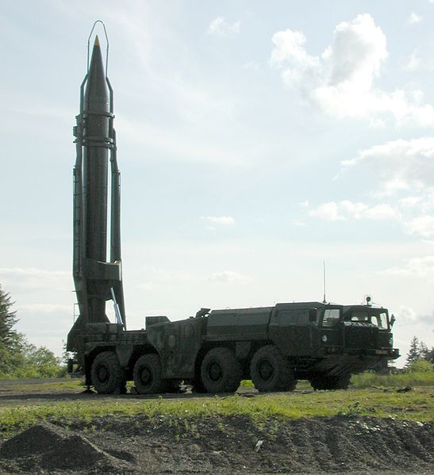
So what's a Scud anyway?
Scud means “to move or run switftly”
Soviet built surface to surface missile
Designed from the German V-2
Scud is the designation NATO gave the missile
Came in various versions as it was refined over the years – Iraq had Scud-B, the most common one (about 7,000 produced)
Can carry explosive, chemical, or 5-80 kilo-ton nuclear warhead
37 feet long
13,000 pounds at
launch
Flies at Mach 5

Slide 9
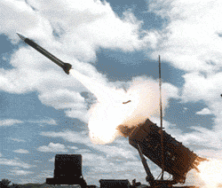
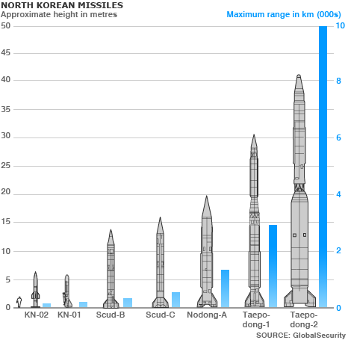
How effective was the Patriot vs the Scud?
In the initial trials, extremely (4 on 1)
In 'economy' mode (1 on 1), somewhat less effective
  The PATRIOT missiles were skewed towards the front of the Scud
  The idea was to disable/detonate the warhead
  Worked as planned, but that left several tons of falling rocket
When deployed to Israel, the 'economy' mode was less helpful as Israel is a densely populated area.
The worst failure occurred Feb 25, 1991 – 28 dead, 97 wounded.
Patriot
Scud

Slide 10
So what went wrong that day?
A software error in the Engagement Control System caused the PATRIOT guarding the area to lose track
Without a good target track, the PATRIOT missiles cannot engage
So it never fired at the Scud

Slide 11
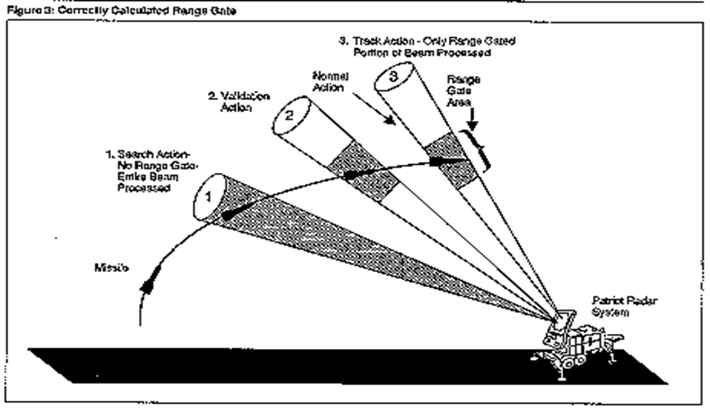
Normal operation
(this is all from the GAO report)

Slide 12
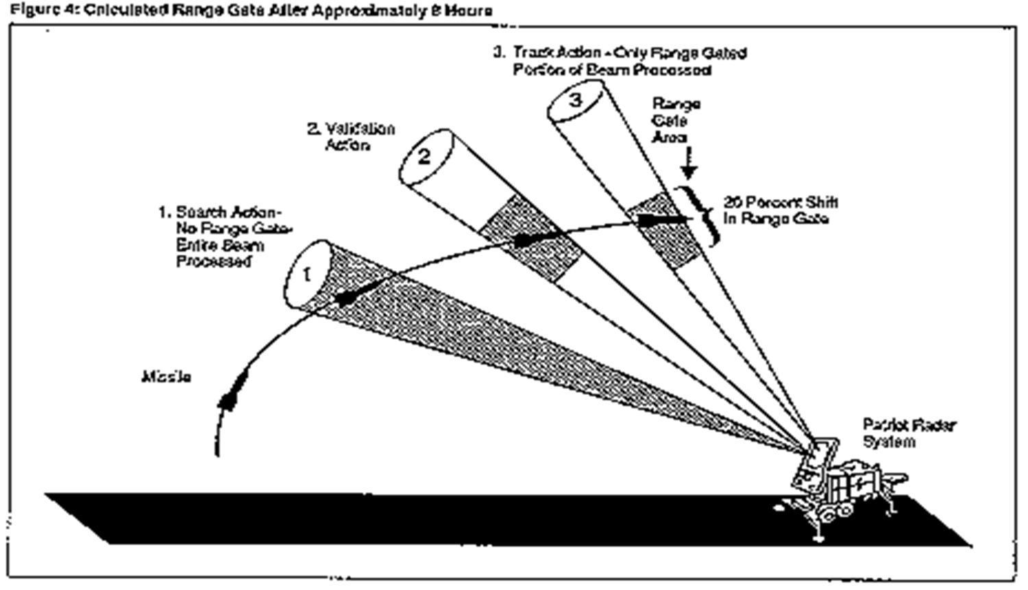
The range gate error

Slide 13
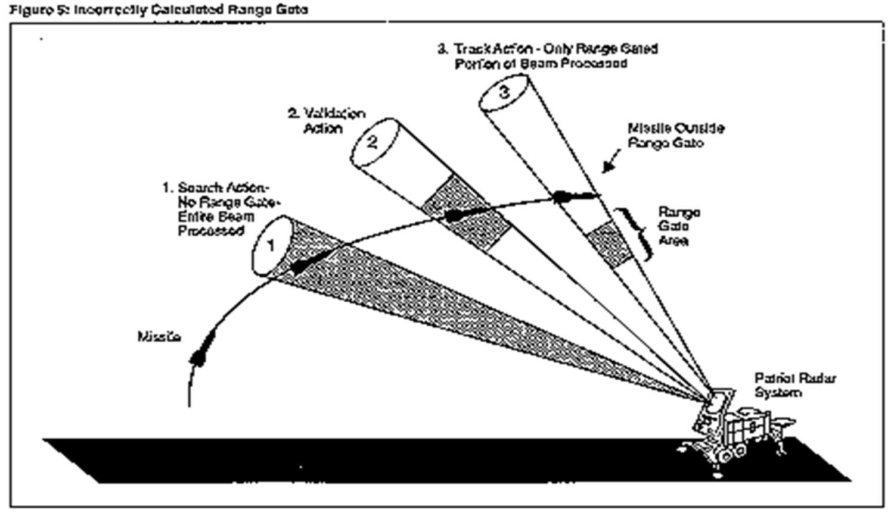
What happened that day

Slide 14
A Perfect Storm of Circumstances
The PATRIOT system's software had a flaw
Our Army never found the flaw due to how they used the system
  Used as a point defense system against the Soviet Union mostly
  Moved around constantly for security reasons
  Pretty reliable, but if down, it took a long time to repair
I had just finished the TMU project at Raytheon, and the upgraded units were in the field – both in Saudi Arabia and Israel.

Slide 15
The Storm Continues Building
The PATRIOT systems were being used in fixed positions, run 24 hours a day
With the TMU improvements I made, the system was both more reliable (it could spot trouble sooner) and much quicker to repair
The Israel Army found the flaw in PATRIOT when running for as little as 8 hours
They alerted our Army, which issued a vague warning that didn't prompt anyone to action

Slide 16
The Storm breaks
The Iraqi launched a Scud missile at Dhahran, in Saudi Arabia
The Scud functions perfectly
The PATRIOT battery guarding the city was running too long, and the flaw prevented the missile from being tracked.
The automatic systems never fired
There was no time for the operators to do anything
The Scud hit the barracks, killing and wounding 125 people

Slide 17
And yet it could have been prevented
Raytheon worked on a software fix to the flaw for 2 weeks after it was found – the two weeks prior to the attack
Patches were distributed for the software to all PATRIOT units in the theatre

Slide 18
And yet it could have been prevented
Raytheon worked on a software fix to the flaw for 2 weeks after it was found – the two weeks prior to the attack
Patches were distributed for the software to all PATRIOT units in the theatre
The patches arrived on Feb 26th
One day after the barracks was destroyed.

Slide 19
Nothing like that can happen to me, right?
No matter what we're working on, there is almost always some potential for disaster, especially with software and hardware for the military (also CIA, NSA, etc.), transportation, and medicine (and many others).
Sometimes it's not even doing your job wrong, but doing it right, that can lead to disaster.
How will YOU handle it?

