Slide 1
Class 11
Work
Keith A. Pray
Instructor
socialimps.keithpray.net
Notes:
Here’s the title slide. Excited already, aren’t you?
Last paper average: Game: Not in Yet
Total points not counting extra credit so far: 32 - 40 - 46

Slide 2
Overview
Review
Assignment
Students Present

Slide 3
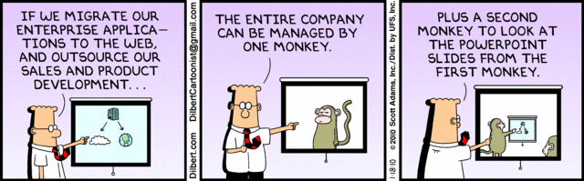
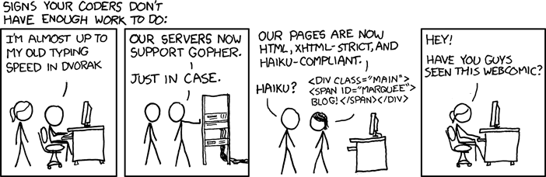
http://xkcd.com/554/

Slide 4
Group Quiz
List 2 ways IT can lead to organizational change.
List 4 ways a Video Game Producer may protect its IP and what specific IP each protects.
List a computing technology that can be used to protect an individual’s privacy.
List a computing technology that can be used to intrude upon an individual’s privacy.
Notes:
Could split into groups of 4-5 for this.
Fill time with Work Discussion on Course Web Site
Maybe watch video:
CGP Grey
Humans Need Not Apply – 2014-08-13
http://www.youtube.com/watch?v=7Pq-S557XQU
Last access 2015-04-23
Look at:
BBC Intelligent Machines
http://www.bbc.com/news/technology-33978561
BBC Likelihood of robot taking your job
http://www.bbc.com/news/technology-34066941
Find out what your DNA says about you and your family.
https://www.23andme.com/

Slide 5
Overview
Review
Assignment
Students Present
Notes:
Review Group Assignment Details.

Slide 6
Overview
Review
Assignment
Students Present

Slide 7
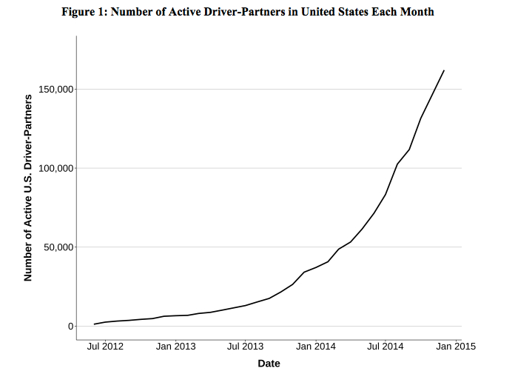
Your Ride, On demand
Fuchen Chen
Uber mobile app
Connect driver to passengers
Timeline
  2009-10 San Francisco Bay Area
  2011 National expansion
  2012-13 International Expansion
58 countries and 300 cities [1]
$10.8B Booking in 2015 [2]
Number of Active Driver-Partners in United States Each Month [3]
Notes:
The company develops, markets and operates the Uber mobile app, which allows consumers with smartphones to submit a trip request which is then routed to Uber drivers who use their own cars.
Uber started in 2009 in San Francisco Bay Area as
Then, it starts to expand to the entire nation in 2011
During 2012-2013, it makes international expansion to Europe, Asia.
By May 28, 2015, the service was available in 58 countries and 300 cities worldwide.
Uber Technologies Inc's global bookings are projected to rise nearly threefold to $10.84 billion this year
reach $26.12 billion the next, according to a recent presentation for potential investors seen by Reuters

Slide 8
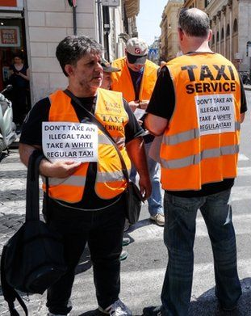
Your Ride, In trouble
Fuchen Chen
Wildly unprofitable [4]
Lawsuits
  Misclassification employees as contract workers [5]
  Case certified as a class action on Sept 2, 2015
  Protest
  European taxi drivers [6]
DON'T TAKE AN ILLEGAL TAXI TAKE A WHITE REGULAR TAXI [6]
Notes:
Uber has traditionally been tight-lipped about its finances, but a new leaked document, obtained by Gawker's Sam Biddle, suggests the $50 billion company is wildly unprofitable.
Its losses in 2012, according to Biddle, totaled $20.4 million. In the first half of 2013 the company lost more than $15 million.
The lawsuit claims Uber has misclassified its employees as contract workers. It alleges that Uber treats drivers like employees but without providing the requisite benefits, like health insurance and expense reimbursements.
Taxi drivers blocked roads in Paris, Madrid, London, Milan, Berlin and other cities in protest against the rise of services booked using smartphone apps. They say there has been a lack of regulation concerning rival mobile service Uber.

Slide 9
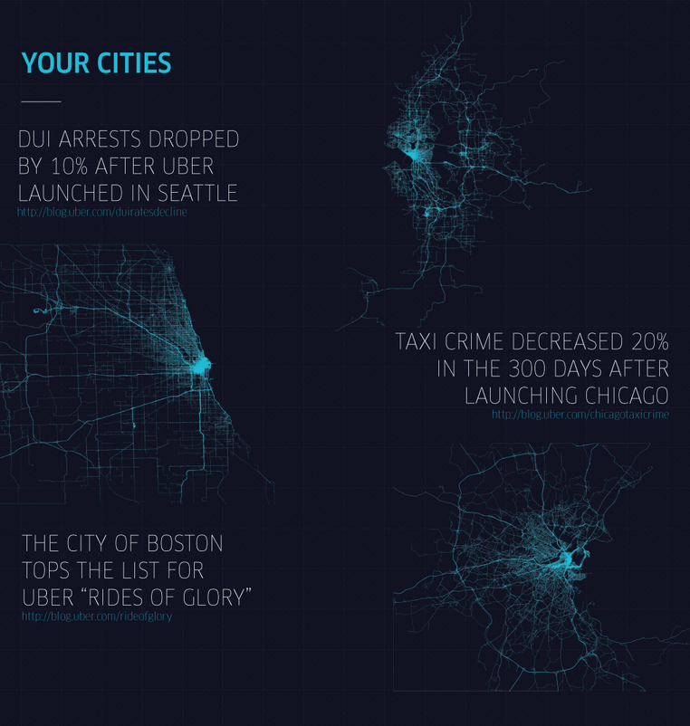
Uber Creates better jobs
Fuchen Chen
  Complete flexibility
  Earn more ($19 vs. $13) [3]
  Efficient (Average pick up time < 10 min) [7]
  Rating system protects drivers and passengers
[7]
Notes:
Uber mobile app as a creative computing technology has created more and better jobs.
It is totally flexible to work as a Uber driver. Driver can choose how many hours they work and when they work. The job can be part time or full time.
Uber drivers earn more than regular drivers. They earn an average of $19 per hour, $6 more than the regular taxi driver.
With the help of GPS, real time tracking system, Uber connects drivers with customers more efficiently, the average pick up time is less than 10 minutes.
The rating system that allow driver and passengers to give rate to each other help prevent rude behavior. Improving the working experience.

Slide 10
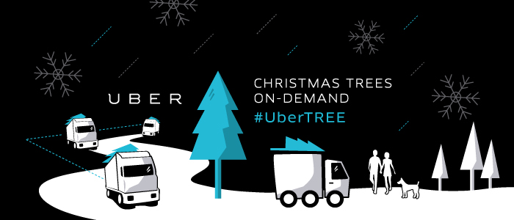
Ride sharing will Create More jobs
Fuchen Chen
Everyone's private driver -> Where lifestyle meets logistics [8]
  UberTREE [9]
Notes:
Ride sharing becomes a very powerful tool to utilize all available resources to achieve more. Uber discovers such large resources. It is trying to make use of them with the aid of computing technology.
In 2013, Uber change its tagline from Everyone's private driver to Where lifestyle meets logistics. Uber's car service of today could form the backbone of a landscape-changing logistics, delivery, and travel company of tomorrow.
At that time, all available resources can be gathered together and people can have lots of jobs to do besides the regular job. One individual may not work a lot every day but if every one contributes a little bit, the result will be huge.
With the help of The Home Depot, Uber delivered trees on-demand Thursday, December 5th 2013 within 10 major U.S. cities. Although it is more like an advertisement, UberTREE shows a little bit what sharing of transportation could do to help delivery and logistics.

Slide 11
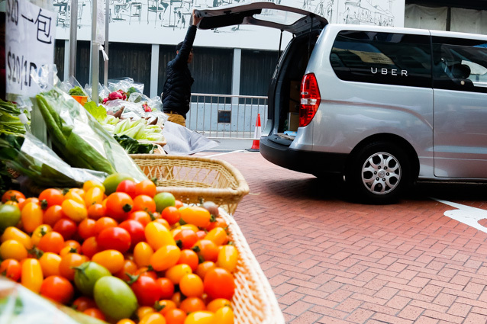
Ride sharing will Create More jobs
Fuchen Chen
  UberCARGO [10]
Notes:
Moreover, Uber is experimenting a new ‘rant a van’ service in Hong Kong.
With UberCARGO, a van arrives wherever you want it to be in minutes. You can load your items in the back of the van yourself or request the driver’s assistance if you need an extra hand. Deliveries can easily be tracked in real-time through the app, the item’s location can be shared with the recipient and you can even ride along with your goods so you’ll have ease of mind that your items are safe.

Slide 12
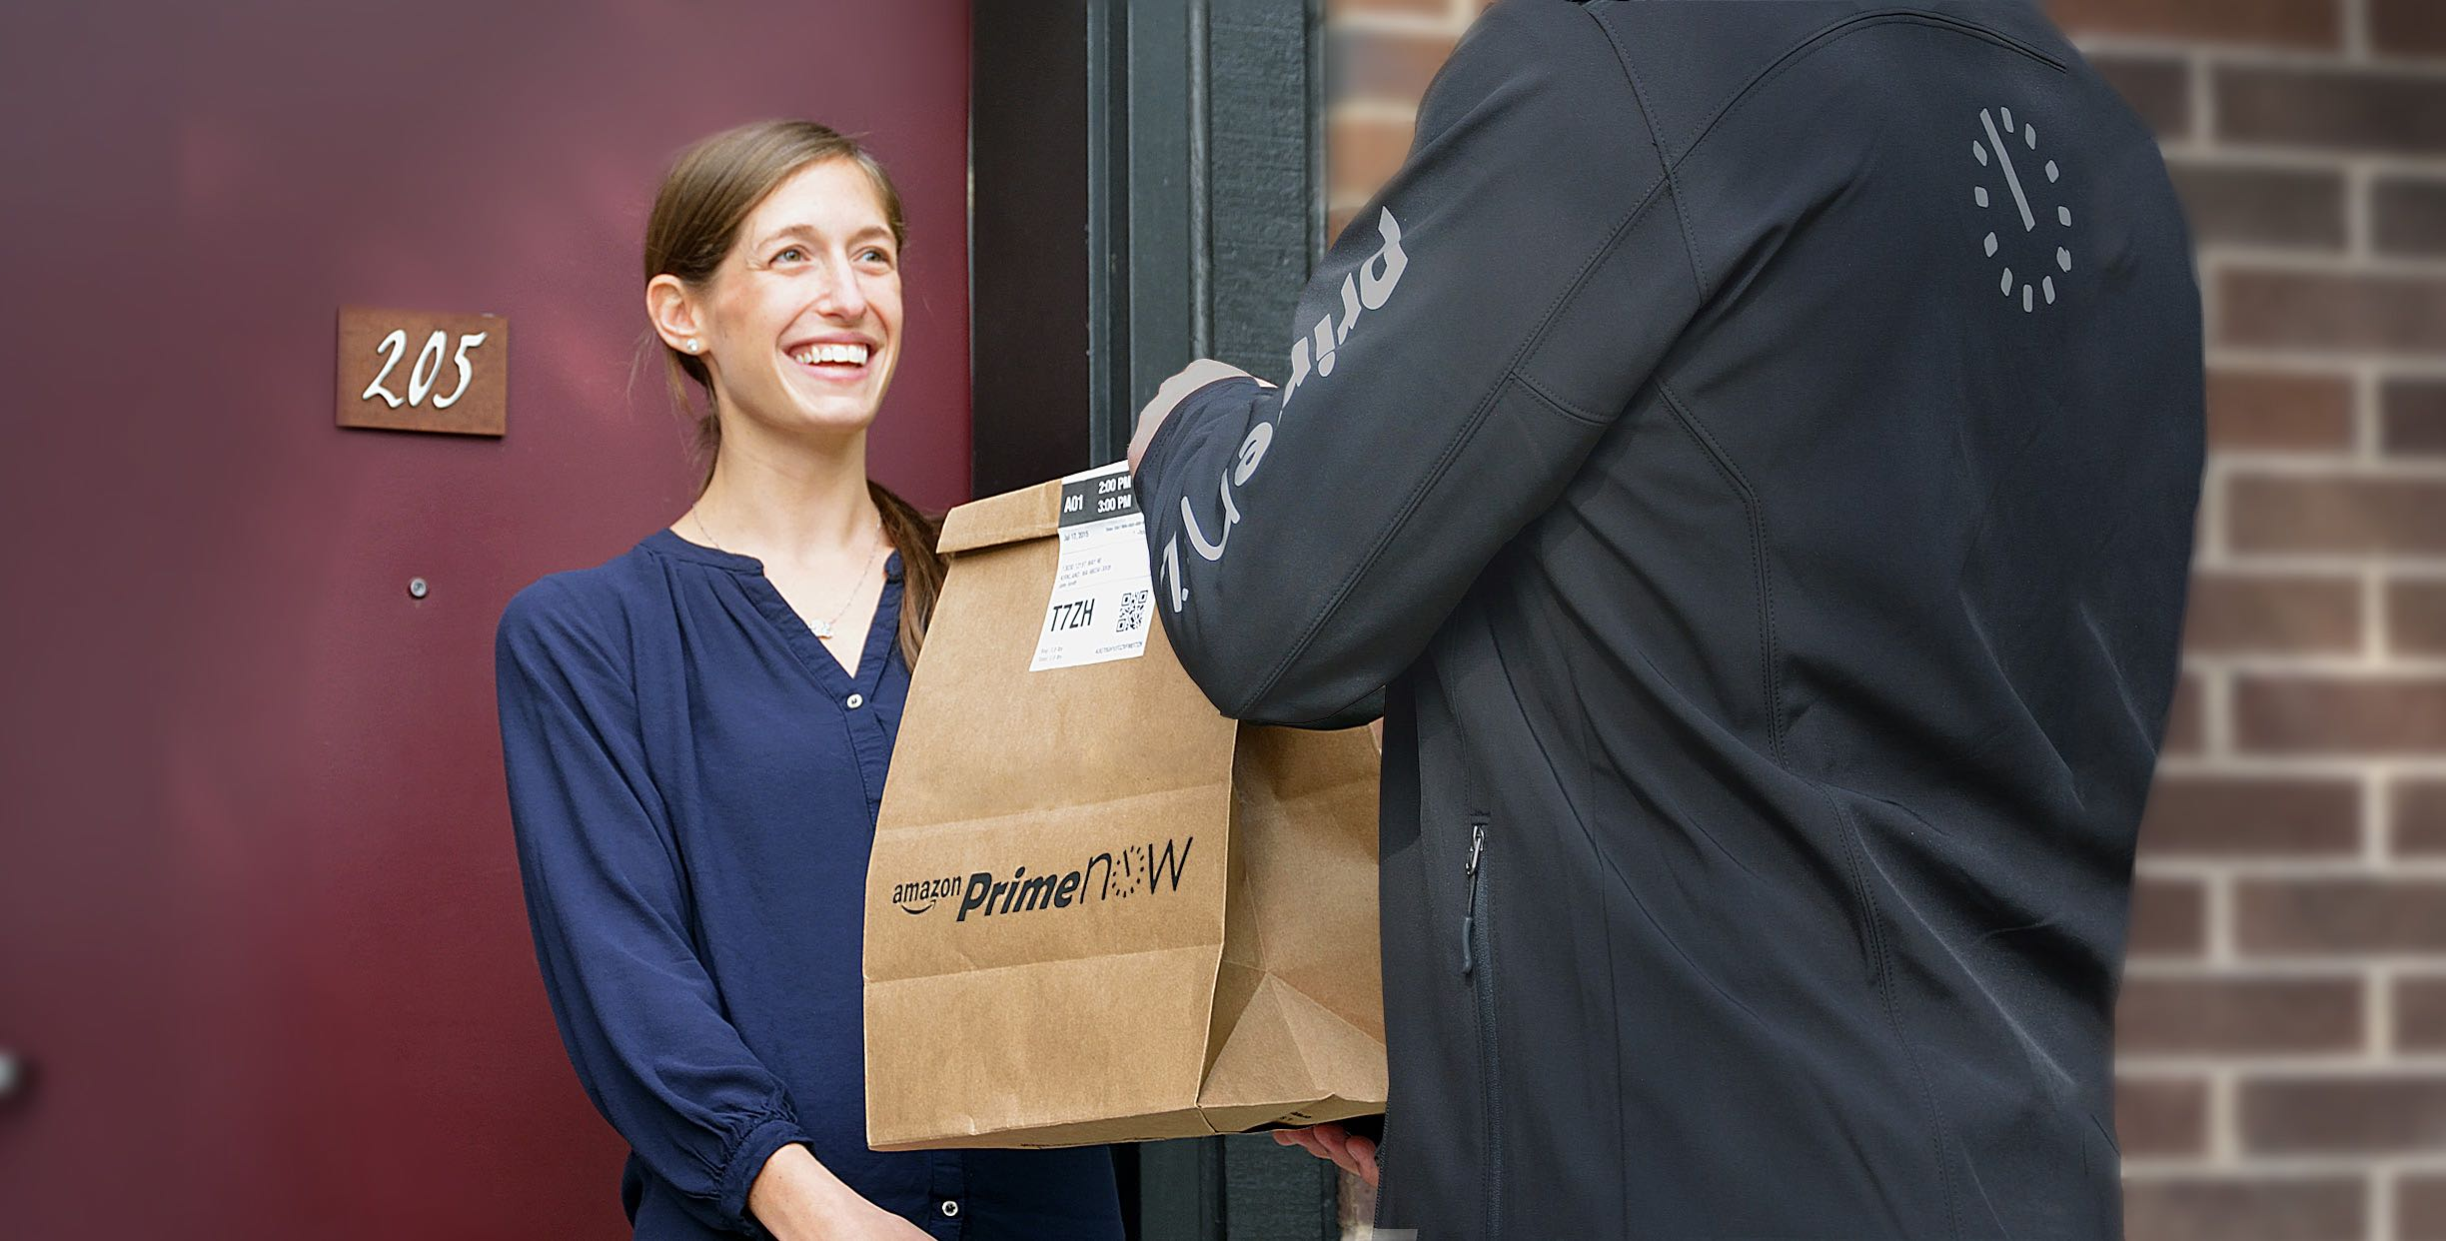
Ride sharing will Create More jobs
Fuchen Chen
  Amazon Flex [11]
Notes:
Not only Uber, other companies are also aiming this market such as Amazon
Make $18–25/hr delivering packages for Amazon with your car and smartphone. Be your own boss: deliver when you want, as much as you want. Available now in Seattle.

Slide 13
References
Fuchen Chen
[1] https://www.uber.com/cities
[2] http://www.cnbc.com/2015/08/21/uber-seen-reaching-108b-in-bookings-in-2015.html
[3] http://venturebeat.com/2015/01/22/inside-ubers-staggering-u-s-growth-40000-drivers-joined-in-december-and-average-19-per-hour/
[4] http://www.businessinsider.com/ubers-revenue-profit-and-loss-2015-8
[5] http://uberlawsuit.com/
[6] http://www.bbc.com/news/world-europe-27792942
[7] https://newsroom.uber.com/2014/05/an-uber-impact-20000-jobs-created-on-the-uber-platform-every-month-2/
[8] http://www.inc.com/adam-vaccaro/uber-isnt-a-car-service.html
[9] http://newsroom.uber.com/2013/12/o-ubertree-o-ubertree/
[10] http://techcrunch.com/2015/01/08/uber-cargo/
[11] https://flex.amazon.com/

Slide 14
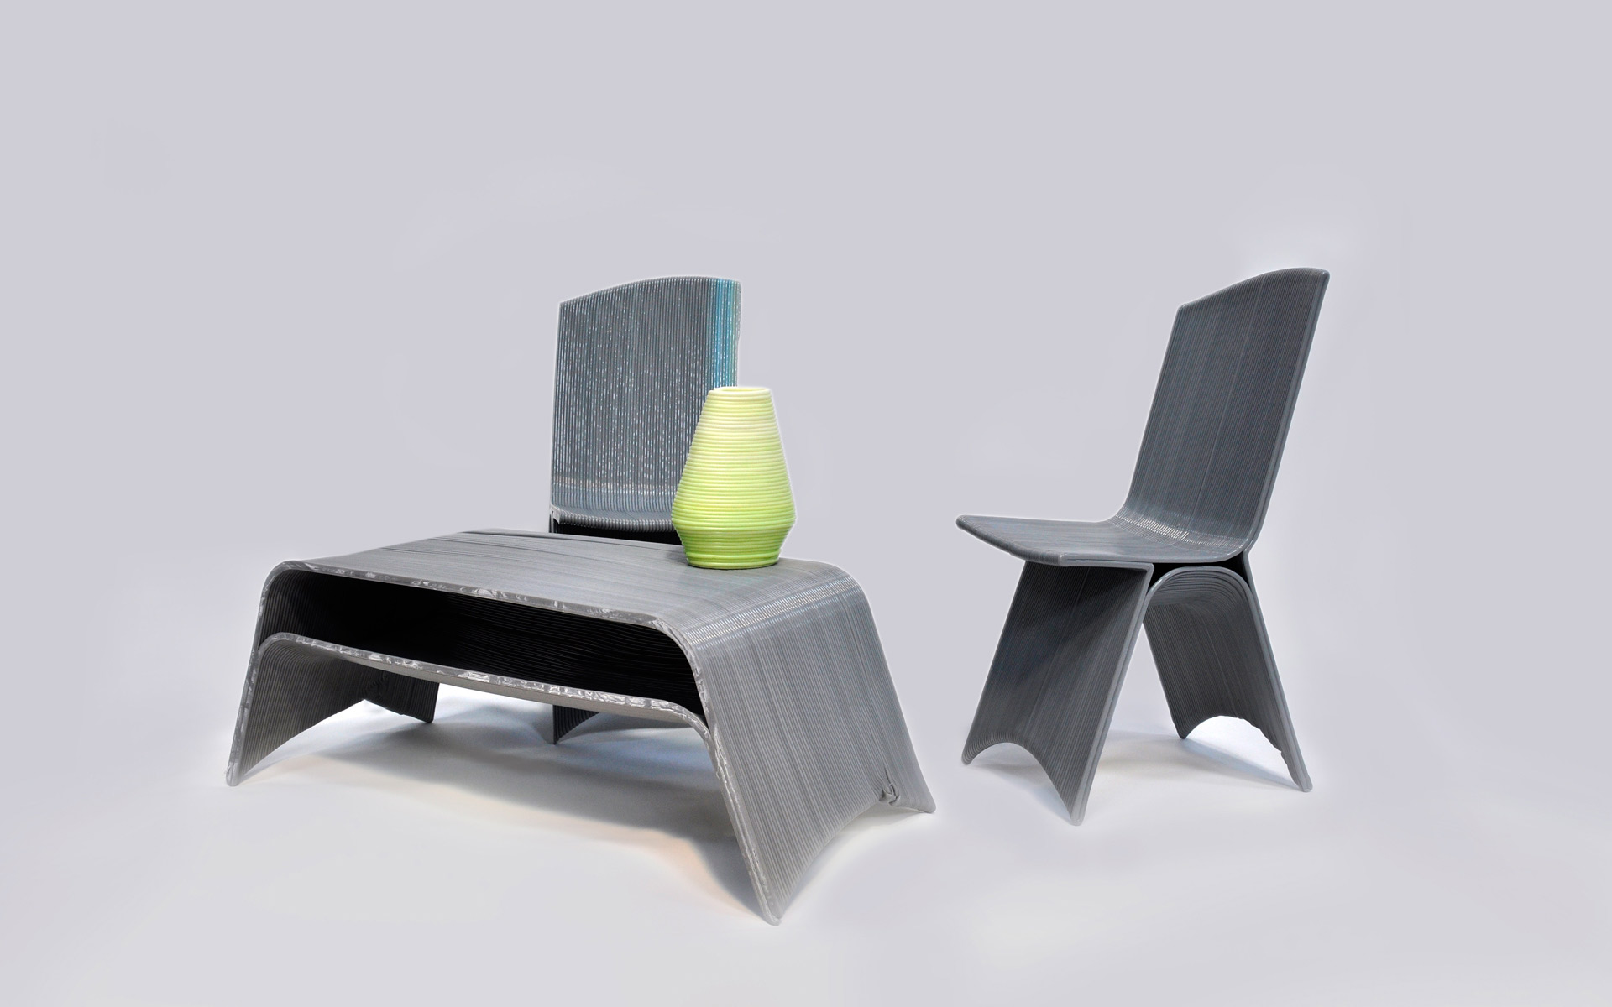
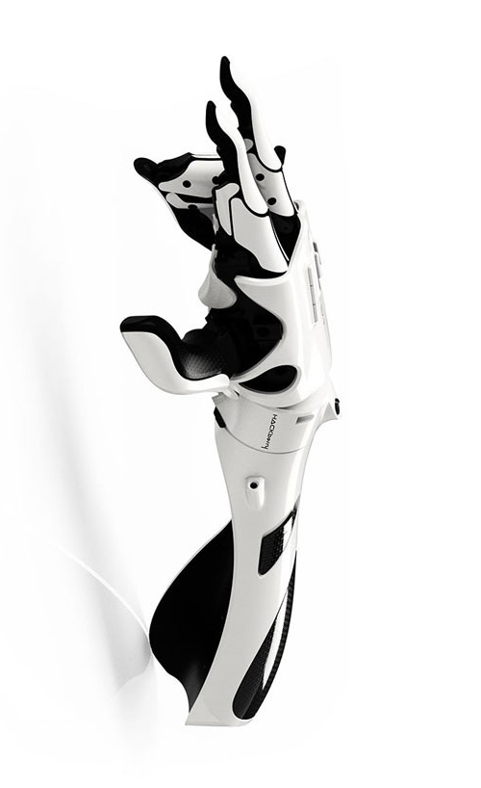
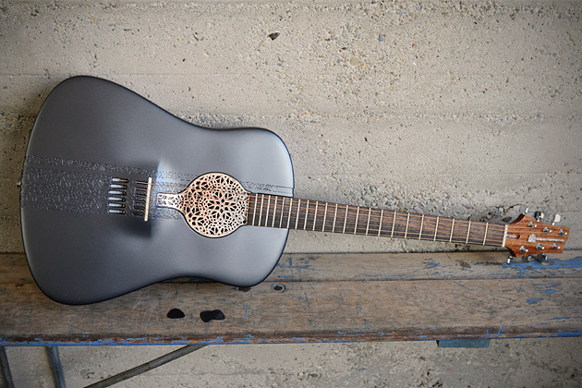
3d Printers in the workplace
Stephen Lafortune
Human Tissue
Drugs
  Can be custom made for patients with different dosages
Furniture
Prosthetic Limbs such as the Exiii Hackberry
  Only $200 compared to over $10,000 for normal prosthetics [5]
Acoustic and Electric Guitars
  Works great and doesn’t break under the 200 pounds pressure of tuning the strings
  Guitar in picture used around $3,000 worth of plastic [11]
http://www.designboom.com/wp-content/uploads/2015/05/exii-bionicarm-desigboom-01-818x500.jpg, http://3dprint.com/wp-content/uploads/2014/06/drawn-featured.jpg, http://images.bwbx.io/cms/2012-10-11/1011_3d_guitar_630x420.jpg
Notes:
Tissues [3]
Prints human tissue layer by layer
Can use someone’s cells so there is less of a chance of rejection
Drugs [2]
Can be made more porous, dissolves instantly
Can have high dosages, know that every dose will be the same
Could have custom medicine for people
Recently FDA approved
Furniture [3]
Can be made with very large 3d printers
Prosthetic Limbs [5]
Hackberry
Much cheaper than normal prosthetics, going from well over $10,000 to only around $200
Guitars
Can make the body of an electric guitar as seen in the picture

Slide 15
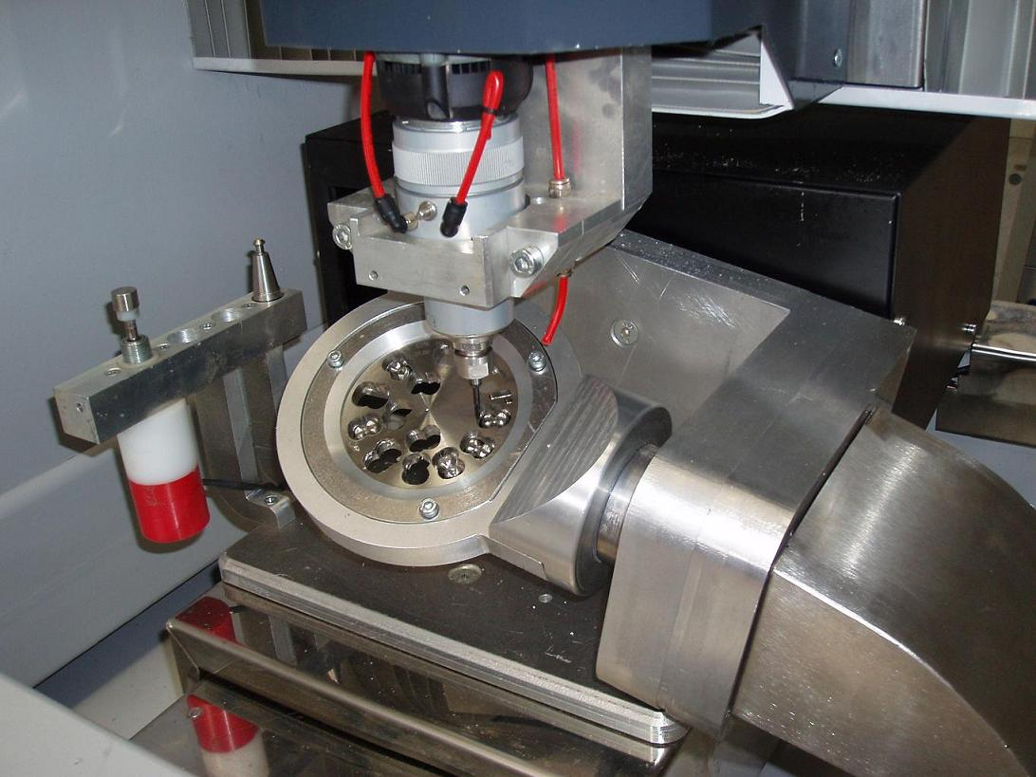
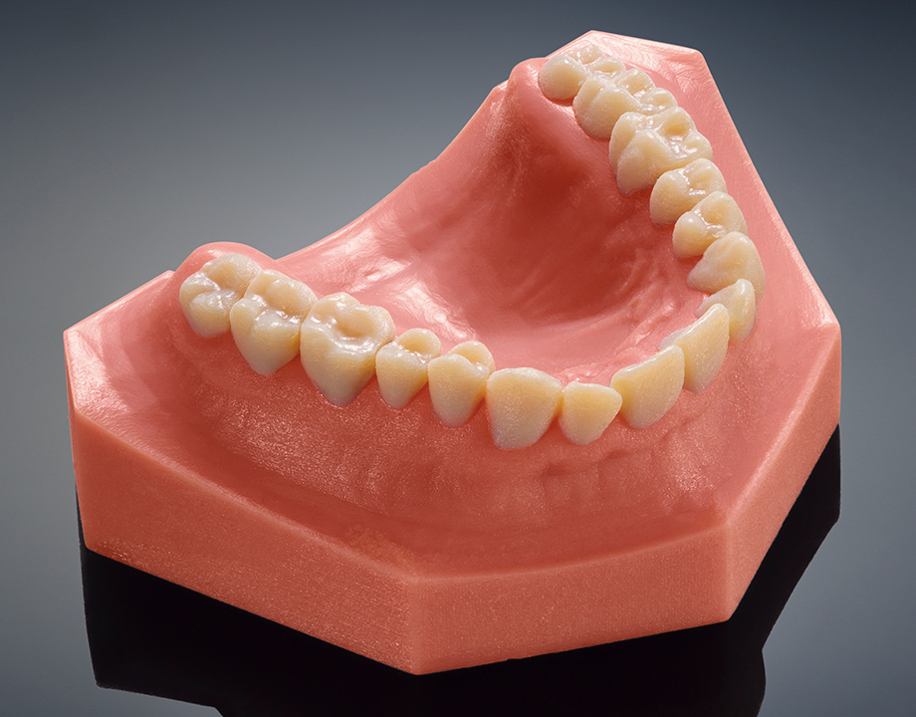
3d Printers in the dental Industry
Stephen Lafortune
Crown procedures
  Traditional procedure several visits over a few weeks compared to just an hour for CAD crown [5]
  CNC milling machine
DENTCA dentures
  2.5 times faster fabrication, turnaround time decrease from 30 days to just 5 [8]
Dental models
http://www.zaridas-cnc.gr/album/dentaldet.jpg, https://i.kinja-img.com/gawker-media/image/upload/m7goxbnxt68dpezea3z9.jpg
Notes:
Crown procedures [4]
Go from taking several visits to just an hour
Camera scans the teeth
Uses a CNC milling machine
Different than a 3d printer in that
Carves the crown out of porcelain
Dentures [8]
New 3D printable denture base, DENTCA
Recently approved by FDA
“light-cured resin indicated for fabrication and repair of full and partial removable dentures and baseplates” [7]
2.5 times faster, fabrication goes from 30 days to just 5
Dental Models [9]
Incredibly realistic models are possible
Allows testing of dental appliances without needing the patient
Dental appliances can then be refined to work better when actually used in the patient

Slide 16
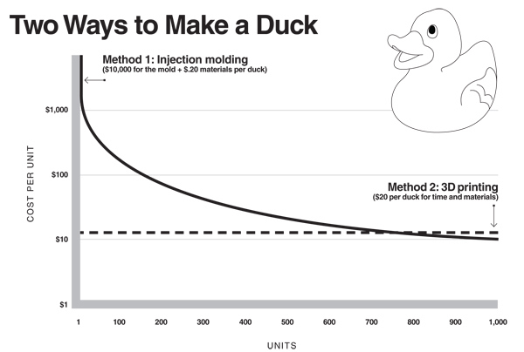
Benefits
Stephen Lafortune
Faster Development Process
Cost
Testing
Visualization and Feel
Customizable
Surpass limits of standard manufacturing
High volume 3d printing getting cheaper
Traditional manufacturing becomes cheaper
https://multimediaman.files.wordpress.com/2013/06/two-ways-to-make-a-duck.jpg
Notes:
Development Process [12]
Testing ideas, building prototypes, accelerates the design process
Cost [12]
Creating prototypes costs much less, only need a printer instead of injection mold tools etc
For actually producing the cost per unit stays pretty consistent
There is a point where traditional manufacturing becomes less expensive
Testing [12]
Can make a prototype, runs into issue, easy to tweak the 3d model and print a new one and test it
Visualization and feel [12]
When pitching a product it is easy for the other person to understand if they can see and feel it
Customizable [12]
Can make something to exact specifications, whether it be a part for a no longer developed toy, or something like custom dentures
Surpass Limits of standard manufacturing [12]
Easy to make things that were impossible or really difficult before
Such as square holes
Mention Negatives
Cost of machine
Time
High volume can be expensive
High volume 3d printing [1]
If 3d printing could get 4x to 10x times faster than current 3d printing, then it could compete with anything else
Building with layers and fusing them with a laser is slow
As speed gets better more companies will switch
More people using 3d printing means the cost of the plastics and other materials will come down, meet the demand
Injection molding will stick around because more materials available

Slide 17
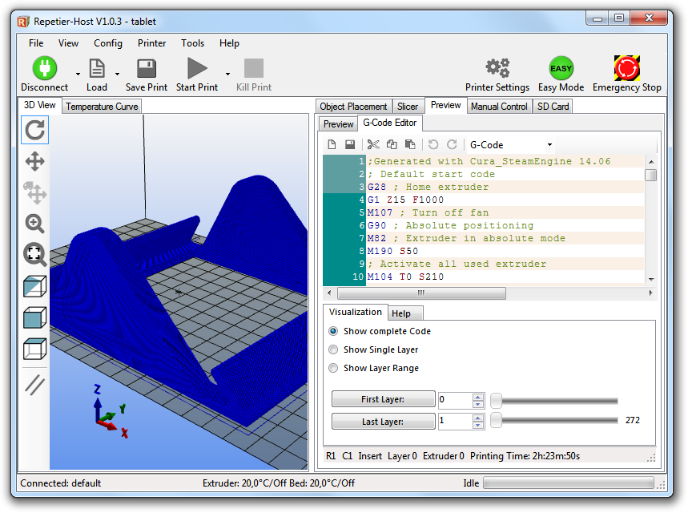
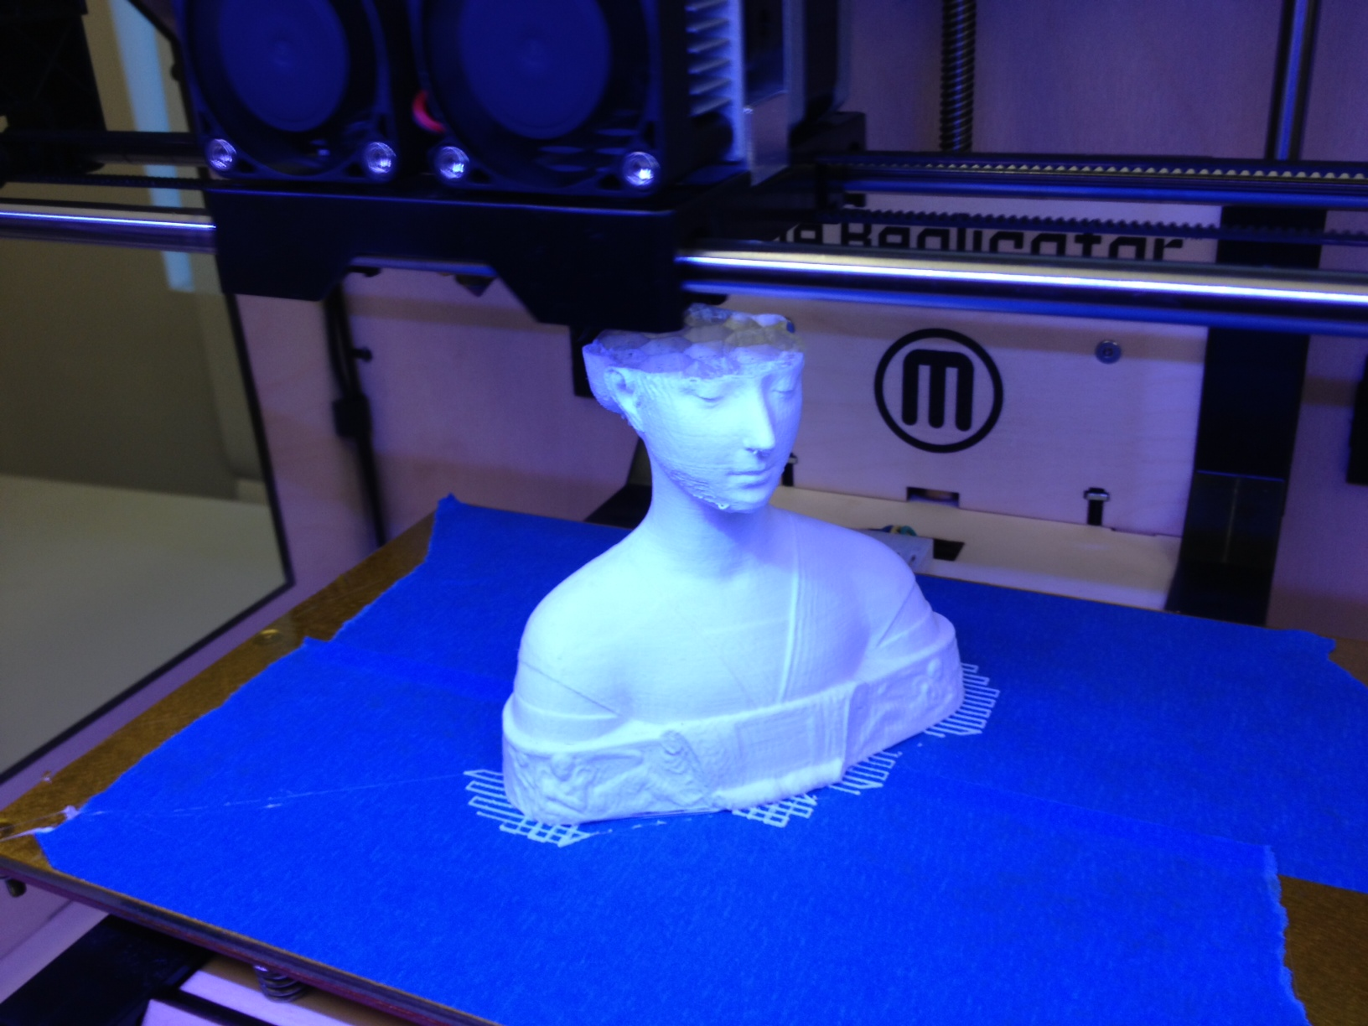
Technology behind 3d printing
Stephen Lafortune
Can “print” a digital 3D model
3D model is used to generate G-Code
G-code tells the printer where to place the print head during the printing process
Fused Deposition Modeling/Fused Filament Fabrication
http://www.repetier.com/w/wp-content/uploads/2013/12/gcodeeditor.png, http:// blogs.baruch.cuny.edu/cis3810/files/2012/09/photo.jpg
Notes:
Uses a digital 3D model and “prints” it out ( layer by layer) [7]
Can download models
Use a camera or 3d scanner to make a model
Make model using CAD software
G-Code
- Tells the machine how to move
Cheapest and Easiest Printing Technologies
Fused Deposition Modeling/Fused Filament Fabrication (printing out layers)
Often used in the home 3d printers
Thermoplastic such as PLA or ABS put into extruder and comes out of hotend
Stereolithography (laser or DLP projector and photosensitive resin)
Printed in a vat, laser hardens the material
Better accuracy, less layers

Slide 18
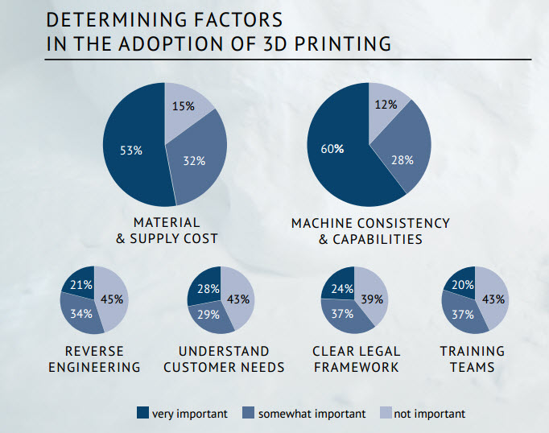
Adoption of 3d Printers
Stephen Lafortune
“Prototyping (63%), proof of concept (27%) and production (26%) are the three most dominant uses of 3D printing in Europe today.”[2]
“68% of respondents are forecasting their spending on additive manufacturing will increase in 2015.”[2]
http://blogs-images.forbes.com/louiscolumbus/files/2015/05/determining-factors1.jpg
Notes:
Additive Manufacturing – synonym for 3d printing
Companies are mainly using it for protyping
Same order of dominant uses in America, with last one being marketing samples
- Reference the faster development process in previous slide
Companies want to spend more on 3d printing
Pie charts
Big factors are the material and supply cost
Initial cost of printers
How much will the materials cost
Saving money with protoyping
Machine consistency and capabilities
Need to be able make what the company needs
Different technologies of printing

Slide 19
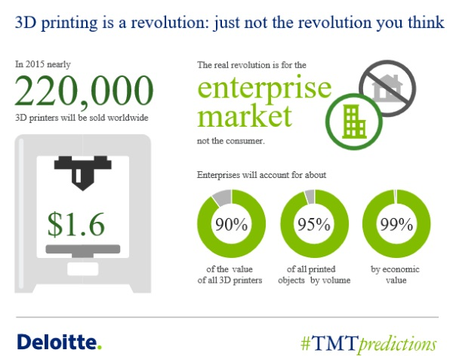
Conclusion
Stephen Lafortune
3D printing changes the production process
Cost efficient and time saving
Wide variety of uses
Next step is having them in homes
  Makerbot Replicator costs $2,899 [10]
http://www.3ders.org/images2015/deloitte-predicts-220000-3dprinters-sold-in-2015-4.jpg
Notes:
3D printing changes the production process
Quicker to make prototypes and test
Cost Efficient and Environment friendly
Materials can cost much less than traditional products
Costs less time too
Wide variety of uses
Reference previous slide
Next step is having them in homes
Consumer 3d printers getting lower in price
Easier for consumers to make things with downloadable models
Imagine printing out a set of toys for your kids or a chess set

Slide 20
References
Stephen Lafortune
[1] Abrams, Michael. "3D Printing for Mass Production." 3D Printing for Mass Production. The American Society of Mechanical Engineers, Feb. 2015. Web. 02 Oct. 2015.
[2] Basulto, Dominic. "Why It Matters That the FDA Just Approved the First 3D-printed Drug." Washington Post. The Washington Post, 11 Aug. 2015. Web. 01 Oct. 2015.
[3] Chuang, Tamara. "10 Amazing Things 3-D Printers Can (or Could) Make." TheStreet. TheStreet, Inc., 26 Oct. 2012. Web. 01 Oct. 2015.
[4] Columbus, Louis. "Why 3D Printing Adoption Is Accelerating Globally." Forbes. Forbes Magazine, 13 May 2015. Web. 30 Sept. 2015.
[5] "Digital Dentistry: Is 3D Printing Revolutionizing Restorations?" Whats in Your Mouth. National Association of Dental Laboratories, 06 Mar. 2014. Web. 30 Sept. 2015.
[6] Hornyak, Tim. "This Exiii Hackberry 3D-printed Hand Costs $200 and Could Mean the World for Amputees." PCWorld. IDG Consumer & SMB, 8 June 2015. Web. 01 Oct. 2015.
[7] Krassenstein, Brian. "What Is 3D Printing & How Do 3D Printers Work? — A Guide." 3DPrint.com. MecklerMedia, 18 July 2015. Web. 30 Sept. 2015.
[8] Krassenstein, Eddie. "DENTCA Receives FDA Approval for World’s First Material for 3D Printed Denture Bases." 3DPrintcom. MecklerMedia, 10 Aug. 2015. Web. 30 Sept. 2015.
[9] Liszewski, Andrew. "These Terrifyingly Real Teeth Were Made By a New Dental 3D Printer." Gizmodo. Gawker, 10 Mar. 2015. Web. 30 Sept. 2015.
[10] "Shop 3D Printers, Support Materials, and More | MakerBot." MakerBot. MakerBot Industries, n.d. Web. 02 Oct. 2015.
[11] Vance, Ashlee. "The World's First 3D-Printed Acoustic Guitar." Bloomberg.com. Bloomberg, 12 Oct. 2012. Web. 02 Oct. 2015.
[12] Yakos, David. "Top 10 Benefits of 3D Printing." Salient Technologies Inc. Salient Technologies, Inc, 20 Oct. 2014. Web. 30 Sept. 2015.

Slide 21
Class 11
The End
Keith A. Pray
Instructor
socialimps.keithpray.net
Notes:
This is the end. Any slides beyond this point are for answering questions that may arise but not needed in the main talk. Some slides may also be unfinished and are not needed but kept just in case.

