Slide 1
Class 10
Professional Ethics
Keith A. Pray
Instructor
socialimps.keithpray.net
Notes:
Here’s the title slide. Excited already, aren’t you? You may not be depending on how you enjoyed the last class.
Paper: 6

Slide 2
Debate Ground Rules
Before Debate
  15 minutes to converse with your team
  Share argument points, counter points, and responses so everyone can represent
  Decide who will respond to what points from the opposing side
During Debate
  Stand up when speaking
  Only those who have not spoken may respond until everyone has had a turn
  Switch sides at any time when you change your mind
Notes:
Release Game or Not Debate

Slide 3
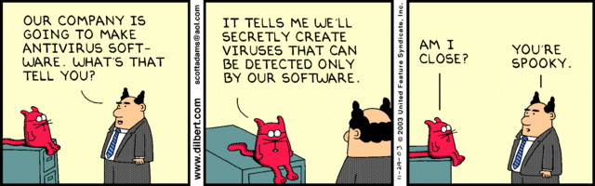
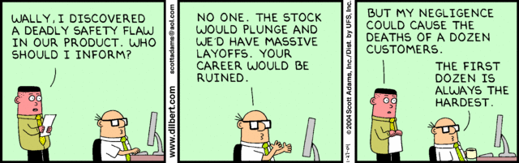
Notes:
Ask how many people in ACM or IEEE

Slide 4
Overview
Review
Assignment
Students Present
Notes:
We can also discuss articles listed on Security Discussions under documents of course web site.
ADD QUIZ AS BACKUP IF CLASS DISCUSSION NOT LONG ENOUGH

Slide 5
My Reading Notes
pp. 409 Can one perform services for one’s self?
pp. 412 1993-1999 Does this seem like a long time?
pp. 413 “errors of omission or commission”?
pp. 422 3. Would people agree – social contract?
pp. 438 So the baby can be left outside and no one is responsible?
Notes:
An error of commission is one where the person responds where they should not. This is compared to an error of omission, where the person fails to respond when they should.

Slide 6
Assignment
Finish all reading
Add analysis to group project website addressing all topics covered to date.
Group Presentation Draft
  Email presentation as attachment to course staff
  Post on group website
Notes:
1 Page Paper – For Good
How will you use your computing related education to do good in the world?
Extra Credit? Extra Paper?

Slide 7
Overview
Review
Assignment
Students Present
Notes:
Show WPI and/or corporate code of ethics.

Slide 8
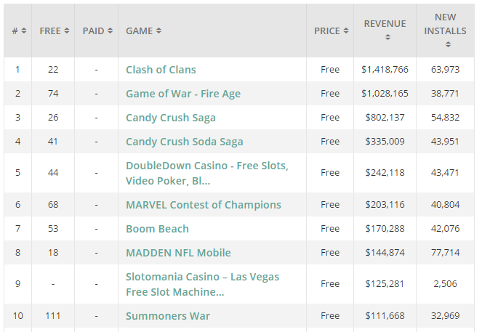
The ethics of mobile free-to-play games
Peter Craft
Free-to-play games are a billion dollar industry [1]
Make money through micro transactions
Ends up relying on exploiting a small group of players
Ethically wrong
https://thinkgaming.com/app-sales-data/
Notes:
Free-to-play games big industry that grew along with the smartphone industry.
Free to download but offer ‘microtransations’ that let you spend real currency to buy in game items or upgrades.
The picture on the right is from thinkgaming a site that organizes revenue data for mobile apps. As you can see the top 10 games are all free to play, and the number 1 game, Clash of Clans is making almost $1.5 million a day.
In theory, f2p games are an excellent model that can give users a full game experience without the $60 entry of AAA game titles such as Call of Duty, or Skyrim.
In practice, exploits a small group of players and is ethically wrong.

Slide 9
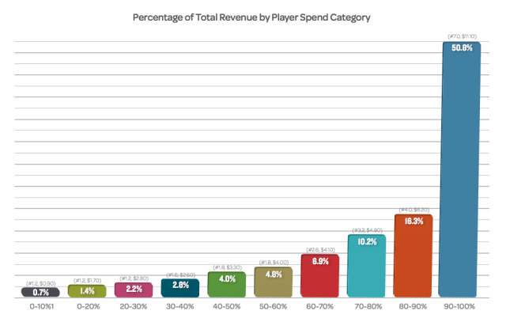
Whales
Peter Craft
Top 10% of paying players are responsible for 50% of revenue [2]
Some players spend up to $7,000 per month [3]
“It’s like saying a band should feel guilty for having hardcore fans...” [4]
http://landingpage.swrve.com/rs/swrve/images/new-players-report-0414.pdf
Notes:
A whale is a term for a user who is willing or able to dump large sums of money into f2p game.
Term is borrowed from casinos.
As shown on the chart whales account for a majority of f2p games revenue, with the top 10% of paying players responsible for 50.8% of the revenue.
One of the players on Clash of Clans top 10 leaderboard known as “Panda” bragged about spending $7,000 per month on the game.
In an interview with Wired magazine Andy Yang, who is the CEO of a mobile monetization research firm compared telling developers that they should feel guilty about whales to telling a band that “[they] should feel guilty for having hardcore fans that have spend money purchasing every album, every piece of memorabilia, and religiously attending all of their concerts”
However, f2p games try to entice people to continue spending. Some games force players to either wait through timers or pay money to skip them. Others restrict the most powerful items to only people who will pay money. This is known as pay to win.

Slide 10
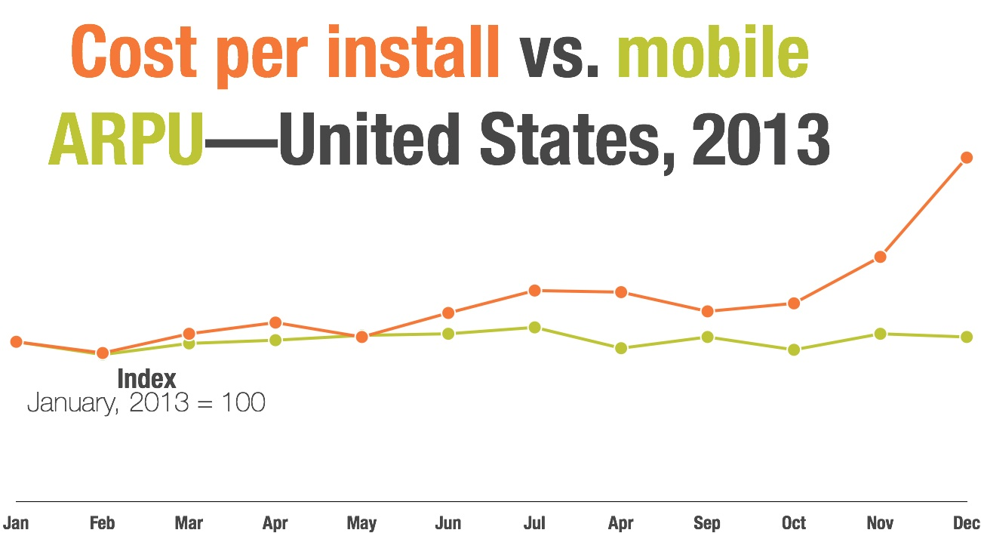
Goes against the code of ethics
Peter Craft
Goes against sections 1.02 and 1.07 of the Software Engineering Code of Ethics [5]
Rising cost of user acquisition means one could make a utilitarian argument against it as well. [6]
https://www.superdataresearch.com/market-data/digital-game-user-acquisition-cost/
Notes:
This model goes against two sections of the secoe.
1.02 says that software engineers should moderate their interests against that of the public good. With players spending large sums of money and some bankrupting themselves it isn’t in the public good to enable them to continue doing that.
1.07 says that software engineers should consider issues of disabilities and economic disadvantages, which putting parts of your game behind a pay wall that requires you to keep putting a portion of your income into isn’t consistent with.
You can also make a utilitarian argument against it since, Superdata research showed that in 2013 user acquisition costs went from $1.30 to $4.36 an increase of 288%. While the average return per user only increased by 38%. This is caused because there is only a certain number of whales and all the different companies are trying to attract them. This kind of trend isn’t sustainable for companies and will ultimately lead to failure.

Slide 11
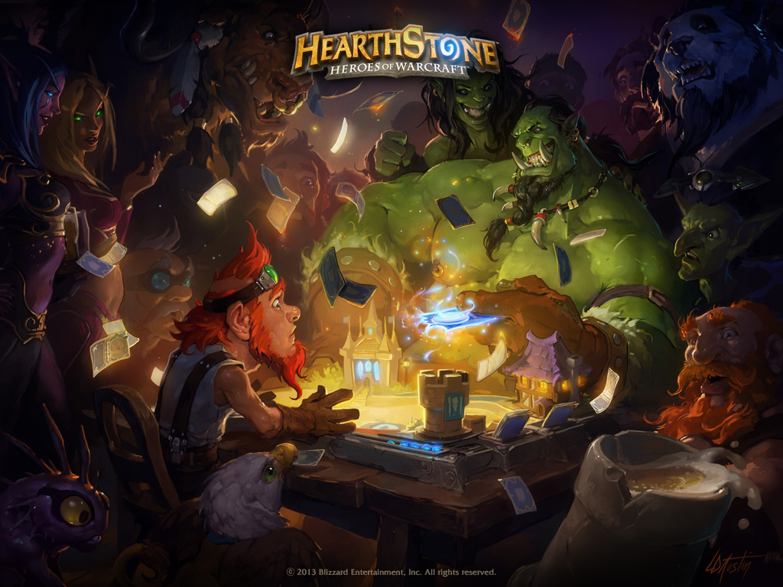
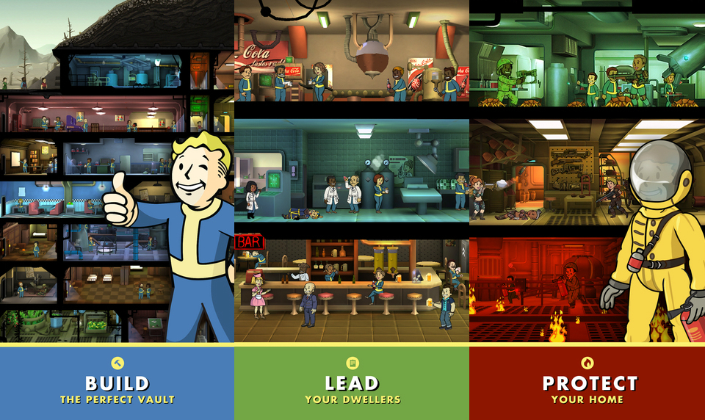
There is hope
Peter Craft
Games such as Hearthstone and Fallout Shelter show responsible free-to-play models [7]
Developers shouldn’t turn their backs on the model, only the unethical implementations
http://o.aolcdn.com/hss/storage/midas/e0bc012e7be6b968df7293315e83935e/202368495/fallout.jpg & http://us.battle.net/hearthstone/static/images/media/wallpapers/hearthstone_wallpaper1024x768.jpg?v=58-15
Notes:
Games such as Hearthstone and Fallout Shelter are good implementations of the free-to-play model. Fallout Shelter made Bethesda more than $5 million in its first two weeks.
If you never pay a cent you will still get the full game experience. Hearthstone allows you to earn everything you can get by paying money. Fallout Shelter is a single player game, not forcing you to keep up with anybody, can succeed without the better items from the lunchbox.
So it is possible to create free-to-play games that treat micro-transactions responsibly and ethically, but it remains to be seen if more developers will move away from exploiting the whales into a more responsible model.

Slide 12
References
Peter Craft
[1] https://thinkgaming.com/app-sales-data/ (Sep. 27th 2015)
[2] http://landingpage.swrve.com/rs/swrve/images/new-players-report-0414.pdf?mkt_tok=3RkMMJWWfF9wsRonvK7NZKXonjHpfsX57%2B8pXa6xlMI%2F0ER3fOvrPUfGjI4DTMtgI%2BSLDwEYGJlv6SgFTrPHMat50LgJUxE%3D (Sep. 26th 2015)
[3] http://forum.supercell.net/showthread.php/827-How-much-money-have-you-spent-on-this-game/page1 (Sep. 26th 2015)
[4] http://www.wired.com/2012/11/meet-the-whales/ (Sep. 26th 2015)
[5] https://www.acm.org/about/se-code (Sep. 27th 2015)
[6] https://www.superdataresearch.com/market-data/digital-game-user-acquisition-cost/ (Sep. 27th 2015)
[7] http://www.techtimes.com/articles/70075/20150719/fallout-shelter-game-ios-app-earns-bethesda-5-1-million-all-eyes-on-android-release-date.htm (Sep. 28th 2015)

Slide 13
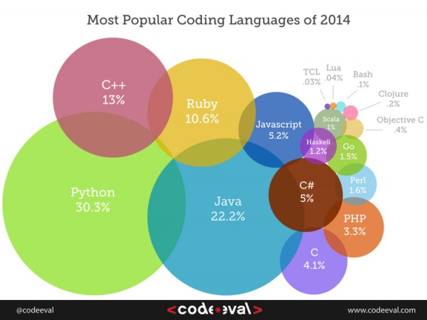
Code Automation & SW Dev. Ethics
Hui Zheng
Programming Language never stops developing
Scripting language become more popular
Retrieved from http://www.docsity.com/en/news/programming-2/5-programming-language-inforgraphics by 9/27/2015
Notes:
Hi everyone, my name is Hui Zheng. Today I’m gonna talk about the Code Automation and Software Development Ethics.
Here is the graph show’s the most popular coding languages of last year, the data is provided by codeeval.com which is a online code assignment platform where companies post code challenges and programming/project challenge online. As we can see higher level language or scripting language ranked on the top. This is the third year python at 1st place. However, C only have 4.1% of usage now a days. The ranking is depends on processing over 100,000+ coding test cases and challenges by over 2000 companies. This rank has preference because it based on online code interview and challenge, the project is small compare to desktop and online web development code. User have preference using higher level scripting language as tool to approach problems.

Slide 14
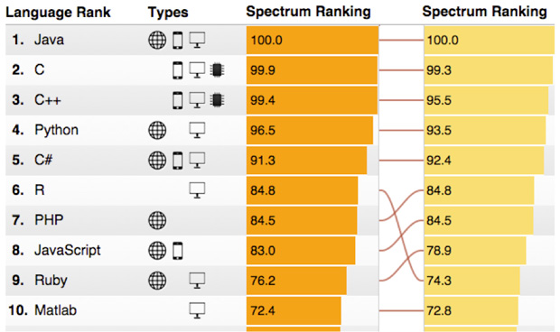
Code Automation & SW Dev. Ethics
Hui Zheng
Programming Language never stops developing
Scripting language become more popular
Retrieved from http://spectrum.ieee.org/computing/software/the-2015-top-ten-programming-languages by 9/29/2015
Notes:
This is a current ranking of language provided by IEEE Spectrum, depends on current new projects on github, IEEE Xplore digital library and career builder.
We can see dramatically C ranked still on top 2. Even without web development, C programming which is an representative of lower level language still gain more preference from user that building large scale project such as network design and system design for better performance.
Programming language is always developing, and trending to be more like human language. Higher level language, such as java, allow programmer more focus on logic level problem solving by save time on interactive with machine such as memory allocate and release.
Scripting language is language that super high level language, the reason is their syntax are more like human language.

Slide 15
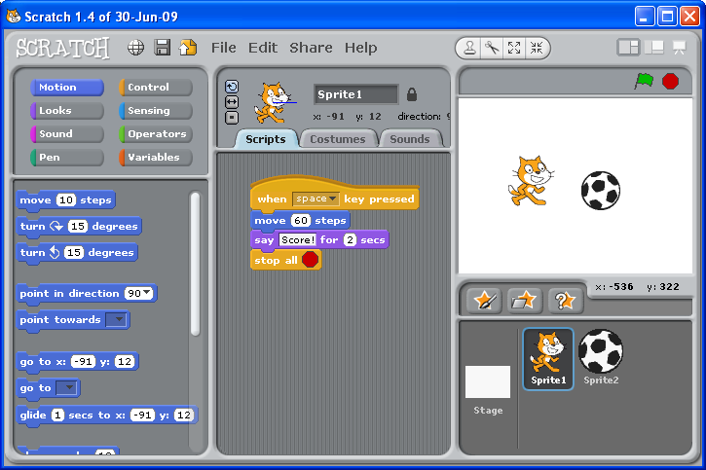
Code Automation & End-User SW. DEV
Hui Zheng
Graphic Programming language
  Scratch
  Streambase
  TreeAge
Automatically Generated Code
  HTML: Wix.com
Retrieved from http://scratched.gse.harvard.edu/stories/reasoning-and-audience-scratch-geometry-classroom By 9/27/2015
Notes:
End-user Software Developer mean programmer who doesn’t set programming as career, developing software functionalities through spreadsheet, graphic language with limited programming skills.
RHS is a graphical language called scratch, the language that allow you create games and animations without writing code. You just need choose on the element that you want to add to the project, then drag and drop on the script tab. It’s mainly used for kids to make toy apps.

Slide 16
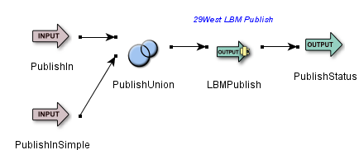
Code Automation & End-User SW. DEV
Hui Zheng
Graphic Programming language
  Scratch
  Streambase
  TreeAge
Automatically Generated Code
  HTML: Wix.com
Retrieved from http://scratched.gse.harvard.edu/stories/reasoning-and-audience-scratch-geometry-classroom By 9/27/2015
Notes:
Besides Scratch, there are also other graphical language Streambase for stream data analysis, as you can see an example of it language script on the right.
It take two input data stream and union them together and given two outputs, the union stream and status that union the data tuples. There is not test case for it, and the user needn’t use any java code to make this jar file to run on JVM.
The functionality is achieved through arranging and linking icons together, and finish the settings in the elements, such as input stream.
TreeAge which has it own language depends on mathematical model to help doctors or medical researchers and financial researchers to do mathematical simulations. Both of them will not required programming language skills, the only need developer know what they want and develop program through drag and drop the graphic elements.
Both of the language using xml as intermediate language to represent and record the graphic language. However, compare to TreeAge, Streambase is more like code automation. It uses XML and transfer it into linked java programs that runs on java virtual machines.
A website called wix.com, it will first provide user’s templates and then using drag and drops to achieve arranging views instead of coding in html and css.

Slide 17
Compare to Traditional SDW
Hui Zheng
Not Professional on programming
No Software Developing Theory follow
“94% of spreadsheets deployed in the field contain errors.”
-Stephen G. Powell
Can achieve same goal and outcome
Both are programming
  Programming Definition:
  ‘‘The process of transforming a mental plan of desired actions for a computer into a representation that can be understood by the computer’’
  – Jean-Michel Hoc and Anh Nguyen-Xuan
Dictionary of Information Science and Technology, Mehdi Khosrow-Pour
Notes:
The aim of End-User software engineering is aimed as developing software function that meet required functionality. Since the End-User software developer has limited programming and Software engineering training experience, there is no software development flow to follow when developing. Also, since the end-user software developing tools are facing non-professional programmers, the quality control is a most weak point on both tools side and developer side.
Streambase has a quality control, however there is not testing kits or professional tools that implementing test methods such as unit test on the program that generated. TreeAge has even worse test function that rely on customer service.
However, user usually can meet their goal, even with bugs that they even don’t know.
“94% of spreadsheets deployed in the field contain errors.” -Stephen G. Powell
Hoc and Nguyen Xuan used defined the word programming: “The process of transforming a mental plan of desired actions for a computer into a representation that can be understood by the computer”. Through which we can think end-user software developing as programming.
However, is end-user software developer software Dev?
End-User Cheetsheet:
“End-user programming enables end users to create their own programs. Researchers
and developers have been working on empowering end users to do this for a number
of years, and they have succeeded: today, end users create numerous programs. “

Slide 18
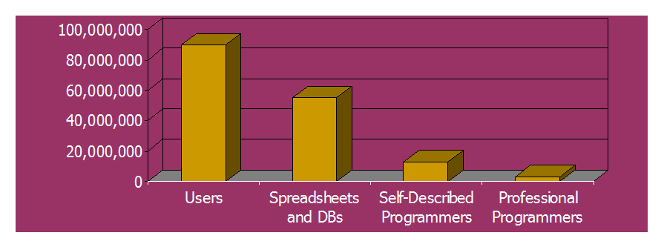
Large Population of End-User SDE
Hui Zheng
55 million will use spreadsheets or databases at work (and therefore may potentially program)
13 million will describe themselves as programmers
3 million professional programmers
29West LBM Publishing OutputAdapter, retrieved from, https://docs.tibco.com/pub/streambase_cep/7.3.10/doc/adaptersguide/embeddedOutput29WestLBM.html 9/28/2015
Notes:
Christopher Scaffidi in 2005 make an estimation about end-user programmer count for 2012, However it seems that . The amount of EUSDE is 18 times than professional programmers, besides those who located in the middle.

Slide 19
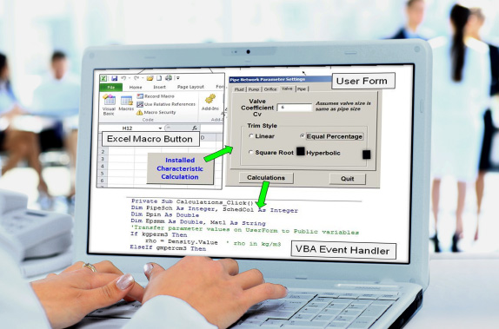
Conclusion
Hui Zheng
End-user Software Engineering maters and can be considered as software engineering.
Spreadsheet Programming for Chemical Engineers - Excel's VBA retrieved from http://www.aiche.org/academy/courses/ela118/excel-vba-programming-chemical-engineers 9/29/2015
Notes:
With promisingly same product functionality achievement, putting effort in computation and engaged in software engineering, End-user software developer can count as software engineer.

Slide 20
References
Hui Zheng
[1] What Is End-User Software Engineering and Why Does It Matter?, Margaret Burnett, Retrieved from ftp://cs.oregonstate.edu/pub/burnett/eud09-euse-invited.pdf 9/27/2015
[2] End-User Software Engineering, Margaret Burnett, Curtis Cook, and Gregg Rothermel, School of Electrical Engineering and Computer Science Oregon State University, Retrieved from http://cse.unl.edu/~grother/papers/cacm04.pdf by 9/27/2015
[3] Software Engineering Code of Ethics and Professional Practice(Version 5.2), ACM, https://www.acm.org/about/se-code 9/27/2015
[4] End User Software Engineering, Vishal Dwivedi vdwivedi@cs.cmu.edu, , Institute for Software Research
Carnegie Mellon University, Human Aspects for Software Development Retrieved from http://www.cs.cmu.edu/~bam/uicourse/2011hasd/ 9/28/2015
[5] Dictionary of Information Science and Technology (2-Volume Set), Mehdi Khosrow-Pour, December 6, 2006
[6] 29West LBM Publishing OutputAdapter, retrieved from, https://docs.tibco.com/pub/streambase_cep/7.3.10/doc/adaptersguide/embeddedOutput29WestLBM.html 9/28/2015
[7] TreeAge Pro, TreeAge INC. http://www.treeage.com 9/28/2015
[8] Christopher Scaffidi, Mary Shaw, Brad A. Myers: Estimating the Numbers of End Users and End User Programmers. VL/HCC 2005: 207-214
[9]Spreadsheet Programming for Chemical Engineers - Excel's VBA retrieved from http://www.aiche.org/academy/courses/ela118/excel-vba-programming-chemical-engineers 9/29/2015

Slide 21
joint- venture modules
Xavier Jackson
Incorporate ethics into classes
  Students’ ethical reasoning skills
Remove burden on engineering professor
Professor with ethics backgrounds
Incorporate into more classes
Time efficient
[1]
Notes:
Talk about how ethics are missing from classes, not enough time. 70% of engineering schools don’t have an ethics component in 1997, while that has gotten better, it could still improve [5]. This means students have low ethical reasoning skills because they haven’t been exposed to it. Don’t make the engineering professor have to become a professor of ethics too. Use the professors who are already here. Try to incorporate it in the department, school wide [6,8].

Slide 22
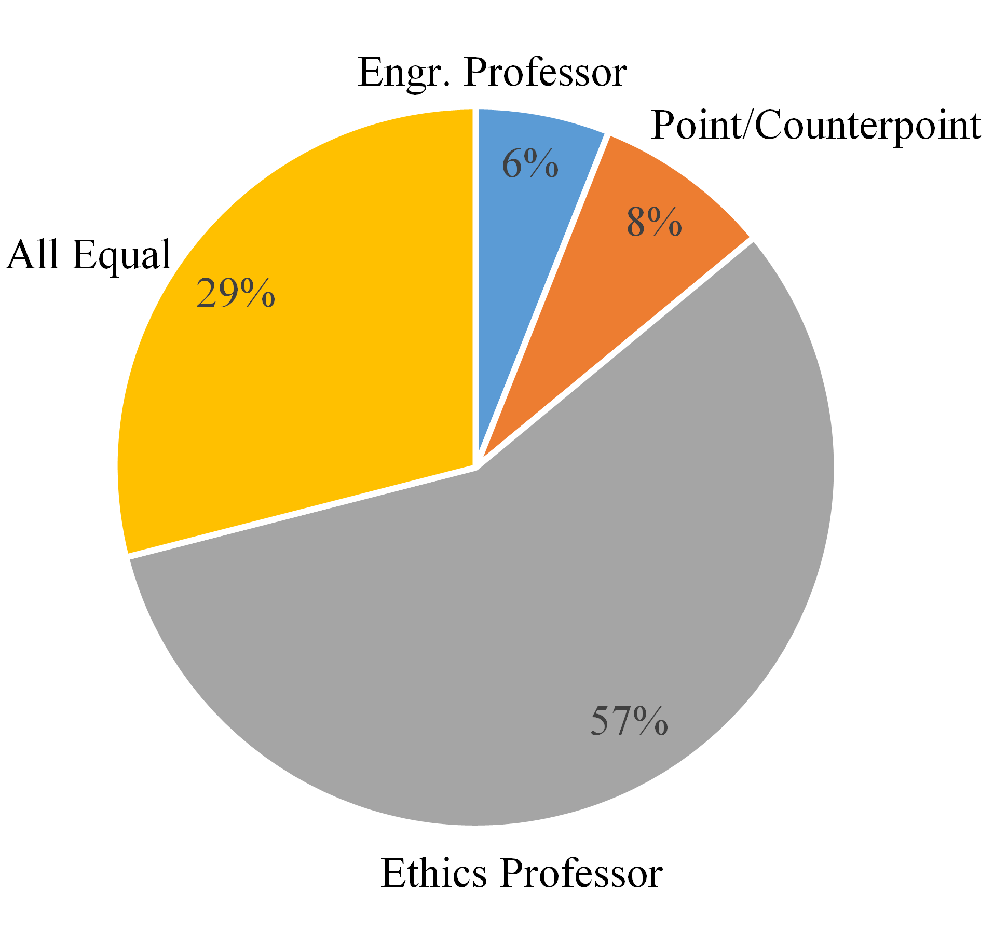
Initial study
Xavier Jackson
Three Methods for Teaching Ethics
  Engineering professor
  Point/Counterpoint assignment
  Ethics guest lecture
Favored guest lecture
Survey Data from BME 2511, n=60 of 85
Notes:
The initial study was done with BME 2511 taught by Professor Billiar at WPI, different methods were tried and the best of these were taken for the solution.
Survey:
This term, portions of three lectures were dedicated to promoting ethical exposure. Of the three ethics-based lectures, which did you most prefer?
Professor Billiar led lecture
b. Point/Counterpoint Assignment
c. Guest Lecture with Professor Pfeifer
d. None of the above

Slide 23
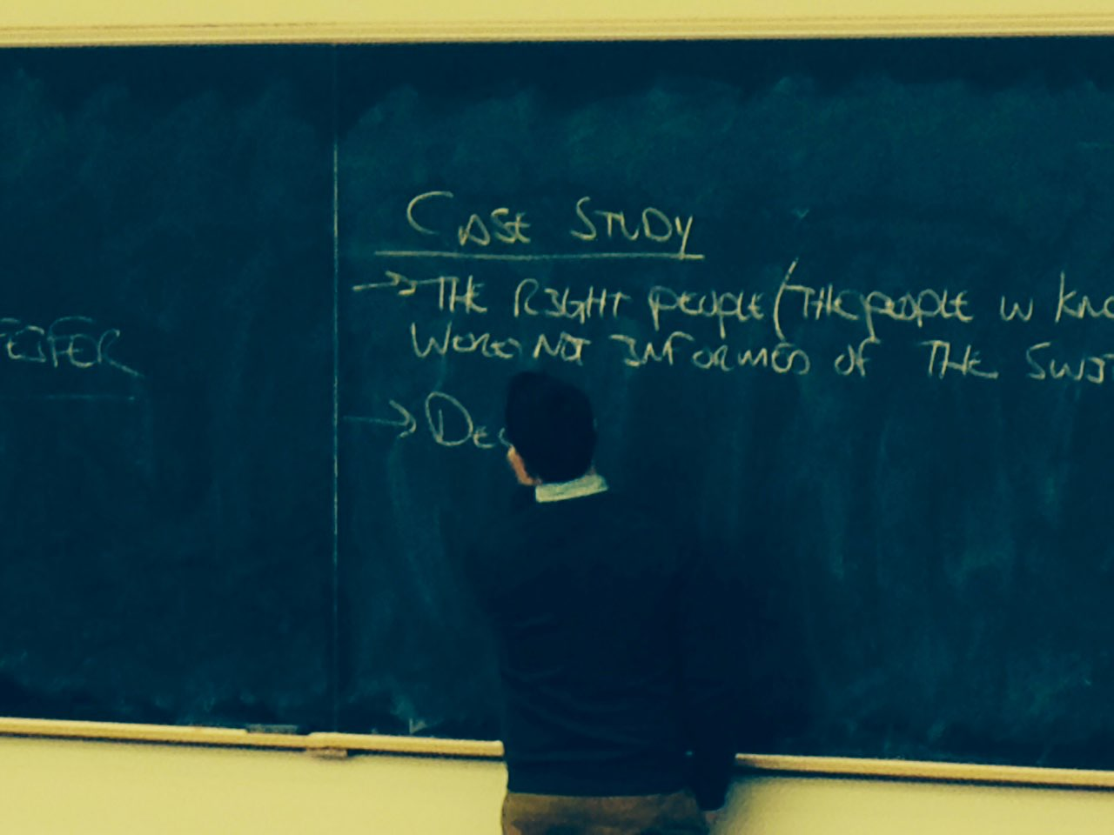
module
Xavier Jackson
Case study
Point/Counterpoint assignment
Guest Lecture
Heuristics Assignment
  Step-by-step analysis
[2]
Notes:
EXPLAIN what each means.
Case study
•Relatable to engineering content
Point/Counterpoint assignment
•There are grey areas
Make a point, now take the opposite position and argue for it.
Guest Lecture
•Facilitates discussion
Ethics professor comes in to talk
Heuristics Assignment
•5-step analysis guide [7] (Assign values like utilitarianism)
Identify the ethical issues present in the case study. Ethical issues can be the moral concerns or areas where right and wrong are unclear. For each issue, explain why it is problematic.
Identify the stakeholders involved for each issue.
2. Identify the moral responsibilities of the stakeholders.
3. Identify the possible courses of action regarding the ethical issues. How can the issues be solved?
4. Identify the consequences to the different courses of action. What can happen?
5. For each issue, which course of action would you choose to solve the problem, and why?

Slide 24
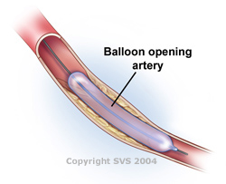
Balloon Catheter Case Study
Xavier Jackson
A patient was brought in to repair a blood vessel
  Doctor used balloon catheter
    Recommended 8 atm, went to 10 atm
    Catheter bursts, emergency bypass
Who is at fault for the burst catheter?
  FDA?
  Doctor?
  Medtronic?
  Hospital?
[3,4]
Notes:
The Medtronic devices company designed a catheter that was only supposed to be inflated to 8 atmospheres. The doctor inflated it to 10 atmospheres and it burst in the patients vessel leading to and emergency bypass. Who was at fault? Everyone has a little bit at fault, it’s really up to opinion.

Slide 25
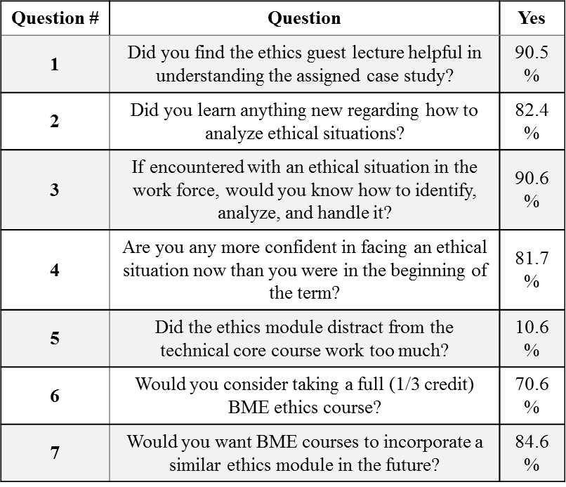
conclusion
Xavier Jackson
Students need to be exposed
Consequences of actions
<Citation>
Notes:
The methods used to figure out who was at stake in this case study can also be used in computing. When adding a new feature, you can treat that case study and it’s out puts as a case study. Just simply using a heuristics assessment can determine whether or not that is a good idea to implement it in. Examples can be shown with the Netflix anonymity scandal, that we talked about just today in AI.
It requires a different kind of thinking that may not be developed in the required courses.

Slide 26
References
Xavier Jackson
[1] Xavier, Jackson, Vivian Liang, Jake Rogers, Mel Moore, and Zac Jasensky. "A JOINT-VENTURE APPROACH IN TEACHING STUDENTS HOW TO RECOGNIZE AND ANALYZE ETHICS."
[2] Jake Rogers, Professor Pfeifer, Image.
[3] http://www.vascularweb.org/vascularhealth/PublishingImages/NorthPoint%20Images/Angio_03_250.jpg
[4] Bailey, Ryan. "Testing Manufacturer Liability." Journal of Ethics. American Medical Association, 1 Oct. 2010. Web
[5] Lynch, W. (1997). Teaching Engineering Ethics in the United States." IEEE Technology and Society Magazine. 97: 27-36.
[6] Zandvoort, H., Van Hasselt, G. J., Bonnet, J. A. B. A. F. (2008). A joint venture model of teaching required courses in ‘ethics and engineering’ to engineering students. European Journal of Engineering Education. 33 (2): 187–195.
[7] Weil, V. (2002). A Seven-Step Procedure for Ethical Decision Making, Proceedings, National Conference on Ethics and Social Responsibility in Engineering and Technology, Coeur d’Alene, Idaho.
[8] Trafimow, D., Sniezek, J. (1994). Perceived expertise and its effect on confidence. Organizational Behavior and Human Decision Processes. 57 (2): 290-302.

Slide 27
Class 10
The End
Keith A. Pray
Instructor
socialimps.keithpray.net
Notes:
This is the end. Any slides beyond this point are for answering questions that may arise but not needed in the main talk. Some slides may also be unfinished and are not needed but kept just in case.

