Slide 1
Class 9
Errors Failures Risks
Keith A. Pray
Instructor
socialimps.keithpray.net
Notes:
Here’s the title slide. Excited already, aren’t you?
What errors? – Have student record list on board
Who looked for existing test strategies?
Who looked for directions on how to test currency?
Paper Reminders:
Use #’s and facts instead of “great, a lot, numerous, many, most, much…”
Avoid absolutes unless quoting facts “always, never, must, will…”
Make organization clear, avoid CP R, CP R through out whole paper.

Slide 2
Survey Results
Likes
  Good class discussion
  Videos/comics/pictures
  Student presentations
Improvements
  Give Example Papers
  Explain assignments better
  More descriptive grading feedback
  Talk about own thoughts on reading
Self Improvements
  Manage time better
  Participate more in discussions
  Better reading notes

Slide 3
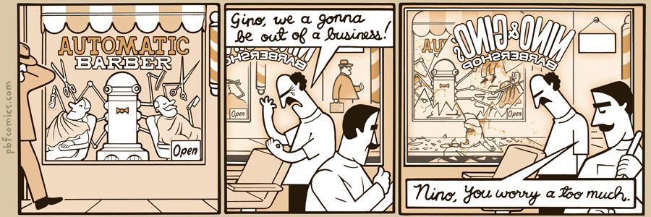
http://pbfcomics.com/197 (2014-09-26)
Notes:
10 – Errors, Failures, Risks
Why Electronic Voting is a BAD Idea - Computerphile
https://www.youtube.com/watch?v=w3_0x6oaDmI

Slide 4
Overview
Review
Assignment
Students Present
Guest Speaker
Notes:
We can also discuss articles listed on Security Discussions under documents of course web site.
ADD QUIZ AS BACKUP IF CLASS DISCUSSION OR GUEST SPEAKER FAIL

Slide 5
My Reading Notes
pp. 362 Any false arrests since 1989?
pp. 368 This is not to keep the system from responding to false alarms.
pp. 371 Always encapsulate units!
pp. 373 Why did they refuse?
pp. 376 Republicans and Florida.
pp. 385 Did the predictions motivate people to change?
pp. 388 What happened to Verification?
pp. 405 How are votes counted for non-DRE voting proposed?

Slide 6
Assignment – 1 Page Paper
From Chapter 9 In-class Exercises # 24.
Should the company produce the game?
Use the SWE Code Of Ethics as the basis for your argument.
The SWE Code of Ethics should not be the sole source for your premises.

Slide 7
Overview
Review
Assignment
Students Present
Guest Speaker
Notes:
We can also discuss articles listed on Security Discussions under documents of course web site.
ADD QUIZ AS BACKUP IF CLASS DISCUSSION OR GUEST SPEAKER FAIL

Slide 8

translation software Introduction
Alex Shoop
Conclusion:
  Machine translation software is not as accurate as human translation
How translation software works:
  Rule-based machine translation (RMBT) [1]
  Statistical machine translation (SMT) [2]
Example software:
  Google Translate [3]
  Bing Translator
  Babylon
https://play.google.com/store/apps/details?id=com.google.android.apps.translate
[1],[2], [3]
Notes:
Introduction of yourself, that you’re part American and part Japanese, and also topic.
AUTOMATED TRANSLATION SOFTWARE
My conclusion I’m arguing for is that machine translation software is not as accurate as human translation, and the social consequences with relying too much on translation software.
First a quick background on some of the methods translation software uses.
RULE BASED: a machine translation system based on linguistic information about the source language and target language, where the info is retrieved from dictionaries and grammar rules. RMBT makes very literal translations.
STATISTICAL BASED: machine translation system uses computer algorithms that pieces together patterns of the target text into possible models of a translated text. It then compares these possible models to previously translated models which were learned from prior translations, basically so that the MT system has a “database” of translations. And there’s a score associated with each possible translation model, and the algorithm picks the translation with the best score.
There are many examples of translation software out there such as the past Yahoo Babel Fish (based on Hitchhiker’s guide to galaxy Babel Fish), Babylon Translation, etc.
When talking about example translation software, I will use GOOGLE TRANSLATE because it is more widely used and one of the free options for translation.
Google Translate started back in 2006 as RULE BASED, but changed to STATISTICAL MACHINE TRANSLATION in 2007. Now has around 90 supported languages. Not only is Google Translate able to translate simple words and phrases through the website or app, but it can even “translate” entire web pages. Btw, for the SMT aspect, it not only uses the thousands of web pages to statistically compare to, but it also uses all United Nations documents in a few languages which themselves are of course fully translated by humans.

Slide 9
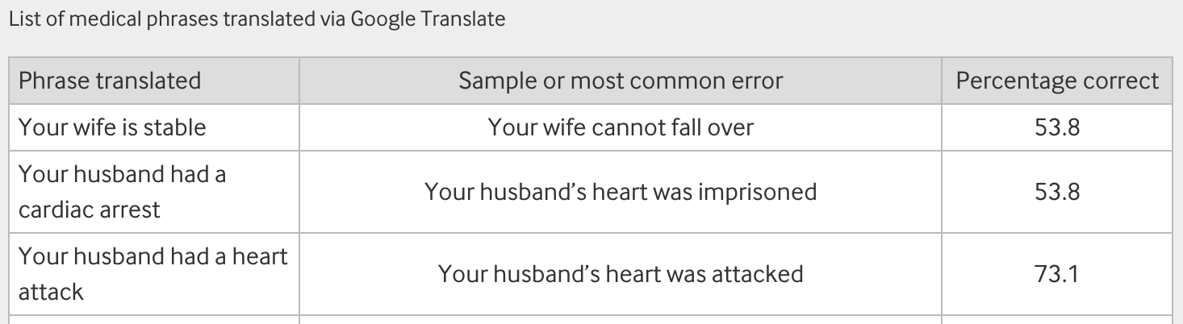
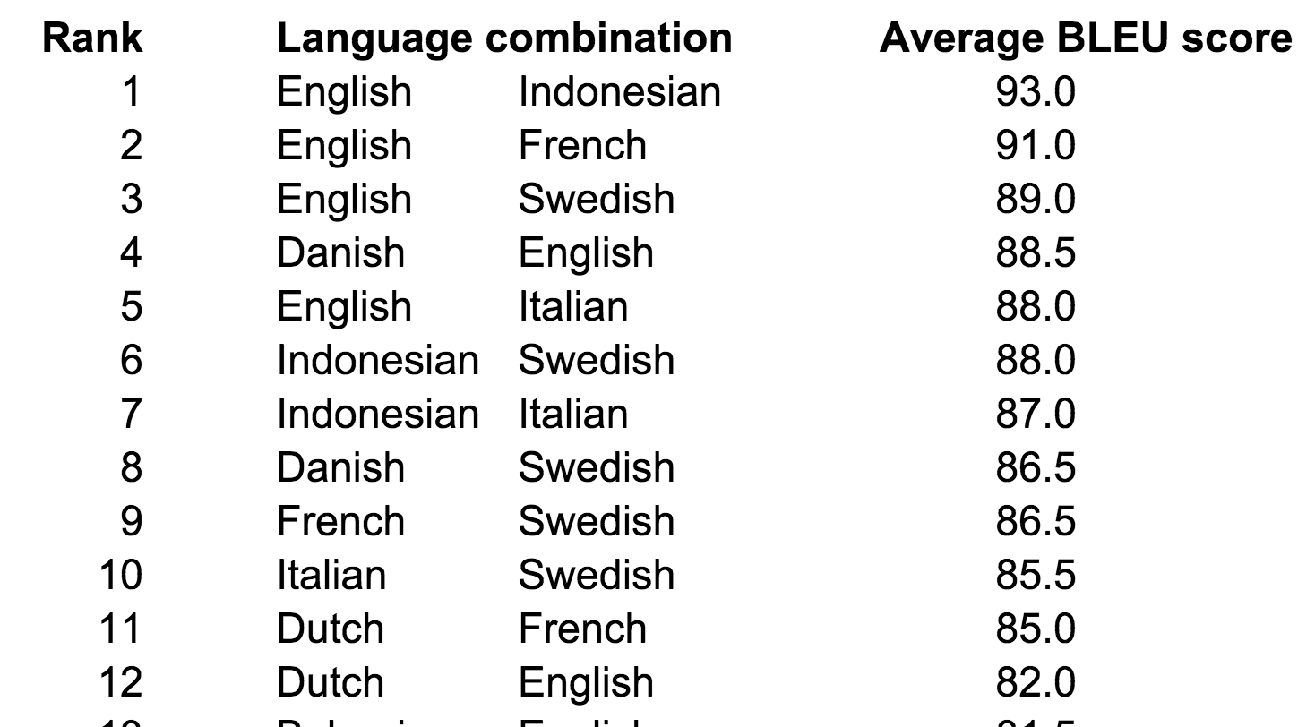
Measuring accuracy of google translate
Alex Shoop
2014 Analysis within Medical
Communication [7]
  10 common medical statements translated
  Google Translate achieved 57.7% accuracy
2011 Analysis TranslationJournal [4]
  Bilingual Evaluation Understudy (BLEU) score [5]
  Asian languages got lower results
Top: http://www.bmj.com/content/349/bmj.g7392
Bottom: http://faculty.bus.olemiss.edu/maiken/pairs.htm
[7],[4], [5]
Notes:
Now I’m going to cover studies that measured how accurate Google Translate is, and if it can actually be used in human communication.
- A medical team in the UK tested Google Translate with 10 common medical phrases such as “Your husband had a cardiac arrest” or “Your husband can donate his organs”
- For all 10 medical phrases, the team translated each one into 26 languages such as French and Polish, etc. Then the translated statements were translated BACK into English (the translated statements were sent to native speakers, and were translated into English by them, aka human translation).
Of all 260 translated phrases, only 150 were agreed by the authors to be correct, while 110 were incorrect.
African languages scored the lowest while Western European languages scored the highest (specifically, Swahili scored lowest at 10% and Portuguese scored highest at 90%)
There were some very serious errors, not only of examples you can see on the slide, but for example “Your child is fitting” into Swahili translated to “Your child is dead” or “Did he have a high fever at home?” into Marathi translated to “Your home temperature was high”
MAIN TAKEAWAY
Clearly, when working with a patient doctors need to say what operation needs to happen or get answers from the patients. The authors said that human translation is the best form of communication for a language barrier, but if the service is not readily available then translation software could be used to a certain extent, with caution
Disclaimer, the in depth analysis on google translate was done back in 2011. Because technology is always evolving, especially in Google’s case, results have changed. But it still gives a good idea of the rough accuracy.
The analysis was done by Milam Aiken and Shilpa Balan (both from Univ of Missippi, both researching in machine translation).
- BLEU is an algorithm that scores source text to translated text, and associates a score (in the case of the analysis) from 0 to 100. The algorithm compares the translated text to actual good quality reference translations, typically done by humans. BLEU has been compared to be close to human judgment.
The two did their analysis with software to test out, at the time, 51 languages and averaged out each language pair (English-Japanese and Japanese-English).
They tested 6 common phrases such as “Pleased to meet you”, “I love you”, and “My hovercraft is full of eels”
On screen are some example scores, and it goes all the way down to rank 1275. It’s not shown, but Asian and other languages were also tested such as Korean and Afrikaans.
- The researchers declared that while this data is nice, there’s no clear threshold of what’s deemed good or bad. In terms of legal, financial, and other critical information, it can be assumed that a higher standard would be placed for language-pair translations. And informal and unimportant materials can have a lower standard.
MAIN TAKEAWAY FOR BLEU STUDY
- They noted that in comparison to Western and European language translations, language pairs with Asian or uncommon languages gave worse results, most likely due to the fact that (because Google Translate runs on SMT) there aren’t many available or learned translations involving the Asian languages. And also the analysis only used 1 reference text, so there was only 1 “correct” result to compare to.

Slide 10
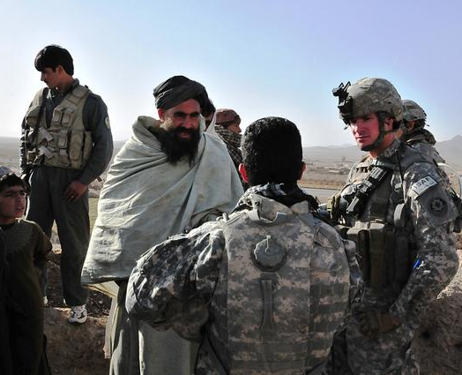
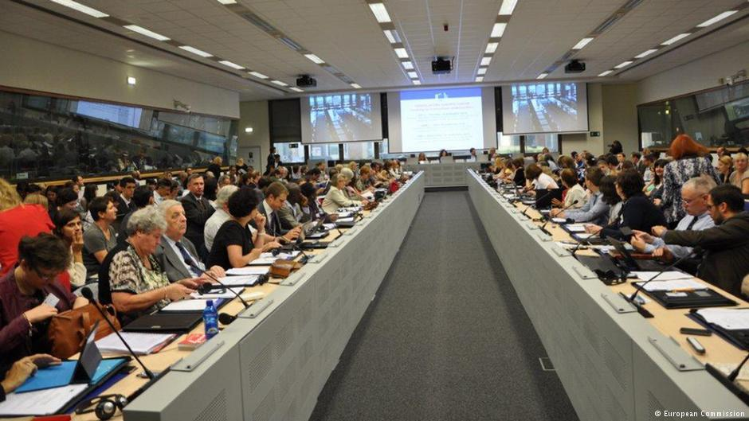
Other fields where language is important
Alex Shoop
Military
  Respond quickly [8]
  Win a counterinsurgency [9]
United Nations [6]
  Documentations
Upper-right: http://www.army.mil/article/54543/machine-foreign-language-translation-systems-bridge-gap-between-soldiers-locals/
Bottom-left: http://www.dw.com/en/push-technology-why-online-translation-may-be-googling-interpreters-out-of-a-job/a-17979947
[6], [8], [9]
Notes:
Now I’ll mention other fields where language communication is very important.
Firstly, the MILITARY
In emergency situations or out in the field, language communication is absolutely important. President Obama stated “in the 21st century, military strength will be measured not only by weapons our troops carry, but by the languages they speak and the cultures they understand.” (Aug 2009)
For example in an incident of a natural disaster such as an earthquake in a foreign region (like the Haiti earthquake), during that incident there was help requested from nearby bases to help save civilians. And civilians were communicating via text messages thankfully because cell phone towers were still functional. But of course the messages were not in English, by working with human translators and to a certain extent MT, the helping military forces were able to save many civilians in a quick manner.
Another example is for the military forces in Afghanistan. Clearly, in order to “win the hearts and minds” of the civilians to like the US military power, one needs to communicate and talk properly. But linguists and human translators cannot be at every given moment when talking to somebody in Afghanistan. So the US utilized what’s called Machine Foreign Language Translation System (MFLST), where developers used as many resources and human translators as possible to create an automated system for both speech-to-speech and text-to-text.
Another quote, from Melissa Holland, chief for US Army Research Laboratory multilingual program, said “Computers could never replace the human translator, but we look for ways to relieve the burden, for less commonly used languages such as Dari, Pashto, and Serbian”
United Nations, where many countries of many languages come for decision and discussion. Clearly, it’s important to know what’s being discussed.
- Even the United Nations website says “translation at the level required at the UN remains a fundamentally intellectual endeavor”, meaning although they do say that certain software is used, it’s only to assist and not completely rely on.
- I mentioned previously that SMT uses probablity. Well most SMT software uses the UN translated documents as a sort of baseline too. So clearly its important.
And then there’s the option that MT can assist with human translation. Where the translation software can do the “heavy lifting” of translating, and then a human editor can fix the translated text to be more natural. While some people argue that MT software can take away translator jobs, I and Christian Galinski (director of international information centre for terminology) argue that it actually helped spread the translation business because the MT software can help with the many different languages that documents and european union summits need to be translated into.

Slide 11
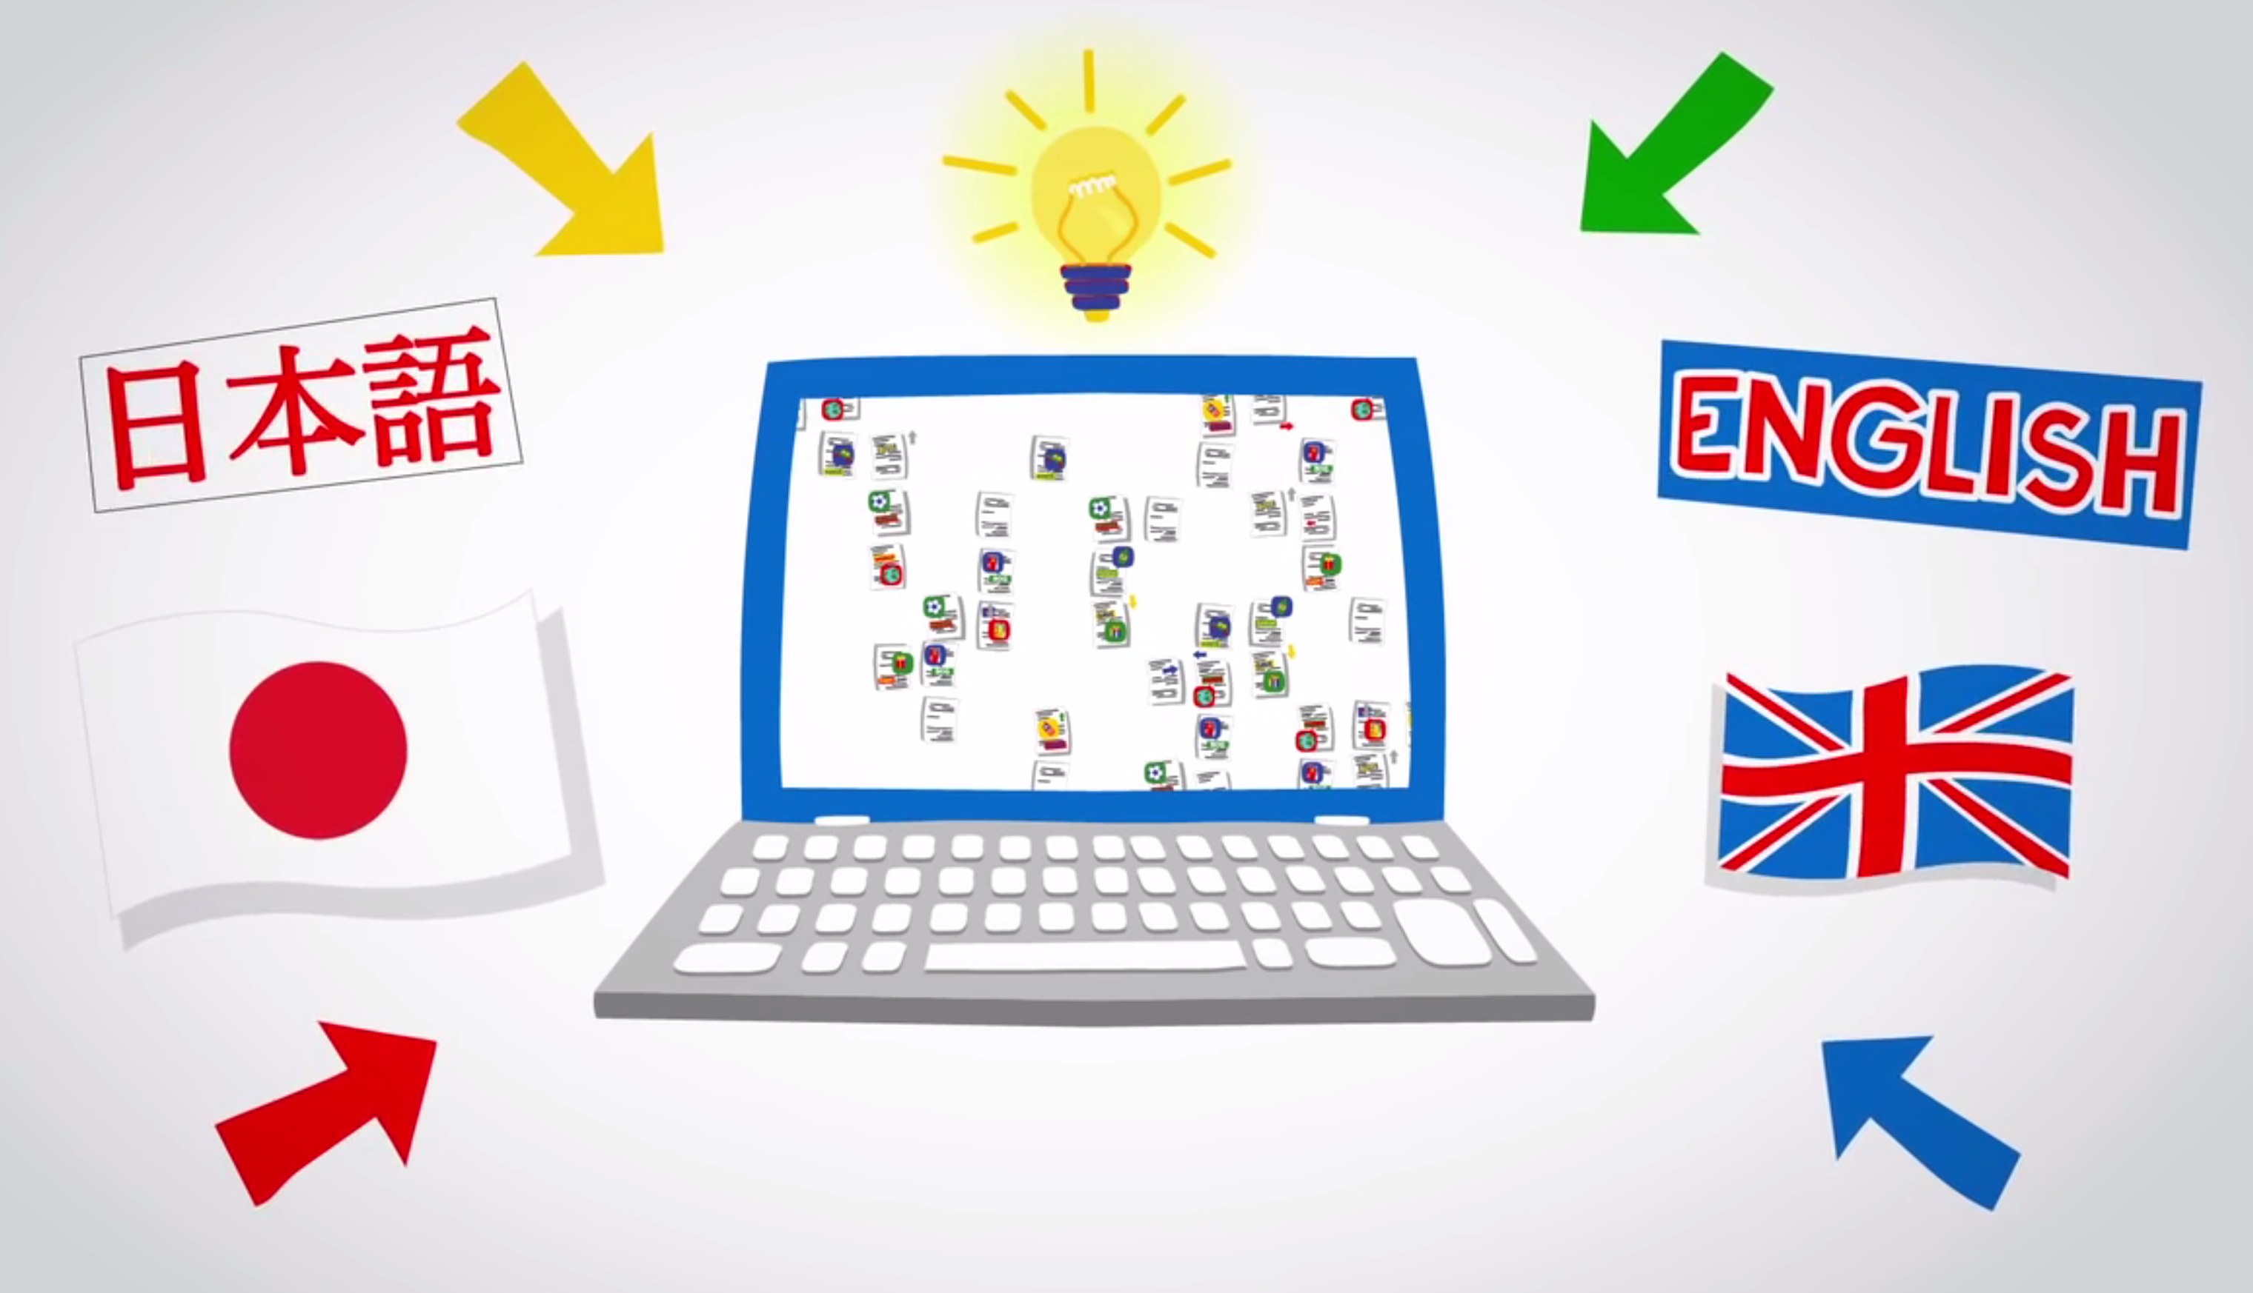
Summary
Alex Shoop
Machine translation < human translation
  Simple words/phrases are okay
SMT uses probability
Accuracy is important
https://www.youtube.com/watch?v=_GdSC1Z1Kzs
Notes:
In summary, despite technology always evolving, machine translation is inaccurate compared to human translation. And although it may be true for simple words and informal phrases that most MT software can do a good job, it still doesn’t meet the authentic translations from an actual multilingual person. I can vouch for this when I see try and translate say Japanese forum pages through google translate’s “translate web page” feature. Good god is it innacurate.
And back to SMT, because it uses probability and relies on already learned/available translated documents, it still can produce bad results. For example, while there may be thousands of English to Spanish translated materials, there are very little Chinese to Swahili documents to try and retrieve some form of good probability score.
Finally, especially when it comes to serious professional industries such as the medical industry, accuracy is extremely important. One research article tested google translate with relatively common medical statements, translating from English into 26 different languages such as French and Polish. As expected, the article found that google translate had an estimated accuracy of 57.7% for medical phrases (of the 10 medical phrases into 26 languages = 260, only 150 were agreed by testers to be correct). A lot of the translations were terribly wrong such as “Your child has been fitting”, into Swahili was “Your child is dead”. Or “Your husband had a cardiac arrest”, into Marathi (a language in India) became “Your husband had an imprisonment of the heart”. Clearly in an industry where doctors need to communicate to patients who likely can’t speak English, it’s better to have a human translator on hand.

Slide 12
References
<Your Name>
[1] Defintion of Rule-Based Machine Translation:https://en.wikipedia.org/wiki/Rule-based_machine_translation. Accessed on September 22, 2015.
[2] Definition of Statistical Machine Translation:http://www.safaba.com/machine-translation/machine-translation-technologies/statistical-machine-translation. Accessed on September 22, 2015.
[3] “About” page of Google Translate: http://translate.google.com/about/intl/en_ALL/index.html. Accessed on September 22, 2015.
[4] In depth analysis from 2011 on Google Translate: http://translationjournal.net/journal/56google.htm. Accessed on September 22, 2015.
[5] Definition of BLEU score: https://en.wikipedia.org/wiki/BLEU. Accessed on September 22, 2015.
[6] Article on EU’s interpreters: http://www.dw.com/en/push-technology-why-online-translation-may-be-googling-interpreters-out-of-a-job/a-17979947. Accessed on September 23, 2015.
[7] Article on Google Translate within Medical Industry: http://www.bmj.com/content/349/bmj.g7392. Accessed on September 23, 2015.

Slide 13
References
<Your Name>
[8] Paper on Haiti earthquake and using translations to save civilians: Chris Callison-Burch, et al. “Findings of the 2011 workshop on Statistical Machine Translation.” Proceedings of the Sixth Workshop on SMT (WMT ‘11). Association for Computational Linguistics, Stroudsburg, PA, USA, 22-64. Accessed on September 25, 2015.
[9] Article on use of Machine Foreign Language Translation System in Afghanistan: http://www.army.mil/article/54543/machine-foreign-language-translation-systems-bridge-gap-between-soldiers-locals/ . Accessed on September 25, 2015.

Slide 14
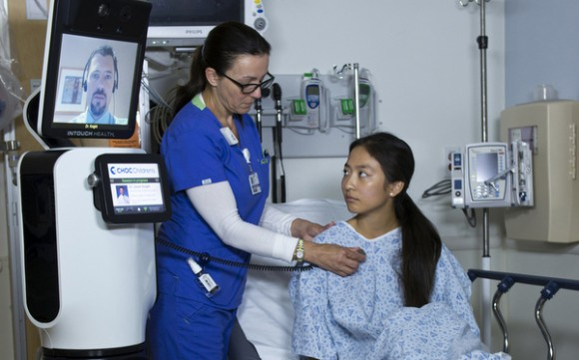
Robotic medical check-ups
Laura Antul
Robots help improve the quality of patient care in hospitals
  RP-7 approved by the FDA in 2008
  RP-VITA approved by the FDA in 2013
<Graphic>
http://www.slashgear.com/fda-approves-irobot-rp-vita-for-use-in-hospitals-25266725/
Notes:
Robots now being used can help monitor patients and make specialists available
My presentation will focus on robots in the United States
RP-7 first robot approved in 2008 created by InTouchHealth
RP-VITA created by InTouch Health and iRobot and approved in 2013
According to an FDA report, “The Remote Presence System, Model RP-VITA, is a clinical communications tool that provides a means of transmitting, receiving, and storing real-time audio and video, and patient data”
Refer to picture and electronic device capabilities of RP-VITA
RP-VITA requires broadband internet connection and lasers, sensors, and sonar
Leads to first potential failure area ODOA systems
Robots are now being used in hospitals to help assist medical staff monitor patients and make specialists available to individuals who may not otherwise have access to them. Although there have been robots created with this purpose in areas all over the world my presentation will focus on robots produced in the United States. The RP-7 was the first robot to be approved by the Food and Drug Administration or FDA for use in medical facilities in 2008 by InTouch Health. [1] The RP-7 was then succeeded by the RP-VITA in 2012 and it was created as a collaboration between InTouch Health and iRobot [2]. According to an FDA report, “The Remote Presence System, Model RP-VITA, is a clinical communications tool that provides a means of transmitting, receiving, and storing real-time audio and video, and patient data” [3]. As you can see in the picture the RP-VITA, “Comes equipped with diagnostic devices such as electronic stethoscopes, otoscopes and ultrasound and can be integrated with live patient data” [4]. In order for the RP-VITA to function properly it utilizes a “broadband internet connection” [3], along with “lasers, sonar, and sensors while operating completely within the cloud” [4]. The reliance of RP-VITA on all of these systems brings me to the first area of potential error, object detection and object avoidance or ODOA systems.

Slide 15
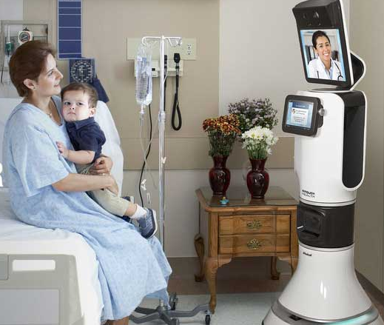
ODOA System Fail-Safes
Laura Antul
ODOA’s rely on data relayed from integrated systems
Undetected objects in hospitals have real risks
RP-VITA has an integrated fail-safe for its ODOA system
<Graphic>
http://essential-design.com/wp-content/uploads/2014/03/cs_0000_hc_rpava_page_1_web.jpg
Notes:
ODOA systems rely on data collected by systems that detect video, audio, heat levels, and other environmental elements
Use this data to understand environment and make decisions accordingly
Robots use systems to avoid collisions while moving around
Hospitals chaotic environment makes robots reactions important
Failure could cause robot to hurt injured or sick patients or hit medical devices
RP-VITA is 5’ 5” tall and weighs 176lbs. could cause a lot of damage in crash
RP-VITA uses ODOA when not being controlled by humans
According to an FDA report, “…if a component critical to the ODOA system fails in autonavigation mode, the device will halt and not move as specified”
Fail-safe ensures RP-VITA will not hurt anyone through collisons
Another area for failure broadband internet connection
ODOA systems rely on data collected through various kinds of integrated systems and sensors that detect video, audio, heat levels, and other environmental elements and changes to analyze the environment to make educated decisions. Robots utilize these systems to analyze their surroundings to ensure they do not collide into anything while they are moving around an area. Hospitals have a very chaotic environment as doctors, nurses, patients, and families are all moving through corridors and into rooms often at fast paces which makes it vital for a robot in this environment to be able to react to its surroundings. If any aspect of a robots ODOA system failed in this environment it could cause the robot to collide with an already sick or injured patient or collide with other medical devices causing the hospital to the have the financial burden of fixing or replacing the equipment. According to a publication by InTouch Health, the RP-VITA is 5’ 5” tall and weighs 176lbs. [5], now you can imagine how much damage a robot of that size could do if it collided with a person or object. The RP-VITA utilizes these ODOA systems when it moves without the help of a human controlling its movements and according to an FDA report, “…if a component critical to the ODOA system fails in autonavigation mode, the device will halt and not move as specified” [3]. This fail-safe ensures that the RP-VITA will not harm any person or object if any sensor ceases to function properly. RP-VITA also relies on a “broadband internet connection” [3], which could also pose risks when failures occur.

Slide 16
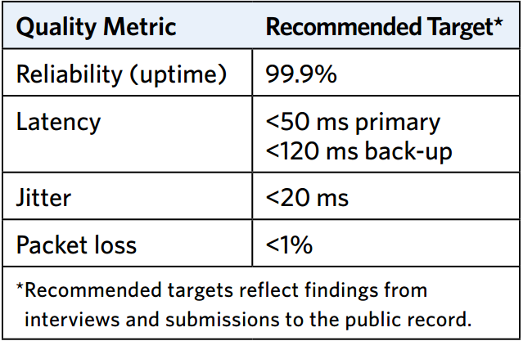
Reliable Hospital internet connections
Laura Antul
Features requiring internet access:
  Video communication
  Access to patient records
  Access to patient test results
<Graphic>
http://download.broadband.gov/plan/fcc-omnibus-broadband-initiative-%28obi%29-working-reports-series-technical-paper-health-care-broadband-in-america.pdf
Notes:
Virtually all forms of real-time video communications rely on some form of access to the internet.
Recommended bandwidths of video communications and video quality
Lack of quality could cause mistreatment of patients
No patient data can be transferred with no internet
Medical history not available with no internet
The Federal Communications Commission or FCC has established what they advise hospitals have for “Quality-of-Service Requirements”
Refer to uptime percentage in picture
The FCC has also established that hospitals must have a bandwidth greater than or equal to 100Mbps
Enough bandwidth for RP-VITAs as long as there are not too many
Virtually all forms of real-time video communications rely on some form of access to the internet. These real-time video communications often have recommended bandwidths to ensure that the quality of the video connection between participants. The RP-VITA allows doctors to communicate with patients and nurses through real-time video communication and therefore the RP-VITA has a minimum and recommended bandwidth as well. If these requirements are not met the video connection can experience reduced quality which could cause mistreatment of patients due to misinterpretation of vocal advisement from the doctors. Without a viable internet connection on either end any data collected from the patient will not be relayed to the doctor therefore causing the doctor to be unable to treat the patient. Past records on the patient would also be unable to be transmitted to the doctor which would cause the doctor to again be unable to diagnose or treat a patient since they would not have access to their medical history. The Federal Communications Commission or FCC has established what they advise hospitals have for “Quality-of-Service Requirements” [6], as you can see in the picture complete loss of internet access in a hospital setting would be incredibly unlikely. The FCC has also established that hospitals must have a bandwidth greater than or equal to 100Mbps [6], which would be more than enough to support the video communications for the RP-VITA as long as they did not implement a vast number of them in one facility without acquiring more bandwidth.

Slide 17
Summary
Laura Antul
RP-VITA helps increases the quality of care in hospitals
RP-VITA addresses ODOA system failures
Hospitals already have enough bandwidth to support RP-VITA
  More bandwidth can be purchased to accommodate RP-VITAs
Notes:
Although ODOA can fail RP-VITA has fail-safe
RP-VITA could fail if no internet
Hospitals have reliable enough internet to prevent this from causing any harm
The patients and families perception of the RP-7 responded, “if asked if care was better because the robot was used, 42 (84%) agreed”
Benefits outweigh risks since creators and hospital systems address potential areas for failure
Although ODOA systems can fail or have errors the creators of the RP-VITAs have implemented a fail-safe in case any of the sensors vital to the system are compromised by forcing the robot to cease functionality immediately. The RP-VITA’s reliance on a reliable internet broadband connection could pose a threat if the connection is not strong enough to support to video communication or if the internet connection fails entirely. Since hospitals already have a “Quality-of-Service Requirements” [6] set by the FCC that allows for only a 0.1% downtime and a required bandwidth that is already high enough to support the RP-VITA’s video communication it is unlikely that failures or errors with the broadband internet connection would cause any serious harm to patients. According to a study and survey conducted on the RP-7, the RP-VITA’s predecessor, and the patients and families perception of the RP-7 responded, “if asked if care was better because the robot was used, 42 (84%) agreed” [7]. Therefore, since the potential system failures in the case of the RP-VITA are either addressed by the creators or the hospitals systems and individuals believe the robot is helping increase their care the benefits of their implementation outweighs the potential risks from failures or errors.

Slide 18
References
Laura Antul
[1] United States. Department of Health and Human Services. Food and Drug Adiministration. 5 10(k) Submission Remote Presence Robotic System. Rockville: Food and Drug Administration, 2008. <http://www.accessdata.fda.gov/cdrh_docs/pdf7/K073710.pdf>.
[2] Kristoffersson, Annica, Silvia Coradeschi, and Amy Loutfi. "A Review of Mobile Robotic Telepresence." Advances in Human-Computer Interaction 2013 (2013): 1-17. Hindawi Publishing Corporation. Web. 24 Sept. 2015. <http://www.hindawi.com/journals/ahci/2013/902316/>.
[3] nited States. Department of Health and Human Services. Food and Drug Adiministration. 5 10(k) Submission Remote Presence Robotic System. Rockville: Food and Drug Administration, 2012. <http://www.accessdata.fda.gov/cdrh_docs/pdf12/K123229.pdf>.
[4] Ackerman, Evan. "RP-VITA Approved for Hospital Use, SUGV Approved for Disruptor Use." IEEE Spectrum. IEEE Spectrum, 21 Jan. 2013. Web. 24 Sept. 2015. <http://spectrum.ieee.org/automaton/robotics/medical-robots/rpvita-approved-for-hospital-use-sugv-approved-for-disruptor-cannon-use>.
[5] "The New Face of Telemedicine." (2013): n. pag. InTouch Health. InTouch Health, 2013. Web. 24 Sept. 2015. <http://webbcopy.com/linked/13-ith-rp-vita-bro-singles-3-6.pdf>.
[6] United States. Federal Communications Commision. Health Care Broadband in America. N.p.: Federal Communications Commision, 2010. <http://download.broadband.gov/plan/fcc-omnibus-broadband-initiative-%28obi%29-working-reports-series-technical-paper-health-care-broadband-in-america.pdf>.
[7] Sucher, Joseph F., S. Rob Todd, Stephen L. Jones, Terry Throckmorton, Krista L. Turner, and Frederick A. Moore. "Robotic Telepresence: A Helpful Adjunct That Is Viewed Favorably by Critically Ill Surgical Patients." The American Journal of Surgery 202.6 (2011): 843-47.Elsevier B.V. Web. 24 Sept. 2015.

Slide 19
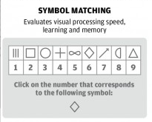
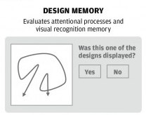
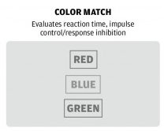
Impact concussion testing
Jillian Hennessy
The most widely used computerized concussion test
  Used by the NFL, NHL, MLS, MLB, WWE, NCAA etc. [1]
Used to measure player symptoms
  Range of different categories of testing
Baseline vs Post Concussion test [2]
Images from: http://sites.psu.edu/rclwarner/wp-content/uploads/sites/16436/2014/10/ImPact-Test.jpgation
Notes:
ImPACT: Immediate Post-Concussion Assessment and Cognitive Testing, the most widely used form of computerized concussion testing available.
Bullet 1: used in many professional sports leagues, colleges and high schools, as well as some military units and cirque du soleil, other tests exist but this is the most popular and backed by professional athletes
Bullet 2: Tests measure if someone has symptoms using agility tests, matching, reasoning and other categories: image shows examples of the tests, that involve matching words to colors, shapes to words, and short term memory of designs on the screen
Bullet 3: First take a baseline test before you are concussed, take the post concussion test once you have shown symptoms, will get comparative scores. Baseline tests suggested every two years and marketed as reliable so long as you follow the protocol and update your tests accordingly
The post concussion test is different than the baseline test so that it is not just a memorization of the answers you submitted previously

Slide 20

Impact is not a reliable test
Jillian Hennessy
Independent studies conducted show:
  Inconsistent [3]
  High error rates
  Misled by other neurological factors
Case Study:
  Healthy adults took ImPACT tests at different times
  22%- 46% were false positives for having a concussion [4]
Image credit: (Steve Dykes/AP IMAGES FOR DICK'S SPORTING GO)
Notes:
Case study 1: 2 groups of individuals averaging between 20-22 years old, group 1 took test 3 times(weekly intervals), group 2 took test 3 times (baseline, after 45 and 50 days). Group two was meant to show what a normal time interval post concussion would be: check after some time when the player is concussed, and then check again a few days later to se if symptoms persist
Study showed non-concussed individuals with worse scores than the baseline that would be enough to assume symptoms.
Concluded they have little practical value for determining whether an athlete should be allowed to play
Another case study with a Similar test: done with the same time intervals as group two, showed similar results with a number of false positives and came to the conclusion that it cannot reliably measure healthy individuals
There has not been any studies using a group of concussed individuals as the subjects and confirming if there would be false negatives where someone who is concussed would be assumed healthy, for health reasons among others

Slide 21
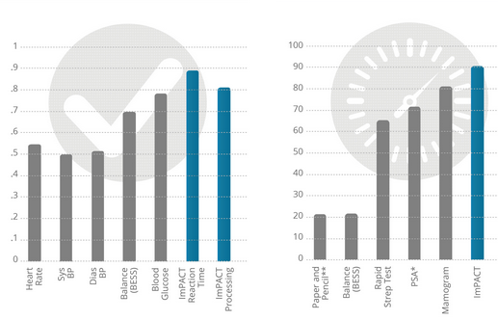
Impact’s reliability claims and warranty
Jillian Hennessy
More reliable/sensitive than other medical tests [5]
Built in measures against purposely flubbing first test
  75 college athletes told to fail test
  Only 11% fooled the test [6]
Terms and conditions [7]
  Not liable for inaccurate data
  Does not “constitute medical advice”
Image from: https://www.impacttest.com/research/?Reliability-and-Sensitivity-3
Notes:
Bullet 1: ImPACT claims to have extensive third party research that supports that it is reliable, including comparisons against other medical tests/ devices such as a blood glucose tests, mammograms and rapid strep tests and how well they do at detecting their respective issues.
Chart: first graph shows reliability of impact vs medical tests, it is said that a correlation of .8 or above is strong enough to assume reliability, second graph shows the sensitivity of impact to concussion symptoms compared to the sensitivity of other tests for example strep test to strep for example, percentage is indicative of how % of time the test was able to recognize the symptoms and identify a concussion.
Bullet 2:One issue people claim is the ability to purposely score low on baseline test in order to avoid detection of a concussion, many NFL players have rumored that this is possible or like Peyton manning have even joked about this being doable for professional athletes, the developers have claimed that as a major selling point of impact is that it can detect any “devious” tests and not count them
Sub bullet: A Study proved that even when told how to fail the test, only 11% of athletes could, as ImPACT is designed to notice when scores seem faulty, they were given exact direction on how to get a low score on the impact test by the physicians that were administering them and still could not succeed in doing so
Bullet 3: Reliability claim comes from the test as a score itself, but the terms and conditions hold them not responsible for decisions made regarding the tests, state that the test is not meant to replace the use of a medical professional, also that there is no warranty in the event someone uses these tests and someone is harmed because of a decision made from them, impact cannot be sued

Slide 22
Misleading research
Jillian Hennessy
Study on both concussed and healthy students [8]:
  64% claimed symptoms, 93% showed signs of symptoms
  30% of control group also showed signs of symptoms
Independent researchers highlight that success is in marketing [9]
  Test developed by Mark Lovell, who was working with NFL at the time
  Hidden role with NFL and NHL, as well as on research studies [10]
Notes:
Bullet 1: Compared the test scores of concussed and non concussed athletes. Authors of the study claimed 29% increase in detection of concussion symptoms, and that while only 64% still felt they had the post concussion symptoms 93% were actually flagged for the symptoms. This was presented as a positive for the test as it being able to detect more people with concussions and keep them safe. The test however failed to highlight that 30% of the non-concussed individuals also showed “symptoms” once they took the test, which means that the test could just vary so much in each case that anyone has a chance to score lower than before
Bullet 2: Conflict of interest: Lovell worked for NFL's Committee on Mild Traumatic Brain Injury (MTBI) and had a similar role with the nhl while he was creating the product to eventually sell to them and market them as his main customers.
He was also involved and Authored papers on ImPACT and evaluating it’s performance without ever disclosing his role in developing the product at the time. In one case the paper had to be taken out of publication and had to change the way the referenced the various authors of the paper due to the deceit.
The main advantages of the impact vs other tests is how its gained popularity through major clients and it is known for having so much research on it that is peer reveiwed. Both of these aspects have been influenced by Lovell

Slide 23
Conclusions
Jillian Hennessy
  ImPACT and other concussion tests are not reliable measures
  ImPACT profits off of something that may not be of any real use
  Able to claim reliability through research, and terms and conditions
  In a time where concussions are a hot topic, the use of these tests give false security about measures being taken to prevent head injuries
Notes:
While the Impact test among other tests are able to show that they are sensitive to the correct symptoms and are good additional measures to take for anyone who has gone through a concussion, they have not proven to actually do anything more than a doctor could do with a pen and paper in person,
Furthermore there are many studies showing that the scores can vary in healthy individuals enough to falsely assume that an individual is experiencing post concussion symptoms which brings about questions of whether the score is actually meaningful or if there are too many other factors that can influence it
The impact test has gotten most of it’s success over the clients that it has and is able to use to market it to other clients, as well as the extensive research on impact tests specifically. However so much of this is swayed by the developer and ceo of the impact group who has taken advantage of studies he’s conducted and places he held high positions in… this has allowed him to profit while other tests that are no worse can be given for free
This is dangerous in a time currently where head injuries are serious concerns in sports, both the nfl and nhl are under fire and dealing with lawsuits by past players and families regarding brain damage as well as the nfl being the subject of the anticipated “Concussion” movie. There has also been suicides by former players in recent past, that many believe are related to brain damage that came from playing these sports for a living. This test is supposed to be another step toward increasing player safety however it is unknown whether it can actually be of any use. Meanwhile, the company is able to avoid these lawsuits through their warranty and terms and conditions. Is this really a preventative measure or a tool to try and save face.

Slide 24
References
Jillian Hennessy
[1] Farnes, Jennifer, Impact Fact Sheet, https://www.impacttest.com/_admin/uploads/impact-fact-sheet-061813.pdf, (September 22, 2015)
[2] Impact Applications Inc., The Impact Test, https://www.impacttest.com/about/?The-ImPACT-Test-4, (September 22, 2015)
[3] Bradley, Bill, Researchers Question Reliability of ImPACT Testing for Concussions, http://www.nfl.com/news/story/0ap1000000245812/article/researchers-question-reliability-of-impact-testing-for-concussions, (September 22, 2015)
[4] Resch et. Al, ImPact Test-Retest Reliability: Reliably Unreliable?, http://natajournals.org/doi/abs/10.4085/1062-6050-48.3.09, (September 22, 2015)
[5] Impact Applications Inc., Reliability and Sensitivity, https://www.impacttest.com/research/?Reliability-and-Sensitivity-3, (September 22, 2015)
[6] Pennington, Bill, Flubbing a Baseline Test on Purpose Is Often Futile,
http://www.nytimes.com/2013/05/06/sports/sandbagging-first-concussion-test-probably-wont-help-later.html?_r=0, (September 22, 2015)
[7] Impact Applications Inc., Terms and Conditions, https://www.impacttest.com/legal/?Terms-and-Conditions-2, (September 22, 2015)
[8] Keating, Peter, Concussion test may not be panacea, http://espn.go.com/espn/otl/story/_/id/8297794/neuropsychological-testing-concussions-not-panacea, (September 22, 2015)
[9] Aschwanden, Christie, Check Your Head, http://www.slate.com/articles/health_and_science/medical_examiner/2012/01/impact_and_other_concussion_tests_for_athletes_may_not_work_.single.html, (September 22, 2015)
[10] Keating, Peter, NFL's concussions expert also sells equipment to league, http://sports.espn.go.com/nfl/news/story?id=2967678, (September 22, 2015)
Notes:
References slide

Slide 25
Class 9
The End
Keith A. Pray
Instructor
socialimps.keithpray.net
Notes:
This is the end. Any slides beyond this point are for answering questions that may arise but not needed in the main talk. Some slides may also be unfinished and are not needed but kept just in case.

Slide 26
Reliability Of Statistics
Are other factors controlled?
Is enough time covered?
Is all data reported?
Use Intuition
  Are results reasonable?
Notes:
Power line dangers. Electromagnetic fields? PCBs in transformers?

Slide 27
Cost-Benefit Analysis
How much does it cost?
What do I get for this cost?
Notes:
Like a social contract.

Slide 28
Risk-Benefit Analysis
What could go wrong?
How likely is it?
How costly are the consequences?

Slide 29
Limitations to
Risk-Benefit Analysis
Hard to quantify probabilities
Hard to quantify costs
Who bears the costs?
Are the potential benefits worth it?
Notes:
What is the value of a human life?
What is the value of a species?
E.g. future generations, poor people.
Omelas

Slide 30
Some Measures
Mean Time To Failure (MTTF)
Mean Time Between Failures (MTBF)
Mean Time To Repair (MTTR)
Notes:
Is it repairable?
What does it mean to repair? Running again? Data fixed? Caught up?
Restoring the GBC Web site.

Slide 31
Relying Too Much
Limits of modeling reality
Limits of precision
Limits of algorithms
Limits of interpretation
Notes:
Battle of the X-Planes
Trusting the statistics. Are differences significant?
Colin Chapman’s Lotus 7 chassis.

Slide 32
Producing Good Software
Good specifications
Good usability
Good design
Robustness
Good implementation
Testing
Notes:
Specs: Know what you are going to do. Often difficult. What does the customer want? What does the customer need?
Usability: Logical and intuitive, Consistent, Helpful, Complete, Accessible, Disability. Complete—not have to write things down.
Design: Logical, Modular, Consistent, Well-specified, Flexible, Extensible, Adaptable, New features, new platforms.
Robustness: Tolerant of data errors, Tolerant of human errors, Tolerant of network errors, Enough detail / not too much. Stack trace vs. “?” “A script error has occurred. Do you want to debug?”
Implementation: Adequate hardware (E.g. memory, storage, speed), Adequate software (Languages, OS, libraries), Internal and external documentation
Testing: Should be at all phases of the development cycle. Plan ahead for it. Consistent, repeatable, documented. Regression testing.

Slide 33
Plan For The Long Term
Version control
Future development
New platforms
Patches
Security
Training
Customer support

