Slide 1
Class 5
Intellectual Property
Keith A. Pray
Instructor
socialimps.keithpray.net
Notes:
Here’s the title slide. Excited already, aren’t you?
Reminders:
Do not change the format, footers, etc. in the template slides.
Paper writing process: Sources → Notes → Conclusion → Argument → Counter Point → Response

Slide 2
Overview
Review
Assignment
Students Present
Guest Speaker
Notes:
Even though Frank could not join us today he has offered to answer any remaining questions you we may have regarding software patent law. Please submit and rate question on the Intellectual Property discussion board on myWPI.

Slide 3
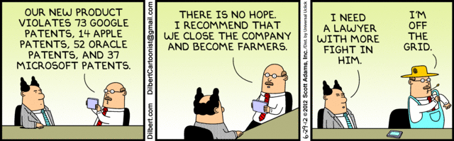
Notes:
Let’s see what everyone decided for the paper!

Slide 4
My Reading Notes
pp. 162 Illegal software stats changed since 2009?
pp. 169 SaaS, Google Search example? “…before he gave them the plot.”?
pp. 176 4.4 #2 preferred?
pp. 182 dial-up is not ordinary any more. revenue != profit
pp. 189 blocking 100% seems impossible
pp. 197 4.7.3 reference?
pp. 202 Perhaps friends should not ask you to break the law? Any successful industries operate as a support service?
pp. 203 Is Perl still most popular? Quality study from 2003, change?
pp. 205 GUI argument ignores Android.
pp. 208 who uses tape?
pp. 223 Any news?
End of Chapter questions I liked: 31

Slide 5
Group Quiz
For each On the left answer a–d on Right
Trademark
Copyright
Patent
Trade Secret
What kind of IP does it protect?
What qualifications does the IP have to meet to be protected?
How long does the protection last?
Give a specific example of IP currently protected?
Notes:
Trademark
Used to denote a product or service.
Apply in specific areas of commerce. Only applies in specified area of business
Indefinite term as long as in use and protected against becoming a common noun or verb.
You do not have to register a trademark unless you want to bring litigation before a federal court (there are other benefits too)
Copyright
Expression, not ideas: Fuzzy. E.g. derivative works, characters, merchandising, plots.
Mickey Mouse, Tarzan.
US Default : Original Author, Exception: work for hire, Transferred: yes
Rights: Publication, Performance / exhibition, Adaptation to other media, Excerpting, Attribution, Derivative works
US Term: Lifetime of author plus 70 years., 95 years for companies.
Governed by US law and international treaties (e.g. WIPO).
Fair Use: News reporting, reviews, etc., Scholarly / educational use, Private, non-commercial use, Lending libraries and archives
Fair Use restrictions: Admission charge, Re-transmission
In general, you can: Read, view, play, etc., Copy for personal use., Time-shift.
In general, you cannot: Copy for others., Transfer to someone else but keep a copy., Show / perform it publicly.
What about video rentals?
Rationale: Encourage creativity. Encourage dissemination. Balance between private and public good. It’s a social contract.
Patent
A mechanism, process, or composition of matter.
Something patentable must be: Novel. Useful. Non-obvious. Described clearly. Must do what it says.
Usual term 20 years.
Utility and plant patents: 20 years.
Design patents last 14 years. (ornamental design of functional item)
Provisional patent gives 1 year, before full patent
Trade Secret
You must take steps.
Enforceable by: Contracts, Laws against industrial espionage.

Slide 6
Overview
Review
Assignment
Students Present
Guest Speaker
Notes:
But first take a look at:
CGP Grey
Copyright: Forever Less One Day
https://www.youtube.com/watch?v=tk862BbjWx4
Tom Scott
http://tomscott.com
Welcome To Life
https://www.youtube.com/watch?v=IFe9wiDfb0E&feature=youtu.be

Slide 7
Assignment - Self Search 1/3
Discussion Board
Post ways one can search for information about a person. Do not repeat entries.
Use each search method listed to produce 2 profiles as an appendix of your paper. Provide a brief description if you’d rather not list the details.
  Profile 1: all information someone might think is you
  Profile 2: all information you know is you.
  You are not responsible for methods posted after Monday Midnight.
For each search method result consider:
  Exactly how did the data get there?
  How can this data be used?
  Is this a secondary use?
  Did you authorized use of the data? If not and you want to, request its use be discontinued and post the correspondence.
Dig deeper than a basic search engine’s (Google, etc.) results.

Slide 8
Assignment - Self Search 2/3
1 Page Paper
Use your search results to help support your conclusion.
This assignment requires you revisit the Discussion Board frequently as new search methods are posted, subscribe to it.
Conclusion idea examples (not comprehensive):
  What impression would a potential employer have of you given these results, assuming they also had a resume and possibly a cover letter from you?
  What would your elder family members (or equivalent) think?
  Are you comfortable with what you found or did not find?
  Do you believe protecting your privacy is important or needed?

Slide 9
Assignment - Self Search 3/3
Profile 2
Is You
1 Page
Paper
Filter
Inspiration
Search Methods
…
…
…
…
Filter
Profile 1
Could Be You

Slide 10
Overview
Review
Assignment
Students Present
Guest Speaker

Slide 11
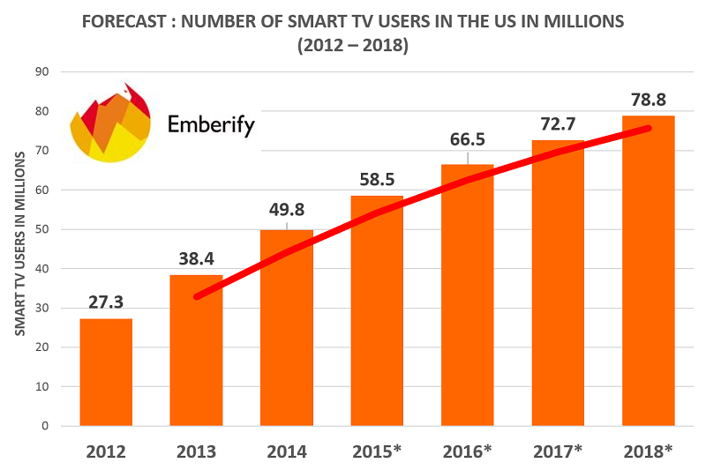
Smart TV Licenses Stifle
Customer rights
Ben Sharron
Smart TV use is growing
  TVs connected to the internet
Samsung SmartTV Terms of Service went viral
  Media questioned privacy
DMCA protects Samsung software
  Customers unable to modify or verify firmware
Image courtesy of: Smart TVs in 2015: The Idiot Box Redefined, [1]
Notes:
In this presentation I will work to conclude that Smart TV licenses inhibit customers’ freedoms and expectations of privacy. Therefore an exemption should be made in the DMCA, similar to that made for smartphone jailbreaking.
I’ll focus on Samsung’s SmartTV voice collection as a case study to demonstrate bad precedent since the issue is one of principle, though LG uses similar language in its privacy policy.
Smart TVs are a fast-growing segment of the tech industry.
This graph is indicative of the clear upward trend in consumer popularity of Smart TV’s in the United States. Since this technology is quickly becoming omnipresent, the issues presented here are even more socially relevant and the balancing of the rights of consumers with the IP rights of Smart TV firmware developers is crucial.
Smart TVs use third party voice recognition software
In February 2015, Samsung’s ToS/privacy policy for their SmartTV went viral, inciting an online media uproar over the potential for this technology to be invasive to customers and the DMCA acting as a deterrent for worried consumers.

Slide 12
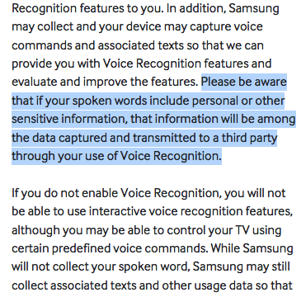
Samsung Privacy Policy
Contained Troubling Statement
Ben Sharron
Samsung’s privacy policy went viral (right) [2]
  Warned customers about transmission of voice data
  Many outlets found this troubling
Samsung released press statement [2]
  Previous vulnerabilities [3]
  Opt-out is either inconvenient or unverifiable
Image courtesy of: https://twitter.com/xor/status/564356757007261696/
Notes:
Starting with The Daily Beast on February 5, 2015, many online publications picked up the viral story of Samsung’s SmartTV vague privacy policy statement regarding its Voice Recognition service
Explicitly warned customers against revealing sensitive spoken information
Vague and broad in process and extent of voice data transmission; “Third Party” is unnamed.
Samsung released a press statement and eventually policy was updated with tighter language and third party company was named
Company ReVuln found vulnerability in Samsung’s SmartTV upon original release, demonstrating “security safeguards” may not be enough
Samsung ensures consumers the feature “can be activated or deactivated by the user” but whether disabling stops data collection is unverifiable and disconnecting the TV from Wi-Fi is counter to the

Slide 13
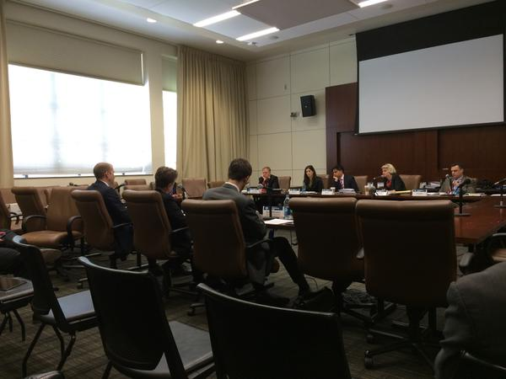
DMCA Makes Modifying or Verifying Firmware Illegal
Ben Sharron
DMCA protects software from being modified [4]
  Also simply verifying setting change is in effect is illegal
  Power to validate product revoked
Software Freedom Conservancy seek exemption for Smart TVs [5]
  Public hearings held
  Comparison to previous exemption for jailbreaking smartphones
  Argument against says exemption would promote piracy
Image Courtesy of: Aaron Williamson Testifies, [5]
Notes:
Knowledgeable users may be able to subvert potential voice data collection or make other changes to Smart TV firmware, however this action is currently illegal under the DMCA
In addition, the simple act of validating that the setting change accomplishes what it’s intent is, is also illegal
As Parker Higgins of the EFF explains: “When you take away users’ ability to research or audit or modify the software that their devices are running, then they’re basically rendered powerless”
Every 3 years, DMCA exemption pleas are heard and considered
Currently the SFC is putting forward an argument for Smart TVs to fall into this category of exemptions
Piracy argument is unfounded “because TVs don't have internal disks, using this type of application would require attaching external storage to the TV, which is no more convenient than hooking up their laptops.”

Slide 14
Conclusion
Ben Sharron
Smart TVs employ questionable data collection techniques
DMCA provides protection
So Smart TVs should be granted an exemption
Image Courtesy of: Aaron Williamson Testifies, [5]
Notes:
Smart TVs have the potential to employ data collection techniques some people may find to be an invasion of privacy
The DMCA currently prevents consumers from even legally validating that these services have been disabled
Thus, I conclude that Smart TVs, like smartphones, should be given an exemption from these harmful aspects of the DMCA

Slide 15
References
Ben Sharron
[1] Majumdar, N. (2015, April 20). Smart TVs in 2015: The Idiot Box Redefined. Retrieved September 10, 2015, from http://emberify.com/blog/smart-tvs-in-2015-the-idiot-box-redefined/
[2] Harris, S. (2015, February 5). Your Samsung SmartTV Is Spying on You, Basically. Retrieved September 10, 2015, from http://www.thedailybeast.com/articles/2015/02/05/your-samsung-smarttevenv-is-spying-on-you-basically.html
[3] Wong, R. (2012, December 14). Samsung Smart TVs: The next frontier for data theft and hacking [video]. Retrieved September 10, 2015, from http://bgr.com/2012/12/14/samsung-smart-tv-hack-security-exploit-discovered/
[4] Grauer, Y. (2015, February 10). Stopping a Smart TV From Eavesdropping On You Could Be a Felony. Retrieved September 10, 2015, from http://www.slate.com/blogs/future_tense/2015/02/10/samsung_s_smarttv_disabling_its_eavesdropping_could_violate_dmca.html
[5] Aaron Williamson Testifies on Conservancy's Behalf to Extend DMCA Exemptions to Smart TVs. (2015, May 21). Retrieved September 10, 2015, from https://sfconservancy.org/news/2015/may/21/DMCA-testimony/
[6] ::: LG Smart World :::. (n.d.). Retrieved September 11, 2015, from http://gb.lgappstv.com/appspc/footer/footer/moveDeviceTerms.lge?type=S_PRG&level=2&link=202

Slide 16

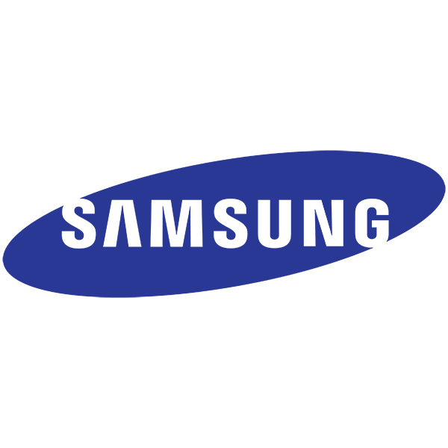
APPLE VS SAMSUNG
Rayan Alsoby
<Graphic>
http://images.apple.com/home/images/og.jpg?201507310104, http://www.samsung.com/us/images/common/samsung-logo.jpg
Notes:
Introduction: Will talk about patent infringement cases between apple and Samsung, first we need to overview the patent in the mobile industry.

Slide 17
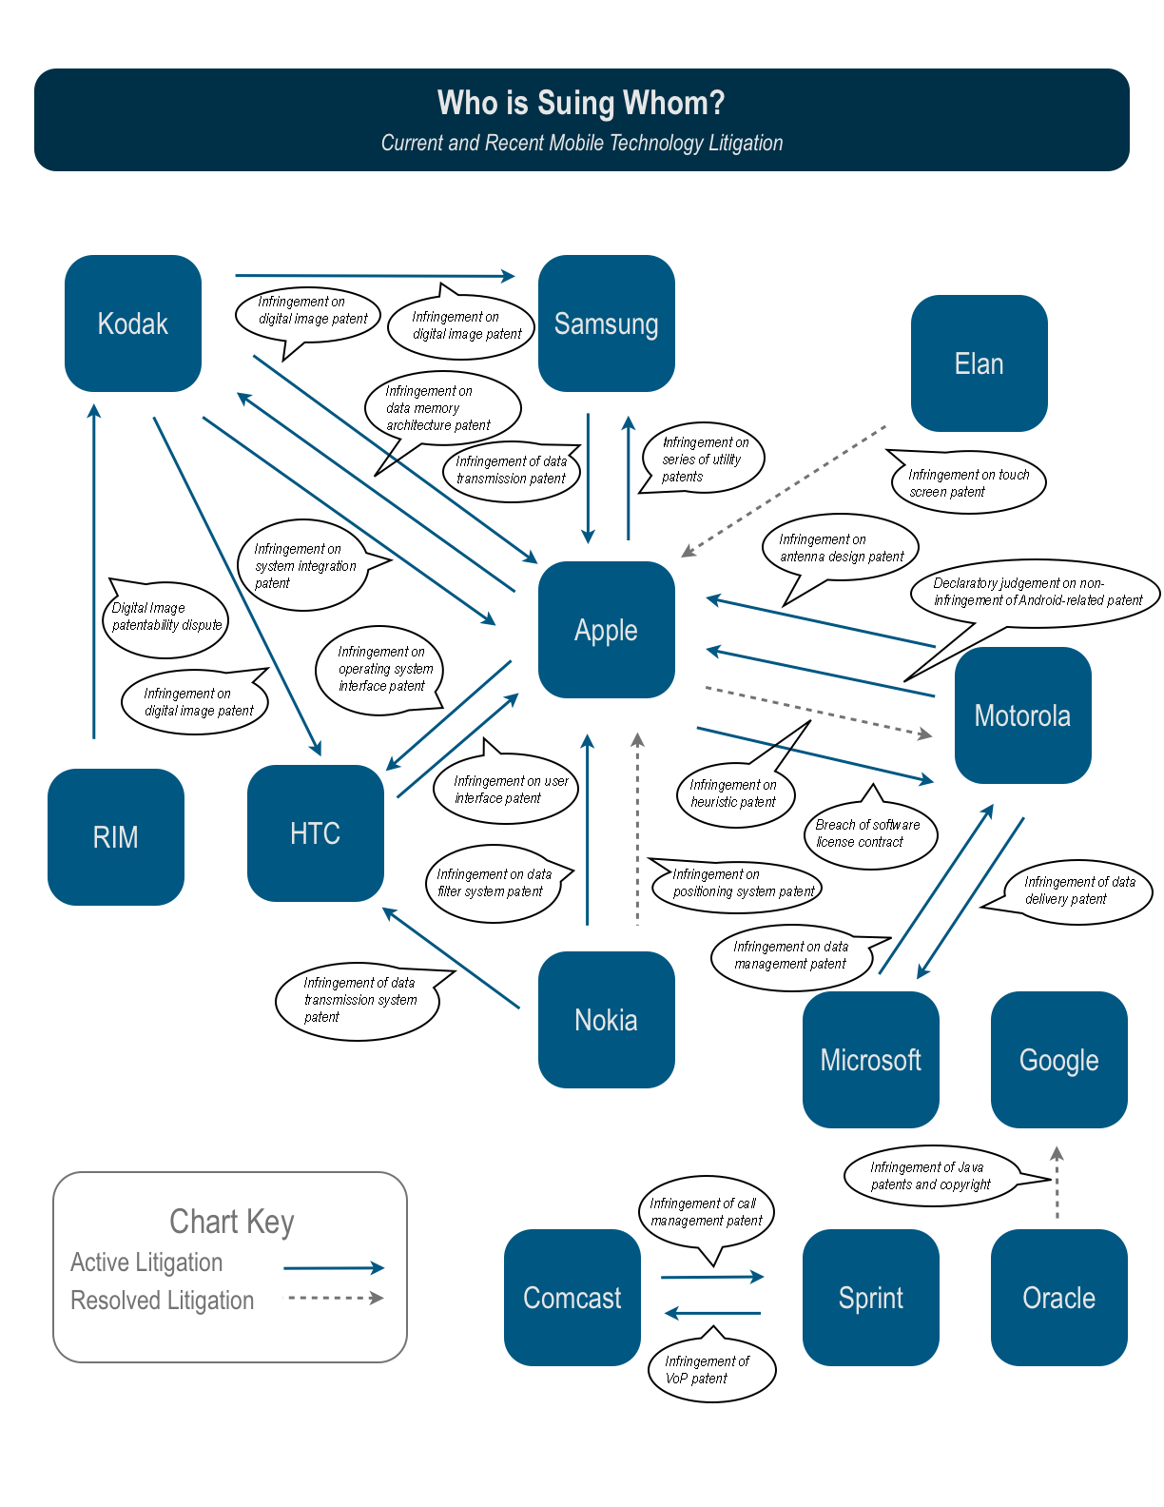
Patent war overview
Rayan Alsoby
Started with Nokia vs Apple in 2009
http://images.businessweek.com/bloomberg/patent_lawsuits.jpg
Notes:
Here is a graph to overview the patent war in the mobile industry. Apple can be seen as the center of the stage.
This graph is not exhaustive, there other cases not included in the graph.
Today we’ll focus only on Apple vs Samsung battle.

Slide 18
Apple sues samsung
Rayan Alsoby
First lawsuit filed on April 2011
Asked for $2.75 billion in damages
4 Design patents
  D593,087 & D618,677: for the front face appearance of the phone
  D504,889: for the overall appearance of the tablet
  D604,305: for the GUI
3 Utility patents
  7,469,381: for the Bounce-Back Effect
  7,844,915: for the On-screen Navigation
  7,864,163: for the Tap To Zoom feature
Notes:
Examples:
677 -> glass edge-to-edge in the front face
087-> home button
Company comments: - Samsung on D’677 “rectangle with round coroners”
889 is the only one Samsung didn’t infringe.

Slide 19
Samsung sues Back
Rayan Alsoby
The case went on trial August 2012
Asked for $421 million in damages
5 patents
  7,675,941 & 7,447,516 : for communication system
  7,698,711: for multi-tasking
  7,577,460: for phone with camera design
  7,456,893: for digital image processing
Notes:
941 -> transmitting and recurving data packets
516 -> supporting enhanced uplink service
Case not as strong as Apple’s. Countersued when case went to trial.

Slide 20
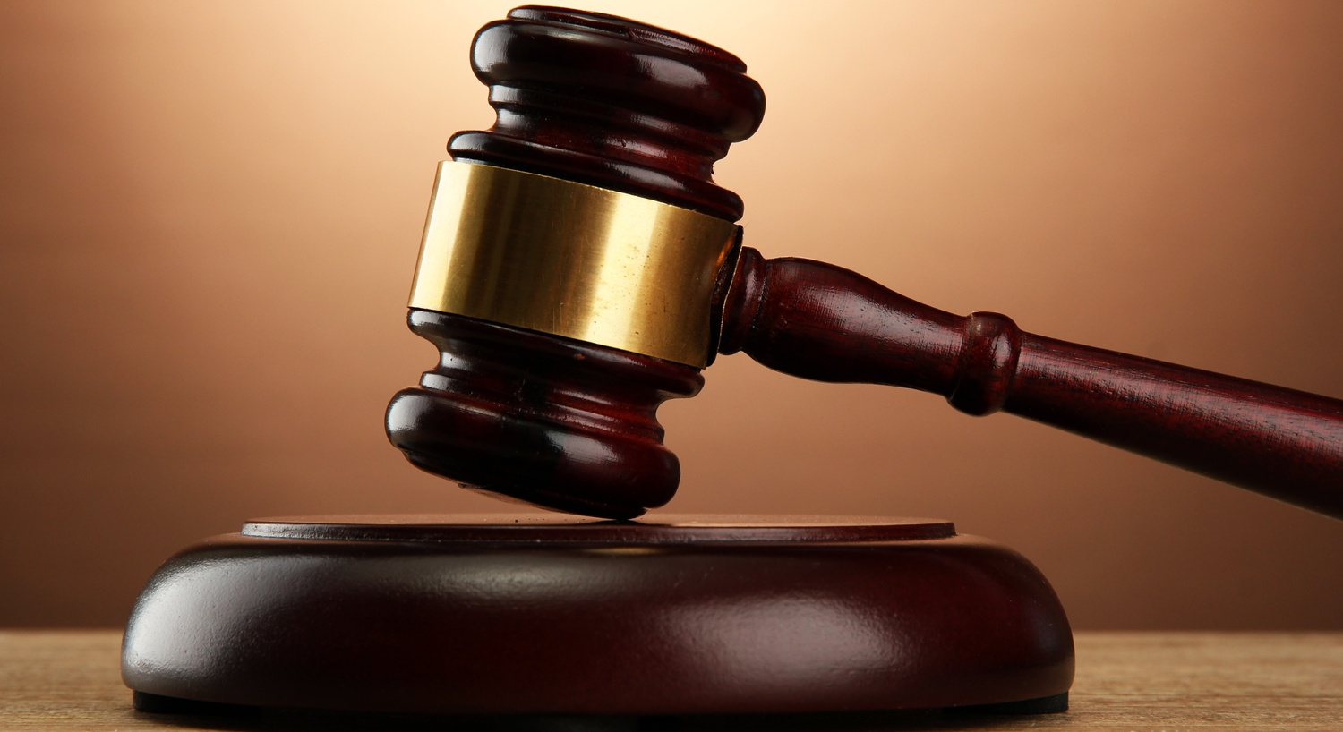
Verdict
Rayan Alsoby
Verdict was reached on August 24, 2012
Samsung
  Guilty on infringing patents in 26 of their devices
  To pay $1.05 billion in damages to Apple
Apple
  Pay zero dollars to Samsung
http://www.herald.co.zw/wp-content/uploads/2013/07/court-hammer.jpg
Notes:
Later on there were other patent infringement cases between the two sides but they weren’t as major as this one.
The 1.05 billion was changed several time wether it was calculations done by the judge or by the jury the final amount turned to be $930 million for Apple.

Slide 21
Market share
Rayan Alsoby
http://www.statista.com/statistics/242388/market-share-of-smartphone-vendors-in-the-united-states-usa/
Notes:
Here is a graph to smartphone market share in the US between 2010 and 2012. In Q3 2011 Apple and Samsung nearly equal market share. Did apple file the lawsuite in April 2011 seeing that the competition is getting tough?

Slide 22
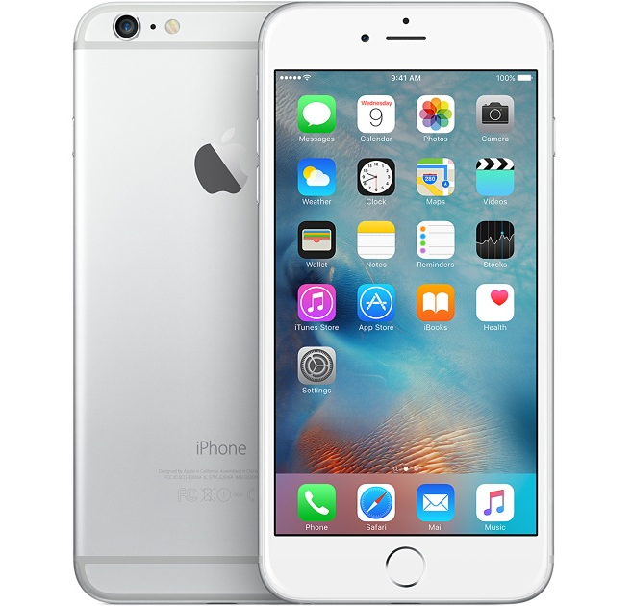
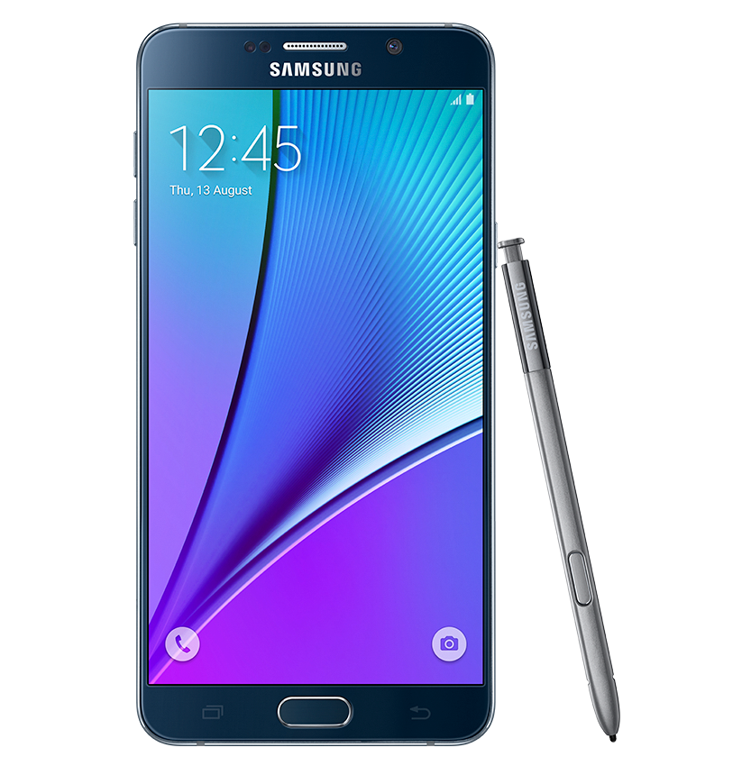
Who won?
Rayan Alsoby
Apple
Samsung
Law firms
The media
The consumers
Notes:
Apple for winning the actual case and getting the compensation, or Samsung for getting the reputation of being an underdog, or law firms who represented those companies because they’’’ charge ridicules fees and make profit, or the media from having a great piece of news that will stir controversy in society, or did the consumer actually win for pushing the companies to better creativity rather than copying each other’s ideas.
Links for the pictures:
http://store.storeimages.cdn-apple.com/4711/as-images.apple.com/is/image/AppleInc/aos/published/images/i/ph/iphone6p/silver/iphone6p-silver-select-2014?wid=1200&hei=630&fmt=jpeg&qlt=95&op_sharpen=0&resMode=bicub&op_usm=0.5,0.5,0,0&iccEmbed=0&layer=comp&.v=1411520692638
http://www.samsung.com/global/galaxy/galaxy-note5/images/galaxy-note5_gallery_with-spen_black.png

Slide 23
References
Rayan Alsoby
[1] United States Court of Appeals for the Federal Circuit, (2015). APPLE INC v. SAMSUNG ELEC. , http://www.cafc.uscourts.gov/sites/default/files/opinions-orders/14-1335.Opinion.5-14-2015.1.PDF
[2] CNET,. (2012). Jury awards Apple more than $1B, finds Samsung infringed - CNET. Retrieved 9 September 2015, from http://www.cnet.com/news/jury-awards-apple-more-than-1b-finds-samsung-infringed/
[3] Carani, Christopher. (2013)Apple v. Samsung Design Patents Take Center Stage. http://designpatentattorney.com/wp-content/uploads/2013/01/Carani-Lanslide-Article-Design-Patents-Take-Center-Stage-Jan-Feb-2013.pdf
[4] Appleinsider Staff(2009). Nokia sues Apple over iPhone's use of patented wireless standards. AppleInsider. Retrieved 8 September 2015, from http://appleinsider.com/articles/09/10/22/nokia_sues_apple_over_iphones_use_of_patented_wireless_standards.html
[5] Love, Brian J., Apple, Google – Please Spend on R&D Not IP (August 22, 2012). San Francisco Chronicle, August 22, 2012. Available at SSRN: http://ssrn.com/abstract=2143294…
[6] Wikipedia,. Apple Inc. v. Samsung Electronics Co.. Retrieved 9 September 2015, from https://en.wikipedia.org/wiki/Apple_Inc._v._Samsung_Electronics_Co.

Slide 24
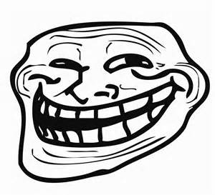
Who, what why
Jessie Johnson
Patent trolls are non-practicing enterprises (NPE)
Patent trolls acquire many loosely defined patents
When another company creates a product they feel is an infraction, they take legal action against them
Source: www.reactionface.info [10]
[10]
Notes:
-cant be counter sued cuz they manufacture nothing

Slide 25
Conclusion
Jessie Johnson
Patent trolls are hurting job growth in America
Counter Point:
  The patent troll industry has created jobs for those offering insurance and protection from patent law suits
  Companies like RPX Corporation buy patents that their subscribers may find they could infringe upon [1]
    The actual patent trolls make money as well the insurance groups
[1]
Notes:
<speaker notes>

Slide 26
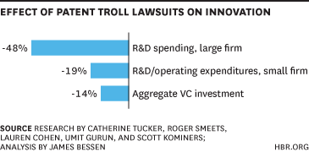
The numbers
Jessie Johnson
  35% of start up companies that have raised 50-100 million dollars are sued [4]
  90% of cases are settled out of court [4]
  41% of companies sued report that their operations are impacted significantly [5]
Source: HBR.org [5]
[4][5]
Notes:
Thus 15% of all start ups are significantly impacted -> assuming start ups are represent an equal amount of those affected
-14% less investments by people in the research field, the best field to bring money into Americas economy
-research and development is avoided including areas in the medical field
-remember to go back to job creation

Slide 27
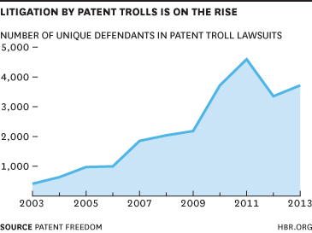
The numbers
Jessie Johnson
Then:
  Litigation cost 2007: 7 Billion Dollars [3]
Now:
  29 Billion dollars in litigation fees in 2011, and 89 billion dollars in lost productivity [3]
  Over 5,800 defenses were made due to NPE’s in 2011[3]
Source: HBR.org [5]
[2][3][5]
Notes:
-just unique defendants in chart not cases
-Firm wealth destroyed = 60B+, litigation cost = 29B+
-decline in 2011 to 2012 due to America Invents Act passed by the Obama Administration in Sept 2011 -> people need to be more specific in their patents [6]
-Shield act is trying to be put into play
-already applied in Europe
-This productivity doesn’t account for businesses that go out due to their loss in profit
-some start ups forced out of business
-litigation fees happen even if the patent troll loses (patent troll doesn’t have to pay litigation fees if they lose)

Slide 28
Case Studies of NPE’s and Insurance
Jessie Johnson
Some companies attack others
  Lodsys has successfully sued or settled with over 500 companies for patent infringement of the idea of “in-app purchases”, “interactive chat software”, “subscription models” and other vague terminology it owns [7]
Others focus on defense but if you don’t buy protection they may sue you
  Intellectual Ventures owns 40,000+ patents that an inventor is likely to infringe upon [8]
  Intellectual Ventures has a “lab” that invents ideas, patents them whether or not they can be done yet [9]
[7][8][9]
Notes:
-settlements could cost a percentage of profit, or hundreds of thousands of dollars
-litigation fees easily cost millions even if you win
-companies start out with the business model of attacking
-as they get more patents they turn to insurance
-can create future ideas
-not very ethical as it only supports self
-Kantianism-> immoral as its basically stealing
-> Act Util says bad too
-lodsys is 1 person vs 500

Slide 29
Case Studies of NPE’s and Insurance
Jessie Johnson
  Podcasters are constantly under fire
    Personal Audio has a patent that says they own:
      “Apparatus for disseminating a series of episodes represented by media files via the Internet as said episodes become available…” [11]
    Personal Audio also says it owns the patent for playlists
      Successfully sued Apple for 8 million [12]
[11][12]
Notes:
-settlements could cost a percentage of profit, or hundreds of thousands of dollars
-litigation fees easily cost millions even if you win
-podcasts –small business
-Personal Audio has an office but no people (most likely 1 person doing this from home similar to lodsys)
-successfully sues large businesses as well
-suing HowStuffWorks
-restate conclusion
-Any Questions?

Slide 30
References
Jessie Johnson
[1] RPX Corporation, “Services | RPX Corp Site”, http://www.rpxcorp.com/rpx-services/ (9/9/2015)
[2] Ashby Jones, “Tech Firms Back Obama Patent Move”, (The Wall Street Journal, June 4, 2013)
[3] Chelsea Sheasley, “BU Law Professors Author Influential 'Patent Trolls' Study”, (Boston University School of Law, July 30, 2012)
[4] Lindsay Blakely, “How Much It Costs to Fight a Patent Troll”, (Inc.com, Dec 20, 2012) <http://www.inc.com/anna-hensel/2015-inc5000-how-pharmapacks-found-loyalty-among-e-commerce-giants.html>
[5] James Bessen, “The Evidence Is In: Patent Trolls Do Hurt Innovation”, (Harvard Business Review, November 2014) (9/9/2015) <https://hbr.org/2014/07/the-evidence-is-in-patent-trolls-do-hurt-innovation/>
[6] William New, “White House Takes Major Action Against ‘Patent Trolls’”, (Intellectual Property Watch, April 6, 2013) 09/09/2015 http://www.ip-watch.org/2013/06/04/white-house-takes-major-action-against-patent-trolls/
[7] Joe Mullin, “Judge tosses Apple motion, allows patent troll Lodsys to continue rampage”, 9/9/2015, http://arstechnica.com/tech-policy/2013/09/judge-tosses-apple-motion-allows-patent-troll-lodsys-to-continue-rampage/

Slide 31
References
Jessie Johnson
[8] Jim Kerstetter and Josh Lowensohn, “Inside Intellectual Ventures, the most hated company in tech”, (Cnet, August 21, 2012) 9/9/2015, http://www.cnet.com/news/inside-intellectual-ventures-the-most-hated-company-in-tech/
[9] Intellectual Ventures, “Inventors | Intellectual Ventures”, (9/9/2015) http://www.intellectualventures.com/inventor-network
[10] “Troll Face”, (9/11/2015) http://www.reactionface.info/face/troll-face
[11] Julie Samuels, Podcasting Community Faces Patent Troll Threat; EFF Wants to Help, (9/9/2015) https://www.eff.org/deeplinks/2013/02/podcasting-community-faces-patent-troll-threat-eff-wants-help
[12] Mike Masnick, “Apple Loses Patent Lawsuit… Over Playlists”, (9/9/2015) https://www.techdirt.com/articles/20110718/00142915120/apple-loses-patent-lawsuit-over-playlists.shtml

Slide 32
Class 5
The End
Keith A. Pray
Instructor
socialimps.keithpray.net
Notes:
This is the end. Any slides beyond this point are for answering questions that may arise but not needed in the main talk. Some slides may also be unfinished and are not needed but kept just in case.

