Slide 1
Class 4
Freedom Of Speech
Keith A. Pray
Instructor
socialimps.keithpray.net
Notes:
Here’s the title slide. Excited again, aren’t you? You should be.
Paper Notes:
Average: ~5
Quantify
State Conclusion clearly
Missing Counter Point and Response
Try reading paper aloud to proof

Slide 2
Overview
Review
Assignment
Students Present
Notes:
Show Epic Rap Battles of History: Steve Jobs vs. Bill Gates (If class ok with obscene lyrics) (2:47)
https://www.youtube.com/watch?v=njos57IJf-0
This Video Will Make You Angry (7:25)
https://www.youtube.com/watch?v=rE3j_RHkqJc
Cedric Gervais - Hashtag (Original Mix) (3:58)
https://www.youtube.com/watch?v=6OmBKd7X7EE
Dave Audé vs Luciana - You Only Talk In #HASHTAG (3:36)
http://www.youtube.com/watch?v=53wIN87lJn0

Slide 3
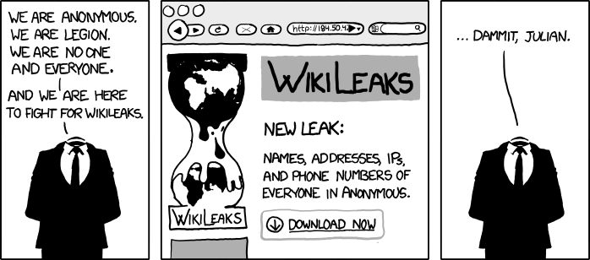
http://www.xkcd.com/834/

Slide 4
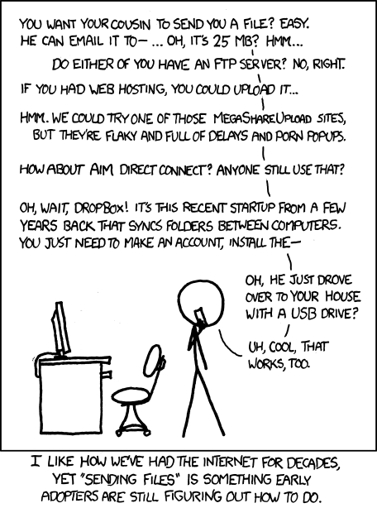
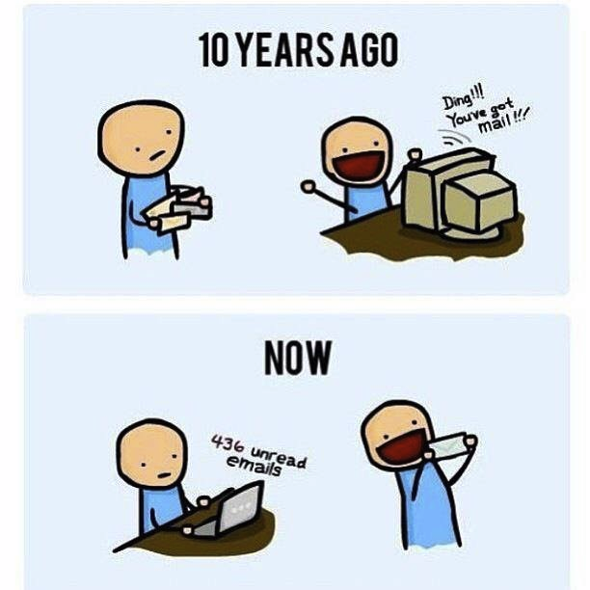
http://poofytoo.com/
20
http://xkcd.com/949/

Slide 5
My Reading Notes
pp. 110 What powers the cell phones and towers? “everyday tasks” not apparent from image.
pp. 111 “over a billion” contradicts pp. 38. [6] from 2008.
pp. 118 [17] from 2005, how is the quality of Wikipedia now?
pp. 131 Is 20% realistic? What will search engines and facial recognition be capable of? Rule Utilitarian ignores the private setting.
pp. 132 Do any filters use imgage processing?
pp. 135 Social Contract - Least restrictive/harmful way to achieve goal?
pp. 138 IM stats from 2002
pp. 139 Sting refs, latest from 2003.
pp. 144 addiction def, ignorance = !addict ?
pp. 146 More accurate to say addicted to single app?
pp. 159 2015 is © of text, time for update
End of Chapter questions I liked: 19, 26 (libel? Yes), 30 (http://en.wikipedia.org/wiki/Wikipedia:Citing_Wikipedia ),

Slide 6
Group Quiz
Name two methods some governments use to control access to information.
A large company has a policy prohibiting employees from blogging about company products.
  Name two possible reasons for the policy.
  Does it violate the First Amendment? Why?
  Is it reasonable? Why?
What does “URL” stand for and what is it?
Notes:
Censorship (religious, governmental, private). Adult authentication. Global dissemination. Freedom of Speech not an absolute right.

Slide 7

Assignment
One page paper
  Open source software development tools, friends or foes?
Extra Credit – One page paper
  Is WPI’s IT Acceptable Use Policy morally acceptable?
Remember to work on your group project.
  See full group project description on course website.
Notes:
Or review right now.
http://opensource.org/files/osi_logo_300X400_90ppi.png
Accessed 2014-09-08

Slide 8
Overview
Review
Assignment
Students Present

Slide 9
Background
Tyler Nickerson
First Chinese café opened in 1996
Provided the Internet to those without computers
Early cafes were opened near college campuses
The Feiyu café “defined a new era”
Number of cafés grew between 2001 and 2004
Notes:
First for-profit cafe opened in Haidian in 1996
Haidian cafe had only 30 computers, each with broadband access
Opened to provide Internet access to those who didn’t own a computer
Cost about 20 renminbi, or 2.40 U.S. dollars, per hour
Early cafes were opened near college campuses
Computers at the time were still relatively expensive, especially for people such as college students
Feiyu cafe in Beijing “defined a new era” in Chinese Internet cafes
Rates were flexible based on the time of day. For example, the cost was 10 RMB during the afternoon, but only 5 RMB from 9 AM to noon
Housed 1,800 computers in 2000
Between 2001 and 2004, the number of cafe users increased from four to sixteen million
The graph illustrates how cyber cafes are designed for middle class and poor communities, with the most users having either no or modest income
Graph: A 2011 survey demonstrates how the majority of Internet café users have either low or no income

Slide 10
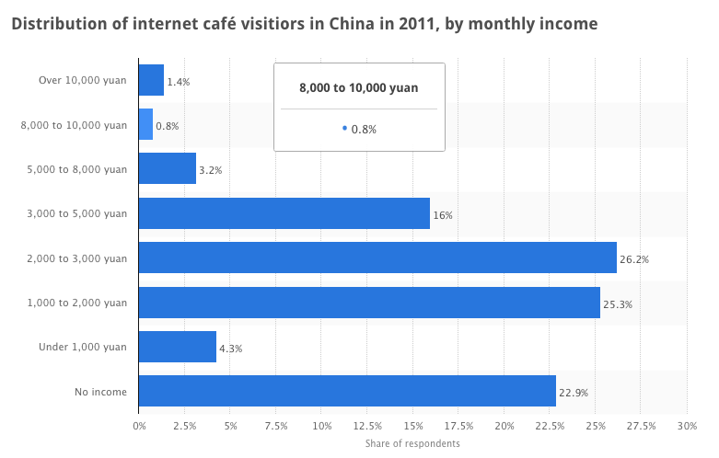
Tyler Nickerson
Chart courtesy of http://www.statista.com/statistics/236735/internet-cafe-visitors-in-china-by-income/
Notes:
Are able to provide Internet to almost anyone, regardless of how much money they have

Slide 11
Implications
Tyler Nickerson
Resulted in the government regulation of Internet cafes
Can provide Internet to almost anyone
Ban of console games in 2000 led to the surge of PC games
  Internet gaming addiction
Notes:
Resulted in the government regulation of Internet cafes
Consists of three steps
Establish a regulatory system to prevent harmful info and illegal sites from being spread
Implement local use policies for cafes, however, local authority is hard to enforce
Manipulating the competition’s prices and hours
Are able to provide Internet to almost anyone, regardless of how much money they have
Ban of console games in 2000 led to the surge of PC games, and thus Internet gaming addictions
Banned due to the belief that console games had poor physical and mental effects on children
Mixed with the previous point, this allows gaming addicts to be allowed unlimited gameplay for a very small amount.
Ironically, this has a poor mental and physical impact on individuals, which we’ll examine next.

Slide 12

Case Studies
Tyler Nickerson
Nantong, Jiangsu: A teenager cut off his own hand
Nanchang, Jiangxi: A woman gave birth in an Internet café
Hong Kong: A man died after playing a game for three days straight
Image courtesy of http://www.dailymail.co.uk/news/peoplesdaily/article-3083242/Chinese-woman-gives-birth-internet-cafe-toilets-carries-surfing-net.html
Notes:
These all happened this year
A teenager cut off his own hand in an effort to stop his online gaming addiction
Stole kitchen knife from house
Cut his hand off at the café, then got into a taxi, requesting he be taken to the emergency room
Doctor believed that the teen would still relapse into his gaming addiction
A woman gave birth in an Internet cafe, then resumed playing her game
A man died after playing a game for three days straight
Lack of motion results in blood clots
Addicts are not aware of how long they’ve stayed stationary
Deaths often go unnoticed, because many people sleep at these cafes
Picture: Woman who gave birth in café during JKTV interview

Slide 13
conclusion
Tyler Nickerson
The banning of game consoles resulted in the popularity of PC games
Internet cafes grew in popularity, as their low prices attracted gamers
For addicts, Internet cafes encourage bad behavior, which is often fatal
Notes:
Conclusion: The banning of game consoles resulted in the popularity of PC games, and thus the popularity of Internet cafes. Mixed with gaming addiction, these Internet cafes provide a fatal medium in which individuals may harm themselves.

Slide 14
References
Tyler Nickerson
[1] Burkitt, L. (2015, July 25). China to End Ban on Videogame Consoles. Retrieved September 6, 2015.
[2] Chow, E. (2015, May 15). Chow, E., & Chan, E. (2015, May 15). Chinese woman secretly gave birth in the toilets of an internet cafe then CARRIED ON surfing the web with her blood-covered son in her arms. Retrieved September 8, 2015. Retrieved September 6, 2015.
[3] D'Orazio, D. (2015, July 25). China officially ends ban on video game consoles. Retrieved September 8, 2015.
[4] Hunt, K. (2015, January 19). Man dies after 3-day Internet gaming binge. Retrieved September 6, 2015.
[5] Peng, W., & Liu, M. (2010). Online Gaming Dependency: A Preliminary Study in China. Cyberpsychology, Behavior, and Social Networking,13(3), 329-333.
[6] Phillips, T. (2015, February 3). Chinese teen chops hand off to ‘cure’ internet addiction. Retrieved September 6, 2015.
[7] Qiu, J. (2005). Through the Prism of the Internet Cafe: Managing Access in an Ecology of Games. China Information, 261-297.
[8] wenku.baidu.com. (n.d.). Distribution of internet café visitiors in China in 2011, by monthly income. In Statista - The Statistics Portal. Retrieved September 05, 2015, from http://www.statista.com/statistics/236735/internet-cafe-visitors-in-china-by-income/.
Notes:
Questions?

Slide 15
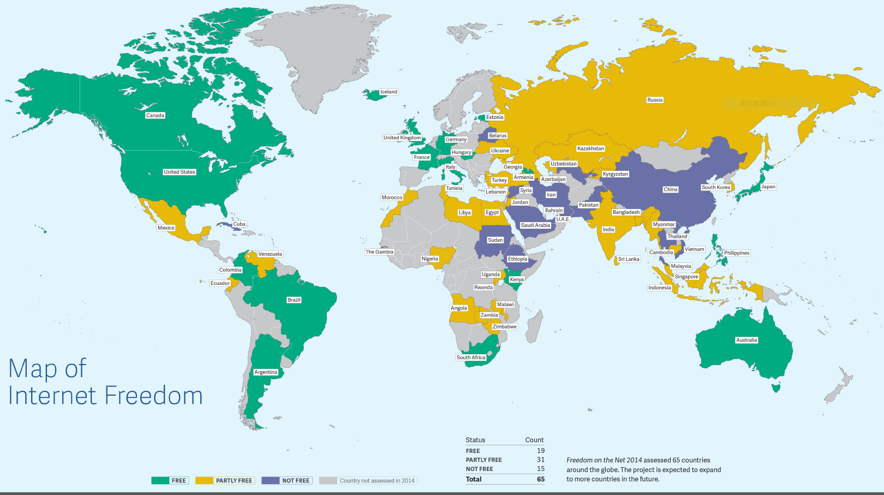
Four countries left that Blocked Facebook: North Korea, Iran, Cuba and ‘another country’
Weijia Tao
Heavy censorship in China
Chinese websites [1]
  Golden Shield Project
  2 million employed to monitor web activity [2]
Foreign websites [1]
  Great Firewall
  Google, Facebook, Twitter, YouTube…
  Foreign individuals and firms must abide by the country's laws [3]
Freedom on the Net 2014 https://freedomhouse.org/report/freedom-net/freedom-net-2014
Notes:
Here is a interesting news published by a Chinese website stating: Four countries left that blocked Facebook: North Korea, Iran, Cuba and ‘another country’
Here is a map of internet freedom for 2014.
China does a great amount of effort on internet censorship.
For domestic control, the Golden Shield Project is developed to keep an eye on what’s happening on all kinds of websites. 2 million people are employed to monitor web activity as internet opinion analysts.
Great Firewall is the tool Chinese government used to block foreign websites access and filter censored key words. Lots of famous websites are blocked in China such as Google, Facebook, Twitter, YouTube
When asked about why Facebook is blocked, Chinese official stated that “Foreign Internet companies can come to China if they abide by the law. We could not allow any companies to enter China’s market and make money while hurting the country.”

Slide 16
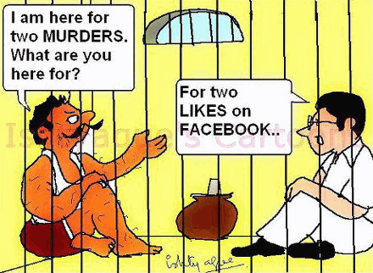
Caution!: Heavy Censorship everywhere
Weijia Tao
Social media websites
  Active deletion
Discussion forums
  Shut down
  Restrict access
Search engines
  Censored keywords
  Blocked
http://www.commentary.com/topics/internet-censorship-china.htm
Notes:
Censorship is everywhere when using internet in China or on Chinese websites.
On social media websites, if someone posted something political sensitive, the message will be deleted in a very short time. For instance, when Liu Xiaobo won the 2010 Nobel Peace Prize "for his long and non-violent struggle for fundamental human rights in China“, the main social media in China has very little information and news about him.
Discussion forums are also under heavy surveillance. For example, a Bulletin Board System (BBS) similar to forum called YTHT created by students in Peking Universities were one of the largest BBS communities in China. However, since it has too much discussion about politics, democracy, and freedom, Chinese government exerts a lot of pressure on it. Finally, on September 13, 2014, the entire BBS is shutdown and all keywords related to the BBS are removed. There are many similar examples for BBSes of Chinese universities. In 2005, government ordered all universities to be reformed into campus-wide communication platforms and requiring users to register under their legal names. The newly registered accounts are not allowed to post new topic until they are reviewed by managers.
Search engines are another big spot where censorship takes place. Search for censored keywords are closely monitored on either international or domestic ones. The results of the search would either returns: “In accordance with local laws and policies, some of the results have not been displayed.” or very few unrelated ones. Google is even blocked in China because it does not want to “follow the law”.

Slide 17
Protect People from Harm
Weijia Tao
Principle of Harm
  Terrorism & fake news harm public
  Pornographic & violent content harm teenagers
Example
  July 2009 Ürümqi riots
  Internet shut down for 10 month
Notes:
We can use principle of harm. If a certain activity by an individual is harming other people, government should step in.
For example, if terrorist uses internet to communicate and spread fake information, the action will result in social chaos and harm other people. Government should monitor their communication and try to arrest them.
In 2009, after a serious rioting happened, Chinese government blamed the organizers using the Internet to stir up hostilities. They decided to cut off internet service and cellphone text messaging across Xinjiang, which makes up one-sixth of China’s territory. The shut down lasts for 10 months.

Slide 18
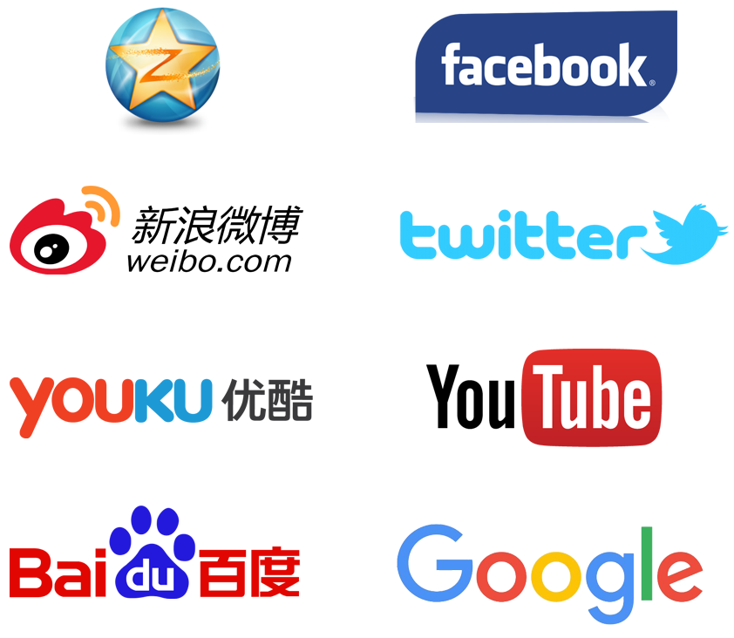
Help domestic Companies develop
Weijia Tao
VS
Notes:
From the view of domestic internet company, the ban of their famous competitors in China does give them a lot more market share. In China, we have our own version of social media, video, search engine websites.

Slide 19
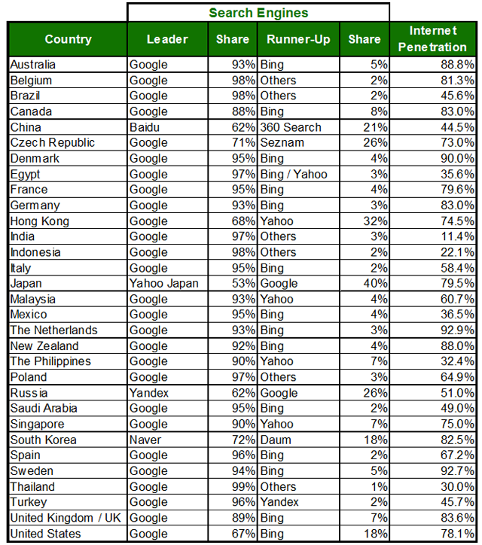
Baidu beats google in china
Weijia Tao
2013 Search Engine Market Share By Country
  Most countries: Google
  China: Baidu
http://returnonnow.com/internet-marketing-resources/2013-search-engine-market-share-by-country/

Slide 20
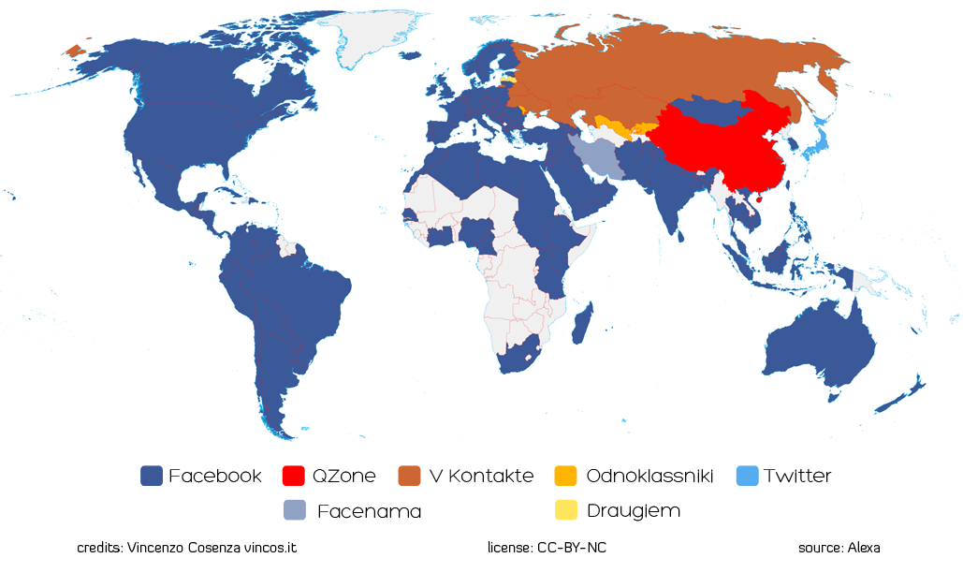
Qzone beats Facebook in china
Weijia Tao
World map of social network December 2014 http://vincos.it/world-map-of-social-networks/

Slide 21

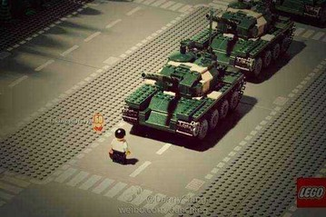
Voice are muted and eyes are blinded
Weijia Tao
Principle of Harm
  Proper political discussion doesn’t harm public
Lack of freedom of speech
  No respect to people’s autonomy
  A means to government’s end
Cover the truth
  Not honest/fair
“Tank Man” Photo http://blogs.wsj.com/chinarealtime/2013/06/04/tiananmen-effect-big-yellow-duck-a-banned-term/
Notes:
If some people are posting their thoughts about certain political issues with proper argument, they won’t hurt anyone and such action actually helps finding solutions for current issues. According to principle of harm, government shouldn’t try to block or delete posts like this.
On the right are pictures banned because they are related to the Tiananmen Square protest of 1989, which Chinese government always wants to hide from people. According to KANTIAN ethical theory, Chinese government doesn’t treat its people as rational agent and doesn’t allow them to express what they think about several political issues. The government even deprives their right of knowing the fact. The government treats its people as a means to its end to keep country stabilized and avoid conflicts. Therefore, it is not a morally acceptable action.
From VIRTUE ETHICS, honesty and fair are both virtues required for governors. Hiding the truth of a protest is not an action of honest. It is also not fair because only a small number of people know about this. The government is not a good government from this point of view.

Slide 22
Protect the People but bot control the people
Weijia Tao
Necessary:
  National security
  Chinese internet companies
Too much:
  Freedom of speech
  Right to know

Slide 23
References
Weijia Tao
[1] How does China censor the internet? http://www.economist.com/blogs/economist-explains/2013/04/economist-explains-how-china-censors-internet (2015/09/07)
[2] China employs two million microblog monitors state media say http://www.bbc.com/news/world-asia-china-24396957 (2015/09/07)
[3] Gregarious and Direct: China’s Web Doorkeeper http://www.nytimes.com/2014/12/02/world/asia/gregarious-and-direct-chinas-web-doorkeeper.html (2015/09/07)

Slide 24
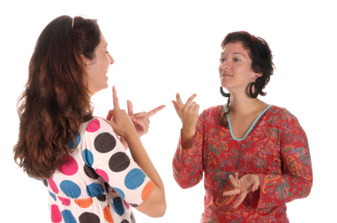
American deaf culture and social media
Andrew Mokotoff
Advancing the deaf population to the information age
  Ability to communicate with the rest of the world
Not all forms can encapsulate American Sign Language
(Personal Observation)
Notes:
Brief background on myself:
Born into deaf family
Learned ASL as my first language
Some of the points I made are from my own personal observations growing up
Social media has essentially taken the deaf out of the dark and let them communicate with everyone else
Would like to mention that due to the difficulties of collecting data on the deaf and the lack of the information/studies regarding the deaf, it is hard to measure the effect
Although it is helpful, due to the complexities of ASL, not all social media can carry the conversations as a deaf person would prefer or find most useful

Slide 25
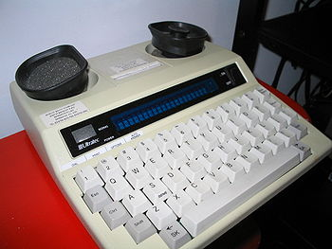
Before social media
Andrew Mokotoff
Nearly impossible to communicate with hearing people
  Deaf people only communicated in person
  Previous communication devices depended on auditory components
  Difficulties comprehending written English
  Translators were mediocre at best
Miniprint 425 TDD (Telecommunications Device for the Deaf)
(Valentine & Skelton, 2009)
Notes:
Telephone, television, and radio all were the forefront of personal interaction and transmission of current events, all of which deaf people were isolated from
ASL is a 1-1 direct/personal language that is hard to translate. It is hard for deaf people to read due to vastly different ways of thinking and expressing thought.
I cannot say that this statistic on college graduation logically supports this, but I can say that I think they correlate because the deaf are generally less educated and therefore have more difficulty comprehending written English, making it harder for them to communicate

Slide 26
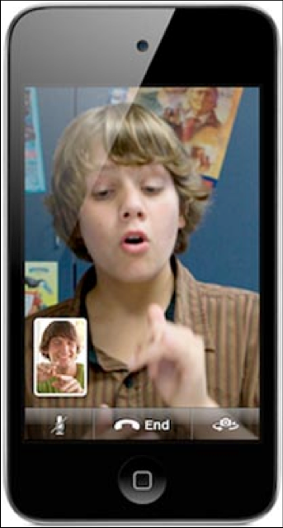
Gateway for society integration
Andrew Mokotoff
Real Time Video and Short Message Services (SMS)
  Ability to communicate with anyone, anywhere, and anytime
  Allows for the preferred personal form of communication
    An advantage the hearing population has had for years
Invention of the Internet (Email, facebook, deafsinglesconnection)
  Anxiety reduction
  Less demanding communicative environment
  Enhanced lexical and syntactic capacity
(Power, & Horstmanshof, 2007), (Valentine & Skelton, 2009), (Johnston & Napier 2010), (Bowe 2002)
Notes:
SMS and Real Time Video provide individuals with the opportunity of communicating with any person at any time and place, something that was only available to the hearing population, thus the social networking radius of the deaf community has expanded into the hearing realm of society. It is also an alternative to the telephone which they needed a TTY machine for as mentioned in the previous slide
Deaf people aren’t as intimidated when talking to people because they can talk to hearing people without being known as deaf. Deaf are able to overcome prejudices or encountered aversions in the general public and given the opportunity to create unbiased relationships with hearing people
Prior to the internet, deaf people needed translators or a pen/pencil in order to communicate with hearing people which often times was stressful and far from easy, but now they can more casually contact people with ease
the general syntactic and linguistic structure of the Internet is more basic to facilitate understanding among a larger range of people due to its simplistic and visual nature. Because many deaf persons are less familiar with written language, the Internet is a more accessible approach for them. The visual approach of this mode of communication translates well with the visual nature of sign, better facilitating the understanding of certain ambiguous situations

Slide 27
Preferences of Social Media
Andrew Mokotoff
SMS and Real Time Video
  Most preferred methods due to simultaneous qualities
Email and Blogging
  Less popular due to lack of personal feel
Abstain from all social media
  Some do not use it at all
    Lack ability to operate technology
    Lack reading and writing skills
    Some find it demeaning and impersonal
(Valentine & Skelton, 2009), (Bowe 2002)
Notes:
many deaf individuals prefer the convenience of mobile phone SMS communication to other modes because of the portability and simultaneous-communicative quality, in turn presenting a sense of interactive equality among hearing peers.
This reasoning is especially true for deaf individuals because they can respond to others in a manner and moment according to their individual linguistic aptitude. However, the waiting lacks the personal connection that deaf people are used to having because ASL is largely based on facial expressions, emotions, and body language. It is much more than just hand motions. (give an example of how the sign “old” without facial expression means something different than with an expression).
The primary reasons are the inability to actually operate such technology, the reading and writing skills, the money, and the abstraction of personal identification as a deaf person. Some deaf people prefer to communicate directly in person and are proud of it because of their deaf culture. Social media lacks the facial expressions which are vital to ASL

Slide 28
Summary
Andrew Mokotoff
Social Media has advanced the deaf population to the information age
  Bridging the gap between English and ASL
    Mother works at an apple store in D.C. and primarily uses a social media app to communicate with other employees
  Increase in innovation (ex. Interpreter mobile apps, Deaf dating sites)
  Increase in deaf communities (ex. Worcester Deaf Club)
(Maiorana-Basas 2014)
Notes:
English and American Sign Language are far different
ASL is very direct personal language that requires not only hand gestures but facial expressions
Based more on actions and feelings rather than explanations
Social media lets the deaf learn how English people convey thoughts more effectively
In turn educates the deaf community in how society works
Deaf people can better understand technology and innovate for their own community
Often times deaf people have a hard time finding and meeting deaf people if they were born into a hearing family, but social media helps them find deaf clubs and etc.

Slide 29
References
Andrew Mokotoff
[1] Valentine, G., & Skelton, T. (2009). An umbilical cord to the world: the role of the internet in D/deaf people’s information and communication practices. Information, Communication & Society, (12) 1, 44-65. (Accessed: 9/5/2015)
[2] Power, M., Power, D., & Horstmanshof, L. 2006. Deaf people communicating via SMS, TTY, relay services, fax, and computer in Australia. Journal of Deaf Studies and Deaf Education, 12 (1), 80-92. (Accessed: 9/5/2015)
[3] Johnston, T. &Napier, J. (2010). Medical signbank: bringing deaf people and linguists together in the process of language development. Sign Language Studies, 10 (2), 258- 273. (Accessed: 9/5/2015)
[4] Bowe, F. (2002). Deaf and hard of hearing Americans’ instant messaging and e-mail use: a national survey. American Annals of the Deaf, 147 (4), 6-10. (Accessed: 9/5/2015)
[5] Maiorana-Basas, M. (2014). Technology Use Among Adults Who Are Deaf and Hard of Hearing: A National Survey. Journal of Deaf Studies and Deaf Education. http://jdsde.oxfordjournals.org/content/early/2014/03/24/deafed.enu005.full (Accessed: 9/8/2015)

Slide 30
Class 4
The End
Keith A. Pray
Instructor
socialimps.keithpray.net
Notes:
Use remaining time to form groups, approve group topics, etc.
This is the end. Any slides beyond this point are for answering questions that may arise but not needed in the main talk. Some slides may also be unfinished and are not needed but kept just in case.

