Slide 1
Class 2
Critical Thinking
Keith A. Pray
Instructor
socialimps.keithpray.net
Notes:
Here’s the title slide. Excited already, aren’t you?
Have myWPI open to show time line.

Slide 2
Overview
Review
Assignment
Critical Thinking
Guest Speaker
Notes:
Review reference notation

Slide 3
My Reading Notes
pp. 3 Plenty of businesses used email in 1990. Compare with academic use? Cell phones do much more now.
pp. 5 Three Mile Island source published 2001, 1979 + 25 = 2004. How about now?
pp. 20 Metric for most popular? Are there are more popular PCs today?
pp. 28 How did computerized prediction of election results get worse from 1952 pp 13?
pp. 29 “…transfer programs and data only.” Isn’t everything data? “200 million email messages” 90% of which are spam (pp. 112)
pp. 31 Lots of buzz on campus for the 1995 switch of backbone providers. 1973 saw the introduction of *handheld* mobile phone, larger versions available dating back to 1946^{[1]} and earlier.
pp. 32 Greek Alphabet a nice addition to this section!
pp. 33 What surfaced was inked?
pp. 34 Email demonstrated in 1968, pp. 29 claims 1972 but maybe just for ARPANET.
pp. 35 the “mother of all demos” is worth watching if you haven’t. Watch it and write a 1 page paper for extra credit (2 points).
pp. 36 HyperCard was my first. Does Windows still have a near monopoly?
pp. 38 “just about everyone” implies a large majority, 7.22 billion people ^{[2]} , ~4 billion email accounts^{[3]} , with many people having multiple accounts.
pp. 43 Q 45, Source for 90%?
End of Chapter questions I liked: 2, 4, 11, 13, 15, 17, 17, 38, 43
Notes:
[1] http://www.corp.att.com/attlabs/reputation/timeline/46mobile.html accessed 2014-09-01.
[2] http://www.wolframalpha.com accessed 2014-09-01
[3] http://www.radicati.com/wp/wp-content/uploads/2013/04/Email-Statistics-Report-2013-2017-Executive-Summary.pdf accessed 2014-09-01

Slide 4
Group Quiz!
List 4 ways of committing plagiarism.
Who invented the computer mouse?
Name earliest wireless network mentioned in Chapter 1.
  List 2 practical reasons it was more rapidly adopted on the continent of Europe than the British Isles.
Notes:
Possible Answers:
copying another’s words without putting the words in quotation marks and citing the source
paraphrasing another’s words without citing the source
incorporating someone else’s figures or drawings without citing the source
referencing facts that are not common knowledge without citing the source
using another person’s ideas without giving that person credit
Douglas Engelbart – Mother of all demos. Announce extra credit for watching the demo and writing a paper.
Semaphore Telegraph
Poor visibility due to weather, distance between islands
-----
Difference between plagiarism and misuse of sources?
Deliberate attempt to conceal source versus failure to use quotes and citations correctly.
Principal innovation of IBM System/360?
Compatible software
Difference between circuit switched and packet switched network?
What different meanings of “codex” can you list?
Earliest books, audio/video encoding schemes,…
When was the term “hypertext” introduced? The concept?
1965 (Ted Nelson) – 1945 (Vannevar Bush)

Slide 5
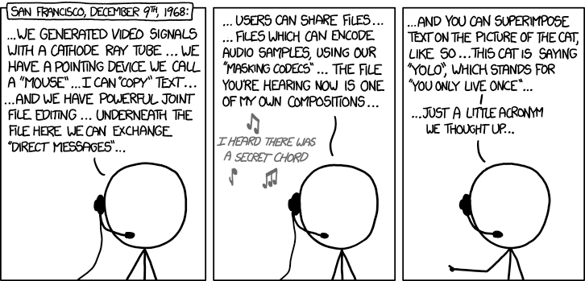
Douglas Engelbart (1925-2013) http://xkcd.com/1234/

Slide 6
Assignment
Create an information processing technology timeline
  You can choose any scope (time periods, domains, etc.) and format you like
  Example timeline - http://www.pbs.org/wgbh/amex/telephone/timeline/timeline_text.html
Write a 1 page paper that draws a conclusion using your timeline to illustrate your point.
Class Timeline Wiki
  Add items from your timeline to myWPI → Timeline → Computing Timeline
  Please (insertion) sort according to date.
  Add your references
Notes:
Be sure to read paper guidelines!
Sign up to present in class
Send TA (and me) email
Specify your topic. By that I mean be specific.
I’ll be happy to discuss your ideas.

Slide 7
Overview
Review
Assignment
Critical Thinking
Guest Speaker

Slide 8
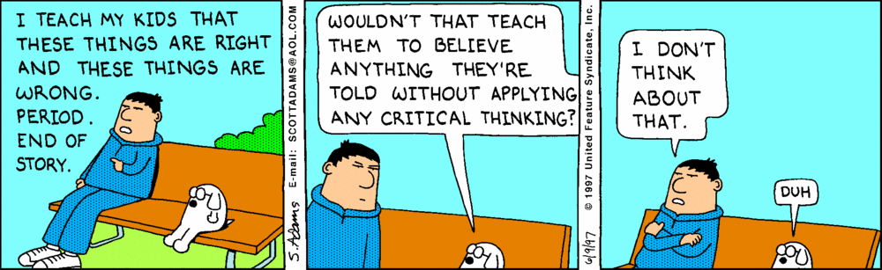

Slide 9
Logical Arguments
Premise 1
Premise 2 (optional)
.
.
.
Premise 3 (optional)
Conclusion
Every A is a B
C is an A
Conclusion: C is a B
Every dog is a canine
Rupert is a dog
Conclusion: Rupert is a canine
Notes:
A basic argument contains 2 or more claims, one of which is the conclusion.
The others are the premises.
The premises should logically lead to the conclusion being true if each in turn is true.
For 1 page papers it might be more clear to start with your conclusion.

Slide 10
Weak Or Strong Arguments
Valid | Invalid
All bats are animals
Some wooden objects are bats
Conclusion: Some wooden objects are animals
Inductive | Fallacious
Sound | Unsound
Strong
Weak
Notes:
Valid: Assuming the premises are true, does it logically follow that the conclusion must be true. One way of doing this is to find a counter example where the premises are true but the conclusion is not.
Inductive: If an argument is invalid it could still be inductive, that is it could increase the likelihood that the conclusion is true. Otherwise it might include a fallacy. A fallacy is an error in logic.
Sound: If an argument is valid or inductive the premises should be verified as facts. If they are true the argument is sound, and the argument strong. Otherwise the argument is weak.
Need better example argument, reused for conflation fallacy.

Slide 11
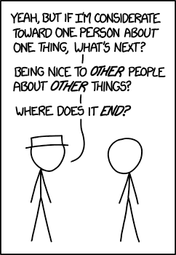
Common Fallacies 1/7
Slippery Slope
  “A bad guy might use computers to steal. Therefore we should outlaw computers.”
http://xkcd.com/1332/
Notes:
Another interesting source:
http://www.informationisbeautiful.net/visualizations/rhetological-fallacies/

Slide 12
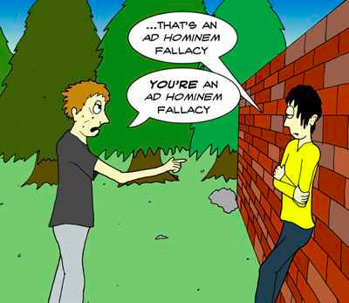
Common Fallacies 2/7
Attack Person, Not Argument
  Ad Hominem
  “He’s a messy eater, obviously his software design will never work.”
http://listverse.com/2012/11/08/15-bad-arguments-we-all-abuse/
Notes:
http://listverse.com/2012/11/08/15-bad-arguments-we-all-abuse/
Accessed 2015-03-19

Slide 13
Common Fallacies 3/7
Begging The Question
  Petitio Principii, Circulus in Probando
  “OO languages are superior to non-OO languages because they have objects as their basic constructs.”
Appeal To Authority
  Ad Vericundiam
  “Ernie, an expert on internet protocols, said MySpace is far superior than Facebook, so it must be so.”
Many / Any
  “Many programming languages have strong typing. Scheme is a programming language so it has strong typing.”

Slide 14
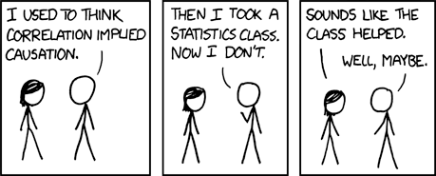
Common Fallacies 4/7
False Cause
  Non Sequitur – post hoc ergo propter hoc
  “The day after Billy Bob Joe bought a Mac, Apple’s stock went up. Clearly Billy Bob Joe’s purchase was the cause.”
http://xkcd.com/552

Slide 15
Common Fallacies 5/7
Composition / Division
  “All the actors in this movie are highly skilled, the movie must be great.”
  “WPI was founded in 1865 so all the faculty must be at least ~168 years old.”
Appeal To The People
  Argumentum ad Populum
  “Windows is installed on more desktop computers than any other OS. Windows is the best OS.”

Slide 16
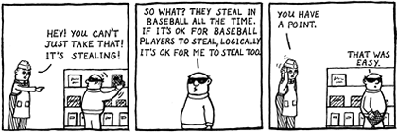
Common Fallacies 6/7
Ambiguity
  Often a form of conflation.
  “All bats are animals. Some wooden objects are bats. Therefore, some wooden objects are animals.”
  Respect – “recognize a right” vs. “hold in high regard”
Notes:
http://www.christianlogic.com/images/uploads/christianlogic_nunaandtoodles_2003_equivocation.png
Accessed 2015-03-19
From Wikipedia: (accessed 2012-08-27)
In logic, conflation is the error of treating two distinct concepts as if they were one. The result of conflating concepts may give rise to fallacies of ambiguity, including the fallacy of four terms in a categorical syllogism. For example, the word "bat" has at least two meanings: a flying animal, and a piece of sporting equipment (such as a baseball bat or a cricket bat). If these two meanings are not distinguished, the result may be the following categorical syllogism, which is clearly intended as a joke (pun):
1. All bats are animals.
2. Some wooden objects are bats.
3. Therefore, some wooden objects are animals.
Conflating words with different meanings can cause real confusion. For example, respect is used both in the sense of “recognize a right" and "have high regard for". We can recognize someone's right to the opinion that humanity is controlled by alien lizards in human form, without holding this idea in high regard. But conflation of these two different concepts leads to the notion that all religious ideas, for example, should be treated with respect, rather than just the right to hold these ideas.

Slide 17
Common Fallacies 7/7
Straw Man
  “He says taking Social Imps is a waste of time. He wants you to think computing and society are useless.”
There are many more… seems to be no limit to the ways in which humankind can err.

Slide 18
Class 2
The End
Keith A. Pray
Instructor
socialimps.keithpray.net
Notes:
This is the end. Any slides beyond this point are for answering questions that may arise but not needed in the main talk. Some slides may also be unfinished and are not needed but kept just in case.

