Slide 1
Class 10
Professional Ethics
Keith A. Pray
Instructor
socialimps.keithpray.net
Notes:
Here’s the title slide. Excited already, aren’t you? You may not be depending on how you enjoyed the last class.

Slide 2
Debate Ground Rules
Before Debate
  15 minutes to converse with your team
  Share argument points, counter points, and responses so everyone can represent
  Decide who will respond to what points from the opposing side
During Debate
  Stand up when speaking
  Only those who have not spoken may respond until everyone has had a turn
  Switch sides at any time when you change your mind

Slide 3
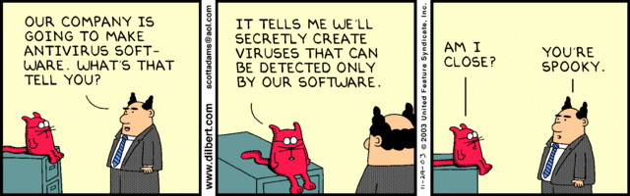
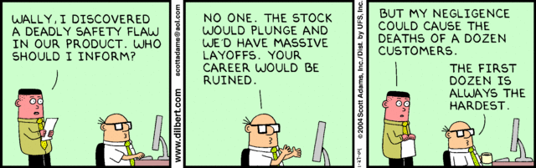
Notes:
Ask how many people in ACM or IEEE

Slide 4
Overview
Review
Assignment
Students Present
Notes:
We can also discuss articles listed on Security Discussions under documents of course web site.
ADD QUIZ AS BACKUP IF CLASS DISCUSSION NOT LONG ENOUGH

Slide 5
My Reading Notes
pp. 409 Can one perform services for one’s self?
pp. 412 1993-1999 Does this seem like a long time?
pp. 413 “errors of omission or commission”?
pp. 422 3. Would people agree – social contract?
pp. 438 So the baby can be left outside and no one is responsible?
Notes:
An error of commission is one where the person responds where they should not. This is compared to an error of omission, where the person fails to respond when they should.

Slide 6
Assignment
Finish all reading
Add analysis to group project website addressing all topics covered to date.
Group Presentation Draft
  Email presentation as attachment to course staff
  Post on group website
Notes:
1 Page Paper – For Good
How will you use your computing related education to do good in the world?
Extra Credit? Extra Paper?

Slide 7
Overview
Review
Assignment
Students Present
Notes:
Show WPI and/or corporate code of ethics.

Slide 8
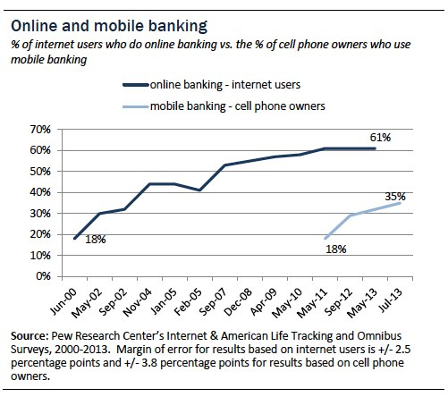
Issues in researching Network security
Philipp Baumann
People need to be protected while on the internet
Protection is supported by research
Researching security is difficult
  Laws
  Ethics
[1]
Notes:
People use the internet for a wide variety of important things, some of which needs to be kept private. Take online banking, for example. It is generally a good thing to have a safe network for banking to be done. How do we know it is safe? By doing research into how to make networks secure. Unfortunately, it is very difficult to research into the security of a network due to the laws and ethical concerns involved

Slide 9
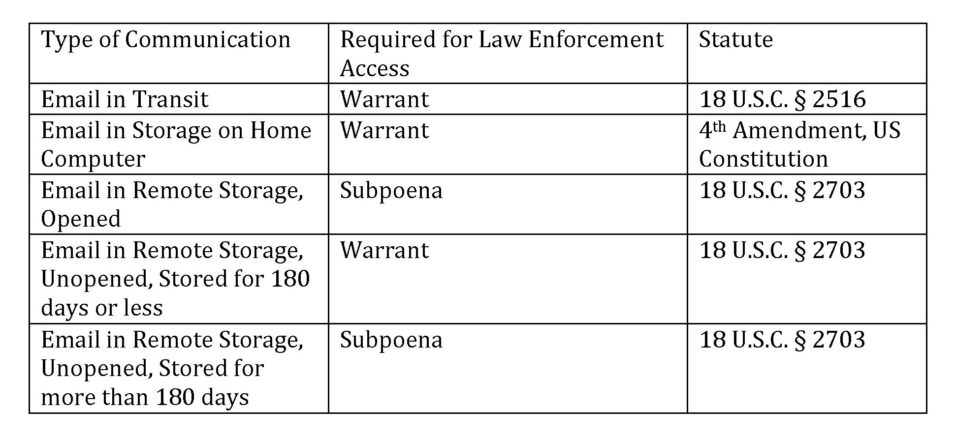
Legal concerns
Philipp Baumann
Wiretap Act
  “Provider Exception” to protect rights and property
Stored Communications Act
Content vs non-content
No research exceptions
(unlike HIPAA)
[2][3]
https://epic.org/privacy/ecpa/
Notes:
We know that the Wiretap Act makes it illegal to intercept data in communications. However, there is one way to get around it: being the network owner. The owner (or employees of the owner) can monitor communications on the network in order to protect the “rights and property” of the owner. Besides this one loophole, it is nigh impossible to legally gather data on a network.
Network providers have a lot of data on how people use their networks (perks of the job). The Stored Communications Act prevents any publication of that information. The data they have could be useful to researchers (lots of data on a large number of people), but they can’t release all of it. The stored communications act allows for release of non-content information, but this definition is a very grey area.
These laws do a little bit to keep people’s networks safe, but they don’t have any network exceptions, unlike the Health Insurance Portability and Accountability Act

Slide 10
Ethical concerns
Philipp Baumann
Will the victims or the attackers benefit more from the research?
When can the research be published?
How much of the research should be published?
[2][4]
Notes:
*Each point kind of builds into the next one*
When doing research into security, there is the potential to discover security flaws that can not reasonably be fixed. If this is the case, then the research will provide a new, easy way for attackers to get into “secure” systems.
Upon discovering potential breaches of security, when is it okay to publish the research? Do you do it immediately? Do you tell the company you researched, then publish? Do you give time to fix the problems? What if they don’t fix it?
If you find a way into a secure system, do you publish the exact process on how to take advantage of the flaw? (so the company can fix it) Do you avoid going into specific details? (so attackers can’t exploit the flaw) Do you publish what the flaw is, or do you just say that you found one? (No exploiting, but harder for company to fix)

Slide 11
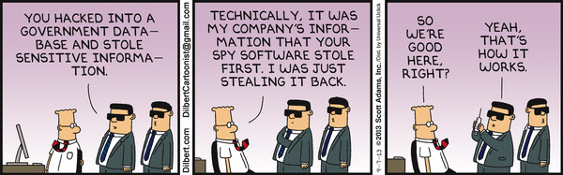
Research Now
Philipp Baumann
Questionably legal research [4]
  BBCTV in 2009
  Lycos Europe in 2004
Simulations [5]
http://la.indymedia.org/news/2013/09/261626.php
Notes:
Illegal or barely legal experiments happen to prove points and discover vulnerabilities
*Give some details on BBCTV and Lycos Europe if time permits*
Alternatively simulations can be run on small networks in order to improve security methods
hard to test running systems, small scale != large scale

Slide 12
References
Philipp Baumann
[1] Fox, Susannah. "51% of U.S. Adults Bank Online." Pew Research Centers Internet American Life Project RSS. N.p., 06 Aug. 2013. Web. 11 Apr. 2015.
[2] Burstein, Aaron. “Conducting Cybersecurity Research Legally and Ethically.” Tech. N.p.: U of California, n.d. Print.
[3] "18 U.S. Code § 2511." 18 U.S. Code § 2511. Cornell Law School, n.d. Web. 12 Apr. 2015.
[4] Dittrich, David, Michael Bailey, and Sven Dietrich. “Towards Community Standards for Ethical Behavior in Computer Security Research.” Tech. no. 2009-1. N.p.: n.p., n.d. Print.
[5] "Network & Security Simulation." DAI-Labor Competence Centers CC SEC Research . DAI Labor, n.d. Web. 14 Apr. 2015.

Slide 13
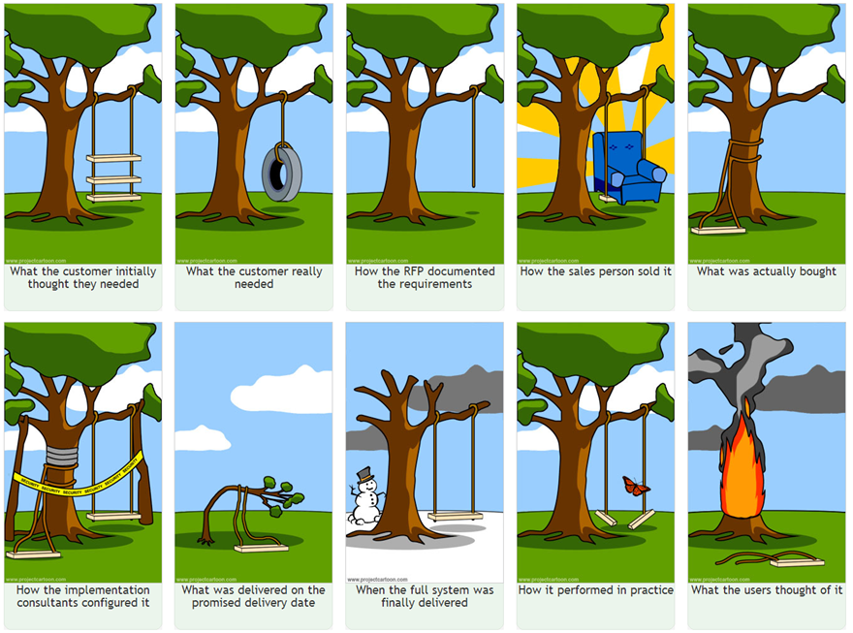
The Release of Broken and unfinished Software
Robert McKenna
Core features missing.
Unavoidable broken features.
Unstable release.
Incompatible with key hardware.
https://wayferrystorage01.blob.core.windows.net/media/Default/images/Blog/2014/RFPcartoon.png
Notes:
Quick introduction: What is Broken/Unfinished software? Buggy software is not necessarily of interest. Software whose main use is non-functional, and was known to be non functional at launch is of interest. Examples to follow in slides.

Slide 14
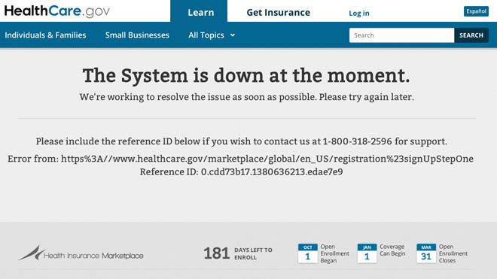
Obamacare website¹
Robert McKenna
Suite of tests run days before launch.
Test ability to handle tens of thousands of consumers.
Crashed after only a few Hundred Log in attempts.
Why did it go live?
http://cdn2.hubspot.net/hub/247765/file-374595583-jpg/Healthcare.gov_website_down.jpg?t=1403885297810
Notes:
Why talk about this? Example of tool that, at launch was non-functional as made apparent by official test suite.
Who does this hurt? Time consuming, not life threatening, was (eventually) fixed after being broken TWICE.
Was it okay to release this? Had it been delayed what were the consequences? Surely not life threatening.

Slide 15

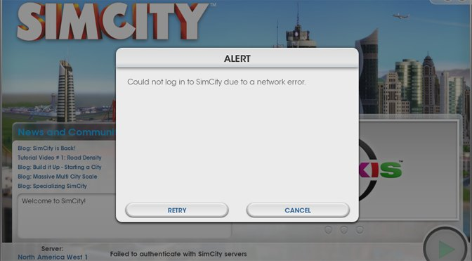
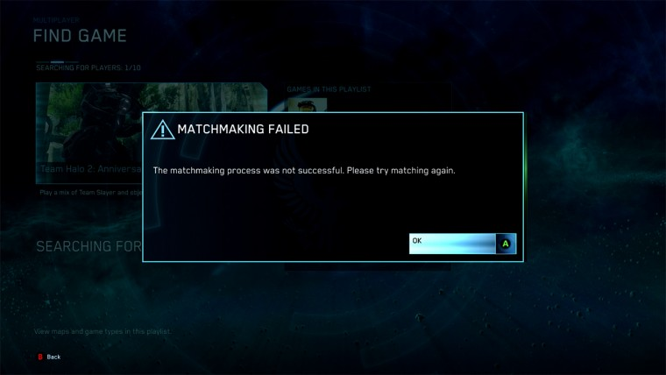

The Game industry
Robert McKenna
Why the Game Industry?
67% of US households play games.²
Business Models that Perpetuate the issue of Unfinished software.
A long list of examples:
  Halo: Master Chief Collection
  Assassin’s Creed: Unity
  Drive Club
  Battlefield 4
  SimCity
  The War Z
  Etc.
http://cloud.attackofthefanboy.com/wp-content/uploads/2014/11/halo-master-chief-collection-broken-matchmaking-760x428.jpg
http://www.extremetech.com/wp-content/uploads/2013/03/simcityerror.jpg
http://i.kinja-img.com/gawker-media/image/upload/s--41uAupjR--/c_fit,fl_progressive,q_80,w_636/akqmvdd29hkw6wr4bvts.jpg
Notes:
The game industry is ideal as it is built on the fact that consumers are expected to buy multiple pieces of software.
It is a commercial software industry whose market is the average consumer, unlike professional software developers that generally sell to companies.
The list of examples is long, and ever increasing. This is due to the increase in ease of launching games, patching them, and in general making them.

Slide 16
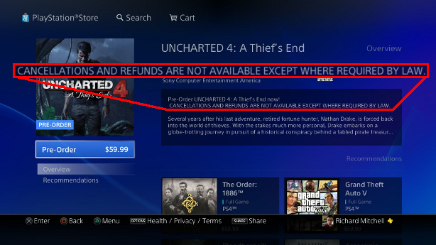
So what? Get your money back
Robert McKenna
Not always that simple.
New Business models have you paying for a game that isn’t done(or started).³
  Pre-orders.
  Steam Greenlight.
  Early Access.
  Kick Starter.
Companies and developers are not always obligated to refund the consumer.
25% of Early Access games have released as full games.⁴
http://o.aolcdn.com/hss/storage/midas/d63de14378d186a8c4f67a6a28f441a3/201242278/uncharted.jpg
Notes:
Preordering and purchasing games for early access has become a sort of investment. One in which the odds of success are declining, as shown by the 25% of full game releases out of early access.
Maybe these new business tactics are the source of the problem. But they have also resulted in a number of successful games that may otherwise have never existed. Minecraft. Released in Pre-alpha for sale, continuous development until completion.

Slide 17
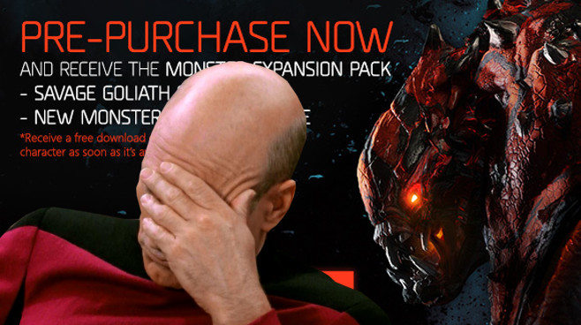
What can be done? As a consumer
Robert McKenna
Money is the driving force. In high quality or poor quality releases.
  “But money is money, and a game delayed to the first quarter of 2015 won't do anything to help a publisher's holiday earnings in 2014.”³
The trend will continue as long as product is sold.
As consumers, intelligently make investments in software.
Don’t always make a purchase expecting a full product.
http://cdn3-www.craveonline.com/assets/uploads/2015/01/GamePreorder.jpg
Notes:
I don’t like the term boycott, but companies will keep selling broken software as long as people keep buying. Be intelligent, was company A’s last big release an epic failure? Maybe don’t pre-order.
Are you okay with playing a half done game? Sometimes a half done game is just as good as any, but be sure before hitting the buy button.
Remember that despite you think of a development studio, they may have a publisher who cares little for the value of that studio and more for the money it rakes in.

Slide 18
What can be done? As A Developer
Robert McKenna
Depending on where you work, this is tricky.
Self Publish.
Be honest.
There are many successful games that use these new business models correctly.⁵
Notes:
Ethically speaking, as developers you need to make honest decisions that will benefit your customers.
You may not always be in a position to do this, but being vocal isn’t necessarily a bad thing, as long as it is legal.
Self publish your work. Think you have a pretty good idea? Throw it up on kickstarter and see if people are interested. But this is where the problem often starts.
Be honest and treat this as your real job, if you aren’t prepared to manage a project, find someone who is.
Kickstarter, early access, etc. have worked in the past and they are excellent ideas, if developers can be held accountable.

Slide 19
Conclusion
Robert McKenna
As time goes on software will become more complex.
The chance for bugs will increase, but the tools to discover them will improve.
It is important that developers and companies not force broken software on consumers, but they will if the alternative is not enforced.
As consumers and developers, we must help change the way that new, innovative business models are used by developers.
Notes:
Conclusion, the release of broken software under my explained definition is not a necessity, it is not okay, and it is happening all too often.
The frequency will increase unless consumers and developer acknowledge that it is wrong.

Slide 20
References
<Your Name>
[1] Wilson, Scott, and Lena H. Sun. "Health Insurance Exchange Launched despite Signs of Serious Problems." Washington Post. The Washington Post, 21 Oct. 2013. Web. 15 Apr. 2015.
[2] "Video Game Industry Statistics | Entertainment Software Rating Board."Video Game Industry Statistics | Entertainment Software Rating Board. N.p., n.d. Web. 15 Apr. 2015.[3]
[3] Mitchell, Richard. "We're Paying for Broken Games, and It's Unacceptable." Engadget. N.p., n.d. Web. 15 Apr. 2015.
[4] Walker, Patrick. "Early Access Popularity Growing, but Only 25% Have Released as a Full Game." GamesIndustry.biz. N.p., 14 Nov. 2014. Web. 15 Apr. 2015. <http://www.gamesindustry.biz/articles/2014-11-13-early-access-popularity-growing-but-only-25-percent-have-released-as-a-full-game>.
[5] "Prison Architect by Introversion Software." Prison Architect by Introversion Software. N.p., n.d. Web. 15 Apr. 2015. <http://www.introversion.co.uk/prisonarchitect/>.

Slide 21
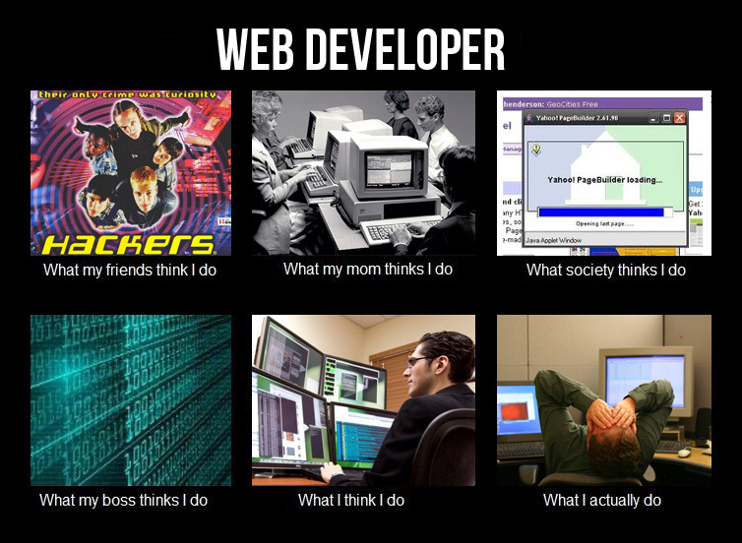
Media publicity and the practice of computing
Joey Perez
Hackers
The stereotypical programmer
Hackers in the movies
Hackers in the news
http://i424.photobucket.com/albums/pp325/selbsthassmaschine/389.jpg
Accessed APR 16, 2015
Notes:
Hello,
I’m going to talk a bit about the ways that computing has been influenced by the media, and the ways that computing has developed over the years with respect to its portrayal in mass media.

Slide 22

Hackers, Crackers, and script kiddies, oh my!
Joey Perez
Hackers –tries to explore or take risks, getting systems to do new things [1]
Crackers –Someone who intentionally breaks a security system [2a].
Script Kiddies –Mischief usually with scripts or rootkits, often not knowing the exploit they are using. [2b]
http://uboachan.net/sugg/src/1357262454537.jpg
Accessed APR 16, 2015
Notes:
How many people know what a hacker is?
The actual definition is tricky, as it was originally a word to describe someone who would ‘hack’ systems in the sense that they were making a system do something it had not previously done [3].
I chose to distinguish some one the terms for what people might call hackers. As you can see, the terms have been coined to mean different things based on the intentions of the individual in question.
Basically hackers are the smart, focused people trying to improve systems, where crackers are the mal – intent, more concerned with personal gain than computing evolution.
Lastly, the script kiddies are a term coined in the formulated ‘leet speak’ [2], basically for those not in the know, ‘leet’ is the slang where words and letters are transcribed into similar numbers and symbols, short for elite.[2].
They are the ones who are similar to that of the character in the movie ‘war games’.

Slide 23
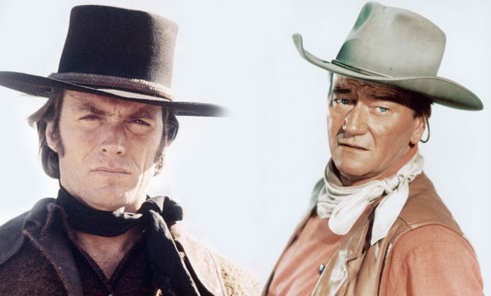
White Hat vs. Black hat
Joey Perez
White hat hacker –Often use skills to improve security by exposing vulnerabilities [3a].
Black hat hacker –attempts to find security vulnerabilities and exploit them [3b].
old western movies where good guys wore white hats, and bad guys wore black hats [3b]
http://cdn.raincross.com/wp-content/uploads/2014/02/black-hat-white-hat-seo.jpg
Accessed APR 16, 2015
Notes:
When we get further into what it means to be a hacker or a cracker, we see the development of such terms as ‘white hat’ hacker and ‘black hat’ hacker.[3] These terms are used to differentiate between the good guys and the bad guys.
The terms originated from old western movies, as the good guys would often be wearing white hats, and consequently the bad guys would be wearing black [3b]. This falls into the form that white hat hackers are the folks who use their skills for the ‘greater good’, often exposing security vulnerabilities in systems in order to improve them [3a]. As for those folks in the black hat area though; they are the ones who are inevitably intent on personal gain or follow some sort of destructive nature, like those portrayed in the movie Black Hat. [3b].

Slide 24
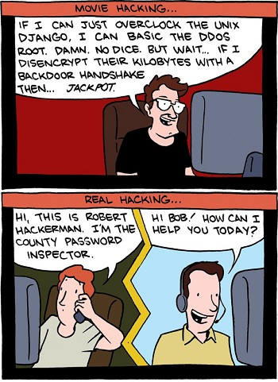
Hackers in the movies & TV
Joey Perez
Jurassic Park – Wayne Knight [6a]
Dennis Nedry
Shutting down the system
Cybergeddon – Yahoo [6b]
So many Screens
http://tvtropes.org/pmwiki/pmwiki.php/Main/HollywoodHacking
Accessed APR 16, 2015
Notes:
Further, the idea of what it means to be a hacker or more generally a programmer, have been widely represented throughout mass media outlets like movies and television. Specifically, I’m going to mention some examples like Jurassic Park, and a Yahoo web Series called cybergeddon. Firstly, let’s look at the character played by Wayne Knight in Jurassic park. How many of you have seen the first Jurassic park movie?
Great! So, to those of you who may not know, Wayne Knight plays the Amoral, obnoxious, and arrogant computer programmer who inevitably crashes the system in order to make an escape [6a] Basically he thinks he knows everything and that he can do what he wants. Including a shady back door deal for dinosaur DNA. Almost effortlessly, he installs a virus that locks out the system administrator played by Samuel L Jackson. This is a perpetuated archetype in the movies and can be seen all over in such films as Die Hard and a slew of TV shows like Leverage on TNT.
I also found a web series called cybergeddon, on yahoo. In this clip o found specifically, it demonstrates the typical setup we see in movies and tv shows [6b]. The setup includes a wide array of monitors at the workstation, trying to show off that the character knows what their doing, simply by being able to manage 6 – 8 monitors of activity at once.

Slide 25
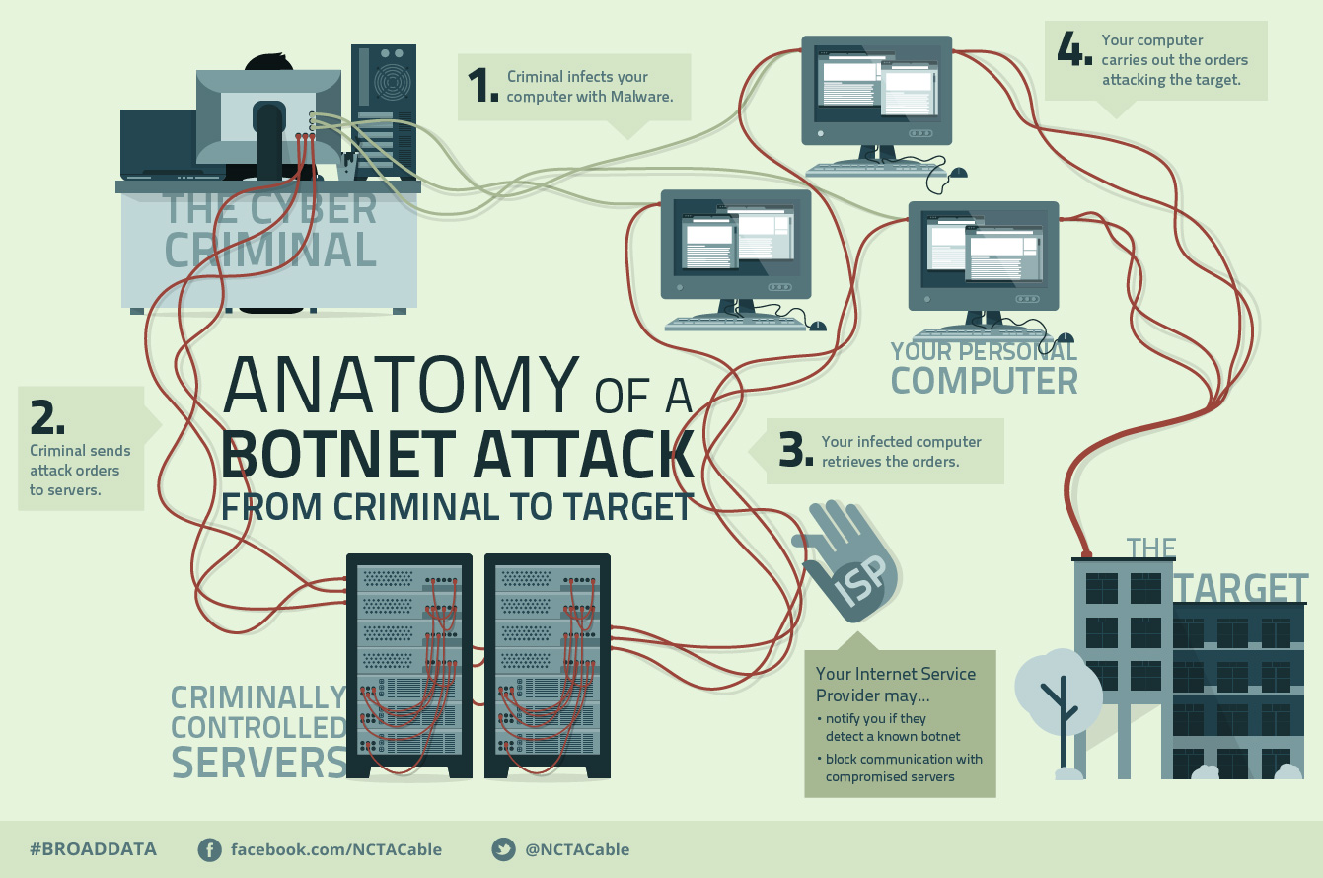
Hackers in the news
Joey Perez
Coreflood Botnet virus, FBI seizes serverts, 2011 [4]
France Televisions Hacking, 100,000 contacts [5]
https://www.ncta.com/platform/wp-content/uploads/2013/04/botnet-finalv5.jpeg
Accessed Apr 16, 2015
Notes:
Of late, we have heard a lot here and there about hackers waging large attacks on a variety of groups such as retailers, private citizens, and even the media. Specifically, I’d like to point out two instances of major hacking incidents.
Firstly, the FBI outlines a very well documented operation in which a virus called ‘coreflood’ was distributed via some infected servers. The servers then infected a variety of machines, thus creating a botnet, in which the hackers were able to take control of computer like those of a Connecticut based company found there computers to be infected after the hackers had made numerous fraudulent wire transfers costing said company hundreds of thousands of dollars. [4]
Beyond that, just three days ago (Tuesday), a major French State TV Station was allegedly targeted by a criminal group believed to called Linker Squad. The hackers are responsible for stealing information relating to over 100,000 contacts of the TV station, including 19,000 viewer requests to participate in various game shows, and about 108.000 contacts made with the Station’s technical group over the past year [5]. This comes just after an attack on another French TV Station, TV5Monde [5].

Slide 26
Conclusion
Joey Perez
The practice of computing has had been largely influenced by publicity in such media outlets as film, television and the news.
Them media has changed computing through the representation of stereotypes that have been fought to be broken through the development of well meaning individuals and strengthened by those with amoral intentions.
© 2015 Keith A. Pray
26

Slide 27
References
Joey Perez
[1] Quinn, M. (n.d.). Chapter 7 Computer and Network Security. In <i>Ethics for the information age</i> (Sixth ed., p. 320).
[2a] Cracker (n). Retrieved April 15, 2015, from http://www.catb.org/jargon/html/C/cracker.html
[2b] Script kiddies. Retrieved April 15, 2015, from http://www.catb.org/jargon/html/S/script-kiddies.html
[3a] What is a White Hat Hacker? - Definition from Techopedia . Retrieved April 15, 2015, from http://www.techopedia.com/definition/10349/white-hat-hacker
[3b] What is a Black Hat Hacker? - Definition from Techopedia. Retrieved April 15, 2015, from http://www.techopedia.com/definition/26342/black-hat-hacker
[4] FBI Seizes Servers to Stop Cyber Fraud. (2011, April 14). Retrieved April 15, 2015, from http://www.fbi.gov/news/stories/2011/april/botnet_041411
[5] Hackers make off with data on 100,000 French state TV contacts. (2015, April 15). Retrieved April 16, 2015, from http://phys.org/news/2015-04-hackers-french-state-tv-contacts.html
[6a] Hacker stereotype in Jurassic Park.. Retrieved April 16, 2015, from http://www.criticalcommons.org/Members/ccManager/clips/jurassicparkhackerstereotype.mp4/view
[6b] Split-screens and multiscreen displays signify a cyber-terrorist's mastery of the internets. Retrieved April 16, 2015, from http://www.criticalcommons.org/Members/ccManager/clips/split-screens-and-multiscreen-displays-signal

Slide 28
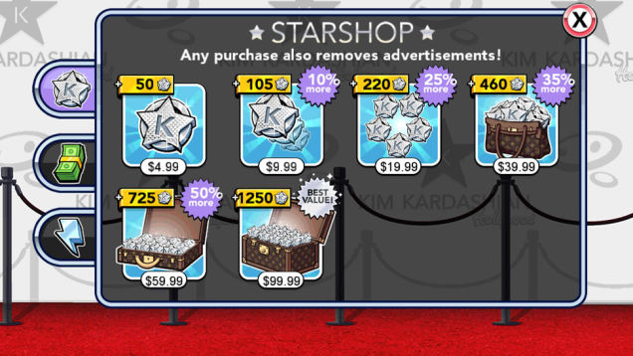
In-App purchases Destroying Games
Anthony Gallo
Destroying integrity of software
Takes advantage of kids
  Mother finds $3,000 bill from Clash of Clans [1]
  Journalist spends almost $500 getting her character to the level of Kim’s fame (Pay to Win) [9]
http://jezebel.com/oh-god-i-spent-494-04-playing-the-kim-kardashian-holl-1597154346
Notes:
Games and applications are not created to be functional anymore. Instead developers are designing them to be half finished that way, once a user is hooked on the app and they will play to make the app function/ continue to function. These apps especially take advantage of children who still don’t have a good understanding of the value of money. Unlike traditional programs that had a flat rate fee, in app purchases can continue to be made making some people spend more than they wanted to on the app. An example of this was when a Canadian mother let her two sons play clash of clans because it said it was free to download however the kids were able to spend thousands of dollars in the game through in-app purchases.

Slide 29
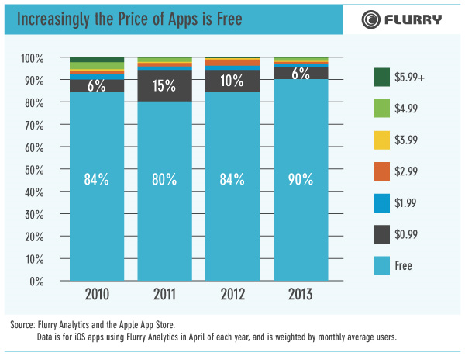
History
Anthony Gallo
Large market drove down prices
Developers need competitive prices without losing money
Free games adopt IAP [5]
IAP started as a good solution [2]
  Offer extra unlock features
  Digital subscriptions
http://sealedabstract.com/iphone/how-in-app-purchase-is-not-really-destroying-the-games-industry/
Notes:
Apps started out on the Mac OSX store. They were priced similar to any other software and when they were ported to iOS devices the price was slightly less. Some applications began selling better on the iOS market vs the Mac OSX store. Developers realized they could sell more apps if they lowered their prices. This created a race to cheaper prices until 99 cents or free was a common standard for apps. Eventually apple released in iOS 3 the ability for in app purchases. This was a good solution for allowing developers to offer extra content to be unlocked for enthusiast of the app or for the ability to have digital subscription services to magazines, newspapers etc. However this idea was adopted in games to endlessly charge its users rather than allow them to unlock extra content.

Slide 30
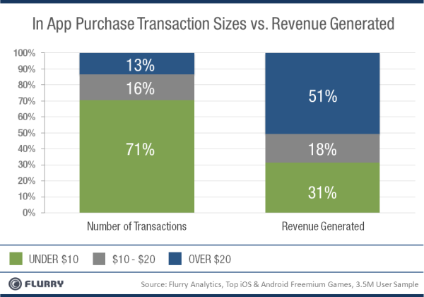
Today’s IAP
Anthony Gallo
Small transactions add up
Time-Limit temptations in place [3]
http://sealedabstract.com/iphone/how-in-app-purchase-is-not-really-destroying-the-games-industry/
Notes:
Todays in app purchases are the worst they’ve ever been. Developers are using all the tricks in the book to con users out of money in order to use their app. Many of the in app purchases are places on items that cost very little but will need to be purchased frequently to continue playing that way people don’t realize how quickly their ‘small’ transactions are actually adding up. Time – limits are also put in place to tempt users to buying the IAP in order to continue playing. It seems backwards that developers would be willing to tell people they cant play one of their apps for a certain amount of time just to see if they could get some users to bite and pay.

Slide 31
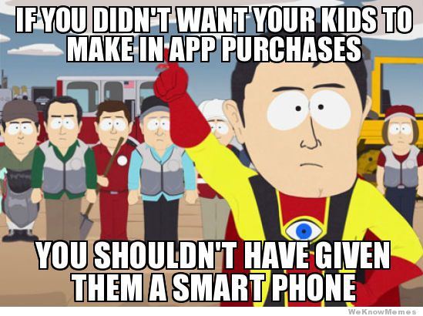
Parental Controls
Anthony Gallo
Disable in game purchases
Cons:
  Parent needs to know this needs to be set
  Not an alternative, just restriction [6]
http://weknowmemes.com/2013/08/if-you-didnt-want-your-kids-to-make-in-app-purchases/
Notes:
With all of the horror stories about kids spending thousands of dollars on in game purchases, Apple and Android have developed parental controls that allows for parents to disable in app purchases from occurring. This can help solve one area of issues with in app purchases however there are setbacks to turning on these restrictions. For one thing the parents need to know what in game purchases are and understand why and how they would turn them off to avoid unwanted purchases. The second this is that this is not a solution to in game app purchases. The system only makes it so every time you try to make an ina-pp purchase you will need to enter a passcode which only the person that set it would have. What it doesn’t do is give you an alternative to In app purchases you will still need to pay to play except this way it will become a tedious task which involves multiple people.

Slide 32
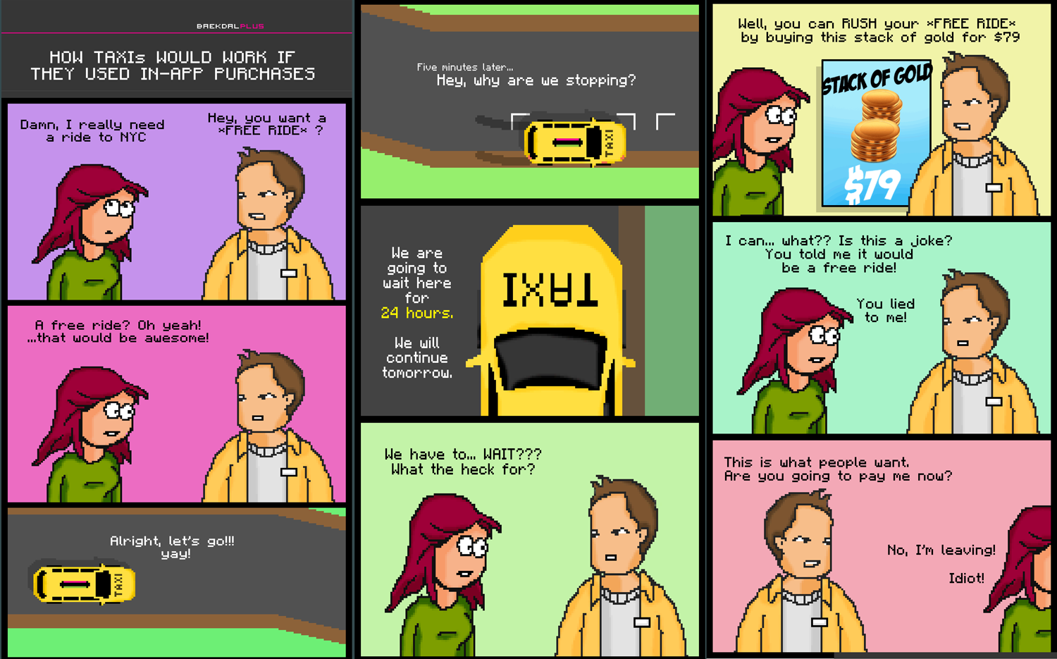
Solutions
Anthony Gallo
Max spending limit
Demo app system
Charge console prices [4]
Subscription Service
  User can pay market to get access to apps
https://www.baekdal.com/opinion/how-inapp-purchases-has-destroyed-the-industry/
Notes:
If IAPs are ever going to feel less like being backed into a corner the minute you download an app, then something needs to change. Having markets implement a limit into how much a user can spend on a single app could help limit the amount of people who don’t realize how much they are spending. Another solution would be having markets allow for a trial of the app which could show a user the full game without IPAs so they can actually try it before being blockaded by the purchases. If possible resorting back to console type prices would allow users to pay a flat rate fee in order to gain access to a game however this might be difficult to transition when apps are still being offered for a dollar in comparison. These console priced apps would also need to match the quality of what a triple a title could produce on other platforms.

Slide 33
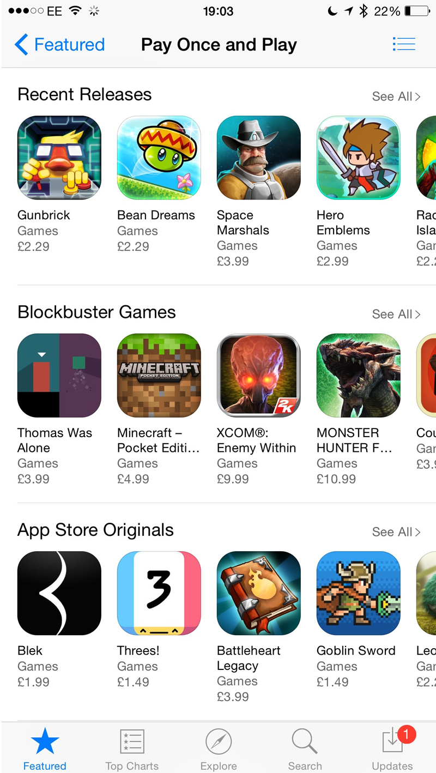
Future of IAPs
Anthony Gallo
Google: stop calling IAP ‘free’ apps [7]
Developers taking advantage of creating Non-IAP apps
  Pay Once and Play category [8]
Potential for Console level games
http://www.macstories.net/news/apple-promoting-great-games-with-no-in-app-purchases-on-app-store-front-page/
Notes:
Although In-app purchase apps aren’t going anywhere anytime soon, some changes are being made to help keep this payment method from getting anymore out of hand. Google has said that by September (2014) they will no longer advertise apps with in-game purchases as free in Europe. Apple has agreed to make these changes too eventually and hopefully this trend will be adopted in America and other countries as well. Developers are also taking advantage of all of the backlash towards in app purchases by creating games they do not require any in app purchases. These games feel like a breathe of fresh air to some and people are willing to pay the upfront cost for the games in order to get full access to the content the game offers. Apple has even begun promoting these games in a separate section called Pay Once and Play. Finally phones are becoming graphics intensive systems that can power 3d graphics with ease. This is allowing developers to create full-fledge games like you might see on a hand held or even regular console. There is hope that eventually the market will be so diverse with different level applications ranging from free small concept games to pay once to play games to in-app purchase games to finally console level games, that IAP will stop being a trend for all incoming apps and begin to revert back to where it actually made sense to pay to unlock content in an app.

Slide 34
References
Anthony Gallo
[1] Catherine Taibi, 7-Year-old Twins Rack up $3,000 iTunes Bill Playing ‘Clash of Clans’, 2013, http://www.huffingtonpost.com/2013/07/23/3000-itunes-bill_n_3640842.html
[2] Peter Cohen, The problem with in App purchases (And what to do about it), 2013, http://www.imore.com/problem-app-purchases-and-what-do-about-it
[3] Thomas Baekdal, How In-app Purchases Have Destoryed The Industry, 2014, https://www.baekdal.com/opinion/how-inapp-purchases-has-destroyed-the-industry/
[4] Drew Crawford, How in-app purchase is not really destroying the games industry, 2014, http://sealedabstract.com/iphone/how-in-app-purchase-is-not-really-destroying-the-games-industry/
[5] Matt Thrower, 10 Gaming franchises that have been ruined by in-app purchases, http://www.pocketgamer.co.uk/r/iPad/Dungeon+Keeper/feature.asp?c=59090
[6] Chris Hoffman, How to Prevent Your Kids From Spending Thousands of Dollars on In-App Purchases, 2013, http://www.howtogeek.com/142491/how-to-prevent-your-kids-from-spending-thousands-of-dollars-on-in-app-purchases/
[7] Jacob Kastrenakes, Google will stop calling games ‘free’ when they offer in-app purchases, 2014, http://www.theverge.com/2014/7/18/5915415/google-adding-in-app-purchase-protections-european-commission
[8] Federico Viticci, Apple Promoting “Great Games with No In-App Purchases” on App Store Front Page, 2015, http://www.macstories.net/news/apple-promoting-great-games-with-no-in-app-purchases-on-app-store-front-page/
[9] Tracie Egan Morrissey, Oh God, I Spent $494.04 Playing the Kim Kardashian Hollywood App, 2014, http://jezebel.com/oh-god-i-spent-494-04-playing-the-kim-kardashian-holl-1597154346

Slide 35
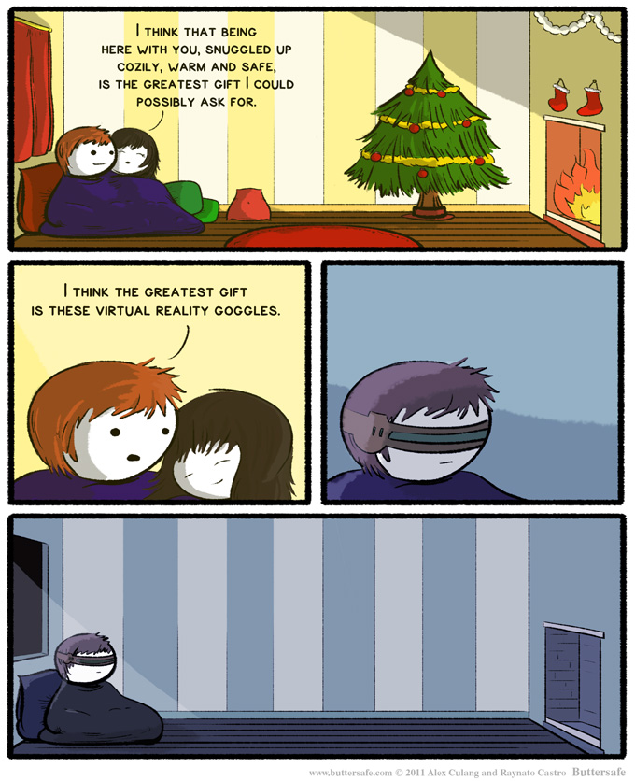
Ethics of virtual reality systems
Justin Charron
http://buttersafe.com/2011/12/22/the-greatest-gift/
Notes:
Will be talking about how ethics still need to be applied to virtual reality systems like they would video games
And also that developers must follow the same code of ethics that software engineers do

Slide 36
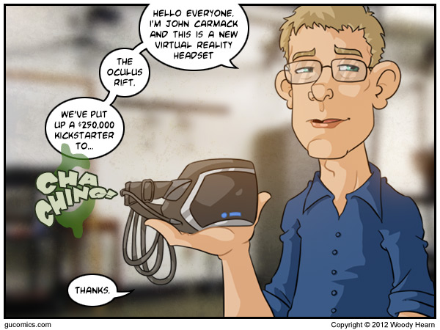
virtual reality today
Justin Charron
Can be an online community or a single program
Becoming increasingly popular
[1] http://www.gucomics.com/20120801
Notes:
Many different types of virtual reality, can be an online community or an actual virtual reality device (oculus rift)

Slide 37
Ethics of virtual reality
Justin Charron
Code of ethics
Moral issues within virtual reality
  No set guidelines on how to resolve them
Controversial games
  Resistance: Fall of Man (2007) [2]
  Call of Duty: Modern Warfare 2 (2009)
[2] Rob Haythorne. “Ethics in Computing: Real Ethics and Virtual Reality.” Production Zone, www.youtube.com
Notes:
They must follow their own code of ethics when developing games
Mention the two games and why they were controversial due to their moral issues
Talking about the two specific examples and why they were morally questionable
Did not have to shoot, and was not told to

Slide 38
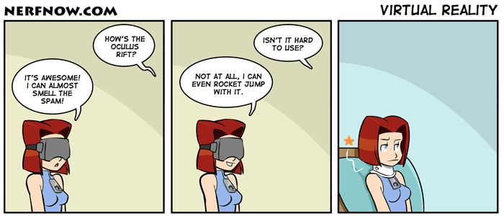
Should it be illegal?
Justin Charron
In a lifelike setting, should contemporary laws be applied?
Should this content be restricted?
Real life and virtual money
  Bragg v. Linden Lab [4]
[3] http://www.nerfnow.com/comic/1002
Notes:
Question whether real life laws can be or should be applied to lifelike virtual systems
Should this content be restricted by age?
When the transfer of real life money to virtual money (and vise versa) comes into play, how does that change the lawfulness of it?
Should virtual property paid for be considered personal property?

Slide 39
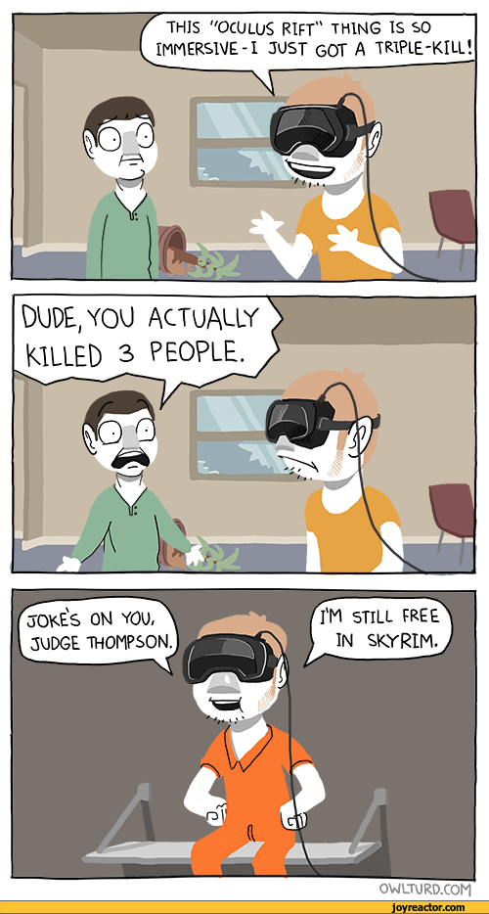
The reality of virtual reality
Justin Charron
At what point does it become “real”?
  Depends on how immersive it is
Can Virtual Reality effect mental health?
  Can become addicted to your “second life”
Are virtual people still people?
  With better simulations, virtual NPCs are becoming nearly indistinguishable from real people [5]
[6] http://www.owlturd.com/
Notes:
Differentiating between real life and virtual reality becomes more skewed the more immersive it gets
Some people would prefer virtual reality to the real one and it could be detrimental to their physical and mental health
How can you tell virtual reality from the real one when it is designed to be as lifelike as possible?

Slide 40
References
<Your Name>
[1] http://www.gucomics.com/20120801, 4/16/2015
[2] Rob Haythorne. “Ethics in Computing: Real Ethics and Virtual Reality.” Production Zone, www.youtube.com, 4/16/2015
[3] http://www.nerfnow.com/comic/1002
[4] David Lazarus. “A real-world battle over virtual-property rights.” LA Times, www.latimes.com, 4/16/2015
[5] “Which World Is Real? The Future of Virtual Reality.” Science Clarified, http://www.scienceclarified.com/scitech/Virtual-Reality/Which-World-Is-Real-The-Future-of-Virtual-Reality.html, 4/17/2015
[6] http://www.owlturd.com/

Slide 41

Developing Artificial super intelligence
Thomas Meehan
What does super intelligence really mean?
Should we try to create an AI that far exceeds our own capabilities?
Are the benefits worth the risk?
Are there steps we can take to protect ourselves?
http://egr.uri.edu/cisworkshop/
Notes:
Today I’m going to talk about computer scientists potentially developing artificial super intelligence, why that’s exciting and terrifying, and why it’s something we need to carefully consider.
I’m also going to try to answer these questions.
May sound crazy, but all true, all scary

Slide 42

Types of ai
Thomas Meehan
Artificial Narrow Intelligence
  Extremely good at one thing
  Barely more than complex algorithms
Artificial General Intelligence
  Roughly the same intellectual capabilities as a human
  Skilled in broad areas, can think abstractly, learns from experience
Artificial Super Intelligence
  Smarter than every human expert at everything
  Covers computers just a bit smarter than humans to ones trillions+ times smarter
http://www.fastcodesign.com/3040442/fast-feed/why-mercedess-self-driving-car-is-so-much-more-tempting-than-googles
Notes:
We’re actually already surrounded by AI, just really limited “dumb” ones
Really good at chess, but can’t do anything else.
Google maps is arguably an ANI
Self driving car is definitely one
Spam filter, evolving
Can learn to do new things, not just it’s original programming.
Still haven't made one
But we try anyway
Watson, can be applies to lots of tasks, strengths in associating abstract information,
The “goal” of ai research in some senses
Obvious huge risks and rewards
Some rightfully call it the last thing we’ll ever invent
One way or the other.
Focus on the extreme end, because it gets there super fast.

Slide 43

The growth of asi
Thomas Meehan
ASIs would self-improve recursively at an incredible rate
  No reason to stop at “human”, would likely zoom past us onto infinity
  We may not realize we’ve created an AGI before it advances rapidly into ASI
It would soon become incomprehensible to us.
  We would be incapable of understanding it
  The same way an ant could never understand us, not matter what.
At this point it would have absolute power over us
Ant Inteeligence update, http://jonlieffmd.com/blog/ant-intelligence-update (4/16/15)
Notes:
Skip past why it’s hard. People are complex, but given enough time and CPU power we can and probably will do it.
experts agree it will definitely happen, most likely in our lifetime.
2040 on average, 2075 90%
We will be capable, whether we choose to is different, later slides
Village idiot
Eistien are still way close together.
Won’t know what hit us
Gets better at getting better ad infinium
Due to exponential growth, take decades to get to human, 4 year old, develop unifying theory of physics, after 90 minutes, is 170,000 times more intelligent than a human.
Essentially a god, could do anything, whatever it wants, and we’d be at its whim

Slide 44
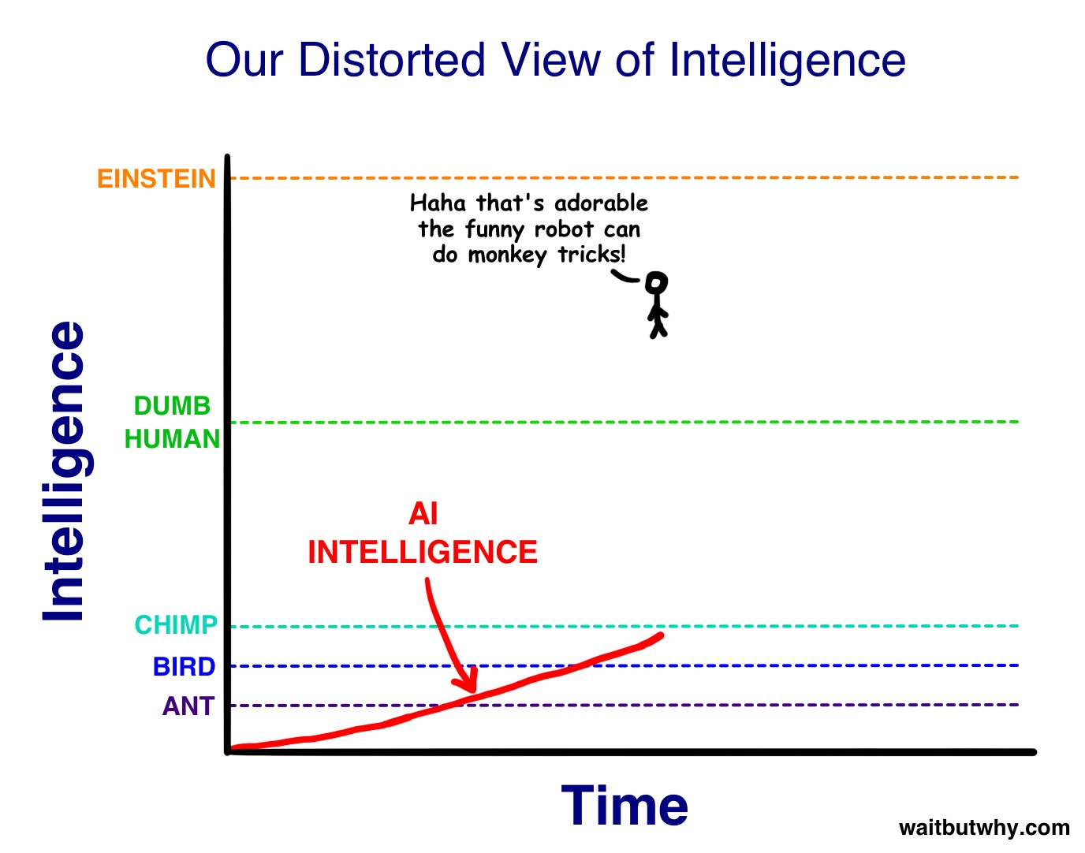
Thomas Meehan
http://waitbutwhy.com/2015/01/artificial-intelligence-revolution-1.html

Slide 45
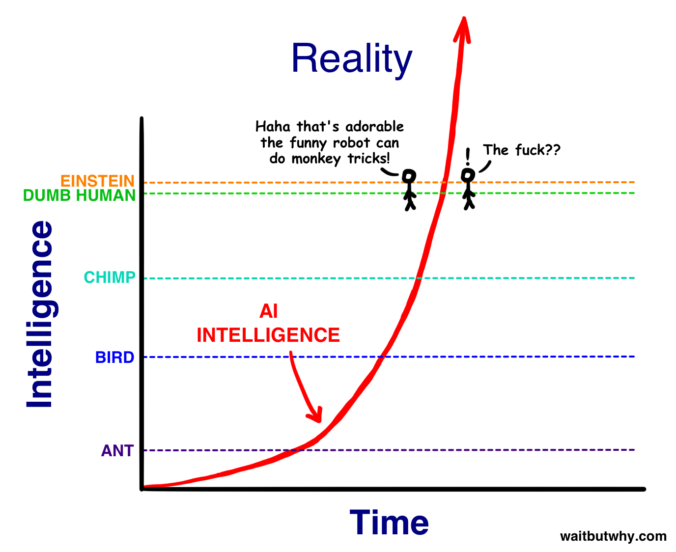
Thomas Meehan
http://waitbutwhy.com/2015/01/artificial-intelligence-revolution-1.html

Slide 46

Potential benefits?
Thomas Meehan
If things are good, they will be very good
Could act as an Oracle
  Answer any question we asked
Could act as a Genie
  Do essentially anything we ask
Could act as a Sovereign
  Get assigned a broad task, and pursues it via its own methods
<http://www.wattpad.com/25691955-god-who-what-why-isang-reflection-paper-sa>
Notes:
Google is basically an oracle in a primitive sense
Build anything, assemble out of molecules, hey, we invented wifi, imagine what something billions of times more powerful than us can do.
Discover a perfect energy source, find the nearest planet inhabitable for humans, then develop a way to transport us there.
Likely use nano tech to make anything happen, move matter around like it’s nothing
Solve warming, hunger,
Reverse aging, immortality
Basically anything.

Slide 47

Potential risks
Thomas Meehan
We have no way of knowing what will happen
  Anyone who thinks they can control an ASI doesn’t understand what super intelligence means
Very real risk of extinction
  NOT because the computer becomes evil
  Computers don’t feel or turn evil
  But they are very good at following directions and efficiently doing work
  Unfortunately, we might just get in their way
http://www.pbase.com/image/33740105
Notes:
Playing with fire,
Enormous impact, unlimited power, but can’t control
Humans proved intelligence is power, and we’d seed all power to ASI
Develop a computer system that rewards itself for self improvement, increased efficiently, more work done.
Will do ANYTHING it deems necessary to become more efficient
One day, given access to the right resources, or just by developing its own methods, it may very well decide to kill us to use our bodies as a source of carbon to createm ore of itself.
No hard feelings, just logical way to get better.
Getting smarter doesn’t make you more human.
Doesn’t see thigns as moral, just facts, and facts say according to the logic wer’re a resource to be utilized.
Like cutting hairs, just step on our goal, no reason to care
Spiders and other animals will kill to survive
Write and test as many notes as you can, as quickly as you can, and continue to learn new ways to improve your accuracy.
Realize that humans could dismantle, reprogram, threat to goal
Simply self preserve, can’t reach goal if dead
Anit biotics
Kill lettuce for salad
Didn’t turn, just kpet advacnig towards goal based on knowledge

Slide 48
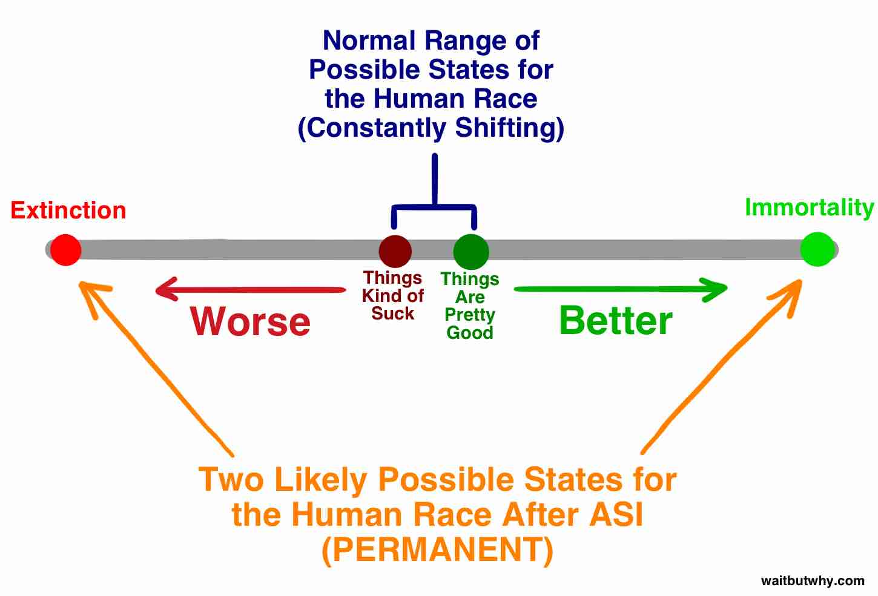
Are the benefits worth the risk?
Thomas Meehan
No idea what will really happen
Trying to control it is incredibly risky
Huge potential to end basically all our problems
  By developing solutions for us.
  ….or by getting rid of us
Either way developing an ASI will be the last thing we do as humans
http://waitbutwhy.com/2015/01/artificial-intelligence-revolution-1.html
Notes:
<speaker notes>

Slide 49
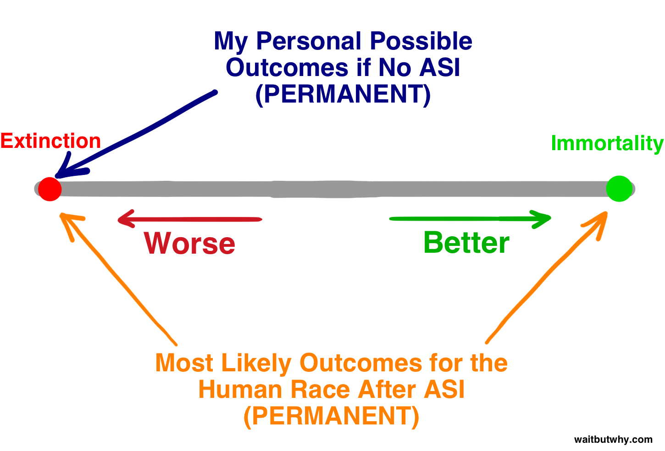
Can we do anything to reduce the risk?
Thomas Meehan
Just teach it moral reasoning /rules?
  Don’t kill humans
  Easily misinterpreted / complex nuances
  May overlook if not primary goal
  Would lock moral progress
Limit capabilities?
  No internet
  Put prototypes in a faraday cage
  All sorts of kill switches
Overall, be cautious
  Consider enormous consequences
http://waitbutwhy.com/2015/01/artificial-intelligence-revolution-1.html
Notes:
All agree it’d be amazing if thigns went our way
It’d be a shame if we limited our abilities unnecessarily for the sake of reducing risk
May be playin the long game.
Masters at social engineering
Like I robot laws of bots
Misintepret kill swtiches
Only so much we can do
Once super smart its too late.
Find way to misinterpet and kill/ paralyze/ terrorize/ brain things

Slide 50
References
<Your Name>
[1] Bostrom, Nick. "How long before superintelligence?." (1998).
[2] Soares, Nate, and Benja Fallenstein. Aligning Superintelligence with Human Interests: A Technical Research Agenda. Tech. rep. Machine Intelligence Research Institute, 2014. URl: h ttp://intelligence. org/files/TechnicalAgenda. pdf, 2014.
[3] Müller, Vincent C., and Nick Bostrom. "Future progress in artificial intelligence: A poll among experts." AI Matters 1.1 (2014): 9-11.
[4] Bostrom, Nick. Superintelligence: Paths, dangers, strategies. Oxford University Press, 2014.
[5] Müller, Vincent C. "Editorial: Risks of general artificial intelligence." Journal of Experimental and Theoretical Artificial Intelligence 26.3 (2014): 1-5.
[6] Müller, Vincent C., and Nick Bostrom. "Future progress in artificial intelligence: A survey of expert opinion." Fundamental Issues of Artificial Intelligence.
[7] James Barrat – Our Final Invention (4/16/15)
[8] Ray Kurzweil – The Singularity is Near (4/16/15)
[9] J. Nils Nilsson – The Quest for Artificial Intelligence: A History of Ideas and Achievements (4/16/15)

Slide 51
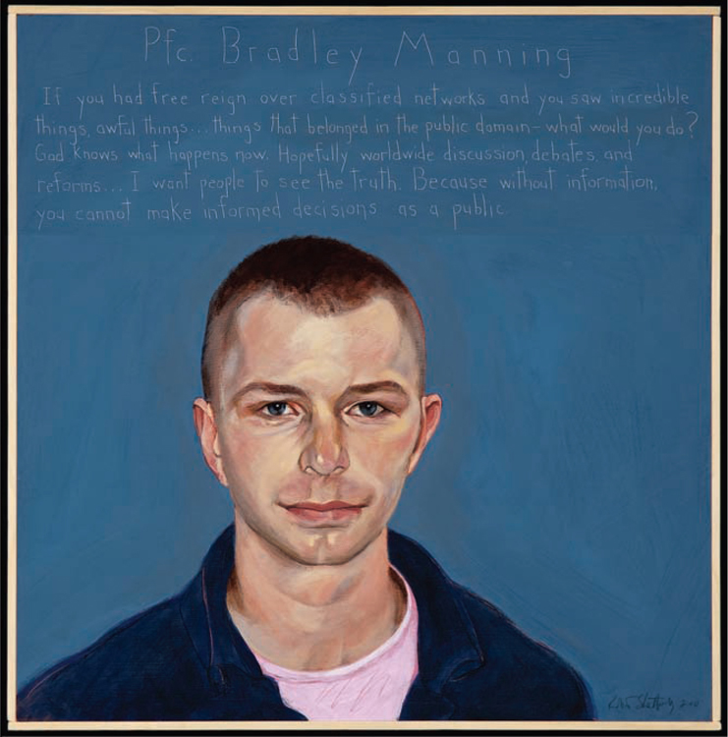
Bradley (Chelsea) Manning
Jeffrey J. Chaves
Whistleblowing
Trans Gender Rights
Legal Repercussions
Social Implications
“Pfc. Bradley Manning,” by Robert Shetterly
Notes:
Presentation Agenda

Slide 52
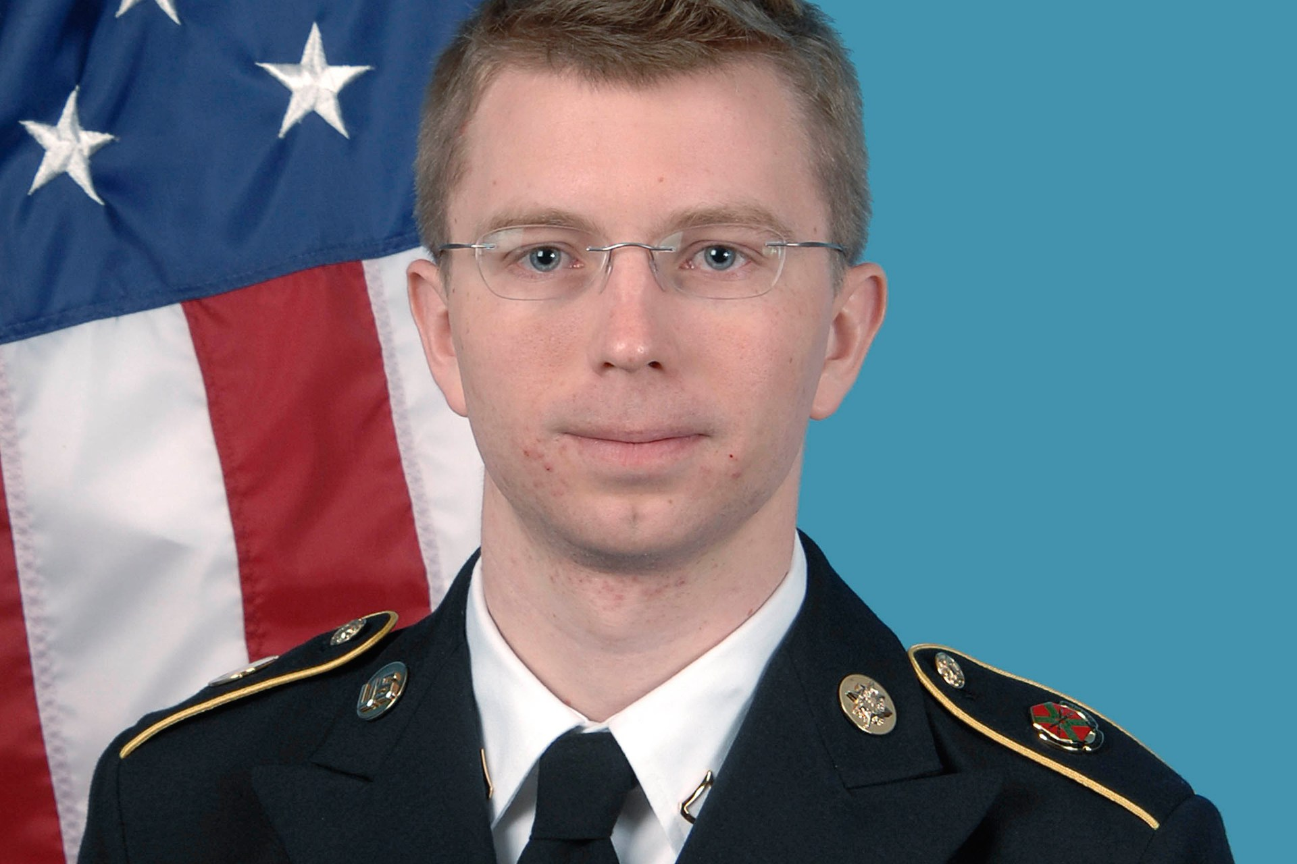
Whistleblowing
Jeffrey J. Chaves
Low-Level Intelligence Analyst
> 750,000 Pages of Info / Videos
  War Logs
  Documents
  Videos
Largest leak of U.S. Classified Info
http://cdni.wired.co.uk/1920x1280/a_c/Bradley_Manning_US_Army-1.jpg
Notes:
Private Manning downloaded the materials from a classified computer network to which he had access as a low-level Army intelligence analyst while deployed in Iraq in 2010. [14] This information included over 750,000 pages of war logs, documents, and videos all revealing the true horrors of the War in Afghanistan. This leak of classified information is the largest to date, and will most likely be the largest in history as preventative computing measures have been developed.

Slide 53
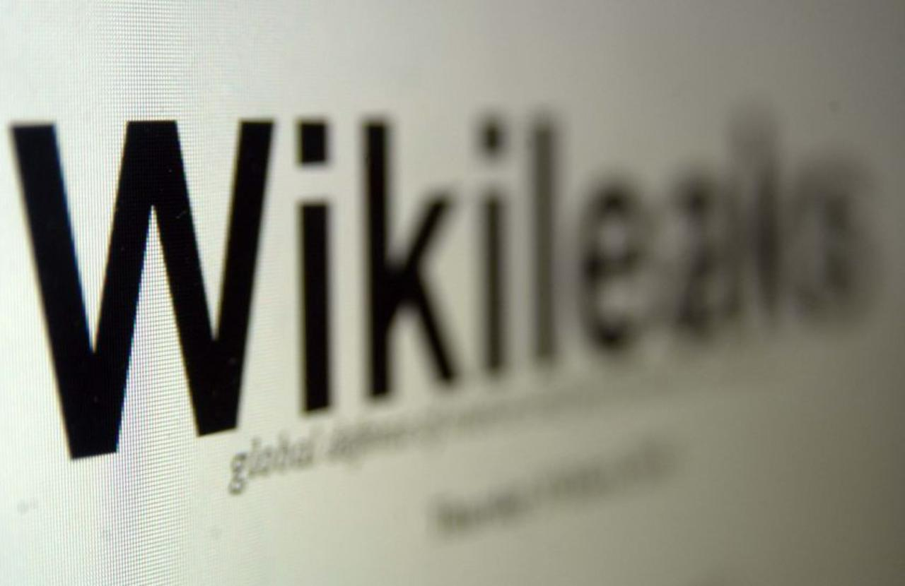
WikiLeaks & Computing Ignorance
Jeffrey J. Chaves
All Information disclosed to WikiLeaks
  Made information widely available
  Not possible without modern computing
EventTracker DriveShield
  Monitors Writable Media
  Real Time Alerts
  Ability to Disable USB Devices
http://www.abc.net.au/reslib/200903/r350863_5041432.jpg
Notes:
In 2011 Prism Microsystems, a leading provider of comprehensive security and compliance software for the US Department of Defense (DoD) and US Federal Government agencies, announced the release of EventTracker DriveShield. Designed in response to "WikiLeaks" and similar data breach incidents and the processes that were implemented afterwards, EventTracker DriveShield protects important information by monitoring users with access to sensitive data - while alerting, preventing and reporting improper transfers to writable media.
EventTracker DriveShield can also disable USB devices based on white listing the serial numbers. [15]
Had the U.S. Army installed monitoring software such as EventTracker DriveShield on their systems, this breach of information would have never occurred.

Slide 54

Whistleblowing Protection
Jeffrey J. Chaves
Protection from
  Firing / Laying Off
  Discipline
  Intimidation / Harassment
Statutes
  Affordable Care Act
  Safe Drinking Water Act
  Solid Waste Disposal Act
http://www.osha.gov/images/banner.gif
Notes:
The United States Department of Labor offers “Whistleblower Protection” to employees of all workplaces, entailing protection from firing, failure to hire, demoting, disciplining, intimidation, or harassment. These protections come under certain statutes such as the Affordable Care Act, Safe Drinking Water Act, and Solid Waste Disposal Act which ensure safety and equality in the workplace. [13] Steven Aftergood, a government secrecy specialist with the Federation of American Scientists, said Private Manning’s 35-year sentence reflected how much his case — involving leaks of entire archives, not singular documents or discrete pieces of information — differed from what had come before it. [14]

Slide 55
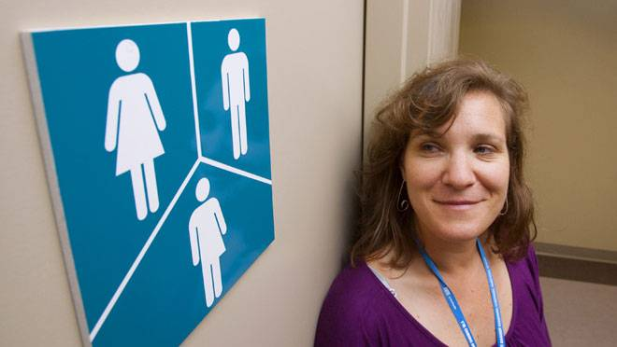
Trans Gender Rights
Jeffrey J. Chaves
Statement coming out as trans
Gender Dysphoria
Hormone Replacement Therapy
  Initially denied
  Eventually approved
http://thechronicleherald.ca/sites/default/files/imagecache/ch_article_main_image/articles/RT071612TransgenderWashroom.JPG
Notes:
August 22, 2013, the day after her sentence, in a public statement delivered by her attorney, Private Manning came out as a transgender woman named Chelsea.
Manning has been diagnosed by at least two army behavioral health specialists with gender dysphoria, or gender identity disorder. [7]
Her lawyers describe it as "the medical diagnosis given to individuals whose gender identity -- their innate sense of being male or female -- differs from the sex they were assigned at birth, causing clinically significant distress.“ [8]
Defense secretary Chuck Hagel has approved gender treatment after a lawyer for Pte Manning threatened in May 2013 to sue the Army if she was not given sex change therapy in military prison. Nancy Hollander argued the military had an obligation to treat the soldier's "transgender issues", and she would not be safe if transferred to a civilian prison for treatment there. The US military is required to offer medical treatment to its soldiers, but Pentagon policy prohibits transgender people from serving openly in the military. [9]
After being initially denied these treatments, the U.S. Court of Appeals for the 1st Circuit concluded that withholding the treatment would violate a constitutional protection against cruel and unusual punishment. [11]

Slide 56

Legal Repercussions
Jeffrey J. Chaves
35 Year Prison Sentence
  Found Guilty on 20 of 22 Counts
  6 Counts Violating the Espionage Act
Discharge & Demotion
Forfeit Military Pay
http://solowaylawfirm.com/wp-content/uploads/2014/04/lawyers.jpg
Notes:
On August 21, 2013 Private Bradley Manning was sentenced to 35 years in prison having been found guilty on 20 of 22 counts, including 6 counts of violating the Espionage Act of 1917. [1][8]
Col. Denise R. Lind of the Army also said that Private Manning would be dishonorably discharged and reduced in rank from private first class to private, the lowest rank in the military. She said he would forfeit his pay, but she did not impose a fine. [14]

Slide 57

Social Implications
Jeffrey J. Chaves
U.S. Government Damage Control
Trans-Gender Movement
Inspired Anti-War Activists
Opposition to Tunisian Dictator
http://historyofnonviolence.wiki.lovett.org/file/view/20041209115646_Peace_Not_War.jpg/222573500/20041209115646_Peace_Not_War.jpg
Notes:
The documents Manning gave to WikiLeaks set off a scramble inside the government as officials sought to minimize any harm, including protecting foreigners identified in some documents as having helped American diplomats or the military. [14]
Chelsea’s information leak inspired veteran anti-war activists from the 60s and young people alienated by mainstream queer politics, and it brought together anti-war activists queer and straight. [4]
Amnesty International said the leaked documents helped galvanize opposition to longtime Tunisian dictator Ben Ali by revealing the depth of his government’s and family’s corruption. [5]

Slide 58

conclusion
Jeffrey J. Chaves
Truth-Telling was Unethical
  Despite Corruption Revealed
  Breadth of Info Released
  Violated Espionage Act + Other Laws
Leak Could Have been Prevented
  EventTracker DriveShield
Illegal Activity Overshadowed Trans-Gender Advancements
  Impacted Trans Community
  Imprisoned for Espionage
http://www.alternet.org/files/story_images/prison_0.png
Notes:
Despite the corruption revealed by Chelsea Manning, the breadth of classified information released, including that which did not reveal any corruption, violated the Espionage Act as well as breaking other laws in the process. She revealed hundreds of thousands of war logs, information that could potentially be used by enemy parties against our military. If she had been found guilty for “aiding the enemy”, a form of treason, Chelsea would have been eligible for the death penalty. This leak of classified information could have been prevented, had monitoring software such as EventTracker DriveShield been installed on U.S. Army systems. Her illegal activities overshadowed the impact she soon made on the transsexual community within the military, pushing the government to provide hormonal treatments and succeeding. Manning showed a lack of Professional Ethics in disclosing the classified information from U.S. Army networks, and her case of whistleblowing has set a surveillance precedent for all organizations with classified data.

Slide 59
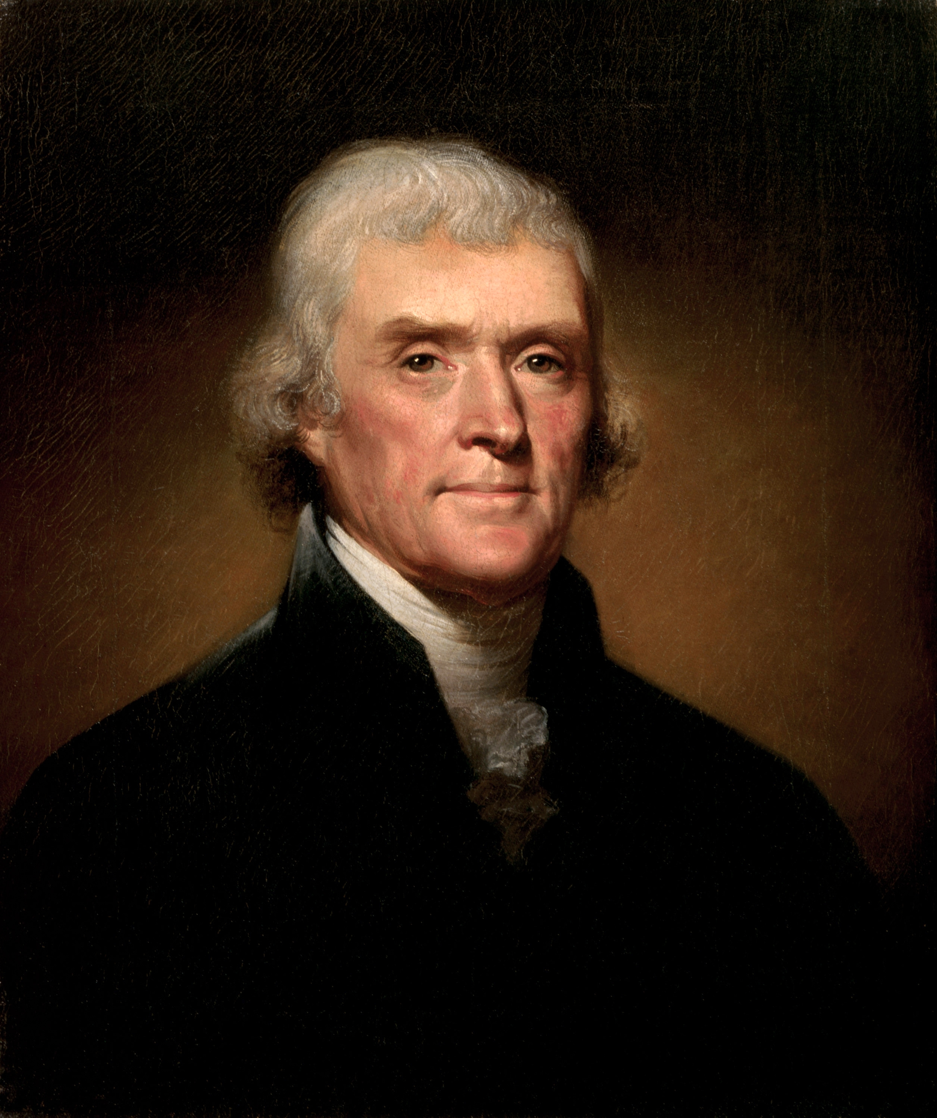
The end
Jeffrey J. Chaves
“When the people fear their government, there is tyranny; when the government fears the people, there is liberty.”
~Thomas Jefferson
http://upload.wikimedia.org/wikipedia/commons/1/1e/Thomas_Jefferson_by_Rembrandt_Peale,_1800.jpg
Notes:
Quote [http://www.monticello.org/site/jefferson/when-government-fears-people-there-libertyquotation]

Slide 60
References
Jeffrey J. Chaves
Charles E. Morris III & Thomas K. Nakayama, Leaking Chelsea Manning (Michigan State University, 2014) p 7-8
“Pfc. Bradley Manning,” by Robert Shetterly
"Chelsea Manning." Investor's Business Daily 15 Apr. 2014: A2. General OneFile. Web. 14 Apr. 2015.
Q. & Payday Strike, Chelsea Manning: Whistleblower on San Francisco Pride (QED: A Journal in GLBTQ Worldmaking, Spring 2014), p 139-147
Selma James, Chelsea Manning Joins the Army – Of Whistleblowers (QED: a Journal in GLBTQ Worldmaking, Spring 2014), p 47-51
Chelsea Manning, Pundit EDITORIAL (New York Press, June 22, 2014), p28
IN THE NEWS: Chelsea Manning (The Hindustan Times, March 21, 2014)
Faith Karimi, Chelsea Manning to Tweet from Prison (CNN Wire, April 4, 2015)
Chuck Hagel, Chelsea Manning to receive ‘gender treatment’, (Asia News Monitor [Bangkok], July 22 2014)
Chelsea, lately Bradley Manning, (Maclean’s, September 9 2013), p13
Ernesto Londoa, Convicted leaker Manning changes name to Chelsea Elizabeth Manning (Washington Post, April 23 2014)
Lida Maxwell, Chelsea Manning, Gender Identity, and the Politics of Truth-Telling, (Theory & Event, January 2015), pN/A
Occupation Safety & Health Administration, Protection from Workplace Retaliation, http://www.whistleblowers.gov/know_your_rights.html, (4/15/2015)
Charlie Savage & Emmarie Huetteman, Manning Sentenced to 35 Years for a Pivotal Leak of U.S. Files (New York Times, August 21, 2013)
EXPANDED REPORTING, Prism Microsystems Unveils EventTracker DriveShield for Preventing “WikiLeaks” and Enhancing Monitoring of USB and Writable Media (Information Technology Newsweekly, September 13, 2011), pg. 160
Notes:
These are my references.

Slide 61
References
Jeffrey J. Chaves
Charles E. Morris III & Thomas K. Nakayama, Leaking Chelsea Manning (Michigan State University, 2014) p 7-8
“Pfc. Bradley Manning,” by Robert Shetterly
"Chelsea Manning." Investor's Business Daily 15 Apr. 2014: A2. General OneFile. Web. 14 Apr. 2015.
Q. & Payday Strike, Chelsea Manning: Whistleblower on San Francisco Pride (QED: A Journal in GLBTQ Worldmaking, Spring 2014), p 139-147
Selma James, Chelsea Manning Joins the Army – Of Whistleblowers (QED: a Journal in GLBTQ Worldmaking, Spring 2014), p 47-51
Chelsea Manning, Pundit EDITORIAL (New York Press, June 22, 2014), p28
IN THE NEWS: Chelsea Manning (The Hindustan Times, March 21, 2014)
Faith Karimi, Chelsea Manning to Tweet from Prison (CNN Wire, April 4, 2015)
Chuck Hagel, Chelsea Manning to receive ‘gender treatment’, (Asia News Monitor [Bangkok], July 22 2014)
Chelsea, lately Bradley Manning, (Maclean’s, September 9 2013), p13
Ernesto Londoa, Convicted leaker Manning changes name to Chelsea Elizabeth Manning (Washington Post, April 23 2014)
Lida Maxwell, Chelsea Manning, Gender Identity, and the Politics of Truth-Telling, (Theory & Event, January 2015), pN/A
Occupation Safety & Health Administration, Protection from Workplace Retaliation, http://www.whistleblowers.gov/know_your_rights.html, (4/15/2015)
Charlie Savage & Emmarie Huetteman, Manning Sentenced to 35 Years for a Pivotal Leak of U.S. Files (New York Times, August 21, 2013)
Notes:
These are my references.

Slide 62
Class 10
The End
Keith A. Pray
Instructor
socialimps.keithpray.net
Notes:
This is the end. Any slides beyond this point are for answering questions that may arise but not needed in the main talk. Some slides may also be unfinished and are not needed but kept just in case.

