Slide 1
Class 7
Privacy
Keith A. Pray
Instructor
socialimps.keithpray.net
Notes:
After this class we will be half done with the course… very sad I know.
Play Somebody’s Watching Me – Rockwell

Slide 2
Overview
Survey
Review
Assignment
Students Present

Slide 3
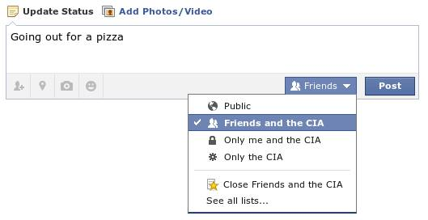
Notes:
Source?

Slide 4
My Reading Notes
pp. 274 Arrests, altering and deleting records are violations of privacy?
pp. 275 Why not try to verify and correct records?
pp. 277 300 times = frames, locations, …?
pp. 289 “…don’t want anyone to know…” like seeking medical advice, etc.?
pp. 291 Just because it’s been happening for years doesn’t make it right.
pp. 297 Wouldn’t it be easy to make and show a fake SSN card?
pp. 298 Confusing false positive and negative explanations.
End of Chapter questions: 1, 31, 51

Slide 5
Group Quiz
List two problems with using biometrics for identification.
List two advantages of using biometrics for identification.
Describe two tools people can use to protect their privacy on the Web.
For each of the 4 categories of Daniel Solove’s privacy taxonomy give an example not listed in the book.

Slide 6
Overview
Survey
Review
Assignment
Students Present

Slide 7
Assignment – Group Project
Add analysis to group project website addressing all topics covered to date.

Slide 8
Overview
Survey
Review
Assignment
Students Present

Slide 9

Tor: the onion Router
Paul Roberts
  Tor is a powerful resource that allows internet privacy for the public.
Conclusion:
  The benefits of legal uses of Tor outweigh the illegal activity it protects.
http://en.wikipedia.org/wiki/Tor_(anonymity_network)
Notes:
Tor or the onion router gives internet security.
Conclusion that Tor is worth the illegal uses.
Developed by the Navy 2004.
Free for public use.
The more people that use it the more private it is.

Slide 10
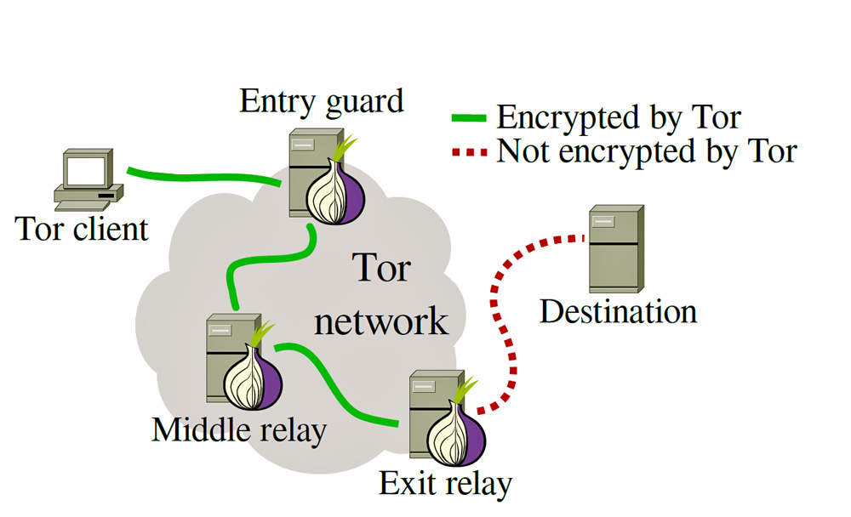
How it works [1]
Paul Roberts
http://cdn.arstechnica.net/wp-content/uploads/2014/01/tor-structure.jpg
Notes:
How tor works.
Layers of encryption. (like onion)
Random relays.

Slide 11
How it works [1]
Paul Roberts
http://upload.wikimedia.org/wikipedia/commons/e/e1/Onion_diagram.svg
Notes:
How tor works.
Layers of encryption. (like onion)
Random relays.

Slide 12
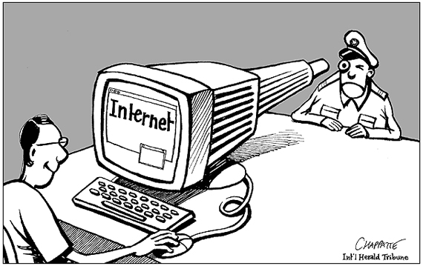
Legal uses [2]
Paul Roberts
Personal Privacy
Journalism
Law Enforcement
Activists and Whistleblowers
Military
http://lbcblogs.com/wp-content/uploads/2012/12/image39.png
Notes:
Because Tor provides privacy to its users there are many benefits.
Personal privacy. Don’t need to worry about government agencies looking over your shoulder. Look at sensitive topics. Protect yourself for identity thieves. And more…
Journalism. China. Truly anonymous source.
Law Enforcement – Online Surveillance of illegal sites with hidden ip. Stings. Tips
Activists – privacy, communication, leaks, corruption…
Military – undercover agents. Hide military ip.

Slide 13
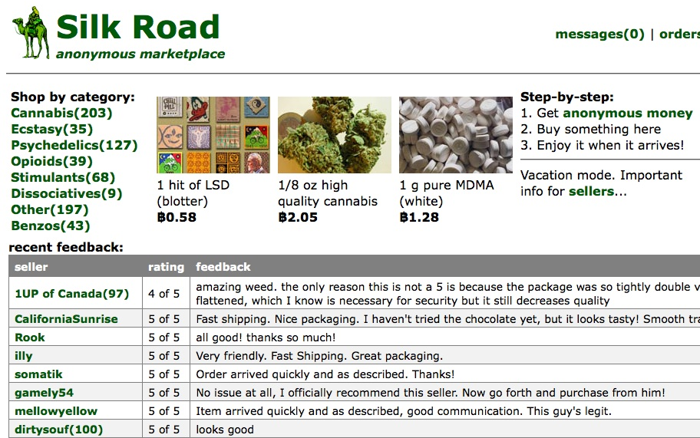
Illegal uses [3]
Paul Roberts
Drug Marketplace
Gun Marketplace
Credit Card Info
Child Pornography
And much more.
http://silkroaddrugs.org/wp-content/uploads/2014/06/silk_road00.jpg
Notes:
Because Tor provides anonymity it allows for illegal activities to occur. The result of this is known as the Dark Web. The dark web contains hidden sites that sell various illegal products. Drugs and guns are the most commonly sold items. Stolen credit card info by the thousands can be purchased.

Slide 14
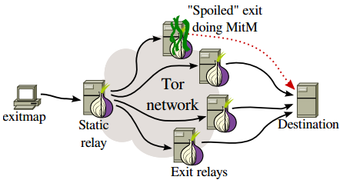
IS TOR Truly private?
Paul Roberts
Malicious exit relays [4]
Communication [5]
Buying and selling [6]
FBI [6]
[4]
Notes:
Tor has security flaws. Get higher level of privacy with a tor server relay running on person computer for extra level of encryption. Communication is more secure. Mobile communication allows for even more security. Using tor with other non .onion sites leaves user vulnerable. Market places with buying and selling of products have others holes besides Tor itself. Money transfer trail. Shipping to and from physical address.
FBI has not cracked tor.

Slide 15
conclusion
Paul Roberts
The benefits of legal uses of Tor outweigh the illegal activity it protects.
Notes:
Although Tor protects illegal activities law enforcements have been successful in shutting down major market places and seizing millions in bit coins. Criminals can be caught on the internet thanks to stings, money trails and more. Private communication is so important to the freedom internet users should have. Tox is a Skype replacement that focuses on security. Tox can work over Tor for security.

Slide 16
References
Paul Roberts
[1] Dingledine, Roger, Nick Mathewson, and Paul Syverson. Tor: The second-generation onion router. Naval Research Lab Washington DC, 2004.
[2] "Tor." Who Uses? Web. 06 Apr. 2015. <https://www.torproject.org/about/torusers.html.en>.
[3] Matthew Dalton, and Andrew Grossman. "Arrests Signal Breach in 'Darknet' --- Police Find Website Operators that used Encrypted Tor Network to Traffic in Illegal Drugs, Guns." Wall Street Journal: B.1. 2014. Print.
[4] Weippl, Edgar, et al. "Spoiled Onions: Exposing Malicious Tor Exit Relays".2014. Print.
[5] Andersson, Christer, et al. "Practical Anonymous Communication on the Mobile Internet using Tor".IEEE , 2007. 39-48. Print.
[6] Greenberg, Andy. "FBI's Story of Finding Silk Road's Server Sounds a Lot Like Hacking | WIRED." Wired.com. Conde Nast Digital, 9 Aug. 2014. Web. 06 Apr. 2015.

Slide 17
Right to be forgotten
Dimitar Vouldjeff
Why should I/We care?
  Understand differences in culture
Notes:
- Make disclaimer that we are not discussing National IDs or data protection from government
- This presentation tries to compare the ideas of privacy in US and EU in the context of corporations, show the EU perspective

Slide 18
United states v. European Union
Dimitar Vouldjeff
Protect a person’s liberty
Main threat is state
Maximum protection is reached in one’s home
Protect a person’s dignity
Main threat is public and mass media
Right of dignity and not to be humiliated in public – control over one’s public image
Notes:
Emphasize on US and protection at home => work and public spaces == no privacy -> liberty
In EU privacy is Article 8 and freedom of speech is Article 10, whereas in US is 4th Amendment and 1st respectively

Slide 19
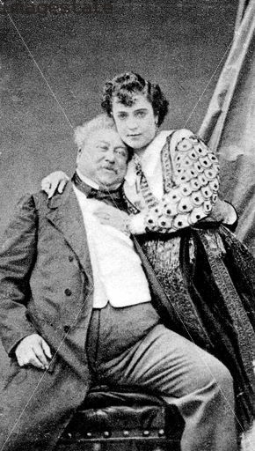
Examples on Different Views
Dimitar Vouldjeff
US: Not much privacy at work (email)
EU: Dumas’ lawsuit
“Good” credit score
Phone number on checkout
Phone marketing
https://ladyamcal.wordpress.com/2010/03/21/19th-century-bohemians-artists-pfaffs-new-york/
Notes:
US private email sent from work computers might not be considered private…
EU: Clearly distinguishes work and personal time… Germany and France are thinking of laws that prohibit work emails in non-working hours.
We hate even when the Phone Company calls to remind about renewal

Slide 20
Consumer Data IN EU
Dimitar Vouldjeff
European Union Directive on Data Protection from 1995
  Regulates the collection, processing and movement of personal data
  Data Protection Authority
General Data Protection Regulation might come in 2015-2017
US: everyone with rightful access is owner
EU: I own my personal data
Notes:
Directive meaning member states implement the directive however they want to achieve the results
Most personal info companies register with Data Protection Authority
EU: defense against private wrongdoing is the state – agency investigates, fines etc
US: let private actors sue each other.
New regulation – meaning consistent law throughout EU, because of difficulty to comply all 28 member state laws
Address issues of digital world

Slide 21

Uneasiness on Personal data
Dimitar Vouldjeff
Data processing consent
Transfer data to third-countries
Safe Harbor is challenged in European Court of Justice [3]
  After NSA mass surveillance EC admits things need improvement
  USA Privacy Act protects only US, unlike similar laws in EU
Google antitrust
  90% market share
  Suggestion to split to forbid info sharing
http://www.export.gov/safeharbor/
Notes:
Processing Consent --- what are you going to do with my data and have you asked me if I agree?
Personal data may be transferred only to countries with comparable laws to EU… US is not such a country.
Data controllers (companies) achieve data transfer through Safe Harbor agreements --- guarantee
After the scandals around Edward Snowden, many Europeans became uneasy about their data being transferred to US
Austrian law student, made the case that the EU-U.S. agreement, called Safe Harbor, no longer guarantees the privacy of European residents. European officials look at the protection of personal data as a fundamental right on par with free expression
This could be a major blow to the whole digital economy

Slide 22
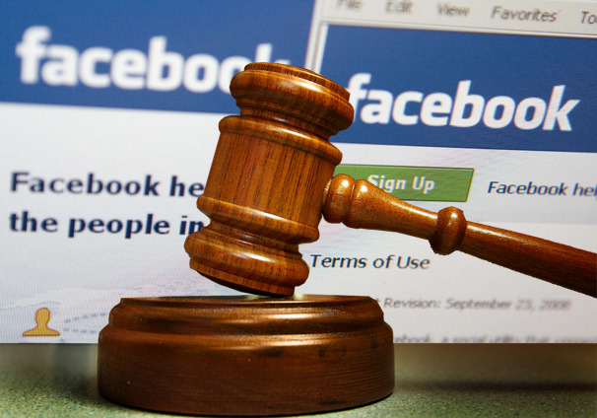
Final thoughts
Dimitar Vouldjeff
Ubiquitous technology == privacy issues
  comprehensive US-EU data agreements
  take into account EU’s view on dignity
http://atlantablackstar.com/2014/06/27/facebook-facing-largest-ever-court-request/

Slide 23
References
Dimitar Vouldjeff
[1] Whitman, J., The Two Western Cultures of Privacy: Dignity Versus Liberty
[2] EU Data Protection Directive http://eur-lex.europa.eu/legal-content/en/ALL/?uri=CELEX:31995L0046
[3] http://www.wsj.com/articles/court-hears-challenge-to-safe-harbor-data-deal-1427206554 accessed on 04/05
[4] http://www.nbcnews.com/id/15221111/ns/technology_and_science-privacy_lost/t/la-difference-stark-eu-us-privacy-laws/#.VSBadPlViko accessed on 04/05
[5] http://www.export.gov/safeharbor/ accessed on 04/05

Slide 24

Legality of Targeted Online Advertising
Yan Yan
Outline:
  What is Targeted Online Advertising?
  3 Main Types of TOA and their Legality
  TOA and Federal Trade Commission (FTC)
http://insideiim.com/wp-content/uploads/2015/02/online-advertising-tvads.png
Notes:
A brief introduction of the concept of targeted online advertising
Talk about 3 types of targeted online advertising and analyze their legality issue
And finally mention the actions that the federal trade commission, or FTC has taken to form new laws regarding legality of TOA

Slide 25

Targeted online advertising
Yan Yan
Online advertisements are placed based on various traits of a person’s online activities which serve as a proxy for these traits[1]
http://www.kineticsocial.com/wp-content/uploads/2014/03/behaiv-targeting.jpg
Notes:
a type of advertising whereby advertisements are placed so as to reach consumers based on various traits such as demographics, psychographics, behavioral variables (such as product purchase history) or other second-order activities which serve as a proxy for these traits. Further classification will be introduced in the next slides.

Slide 26
Types of online ad targeting
Yan Yan
Contextual Targeting [2]
Behavioral Targeting
Internet Service Provider-Based Tracking
<Citation>

Slide 27
Contextual Targeting and its legality
Yan Yan
Display advertisements based on the keywords in the web pages visited by the users
Little information collected and no information stored
Innocuous in general
http://s2.cdn.memeburn.com/wp-content/uploads/2013/07/Contextual-Advertising.jpg
Notes:
Contextual advertisements are thematically related to the webpage a consumer visits at a current online session. - 1
Little information about the consumer is collected and used. Virtually no information is stored past the visit of this webpage and the consumer can readily see the connection. In other words, the consumer is usually aware of how the advertiser is using his or her information.
Because the advertiser doesn’t collect and store information related to any specific user, contextual targeting is fairly innocuous from a privacy perspective.

Slide 28

Behavioral Targeting
Yan Yan
More sophisticated – analyzing consumers’ online behavior [3]
Collecting information about consumers’ internet activities
  Usually in a form of cookie [4]
http://addictos.addoor.net/targeting.jpg
Notes:
a technique for delivering relevant messages to consumers by basing the messages on an analysis of the consumers’ online behavior.
advertisers or their agents collect information about an individual consumer's Internet activities to gain a broad consumer profile. The collected data include which websites the consumers visited, what search terms they used, and whether goods or services were purchased. This information is at times combined with demographic and geographic data that can also be retrieved from the Web. Once analyzed, the collected information enables advertisers to deliver pertinent and targeted messages.

Slide 29

Legality of Behavioral Targeting
Yan Yan
Generally not illegal to use tracking cookies [2]
Except in European Union - The EU Privacy Directive, or “EU cookie law” starting from 2002 [5]
  Explicit consent must be gathered from users
  Exemption from consent for cookies that are vital to the website operation
    Advertising function is not exempt
http://www.adservices.net/blog/wp-content/uploads/2010/11/behavioral-targeting.png
Notes:
In 2002, the European Union launched a policy requiring end users’ consent for the placement of cookies, and similar technologies for storing and accessing information on users’ equipment. In particular, storing data in a user’s computer can only be done if the user is provided information about how this data is used, and the user is given the possibility of denying this storing operation.
explicit consent must be gathered from web users who are being tracked via cookies
2012 - An exemption has been made for cookies that are deemed to be vital to the operation of a website

Slide 30

Internet Service Provider-Based Tracking
Yan Yan
Internet Service Provider (ISP) provides IP address to computers and keeps log file to record internet activities of its customers [2]
ISPs partner with Advertising Company to distribute targeting ads
ISP targeting could be based on all web transactions
Hard for customers to defeat this system
http://www.puremail.com/images/icon-Telecom0.jpg
Notes:
the most abusive form of online behavioral targeting is based on ISP tracking
ISP knows the actual physical location of each customer logging on to the Internet
ISP allowed an advertising company to access log data
The advertising company analyzes the data to create a profile of each individual consumer based on the consumer's past online behavior
ISP targeting can be based on virtually all Web transactions, including visits that usually do not use cookies
the consumer cannot defeat this system by simply switching browsers or even switching computers

Slide 31

CASE study: nebuad
Yan Yan
American online advertising company
Partnered with various ISPs, intercepted and modified network traffic to monitor users
Conflicts with United States Wiretap Act
  “prohibits real-time interception of contents of electronic communications”
Closed down in 2009
http://origin.arstechnica.com/news.media/nebuad.jpg
Notes:
NebuAD is an American online advertising company founded in 2006
Makes money by signing agreements with ISPs to enable them to analyze customer’s websurfing habits to provide them with more relevant advertisements.
They achieve it by installing hardware to store information related to each customer in their partner ISPs and intercept packets to insert javascripts to track each user through cookie
What they do was revealed in a report in 2008 which states that the company did a man-in-the-middle attack and illegally intercept the network traffic, which conflicts with wiretap act
Get sued and closed down in 2009

Slide 32

Federal Trade Commission (FTC)
Yan Yan
An independent agency of United States government
Aim to promote consumer protection
Actively engaged since 1995 in exploring the legal and policy parameters of what it refers to as “understand[ing] the online market and the privacy issues it raises for consumers” [2]
Proposed a legislative framework for consumer data privacy [8]
  “Do Not Track” mechanism
  Introduced bills into Congress to regulate behavioral advertising
http://upload.wikimedia.org/wikipedia/commons/thumb/4/43/US-FederalTradeCommission-Seal.svg/2000px-US-FederalTradeCommission-Seal.svg.png
Notes:
FTC held a series of workshops, published a number of reports and gave numerous recommendations regarding both industry self-regulation and Federal regulation
In late 2010, the FTC proposed a legislative framework for U.S. consumer data privacy including a proposal for a "Do Not Track" mechanism
“uniform and comprehensive consumer choice mechanism”
FTC believes that a Do Not Track mechanism is preferable to the existing cookie opt-outs
“clear, easy to locate and effective” and conveys the user’s choice to opt out of tracking directly to websites
In 2011, a number of bills were introduced into the United States Congress that would regulate OBA
Do Not Track Me Online Act of 2011
Kerry/McCain Commercial Privacy Bill of Rights Act of 2011
But they are not enacted.

Slide 33

Conclusion
Yan Yan
Targeted Online Advertising is Legal in general
  Especially after obtaining customers' consent for behavioral and Internet Service Provider-Based Advertising
Federal Trade Commission is putting efforts into regulating Targeted Online Advertising
  Likely to form new laws in future
http://gr8plans.com/wp-content/uploads/2011/06/cropped-internet-advertising-image_476x287.jpg
Notes:
<speaker notes>

Slide 34
References
Yan Yan
[1] http://www.engadget.com/2011/01/28/google-testing-display-ads-in-gmail-our-patience/ (04/06/2015)
[2] Nill, A., & Aalberts, R. J. (2014). Legal and Ethical Challenges of Online Behavioral Targeting in Advertising. Journal of Current Issues & Research in Advertising, 35(2), 126-146.
[3] http://www.cbsnews.com/news/what-is-behavioral-targeting/(04/06/2015)
[4] http://www.bullguard.com/bullguard-security-center/internet-security/internet-threats/tracking-cookies.aspx (04/06/2015)
[5] http://www.datadial.net/blog/index.php/2012/03/15/the-new-eu-cookie-laws-what-you-need-to-know-a-round-up/#.VSIoMfnF9iQ (04/06/2015)
[6] http://www.freepress.net/sites/default/files/fp-legacy/NebuAd_Report.pdf (04/06/2015)
[7] https://www.ftc.gov/tips-advice/business-center/advertising-and-marketing/online-advertising-and-marketing (04/06/2015)
[8] https://epic.org/privacy/consumer/online_tracking_and_behavioral.html (04/06/2015)

Slide 35
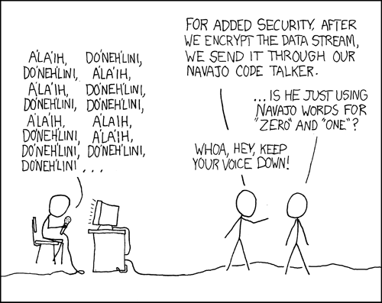
The Right to encrypt
Josh Hebert
[1]
35
Notes:
In keeping with the theme, obligatory xkcd
Chapter talked a lot about regulation of government data interception
However, it doesn't really talk about the other side, which is what happens when they lack the technical ability to do so.
As an individual, by obfuscating my communications, I am depriving them of their legal right to tap/search/whatever my data
35

Slide 36
Legality OF strong encryption
Josh Hebert
UK
  Mandatory disclosure [7]
France
  Maximum key length [10]
Russia
  All encryption requires license [11]
36
Notes:
So to set some background, I want to talk about the policies of other countries to set a context for our discussion.
“You will be sent to jail for refusing to give up encryption keys, regardless of whether you have them or not. Five years of jail if it’s a terrorism investigation (or child porn, apparently), two years otherwise. “ [7]
France's key limit was very recently raised from 56 bits to 128 bits. If you use one of longer length, you are legally required to provide the government with a copy of the key.
The Russian government has some of the strongest control over encryption in the world. To enter the country with a strong encryption product, you need to apply for a license
At this point you, might be thinking, “yeah josh, that sounds kinda bad, but those places are far away and this is the land of the free, right?
36

Slide 37
Smartphones
Josh Hebert
Apple and Google both made encryption standard on their devices last year. [2]
Lock the door and throw away the key
37
Notes:
Wrong. So, smartphones: who has one?
I'll assume almost everybody. So, why is that important?
Let me preface this by saying that the smartphone market is essentially compromised shared by Apple and Google (96.4% between the two of them [2])
Last year (around september), both Google and Apple made encryption the default on their mobile devices.
With this, even if police obtain a device, Google/Apple can't get data off of it, even if they wanted to. They've, in a sense, locked the door and thrown away the key.
The important point here is that encryption isn't just for conspiracy theorists and crypto nerds anymore; it exists everywhere
The reaction from the law enforcement community( the FBI, NCIS, whatever your favorite multiletter governmental organization is) has been overwhelming
37

Slide 38

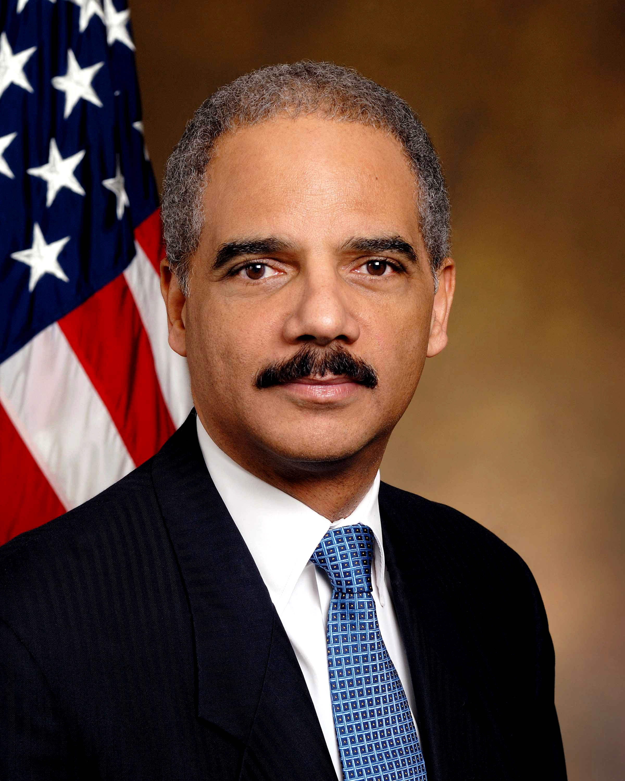
Response From Law Enforcement
Josh Hebert
"Sophisticated criminals will come to count on these means of evading detection" [4]
                ~James Comey
"[Companies should] work with us to ensure that law enforcement retains the ability, with court authorization, to lawfully obtain information in the course of an investigation” [3]
                ~Eric Holder
[5][6]
38
Notes:
38
Comey is the directory of the FBI and Holder is the US Attorney general

Slide 39
In the united States
Josh Hebert
Commonwealth v. Gelfgatt
United States v. Doe
Lavabit
39
Notes:
Commonwealth v. Gelfgatt
-"an act of production does not involve testimonial communication where the facts conveyed already are known to the government...". [8]
United States v. Doe
-The 11th U.S. Circuit Court of Appeals agreed that decryption violated 5th amendment rights [9] (2011)
-Lavabit [10]
Rather than hand over encryption keys mandated by a court order, Lavabit deleted them and shut down. (2013)
39

Slide 40
Summary
Josh Hebert
Encryption is now everywhere!
In the US, it isn't illegal
  Not so in other countries
(Usually) not protected under the 5th Amendment (sometimes)
40
Notes:
So, in short: encryption isn't a niche idea- It's everywhere today!
While other countries have restrictive legislation regarding its use, the US does not. Fortunately for us, we have the right to use whatever technology we want to obfuscate our legal data.
Until you're a terrorist. Or the government thinks you've done something illegal. At this point, it becomes a little more situational. Depending on the context, the court may or may not compel an individual to disclose private keys.
40

Slide 41
Discussion
Josh Hebert
Should the government be given backdoor access to encrypted devices?
41
Notes:
Let's discuss! (or ask questions, those are fun too)
41

Slide 42
References
Josh Hebert
[1] xkcd.com/257/
[2] Vance, Cyrus R., Jr. "Apple, Google encryption helps crooks." Washington Post 26 Sept. 2014. Academic OneFile. Web. 4 Apr. 2015.
[3] Timberg, Craig. "Holder: stronger encryption helps kidnappers, abusers." Washington Post 30 Sept. 2014. Academic OneFile. Web. 4 Apr. 2015.
[4] Haseeb, Ali. SNL Kagan Media & Communications Report (Oct 20, 2014).
[5] http://upload.wikimedia.org/wikipedia/commons/6/6a/Eric_Holder_official_portrait.jpg
[6] http://news.softpedia.com/images/news2/FBI-Director-James-Comey-Says-Agencies-Are-Making-Cyber-Security-a-Top-Priority-429618-2.jpg
[7] http://www.legislation.gov.uk/ukpga/2000/23/section/53
[8] Commonwealth v. Gelfgatt (Report) 468. Supreme Judicial Court of Massachusetts. June 25, 2014. p. 512.
[9] https://www.eff.org/press/releases/appeals-court-upholds-constitutional-right-against-forced-decryption
[10] http://www.irishtimes.com/business/strong-encryption-prohibition-relaxed-1.1258616
[11]http://www.nationaldefensemagazine.org/archive/2013/August/pages/UseCautionWhenTravelingWithEncryptionSoftware.aspx
All references were accessed on April 4th
42
Notes:
-references-
42

Slide 43
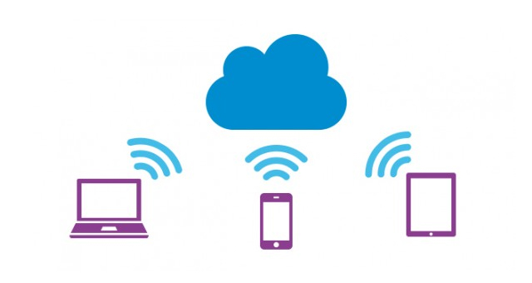
Cloud storage…
Kerrin Spinney
Remote Storage
Access Anywhere
<https://www.surdoc.com/cloud-storage/preface-to-cloud-free-cloud-storage/>
Notes:
Enables remote storage and access of information through the internet
Storage space not limited by capabilities of local hardware
Access information on any connected device

Slide 44
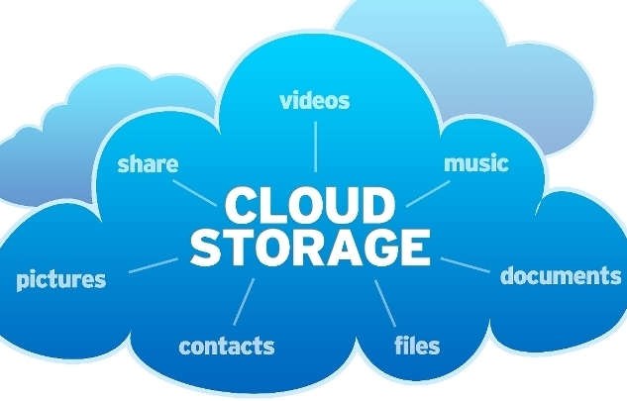
…Is everywhere
Kerrin Spinney
Google Docs
Google Drive, Dropbox
Gmail, Yahoo mail, etc
Facebook
Flickr, Picasa
Steam
Itunes
http://www.triplepundit.com/special/storing-data-cloud-safe/
Notes:
A lot of your personal life is in the cloud
A lot of sensitive business information is in the cloud

Slide 45
4th amendment – 3rd party doctrine
Kerrin Spinney
Smith vs Maryland
  “A person has no legitimate expectation in the privacy of information he voluntarily turns over to third parties”
  Cloud storage is 3rd party storage
Notes:
Governments can search through anything with a warrant, but information in the cloud is treated differently

Slide 46
Is cloud storage private?
Kerrin Spinney
Government access is regulated
Electronic Communications Privacy Act
  Subpoena or Court order
  Must notify
Notes:
US government does not need a warrant to access cloud stored information, but it does regulate when and how it can access information
Need a subpoena or court order to access info
Need a warrant to access emails stored for under 180 days
Must notify unless they can demonstrate this would hinder investigation

Slide 47
Can we hide?
Kerrin Spinney
Encryption?
  Increase cost burden on government
  Backdoors
Offshore servers?
  Mutual legal assistance treaties
Notes:
Can we take back our privacy? No
Encryption – if cloud storage providers encrypted data, it could increase the cost of investigating individuals, forcing law enforcement to choose only high priority targets
black bagging – need warrant to enter home
govs could force service providers to circumvent encryption by inserting backdoors into their own products

Slide 48
Breach of privacy?
Kerrin Spinney
Government access is regulated
  “While our systems may differ in approach, let me assure you that we have in place protections that are fundamentally similar to those in Europe. In a number of critical areas, the U.S. provides more restrictions to the access of personal data than do European Member States”
http://useu.usmission.gov/kennard_032112.html
Notes:
Technology has left legislation in the dust
Many would argue that the prevalence of cloud storage should necessitate having a warrant to search

Slide 49
References
Kerrin Spinney
[1] Meyer, Theodoric; “No Warrant, No Problem: How the Government Can Get Your Digital Data.” ProPublica, June 27, 2014. Web. 07 Apr. 2015
[2] Figliola, Patricia M. Fischer, Eric A. “Overview and Issues for Implementation of the Federal Cloud Computing Initiative: Implications for Federal Information Technology Reform Management.” Congressional Research Service, January 20, 2015. Web 06 Apr 2015
[3] Kennard, William E. “Living With our Heads in the Cloud.” March 21, 2012. Web 07 Apr 2015
[4] Soghoian Christopher; “CAUGHT IN THE CLOUD: PRIVACY, ENCRYPTION, AND GOVERNMENT BACK DOORS IN THE WEB 2.0 ERA.” Web 06 Apr 2015
[5] Maxwell, Winston; Wolf, Christopher; “A Global Reality: Governmental Access to Data in the Cloud.” July 18 2012. Web 06 Apr 2015

Slide 50
Medical systems have a lot of data:
Yifan Zhao
Sample ER form
Your Basic Information
  Name, DOB
  SSN
  Address
  Allergies
  Primary care physicians
  Reason for ER Visit today
  Current medical problems
  Level of Mental retardation
  Consent Status
WPI health service/Insurance
Your Basic Information
  Name
  SSN
  Address
Your medical history
  Allergies
  Surgery
  Medical history of your family
Billing information
Notes:
Hi everyone! My name is Yifan. Today I’m going to talk about the privacy in medical information systems.
So, what information do the medical systems have?
Here are some examples of what information the medical systems are going to collect.
If you go to an ER, the nurse will help you fill out the information on the left side, like…
If you go to WPI health service, you need to fill out a survey online before your first visit. Questions include…

Slide 51
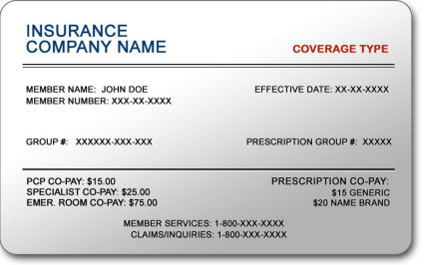
The data is important [1]
Yifan Zhao
Stolen health credentials can be sold at $10 each.
Data for sale:
  Names, birth dates, policy numbers, diagnosis codes, billing information
Create fake IDs
  To buy medical equipment or drugs
  To file made-up claims with insurers
Any crime related to your SSN [6]
  Open financial accounts
  Get medical care
  File for a fraudulent tax refunds
  Commit crimes
  Steal your benefits
http://www.clemmonsurgentcare.com/yahoo_site_admin/assets/images/insurance_card.11284214_std.jpg
Notes:
You probably don’t understand why the hackers would steal your medical information. Here’s what the hackers will do with the stolen information.
“The data for sale includes names, birthdates, policy numbers, diagnosis codes, and billing information.”

Slide 52

The data is important
Yifan Zhao
Your medical information can be used against you in the court!
Angie’s husband stole her medical records and used it as evidence against her in custody trial. [3]
http://www.hillerlaw.com/wp-content/uploads/2013/05/custory-trials-panel.jpg
Notes:
Here is one example of how people might use the medical information. A woman named Angie posted a question on injury claim coach.com.
Basically, her husband has stolen her medical records, claiming that her mental disorders might affect her ability to take care of their children.
Therefore, he used the stolen medical information against Angie in their custody trial.

Slide 53
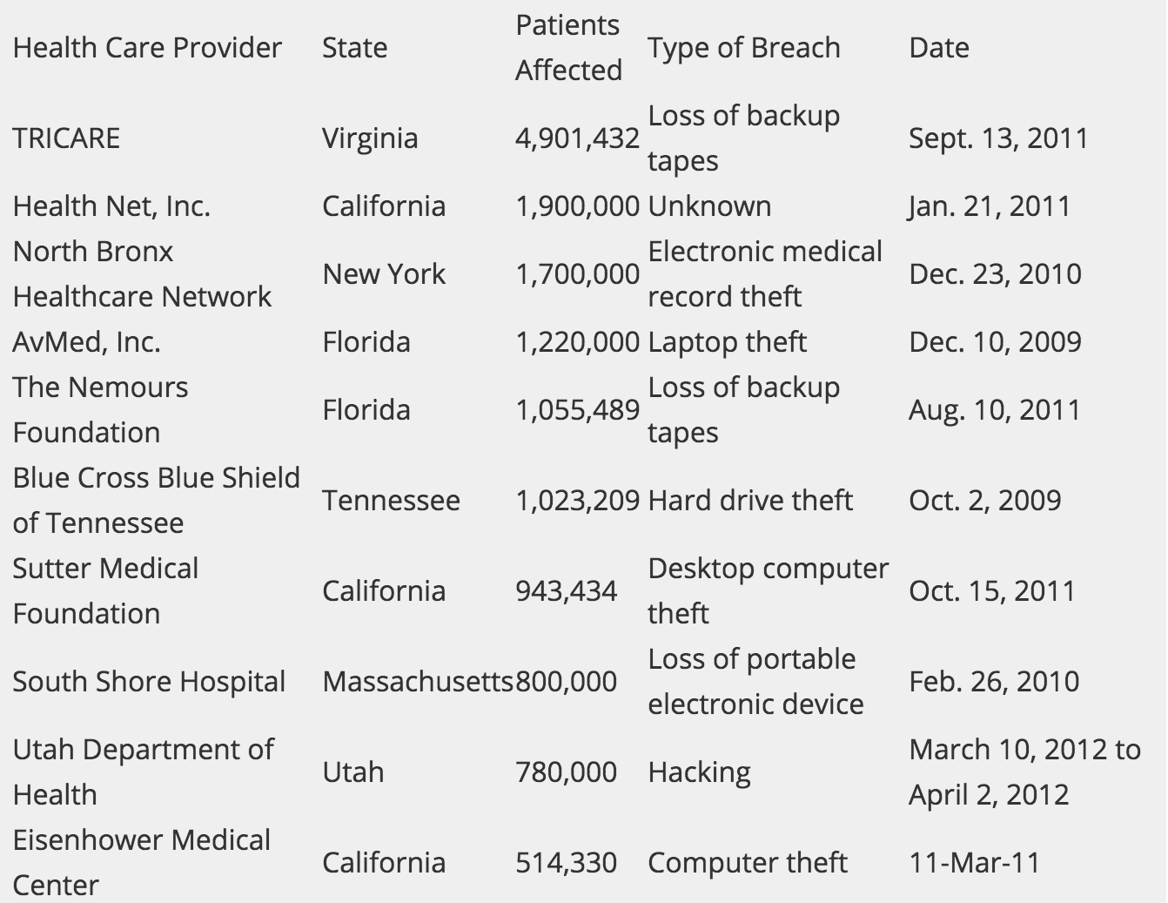
It happens and can happen to you [1]
Yifan Zhao
Attacks on the rise:
  Cyber attacked healthcare organizations: 20% in 2009 to 40% in 2013
Reason
  Technology advancement:
  Shift to electronic medical records by a majority of U.S. healthcare providers.
http://kaiserhealthnews.org/news/electronic-health-records-theft-hacking/
Notes:
Here are some statistics showing that the medical systems have been attacked more and more across years.
It shows that the percentage of healthcare organizations that have reported a criminal cyber attack has risen to 40% in 2013 from 20% in 2009, according to an annual survey by the Ponemon Institute think tank on data protection policy.
The reason behind the increase in both number of cyber attacks and number of records stolen in those breaches is the shift to electronic medical records by a majority of US healthcare providers.

Slide 54

Example of violating HIPAA [3]
Yifan Zhao
May 14 , 2012
Laurie Napper was charged against violating HIPAA.
Over 17 months, she used her position at hospital to gain patients’ names, addresses, and Medicare numbers to sell their information.
She could end up in prison up to 10 years!
http://www.trbimg.com/img-542ee6fc/turbine/chi-howard-university-hospital-20141003
Notes:
So, what has the government contributed to protecting the privacy of medical information?
Two regulations are mentioned in the book.
The first one is genetic information nondiscrimination act, which prevent discrimination in the areas of medical benefits and employment based on genetic information. It prohibits health insurance companies and health plan administrators from requesting genetic information from individuals or their family members, and it forbids them from using genetic information when making decisions about coverage, rates, or preexisting conditions.
It also prohibits most employers from taking genetic information into account when making hiring, firing, promotion, or any other decisions related to the terms of employment.
The second regulation mentioned in the book is Health Insurance Portability and Accountability Act (HIPAA) included guidelines for protecting the privacy of patients.
The covered entities include doctors and nurses, pharmacies, hospitals, clinics, and nursing homes, health insurance companies, health maintenance organizations, employer group health plans, certain government programs that pay for health care, such as Medicare and Medicaid.
Here is an example of people violating HIPAA.

Slide 55
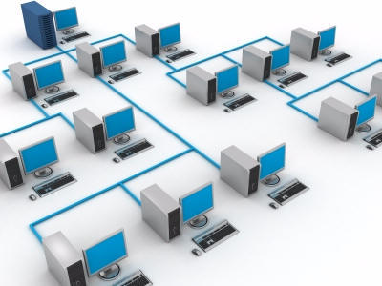
how can the government help?
Yifan Zhao
Government
Creating a uniform system for medical systems?
  Probably more cons than pros
    Costs more
    As long as attacked, large number of data will be lost
New regulations?
  Specific requirements for medical systems?
  Most recent rule in 2009: [3]
    Breach notification rule
http://www.tspconsultant.com/uploads/3/7/0/0/37007755/9903228_orig.jpg
Notes:
Such system would be similar to creating national IDs.
When a breach occurs that affects more than 500 or more patients, health care providers now must notify not only HHS, but also the media.
It seems that the government can barely do anything to protect the systems.

Slide 56
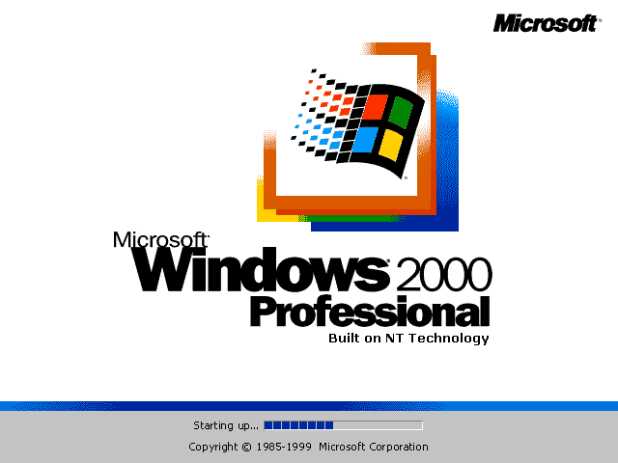
What can the hospitals do?
Yifan Zhao
Hospitals seem to use very old systems – very insecure.
  10 plus years old that have not seen a patch
  Some of the easiest networks to break into
Upgrade the systems?
  Invest in firewall
  Invest in technicians
  However, why not buy a new MRI?
  Maybe the government can help?
http://www.guidebookgallery.org/pics/gui/startupshutdown/splash/win2000pro.png
Notes:
So, what about the hospitals? Can they do anything to help?
Actually, definitely! It shows that the systems that the hospitals use are outdated, which increases the risk of being attacked.
So, why not upgrade the systems?
Good question, but as a hospital, if they have more money, would they invest in a new MRI or laser surgery, or put the money into a new firewall?
Maybe the government can help?

Slide 57

What can we do to protect our info? [5]
Yifan Zhao
Talk with your doctor about your confidentiality concerns.
Request a copy of your medical records.
Register your objections to disclosures that you consider inappropriate.
But actually, there’s nothing much we can do.
http://transcribable.com/wp-content/uploads/2013/01/Patient-talking-to-doctor.jpg
Notes:
What can you do to protect our medical information?

Slide 58

conclusions
Yifan Zhao
Wish list:
  Develop a new medical system with the following features:
    Easy to transfer data from the old system to the new
    Strong firewall protection
    Updates regularly
This can be a good career opportunity for CS students! ☺
http://rmsbunkerblog.files.wordpress.com/2012/05/2012-healthcare-trends.png
Notes:
<speaker notes>

Slide 59
References
Yifan Zhao
[1] Caroline Humer and Jim Finkle, Your Medical Record is Worth More to Hackers than Your Credit Card, http://www.reuters.com/article/2014/09/24/us-cybersecurity-hospitals-idUSKCN0HJ21I20140924, 04/06/2015
[2] David Shultz, As Patients’ Records Go Digital, Theft and Hacking Problems Grow, http://kaiserhealthnews.org/news/electronic-health-records-theft-hacking/, 04/06/2015
[3] Angie, My Medical Records Were Stolen and Used Against me in Court, http://www.injuryclaimcoach.com/my-medical-records-were-stolen-and-used-against-me-in-court.html, 04/06/2015
[4] Michael J. Quinn, Ethics for the Information Age (Pearson, 02/24/2014), pages 297-298
[5] Protect Your Medical Privacy,
http://www.usa.gov/topics/family/privacy-protection/medical.shtml, 04/06/2015
[6] Christine DiGangi, 5 Things an Identity Thief Can Do with Your Social Security Number, http://blog.credit.com/2015/02/5-things-an-identity-thief-can-do-with-your-social-security-number-108597/, 04/07/2015
Notes:
Thanks!

Slide 60
Class 7
The End
Keith A. Pray
Instructor
socialimps.keithpray.net
Notes:
This is the end. Any slides beyond this point are for answering questions that may arise but not needed in the main talk. Some slides may also be unfinished and are not needed but kept just in case.

