Slide 1
Class 5
Intellectual Property
Keith A. Pray
Instructor
socialimps.keithpray.net
Notes:
Here’s the title slide. Excited already, aren’t you?
Reminders:
Do not change the format, footers, etc. in the template slides.
Paper writing process: Sources → Notes → Conclusion → Argument → Counter Point → Response

Slide 2
Overview
Review
Assignment
Students Present
Guest Speaker

Slide 3
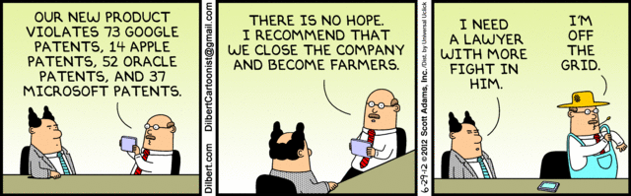

Slide 4
My Reading Notes
pp. 162 Illegal software stats changed since 2009?
pp. 169 SaaS, Google Search example? “…before he gave them the plot.”?
pp. 176 4.4 #2 preferred?
pp. 182 dial-up is not ordinary any more. revenue != profit
pp. 189 blocking 100% seems impossible
pp. 197 4.7.3 reference?
pp. 202 Perhaps friends should not ask you to break the law? Any successful industries operate as a support service?
pp. 203 Is Perl still most popular? Quality study from 2003, change?
pp. 205 GUI argument ignores Android.
pp. 208 who uses tape?
pp. 223 Any news?
End of Chapter questions I liked: 31

Slide 5
Group Quiz
For each On the left answer a–d on Right
Trademark
Copyright
Patent
Trade Secret
What kind of IP does it protect?
What qualifications does the IP have to meet to be protected?
How long does the protection last?
Give a specific example of IP currently protected?
Notes:
Trademark
Used to denote a product or service.
Apply in specific areas of commerce. Only applies in specified area of business
Indefinite term as long as in use and protected against becoming a common noun or verb.
You do not have to register a trademark unless you want to bring litigation before a federal court (there are other benefits too)
Copyright
Expression, not ideas: Fuzzy. E.g. derivative works, characters, merchandising, plots.
Mickey Mouse, Tarzan.
US Default : Original Author, Exception: work for hire, Transferred: yes
Rights: Publication, Performance / exhibition, Adaptation to other media, Excerpting, Attribution, Derivative works
US Term: Lifetime of author plus 70 years., 95 years for companies.
Governed by US law and international treaties (e.g. WIPO).
Fair Use: News reporting, reviews, etc., Scholarly / educational use, Private, non-commercial use, Lending libraries and archives
Fair Use restrictions: Admission charge, Re-transmission
In general, you can: Read, view, play, etc., Copy for personal use., Time-shift.
In general, you cannot: Copy for others., Transfer to someone else but keep a copy., Show / perform it publicly.
What about video rentals?
Rationale: Encourage creativity. Encourage dissemination. Balance between private and public good. It’s a social contract.
Patent
A mechanism, process, or composition of matter.
Something patentable must be: Novel. Useful. Non-obvious. Described clearly. Must do what it says.
Usual term 20 years.
Utility and plant patents: 20 years.
Design patents last 14 years. (ornamental design of functional item)
Provisional patent gives 1 year, before full patent
Trade Secret
You must take steps.
Enforceable by: Contracts, Laws against industrial espionage.

Slide 6
Overview
Review
Assignment
Students Present
Guest Speaker
Notes:
But first take a look at:
CGP Grey
Copyright: Forever Less One Day
https://www.youtube.com/watch?v=tk862BbjWx4
Tom Scott
http://tomscott.com
Welcome To Life
https://www.youtube.com/watch?v=IFe9wiDfb0E&feature=youtu.be

Slide 7
Assignment - Self Search 1/3
Discussion Board
Post ways one can search for information about a person. Do not repeat entries.
Use each search method listed to produce 2 profiles as an appendix of your paper. Provide a brief description if you’d rather not list the details.
  Profile 1: all information someone might think is you
  Profile 2: all information you know is you.
  You are not responsible for methods posted after Thursday Midnight.
For each search method result consider:
  Exactly how did the data get there?
  How can this data be used?
  Is this a secondary use?
  Did you authorized use of the data? If not and you want to, request its use be discontinued and post the correspondence.
Dig deeper than a basic search engine’s (Google, etc.) results.

Slide 8
Assignment - Self Search 2/3
1 Page Paper
Use your search results to help support your conclusion.
This assignment requires you revisit the Discussion Board frequently as new search methods are posted, subscribe to it.
Conclusion idea examples (not comprehensive):
  What impression would a potential employer have of you given these results, assuming they also had a resume and possibly a cover letter from you?
  What would your elder family members (or equivalent) think?
  Are you comfortable with what you found or did not find?
  Do you believe protecting your privacy is important or needed?

Slide 9
Assignment - Self Search 3/3
Profile 2
Is You
1 Page
Paper
Filter
Inspiration
Search Methods
…
…
…
…
Filter
Profile 1
Could Be You

Slide 10
Overview
Review
Assignment
Students Present
Guest Speaker

Slide 11
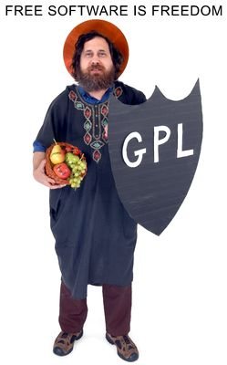
Copyright... or left?
Peerapat Luxsuwong
GNU project [1]
  Free(dom) software (GCC)!
Copyleft
  It's not a public domain... but it belongs to everyone!
  GNU GPL
Image: http://www.innovartic.cl/imagenes/richard-stallman_1.jpg
Notes:
GNU started in 1983
Freely distributable software to programmers
e.g. GCC, GDB
Copyleft: makes program and children program free, achieves goals of GPL
Richard Stallman made GNU software, but not kernel
Linus: 1991: Linux, proprietary, 1992: free

Slide 12
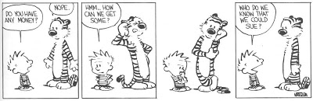
SCO Goes for broke
Peerapat Luxsuwong
SCO vs Linux [2]
  SCO versus giants
  5 major lawsuits
SCO vs IBM
Claim: IBM put SCO code in Linux
Microsoft funds SCO
Image: http://3.bp.blogspot.com/-0Dc38pB1g8o/TZjInUJTl5I/AAAAAAAAADA/-lQK19hI-Oo/s400/SCO_Imitates_Calvin_And_Hobbes.jpg
Notes:
SCO:
IBM
Red Hat
Novell
Daimler Chrysler
AutoZone
hates Linux devs and users
claims unwarranted UNIX ownership
did not disclose copied code
Microsoft bought fake “Unix & Unix-related patents”

Slide 13
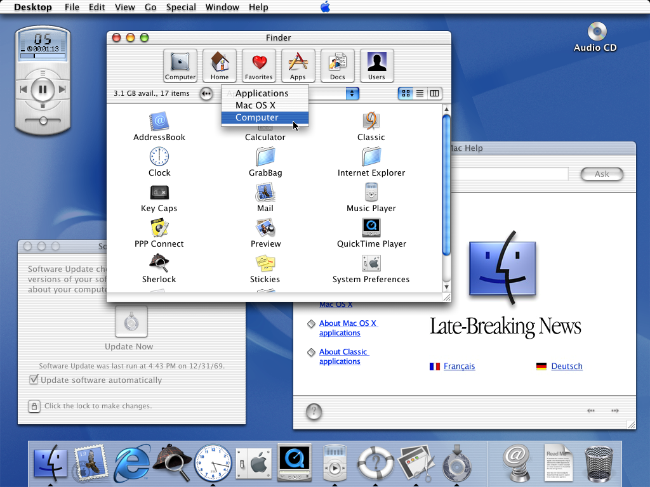
Apple Lawsuits
Peerapat Luxsuwong
Unix to Apple
  FreeBSD
Apple versus Microsoft
  GUI “Look and Feel” [3]
Patent War [4]
  Apple versus Nokia
  Apple versus Samsung
http://upload.wikimedia.org/wikipedia/en/7/78/Macosxpb.png
Notes:
Mac OS X contains FreeBSD code, of unix origins
Apple vs Microsoft “look and feel”
Apple claimed GUI as a whole was theirs by copyright
Lost individual cases against GUI element lawsuits
Apple didn’t own any of the elements (licensed by Xerox)
Xerox sued Apple too
Patent war in 2009 (Nokia -> Apple)
Sue, Counter-sue
Rapid development of mobile OS
If lawsuit succeeds, may have to remove feature

Slide 14

Implications
Peerapat Luxsuwong
Intellectual Property
  Losing objectiveness
  May hinder progress
OS Evolution
  Patent Race
OS OS
  Inevitable integration with commercial OSes
http://www.omgubuntu.co.uk/wp-content/uploads/2011/08/Linux-Vs-windows.jpg
Notes:
“look and feel”: less objective assertions made
GNU/Linux wouldn’t exist if Linus didn’t change Linux from proprietary to free
Due to copyleft open source is becoming increasingly popular (e.g. Apache webservers)

Slide 15
REFERENCES
<Your Name>
[1] Stallman, Richard. "About the GNU Project - GNU Project - Free Software Foundation." About the GNU Project - GNU Project - Free Software Foundation. GNU Operating System, 14 May 2014. Web. 31 Mar. 2015. <https://www.gnu.org/gnu/thegnuproject.html>.
[2] "SCO–Linux Controversies." Wikipedia. Wikimedia Foundation, 30 Mar. 2015. Web. 31 Mar. 2015. <http://en.wikipedia.org/wiki/SCO–Linux_controversies>.
[3] "Apple Computer, Inc. v. Microsoft Corp." Wikipedia. Wikimedia Foundation, 29 Mar. 2015. Web. 31 Mar. 2015. <http://en.wikipedia.org/wiki/Apple_Computer,_Inc._v._Microsoft_Corp.>.
[4] "Smartphone Patent Wars." Wikipedia. Wikimedia Foundation, 11 Mar. 2015. Web. 31 Mar. 2015. <http://en.wikipedia.org/wiki/Smartphone_patent_wars>.

Slide 16
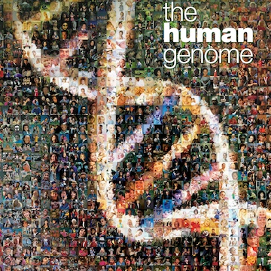
What is a bioinformational system
Meagan Hiatt
Software System
Medical Information
Assist Researchers
https://unlockinglifescode.org/timeline
Notes:
- Bioinfor Sys – extensive databases of medical information, the databases themselves, the software and algorithm that aids in retrieving, analyzing, comparing and visualizing the information.
- Initially the role of CS in the molecular biology field was confined to the extent of data management and cataloguing. However the need to access information from these databases lead to the development of mining software.
- Bioinfo systems allow researchers to easily share information, which they use for their own individual projects as well as collaboration projects, such as the human genome project. The human genome project was the worlds largest biological international collaboration project, and it was completed in 2003.(see pic) Because of bioinformational technology, they were able to fully map the human genome and discovered 16mil types of DNA that they previously didn’t know existed.
- Software tends to be built for the database/information type, so it’s fairly specialized.

Slide 17


Intellectual Property Laws
Meagan Hiatt
US Patent and Trademark Office
  Computer Readable Media
    Hardware
    Software
      Database
      Software
VS.
http://www.excel.com/, http://www.att.com/
Notes:
- USPatentTrademarkOffice defines Bioinfo systems as ‘inventions implemented under computer-readable media’
Computer-r-m are split into two parts – hardware and software. Bioinfo systems fall under the software section.
- Bioinfo systems are split into who subsections: Database and Software
- Database
- However a patent for bioino databases are for the process of compiling and operating the database, namely the software. It doesn’t extend to the data, because the data is still considered information, which is not covered by patents. Someone could use the information and modify the algorithm or software to generate the database and call it their own. In may countries databases can not be patented.
- Copywrite could protect the information, however Copywrite protection extends only to the compilation (the original selection and arrangement of info) not to the actual contents.
- Software
– It’s now patentable, however there are restrictions. It has to be able to produce a useful, concrete and tangible result. For example when ATT tried to sure excel communications for using a slightly altered version of one of their software’s , the US court claimed the software was not patentable because it only recites a mathematical algorithm.
- Copywrite - only protects the original work, and if someone alters it enough to where it’s not considered a substantial copy, then they can claim it as their own.
- Current system need improving, which is why there is a debate on whether IP should cover bioInfo systems
- Objections against IP protection
- such protection would act to enclose the ethically sensitive realm of human gene-related studies. It’s contented that human genomic science should be common and accessible to all and shouldn’t be restricted to a few.
- On the other side of this, others can claim the information and research as their own work

Slide 18
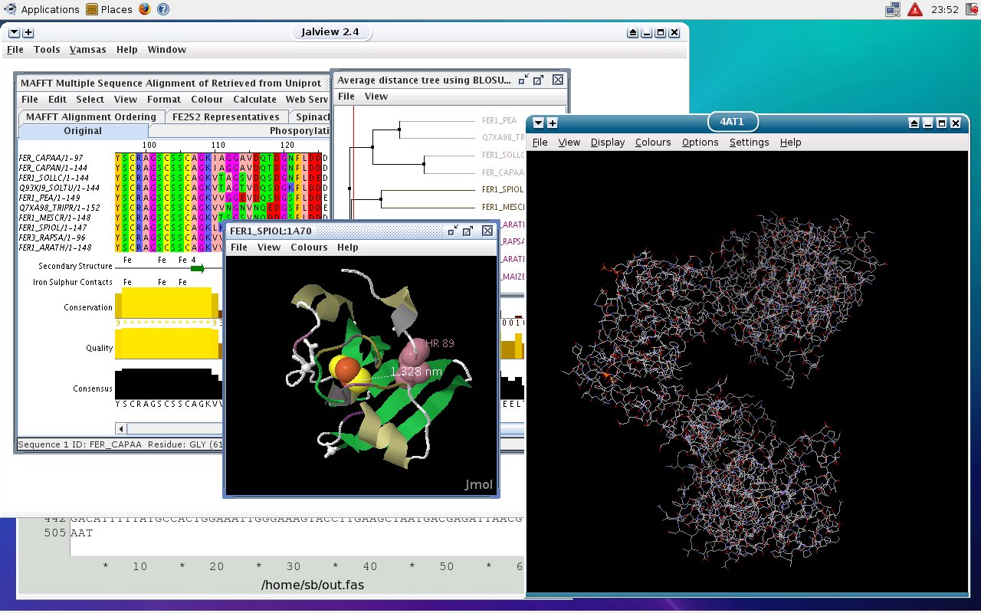
Intellectual Property Laws
Meagan Hiatt
Patents encourage innovation
  Funding
  Original Protection
Who should own it?
http://www.dnalinux.com/screen1.jpg
Notes:
Ensures profits that can fund making products to the market. These funds can go back into research and development of new software, which you can see a picture of one of the software's available. This program maps DNA chromosones.
Copywrite on the information could protect the specific information, however © protection extends only to the compilation (the original selection and arrangement of info) not to the actual contents of the database.
So if there was a patent, who should own it?

Slide 19
Intellectual Property Laws
Meagan Hiatt
Software Companies
  Censorship
Medical Community
    No Reward for Software makers
Both
Java Based Bioinformational System Structure
Client
(Java Applet)
Database Access Object
Biological Database
Web Server
Biological Database
http://www.avajava.com/
Notes:
To get an idea of typically system structures, there is the client or applet, which communicates with a access object, which goes to the web server and then finally the database. This is obviously a very basic system and for java applications. There are applications in other languages, but the overall concepts are the same which can cause problems with ownership.
If the software companies own the bioinfo system,
- they can have rights towards the content within the system. This can cause censor ship issues. If the software company has licensing, they can influence who sees the information. Or cause researchers to have to pay to not only see, but use the data in their own research.
If med researches have ownership:
- If there is no patent on the software, they can share the software, so there is no profit for software engineers. These databases are huge and sorting through all the data can require if powerful and complex algorithms and programs. This takes a lot of time (labor) on the SE’s part - there is no profit on the SE’s side, then the quality and quantity of bioinfo systems can decline – who wants to make a powerful searching algorithm, then get very little in reward?
- if there is a patent on either side, there is a large grey area in the middle, where the patents can conflict. In this case the access object could be covered by either patent.

Slide 20
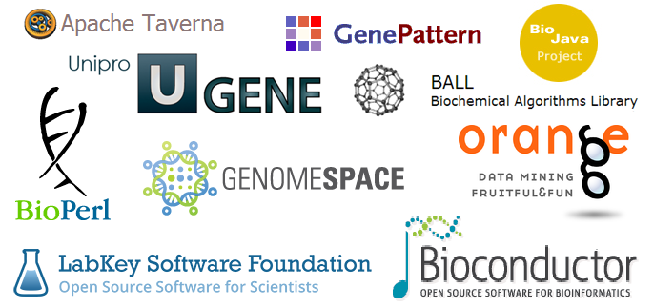
Open Bio Movement
Meagan Hiatt
Open Source
  Rapid release
  Collaboration
  No restrictive agreements
http://bioinformaticsonline.com/pages/view/7986/list-of-bioinformatics-open-source-projectssoftware
Notes:
- Then there is the Open Bio movement, inspired by open source software.
- Rapid release of information
- easy to collaborate with other members of the bioInof system
- no restrictive agreement or licensing on information so members of the bio-system can use the information freely.
Two open-source systems are Unipro and Ball, and there are many more. While BALL specializes in biochem algorithms for searching, unipro produces a toolkit which includes searching, but it’s main feature is comparison (visually) of the data.

Slide 21
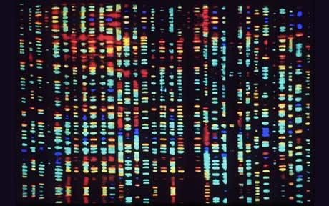
Open Bio Movement
Meagan Hiatt
Open Source
  Rapid release
  Collaboration
  No restrictive agreements
http://www.telegraph.co.uk/news/health/news/8092027/Scientists-from-1000-Genomes-Project-have-identified-95-per-cent-of-genetic-variations.html
Notes:
- Then there is the Open Bio movement, inspired by open source software. Where an open bio project was something that is designed to permit other members of the scientific community to collaborate on the project as well as ensure, that telling the public occurred rapidly. For the HGP the public was notified when important information over 1kb was collected.
- However, an open source software programmer, known as the distributed annotation system (DAS), was set up to facilitate collaborative improvement and annotation of the genome.
- Attempts have been made to make human genome sequence information freely accessible to researcher since 1970. Human Genome Initiative has been created with the said purpose in mind.
- expeditiously and effectively increase our knowledge of genetics depends on the ability of researchers to access current information

Slide 22

Conclusion
Meagan Hiatt
Open Source
Medical Researchers
  free & easy access to research
plherrera/iStockphoto
Notes:
- Open Bio has certain merits as well as demerits. It promotes access to certain research tools and encourages user innovation that might be absent from a different development process, however, it may also reduce the profits from commercial R&D in the area of research tools
- But sharing and collaboration is the main importance and the open-source concept allows this with ease.

Slide 23
References
<Your Name>
Singh, K. (2015). Intellectual Property Protection to Bioinformatics and Genomic Databases and Open Source Analogy to Biotechnology. In Biotechnology and intellectual property rights: Legal and social implications (p. 254). Springer.
Gold, R., Joly, Y., & Caulfield, T. (2005). Genetic Research Tools the Research Exception and Open Science.GenEdit, Vol III(No2), 11-11. Retrieved March 30, 2015, from http://www.cipp.mcgill.ca/data/publications/00000040.pdf
Hultquist, S., Harrison, R., & Yang, Y. (2002). Patenting bioinformatics inventions: Emerging trends in the United States and Europe. Nature Biotechnology, 20, 743-744. Retrieved March 30, 2015, from http://www.hultquistip.com/files/bioinformatics01.pdf
Why Open Biotechnology? (2015, January 1). Retrieved March 31, 2015, from http://www.openbiotech.com/category_s/1821.htm
Eriksson, D. (2015, January 1). AVAJAVA Web Tutorials. Retrieved March 31, 2015, from http://www.avajava.com/tutorials/lessons/biological-database-integration---computer-technology.html

Slide 24
Class 5
The End
Keith A. Pray
Instructor
socialimps.keithpray.net
Notes:
This is the end. Any slides beyond this point are for answering questions that may arise but not needed in the main talk. Some slides may also be unfinished and are not needed but kept just in case.

