Slide 1
Class 4
Freedom Of Speech
Keith A. Pray
Instructor
socialimps.keithpray.net
Notes:
Here’s the title slide. Excited again, aren’t you? You should be.
This should be fine:
Dave Audé vs Luciana - You Only Talk In #HASHTAG
http://www.youtube.com/watch?v=53wIN87lJn0
Show Epic Rap Battles of History: Steve Jobs vs. Bill Gates (If class ok with obscene lyrics)
https://www.youtube.com/watch?v=njos57IJf-0
This Video Will Make You Angry
https://www.youtube.com/watch?v=rE3j_RHkqJc

Slide 2
Overview
Review
Assignment
Students Present
Notes:
Here’s the title slide. Excited already, aren’t you?
Perhaps show Epic Rap Battles of History: Steve Jobs vs. Bill Gates (lyrics a bit much for class)
https://www.youtube.com/watch?v=njos57IJf-0
This might be better:
Dave Audé vs Luciana - You Only Talk In #HASHTAG
http://www.youtube.com/watch?v=53wIN87lJn0

Slide 3
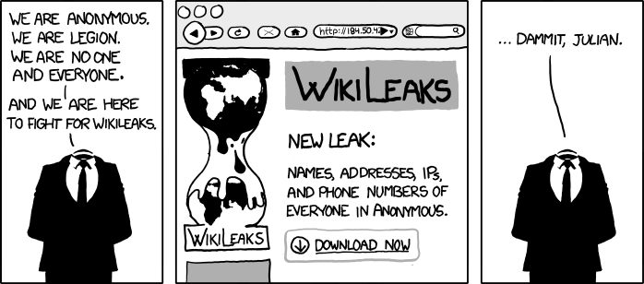
http://www.xkcd.com/834/

Slide 4
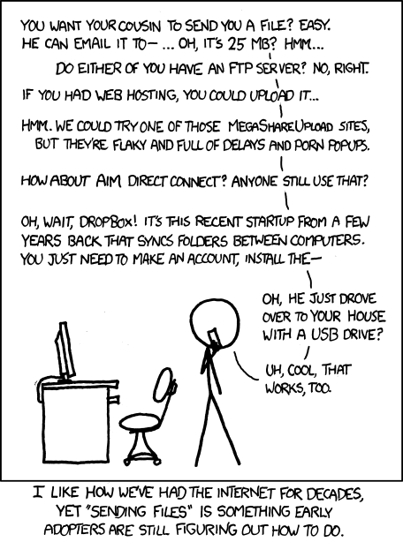
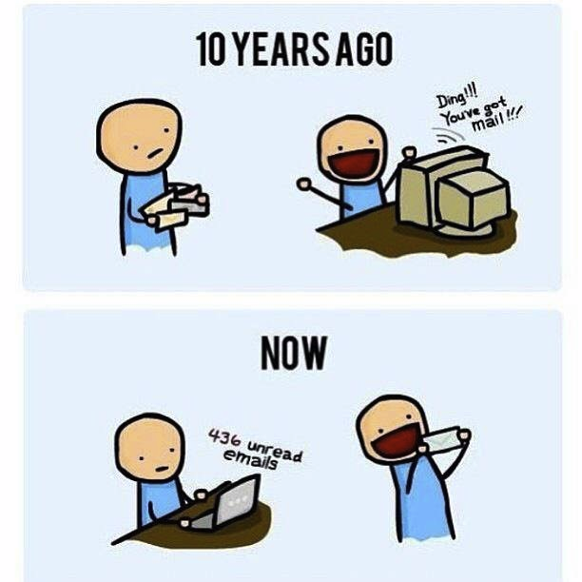
http://poofytoo.com/
20
http://xkcd.com/949/

Slide 5
My Reading Notes
pp. 110 What powers the cell phones and towers? “everyday tasks” not apparent from image.
pp. 111 “over a billion” contradicts pp. 38. [6] from 2008.
pp. 118 [17] from 2005, how is the quality of Wikipedia now?
pp. 131 Is 20% realistic? What will search engines and facial recognition be capable of? Rule Utilitarian ignores the private setting.
pp. 132 Do any filters use imgage processing?
pp. 135 Social Contract - Least restrictive/harmful way to achieve goal?
pp. 138 IM stats from 2002
pp. 139 Sting refs, latest from 2003.
pp. 144 addiction def, ignorance = !addict ?
pp. 146 More accurate to say addicted to single app?
pp. 159 2015 is © of text, time for update
End of Chapter questions I liked: 19, 26 (libel? Yes), 30 (http://en.wikipedia.org/wiki/Wikipedia:Citing_Wikipedia ),

Slide 6
Group Quiz
Name two methods some governments use to control access to information.
A large company has a policy prohibiting employees from blogging about company products.
  Name two possible reasons for the policy.
  Does it violate the First Amendment? Why?
  Is it reasonable? Why?
What does “URL” stand for and what is it?
Notes:
Censorship (religious, governmental, private). Adult authentication. Global dissemination. Freedom of Speech not an absolute right.

Slide 7

Assignment
One page paper
  Open source software development tools, friends or foes?
Extra Credit – One page paper
  Is WPI’s IT Acceptable Use Policy morally acceptable?
Remember to work on your group project.
  See full group project description on course website.
Notes:
Or review right now.
http://opensource.org/files/osi_logo_300X400_90ppi.png
Accessed 2014-09-08

Slide 8
Overview
Review
Assignment
Students Present

Slide 9


You won’t believe what happens next!
Arthur Lockman
Clickbait
  An online article with a title designed to “bait” a viewer into clicking on the link to the article
  Often have purpose of simply displaying ads to the user without any actual content
Common Content Sources
  BuzzFeed, Upworthy, Click Hole
Common Content Types
  “Listicles”
  Multi-page image articles
Consequences from [3]: Lots to See, Little to Read
Notes:
Let’s start off this presentation with a formal definition of what I talk about when I say “clickbait”. [read definition]
I’m sure you’ve all seen this stuff on facebook, tumblr, etc.
Some common sources of these articles are Upworthy, Buzzfeed, and ClickHole
I include clickhole jokingly, since it is intended as Satire against clickbait, though sometimes it’s hard to tell a joking clickhole article from an actual BuzzFeed one
Some common content types include “listicles” and multi-page image articles
Listicles are just articles that are lists of things (often images) with “clever” titles

Slide 10
You won’t believe what happens next!
Arthur Lockman
Example Titles
  23 Corgis Who Made The World A Better Place
  A Truly Eye-Opening Photo Of Kim, Kanye, And North West
  27 Things That Will Make Every Chef’s Blood Boil
  A Garage For Clothes? You Won’t Believe The Outrageous Ways Celebs Are Blowing Their Money Now
Motivations
  Almost entirely ad revenue
Comment on Corgis from [1]
Notes:
So let’s take a look at some example titles for these articles, so that we can get an understanding of why they’re so clickable
[read titles]
One of these is from Clickhole, can you tell which one?
On the side is an XKCD about Clickbait – mildly interesting
Let’s take a look at the key components of each of these titles – I chose them for a reason
23 corgis – promotes happiness mainly, is a very happy title. People like corgis, and they like to feel like the world is being made a better place – they love feeling altruistic by forwarding content.
Kim and Kanye – people like celebrities, but most of all they love to be shocked or awed by the content. Eye-opening promotes the idea of awe.
Blood boil – people LOVE to share anger. We’ll talk more about this in a minute.
Garage for clothes – a classic example of the “you won’t believe what happens next” style article, fake, appeals to shock and awe

Slide 11
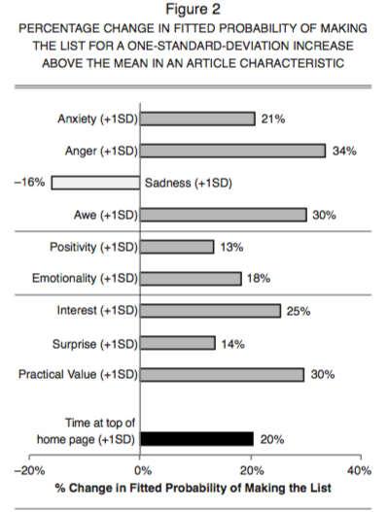
Shareable content
Arthur Lockman
Collected from 7000 NYT articles by an automatic crawler
Machines gauged article positivity
Humans measured other emotional variables
  Shock and awe, anger, etc
Graph from [2]: What Makes Online Content Viral?
Notes:
Let’s take a look at some data to see why these titles are used in clickbait articles.
These statistics were derived by examining 7000 NYT articles to see which of the articles ended up on the times’ “most-emailed” list.

Slide 12
Shareable content
Arthur Lockman
Content that is very positive or negative is shared more
Relation to emotion is complicated
  In general, awe-inspiring content is more viral than sad content
  Anxiety and anger-inducing content is more likely to make email list
Relations between emotion and virility apply across content subjects, and also within those subjects
Highly emotional titles = more advertising revenue
Conclusions from [2]: What Makes Online Content Viral?
Notes:
Let’s try to draw some conclusions from this data.
Extremely positive and negative content is shared more than content that doesn’t evoke emotions
Positive more likely to be shared than negative from this category, though
The relation of how viral content is to emotion is more complicated
Unsurprisingly, awe-inspiring content will be shared more.
Surprisingly, the seemingly negative emotions of anxiety and anger will be shared more (anger more than anything else)
These relations hold true across categories of content, and within those categories
Means that an awe-inspiring article on a subject will be shared more than one with the same facts that isn’t as awe-inspiring
The study in “What Makes Online Content Viral” shows that these hold true for not just articles, but customer service experiences and ad campaigns.
The biggest point here is that highly emotional titles lead to greater advertising revenue.

Slide 13
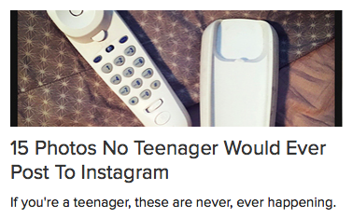
Implications
Arthur Lockman
Shared articles are losing “value”
Angry articles are the most likely to be shared
  Can cause people on the internet to rally around negative experiences that only impacted one person – boycott effect [4]
  Leads to a lot of anger being shared around the internet
Users are annoyed by news feeds being filled by clickbait
Consequences from [3]: Lots to See, Little to Read
Image from Buzzfeed
Notes:
What are some consequences of this type of article’s pervasiveness? Mainly that “news” that is shared has almost no practical or informative value anymore. It’s all about getting clicks and shares, not about sharing actual content.
What “value” does this article have? Not much.
Angry articles are most likely to be shared, meaning that angry content and anger are dispersing through the web faster than other content types
People are more likely to start a social movement of a boycott based around one person’s bad experience
Comcast customer service example – not saying I like comcast, but the anger stirred up over a few people’s bad experience is huge
Leads to a larger amount of anger being shared around the internet than anything else
This also annoys a good portion of users – myself included.
Brings us to the final topic – flamewars.

Slide 14
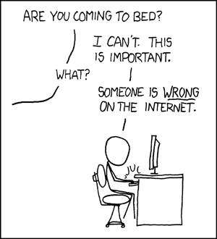
Flamewars
Arthur Lockman
Flamewar
  War of negativity and anger between two social groups on the internet, resulting in the alienation of one from another and a complete inability to communicate between the two groups
  Usually a result of a desire to prove the other party wrong
Examples
  PC vs. Mac
  Linux Users
  Linus Torvalds vs. Andy Tanenbaum
  Gamergate
What do you want me to do? LEAVE? Then they’ll keep being wrong!
Image from http://xkcd.com/386/
Notes:
Let’s start with a definition of a flamewar [definition]
Let’s go over some examples of famous flamewars
PC vs. Mac
Linux users have a new one almost every month – lastest one is systemd vs. init.d
In the 90’s Andy Tanenbaum wrote MINIX, which was an alternative to Linux and made the claim that Linux was obsolete. This sparked an all-out war.
Gamergate – a group of “gamers” who believe that they’re being “oppressed” by women who want to get into the games industry and gaming, and lash out against them.

Slide 15

Flamewars
Arthur Lockman
Often started over very trivial things and blown up out of proportion
Paper cites the Founding Fathers flamewar on LiveJournal
Comment types
  Ad hominem insults
  Dehumanization of entire groups of people
  Sarcasm
Extremely quick escalation
From [5]: The Flamewar as a Genre in the Russian Blogosphere
Image from quickmeme: http://www.quickmeme.com/p/3vmxri
Notes:
Flamewars are often started over very trivial things and blow way out of proportion
Tend to expand by a snowball effect – one person makes a comment that is taken out of context, the next makes a more offensive comment, and it’s all downhill from there.
Founding Fathers war on Livejournal
Essentially a few members of the site arguing over who had the right to call themselves founding fathers – erupted into a four-day flamewar
What often happens is that the most negative aspects of one side’s argument are shared more between members of the community. This alienates one community so far from the other, and creates an entirely negative and perfectly enraging image of the other within each community.
Usually use ad hominem insults, dehumanization, and sarcasm
Largest characteristic of a flamewar is how quickly it escalates from a small disagreement to an all-out war

Slide 16
Consequences
Arthur Lockman
Internet forum threads tend towards anger and negativity
  Many internet news sites have removed commenting functionality from their sites due to flamewars being waged in the comments
  Alienates many users from these areas of the internet due to a bad experience
Flamewars can bleed over into the “real world”
Shared content and comments trend towards anger – what does that say about our culture today?
Notes:
Gamergate is an excellent example of a flamewar moving into real life. No matter which side of the argument you’re on, it’s impossible to ignore that people associated with the GG flamewar are harassing anti-GG people in the real world.
Brianna Wu, Anita Sarkeesian, doxxing, swatting
Since we’ve shown that these flamewars are extremely angry and negative AND that anger is most likely to be shared, what does that say about our culture and society? Would this have been the case many years ago?
People talk a lot about the negative impacts that the internet has on our culture, and I think that this is by far the biggest one. Since angry content gets shared around more, people are driven to be more angry and more hostile since a lot of what they see in their news feeds on Facebook and Twitter is anger and flamewars.
Drives internet culture to be very toxic and hard to get in to for a lot of people which turns potential new members of online communities away
Takes away from meaningful discussions – often turns them into anger fights

Slide 17
References
Arthur Lockman
[1] Ho, J. Y. C., & Dempsey, M. (2010). Viral marketing: Motivations to forward online content. Journal of Business Research, 63(9/10), 1000-1006. doi:10.1016/j.jbusres.2008.08.010
[2] Berger, J., & Milkman, K. L. (2012). What makes online content viral? Journal of Marketing Research, 49(2), 192-205. doi:10.1509/jmr.10.0353[3] <reference 3>
[3] McElroy, D. (2015). Lots to see, little to read. British Journalism Review, 26(1), 12-13.
[4] Plangger, K., & Mills, A. J. (2013). Viral media & marketing: Strategy, policy and exploitation. Journal of Public Affairs, 13(2), 143-145. doi:10.1002/pa.1479
[5] Perelmutter, R. (2013). Klassika zhanra: The flamewar as a genre in the russian blogosphere. Journal of Pragmatics, 45(1), 74-89. doi:10.1016/j.pragma.2012.10.006
Notes:
And here are some references

Slide 18
Class 4
The End
Keith A. Pray
Instructor
socialimps.keithpray.net
Notes:
Use remaining time to form groups, approve group topics, etc.
This is the end. Any slides beyond this point are for answering questions that may arise but not needed in the main talk. Some slides may also be unfinished and are not needed but kept just in case.

