Slide 1
Class 11
Work
Keith A. Pray
Instructor
socialimps.keithpray.net
Notes:
Here’s the title slide. Excited already, aren’t you?
Last 2 paper averages: Code: 4.5 Game: 5.5
Total points not counting extra credit so far: 35 - 43 - 55

Slide 2
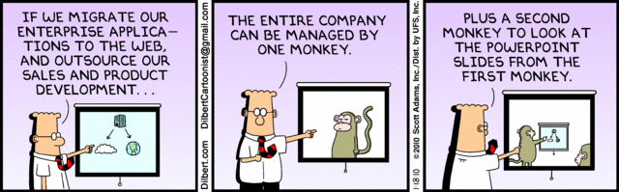
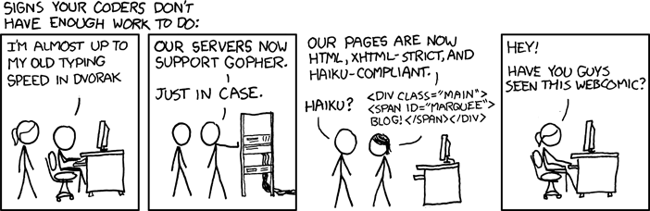
http://xkcd.com/554/
Notes:
Maybe watch video:
http://www.youtube.com/watch?v=7Pq-S557XQU
Andrew uses this video as a source, watch at end of class if time.

Slide 3
Overview
Review
Assignment
Students Present
Notes:
Fill time with Work Discussion on Course Web Site

Slide 4
Group Quiz
List 2 ways IT can lead to organizational change.
List 4 ways a Video Game Producer may protect its IP and what specific IP each protects.
List a computing technology that can be used to protect an individual’s privacy.
List a computing technology that can be used to intrude upon an individual’s privacy.
Notes:
Let’s split into groups or 4-5 for this.

Slide 5
Overview
Review
Assignment
Students Present
Notes:
Review Group Assignment Details.

Slide 6
Overview
Review
Assignment
Students Present
Notes:
We can also discuss articles listed on Security Discussions under documents of course web site.
ADD QUIZ AS BACKUP IF CLASS DISCUSSION OR GUEST SPEAKER FAIL

Slide 7
Female gamers
LilyAnne Lewis
How has the gender ratio changed over the years?
Industry
Casual Gamers
Professional Gamers
Notes:
The question I will be answering is: how has the gender ratio in gaming (industry and for fun) changed over the years. If there is change, does the gender ratio effect the harassment/gender equality.
To look at this, I will be looking at the following areas and seeing the change.
Industry
Casual Gamers
Professional Gamers

Slide 8

Industry
LilyAnne Lewis
2013:
11 percent of game designers were women [1]
3 percent of programmers were women
2014:
No change
Many women in the industry have experienced sexism[2]
Att.com
Notes:
First I will be looking at the industry.
Some people may remember this image from a recent commercial. Let them laugh. The reason this is so funny is because this ratio does not usually happen in real life. Usually it is the opposite. Most of the time, there is no female at all.
No growth in the gaming industry, percentage is the same as it says on the slide.
This is opposed to looking at broader fields in general such as graphic design and technology, with 60 percent and 25 percent respectively.
Fun fact: In Massachusetts video game employment has risen nearly 80 percent since 2009. However, there are no statistics available on the number of women working at these companies.
A study was done earlier this year. The study found that 66 percent of women in the game industry have experienced sexism (any discomfort or discrimination that is caused as a result of a person’s gender) [7]
77 percent of women and 55 percent of men have female friends in the industry that have experienced sexism.
39 percent of women were not confident that HR could handle their disputes in the event of a problem with their coworkers.
36 percent of women know or suspect a pay difference due to their gender. (10-12 thousand difference)
All of these percentages were found in 2014. for the same studies done in 2013 – 2011, the result were nearly identical.
Conclusion: gender ratio has not changed. Level of harassment has not changed.

Slide 9
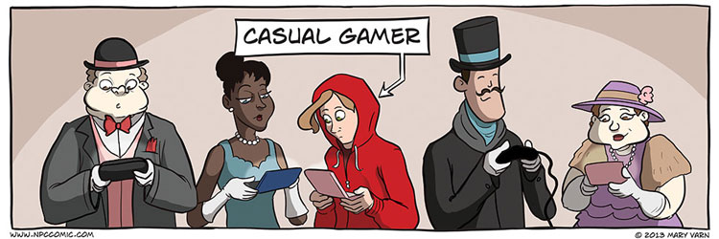
Casual Gamer
LilyAnne Lewis
What is a casual gamer?
2013:
45 percent of casual game players are female [3]
Women 18 or older (31 percent) vs men 17 and younger (19 percent)
2014:
48 percent of game players are female [4]
Women 18 or older (36 percent) vs men 18 and younger (17 percent)
http://cdn.duelinganalogs.com/wp-content/uploads/2013/12/casual-gamer.jpg
Notes:
It is difficult to define a casual gamer. Casual gamers can consist of anyone who shows more than a passing interest in video games. Because of this broad definition, casual games are usually made with simple rules.
Because there are so many ways to define a casual gamer, the image above could be considered a correct definition of a casual gamer.
Fun fact: When buying a game defined as ‘casual’ 73 percent of buyers are women.
One possible reason for the increase of female players (as shown on the slide is the increase usage of smartphones [5]. Easy access/popular apps (Candy Crush). Most popular apps tend to be gender neutral as well. Many popular games are gender neutral (Minecraft)
From a recent study containing 847 subjects, 60 percent of all female respondents have experienced sexism/harassment while playing video games. 79.3 percent of all subjects said that sexism is prominent in games. 20 percent of women subjects say that they have been bothered by a male player post-game. [6]
The same study taken a year prior to this one showed similar results.

Slide 10
Professional gamers
LilyAnne Lewis
What is a professional gamer?
2014:
15 percent of all professional gamers are female
2013:
14 percent of all professional gamers are female
Notes:
Professional gamers are gamers who play games competitively, often making a living. Many are sponsored.
Not many all female teams. Two examples of all female teams would be:
The FragDolls
The Sirens (disbanded after a month due to retaliation and harassment from their introduction video)
Raise in female professional gamers by 1 percent. 95 percent of these female gamers say they have experienced sexism. 12 percent of female professional gamers have been kicked out of a tournament at some point just because they were female.

Slide 11
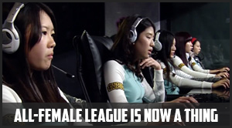
All Female league in esports
LilyAnne Lewis
Pros:
Possibility of attracting more female professional gamers
Cons:
Example of Segregation [8]
Some female gamers kicked out of other tournaments
http://www.newsoflegends.com/index.php/sexism-in-esports-why-cant-women-succeed-as-pro-gamers-17414/
Notes:
An all female league was created in the hopes of attracting more female competitors. There are pros and cons listed above.

Slide 12
Conclusion
LilyAnne Lewis
Gender ratio is decreasing
Level of harassment is the same.
Sexism is not decreasing as the gender ratio decreases.
Notes:
Conclusion, the gender ratio is decreasing between males and females has decreased. However, this has not effected the level of sexism/harassment.
Level of harassment may be decreasing with the introduction of gender neutral games.
Gender neutral games may be one of the reasons that attracted more female gamers.

Slide 13
References
<Your Name>
[1] Leah Burrows, Women remain outsiders in video game industry, http://www.bostonglobe.com/business/2013/01/27/women-remain-outsiders-video-game-industry/275JKqy3rFylT7TxgPmO3K/story.html, January 27th, 2013, (Accessed September 30th, 2014)
[2] Taylor Casti, Women Play Video Games…, http://www.huffingtonpost.com/2014/04/24/female-gamers_n_5207137.html, April 26th, 2014, (Accessed September 30th, 2014)
[3] Essential Facts about the Computer and Video Game Industry 2013, http://www.theesa.com/facts/pdfs/esa_ef_2013.pdf, (Accessed September 30th, 2014)
[4] Essential Facts about the Computer and Video Game Industry 2014, http://www.theesa.com/facts/pdfs/esa_ef_2014.pdf, (Accessed September 30th, 2014)
[5] Charles Pulliam-Moore, Women significantly outnumber teenage boys in gamer demographics, http://www.pbs.org/newshour/rundown/female-adults-oust-teenage-boys-largest-gaming-demographic/, August 21st, 2014
[6] Colin Campbell, Misogyny in games: Stats and Sexism, http://www.gamasutra.com/view/news/179563/Misogyny_in_games_Stats_and_sexism.php, October 19th, 2012, (Accessed September 30th, 2014)
[7] Jennifer Allaway, The Reality of Sexism in the Game Industry, http://gamasutra.com/blogs/JenniferAllaway/20140331/214320/The_Reality_of_Sexism_in_the_Game_Industry.php, March 31st, 2014, (Accessed September 30th, 2014)
[8] Sexism in Sports…, http://www.newsoflegends.com/index.php/sexism-in-esports-why-cant-women-succeed-as-pro-gamers-17414/, April 5th, 2014 (Accessed September 30th, 2014)

Slide 14
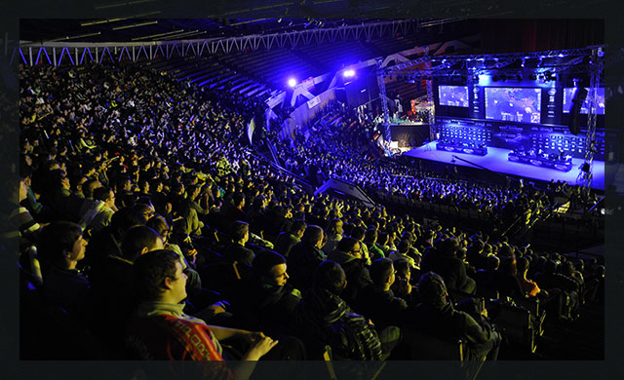
Professional eSports
Tom Paolillo
Computers ushered in many industries
  Computer/Software Engineers
  Computer Scientists
  Programmers
  System Administrators
  Professional Gaming [1]
http://en.intelextrememasters.com/season8/world-championship (Sept 27, 2014)
Notes:
I’m going to talk about what esports is, its recent growth, and its viability to become an accepted career path in society.
With the rise of computers in our society, careers like computer engineers and software engineers, computer scientists, programmers, and system administrators have emerged. All these careers revolve around creating something of some use with computers. A less anticipated career to come from the normalization of computers is that of professional gaming, an industry similar to that of traditional sports. While it is a profession that certainly wouldn’t be possible without computers or related technology, it isn’t as closely related to working with computers as the other professionals mentioned. It uses computers and computer related technologies as a medium through which competitions can be held to demonstrate skill, knowledge, and experience. The medium is often thought of as a new form of sport, where each game being played professionally like DotA, League of Legends, and Starcraft each have their own fans and their own following like traditional sports with baseball, basketball, and football. Players typically are paid to play by their sponsored team as well as the gaming companies. This salary is usually comfortable livable but insignificant to the payouts from winning events.

Slide 15
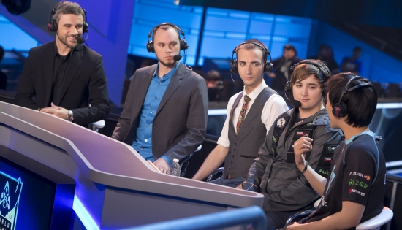
The link to traditional sports
Tom Paolillo
Many jobs involved
  Players
  Coaches
  Managers
  Commentators
  Analysts
  Journalists
The government is convinced[2]
Future development
  College and grade school teams
http://static.ongamers.com/uploads/original/0/3/3881-monte1.jpg (Oct 1, 2014)
Notes:
As with traditional sports, the industry opens more opportunities than just those for the players. Each team of course has players but also has a manager that makes executive decisions about benching and trading players and also has a coach to give strategic advise and help the team improve. Events also open positions for commentators to talk over live games and discuss the actions players are taking, analysts to give pre-game and post-game analyses, and journalists to interview players and write articles about the events. When an spectator sport becomes an industry like this, it’s no longer just about the players, but also everyone involved with running events and providing entertainment.
To the people who might not mind the idea of professional gaming but wouldn’t take it so far as to call it a sport, the US government has actually ruled in its case already. Because it can be a hassle for professional players from Europe, Asia, and other continents and countries to enter the United States to play in tournaments, the esports manager of Riot Games made a case for esports players to be treated as professional athletes. After a long back and forth, the government agreed with the legitimacy of the claim and allowed athletic visas to esports players to make traveling to the U.S for events less of a hassle.
Because the industry is no where near as developed as traditional sports, there aren’t many organizations in place to help promote these career paths. Hopefully in the near future, with the scene will expand and include some things to get more people interested in professional esports. You’ve probably heard in sports movies things like talent scouts will be at the big game looking to recruit players, and things of this nature. It’s possible and probable that esports eventually get to this point where there are college teams and competitions that actively search for talented players and offer scholarship money to them. As it becomes more ingrained into society, hopefully more recreational teams for young children up through high school become more prevalent.

Slide 16
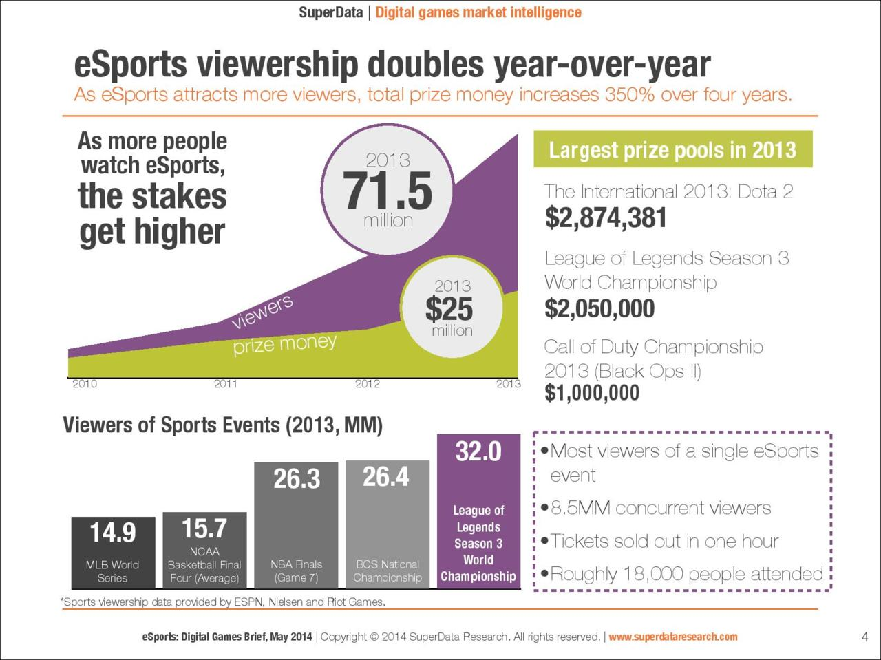
The demand for eSports
Tom Paolillo
Huge following[3]
Grown 3.5 times larger in 3 years[3]
Substantial payouts[3]
Live streaming
Televised events[4]
http://www.ongamers.com/articles/report-more-than-70-million-people-watch-esports-worldwide/1100-1157 (Sept 27, 2014)
Notes:
Despite not having much coverage or being taken very seriously by mass media, professional gaming has a substantial following. Last year, there was a combined viewership of 71.5 million people across the major esports championship events, the largest single event being the League of Legends world championship, bringing in 32 million viewers. When compared to large event of traditional sports like The Super Bowl, which had 117.7 million viewers[5], or the FiIFA World Cup, which had 715.1 million viewers[6], professional gaming as of now falls short. However, as a very new industry, rapid growth is expected and already observable.
This year is expected to have even more viewers as the trend shows viewership has increased more than 3 fold between 2010 and 2013.
There is also a great monetary incentive for these players, with top events offering millions of dollars in winnings.
There is such a demand for watching professional play that many players stream their practices live online and make ad revenue for it.
Countries that already have a developed Esports scene like Sweden and South Korea already have events televised like traditional sports.

Slide 17
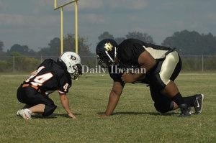
Why is it so popular?
Tom Paolillo
Pros
  There’s few physical advantages
  Easier to pick up and practice
  More convenient
Cons
  Equipment[7]
http://www.iberianet.com/sports/big-or-small/article_0ef8936b-02b7-518a-afc9-0ca001d27a22.html (Oct 1, 2014)
Notes:
Lets say you were playing someone in a game of basketball. If you were twice as skilled as them but they were 2 feet taller than you, they have an inherent advantage. In the picture on the right, which player is more likely going to be a more effective football player? Despite being in the same age range, one is 6 foot 4 and 400 pounds while the other is 4 foot 9 and 140 pounds [8]. While traditional sports require physical training and conditioning, there are natural advantages certain body types have over others. Esports reduce this bias significantly because the only physical limitations are having two functional hands (which some people still are able to get by without). The training still exists in honing skills of precision, accuracy, and reflexes, but the baseline is an even playing field for the most part.
Because esports games are played online with people all over the world, it is easier to learn a game and become experienced with it than it is for a traditional sport. In order to play a regulation game of basketball, you need to find 9 people willing to play, coordinate a time that works for everyone, and find an open court to play in. With an online game, a game can be found within minutes either with random people or coordinated with friends. This allows people to play more often and with people of different skill levels. This also allows the professional scene to evolve faster because new talent doesn’t take long to develop. A person playing a sport professionally has likely been playing for many years to get to where they are. A professional esports gamer might have discovered the game only 2 years ago, but has been able to practice so much so quickly that they can rival people who have played two to three timers longer than them.
This also makes playing more convenient. You can decide to play or not whenever you want, you aren’t bound by the schedules of yourself or other people. You don’t even have to leave the comfort of your own home, although you still have the option to. The activity can still be as socially active as traditional sports are, but it can also be a hobby that someone does just by them self, the allure here is there is a choice available.
One drawback of having worldwide connectivity is requiring the equipment to do that. Where in a sport you might need a few dollars for a ball and some protective gear, gaming systems can costs hundreds of dollars. On top of that, internet service is required, buying the games themselves is required, and system maintenance is required. However, we live in a world that is ever expanding with technology, and luxuries like these are often affordable by a great majority of people.

Slide 18
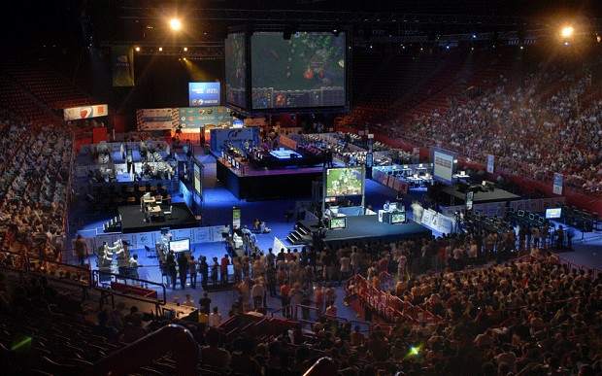
Conclusion
Tom Paolillo
Integration is imminent
  Ease of access
  Level playing field
  Extremely fast growth
http://www.telegraph.co.uk/technology/video-games/10132883/Video-games-the-sport-of-the-future.html (Oct 1, 2014)
Notes:
Esports’ ease of access and level playing field appeals to a wide audience and makes it easy to get involved with either as a casual or competitive player. With the extremely rapid growth and acceptance of esports, I believe it’s completely possibly to see it televised and presented as a viable career path in the near future similar to a career in traditional sports.

Slide 19
References
Tom Paolillo
[1] Eric Johnson, What Are eSports? A Pro Videogaming Guide for the Rest of Us, http://recode.net/2014/06/22/what-are-esports-a-pro-video-gaming-guide-for-the-rest-of-us/(Sept 29, 2014)
[2] Paul Tassi, The U.S. Now Recognizes eSports Players As Professional Athletes, http://www.forbes.com/sites/insertcoin/2013/07/14/the-u-s-now-recognizes-esports-players-as-professional-athletes/ (Oct 1, 2014)
[3]Rod Breslau, More than 70 million people watch epsorts worldwide, http://www.ongamers.com/articles/report-more-than-70-million-people-watch-esports-worldwide/1100-1157 (Sept 28, 2014)
[4] Leah Jackson, The Rise of Esports in America, http://www.ign.com/articles/2013/07/25/the-rise-of-esports-in-america (Sept 28, 2014)
[5] Anthony Riccobono, Super Bowl 2014 Ratings: How Many People Watched The Seattle Seahawks Vs. Denver Broncos?, http://www.ibtimes.com/super-bowl-2014-ratings-how-many-people-watched-seattle-seahawks-vs-denver-broncos-1552989 (Oct 2, 2014)
[6] FIFA World Cup, http://www.fifa.com/aboutfifa/worldcup/ (Oct 2, 2014)
[7] Jared Wynne, Starting a New Esports Scene isn’t Easily Done, http://www.oneworldsports.com/blogs/starting-new-esports-scene-isnt-easily-done/ (Oct 1, 2014)
[8] Chris Landry, Big or Small, http://www.iberianet.com/sports/big-or-small/article_0ef8936b-02b7-518a-afc9-0ca001d27a22.html (Oct 1, 2014)

Slide 20
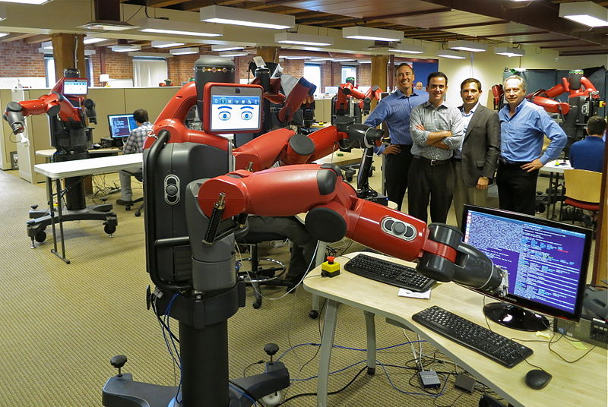
AUTOMATION of the Computer Science Industry
Andrew Ray
Computers that Learn
Programs that Write other Programs
Is it good for us?
  Why is it hard to know yet?
<http://commons.wikimedia.org/wiki/File:Caught_Coding_(9690512888).jpg>
Notes:
“Automation of the Computer Science Industry”
The book refers to “futurists [who] warn that advances in artificial intelligence and robotics will lead to massive unemployment in the not-too-distant future.”
I’m apparently one of those people.
Covering: Computers that learn, programs that rewrite themselves, programs that write other programs, Is this good for us? and why is it hard to know?

Slide 21

Computers that learn
Andrew Ray
Wall Street [1, 2]
  Who trades stocks? Computers.
Baxter [3]
  A Robot that anybody can control.
NASA Spacecraft [2]
  Currently takes more than 10 hours to patch bugs.
<https://kategale.wordpress.com/tag/wall-street/>
Notes:
People say, “Computers can’t learn” – they can.
Who trades stocks at Wall Street? Not people.
Computers that taught themselves to.
Jake Loveless & Amrut Bharambe wrote the first one in 2003 according to a report by Jake Loveless. Since then, fewer people have been trading stocks, and exponentially more computers have.
The stock market today is almost entirely computers.
The stock market is too complicated to try to program in all the states manually, so having a computer learn on its own is ideal in this situation.
Baxter: A Robot that can be trained by anybody
Nobody needs to program it specifically to do something
Already commercially available
Trainers just need to move the arms and tell it “do this” and it will. No computer science person required.
NASA Spacecraft:
Right now, when a spacecraft malfunctions, it has to send a message home to earth, where a programmer fixes the problem and releases the patch. 10 hours later, the problem is solved. If the spacecraft could reprogram itself, then this process could be simplified in most cases. Adrian Stoica at NASA’s Jet Propulsion Laboratory is working on doing this. If the system can be fixed by itself, then this delay can be sharply reduced; additionally, no people are required to do this.

Slide 22
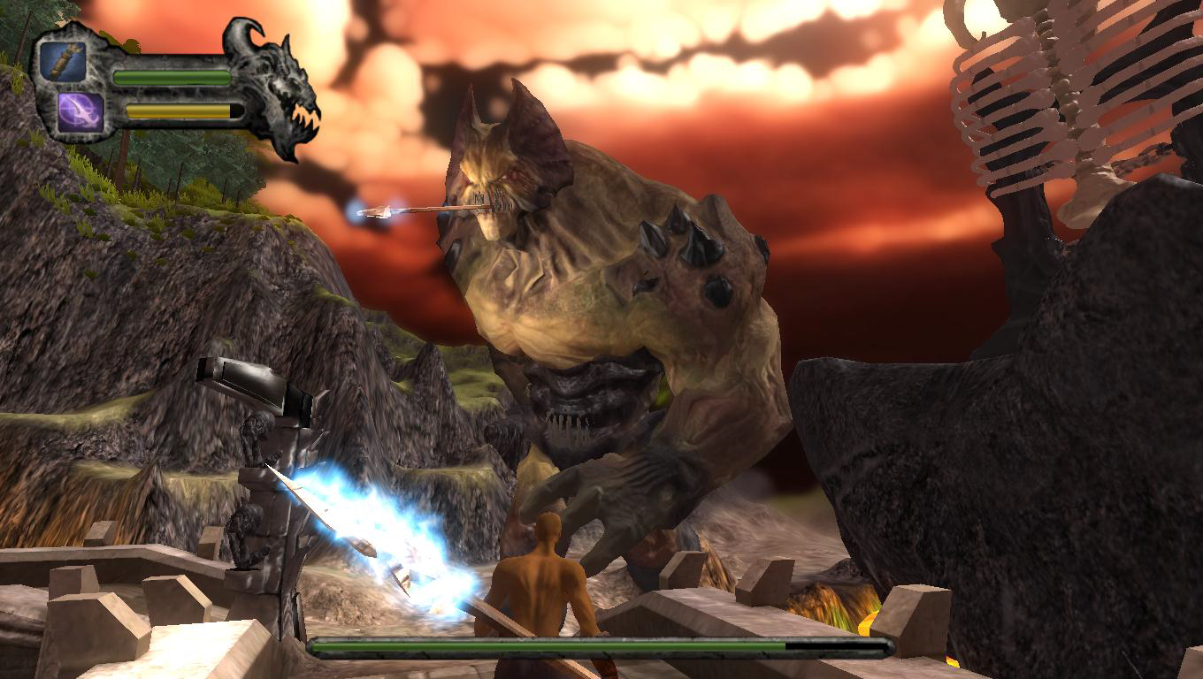
Programs that Rewrite Themselves
Andrew Ray
Obsidian [4]
IBM’s Watson [5]
Image From the Obsidian Project Report
Notes:
Obsidian:
An IMGD MQP in 2011. Sole focus is to beat the boss. Start the game, fight the boss. Essentially a boss-fight game. Uses an adaptive AI for the boss monster that rewrites itself using a genetic algorithm (will mention later). Based on what is most effective, the boss continues to modify itself.
IBM Watson:
Probably heard of Watson when he won Jeopardy.
Actually a doctor. Reads medical research and adds to and edits its code and databases based on it.
No computer scientist (or doctor) required to program medical research into the system.

Slide 23
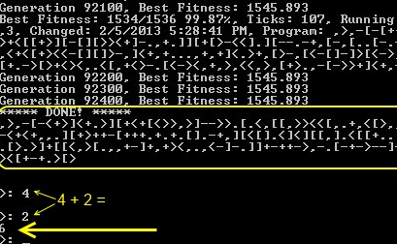
Programs that Write Other Programs
Andrew Ray
,>,-[-<+>]<+.
  Addition of numbers
  Other programs written by the same program
Genetic Writing [7]
  Make all single-unit changes
  Use the fitness function to evaluate
  Choose the best one
  Repeat
<http://www.primaryobjects.com/CMS/Article150.aspx>
Notes:
Programs that write other programs
The program shown adds two numbers together after taking them as input and prints their sum as shown in the command line window.
It doesn’t matter if there’s extra stuff after the end; trivial to remove extra by taking characters off the end and seeing if the result changes.
The program that wrote this code is particularly interesting because given different fitness functions, it can write a wide variety of programs. In addition to the adding program, it wrote a “Hello World program,” a “Hello <username>” program, and a subtraction program as well. A program that does not need to be rewritten to do a specific task, unlike the stock market program, can be reused; no computer scientist required.
In genetic writing, the computer does a fitness search of all possible single-unit changes.
In Brainf***, the single-unit change is one character.
The fitness function is an indicator of accuracy. A more accurate program will evaluate higher on the fitness function.
Repeat until fitness is 100% (or equivalent). In theory, genetic algorithms can also be used to generate not just a program that does what is asked, but also the most efficient program that does what is asked, something that human programmers cannot always do on the first or second try.

Slide 24
Scary?
Andrew Ray
This all sounds good, right?
However…
  Fewer jobs will be available in the industry.
  The job description will be more about writing these adaptive AI’s and genetic algorithms and the fitness functions than conventional programming.
  These computer programs may replace the rest of us.
Still to soon to know for sure.
Notes:
So… is this scary? It all sounds good.
However…
Recurring theme: No computer science person required.
Those jobs that remain will be mostly writing adaptive AI’s and genetic programmers that are better than older ones, and writing the fitness functions for the genetic algorithms.
Other CS jobs will be replaced by these genetic programs.
It is really too early to predict the full implications of this upcoming change, since there are not yet programs that are writing large-scale code.
On that note… questions?

Slide 25
References
Andrew Ray
[1]. CGP Grey. Humans Need Not Apply. YouTube, August 13, 2014. https://www.youtube.com/watch?v=7Pq-S557XQU, October 1, 2014.
[2]. Dennis Shasha. The Changing Nature of Invention in Computer Science. ACM, September 30, 2014. Webinar.
[3]. Rethink Robotics. “Baxter with Intera 3.” Rethink Robotics.http://www.rethinkrobotics.com/baxter/, October 1, 2014.
[4]. Sean Beck, Richard Pianka, Ryan Chadwick, Douglas Turcotte, Patrick Knight. Obsidian. WPI, April 27, 2011. http://www.wpi.edu/Pubs/E-project/Available/E-project-042711-203938/, September 30, 2014.
[5]. IBM. “Why Cognitive Systems?” IBM. http://www.research.ibm.com/cognitive-computing/why-cognitive-systems.shtml#fbid=BaV3wU_mwGD, October 1, 2014.
[6]. Kory Becker. “Pushing the Limits of Self-Programming Artificial Intelligence.” Primary Objects, March 4, 2014. http://www.primaryobjects.com/CMS/Article150.aspx, October 1, 2014.
[7]. Kory Becker. “Using Artificial Intelligence to Write Self-Modifying/Improving Programs.” Primary Objects, January 27, 2013. http://www.primaryobjects.com/CMS/Article149.aspx, October 1, 2014.

Slide 26
Class 11
The End
Keith A. Pray
Instructor
socialimps.keithpray.net
Notes:
This is the end. Any slides beyond this point are for answering questions that may arise but not needed in the main talk. Some slides may also be unfinished and are not needed but kept just in case.

Slide 27
My Reading Notes
pp.
pp.
pp.
pp.
pp.

