Slide 1
Class 9
Errors Failures Risks
Keith A. Pray
Instructor
socialimps.keithpray.net
Notes:
Here’s the title slide. Excited already, aren’t you?
What errors?
Who looked for existing test strategies?
Who looked for directions on how to test currency?
Paper Reminders:
Use #’s and facts instead of “great, a lot, numerous, many, most, much…”
Avoid absolutes unless quoting facts “always, never, must, will…”
Make organization clear, avoid CP R, CP R through out whole paper.

Slide 2
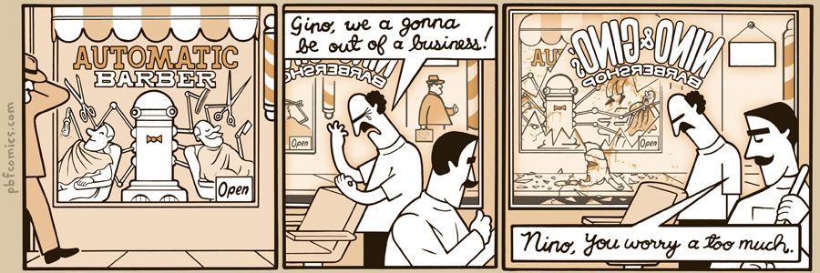
http://pbfcomics.com/197 (2014-09-26)
Notes:
10 – Errors, Failures, Risks

Slide 3
Overview
Review
Assignment
Students Present
Guest Speaker
Notes:
We can also discuss articles listed on Security Discussions under documents of course web site.
ADD QUIZ AS BACKUP IF CLASS DISCUSSION OR GUEST SPEAKER FAIL

Slide 4
My Reading Notes
pp. 362 Any false arrests since 1989?
pp. 368 This is not to keep the system from responding to false alarms.
pp. 371 Always encapsulate units!
pp. 373 Why did they refuse?
pp. 376 Republicans and Florida.

Slide 5
Assignment – 1 Page Paper
From Chapter 9 In-class Exercises # 24.
Should the company produce the game?
Use the SWE Code Of Ethics as the basis for your argument.
The SWE Code of Ethics should not be the sole source for your premises.

Slide 6
Overview
Survey
Review
Assignment
Students Present

Slide 7
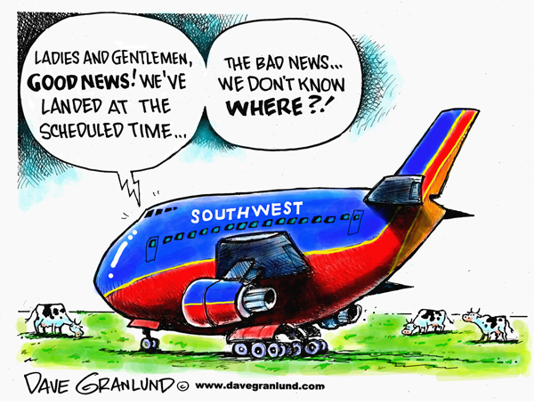
Aircraft system failure
Jun Liang
What are the concerns for aircraft system?
  Why?
16% of pilot errors caused by aircraft software system failures.
http://static.guim.co.uk/sys-images/Guardian/Pix/pictures/2014/6/24/1403621541410/6244011b-9ba9-4fcb-b22d-f6f48675956b-460x276.jpeg
Notes:
For this question, I think the answers should be reliability and robustness.
Reliable means the program gives you correct result; robust means the program is running without exception.
About 16% of pilot errors caused by aircraft system failures.
Other reasons are weather issues and mechanical failures.

Slide 8
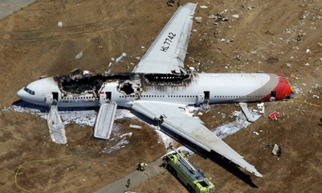
pilot error
Jun Liang
Pilot error is a decision, action or inaction by a pilot determined to be a cause or contributing factor in an accident or incident.
Pilot error can be a mistake, oversight or failure to exercise due diligence by pilots during the performance of their.
http://www.davegranlund.com/cartoons/wp-content/uploads/Southwest-pilot-error1.jpg
Notes:
Pilot error is a decision or action by a pilot.
Pilot error can be a small mistake or lapse in judgment during the flight.

Slide 9
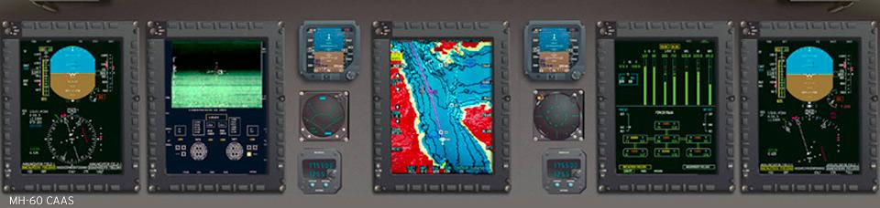
Avionics software
Jun Liang
Embedded software with legally mandated safety and reliability concerns used in avionics
The main difference between avionic software and conventional embedded software is that the development process is required by law and is optimized for safety.
http://www.presagis.com/solutions/military_commercial_avionics_software_development_design/
Notes:
<speaker notes>

Slide 10
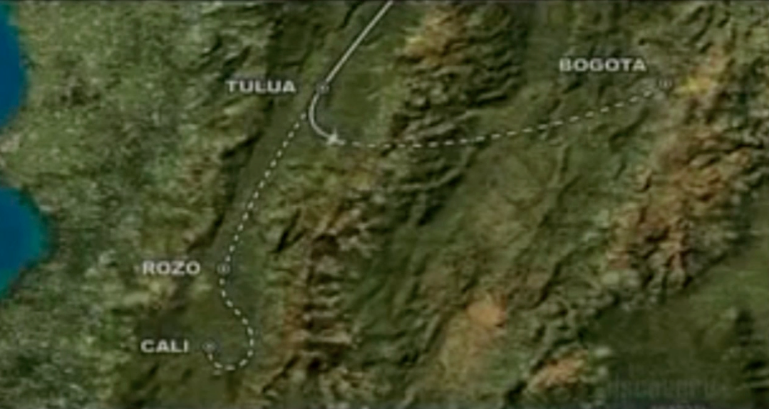
American Airlines Flight 965
Jun Liang
It was a scheduled flight from Miami (U.S.) to Cali (Colombia).
Crashed into a mountain in Buga, killing 151 passengers and 8 crew members.
The Colombian police determined it was caused by navigational errors by the flight crew.
http://code7700.com/images/american_airlines_965_flight_track.png
Notes:
<speaker notes>

Slide 11
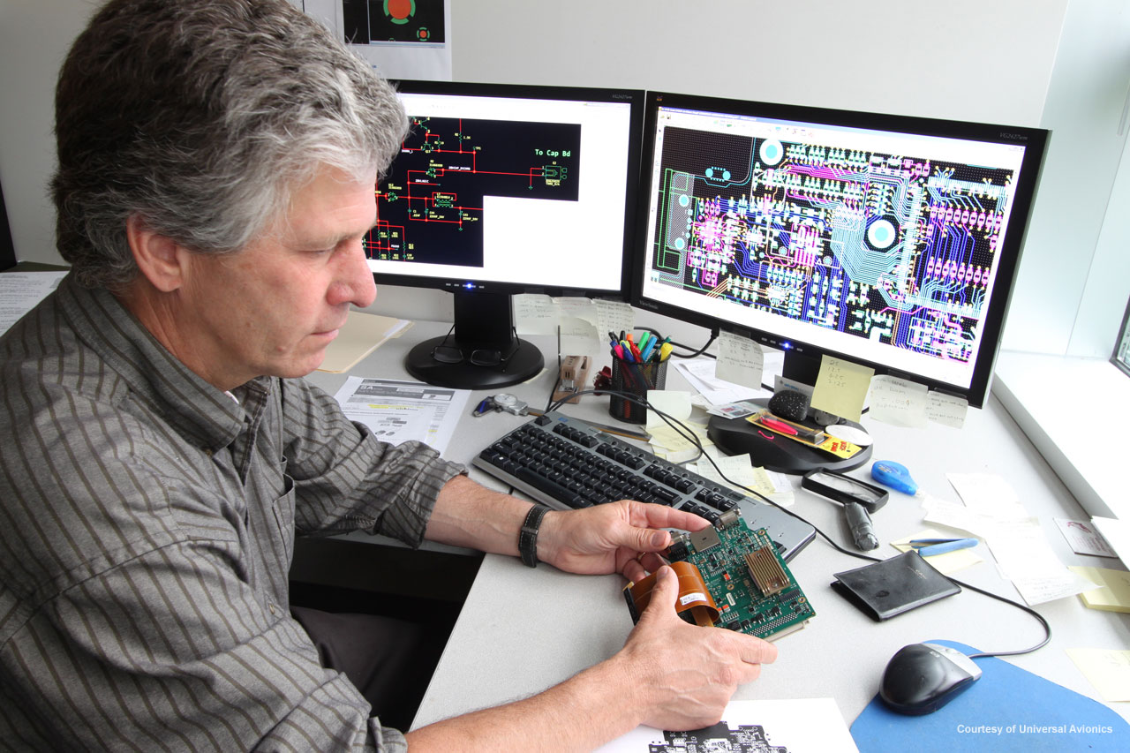
Development Process
Jun Liang
Human interfaces
Hazard analysis
Maintenance manual, Design and specification documents
Code production and review
Unit testing
Integration testing
http://arizonaexperience.org/sites/arizonaexperience.org/files/base_images/space-based_engineering-2.jpg
Notes:
<speaker notes>

Slide 12
References
Jun Liang
[1] Woodward Aircraft Flight Control Systems, //www.woodward.com/airframeflightcontrols.aspx (Sep 24, 2014)
[2] Military & Commercial Avionics Software Development & Design, http://www.presagis.com/solutions/military_commercial_avionics_software_development_design/(Sep 24, 2014)
[3] Safety- and security-critical avionics software, http://www.militaryaerospace.com/articles/print/volume-22/issue-2/technology-focus/safety-and-security-critical-avionics-software.html (Sep 24, 2014)
[4] Colombia Aeronautica Civil, Controlled Flight Into Terrain, American Airlines Flight 965, Boeing 757-223, N651AA, Near Cali, Colombia, December 20, 1995 (Prepared by University of Bielefeld, Germany (Sep 24, 2014)
[5] Publitek Marketing Communications, Developing Reliable Software for Avionics, Military, and Space Applications, http://www.digikey.com/en/articles/techzone/2014/may/developing-reliable-software-for-avionics-military-and-space-applications (Sep 24, 2014)
[6] Causes of Fatal Accidents by Decade, http://www.planecrashinfo.com/cause.htm (Sep 24, 2014)

Slide 13
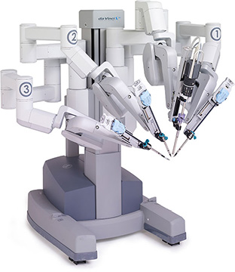
The DaVinci Robot
Brian Rubenstein
What is the DaVinci robot? [1]
Concerns about safety.[2]
Should the DaVinci robot be used?
Who should be responsible upon failure?
(n.d.). Retrieved September 21, 2014, from http://www.winthrop.org/departments/institutes/family/ob-gyn/robotic-surgery/daVinci-Si-HD-Surgical-System/davinci-robot.jpg
Notes:
Who here knows what the DaVinci robot is? (Show of hands)
For those who don’t know, the DaVinci robot is a robot with four robotic arms created to assist with surgery. One of these arms holds a three dimensional camera to allow the surgeon see what they are working on, and the others are equipped with miniaturized wristed instruments for doing the operation.[1,4] However, there have been some concerns over its safety and reliability. [2]
The two questions I will be analyzing in this presentation are: Should the DaVinci robot be used in hospitals, and should failure occur, who should be responsible, the surgeon or Intuitive Surgical, the company that makes DaVinci?

Slide 14
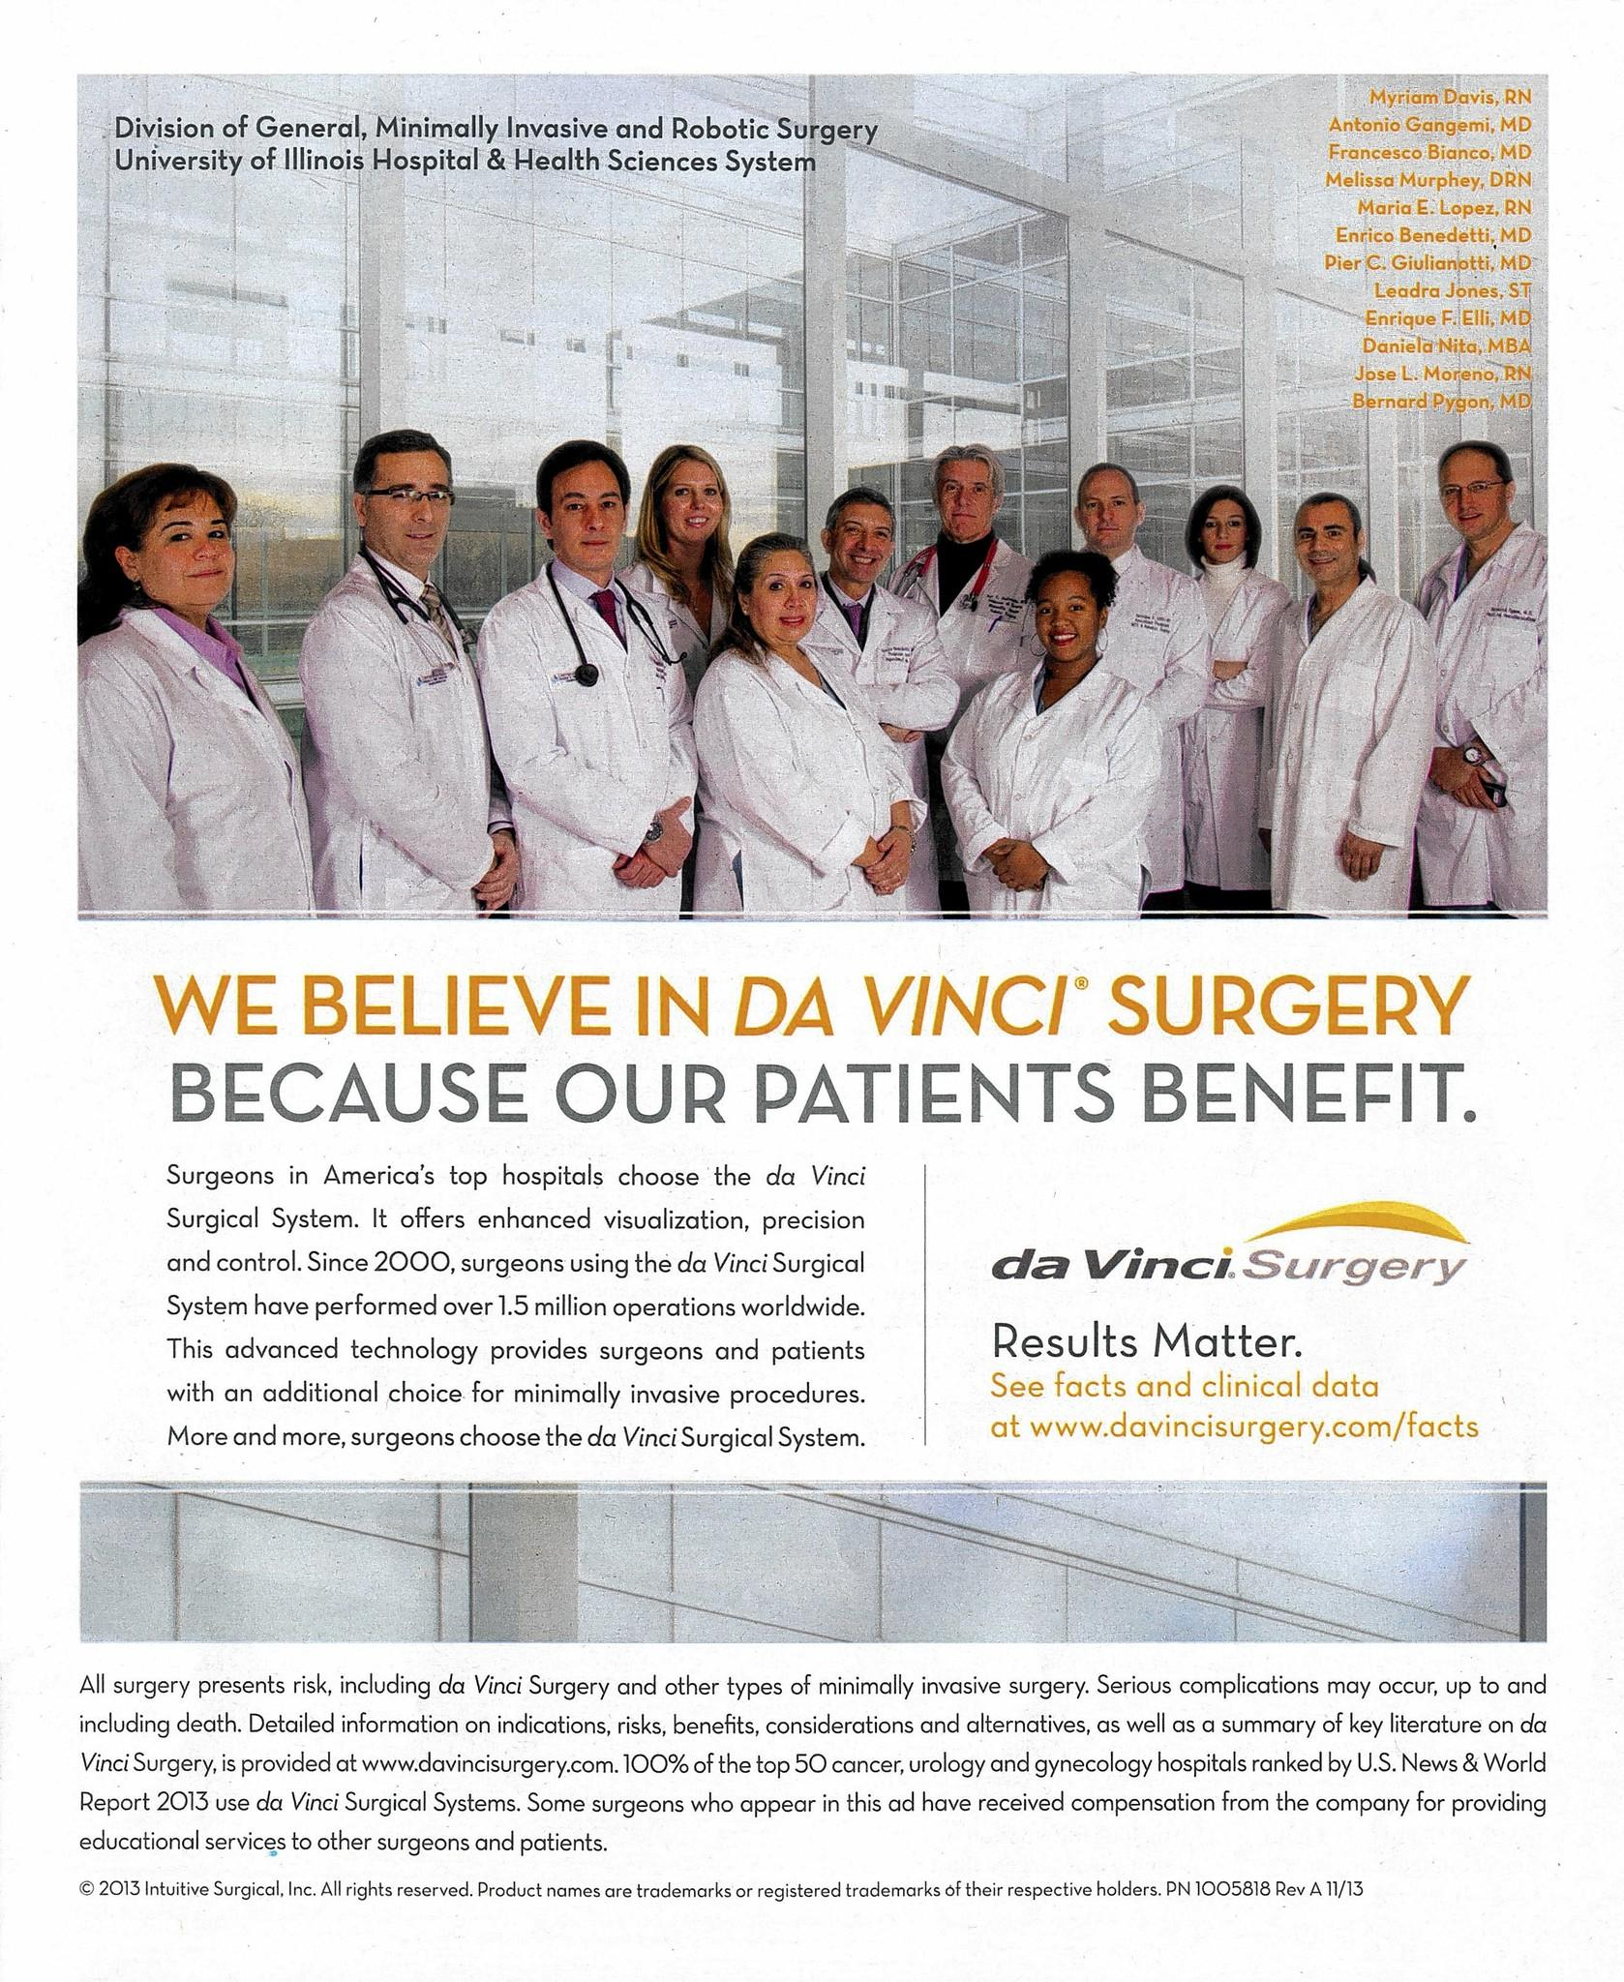
Cons of the DaVinci Robot
Brian Rubenstein
When does failure occur?
Issues with cost
How much of the reported benefit is from company advertisement?
Improper use and ill training
(n.d.). Retrieved September 25, 2014, from http://www.trbimg.com/img-530585f6/turbine/ct-met-aj-uic-robots-0220-jpg-20140219/2048/1678x2048
Notes:
There have been many studies and surveys regarding the use of the Davinci robot.
There was a survey done in 2010 that found that 56.8% of all of the surgeons surveyed anonymously had experienced irrecoverable operative malfunctions while using the DaVinci robot
However, in a study done at the University of Chicago Pritzker School of Medicine, they found that in 725 robot-assisted laparoscopic radical prostatectomies, surgeon handicap occurred in only 3 cases (0.4%), and four patients had their procedures aborted due to initial set up problems (0.5%). They also looked at the data reported by Intuitive Surgical and found that only four out of 807 cases had resulted in an aborted or converted case [3].
It is clear that there is a huge difference in these numbers.
It could be that some of this is due to company advertising, or it could be that the surgeons who use DaVinci perform enough surgeries using it that they are bound to experience at least one failure.
Another reason for these issues could be lack of training. In 2010, a New England Journal of Medicine essay by a doctor and a health policy analyst wrote that surgeons must do at least 150 procedures to become adept at using the DaVinci system.[5] If surgeons are not trained then the risk of failure is higher.
Another con of the DaVinci robot is its price. The robot costs around 1.45 million dollars per robot, plus around one hundred thousand in service agreements each year. [5]

Slide 15
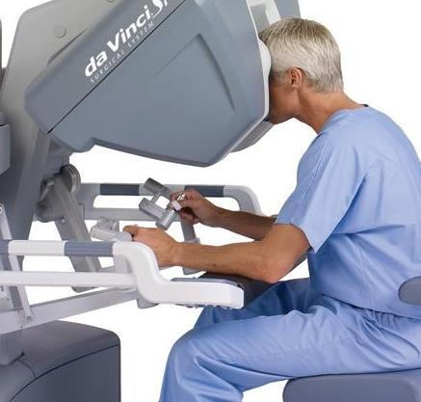
Benefits of DaVinci
Brian Rubenstein
Accuracy
Tremble-free
3D camera
No autonomous control
Automatic shutdown
(n.d.). Retrieved September 21, 2014, from http://www.bogg.com/custom/images/davinci-surgeonconsole-crop.jpg
Notes:
On the other hand, there are a number of benefits to the DaVinci system.
The first is the accuracy of the system. Due to a ‘tremble-free’ mechanism built into the robot, minute shaking and trembling in the hands is less likely to cause an issue. [1] The goal of this is to reduce unintended movements to make the surgery more precise than a human hand could be.
These operations are often less tiring for the surgeon as well. This leads to less of a chance of failure due to weariness.
These two combined means that advocates of the system have been saying that people who get the surgery are often sent home earlier and with less bleeding.[5]
Another thing that the DaVinci robot is designed to do is run thousands of checks on itself every second, and if anything is wrong it will shut off. It is also designed to do nothing without input from the surgeon, which means that there is no chance of autonomous control going wrong.
Overall, there is enough redundancy built into the robot that the chances of something going wrong in a skilled surgeon’s hands is minute.

Slide 16

Conclusion
Brian Rubenstein
The Da Vinci Surgical System should be used
The surgeon should be held responsible in the case of failure
Report system
(n.d.). Retrieved September 25, 2014, from http://www.cluepoints.com/sites/default/files/15.jpg
Notes:
State conclusion: The DaVinci robot should be used in hospitals provided that the surgeon has been trained in its use. Should failure occur, in most situations the surgeon should be held responsible, not the company that makes DaVinci.
My conclusion is that the DaVinci robot should be used provide that the surgeons have been trained in its use. Should failure occur, in most situations the surgeon should be held responsible, not the company that makes DaVinci. Added on to this is the fact that there should be someone trained in regular surgery on hand in case something goes wrong and the system shuts down. This builds more redundancy into the system.
If there is an error in the robot, it needs to be reported. Reporting an issue to the FDA can help mitigate future issues.

Slide 17
References
Brian Rubenstein
[1] The da Vinci® Surgical System. (n.d.). Retrieved September 24, 2014.
[2] New Concerns on Robotic Surgeries. (n.d.). Retrieved September 24, 2014, from http://well.blogs.nytimes.com/2013/09/09/new-concerns-on-robotic-surgeries/?_php=true&_type=blogs&_r=0
[3] Zorn, K. (n.d.). Da Vinci robot error and failure rates: Single institution experience on a single three-arm robot unit of more than 700 consecutive robot-assisted laparoscopic radical prostatectomies. Retrieved September 24, 2014.
[4] Products. (n.d.). Retrieved September 24, 2014, from http://www.intuitivesurgical.com/products/
[5] Surgical robot da Vinci scrutinized by FDA after deaths, other surgical nightmares. (n.d.). Retrieved September 24, 2014.

Slide 18

Software failure case study
Zachary Richards
Bugs are present in all software
Depending on the application, bugs can have a different effect on the system
Application’s purpose dictates the robustness that is expected
What are some extreme consequences of software defects?
Should there exist a set of software quality standards (similar to building/electrical codes)?
http://code-ninja.org
Notes:
No software is defect free, not necessarily a good thing either,
Want to get software out the door asap, customers can live with minor bugs that are fixed later, would rather have
Core functionality
A bug in a missile defense system is going to be more harmful than a bug in a word processor
Software building codes, i.e. similar to the ones that exist for construction workers, electricians, plumbers, etc.

Slide 19


Two Major Vulnerabilities and their Consequences
Zachary Richards
1983 Soviet nuclear false alarm incident
2014 Heartbleed bug
http://www.cia.gov, http://www.heartbleed.com
Notes:
There have been bugs in both open and closed source production software that have had, or could have had enormous consequences.

Slide 20
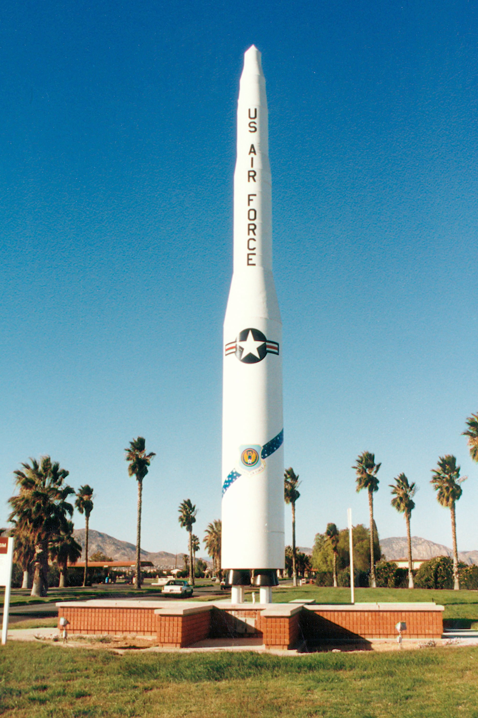
1983 Soviet Nuclear False Alarm Incident
Zachary Richards
September 26, 1983
Stanislav Petrov, Commander of the Serpukhov-15 Nuclear Bunker
A Soviet satellite sent a signal to the bunker, warning that the US has launched a nuclear missile at the Soviet Union
Then the system reported that 4 more Minuteman ICBMs were launched
http://www.skytamer.com
Notes:
31 years ago today
The satellite weighed the signal against static, and confirmed that a missile had been launched
His role was to report to his superiors if he felt that a counter-attack should be launched

Slide 21
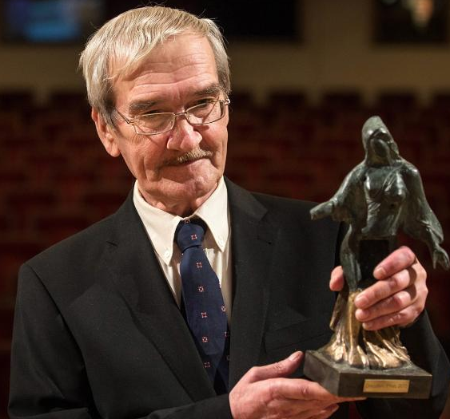
1983 Soviet Nuclear False Alarm Incident (cont’d)
Zachary Richards
He did nothing
Concluded that the report must be false
Software bug caused the false report
Software picked up the sun’s reflection from the tops of clouds and mistook for a launch [4]
Petrov was neither punished nor rewarded by the Soviets
http://dagbladet.no
Notes:
He said, “Why would they only launch 5 missiles? You could do little damage with 5 missiles” [4]
The program that was supposed to filter out the sun’s reflection was rewritten and didn’t work properly
Could have literally destroyed the entire Northern Hemisphere
Awarded the World Citizen Award by the San Francisco based association of world citizens in 2004, along with a trophy for his actions

Slide 22
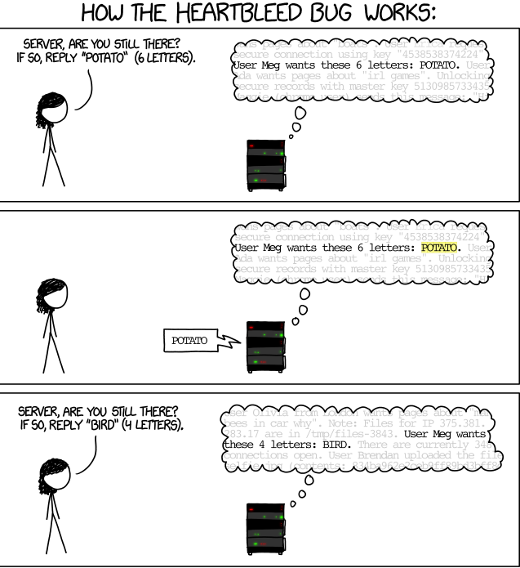
2014 Heartbleed Bug
Zachary Richards
An exploit of the Heartbeat feature in OpenSSL
Introduced in December 2011
Discovered on March 21, 2014
Fixed on April 7, 2014
Allowed the attacker to read up to 64k of the server’s memory
http://xkcd.com/1354/
Notes:
OpenSSL, implements basic cryptographic functions and provides various utility functions for sending data securely across the internet [6]
The heartbeat feature ensures the server that the client is still online (alive) [5]
Discovered on or around March 21 (initial discovery was extremely secretive to prevent as much use of the exploit as possible [7]
April 1: Email sent to OpenSSL’s core team members alerting them that the bug was present. And urged a fix ASAP
April 4: rumors began to circulate of a bug in OpenSSL
Couldn’t control which 64k block of the server’s memory
This is the proper function

Slide 23
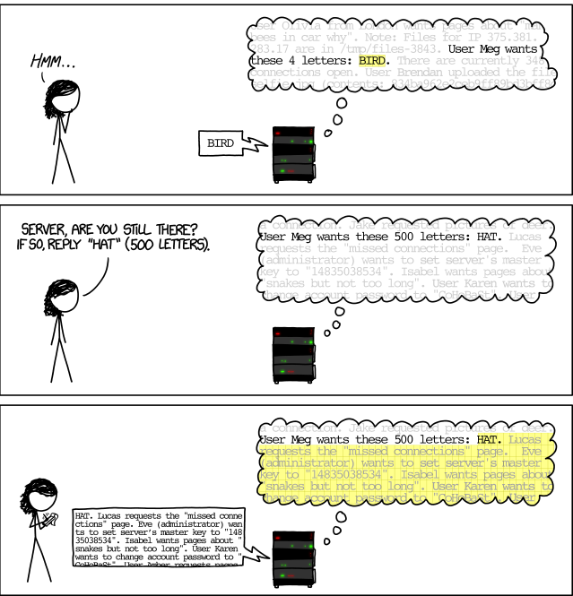
2014 Heartbleed Bug
Zachary Richards
Affected companies:
  Google
  Facebook
  Yahoo!
  Netflix
  YouTube
  WPI
Fortunately, no major US financial institutions were affected
http://xkcd.com/1354/
Notes:
Exploited functionality
Meg is able to view the unencrypted extremely sensitive data
No way of knowing if it was exploited or not.
The attack left no trace in the log files
Patching didn’t remove the vulnerability as attackers could have stolen encryption keys
WPI Was affected but no action was required by students, faculty or staff [8]

Slide 24
Conclusion
Zachary Richards
Vulnerabilities in software have the potential to cause a lot of damage
Open source software, and most closed source software has limited to no warranties
Quality is improving rapidly
Software has no cross-industry “building codes”
would be very difficult to create and apply to the entire industry
Extreme care must be taken when using software for critical purposes
Notes:
Software doesn’t have cross industry building codes:
It is bad practice to duplicate software, not the same with buildings
Software is a rapidly developing industry
New software has never been done before so standards don’t exist for it yet
Requirements and technology are changing extremely rapidly
Currently existing quality codes govern

Slide 25
References
<Your Name>
[1] Software Quality and Standards, Bednar & Robertson, September 20, 2014, http://www.inf.ed.ac.uk/teaching/courses/seoc2/2004_2005/slides/quality.pdf
[2] Licenses, September 21, 2014, http://choosealicense.com/licenses/
[3] Nick Health, Why open source software development is getting more secure, http://www.techrepublic.com/article/open-source-vs-proprietary/
[4] ‘I had a funny feeling in my guy’, David Hoffman, http://www.washingtonpost.com/wp-srv/inatl/longterm/coldwar/shatter021099b.htm
[5] Heartbleed FAQ, April 14, 2014, http://thehackernews.com/2014/04/heartbleed-bug-explained-10-most.html
[6]openssl.org
[7] Heartbleed bug timeline, Ben Grubb, http://www.smh.com.au/it-pro/security-it/heartbleed-disclosure-timeline-who-knew-what-and-when-20140415-zqurk.html
[8] http://www.wpi.edu/Admin/IT/News/servicesalert.html#newsitem1397126108,66953,

Slide 26
Class 9
The End
Keith A. Pray
Instructor
socialimps.keithpray.net
Notes:
This is the end. Any slides beyond this point are for answering questions that may arise but not needed in the main talk. Some slides may also be unfinished and are not needed but kept just in case.

Slide 27
Reliability Of Statistics
Are other factors controlled?
Is enough time covered?
Is all data reported?
Use Intuition
  Are results reasonable?
Notes:
Power line dangers. Electromagnetic fields? PCBs in transformers?

Slide 28
Cost-Benefit Analysis
How much does it cost?
What do I get for this cost?
Notes:
Like a social contract.

Slide 29
Risk-Benefit Analysis
What could go wrong?
How likely is it?
How costly are the consequences?

Slide 30
Limitations to
Risk-Benefit Analysis
Hard to quantify probabilities
Hard to quantify costs
Who bears the costs?
Are the potential benefits worth it?
Notes:
What is the value of a human life?
What is the value of a species?
E.g. future generations, poor people.
Omelas

Slide 31
Some Measures
Mean Time To Failure (MTTF)
Mean Time Between Failures (MTBF)
Mean Time To Repair (MTTR)
Notes:
Is it repairable?
What does it mean to repair? Running again? Data fixed? Caught up?
Restoring the GBC Web site.

Slide 32
Relying Too Much
Limits of modeling reality
Limits of precision
Limits of algorithms
Limits of interpretation
Notes:
Battle of the X-Planes
Trusting the statistics. Are differences significant?
Colin Chapman’s Lotus 7 chassis.

Slide 33
Producing Good Software
Good specifications
Good usability
Good design
Robustness
Good implementation
Testing
Notes:
Specs: Know what you are going to do. Often difficult. What does the customer want? What does the customer need?
Usability: Logical and intuitive, Consistent, Helpful, Complete, Accessible, Disability. Complete—not have to write things down.
Design: Logical, Modular, Consistent, Well-specified, Flexible, Extensible, Adaptable, New features, new platforms.
Robustness: Tolerant of data errors, Tolerant of human errors, Tolerant of network errors, Enough detail / not too much. Stack trace vs. “?” “A script error has occurred. Do you want to debug?”
Implementation: Adequate hardware (E.g. memory, storage, speed), Adequate software (Languages, OS, libraries), Internal and external documentation
Testing: Should be at all phases of the development cycle. Plan ahead for it. Consistent, repeatable, documented. Regression testing.

Slide 34
Plan For The Long Term
Version control
Future development
New platforms
Patches
Security
Training
Customer support

