Slide 1
Class 7
Privacy
Keith A. Pray
Instructor
socialimps.keithpray.net
Notes:
After this class we will be half done with the course… very sad I know.
Play Somebody’s Watching Me – Rockwell

Slide 2
Overview
Survey
Review
Assignment
Students Present

Slide 3
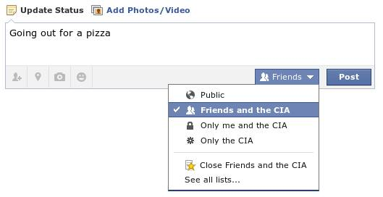
Notes:
Source?

Slide 4
My Reading Notes
pp. 274 Arrests, altering and deleting records are violations of privacy?
pp. 275 Why not try to verify and correct records?
pp. 277 300 times = frames, locations, …?
pp. 289 “…don’t want anyone to know…” like seeking medical advice, etc.?
pp. 291 Just because it’s been happening for years doesn’t make it right.
pp. 297 Wouldn’t it be easy to make and show a fake SSN card?
pp. 298 Confusing false positive and negative explanations.
End of Chapter questions: 1, 31, 51

Slide 5
Group Quiz
List two problems with using biometrics for identification.
List two advantages of using biometrics for identification.
Describe two tools people can use to protect their privacy on the Web.
For Daniel Solove’s taxonomy of privacy give an example not listed in the book of the 4 categories.

Slide 6
Assignment
One Page Paper
Will eliminating anonymity make computers more secure?
Sources could include legislation not covered in your text concerning computer related crimes.
Notes:
Perhaps skip this one in favor of working on group projects? Yes, let’s do that.

Slide 7
Overview
Survey
Review
Assignment
Students Present

Slide 8
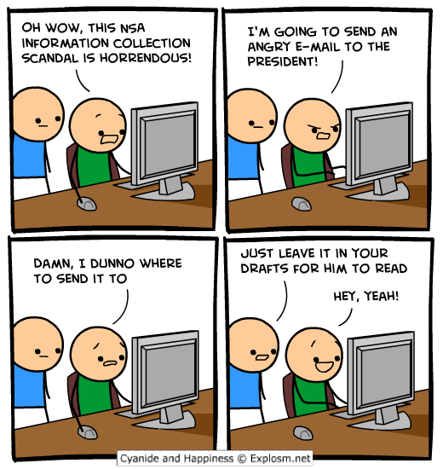
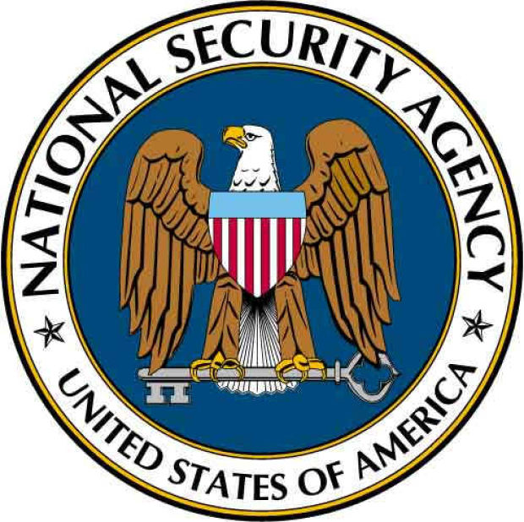
Does the nsa make us safer?
Alec Benson
Created out of necessity.
The NSA deserves a place in our government..
But it should be kept under check.
http://explosm.net/comics/3201/ (Sep 17th)
http://bloximages.chicago2.vip.townnews.com (Sep 19th)
Notes:
With all the recent news about the NSA, it’s important to understand what is going on.
I will be answering the question, “does the NSA make us safer?”
1. How did the NSA start, and is its mission still relevant today?
Is the NSA’s surveillance effective?
If there is increased safety due to the NSA’s efforts, do the benefits justify the invasion of our privacy?

Slide 9
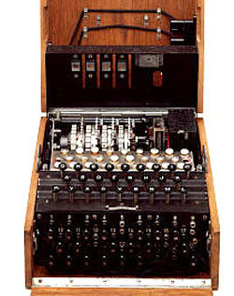
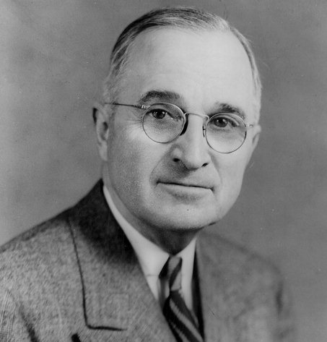
How was the nsa formed?
Alec Benson
November 4th, 1952 [1]
  Established by president Truman
World has just emerged from WWII
  Enigma machine (right)
Continue code-breaking efforts [1]
http://0-www.pbs.org.librus.hccs.edu/wgbh/nova/military/how-enigma-works.html (Sep 17th)
http://i2.wp.com/listverse.com/wp-content/uploads/2007/12/harry-truman.jpg (Sep 17th)
Notes:
Before we can decide whether or not the NSA continues to serve its purpose, it is important to understand how it came about.
Created by President Truman following World War II.
Codebreaking played an incredibly important role in the war.
The United States realized that being able to protect ideas, develop codes, and crack the enemy’s messages was extremely important to keeping its people safe.
NSA is formed in 1952 in an effort to continue this research and development.
During this time, the US is invading Korea.
Being able to provide reliable intelligence to troops in the field gave the U.S. a large strategic advantage.
PICTURED:
Enigma Machine, broken in 1941.
President Harry Truman, who established the NSA

Slide 10
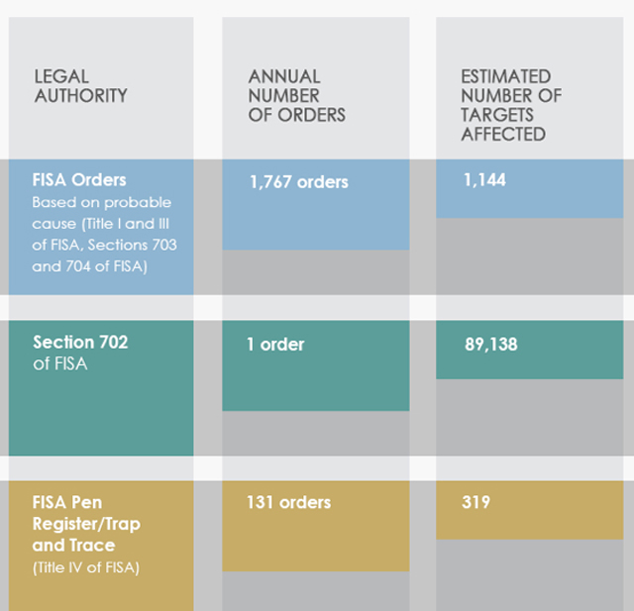
The NSA Today
Alec Benson
NSA works very closely with the military.
Intercepts over 1.7 billion messages everyday [2]
Only a small portion of this surveillance goes through due process
[3] http://www.forbes.com/sites/gregorymcneal/2014/06/27/nsa-releases-new-statistical-details-about-surveillance/ (Sep 17th)
Notes:
What does the NSA do today?
Still works closely with the military. That much has not changed. But..
In 2013, the agency released details on the number of surveillance orders it placed for the year.
-Claimed to have filed approximately 2,000 surveillance orders affecting 90,000 people for the year
But in contrast, the Washington Post recently reported that the NSA intercepts over 1.7 billion messages each day. So, of all the information collected, only a small portion requires due process.
How do you even manage 1.7 billion pieces of information each day? Keep it focused and individualized.
Goes to show that the power of the NSA isn’t being kept in check as much as I think it should be (though you are free to disagree)

Slide 11
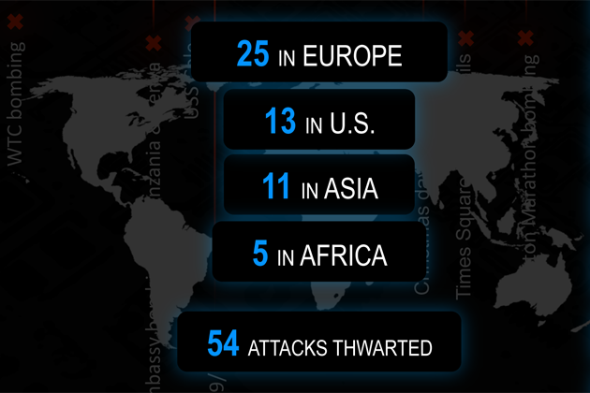
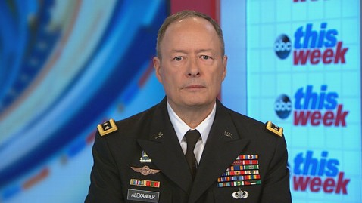
The nSA Today
Alec Benson
Allegedly thwarted 54 potential threats [4].
  Not all ‘plots’ related to the U.S.
  Later admitted that “they weren’t all plots and they weren’t all foiled” [6].
  Only one or two plots were discovered through bulk phone call collection [6].
http://www.propublica.org/article/claim-on-attacks-thwarted-by-nsa-spreads-despite-lack-of-evidence (Sep 18th)
http://a.abcnews.com/images/Politics/abc_keith_alexander_this_week_jt_130623_wblog.jpg (Sep 19th)
Notes:
In 2013, General Keith Alexander reported that the government surveillance programs thwarted 54 known threats.
But later that year, he admitted that not all of the 54 plots were domestic, and that he agreed that they “weren’t all plots and they weren’t all foiled”.
Gen. Alexander additionally admitted that only “one or two” of these plots were discovered through bulk phone call collection.

Slide 12
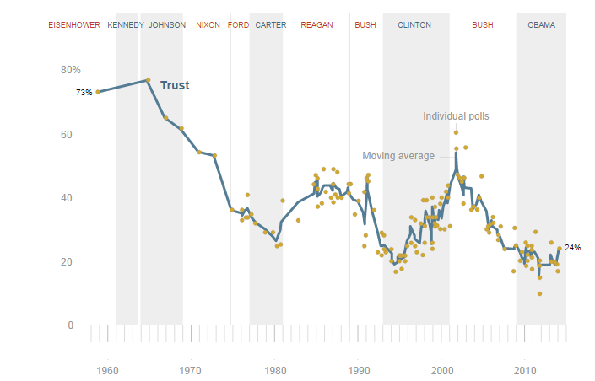
Keeping the nsa in check
Alec Benson
Increasing distrust in government [6]
  Start – 1958
  Dip in 1980
  Spike after 1991 Gulf War
  General distrust in ‘94
  Spike after 9/11
Counterproductive?
[6] http://www.people-press.org/2013/10/18/trust-in-government-interactive/ (Sep 17th)
Notes:
So it shouldn’t surprise you that there has been an increasing distrust in our government.
Counterproductive to foster a distrustful relationship with the people you’re trying to protect.
Starting high: question first asked in 1958.
Bottom of first dip: 1980 – economically hard times brings government trust down to 25%
First spike since 1980: Beginning of the Gulf War in 1991 brings a brief increase in governmental trust.
Second Spike after 9/11
Steady decline since.

Slide 13
Conclusion
Alec Benson
NSA still deserves a place in our government.
Needs to work on gaining the trust of the people.
Needs to be kept in check.
http://bloximages.chicago2.vip.townnews.com (Sep 19th)
Notes:
NSA still deserves a place in our government. If even one of those thwarted “threats” saved an innocent life, then it goes to show that the NSA’s efforts are worthwhile.
But, it also needs to gain the trust of it is people. Counterintuitive to anger the people you’re trying to protect.
While the NSA may keep us safe, it should be kept under control.
How?
-NSA needs to be made accountable and needs to be contained by checks and balances.
-Surveil based on case-by-case suspicions
-Collection doesn’t need to be made publically available, but it shouldn’t take a whistleblower to reveal the extent of the NSA’s surveillance operations

Slide 14
References
Alec Benson
[1] Frequently Asked Questions About the NSA, https://www.nsa.gov/about/faqs/about_nsa.shtml (September 17th)
[2] Priest, Dana & Arkin, William M, A Hidden World, growing beyond control, http://projects.washingtonpost.com/top-secret-america/articles/a-hidden-world-growing-beyond-control/3/ (September 17th)
[3] McNeal, Gregory, NSA Releases New Statistical Details About Surveillance, http://www.forbes.com/sites/gregorymcneal/2014/06/27/nsa-releases-new-statistical-details-about-surveillance/ (September 17th)
[4] Kube, Courtney, NSA chief says surveillance programs helped foil 54 plots, http://usnews.nbcnews.com/_news/2013/06/27/19175466-nsa-chief-says-surveillance-programs-helped-foil-54-plots (September 18th)
[5] Waterman, Shaun, NSA chief’s admission of misleading numbers adds to Obama administration blunders, http://www.washingtontimes.com/news/2013/oct/2/nsa-chief-figures-foiled-terror-plots-misleading/?page=all (September 18th)
[6] Public Trust in Government: 1958-2013, http://www.people-press.org/2013/10/18/trust-in-government-interactive/ (September 17th)

Slide 15

Cryptocurrencies and Privacy
Thomas Clark
Cryptocurrencies are not a catch-all safety for privacy, but their existence shows that privacy is something people care about.
http://www.reddit.com/r/Bitcoin/comments/18smyy/ideas_for_rbitcoin_ads/c8hmtr2
Notes:
What is cryptocurrency?
Cryptocurrency is a form of digital currency where, rather than having a database of account balances, the entire system is distributed.
Without going too much into detail, cryptography is used to verify any transactions that take place.
The computing power to verify transactions is spread out over many clients, removing the need for a central server.
So, no single point of failure, and there's also no person or company that controls a cryptocurrency.
15

Slide 16
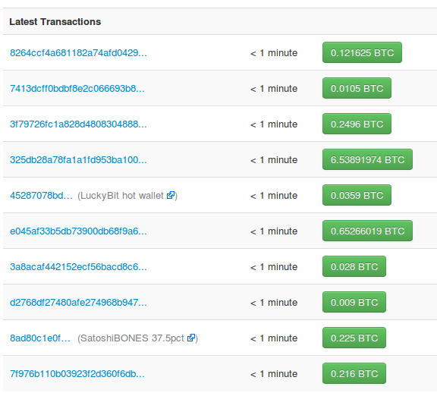
Cryptocurrency
Thomas Clark
What is “cryptocurrency”
A cryptocurrency is a decentralized currency that uses cryptography
Designed for anonymous transactions [1]
www.blockchain.info
Notes:
With cryptocurrencies such as Bitcoin, all transactions are publicly available to everyone, but you don't have to disclose your actual identity.
This shows a recent part of the Bitcoin blockchain, which is a record of all Bitcoin transactions that have ever taken place.
It includes hashes, but not names. This isn't just an implementation detail, it's important because it means the system can be distributed among all users' machines without everyone knowing who each other is.
Crypocurrency was designed for anonymous usage.
16

Slide 17
Privacy
Thomas Clark
All transactions are public
Identities don't have to be public
No central watchdog [2]
www.blockchain.info
Notes:
This allows some amount of privacy when making transactions.
So, it seems ideal for circumventing government data mining, if you have an ethical opposition to it.
One can avoid invasive government actions when purchasing goods and services.
Of course, cash can accomplish the same thing to some extent, but cryptocurrency allows consumers to do this online. This allows privacy to be more convenient, and also means that no one even has to see you.
17

Slide 18
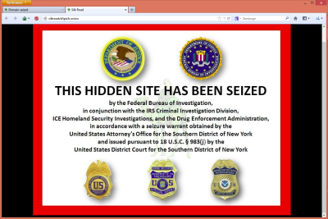
Illegal usage
Thomas Clark
Popular for illegal goods
Silk Road was shut down [3]
http://tctechcrunch2011.files.wordpress.com/2013/10/silkroad_domain_seized.png
Notes:
Possibly a downside of the privacy that cryptocurrencies grant, illegal use of them is popular.
Silk Road was a deep-web site where people exchanged Bitcoins, typically for illegal drugs and guns.
Silk Road was shut down by FBI, and the owner was arrested. Since this didn't stop Bitcoin, it shows that people are interested in cryptocurrency because they like the idea of privacy, not just to use illegally.
On the other hand, the fact that the FBI caught the owner shows that the privacy features aren't perfect.
18

Slide 19
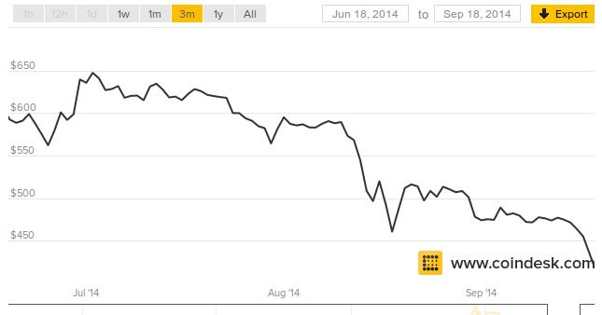
Privacy – The downside
Thomas Clark
Not regulated by the United States government
Services have shut down without compensating users
No insurance or standards for banks [4]
http://www.coindesk.com/price/
Notes:
Because of the anonymous nature of cryptocurrency, they are hard to regulate.
There is no equivalent of the FDIC.
Mt. Gox was a service that provided an on-line wallet for Bitcoin users, and a convenient place to exchange different virtual currencies.
Mt. Gox shut down their website without returning the contents of their users' wallets. They claimed they were hacked and could not afford to pay everyone back.
Services like Mt. Gox have no legal obligation to keep cryptocurrency wallets safe, since they're not real banks.
This is one contributing factor in making people lose confidence in anonymous virtual currencies, which has had a negative impact on their value.
It might be worth giving up some privacy to the government for the financial safety
19

Slide 20
Conclusion
Thomas Clark
Cryptocurrencies have many practical issues, but their popularity shows an interest in privacy from the government
Notes:
In conclusion:
The way cryptocurrencies work in a distributed manner makes them very suitable for anonymous transactions, but the same anonymity introduces many practical concerns.
In addition, there has been evidence of government agencies catching criminals that operate with Bitcoins, so they may or may not even be safe from data mining.
However, the fact that there's a mainstream interest in a convenient method of private transactions shows that privacy is something people actually care about.
20

Slide 21
References
Thomas Clark
[1] Andy Greenberg, “Crypto Currency”, Forbes, http://www.forbes.com/forbes/2011/0509/technology-psilocybin-bitcoins-gavin-andresen-crypto-currency.html (Accessed Wed Sep 17 2014)
[2] Adam Hofman, “Stop Thinking Bitcoin is Just a New Kind of Currency”, Bitcoin Magazine, http://bitcoinmagazine.com/16297/stop-thinking-bitcoin-just-new-kind-currency/ (Accessed Thu Sep 18, 2014)
[3] Matt Burns, “FBI Seizes Deep Web Black Market Silk Road, Arrests Owner”, TechCrunch, http://techcrunch.com/2013/10/02/fbi-seize-deep-web-marketplace-silk-road-arrest-owner/ (Accessed Thu Sep 18, 2014)
[4] Cameron Keng, “Bitcoin Must Create a Community-Backed FDIC”, Forbes, http://www.forbes.com/sites/cameronkeng/2014/03/20/bitcoin-must-create-a-community-backed-fdic/ (Accessed Thu Sep 18, 2014)
[5] Rachel Abrams Matthew Goldstein and Hiroko Tabuchi, “Erosion of Faith Was Death Knell for Mt. Gox”, The New York Times, http://dealbook.nytimes.com/2014/02/28/mt-gox-files-for-bankruptcy/ (Accessed Thu Sep 18, 2014)

Slide 22
Class 7
The End
Keith A. Pray
Instructor
socialimps.keithpray.net
Notes:
This is the end. Any slides beyond this point are for answering questions that may arise but not needed in the main talk. Some slides may also be unfinished and are not needed but kept just in case.

