Slide 1
Class 3 Ethics
Keith A. Pray
Instructor
socialimps.keithpray.net
Notes:
Here’s the title slide. Excited again, aren’t you? You should be.

Slide 2
Logistics
Email both the TA and me, you’ll get a quicker response
Notes:
Email Etiquette – thoughts?

Slide 3
Overview
Group Project
Review
Ethics
Imaginary Societies
Assignment

Slide 4
Group Project Overview
Movie or Computing Technology?
Project Web Site
Analyze subject from the prospective of each topic covered in class
Critical Thinking, Ethics, and Professional Ethics are analysis tools, not topics
Movie: Explore each computing technology portrayed
Computing Technology: How technology portrayed in mass media?
Presentation
Give arguments for most salient conclusions drawn

Slide 5
Overview
Group Project
Review
Ethics
Imaginary Societies
Assignment

Slide 6
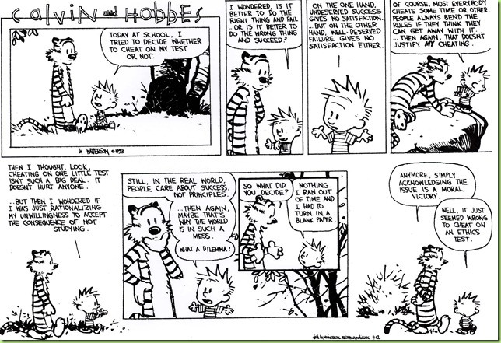

Slide 7
My Reading Notes
pp. 57 Does mention of Hitler invalidate the argument? - Mike Godwin
pp. 58 “Instincts were learned…”?
pp. 67 There’s no expectation the doctor’s practice would suffer?
pp. 80 Insurance companies do it, should they?
pp. 86 “individualism” contrary to Dalton Conley in Ch. 1 interview?
pp. 88 “mother’s right to privacy”?
pp. 96 Do most states have anti-texting while driving laws now?
pp. 99 Good to see using theories and seeing how many produce the same outcome
pp. 106 “…everyone…become…programmer” – Why is this an ethical issue?
End of Chapter questions I liked: 8, 9, 10, 11, 17, 18*, 41

Slide 8
Group Quiz Scenario 4 in Section 2.1.2
Do you recommend release next week ?
Raise your hand if you reasoned using:
Kantian
Act Utilitarian
Rule Utilitarian
Social Contract Theory
Virtue Ethics
Provide justification (argument)

Slide 9
Overview
Group Project
Review
Ethics
Imaginary Societies
Assignment

Slide 10
Rights
Where do they come from?
What are they?
“Life, liberty, and property” – Locke.
“Life, liberty, and the pursuit of happiness” – Jefferson.
Others?
How does one acquire a specific right?
E.g. ownership?
Types of rights
Negative (liberties)
Positive (claim-rights)
Notes:
God? Society? Government?
Privacy? Due process?
Turning natural resources into personal property.
Actions can be ethically mandatory, prohibited or acceptable.
Positive: someone else has to do something.
Examples?

Slide 11
Ethics Vocabulary
Deontological Theories
A.K.A. nonconsequentialist
Theory/study of moral obligation
Consequentialist Theories
Social Contract Theory
Virtue Ethics
A.K.A. Character Based Theory
Greek deon = duty
Emphasizes duty and absolute rules to be followed whether they lead to good or bad consequences.
Kant often primary example.
Rules should apply to everyone.
Good rules intrinsically follow logic. Follow reason not emotion to make decisions.
Treat people as an ends, not solely as a means. Respect for persons.
Notes:
Which formulation of the categorical imperative do you prefer?

Slide 12
Ethics Vocabulary
Deontological Theories
A.K.A. nonconsequentialist
Theory/study of moral obligation
Consequentialist Theories
Social Contract Theory
Virtue Ethics
A.K.A. Character Based Theory
Consequentialist
Main example is Utilitarianism.
Increase aggregate utility or happiness. How to measure?
Watch out for theories going to far; violating rights of a few for the “good” of the many.

Slide 13
Ethics Vocabulary
Deontological Theories
A.K.A. nonconsequentialist
Theory/study of moral obligation
Consequentialist Theories
Social Contract Theory
Virtue Ethics
A.K.A. Character Based Theory
Uses rights as basis, explains people’s selfishness in absence of common agreement, analysis of moral issues regarding people and government.
Characterization of actions can change outcome of analysis, does not solve conflicting rights,
Are laws based on ethics?
Are all laws ethical?
Notes:
From Wikipedia:
“Consent of the governed" is a political theory stating that a government's legitimacy and moral right to use state power is, or ought to be, derived from the people or society over which that power is exercised. This theory of "consent" is historically contrasted to the divine right of kings and has often been invoked against the legitimacy of colonialism. Following John Locke's notion of a nation of "free and equal" citizens, the Founders of the United States believed that consent of the governed was the only legitimate basis upon which one "free and equal" citizen could exercise legal authority over another -- otherwise neither equal could overcome the other.

Slide 14
Ethics Vocabulary
Deontological Theories
A.K.A. nonconsequentialist
Theory/study of moral obligation
Consequentialist Theories
Social Contract Theory
Virtue Ethics
A.K.A. Character Based Theory
Stresses character development and moral education, not formalized rules.
What kind of person should I be?
Depends on homogeneous community standards for morality.
Plato and Aristotle, more recently by Alasdair MacIntyre.

Slide 15
Ethical Actions
Based on belief that people are
Rational
Free to choose
Mandatory
Prohibited
Acceptable
Why does society care?
Why do individuals care?
Notes:
Harming someone else may be unavoidable.
Examples?

Slide 16
Utopias and Dystopias
Types:
Economic
Political
Technological
What makes it a utopia or dystopia?
Why do we create them?
Examples, real or fictional?

Slide 17
Overview
Group Project
Review
Ethics
Imaginary Societies
Assignment

Slide 18
Assignment Sign up for individual presentation
Current schedule at:
http://socialimps.keithpray.net
Do not wait until last minute
Slots start disappearing Tuesday
Send TA and me email
Specify your topic
By that I mean be specific.
It may take time to refine your topic
I’ll be happy to discuss your ideas

Slide 19
Class 3 The End
Keith A. Pray
Instructor
socialimps.keithpray.net
Notes:
This is the end. Any slides beyond this point are for answering questions that may arise but not needed in the main talk. Some slides may also be unfinished and are not needed but kept just in case.

