Slide 1
Class 14
Last Day
Keith A. Pray
Instructor
socialimps.keithpray.net
Notes:
Here’s the title slide. Excited already, aren’t you?

Slide 2
Overview
Course Evaluations
Students Present
Guest
Notes:
Fill time with Work Discussion on Course Web Site.

Slide 3
Course Evaluation
Write MY NAME and COURSE TITLE in box at top of form
  Keith A. Pray
  CS 3043 Social Implications Of Information Processing
Use only BLUE or BLACK ballpoint pen
Use an X to mark (Do NOT fill in box)
TA Name: Doug MacFarland
Course Evaluation return to Academic Advising Office in Daniels Hall with “Evaluation Sheet” cover letter.
TA Evaluation Form return to CS department: Fuller 233
Notes:
Instructor provided ranked questions: REMOVE IF NONE

Slide 4
Overview
Course Evaluations
Students Present
Guest
Notes:
Fill time with Work Discussion on Course Web Site.

Slide 5

Privacy and information security in China
Xia Li
Internet censorship in the People's Republic of China
“harmonized” - a Chinese expression that refers to online censorship of sensitive comments.
http://www.frontpagemag.com/wp-content/uploads/2013/03/china-censored-21.jpg, accessed 06 May, 2014
5
Notes:
Hi everyone, here is my presentation of privacy and information security in China.
As you may know, China has the censorship on the Internet.
And China had 618 million Internet users by the end of December 2013, a 9.5 percent increase over the year before and a penetration rate of 45.8%.
This is quite a huge population using the Internet, so there is no strange that the born of the Internet censorship,
Personally, I support the policy of the cencership on Internet users' behaviors.
Many people may have the opposite view with me since they thought everything they published online being censored, being deleted without their permission is the loss of freedom of speech which I totally agree.
Every statement people published on the Internet may be "harmonized" by the so-called administrators since their statements may violate some rules like involving sensitive political views or political dissents.
Even worse they will be forbiddened to speak out their own voice anymore if they have violated the rules several times before

Slide 6
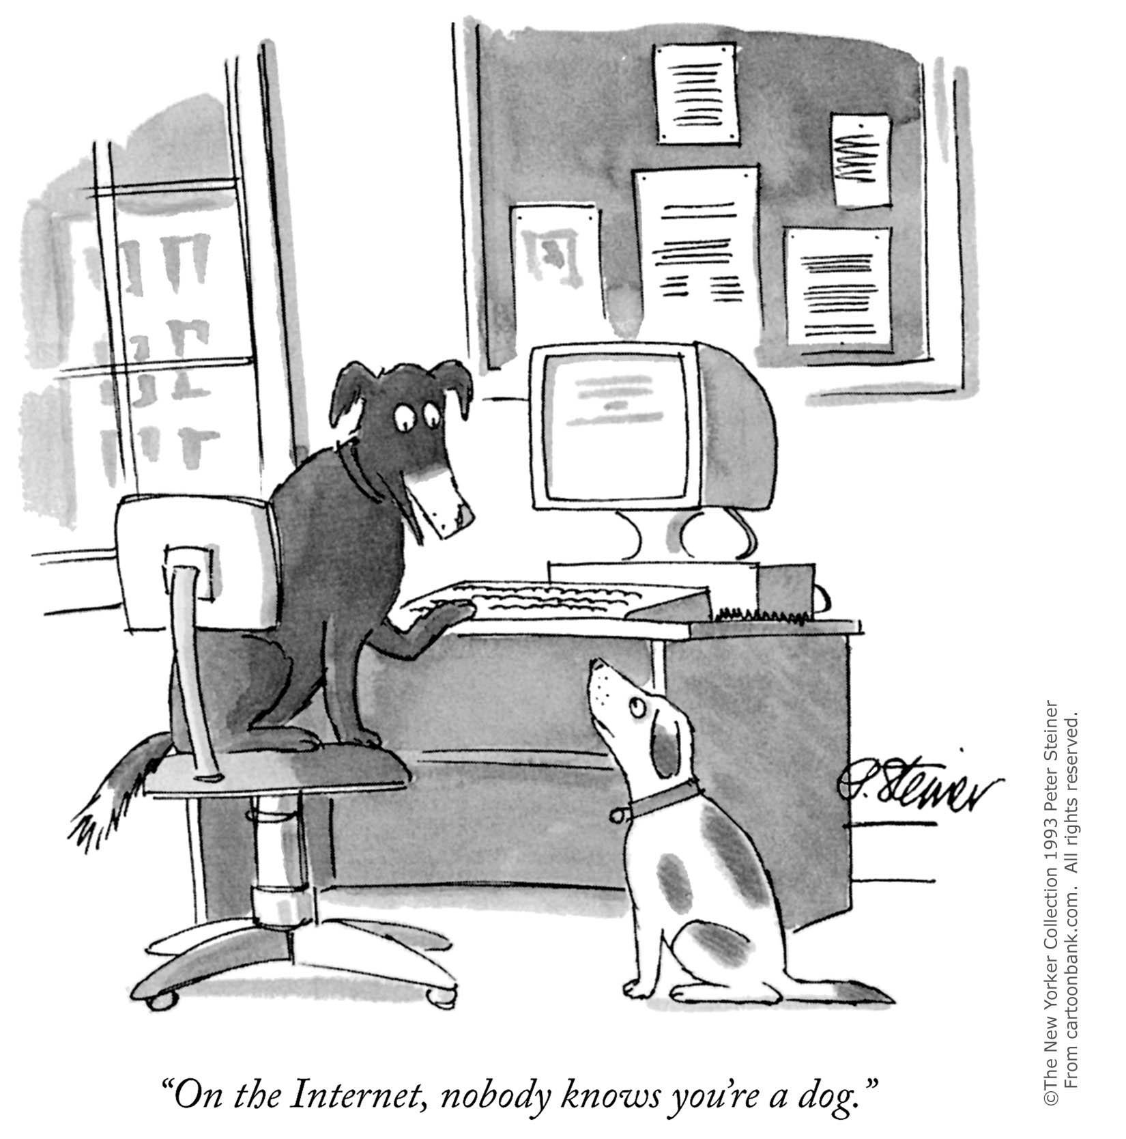
Real-Name Registration Online
Xia Li
Provide ID to access the Internet Cafes
Microblog website: Sina Weibo
6
Notes:
There are many different ways to carry out the censorship.
One of them is to require people using their real names to surf on the Internet.
The customers of the Internet Cafes need to provide their ID to be able to use the Internet. (From 2003)
Also there is a microblog website in China called Sina Weibo which is similar to Twitter.
Weibo is a country's widely popular microblog website which have become a major source of news for many Chinese since its convience of publishing and spreading news.
Every user in Weibo can be a journalist, publishing unofficial news or disclosing corruption of some government officials.
People may publish whatever they want and they may also believe what others post without questioning the credibility.
So this brings the problem of spreading rumors online.

Slide 7
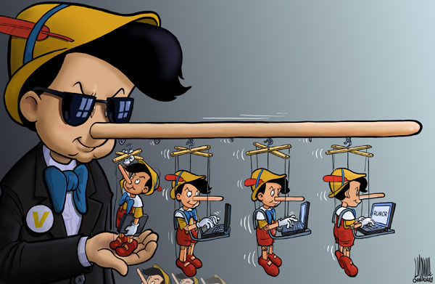
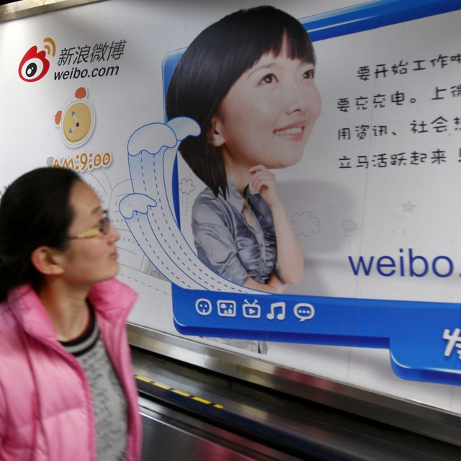
Spreading rumors
Xia Li
ds
China jails blogger for 3 years for "rumor-mongering"
http://images.china.cn/attachement/jpg/site1007/20130827/001ec949c22b13864e6303.jpg, accessed 06 May, 2014
http://titleimages.cir.ca/133/fc4a9bf34245b24823b164acc5c1.jpg
http://titleimages.cir.ca/133/fc4a9bf34245b24823b164acc5c1.jpg, accessed 06 May, 2014
7
Notes:
Advantages of the censorship online.
Limiting the spread of malicious rumors, pornography, swindles and other unhealthy practices on microblogs.
Chinese police arrest 45 people for spreading rumors online about terrotism attack in Kunming.
All the suspects have been arrested for "deliberately creating a panicked mood and disturbing social order, and will be dealt with according to the law and punished by public security".
The standard of being defined as a crime is the number of reposting reachs more than 500.
I think this is pretty essential for cleaning the network environment.
I have once bad experience that one of my family members was slandered by an online anonymous user.
The people who spread rumors was tracked and found eventually by the police. This person was not arrested since the number of those posts is not 500 enough.
But this brings quite a big influence on my family's daily life since this rumor not only attracts censors from the higher authorities but also brings bad effect on the repution.
----Background:
Xinhua ( China's official newswire) described the violence as "an organised, premeditated violent terrorist attack".
Attackers "separatists" from the ethnically riven north-west region Xinjiang.

Slide 8
Online censorship
Xia Li
Double-edged sword.
Comparing to Korea
8
Notes:
So the online censorship will delete the fake information and charge the publisher which is a good thing to the society.
But the government may hide some truth from common people in some accidents through censoring every delicate dialogues online.And th
Korea used to successfully implement the real name system since June.28 2009, but abolished this policy in August.23 2012 since the system does not seem to have been beneficial to the public. Despite the enforcement of the system, the number of illegal or malicious postings online has not decreased. Instead, users moved to foreign Websites and the system became discriminatory against domestic operators. It also prevented foreigners who didn’t have a resident registration number here from expressing their opinions online.
The public voice started to agree on the abolishment of a name-registration system because of the severe problem caused by information leakage. Now the official response from the administration is that they will supplement the certain regulations of personal information on the Internet.

Slide 9
Conclusion
Xia Li
Censorship can bring a purier network environment
The level of the censorship can be adjusted and it is loosened these years
9
Notes:
The censorship has a much stricter limitation few years ago.
But the limitation has been loosened more and more these years.

Slide 10
Sources
Xia Li
Jonathan Kaiman, "Chinese police arrest 45 for 'spreading rumours' online after knife attack" http://www.theguardian.com/world/2014/mar/06/chinese-police-arrest-rumours-online-knife-attack-kunming, (06 May, 2014)
VOA News, "People Turn to Web to Debate Chinese Censorship", http://www.voanews.com/content/chinese-censorship-debate-grows-online/1579645.html, (06 May, 2014)
World News, "China jails blogger for 3 years for "rumor-mongering", http://cir.ca/news/china-internet-rumor-law (06 May, 2014)
Michael Wines, "China Expands Program Requiring Real-Name Registration Online" http://www.nytimes.com/2012/01/19/world/asia/china-expands-program-requiring-real-name-registration-online.html?ref=global-home&_r=1& (06 May, 2014)
Adam Taylor, "China's War On Online Gossip Is Starting To Get Scary", http://www.businessinsider.com/china-is-waging-a-war-on-online-rumors-2013-8#!JwFL2 (06 May, 2014)
Tania Branigan, "China train station knife attack: police hunt suspects", http://www.theguardian.com/world/2014/mar/02/china-train-station-knife-attack-police-suspects (06 May, 2014)
10
Notes:
KAP Note: I needed to reformat slides since all used title slide layout despite guidelines and feedback.

Slide 11
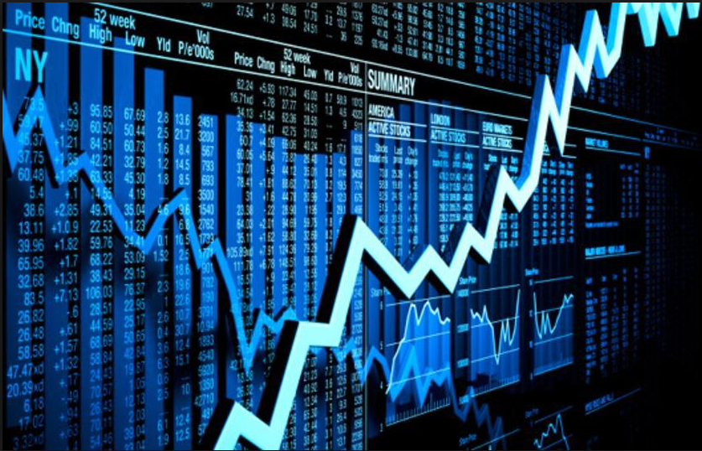
Automated Trading Systems
Youwei Hu
Traditional ways of trading
Popular way to trade nowadays
Future trend of Trading Systems
<Place citation here or at the end of slides.>
Notes:
Stock markets did not begin as the super-sophisticated, simultaneous, worldwide trading exchanges of today. It was not until 1531 when the first institution roughly approximating a stock market emerged. The first major technological invention came in 1832, when the telegraph was invented. This was a major achievement in communications, culminating in the appearance of the first financial newsletters. By 1856, when Western Union was founded, people from cities and towns outside of Wall Street were able to place orders and buy and sell securities. In 1866 first successful quotation device for gold prices was invented. It was a simple machine, which printed the prices on a continuous basis and in less than a year; The telephone made its first appearance on Wall Street in 1878 and, just as the ticker relayed price information to other parts of the city and nation, so the telephone could be used to buy and sell securities. After World War II, the invention of the computer that had an huge impact of machinery on Wall Street and the stock market which led to the way we trade nowadays.

Slide 12
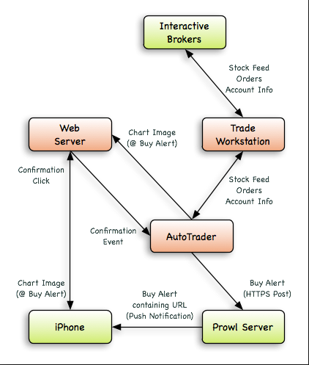
What is Automated Trading Systems?
Youwei Hu
Automatically submits trades to an exchange
Enable Traders to implement their strategy into the system
Difference between semi-automated full automated trading
Notes:
So what exactly is an automated trading system? An automated trading system (ATS) is a computer trading program that automatically submits trades to an exchange. They are designed to trade stocks, futures and forex based on a predefined set of rules which determine when to enter a trade, when to exit it and how much to invest in it. Therefore automated trading system enables traders to develop their own strategies and implement into the system so that the system can follow the pre-defined rules and conduct the trading by automatically. (Then Explain the graph a little bit). In fact, the graph above is semi-automated trading system. The difference between semi-automated and full automated system is that in a fully automated trading system, the program will be able to automatically upload data and transmit orders throughout the trading day or even orver many days, meanwhile, in a semiautomatic system, the trader still needs to manually press a button to transmit the orders at the appropriate time.

Slide 13
Advantages and Disadvantages of Automated Trading System
Youwei Hu
Advantages
Disadvantages
Minimize Emotions
Mechanical failures.
Achieve Consistency.
Over-optimization.
Improved Order Entry Speed.
Notes:
Automated trading systems minimize emotions throughout the trading process. By keeping emotions in check, traders typically have an easier time sticking to the plan. Since trade orders are executed automatically once the trade rules have been met, traders will not be able to hesitate or question the trade.
One of the biggest challenges in trading is to plan the trade and trade the plan. Even if a trading plan has the potential to be profitable, traders who ignore the rules are altering any expectancy the system would have had. There is no such thing as a trading plan that wins 100% of the time – losses are a part of the game. But losses can be psychologically traumatizing, so a trader who has two or three losing trades in a row might decide to skip the next trade. If this next trade would have been a winner, the trader has already destroyed any expectancy the system had. Automated trading systems allow traders to achieve consistency by trading the plan.
Markets can move quickly, and it is demoralizing to have a trade reach the profit target or blow past a stop loss level – before the orders can even be entered. An automated trading system prevents this from happening.
Depending on the trading platform, a trade order could reside on a computer – and not a server. What that means is that if an Internet connection is lost, an order might not be sent to the market. There could also be a discrepancy between the "theoretical trades" generated by the strategy and the order entry platform component that turns them into real trades.
Though not specific to automated trading systems, traders who employ backtesting techniques can create systems that look great on paper and perform terribly in a live market. Over-optimization refers to excessive curve-fitting that produces a trading plan that is unreliable in live trading.

Slide 14
Conclusion
Youwei Hu
This new method of trading is getting more and more popular
Although there is a possibility of Machine failure, automated trading system is desirable
Notes:
As of the year 2010 more than 70% of the stock shares traded on the NYSE and NASDAQ are generated from automated trading systems.
From my own experience from the IQP project, the team put our own theories into practice by scientifically developing a trading system that an average citizen can use to improve their trading. And the result was that 28 of the 30 stocks back tested would have generated a net-profit if traded during the testing period.
Even if Machine fails….

Slide 15
Sources
<Your Name>
Joshua Ritchie, MintLife Blog. Retrieved May 6, 2014, from https://www.mint.com/blog/investing/the-history-of-the-stock-market
Wyckoff, Peter, Wyckoff, Peter. Wall Street and the Stock Markets, Chilton Book Company, Philadelphia, 1972.
Jean Folger, The Pros And Cons Of Automated Trading Systems. Retrieved May 6, 2014, from http://www.investopedia.com/articles/trading/11/automated-trading-systems.asp

Slide 16
Overview
Course Evaluations
Students Present
Guest
Notes:
Fill time with Work Discussion on Course Web Site.

Slide 17
Class 14
The End
Keith A. Pray
Instructor
socialimps.keithpray.net
Notes:
This is the end. The slides beyond this point are for answering questions that may arise but not needed in the main talk. Some slides may also be unfinished and are not needed but kept just in case. In this particular presentation there are no further slides but it will say this on The End for most of them so I figured I’d get you ready for it now.

