Slide 1
Class 11
Work
Keith A. Pray
Instructor
socialimps.keithpray.net
Notes:
Here’s the title slide. Excited already, aren’t you?

Slide 2
Overview
Work
Assignment
Students Present
Notes:
Fill time with Work Discussion on Course Web Site.

Slide 3
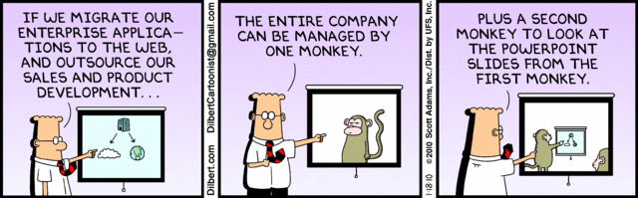
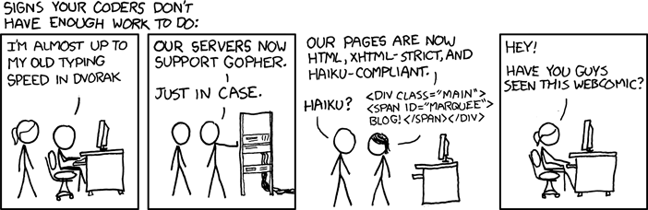
http://xkcd.com/554/

Slide 4
Group Quiz
List 2 ways IT can lead to organizational change.
List 4 ways a Video Game Producer may protect its IP and what specific IP each protects.
List a computing technology that can be used to protect an individual’s privacy.
List a computing technology that can be used to intrude upon an individual’s privacy.

Slide 5
Overview
Work
Assignment
Students Present
Notes:
Fill time with Work Discussion on Course Web Site.

Slide 6
Assignment
See Group Project Details Slide Deck.

Slide 7
Overview
Work
Assignment
Students Present
Notes:
Fill time with Work Discussion on Course Web Site.

Slide 8
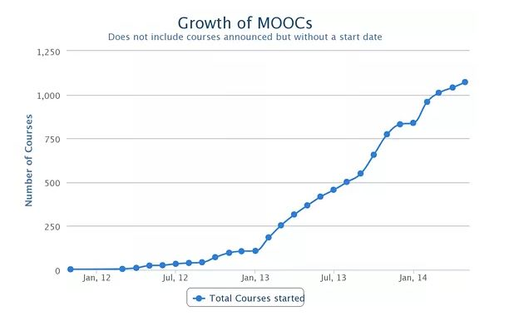
Moving Towards Online Learning
Matt Costi
Massive Open Online Courses
Growing Rapidly[1][2]
Where are they headed?
  Impact on Institutions
  Supplementary uses
  K-12 use
Graph source: [2]
Notes:
Hello everyone, I’m Matt Costi, and today I’ll be talking about the new trend of online learning and MOOCs.
For those of you who don’t know, MOOC stands for “Massive Open Online Courses”.
Massive: To get a feel for how massive these courses are, some of them have total enrolment numbers reaching over 100,000 and nearing 200,000 students [1]
Open: They are all offered completely free or for minimal costs (usually for more features or one on one help)
the idea is that anyone can sign up for these classes to further their education.
There are no restrictions or application process like traditional colleges.
Online: All you need is an internet connection to access the course material.
Courses: Finally courses. When I say courses, I’m talking about high quality, college level classes.
Many Ivy League colleges and professors are now starting to make online versions of their courses available through MOOC platforms.
MOOCs are growing very rapidly, seeing the most growth during 2013, with more than 1200 unique courses being offered through different companies
edX = over 370,000 for fall 2012 [1]
Coursera = 1.7 million students enrolled[1]
With this in mind, I predict that number of courses and providers will continue to grow, but that there will be little impact on the way that courses are taught.
colleges will generally be unaffected [5]
Instead, MOOCs will be used by college students and working professional to supplement what they are learning as a better way to understand material or go deeper in a specific topic.
However I believe there is room for experimentation and improvement with the way K-12 courses are taught, and that online courses and learning can be used as a great supplement to their class.

Slide 9
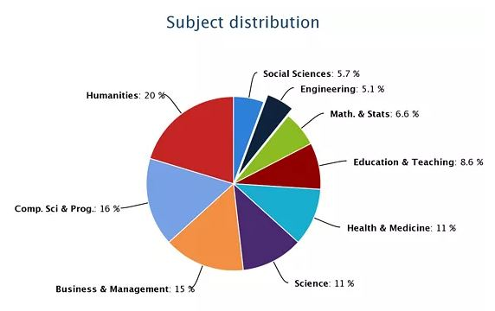
Learn Almost Anything
Matt Costi
Graph source: [2]
Notes:
The types of courses available through MOOCs is surprisingly quite large.
When MOOC’s first started, the courses that were available were primarily targeted towards those interested in Computer Science, and was designed to bring Computer Science to those who have never seen it before. [2]
Many “Intro to Computer Sciences” classes and related classes were popping up all over the place.
As MOOCs became more popular and backed by higher institutions, a wider variety of classes started being offered.
classes in the Humanities having the highest count of MOOC offerings [2]
Almost any subject you could possibly want to learn about probably has some MOOC offering somewhere.
For example, the current largest provider of MOOCs, Coursera, has over 600 courses from 80+ institutions

Slide 10
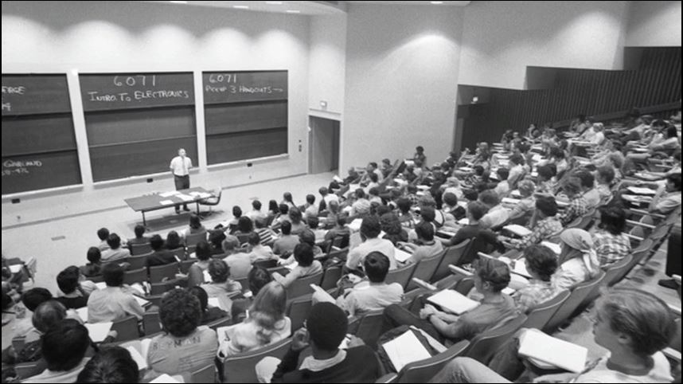
A New Way Of Learning
Matt Costi
Short Lessons[3]
Mastery
  Quizzes [3]
Self Paced
  Ability to “Rewind” [3]
Picture source: [3]
Notes:
Besides allowing for anyone to learn college level material at no cost, MOOCs have shown that there are new ways that subject material can be taught.
This is arguably better and easier for students to retain and master.
Instead of lecturing for an hour short video lessons are used instead. Video lengths can be anywhere from as short as 2 minutes to usually no more than 12.
Makes it easier to digest
“it’s like sitting down at a bar with a really smart friend and having them explain something to you”. [3]
Surprisingly personal.
In-between these lessons, short ‘quizzes’ can be asked of the student to make sure they understand what is being lectured [3]
Further mastery of the course material.
It is more interactive
Along with this, the courses are for the most part self paced, or semi self paced. Students can go through the lessons and material at their own pace.
Added ability of being able to ‘rewind’ the professor to hear what they said for better understanding
no more ‘scrambling’ to take good notes that you end up getting lost for remainder of lecture and having to play catch up.
An interesting statistic I found was that among people who have taken both college courses and MOOCs:
63% said it was better than similar college class, 36 % comparable, 1 % worse [1]

Slide 11
Blended Learning
Matt Costi
Classroom Flipping
  Watch videos before, do problems in class [4] [3]
Great for K-12 learning [4]
  Khan Academy
Less effective for large (>20-30 students) college lectures
Notes:
One of the more interesting uses of these MOOCs is for supplemental learning. Combining lectures with MOOC content.
This is sometimes referred to as flipping the classroom.
students could be assigned to watch MOOC videos, and then do more interactive problems and questions in the regular lecture time
This has already started and been experimented within K-12 classrooms.
Grade school teachers assign Khan Academy videos for homework, and then in class they work on problems and do what would normally be assigned for homework.
This lets the teacher see how each is performing and helps eliminates the one size fits all lecture [4]
Students walk in having a better understanding or having questions, which is more productive.
As you might imagine this is less effective for large classes since the professor can’t get around to all students.
It also assumes every student comes to class prepared.
Doesn’t mean MOOCs can’t also be used as a supplement to help remedy the one size fits all lecture.

Slide 12
Conclusions
Matt Costi
MOOCs will continue to grow
College lectures will largely remain the same[5]
Possible K-12 reform [4]
There is a lot to learn about education
  Less “one size fits all” lectures [4]
  More focus on immediate mastery
Notes:
In conclusion, MOOCs will continue to grow in the future, with even more courses being offered and more students taking them.
Whether it be for supplemental learning in their class, or for the sake of learning.
College lectures will be mostly unaffected by the MOOC movement.
Lectures will NOT be replaced [5]
Up to students to seek the additional help through on their own and through their own motivation.
The most I end up seeing is professors offering MOOC versions of their class and students being able to go back and ‘rewind’.
not just class capture, actual MOOC experience [1]
Class capture = recording of an actual lecture given to a large group of students, like if we had a camera recording the powerpoint, audio, and professor.
MOOC = built specifically for video, directed specifically to the person watching, not the lecture hall [1]
However in K-12 classroom environments, there is a lot to be learned and changed, namely will classroom and homework flipping [4]
In general MOOCs are teaching us that there are maybe better ways to teach.
Students can learn more when they get to go at their own pace.
Having short videos and interactive quizzes makes students feel more engaged, and confident in the material.
Instead of having tests every few weeks, mastery can be ensured at the lesson to lesson level.

Slide 13
Sources
Dhawal Shah, “MOOCs in 2013: Breaking Down the Number”, https://www.edsurge.com/n/2013-12-22-moocs-in-2013-breaking-down-the-numbers
Matt Costi
Laura Pappano, “The Year of the MOOC”, http://www.nytimes.com/2012/11/04/education/edlife/massive-open-online-courses-are-multiplying-at-a-rapid-pace.html?pagewanted=all (Access 4/23/14)
Dhawal Shah, “MOOCs in 2013: Breaking Down the Numbers”, https://www.edsurge.com/n/2013-12-22-moocs-in-2013-breaking-down-the-numbers (Access 4/23/14)
Anant Agarwal, TED Talk “Why Massively Open Online Courses (still) Matter” (Access 4/23/14)
Salman Khan, TED Talk “Let’s use video to reinvent education” (Access 4/23/14)
Rachel De Jong, “Have MOOCs Replaced the Classroom?” , http://www.mindingthecampus.com/originals/2014/01/have_moocs_replaced_the_classr.html (Access 4/23/14)
Notes:
<Your notes here.>

Slide 14
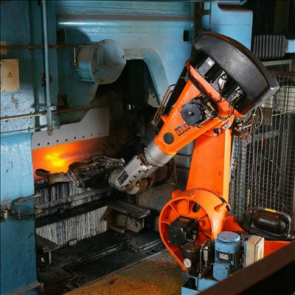
Future of industrial robots
<Quan Peng>
Advantages of robots [1]
  Working longer than humans
  Don't get bored
  Most of them perform tasks faster and more accurately
Industrial robots will be widely in used in factories [2]
[7]
Notes:
Hi everyone, today, I will talk about the relationship between numbers of robots in use and unemployment rate in China.
Compared to human workers, industrial robots have many advantages. Industrial robots can work longer than human workers. During working period, many industrial robots can work 24 hours per day and 7 days per week. They never get bored by repetitive works. Additionally, most of them can perform tasks much faster and more accurately than human workers. As the price goes down, in the future, industrial robots will be widely used in factories.

Slide 15
Debate about industrial robots in China
<Quan Peng>
China has huge amount of labor force [3]
  Total population: 1.35 billion [9]
  Labor population: 0.94 billion [10]
Debate: whether or not industrial robots will increase unemployment rate [3]
  Similar debate happened in U.S. [8]
Notes:
As the country with the biggest population, China has a huge amount of labors. As more and more robots are adopted and used in recent years, there is an increasing concern about whether or not robots will increase unemployment rate in China. Similar debates also happened in U.S. It seems it might be an worldwide problem in the future.

Slide 16
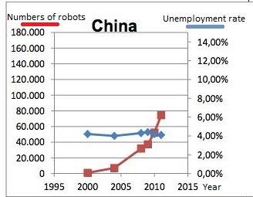
Unemployment rate vs Robots in use
<Quan Peng>
Numbers of robots in use increase fast [4]
Unemployment rate keeps the same level [4]
Why?
Notes:
This figure shows the rate of unemployment trend versus numbers of robots in use in China. The blue line represents the percentage of unemployment and the red line represents numbers of robots in use. We can see that numbers or robots in use increase fast while the unemployment rate keeps almost at the same level, which means the use of robots didn’t affect the unemployment rate in China.
In order to figure out why this phenomenon happened, we have to figure out what the basic reason for increasing use of robots in China is.

Slide 17
Reasons for increasing use of industrial robots
<Quan Peng>
Labor shortage
      Population bonus disappears [5]
        Gradually disappears from 2013
      Increase in labor cost [6]
        Workers’ salary increases 19% each year from 2005 to 2010
      Labors change their attitudes towards work [1]
Notes:
The basic reason for factories to increasingly adopt robots is labor shortage which is caused by three factors. The first factor is that Population bonus gradually disappears in China. Population bonus refers to abundant supply of cheap labor in China. As the result of once child policy from 1980, there is a decline in the labor force and an increase in aging population. Population bonus disappearing inevitably increases the wages of workers. From 2005 to 2010, workers’ salary increases 19% each year. In addition to population bonus disappearing and increase in labor cost, the change of labors’ attitudes towards work also results in labor shortage. As the life quality increases, workers born after 1980s don’t want to work like older generations anymore. Simple, repetitive and mechanical works are not attractive to them. Many of them expect work to bring them joy and feeling of satisfaction. Therefore, it becomes much harder for factories to hire human labor force in production line.

Slide 18
Conclusion
<Quan Peng>
Labor shortage causes increasing use of industrial robots
Increasing number of robots didn’t affect unemployment rate
Notes:
In China, labor shortage is the basic reason for increase in use of robots. Factories adopting robots do not aim to replace existing human labors, but to compensate existing human labors. As a result, at present stage, increasing number of robots doesn’t affect unemployment rate in China.

Slide 19
Any Questions
<Quan Peng>
Reference:
[1] Advantages and Disadvantages of Robots. (n.d.). 14hmj -. Retrieved April 24, 2014, from http://14hmj.qataracademy.wikispaces.net/Advantages+and+Disadvantages+of+Robots
[2] Pinto, J. (n.d.). Robotics Technology Trends. The Future of Robots. Retrieved April 24, 2014, from http://www.automation.com/library/articles-white-papers/articles-by-jim-pinto/robotics-technology-trends
[3] 艰难的起步 - 中国机器人之路. (n.d.). . Retrieved April 24, 2014, from http://www.elecfans.com/article/90/155/2012/1122298921_2.html/
[4] 机器人采用率和失业率数据分析. (n.d.). . Retrieved April 24, 2014, from http://www.gkong.com/item/news/2013/04/72735.html
[5] 2013年中国人口红利或将消失. (n.d.). 时政--人民网. Retrieved April 24, 2014, from http://politics.people.com.cn/n/2012/0824/c1001-18820528.html
[6] 徐, 光. (n.d.). "机器人时代"如何影响我们就业？. . Retrieved April 24, 2014, from http://biz.zjol.com.cn/05biz/system/2013/05/29/019370212.shtml
[7] KUKA Roboter GmbH, Zugspitzstraße 140, D-86165 Augsburg, Germany, Dep. Marketing, Mr. Andreas Bauer, http://www.kuka-robotics.com
[8] US Unemployment Is 7.9%-Are Robots to Blame?. (n.d.). Singularity Hub. Retrieved April 25, 2014, from http://singularityhub.com/2013/02/07/us-unemployment-is-7-9-are-robots-to-blame/
[9] 国家数据. (n.d.). 国家数据. Retrieved April 25, 2014, from http://data.stats.gov.cn/search/keywordlist2?keyword=%E6%80%BB%E4%BA%BA%E5%8F%A3
[10] 中国劳动年龄人口数量. (n.d.). _资讯频道_凤凰网. Retrieved April 25, 2014, from http://news.ifeng.com/gundong/detail_2013_02/24/22422835_0.shtml
Notes:
<Your notes here.>

Slide 20
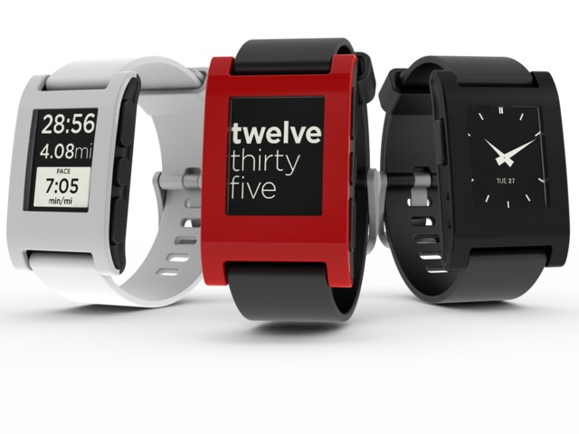

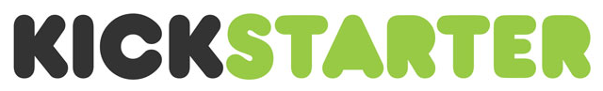
Kickstarter Success and Failure
Sean Halloran
Pebble Smart Watch
  Funded $10.2M, asked for $100K
  Delivered behind schedule
  Best Buy Controversy
  Ultimately successful product
Seth Quest and the iPad Stand
  Funded $35K, asked for $15K
  Failed to deliver product
  Sued by backers
  Resulted in bankruptcy
Notes:
Explain kickstarter system:
Month to fundraise, all or nothing campaign, backer rewards, stretch goals
Pebble:
$10.2M in funding after asking for $100k, most funded kickstarter project ever
All backer rewards have been fulfilled to date, product is on sale in Best Buy now, self supporting product now with new models in the works
Dangers of having product in public eye
delays and launching in Best Buy stores before shipping to backers who have already paid, upset consumers
75% of projects deliver behind schedule
Quest:
Seth Quest is a designer, never worked in business, never ran a company before, fits target audience for kickstarter
Delayed product until he announced he would not finish it and deliver any rewards to backers.
First project to be sued by a backer
Why did it fail? Having a public budget, manufacturers were able to haggle prices too high for product to be profitable
He never incorporated his company, making him personally liable to refund all of his backers, putting him into bankrupcy
After the disaster, he could not find a full time job in the design industry

Slide 21
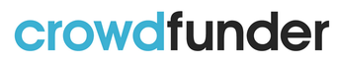
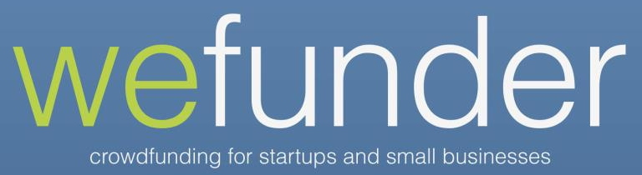
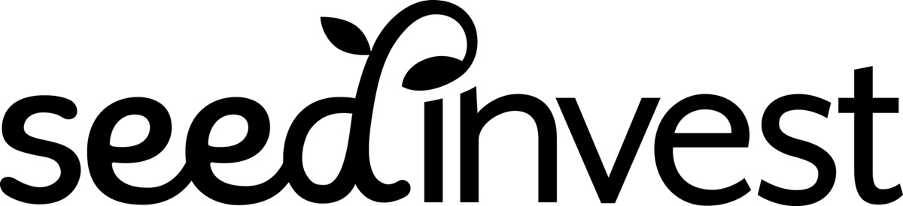
More Kickstarter Controversy
Sean Halloran
Oculus VR
  Funded by “the crowd,” bought by Facebook
  “I would have rather bought a few shares of Oculus rather than my now worthless $300 obsolete VR headset.”
Equity Model
  Kickstarter will not sell stock in start-ups
  However, new websites will
  JOBS Act
-Kickstarter Backer
Notes:
Stated in Kickstarter’s TOS, and in many blog posts and interviews:
Kickstarter is not a place to buy things
Kickstarter is not a place to invest
Kickstarter is a place for fans to help creators make things
Backers of OculusVR uneasy about big buyout. Makes the kickstarter feel like it was unnecessary
Brings up the Question of investing vs. “backing”
Equity, stake in a company, return on investment
Jumpstart our Business Startups (JOBS) Act allows companies to exchange stock for small investments

Slide 22


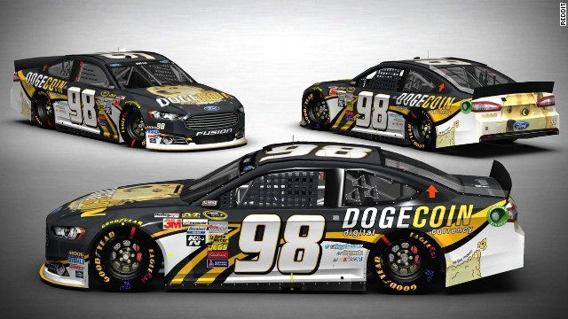
Alternate Crowdfunding Sources
Sean Halloran
Indiegogo
  Kickstarter, with fewer rules
  Flexible Funding Projects
  1/6th the size of Kickstarter
Patreon
  Pay content creators upon content delivery
  Ongoing project funding
  Biggest Project: $10,748 per Month
Cryptocoin
  Decentralized crowdsourcing
  Dogecoin Nascar Car
  Funded $55,000 or
  67M DogeCoin
  Race is May 4th at Talladega
Notes:
Indiegogo
Allows people of all countries to start projects
Not limited to creative projects, can be to fund anything (even your tuition!)
Not all or nothing projects
Smaller and less publicity than kickstarter
Patreon
Choice for content producers on youtube worried about youtube payment models
tries to solve problem of kickstarter projects not delivering
stretch goals at levels of funding per month
backer rewards at money given per month
allows backers to cap payment per month
Cryptocoin
A 16 year old Reddit user found a NASCAR driver with no sponsorship, and wanted to fund him
Contacted the driver on twitter, and then over the phone, raised money with dogecoin in only a few days
Dogecoin foundation has used cryptocurrency and crowdfunding to build wells in Africa and fund Olympic teams

Slide 23
Conclusion
Sean Halloran
Crowdfunding Backers
  Entitled to very little, depending on crowdfunding method
Crowdfunding Entrepreneurs
  Carefully chose crowdfunding method
  More accountability in future
In General
  Movement away from kickstarter
  Fewer products more projects

Slide 24
Sources
Sean Halloran
Charles Luzar, Why this jilted kickstarter backer decided to sue, http://venturebeat.com/2013/01/22/why-this-jilted-kickstarter-backer-decided-to-sue-why-he-was-right/, 4/24/2014
Handfree iPad Accessory, https://www.kickstarter.com/projects/831303939/hanfree-ipad-accessory-use-the-ipad-hands-free, 4/24/2014
Eric Markowitz, When Kickstarter Investors Want Their Money Back, http://www.inc.com/eric-markowitz/when-kickstarter-investors-want-their-money-back.html, 4/24/2014
Perry Chen, Yancy Strickler, Charles Adler, Accountability on Kickstarter, https://www.kickstarter.com/blog/accountability-on-kickstarter, 4/24/2014
Andrianne Jeffries, If you back a Kickstarter project that sells for $2 billion do you deserve to get rich?, http://www.theverge.com/2014/3/28/5557120/what-if-oculus-rift-kickstarter-backers-had-gotten-equity, 4/24/2014
Len Kendall, Crowdfunding Doesn’t Work for Content, http://thenextweb.com/entrepreneur/2014/04/22/crowdfunding-doesnt-work-content/, 4/24/2014
Pebble’s controversial early strategy, http://smartwatchiz.com/pebbles-controversial-early-strategy/#, 4/24/14
Gerry Smith, Kickstarter Reminds Worried Backers: We are ‘Not A Store’, http://www.huffingtonpost.com/2012/09/21/kickstarter-guidelines-backers-blog_n_1904050.html, 4/24/2014
Larry Frum, Reddit Dogecoin support NASCAR racer at Talledaga, http://www.cnn.com/2014/04/24/tech/web/nascar-dogecoin-talladega/, 4/24/2014
Notes:
<Your notes here.>

Slide 25
Microfinance
Penny Over
Financing for low income people who do not have banking
About 30 years old
Micro loans
http://www.microfinancegateway.org/p/site/m/template.rc/1.26.12263/
Notes:
Formal definition, in practice almost always loans with little or no collateral
Networks of loaners across the world
Small loans so poor people can pay them off
usually with high interest rates, but short loan periods
There are still a lot of people who don’t have access to this

Slide 26
And Cloud Computing
Penny Over
Microfinance can be done through cloud computing
To connect loaners and institutions across the globe
Better for smaller institutions
Notes:
Cheaper for the organization to use a service online, instead of proprietary software
Reach from their remote areas to national networks of loaners
Why use any new software: easier way to automate services, delivery, repayment, compliance, risk management
Smaller institutions: more money for less

Slide 27
Mission Drift
Penny Over
An institutions stated mission does not match an its actions
Increase in average loan size over time
Progressive lending
Cross subsidation
Notes:
Smaller loans means reaching more people
As current clients need bigger loans, institutions offer them
Loaning to middle class people without banks as well as lower level people

Slide 28
And the Cloud
Penny Over
Reaching out to borrowers through the cloud
Including software means more regulation
Mobile banking
Cheaper, so less drift
http://www.thehindu.com/todays-paper/tp-opinion/warts-and-all-micro-finance-is-working/article3347200.ece
Notes:
As mission drift continues and the usage of cloud computing increases, then institutions will start to reach out to more people with computers, middle class
Also with automation there are set loan sizes and more documentation to see that they aren’t reaching low income people any more
This accountability is already happening
Reach more people by phone, easier to pay etc
Because computing saves money, institutions don’t have to go to wealthier borrowers to make enough money

Slide 29
Conclusion
Penny Over
Cloud computing and other computing methods have the potential to aid mission drift, but more potential for helping to end mission drift

Slide 30
Sources
Penny Over
Armendariz, B., and A. Szafarz. "Microfinance Mission Drift?" Microfinance Gateway. Centre Emile Bernheim Research Institute in Management Sciences, n.d. Web. 20 Apr. 2014.
Ashta, Arvind, Mawuli Couchoro, and Abu S. Musa. "Dialectic Evolution through the Social Innovation Process: From Microcredit to Microfinance." Journal of Innovation and Entrepreneurship. N.p., 14 Jan. 2014. Web. 20 Apr. 2014.
Sharma, Meaghan, Loveleen Gaur, and Nishant Agrawal. "APPLICATION OF CLOUD COMPUTING IN MICROFINANCE." Academia.edu. N.p., July 2012. Web. 20 Apr. 2014.
"Technology Overview." Microfinance Gateway. CGAP, n.d. Web. 20 Apr. 2014.
Vasudevan, P. N. "Warts and All, Micro Finance Is Working." The Hindu. N.p., n.d. Web. 20 Apr. 2014.
"What Is Microfinance?" Microfinance Gateway. CGAP, n.d. Web. 20 Apr. 2014.
Notes:
<Your notes here.>

Slide 31
Class 11
The End
Keith A. Pray
Instructor
socialimps.keithpray.net
Notes:
This is the end. The slides beyond this point are for answering questions that may arise but not needed in the main talk. Some slides may also be unfinished and are not needed but kept just in case. In this particular presentation there are no further slides but it will say this on The End for most of them so I figured I’d get you ready for it now.

