Slide 1
Class 10
Errors Failures Risks
Keith A. Pray
Instructor
socialimps.keithpray.net
Notes:
Here’s the title slide. Excited already, aren’t you?
What errors?
Who looked for existing test strategies?
Who looked for directions on how to test currency?

Slide 2
Overview
Errors, Failures, And Risks
Assignment
Students Present
Guest Speaker
Notes:
We can also discuss articles listed on Security Discussions under documents of course web site.

Slide 3
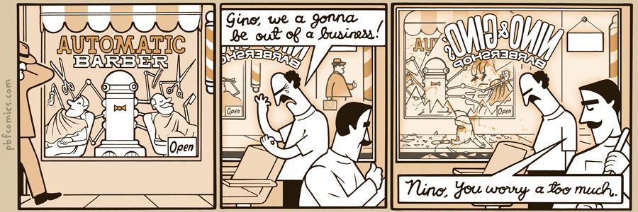
http://pbfcomics.com/197/
Notes:
10 – Errors, Failures, Risks

Slide 4
Overview
Errors, Failures, And Risks
Assignment
Students Present
Guest Speaker

Slide 5
Assignment
Finish reading
First draft of group presentation
  Due Tuesday 2:59 PM
  Post on group website
  Email presentation to me and TA
Notes:
1 Page Paper – For Good
How will you use your computing related education to do good in the world?

Slide 6
Overview
Errors, Failures, And Risks
Assignment
Students Present
Guest Speaker

Slide 7
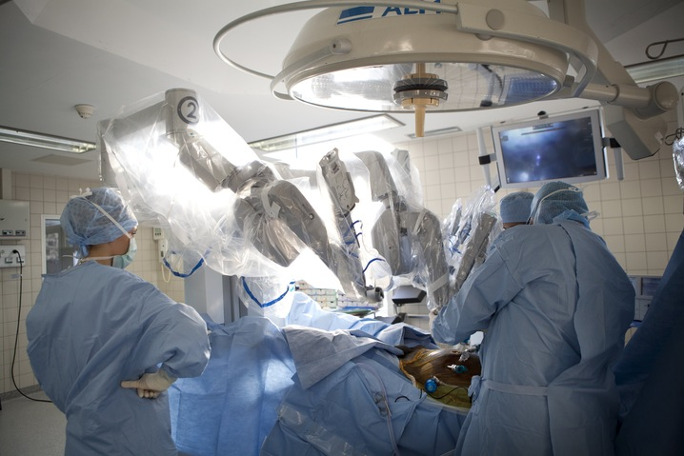
Reliability of Surgical Robots
Justin Hess
Image from http://www.pbs.org/newshour/rundown/mishaps-and-deaths-caused-by-surgical-robots-going-underreported-to-fda/
Notes:
[Introduction]
- As you can see here is the daVinci robot, a telepresence surgical system. I will talk about it more in depth later and some of the reliability incidents it experienced.
- I chose this topic because of my interest in medical devices and surgical robots.

Slide 8
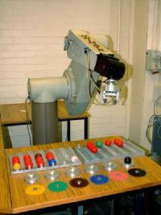
Background: First Surgical Robots
Justin Hess
PUMA 560
    First robot used for Neurosurgery, 1985
    Lacked ultrasound imaging capabilities^{[1]}
PROBOT
    Transurethral resection of prostate
    Image-guided, simulation-based^{[2]}
ROBODOC
    First to perform Total Hip Arthroplasty^{[2]}
    Used in > 24,000 surgeries since 1992^{[2]}
http://allaboutroboticsurgery.com/surgicalrobots.html
Notes:
Developed in UK as the first robot used in Neurosurgery in 1985: the Programmable Universal Manipulation Arm (PUMA) 560, used to place a needle for a brain biopsy using guidance of CT scan. Was not sufficient for prostate surgery due to lack of ultrasound imaging capabilities.
PROBOT in 1988 was developed for the transurethral resection of prostate tissue. It was image guided and a simulation based system.
The ROBODOC made medical history in 1992 after being able to assist in performing a Total Hip Arthroplasty. It has been used in over 24,000 surgical procedures worldwide since 1992.

Slide 9
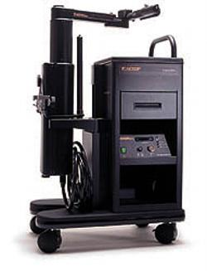
Recent Surgical Robots: AESOP
Justin Hess
AESOP
    Voice-activated arm with endoscope
    Approved by FDA in 1994^{[1]}
    Used in over 70,000 procedures^{[2]}
http://allaboutroboticsurgery.com/surgicalrobots.html
Notes:
-The AESOP (Automated Endoscopic System for Optimal Positioning) produced by Computer Motion (now Intuitive Surgical) and approved by FDA in 1994. Main feature is voice-activated robotic arm that holds and endoscope. Very successful used in over 70,000 procedures, so successful that it was incorporated into the ZEUS system.

Slide 10
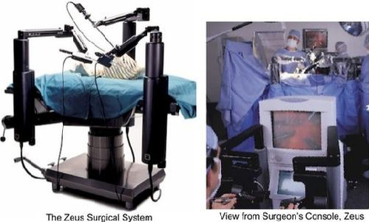
Recent Surgical Robots: ZEUS
Justin Hess
ZEUS
    3 robotic arms, uses AESOP arm^{[2]}
    Laparoscopic, thoracoscopic surgeries^{[1]}
http://allaboutroboticsurgery.com/surgicalrobots.html
Notes:
-ZEUS made by Computer Motion as well, was approved by FDA in 2001, consists of three robotic arms, is a telepresence surgery system, one is voice-automated arms and others are extensions of surgeon’s arms that can be used to create 3D images virtually. 30 are in US currently.

Slide 11
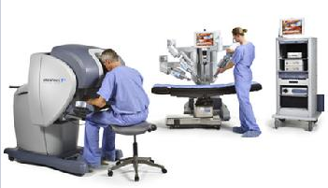
Recent Surgical Robots: daVinci
Justin Hess
daVinci
    First ‘surgical robot’ approved by FDA in 2000^{[6]}
    Based on telemedicine research from NASA^{[5]}
http://allaboutroboticsurgery.com/surgicalrobots.html
Notes:
-DaVinci produced by Intuitive Surgical Inc., another telepresence robotic surgery system used by surgeon. daVinci and ZEUS are the only two robotic systems approved for marketing in US for laparoscopic and thoracoscopic surgeries. First approved by FDA as a robotic surgical system in 2000.

Slide 12
Advantages of Surgical Robots
Justin Hess
Telesurgery and Robots
  Can lower healthcare costs with less personnel^{[5]}
Reduced Pain, smaller incisions
  daVinci uses 1-4cm incisions on chest, less pain^{[7]}
Enhanced precision
  87% success rate of transurethral access with Robots^{[5]} (85% with human surgeon)^{[8]}
Reliability of just using robots as tools
  No robots perform surgery autonomously^{[5]}
Notes:
- Telesurgery has promises to allow doctors to perform surgery from miles away. Healthcare cost can be lowered with less personnel to perform surgery with the use of robots. (Might only require an anesthesiologist, two surgeons and robot in the future).
Reduced pain (ex daVinci system uses 3,4 1 cm incisions on patient’s chest for heart bypass surgery, compared to regular 1 ft incision causing less pain and trauma), It has also been shown that Robots help reduce pain in head and neck surgeries compared to just using human surgeons.
Enhanced precision (such as needle with PUMA 560), 87% success rate of transurethral access using robots like PUMA, 85% with human surgeon observed.
Robots are simply used as tools or extensions of the arms for surgeons, there are no current surgeries are performed using a pre programmed robot that acts on its own

Slide 13
Reliability Issues
Justin Hess
Journal for Healthcare Quality Study
  245 incidents reported to FDA over 12 years – daVinci system^{[7]}
Latency issue with Telesurgery
  Can lag between device and user be fatal?^{[4]}
Learning Curve for Surgeons
  12-18 patients before surgeons use to procedure^{[2]}
Notes:
- Journal for Healthcare Quality published study spanning 12 years that included 245 incidents reported to FDA, including 71 deaths and 174 non fatal injuries, 5 cases were not reported at all. However, daVinci system installations have grown in US hospitals by 75 percent from 2007 to 2011 from 800 to 1,400, over 700,000 procedures in 2012.
- Latency is a reliability issue if telesurgery becomes more popular, as there is a time delay between surgeon moving his hands and robot responding miles away
- Despite the training program, surgeons reported it took roughly 12-18 patients before they felt learning the procedure indicating a steep learning curve

Slide 14
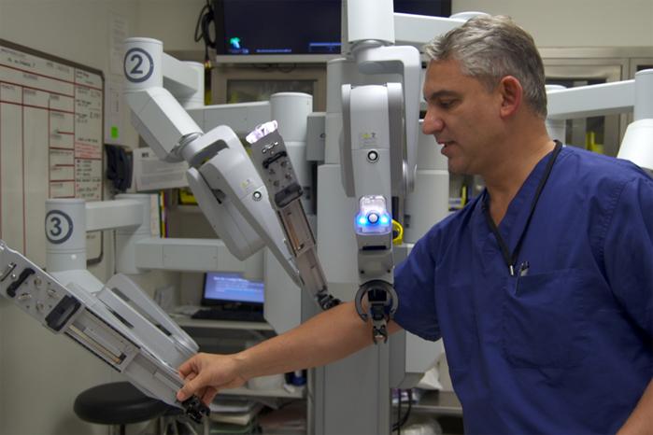
More Reliability Issues
Justin Hess
Gray area: fault of surgeon or robot
    Who is to blame?
Manufacturer to blame
  Doctor must provide
  disclosure of risks^{[7]}
Inadequate educational
materials
  37% of US hospitals post
  info, 0% inform of risks^{[7]}
http://www.roboticoncology.com/history/
Notes:
-There is a reliability gray area whether fault of surgeon or robot, no set guidelines are in place currently to clearly point blame in case of incident.
-It seems that if doctors can better disclose potential risks, in case of an incident the manufacturer may be at more fault the the actual doctor
-The only available patient education materials related to robotic surgical procedures are generic resources from the manufacturers, not enough information needed for patient to make informed decision about using robots
-Among 37 percent of US hospitals that post information about the robots they use, none of them actually post the risks or complications. This is a huge issue of uninforming patients.

Slide 15
Conclusions
Justin Hess
Overall, robots prove advantageous
  Though DaVinci has several incidents reported
Reporting to FDA is crucial
  More regulations needed in case of incidents
Informative training and materials
  Patients must be informed, doctors well trained
Who is at fault when incidents occur?
  Guidelines must set risks using robotic surgery
Notes:
-In conclusion, most robotic systems used in surgery have shown to improve quality of surgery. Systems like daVinci have shown to reduce pain in patients using smaller incisions on chest in laparoscopic surgeries. Systems like AESOP had breakthroughs assisting surgeons using voice-activated arms, and it was so successful with 70,000 procedures that it was introduced into more advanced systems such as ZEUS and daVinci. Some surgeries like neck and heart have shown to have better results with using robots.
-It is very important that the FDA is reported to every incident that is caused in surgery using a robot. The survey conducted by the Journal of Healthcare Quality proves this, as several incidents of the daVinci system went unreported and regulations as a result were not met. This can lead to faulty systems used in surgeries to continue to be in use and potentially cause more incidents to patients.
-It is shown that with the lack of informative materials of the robots used in hospitals patients do not get proper education on the risks and complications they could potentially undergo. Only 37 percent of hospitals actually post information about the robots used, while none inform the risks or complications.
-One last important question to ask is who is to blame, when an incident occurs, the surgeon or the robot? After all, most robotic systems used today are simply extensions of a surgeon’s arms or are controlled by surgeon such as with Zeus and daVinci. It seems that if the doctor informs the patients ahead of time of the risks, they may be protected if an incident occurs with a patient.

Slide 16
Sources
Justin Hess
[1] Dwivedi, Jyotsna, Robotic Surgery - A Review on Recent advances in Surgical Robotic Systems, Retrieved April 12, 2014 from http://www.eng.fau.edu/conf/fcrar/papers/FCRAR_2012_2_1_Dwivedi_Mahgoub_FAU.pdf
[2] AVRA Surgical Inc., Surgical Robots, Retrieved April 12, 2014 http://allaboutroboticsurgery.com/surgicalrobots.html
[3] Kent, Martha, Are Medical Robots Safe?, Retrieved April 13, 2014 from http://scinotions.com/2012/09/medical-robots-surgical-operation-is-it-safe/
[4] Bonsor, Kevin, and Jonathan Strickland. "How Robotic Surgery Will Work" 30 October 2000. HowStuffWorks.com. Retrieved April 13, 2014 from http://health.howstuffworks.com/medicine/modern-technology/robotic-surgery.htm
[5] Francis, Paula, Medical Robotics: The Impact on Perioperative Nursing Practice, Retrieved April 14, 2014 from http://www.medscape.com/viewarticle/531748_1
[6] Samadi, David, History of Robotic Surgery, Retrieved April 15, 2014 from http://www.roboticoncology.com/history/
[7] Evans, Marissa, Mishaps and Deaths Caused By Surgical Robots Going Underreported to FDA, Retrieved April 15, 2014 from http://www.pbs.org/newshour/rundown/mishaps-and-deaths-caused-by-surgical-robots-going-underreported-to-fda/
[8] Atena, Clinical Policy Bulletin, Retrieved April 18, 2014 from http://www.aetna.com/cpb/medical/data/1_99/0079.html

Slide 17
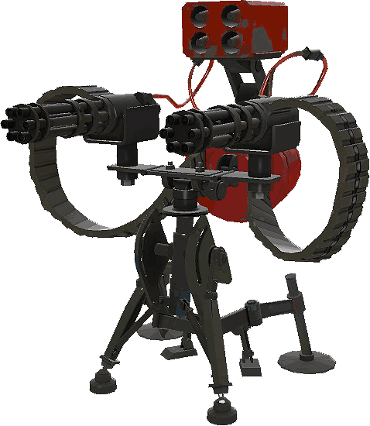
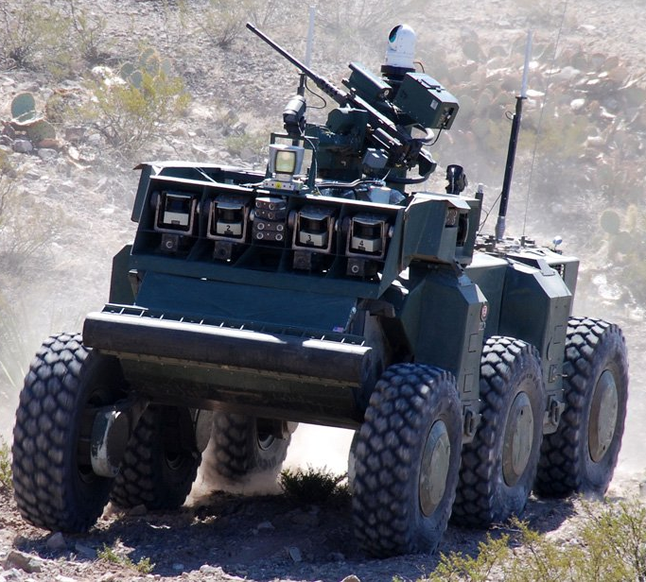
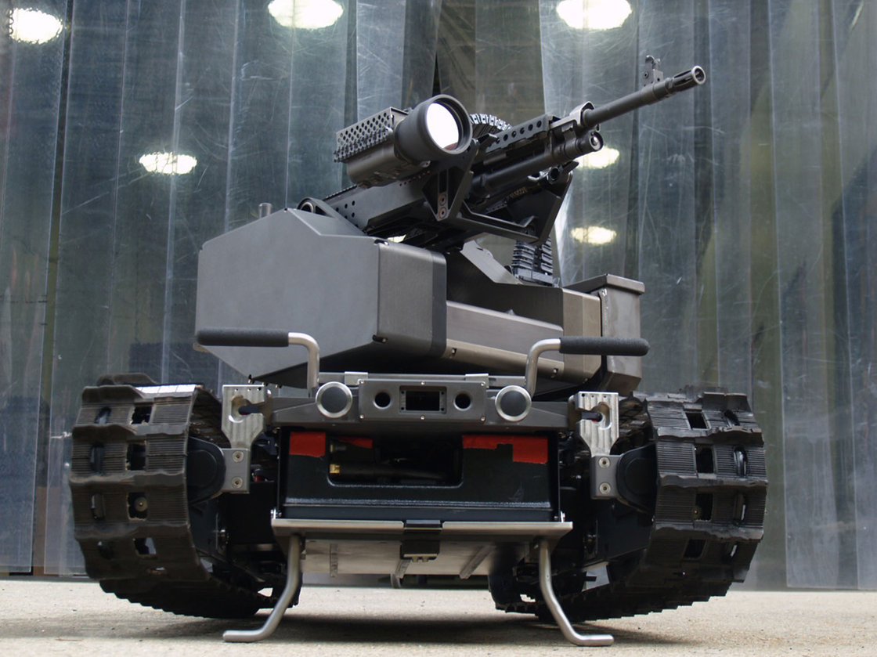
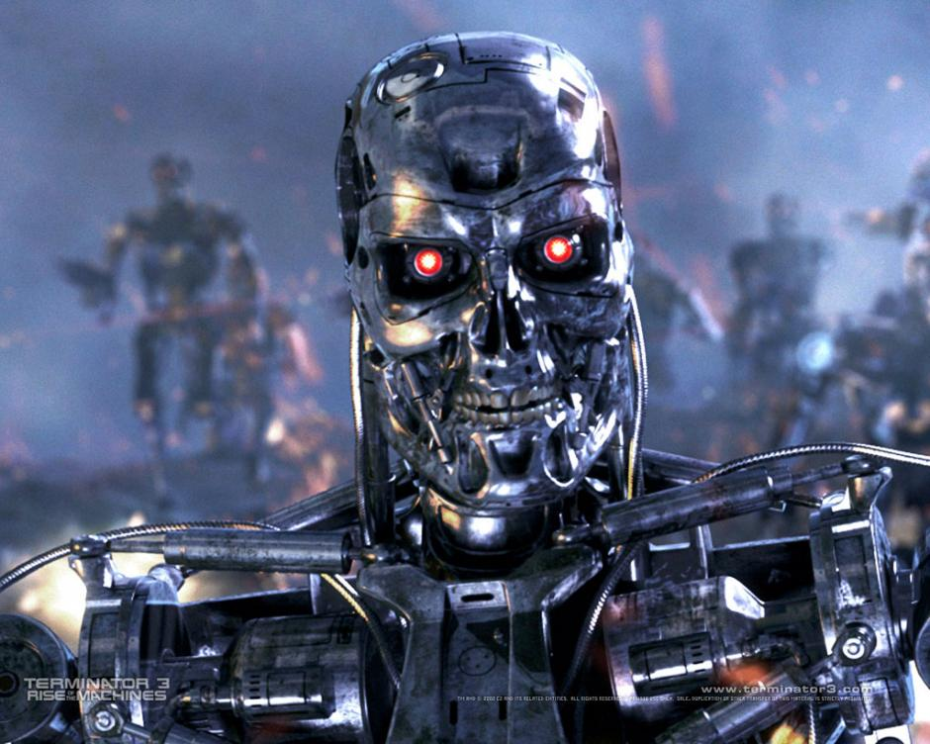
Military Robots
Ted Armstrong
And autonomous weapons
Notes:
My name is Ted Armstrong and I would like to talk to you about Military Combat robots and Autonomous Weaponry.
Shown here are the MAARS robot (Modular Advanced Armed Robotic System), a robot being developed for the military, the Crusher which I will show soon, the third level Sentry Gun from TF2 which operates autonomously and manually, as well as the infamous Terminator robot made popular by the Terminator movies.

Slide 18
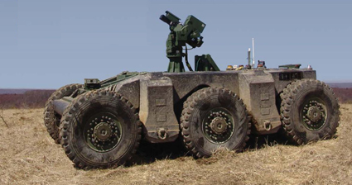
Crusher UGCV
Ted Armstrong
Fire support
Reconnaissance
Medevac
Sentry
Supply mule
No plans for
service
Defense Advanced Research Projects Agency,. 2006. 'CRUSHER UNMANNED GROUND COMBAT VEHICLE UNVEILED'.
Notes:
The Crusher Unmanned Ground Combat Vehicle
Developed by Carnegie Mellon University and DARPA
6 wheeled, skid-steered, all-wheel-drive,
hybrid electric (allows for stealth), can turn engine off
Underneath skid plate. Can adjust suspension by 30inches
14000lbs fully fueled, can carry 3000lb payload
Point and click navigation. Human designates waypoint, Crusher navigates there automatically.
Recognize troops over 2miles away. Sensors
Potential purposes:
Fire support: Engage enemy combatants with weapons
Reconnaissance: Sit and listen, turn off engine, wait and watch
Medevac: Drive in and scoop up wounded soldiers, and escort them to safety
Sentry: Wait and watch, fire on combatants
Supply Mule: Carry extra weight so that soldiers don’t need to transport such weight
Not planned to be used in service, used as a framework for future UGCV projects.

Slide 19
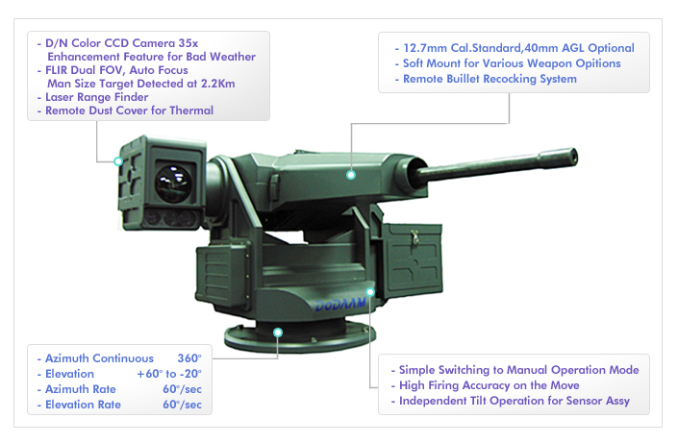
DoDaam Super Aegis II
Ted Armstrong
'Dodaam Systems'. 2014. Dodaam.Com. http://dodaam.com/eng/sub2/menu2_1_4.php.
Notes:
The Super Aegis II is an autonomous turret weapon system developed by DoDAAM; a South Korean company.
Meant to be an auto targeting turret (similar to the TF2 one)
Can target a man sized target at 1.36 miles, multitude of sensors:
Digital Camera with 35x zoom. Thermal Imaging Camera can detect a Man target
Laser range finder
12.7mm Machine gun or 40mm Grenade Launcher
Gyroscopic Stability
~310 pounds
Stationary mount or mounted to a vehicle
2 Modes:
Full autonomous (shoot first, ask questions later)
Manual Mode (requires human intervention to fire)
Commercially available…

Slide 20
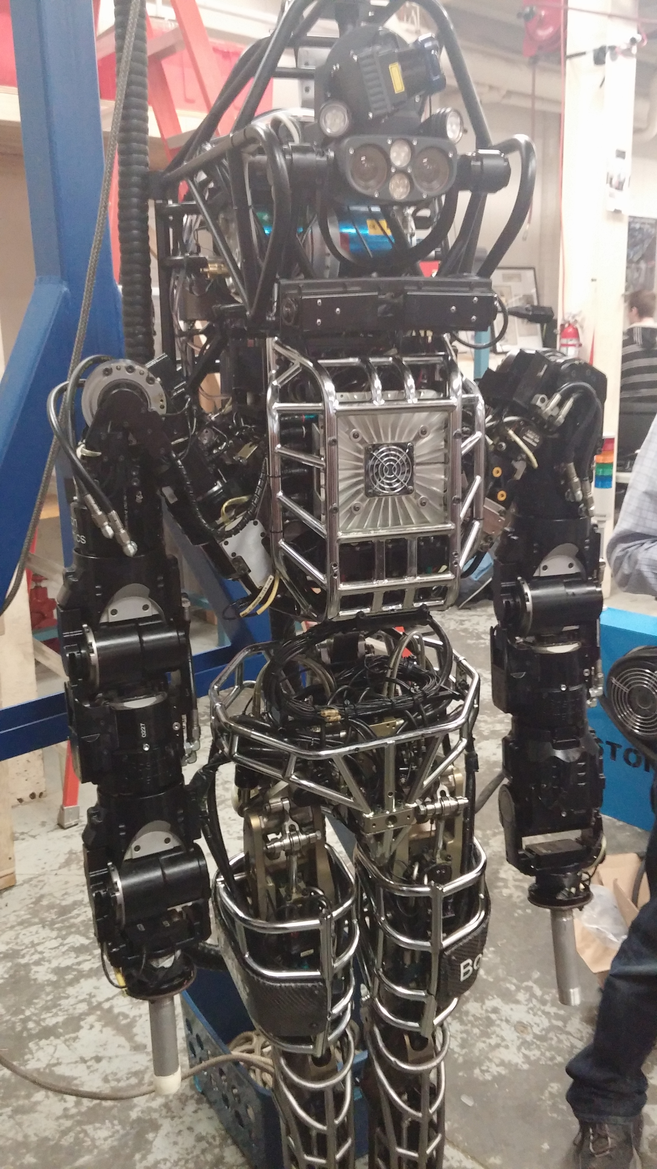
Atlas
Ted Armstrong
Created by Boston Dynamics
  Bought out by Google recently
DARPA Robotics Challenge
  Perform tasks in a disaster
  scenario
'DARPA’S ATLAS Robot Unveiled'. 2013. Darpa.Mil. http://www.darpa.mil/NewsEvents/Releases/2013/07/11.aspx.
Notes:
The Atlas robot was created by Boston Dynamics for the DARPA Robotics Challenge.
The DRC is a competition where robots have to perform several tasks simulating a disaster scenario (e.g. Walking, climbing a ladder, removing debris, handling power tools, turning a valve, etc.)
WPI won 7th in last December. I am on the team for the next competition.
28 hydraulically-actuated degrees of freedom, two hands, arms, legs, feet and a torso.
Multisense Head featuring stereo camera and LIDAR range finder.
Powered off-board, electric power supply.
Military robot alarmists are concerned about military applications, (i.e. if it can manipulate a power tool and drive a car, it could use a firearm and drive a tank, etc.)
Unlikely.

Slide 21
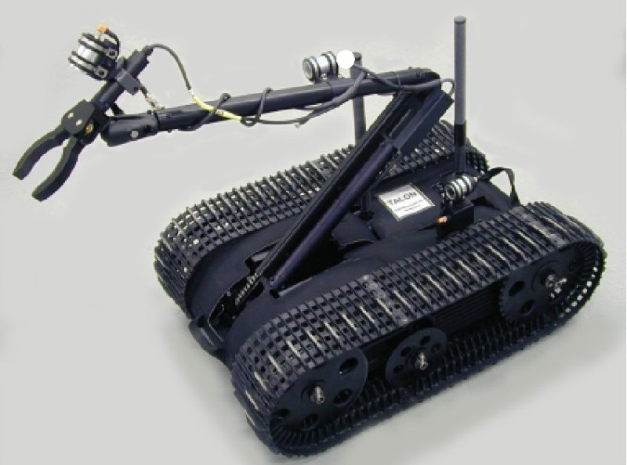
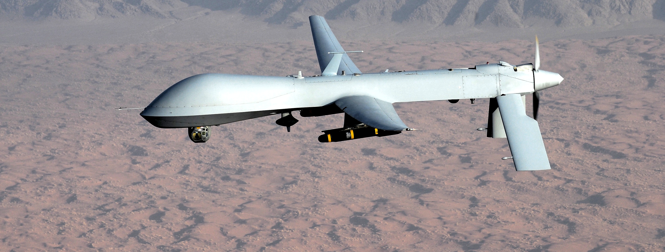
Military transition
Ted Armstrong
$4 million per soldier
U.S. Army wants to cut human soldiers by ¼
Plans to roboticize the military
Many robots already integrated into the U.S. Military
Unlikely to transition to humanoid robots
Harris, Francis. 2005. 'Pentagon Prepares To Build $130Bn Robot Army'. The Telegraph.
'US Army Studying Replacing Thousands Of Grunts With Robots'. 2014. Defense News. http://www.defensenews.com/article/20140120/DEFREG02/301200035/US-Army-Studying-Replacing-Thousands-Grunts-Robots.
Krishnan, Armin. 2009. Killer Robots. 1st ed. Farnham, UK: Ashgate.
Notes:
A human soldier costs the Pentagon $4 million over their lifetime. A robot would cost less than 10 percent of that value.
Army General Robert Cone states that the army is considering reducing the size of a Brigade Combat Team from 4,000 soldiers to 3,000. Lost firepower would be made up with robots and drones.
The US Military already utilizes multiple robots: REMOTEC HD-1 / TALON for disposal of IEDs, as well as the Predator UAV.

Slide 22
Implications
Ted Armstrong
Removes soldiers from harm
Humans could be detached from killing
U.N. wants moratorium on killer robots
  “War without reflection is mechanical slaughter”
Breaks Asimov’s first law
Current state of technology makes lethal autonomous weapons inappropriate. In the future…
U.N. General Assembly, 23rd Session. Report of the Special Rapporteur on extrajudicial,
summary or arbitrary executions, Christof Heyns (A/HRC/23/47). 9 April 2013.
Notes:
The primary advantage of replacing soldiers with robots is the reduction of exposure to life-threatening situations. The US Military values reduction of loss of life (look at drone program).
A disadvantage could be the transformation of war into a ‘sport.’ Robots vs. Robots. Automatic action could cause war desensitization.
Christof Heyns, the United Nations special rapporteur on extrajudicial, summary or arbitrary executions, spoke out against killer robots stating: “War without reflection is mechanical slaughter,” and made a report stating the need for a Global moratorium on killer robots.
Heyns wants to limit a machines ability to destroy human life. A counterpoint could be that machines have already been deciding to end human life with the invention of the landmine.
With the current state of technology and AI algorithms, I don’t think lethal autonomous weapons should be implemented. Given 30 years, I can see its use.
I want to hear your thoughts on the matter. Should the world develop autonomous robots with lethal functionality? Who responsible if a robot makes a poor decision?

Slide 23
Image Sources
<Your Name>
http://www.extremetech.com/wp-content/uploads/2012/10/1269891719_r31_0000-640x409.jpg.
http://media.npr.org/assets/img/2014/03/20/ap071008015852-ef1d03c82cfbd9953fd5edf1a9b26bd0fc9d00a9-s40-c85.jpg
http://static.knowyourmobile.com/sites/knowyourmobilecom/files/styles/gallery_wide/public/2/59/20100204104618!Terminator.jpg?itok=oMjDRP8M
http://dodaam.com/eng/images/sub/sub2_2.jpg
http://www.tfportal.de/gfx/items/large/sentry3.gif
http://www.blogcdn.com/www.engadget.com/media/2006/04/crusher.jpg
http://www.globalsecurity.org/military/systems/ground/images/talon-01.jpg
http://upload.wikimedia.org/wikipedia/commons/0/08/MQ-1_Predator_unmanned_aircraft.jpg
Notes:
<Your notes here.>

Slide 24
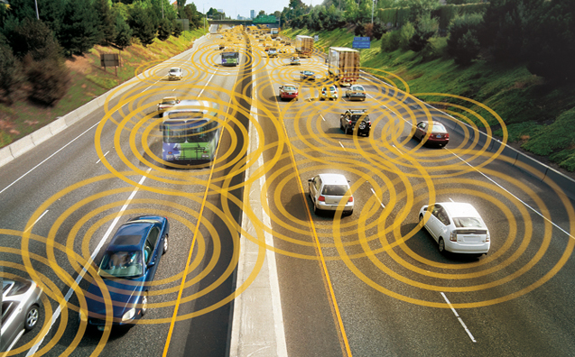
Why Connected Vehicles?
Nicholas McMahon 1
What causes car accidents?*
  Distracted Driving
  Speeding
  Drunk Driving
Annual US Crash Statistics ^{[2]}
  37,000 deaths
  2.35 million injuries
Annual Global Crash Statistics ^{[2]}
  1.3 million deaths
  20-50 million injuries
[1]
* Michael Pines, Top 3 Causes of Car Accidents in America, http://www.drivers.com/article/1173/ (April 18, 2014)
Notes:
Poll the class:
How many people here have been in a car accident?
Read accident statistics
How can we reduce the number of accidents?
Introduce idea of V2V Communication
Give example scenario
Curved road
View is obstructed by trees.
Road is narrow.
It is snowing.
What if your car could tell you about an oncoming vehicle around the curve?
Take the necessary actions to prevent a collision.

Slide 25
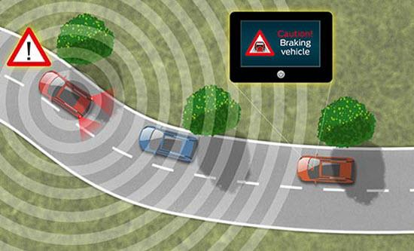
Government Interest
Nicholas McMahon 2
On February 3, 2014, the US Government announced mandate to ultimately have all vehicles equipped with V2V technology.^{[3]}
V2V technology can address a large majority of crashes.
[4]
Notes:
On February 3rd of this year, the US government announced its mandate to enable vehicle to vehicle communication technology in future vehicles.
DOT research indicates that safety applications using V2V technology can address a large majority of crashes involving two or more motor vehicles
Sending data such as speed and location
Car can identify risks
Provide drivers with warnings
Current systems (the ones of the mandate) DO NOT automatically operate any vehicle systems.
However, they are expected to blend with future V2V technology

Slide 26
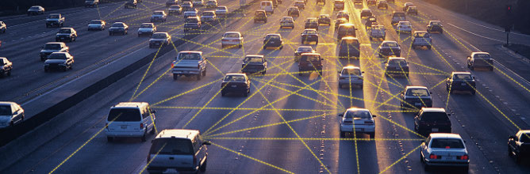
What are the requirements?^{[6]}
Nicholas McMahon 3
Low Latency
Reliable access
Scales well
[7]
Notes:
V2V is a safety system, so reliability is top priority
Low latency is crucial. Reliability is crucial.
Must be able to scale well.
Currently, systems can become much more complex with dense traffic
Some research is looking into multi-hop v2v networks.

Slide 27
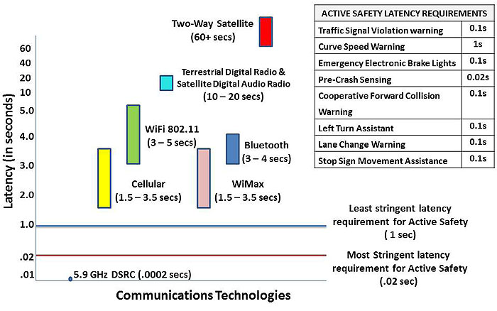
DSRC is Fast Enough^{[8]}
Nicholas McMahon 5
Latency Requirements of Active Safety Applications
[8] Christopher Hill, Connected Vehicles, http://www.pcb.its.dot.gov/eprimer/module13.aspx (April 16, 2014)
Notes:
The red line represents the strictest latency requirements (pre-crash sensing)
The blue line represents the least strict latency requirement (curve speed warning)
None of the other technologies meet this requirement.
Dedicated Short Range Communications provides:
Fast network acquisition
High reliability
The ability to work on vehicles at high speed
Immunity to weather conditions
Security
Prioritization of safety messages.
DSRC is 5.9 GHz with a 0.0002 second latency. 300km to 1000km
Well below the other wireless technologies.

Slide 28
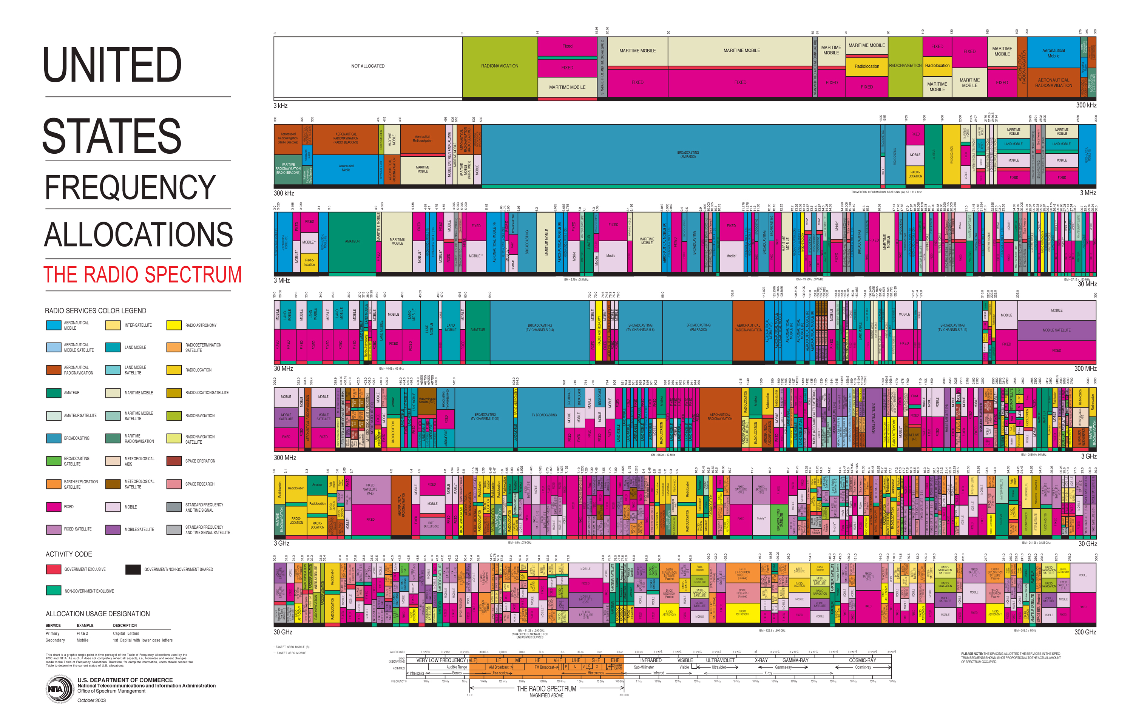
Nicholas McMahon 4
[5]
Notes:
Electromagnetic spectrum is a finite resource
The challenge is finding spectrum to use for this technology.
Possibility of using spectrum previously dedicated to TV channels

Slide 29
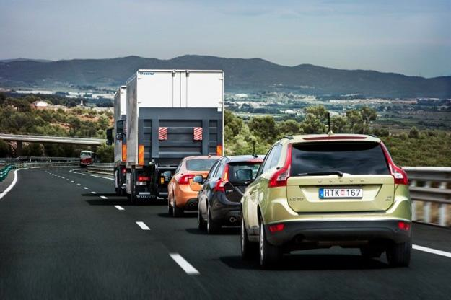
Volvo SARTRE Project^{[9]}
Nicholas McMahon 6
Professional Driver
Wireless Communication
Existing Safety Systems
  Cameras
  Radar
  Laser Sensors
10,000 km total in tests beginning in 2009
Tested on public roads in May of 2012 in Barcelona, Spain.
[10]
Notes:
Safe Road Trains for the Environment
An example of a semi-autonomous car
Led by a professional driver
Uses wireless V2V communication and existing sensors to detect safety hazards
Acceleration and braking mimic the lead driver.
Tested on public roads for 200 km distance
Travelled 10,000 km total in tests since 2009
Users can do other tasks while in a road train, like use a laptop or read a book
Quick acclimatization

Slide 30
Conclusions
Nicholas McMahon 7
V2V communication could greatly reduce automobile collisions
Reliability is key to ensure safety
V2V communication could lead to reliable semi-autonomous cars.

Slide 31
Sources
Nicholas McMahon 8
[1] http://images.thecarconnection.com/med/department-of-transportation-vehicle-to-vehicle-v2v-program_100349712_m.jpg (April 16, 2014)
[2] Road Crash Statistics, http://www.asirt.org/initiatives/informing-road-users/road-safety-facts/road-crash-statistics.aspx (April 16, 2014)
[3] U.S. Department of Transportation Announces Decision to Move Forward with Vehicle-to-Vehicle Communication Technology for Light Vehicles, http://www.nhtsa.gov/About+NHTSA/Press+Releases/2014/USDOT+to+Move+Forward+with+Vehicle-to-Vehicle+Communication+Technology+for+Light+Vehicles (April 16, 2014)
[4] http://media-social.s-msn.com/images/blogs/00100065-0000-0000-0000-000000000000_00000065-06d9-0000-0000-000000000000_20130620183641_ElectronicBrakeLight_01_preview.jpg
[5] http://urbanomnibus.net/redux/wp-content/uploads/2011/07/allochrt.jpg
Notes:
<Your notes here.>

Slide 32
Sources
Nicholas McMahon 9
[6] Erik Ström, Hannes Hartenstein, Paolo Santi and Werner Wiesbeck, Vehicular Communications: Ubiquitous Networks for Sustainable Mobility, http://publications.lib.chalmers.se/records/fulltext/local_129711.pdf (April 16, 2014)
[7] http://www.kapsch.net/KapschInternet/media/TrafficCom/Header/KTC_Header_v2x.jpg
[8] Christopher Hill, Connected Vehicles, http://www.pcb.its.dot.gov/eprimer/module13.aspx (April 16, 2014)
[9] SARTRE road train premiere on public roads, http://www.volvocars.com/intl/top/corporate/news/pages/default.aspx?itemid=373 (April 16, 2014)
[10] http://www.digitaltrends.com/wp-content/uploads/2012/05/Project-Sartre-Volvo-road-train-travels-120-miles-autonomously-in-Spain.jpg
Notes:
<Your notes here.>

Slide 33
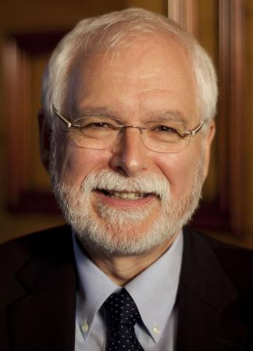
Mind Controlled Robotics
Elina Saint-Elme
https://news.brown.edu/pressreleases/2011/04/donoghue
Notes:
John Donahuge = the director of the Institute for Brain Science at Brown University,
His philosophy: Right now, people with paralyzing injuries or diseases can only imagine what it's like to move. But in the future, imagining may be enough to control robotic limbs that can assist them

Slide 34
What is it and how does it work?
Elina Saint-Elme
neural microphone (EEG)
record spikes
average spikes
convert
[1]
Notes:
NUERAL MICRPHONE
Neurons in the brain create electric signals. When the neurons are sufficiently tickled by inputs, they fire electrical impulses called spikes. We have a simple tool to record those spikes, the microelectrode, which has been around since the 1930s. EEG [electroencephalography] electrodes record the neurons' activity from outside the head or on top of the cortex, but the resolution is blurry.
So you created that neural microphone—a silicon chip with 100 electrodes implanted in the brain
Record spikes
Once I have the microelectrode array in your motor cortex, the brain's command center for movement, you watch a cursor on a video moving left and right. I then say, "Imagine you’re doing that by moving your hand on a mouse." As you imagine doing this, and the cursor moves to the right, I record the number of spikes, and it's five. And when the cursor moves to the left, it’s two. So now I have a coding model. Five means right, two means left.
Average spikes
That's what's so remarkable. The brain operates over broad networks. There's a tendency to think you've got one neuron that’s saying "left." But if that one cell dies, it doesn’t make any difference, because the message is distributed over many neurons. Of the many million neurons in the motor cortex, most of them have some kind of information about leftness. Now, the code for a single neuron is not so simple. Sometimes imagining left might produce two spikes, sometimes four. It's variable. So we average a set of neurons together. With [my patient] Cathy, we were using a few dozen neurons, and the computer decoded the likelihood that they were signaling "go left" or "go right."
Convert
The signal comes out of the computer, and it's converted into electronic commands that the robot arm understands as: move a little bit forward, back, up, down, go left, go right, or open or close the hand

Slide 35
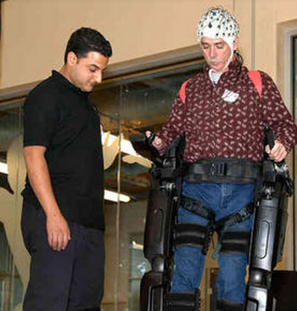
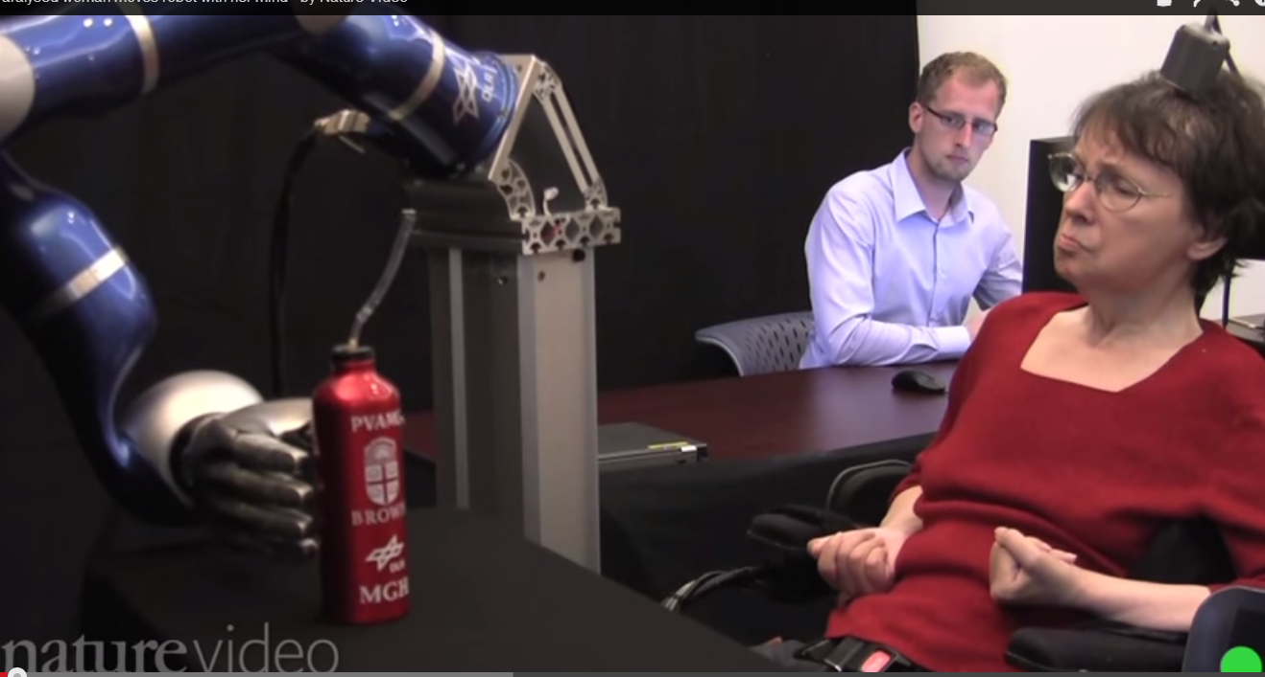
How are they used?
Elina Saint-Elme
[3] [4] [5] [6] [7] [9]
Notes:
Cathy Hutchinson = spectrum 1 using mind to control a surrogate device.
Steve Holbert = spectrum 2= using mind to control devices that attached to the body, like an exoskeleton.

Slide 36


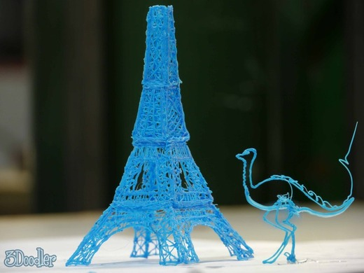
How are they used?
Elina Saint-Elme
Notes:
Picture 1: Create and play music with only your mind MiND ensemble (Music in Neural Dimensions) from the University of Michigan.
Picture 2: Create objects with your mind
George Laskowsky, the chief technical officer of the Santiago-based startup Thinker Thing, created the first-ever such object in January 2012.
The Thinker Thing system employs an Emotiv EPOC EEG headset to map its wearer's brainwaves. The company's Monster Dreamer project gave schoolkids the opportunity to use the software to create the monster of their dreams, or nightmares, in a matter of minutes.
Picture 3: Control another body with the mind via internet
Scientists achieved the first remote human-to-human brain interface this week, when Rajesh Rao sent a brain signal over the Internet that moved the hand of colleague Andrea Stocco—even though Stocco was sitting all the way across the University of Washington's campus.
Using one human brain to direct another person's body via the Internet was an amazing breakthrough. But other feats of mind control are already realities, particularly in the realm of human machine interfaces (HMIs).

Slide 37
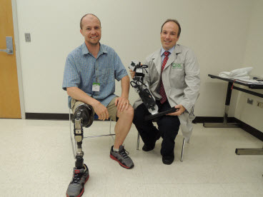
Errors and Risks
Elina Saint-Elme
Problem = Low response time
Problem = Brain signals change over time
Possibility of 12.9% to 1.8% error reduction
[10] [11][12]
Notes:
Problems with devices for people like Kathy Hutchinson.
In the example of Kathy hutinson, the response time between her thoughts and is slow. It lags. Fast time is critical, because the purpose is to make her movements as real - time as possible.
Since brain changes over time, the signal that is able is procuded originally needs to be updated. The lag is too long.. takes about 30 seconds for cup to reach her.
HOW TO SOLVE THESE PROBLEMS:
Keep bci tuned by its owner through online adaptations/
Detect errors using the eeg. To account for an offset. It preducts errors! Commands are executed if there are no errors, and this can happen wit the milliseconds.
These problems don’t exist with all brain controlled devices. With prosthetic legs, by increasing the readings of BPI and reading certain muscle movements, the errors decreased from 12.8 percent to 1.8%.

Slide 38
Conclusion
Elina Saint-Elme
Unpredictable brain behavior = main source for risk
Technology already exists to accommodate for unpredictable brain behavior
Notes:
The main source for risk = unpredictable brain behavior and offset.
Since the brain behavior is unpredictable, and there may be an offset and deal, thus error is critical! Because this is essentially a robot in the real world. (explain the two types of robots) off sets can result to damage in the world around it, and the user can’t really control it.
This is “new technology” the errors and risks that are currently exists, may not be an issue within a few years. Risks for the user can be non existence, as in the case with the prosthetics arm. As mentioned previously there are technologies for it.

Slide 39
Sources
Elina Saint-Elme
[1] http://discovermagazine.com/2013/jan-feb/7-debut-of-the-mind-controlled-robots 4/18/14
[2] http://www.ishitnoise.com/wiki/index.php?title=NO_MUSIC
[3] https://www.youtube.com/watch?v=ogBX18maUiM (image) 4/18/14
[4] http://computer.howstuffworks.com/brain-computer-interface.htm(image) 4/18/14
[5]http://cdn.dogomedia.com/system/ckeditor_assets/pictures/51251d641860e0676c006fa6/content_doodle6bd9c4b21565ef618416ddaac1125dbe_large.jpg (image) 4/18/14
[6] http://www.springlakeparkschools.org/news/201401/you-or-someone-you-know-may-qualify-reduced-rate-internet-service (image) 4/18/14

Slide 40
Sources
Elina Saint-Elme
[7] http://news.nationalgeographic.com/news/2013/08/130829-mind-brain-control-robot-brainwave-eeg-3d-printing-music/ 4/18/14
[8] http://www.kurzweilai.net/how-to-use-mind-controlled-robots-in-manufacturing-medicine 4/18/14
[9] http://www.cnet.com/news/next-up-in-robot-suits-for-the-paralyzed-mind-control/ 4/18/14
[10] http://www.medscape.com/viewarticle/811644 4/18/14
[11] http://infoscience.epfl.ch/record/146170/files/millan_2008_is.pdf 4/18/14
[12] http://www.pbslearningmedia.org/resource/nvsn6.sci.tech.arm/mind-controlled-robotic-arm/ 4/18/14

Slide 41
Dos and DDos
<Karl Kuhn>
Dos: Denial of Service Attack
DDos: Distributed Denial of Service Attack
Dos: is an attempt to make a machine or network resource unavailable to its intended users.
DDos: Sent by two or more persons or bots
Notes:
WOO, intro. Don’t have to go over what they are that’s proven by the demo and the book

Slide 42
Who wants to be a computer?
<Karl Kuhn>
Receive simple math problems as lists
Ex: 2,2 = 2+2 = 4
Rules:
  Addition only
  Only single digit numbers
Notes:
Chose someone, make him/her the computer
Give some examples of simple problems

Slide 43
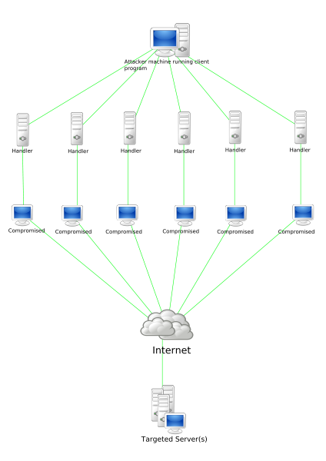
Techniques:
<Karl Kuhn>
Internet Control Message Protocol flood
SYN flood
Teardrop attacks
Peer to peer attacks
Application level floods
Nuke
HTTP POST DDOS attack
R U Dead Yet
Reflected / Spoofed attack
Unintentional denial of service
<http://upload.wikimedia.org/wikipedia/commons/thumb/3/3f/Stachledraht_DDos_Attack.svg/424px-Stachledraht_DDos_Attack.svg.png.>
Notes:
Choose 1 or 2 by class preference to go over.
Picture is not important… just kind of something to look at

Slide 44
Internet Control Message Protocol flood (ICMP)
<Karl Kuhn>
Smurf Attack:
  Misconfigured network devices
  Sends to all computers via broadcast address
  Uses up all bandwidth
Ping Flood:
  Overwhelms with ping commands
  Relies on attacker having high bandwidth
Ping of Death:
  Sending a malformed ping packet
  Pings are 56 bytes, send a 65K byte ping instead
<http://web.archive.org/web/20100914222536/http://anml.iu.edu/ddos/types.html>
Notes:
Smurf: covered last class
Ping: covered last class (out bandwidth war)
Ping of death: no longer a factor, since TCP/IP has gotten better, but in older computers one could fragment, then send, a ridiculously sized ping message.

Slide 45
(S)SYN flood
<Karl Kuhn>
Occurs when a host sends a lot of TCP/SYN packets
Server sends back TCP/SYN-ACK
Waits
Since the packets are false anyway, the half open connections keep the server busy.
<http://tools.ietf.org/html/rfc4987>
Notes:
We went over this last class, with pictures!... Basically lots of waiting for reply's slows down a server.

Slide 46
Teardrop Attacks:
<Karl Kuhn>
Sends mangled IP to an operating system
Due to bugs in TCP/IP fragmentation re-assembly code this could lead to crashes.
Effected operating systems:
  Windows 3.1x
  Windows 95
  Windows NT
  Linus pre 2.1.63
<http://www.cert.org/historical/advisories/CA-1997-28.cfm>
Notes:
Mangled packets are packets that simply are not coherence, often with inserted code used to confuse or disrupt firewalls.
Most modern firewalls can handle this.

Slide 47
Peer to Peer Attacks:
<Karl Kuhn>
Reroute peer to peer sites to an specific website
Most websites can handle a few hundred connections per second
A site could be hit with around 750,000 connections per second
Possible fix: Throttling Server and client side.
<https://tools.ietf.org/html/rfc6335>
Notes:
Imagine most of facebook trying to connect to some rarely used website.
Most common websites are big enough to handle the traffic
Throttling, is making sure the server is good enough if it slows down individual requests.

Slide 48
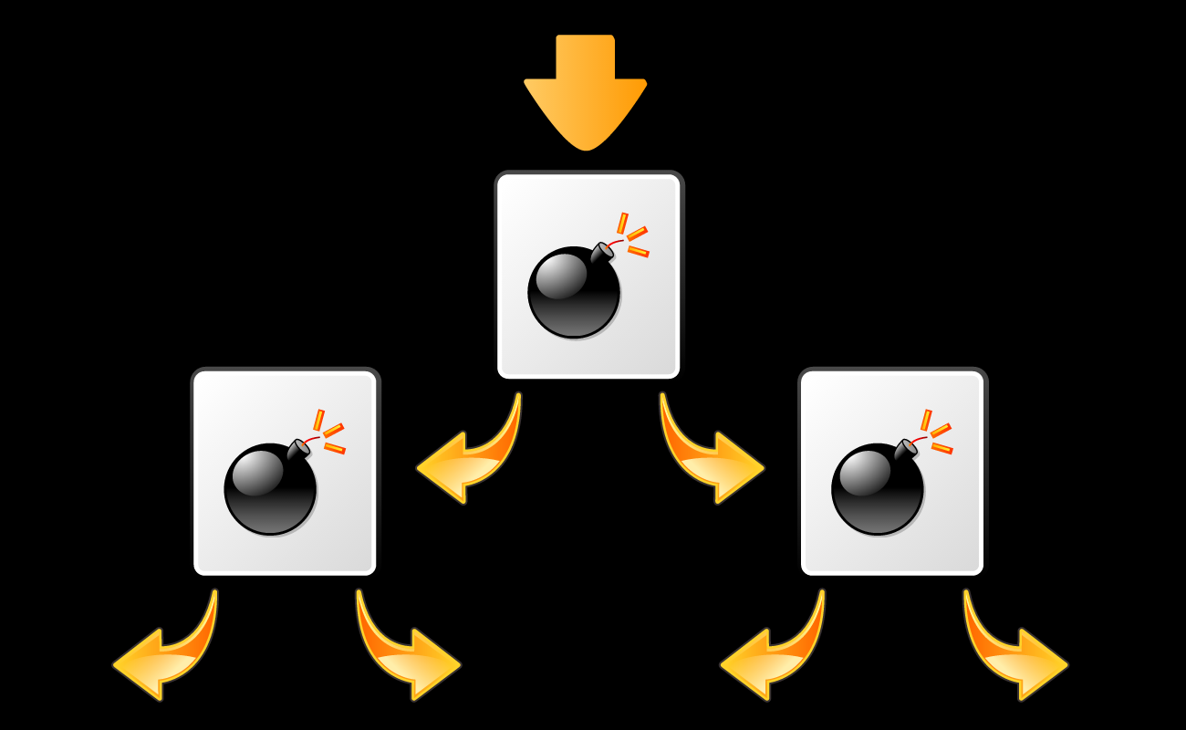
Application-level floods
<Karl Kuhn>
Abuse buffer errors in software.
Often leads to a fork bomb
Wastes run cycles.
<http://upload.wikimedia.org/wikipedia/commons/5/52/Fork_bomb.svg>
Notes:
In the abusable buffer someone writes a fork bomb
Fork bombs are simple, just call a fork function over and over again(think fork() in while{};
Exponential acceleration.

Slide 49
Nuke
<Karl Kuhn>
Sent corrupt internet control message protocol
Used ping to send them often
Windows 95, had a vulnerability in the NetBIOS handler that caused it to blue screen of DEATH when WinNuke was introduced
Notes:
Not a problem now that most computers correctly refuse corrup ICMPs
Winnuke used a “urgent pointer” giving it priority and it used that to blue screen it….

Slide 50
HTTP POST DDoS Attack
<Karl Kuhn>
Legitimate HTTP POST header
‘Content-Length’ field set to very large
Content sent very slowly (~1byte/100 seconds)
The target will attempt to wait and receive
Apache, by default, accepts 2 gigabytes of information
<https://www.owasp.org/images/4/43/Layer_7_DDOS.pdf>
Notes:
<Your notes here.>

Slide 51
R U Dead Yet? (RUDY)
<Karl Kuhn>
Clients send requests to a server, but never finish the request
Just keep the server interested for as long as possible
Filling up the maximum concurrent Connection Pool
<http://ha.ckers.org/slowloris/>
Notes:
<Your notes here.>

Slide 52
Reflected / Spoofed Attack
<Karl Kuhn>
Send a forged request
Computers read this request and send back
But to the target
Floods the target with replies
<http://www.internetsociety.org/sites/default/files/01_5.pdf>
Notes:
A type of DDoS from a single computer. Your single computer sends requests to as many computers as it can then all of those computers send requests to the

Slide 53
Unintentional denial of service
<Karl Kuhn>
Most DDoS occurrences are caused by a attacker overflowing a server
This occurs when a website is simply overflowing from a popularity spike.
Google crash after Michael Jackson died
<http://news.bbc.co.uk/2/hi/8120324.stm>
Notes:
Oops.
Most websites are trying to have a far larger available cap than nessary

Slide 54
Finding out?
<Karl Kuhn>
To figure out if you are being DDoS’d
  Ping a reliable server (google) and judge response
  Run Netstat
    Open command prompt
    Type “netstat –ano”
    This will show all current connections if the list is particularly suspicious (a lot from one IP, states too consistent) or large could be a DoS or DDoS attack.
    Updates about once per second, if one is getting DDoSed it will be noticeably faster
Notes:
Basically, trying to figure out if wpi internet is just being a problem, or if there is actual DDoSing going on.

Slide 55
Prevention
<Karl Kuhn>
Take network traffic and run it through a filter
Try to parse, what is human, and what is bot
Compare signatures and attributes of the traffic
  IP addresses
  Cookie variations
  http headers
  Javascript footprints
Simply changing IP address works for individuals
Virtual private network and proxy servers
Update Skype!
Notes:
Most modern firewalls try to parse
Disallow buffers to execute code
Change the “to” location
VPN -> masks the sending location
Previous versions of skype allowed a direct access from computer to computer with only knowing the username. One could then Ddos that IP address
Most recent version of skype has an option to turn direct access off.

Slide 56
Sources
<Karl Kuhn>
W. Eddy, TCP SYN Flooding Attacks and Common Mitigations http://tools.ietf.org/html/rfc4987 (4/16/14)
Types of DDoS Attacks, http://web.archive.org/web/20100914222536/http://anml.iu.edu/ddos/types.html (4/16/14)
http://upload.wikimedia.org/wikipedia/commons/thumb/3/3f/Stachledraht_DDos_Attack.svg/424px-Stachledraht_DDos_Attack.svg.png (4/16/14)
IP Denial-of-Service Attacks http://www.cert.org/historical/advisories/CA-1997-28.cfm (4/16/14)
Special Agent Barbara Woodruff, Phony Phone Calls Distract Consumers from Genuine Theft, http://www.fbi.gov/newark/press-releases/2010/nk051110.htm (4/16/14)
Internet Engineering Task Force (IETF), https://tools.ietf.org/html/rfc6335 (4/16/14)
Wong Onn Chee and Tom Brennan, H…t…t…p…p…o…s…t, https://www.owasp.org/images/4/43/Layer_7_DDOS.pdf (4/16/14)
http://ha.ckers.org/slowloris/ (4/16/14)
Maggie Shiels, Web slows after Jackson’s Death, http://news.bbc.co.uk/2/hi/8120324.stm (4/16/14)
Matthew Gunnin, DDoS Prevention Guide http://lol.gamepedia.com/DDoS_Prevention_Guide#VPN (4/16/14)
Notes:
<Your notes here.>

Slide 57
Overview
Security & Errors, Failures, And Risks
Assignment
Students Present
Guest Speaker

Slide 58
Class 10
The End
Keith A. Pray
Instructor
socialimps.keithpray.net
Notes:
This is the end. The slides beyond this point are for answering questions that may arise but not needed in the main talk. Some slides may also be unfinished and are not needed but kept just in case.

Slide 59
Risk
What is it?
Chance of it happening?
  Random, Historical statistics, Analysis
Give examples of risks with computer systems
Notes:
Something that could go wrong. Natural, deliberate, accidental…
Inherently random, like Roulette - 1/37 or 1/38 chance of any one number coming up.
Historical statistics, Number of auto accidents per passenger-mile.
Analysis, Nuclear accident, Power grid, Asteroid strike, Chance of failure of various components.
Hardware failure, Software failure, Data corruption, Incorrect data, Disclosed data, Weird things, Hardware failure is pretty rare and can be checked. (Alpha particles? / ECC), Computer falling on you., Accidental war, Traffic-stop suicide, Therac

Slide 60
Predicting Risk
What are the factors?
Enough data to be statistically significant?
Can you reduce or increase your own risk?
  Chance
  Severity
Notes:
Space Shuttle
Disease: exposure, vaccination, hand washing, quarantine.

Slide 61
Reliability Of Statistics
Are other factors controlled?
Is enough time covered?
Is all data reported?
Notes:
Power line dangers. Electromagnetic fields? PCBs in transformers?

Slide 62
Cost-Benefit Analysis
How much does it cost?
What do I get for this cost?
Notes:
Like a social contract.

Slide 63
Risk-Benefit Analysis
What could go wrong?
How likely is it?
How costly are the consequences?

Slide 64
Limitations to
Risk-Benefit Analysis
Hard to quantify probabilities
Hard to quantify costs
Who bears the costs?
Are the potential benefits worth it?
Notes:
What is the value of a human life?
What is the value of a species?
E.g. future generations, poor people.
Omelas

Slide 65
Some Measures
Mean Time To Failure (MTTF)
Mean Time Between Failures (MTBF)
Mean Time To Repair (MTTR)
Notes:
Is it repairable?
What does it mean to repair? Running again? Data fixed? Caught up?
Restoring the GBC Web site.

Slide 66
Relying Too Much
Limits of modeling reality
Limits of precision
Limits of algorithms
Limits of interpretation
Notes:
Battle of the X-Planes
Trusting the statistics. Are differences significant?
Colin Chapman’s Lotus 7 chassis.

Slide 67
Value of Intuition
Are results reasonable?
Notes:
Trust in computer infallibility.
Statistics software.

Slide 68
Producing Good Software
Good specifications
Good usability
Good design
Robustness
Good implementation
Testing
Notes:
Specs: Know what you are going to do. Often difficult. What does the customer want? What does the customer need?
Usability: Logical and intuitive, Consistent, Helpful, Complete, Accessible, Disability. Complete—not have to write things down.
Design: Logical, Modular, Consistent, Well-specified, Flexible, Extensible, Adaptable, New features, new platforms.
Robustness: Tolerant of data errors, Tolerant of human errors, Tolerant of network errors, Enough detail / not too much. Stack trace vs. “?” “A script error has occurred. Do you want to debug?”
Implementation: Adequate hardware (E.g. memory, storage, speed), Adequate software (Languages, OS, libraries), Internal and external documentation
Testing: Should be at all phases of the development cycle. Plan ahead for it. Consistent, repeatable, documented. Regression testing.

Slide 69
Plan For The Long Term
Version control
Future development
New platforms
Patches
Security
Training
Customer support

