Slide 1
Class 9
Crime
Keith A. Pray
Instructor
socialimps.keithpray.net
Notes:
Here’s the title slide. Is anyone not excited?

Slide 2
Overview
Crime
Assignment
Students Present

Slide 3
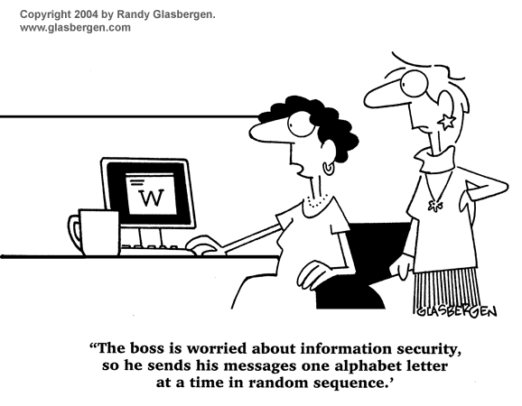
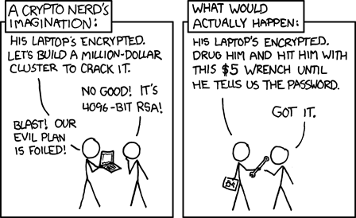
http://xkcd.com/538/ (2010-11-14)
Notes:
Are there any questions on the assigned reading?
Use the slides ahead to explain any of the attack methods from the text.
If there are no questions you can skip those slides.

Slide 4
Buffer Overrun
Run time stack
Local Variables
Return Address
Parameters
Variable Attack
buffer
Target Variable
Stack Attack
buffer
Return Address
code
Return Address
Notes:
When a function call is made, local variables, return address, parameters stored on run time stack. Local variables occupy lower memory addresses.
Variable attack – change variable value. Program expects user to input character and allocates a buffer for them. Attacker supplies too many characters and ends up over writing a variable.
Stack Attack – goal is to change value of return address so execution control goes to code which the attacker has provided in the input buffer.
Prevention: add checks against array bounds being exceeded, or modify operating system to not execute instructions stored on run time stack.

Slide 5
TCP Three-way Handshake
SYN
SYN-ACK
ACK
Notes:
SYNchronize
SYNchronize ACKnowledgement (socket reserved awaiting ACK)
ACKnowledgement
TCP socket connection established

Slide 6
SYN Flood Attack
Target
Attacker
SYN
SYN-ACK
Notes:
Attacker spoofs the IP address so the SYN-ACK is sent to a different machine that cannot respond to the SYN-ACK.
This leaves the connection half open on the server machine decreasing the resources (sockets, memory, threads/processes) available to respond to legitimate clients.
The attacker send many such spoofed SYN messages.

Slide 7
Ping Attack
Target
Attacker
ping
ping
Notes:
Attacker finds routers that support broadcasting messages to all computers on their local area networks.
The attacker sends a spoofed ping message, which the routers echo to the spoofed address.

Slide 8
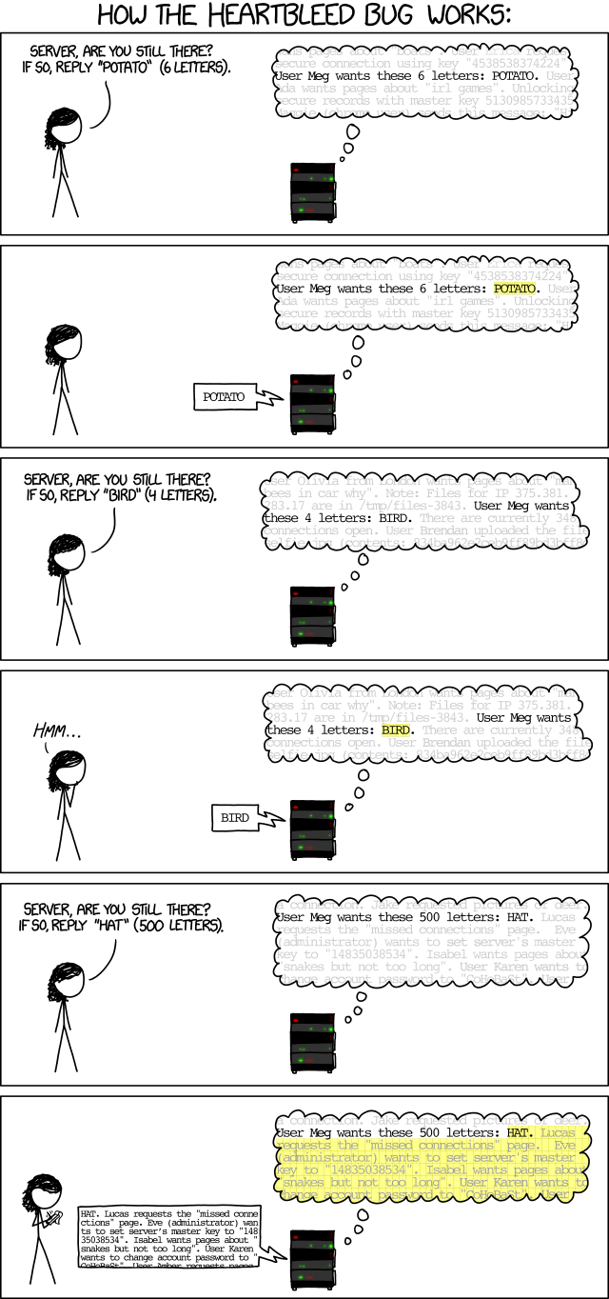

Penny Over
HeartBleed
OpenSSL: open source library for secure message passing on internet, part of https encryption
HeartBeat: Keep alive for connections to server, inside OpenSSL
HeartBleed: exploit in HeartBeat, where there is no bounds checking, so servers will spit out random memory if the size asked for is too big.
4/14/14
© 2014 Keith A. Pray
8
Notes:
Https is very common, does not affect http
Change passwords on protected systems
Examples: tumblr, GitHub
http://heartbleed.com/
http://searchsecurity.techtarget.com/definition/Secure-Sockets-Layer-SSL
https://www.openssl.org/
http://xkcd.com/1354/
4/14/14
8

Slide 9
Group Quiz
A denial of service attack shuts down a bunch of retailer, stock brokerage, large corporate entertainment and information web sites. Possible guilty parties:
  Terrorist who aimed to cause billions of damage to U.S. economy.
  Protest organization opposing commercialization of the web and corporate manipulation of consumers.
  Script kiddie just having fun with tools he found on the web.
  Show off hacker in search of bragging rights.
State what penalties are appropriate for each.
Explain your answer to 1. using a single Ethical Theory for all.
Name the laws/acts under which these parties could be prosecuted.
Notes:
Note: short answer format expected.
Note: 2. only one argument needed, should include logic for all parties
Note: 3. same law(s) should be applicable to all parties

Slide 10
Overview
Crime
Assignment
Students Present

Slide 11
Assignment - Code Testing 1/2
Design tests for the code on the following slide.
Contains at least one major defect and several minor ones.
Write a paper (1-2 pages OK not counting source) including :
  Did you choose a good test strategy? (This is your conclusion.)
  The inputs and expected outputs
  What defects you found
  How you would fix the defects (you may include fixed source)
  Why would that fix the problems?
  What could happen if the defects are not found before the code is put into production?
Working example: http://socialimps.keithpray.net/assignments/index.jsp?content=Code_Test.jsp
Notes:
The online working example source code is best not viewed with IE though looking at the source for the page will reveal the implementation.
If guest presenter coming next class remind students to prepare questions for him.
Remember to work on groups projects.
Each group should have material on their sites for the topics we’ve covered so far.

Slide 12
Assignment - Code Testing 2/2
import java.text.NumberFormat;
public class SalesFun {
public static double calculateSalesTotal ( double amount, double discountRate, double taxRate ) {
double discount = amount * discountRate;
double total = amount - discount;
double tax = total * taxRate;
double taxedTotal = tax + total;
NumberFormat numberFormat = NumberFormat.getCurrencyInstance();
System.out.println ( "Subtotal : "+ numberFormat.format ( amount ) );
System.out.println ( "Discount : " + numberFormat.format ( discount ) );
System.out.println ( “Total : “ + numberFormat.format ( total ) );
System.out.println ( "Tax : " + numberFormat.format ( tax ) );
System.out.println ( "Tax+Total: " + numberFormat.format ( taxedTotal ) );
return taxedTotal;
}
}
} Lines of interest
Notes:
Bold lines are real focus.
Example input:
amount = 100.05;
discountRate = 0.10;
taxRate = 0.05;
OR
70.0, 0.0, 0.05
95.67, 0.20, 0.7

Slide 13
Overview
Crime
Assignment
Students Present

Slide 14
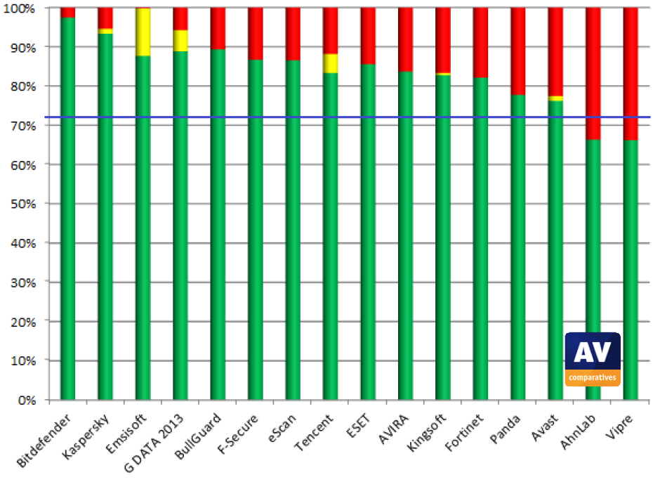
Virus Scanning
James Anouna
Signature Scanning[4]
  Most common
  Only works for known viruses
Heuristic Algorithms[2]
  Can detect unknown viruses
Analysis of the heuristic capabilities of a variety of virus scanners
Image: http://www.av-comparatives.org/wp-content/uploads/2013/08/avc_beh_201303_en.pdf [1]
Notes:
Signature scanning involves checking the contents of files against a database of known virus signatures. Can also be used to find viruses that are very similar to known viruses (different skin, same body).
Heuristic algorithms look for patterns in the code or behavior of programs and attempt to identify malicious intent. Can be used to identify previously unknown viruses.
Picture is an analysis of the proactive (heuristic) network analysis done by AV Comparatives (an independent anti-virus benchmarking group) in 2013. Green is percent viruses caught, yellow is user-dependent, and red is percentage missed by each scanner. The blue line is the percentage caught by Microsoft Security Essentials (used as a reference because it comes pre-installed in out-of-the-box Windows 7). Does not include false positives (handled in a separate study). In a test of an unknown number of commonly downloaded software packages was done to test false alarms on these products. MSE had very few false alarms, most had 3-15, and G Data, eScan, and a couple of the weaker ones had many (over 15) false positives.

Slide 15
Strategies for Heuristic Scans
James Anouna
Examine Program Code[2]
  Decompile executables
  Macros in word processors
  Email attachments in preview mode[3]
Run Programs in VMs[2]
  “Sandbox”
  Examine behavior
Notes:
In the case of executables, the assembly for the program is examined to determine whether or not a program is a virus. Deleting other files or self-replication are a couple of key indicators of a virus. In addition to executables, word documents and other files that can contain macros also have the potential to contain viruses. This includes previewing email attachments in an email client, and it some cases even just opening the email body can activate a hidden virus. These files must all be scanned to keep a system completely safe.
Another method used in heuristic scanning is to run a suspicious program in an isolated virtual machine, or “sandbox.” In this “sandbox” the anti-virus program looks for clues in the operation of the program that may indicate malicious intent.
When a program or file is believed to be infected with a virus, it is quarantined by the program, and the user is notified, just like in a normal signature scan.

Slide 16
Advantages
James Anouna
Can identify unknown viruses
  Signature scanning can’t do that
  Can find variants of existing viruses
Notes:
What more reason do you need?

Slide 17
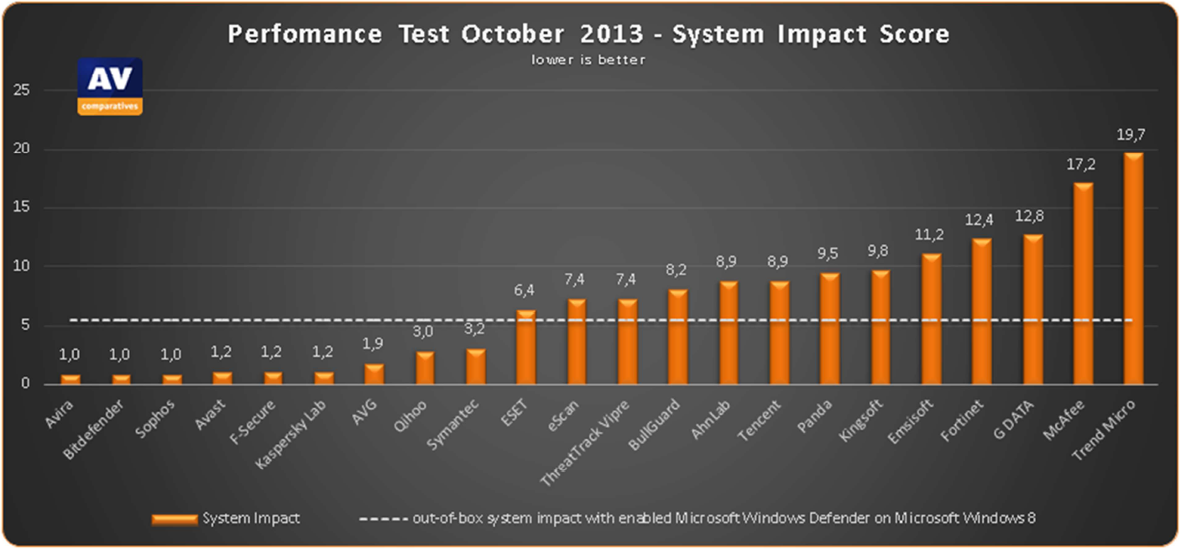
Disadvantages
James Anouna
Human Algorithms
False Positives
  Users are the final arbiter
  Difficult to read the technical jargon
System Resources
  Another step
The relative impact of various AV packages on system resources
Image: http://www.av-comparatives.org/wp-content/uploads/2013/11/avc_per_201311_en.pdf [1]
Notes:
The heuristic algorithms cannot possibly be perfect, and can only search for virus behaviors that the algorithm writers think of. If a new virus appears that has very different behavior than all previous viruses then no algorithm will find it without modifications.
The average user doesn’t know what to do with Windows User Account Control. If a window pops up that says some random file they have never heard of is malicious, they are not going to second guess the “all-knowing” anti-virus program they pay $20 a year for. False positives are bad.
Heuristic scanning takes a lot longer (either scanning the code, running in the sand box, or both) and is another step on top of the normal signature scan.
Chart: low is good. Windows Defender on Windows 8 is the reference at 5.5

Slide 18
Is it worth it?
James Anouna
Provides an additional layer of protection
  Other methods can’t find new viruses
Takes additional time
A (slightly) slower working computer or a fast infected computer?
Notes:
Infections improve your immune system, right? Only if they don’t kill you.

Slide 19
Sources
James Anouna
[1] AV Comparatives http://www.av-comparatives.org/ (4/14/14)
[2] Taylor Thomas, What is Heuristic Virus Scanning? http://internet-security-suite-review.toptenreviews.com/premium-security-suites/what-is-heuristic-antivirus-detection-.html (4/14/14)
[3] Kapersky Antivirus https://support.kaspersky.com/us/8641 (4/14/14)
[4] Symantec http://www.symantec.com/connect/articles/heuristic-techniques-av-solutions-overview (4/14/14)

Slide 20
TCP/IP Vulnerabilities
Saraf Rahman
Background
  Definition of TCP/IP
  How it works
Thing to think about:
  Why does this matter?
  How does this affect me?
  How does this affect society?
Notes:
Hi everyone, I’m Saraf and today I’m going to talk about TCP/IP Vulnerabilities. TCP stands for transmission control protocol and deals with making sure that packets are delivered from one computer to another, and IP stands for Internet Protocol and deals with routing these packets from one node to another. Another way to look at the relationship is that TCP kind of sits on top of IP.

Slide 21
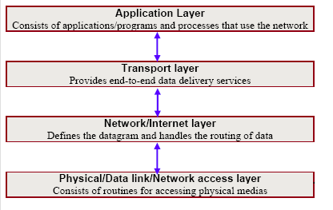
Saraf Rahman
TCP/IP Stack
Notes:
The TCP/IP Stack has four ‘layers’: the application layer has protocols like HTTP, SSH, TLS/SSL, etc. This layer is a bit flawed because, for example, two of the protocols that are in the application layer are HTTP and TLS/SSL, but HTTP depends on TLS/SSL for security purposes. The Transport Layer has protocols such as TCP, UDP, etc. and it is the layer that actually delivers and receives the data. The Network Layer includes protocols like IP, ICMP, IGMP, etc. and deals with how data is routed, and the last layer is the Link or Physical Layer which includes things like Ethernet, wifi, etc. The vulnerabilities occur because IP is not reliable. Unlike TCP, IP is a connectionless protocol meaning that it just doesn’t know if a packet that was sent was actually received

Slide 22
Packet Sniffing
Saraf Rahman
Types
  Commercial
  Underground
Protocol Vulnerabilities
  HTTP, Telnet & rlogin
Notes:
Packet sniffing – act of intercepting + reading network traffic that’s transmitted across a shared network
Commercial – used to maintain networks
Underground – used to break into computers
Packet Sniffing is a double-edged sword because it’s necessary in order to maintain networks, but can also be exploited in order to gain access to unauthorized information.
Protocols that are vulnerable: http, telnet and rlogin. HTTP is vulnerable because a lot of websites that use this just have basic authentication which send your username and password in plain-text across the network. Similarly, with Telnet & rlogin, packet sniffers can capture keystrokes as a person is typing them, so that’s another way that these sniffers can access your username and password. By placing a packet sniffer on a network in promiscuous mode, an intruder can capture and analyze all of the network traffic.

Slide 23
Sniffing Prevention
Saraf Rahman
Use of encryption tools
  Deslogin
  Kerberos
  One time password techniques – KeePass
Tools to detect packet sniffers
  Antisniff
  Neped
  Sentinet
Notes:
There are many methods to prevent sniffing such as using authentication schemes that will make sure that your information is not sent in plain text across the network. There’s also a way in Unix machines, to find all sniffer programs running in promiscuous mode.

Slide 24
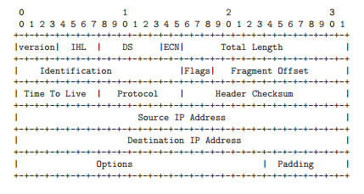
IP Spoofing
Saraf Rahman
Types
  Non-blind
  Blind
How it’s done
  Connection Killing
  Connection Hijacking
Notes:
IP Spoofing – in order to gain access, hackers create packets with spoofed source IP address which exploits applications that use authentication based on IP addresses.
Hijacking – Once hackers have root access, they can hijack an existing terminal and login connections from any user on the system
Non-blind spoofing – to interfere with a connection that sends packets along your subnet
Blind spoofing – to interfere with a connection or creating one, that doesn’t send packets along your cable
Connection killing – send a fake reset packet. All you need to do this is the correct sequence number, and then send this flag and kill the connection. You can also send a FIN flag with states that no more data will be sent over the connection so the receiving server ignores the rest of the data that’s sent. Connection Hijacking is really where IP’s flaws come into play. This is when Server A and Server B are sending information, then an intruder decides to take over, so they impersonate Server A by providing Server B with the correct Sequence and Acknowledgement numbers

Slide 25
Denial of Service
Saraf Rahman
Types of Attacks
  Email Bombing and Spamming
  Virus
  Crashing Systems with Ping Flooding
Notes:
Denial of Service (DoS) Attacks are almost always fueled with malicious intent. These attacks are difficult to prevent against because there are about 21 different types of attacks and they are very widespread, so it’s often difficult to pinpoint the problem quickly. 3 attacks that I chose in particular are because they are ridiculously easy to launch and very difficult to prevent. For example, email bombing is where an attacker will send an identical email message to an address repeatedly which results in high bandwidth for the victim, less space on a hard disk, etc. Email spamming is about sending email to a bunch of people and the effect on bandwidth is similar. There’s no way to prevent it.
Viruses are written specifically to spread and destroy systems and is the most famous type of DoS attack. There is a notion that writing viruses are difficult, but if you know assembly language and have source code to work with, it’s really easy. There are even tools out there that will help programmers learn how to write a virus.
If someone can ping a machine, it’s possible to reboot or freeze it. The attacker has to write one line in the command prompt and include the machine address they want to target, and the machine will freeze or reboot. This works for older operating systems

Slide 26
Denial of Service
Saraf Rahman
Solutions
  Security Patches
  Check for Attacks
  Extra Security Systems
  Monitoring Security
  Keeping Up to Date
Notes:
There’s no way to make sure that your machine is completely safe from DoS attacks, but there are steps you can take to reduce the risk of an attack. Some of these solutions are things you should be doing like keeping your system up to date and monitoring security. However, solutions like security patches are temporary because patches change over time. Obviously, if you suspect an attack, check for them and add extra security measures

Slide 27
Conclusion
Saraf Rahman
TCP/IP Vulnerability because of IP
Need to be more aware of these attacks
Impacts on society
Notes:
In conclusion, TCP/IP Vulnerability is largely due to the unreliability of IP and TCP’s dependency on this unreliable protocol.
The point of attacks like packet sniffing and IP spoofing is designed to get your information, so protecting against it is very important. Especially as students on a network, we are more susceptible to these attacks. The consequences of TCP/IP vulnerabilities is that these attacks can breach not only our personal security, but everyone in the network’s security as well. Preventing against these attacks are important in order to protect your information and the information of others.

Slide 28
Sources
Saraf Rahman
Gilbert, H. “Introduction to TCP/IP”. 04-11-14. http://www.yale.edu/pclt/COMM/TCPIP.HTM
Slater, Bill. “How TCP/IP Works”. Diagram. 04-09-14. www.billslater.com/internet/
Venkatesan, Rudrakumar. Lakkavalli, Shashidar. “TCP/IP Vulnerabilities”. ECE 478/578 Computer and Network Security Project. 04-03-14. http://cs.ucsb.edu/~koc/ns/projects/00Reports/LV.pdf
Quinn, Michael J. “Ethics for the Information Age”
Kak, Avi. “Lecture 16: TCP/IP Vulnerabilities: IP Spoofing and Denial-of-Service Attacks”. 04-14-14. https://engineering.purdue.edu/kak/compsec/NewLectures/Lecture16.pdf
Notes:
<Your notes here.>

Slide 29
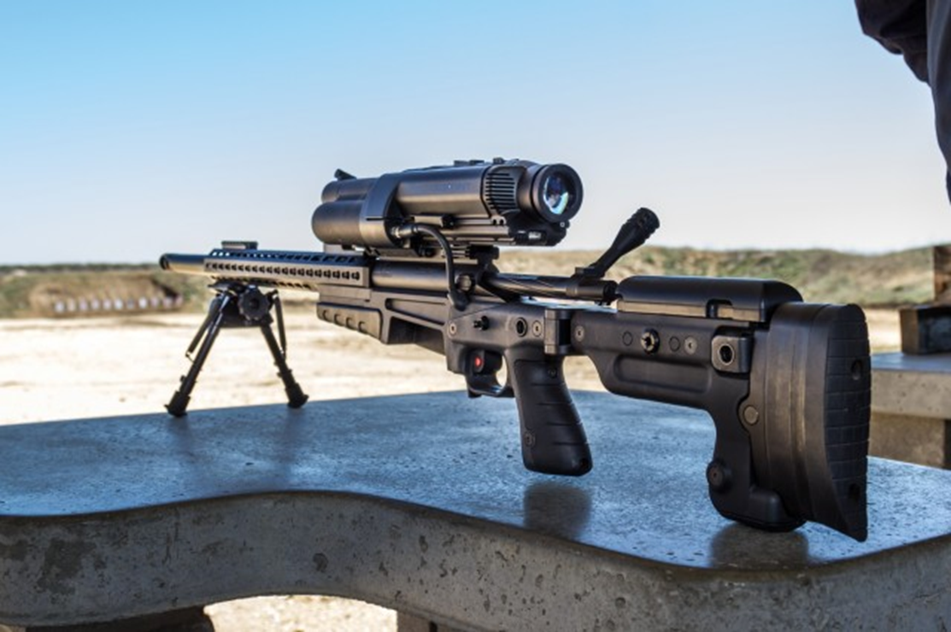
The XS1 Linux Powered Sniper Rifle
Kyle Davidson
3
Notes:
The XS1 Rifle produced by the TrackingPoint company is capable of hitting targets accurately from over 1000 yards away (when used by a first timer).
You may ask yourselves how such a weapon could affect the public outside of its intended use as a hunting rifle, such as being used by criminals.

Slide 30
Shooting Information
Kyle Davidson
Three step shot: tag -> pull trigger -> optimal shot ¹
Visual of shot sequence:
Notes:
Three step shots
Tag – this marks where you want your bullet to hit using a laser, changes the reticle to target mode
Track – the embedded system image keeps track of the location on the surface where your tag was placed
Optimal shot – hold down the trigger, turning the image crosshair red, then overlap the reticle and the tag, if the gun is held steady it will fire

Slide 31
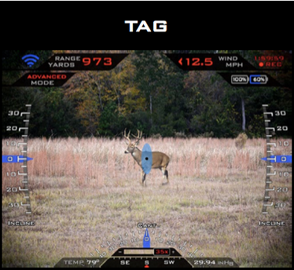
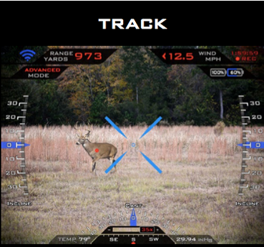
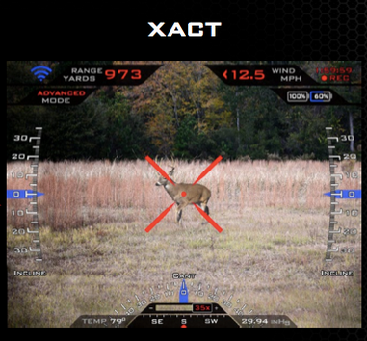
Kyle Davidson
4
Notes:
A visual of the steps to shooting:
The animal is tagged
The animal moves
The trigger is held down

Slide 32
Additional tech
Kyle Davidson
Embedded System in Scope ¹
Wi-Fi ²
Example of Live Streaming
Notes:
The embedded system inside the scope keeps track of environmental factors
Temperature
Humidity
Incline
Ammo weight
Controls trigger weight, only allowing fire when shot is lined up
Runs a wifi server which streams recordable audio and video to a specially designed Ipad application

Slide 33
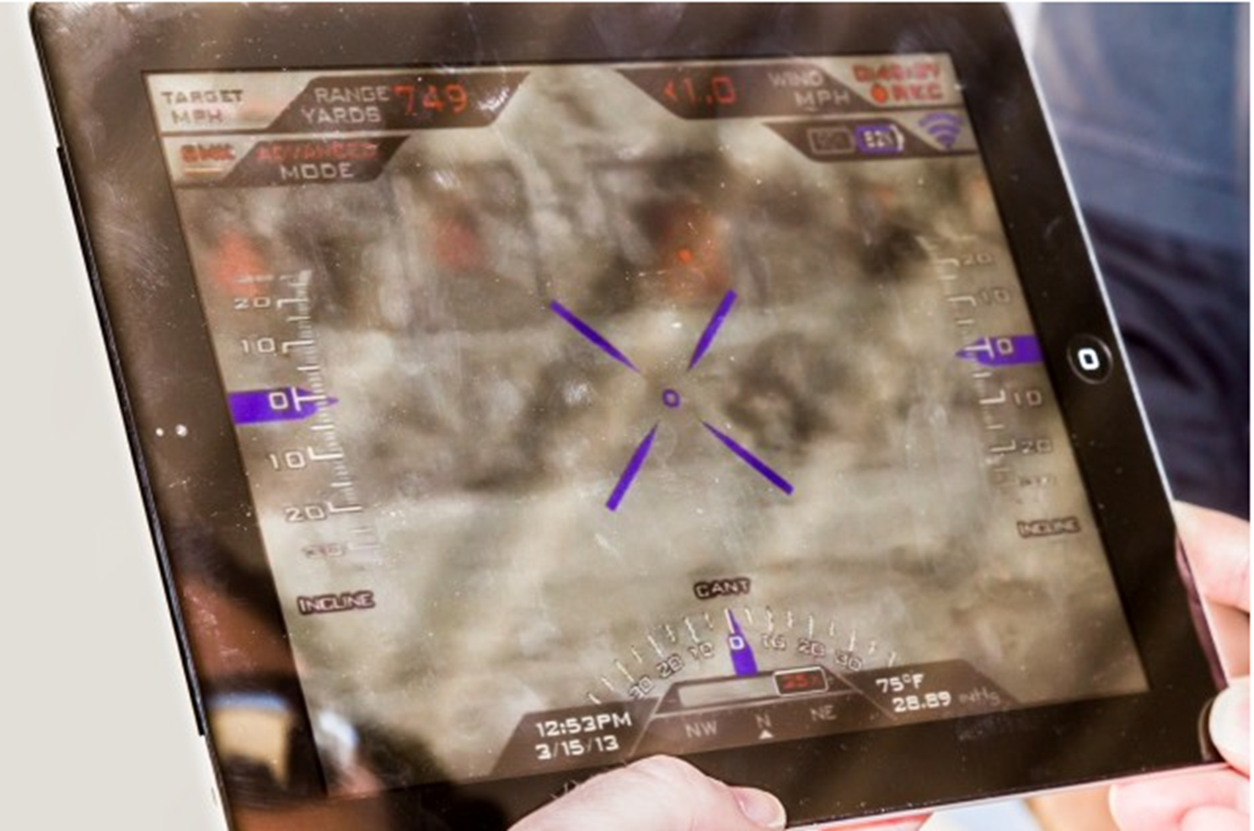
Kyle Davidson
5
Notes:
Live streaming example, you see what the scope sees

Slide 34
Criminal applications
Kyle Davidson
Not useful for most ¹
Contract killer may enjoy
  Designed for target selection at long distance
Notes:
Not very useful to criminals
High cost and low fire rate, not useful for average engagements
Best example of use would be a contract killer
Design for target selection and accuracy fits the profession

Slide 35
Law Enforcement Potential
Kyle Davidson
Interest in assisted accuracy is minimal ¹
Range is unneeded ¹
High interest for “record keeping” purposes ¹
Notes:
Law enforcement snipers are already well trained and do not require the assistance in aiming
Average police sniper situation is at a distance of about 75 yards, less that 1/10 of gun’s range
High interest has been displayed in the recording aspects
Shows the shooters intended target
Conditions the shooter was in
Possibility for the Ipad user to choose the targets

Slide 36
Conclusion
Kyle Davidson
This is a recreational weapon. There are better options available to law enforcement and criminals alike.

Slide 37
Sources
Kyle Davidson
[1]Hutchinson, Lee. "Bullseye from 1,000 Yards: Shooting the $17,000 Linux-powered Rifle." Ars Technica. N.p., 31 Mar. 2013. Web. 27 Mar. 2014. <http://arstechnica.com/gadgets/2013/03/bullseye-from-1000-yards-shooting-the-17000-linux-powered-rifle/>.
[2]"Introducing the World's First Smart Rifle." Official Site – XactSystem™ Precision Guided Firearms. TrackingPoint, n.d. Web. 09 Apr. 2014. <http://tracking-point.com/>.
Notes:
<Your notes here.>

Slide 38
Image Sources
Kyle Davidson
[3] Michael, Steven. Tp2-xs2-oblique-640x426. Digital image. Ars Technica. N.p., 31 Mar. 2013. Web. 27 Mar. 2014.
[4] Michael, Steven. Tp-track-640x204. Digital image. Ars Technica. N.p., 31 Mar. 2013. Web. 27 Mar. 2014.
[5] Michael, Steven. Tp2-ipad-640x426. Digital image. Ars Technica. N.p., 31 Mar. 2013. Web. 27 Mar. 2014.
Notes:
<Your notes here.>

Slide 39
Class 9
The End
Keith A. Pray
Instructor
socialimps.keithpray.net
Notes:
This is the end. The slides beyond this point are for answering questions that may arise but not needed in the main talk. Some slides may also be unfinished and are not needed but kept just in case.

Slide 40
Crime How
Technical and Non-Technical
  Break into computer.
  Prevent access to computer.
What things make computer related crime easy?
Notes:
Exploit security holes, Break encryption, Spoofing
Social Engineering: Guess passwords, Find out passwords and procedures
Poor passwords, Insecure protocols, Program limitations (buffer overruns), Eavesdropping (Email, Interactive), Insecure files

Slide 41
Crime Bane
Trojan Horse
Virus
Worm
Bot Network
Buffer Overrun
(Distributed) Denial Of Service Attack
How do they work?
How harmful are they?

Slide 42
Crime Why
Why?
Notes:
Money: stolen credit cards, change records, stolen property.
Political, military, economic.
Challenge, Revenge, Mean
Why do at all? Have motivation, think about it, think it will help, think it’s acceptable.
Feel forced. Don’t agree. Don’t care.

Slide 43
Crime Time
What is different now compared to:
  10 years ago?
  20 years ago?
  30 years ago?
  40 years ago?
Notes:
More computers. Unsophisticated owners. More complex software. Greater connectivity. Easy access to cracking tools. Incentives. File-sharing
In ’60s and ’70s, access was mostly localized.
Modems. Wardialing.
Some Arpanet and Usenet.

Slide 44
Crime Doers
Hacker or Cracker
  Pre-1980 - Golden Age ☺ ?
  Eighties
  Nineties
  Naughts
Criminal Hacking == Cracking?
Notes:
Script kiddies
Phreakers
Security analysts
Packet monkey

Slide 45
Crime Gain
Justifications for Computing Crimes?
What can be done after access is gained?
  What resources are available?
  How valuable are they?
Notes:
Machines are unused. No harm done. Education. Exposes security holes. Exposes abuses.
Use computer and/or resources. Take data. Destroy data. Alter data. Lock out others. Attack other computers.
Equipment, Processor Time, Disk space, Printer time / paper, Bandwidth

Slide 46
Crime Pay
Computer Fraud and Abuse Act (1986)
  Bans :
    unauthorized access or use of computers, copying, modifying, or destroying data, disclosing of passwords.
    disrupting government and utilities.
  Covers government, financial, medical, and interstate systems.
USA Patriot Act (2001)
  Raised penalties.
  Permits freer surveillance and monitoring to detect illegal activity.
Electronic Communications Privacy Act
  Illegal to intercept telephone, email, other data transmissions, access stored email messages without authorization
Assign Cybercrime Treaty (2006), Wire Fraud Act, National Stolen Property Act, Identity Theft and Assumption Deterrence Act
Notes:
Are either of these laws still in effect? Have they been changed?
For additional legislation ask for presenting volunteers to brief recent incidents/cases.
Also ask for volunteers to find out laws from their home country/state.

Slide 47
Crime Stop
Technical
  Protect Data
  Protect Machine
  Protect Access
Non-technical?
  Social?
  Legal?
Notes:
Encryption, Authentication, Biometrics, Anti-virus, File integrity checking (E.g. Tripwire), Virtual private networks, Point-to-point networking (Twisted-pair Ethernet vs. Coax vs. wireless)
Security through obscurity, physical access required, not on network, behind locked doors.
Remove desire, remove incentives
Legalize, increase penalties, increase chance of getting caught.

