Slide 1
Class 7
Privacy
Keith A. Pray
Instructor
socialimps.keithpray.net
Notes:
After this class we will be half done with the course… very sad I know.

Slide 2
Overview
Logistics
Survey
Privacy
Assignment
Students Present

Slide 3
Logistics
We need Groups to volunteer to present Tuesday
2014-04-29. The first 4 to send the TA and me email win.
Groups email me their web site location
Please send email to both me and the TA for quickest response time
Presentations are due 24 hours before class
Use Presentation Guidelines on course web site
Notes:
Not needed this time:
- We will now be using the myWPI Safe Assign feature to pass in papers in addition to hard copies due at the beginning of class. TA will send out detailed directions.
- High quality reference sources, writing, responses

Slide 4
Overview
Logistics
Survey
Privacy
Assignment
Students Present

Slide 5
Overview
Logistics
Survey
Privacy
Assignment
Students Present

Slide 6
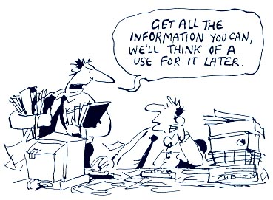
http://bimeanalytics.com/blog/privacy-and-web-analytics/
Notes:
Accessed 2011-09-19

Slide 7
Overview
Logistics
Survey
Privacy
Assignment
Students Present

Slide 8
Assignment
One Page Paper
  Would a National ID System be a good thing?
  One acceptable approach is to show the argument in the book for the position opposite to your conclusion is a weak argument.
  Feel free to reference or build upon your self search work if it helps your argument.
Notes:
Include references in addition to the book.
This is mandatory to receive the points for supporting your point and providing references.

Slide 9
Overview
Logistics
Survey
Privacy
Assignment
Students Present

Slide 10

Tor Network
Johnny Hernandez
Short for The Onion Router
  Uses onion routing technique
Used for privacy on the Internet
  Web browsing
  Using blocked services
  “Hide among other user’s on the network”
Image retrieved from: https://media.torproject.org/ (04/06/2014)
Notes:
Originally developed for the U.S Navy to protect government communications. Now used to anonymize user’s connecting to the internet, used by normal people, journalists, activists, and many others.
Onion Routing – Clients go through the network by building a path of nodes (circuit) where each node knows its predecessor and its successor, but no other nodes in the path. Traffic flows down the circuit in fixed sized cells , which are unwrapped by a symmetric key at each node (earned it the name onion routing) and continues down stream.
A way to connect to the internet by moving encrypted traffic through several Tor servers so anyone who wants to see incoming traffic will see some node on the network rather than your computer.

Slide 11
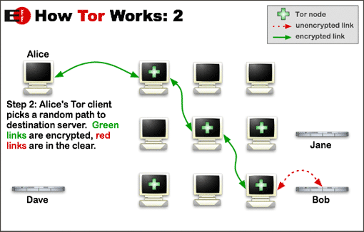
Johnny Hernandez
Image retrieved from: https://www.torproject.org/about/overview.html (04/06/2014)
Notes:
(Removed other steps to save on slides/time) Step 1: Alice’s Tor client obtains a list of Tor nodes from a directory server
Step 2: Her Tor client will randomly generate a random path that leads toward the destination of her request
The reason for this is to ensure a difficult, winding path that is hard to trace back to the original sender
Due to how onion routing works, no individual node knows the entire path and the path has a different set of encryption keys for each node (Harder to trace)
Step 3: Usually a path for similar connections is kept the same (for performance reasons). After a period of time (Roughly 10 minutes or a connection with a new destination), a new path will be generated.

Slide 12
Good Use of the Tor Network
Johnny Hernandez
Getting around censorship
  Iran
  China (Attempts to block Tor Network)
Journalism
U.S. Navy
  Recently used when deployed in the Middle East
Law Enforcement
Avoiding Traffic Analysis
Notes:
The Tor Network has recently become a popular way of getting around national censorship systems (for example, in China and Iran)
An attacker (In this case the censorship system) cannot find out which website a user is visiting and cannot block access
An anonymous network helps to encourage whistle blowing and dissidents, for just causes of course. Generally reporting sensitive information that could put someone’s life in danger if they were traced back to a leak.
A branch of the U.S. Navy uses the network for intelligence gathering.
Keeping a close eye on certain websites without leaving government information in the websites traffic logs
Traffic Analysis – Simply put, is a type of attack that can identify a sender and the recipient. Using this information to track behavior, interests, and other personal information that can be used against you. (Like Miguel’s presentation)

Slide 13
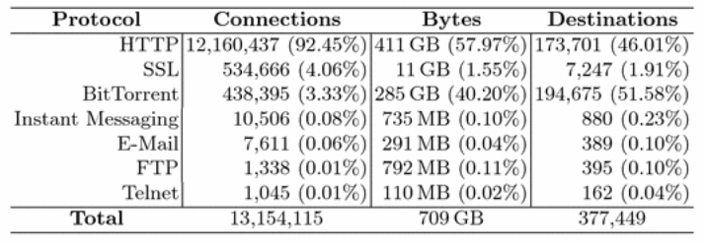
Harmful Use of the Tor Network
Johnny Hernandez
BitTorrent usage
Malicious client behavior
  HackBB
  “A vast portion of the web’s child pornography”
Image retrieved from: Privacy Enhancing Technologies p. 67 (04/06/2014)
Notes:
A large percentage of Tor user’s use the anonymous network to remain anonymous while using P2P networks (specifically BitTorrent). Whether this be for piracy or legitimate reasons, this significantly slows down an already slow network (large use of bandwidth).
A lot of the activity by client’s can be malicious. (Anonymity can bring out the worst in us)
One of the study’s measuring usage of Tor by hosting their own exit node received a large number of complaints for “allegations of copyright infringement, reported hacking attempts, IRC bot network controls, and web page defacement” going through the exit node.
Institution asked to shut down the exit node shortly after data collection was finished
HackBB – A popular gathering place on the darknet for users to “buy stolen credit cards, skimming ATMs, and hacking anything from personal computer’s to server hardware.”
Eric Marques – Hosted a large amount of servers for child pornography

Slide 14
Weaknesses
Johnny Hernandez
Onion Routing
  Technique makes establishing connections slow
Insecure Protocols and Malicious Routers
Suspicion
  NSA
  Vulnerable to “Man In the Middle” Style Attacks
Notes:
Unfortunately, one of the strengths of the Tor network is also a weakness in that routing a request through several nodes, rather than directly, will make establishing connections much slower than normal.
Due to several insecure protocols that transmit login credentials in plain-text existing.
This can be easily exploited by Malicious Routers, as routers are hosted by volunteers and the code is open source, to act as normal exit nodes that scan and record user name and password information from users that go through malicious exit nodes.
While using the Tor network makes it difficult to track the source of a request, recipients can tell that the Tor network is being used.
NSA brands Tor users as suspicious and makes them more likely to be targeted.
Tor Network is hard to get around, but browser exploits are far easier to obtain your information
“Man In the Middle” Style Attacks – Using a fake security certificate to make it seem like the user is browsing the actual website, and then intercept data being sent to that website through the browser.

Slide 15
Conclusions
Johnny Hernandez
Is using Tor worth it?
  Depends on the user
Ethics and Tor
  Can we handle anonymity?
  Good vs. Harmful uses
Notes:
Is using Tor worth it?
Depends on the user. While the common man may like to avoid traffic analysis or remain truly anonymous on the web, there are most likely better alternatives (VPN or Proxy) that may achieve a similar effect with a little less slowdown, and suspicion.
In it’s current state, it provides anonymity not security (Not ideal to use when logging into sensitive accounts)
Ideal for when one needs to remain anonymous when providing or gathering sensitive information (Whistle blowing or surveillance)
Can we handle anonymity?
“Anonymity can bring out the worst in people” – When you can say something without taking responsibility for it, will everyone be able to abide by social norms/remain civil?
In a social setting, you can harm your reputation, so that can keep you in line. Might be different when anonymous
Also lends to freedom of speech, less fear of being thought less of when sharing thoughts that aren’t tied to you. Allows true self to display.
Can we trust users with anonymity? (I think this is pretty open ended, discussion worthy at least)
Does the good that can be done with Tor outweigh the harmful uses
Possible uses of piracy and malicious activity over benefits to society
Each act has questionable case by case ethics: Does the large amount of illegal activity over the network warrant the benefits to Journalists and National Defense?

Slide 16
Sources
Johnny Hernandez
Tor: Overview, https://www.torproject.org/about/overview.html.en (04/06/2014)
Privacy Enhancing Technologies, McCoy et al., 2008, pp 63-76
Tor: The Second-Generation Onion Router, R. Dingledine; N. Mathewson; P. Syverson. http://www.onion-router.net/Publications/tor-design.pdf
What is Tor and Should I Use It, http://lifehacker.com/what-is-tor-and-should-i-use-it-1527891029 (04/06/2014)
To Bust a Giant Porn Ring, Did the FBI Crack the Dark Web?, http://motherboard.vice.com/blog/the-fbi-says-it-busted-the-biggest-child-porn-ring-on-the-deep-web-1 (04/06/2014)
The Blockbuster Heist that Rocked the Deep Web, http://www.dailydot.com/crime/deep-web-boneless-optimuscrime-hackbb-credit-card-fraud/ (04/06/2014)
Notes:
<Your notes here.>

Slide 17
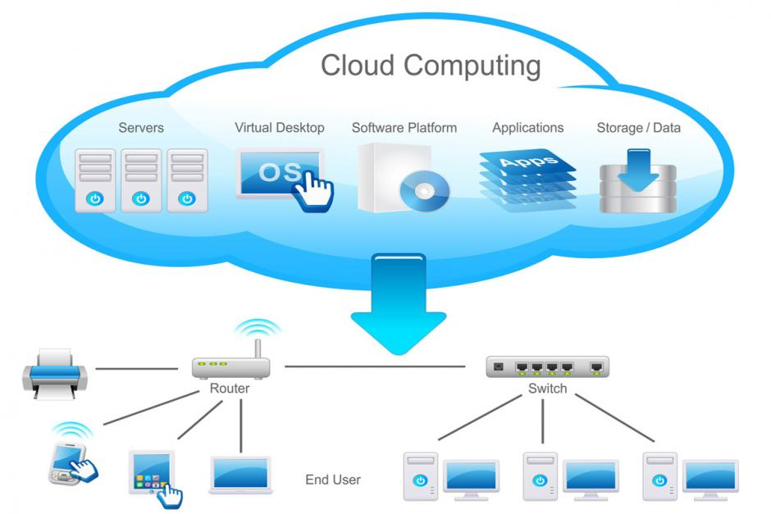
Security Threats in Cloud Computing
Fiona Heaney
Notes:
Cloud computing: the practice of using a network of remote servers hosted on the Internet to store, manage, and process data, rather than a local server or a personal computer.

Slide 18
Increased Usage of Cloud Computing
Why has been it become so popular?
What does this mean for the user?
Increase in usage of cloud computing creates higher chance of security breach
It will never be possible to fully secure cloud computing
Notes:
Become popular because of scalability, reduced licensing costs, reduced hardware costs, easy administration, and ability to work from anywhere
Increased target for malicious attacks that could result in loss of personal information and files
Last two are conclusion points. As more people reach for cloud services, the more likely they are to become a target for hackers and the like. This also means that in time, more effort will be done to secure the cloud however, the usage of third party hosting and government back doors make full security impossible

Slide 19
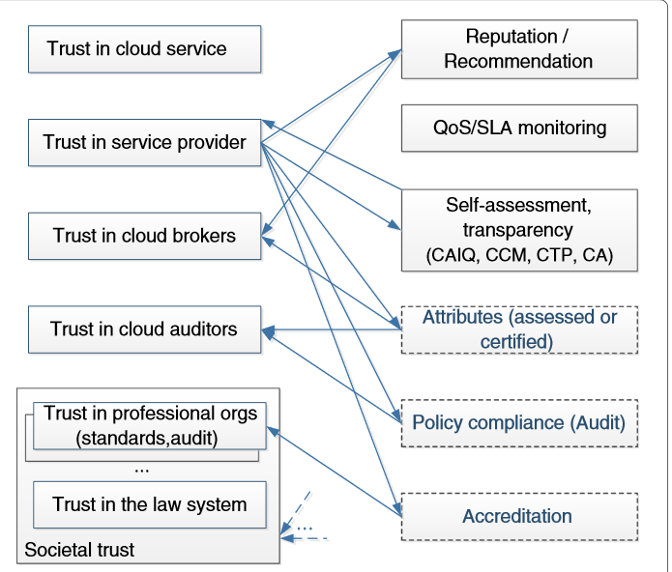
Why Users Trust the Cloud
Fiona Heaney
Initial need for free service
Growing number of users
Commercial interest
Notes:
Text editing, file sharing, collaboration tools
The general “oh everybody is doing it” social trend has made it more acceptable and recommended to use cloud computing
Those who utilize cloud computing in the work place ay be more likely to utilize it for personal uses and have a trust in it because the corporation they work for does

Slide 20
Potential Malicious Attacks on Cloud Computing
Fiona Heaney
Data Breaches
Account or Service Traffic Hijacking
Government Backdoors
Password Hijacking
Notes:
Data breach: listening in on another VM transmissions via “side channeling”
note: target security breach may be analogous to scale of possibilities in cloud computing
note: side channeling- any attack based on information gained from the physical implementation of a cryptosystem, rather than brute force or theoretical weaknesses in the algorithms(compare cryptanalysis)…Big piece of it is auto-suggest which helps hacker figure out what users may have typed before. Also pertains to the fact that multiple VMs may run on a single piece of hardware allowing hackers to steal incoming info without alerting the other VM about what’s going on
Account or Service Traffic Hijacking: “Phishing, exploitation of software vulnerabilities such as buffer overflow attacks, and loss of passwords and credentials can all lead to the loss of control over a user account.”
Government Backdoors: NSA hacked into encrypted UN communications. Has potential to be used on civilians
Password Hijacking: Mac OSX Maverick hosts all passwords in iCloud. Governement backdoors open potential for insecurity

Slide 21
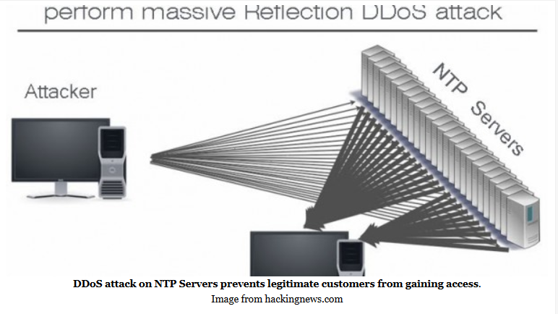
Potential Malicious Attacks on Cloud Computing (contd)
Social Engineering
Distributed Denial of Service
Notes:
Social engineering: “In this regard the security's weakest link is the human, and while this might also happen within a cloud service provider, they will usually be more cautious about such attacks than an SME hosting all its data in-house. “ Humans convincing other humans that they have access to information when they don’t
Denial of service: A DoS attack makes your network or machine unavailable to the intended users by flooding them with connection requests.
94% of data center operators reported security attacks, 76% had suffered distributed denial of service (DDoS) attacks towards their customers, while just under half (43%) had partial or total infrastructure outages due to DDoS and yet only 14% of respondents had seen attacks targeting any form of cloud service.”

Slide 22
Ways to Protect Yourself
“Trust, but verify”
  STAR Program
  CloudAudit
Back up your data to multiple places
Notes:
Service Level Agreements → legal contract between user and cloud service
Quality of service monitoring & SLA verification
the Cloud Security Alliance (CSA) launched the “Security, Trust & Assurance Registry (STAR)” program, a free publicly accessible registry which allows cloud service providers to publish self-assessment of their security controls, in either a “Consensus Assessments Initiative Questionnaire (CAIQ)” or a “Cloud Controls Matrix (CCM)”
CloudAudit initiative, which provides a common interface and namespace for cloud providers to produce audit assertions, and allows cloud users to automate use of that data in their own audit processes.

Slide 23
Sources
Fiona Heaney
Jones, Trevor “Six Reasons Computing is Becoming Popular with Small Business” http://www.gwi.net/ 5 April 2014
Kim, Sarah & Ayoung Noon “Do I Trust Google? An Exploration of How People Form Trust in Cloud Computing” http://www.asis.org/ 5 Apirl 2014
Meyer, David “NSA hacked into encrypted UN communications, leaked documents show” http://gigaom.com/ 5 April 2014
Huber, Serge “Should you trust the cloud? Really?” http://www.aiim.org/ 6 April 2014
Huang, Jingwei & David M Nicol “Trust Mechanisms for Cloud Computing” http://www.journalofcloudcomputing.com/ 6 April 2014
Boston Univeristy “How to Safely Store your Data in the Cloud” http://www.bu.edu 6 April 2014
Bentajer, Ahmed “Survey on side-channel attacks in cloud computing” http://www.websphereusergroup.org/ 7 April 2014
Notes:
<Your notes here.>

Slide 24
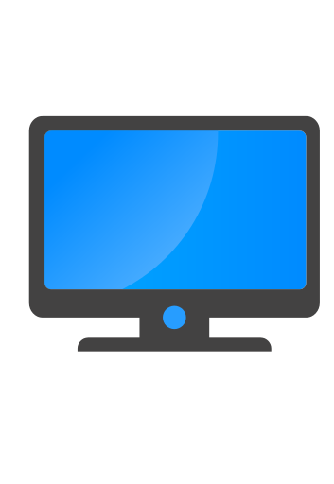

Privacy & Trusted Computing
Doran Smestad
Notes:
Talking about Privacy and Trusted Computing.
First, I’m going to talk about device privacy with a frame of mobile computing
Second, I’m going to discuss trusted computing and a well known commercial success
Then, we will discuss the choice: privacy by means of trusted computing, or the current state
Computer = https://www.iconfinder.com/icons/173187/computer_icon#size=512
Check = https://www.iconfinder.com/icons/86134/checkmark_g_icon#size=128

Slide 25






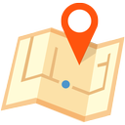


Device Privacy?
Doran Smestad
Notes:
Privacy concerns exist with the plethora of computing devices
The device knows your address book
Your location
Your credentials to internet sites
Files stored locally and possibly remotely as well
What if a malicious application is installed? Now what?
- For example, your smartphone is able to record voice, yes? How do you know it isn’t on right now?
- You trust your device, but is it worthy of such trust? – Hard question, if even possible to know
- So what can we do to restrict what our devices run? How do we protect against who they communicate with?
There is work, for example “Taming Information-Stealing Smartphone Applications” which discusses adding additional restrictions to applications to protect users from rouge apps [3]
[3] http://link.springer.com/chapter/10.1007/978-3-642-21599-5_7
Black Icons = https://www.iconfinder.com/search/?q=iconset:peelicons-vol-1
Instant mini blogging (bird) = https://www.iconfinder.com/icons/88491/twitter_icon#size=128
Map = https://www.iconfinder.com/icons/171263/location_icon#size=128
Addressbook = https://www.iconfinder.com/icons/47054/addressbook_contacts_icon#size=128
Smartphone = https://www.iconfinder.com/icons/183589/smartphone_icon#size=256

Slide 26

Trusted Computing?
Doran Smestad
Web
Browser
Malware,
Spyware
IDE,
Text Editor
Notes:
What is trusted computing?
A way to enforce only “good” applications run
For example, we will allow our web browser, stop any malware, and other utilities
Great! But wait.. How does that even work? How do we know a good app verses a bad app?
- VERY hard question.
Trusted computing as defined by the Trusted Computing Group. https://www.trustedcomputinggroup.org/resources/tpm_main_specification (accessed 4/8/14)
App Icon = https://www.iconfinder.com/icons/37027/app_application_program_software_icon#size=128
Red App = https://www.iconfinder.com/icons/111231/apps_red_soda_icon#size=512

Slide 27
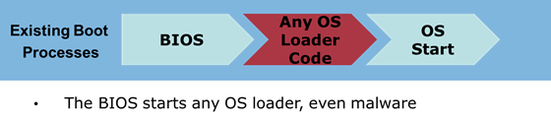
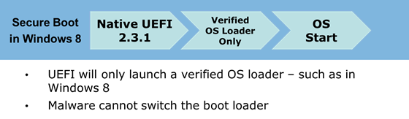
Secure Booting
Doran Smestad
Images From: http://blogs.msdn.com/b/b8/archive/2011/09/22/protecting-the-pre-os-environment-with-uefi.aspx
Notes:
How do we make a trusted platform? Begins at the hardware.
By requiring hardware to verify the bootloader, we can continue verifying the next program results in no more malware hiding from the operating system.
We can verify that only approved software runs right from when you hit the power button, how is this done?
Let’s review apple’s ios security guide for a more indepth answer
Images from: http://blogs.msdn.com/b/b8/archive/2011/09/22/protecting-the-pre-os-environment-with-uefi.aspx (accessed 4/8/2014)

Slide 28
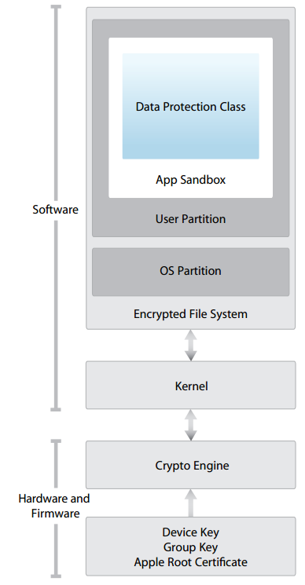
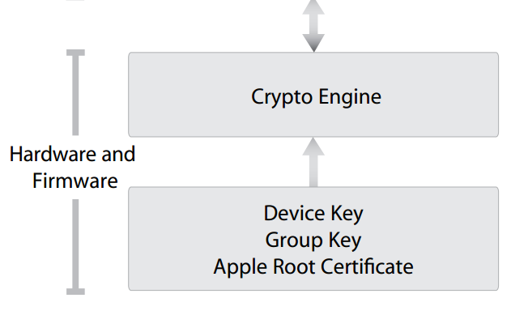
Secure Booting
Doran Smestad
Images From: http://images.apple.com/ipad/business/docs/iOS_Security_Feb14.pdf
Notes:
In apple’s model we start with enforcement of the bootloader, and we load up public-private cryptography to verify the kernel before we start it.
Images and knowledge from: http://images.apple.com/ipad/business/docs/iOS_Security_Feb14.pdf (accessed 4/8/14)

Slide 29
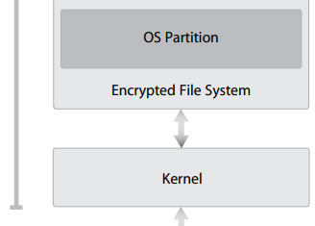
Secure Booting
Doran Smestad
Images From: http://images.apple.com/ipad/business/docs/iOS_Security_Feb14.pdf
Notes:
The kernel loads, then unlocks the file system and loads the user parition.
Images and knowledge from: http://images.apple.com/ipad/business/docs/iOS_Security_Feb14.pdf (accessed 4/8/14)

Slide 30
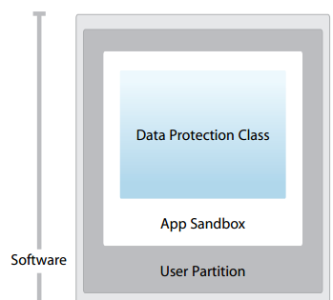
Secure Booting
Doran Smestad
Images From: http://images.apple.com/ipad/business/docs/iOS_Security_Feb14.pdf
Notes:
We arrive at a fully booted and verified system able to enforce only trusted applications are run on the system. In addition the app sandbox allows us to enforce extra restrictions on what exactly the app is allowed to do. We trust it, but we don’t allow it to do anything.
Images and knowledge from: http://images.apple.com/ipad/business/docs/iOS_Security_Feb14.pdf (accessed 4/8/14)

Slide 31


Restrictions
Doran Smestad
Allowed
Disallowed
Notes:
If I have an application, I can allow it to perform certain functions, but not all functions.
We can selectively protects ourselves from the app, and other app’s data.
This probably sounds familiar as this protection scheme is already in use.
Microphone = https://www.iconfinder.com/icons/216335/microphone_icon#size=128

Slide 32



The Trust Base
Doran Smestad
User Choice?
Dictated by Corporations?
Notes:
Somebody has to make the trust decision.
But who?
A study was performed which concluded users were wiling to pay extra costs for ensuring privacy [2]
[2] http://link.springer.com/chapter/10.1007/978-3-642-39498-0_10 (accessed, April 4th, 2014)
Users = https://www.iconfinder.com/icons/40879/group_user_users_icon#size=128
App Icon = https://www.iconfinder.com/icons/37027/app_application_program_software_icon#size=128
Certificate = http://macosxautomation.com/mavericks/codesign/01.html
Corporation = https://www.iconfinder.com/icons/111079/factory_icon#size=256

Slide 33
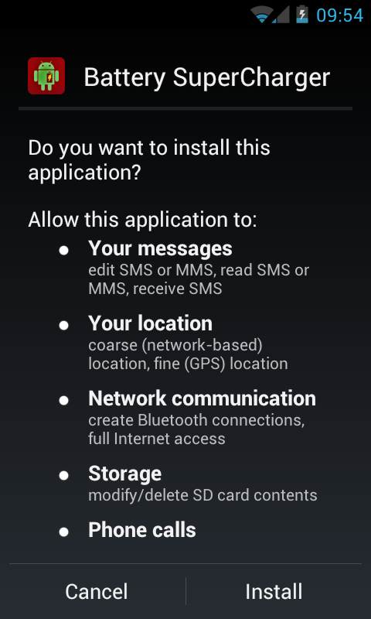
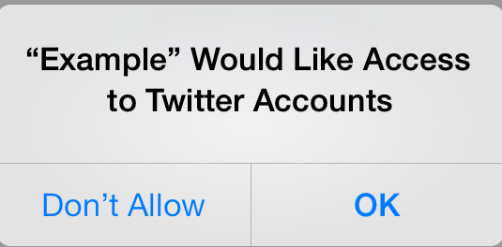
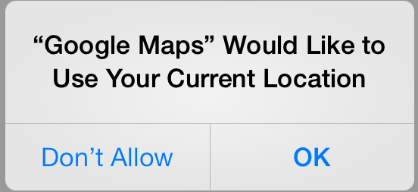
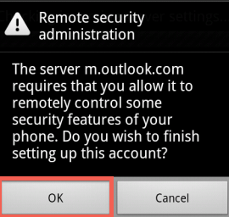
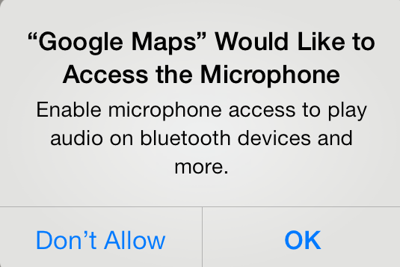
Ask the user!
Doran Smestad
Notes:
Point out the various “sketchy” apps and permission requests
Who’s <insert family member> would just accept permissions at anytime?
(most people should raise their hand for this..)
Remember your answer as we look at trusted computing
A study was performed and only 38.6% scrutinize security warnings [1]
[1] http://www.aueb.gr/users/amylonas/docs/COSE%20Smartphone%20Awareness.pdf
Twitter prompt = https://dev.twitter.com/docs/ios
Android allow remote security control = https://kb.indwes.edu/Communication/Student_Email/User_Guide/Setup_Email_on_Mobile_Devices_and_Other_Mail_Clients/Android_Devices
Battery permissions = http://shkspr.mobi/blog/2013/04/what-can-android-learn-from-symbians-security-model/
Google maps microphone = http://apple.stackexchange.com/questions/102565/why-do-these-apps-like-to-access-the-microphone
Google maps location = http://www.howtogeek.com/177711/ios-has-app-permissions-too-and-theyre-arguably-better-than-androids/

Slide 34
The Choice
Doran Smestad
User Chooses Applications
May Protect Privacy
Applications Verified
To Protect Privacy
** Sources available upon request, they are associated with each slide in the presenter notes.
Notes:
In conclusion, we have seen one successful implementation of trusted computing to stop running programs which aren’t verified. Apple wants to continue this trend and enforce only verified applications on their desktops & laptops (though backed off after negative feedback). Microsoft is laying the foundations with many OEMs to make this a possibility as well.

Slide 35

Stop Online Piracy Act (SOPA)
Gregory Giola
SOPA – House of Representative
Lamar Smith
  House Judiciary Committee Chair
Allows intellectual property owners to attack foreign websites
  Without court appearance
Focused at foreign sites
Creates a blacklist of internet sites
Contains an “anti-circumvention” clause
http://www.wired.com/images_blogs/threatlevel/2009/11/picture-49.png
Notes:
“For example if Warner Bros. says that a site in Italy is torrenting a copy of The Dark Knight the studio could demand that Google remove that site from its search results, that PayPal no longer accept payments to or from that site, that ad services pull all ads and finances from it, and – most dangerously – that the site’s ISP prevent people from even going there,” Gizmodo
Google/PayPal/etc. has only 5 days to abide or challenge quarantine notice
Anti-circumvention clause holds that telling people how to work around the restrictions as violating SOPA

Slide 36
Protect IP Act (PIPA)
Gregory Giola
PIPA – Senate
Very similar to SOPA
Does not require search engines to remove infringing sites
Does require more court intervention
Does not have any provisions penalizing false claims
Notes:
SOPA and PIPA were almost identical
PIPA had initially more support in the senate but after media outcry supporters changed there views

Slide 37
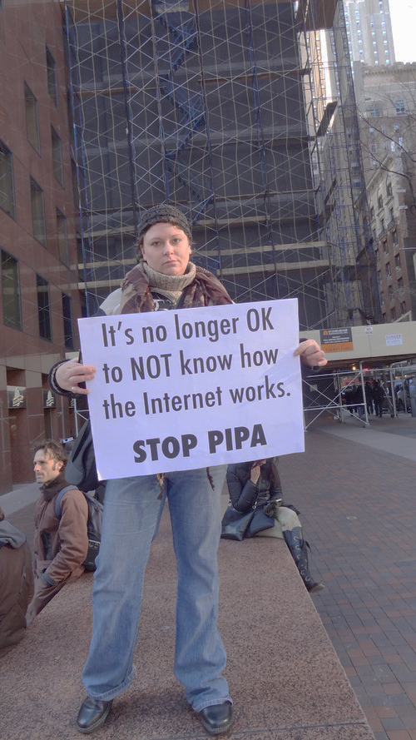
Results of SOPA and PIPA
Gregory Giola
Mass Internet blackouts
  Wikipedia, Reddit, Craigslist
Petitions against the acts
  4.5 Million signatures
DoS Attacks by the hacktivist group Anonymous
White House responded against the acts
  “Combating Online Piracy while Protecting an Open and Innovative Internet”
Vote on SOPA and PIPA were postponed
http://www.pcworld.com/article/248401/were_sopa_pipa_protests_a_success_the_results_are_in.html
Notes:
Websites tried to raise awareness of SOPA, PIPA and the petitions
Government sites and music industry sites were attacked

Slide 38
Current Situation
Gregory Giola
Neither bill has been reintroduced since 2012
“Combating online infringement is a governmental priority,” McCullagh
The White House has endorsed legislations like SOPA
  targeting offshore Web sites
Notes:
OPEN – Online Protection and Enforcement of Digital Trade

Slide 39
Internet Privacy and CISPA
Gregory Giola
SOPA/PIPA → CISPA
Voluntary information sharing between private and government in event of a cyber attack
Allows companies to easily hand over users’ private information
  Overriding privacy laws
Passed by House of Representatives twice
Senate refused to vote on CISPA
Notes:
SOPA and PIPA lead to the creation of CISPA or Cyber Intelligence Sharing and Protection Act
Also allows the government to take down websites if attacks are detected
SOPA/PIPA allowed websites to be pulled from the web which concerned legitimate websites being taken offline
Summary:
These large problems will be a concern until we find laws to fix them.
Laws should be focused on fixing the exact problems not just knee jerk reactions to the problems

Slide 40
Sources
Gregory Giola
What Is SOPA? Barrett, Brian. Gizmodo. January 17, 2012. http://gizmodo.com/5877000/what-is-sopa/all
Were SOPA/PIPA Protests a Success? The Results Are In. Paul, Ian. PCWorld. January 19, 2012. http://www.pcworld.com/article/248401/were_sopa_pipa_protests_a_success_the_results_are_in.html
SOPA Isn’t Dead. Biddle, Sam. Gizmodo. January 17, 2012. http://gizmodo.com/5876941/sopa-isnt-dead/all
Obama Administration Responds to We the People Petitions on SOPA and Online Piracy. Phillips, Macon. January 14, 2012. http://www.whitehouse.gov/blog/2012/01/14/obama-administration-responds-we-people-petitions-sopa-and-online-piracy
Combating Online Piracy while Protecting an Open and Innovate Internet. Espinel, Victoria. Official White House Response. White House Petitions. https://petitions.whitehouse.gov/response/combating-online-piracy-while-protecting-open-and-innovative-internet
Notes:
<Your notes here.>

Slide 41
Sources
Gregory Giola
After a year in the grave, can SOPA and Protect IP return? McCullagh, Declan. Cnet. January 18, 2013. http://www.cnet.com/news/after-a-year-in-the-grave-can-sopa-and-protect-ip-return/
White House calls for new law targeting ‘offshore’ Web sites. McCullagh, Declan. Cnet. March 30, 2012. http://www.cnet.com/news/white-house-calls-for-new-law-targeting-offshore-web-sites/
SOPA VS. PIPA: ANTI-PIRACY BILLS, UPROAR EXPLAINED. Couts, Andrew. Digital Trends. January 16, 2012. http://www.digitaltrends.com/computing/sopa-vs-pipa-anti-piracy-bills-uproar-explained/#!C71EW
From SOPA to CISPA. The Economist. April 20, 2013. http://www.economist.com/news/united-states/21576425-controversial-cyber-bill-sparks-heated-debate-about-online-privacy-sopa-cispa
Notes:
<Your notes here.>

Slide 42
Class 7
The End
Keith A. Pray
Instructor
socialimps.keithpray.net
Notes:
This is the end. The slides beyond this point are for answering questions that may arise but not needed in the main talk. Some slides may also be unfinished and are not needed but kept just in case. In this particular presentation there are no further slides but it will say this on The End for most of them so I figured I’d get you ready for it now.

Slide 43
Privacy Topics
Look at: http://socialimps.keithpray.net/documents/index.jsp?content=Privacy_Discussion.html
Is privacy a right?
Our privacy compared to 100 or 200 years ago?
Rewards and loyalty programs.
Body scanners.
Data collected about you.
Notes:
Is privacy a right? – Telemarketing and do not call list as example of privacy being a prudential right, a right granted because of its benefits to society.
Our privacy compared to 100 or 200 years ago? – Extended families, small communities, pressure to conform. Children lived at home until married. Society of strangers, how to trust them?
Rewards and loyalty programs. – around for more than 100 years: S&H Green Stamps. Now a days consumers not in the program can pay more rather than members paying less.
Body scanner. – Some stores in the U.K. use them to recommend clothing that will fit well and for producing custom clothing.
Data collected about you. –
TiVo sells data about viewing habits. Only 54% of customers skip commercials.
Automobile black boxes.
Enhanced 911 Service: FCC requires cell phone providers be able to track locations of active cell phones within 100 meters. Cell phone companies can use the same technology to tell where signal is weak or nonexistent. Could the cell phone company tell your employer where you really are when you call in sick to work? Would they for a fee?
RFIDs: tracking location at work, use in passports, terrorist scanning for hostages?
Implanted chips: in Taiwan every domesticated dog must have one identifier owner and residence. There are such approved for human use; medical info, debit/credit cards, children.
Biometrics.
Government surveillance.

