Slide 1
Class 5
Freedom Of Speech
Keith A. Pray
Instructor
socialimps.keithpray.net
Notes:
Here’s the title slide. Excited already, aren’t you?

Slide 2
Overview
Freedom Of Speech
Assignment
Students Present

Slide 3
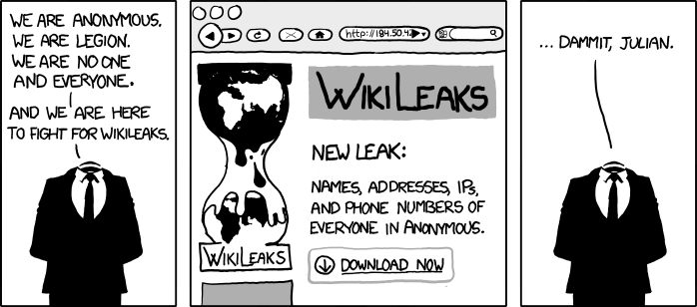
http://www.xkcd.com/834/
Notes:
Freedom of Speech

Slide 4
Group Quiz
Name two methods some governments use to control access to information.
A large company has a policy prohibiting employees from blogging about company products.
  Name two possible reasons for the policy.
  Does it violate the First Amendment? Why?
  Is it reasonable? Why?
What does “URL” stand for and what is it?
Notes:
Censorship (religious, governmental, private). Adult authentication. Global dissemination. Freedom of Speech not an absolute right.

Slide 5
Overview
Freedom Of Speech
Assignment
Students Present

Slide 6
Assignment
One page paper
  Open source software development tools, friends or foes?
Extra Credit – One page paper
  Is WPI’s IT Acceptable Use Policy morally acceptable?
Remember to work on your group project.
  See full group project description on course website.
Notes:
Or review right now.

Slide 7
Overview
Freedom Of Speech
Assignment
Students Present

Slide 8
Where is our technology going?
Prateek Sahay
Social Interaction
Barbecue Grill
Radio
MMOs
Television
Technological Advancement
Headphones
Personal Computer
Handheld Consoles
The Internet
Smartphones
Oculus Rift
Notes:
About VR--relevant topic because this is the direction tech is going, why VR might be bad
Oculus Rift/Project Morpheus
Studies have proven a link between videogame usage and declining relationships with friends/family
Over 2/3 of households have active computer or video gamers
Currently for gaming, but we know it’ll go beyond and have soc impl
VR starts this year, will change the way we network
Mark Zuckerberg says “Oculus has the potential to be the most social platform ever.” But is this really true at all? Is the purpose of virtual reality really to make us more connected?
Clear trend in electronics that demand ownership/isolating user for control

Slide 9
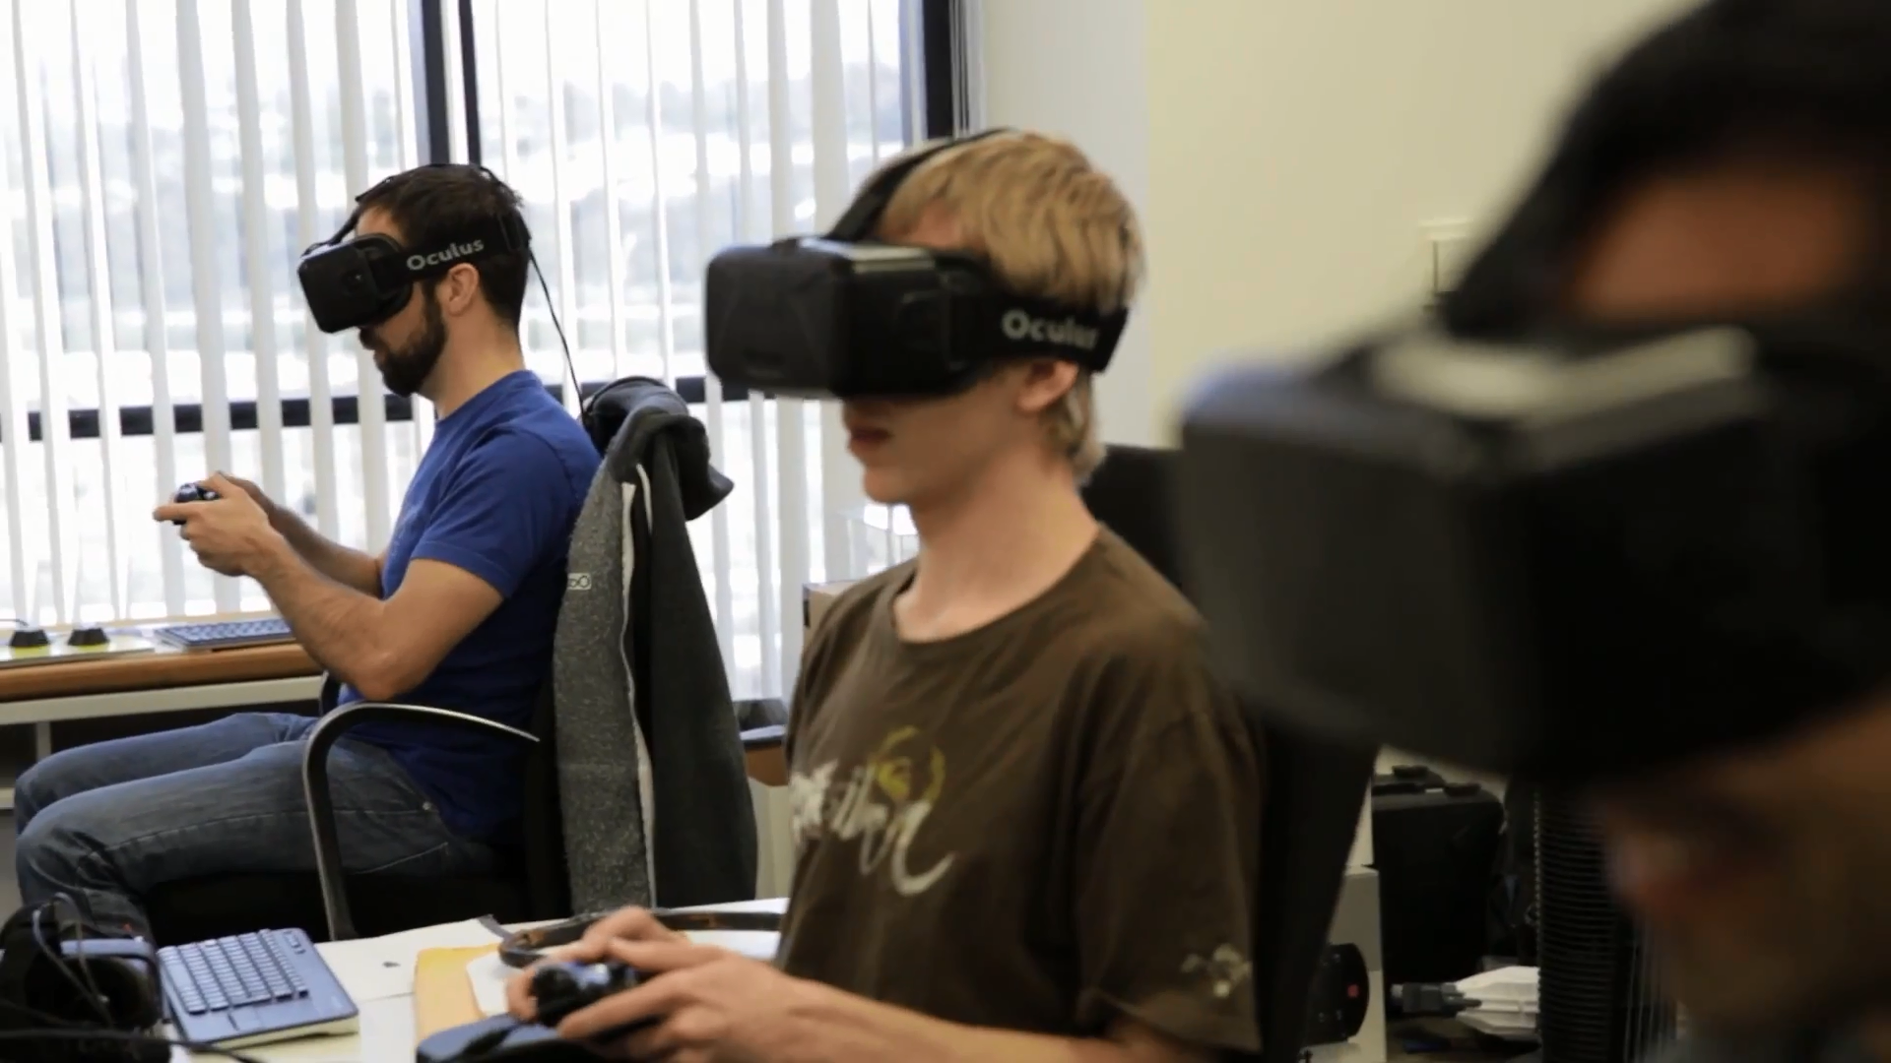
What is technology doing to us?
Prateek Sahay
http://www.oculusvr.com/
Notes:
Seeing the direction we’re going, in 1993 Michael Heim wrote The Metaphysics of VR, and he discusses one possible future of humankind.
Proposes VR will alter the way we behave/communicate until we get to the point where we become bodiless beings in a network, unaware of one another’s presence and completely detached from the world.
This seems revolting, but look at the trends in technology we’ve been making, it’s fairly clear that this is the direction we’re headed
It becomes a philosophical question then—do we care enough about the physical world that we should strive to protect it?
I think we should!
I don’t think we could produce a world more beautiful than the one we were created from

Slide 10
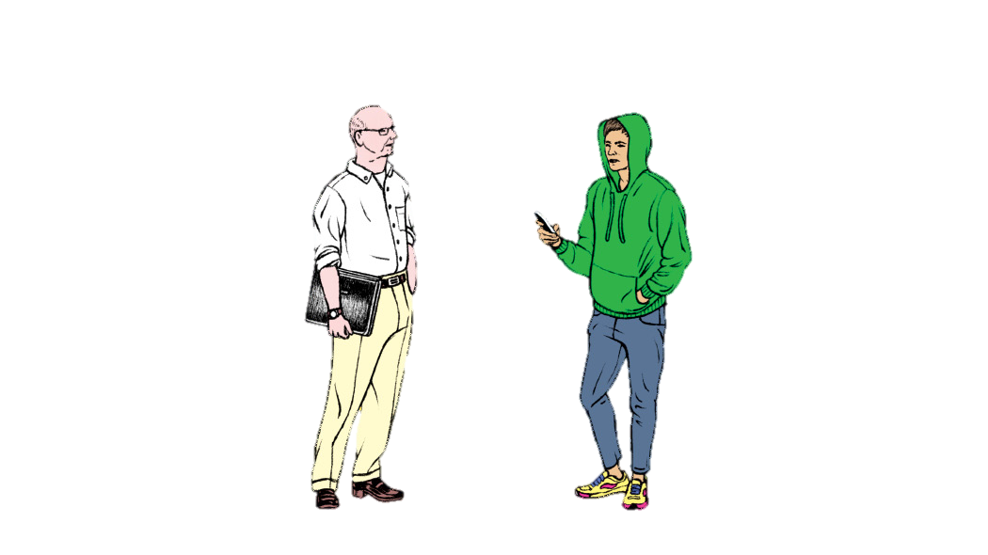
When will you make something that matters?
When will you make something cool?
Yiren Lu, Silicon Valley’s Youth Problem, NY Times, www.nytimes.com/2014/03/16/magazine/silicon-valleys-youth-problem.html?_r=0
Notes:
I urge you to consider ramifications of new technologies instead of just accepting them because they’re “cool” or because technology is always good
Growing disturbing trend in Silicon Valley of creating rampant new technology because it’s cool or makes money, etc.
E.g. sexting apps
Virtual reality is a ball that won’t stop rolling
We need to control its fall before it makes us into something we aren’t

Slide 11
Sources
Prateek Sahay
Michael Heim, The Metaphysics of Virtual Reality
Michael J. Quinn, pp. 126, Ethics for the Information Age
Rachel Emma Silverman, WSJ: Xbox to Exile? Videogames Linked to Antisocial Behavior, blogs.wsj.com/juggle/2009/01/23/xbox-to-exile-new-study-links-videogames-with-antisocial-behavior/
Yiren Lu, Silicon Valley’s Youth Problem, NY Times, www.nytimes.com/2014/03/16/magazine/silicon-valleys-youth-problem.html?_r=0
Notes:
<Your notes here.>

Slide 12
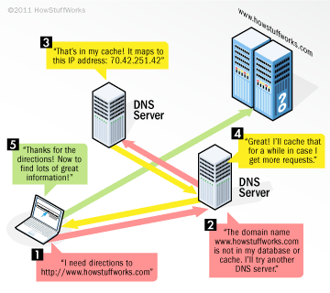
Domain Name System (DNS)
Mitchell Caisse
Converts Domain Names to IP addresses
Adds latency without caching
Lacking security
Notes:
Doman Name System, or DNS, is one of the most important services on the internet.
It is responsible for translating human readable domain names, into IP addresses which the underlying network uses to transfer data from one host to another.
Before a web browser can connect to a website (ie howstucckwo) it needs to know the IP address, so it sends a request to its DNS server, which it knows the IP address of.
That server will send back the IP address of the site if it is cached, or ask another DNS server for the IP. This can take a long time, and adds undesirable latency,
Causing DNS servers to cache results, rather than going to the root server each time.
As with a lot of network technology, there is no security built into the DNS protocol.
This means that it is hard for an end host to verify that the information it received from a DNS server, is valid.

Slide 13
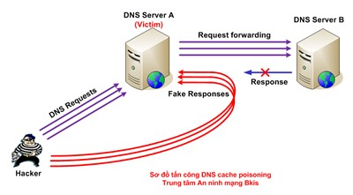
DNS Cache Poisoning
Mitchell Caisse
Inject a record into a DNS server
Unrelated Data Attack
Related Data attack
Notes:
This leads into one of the possible attacks on DNS servers, DNS Cache Poisoning. Cache poison takes advantage of the cache used by DNS servers, and aims to inject false records into a DNS server or end hosts’ cache.
These records will usually have high timeout values in order to exist in the cache for a while. As once the record is in the cache the DNS server will not request that record again.
This is commonly accomplished in a few ways, Unrelated / related data attacks, DNS ID attacks, and DNS Server attacks.
A Unrelated Data Attack is by far the easiest way to add a record. To start a hacker asks a DNS server for a nonexistent name mapping in a domain that they control. The DNS server will never be aware of this mapping, so it will
Ask the authoritative DNS server of the address, and the hacker can have his DNS return the mapping for that address and add any records he wishes, which are then added to the victim DNS cache
Related data Attack is very similar to this, however instead of adding additional unrelated records, it adds the record to additional fields in the DNS record, such as MX (Mail Server) CNAME (Canonical name) or NS (Domain’s DNS Server).
However these attacks have both been patched in the majority of DNS servers and aren’t as effective anymore. Unrelatated Data exploit was fixed with BIND 8.1 in around 2001, and related data was fixed in Bind 9.5 around 2008.

Slide 14
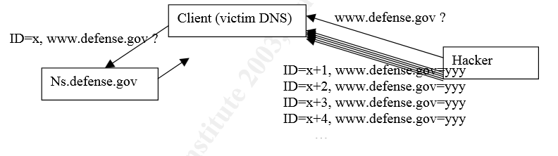
DNS Cache Poisoning
Mitchell Caisse
DNS ID
  Brute Force
  Educated Guess
DNS Server Attacks
Notes:
The other two attacks, DNS ID, and server attacks, still work.
A DNS ID attack is performed by spoofing the ID that the DNS protocol uses to verify the request. When a client sends a request to a DNS server, it will include an ID, which the server will respond with the same ID,
If the IDs do not match the client will disregard the message. If you are not on the same LAN as the victim this is a complicated procedure. A hacker can brute force the ID, which will tell him what the ID was, but this method is very slow, and the
Client is likely to get the correct response from the server, before the hacker gets the correct ID. It is possible for the hacker to flood the server to slow it down and delay the response, but it is not that much more effective.
The hacker can also take advantage of how the victim server generates ID’s as some servers simply increase the ID, meaning all the hacker has to do is make a valid request, and then inject his record with a response in the range of that ID.
There is one other way that can be used for cache poisoning, and this is Server Attacks, however these attacks are based on vulnerabilities in the server implementation themselves and differ depending on the software used.
They are also frequently patched and new ones are discovered.

Slide 15
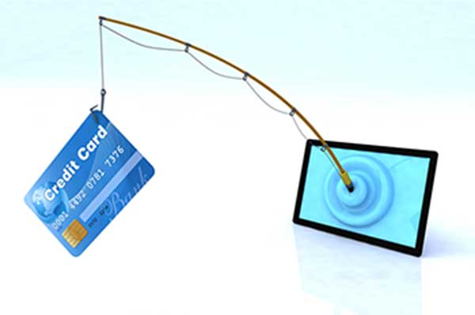
Poison Use
Mitchell Caisse
Maliciously Redirect traffic
Phishing
Block websites
Notes:
What can this Cache Poisoning actually be used for? The majority of uses are malicious and range from either installing malware on a users computer to blocking access to websites.
Using cache poisoning a hacker can redirect traffic from certain web sites (ie. Google.com) to their own website, or any other website. The redirected website can contain malware or other harmful programs.
An example if this is in 2002, OS X software updates were performed over HTTP with no authorization, allowing an attacker to easily redirect update requests to their servers using cache poisoning.
It can also redirect to phishing websites, ie facebook.com can redirect to a website that mirrors facebook.com, and the url would stay exactly the same, but it would be a different webserver, allowing a hacker to gain accounts and passwords.
It can also be used for blocking access to certain websites, earlier this year in China a cache poisoning affected 2/3rds of their DNS infrastructure, and affected all of their top level domains. This left many Chinese internet users unable to visit websites
For around 12 hours.
Similar to this incident is the blocking of Twitter and Youtube in Turkey recently Turkey’s DNS servers wouldn’t resolve twitter.com or youtube.com and all
Requests to other DNS servers, were redirected to their own, spoofing the external DNS servers. While this was a DNS Spoofing attack rather than a cache poisoning, the outcome of the attack is the same.

Slide 16
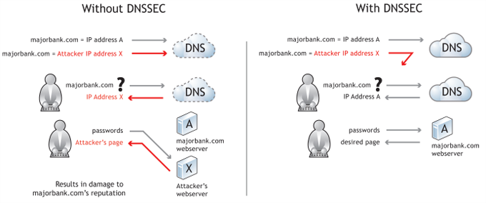
DNSSEC
Mitchell Caisse
Digitally signs records
Backwards Compatible
Notes:
DNS Security Extensions, introduced in 2005, adds validity to the existing DNS protocol. It digitally signs each DNS record, this allows any tampering to be detected.
The digital signatures are done in a hierarchical order, each record is signed by the previous node in the tree, this allows the validation of DNS records.
The digital signatures use public key cryptography, and range from an MD5 hash to a SHA-384 hash, the latter be more secure.
DNSSEC is completely backwards compatible, therefore implementing it will not break the internet for older clients that do not support DNSSEC, it can be queried just like a normal DNS server.
As of January of this year more than 50% if TLD’s have deployed DNSSEC.
DNSSEC is not a solution to all of DNS’s vulnerabilities, and makes the DNS amplification attacks worse, as the message sizes of responses is possible to be much larger now with the addition of
Signature keys.
Amplification attack is an attack that takes advantage of the fact that a small DNS request can generate a large DNS response, which can cause an increase in network traffic, and cause the DNS server to slow down
Resulting in service denials.

Slide 17
Sources
Mitchell Caisse
How Domain Name Servers Work, http://computer.howstuffworks.com/dns.htm (3/30/2014)
Security Issues with DNS, http://www.sans.org/reading-room/whitepapers/dns/security-issues-dns-1069 (3/31/2014)
DNS Poisoning slams web traffic from millions in China into the wrong hole http://www.theregister.co.uk/2014/01/21/china_dns_poisoning_attack/ (3/31/2014)
Turkey Hijacking IP Address for popular Global DNS providers http://www.bgpmon.net/turkey-hijacking-ip-addresses-for-popular-global-dns-providers/ (3/31/2014)
DNSSEC | ICANN http://www.icann.org/en/news/in-focus/dnssec (3/31/2014)
SoftwareUpdate DNS Spoof http://www.securemac.com/macosxphantomupdate.php (4/1/2014)
Notes:
<Your notes here.>

Slide 18
Class 5
The End
Keith A. Pray
Instructor
socialimps.keithpray.net
Notes:
This is the end. The slides beyond this point are for answering questions that may arise but not needed in the main talk. Some slides may also be unfinished and are not needed but kept just in case.

Slide 19
Logistics
Send email to Instructor and TA for fastest response.
This course is about the social implications of computing. All assignments will have this focus.
Follow the paper and presentation guidelines listed on the course web site.
Email salutations.
Notes:
Possible Reminders:
Send email to Instructor and TA for fastest response.
This course is about the social implications of computing. All assignments will have this focus.
Follow the paper and presentation guidelines listed on the course web site.
Put your name on every slide or points will be deducted
Presentation slides are due no later than 3 PM the day before you present.
Please name presentation files:
FirstnameLastname-Topic.pptx

Slide 20
My Reading Notes 1/2
pp. 109 “…more Americans…” How are online versions of newspapers counted?
pp. 110 40% + 35% Is the remainder from TV and radio? Sexting vs. Polaroids?
pp. 112 “As recently as 2000…” % of email’s existence?
pp. 113 Agreeing to “occasional offers…” makes it not spam, right? 1/100K = profit… doesn’t profit depend on profit/unit sold?
pp. 114 Spam relies on being able to respond in some manner.
pp. 116 Social Contract, Why disguising identities and motives not in other evaluations? Why is it used here when it is not in definition of spam?
pp. 117 “…comfort of our homes.” Just like catalog mail order. 8.7%, higher now?

Slide 21
My Reading Notes 2/2
pp. 119 Online game does not need to support simultaneous players. $3K seems low.
pp. 124 3.4.4 Have you observed Kant’s rhetorical question?
pp. 130 Act Utilitarian, Moral luck?
pp. 131 Why not have adult and minor user accounts, etc.? Filter as background process… that blocks?
pp. 134 Act Utilitarian, seems to never decide. How useful is the analysis?
pp. 136 In 2002-2003 I found out about identity theft when moving accounts online.

Slide 22
Freedom Of Speech
How has information processing technologies changed free speech?
How will it?
Notes:
Censorship (religious, governmental, private). Adult authentication. Global dissemination. Freedom of Speech not an absolute right.

Slide 23
Freedom Of Speech
Is Free Speech a negative or positive right?
Why is it considered important in general?
What are some examples of speech not permitted?
  Are these standards shared by everyone?
What are some serious results?
How to apply to the online content?
  Standards? Enforcement?
Notes:
Negative, positive or liberty, claim-right
“Shouting ‘Fire!’ in a crowded theater.”, Copyright law., False advertising., Libel & slander., Telemarketers., Spam. “Clear and present danger”, Commercial speech., Untrue & damaging. Child pornography., depends on community standards
Legal prosecution, Sexual harassment in the workplace, Books in libraries, Textbooks / school reading, Restrictions on school speech / writing.
What standards should apply? What locality has jurisdiction? How to enforce?

Slide 24
In-Class Exercise I
You are the head of the computer center at a public university. A state legislator goes to the university president to complain that sexually explicit words and pictures are being sent through the school’s computers and network, by email, Web, newsgroups, chat, and Webcams.
Notes:
From Professor Ciaraldi.

Slide 25
In-Class Exercise I
Divide into groups.
Each group contains:
  1 university librarian
  1 legislator
  1 researcher
  1 computer expert
  1 college student
The group must decide:
  What materials should be allowed and what banned?
  What activities should be allowed and banned?
  How will you enforce this?
  Who will decide?
Notes:
From Professor Ciaraldi.

Slide 26
Further Thought
What if the material concerned:
  Violence
  Hacking
  Prejudice / discrimination / hate
    Canada and some schools have rules against “hate speech”.
Must we accept restrictions on some freedoms to preserve others?
  Other people or other freedoms?
Notes:
From Professor Ciaraldi.

