Slide 1
Class 4
Professional Ethics
Keith A. Pray
Instructor
socialimps.keithpray.net
Notes:
Here’s the title slide. Excited already, aren’t you? You may not be depending on how you enjoyed the last class.
Remind class to email individual presentations to me, affords more time to accept last hour changes.
----- Meeting Notes (3/28/14 16:49) -----
remind students to turn in hard copies and online.

Slide 2
Overview
Professional Ethics
Assignment
Students Present
Notes:
Email greetings
Individual presentations (after class)
Break at 3:50
2 student presentations, need 25 minutes, start at 4:25

Slide 3
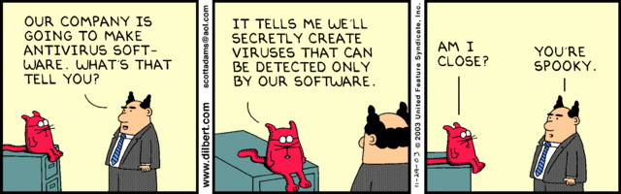
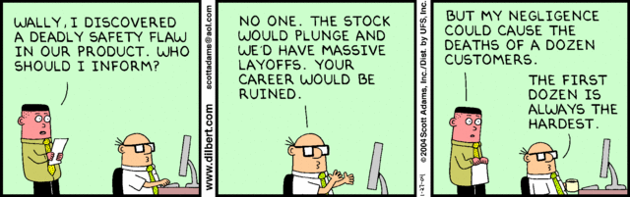

Slide 4
Overview
Professional Ethics
Assignment
Students Present
Notes:
Remind students to send questions to TA as well to improve response time.

Slide 5
Assignment
One page paper:
  Are online sources a better medium for dissemination of newsworthy information than traditional methods like print newspapers and television/radio news broadcasts?
Notes:
Reminders not needed this go:
Be sure to references sources outside the text book to strengthen your arguments.
Discuss Group Project

Slide 6
Overview
Professional Ethics
Assignment
Students Present
Notes:
Remind students to send questions to TA as well to improve response time.

Slide 7
Software Ethics
Miguel Mora 1
Computing Ethics are Global.
Subject to change.
Depends on the use of technology.
Influence by human and social values.
Ética Informática y Educación, http://www.ugr.es/~sevimeco/revistaeticanet/numero8/Articulos/Formato/articulo2.pdf (3/27/2014)
Notes:
Conclusion: Software professional ethics are global and always changing based on my findings Venezuela has the same code ethics as the USA and many other countries. The only thing that sets Venezuela apart is the use of technology and how people interact with it. Since technology is always changing the ethics have to adopt to those changes. Venezuelan social values is greatly influence by the government, culture, and technology availibility.

Slide 8
Venezuela’s influences in Ethics
Miguel Mora 2
Government
Culture
Economic conditions
Technology availability
Ética Informática en la Sociedad de la Información, http://www.scielo.org.ve/scielo.php?pid=S1315-99842006000400004&script=sci_arttext (3/27/2014)
Notes:
Venezuela use of technology is highly influence by the government. The government has regulation when it comes to browsing the internet. The last president Hugo Chaves stated that webpages should not have the right to say what ever they want. Government tries to limit the freedom of speech by limiting the internet use.
Technology is not a big aspect of the culture in Venezuela. Most people do not own computer or smart phones. Example where I used to lived there are, cyber Houses, where you pay a set amount to use a computer. In most of the country people are more worried about getting the resources to survive like food water rather than buy technology.
Economic conditions: Government regulates the money that flows to the country, most people are poor and inflation is high. It is very expensive to buy any product that includes smartphones and computers. People do not use the internet to buy products online as much as usa bc the dollar is regulated and there is a fix amount they give you.
Technology is hard to find in certain stores since everything is imported.

Slide 9
Common Problems In Venezuela
Miguel Mora 3
Falsification of documents.
Tracking of financial information.
Use of Internet to plot crimes.
Virtual Kidnapping
Ética Informática y Educación, http://www.ugr.es/~sevimeco/revistaeticanet/numero8/Articulos/Formato/articulo2.pdf (3/27/2014)
Notes:
Falsification of problems is the most common violation of ethics. People use technology to make documents and present them to offices where they do not have resources to verify that they are real. Example met a girl in the embassy in Boston who identity was stolen via internet, the other person made documents to buy dollars from the bank pretending he was a student.
Lots of companies are afraid that people wash the books.
Plotting crimes have increase in Venezuela one of the most common has been virtual kidnapping.
Here we can see that this crimes are similar to those in the USA

Slide 10
Maintaining good ethics
Miguel Mora 4
Four Properties : Silva Naif & Espina Jane
Stability,
Modularity
Severity
Integrity.
José Bernardo Peña Arcila : 10 Rules
Notes:
Ethic in computing have to have the four properties according to Silva, Neif and Espina, Jane.
Stability: the evolution of technology has created a rapid expansion of cyberspace, replacing activities by humans for computers or expert systems and the impact of information and communication technologies is directly on humans.
Modularity: ethics is based on the modular and incremental reasoning, information systems and components of cyberspace are complex engineering products, therefore it must be modular.
Severity: establishment of an ethical theory based on a rigorous reasoning.
Fortitude: there must be a place in the ethics of information for coding the values​​, reflective analysis and allow for the study of typical cases, be legitimate, exclude the trivial, since each statement is judged to be true.
Code ethics does not show the morals but it can give a perspective of how to improve so the whole population does not get affected by it.
José Bernardo Peña Arcila, in his paper with other colleagues Computing Ethics and Education discusses the 10 rules to live by when doing computing and they are like mandaments. You will not use a computer to harm someone, to steal cause fraud, infiltrate someone document.

Slide 11
Sources
Miguel Mora 5
Cifras del internet en Venezuela, http://www.elmundo.com.ve/noticias/tecnologia/internet/cifras-del-internet-en-venezuela.aspx (3/27/2014)
Ética Informática, http://www.monografias.com/trabajos56/etica-informatica/etica-informatica.shtml (3/27/2014)
Ética Informática en la Sociedad de la Información, http://www.scielo.org.ve/scielo.php?pid=S1315-99842006000400004&script=sci_arttext (3/27/2014)
Ética Informática y Educación, http://www.ugr.es/~sevimeco/revistaeticanet/numero8/Articulos/Formato/articulo2.pdf (3/27/2014)
Una familia fue víctima de un "secuestro virtual" en Los Teques , http://www.eluniversal.com/sucesos/110406/una-familia-fue-victima-de-un-secuestro-virtual-en-los-teques (3/27/2014)
Notes:
<Your notes here.>

Slide 12
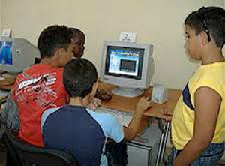
Computing Education in Cuba
Julieth Ochoa
Limited access to computers in school
  1-hour lab session per week
  Computer to student ratio is about 1:3 – 1:5
Computer Class for Students in Cuba at an Elementary School. Computer to Student ratio displayed of 1:4
Image retrieved from: http://www.havanatimes.org/?p=85719
(3/24/2014)
Notes:
Only a few computers in a lab, with a 1-hr lab session per week where the computer to student ratio is about 1:3 – 1:5
Computing technology is very obsolete
Computer classes are in many occasions dedicated to letting the kids play some simple games on the computer since they lack educational software that can be used during class time, such as Khan Academy, Virtual Libraries, etc.

Slide 13
Computing Careers in Cuba
Julieth Ochoa
Students who want to pursue a CS career have to attend the government-controlled University of Information Science (UCI)
  Must be loyal to the government
  Must be willing to work on any project they are assigned no matter what their professional ethics code dictates.
Notes:
This conditions persist from elementary schooling to college.
In some colleges that are strictly controlled by the government, this ratio can get reduced to 1:2. So students who want to study CS and need better computer access (because they don’t have computers at home) have to attend the UCI.
However, admission to this school comes with a high price…(sub-bullets)
When I was a CS student at a university in Cuba only 10% of the CS majors in my class had computers at home (very old computers). I was part of that 10% and believe me, were privileged.

Slide 14
Internet Access in Cuba
Julieth Ochoa
No Internet access!
  Only some government employees have Internet access
  Public centers that have computers with Internet charge $6 USD per hour (almost half of many monthly wages)
Government dictates who “needs” Internet access
  No access to political sites, newspapers, etc.
Notes:
Designated authorities and computing professionals who serve the corrupt government determine which websites can be accessed and which ones not
What’s the point of teaching students some basic computers skills since elementary school if they barely have access to computers to practice and strengthen those skills?
How can we further CS education if students can’t have access to the Internet not even to do school-related work? How do they work on any research projects, or on they Master’s or PhD theses. How they find out about the latest technologies?
I don’t mean to suggest CS academic progress cannot be made without the Internet because it was clearly made before its existence. But I believe that to further academic progress we must make good use of the technological resources that have already been made available for us.

Slide 15
Conflict of Interests
Julieth Ochoa
Promote no interest adverse to their employer or client, unless a higher ethical concern is being compromised…
  Going against the government in Cuba can result in:
  Best case scenario: Losing job and never again being hired as a professional by any company
  Worst case scenario: Going to jail; Being murdered (depending on the importance of the project)
Notes:
…In that case, inform the employer or another appropriate authority of the ethical concern

Slide 16
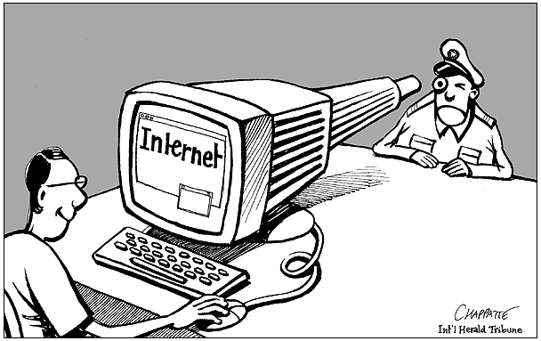
Respecting User’s Rights
Julieth Ochoa
Work on computing projects that respect the privacy of those who will be affected by them
  Blocking Internet access to the population
  Restricting information
Image retrieved from: http://goo.gl/A7d56
(3/24/2014)
Notes:
How can computing professionals in Cuba abide to these rules if they are “forced” to work on unethical projects, such as … (sub-bullets) … ?
Restricting information accessible to the few citizens who have limited (timed) access to the Internet

Slide 17
Employment and Remuneration
Julieth Ochoa
Fair and just remuneration.
  Entry-level Cuban programmers make 150 – 300 pesos per month ($7.50 - $15 USD)
Not unjustly prevent someone from taking a position for which they are suitably qualified.
  Previously demonstrated loyalty to the government
  Relatives of powerful government employees
Notes:
Graduates of the UCI who are lucky enough to get hired must meet one of these two requirements.
Once employed, they are assigned to unethical missions, such as:
blocking internet access to the population
Restricting the flux of information
Serving on similar unethical missions in other countries supported by Cuba (like Venezuela).
In case you are not aware, there is an ongoing rebellion in Venezuela right now because students are protesting against the government they have. Cuba has demonstrated their support to the Venezuelan government by sending not only military troops to fight the students protesting on the streets, but also many of their CS graduates of the UCI to block all sort of social network communication between anyone in Venezuela and the rest of the world in order to avoid evidence of the situation being sent out the rest of the world.

Slide 18
Government vs. Ethical Code
Julieth Ochoa
Avoid associations with organizations that are in conflict with this Code
  The government clearly doesn’t follow this Code.
Report to appropriate authorities significant violations of this Code
  There are no other authorities to reach out to: the Cuba government controls everything!
Notes:
Everything in Cuba is owned by the government. There are no private companies. If a persons wants to work in their professional field, especially in Computing, they must work for the government.
So how can computing professional avoid associating with organizations that are in conflict with the Code if all organizations serve the government’s interests which are clearly unethical?

Slide 19
Conclusions
Julieth Ochoa
Computing in Cuba is many decades behind and there are no hopes for a major change
Computing professional must decide between:
  Working for the government = engaging in all sorts of unethical government-enforced projects
  Never working in their professional field = working as handymen, etc.
  Working as self-employed computing professionals, which is in fact illegal in Cuba
Notes:
Clearly, the vast majority of computing professionals in Cuba don’t actively follow the Software Engineering Code of Ethics.
Is there any reasonable escape to this ethical dilemma for computing professionals in Cuba?

Slide 20
Sources
Julieth Ochoa
Ethics of the Information Age, Fifth Edition; Michael J. Quinn; 2012 (Chapter 9)
Accessed on 3/24/2014: http://www.havanatimes.org/?p=85719
Accessed on 3/24/2014:
  http://www1.american.edu/carmel/ms4917a/SW%20Mftg.htm
Accessed on 3/24/2014:
  http://www.ipsnews.net/2013/03/young-computer-scientists-in-cuba-short-of-opportunities/
Notes:
<Your notes here.>

Slide 21
Class 4
The End
Keith A. Pray
Instructor
socialimps.keithpray.net
Notes:
This is the end. The slides beyond this point are for answering questions that may arise but not needed in the main talk. Some slides may also be unfinished and are not needed but kept just in case.

Slide 22
My Reading Notes
pp. 404 One can perform services for oneself?
pp. 407 1993-1999 Does this seem like a long time?
pp. 408 “errors of omission or commission”?
pp. 417 3. Would people agree – social contract? Does virtue ethics beg the question?
pp. 419 Virtue Ethics Complements… Same example from Ch. 2? “…practice it on your mother-in-law…” means to an end?
pp. 425 8.06 “…followed…three clauses…”?
pp. 435 So the baby can be left outside and no one is responsible?
Notes:
An error of commission is one where the person responds where they should not. This is compared to an error of omission, where the person fails to respond when they should.

Slide 23
Professions
Examples?
Compensation
Qualifications -Skills, Education
Autonomy, clients, and mobility
Associations
  Standards
  Licensing
  Code of Ethics – Why?
  Self Regulation
Notes:
Doctors, lawyers, accountants…
Do all examples given share these characteristics? Shown in slide on click.
Why would they?
Professional societies. AMA, ABA, ACM, IEEE-CS.
How are standards enforced? Force of law? Disbarment?
Why Ethics? Professionals have special expertise; people rely on them. Their actions affect large numbers of people.
Computing related careers not fully formed profession, no licensing.

Slide 24
Codes of Computer Ethics
ACM
  General Moral Imperatives
    Contribute to society and human well being
    Avoid harm to others
    Be honest and trustworthy
    Be fair and take action not to discriminate
    Honor property rights including copyrights and patent
    Give proper credit for intellectual property
    Respect the privacy of others
    Honor Confidentiality
Notes:
Just a quick run through so we can have the class discussion.

Slide 25
Case Study – Anti Worm
Internet plagued by worm exploiting a security hole in nameless popular OS.
Mr. Smartypants creates anti-worm that exploits same security hole, downloads and installs a patch for security hole. He releases the anti-worm.
Mr. S. take precautions to ensure the anti-worm cannot be traced to him.
Just like the malicious worm, the anti-worm quickly spreads to millions of computers and consumes large amounts of network resources.
The anti-worm looks just like another worm to systems administrators who try to stop it.
Using the SWE Code of Ethics let’s discuss if Mr. Smartypants did the right thing.

Slide 26
Codes of Computer Ethics
ACM/IEEE-CS
  Principles
    Public
    Client And Employer
    Product
    Judgment
    Management
    Profession
    Colleagues
    Self
Notes:
Assign if no one can explain a point.

Slide 27
Codes of Computer Ethics
ACM
  Professional Responsibilities
  Organizational Leadership Imperatives
  Compliance With The Code
Why have these things?
Give examples when these should have been followed
  Why?
Notes:
Professionals have special expertise; people rely on them.
Their actions affect large numbers of people.

Slide 28
Professional Ethics
Why?
Notes:
Professionals have special expertise; people rely on them.
Their actions affect large numbers of people.

Slide 29
Assignment
Get started on Group Project.
Do we want Movies or New Technology?
  Please see Assignment slides for details.
Movies!
Notes:
Can’t conduct a course with out cool homework and stuff.
New Technology!
Please see Assignment slides for details.

