Slide 1

Class 11
Livelihood
Keith A. Pray
SocialImps.com
Notes:
Styx - Mr. Roboto (1983) (5:34)
https://www.youtube.com/watch?v=uc6f_2nPSX8
Accessed 2025-04-28
Ask about Automation paper:
What did people choose to automate
Share 1 main reason

Slide 2
Papers
Bad News: Looks like regression, need 2nd grading pass
Good News: Automation Paper will not be due until 48 hours after you get feedback or later
https://socialimps.com/assignments/paper-guidelines/
Notes:
Save for next time:
https://socialimps.com/assignments/references/
Excellent improvement!
Better quantification, some improvement left to be had
Use high quality sources
Clearly state conclusion
First statement preferred
Absolute statements are difficult to prove
Avoid: all, always, any, every, everyone, never, none… unless you can show it
Be sure to put quotes around entire quote
Hyperbole is the best thing ever!
but not in these papers
Print 2 sided and save a tree
Use template, saves time (and -1 point)
Include Counter Point and Response
Include Author, Title, Publish Date, Publisher for references
Read paper aloud to proof
Changing a couple words does not constitute paraphrasing.
Include tests/results in Appendix
Ask for help if you have trouble with backing data
Define test strategy clearly

Slide 3
Grades
To Date
44 Max Possible
- Discussion 1-10
- Papers 1-3
- Includes Facial Recog.
Subject to change after 2nd grading pass of paper 3

Slide 4
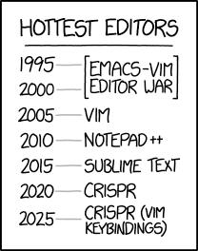
Overview
Review
Assignment
Students Present
https://www.xkcd.com/1823/
Notes:
Used to be full circle. Might have to retire this if no one know what emacs and vi are.
CRISPR: Clustered Regularly Interspaced Short Palindromic Repeats
Allows permanent modification of genes within organisms.
Published 2017-04-12 according to https://www.explainxkcd.com/wiki/index.php/List_of_all_comics_(1501-2000)
Kickstarter Charter
https://www.kickstarter.com/charter?ref=about_subnav

Slide 5
Overview
Review
Assignment
Students Present
C lustered
R egularly
I nterspaced
S hort
P alindromic
R epeats
Permanent gene modification
https://www.xkcd.com/1823/
Notes:
Full circle (not quite since the Emacs/VIM comic no longer used… may have to retire this as students seem to not be aware of different text editors).
CRISPR: Clustered Regularly Interspaced Short Palindromic Repeats
Allows permanent modification of genes within organisms.
Published 2017-04-12 according to https://www.explainxkcd.com/wiki/index.php/List_of_all_comics_(1501-2000)
Kickstarter Charter
https://www.kickstarter.com/charter?ref=about_subnav

Slide 6
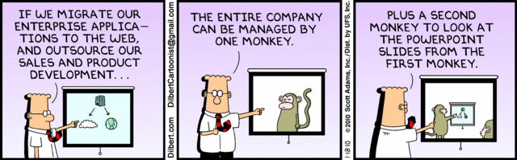
Let’s Look At One way to handle a Decrease In Jobs
Notes:
Poll class:
Expected salary range upon graduation? Min, Max? Put in spreadsheet.
Assume 40 hour work week.
How many people would work:
32 hours for 0.8 * Max?
24 hours for 0.6 * Max?
…continue until Min is reached.

Slide 7
My Reading Notes
p. 457 “Mr.” → “Ms.”
p. 458 Asimov “Three Laws of Robotics” not guarantee as his stories show… absolutes “never” difficult to prove.
p. 459 Tesla and other newer car manufacturers similar to 15 person hours per car? 2003, 2008 sources update?
p. 460 “all time… work time” 1998 source, newer corroborate?
p. 461 securities industry employment rise source 2005.
p. 462 “Working less, making more” 2001 source, now? “stone-age” source 1991, now?
p. 463 Cost of AC, screens, etc. much lower. 2022 home size source 2001? Cancelled vacation not computing, sounds likely, just in computing fields? Kantian, Stuart treated himself as a means to an end, see Virtue p. 464
p. 465 Multiple citing Wikipedia ☹
p. 468 ChatGPT Plus (et al) → more Digital Divide?
p. 473 Hawking, appeal to authority fallacy? AI needs us like we need plants, we’ve done great keeping plants safe…
p. 475 Generative AI transparency difficult with text. Brake efficiently, rear end collision most common accident p. 379, 2017, diff. now?
p. 476 Trolly, most, many, quantify.
p. 479 Amazon, Slack, source title Intel.
p. 481 Uber/Lyft lawsuit sources 2015, outcome? Monitoring data needs update, 2008 newest. Security and IP seem more likely primary purpose, 2002 source. Many people only regular Internet access was at work. More schools using cameras source 2003, need newer for claim.
p. 482 Multinational Team Patents need sources. India salary info from 2003. Jobs moving out of US 2008 source.
p. 483 3. Arg statement, 1999, still holding?
p. 484 WTO seems implementation complaint, not globalization. Corn, wheat example from 2012. Are the subsidies more the problem than globalization?
p. 485 Gates quote, what about new grads without experience?
p. 486 90% computers made in China 2014 source. 2015 example of Chinese university accomplishment.
p. 489 No other reasons for North Korea? No newspaper, radio, TV claim from 2001. Secondary school 2003. DVD player may be more relevant example than VCR.
p. 491 Online courses synchronous or asynchronous?
p. 492 DSL still relevant?
p. 493 More Wikipedia citing ☹
p. 494 2022 CEO salary source 2003? Still true more people know Windows than Mac? Is US still dominant economic power?
p. Rec Center gives students advantage, but who really pays?
p. 496 Blue laws limiting store hours computing?
p. 498 “bus” → “bust”
p. 501 21. I think Blaise doesn’t watch movies.
p. 502 29. Ignores cost of living differences.
Questions I liked: 15, 16, 17, 22, 23, 24, 25, 26, 27, 32, 33

Slide 8
Group Quiz
List 2 ways IT can lead to organizational change.
List 4 ways a Video Game Producer may protect its IP and what specific IP each protects.
List a computing technology that can be used to protect an individual’s privacy.
List a computing technology that can be used to intrude upon an individual’s privacy.
Notes:
Could split into groups of 4-5 for this.
Fill time with Work Discussion on Course Web Site

Slide 9
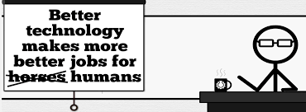


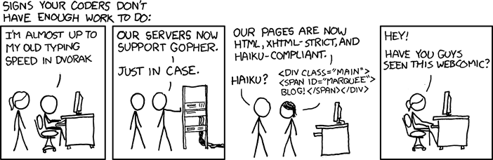
Overview
Review
Assignment
Students Present
http://xkcd.com/554/
Notes:
CGP Grey
Humans Need Not Apply (15:00) – 2014-08-13
http://www.youtube.com/watch?v=7Pq-S557XQU
Last access 2016-04-22
These 3D printed homes can be constructed for $4,000 (3:00 – 2018-04-02)
http://www.businessinsider.com/3d-printed-homes-constructed-icon-new-story-tech-charity-4000-dollars-2018-3
https://www.youtube.com/watch?v=SvM7jFZGAec (1:28)
Last access 2018-04-22
David Autor
Will automation take away all our jobs? (18:27) (2016)
https://www.ted.com/talks/david_autor_will_automation_take_away_all_our_jobs/transcript?language=en
TEDxXambridge, 2016-12-19
Review Group Assignment Details.
Or first watch video: depends on student presentations, no thunder stealing.
Look at:
BBC Intelligent Machines
http://www.bbc.com/news/technology-33978561
BBC Likelihood of robot taking your job
http://www.bbc.com/news/technology-34066941
Gopher protocol for sharing library data, ftp search, precursor to web/http

Slide 10
Assignment Reminders
Finish all reading
Finish Automation Paper
Optional Game Paper due last day of class
Group Web Sites and Presentations
If your group is not presenting next class prepare 3 questions for each group that is presenting by visiting their web sites.
  See Group Project Details

Slide 11
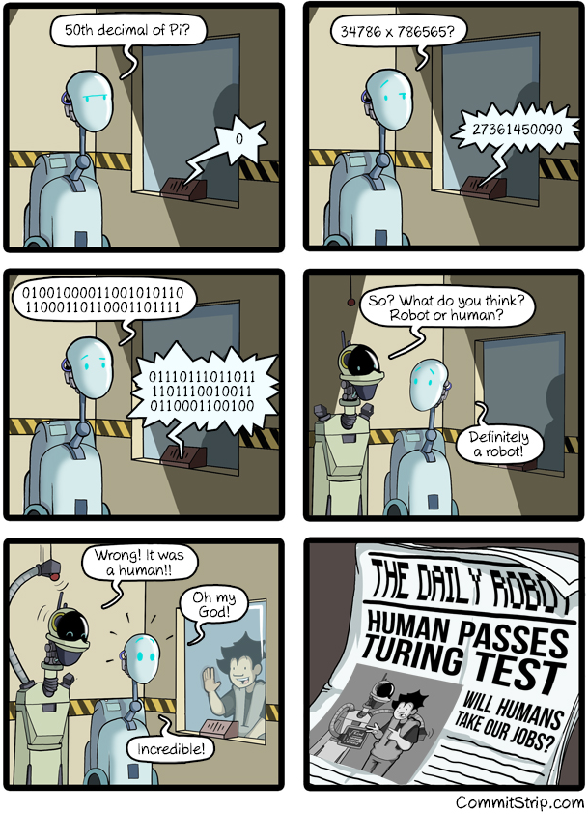
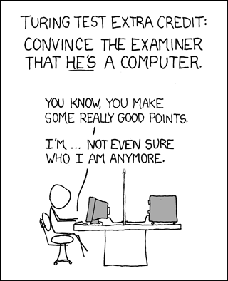
Overview
Review
Assignment
Students Present
https://xkcd.com/329/
Notes:
http://www.commitstrip.com/en/2016/04/14/meanwhile-in-a-parallel-universe-3/ (2016-04-14)
01001000011001010110
11000110110001101111
Hello
01110111011011
1101110010011
0110001100100
World
https://xkcd.com/329/ (2007-10-15)

Slide 12
MANUFACTURING AUTOMATION: IS IT WORTH IT?
Ryan Agge
Notes:
Overview: Talking about advancements made in manufacturing automation
Lots of positives, some room for improvements/concerns

Slide 13
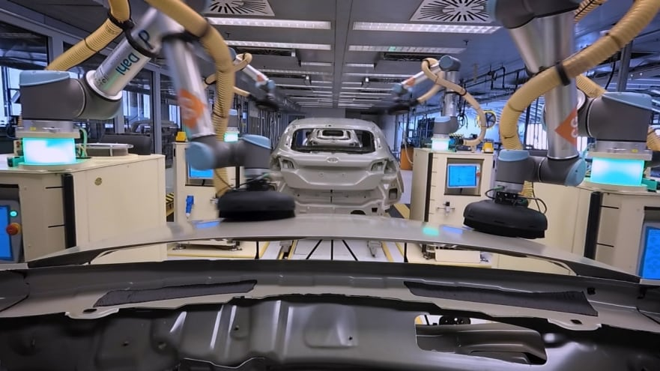
What Is Playing A Role?
Ryan Agge
Artificial Intelligence
Less waste, useful for large datasets [1,2,3]
Optimizing workflow [1]
Preventing severe system damage [2]
Robotics
Completes strenuous work [4]
  6 robots take 35 seconds to sand car body panels [4]
Safer work environment [5]
Regardless of skill, accidents can happen to any worker!
Ford Fiesta Assembly Line in Germany [4]
Notes:
- Artificial intelligence has a use in being able to analyze large datasets and taking over time consuming tasks (data entry, filing) that can enhance productivity among workers [1]
Artificial intelligence can analyze data from sensors to ensure that proper maintenance is performed to prevent catastrophic failure with machinery or other technology [2]
The Ford Motor Company is a company that implemented robots at their factory in Germany that work alongside engineers. Focus on preventing human need for labor-intensive work, with the sanding process of body panels being mentioned. [4]
Robotics are useful in their ability to keep workers away from tasks that run the risk of potential injury. Heavy lifting and welding are two tasks that robotic automation has become more used in which both run risks of human injury. [5]

Slide 14
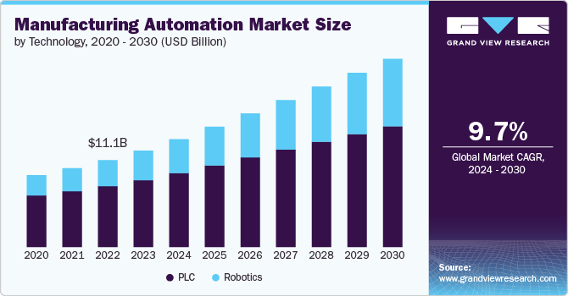
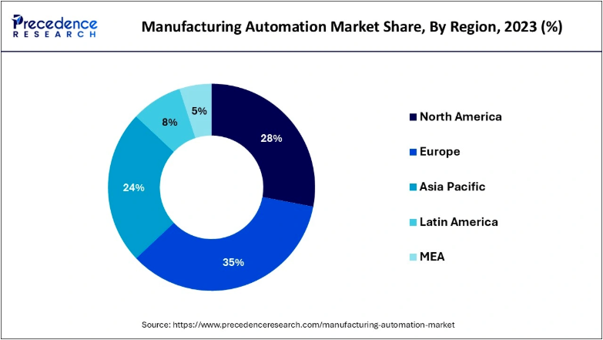
How has the market grown?
Ryan Agge
Future advancements expected to keep market growing [1]
  12.28-billion-dollar estimate in 2023
Europe ahead, but North America expected to grow[2]
  US expected to have highest CAGR (Compound Annual Growth Rate) from 2024-34
Associated with rising labor costs and scarcity of skilled workers to fill essential roles [1,2]
As production costs go down, profit goes up [8]
CAGR estimation from 2024-2030 [1]
Market share across continents[2]
Notes:
- Global manufacturing automation value expected to keep growing as predicted by networking architects from further developments in robotics, ai, and machine learning [1]
- Europe has had the biggest head start in automation of manufacturing, but US and North America expected to make the biggest gain in period of 2024-2034 [2]
Europe benefitted from this autonomy, as quality standards in regions with the adoption of these standards increased, and led to more job opportunities [2]
- As labor cost rises, there is a growing desire from companies to adopt in more optimization of their manufacturing processes, as well as skilled workers able to handle these jobs becoming scarcer. [1,2]
- For businesses, the desire to move to automated manufacturing can be backed up by the cheaper cost to produce items [8]

Slide 15
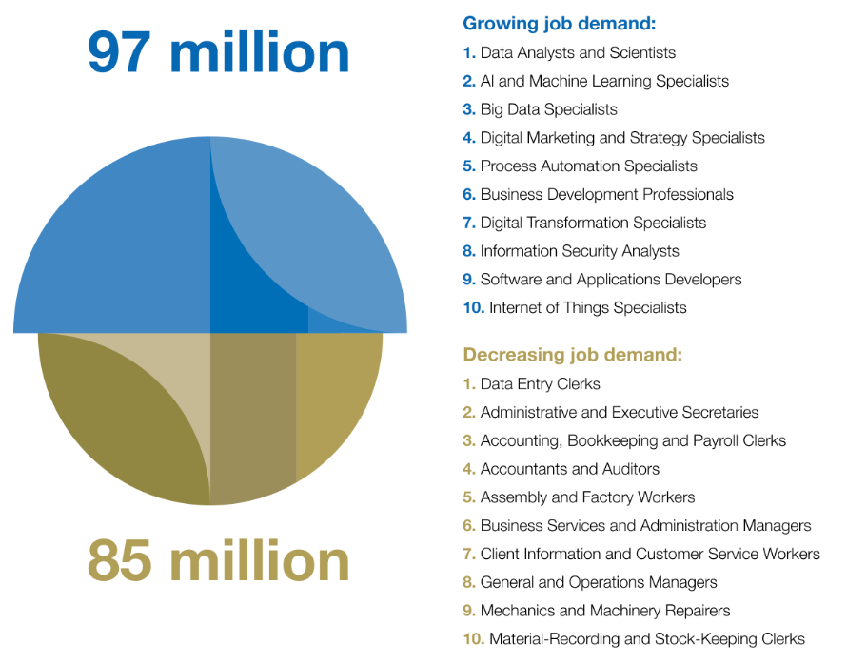
The impact on jobs
Ryan Agge
US jobs have been lost, but not necessarily automation’s fault [6]
  NAFTA in the 1900s, 700k jobs left US
Automation requires jobs [6]
  Increase in automation firm productivity = increase in jobs [14]
Predicted loss of 85 million jobs, gain of 97 million jobs [7]
Positive relationships form with employees [11]
  Automation takes over trivial tasks -> work force is more productive [11]
Shift in Job Landscape, estimated by 2025 [7]
Notes:
Jobs in the US have fallen, but this is largely due to globalization and less-so automation taking jobs away. NAFTA (1990s) is an example of this, as 700,000 jobs left the US for Mexico due to its implementation. [6]
Automation, while will remove some jobs, will also bring forth new opportunities as people are needed to implement and work alongside new manufacturing technology. Engineers, data analysts, and operators are positions needed for these machines to work, as well as the creation of programs and training courses needed so people can be educated about what they will be using. [6]
A study showed how a domino effect can occur from automation growth: As automation firms become more productive, their prices will drop and demand will increase, which will then translate to higher employment. [14]
An estimation by the World Economic Forum in 2020 said that 12 million jobs would be created by 2025 with AI playing a role in the net gain. [7]
A study conducted by Harvard found that automation and employees had grown a positive relationship and ended up improving the productivity of workers [11]
“After adopting automation technologies, firm owners increase their profits but pass through some of the productivity gains to consumers, inducing scale effects. Automation can thus lead to higher firm profits, lower consumer prices, increased consumer demand, and in turn to increased firm and industry scale, higher labor demand and higher domestic employment at the expense of foreign competitors.” [11]

Slide 16
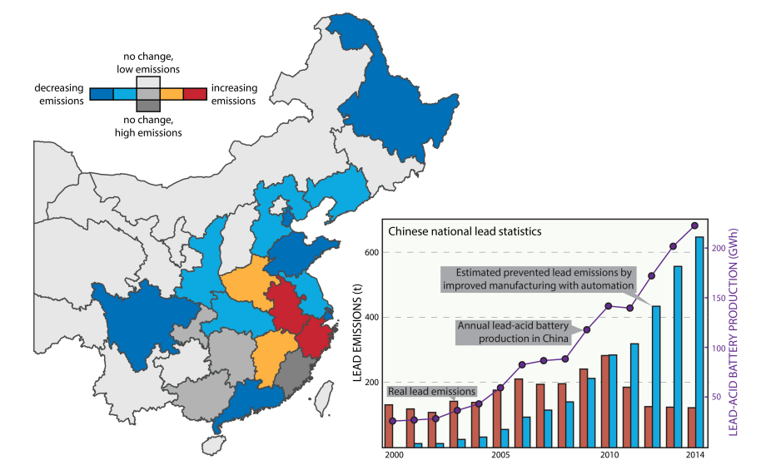
THE impact on THE ENVIRONMENT
Ryan Agge
Streamlined production can lead to less emissions, but research results have varied [8,10]
  Lead-acid battery production doubled, yet emissions dropped, 40% attributed to automation
Robots are more efficient, but can come at environmental cost [10]
Industrial growth offsets gains present in automation [10]
AI takes lots of energy (Saying “thank you” to ChatGPT) [13]
Prevented lead emissions in China [8]
Notes:
Having a well-automated manufacturing process reduces the amount of pollution caused by the manufacturing process, as well as the energy needed. [8]
At a lead-acid factory in China, despite the doubling of the production, there was a decrease in the amount of pollution caused by the process due to an increased use of automation in the manufacturing process. [8]
Robots are much more efficient, but the downside is these robots will produce a lot of emissions. Many efficiency gains in energy that are present in automation are offset by the growing amount of industrial activity. [10]
AI takes a lot of energy. OpenAI CEO Sam Altman recently said that simply saying “thank you” to ChatGPT was taking up a ton of energy. “Tens of millions of dollars”. Parallel to energy AI may consume if it becomes a mainstay in manufacturing? [13]

Slide 17
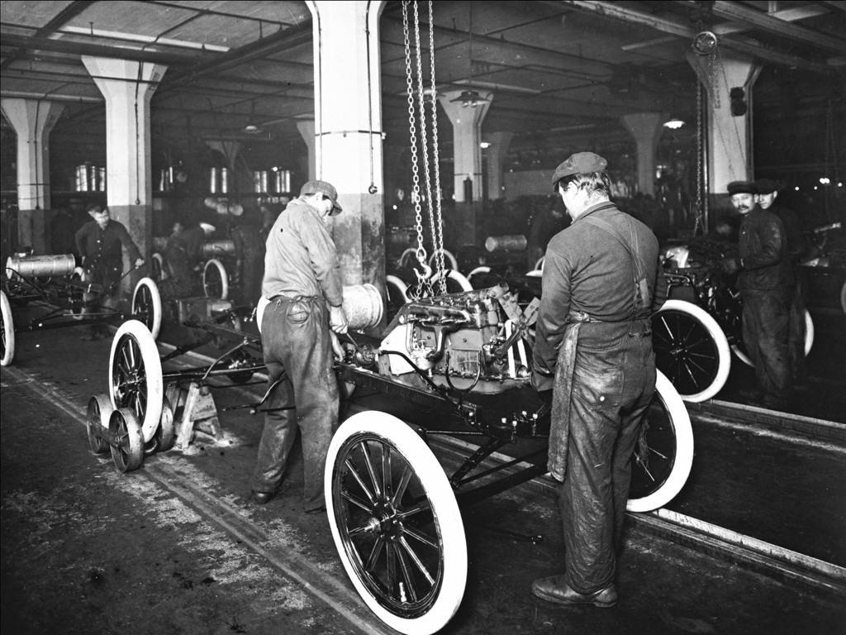
What does it mean for MOST consumers?
Ryan Agge
Cheaper
  Benefit seen 100 years ago with Ford Model-T [8]
  $600 to $360 from 1912-1916
Speedier delivery, supply chain improvements
  COVID was example of unprepared supply chain [8]
Improved quality control
  Medical industry [8]
Building process of the Ford Model-T [9]
Notes:
The cheaper it will be to produce something, the cheaper the price for that item will be. [8]
Ford is one of the most well-known companies for their advancement in the streamlining of the manufacturing process, with Henry Ford’s assembly line being able to make cars very efficiently, resulting in a price drop of $240 in the 1910s. [8].
Automation in manufacturing will help with enhancing a supply chain that was shown to be unprepared for a massive shake-up like what was seen with COVID, where many industries suffered shortages. The speed and improved quality that is brought with automation would be incredibly beneficial in case another pandemic occurs. [8]
The difference in terms of quality when accessing automation in manufacturing can be highlighted in pharmaceutical production, where there are strict standards that are more easily tackled with automated practices. [8]

Slide 18
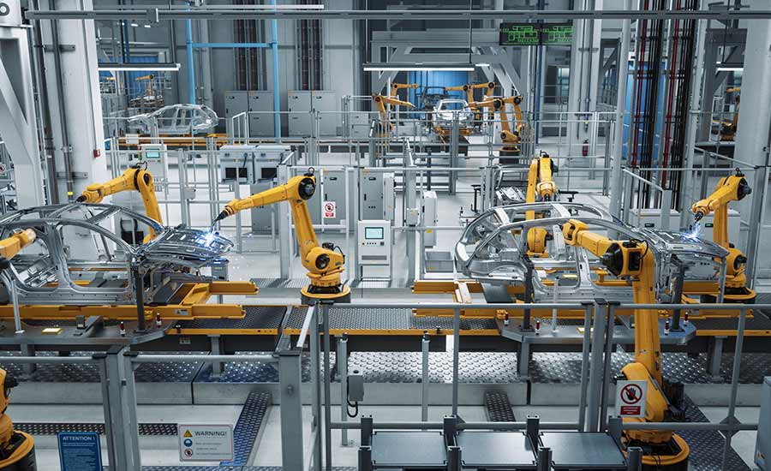
SUMMARY
Ryan Agge
Yes, it is worth it.
Growth of manufacturing automation has many positives
  AI and Robotics pivotal
Environmental concerns worth considering
  Can be more efficient, but is it worth it? How can the process be improved?
Creates job opportunities
  Variation in jobs taken vs jobs created
Positives for customers
[12]
Notes:
Yes, the advancements made in manufacturing automation are worthwhile due to it’s benefits for consumer’s employees, and companies.
The environmental impact is not devoid of concerns however, and it is worth questioning what could be changed regarding automation manufacturing progression to ensure the planet is not becoming a victim of the newer age of automation.

Slide 19
References
Ryan Agge
[1] Manufacturing Automation Market Size, Share & Trends Analysis Report By Technology, By Component, By Deployment, By End-use, By Industry Vertical, By Application, By Solution, By Enterprise Size, By Region, And Segment Forecasts, 2024 – 2030 (Grand View Research, n.d.), https://www.grandviewresearch.com/industry-analysis/manufacturing-automation-market-report#:~:text=Manufacturing%20Automation%20Market%20Trends,9.7%25%20from%202024%20to%202030. (accessed 4/12/2025)
[2] Manufacturing Automation Market Size, Share and Trends 2024 to 2034 (Precedence Research, last updated 11/13/2024), https://www.precedenceresearch.com/manufacturing-automation-market#:~:text=The%20global%20manufacturing%20automation%20market%20size%20is%20calculated%20at%20USD,due%20to%20rising%20labor%20shortages. (accessed 4/12/2025)
[3] How is AI being used in manufacturing? (IBM, 11/15/2024), https://www.ibm.com/think/topics/ai-in-manufacturing#:~:text=Benefits%20of%20using%20AI%20in%20manufacturing,-Beyond%20the%20use&text=Cost%20reduction%3A%20Automation%2C%20predictive%20analytics,more%20cost%2Deffective%20production%20environment. (accessed 4/12/2025)
[4] Ford Choreographs Robots to Help People – and Each Other – on the Fiesta Assembly Line (Ford Media Center, 09/26/2019), https://media.ford.com/content/fordmedia/feu/en/news/2019/09/26/ford-choreographs-robots-to-help-people--and-each-other--on-the-.html#:~:text=Collaborative%20robots%20(cobots)%20work%20together,Paint%20Shop%2C%20Ford%20of%20Europe. (accessed 4/12/2025)
[5] Robotics in Manufacturing: Transforming Production(Universal Technical Institute, 1/31/2025), https://www.uti.edu/blog/robotics-and-automation/robotics-in-manufacturing (accessed 4/12/2025)
[6] Keith, Elphick, Automation Isn't the Biggest Threat to US Factory Jobs (Airline Hydraulics, 3/5/2024) https://blog.airlinehyd.com/automation-isnt-the-biggest-threat-to-us-factory-jobs (accessed 4/12/2025)

Slide 20
References
Ryan Agge
[7] Don't fear AI. It will lead to long-term job growth.(World Economic Forum, 10/26/2020) https://www.weforum.org/stories/2020/10/dont-fear-ai-it-will-lead-to-long-term-job-growth/ (accessed 4/12/2025)
[8] Alison Fang, Vickie Chen, Matthew A. McDonald, Breaking down the impact of automation in
manufacturing (MIT Science Policy Review, 8/31/2023) https://sciencepolicyreview.org/wp-content/uploads/securepdfs/2023/08/MITSPR-v4-191618004018.pdf (accessed 4/15/2025)
[9] Game Changer: 100th Anniversary of the Moving Assembly Line (Ford Newsroom, 9/12/2013) https://media.ford.com/content/fordmedia/fna/us/en/features/game-changer--100th-anniversary-of-the-moving-assembly-line.html (accessed 4/15/2025)
[10] Ahlam Almusharraf, Automation and Its Influence on Sustainable Development: Economic, Social, and Environmental Dimensions. (Sustainability, 1/15/2025) https://doi.org/10.3390/su17041754 (accessed 4/23/2025)
[11] Philippe Aghion, C´eline Antonin, Simon Bunel, Xavier Jarave, What Are the Labor and Product Market Effects of Automation? New Evidence from France (Harvard, 12/2021) https://scholar.harvard.edu/files/aghion/files/what_are_the_labor_and_product_market_effects_of_automation_dec_2021.pdf (accessed 4/23/2025)
[12] https://modula.us/blog/automation-in-production/ (used for image, accessed 4/25/2025)
[13] Do you say 'Please' to ChatGPT? Sam Altman reveals how much electricity your manners cost to OpenAI(The Economic Times, 4/22/2025) https://economictimes.indiatimes.com/magazines/panache/do-you-say-please-to-chatgpt-sam-altman-reveals-how-much-electricity-your-manners-cost-to-openai/articleshow/120455018.cms?from=mdr (accessed 4/26/2025)
[14] Philippe Aghion, Céline Antonin, Simon Bunel, Xavier Jaravel, The Direct and Indirect Effects of Automation on Employment:
A Survey of the Recent Literature (Harvard, n.d.) https://scholar.harvard.edu/files/aghion/files/direct_and_indirect_effects_of_automation.pdf (accessed 4/27/2025)

Slide 21
E-Waste in Nigeria
Tiffany Semexant
Notes:
(Introduce self)
Going to talk about e-waste and its effects on the environment and privacy.

Slide 22
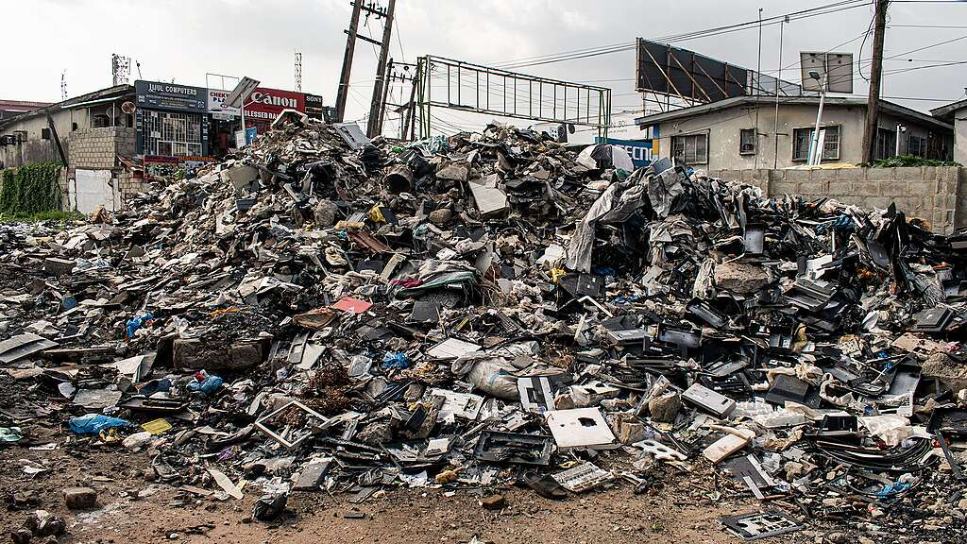
Conclusion
Tiffany Semexant
E-waste production needs to be managed and regulated by governments and tech industries alike
  Presents problems on global and local scale
  Will be focusing on impacts in Nigeria
Lagos, Nigeria [3]
Notes:
The production of e-waste globally needs to be managed and regulated to reduce harm to the environment, lower environmental injustice in regions that are disproportionately affected by the harmful health effects of said waste, and to protect personal consumer data and privacy. This should be the responsibility of the governments of said regions who choose to import said waste, and it should be the responsibility of governments around the world to hold large tech corporations accountable for the role they play in this too. Consumers can also take on certain responsibilities to help reduce their roles in contributing to the issue. To exemplify this global issue, we will be focusing specifically on one country: Nigeria.

Slide 23
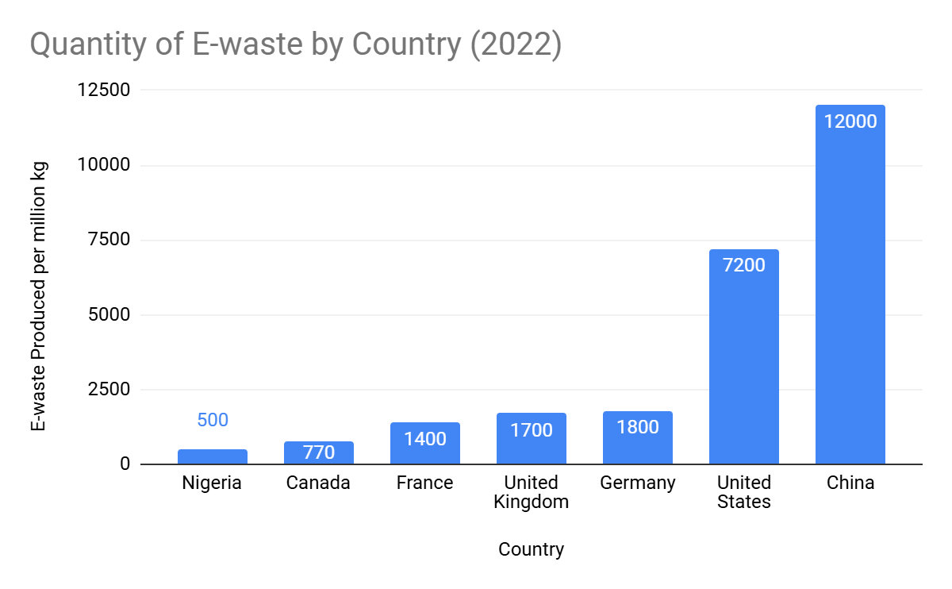
Context
Tiffany Semexant
Higher income countries export waste to lower income countries [2]
  Cheaper to process in foreign country
~54,431,084 kg of e-waste are imported to Nigeria each year [5]
Amount of waste produced by countries that export to Nigeria, compared to Nigeria. (with data from [1])
Notes:
General Overview about E-waste in Nigeria: Nigeria is one of several countries that will receive imports of e-waste from other countries to be processed because of the looser regulations around processing, especially since the system in Nigeria is managed by the private sector. Regulations in the exporting countries generally call for much of the waste to be recycled in safer and more sustainable ways. However, higher-income countries can avoid the lengthy and costly process by exporting their waste to other countries. [5] Particularly for Nigeria, 0% of it is formally recycled. [1] That means these electronics mostly end up sitting in landfills or incinerated. However, it also can open up opportunities for workers at these waste management facilities to take any electronics that may be in working order. They may then refurbish and sell these electronics. RoRo vehicles (Roll on/Roll off) are seemingly the most common way to transport waste. I would love to give you specific number of exactly how common, but it’s difficult to do because most of these vehicles do not report that they are carrying e-waste and will often disguise that they are carrying it. [5] In fact, one study found that only 3% of roro vehicles found to be carrying e-waste had been cleared with the regulatory agency NESREA [5]. (National Environmental Standards and Regulations Enforcement Agency)
About the graph: Graph represents the amount of e-waste produced by each country. Every other country listed exports e-waste to Nigeria [5]. Fairly consistently, Germany, and the UK export the most to Nigeria, with 10.9 million kg, 10.6 million kg, respectively [5]. Even though these countries aren’t exporting all of their waste to Nigeria, they are exporting it to other countries, like India, Indonesia, Vietnam, Ghana, and Thailand. The only other country on this graph that accepts e-waste imports is China, which accepted 35million kg of e-waste in 2022 [1].

Slide 24
It hurts more than it helps
Tiffany Semexant
Environmental concerns
  Electronics contain metals like Copper, Cadmium, Nickel, Chromium, Lead, and Mercury; these are present in e-waste in Nigeria[2, 4]
  Cause pollution and affect both people and environment
Health concerns
  The levels of theses metals in people cause serious health concerns [8]
  Likelihood of developing asthma, rashes, lung cancer, kidney and liver damage, respiratory issues increases because of exposure [8]
Poor payment for workers
  Those working in the formal sectors of e-waste management are only paid minimum wage: appx. $50 USD per month [9]
  E-waste sector generates appx. $50 million USD– only about .015% of GDP [9]
Many still rely on e-waste for their incomes (informally)
  Refurbishers, scavengers, and recyclers can all make money from e-waste (though not very much) [9]
Notes:
Because e-waste contains larger percentages of heavy metals than normal waste, e-waste can produce serious environmental and health concerns. These heavy metals have been known to pollute the air, soil, and water, contaminating it not only for people, but for other organisms that depend on these three vital things [4, 2] (European Food Safety Authority has done studies). Metals that leech into the soil can alter the microbial composition of and affect the plants that grow in it. Runoff that contaminates the water can have a similar effect, and these metals have been found in fish that are then passed to humans when consumed [4]. Methods for managing the waste, including incineration and the use of certain acids release the metals into the air people breathe. People can be exposed to these metals via skin contact if they work with the electronics. Even the slightest exposure to metals like mercury can result in neurological issues and a whole other host of problems. [4] Workers in managed waste sites can obviously be exposed to these risks directly, but many dump sites are located near towns and villages that will also bear the impacts of the pollution and contamination. Additionally, because of the economic and monetary opportunities that these dump sites present, small communities and towns will also form around them as well [8]. Formally, most e-workers earn the minimum wage, which is around $50 usd per month, and formal e-waste work generates around $50 million usd for Nigeria, which is only about .015% of its GDP [9]. However, this is only the formal sector. There’s no real way to estimate how much people can make from the informal sector or how much that it contributes the GDP since its, well, informal. The most common informal jobs in e-waste are refurbishment, collection and recycling [9]. Refurbishers tend to make the most money because of the skill required to take something in imperfect condition and transform it into something workable and sellable. Scavengers collect recyclable materials and sell them to refurbishers or recyclers for a fee. Recyclers break down any components or materials that are salvageable and then sell them to “manufacturing facilities as secondary raw materials”[9]. To a lot of Americans especially, the payout for doing such dangerous tasks doesn’t seem worth the extreme health concerns that are posed.

Slide 25
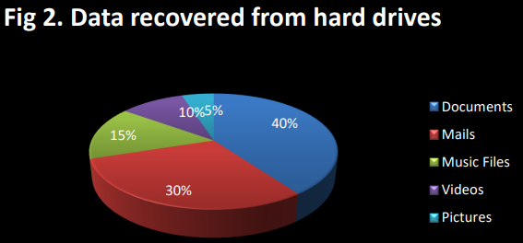
this impacts you too
Tiffany Semexant
Environmental concerns
Environmental injustice
  Definition: when hazardous environmental concerns disproportionately impact marginalized or poor groups
Your Privacy and Data Security
  70% of hard drives found had data on them that was able to be retrieved [6]
  70% of retrieved data were emails and documents [6]
[6]
Notes:
Why should you, the audience, care about this? Apart from the concerns you should have for the world we live in being polluted and contaminated with heavy metals and plastic, and the concern you should have about the gross environmental injustice occurring to mainly lower income people whose labor is being exploited and whose health is being put at risk to manage the waste of foreign countries, there is a way that this may impact you, the consumer, directly. In a more general sense, many of these heavy metals are quite precious and limited and so destroying them means that we won’t have more material to make new technological innovations. But in a more specific sense, I mentioned earlier how the United States is one of the countries that exports e-waste to Nigeria. So, its very possible that consumer devices from the U.S. have ended up in Nigeria. Studies on devices found in e-waste management facilities have shown that personal data can still be recovered from drives found on the electronics. [6] This doesn’t just mean that data stored on your personal devices has the possibility of being recovered, but data stored about you from business and/or sold to third parties may also be able to be recovered. [7] Your personal data is not only stored on computers and smartphones, but also on our lovely Internet of Things devices also present possible vulnerabilities to security that may be exploited. Not only do they store data that you may or may not have consented to, but the (over) abundance of them shortens product lifetimes and offers plenty of opportunities to ditch their “outdated” tech for something new [7]. And remember what I said about refurbishers? And how they are skilled at taking something near the end of its life to be repurposed? Now, this isn’t some conspiracy theory where I’m trying to convince you that your data is being stolen by random people in Nigeria or anywhere else in the world where e-waste gets shipped, I’m simply pointing out how this aspect of privacy and security is often overlooked and under-researched [7].

Slide 26
How This can be fixed
Tiffany Semexant
Privacy Concerns
  Consumers can take proper precautions to wipe data from their drives
  Business can do the same as well, and can be held that standard lawfully by governments
  Reduce consumption of tech products that are cheaply made, easily disposable, and may have vulnerabilities
Environmental/Health Concerns
  Consumers can lower their consumption of tech products
  Local governments can better regulate e-waste management and restrict amount of e-waste imported
  Governments worldwide can crack down on illegal exporting of e-waste and find better solutions to managing own waste
Notes:
In terms of privacy, ensuring personal data and information security mostly falls onto the responsibility of consumers. As people who study computer science, this may not be a big deal for us, but for the greater population at large, many may not know how to properly delete data from their hard drives before disposal. In fact, approx. 52% of people when asked stated that they did not format their hard drives before disposing of their devices, and approx. 60% did not delete all programs from their devices [6]. Additionally, standard options on OSs for hard drive deletion do not properly delete the data, they merely mark it as being able to be written over. [7] Businesses should also be legally held to a standard to wipe consumer data from their drives before disposing of any tech. Publicly holding tech companies to a standard of ensuring consumer data is properly protected even after devices near their end of life could also be beneficial. Regarding solving the environmental and health concerns that e-waste poses, it’s way more nuanced. On a general level, we as consumers should greatly consider reducing our consumption. Buying tech products that we don’t actually need or replacing devices that work perfectly well in favor of newer models only contributes to the problem [5]. Higher-income countries, like the U.S., should stop exporting their products to lower-income countries and invest in recycling and upcycling electronics that are still usable and salvageable [6]. However, I am hesitant to suggest how foreign countries like Nigeria should handle the issue of importing e-waste. It’s easy from my perspective to say that they should ban importing e-waste, or that they should better regulate systems that are already in place. However, I feel like that statement overlooks the complexities involved. Though it may not be the largest sector of the economy, refurbishers, recyclers, scavengers, and other e-waste workers rely primary on the availability of e-waste to earn their income. Secondhand electronics offer very affordable alternatives to otherwise luxury products. Many of these second-hand electronics come the aforementioned refurbishers.[10] So, un upheaval of this system, regardless of how necessary it may be, could disrupt the lives of a lot of people. I think that following the advice of researches from the country on how to make improvements would be much better suited. Some suggest investing in formal recycling centers in the country, and formalizing many of the informal means of income that people derive from e-waste [4, 6].

Slide 27
References
Tiffany Semexant
[1] Cornelis P. Baldé, Ruediger Kuehr, Tales Yamamoto, Rosie McDonald, Elena D’Angelo, Shahana Althaf, Garam Bel, Otmar Deubzer, Elena Fernandez-Cubillo, Vanessa Forti, Vanessa Gray, Sunil Herat, Shunichi Honda, Giulia Iattoni, Deepali S. Khetriwal, Vittoria Luda di Cortemiglia, Yuliya Lobuntsova, Innocent Nnorom, Noémie Pralat, Michelle Wagner; THE GLOBAL E-WASTE MONITOR 2024; (International Telecommunication Union (ITU) and United Nations Institute for Training and Research (UNITAR); 2024
[2] Bo Jiang, Adedoyin Adebayo, Jianli Jia, Yi Xing, Songqiang Deng, Limin Guo, Yuting Liang, Dayi Zhang; Impacts of heavy metals and soil properties at a Nigerian e-waste site on soil microbial community; Elsevier: Journal of Hazardous Materials; 2019
[3] Fayefunmi Oluwanifemi; Lagos is drowning in Nigeria’s plastic and e-waste crisis; Greenpeace; 22 April 2025;
https://www.greenpeace.org/africa/en/blog/57326/lagos-is-drowning-in-nigerias-plastic-and-e-waste-crisis/ ; 27 April 2025
[4] Emmanuel Sunday Okeke, Adebisi Enochoghene, Brendan Chukwuemeka Ezeudoka, Steve Dokpo Kaka, Yao Chen, Guanghua Mao, Chukwuebuka ThankGod Eze, Weiwei Feng, Xiangyang Wu; A review of heavy metal risks around e-waste sites and comparable municipal dumpsites in major African cities: Recommendations and future perspectives; Elsevier: Toxicology; 2023
[5] A.O. Odeyingbo, I.C. Nnorom, O.K. Deubzer; Used and waste electronics flows into Nigeria: Assessment of the quantities, types, sources, and functionality status, Science of The Total Environment; Elsevier: Science of the Total Environment; 2019
[6] Godfrey Oise; A Framework on E-Waste Management and Data Security System; International Journal on Transdisciplinary Research and Emerging Technology; 2023
[7] Stefan Schiffner, Jetzabel Serna, Demosthenes Ikonomou, Kai Rannenberg; Privacy Technologies and Policy 4th Annual Privacy Forum; Springer; 2019; pg. 48 – 68;
[8] Children and digital dumpsites: e-waste exposure and child health; Geneva World Health Organization; 2021
[9] From waste to jobs: Decent work challenges and opportunities in the management of e-waste in Nigeria; International Labour Office, Sectoral Policies Department (Geneva); 2019.
[10] Ayokunle Omobowale; Global E-Waste Management and Second-Hand Consumption in the Third World: Substandard Context and Tokunbo Phenomenon in Nigeria; The Nigerian Journal of Sociology and Anthropology; 2012

Slide 28
Digital Licensing and You
Alex Knox

Slide 29
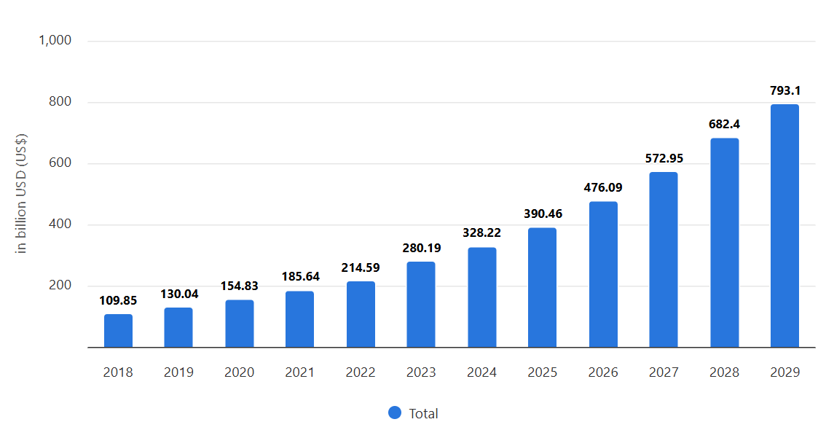
You own less than you think
Alex Knox
Software as a Service is the predominant business model after the 1990s
  $328.22 billion USD Global Market in 2024
  Yearly growth rate around 17.6 percent
Makes subscription-based models easy to sell and adjust to market costs [1]
Saas Global Market and Prediction [13]
Notes:
You likely own less than you think in term of licensing
As a class when we reviewed the intellectual property unit, we talked a little about software as a service
This presentation will go a little more into detail of how that relates to licensing to users
Saas is predicted to continue to grow globally and is easily profitable for companies due to its flexibility

Slide 30

Licenses through wpi
Alex Knox
WPI offers access to 177 different software programs
“Free” and paid by tuition or student life fee
Common ones
  Solidworks
  Microsoft Suite
  Fusion 360
  Adobe Suite [9]
Search bar from WPI’s software library [9]
Notes:
We as WPI students use licensing for a lot of the more expensive softwares we don’t directly pay for
WPI offers them through ITS, so everyone in here uses some form of licensed software (microsoft)

Slide 31
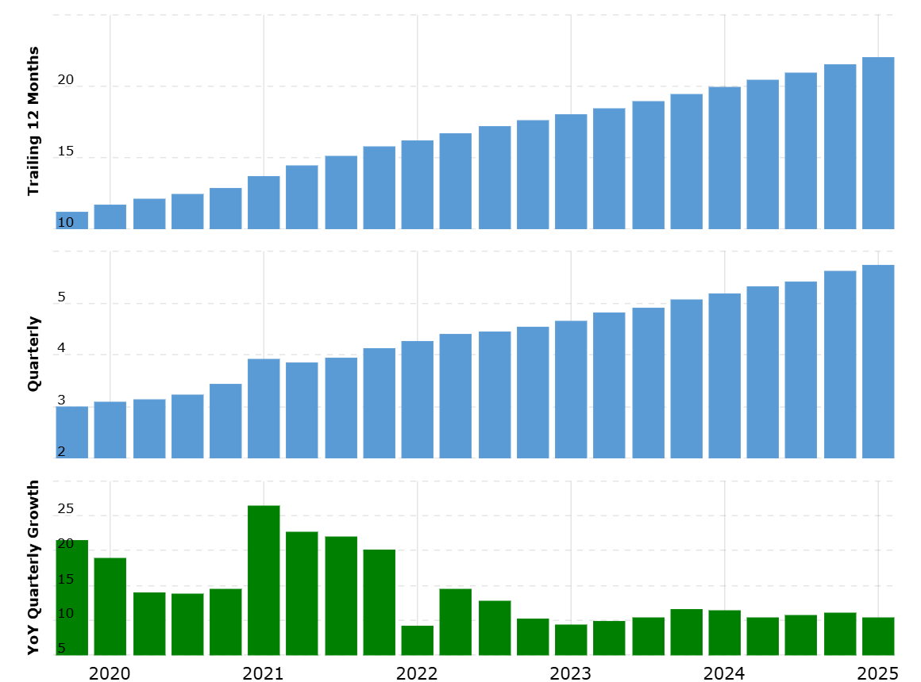
ADOBE LICENSES
Alex Knox
Named user licensing
Multiple purchases, sets the price for a given time period
  Some Adobe software has since been retired
Renewing software agreements each time the license is bought [4]
Adobe revenue [10]
Notes:
One of the suites WPI pays for, for its students is the adobe suite
I personally use it for one of my classes, since it is required
Some parts are paid for, and in our case paid for by the school
They use named usesr licensing, and focus primarily on subscription based platforms
The entire Adobe Creative cloud is 59.99 a month [11], other plans are around 20 to 25 dollars
Each time is is bought and installed on a machine, you must agree to the software agreement created by adobe

Slide 32
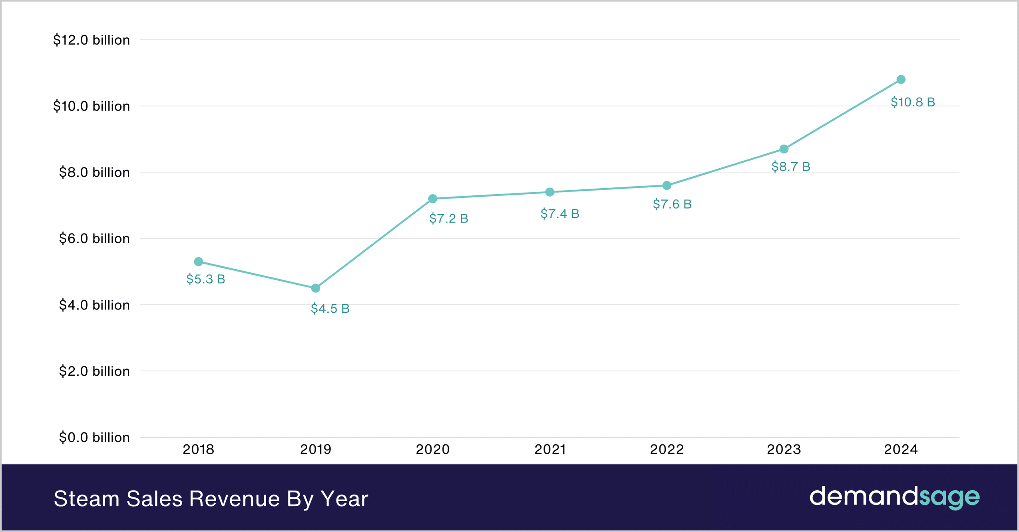
STEAM LICENSES
Alex Knox
Perpetual Software Licenses
One time purchase unless voided as listed in the Steam Subscriber Agreement [3]
Regular user completes two main agreements
  Access as allowed through a Steam account (Valve Corporation)
  End User License Agreement each time a game is purchased [5]
Steam revenue [6]
Notes:
Steam is another popular platform, I would expect in a CS course there are a bunch of users
As you might know from using steam, they use perpetual software licenses
You wouldn’t loose it after the purchase unless you’ve generally made a breach in contract
Breach of either of these two agreements means you lose access, though very rare
Each time you buy a game of software you must reagree to their most updated EULA

Slide 33


poor business practices
Alex Knox
Fee hiding and preventing software cancellations
Federal Trade Commission working through official complaint
Complaint made against Adobe
  Hiding early cancellation fees within long license agreements
  Forcing longer purchases than initially intended [12]
Notes:
However sometimes companies do acts that while legal are poor business practices
Adobe’s actions violate the Restore Online Shoppers’ Confidence Act
Since adobe sells on the Saas business model and sells online subscription based plans, making fees hard to understand or hiding them deep within a long contract is unfair
Users are still responsible for reading adobe’s contracts
Still ongoing, but has been transferred to the Department of Justice as of early 2025

Slide 34


Poor business practices… again
Alex Knox
Implying outright purchase of the game/software, and not purchasing a license
  Changes how a user can access the purchase
New California bill passed to force greater transparency
  AB 2426 [2]
Notable impact was on Steam and changing their EULA [5]
Notes:
A new California bill was proposed and passed:
AB 2426: Consumer protection: false advertising: digital goods
This law forces companies to explicitly state users are buying the rights to access and not the software or game outright
Notably the steam EULA changed September 2024, and all new purchases must agree to this updated EULA each time

Slide 35
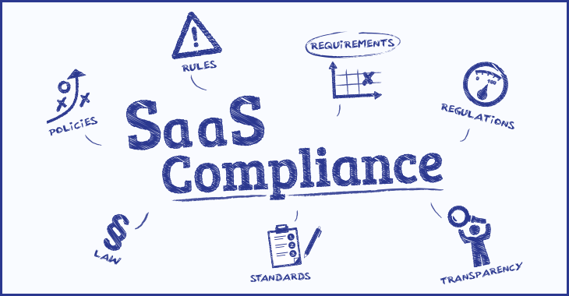
Conclusion
Alex Knox
Companies have significantly more resources than users when going through software agreements
Legislation can and does change to support users’ rights
No software license agreement is above the law even when both parties are in agreement
Saas compliance graphic [10]
Notes:
Users are responsible for what they agree to, but the company is responsible for following fair and reasonable business practices
No software agreement a company writes can supersede the law
Companies cannot grandfather in unfair business practices

Slide 36
References
Alex Knox
Author, Title, (Publisher, Date), URL (Access Date)
[1] Li, Cheng, Duan, Yang, A Study of Enterprise Software Licensing Models, (Journal of Management Information Systems, January 2017) https://www.researchgate.net/publication/316286667_A_Study_of_Enterprise_Software_Licensing_Models (April 27)
[2] California House Assembly, AB 2426: Consumer protection: false advertising: digital goods., (CalMatters, September 9 2024), https://calmatters.digitaldemocracy.org/bills/ca_202320240ab2426 (April 28 2025)
[3] L.A. Tech and Media Law, Termination of Software License Agreements for Technology Companies and Startups, (David N. Sharifi, Esq) https://techandmedialaw.com/termination-of-software-license-agreements/ (April 27 2025)
[4] Adobe, User Guide Licensing overview, (Adobe, March 4 2025) https://helpx.adobe.com/enterprise/using/licensing.html, (April 29 2025)
[5] Steam, Steam Subscriber Agreement, (Valve, September 26 2024), https://store.steampowered.com/subscriber_agreement/ (April 27 2025)
[6] Naveen Kumar, Steam Statistics 2025 – Users, Revenue, & Market Share, (DemandSage, January 30 2025) https://www.demandsage.com/steam-statistics/ (April 27 2025)
[7] Sid Jain, SaaS Growth Report, (ChartMogul, 2024), https://chartmogul.com/reports/saas-growth-report/, (April 28 2025)

Slide 37
References
Alex Knox
Author, Title, (Publisher, Date), URL (Access Date)
[8] Business Fortune Insights, Software as a Service (SaaS) Market Size, Share & Industry Analysis, (Business Fortune Insights, April 14 2025) https://www.fortunebusinessinsights.com/software-as-a-service-saas-market-102222 (April 27 2025)
[9] WPI, Software Library, (WPI, 2025), https://hub.wpi.edu/Software-Library (April 29 2025)
[10 MacroTrends, Adobe Revenue 2010-2025 | ADBE, (MacroTrends, 2025) https://www.macrotrends.net/stocks/charts/ADBE/adobe/revenue#:~:text=Adobe%20revenue%20for%20the%20twelve,a%2010.24%25%20increase%20from%202022 (April 28 2025)
[11] Adobe, Plans and pricing for Creative Cloud apps and more, (Adobe, 2025) https://www.adobe.com/creativecloud/plans.html (April 28 2025)
[12] Federal Trade Commission, FTC Takes Action Against Adobe and Executives for Hiding Fees, Preventing Consumers from Easily Cancelling Software Subscriptions, (Federal Trade Commission, June 17 2024), https://www.ftc.gov/news-events/news/press-releases/2024/06/ftc-takes-action-against-adobe-executives-hiding-fees-preventing-consumers-easily-cancelling (April 28 2025)
[13] Statista, Software as a Service, (Statista, Jan 2025), https://www.statista.com/outlook/tmo/public-cloud/software-as-a-service/worldwide (April 29 2025)
[14] Grigorescu, SaaS Compliance: What is the True Cost?, (ParyPro Global, August 23 2022) https://blog.payproglobal.com/saas-compliance-what-is-the-true-cost (April 29, 2025)

Slide 38
Class 11
The End
Keith A. Pray
SocialImps.com
Notes:
If there’s time and we didn’t get to it:
Kickstarter Charter
https://www.kickstarter.com/charter?ref=about_subnav
CGP Grey
Humans Need Not Apply (15:00) – 2014-08-13
http://www.youtube.com/watch?v=7Pq-S557XQU
Last access 2016-04-22
These 3D printed homes can be constructed for $4,000 (3:00 – 2018-04-02)
http://www.businessinsider.com/3d-printed-homes-constructed-icon-new-story-tech-charity-4000-dollars-2018-3
https://www.youtube.com/watch?v=SvM7jFZGAec (1:28)
Last access 2018-04-22
Look at:
BBC Intelligent Machines
http://www.bbc.com/news/technology-33978561
BBC Likelihood of robot taking your job
http://www.bbc.com/news/technology-34066941

Slide 39
Remote With Zoom
Turn your camera on
Sign in with First and Last Name
Stay muted unless you are going to speak
Use the raise your hand feature to ensure a turn
Wait until the end of student presentations to ask questions
  Write them down so you don’t forget

