Slide 1
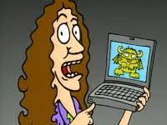
Class 8
Security
Keith A. Pray
SocialImps.com
Notes:
“Weird” Al Yankovic – Virus Alert (2006) (3:43)
https://www.youtube.com/watch?v=zvfD5rnkTws
Internet of Things (IoT) first coined in 1999
Take 5 minutes to fill out survey on Canvas → Quizzes → SGA’s Midterm Course Feedback Questionnaire

Slide 2
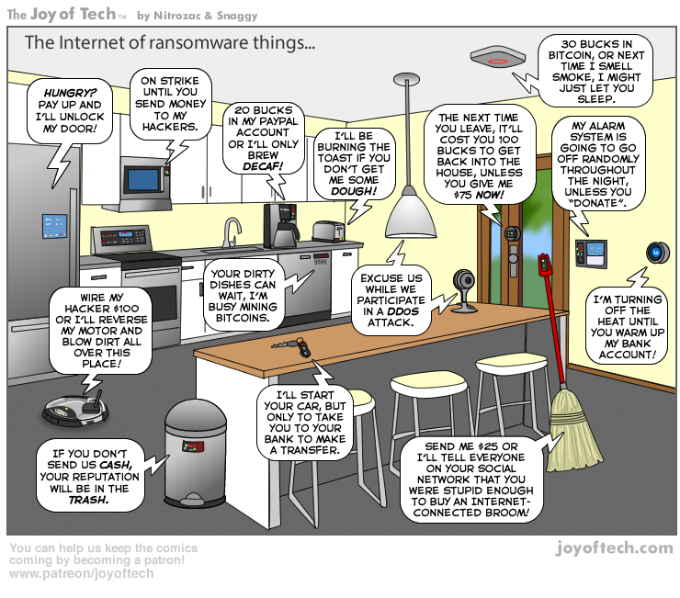
https://cointelegraph.com/storage/uploads/view/5e8f6e0d3a029807dfe181dc3d160cf0.png
Notes:
TODO:
Find publish date
Note which really exist
Extra credit

Slide 3
Papers
Support each claim with data, including counter point and rebuttal
Quantify
  Instead of terms like: less, more, a lot, huge, great, big, tiny, growing, etc.
Be wary of sources with an agenda. A company selling privacy protection services is biased.
Let me know if it looks like your counterpoint or rebuttal was missed
http://socialimps.com/assignments/paper-guidelines
Notes:
0s not included.
Save for next time:
Search results provide a single data point, motivation, and anecdotal context. Still need to back claims with high quality source and data.
Use sources that back claims with data
Read assignment
many profiles missing
space used to describe search findings instead of providing argument
Make decisive conclusions
may, could, etc. = trivial
Absolute statements are difficult to prove
Avoid: all, always, any, every, everyone, never, none… unless you can show it
Be sure to put quotes around entire quote
Hyperbole is the best thing ever!
but not in these papers
Print 2 sided and save a tree
Use template, saves time
Use and cite supporting data from at least 5 high quality sources
Argument should directly support conclusion
Response should directly address counter point
Arguments should have at least 3 statements
Review fallacies in Appendix B and Class 2 Slides
Avoid Strawman Fallacy
Counter Point and Rebuttal should relate to each other and conclusion
Use supporting data in counter point and rebuttal
Clear, strong conclusion, easy to find
Quantify
Instead of terms like: less, more, a lot, huge, great, big, tiny, growing, etc.
Make clear what claim evidence is supporting, explain how it’s relevant
Avoid fallacies, e.g. begging the question
Try reading paper out loud to yourself to catch typos, grammatical errors, contradictions
Be concise with language, avoid filler words
Review feedback from previous papers, located in Word doc attachment in Canvas
Name files: “FirstnameLastname-Topic.docx”

Slide 4
Grades
To Date
30 Max Possible
7 Classes
2 Papers

Slide 5
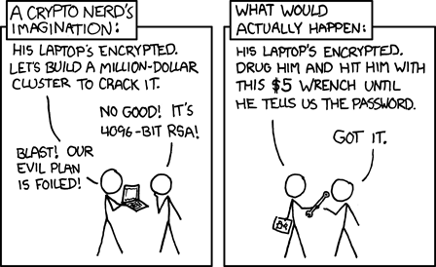
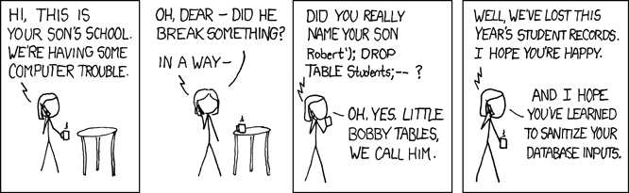
Overview
Review
Assignment
Students Present
https://xkcd.com/538/ (2010-11-14)
https://xkcd.com/327/ (2007-10-10)
Notes:
Are there any questions on the assigned reading?
Use the backup slides to explain Buffer Overflow or TCP attack methods from the text.
XKCD Links last accessed 2020-09-25

Slide 6
My Reading Notes
p. 315 2 movies first page. Compare current modem with WarGames modem.
p. 316 Previous edition had interesting history of the word “hacker”. Interesting to compare password guidance over the years. Any sources newer than 2013? Writing down pw not option for classified systems. Giving silly answers good for info privacy too.
p. 319 Apple altruism or marketing? Precedent setting to take advantage of emotions?
p. 320 Rare to find just HTTP today, but common during Firesheep event.
p. 322 privacy policies AND implementations need to change. Getting on TV much more difficult than releasing software.
p. 324 Virus could be new, 0 Day.
p. 326 Goals include infect 3 machine per LAN and as many computers as possible?
p. 327 Never make last minute changes before release. Were they related to the defects? Testing w/out DEBUG often neglected
p. 329 Do people use the Internet as an experimental laboratory these days?
p. 330 “send reports back to a host computer”? 90% spam sent through botnets, source 2006.
p. 332 BAE prohibits use of non-company owned devices. New trend?
p. 333 “An interesting development” *was*
p. 334 Did DoS attacks become an important part of the terrorist arsenal? Source 2003.
p. 335 1993 BMW in 2005, maybe crime doesn’t pay.
p. 338 “…paralyzed a third of them… attack was relatively minor…”?
p. 340 South Park – Trapped In The Closet
p. 344 12 study from 2003, now? 14 Why couldn’t server authenticate sender? Eliminating anonymity may help with email, but everywhere?
End of Chapter questions: 1, 14, 30
Notes:
- If time ask class about online voting in light of COVID-19 challenges.

Slide 7
Hacker Used To Mean Something Else
1950s
  Hack: newly constructed piece of equipment, useful, demonstrated “creator’s technical virtuosity”
  Hacker: Explorer, risk taker, make system do something it had never done
  “person who delights in having an intimate understanding of the internal workings of a system, computer and networks in particular” [2]
1980s:
  Start of change to negative connotation
1990s: Hacker / Hero / Villain
2000s: Negative
Hackathon may be the last positive use
Hacker
Cracker
Phreakers
Cyberpunk
Packet Monkey
Script Kiddie
Phisher
Cyber Terrorist
Security Analysts
Black/White Hat – Should these be used?
Notes:
[1] Michael J. Quinn, Ethics for the Information Age, Eighth Edition, 2020. Addison-Wesley. ISBN: 9780136681595
[2] G. Malkin and T. LaQuery Parker, editors. “Hacker.” Internet Users’ Glossary, January 1993. https://www.rfc-editor.org https://www.rfc-editor.org/rfc/rfc1392.html#appendix-H (Accessed 2024-09-17)

Slide 8
Buffer Overrun
Run time stack
Local Variables
Return Address
Parameters
Variable Attack
buffer
Target Variable
Stack Attack
buffer
Return Address
code
Return Address
Notes:
When a function call is made, local variables, return address, parameters stored on run time stack. Local variables occupy lower memory addresses.
Variable attack – change variable value. Program expects user to input character and allocates a buffer for them. Attacker supplies too many characters and ends up over writing a variable.
Run example of this if there’s interest – next slide (retired, modern compilers check for this and insert warnings or don’t allow it at all)
Stack Attack – goal is to change value of return address so execution control goes to code which the attacker has provided in the input buffer.
Prevention – add checks against array bounds being exceeded. modify operating system to not execute instructions stored on run time stack.

Slide 9
Transmission Control Protocol (TCP) Three-way Handshake
SYN
SYN-ACK
ACK
SYN – SYNchronize
ACK - ACKnowledgement
Notes:
SYNchronize
SYNchronize ACKnowledgement (socket reserved awaiting ACK)
ACKnowledgement
TCP socket connection established

Slide 10
SYN Flood Attack
SYN
SYN-ACK
SYN – SYNchronize
ACK - ACKnowledgement
Notes:
Attacker spoofs the IP address so the SYN-ACK is sent to a different machine that cannot respond to the SYN-ACK.
This leaves the connection half open on the server machine decreasing the resources (sockets, memory, threads/processes) available to respond to legitimate clients.
The attacker send many such spoofed SYN messages.

Slide 11
Group Quiz
Ethical Analysis Guide:
https://socialimps.com/documents
A denial-of-service attack shuts down a bunch of retailer, stock brokerage, large corporate entertainment, and information web sites.
Guilty parties:
  Terrorist who aimed to cause billions of damage to U.S. economy
  Protestor opposing corporate manipulation of consumers
  A minor just having fun with tools found on the web
  Show off hacker in search of bragging rights
State what penalties are appropriate for each
Use one ethical theory to evaluate decisions from previous step:
  Kantian, Rule Utilitarian, Act Utilitarian, Social Contract Theory, Virtue Ethics
Notes:
Works well as small group exercise.
Note: short answer format expected.
Note: 2. only one argument needed, should include logic for all parties
Note: 3. same law(s) should be applicable to all parties
Usually no time for groups to get to:
4. Name the laws/acts under which these parties could be prosecuted

Slide 12
Assignment
Code Testing 1 Page Paper 1/2
Research testing, decide on test strategy, test the given code
There are major and minor defects to find
  Come to next class prepared to share the defects you found
Write paper with conclusion: “Testing strategy was adequate.” or better…
Include tests and results in an Appendix to save paper space for argument
Things that might be useful in your argument:
  Rationale for testing strategy used (use data, high quality sources)
  Explanations of defects found (use data, high quality sources)
  How to fix them (use data, high quality sources)
  Consequences of leaving defects in production code (use data, high quality sources)
Weakness in testing strategy as counter point (use data, high quality source)
Working example: http://socialimps.com/assignments/Test_Sales_Fun
Notes:
If guest presenter coming next class remind students to prepare questions for him.
Remember to work on groups projects.
Each group should have material on their sites for the topics we’ve covered so far.
OLD Prompt:
Design tests for the code on the following slide.
Contains at least one major defect and several minor ones.
Write a paper (1 page not counting any source code) including :
Did you choose a good test strategy? (This is your conclusion.)
The inputs and expected outputs
What defects you found
How you would fix the defects (you may include fixed source)
Why would that fix the problems?
What could happen if the defects are not found before the code is put into production?

Slide 13
Assignment
Code Testing 2/2
import java.text.NumberFormat;
public class SalesFun
{
public static double calculateSalesTotal ( double amount,
double discountRate,
double taxRate )
{
double discount = amount * discountRate;
double total = amount - discount;
double tax = total * taxRate;
double taxedTotal = tax + total;
NumberFormat numberFormat = NumberFormat.getCurrencyInstance();
System.out.println ( "Subtotal : " + numberFormat.format ( amount ) );
System.out.println ( "Discount : " + numberFormat.format ( discount ) );
System.out.println ( "Total : " + numberFormat.format ( total ) );
System.out.println ( "Tax : " + numberFormat.format ( tax ) );
System.out.println ( "Tax+Total: " + numberFormat.format ( taxedTotal ) );
return taxedTotal;
}
}
}Lines of interest
Notes:
Bold lines are real focus.
Do not copy/paste this code, may have problems with smart quotes and such.
Example input:
amount = 100.05;
discountRate = 0.10;
taxRate = 0.05;
OR
0.70, 0.0, 0.05
95.67, 0.20, 0.7

Slide 14
Overview
Review
Assignment
Students Present

Slide 15
Ethical Hacking
Kristen Thebeau

Slide 16
Is hacking ever ethical?

Slide 17
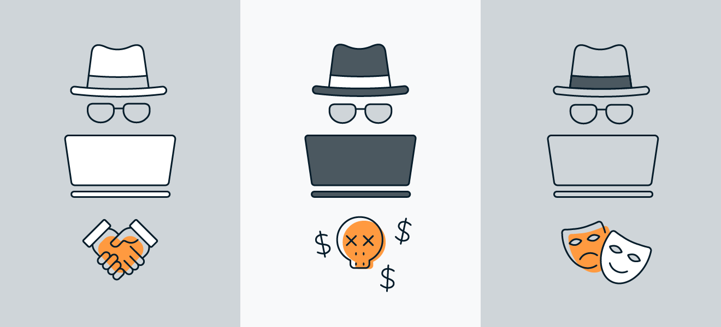
What Is Hacking? [2]
Kristen Thebeau
Unauthorized Hackers
  Malicious
Authorized Hackers
  Ethical
Grey-Hat Hackers
  Exploit vulnerabilities to spread public awareness
Three Main Types of Hackers [6]
Notes:
Roles of an Ethical Hacker
Discovering OS and network weaknesses
Demonstrate cyberattacks
Security assessment simulations
Report security breaches and vulnerabilities
Confidential
Wiping traces of the hack

Slide 18
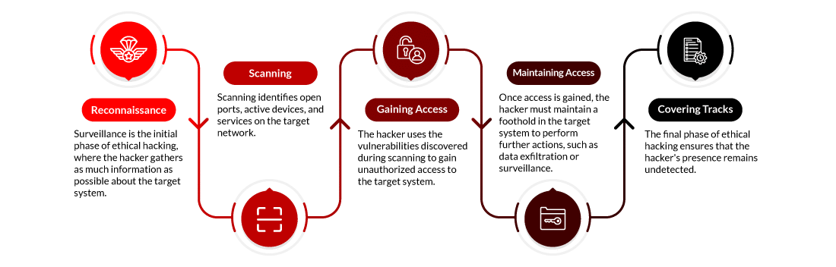
What Is Ethical Hacking?
Kristen Thebeau
“Process of detecting vulnerabilities in an application, system, or organization’s infrastructure that an attacker can use to exploit an individual or organization.” [1]
Process of Hacking [1]
Notes:
DEFINITION: a type of cybersecurity profession [10]
Annual pay average: $132,962
Annual pay maximum: >$170,000
Types of Reconnaissance
Active – direct interaction with the target system
Passive – collecting data without direct contact
Types of Scanning
Port Scanning – open ports or services
Vulnerability Scanning – detecting known weaknesses
Network Mapping – creating a blueprint of the network
Ways to Gain Access
Password cracking
Exploration of vulnerabilities
Privilege escalation
Man-in-the-Middle (MITM) – intercepting communications between two parties
Ways to Maintain Access
Installing backdoors
Creating hidden user accounts
Tunneling
Keystroke logging
Trojan Horses
Ways to Clear Track
Log tampering
Steganography – hiding malicious files or data within legitimate ones
File timestamp alteration
Clearing command histories
Encryption

Slide 19
What Is Ethical Hacking? [5]
Kristen Thebeau
Certified Ethical Hacker (CEH)
  Can look for weaknesses and vulnerabilities in a system
  Same knowledge as a malicious hacker
  EC-Council: 350,000 certified
Offensive Security Certified Professional (OSCP)
  Can gather information about the network
  Can identify system vulnerabilities
  Can execute an attack and efficiently report them
Types of assignments:
Threat modeling
Security assessment
Vulnerability threat assessment
Report writing
Notes:
Certified Ethical Hacker
EC-Council = International Council of E-Commerce Consultants
Roles of an Ethical Hacker
Discovering OS and network weaknesses
Demonstrate cyberattacks
Security assessment simulations
Report security breaches and vulnerabilities
Confidential
Wiping traces of the hack

Slide 20
Hacking Timeline [3]
Kristen Thebeau
1960
1970
1980
1990
2023
The term “hacking” is first used at MIT
Phreaking & Tiger Teams
Adoption of personal computers, hackers denoted as dangerous criminals by the media
Kevin Poulsen
Potential losses due to hacking exceed $12.5 billion
Actual losses totaled $23 billion [9]
Notes:
1960s
The term “hacking” was used by MIT to describe the inventive process of optimizing technology and efficiency
1970s
Phreaking – form of hacking telephone systems (i.e. free long-distance calls)
Tiger Teams – first ethical hackers; groups hired by governments / corporations to identify and fix security weaknesses
1980s-1990s
More personal computers = more digital data
Media spotlighted hackers as dangerous criminals
Kevin Poulsen – criminal turned ethical hacker; more info on the next slide
2023
U.S. government reported 880,418 complaints with potential losses exceeding $12.5 billion due to hacking
2024 Identity Fraud Study from Javelin Strategy and Research – identity fraud losses

Slide 21

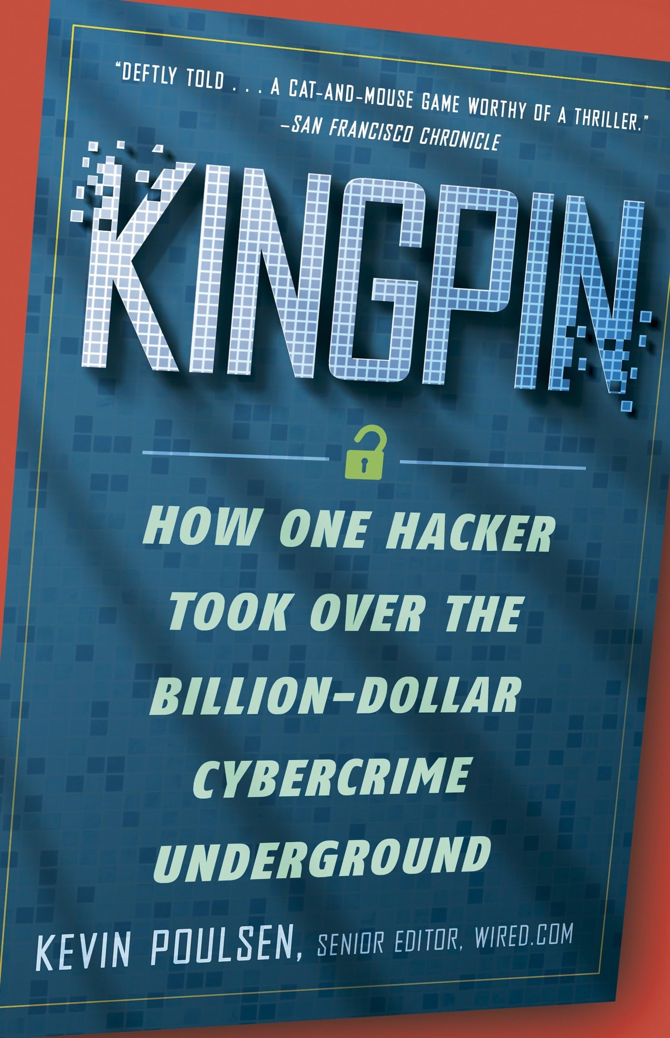
Kevin Poulsen [4]
Kristen Thebeau
1990s – penetrated telephone company computers to win radio station phone-in contests
1991 – arrested and sentenced for computer fraud
Became an ethical hacker and journalist upon release
  Editorial director of SecurityFocus
  MySpace
  CIPAV reveal
Kevin Poulsen [7]
Kevin Poulsen’s Kingpin [8]
Notes:
1990s – took over phone lines leading to Los Angeles radio stations and was able to guarantee that he would be the proper-numbered caller to win
1991
Went underground as a fugitive, pursued by the FBI
Featured on NBC’s Unsolved Mysteries
Pleaded guilty to computer fraud and served >5 years in prison (longest U.S. sentence ever given for hacking at the time)
1998 – first magazine feature ran in WIRED and covered computer programmers who were driven to survivalist tactics by fear of the Y2K bug (computers would crash when switching from 1999 to 2000)
Editorial director of SecurityFocus (2000) – began reporting security and hacking news
MySpace (2006) – wrote the software that scoured for registered sex offenders
CIPAV reveal (2007) – revealed that the FBI had been using a custom spyware to infect computers of criminal suspects
Grey-Hat Hacker

Slide 22
Conclusion
Kristen Thebeau
QUESTION: Is hacking ever ethical?
ANSWER: Yes, hacking can be ethical.
Considerations
  Grey-Hat vs. White-Hat Hackers
  Type of information obtained
Notes:
Grey-Hat vs. White-Hat Hackers
From the perspective of society: Grey-Hat Hackers are [INSERT WORD]
From the perspective of corporations: White-Hat Hackers are [INSERT WORD] and Grey-Hat Hackers are malicious
Type of Information Obtained – Kevin Poulsen
2007 report of FBI using CIPAV to infect computers of criminal suspects
2010 broke the news that the government had secretly arrest a young Army intelligence analyst in Iraq on suspicions of leaking thousands of documents to WikiLeaks

Slide 23
References
Kristen Thebeau
[1] EC-Council, “What is Ethical Hacking” (International Council of E-Commerce Consultants, 01/19/2024), https://www.eccouncil.org/cybersecurity-exchange/ethical-hacking/what-is-ethical-hacking/#:~:text=Ethical%20hacking%20is%20a%20process,and%20looking%20for%20weak%20points (04/01/2025)
[2] CompTIA, “What is Ethical hacking?” (Computing Technology Industry Association, n.d.), https://www.comptia.org/content/articles/what-is-ethical-hacking (04/01/2025)
[3] National Cybersecurity Alliance, “The Evolution Of Ethical Hacking: From Curiosity To Cybersecurity” (National Cybersecurity Alliance, 09/15/2024), https://www.staysafeonline.org/articles/the-evolution-of-ethical-hacking-from-curiosity-to-cybersecurity (04/01/2025)
[4] Kevin Poulsen, “About the Author” (Kevin Poulsen, 2025), https://www.kingpin.cc/about/ [04/01/2025)
[5] Steven Bowcut, “How to become an ethical hacker: A blueprint” (Cybersecurity Guide, 04/03/2024), https://cybersecurityguide.org/resources/ethical-hacker/ (04/08/2025)
[6] Oliver Buxton & Deepan Ghimiray, “What are the three main types of hackers?” (11/03/2023), https://www.avast.com/c-hacker-types (04/13/2025)
[7] Kevin Poulsen, “Why I Hope Congress Never Watches Blackhat” (01/16/2015), https://www.wired.com/2015/01/why-i-hope-congress-never-watches-blackhat/ (04/13/2025)
[8] Kevin Poulsen, “Kingpin: How One Hacker Took Over the Billion-Dollar Cybercrime Underground” (02/07/2012), https://www.amazon.com/Kingpin-Hacker-Billion-Dollar-Cybercrime-Underground/dp/0307588696 (04/13/2025)
[9] Sean Michael Kerner, “35 cybersecurity statistics to lose sleep over in 2025” (TechTarget, 01/10/2025), https://www.techtarget.com/whatis/34-Cybersecurity-Statistics-to-Lose-Sleep-Over-in-2020 (04/15/2025)
[10] Sacred Heart University, “The True Definition of Hacking Within the Computer Science Field” (Sacred Heart University, 04/04/2024), https://www.sacredheart.edu/news-room/news-listing/the-true-definition-of-hacking-within-the-computer-science-field/ (04/15/2025)

Slide 24
The power behind AI: how nuclear can solve ai’s growing energy crisis
Jonathan Dyson
Notes:
The power behind AI, how nuclear can solve ai’s growing energy crisis

Slide 25
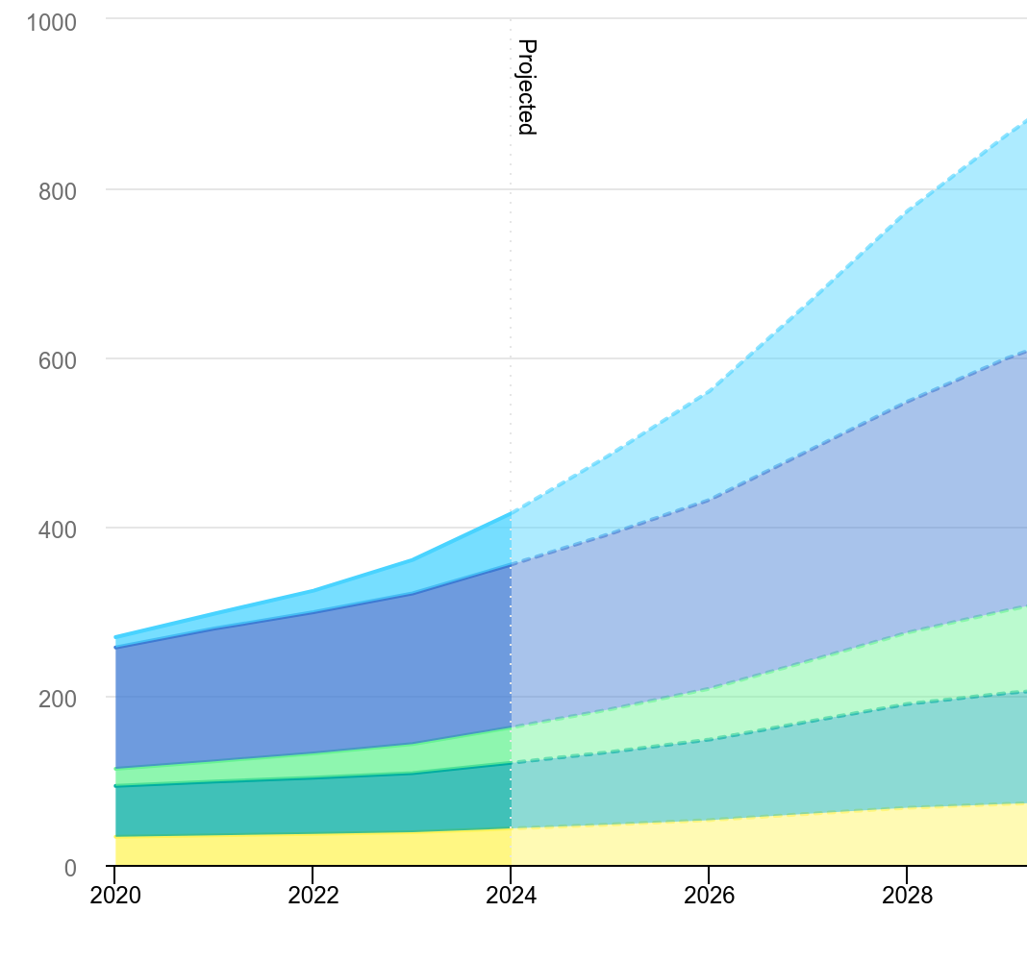
AI is driving a spike in electricity demand
Jonathan Dyson
AI’s global power use is projected to reach 3-4 percent by 2035 IEA (2025)
ChatGPT generated 700 million images in the first week of its new model OpenAI(2025)
This influx of energy, requires nuclear as a new source of energy to keep up
<Graphic as big as will fit>
Notes:
The IEA (International Energy Agency) has the estimated power draw by 2030 be over 1000 Terawatt hours Which is higher than IEA’s high projection from 2024 it was under 750
Japan only used 985.4 terawatt hours
Clearly High demand for ai output
1 billion queries a day
Graph is total power usage of data centers
The colors on the graph split the different technologies within data centers (cooling, Accelerated servers, traditional servers)
Biggest effect on local infrastructure, data centers already make up more then 25% of Virginia's electricity use and it is supposed to rise to 30-46 percent in the next 5 years

Slide 26
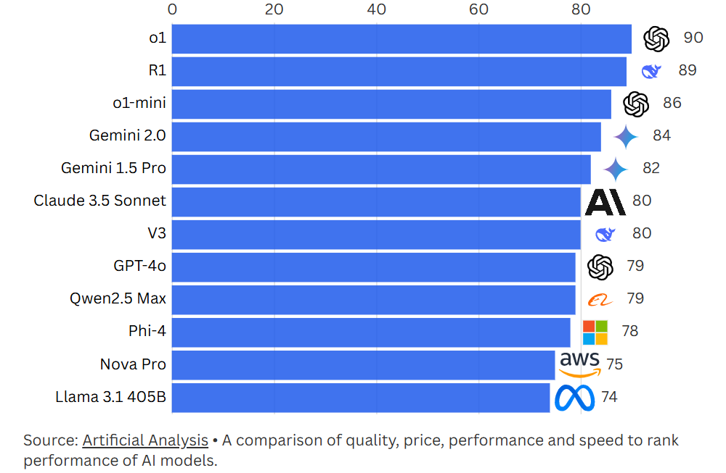
Energy-efficiency might not solve the problem
Jonathan Dyson
DeepSeek’s “efficient” reasoning uses 87% more energy per answer than other models MIT(2025)
Nuclear will likely still be necessary to power widespread use
<Graphic as big as will fit>
Notes:
Deep Seek made headlines globally not only because it was free and comparable to chatgpt but because the information about training they put out claimed lots of efficiency gains
new data shows it actually uses more energy per response than Meta's models — up to 87% more — because of longer, more complex answers driven by reasoning. This is part of a known economic phenomenon called the Jevons paradox: efficiency doesn’t always reduce consumption. In AI, more efficient models encourage more usage and more powerful training. So even as we optimize training, the cost of inference — the energy to answer questions — still grows. Unless we have scalable clean energy like nuclear behind it, that growth could undo the benefits

Slide 27
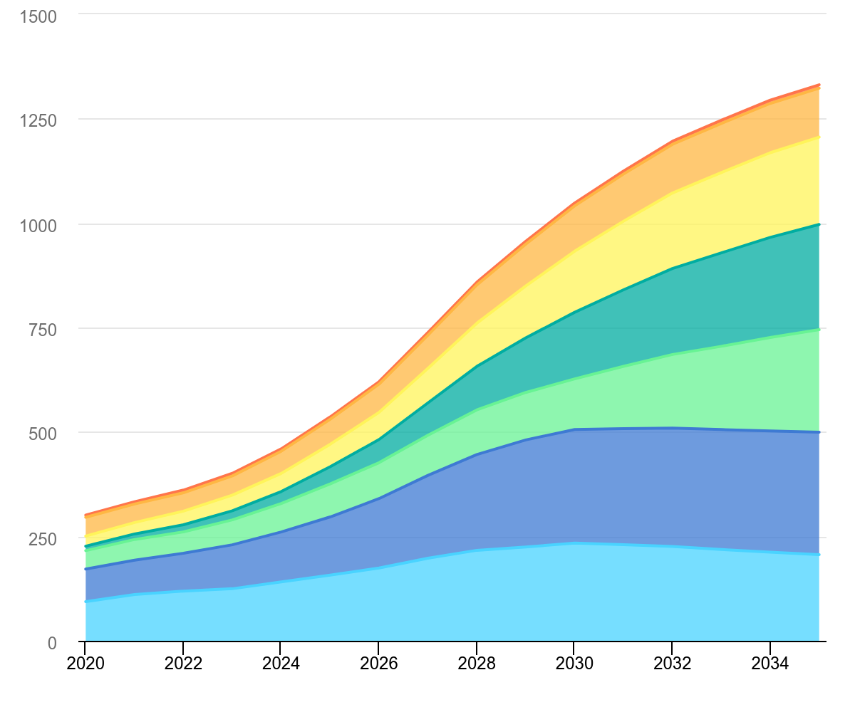
Carbon footprint
Jonathan Dyson
Most data centers still rely on fossil fuels. IEA(2025)
Companies like Google and Microsoft are pushing for greener energy sources The Bulletin(2024)
<Graphic as big as will fit>
Notes:
Coal and Natural Gas make up 56 percent of the current energy supply for data centers globally and 60 percent in the US
Even as companies become more energy efficient, the demand is outpacing those gains. Most AI data centers are still powered by a grid dominated by fossil fuels. While tech giants like Google are building renewable-powered centers, we’re still not scaling clean energy fast enough to meet AI’s demands. Its projected to outpace it for at least the next 5 years

Slide 28
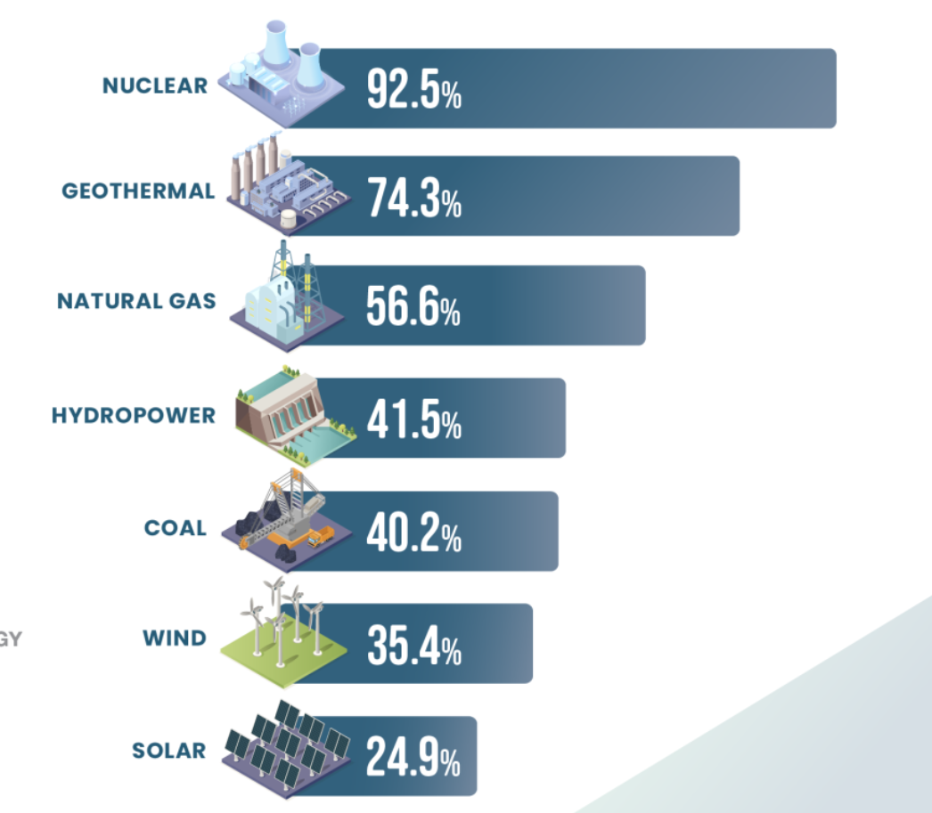
Nuclear
Jonathan Dyson
Nuclear produces very low carbon emissions during operation
Reliable base-load energy for 24/7 AI operations US Department of Energy
New designs help make nuclear safer and easier to build
Nuclear is safer than natural gas
Notes:
As you can see, nuclear energy has by far the highest capacity factor of any other energy source. This means nuclear power plants are producing maximum power more than 92% of the time during the year
Nuclear power always being on is essential to power data centers which is why Microsoft is reopening 3-mile island and google is investing in SMR’s
Small modular reactors hold the promise of being more affordable, easier and faster to build than conventional large reactor Given their smaller footprint, SMRs can be sited on locations not suitable for larger nuclear power plants and it being modular makes it possible for systems and components to be factory-assembled and transported as a unit to a location for installation.
The biggest issue with Nuclear is the social aspect as it still has a large stigma around it.
However nuclear is actually a much safer energy source then fossil fuels and new technology like thorium reactors promise even better safety measures
(SMR reactors) They are designed to be ultrasafe, use significantly fewer pumps and pipelines and can also be built underground.
AI is promising a lot for the future but if its power needs aren’t sustainably met then it will create very large issues down the line

Slide 29
References
Jonathan Dyson
[1] IEA, Energy and AI (2025), https://www.iea.org/reports/energy-and-ai (Accessed 4/13/25)
[2] Sophia Chen, Nature (Published March 5, 2025), https://www.nature.com/articles/d41586-025-00616-z (Accessed 4/13/25)
[3] David Pogue, CBS News – Big Tech’s Big Bet on Nuclear Power to Fuel Artificial Intelligence (Published March 9, 2025), https://www.cbsnews.com/news/big-techs-big-bet-on-nuclear-power-to-fuel-artificial-intelligence/ (Accessed 4/13/25)
[4] James O'Donnell, DeepSeek Might Not Be Such Good News for Energy After All, MIT Technology Review (Published January 31, 2025), https://www.technologyreview.com/2025/01/31/1110776/deepseek-might-not-be-such-good-news-for-energy-after-all/ (Accessed 4/13/25)
[5] Melissa Heikkilä, Making an Image with Generative AI Uses as Much Energy as Charging Your Phone, MIT Technology Review (Published December 1, 2023), https://www.technologyreview.com/2023/12/01/1084189/making-an-image-with-generative-ai-uses-as-much-energy-as-charging-your-phone/ (Accessed 4/13/25)
[6] Jenny Lyons-Cunha, AI Energy Consumption, BuiltIn, https://builtin.com/artificial-intelligence/ai-energy-consumption (Accessed 4/13/25)
[7] U.S. Department of Energy, Nuclear Power: The Most Reliable Energy Source, https://www.energy.gov/ne/articles/nuclear-power-most-reliable-energy-source-and-its-not-even-close (Accessed 4/13/25)

Slide 30
Count on you
Alden Lo

Slide 31
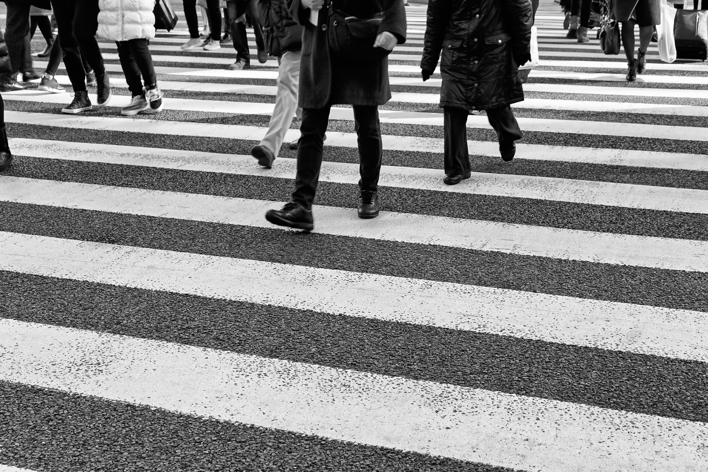
Algorithm and social
Alden Lo
A study was conducted in 2021 by Eric Bogert, Aaron Scheter & Richard T. Watson from the Management Information Systems Department of the University of Georgia[1]
A counting problem on how many people were in a photograph [1]
Choose between algorithm or “average guess of 5000 other people” [1]
Microsoft stock images
Notes:
We use these algorithms daily
Example as to how algorithms help with difficult tasks:
Study to test the influence of algorithmic advice, compared to social advice[1]

Slide 32
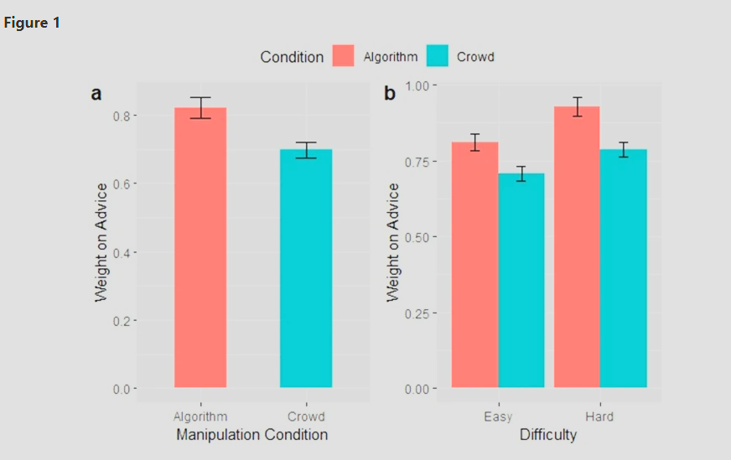
Algorithm and social - CONTINUED
Alden Lo
“Subjects who receive advice from algorithms on easy problems will revise their responses 11% more than subjects receiving advice from the crowd” [1]
For a difficult problem, subjects will revise an additional 3.6% more[1]
Figure 1 [1]
Notes:
Study concludes that as tasks get harder, people rely more on algorithmic relative to social advice [1]
Rather than following the “wisdom of the crowd” [1]
Rely on more algorithm > social influence [1]
So it IS helpful in analyzing difficult tasks

Slide 33
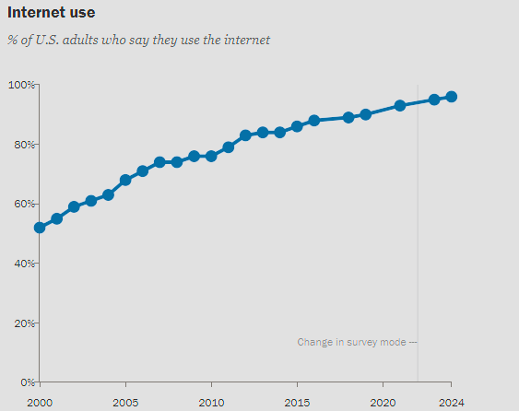
Therefore we Keep using…
Alden Lo
An Internet, Broadband Fact Sheet done by Pew Research Center[2]
In 2000, there were 52% of US adults that used the Internet [2]
In 2024, it is 96% of US adults that use the Internet [2]
[2]
Notes:
Everyone uses computer systems some way or another now
We have essentially fully relied on computer systems and devices for our daily lives

Slide 34
Search for all your questions
Alden Lo
Google Ads statistics show that there are more than 5 trillion Google Search annually [3]
Notes:
If I did not understand a word, I would search it up before using the glossary(Personal Examples)
So do EVERYTHING???(Personal Examples)

Slide 35
Efficiency and accuracy
Alden Lo
A study published in November 2024 by Colin Greeley, Lawrence Holder, Eric E. Nilsson & Michael K. Skinner [4]
Study: Scalable deep learning artificial intelligence histopathology slide analysis and validation [4]
Notes:
Computer systems are more efficient and more accurate, thus the reliance on computer systems.
Example:
A deep learning approach is developed for histopathology diagnostics [4]
Provides superior performance for automating image recognition tasks [4]
Exceeding human capabilities in both time and accuracy [4]

Slide 36
Over-rely CASE
Alden Lo
An incident received from the National System for Incident Reporting in Canada where a pharmacy staff member entered 3 letters of the medication name, then choosing the medicine from a drop-down list [5]
The staff name was interrupted, and when the task was resumed, the wrong medication was selected. This led to the patient exhibiting significant hypotension and bradycardia the next morning [5]
Notes:
Although the systems really help, but there are some cases where manual input is still required
And example above showcases
My conclusion:
Sometimes the over reliance has affected our daily lives
When something needs to be done manually, do not know what to do
Need to double-check
Therefore, there still is emphasis on learning skills: medicine, technical, engineering
And use the knowledge learnt to fact check

Slide 37
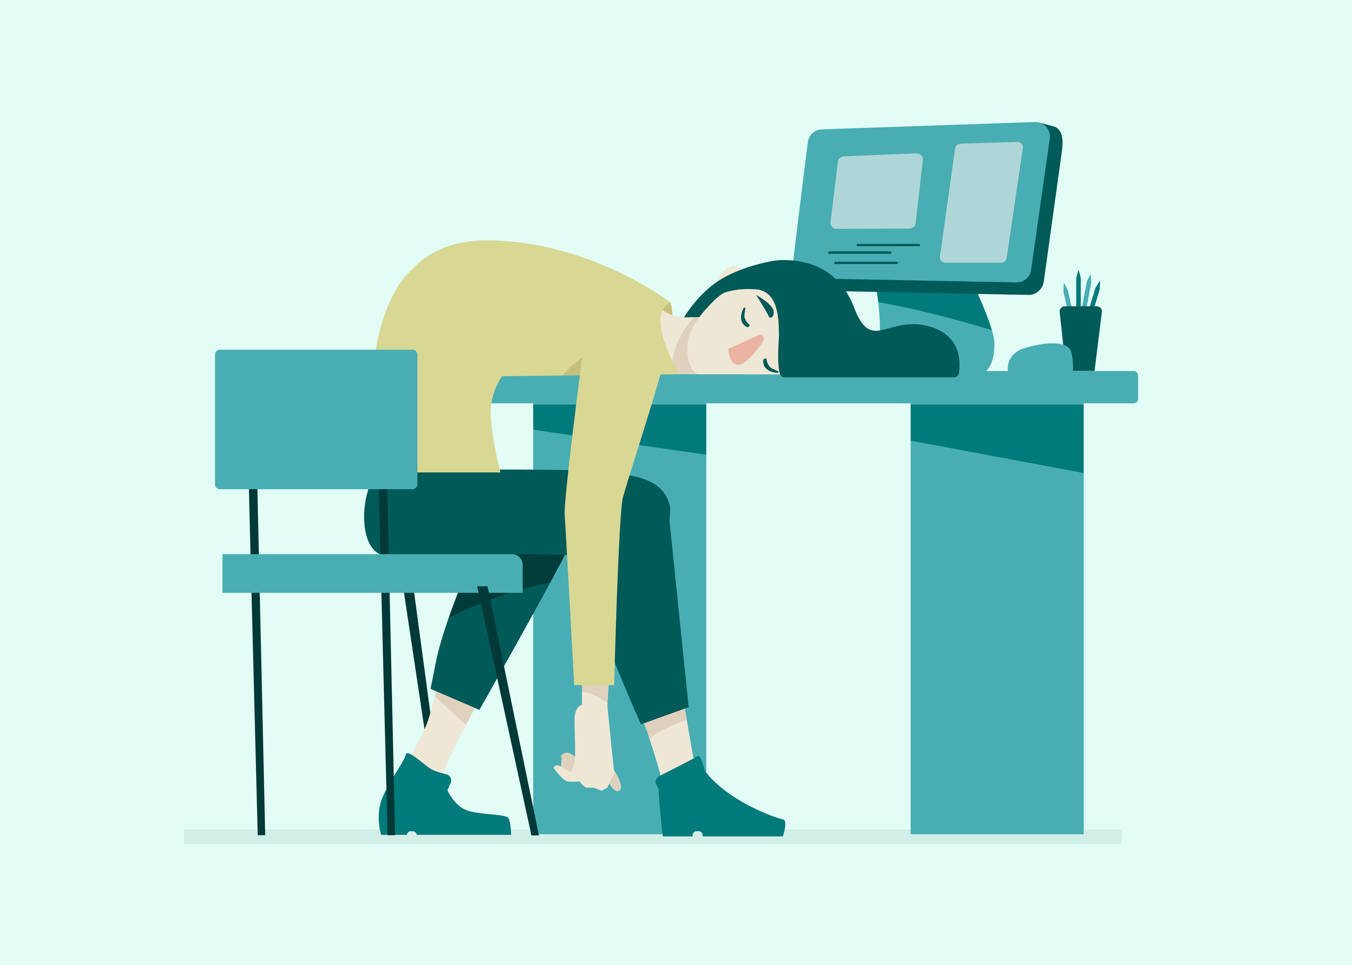
what if it is down, how will everyone function?
Alden Lo
In July 2024, a CrowdStrike update caused “Microsoft Windows operating systems to crash, causing maybe the largest IT outage in history” [6]
Microsoft stock images
Notes:
Since we are proven to be so reliant on these systems, what will actually happen if they are temporarily down for an update?
These systems might experience temporary shutdowns
Example:

Slide 38
How to solve this?
Alden Lo
Microsoft is introducing new tools after the July incident like Quick Machine Recovery, aiming to aid with fixing Windows Updates, even when machines are unable to boot [7]
Notes:
Attachment/Reliance is hard to change, so…
Systems can improve via updates
And then example:

Slide 39

conclusion
Alden Lo
Although systems continue to improve from testing/updates
There is still a responsibility for someone using these systems to have the knowledge to know they are doing, especially if manual instruction is still required
These skills are still valuable
Microsoft stock images

Slide 40
References
Alden Lo
[1] Bogert, Eric, et al. “Humans Rely More on Algorithms than Social Influence as a Task Becomes More Difficult.” Scientific Reports, vol. 11, no. 1, 13 Apr. 2021, www.nature.com/articles/s41598-021-87480-9, https://doi.org/10.1038/s41598-021-87480-9.
[2] Pew Research Center. “Internet/Broadband Fact Sheet.” Pew Research Center: Internet, Science & Tech, Pew Research Center, 31 Jan.2024, www.pewresearch.org/internet/face-sheet/internet-broadband/.
[3] Srinivasan, Vidhya. “AI, Personalization and the Future of Shopping.” Google, 3 Mar. 2025, blog.google/products/ads-commerce/ai-personalization-and-the-future-of-shopping/.
[4] Greeley, C., Holder, L., Nilsson, E.E. et al. Scalable deep learning artificial intelligence histopathology slide analysis and validation. Sci Rep 14, 26748 (2024). https://doi.org/10.1038/s41598-024-76807-x
[5] Institute for Safe Medication Practices Canada REPORT MEDICATION INCIDENTS Online:
Phone: 1-866-544-7672 Understanding Human Over-Reliance on Technology
[6] Office, Accountability. “CrowdStrike Chaos Highlights Key Cyber Vulnerabilities with Software Updates.” Gao.gov, 16 July 2024, www.gao.gov/blog/crowdstrike-chaos-highlights-key-cyber-vulnerabilities-softward-updates.
[7] Windows Experience Blog, and David Weston. “Windows Security and Resiliency: Protecting Your Business.” Windows Experience Blog, 19 Nov. 2024, blogs.windows.com/windowsexperience/2024/11/19/windows-security-and-resiliency-protecting-your-business/.

Slide 41
Class 8
The End
Keith A. Pray
SocialImps.com
Notes:
Any slides beyond this point are for answering questions that may arise but not needed in the main talk.
Some slides may also be unfinished and are not needed but kept just in case.

Slide 42
Run Example Code
Notes:
Retired demonstration. Most students have this in depth from new class now.
Also, compilers getting more difficult to disable protections, need older HW/OS/compiler for demo to work.
> imps
> assembly
> 123456789qwerty1

Slide 43
Buffer Overrun Code
#include <stdio.h>
#include <string.h>
int main ( void ) {
char buff [ 15 ]; int ace = 0;
printf ( "\n Enter best class ever : \n" );
gets ( buff );
if ( strcmp ( buff, "imps" ) ) {
printf ( "\n %s is wrong! You should FAIL! \n ace=%i\n", buff, ace ); }
else { printf ( "Correct! \n") ; ace = 1; }
if ( ace ) { printf ( "You get an A! \n" ); }
return 0; }
} The Naughty Line
Notes:
Retired slide. Most students have this in depth from new class now.

Slide 44
Ping Attack
Target
Attacker
ping
ping
Notes:
Retired slide. Most students have this in depth from new class now.
Attacker finds routers that support broadcasting messages to all computers on their local area networks.
The attacker sends a spoofed ping message, which the routers echo to the spoofed address.

Slide 45
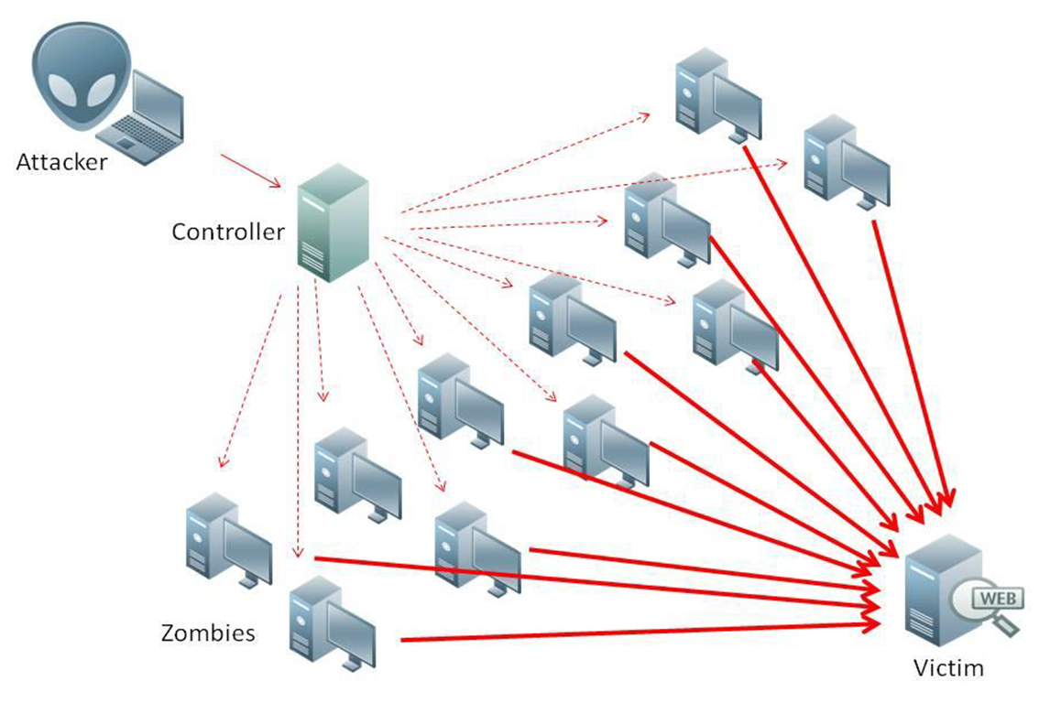
What is Denial of Service (DoS)
Attempts to make target unavailable by flooding with traffic
If victim has to filter attack, it’s too late
Internet Providers have no incentive to help
  Businesses get affected, but would not pay provider enough to make worthwhile
  This is why Cloudflare, e.g., exists
Many ways to perform this attack
Notes:
Contributed by Brett Ammeson.
https://www.cloudflare.com/ddos/reflection-attack-1.png
https://i.imgur.com/lxYv8cF.png

Slide 46
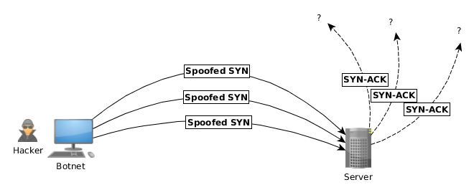
Distributed DoS Vectors
TCP SYN attack
  SYN packets are small, low difficulty for attacker
  Leaves half-open connections on server
  SYN cookies mitigate this
DNS amplification attack
  DNS requests are small
  Can request all records on server
  Crippled by proper configuration
Ingress/egress filtering will reduce effect
Notes:
Contributed by Brett Ammeson.
TCP SYN: https://www.cert.org/historical/advisories/CA-1996-21.cfm
DNS amplification: https://www.cert.org/historical/incident_notes/IN-2000-04.cfm
Ingress/egress: www.giac.org/paper/gsec/705/egress-filtering-keeping-internet-safe-systems/101588

Slide 47
Crime How
Technical and Non-Technical
  Break into computer.
  Prevent access to computer.
What things make computer related crime easy?
Notes:
Exploit security holes, Break encryption, Spoofing
Social Engineering: Guess passwords, Find out passwords and procedures
Poor passwords, Insecure protocols, Program limitations (buffer overruns), Eavesdropping (Email, Interactive), Insecure files

Slide 48
Crime Bane
Trojan Horse
Virus
Worm
Bot Network
Buffer Overrun
(Distributed) Denial Of Service Attack
How do they work?
How harmful are they?

Slide 49
Crime Why
Why?
Notes:
Money: stolen credit cards, change records, stolen property.
Political, military, economic.
Challenge, Revenge, Mean
Why do at all? Have motivation, think about it, think it will help, think it’s acceptable.
Feel forced. Don’t agree. Don’t care.

Slide 50
Crime Time
What is different now compared to:
  10 years ago?
  20 years ago?
  30 years ago?
  40 years ago?
Notes:
More computers. Unsophisticated owners. More complex software. Greater connectivity. Easy access to cracking tools. Incentives. File-sharing
In ’60s and ’70s, access was mostly localized.
Modems. Wardialing.
Some Arpanet and Usenet.

Slide 51
Crime Gain
Justifications for Computing Crimes?
What can be done after access is gained?
  What resources are available?
  How valuable are they?
Notes:
Machines are unused. No harm done. Education. Exposes security holes. Exposes abuses.
Use computer and/or resources. Take data. Destroy data. Alter data. Lock out others. Attack other computers.
Equipment, Processor Time, Disk space, Printer time / paper, Bandwidth

Slide 52
Crime Pay
Computer Fraud and Abuse Act (1986)
  Bans :
    unauthorized access or use of computers, copying, modifying, or destroying data, disclosing of passwords.
    disrupting government and utilities.
  Covers government, financial, medical, and interstate systems.
USA Patriot Act (2001)
  Raised penalties.
  Permits freer surveillance and monitoring to detect illegal activity.
Electronic Communications Privacy Act
  Illegal to intercept telephone, email, other data transmissions, access stored email messages without authorization
Assign Cybercrime Treaty (2006), Wire Fraud Act, National Stolen Property Act, Identity Theft and Assumption Deterrence Act
Notes:
Are either of these laws still in effect? Have they been changed?
For additional legislation ask for presenting volunteers to brief recent incidents/cases.
Also ask for volunteers to find out laws from their home country/state.

Slide 53
Crime Stop
Technical
  Protect Data
  Protect Machine
  Protect Access
Non-technical?
  Social?
  Legal?
Notes:
Encryption, Authentication, Biometrics, Anti-virus, File integrity checking (E.g. Tripwire), Virtual private networks, Point-to-point networking (Twisted-pair Ethernet vs. Coax vs. wireless)
Security through obscurity, physical access required, not on network, behind locked doors.
Remove desire, remove incentives
Legalize, increase penalties, increase chance of getting caught.

Slide 54
what works well Online With Zoom
Turn your camera on
Sign in with First and Last Name
Stay muted unless you are going to speak
Use the raise your hand feature to ensure your turn
Wait until the end of student presentations to ask questions
  Write them down so you don’t forget

