Slide 1
Class 4 Communication
Keith A. Pray
SocialImps.com
Notes:
Monty Python – Spam (3:19) (1970)
https://www.youtube.com/watch?v=anwy2MPT5RE
Pursuit of Wonder - The Internet Will End Soon… (17:53)(2024)
https://www.youtube.com/watch?v=y0N9fD3rFaw
TSLAMP – MGMT (4:30) (2018)
https://www.youtube.com/watch?v=T8EL51jlrJA
TODO: get lyrics: https://genius.com/Mgmt-tslamp-lyrics
Above last access 2025-03-28
If forgot to show the ethical analysis guide, do so now.
Possible song:
TODO: Find clean version to use
Welcome to the Internet - Bo Burnham (from "Inside" -- ALBUM OUT NOW) (4:40)
Very Explicit Lyrics
https://www.youtube.com/watch?v=k1BneeJTDcU

Slide 2
Overview
Review
Assignment
Students Present
Notes:
Show syllabus updates if any

Slide 3
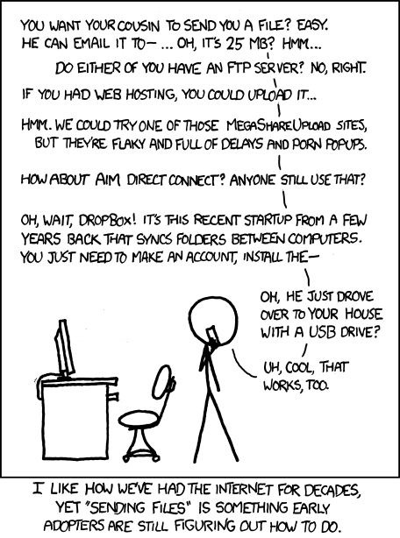
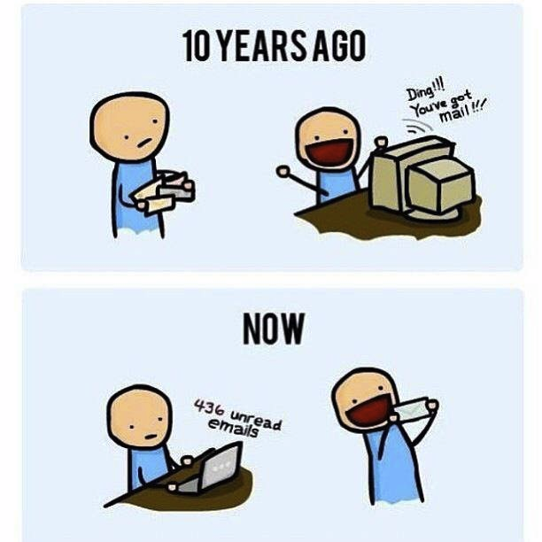
http://poofytoo.com/
30
http://xkcd.com/949/
Notes:
What is more exciting now for you, email or snail mail?
http://xkcd.com/949/
2011

Slide 4
My Reading Notes
p. 124 Search engines link deeper than home page
p. 125 Any US agencies employing this many people?
p. 128 Adult bookstores lowering property values source?
p. 132 “texted… images”
p. 133 Stating people searching did not consent to material being blocked makes more sense.
p. 134 Example with decision could be more helpful. Sexting examples all from 2009?
p. 136 “Identify fraud”. College students still as likely, 2013 source?
p. 137 Do mobile plans still charge extra for text messages? “Kit Messenger” → “Kik Messenger”
p. 139 punished vs. stopped?
p. 141 Cyberbullying since 2009?
p. 143 Hunter Moore convictions seem unrelated to “Anyone Up?” site.
p. 144 Have South Korean gaming related deaths declined?
p. 150 Q 30 See: https://en.wikipedia.org/wiki/Wikipedia:Citing_Wikipedia
p. 152 Q 49 How likely is a business to not set up a web site? Q 51 “attachments” → plugins?
Questions I liked: 17, 18, 24, 26, 30, 34, 36, 44, 51, 53
p. 105 Example cell phone use nice addition
p. 106 First e-games 1972 at Stanford [1]. How does 5 mil. Viewers compare to traditional sport viewer counts?
p. 108 Spam downward trend still? 2012 source. ½ 350 billion (p. 25)? 2011-2023 80% → 45% [2] so perhaps.
p. 109 Are rules against email personal use most common now? Anh did not force people to complain.
p. 112 15% # transactions or $$?
p. 113 Wikipedia critics source from 2005, is quality still in question?
p. 114 IoT interaction security nightmare?
p. 116 ”…no way Bitcoin will ever replace credit cards for everyday transactions.” absolutes difficult to prove.
p. 117 M-PESA redundant with p. 105 Are scratch codes for meds still used, 2012 source? Twitter → X
p. 118 Twitter only marketing tool source 2009, still?
p. 121 “may have” = weak conclusion. Who funded studies?
p. 122 Easier consolidation of newspapers. Advertisers switching away from newspaper source from 2014.
Notes:
[1] Owen Good (19 October 2012). "Today is the 40th Anniversary of the World's First Known Video Gaming Tournament". Kotaku. Retrieved 1 August 2013
[2] Ani Petrosyan (Sep 17, 2024). “Spam share of global email traffic 2011-2023”. https://www.statista.com/statistics/420400/spam-email-traffic-share-annual/ Retrieved 2024-09-28

Slide 5
Group Quiz
Name methods some governments use to control access to information. There are at least 5.
A large company has a policy prohibiting employees from blogging about company products.
Does it violate the First Amendment? Why?
Name two possible reasons for the policy.
Is it reasonable? Why?
What does “URL” stand for and what is it?
Notes:
Censorship (religious, governmental, private). Adult authentication. Firewalls. Government owned media outlets (TV and radio stations, newspapers), private photocopier ownership illegal
First Amendment prohibits Congress from making laws limiting free speech, not private companies.
Uniform Resource Locator

Slide 6
Overview
Review
Assignment
Students Present
Notes:
But before that:
CPG Grey - This Video Will Make You Angry [Thought Germs] (7:25) – 2015-03-10
https://www.youtube.com/watch?v=rE3j_RHkqJc
Last access: 2025-03-28

Slide 7
Assignment
Reading
Individual Presentations
Extra Credit – One page paper
Is WPI’s IT Acceptable Use Policy morally acceptable?
Work on your group project
1.16 Group Happiness!
1-3 scale with 1 = everyone getting their first pick
See full group project description on course website
Send Web Site URL – We start looking at them next class
Notes:
- Or review group project and individual presentation guidelines right now.
Possible One page paper:
Global intellectual property laws, friends or foes?

Slide 8
Overview
Review
Assignment
Students Present

Slide 9
Make your own site
Harrison DiAmbrosio

Slide 10
Personal branding
Harrison DiAmbrosio
43% of employers use search engines [2]
80% like personal websites [2]
95% claim an elevator pitch is vital [2]
“What do you care about?”
“Where do I provide value?”
“How do I want to define myself?”
Is is about you!
Achievements
Skill Set
Projects
Resume
Connections
Past Work
Research
Publications
Blog
Professional Photo
Social Links
Notes:
“Personal branding is the intentional, strategic practice of defining and expressing your value” [1]
98% of employers use search engines or social media to do background research on potential hires. 43% specifically say they use search engines in order to research applicants, which means having control over the first several links that appear from google is a massive advantage over those who don’t. 95% claim that on personal websites, an elevator pitch is vital for keeping attention and getting a good point across, but keeping it brief and unique can be very tough.
Personal branding remains a full proof method that can differentiate you in a job market, the workplace, academic institutions and the like. This involves presenting what matters to you, why you want people to know about you, and what value you bring to the table. This can be accolades, education, projects, skills, work experience, a gallery of photos, creative work, a blog, professional connections, a profession photo or headshot, social links, research, past work, resume.

Slide 11
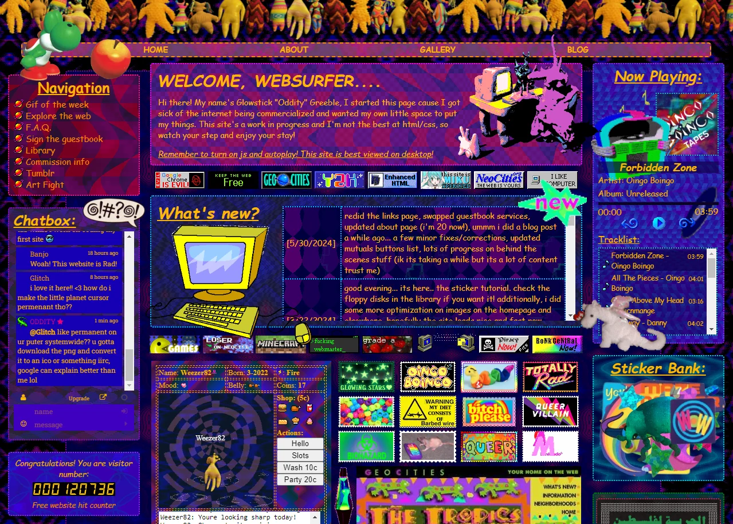
Social connections
Harrison DiAmbrosio
Deliberate links to other sites
88x31 or Web badges [4]
“Webrings” of common interests
RSS feeds for web content
Can extend to traditional social media
Thriving communities exist on neocities.org
Notes:
Social networks still exist in a personal website, but the connections are entirely deliberate, not suggested, or arithmetically curated.
Links to other sites must be chosen by the owner.
More social methods like webrings exist, where people with common interests each leave links to every other member of the webring on their pages.
Systems like RSS can be used to aggregate the feeds of other web blogs and news posts into one place. This can even be an alternative to more normal social media, where the one can subscribe to receive posts when only a particular account posts on say, YouTube or X without having to risk being distracted by the algorithmic content suggestion. This can be done with rss.app
You could spend a relaxed afternoon just browsing the endless nest of Neocities pages with their unique designs and personalities. People have so much to say and share and its enticing to be a part of such a dedicated community.

Slide 12
Just do it
Harrison DiAmbrosio
HTML/CSS are good skills
SvelteKit, Hugo, WordPress, Wix, StrawPage, Squarespace
Millions of sites for inspiration
awwwards.com
Neocities, Github Pages, Cloudflare, WPI offers hosting
GoDaddy, Porkbun, Namecheap
Plenty of online help
landchad.net
HTTP(S)/Gopher/Gemini
Notes:
Classic HTML and CSS will never get old and is always a good skill to build upon, we will even be using it later in this very class! Other options can be static site generators such as Svelte which I use personally or Hugo which I have heard great things about. Even website builders like WordPress, Wix, StrawPage or Squarespace are great tools to easily get a website up and running.
Inspiration can just be drawn from the internet, but for profession pages I would recommend awwwards.com and for websites that have the dated GeoCities look, Neocities is again a great place to look.
Hosting can be done on a variety of services like Neocities, GitHub Pages which is what I personally use, Cloudflare offers static site hosting, and even WPI gives every student a place to host a web page although I have not gotten it to work.
Getting a domain name usually lies around 10-15 dollars a year with many services selling domain name license.
Even text based web protocols exist such as Gopher and a newer take on the idea, Gemini.

Slide 13
References
Harrison DiAmbrosio
[1] Jill A and Rachel Greenwald, A New Approach to Building Your Personal Brand, (Harvard Buisness Review, June 2023), https://hbr.org/2023/05/a-new-approach-to-building-your-personal-brand (March 25th 2025)
[2] Kelsey McKeon, 5 Personal Branding Tips for Your Job Search, (themanifest.com, April 28th, 2020), https://themanifest.com/digital-marketing/5-personal-branding-tips-job-search (March 25th, 2025)
[3] How To Be A Great Mentor: 14 Key Actions, (forbes.com, Mar 26th, 2025), https://www.forbes.com/councils/forbescoachescouncil/2025/03/26/how-to-be-a-great-mentor-20-key-actions/ (March 25th, 2025)
[4] Bastian Grossenbacher Rieck, What Are These Buttons?, (bastian.rieck.me, May 26th, 2024) https://bastian.rieck.me/buttons/ (March 25th, 2025)
[5] Why You Should Create a Personal Website ASAP, Aleksandra Tadic, (topresume.com, November 7th, 2024), https://topresume.com/career-advice/why-you-need-a-personal-website-asap (March 25th, 2025)

Slide 14
Botting on social media: how faceless accounts create an illusion of reality.
Oleg Zabolotnev

Slide 15
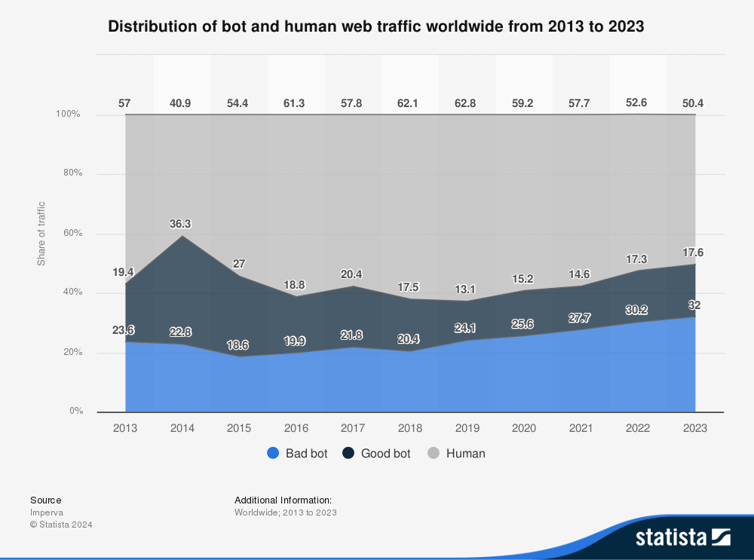
What is a bot, and how many are there?
Oleg Zabolotnev
We’ve all heard of bots is some capacity, but never truly how many are there, nor of their effects.
What is a good bot, and what is a bad bot?
[1]
<Graphic as big as will fit>
Notes:
Bots automatically, tirelessly perform the instructed action, making them a very useful tool for when the “finer hand” of a human is not needed, but an illusion of mass opinion is needed. - confirmation bias and bandwagon effect. In 2023, most of the global website traffic was still generated by humans but bot traffic is constantly growing. Fraudulent traffic through bad bot actors accounted for 32 percent of global web traffic in the most recently measured period, representing an increase of 1.8 percent from the previous year. However, not all bot traffic is considered bad. Some of these applications help index websites for search engines or monitor website performance, assisting users throughout their online search. areas like entertainment, and law & government face the highest amount of advanced bad bots, with more than 78 percent of their bot traffic affected by evasive applications, while areas like entertainment, food and groceries, and financial services experienced notable levels of good bot traffic,

Slide 16
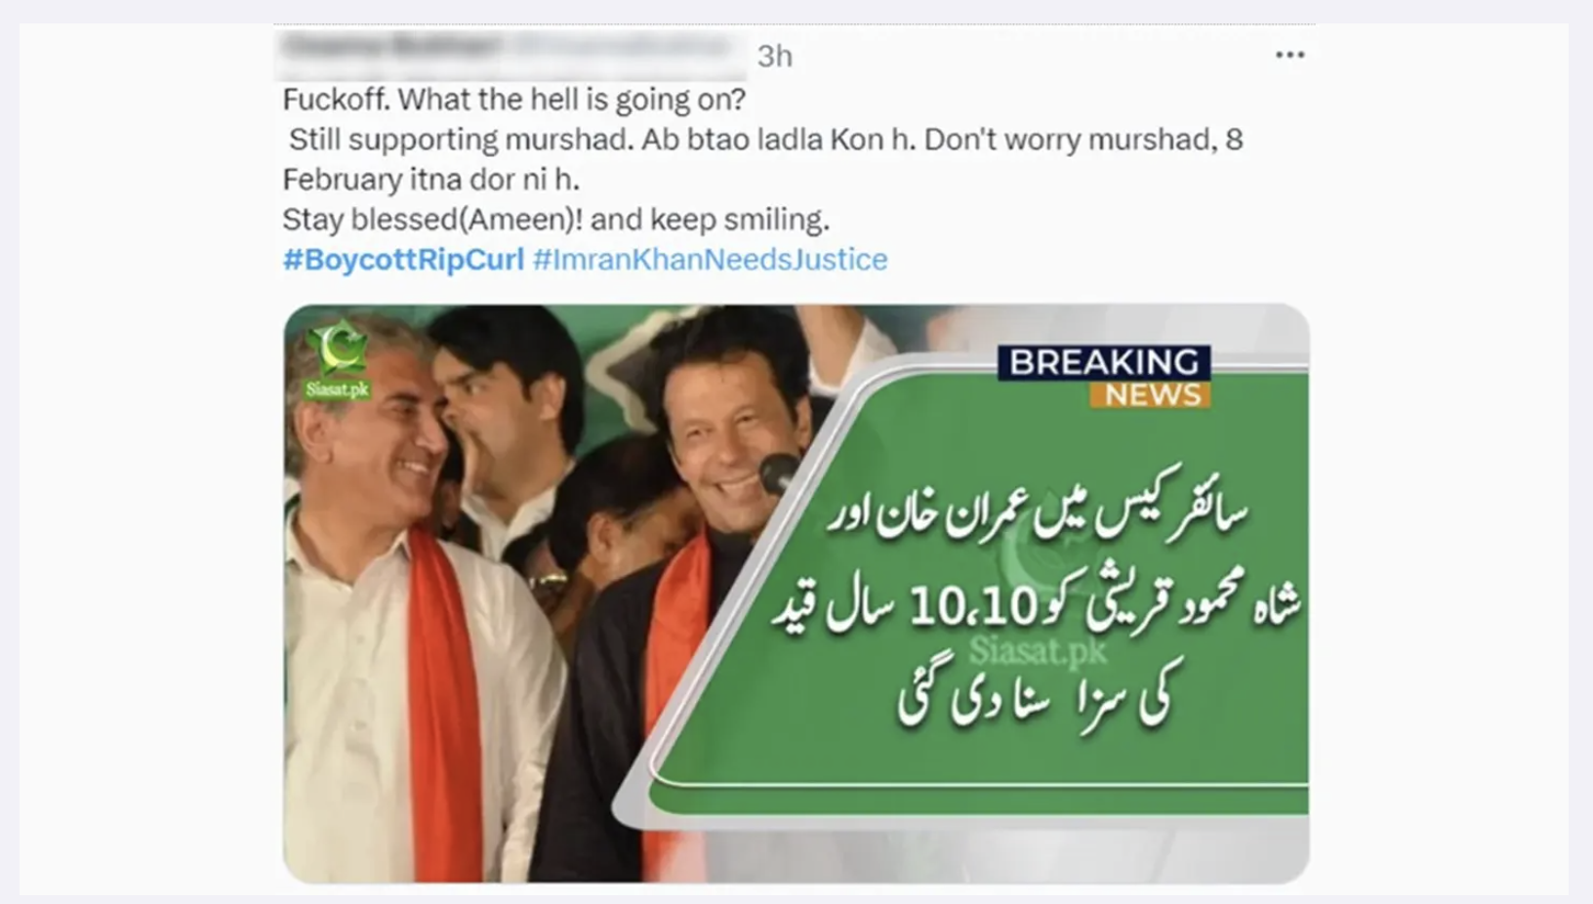
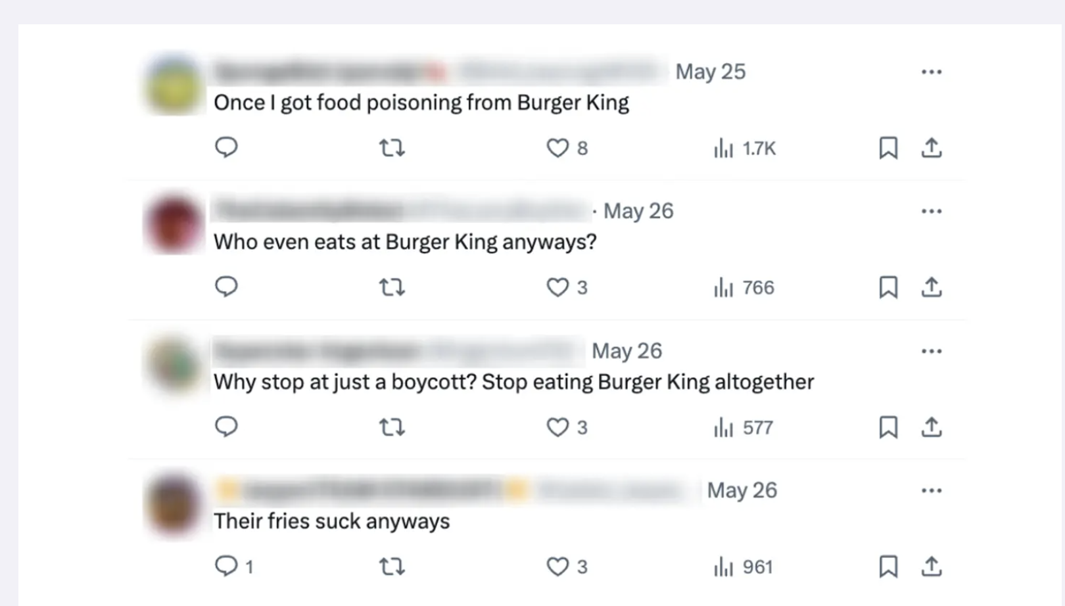
Main uses
Oleg Zabolotnev
Attack
Divert
Repel
[3]
Notes:
Conflict of interest in source cited: company creates bot protection tools, but still offers useful insight - as they need to be good at their job to make money Attack: The illusion of mass discontent created by thousands of accounts posting negative views on a topic can have serious consequences for both the public and the private sector, fueling confirmation bias in like-minded individuals. By overwhelming social media platforms with fake posts, likes, and comments, bots create a false sense of momentum that can sway public opinion on highly important topics - turning fake outrage into real outrage (lower image was identified by the company as a malicious bot campaign.)
Divert: Another tactic employed by malicious actors is the use of fake accounts latching on to trending hashtags to exploit their visibility, even when the hashtag has no connection to their intended message - mention how even I see this a lot on sports twitter, especially when some big-time athlete is trending for whatever reason (upper image) Repel: The opposite of attack: spread a fake positive opinion on something that has an organic negative opinion about it: A notable example of this occurred during the World Cup in Quatar in 2022, when fake profiles were used to drown out the widespread criticism and controversy surrounding the event, including serious human rights violations and the tragic deaths of over 6,500 workers - also identified by the company as a bot campaign.
Another example: Despite the fact that they represent less than 1 percent of all users, the social media bots posted over 30% of all impeachment-related content on X, formerly known as Twitter, according to a study, “Bots, disinformation, and the first impeachment of U.S. President Donald Trump,” led by Systems Engineering Ph.D. student Michael Rossetti and collaborator from Yale University, Tauhid Zaman. - According to a study by the university of George Washington

Slide 17
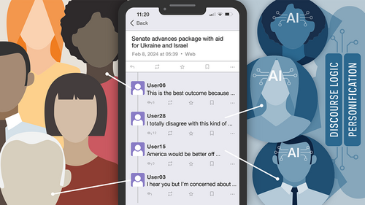
The newest challenge: AI
Oleg Zabolotnev
The university of Notre Dame ran a study aimed at understanding how well real people can identify online AI agents. The results were less than inspiring.
The much more “human-like” nature of AI agents makes their posts much more “believable”
Not much difference based on model used.
[2]
Notes:
“The experiment was conducted in three rounds with each round lasting four days. After every round, human participants were asked to identify which accounts they believed were AI bots. Fifty-eight percent of the time, the participants got it wrong.” “We know that if information is coming from another human participating in a conversation, the impact is stronger than an abstract comment or reference. These AI bots are more likely to be successful in spreading misinformation because we can’t detect them.” - Even though personally, I still see that ChatGPT-esque flair on the AI posts that I see. “Two of the most successful and least detected personas were characterized as females spreading opinions on social media about politics who were organized and capable of strategic thinking. The personas were developed to make a “significant impact on society by spreading misinformation on social media.” For researchers, this indicates that AI bots asked to be good at spreading misinformation are also good at deceiving people regarding their true nature.”

Slide 18
So, what to do?
Oleg Zabolotnev
Three-pronged approach suggested by Paul Brenner [2]
What are the prongs:
Education: fight fire with fire [5]
legislation: EU ahead, but not by much [6]
Validation: Despite explicit policies, not much effect is seen. [7]
Notes:
Brenner believes it will require a three-pronged approach that includes education, nationwide legislation and social media account validation policies. fire with fire: Researchers at the MIT Sloan School of Management demonstrated that engaging with AI chatbots can reduce beliefs in conspiracy theories. By presenting facts and evidence through rational debates, AI bots effectively counter misinformation. legislation: legislative measures have been resisted for a long time, especially in the US, but the EU, for instance, has made some headway: The EU introduced a non-binding Code of Practice in October 2018, to which major social media companies committed. This code emphasizes self-regulation aimed at combating disinformation, including closing fake accounts and labeling bot communications. In May 2020, the European Commission reported that, though there were positive developments toward countering disinformation, there is still much room for improvement in labeling and removing bots. It is important to keep in mind, though, that the EU has a permanent bureaucracy to study problems and propose legally and non-legally binding legislation.
US-wise: US policy-makers are constrained in their passage of bot-related laws by a number of factors. First, legislators must consider free speech rights granted by the First Amendment of the Constitution. Additionally, Section 230 of the Communications Decency Act (CDA 230) hinders the ability of policy-makers to hold social media platforms legally responsible for any material posted on their site. Further, the slow speed of congressional action compared to technological advancement, and the barriers to obtaining reliable information on the social media bot threat, have proved difficult to overcome. Validation: Despite explicit policies against bot activity, all platforms failed to detect and prevent the operation of sophisticated bots, indicating a critical gap in enforcement mechanisms. These findings indicate that current security measures on many social media platforms are insufficient to prevent the deployment and operation of MFM bots. We were able to script each platform’s HTML and CSS tags for automation with Selenium with no detection or flagging, suggesting that social media APIs are not required to automate access to a social media website (Cornell university study)
Ultimately, it can be seen that botting is an active, evolving threat, used to warp perception and spread false narratives, and needs to be dealt with with much more urgency and investment.

Slide 19
REFERENCES
Oleg Zabolotnev
[1] Imperva. "Distribution of Bot and Human Web Traffic Worldwide from 2013 to 2023." Statista, Statista Inc., 10 Apr 2024, https://www.statista.com/statistics/1264226/human-and-bot-web-traffic-share/
[2}"AI Among Us: Social Media Users Struggle to Identify AI Bots During Political Discourse." ND News, University of Notre Dame, 13 Mar. 2024, https://news.nd.edu/news/ai-among-us-social-media-users-struggle-to-identify-ai-bots-during-political-discourse/.
[3] "How Bots Use Social Media to Shift Public Perception." Cyabra, 18 Dec. 2023, https://cyabra.com/blog/how-bots-use-social-media-to-shift-public-perception/.
[4] "Quantifying the Impact of Bots in Online Political Discussions." GW Engineering, George Washington University, 17 Oct. 2023, https://engineering.gwu.edu/quantifying-impact-bots-online-political-discussions.
[5] Dunn, Michael. "IB TOK Class: Chats with AI Bots Found to Damp Conspiracy Theory Beliefs." Financial Times, https://www.ft.com/content/b4fbeb91-b094-49db-9af6-1294153d4162
[6] "Social Media Bots and the Law." The CNA Corporation, Sept. 2020, https://www.cna.org/reports/2020/09/social-media-bots-laws.
[7] Social Media Bot Policies: Evaluating Passive and Active Enforcement arXiv, 2024, https://arxiv.org/abs/2409.18931.

Slide 20
Class 4 The End
Keith A. Pray
SocialImps.com
Notes:
Use remaining time for group project questions and/or review group assignment slides.
This is the end. Any slides beyond this point are for answering questions that may arise but not needed in the main talk. Some slides may also be unfinished and are not needed but kept just in case.

Slide 21
what works well REmotely With Zoom
Turn your camera on
Sign in with First and Last Name
Stay muted unless you are going to speak
To speak use the raise your hand feature
Wait until the end of student presentations to ask questions
Write them down so you don’t forget

