Slide 1
Black Panther
Wakanda Forever
1
Kenneth Smith, Nathan Wong, Sukriti Kushwaha, Ella Dunne, Kenny Doan

Slide 2
03
04
05 & 10
Plot Summary
Conclusions
Computing Tech
2
Table of Contents

Slide 3
Plot Summary
French Invade Wakanda
T'Challa Dies
Wakandans Defeat Talokan
3
Queen Ramonda Dies
Wakanda faces international tensions due to vibranium usage
Namor & Talokan attack Wakanda. Technologically and physically outmatched, Wakanda cannot defend itself
Vibranium Detector Stolen
Shuri fails to recreate Heart-Shaped flower using DNA splicing technology
Riri Williams creates the first vibranium detector. Navy Seals and CIA seize and use it. This reveals the existence of Talokan and begins the primary conflict
Shuri recreates the heart-shaped flower and embraces her role as the Black Panther. She also develops the Midnight Angel Suits, builds a ship and alters the vibranium detector with sonar technology
Notes:
The plot of Wakanda Forever is distinctly tied to technology, with almost every major plot point having a technological success, or failure, associated with it.
The movie begins with the death of King T'Challa, something which, while actually the result of the unfortunate passing of Chadwick Boseman, occurs in the film due to a technological failure. Shuri is unsuccessful in recreating the Heart-Shaped Herb despite the advanced technology at her disposal, resulting in T'Challa dying of an illness.
This death has a large impact on Shuri, who, because of her failure, distances herself from Wakanda's culture.
With the passing of the last black panther, Shuri is of the belief that only technological advancement will save Wakanda from its future conflicts.
Chapter 8: Computer Reliability, 8.8 Computer Simulations, issues with producing the correct result because of limitations with validation? -> Ultimately, systems cannot be used to their full extent without an expert there who can confirm the validity
The movie then highlights yet another failure of technology: despite Wakanda's best efforts to encourage technological collaboration, their hesitance in sharing vibranium prompts the French government to send mercenaries to seize those resources. These mercenaries fail, and the international tensions between Wakanda and the rest of the world continue to increase.
This tension once again highlights an internal struggle occurring in Wakanda throughout this film: How does Wakandan technology intersect with its culture?
Some, like Shuri, believe technological advancement and collaboration is the future of Wakanda.
Others still believe Wakandan culture states they must remain isolated, and protect their resources from the outside world.
Queen Ramonda is stuck in the midst of this debate, unable to fully finalize the plan her son T'Challa had to open Wakanda
Chapter 4: Vibranium is Wakanda's by property law: but what else protects it? And what happens IF vibranium is acquired outside of Wakanda? In addition, does Wakanda, knowing vibranium is both very powerful but can also save and improve lives, have an obligation to share it with the rest of the world?
In the wake of the decision by Wakanda to continue restricting vibranium, we the viewer are then shown yet another technological failure. Despite the wishes of Wakanda, the U.S. Navy Seals and CIA have gotten their hands on a vibranium detector: a piece of technology thought to be impossible to create. They then use this machine to search for vibranium outside the territory of Wakanda in the Atlantic ocean for their own gain.
This usage of this technology, a machine that was originally made for research purposes, reveals the existence of Talokan and kickstarts the primary conflict.
It also highlights one of the core topics talked about in the book and this class: Regardless of what the original intent of technology is, if not kept accountable, those same technologies can be used for bad
Chapter 7?
Through this conflict, key issues about technology, resources, and who gets to make decisions that may impact others arise:
Namor, the King of Talokan, resents the Wakandans for telling the rest of the world about vibranium. As a powerful technology, Namor believes it should only be known about and used by a select few. (Something that is in direct opposition to King T'Challa's wishes, who believed technology should be shared for the betterment of society)
Namor makes an ultimatum with Wakanda, demanding the scientist who created the machine to be delivered to Talokan to be killed, or be subject to war.
When Queen Ramonda, Shuri, and Okoye fail to produce Riri Williams, the creator of the vibranium detection machine, Namor and Talokan attack Wakanda. In a show of technological and physical dominance, the technological capabilities of Wakanda (something Shuri and the viewer have put upmost stock in) fail to hold off the Talokanils, who end up killing Queen Ramonda through use of water-based explosives.
In preparation for the final conflict, Shuri then demonstrates a series of technological successes.
She is able to recreate the Heart-Shaped Flower,
Finalize the Blue Angel Suits which greatly advance the capabilities of the Dora Milaje,
Modify the vibranium detector alongside Riri Williams to turn it into a weapon,
Creates weapon to defeat Namor,
Assists Riri in finishing the Ironheart suit.
Through this combination of technological advancements, as well as Shuri accepting the importance of Wakandan culture alongside technology, Wakanda is successful in defeating Talokan.

Slide 4
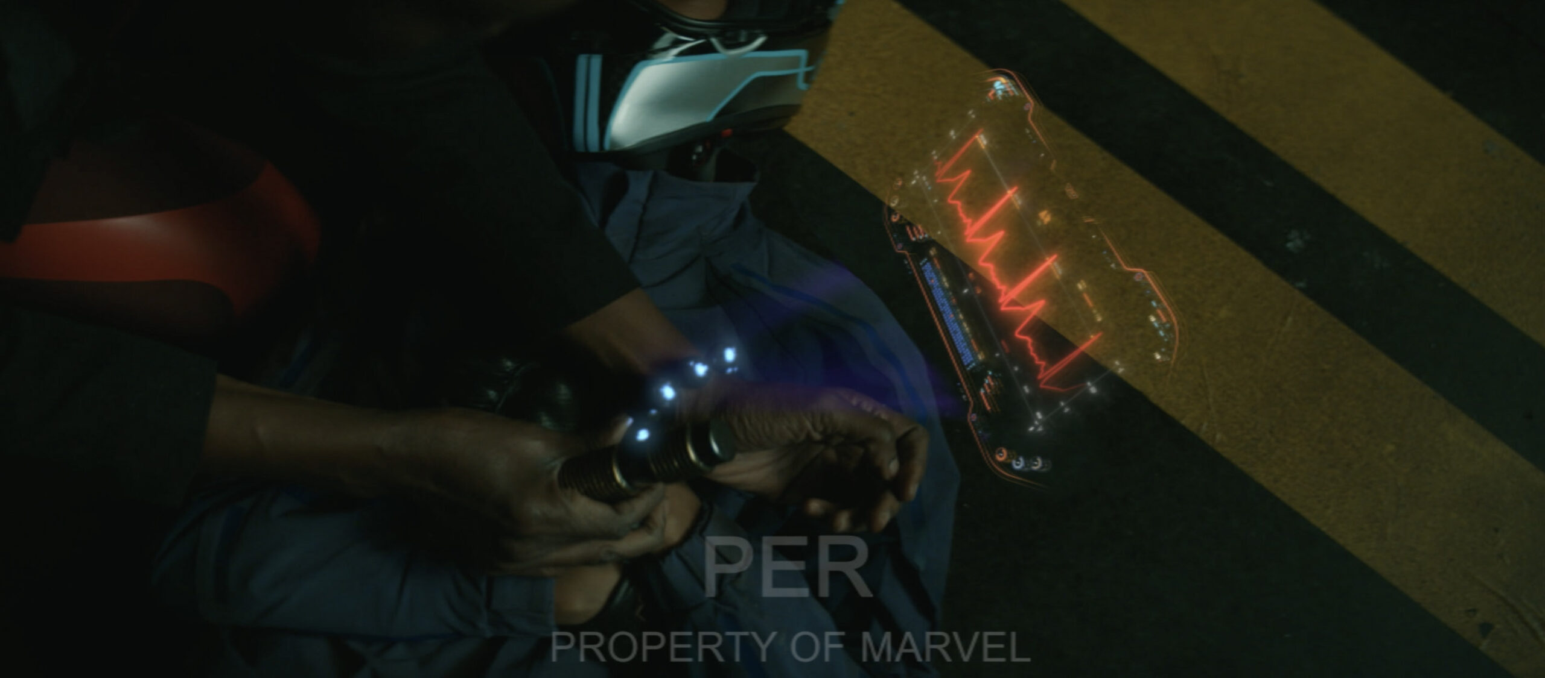
Computing Technology
4
Vibranium Detector
Kimoyo Beads/Earrings
Exosuits
Augmented Reality Displays
AI Assistant, Griot (Similar to Jarvis)
Artificial Sun
[1]
Notes:
A list of some of the key computing technologies in Wakanda Forever that intersect with the plot points.
Some are based off of real technologies, others aren't.
However, a key point to take away from some of these technologies is how they reflect Wakandan culture: both in their basis and design
The Kimoyo beads are very powerful, having the capability to function as a communication method, as well as perform a number of tasks such as acting a keycard, a shield, a defoliator in one scene. But their design is very different than most high tech gadgets we see.
Similarly, two different types of exosuits are seen in the film. One, the Iron Heart suit, is very similar to the Iron Man suit. The Midnight Angels suits, though, being Wakandan, are drastically different in their usage and look.
And both the augmented reality displays and Griot were also made with Wakandan culture in mind for their design
Modern mineral detectors
No direct real-life tie to Kimoyo Beads (they just do too much)
Soft exosuits meant to reduce physical stress on the body: Soft Exosuits | Harvard Biodesign Lab
Augmented reality displays: VR Headsets, Apple Vision
AI Assistants: Siri, Alexa

Slide 5
Conclusion 1
5
Culture influences how technology is implemented within society
Notes:
Our first conclusion: As a major theme in the movie and echoed by the director and individuals working on the film:

Slide 6
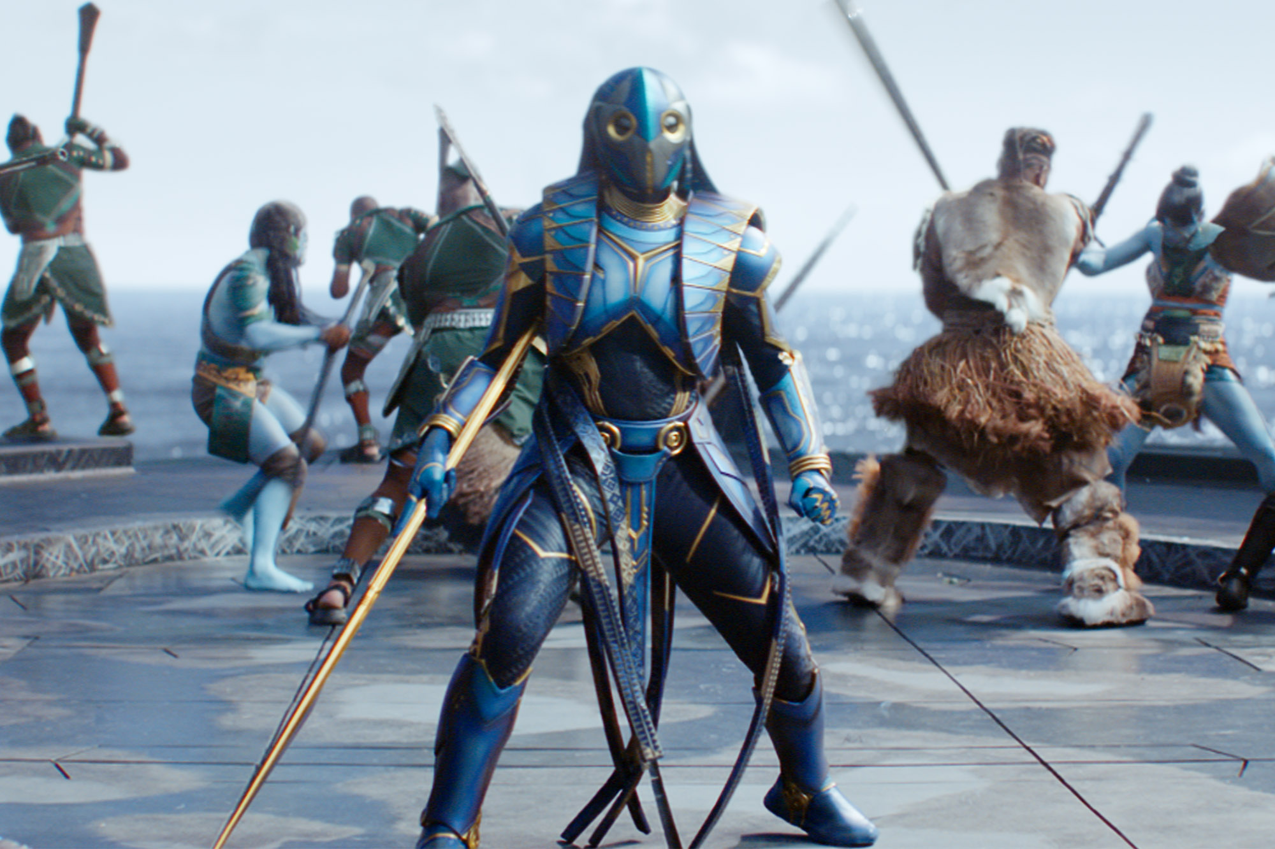
Technology Is Viewed Through Cultural Lens
6
Certain Wakandans dislike new technologies introduced throughout the movie
Okoye dislikes the vibranium energy daggers used by Aneka, as well as the Midnight Angel suits
Ramonda dislikes Griot (AI Assistant)
In opposition: Shuri believes the heart-shaped herb is unnecessary due to technological advancements
Midnight Angel Suit created by Shuri [13]
Notes:
One of the interesting dichotomies the film presents is how residents of Wakanda view technology and technological advances.
Newer technologies offer quality of life improvements and enhance productivity/efficiency:
- Vibranium energy daggers are easier to conceal and just as deadly as vibranium spears
- Midnight angel suits offer better protection, analytics, and flight capabilities
Yet Okoye does not want to use the new daggers and suits because the Dora Milaje have been using their traditional spears and armor for centuries. She fund
- Throughout the movie, Shuri buries herself in creating new technologies to cope with the loss of her brother – instead of engaging herself with the cultural customs that her mom encourages (burning the funeral robes)
- By the end of the move, we see that Shuri continues to improve the capabilities of the Black Panther through technology but also relying on the heart-shaped herb for power, ultimately showing that technology and culture can coexist

Slide 7
Does Technology Kill Culture?
7
The ease that comes with advancements in technology can dissuade individuals from participating in cultural norms [5]
Aworis in Nigeria [6]:
Traditionally a farming/fishing tribe, by 2012, Awori tribes transitioned to an industrialized economy
Survey with 203 Aworis [6]:
52% believe Aworis youth are no longer interested in promoting cultural values
59% believe that cultural values have eroded due to foreign industrialization
43% believe that their culture is not safe from further erosion
Cultural Homogenization [8]
Notes:
- While advancements in technology can help spread cultural ideas, people can become reliant on certain technologies and less engaged in cultural traditions [5]
- For example, advancements in medical technology can convince people to forsake more traditional forms of medicine
- Aworis starting modernizing in a similar fashion to Western modernization [6]:
- Many farmers and fishermen began working in factories
- Opened more schools and provided a Western style education (facilitated by computing devices to help teach
- Survey was conducted with Aworis adults (20 years or older) [6]
- For each of the questions the participants were given a choice of Yes, No, I Don't Know [6]
- Aworis youth no longer interested in cultural values: 53% Yes, 9% IDK, and 38% No
- Cultural values have eroded: 59% Yes, 7% IDK, 34% No
- Culture is not safe from further erosion: 43% Yes, 19% IDK, 38% NO
[8]
Although globalization is related to how technological advancements have allowed for more interlinked business and trade, it has been noted that it leads to more homogenized cultures. This is because as national and regional boundaries are decreased, people become more willing and likely to go beyond these boundaries. As multicultural/multinational interactions increase, the sameness of unique identities increases with it.
Globalization's Cultural Consequences on JSTOR
Global culture follows the global economy.
Ties back to the 'winner-takes-all' thing in the book: The prevalence of the internet allows the top performers to receive a disproportionate share of the rewards (something the book actually notes is seen a lot in the arts and entertainment already). If the "top-performer" is specific cultural traits, then they'll become the normal and other cultures will fade away.

Slide 8
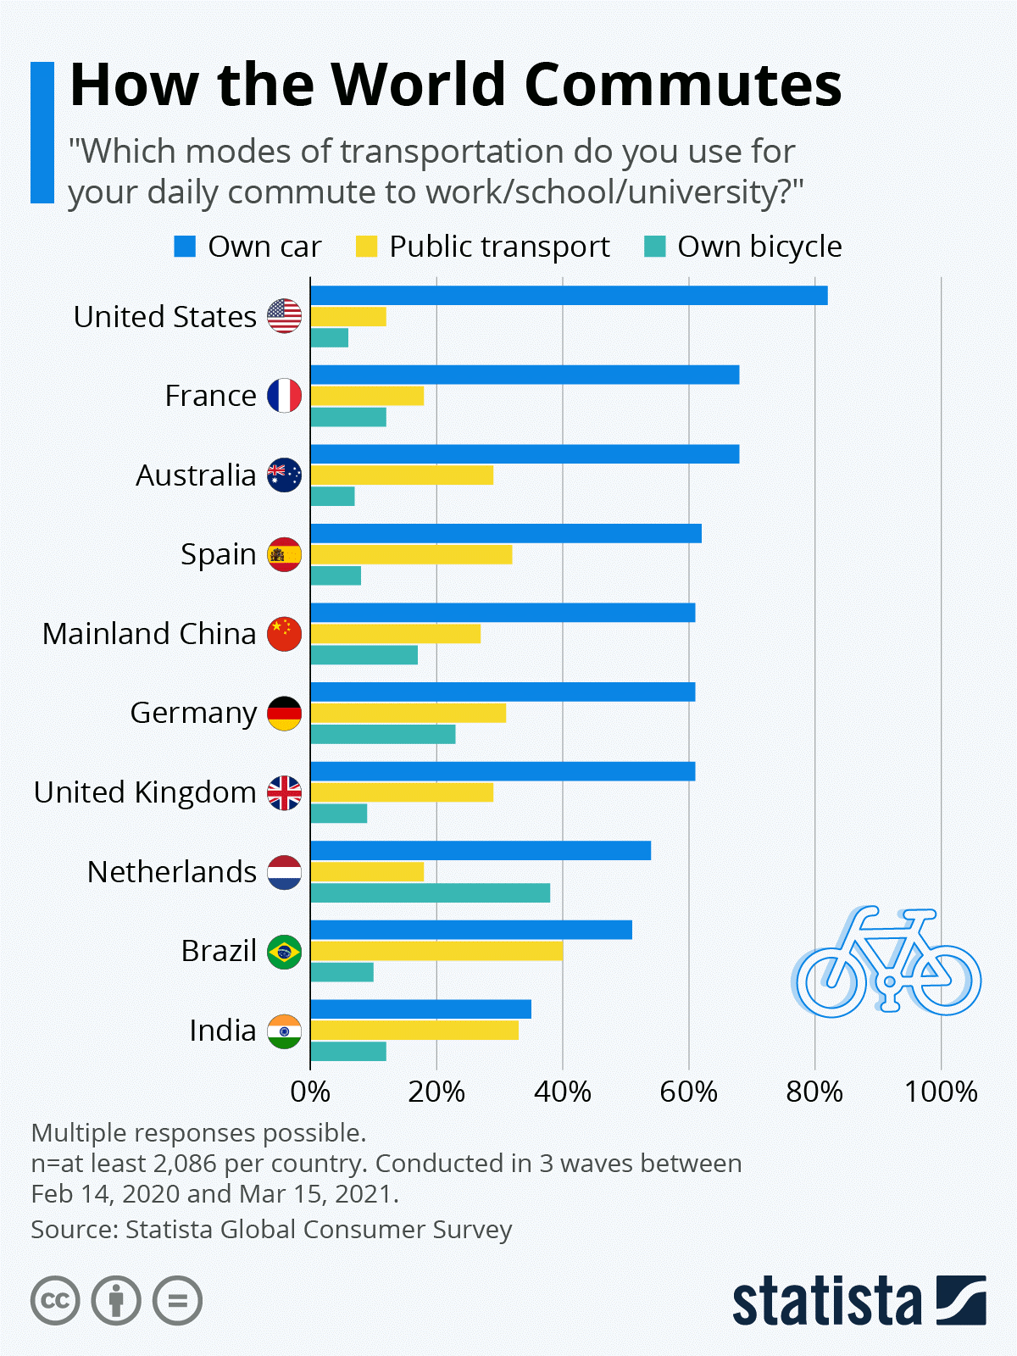
Technology Can Coexist with Culture
8
Technology can facilitate freedom and creativity to shape cultural traditions [9]
The impact of the automobile in America:
In 2021, 76% of Americans use a car to commute to work [10]
From 1950 to 1970, the suburban population doubled to 74 million [11]
The preservation of language through the internet [12]
Over 3,000 Threatened/Endangered Languages
[8]
Notes:
Technology shapes our culture, and likewise culture adapts and evolves around new technologies
An example would be how the invention of the automobile had impacted life in America
Our societies today are based around cars, for example in 2021 it was reported that 76% of Americans use a car to commute to work everyday
In fact, the US has the most car usage in terms of daily commute
Around the time the automobile was invented, the suburban population had doubled to 74 million in the following 20 years
There are over 3,000 threatened and endangered languages
Language is a crucial part of local culture and how we express ourselves, so preserving less spoken languages helps preserve culture
Research organizations like the Living Tongues Institute for Endangered Languages, and even apps such as Duolingo, have allowed technology and specifically the internet to aid in documenting, protecting, and promoting languages

Slide 9
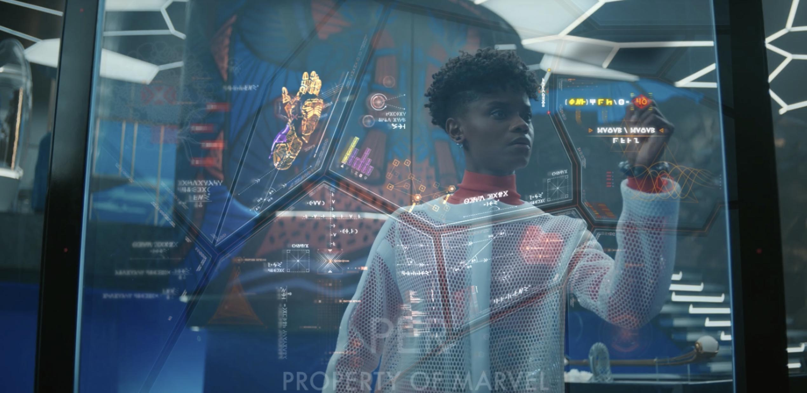
Moviemaker's Intent
9
Director Ryan Coogler and the importance of vibranium [2]
Perception: How Wakandan lore and culture influence technology [1]
Production Designer Hannah Beachler: The evolution and culture of Talokan after relocating underwater [3]
Costume: Suits have elements of African design [13]
[1]
Notes:
Director Ryan Coogler notes that the main takeaway for the audience is that vibranium is extremely powerful.
This puts Wakanda in a unique position where they have an absolute advantage over other countries in both their natural resources and technology.
It also has allowed Wakandan culture to develop into a very futuristic form: Afrofuturism, something that takes existing African culture and history and imagines how having such resources may have influenced the development compared to existing countries and cultures
Perception, a company contracted by the director, wanted to consider how Wakandan lore and culture would affect their technology
This became a driving factor behind the colors and look of most of the visual effects in the film
Production Designer Hannah Beachler considered how the Talokans evolved after relocating underwater and the types materials they would use to build elements of their city
Similar to the discussion of Afrofuturism: How do we develop a society and culture that is very unique to the fictional world yet has very real roots. And how do we do so in a way that honors those roots
Costume Designer Ruth E Carter:
She and perception came up with some sort of iridescent paint to use for costumes that would change color depending on how the light hit it
Took inspiration of designs from different African countries for the midnight Angel suits
Fun fact: She won an Oscar for best costume design for her vision of Afro-futurism

Slide 10
Conclusion 2
10
Countries with a technological advantage over others have a responsibility to share their technologies with other nations
Notes:
Countries have a responsibility to share their technological advances with less advanced countries

Slide 11
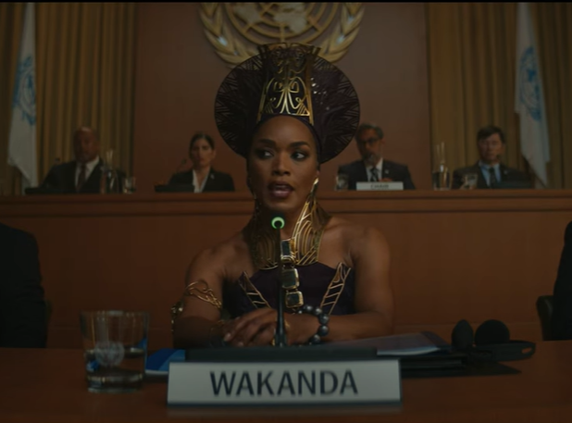
Wakanda Limits Access to Vibranium
11
Wakanda is under pressure to share vibranium technologies with the rest of the world
US argues that vibranium can help tackle global challenges
France argues that vibranium must be shared to prevent the proliferation of vibranium WMDs
"It has always been our policy to never trade Vibranium... not because of the dangerous potential of Vibranium, but because of the dangerous potential of you." - Queen Ramonda (00:08:05)
Notes:
Following other events in the Marvel Cinematic Universe, King T'Challa's choice to open Wakanda to the rest of the world has created a demand for vibranium export.
With concerns about how the rest of the world will use their resources, Queen Ramonda and other Wakandans are hesitant to greenlight open trade of vibranium however.
Both Wakandan and global concerns over Wakanda's current policies are voiced duing a UN meeting in the film:
- WMDs = Weapons of Mass Destruction
- The US and France want access to vibranium to make their own WMDs; however, they bring up interesting points about sharing resources and technologies with other nations
- When the US argues that vibranium can help tackle global challenges – this is true:
- We have already seen the many applications of vibranium (it can enhance healthcare and make enhanced suits, artificial suns, and advanced aircraft)
- When the French argue that restricting access to vibranium goes against non-proliferation – this is also true:
- The potential of vibranium is similar to uranium/nuclear weapons (an absolute advantage over any enemies)
- When we do not regulate nuclear technology and share technologies with each other, it becomes a free for all where countries eventually find the resource and create weapons in an unrestricted fashion
- This can lead to something like the Cold War
In addition, the black market trade of vibranium is something we've seen in other MCU films
- Sharing technologies allows us to understand the dangers and create restrictions on its use
- Also worth mentioning the Talokan holds similar ideas to Wakanda around the distribution of vibranium, yet are even more harsh: Namor believes that the world having access to vibranium threatens their existence, and the only way to continue living isolated is to restrict all access to vibranium

Slide 12
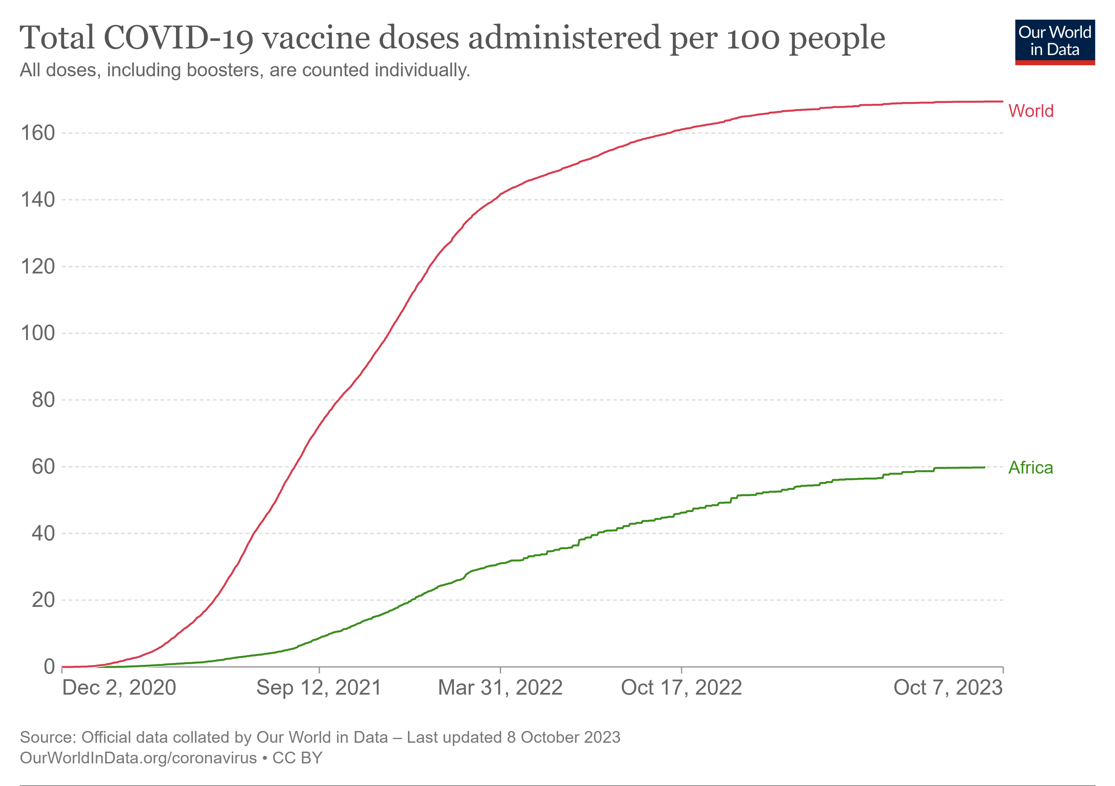
Gatekeeping Creates Inequity
12
Global healthcare supply chains highlight the importance of resource accessibility
More than 12 billion COVID vaccine doses administered worldwide
Yet, as of August 2022, “more than 80% of people in Africa had not received one dose” [4]
Around 10 million children worldwide under the age of 5 die from preventable illnesses every year due to lack of resources [7]
[14]
Notes:
During the COVID-19 outbreak, rapid developments in mRNA technology allowed for the swift development and administration of vaccines. However, not everyone had equal access to these vaccines.
Despite the number of vaccines readily outpacing the global population, as of August 2022 more than 80% of the African population had yet to receive a single dose.
And this issue goes beyond COVID. Around 10 million children under the age of the 5 die worldwide due to lack of medical resources and care.
Poverty acts as a barrier for many worldwide to access life-saving medicines and technology.
However, Information and Communcation Technologies (ICTs), have been shown to positively correlate with reduced poverty rates in a study of rural Chinese counties. This is because ICT's allow for more diversified sources of income and livelihoods. Beyond China, the increased spread of ICTs has the capability to improve lives of individuals in rural, developing countries. https://www.tandfonline.com/doi/full/10.1080/02681102.2022.2123772

Slide 13
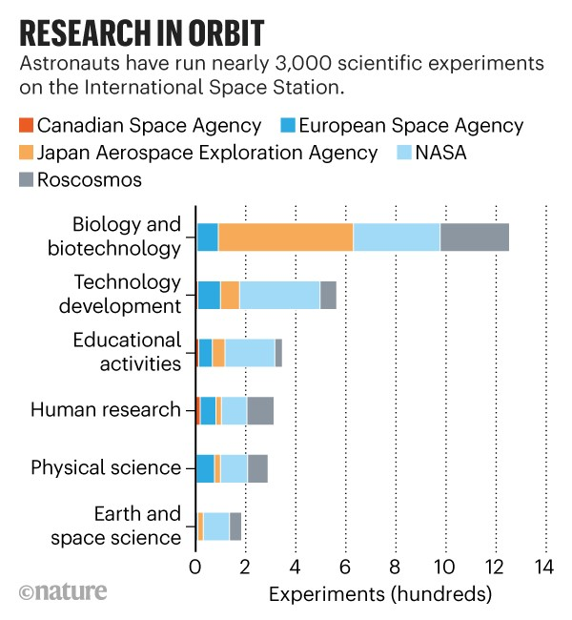
Sharing Technology Drives Innovation
13
ISS
Space research laboratory developed and deployed in collaboration of 5 international space agencies and 15 countries [15]
Human Genome Project
Needed a systemic way to map the human genome
over 4,000 genome sequences have been produced [18]
Initial investment - $3.5 billion [18]
Return on Investment - $800 billion [18]
[16]
Notes:
ISS is a collaboration between 15 countries and 5 international space agencies
Benefits humanity: tech used for water purification on the ISS has been used to provide places on Earth that need access to clean water with filtered water from lakes and rivers[19]
To study neutron stars, researchers aboard the ISS wanted to create an X ray scanner that could turn on and off very quickly. A neurologist at MGH needed a similar technology to improve CT scans, so in collaboration with the ISS crew, they created and patented a device that allows for limited radiation exposure[19]
Systems developed aboard the ISS to monitor temperature, light intensity, and humidity for plants used for research. This tech developed into air purifying systems to prolong the shelf life of fruits and vegetables on Earth and began being used in households during the pandemic[19].
Human Genome project is a way to systemically map human genome to prevent and cure illnesses
In 1990 tech was not advanced enough to map 3 billion base pairs of the human genome
International funds and cooperation made such research possible, and all maps and sequence data were released to the public, which accelerated the process of gene identification [17]
Evidently, international collaboration aids & advances technology and makes certain challenging operations feasible

Slide 14
Takeaways from Black Panther: Wakanda Forever
14
Culture influences technology
How it is implemented within society
How it is designed
Countries with a technological advantage over others have a responsibility to share their technologies with other nations
Technology can do good and bad things: but ultimately it is our job to recognize how our technologies may be used

Slide 15
References
15
“Black Panther: Wakanda Forever Technology Design.” PERCEPTION, 26 Sept. 2023, www.experienceperception.com/work/black-panther-wakanda-forever-technology/.
Eisenberg, Eric. “How Ryan Coogler Went about Defining Vibranium and the Heart-Shaped Herb in Black Panther.” CINEMABLEND, Cinemablend, 15 Feb. 2018, www.cinemablend.com/news/2311911/how-ryan-coogler-went-about-defining-vibranium-and-the-heart-shaped-herb-in-black-panther.
Wallace, Rachel. “How Hannah Beachler Created an Underwater City for ’Black Panther: Wakanda Forever’-Literally.” Architectural Digest, Architectural Digest, 23 Nov. 2022, www.architecturaldigest.com/story/hannah-beachler-underwater-city-black-panther-wakanda-forever.
Kagame, Paul. “Sharing Technology and Supporting Innovation Is Not Just about Equity. It’s Also the Best Way to Stop Pandemics.” World Health Organization, World Health Organization, 2022, www.who.int/news-room/commentaries/detail/sharing-technology-and-supporting-innovation-is-not-just-about-equity.-it-s-also-the-best-way-to-stop-pandemics.
Mitchell, Janel. “Technology and Culture.” Understanding Technology, uen.pressbooks.pub/tech1010/chapter/technology-and-culture/. Accessed 7 Oct. 2023.
Wahab, E. O., et al. “Causes and consequences of rapid erosion of cultural values in a traditional African society.” Journal of Anthropology, vol. 2012, 2012, pp. 1–7, https://doi.org/10.1155/2012/327061.
Kraiselburd, Santiago, and Prashant Yadav. "Supply chains and global health: an imperative for bringing operations management scholarship into action." Production and operations management 22.2 (2013): 377-381.
Zulfiqar, Amma, and Faiza Khalid. "New Media and Identity Crises: A challenge of cultural homogenization." Pakistan Journal of Social Research, vol. 04, no. 04, Dec. 2022, pp. 143-147, https://doi.org/10.52567/pjsr.v4i04.796.
Ali, Ahmad. “10+ Positive and Negative Impacts of Technology on Culture " Hubvela.” Edited by Rehmat Ullah, Hubvela, 20 June 2023, hubvela.com/hub/technology/positive-negative-impacts/culture/.
“Cars Still Dominate the American Commute.” World Economic Forum, 19 May 2022, www.weforum.org/agenda/2022/05/commute-america-sustainability-cars/.
Notes:
Wahab, E. O., et al. “Causes and consequences of rapid erosion of cultural values in a traditional African society.” Journal of Anthropology, vol. 2012, 2012, pp. 1–7, https://doi.org/10.1155/2012/327061.

Slide 16
References
16
11. “26.2: The Rise of the Suburbs.” Humanities LibreTexts, Libretexts, human.libretexts.org/Bookshelves/History/National_History/Book%253A_U.S._History_%28American_YAWP%29/26%253A_The_Affluent_Society/26.02%253A_The_Rise_of_the_Suburbs%E2%80%8B. Accessed 9 Oct. 2023.
12. “About Living Dictionaries.” Living Dictionaries, livingdictionaries.app/about. Accessed 9 Oct. 2023.
13. Coggan , Devan. “Costumer Designer Ruth E. Carter Breaks down the Looks in ‘Black Panther: Wakanda Forever.’” EW.Com, 2022, ew.com/movies/black-panther-wakanda-forever-costumes-ruth-e-carter/.
14. Saunders, Ike. “Total Covid-19 Vaccine Doses Administered per 100 People.” Our World in Data, 2023, ourworldindata.org/grapher/covid-vaccination-doses-per-capita?time=earliest..2023-10-07&country=OWID_WRL~OWID_AFR
15. Ruttley, Tara M., Julie A. Robinson, and William H. Gerstenmaier. "The international space station: collaboration, utilization, and commercialization." Social science quarterly 98.4 (2017): 1160-1174.
16. Witze, Alexandra. “Astronauts Have Conducted Nearly 3,000 Science Experiments Aboard the ISS.” Nature News, Nature Publishing Group, 3 Nov. 2020, www.nature.com/articles/d41586-020-03085-8.
17. Collins, Francis S., and Victor A. McKusick. "Implications of the Human Genome Project for medical science." Jama 285.5 (2001): 540-544.
18. Hood, Leroy, and Lee Rowen. "The human genome project: big science transforms biology and medicine." Genome medicine 5 (2013): 1-8.
19. “International Space Station.” NASA, NASA, 29 Sept. 2023, www.nasa.gov/international-space-station/.
Notes:
Wahab, E. O., et al. “Causes and consequences of rapid erosion of cultural values in a traditional African society.” Journal of Anthropology, vol. 2012, 2012, pp. 1–7, https://doi.org/10.1155/2012/327061.

